Slide 1

Introduction to the BDF-TSAC1 https://indico.cern.ch/e/BDF-TSAC-2025
Marco Calviani (CERN, SY-STI)
4-6 March 2025

Slide 2
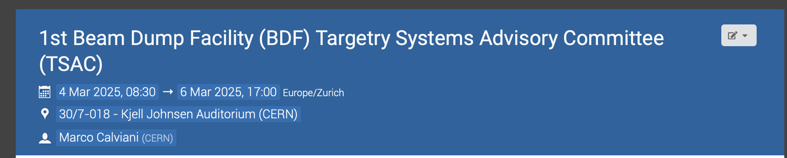
A very warm welcome to committee, speakers and participants

Slide 3

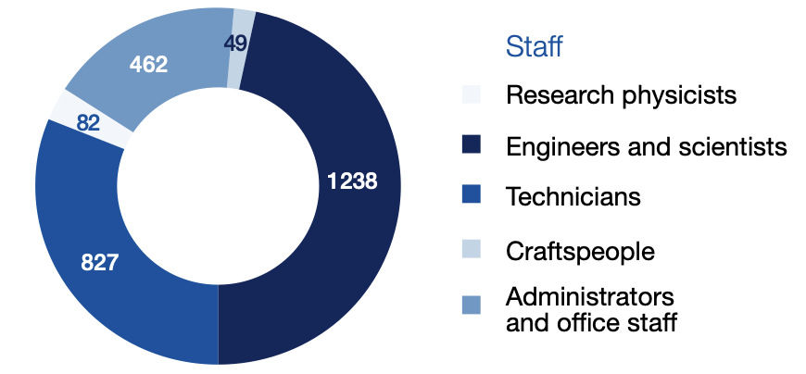
About CERN
European Organization for Nuclear Research
Founded in 1954 in Geneva (Switzerland)
Primary mission – advance the understanding of fundamental physics via a state-of-art accelerator complex, collider and fixed-target physics
23 Member States + 10 Ass. MS
Annual budget of 1200 MCHF
2600 staff
900 fellows
~12000 users

Slide 4
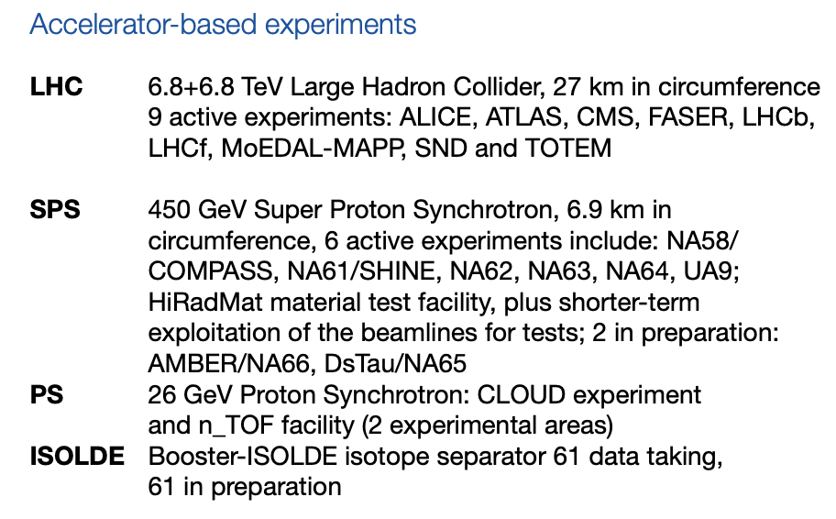
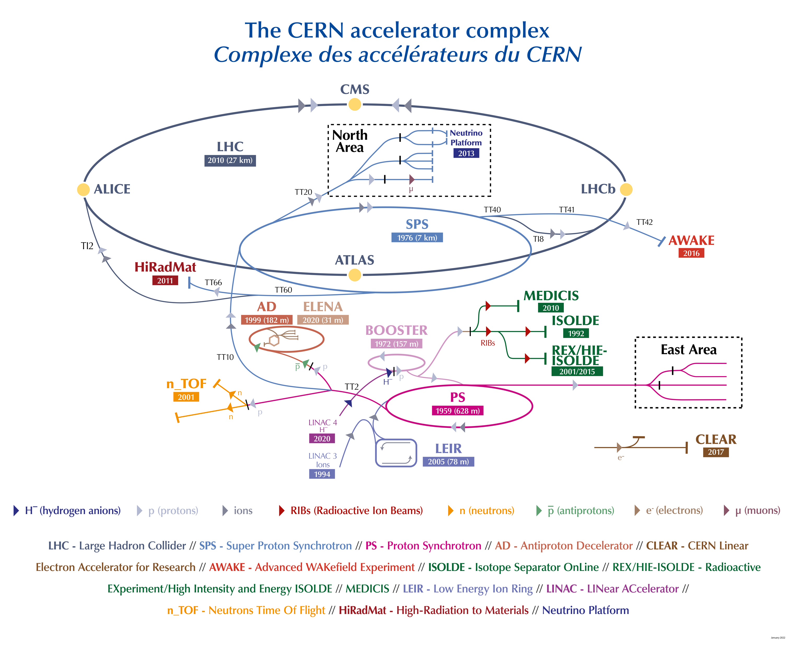

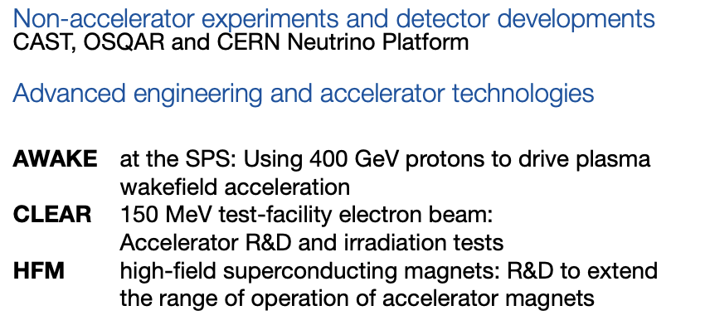
CERN’s accelerator complex

Slide 5
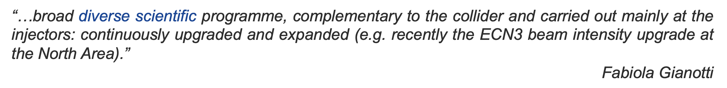
High Intensity ECN3
In April 2024, CERN Council has endorsed the realization of a new high-energy fixed-target infrastructure aimed at delivering beam for the SHiP (Search for Hidden Particles) experiment
  With ~62 MCHF (over 7 years) reserved for the HI-ECN3 project in CERN’s Medium-Term Plan
  Approved together with ~170 MCHF for consolidation of the North Area (NA-CONS project)
400 GeV/c beam, slowly extracted (1 s spill), 4*10¹³ ppp (2.6 MW), 350 kW average beam power on a production target
  Beam on target by 2031
See M. Fraser

Slide 6
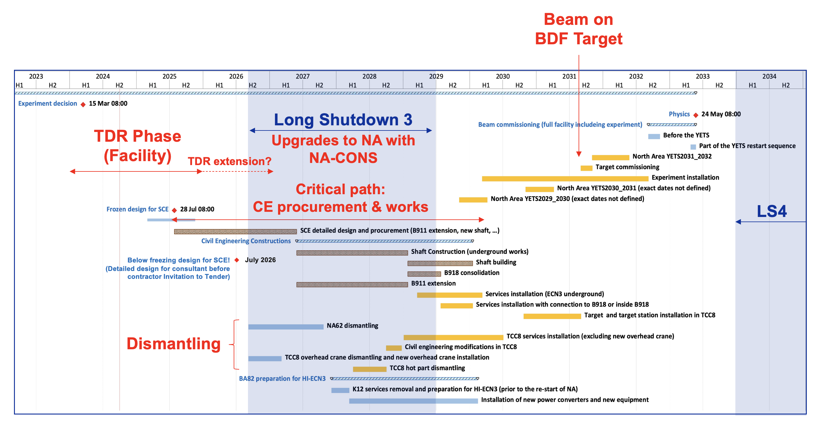
High Intensity ECN3 Timeline
See M. Fraser

Slide 7
What is the BDF-TSAC (excerpts of EDMS 3166418)
Given the challenges associated to the HI-ECN3, specifically to the Target Systems, together with the Project it was decided to form a specific advisory committee
The BDF Target Systems Advisory Committee (BDF-TSAC) [will] provide independent advice to the HI-ECN3 Project team and specifically to the BDF Target Systems team […] on matters associated with […] achieving project goals, based on the most recent knowledge, state-of-the-art and experience worldwide
Target Systems within the scope of the BDF-TSAC includes the production target assembly itself as well as the target station with its shielding, confinement, radiation levels, cooling, ventilation and handling systems. […] Target Systems include also the definition of the processes in the service building and the handling of highly radioactive components for maintenance and waste packaging

Slide 8
What is the BDF-TSAC (excerpts of EDMS 3166418)
The BDF-TSAC is not a review committee. A key aim in setting up this committee early in the life of the project is to ensure the committee members develop an in-depth knowledge of the project and to ensure continuity of advice […] throughout the design and construction phases of the project
Formal reviews of the BDF Target Systems will be organized by the HI-ECN3 Project Management at key phases of the project and will be done under a separate initiative to the BDF-TSAC.
The project phases within the scope of the BDF-TSAC includes the design, manufacture, assembly, operation, and safety analysis of the BDF Target Systems
It is expected that the BDF-TSAC will accompany the project until the facility starts up and is commissioned

Slide 9
Charge for BDF-TSAC1 (EDMS 3208154)
Primary objective of BDF-TSAC1
  The primary objective of the 1st BDF-TSAC is to make sure the members have a clear understanding of the design choices, specifications and history of the project. This includes the BDF/SHiP project scope, operational expectations and design of the various relevant subsystems, including the respective interfaces. This also includes aspects associated with radiation protection, remote handling and maintenance scenarios

Slide 10
Charge for BDF-TSAC1 (EDMS 3208154)
Secondary objectives of BDF-TSAC1
  Comment on the project’s current design and on its state of maturity relative to the objective of delivering a Technical Design Report in early 2026.
  Evaluate the preliminary design of the target assembly, specifically for the two concepts being investigated in parallel
  Evaluate the preliminary design of the target complex and associated subsystems, including integration, maintenance plans and handling aspects.
  Address whether the proposal of a He-cooled full tungsten target is well justified.
  Identify possible limitations and critical items in the current design phase, among which production techniques, cooling system, thermal behavior, prototyping activities and other technical challenges ahead
  Comment on whether the addition of a service cell would be appropriate and useful for both the safe and reliable operation of the target systems and […] radioactive waste

Slide 11
Committee members
Rikard Linander (ESS) (chair)
Steve Gallimore (STFC/ISIS)
Yong Joong Lee (ORNL) (remote this time)
Michael Larmann (FRIB)
Katsuhiro Haga (JPARC)
Patrick Hurh (FNAL)

Slide 12
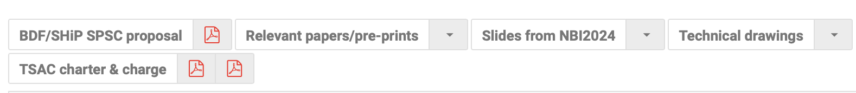
Available material on INDICO
Due to the recent approval of the project (and tight schedule) – not too much material has been crystallized in written form (waiting for TDR in 2026) for the latest design options
However relevant material could be found :
  BDF/SHiP SPSC proposal (CERN-SPSC-2023-033 ; SPSC-P-369)
  Slides from the Neutrino Beam & Instrumentation 2024 workshop (organized at JPARC, https://conference-indico.kek.jp/event/270/)
  As well as the BDF-TSAC charter and BDF-TSAC1 charge
  Some relevant papers and pre-prints under review & technical drawings

Slide 13
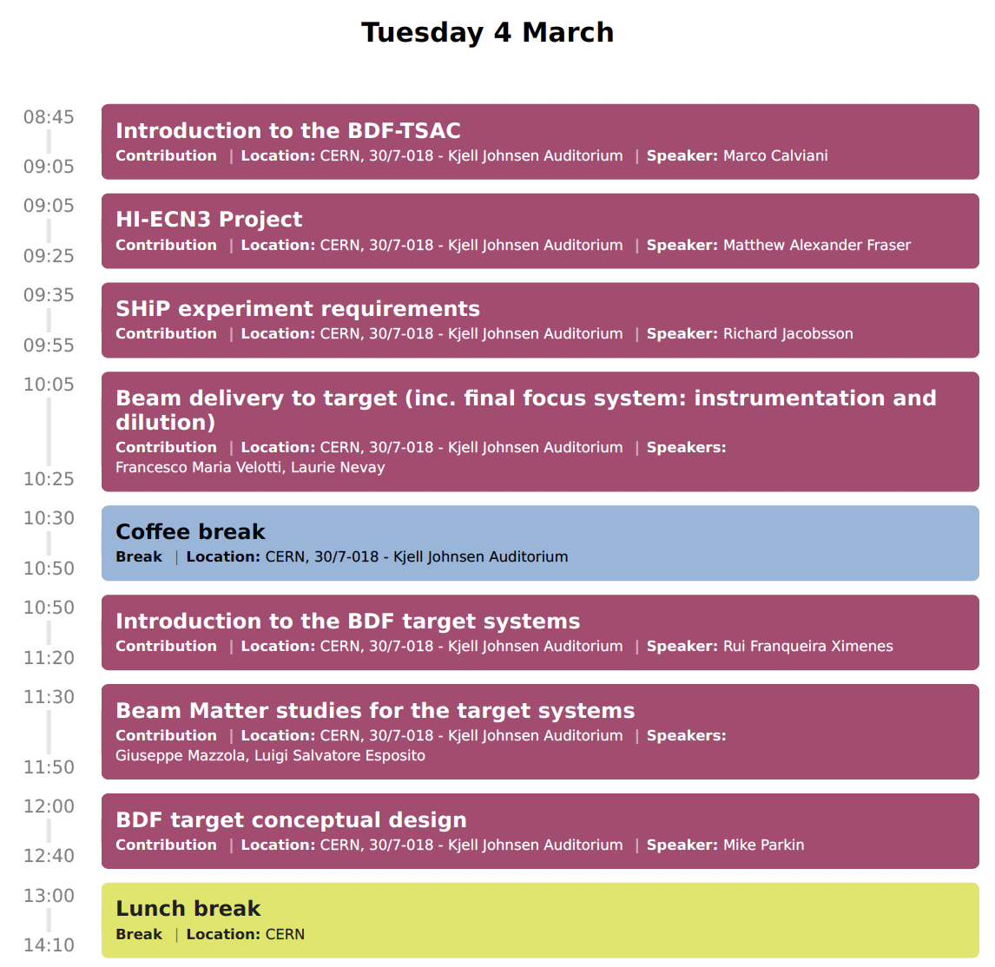
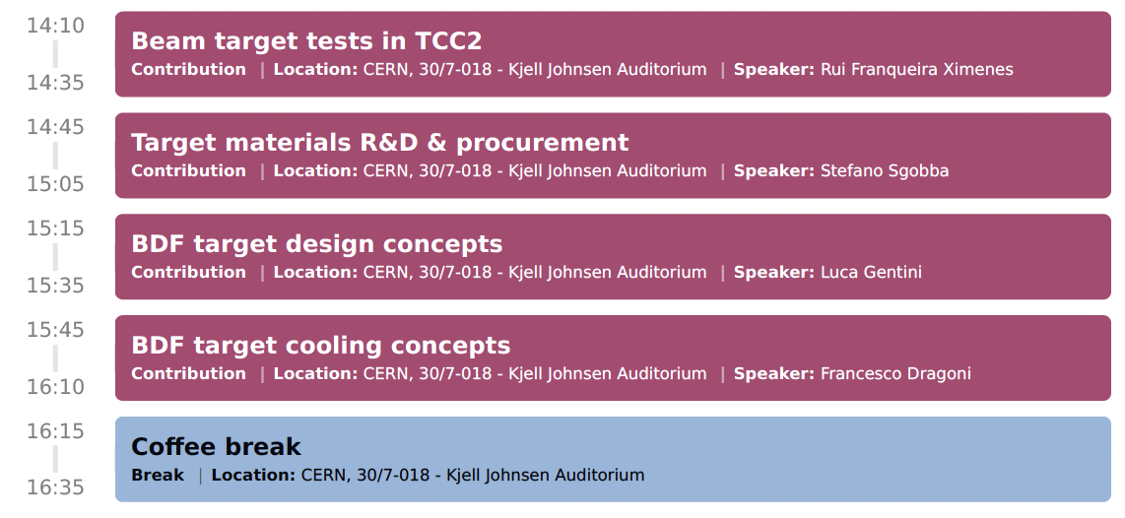
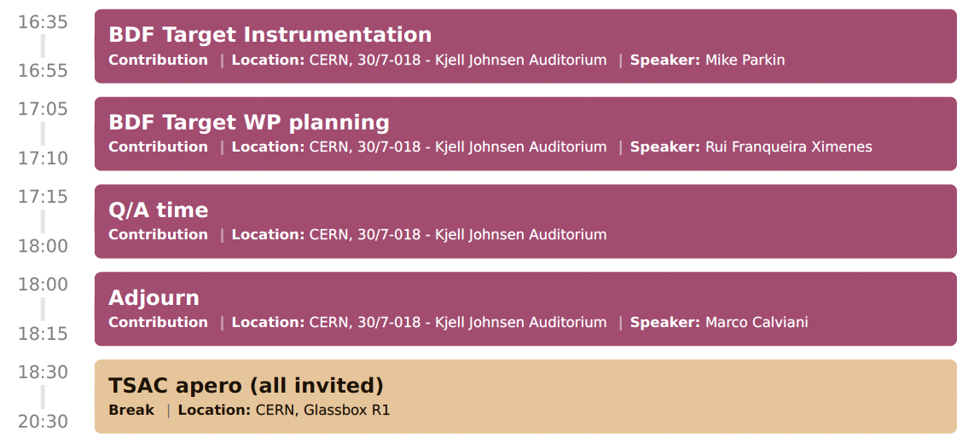
… Focused on production target...
+ group photo!
Open to all!

Slide 14
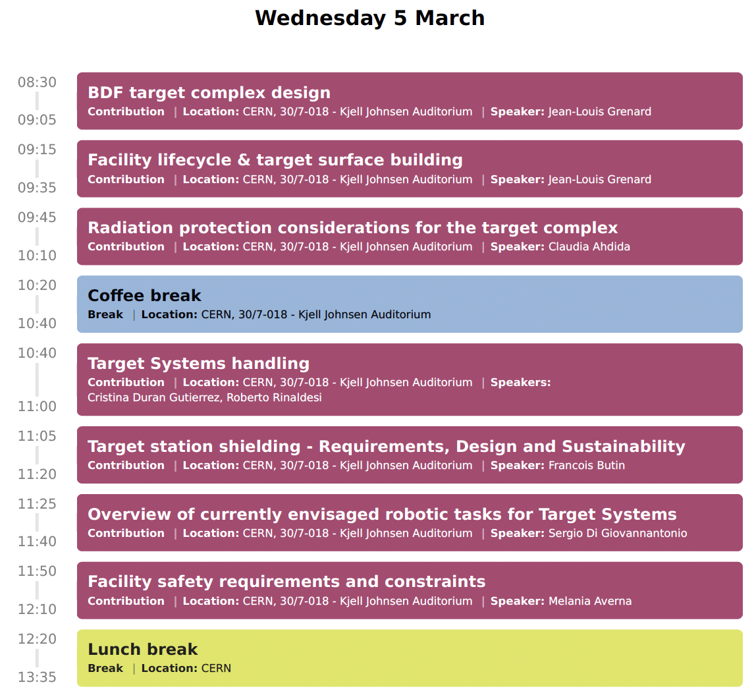
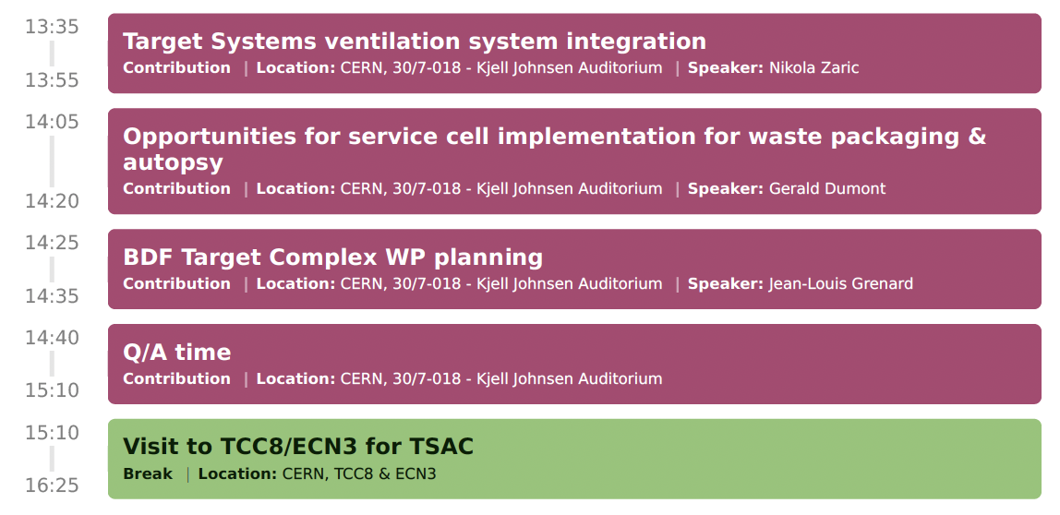

… Focused on target complex and associated subsystems...

Slide 15
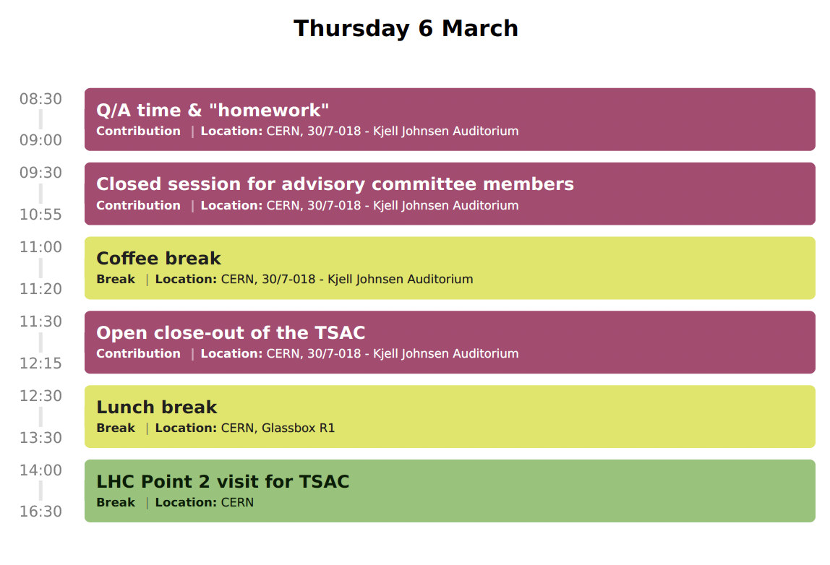
Open to all!

Slide 16
Close-out & final report
The committee chairperson is expected to provide a quick close-out on March 6th at 11h30
A written summary of the event, with a comment on the objectives as well as a reply to all the other questions in the BDF-TSAC1 charge will be provided within 2-3 weeks

Slide 17
Final remarks to speakers
In the interest of time, please make sure you stick with the allotted time on INDICO
For committee members:
  10 minutes are available at the end of most talks for Q/A
  30/45 minutes Q/A time foreseen at the end of each day
It is an advisory committee so I would like to encourage a bidirectional exchange between speakers, participants and committee

Slide 18
I wish you productive discussions and exchanges during the next 3 days

