Slide 2
An introduction to the HI-ECN3 project
BDF Target Advisory Committee #1
M. Fraser (SY-ABT-BTP) and C. Ahdida (HSE-RP-AS) on behalf of the HI-ECN3 project team
CERN, Geneva, Switzerland, 4 - 6th March 2025
https://hiecn3.web.cern.ch

Slide 3

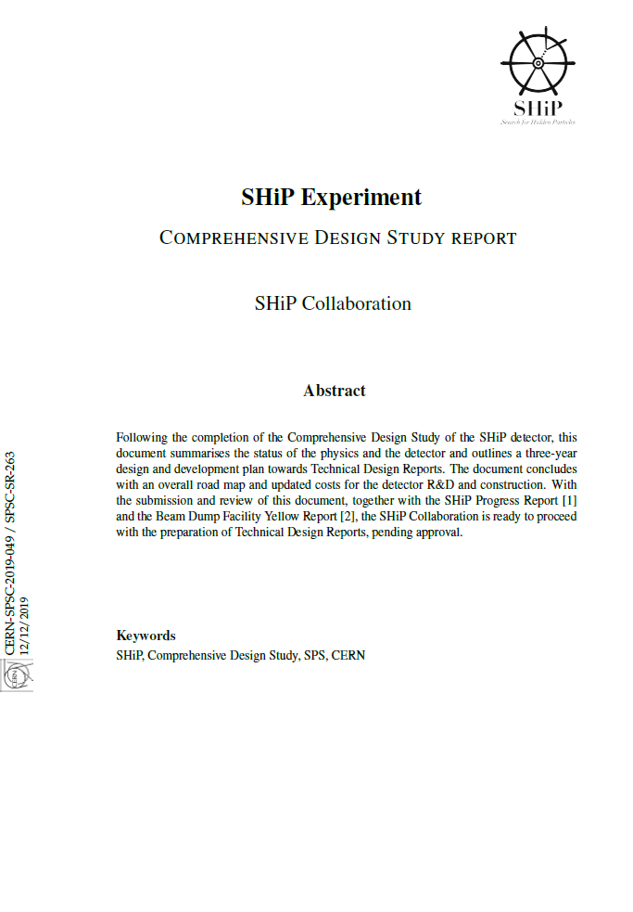


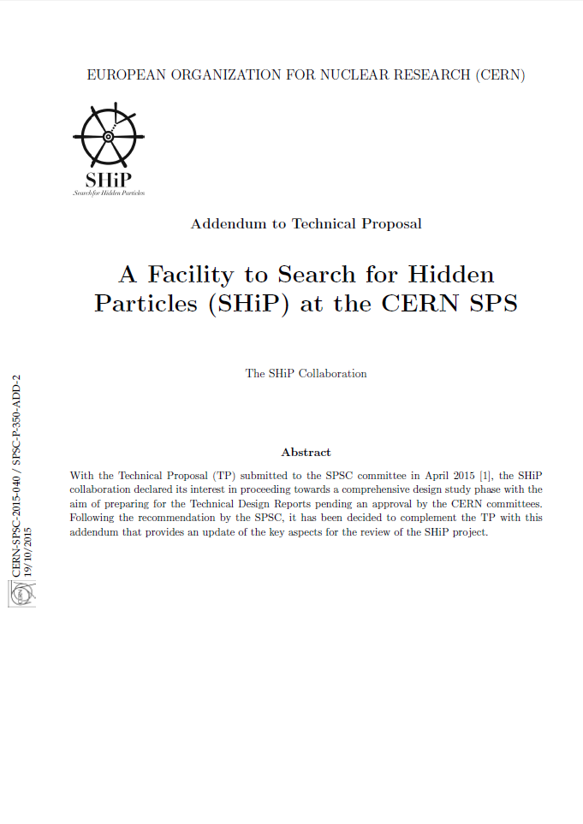
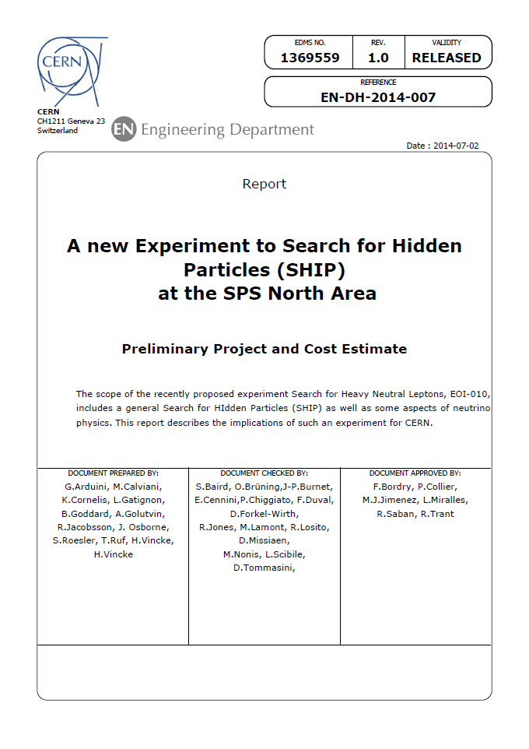
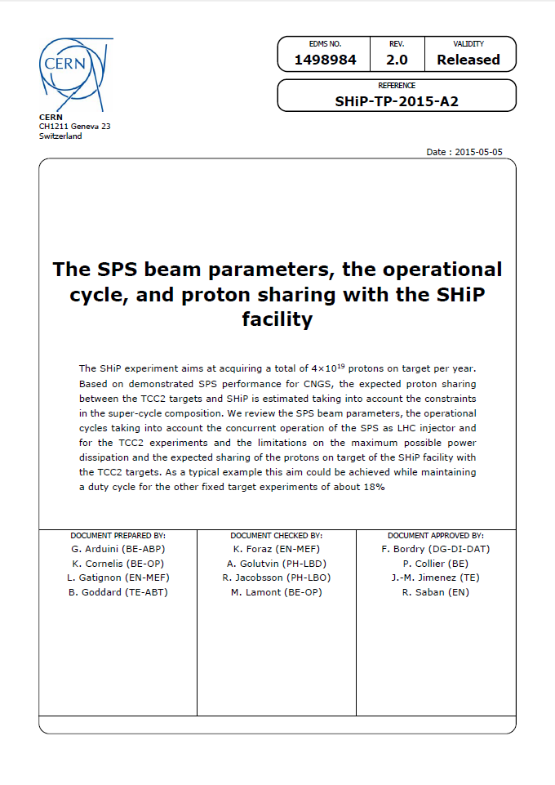
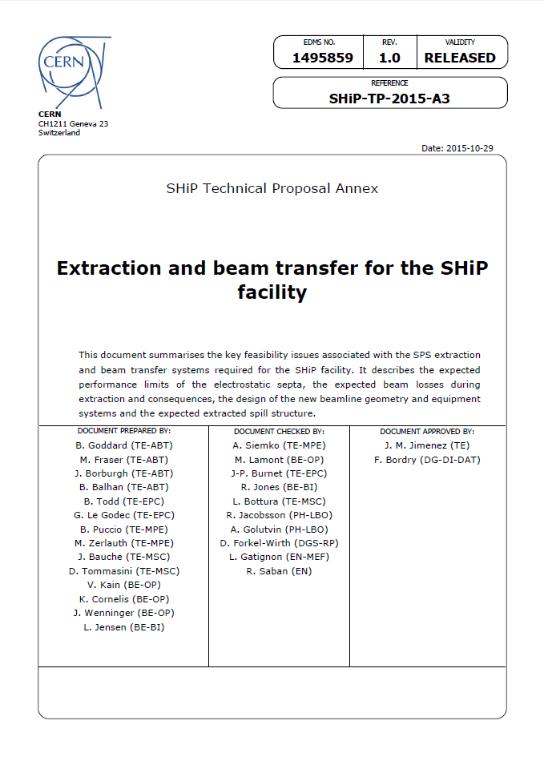
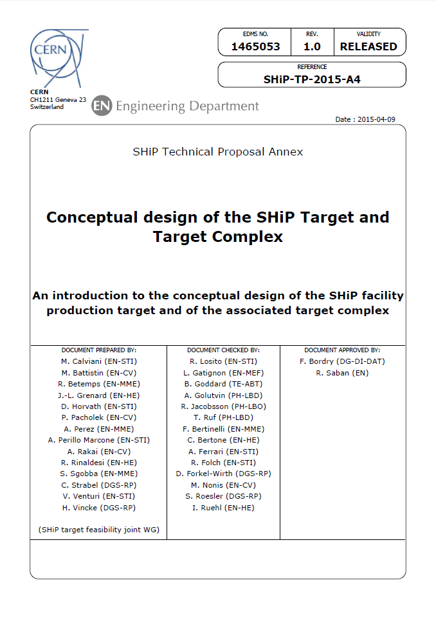
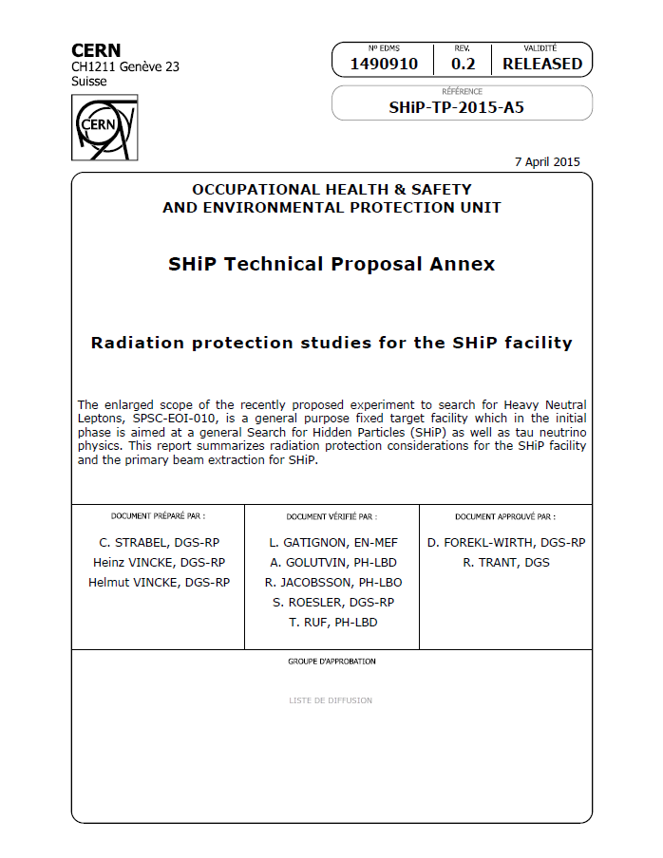
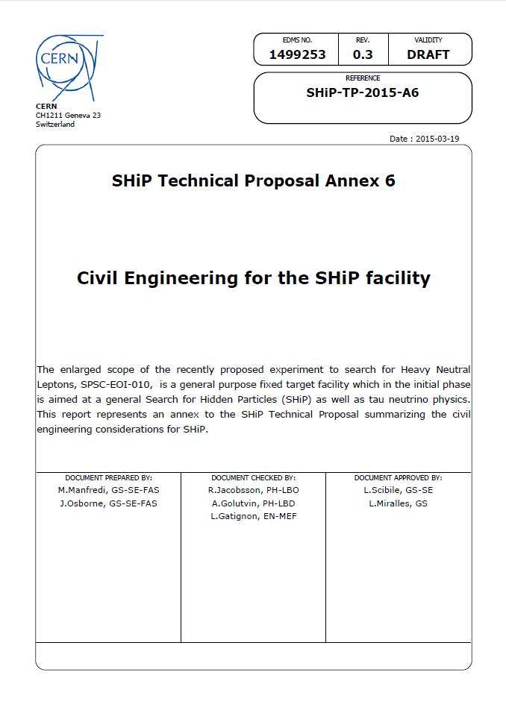
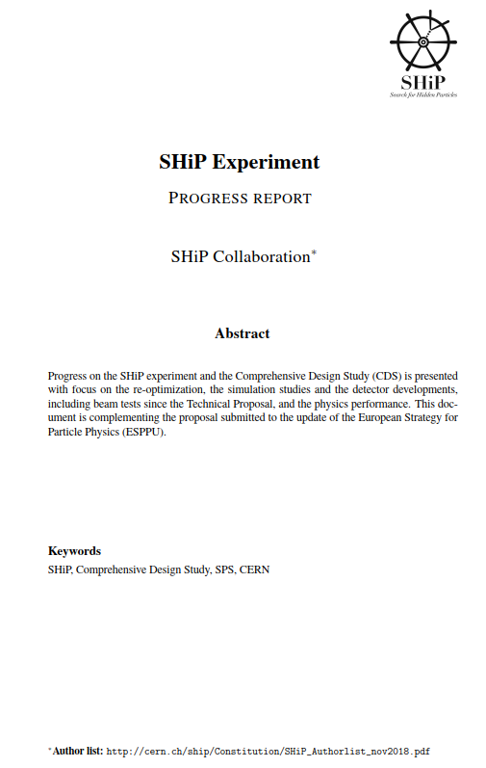
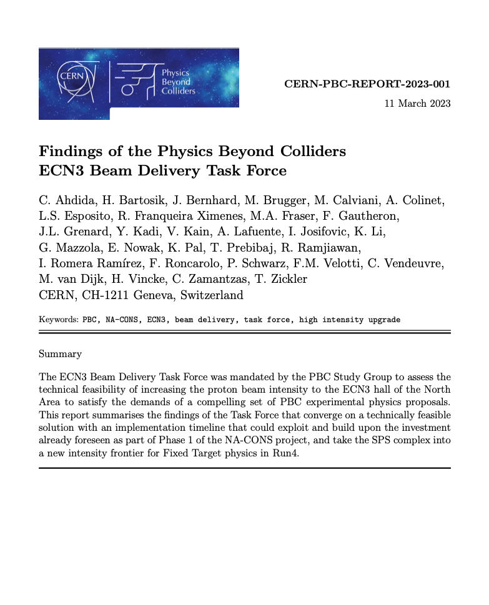
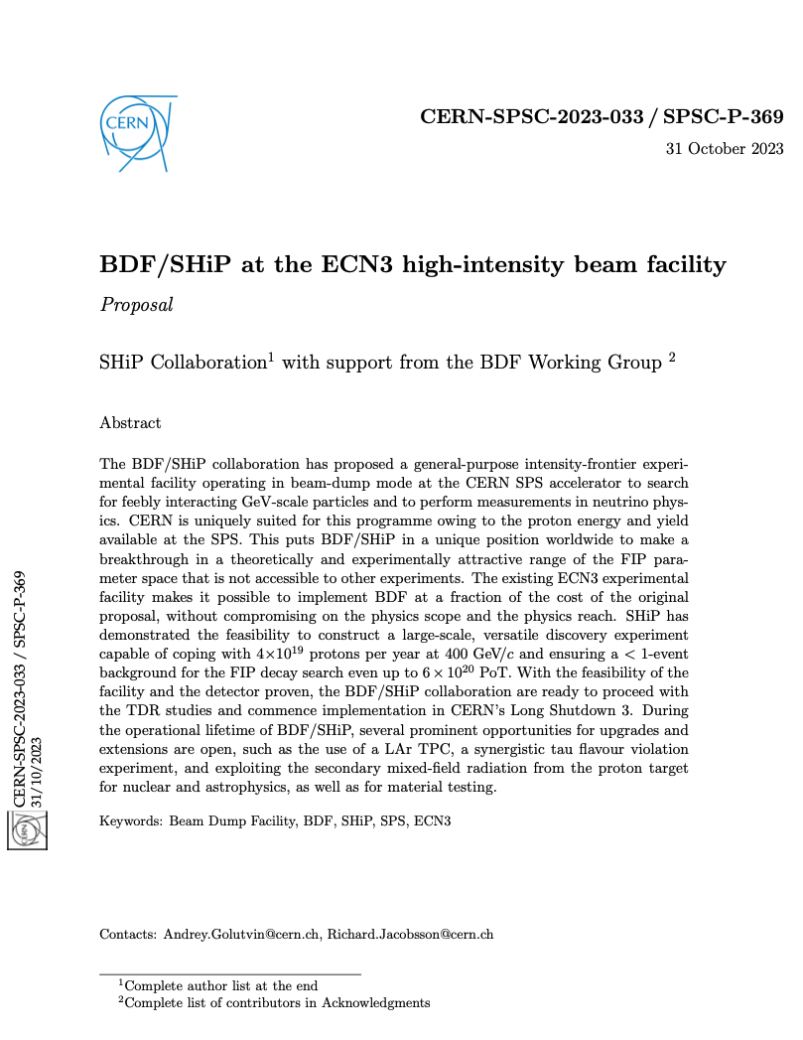
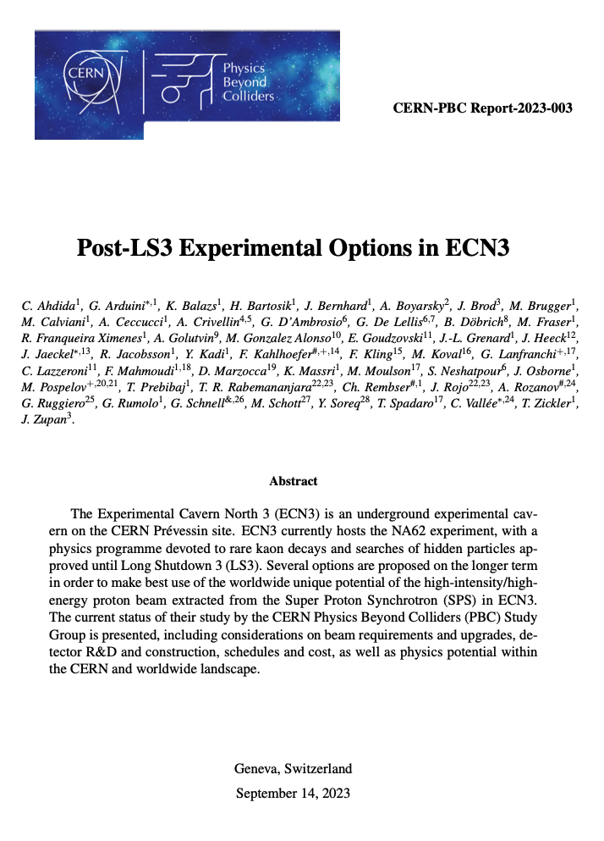
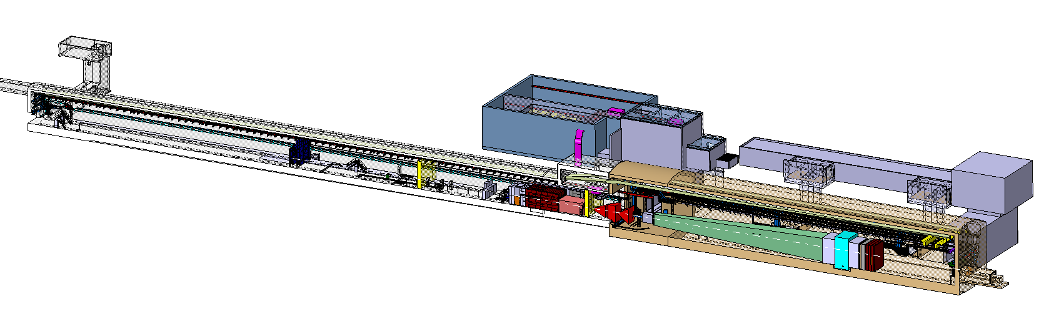
A brief history of BDF/SHiP…
2013: EOI with SHiP @ SPS North Area in a new underground area (ECN4)
2015: Technical Proposal with ~700 pages by SHiP theorists, experimentalists, and CERN accelerator, engineering, and safety departments
2016: Recommendation by SPSC to proceed to Comprehensive Design Study and CERN management launch of Beyond Collider Physics study group
2018: European Particle Physics Strategy Update contribution submitted by SHiP and BDF
2019: CDS reports on BDF and SHiP at ECN4 submitted to SPSC
2020: CERN launches continued BDF R&D with SHiP MoU
2021: BDF/SHiP WG identified ECN3 as post-LS3 option: motivated PBC ECN3 Task Force
2023: HI-ECN3 Study Project established
2024: CERN Directorate select SHiP in March 2024 with approval of HI-ECN3 Project
BDF/SHiP in ECN3

Slide 4

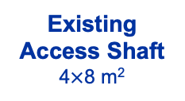
BDF/SHiP in ECN3
TCC2
inc. T4
TCC8
ECN3
EHN2
TT20 Beam Lines
P42 Beam Dump
EHN1
TT20 Beam Dump (TED)
SPS LSS2
BA80
P42 Beam Line
BA81
ECN3 Bridge over River Lion
BA82
Beam from SPS
New Target
Service Building
Existing
Access Shaft
4$×$8 m²
BDF’s Target Complex
containing a high-Z target (W)
New
Access Shaft
(material only)
8x8 m²
Decay Vessel
B911
B918
Beam Dilution System + several changes in P42 beamline
TCC8
Magnetised Hadron Stopper
iron shielding magnetised by a coil
ECN3
Muon Shield
chain of SC/NC magnets
Spectrometer Magnet

Slide 5
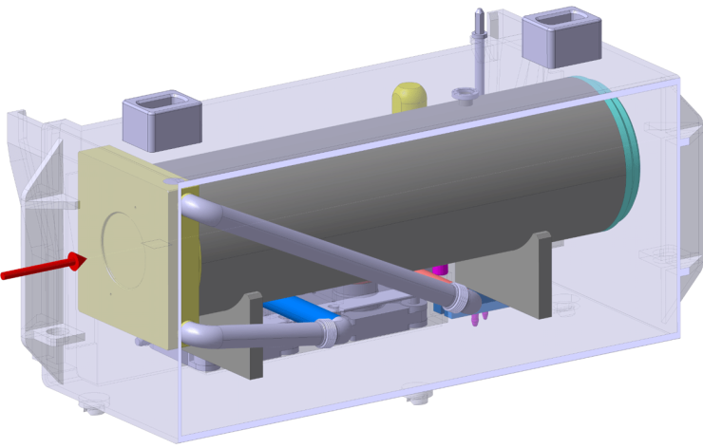
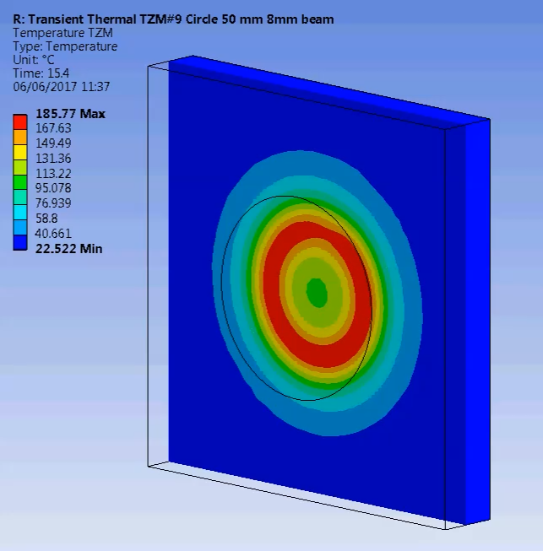
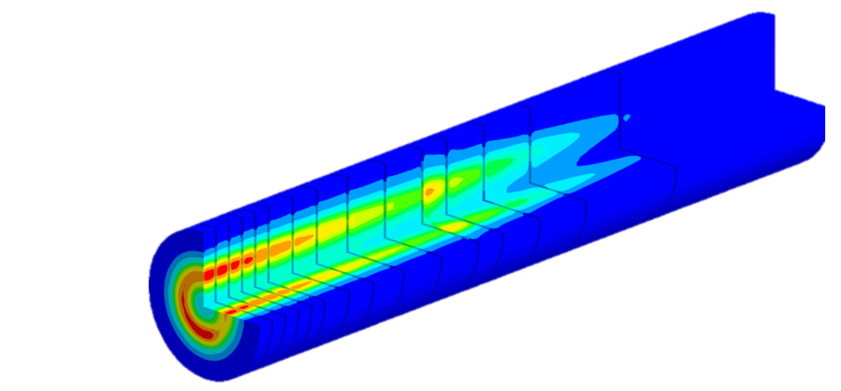
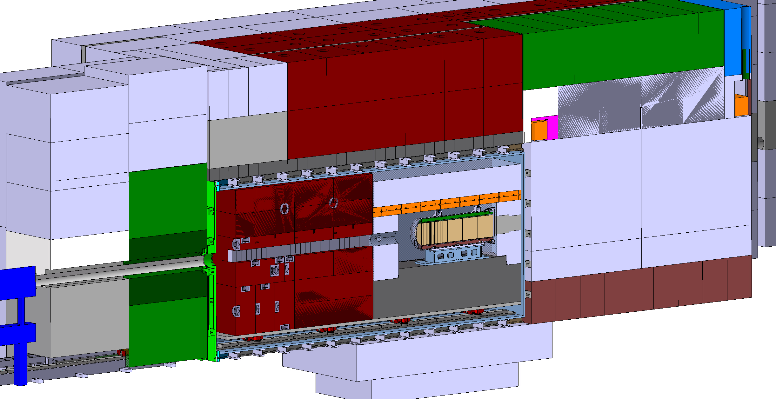
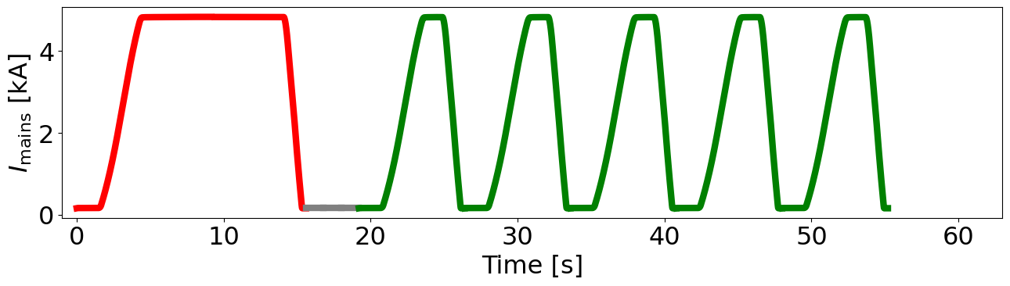
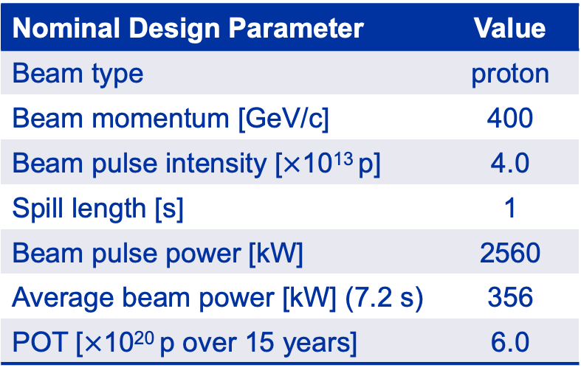
BDF Design Parameters
Nominal Design Parameter | Value
Beam type | proton
Beam momentum [GeV/c] | 400
Beam pulse intensity [$×$10¹³ p] | 4.0
Spill length [s] | 1
Beam pulse power [kW] | 2560
Average beam power [kW] (7.2 s) | 356
POT [$×$10²⁰ p over 15 years] | 6.0
W target ~ 1500 – 2000 mm
Diameter ~ 250 mm
H₂O or He-cooled
Beam size = 8 mm (𝝈)
Dilution freq. = 4 Hz
Sweep rad. = 50 mm
Target Complex
SFTPRO
To TCC2 (EHN1 / EHN2)
SFTSHiP
To ECN3
Shielding Bunker
15.6 s
7.2 s
Magnetised Hadron Stopper
356 kW
Beam power
on BDF target
Target
Vacuum Containment Vessel
232 kW
Excavated floor with
reinforced shielding

Slide 6

Study Project $→$ Approved Project
Upgrade of beam intensity at North Area and SHiP beam-dump (BDF/SHiP) experiment approved recently…
… with ~ 62 MCHF (over 7 years) reserved for the High Intensity upgrade of ECN3 (HI-ECN3) project in CERN’s Medium-Term Plan ratified by CERN Council in June 2024.
Approved together with ~ 170 MCHF for consolidation of the North Area (NA-CONS project)
The HI-ECN3 project is a part of CERN’s…
“…broad diverse scientific programme, complementary to the collider and carried out mainly at the injectors: continuously upgraded and expanded (e.g. recently the ECN3 beam intensity upgrade at the North Area).”
Fabiola Gianotti

Slide 7
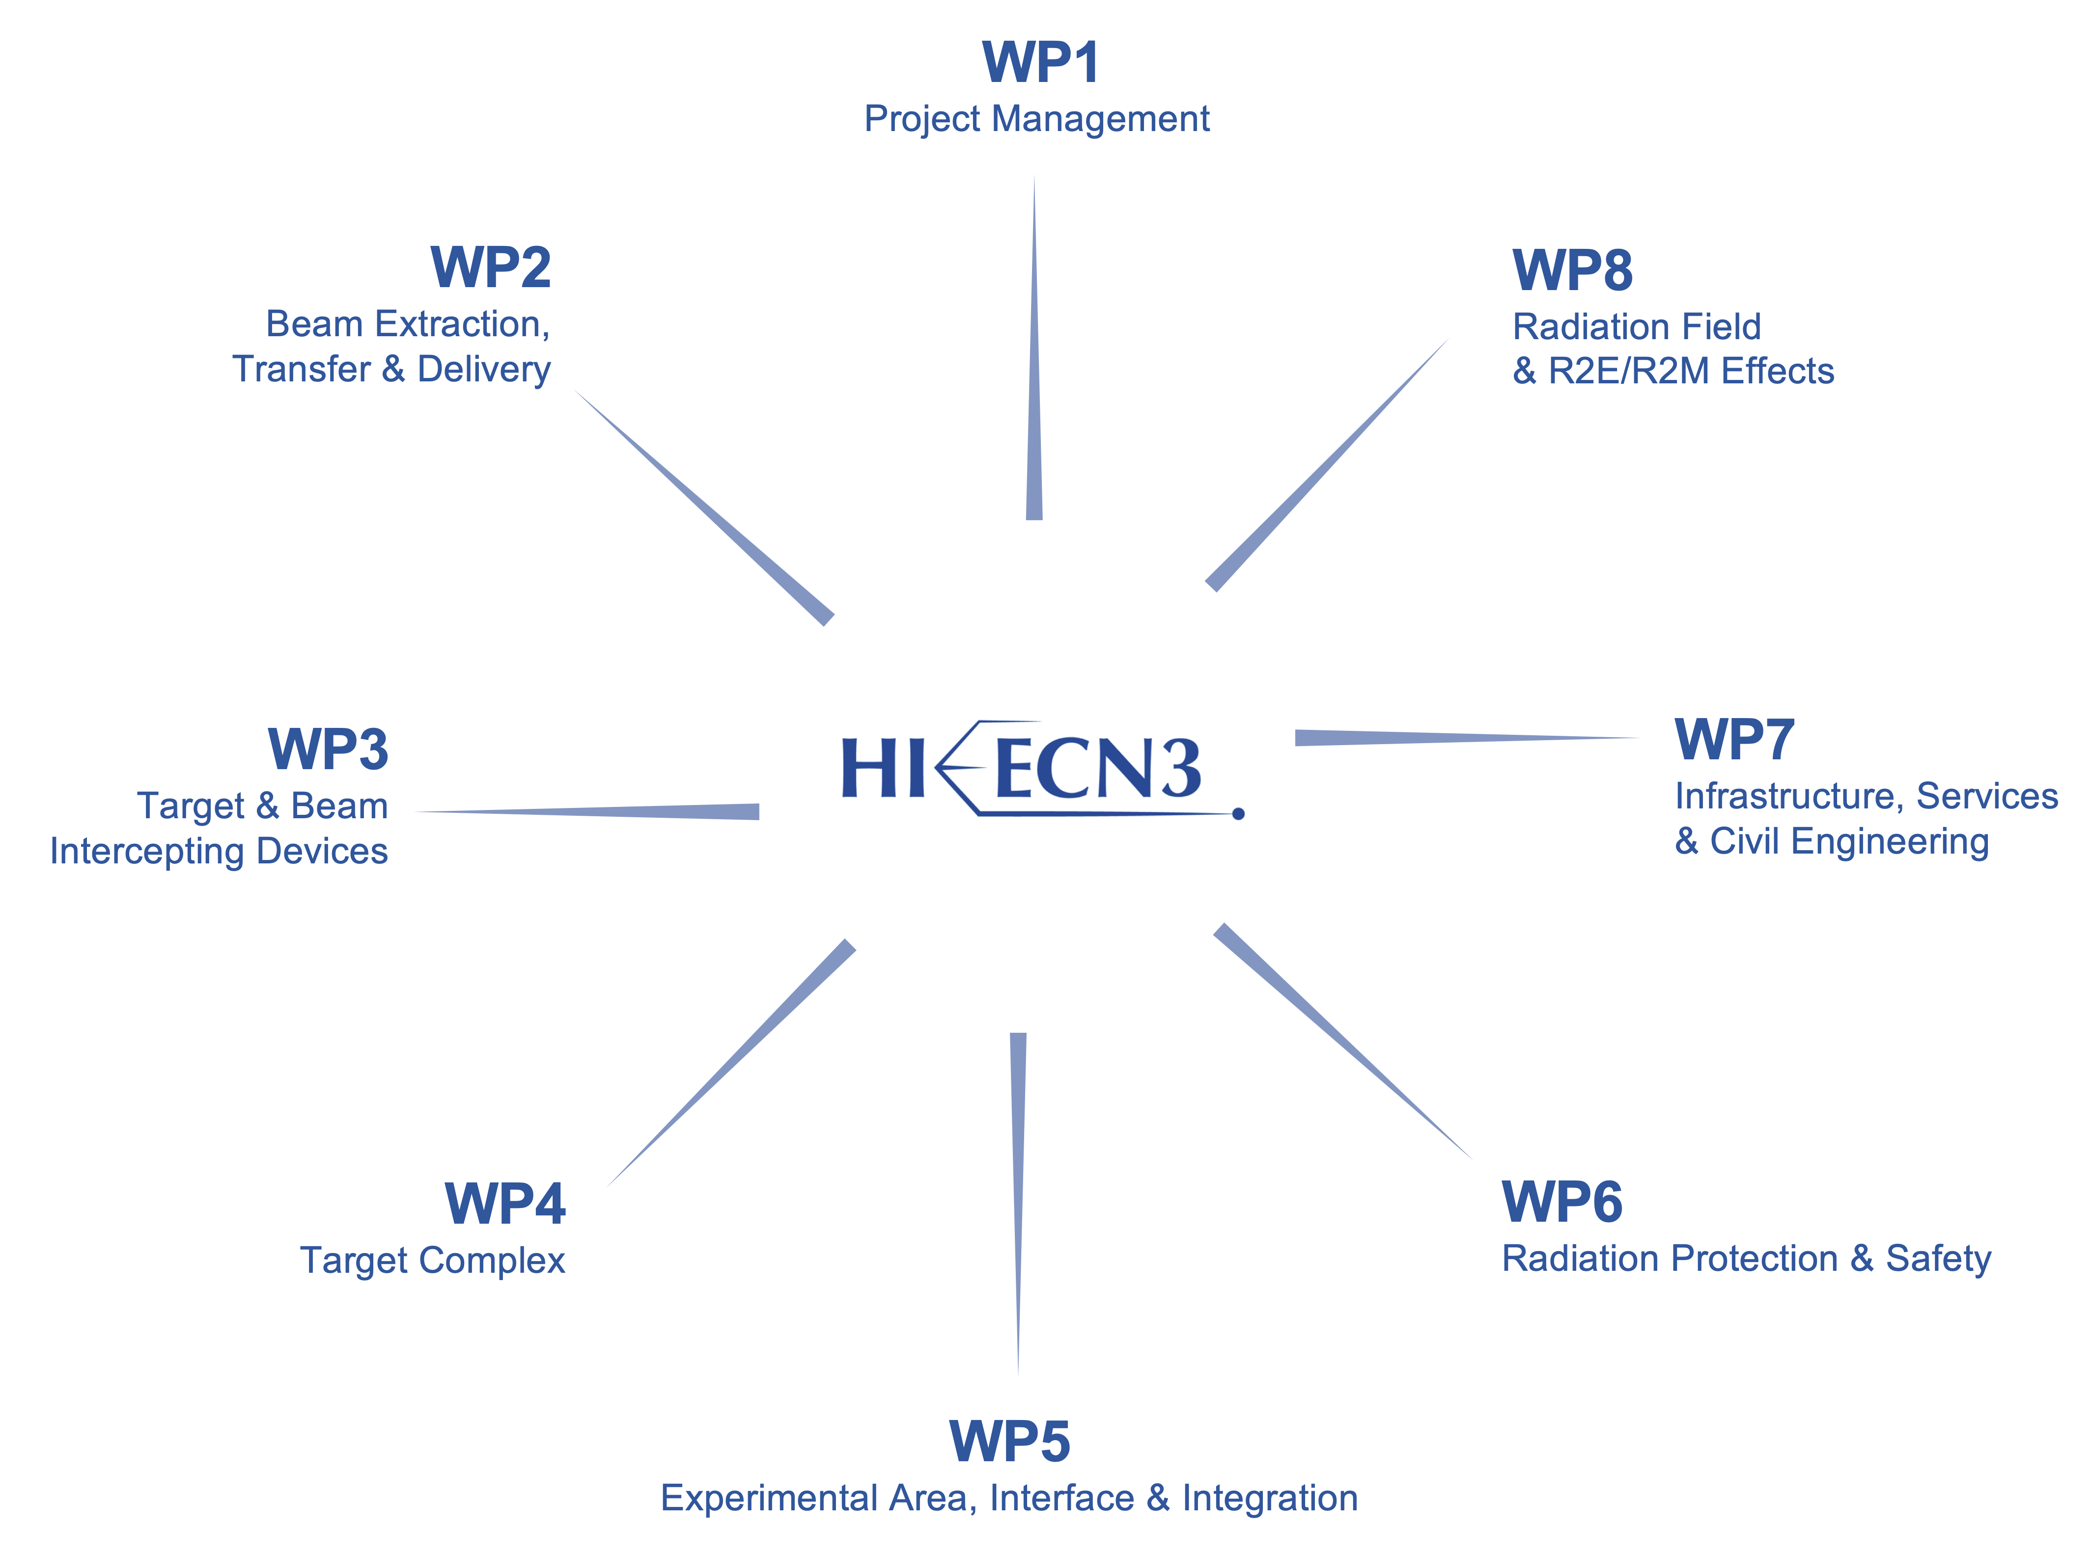
Experiment Project Leader: Richard JACOBSSON
SHiP Experiment Safety Correspondent: Letizia DI GIULIO
HI-ECN3 Project Structure
PL: Matthew FRASER
DPL: Claudia AHDIDA
Francesco VELOTTI & Laurie NEVAY
Luigi ESPOSITO
Rui FRANQUEIRA XIMENES
Fernando PEDROSA
Jean-Louis GRENARD
Claudia AHIDIDA
Project Safety Officer (PSO): Melania AVERNA
Project & Experiment Safety Support (PESS) Correspondent: Jamie CURRIE
Francois BUTIN

Slide 8
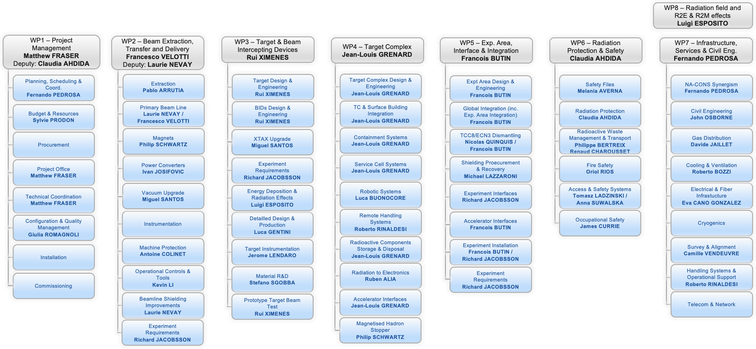
HI-ECN3 Work Breakdown Structure
DRAFT

Slide 9
HI-ECN3 TDR GRAD Team
Person | Role | Group | Supervisor | Programme | BC Description | PRQ | Start Date
Ixone VAQUERO | Planning & Coordination | EN-ACE | Fernando PEDROSA | ORIGIN | HI-ECN3 / NA-CONS | Completed | 1/10/2023
Xavier PALLE | Planning & Coordination | EN-ACE | Fernando PEDROSA | ORIGIN | HI-ECN3 / NA-CONS | Completed | 1/3/2024
James CURRIE | TDR | HSE-OHS | Simon MARSH | ORIGIN | HI-ECN3 | Completed | 1/2/2024
Rahul JANARDHAN | FIRIA | HSE-OHS | Oriol RIOS | QUEST | HI-ECN3 / HSE | Completed | 1/9/2024
Guillaume CNUDDE | TDR (& implementation) | SCE-PPM | David GOMEZ | QUEST | HI-ECN3 | Completed | 1/10/2024
Nikola ZARIC | TDR | EN-CV | Roberto BOZZI | QUEST | HI-ECN3 | Completed | 1/2/2024
Angelo PETRELLESE | Secondary Vacuum | BE-EA | Miguel SANTOS | ORIGIN | HI-ECN3 / NA-CONS / PBC | Completed | 1/4/2024
Fabian METZGER | TDR | BE-EA | Laurence NEVAY | GRAF | HI-ECN3 | Completed | 1/4/2024
TBC | TDR / LS3 prep | BE-EA | Francois BUTIN | ORIGIN | HI-ECN3 | Pre-LS3 | Q3 2026
Beatriz MARTINEZ SUTIL | TDR | BE-EA | Michael LAZZARONI | ORIGIN | HI-ECN3 | Completed | 2/5/2024
Ming LIU | TDR | EN-EL | Eva CANO GONZALEZ | QUEST | HI-ECN3 / NA-CONS | Completed | 2/5/2024
Cristina DURAN GUTIERREZ | TDR | EN-HE | Roberto RINALDESI | ORIGIN | HI-ECN3 | Completed | 1/6/2024
Olin PINTO | TDR | HSE-RP | Claudia AHDIDA | QUEST | HI-ECN3 | Completed | 1/2/2024
Mike PARKIN | TDR | SY-STI | Rui FRANQUEIRA XIMENES | QUEST | HI-ECN3 | Completed | 1/4/2024
Patrick CURRAN | TDR | EN-MME | Stefano SGOBBA | QUEST | HI-ECN3 | Completed | 1/2/2025
Gemma HUMPHREYS | TDR | SY-STI | Jean Louis GRENARD | QUEST | HI-ECN3 | Completed | 1/12/2024
Giuseppe MAZZOLA | R2E / FLUKA | SY-STI | Luigi ESPOSITO | QUEST | HI-ECN3 | Completed | 1/2/2022
Anna HUNCIKOVA | TDR | BE-GM | Camille VENDEUVRE | QUEST | HI-ECN3 / NA-CONS | Completed | 1/12/2024
TBC | BLM | SY-BI | Christos ZAMANTZAS | ORIGIN | HI-ECN3 | TBC | Q3 2026
TBC | BLM | SY-BI | Christos ZAMANTZAS | TECH | HI-ECN3 | TBC | Q3 2026
Panagiotis MENACHILIS | TCSC CONS | SY-STI | Nicolas SOLIERI | QUEST | NA-CONS | Completed | 1/10/2024
Iasonas CHATZIGEORGIOU | XTAX CONS | BE-EA | Miguel SANTOS | QUEST | NA-CONS | Completed | 1/2/2023
Giorgio GARLASCHELL | TDC2 / TCC2 | HSE-RP | Helmut VINCKE | QUEST | NA-CONS | Completed | 1/9/2024
Alexander GORN | TDR | SY-ABT | Matthew FRASER | GRAF | PBC / SY / HI-ECN3 | Completed | 1/10/2023
Tamara BUD | ECN3 tasks on request | SCE | John OSBORNE | QUEST | PBC | Completed | 1/1/2024
Francesca LUONI | ECN3 tasks on request | HSE-RP | Claudia AHDIDA | FELL | PBC | Completed | 1/9/2023
Tirsi PREBIBAJ | ECN3 tasks on request | BE-ABP | Hannes BARTOSIK | GRAF | PBC | Completed | 1/3/2023

Slide 10
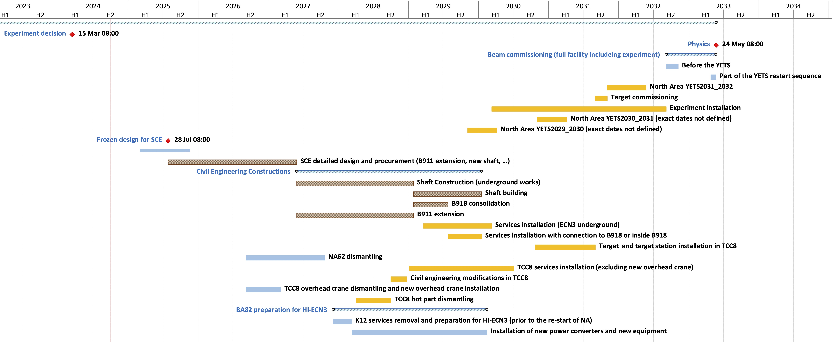
Project Master Schedule
Beam on BDF Target
Long Shutdown 3 (SPS)
Upgrades with NA-CONS
TDR Phase
(Facility)
TDR
extension?
Critical path:
CE procurement & works
LS4
Below freezing design for SCE!
(Detailed design for consultant before contractor Invitation to Tender)
July 2026
Dismantling

Slide 11
HI-ECN3 TDR
Aiming for TDR publication mid-2026: with updated cost & resource estimates of project baseline
Timeline:
  September 2025 (Q3 2025): Frozen design* as part of completion of IRP Design Study needed for consultant Invitation to Tender (IT)
  Scope, with loads & volumes needed in 2025
  Choice of target technology (H2O vs. He) must not impact envelopes for civil engineering:
    Final validation of He-cooled design will not be available until after the beam tests in 2025 and 2026
  The Service Cell must not impact civil engineering
  December 2025: Preliminary design for consultant
  July 2026: Detailed design for consultant
  October 2026: Launch contractor IT: significant cost impact and delay with any further changes
  *Frozen design = volumes, loads & structural definition (small openings and internal integration have some flexibility)

Slide 12
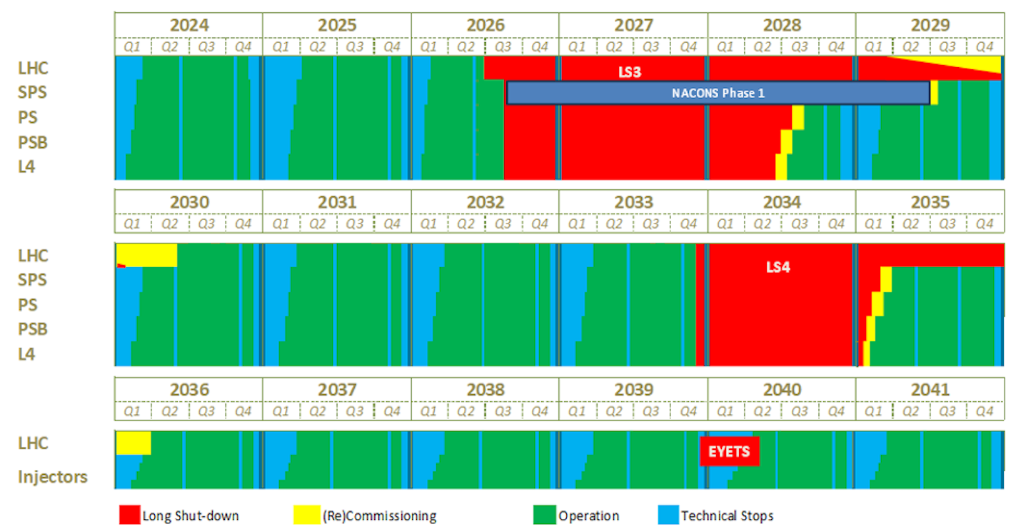
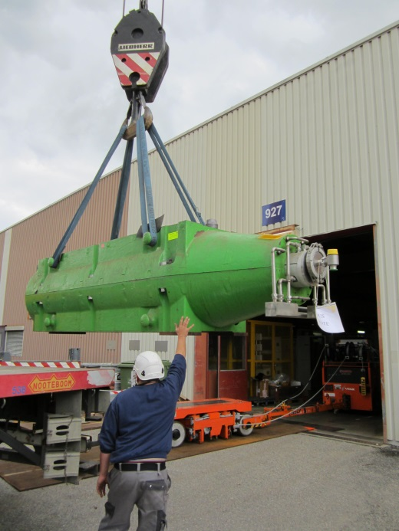
M. Lamont, Updated schedule for CERN’s accelerators, CERN Bulletin, 4 October 2024
CERN Accelerator Schedule
Today
NA available exclusively for EHN1/2 from mid-2029:
Test-beam users & other POT demanding experiments
(e.g. AMBER, MuonE)
ECN3 beam to dump in P42 for commissioning of TCC2
whilst construction ongoing
HI-ECN3
TDR Phase
NA-CONS Phase I
HI-ECN3
Commissioning
HI-ECN3
Operation
NA-CONS Phase II
(TBC)
Operation out to late 2040s:
beyond HL-LHC
(frequency & length of LS’s TBC)
NA-CONS
HI-ECN3 Operation

Slide 13


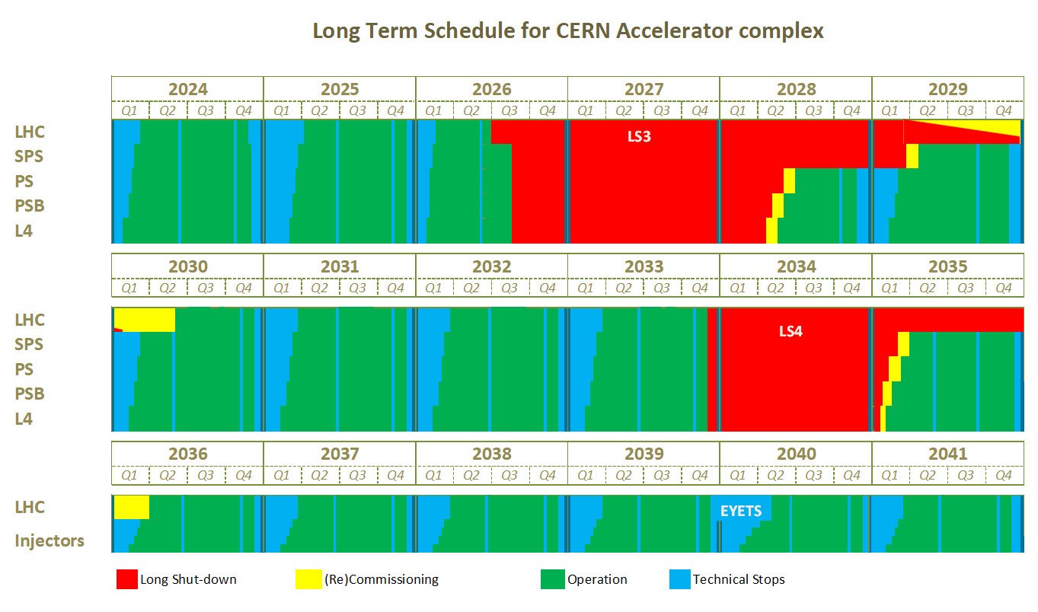

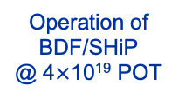
Commissioning High Intensity for ECN3
The commissioning of HI-ECN3 can be grouped into two phases:
  Commissioning TCC2 (2029 – 30, ~ 2 yr) with NA-CONS: inc. SPS, slow extraction
  Commissioning of ECN3 (2031 – 32, ~ 1.5 yr): inc. BDF in TCC8, beam transfer from TCC2 to TCC8, before ramping up to nominal operation together with SHiP before end 2032
YETS30/31:
Remove P42 beam dump & reconfigure beam line
Q3 2031:
Beam on BDF Target
Operation of
BDF/SHiP
@ 4$×$10¹⁹ POT
NA-CONS Phase 1
NA-CONS Phase 2
Upgrades of TCC2 for HI-ECN3
Commissioning of SPS and NA (TCC2) for HI-ECN3
BDF commissioning
(flexible with SHiP installation)
Commissioning of SHiP:
ramping intensity

Slide 14
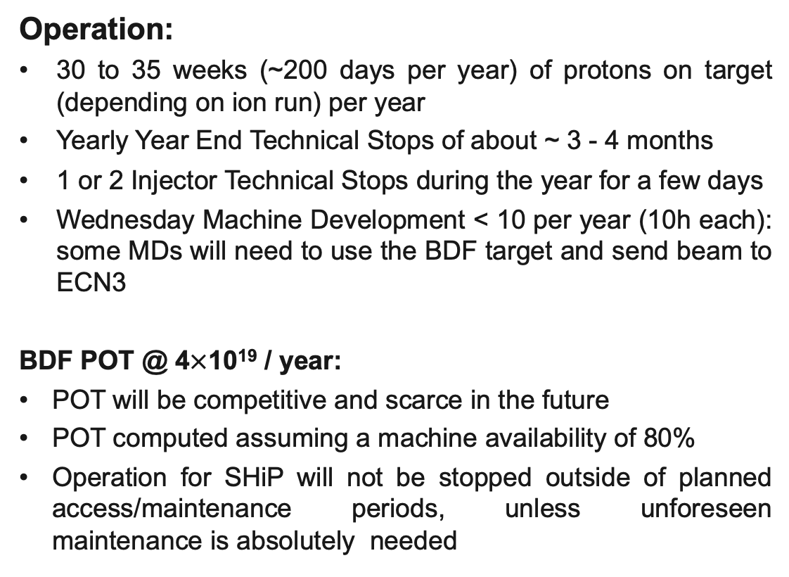
CERN Operation
Operation:
  30 to 35 weeks (~200 days per year) of protons on target (depending on ion run) per year
  Yearly Year End Technical Stops of about ~ 3 - 4 months
  1 or 2 Injector Technical Stops during the year for a few days
  Wednesday Machine Development < 10 per year (10h each): some MDs will need to use the BDF target and send beam to ECN3
  BDF POT @ 4$×$10¹⁹ / year:
  POT will be competitive and scarce in the future
  POT computed assuming a machine availability of 80%
  Operation for SHiP will not be stopped outside of planned access/maintenance periods, unless unforeseen maintenance is absolutely needed
BDF TSAC #1 4 – 6th March 2025

Slide 15
Let’s have a productive few days…!
Any questions…?

