Slide 1

Beam Delivery to the Target
Final focus system, instrumentation and dilution
L. Nevay, F. Velotti, D. Banerjee, M. Fraser, A. Gorn, F. Metzger, T. Prebibaj.
21st February 2025

Slide 2

BDF / SHiP in the CERN Complex
North Area
including BDF/SHiP
5
LHC
4
AWAKE
SPS
nTOF
HiRadMat
AD
PS
East Area
3
Schematic not to scale
2
PSB
“PSB” = “booster”
ISOLDE
1
Linac4

Slide 3
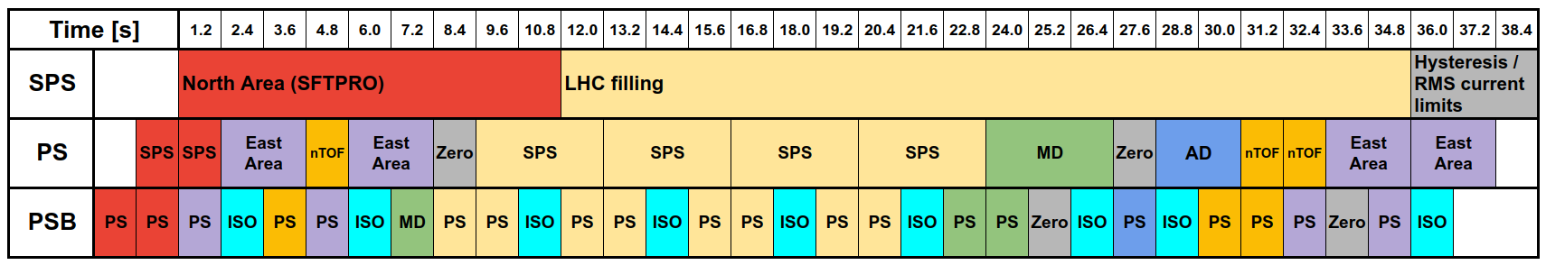
Supercycles
The injector complex delivers protons to multiple facilities in parallel, typically over ~31 weeks per year
  PSB → PS, ISOLDE
  PS → SPS, nTOF, EAST, AD
  SPS → LHC, North Area, AWAKE, HiRadMat
A supercycle is a sequence of cycles directed to the different facilities
The supecycles are defined based on the accelerator capabilities & facility requests
The proton sharing between facilities is achieved using supercycles
Below is a typical supercycle
See T. Prebibaj’s talk for details:
https://indico.cern.ch/event/1469359/contributions/6233099/
T. Prebibaj

Slide 4
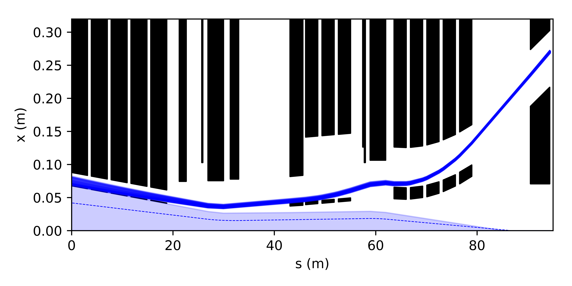
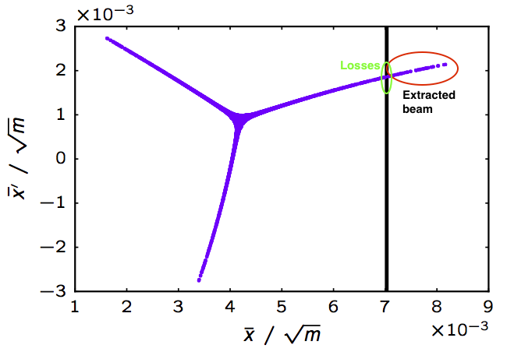
SPS Slow Extraction
The beam in the SPS is excited with a 3rd order resonance in the horizontal plane
RF gymnastics are performed first to reduce momentum spread and give the most uniform distribution in time
High amplitude particles are extracted
with a thin electro-static septum
The beam extracted is nominally
uniform in time with no bunch
structure
Electrostatic Septum
(ZS)
Magnetic
Septum (MST)
Magnetic
Septum (MSE)
Quad
QFA216
Quad
QDA217
Bumper
TPST
mask
Quad
QFA218
Quad
QDA219
North
Area
horizontal phase space

Slide 5
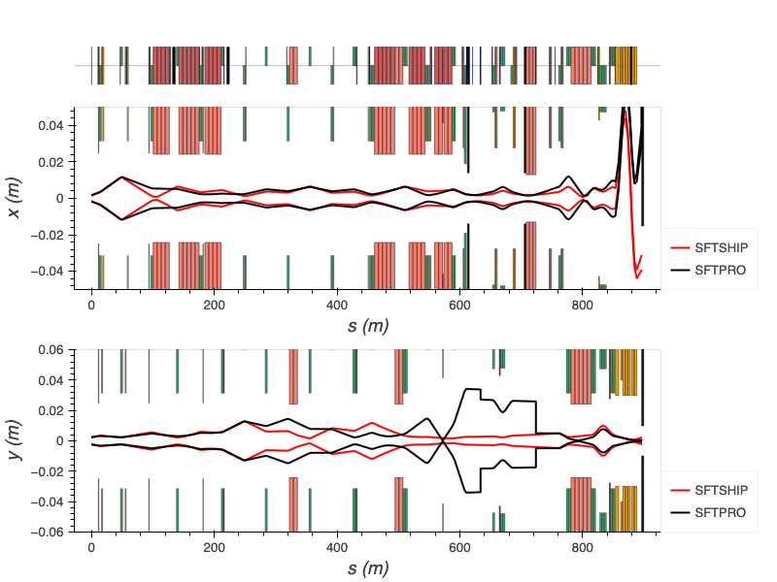
Shared and Dedicated Beam
Shared with splitting:
field free region
The beam from the SPS is normally split with magnetic splitters twice
  the vertical position on the splitter determines the sharing ratio
  the 3 beams are directed onto 3 targets producing 5 secondary beams and 1 left-over primary beam
For BDF / SHiP, a new set of optics will be used that bypass the splitters without splitting (low losses)
losses (~5%)
B
horizontally deflected
straight ahead
SPS
P42
vertical beam envelopes
Dedicated delivery:
no splitting
B

Slide 6
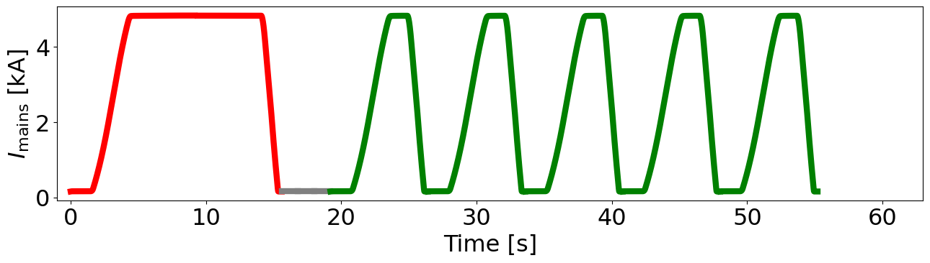
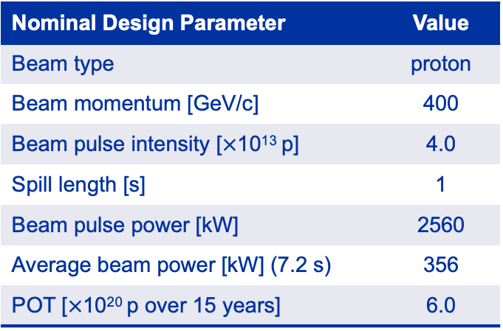
BDF Beam and SPS Supercycle Composition
Nominal 4 x 10¹³ protons in a 1s spill to BDF/SHiP
  the 1 s of continuous beam is inside a 7.2 s overall cycle
A study has shown 5 x 10¹³ protons / spill would mean ~40% more spills to other North Area users
  MDs this year will investigated SPS intensity limits
  previously operated at 4.8 x 10¹³ for CNGS (fast extraction)
  greater North Area availability from a proton-sharing point of view
Nominal Design Parameter | Value
Beam type | proton
Beam momentum [GeV/c] | 400
Beam pulse intensity [$×$10¹³ p] | 4.0
Spill length [s] | 1
Beam pulse power [kW] | 2560
Average beam power [kW] (7.2 s) | 356
POT [$×$10²⁰ p over 15 years] | 6.0
T
splitters
T2
H2
SFTPRO
SFTSHiP
H4
H6
EHN1
15.6 s
7.2 s
T4
H8
SFTSHiP
cycle
P42
ECN3
BDF/SHiP
Beam power
on BDF target
356 kW
T6
M2
232 kW
EHN2
Rest of North Area

Slide 7
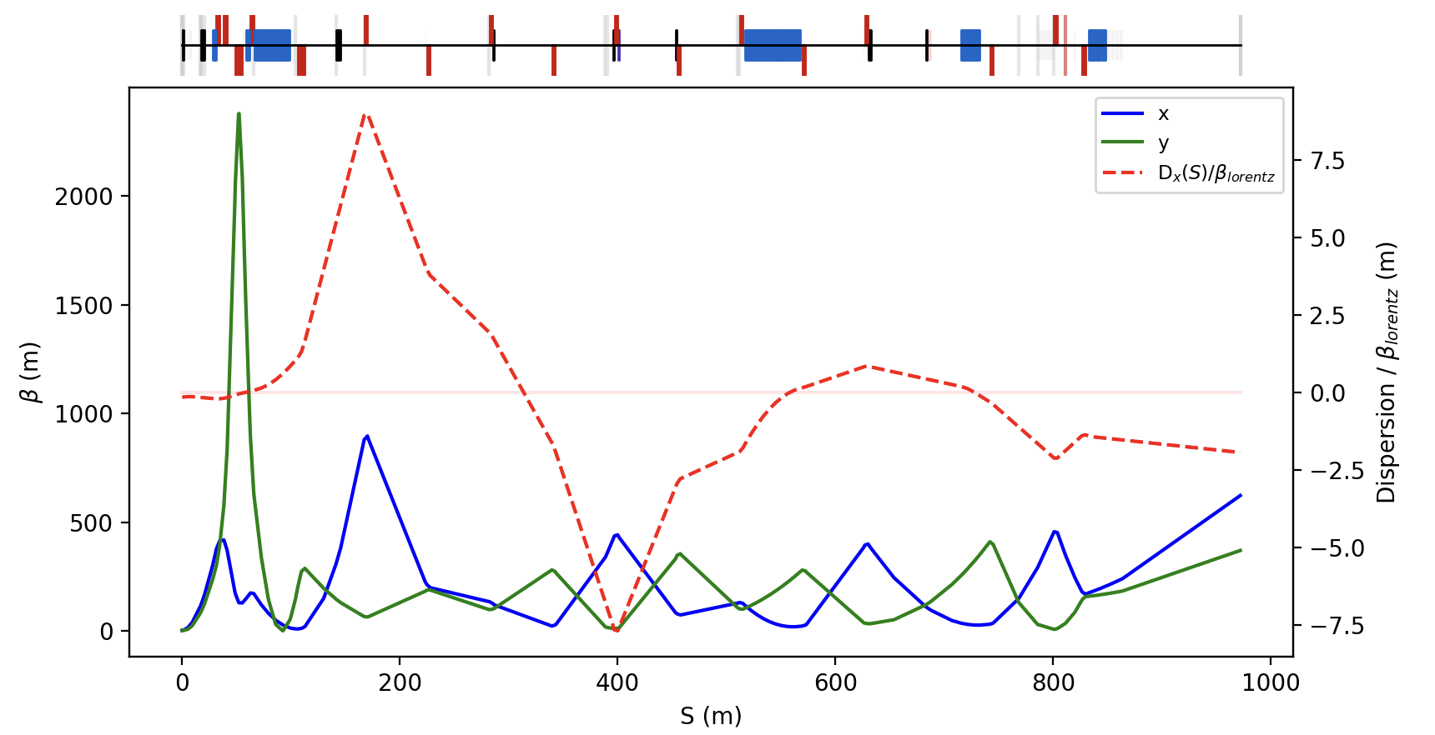
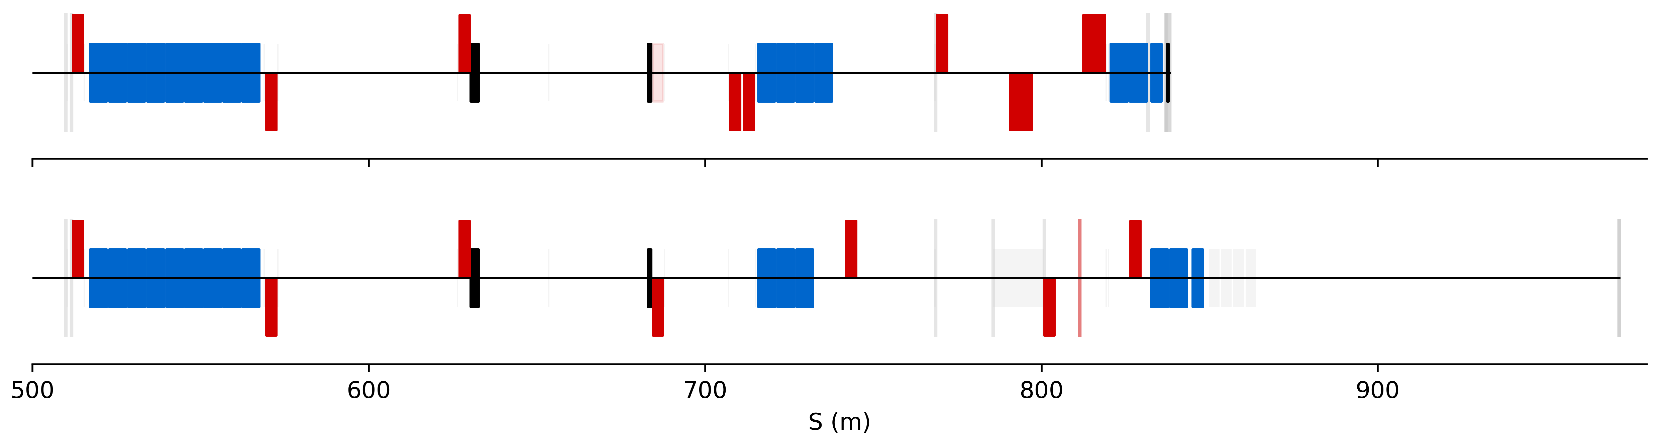
P42 Final Focus & Dilution System
The beamline “P42” that delivers protons to ECN3 will be modified in the final 200 m
  quadrupoles will be removed and shifted to create a much larger beam
  beam size and ratio will be adjustable independently
  100 m from last magnet to front of BDF target
A dilution system of N dipoles will sweep the beam in a circle
  number of magnets / plane depends on possible failures and being studied
No sweeping and a large beam size is possible, but we must stay clear of the aperture
Beam size can easily be produced from 𝜎 = 1 - 20 mm, but choice affects design of vacuum chamber
today
dilution system
There will be beam halo and the aperture must be clear of this
future
BDF

Slide 8
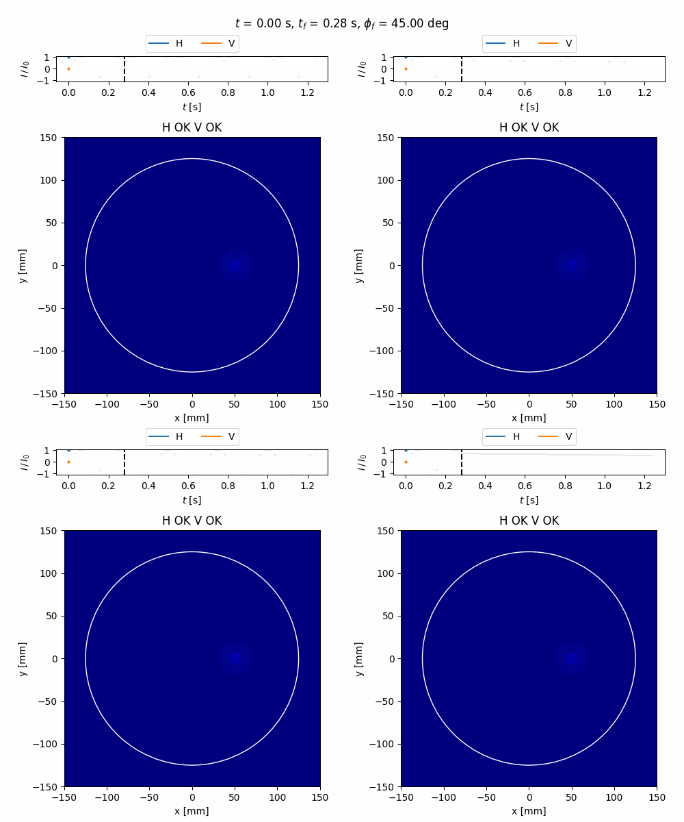
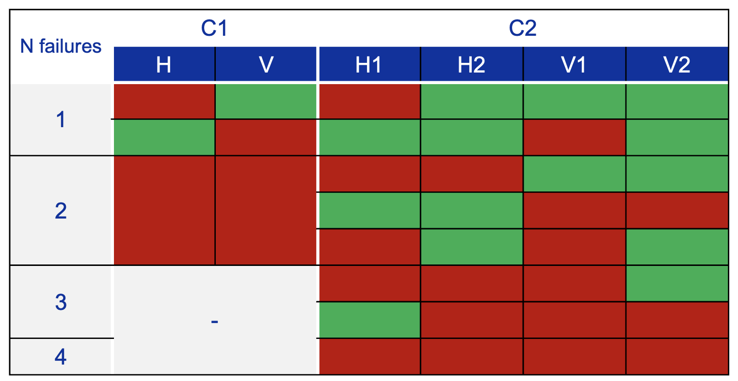
Nominal and Accident Scenarios
Magnets along the beamline can fail
  change in beam position and size as the field drops
Beam loss monitors will be placed on each quadrupole to cut the beam quickly if losses high
A crucial failure mode will be that of the dilution system magnets and power supplies
1 magnet per plane
2 magnets per plane
Patterns on target vary depending on the magnet and exact time of failure

Slide 9
Beam Instrumentation Requirements
Beam Delivery & Experiment
Target
Beam position to ensure sweeping
Beam spot size each spill
Avoid front-mounted diagnostics as complicated to access / maintain
Beam position during spill
    can be given after each spill to the experiment
    ensure sweeping radius
  Beam intensity (< 3% absolute error)
The strategy for beam instrumentation immediately before BDF is being studied
Background for the experiment created by matter interaction with the beam being studied
  muons far from the axis could possibly be captured into the experiment (to be studied)
We must align the beam axis well w.r.t. the target and know the beam size and sweep radius
Foresee an instrumentation package 10 - 20 m upstream of the front of the target
Diagnostics must give feedback during the spill on a short time-scale
  avoid slow, high-level software interlocks

Slide 10
Interlocking
The baseline maximum intensity allowed without sweeping is 2 x 10¹² protons
  this corresponds to a maximum of a 50 ms spill at the nominal extraction intensity
Fast interlocks can act on the time-scale of O(100 μs) and cut the SPS extraction
The current of most transfer line power converters will be monitored
  this includes the ramp across the spill to compensate for the shift in momentum
Beam loss monitors (BLMs) will be placed beside each quadrupole and in key locations
We will consider an independent method of verifying the beam sweeping pattern on the target
  e.g. an independent current measurement
  or, 4 beam loss monitors for position via asymmetry of back-splash

Slide 12
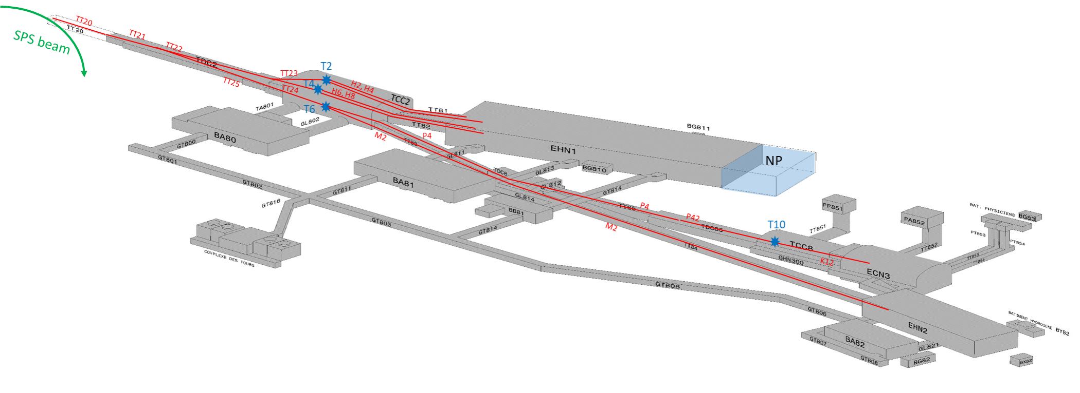
Tunnel Names
TCC2
TT83
TDC8
TT85
TCC8
ECN3

