Slide 1
Beam Matter studies for the target system
G. Mazzola, L.S. Esposito (SY-STI-BMI)
Acknowledgements: M. Calviani, J-L. Grenard, R. Franqueira Ximenes, M. Parkin, A. Romero Francia (SY-STI-TCD), M. Fraser, F. Velotti (SY-ABT-BTP), R. Jacobsson (EP-SME-SHP), C. Ahdida, O. Pinto (HSE-RP-AS)
1st Beam Dump Facility (BDF) Targetry Systems Advisory Committee (TSAC) – March 4-6, 2025

Slide 2
Outlook
FLUKA simulations and motivation
Geometry and beam parameters
Particle yields and energy deposition in various systems
DPA and gas production in target
Radiation fields around target complex and R2E considerations
Conclusion and outlook

Slide 3
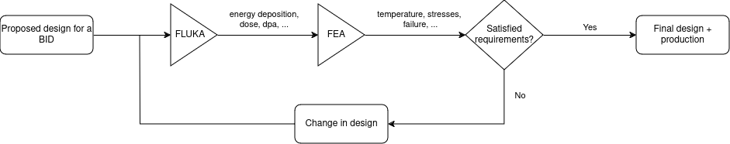
FLUKA simulations and motivation
FLUKA is a general-purpose Monte Carlo code for particles transport and interaction with matter
Results coming from FLUKA.CERN simulations are used as input for Finite Element Analysis (FEA) to validate the design of different Beam Intercepting Devices (BID) distributed along the accelerator lines

Slide 4
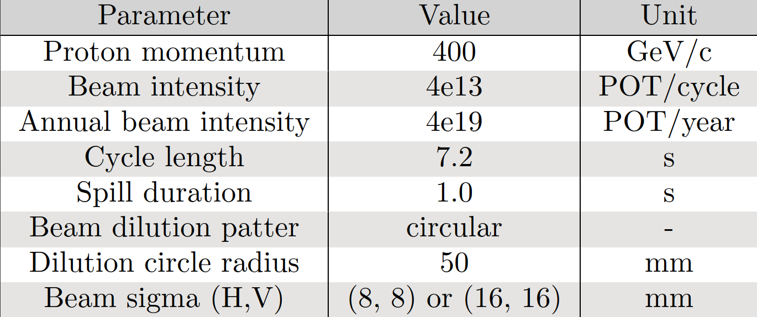
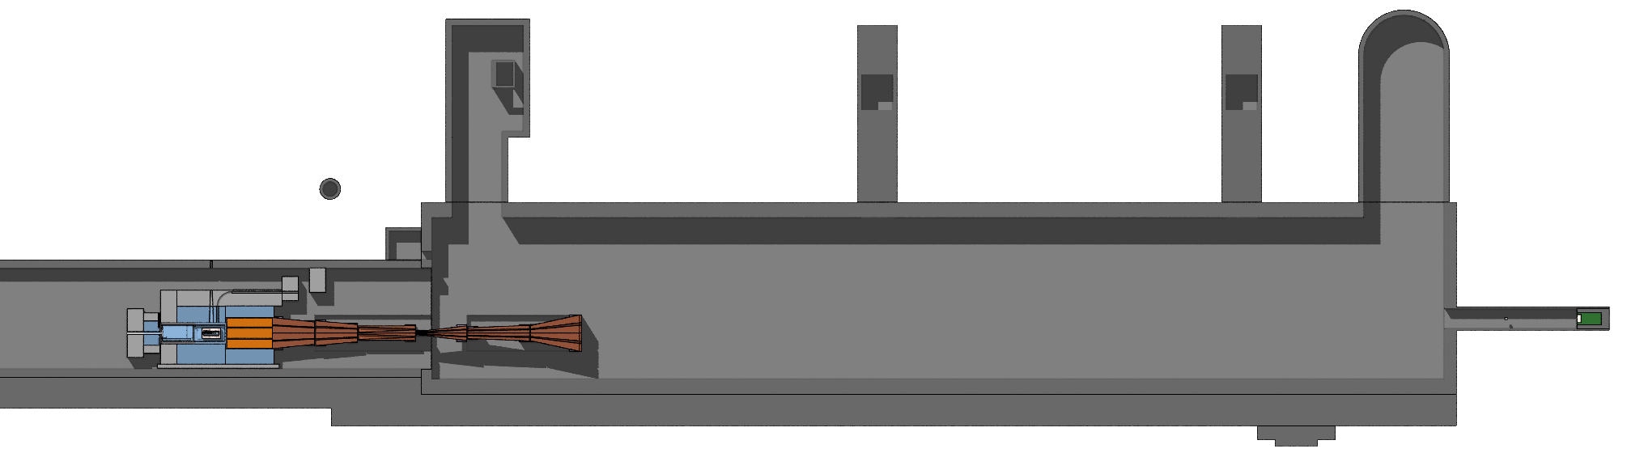
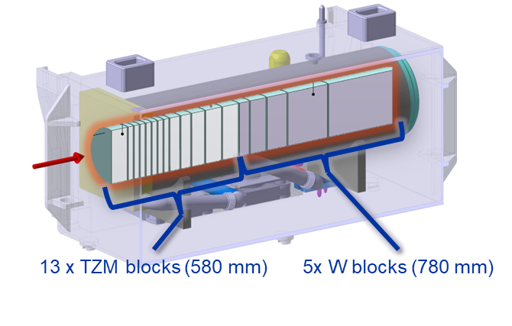
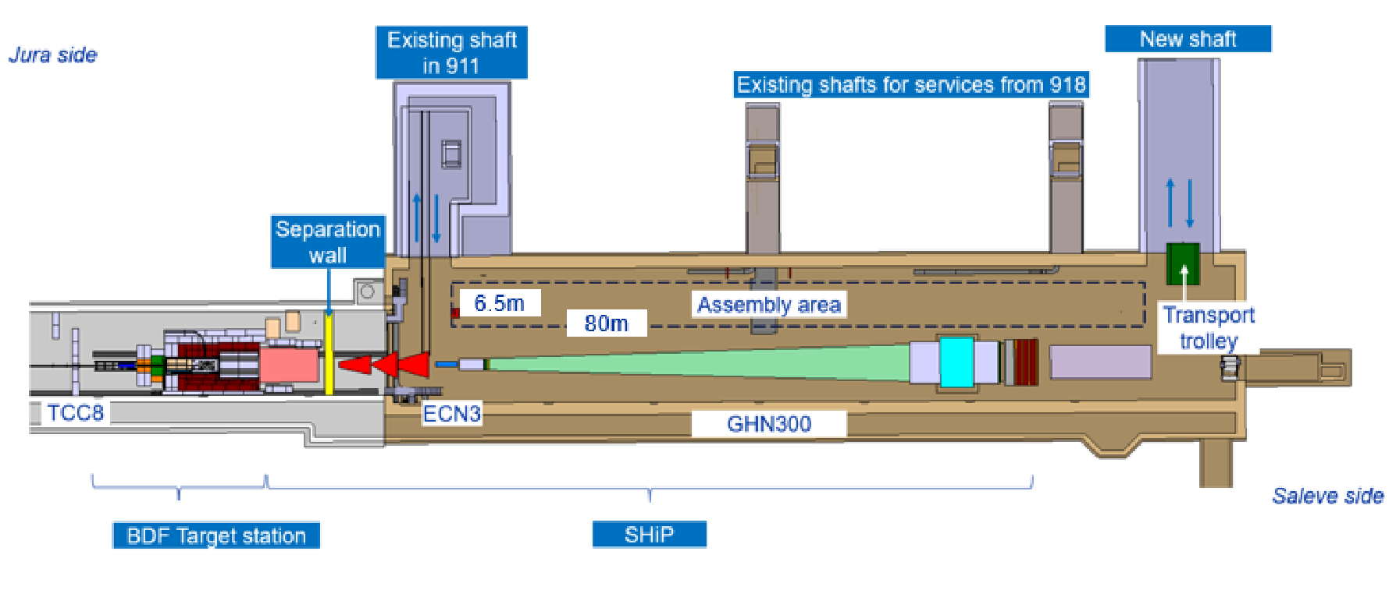
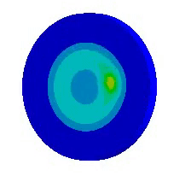
Geometry and beam parameters
Geometry design
Beam parameters
Top view of FLUKA model for BDF/SHiP
Beam parameters of the BDF target operation –
CDS (Comprehensive Design Study) book
Magnetized Hadron Stopper (MHS)
Warm Muon Shield (MS)
Target complex
Top view of BDF/SHiP integration model – EDMS 2936008
Representation of beam sweep (left) and CDS design target for BDF (right)

Slide 5
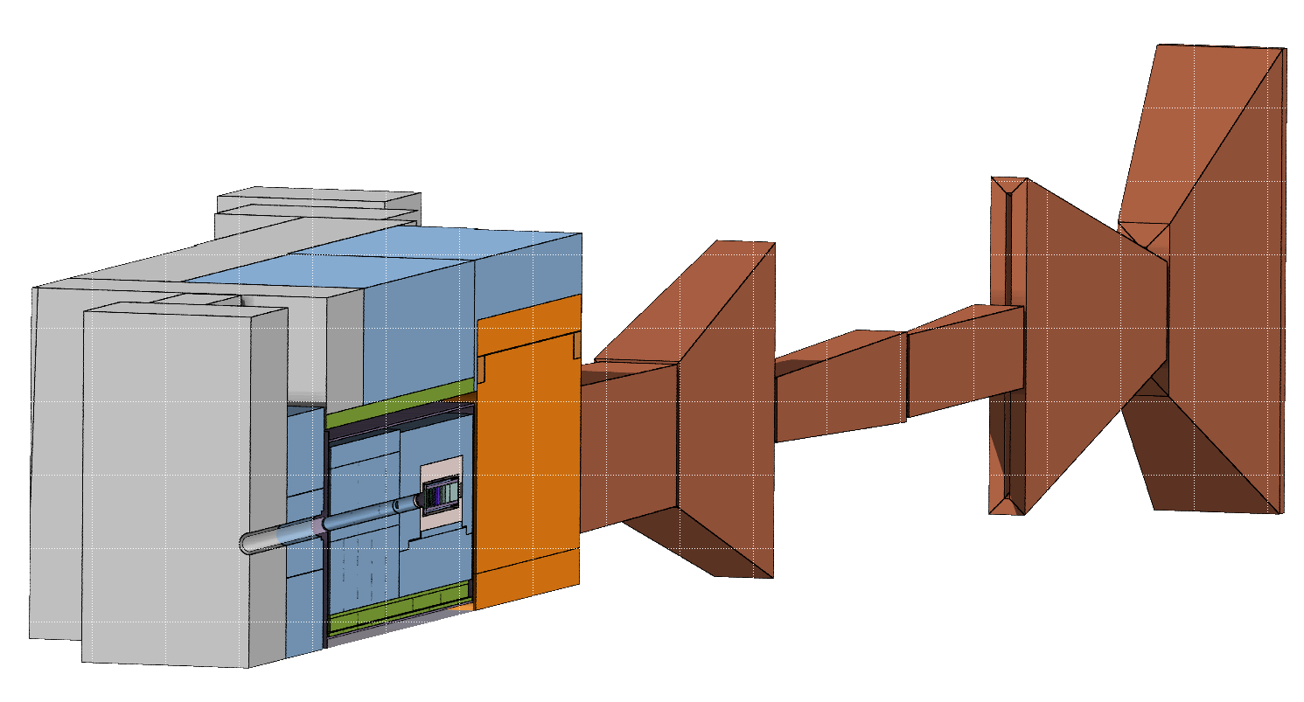
Concrete shielding
Vacuum vessel
Warm Muon Shield (MS)
Proximity shielding
Particle yields and energy deposition in various systems
Magnetized Hadron Stopper (MHS)
Iron shielding
Target

Slide 6
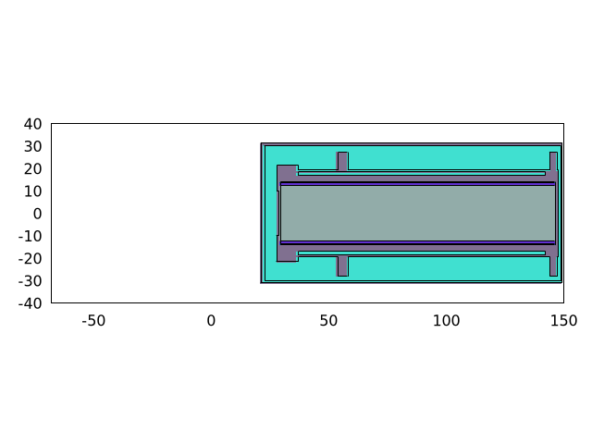
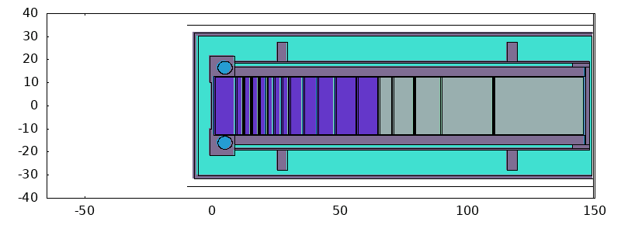
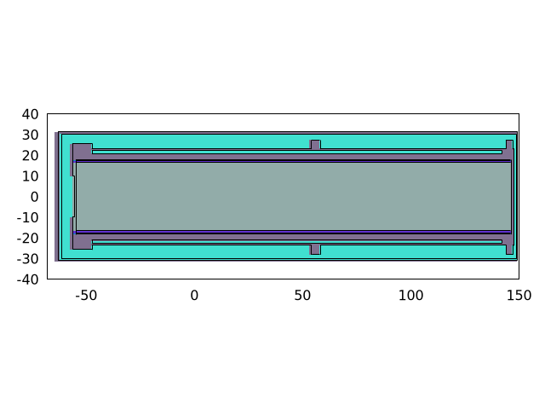
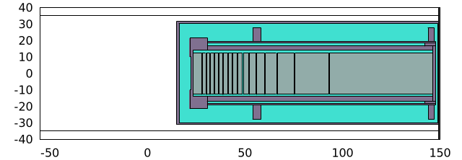
Geometry: Target core designs
Different core designs evaluated to maintain/improve the SHiP physics reach with respect to the CDS design
  Option 1) CDS target – sweep σ = 8 mm
  Option 2) CDS target – sweep σ = 16 mm
  Option 3) W target 1.2 m – sweep σ = 8 mm
  Option 4) W target 2 m – sweep σ = 8 mm
25 cm
25 cm
TZM 64 cm
W 80 cm
119 cm
  Option 5) Optimum W target – sweep σ = 8 mm
W-He target
33 cm
25 cm
33 cm
123 cm
201 cm
201 cm

Slide 7
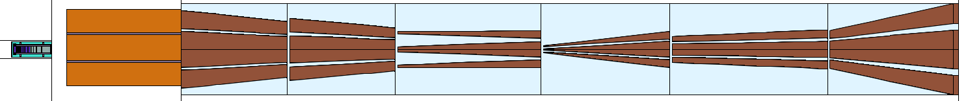
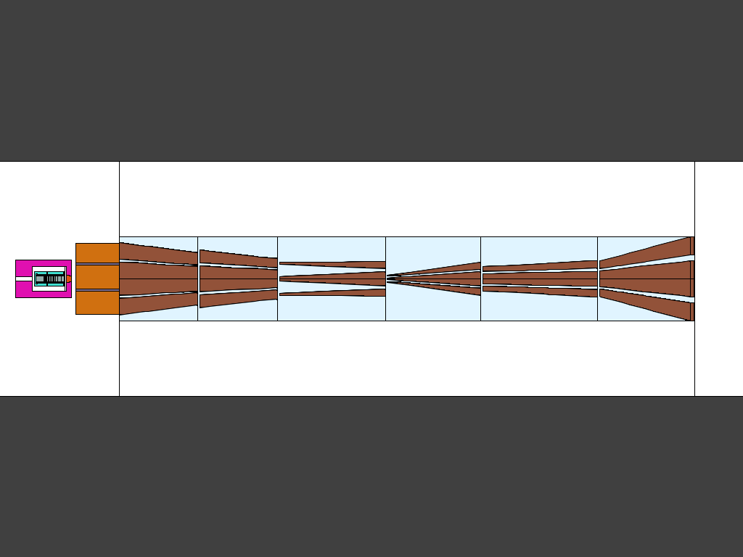
Geometry: Reduction of MHS length
CDS geometry
4.5 m
As requested by SHiP, a shorter MHS would allow to reduce the aperture of the SC magnet
  Full W target 1.5 m long, ⍴ = 19.3 g/cm³, ⌀ = 25 cm
  Cast-iron proximity shielding length downstream 25 cm
  W plug ⍴ = 18.5 g/cm³, ⌀ = 30 – 25 cm
  Hadron absorber: 2.3 m long (from 4.5 m)
  sweep σ = 8 mm
2.3 m
Option 6) New baseline

Slide 8
Geometry: Reduction of MHS length
As requested by SHiP, a shorter MHS would allow to reduce the aperture of the SC option:
  Full W target 1.5 m long, ⍴ = 19.3 g/cm³, ⌀ = 25 cm
  Cast-iron proximity shielding length downstream 25 cm
  W plug ⍴ = 18.5 g/cm³, ⌀ = 30 – 25 cm
  Hadron absorber: 2.3 m long (from 4.5 m)
  sweep σ = 8 mm
4.5 m
Option 1) CDS target + MHS + MS
2.3 m
Option 6) New baseline

Slide 9
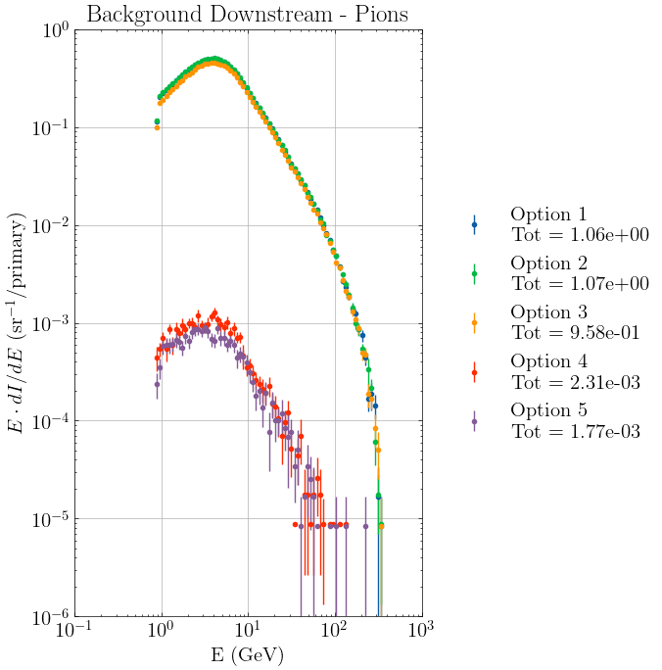
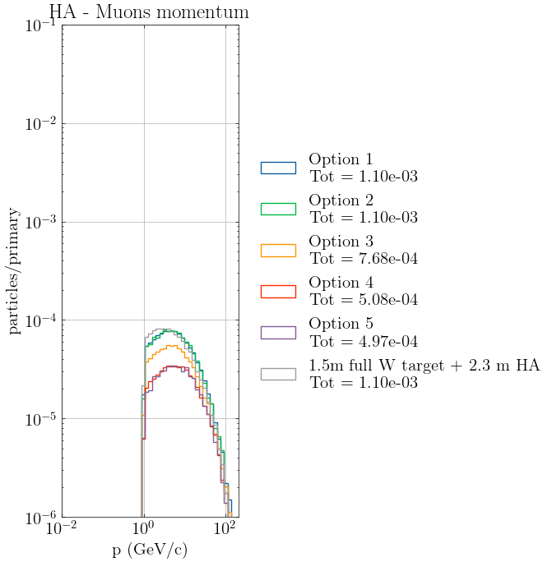
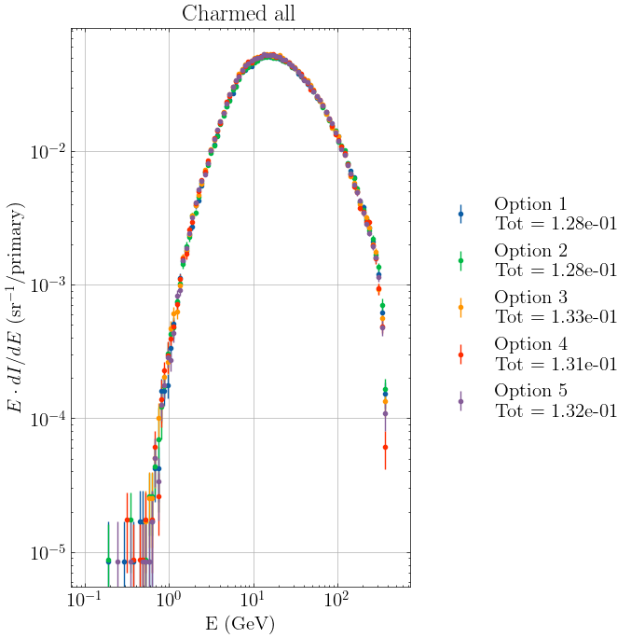
Target: Physics parameter metrics
Option 1) CDS target – sweep σ = 8 mm
Option 2) CDS target – sweep σ = 16 mm
Option 3) W target 1.2 m – sweep σ = 8 mm
Option 4) W target 2 m – sweep σ = 8 mm
Option 5) Optimum W target – sweep σ = 8 mm
Option 6) W target 1.5 m – MHS 2.3 m – sweep σ = 8 mm
For each target design, signal production and background suppression are evaluated – SHiP CM
Spectra of charmed particles produced in target
Metrics used as trace for SHiP desired signal
Spectra of pions exiting target downstream
Metrics used for background suppression evaluation
Spectra of muons exiting MHS
Metrics used for background suppression evaluation
MHS -
MHS
Note the excess of
1 GeV muons after the shorter MHS for the new baseline.

Slide 10
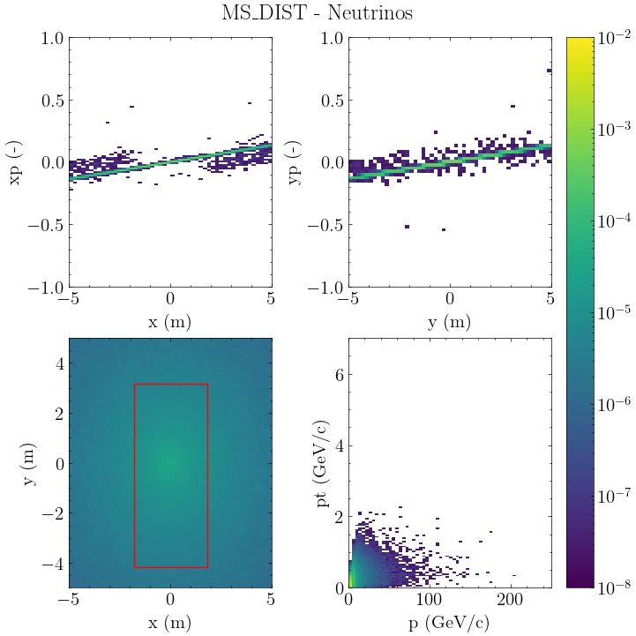
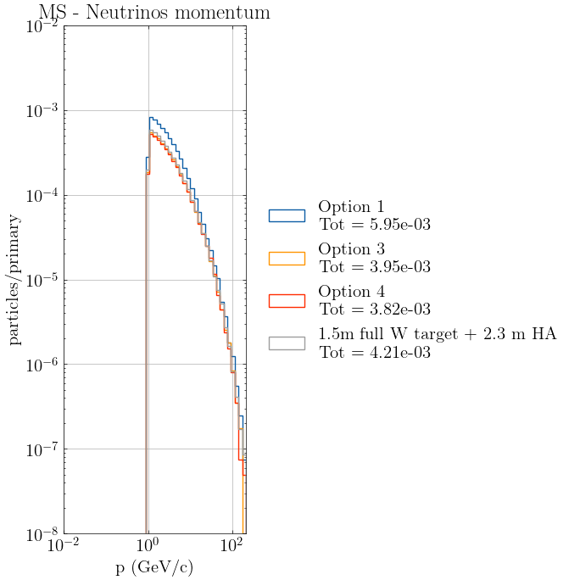
MS: Neutrino distributions
Option 1) CDS target – sweep σ = 8 mm
Option 2) CDS target – sweep σ = 16 mm
Option 3) W target 1.2 m – sweep σ = 8 mm
Option 4) W target 2 m – sweep σ = 8 mm
Option 5) Optimum W target – sweep σ = 8 mm
Option 6) W target 1.5 m – MHS 2.3 m – sweep σ = 8 mm
Option 1
Phase space distribution ν
Comparison
Spectra of ν exiting MS
Considered all neutrinos and anti-neutrinos flavors
Simulated 40 M protons on target
Downstream the MHS, similar reduction factor obtained going from CDS to full W target
The new baseline sits in between CDS and Options 3/4
MHS

Slide 11
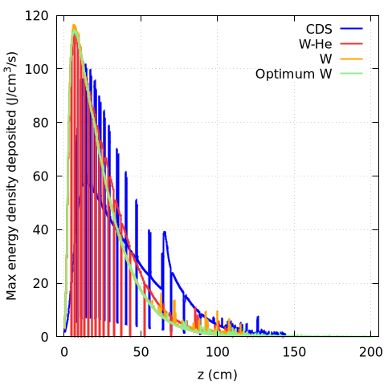
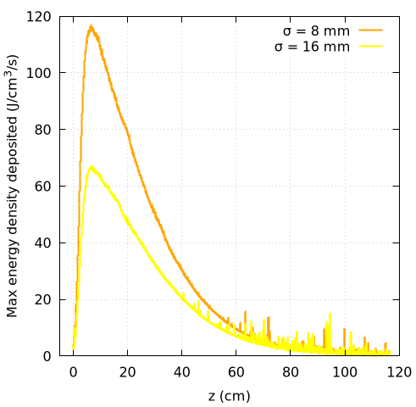
Target: Energy deposition
Evaluation of energy deposited in the core for the different target designs
Verification of thermo-mechanical properties and design optimization
Maximum energy density deposited by beam
For all designs same beam delivery
(sweep 50 mm radius, 8 mm σ)
Maximum energy density deposited by beam
W target with different beam delivery
(sweep 50 mm radius, 8 mm and 16 mm σ)
Results normalized to 4e13 p/cycle with 7.2 s/cycle

Slide 12
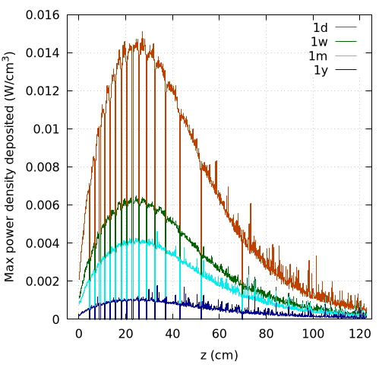
Target: Decay heat
Residual maximum power density deposited
W-He target, beam sweep 50 mm radius 8 mm σ for 5 years with 4e19 p/year
For CDS design, the decay heat in the target material is considerable and it is significantly driven by the cladding.
The possibility of a Loss-of-Coolant Accident (LOCA) poses a critical safety risk. This risk leads to several potential problems
  Uncontrolled temperature and pressure increase
  Potential risk of core melting (due to decay heat)
  In case of cladding rupture, the release of radioactive material
Reducing/avoiding Ta cladding as mitigation strategy

Slide 13
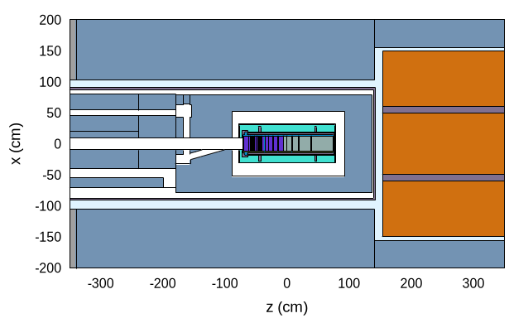
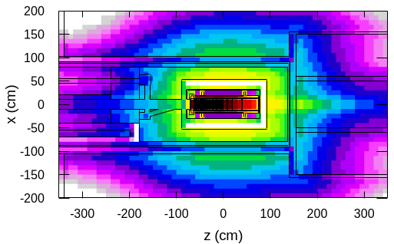
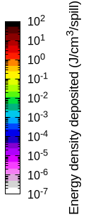
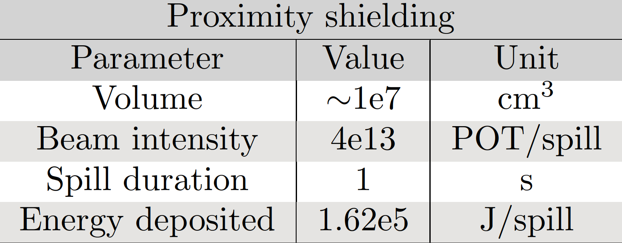
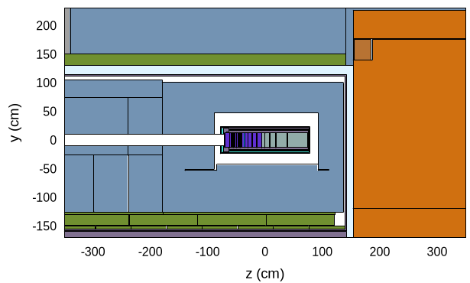
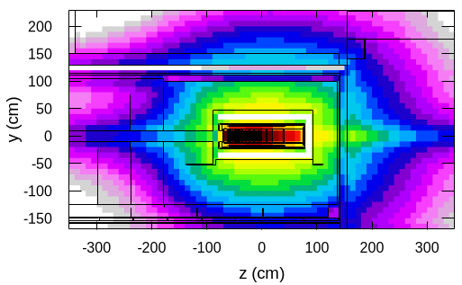
Proximity shielding: Energy deposition
The proximity shielding is placed inside the vacuum vessel, and it surrounds the whole target → high energy deposited, and active cooling required
Top view and side view of BDF target complex
Proximity shielding highlighted
Top view and side view for energy density deposited in BDF target complex. Results normalized with 4e13 p/spill
Parameters and integral energy deposited in proximity shielding
Proximity shielding
Cast iron

Slide 14
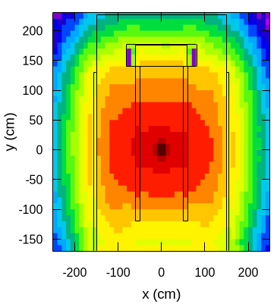
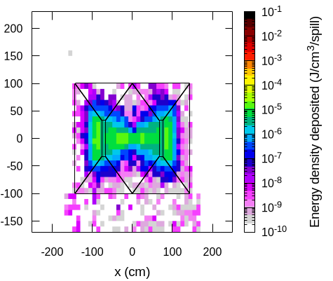
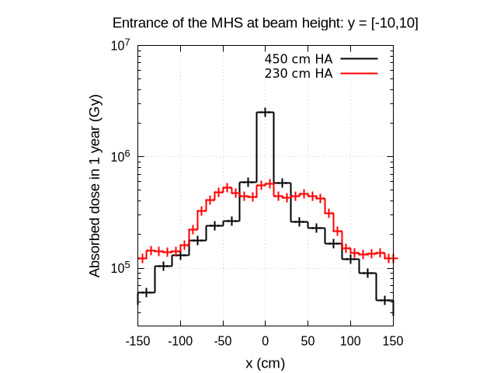
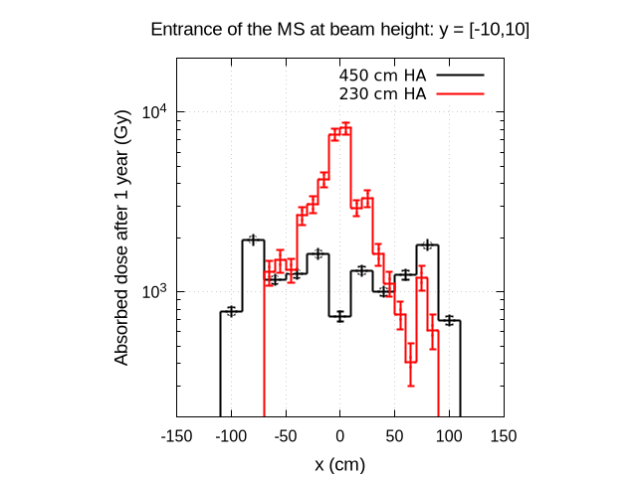
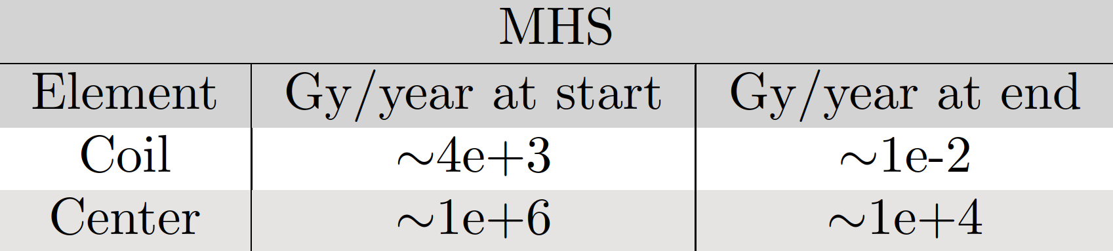
MHS and MS: Energy deposition
The Magnetized Hadron Stopper (MHS) and the Muon Shield (MS) are fundamental elements in the background suppression for SHiP:
  MHS aims to stop all hadrons escaping the target and applies a first sweep to the muons through a magnetic field. Energy deposition evaluated in the coil and yoke to appropriately design the element.
  MS is composed by a series of magnetized blocks which sweep horizontally the muons exiting downstream BDF creating the “ship” shape. Options for a fully warm and hybrid (super conducting + warm) MS are being investigate.
CDS geometry. Cross section for energy density deposited.
Results normalized to 4e13 p/spill
Effect of 1.5 m W target + plug + reducing the MHS
at the start of MS
MHS
MHS
Yearly value of TID for the coil and yoke’s center at start and at the end of MHS. 4e19 p/year considered.
MHS
MHS
at the start of MHS

Slide 15
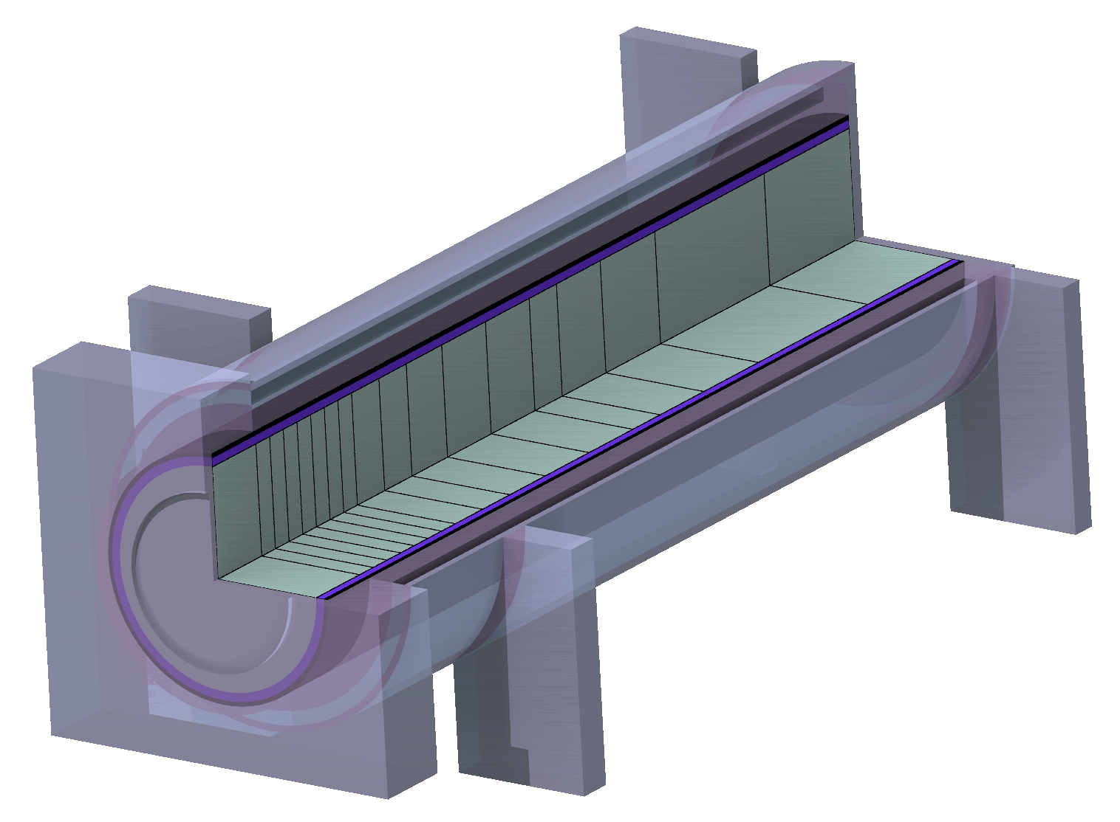
DPA and gas production in target
Core
(W blocks)
Vessel
Window

Slide 16
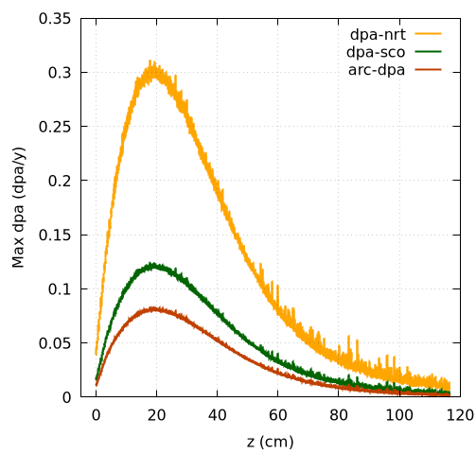
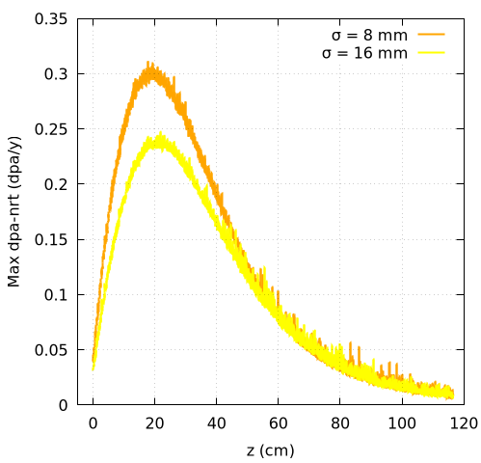
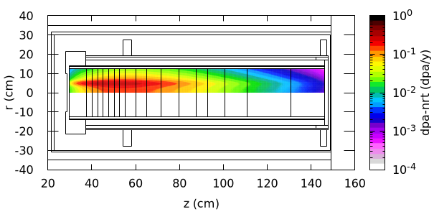
DPA in target
Evaluation of displacement per atom in the target’s core evaluated with different models and used as figure of merit for the radiation induced damage:
    ARC-DPA model assigns an energy-dependent damage cross section. Parameters are needed for DPA evaluation.
Maximum yearly DPA, computed with different models, along W target
Beam sweep 50 mm radius, 8 mm σ
Distribution of DPA-NRT in
W target with beam sweep 50 mm radius,
8 mm σ. Values averaged angularly.
Maximum yearly DPA-NRT along W target with different beam delivery (sweep 50 mm radius, 8 mm and 16 mm σ)
For W with ARC-DPA model, parameters:
E_{d} = 70 eV, b_{arc} = -0.564 and c_{arc} = 0.119 (ref)

Slide 17
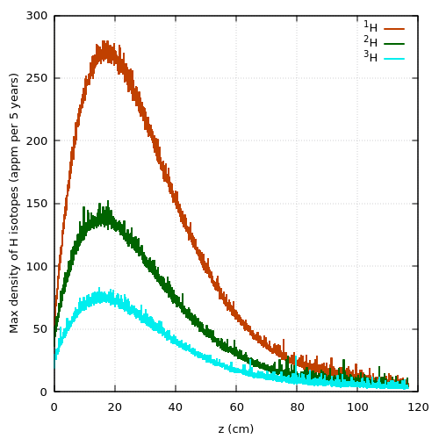
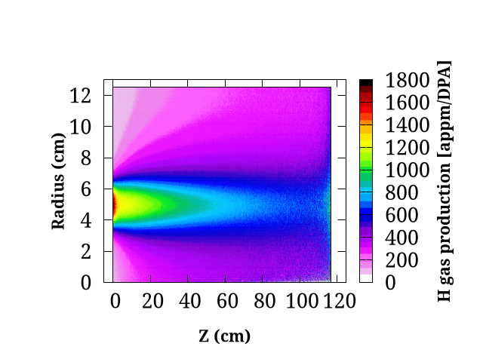
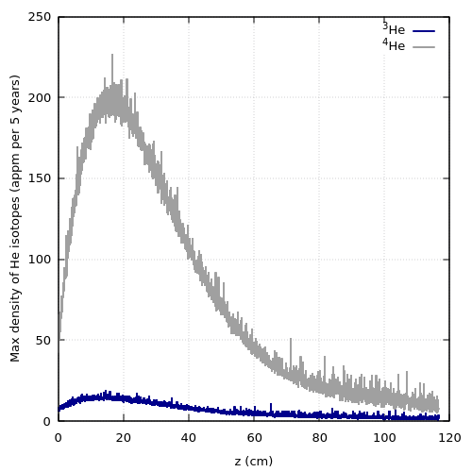
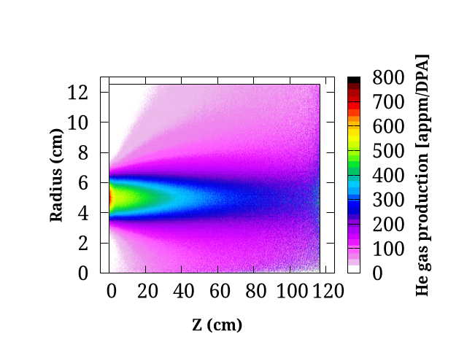
Gas production in target
Evaluation of residual gas (H and He) production in target core. Gas production can generate concern in safety and can change material properties
Maximum density of hydrogen isotopes along W target with beam sweep 50 mm radius, 8 mm σ
after 5-year operation
Maximum density of helium isotopes along W target with beam sweep 50 mm radius, 8 mm σ
after 5-year operation

Slide 18
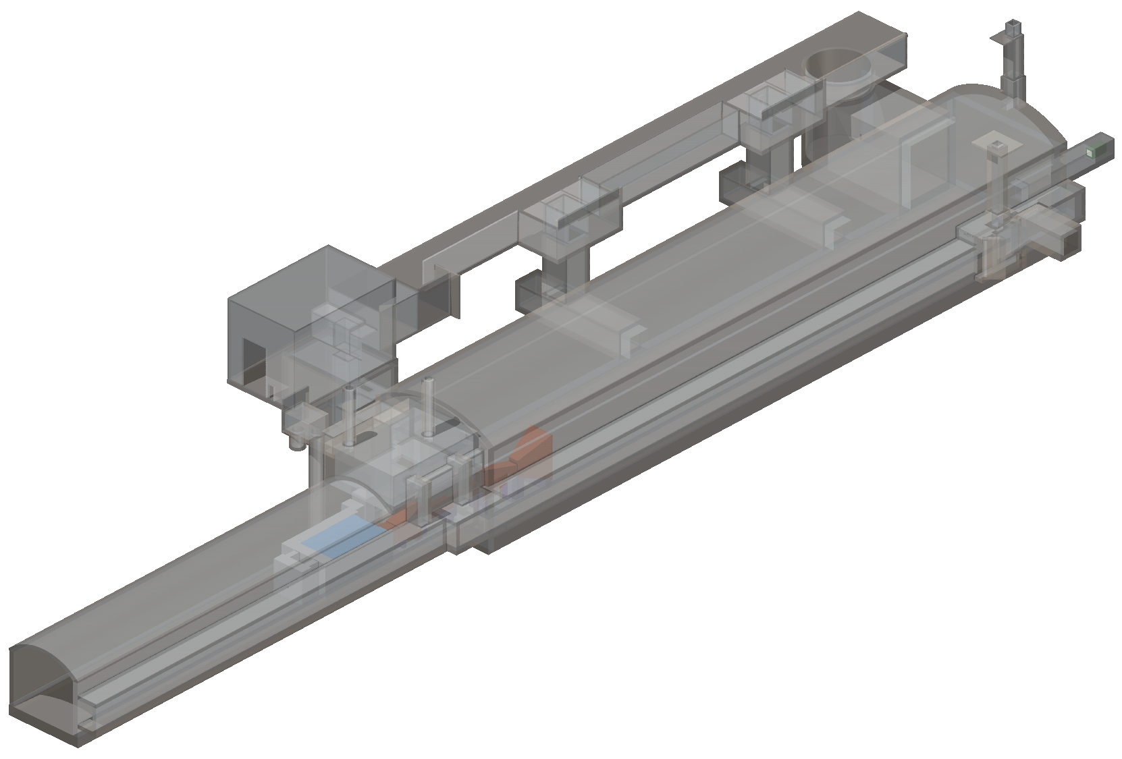
911 shaft door
Ventilation
room
ECN3
Radiation fields around target complex and R2E considerations
SHiP detectors
Muon Shield (MS)
TCC8
BDF target complex

Slide 19

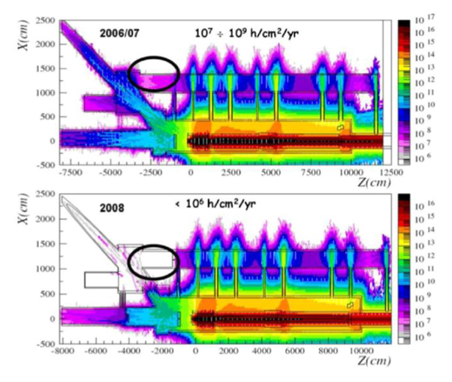
R2E lesson from CNGS experience
Electronics
Ventilation Units
During the 2007 CNGS physics run, 8×10¹⁷ p.o.t. delivered, i.e., ~2% of a nominal CNGS year
Single event upsets (SEU) in the electronics of the ventilation units caused control failure and interruption of communication
Critical review of installation of all electronics in CNGS:
installing thick radiation shields in situ
moving all the control systems into a protected area
CV,crane,
fire
This triggered the creation of the R2E Project, with large impact for LHC operation and HL-LHC
→ This must be considered for any new facilities

Slide 20
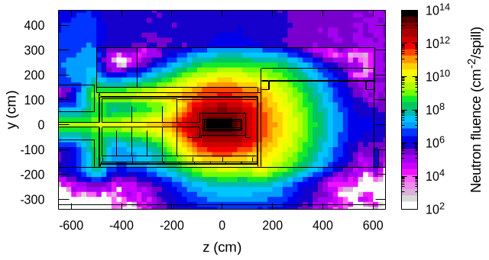
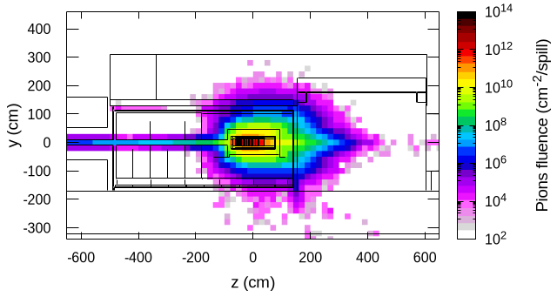
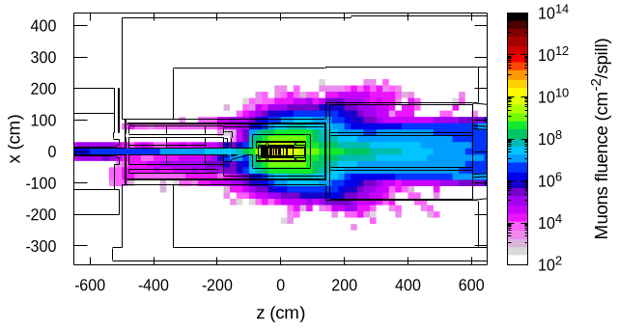
Radiation field around the target complex
Protons of 400 GeV/c impacting on a 12 λ long target (CDS) generate a high radiation field all around the target and the target complex
  Constraints for radiation protection and radiation to electronic aspects → Great amount of shielding required
  On the other side, the radiation field can be exploited for material and electronics irradiation tests → (backup slide)
Side view of neutron (left) and pions (middle) around target complex. Right, top view of muons fluence.
Results normalized considering 4e13 p/spill. Plots averaged around BDF target (CDS design).
Radiation field results to be dominated by neutrons, pions stopped in MHS while muon exit downstream BDF

Slide 21
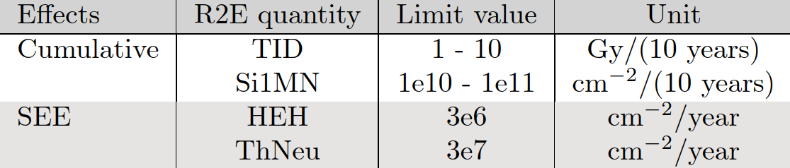
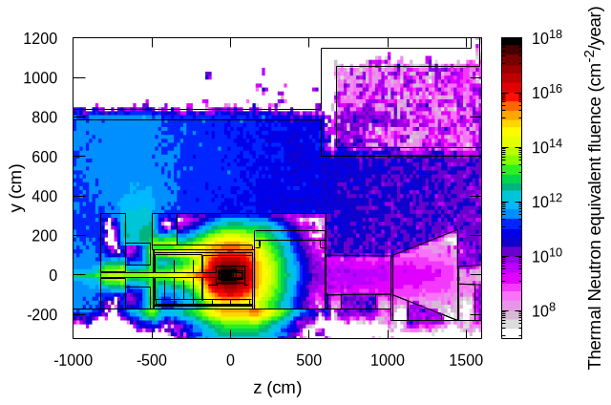
R2E in TCC8
General limits for R2E considerations
The radiation field generates constrains due to radiation to electronic effects mainly leading to cumulative damage and Single Event Effect (SEE)
Some general limits (EDMS) are defined for specific R2E quantities (Indico) to characterize an area as radiation-safe for electronics.
Side view of BDF and ventilation room in TCC8.
ThNeu yearly fluence averaged along target.
Grey color represents the limit of 3e7 cm⁻²/year
The radiation levels in different areas which will store active electronics has been evaluated:
  Ventilation room above BDF in TCC8
  911 shaft door
  SHiP detector in ECN3
Similar plots present also in BDF/SHiP proposal, considering previous integration model of BDF

Slide 22
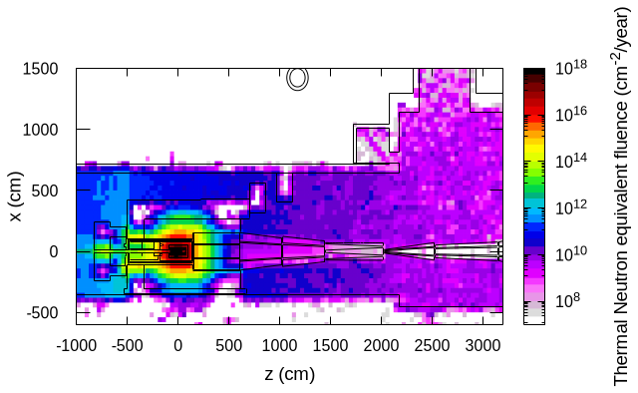
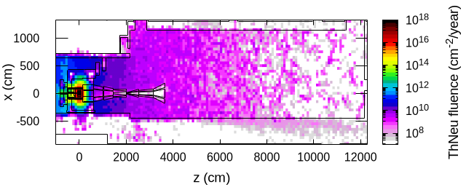
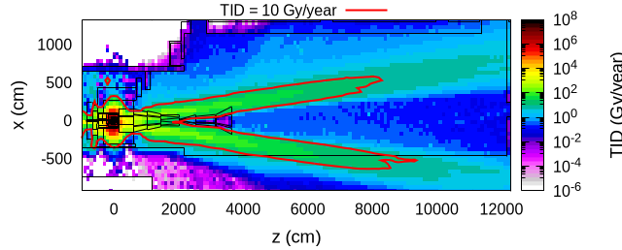
R2E in 911 shaft and ECN3
General limits for R2E considerations
The radiation levels in different areas which will store active electronics has been evaluated:
  Ventilation room above BDF in TCC8
  911 shaft door
  SHiP detector in ECN3
Top view of BDF and 911 access shaft.
ThNeu yearly fluence averaged at beam height.
Grey color represents the limit of 3e7 cm⁻²/year
Top view of yearly thermal neutron equivalent fluence (left) and Total Ionizing dose in one year (right) in ECN3.
For left plot, the grey color represents the limit of 3e7 cm⁻²/year. In the right plot, value of 10 Gy/year represented by red contour

Slide 23
Conclusion and outlook
Different studies have been conducted for BDF target: building upon the solid baseline design (CDS), the goal was to optimize it and explore new solutions
This presentation summarizes the main results (energy deposition, DPA, and radiation levels).
In addition, studies have been performed on future targets for irradiation, the SC MS, and parasitic irradiation facilities (info in backup slide)
Target design optimization is nearly finalized. A tungsten-helium (W-He) cooled target offers promising benefits in terms of mechanical properties and background reduction
New simulations are planned after incorporating the updated design into the target facility model for the TDR

Slide 25



Radiation field and irradiation stations
The neutron-dominated radiation field generated around BDF is of interest for Electronics and Materials irradiation and Nuclear Activation
Integral particles fluence in different irradiation stations
Parasitic irradiation of samples in well-defined irradiation stations
HI-ECN3 Irradiation Opportunities Workshop
Top view of the BDF target complex with CDS design for target. Highlighted the proposed irradiation stations.
(BEAS)
R2E@4m
Rabbit channel
Vacuum
vessel
BRIS
BHFIM2
BHFIM1

