Slide 2
Target conceptual design
Beam Dump Facility (BDF)
Targetry Systems Advisory Committee (TSAC) #1 https://indico.cern.ch/event/1488161/
Mike Parkin, Rui Franqueira Ximenes, Alvaro Romero Francia, Truls Kolstad
With contributions from many others
04/Mar/2025
https://hiecn3.web.cern.ch

Slide 3
Specific questions for the Committee
Do you see any feasibility issues in the proposed designs, …future production and assembly?
Do you see any potential showstopper in the FEA / thermo-mechanical calculations, for both nominal and for degraded scenarios? Are there specific topics which have been under evaluated?
Are the most important operational considerations and accident scenarios being fully addressed? Shall other situations be considered?
Do the target block R&D plans adequately support the design efforts? Do you see any potential missing aspects that would need to be considered at this stage?
Are the present target block design options appropriate for long-term reliability – should options be included or eliminated? • Are the plans for target prototype proton beam testing appropriate and useful to support the target development plans? Shall other complementary tests be explored?
Do you identify any specific risks in the proposed target designs? Do you see areas for optimisation?
Is the proposed target instrumentation package suitable for diagnosing operational and potential accident scenarios? Is there any other instrumentation you would suggest?
Is the current target station design in line with best operational and maintenance practices from the international community? Are there any specific improvements or design options that should be considered at this stage?
Is the design of the cooling and ventilation systems adequate for the needs of the target systems? Are the safety concerns associated with such a cooling system being addressed and mitigated in the current design? Including maintenance scenarios of the cooling system
Are radiation protection aspects adequately considered in the design of the complex, both in terms of operation as well as waste management?
Is the concept for the service cell in the target service building appropriate to tackle the challenges of maintenance and waste packaging of the target systems?
Do we have to consider additional failure scenarios?
→ Slides 6, 9, 11-13, 17, 21, 26, 28-31
→ Slides 11-21
→ Slides 6, 13-15, 27, 21, 25, 28-30
→ Slides 6, 9, 11-15, 28-30,
→ Slides 6, 9, 17, 21, 29-30

Slide 4
Contents
Helium Target
Cladding & Core Material structure
Helium Modelling Assumptions & Design Methodology
Helium Simulation Results
  Target size & beam parameters
  Radiation damage – stress
  Radiation damage – Fatigue
Helium & Water Target
Comparison
Helium target ‘Backup’ options
FMEA
Further work
Key takeaways

Slide 5
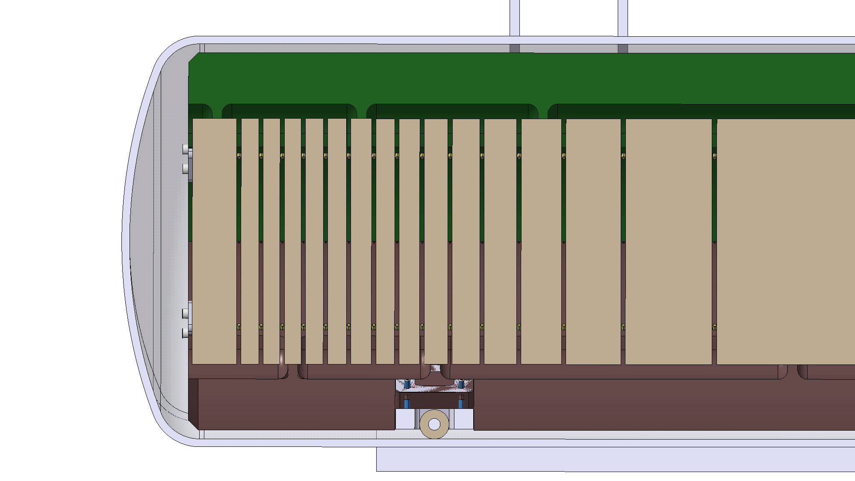
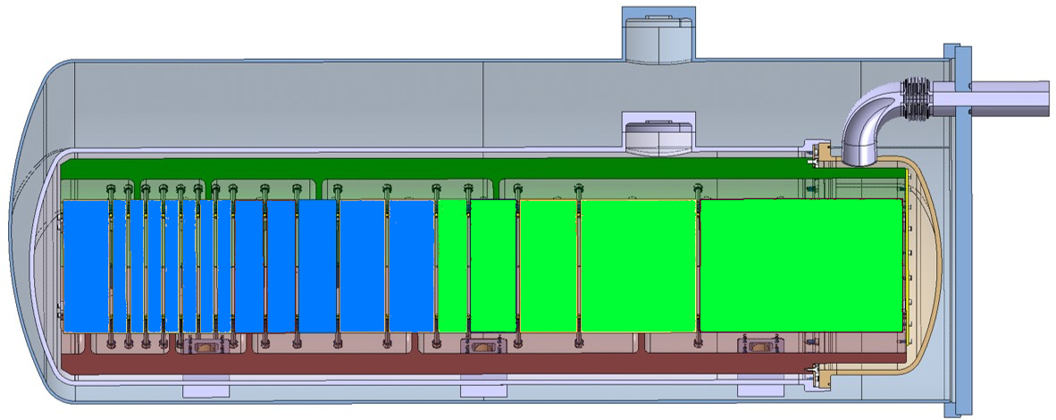
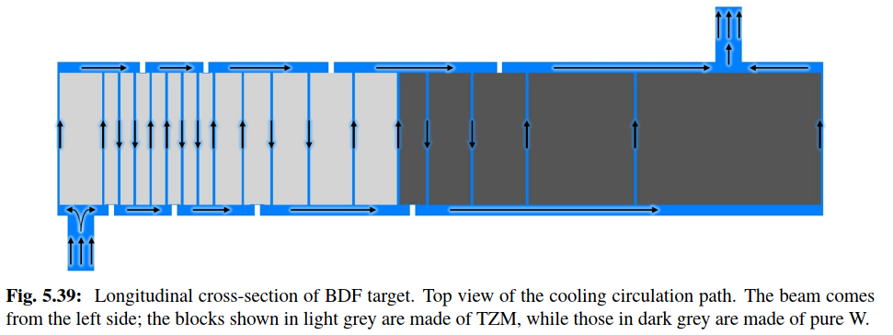
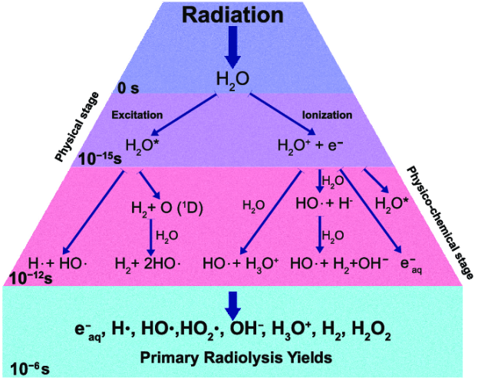
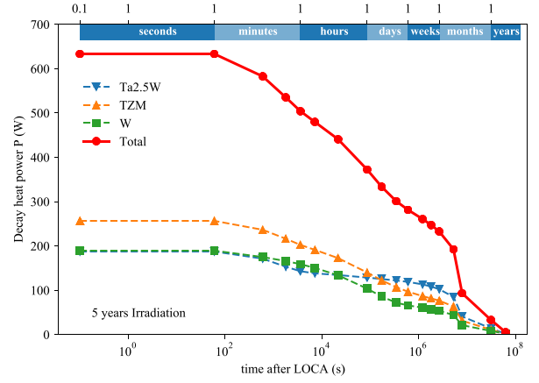
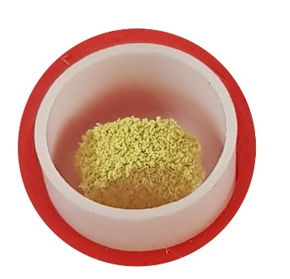
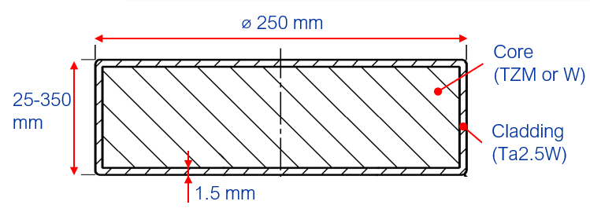
In search of an alternative design
Main motivations
https://doi.org/10.1103/PhysRevAccelBeams.22.113001
Helium cooled design on core blocks
CDS Design
Static He
400GeV/c p+ beam4x10¹⁹ POT
Water cooling
Most of the shower develops on TZM and not on W → Increase ρ at shower for better physics production
Water in-beam promotes formation of radicals → Remove water
Decay heat on CDS target is considerable & driven by cladding: critical safety risk → Reduce Ta cladding
PIE revealed W quality to be poor → Improve W properties
D250 mm
BDF Target water cooling layout (20bar, 5m/s)
13 x TZM blocks (Z=42, ρ=10.2g/cm³)
(580 mm)
5x W blocks (Z=74, ρ=19.3g/cm³)
(780 mm)
W
Water-cooled, Ta-cladded TZM + W Core
TZM: Absorbs most of the power. Higher strength, better creep resistance, higher recrystallisation temp wrt Mo.
W: Good radiation damage resistance. Best for physics.
Ta2.5W: To avoid corrosion-erosion of the core materials
Manufacturing: Forged TZM, sintered W (single blocks). Cladding via HIP.
Cooling: 22 bar, 5 m/s, ~660l/min,
BDF Target. Coolant by Gaseous helium, ~200m/s.
3 or 4 channels in parallel.

Slide 6
W material
Past study: Post-irradiation examination of a prototype tantalum-clad target for the Beam Dump Facility at CERN, T. Griesemer, R.F.Ximenes, https://doi.org/10.48550/arXiv.2410.01964
Drivers:
Must be clad for HIPing joining process
Don’t want cladding: high stresses at the cladding
Don’t want cladding: Ta produces lots of decay heat
Do want cladding at circumference: Compressive stresses beneficial to W sheets
Hot rolled W & cladding
Water cooled target was Sintered & HIPd; – pores, crack near cladding & poor UTS
Now looking at Hot rolled W sheets
  Aiming for improved material properties & reduced risk of cracking
5mm vs 17mm (later blocks could be SH)
  Guaranteed properties vs reducing interlayers
Weak point likely to be interface
  Now bulk W properties much improved
From studies, we expect good thermal contact
Lasagna structure applicable for Helium and H₂O target
Investigating 3 cladding cases for He target only
Is cladding needed to keep the laminations together? (& at high irradiation!?)
Ongoing material testing
Manufacture: Cladded for HIP, then partially/fully/none machined away
Full encapsulation
Circumferential encapsulation
No encapsulation
Ta cladding
W Sheets
50um Ta interfoil
Helium coolant
Fully Bonded
Frictional
No Friction
Cases to be investigated

Slide 7
Helium Target Modelling

Slide 8
He simulation Overview
Schematic of Temperatures of helium on Block Surfaces used in model
W
Ansys steady state thermal
￭ Halo beam
￭ Fluid temperature channel step change
HTC calculations
HTC, Not Varying*
30°C
87°C
143°C
Check
*Schematic of heat transfer coefficient used in model
Heat map
Steady state
temperature
2000
W/m².K on flat faces
200 W/m².K curved faces
Ansys CFX
Heat map
FLUKA
Heat map
Ansys transient thermal
￭ Halo beam
￭ Fluid temperature channel step change
Temperature
results
Baseline beam parameters of BDF target operation
Proton momentum | GeV | 400
Beam intensity | p+ / spill | 4×10¹³
Facility intensity | p+/year | 4×10¹⁹
Spill duration | s | 1
Cycle length | s | 7.2
Beam dilution pattern | - | Circular
Beam sweep structure | Turns/pulse | 4
Dilution radius | mm | 50
Beam sigma | mm | 8
Average beam power | kW | 356
Average beam deposited in target | kW | 305
Average beam power during spill | MW | 2.3
Assumptions used in models so far
Non internal block structure
Isotropic materials
HTC not varied in x,y,z.
Used simplified Helium temperature change
Halo beam used
→ 4Hz Painted beam compared to halo for many cases
Simulations assume steady 7.2s cycle. Supercycle is ignored, except when investigating fatigue!
Key
Simulations & calculations
Inputs / outputs
FLUKA outputs
Results
Transient
temperature
Ansys quasi-static structural
Stress and Strain results
Stress Cycles
dpa map
Matlab fatigue analysis
Fatigue analysis

Slide 9
Design methodology
References:
[1]CERN EDMS 2648378
[2]“Vaporization of tungsten in flowing steam at high temperatures”, G.A Greene and C.C. Finfrock, Experimental Thermal and Fluid Science, 2001 https://doi.org/10.1016/S0894-1777(01)00063-2
[3]https://doi.org/10.1016/j.jnucmat.2017.12.018
[4] J. Habainy et al., “Mechanical properties of tungsten irradiated with high-energy protons and spallation neutrons,” Jn Nuclear Mat. vol. 514,(2019) 189-195
[5] J. Habainy et al., “Fatigue properties of Tungsten from two different processing routes,” Jn Nuclear Mat. vol 506 (2018) 83-91
  Light optimisation was performed to obtain a model that was then used for investigations & sensitivity studies.
  16mm beam σ was used
  This geometry was then used for the simulations in this talk, including for 8mm beam
  Optimisation will be reperformed when initial material testing / HIP results are available
**More on fatigue methods in later slides!
Design limits chosen:
Property
Limit description
Values
Limit logic used
Surface temperature limit
UTS limit
Goodman equivalent at 1e7 cycles
Christensen criterion
Oxidation/ Corrosion
Stress
Fatigue limit
Stress in brittle material
350°C
150MPa
≤164MPa**
From mech’ testing results
50°C under formation of oxide WO₂ @ 400°C. [1-3]
Factor ×2 under UTS of 1cm cross rolled W plate at 2dpa [4]
Back calculated equivalent stress from [5], extrapolated to 1e7c, reduced ×2 for irradiation**
<0.5 in blocks 1-14.

Slide 10
Helium Target Results

Slide 11
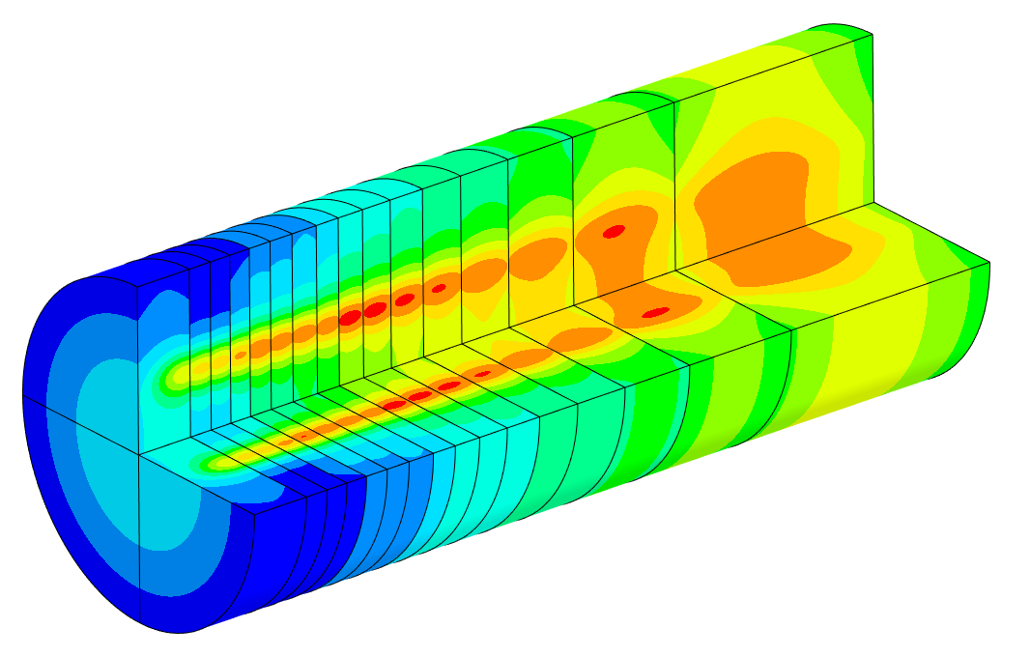
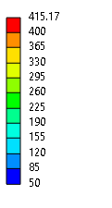
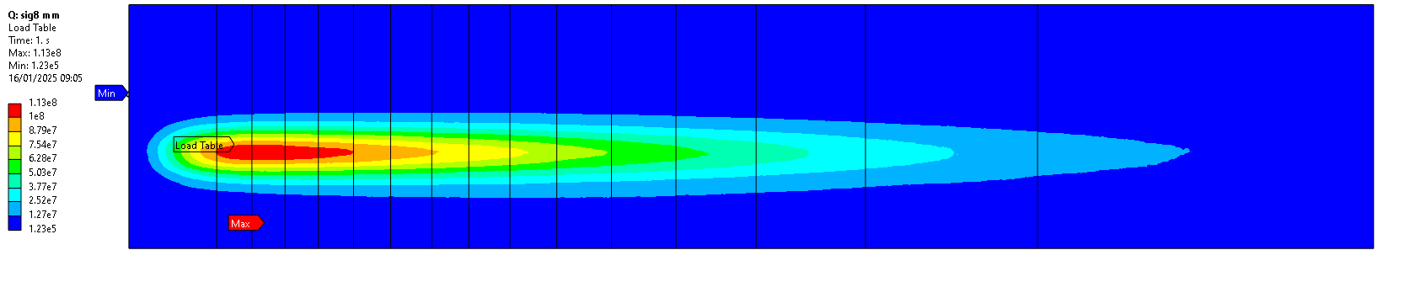
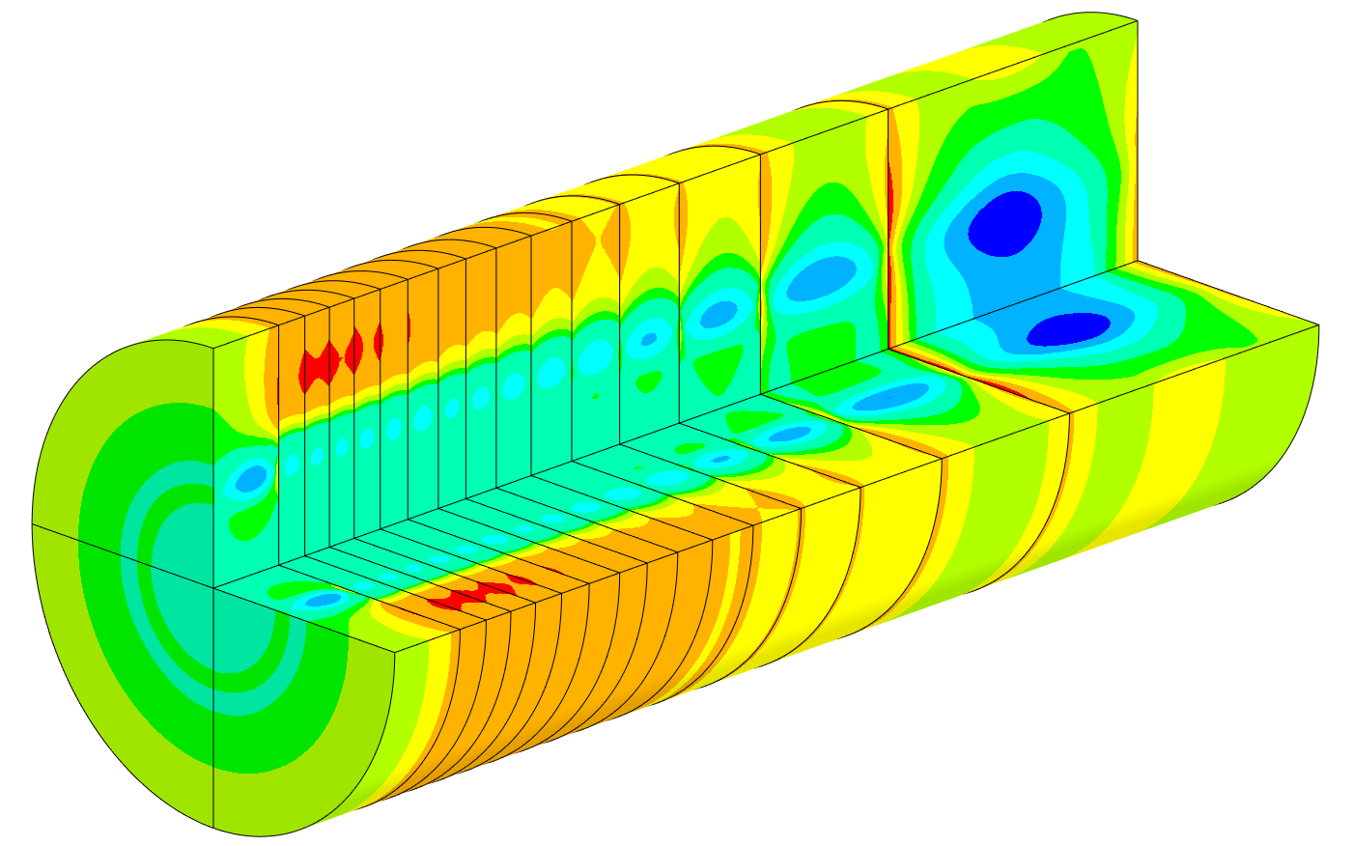
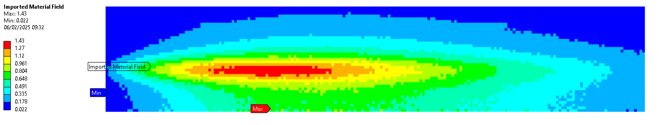
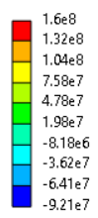
Simulation Results
Block temperatures not sensitive to value of HTC.
Block temperature step-increase ‘pattern’ is highly dependent on Helium temperature.
Helium Target Overview
Max temperature
415°C-
8mm beam, after pulse
ø250mm
Blocks 1-16 shown
640mm
W/m^3
52°C-
Heat deposition on US plates of target
Making blocks thinner reduces Temperatures and stresses strongly
Area of high stress,
& high fatigue
Steady state stress regions
125mm
Increasing steady state stress
Making blocks thinner reduces stresses slightly
Beam shower centre.
High thermal cycling
dpa 5yr
Radiation damage on US of target
Max principal stress
160MPa-
640mm
0MPa
Small area of high fatigue on block#1.
-97MPa-

Slide 12
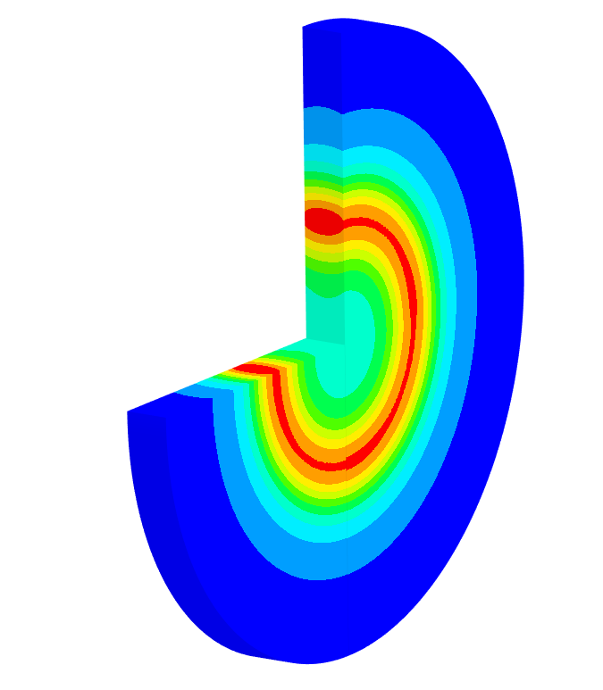
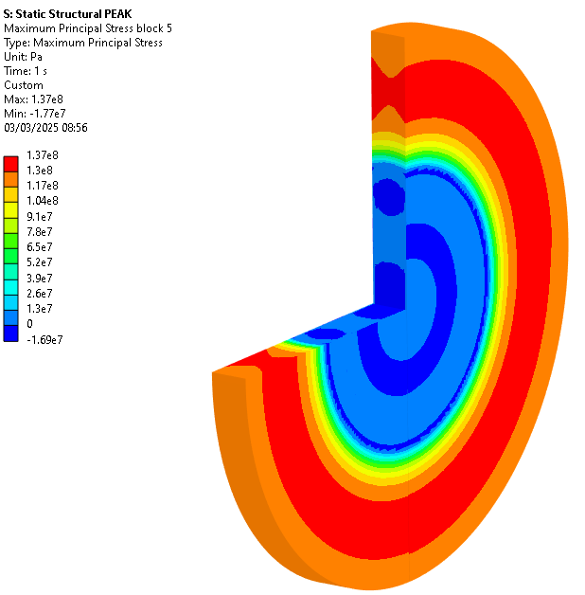
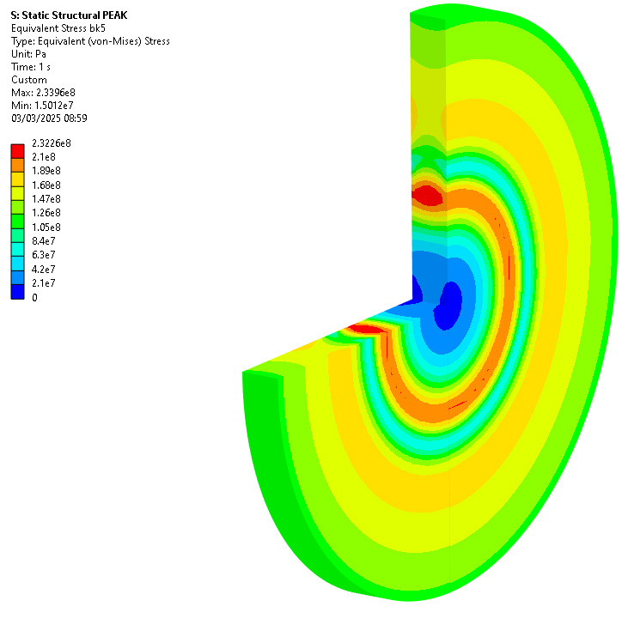
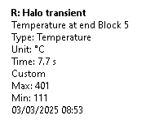
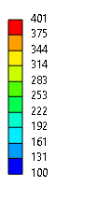
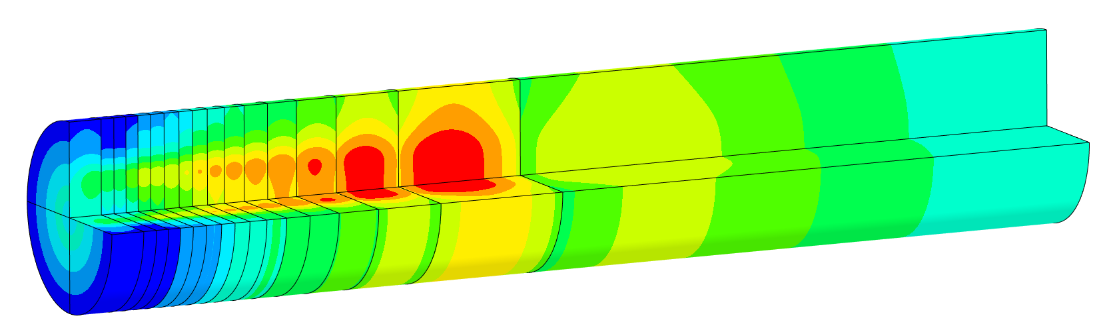

Simulation Results
Circumferential tensile stress
Helium Target block – σ 8mm - after pulse
Temperature
Principal stress
Equivalent stress
Block 5
steady state temperature

Slide 13


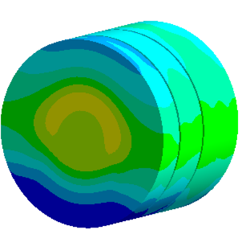
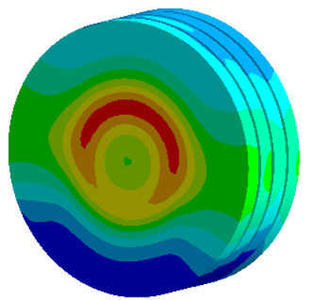
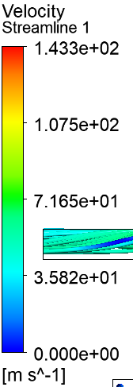
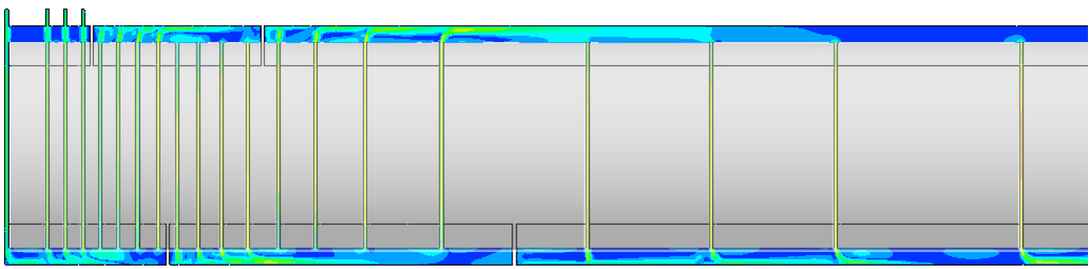
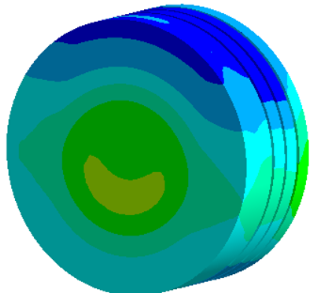
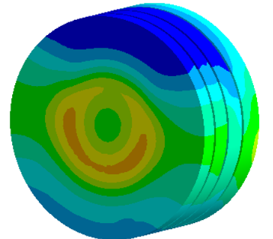


Note uneven temperature map
Results shown are Quasi -steady-state
-Temperature map not included in general thermal model
Final channel distribution TBD
These results from older geometry (v2)
Plan is to re-perform CFD with latest CAD geometry (v3, ø250mm) in March 2025
CFD
blocks
5-8
blocks
14-16
400g/s
Outlet helium ~170°C
Pressure at inlet = 16bar
ΔP = 0.7bar
Channels in parallel = 4
blocks
1-4
blocks
9-12
13

Slide 14
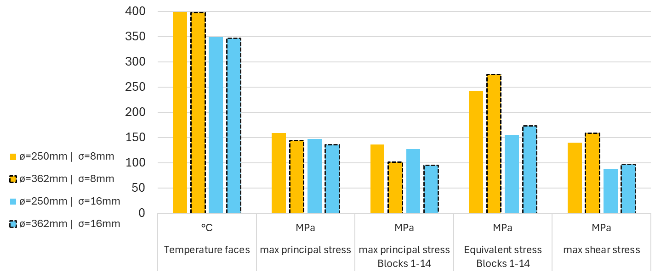
Target diameter &
Beam size
Larger target diameter slightly decreases tensile stresses, increases compressive stresses
Larger beam size reduces T (Δ~50°C) & σ (Δ~10MPa)

Slide 15
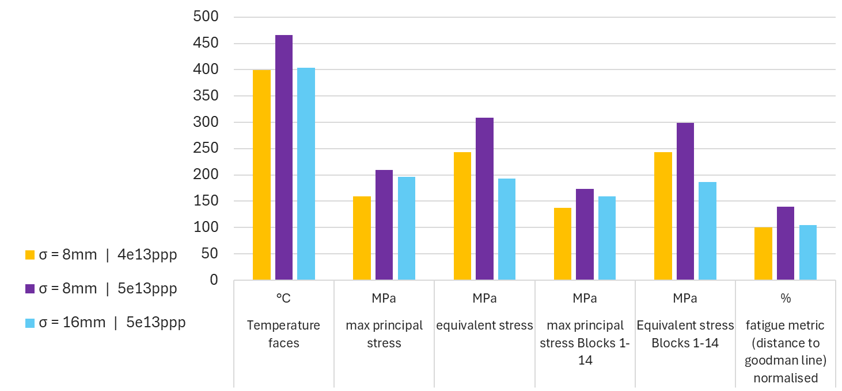
Intensity &
Beam size
Increased intensity to 5e13ppp substantially increases T, Stresses and fatigue.
Increase is reduced or eliminated, with large beam size

Slide 16
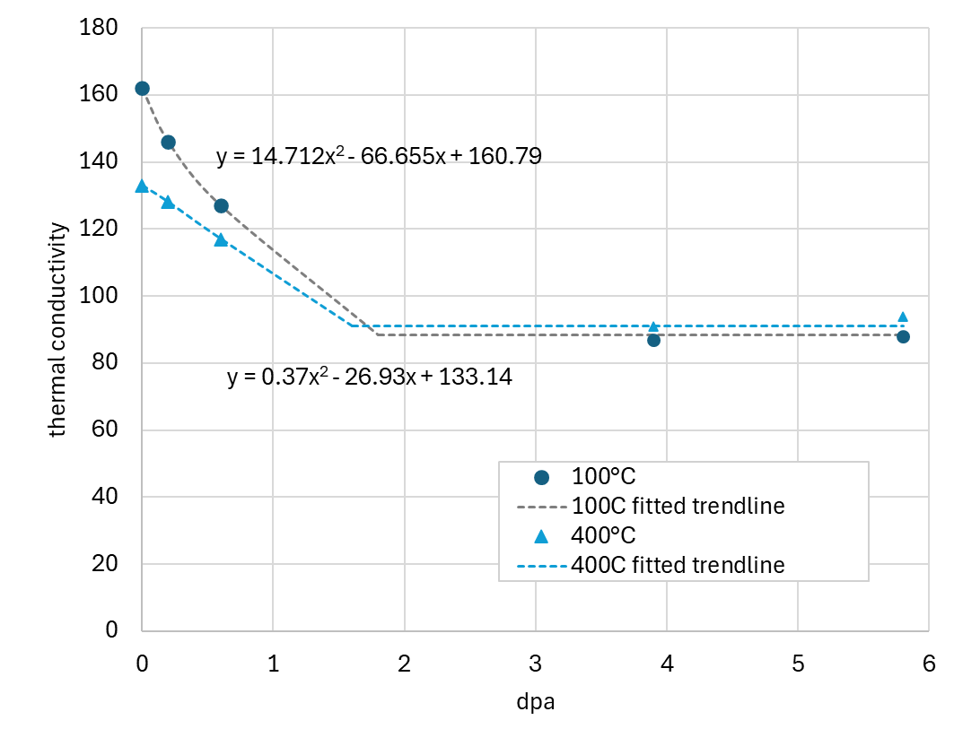
Radiation reduced Thermal conductivity
Material data used in BDF Irradiated thermal conductivity model
FH SH Tested results at 100°C
DPA dependent conductivity results from literature
  At 100°C and 400°C
  Mainly using neutron data at our level of dpa (<1.5)
We applied the dpa dependent conductivity to the Ansys model…
FH SH Tested results at 400°C
neutron data [1]
proton data [2]
References - Dpa dependent conductivity in the literature
[1] Data [neutrons]: M.Roedig et al. “Post irradiation testing of samples from the irradiation experiments PARIDE 3 and PARIDE4,” Journal of Nuclear materials 329-333 (2004)766-770
[2] Data [protons]: J. Habainy et al. “Thermal Diffusivity of tungsten irradiated with protons up to 5.8dpa,” Journal of Nuclear materials 509 (2018) 152-157

Slide 17
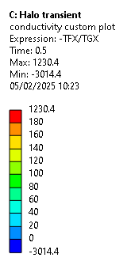
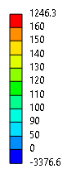
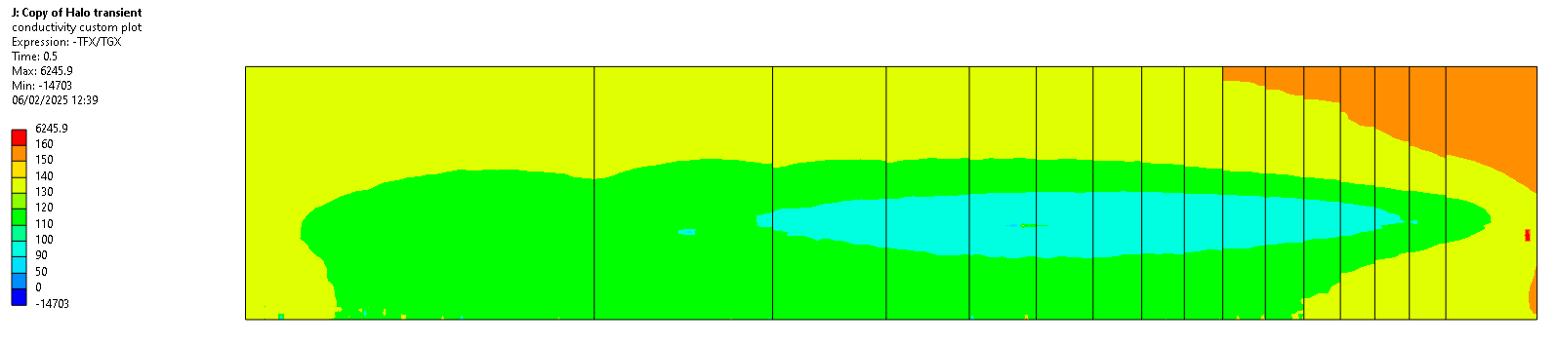
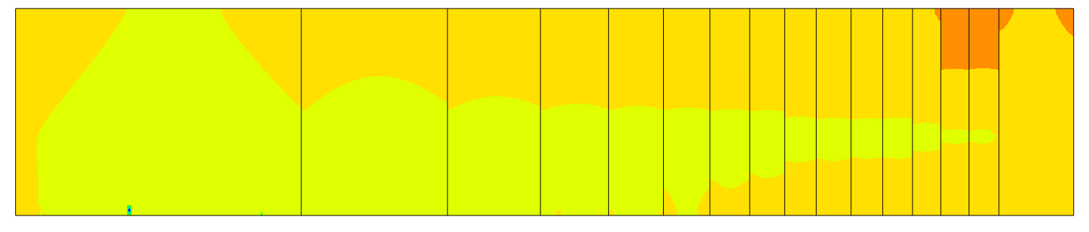
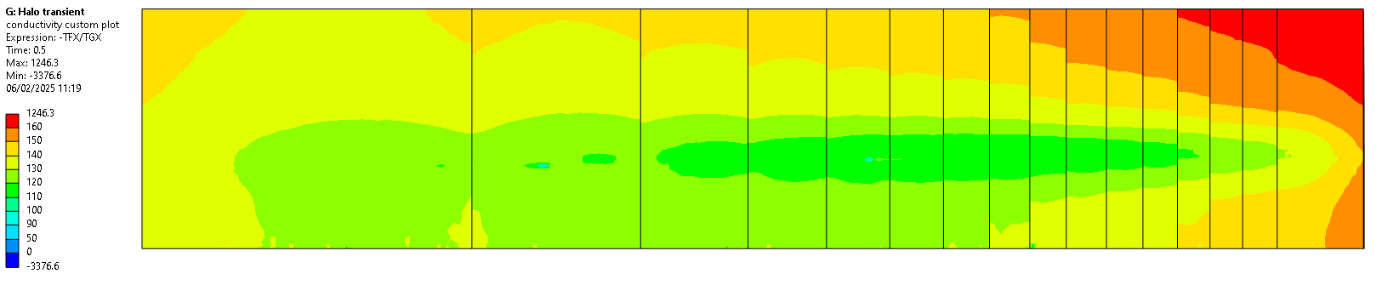
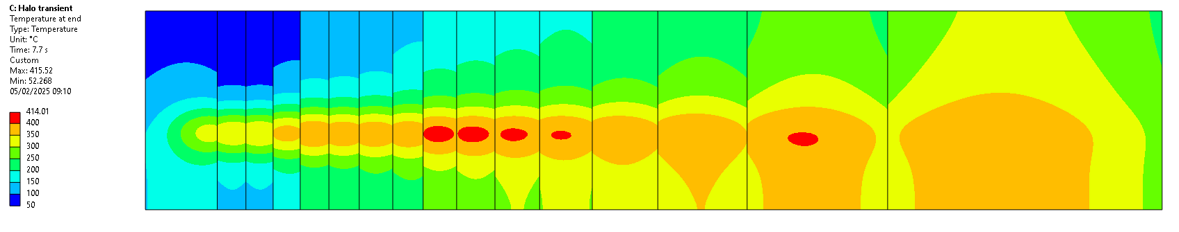
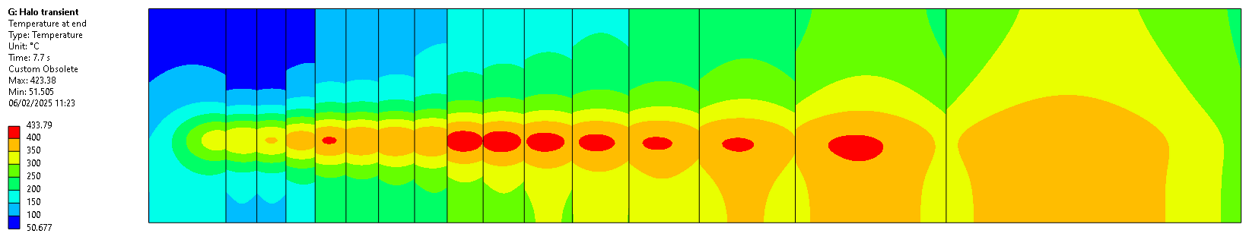
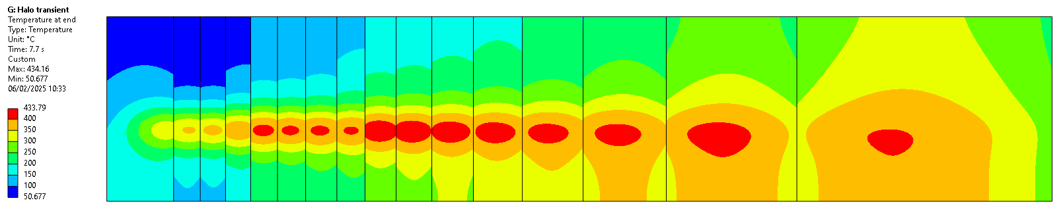
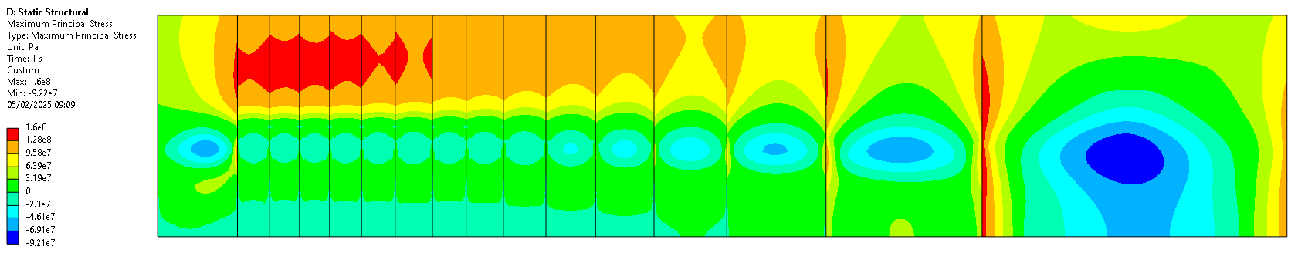
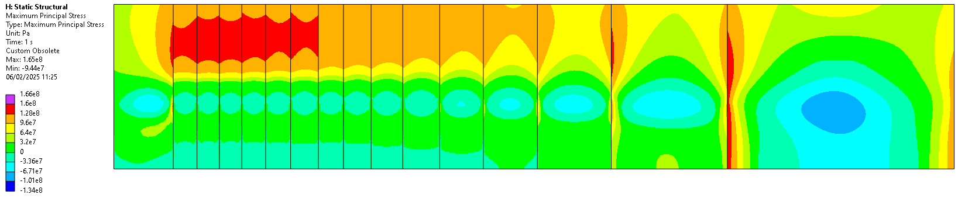
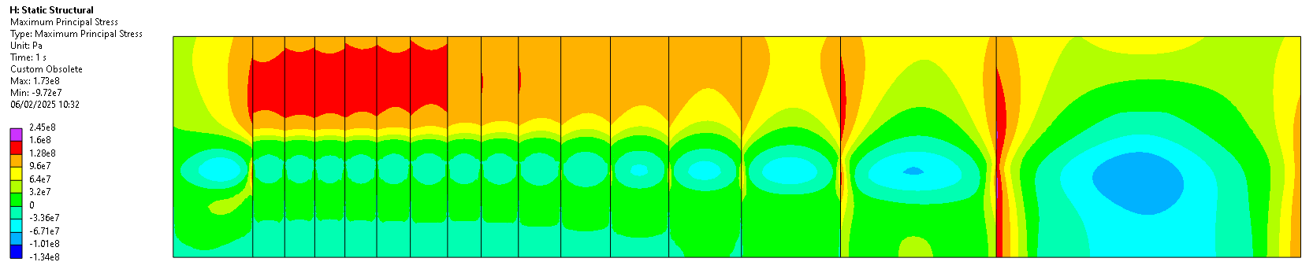
Radiation degraded conductivity – Helium target
Temperature dependent k
0 POT
0 years operation
DPA dependent k
1e20POT
2.5 years operation
DPA dependent k
2e20POT
5 years operation
scale/2
0dpa
0.01-0.73 dpa (2.5yr)
0.02-1.46 dpa (5yr)
(note the different scale)
130-168 W/m.K
114-178 W/m.K
94-170 W/m.K
Higher radiation will also increase DBTT above the working temperature
50-416°C
51-423°C
50-434°C
160 MPa
165 MPa
173 MPa

Slide 18









Goodman diagrams
Material testing data points
σ_{a}
Stress Amplitude
σ_{e}
Endurance Limit
Gerber relation
(better fit to data)
Material testing example:
Fully reversed stress
σ Stress
S_{max}
₊
safe zone
Goodman relation
(more conservative)
σ_{a} = ½ (S_{min}- S_{max})
₀
time
σ_{m}
Mean Stress
σ_{m} = ½ (S_{min}+ S_{max})
σ_{UTS}
₋
Goodman Diagram can be used to compare stress cycles with different σ_{m &} σ_{a}.
Goodman and Gerber lines are different fits to the material testing data.
  Endurance limit σ_{e} is when σ_{m} stress = 0, ∴r = -1.
  σ_{UTS} is where σ_{a} =0.
Without material data from fully reversed cycles (σ_{m} =0) the Endurance limit (σ_{e}) is not well known
From the theory, it is therefore not conservative to draw/calculate σ_{e} using goodman from a small number of non-fully reversed testing points
S_{min}
R=S_{min}/S_{max}
When test cycles are fully reversed, R= -1.
If fully in tension, 0<R<+1

Slide 19
DPA fatigue damage approach
Available fatigue data
Unirradiated W | 2e6 cycles 3-point-bend tests | Ø5mm bar Sintered, rolled & annealed Ø5mm bar Sintered and HIPd | [1]
Unirradiated W | 2e7 cycles | No data
Irradiated W | No data | No data
Obtain a dpa damage map from FLUKA
Convert to a damage factor based on literature
Apply the damage factor map to the target stress results
DPA | damage factor = stress increase factor
0 to 1 | Linear increase from 1 to 2
>1 | =2
FACTOR OF 2: p+ irradiated tungsten: UTS reduced by ½ and saturated by or before 1.3dpa [1].
THEN SATURATES: Yield stress increased steeply up to 1dpa, and then gradually up to 23 dpa [2].
LINEAR INCREASE: n. irradiated Tungsten: hardness increased linearly between 0.2 and 1dpa at 600°C [3].
The results for BDF target are represented on a goodman diagram (next slide) with an added general safety factor of ×2
Key to the validity of this approach is that increasing the maximum principal stress of a node through stress cycles proportionally increases:
  Mean stresses
  & Stress amplitudes
We believe this approach is conservative (Applying a fatigue factor based on end of life dpa levels is inherently conservative) but not overly conservative.
References:
[1]”Mechanical properties of Tungsten irradiated with high-energy protons and spallation neutrons, J. Habainy, Y. Dai, Y Lee, S. Iyengar, Journal of Neuclear Materials 514 (2019) 189-195
[2]“Radiation Effects in a Couple Solid Spallation Target Materials”, S.A. Maloy, W. F. Sommer, M.R. James, T.J. Romero, M.L. Lopez, Los Alamos National Laboratory, Los Alamos, NM 87545
T.S. Byun. Oak Ridge National Laboratory, Oak Ridge, TN
[3] Neutron irradiation hardening across ITER diverter tungsten armour D. Terentyev, C. Yin, A. Dubinko , C.C. Chang, J.H. You

Slide 20
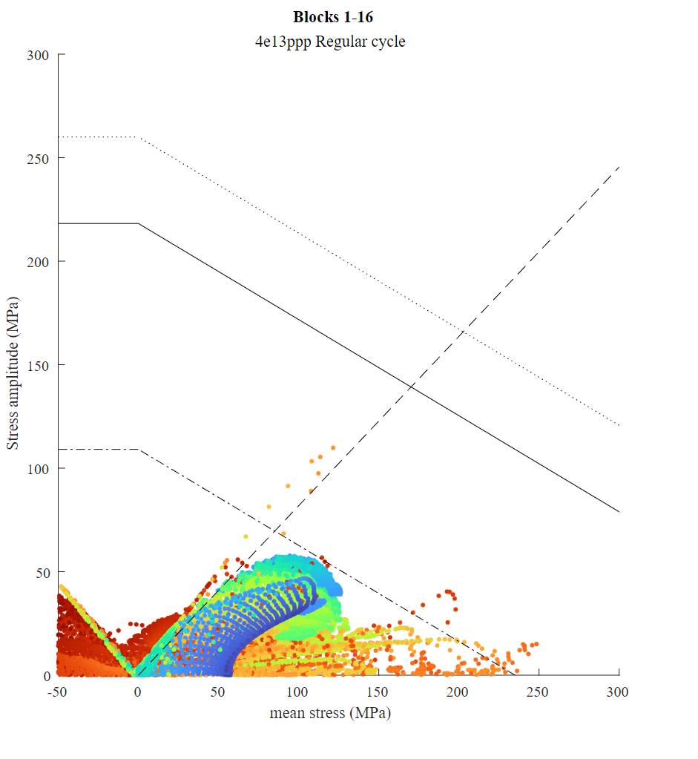
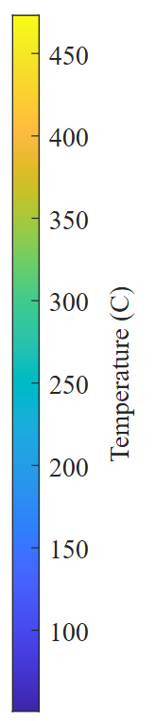
Target Fatigue - Helium
With radiation damage penalty
Dataline drawn on simulation data
R=0.1
Material will be tested at this.
Target simulations with dpa penalty
Goodman equivalent Habainy et al with SNS processing (back calculated goodman)
Block 1, reduced with added channel.
downstream blocks, reduced with added channel.

Slide 21
Target Fatigue - Helium
With radiation damage penalty
Stress amplitude when
R=0.1 with safety factor of ×2
= 139.2MPa
Dataline drawn on simulation data
Stress amplitude to use for material fatigue testing
R=0.1
Material will be tested at this.
Dataline with safety factor ×2
SF of 2 increases Vector magnitude x2
Target simulations with dpa penalty
Vector
Goodman equivalent Habainy et al with SNS processing (back calculated goodman)
Block 1, reduced with added channel.
Results for swept beam @4Hz has not yet been analysed
downstream blocks, reduced with added channel.

Slide 22
Comparison of Helium & Water Target

Slide 23
H₂0 & He Targets comparison -
Margins
Note: re-optimisation to be performed to bring temperature <350°C
W aim to keep below
8mm beam
YS,
TZM
Goodman Eq’ stresses
UTS, irradiated
Ta2.5 aim to keep below
W: sintered & HIP’d,
non-irradiated,
for comparison
YS,
Ta2.5
SF of 2
SF2
SF of 2
Safety Factor of 2
SF2
SF of 2

Slide 24
H₂0 & He Targets comparison – Results table
Material | Target design | Coolant pressure | Blocks bulk max T | Blocks Surface Temperature | Stress Max Principal | Stress Equivalent
 |  | bara | °C | °C | MPa | MPa
 |  |  | Whole Target | Whole Target | Blocks 1-14 | Whole Target
All | Water Cooled | 25 |  | -
Tungsten | Water Cooled | 25 | 150 | - | 82 | 82
Ta2.5 | Water Cooled | 25 | 160 | 160 |  | 95
TZM | Water Cooled | 25 | 180 | - |  | 128
Tungsten | Helium Cooled (Not clad) | 16 | 415 | 400 | 137 | 243
Tungsten | Helium Cooled 1/8ths (Not clad) | 16 |  | 400 | 95 | 143
Material | Target design | Coolant pressure | Blocks bulk max T | Blocks Surface Temperature | Stress Max Principal | Stress Equivalent | Chrsitensen if: UTS=300MPa UCS=800MPa | σ_{a} | σ_{m} | Fatigue limit [1] | YS Sintered&Hip’d for W [2]
 |  | bara | °C | °C | MPa | MPa | - | MPa | MPa | MPa | MPa
 |  |  | Whole Target | Whole Target | Blocks 1-14 | Whole Target | Blocks 1-14
All | Water Cooled | 25 |  | -
Tungsten | Water Cooled | 25 | 150 | - | 82 | 82 |  | 32.5 | 49.5 | 180 | 330 [YS] at RT *
Ta2.5 | Water Cooled | 25 | 160 | 160 |  | 95 |  | 45 | 50 | 310 | 190 [YS ]at 200°C
TZM | Water Cooled | 25 | 180 | - |  | 128 |  | 58 | 68 | 440 | 370 [YS] at 200°C
Tungsten | Helium Cooled (Not clad) | 16 | 415 | 400 | 137 | 243 | 0.32 | 43 (unirr’) | 98 (unirr’) |  | 330 [YS] at RT *
Tungsten | Helium Cooled 1/8ths (Not clad) | 16 |  | 400 | 95 | 143 |  |  |  |  | 330 [YS] at RT *
Material | Target design | Coolant pressure
 |  | bara
All | Water Cooled | 25
Tungsten | Water Cooled | 25
Ta2.5 | Water Cooled | 25
TZM | Water Cooled | 25
Tungsten | Helium Cooled (Not clad) | 16
Tungsten | Helium Cooled 1/8ths (Not clad) | 16
Material | Target design | Coolant pressure | Blocks bulk max T | Blocks Surface Temperature | Stress Max Principal | Stress Equivalent | Chrsitensen if: UTS=300MPa UCS=800MPa | σ_{a} | σ_{m} | Fatigue limit [1] | YS Sintered&Hip’d for W [2] | SF on yield / UTS | SF on fatigue
 |  | bara | °C | °C | MPa | MPa | - | MPa | MPa | MPa | MPa
 |  |  | Whole Target | Whole Target | Blocks 1-14 | Whole Target | Blocks 1-14
All | Water Cooled | 25 |  | -
Tungsten | Water Cooled | 25 | 150 | - | 82 | 82 |  | 32.5 | 49.5 | 180 | 330 [YS] at RT * | 4 | 5
Ta2.5 | Water Cooled | 25 | 160 | 160 |  | 95 |  | 45 | 50 | 310 | 190 [YS ]at 200°C | 2 | 5.8
TZM | Water Cooled | 25 | 180 | - |  | 128 |  | 58 | 68 | 440 | 370 [YS] at 200°C | 3 | 6.7
Tungsten | Helium Cooled (Not clad) | 16 | 415 | 400 | 137 | 243 | 0.32 | 43 (unirr’) | 98 (unirr’) |  | 330 [YS] at RT * | 2.4 | 2.6 (unirr’) by same metric used above
Tungsten | Helium Cooled 1/8ths (Not clad) | 16 |  | 400 | 95 | 143 |  |  |  |  | 330 [YS] at RT * | 3.5
[1] Fatigue limits from CDS referenced as:
TZM: H. A. Calderon et al. “Microstructure and plasticity of two molybdenum-base alloys (TZM)”.In:Mater. Sci. Eng. A160 (1993), pp. 189–199.
W: J. Habainy et al. “Fatigue properties of tungsten from two different processing routes”. In:J. Nucl.Mater.506 (2018), pp. 83–91.
Ta2.5: W. Martienssen, H. Warlimont. “Refractory metals and alloys”. In:Springer Handbook of Condensed Matter and Materials Data. Springer, 2005. Chap. 3.1.9
[2] YS, UTS from CDS referenced as:
Fraunhofer IFAM.TaW-clad Refractory Metals. Internal communication. 2017.
Plansee GmbH.TZM Measurements. Internal communication. 2018.
W: J. Habainy et al. “Fatigue properties of tungsten from two different processing routes”. In:J. Nucl.Mater.506 (2018), pp. 83–91.
Water cooled limits: Comprehensive design study (CDS)
https://e-publishing.cern.ch
/index.php/CYRM/issue/view/106/pdf_7

Slide 25
Target baseline selection
Pro / manageable concerns / low risk
Medium / substantial concerns / medium risk
Con / large concerns / high risk
Pros and cons
 | Physics production | Physics background | Radio-isotope production & concerns | Temperature levels | Stress and fatigue levels margins | Stress and fatigue in areas of high dpa | LOCA | Ease of manufacture / installation CORE | Ease of manufacture / installation VESSELS | Procurement / installation risk CV STATION | Instrument-ation & instrument integration | Ease of installation / replacement | Ease of maintenance of auxiliary systems | Unproven lack of W Cladding in beam
Water cooled target
Helium cooled target |  |  |  |  |  |  | TBC Depends on cladding
Helium cooled target 1/8^{ths} |  |  |  |  |  | TBC Depends on cladding | TBC Depends on cladding | Depends on cladding | Depends on cladding
Based on simulations / calculations in other talks
Simulations covered in this talk
Engineering Judgement
Estimates
Cladded version of helium target not yet fully analysed

Slide 26
Target Selection Decision
The BDF Target team has selected the Helium cooled option as the preferred option (so far).
This is due to the Design mitigating or improving on the following issues:
Improved physics production → From all W target
Improved background → From replacing water with Helium in the coolant channels
Lower activation of coolant → Due to removal of water from the beam shower
Potential to improved LOCA situations. → Potential for removing Ta cladding
Using a helium system does come with risks:
Increased leak rates & additional risk in procuring items such as compressors, valves, seals etc for helium at elevated temperature and pressure.

Slide 27
Backup options, failure modes & Future work
Helium Target

Slide 28
Backup target design options
Positive impact
Small positive impact
Neutral / negligible impact
Small negative impact
Negative impact
Optional areas to benefit target
Proposed change to benefit target mechanics | Impact for physics | Impact on target thermal / mechanical | Impact on target fatigue | Impact on target manufacture
1/8th slices | Negligible change if gaps are at angle to beam direction | Significantly reduced temperature and stress or number of channels ☺ High stresses moves to location of high DPA ☹ | Lower stresses, but high fatigue moves to areas with high dpa -to be studied | Increase of difficulty, especially if clad.
Increased target core radius | Slight improvement in background. | Decrease of maximum principal stresses due to compressive effect of increased material at circumference. Change to max plasticity of cladding? To be studied | Estimated improvement due to compressive effect of extra material | Extra cost (minor consideration)
Increased beam spot size | Slight decrease. | Decrease in max stresses. | Substantial improvement | -
Increased number of channels | Negligible decrease | Large improvement in DS (steady state) areas of target. Fair improvement in US, high irradiation, high stress areas. | Improvement on DS blocks and small area of 1st block. Very minor improvement in US blocks | Negligible

Slide 29
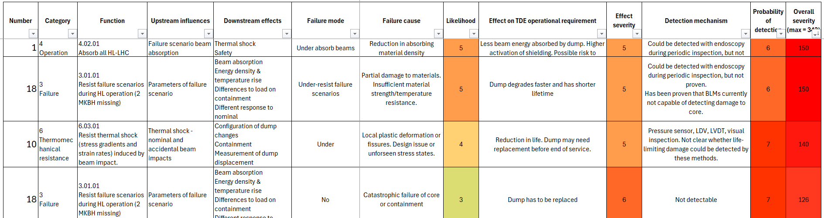
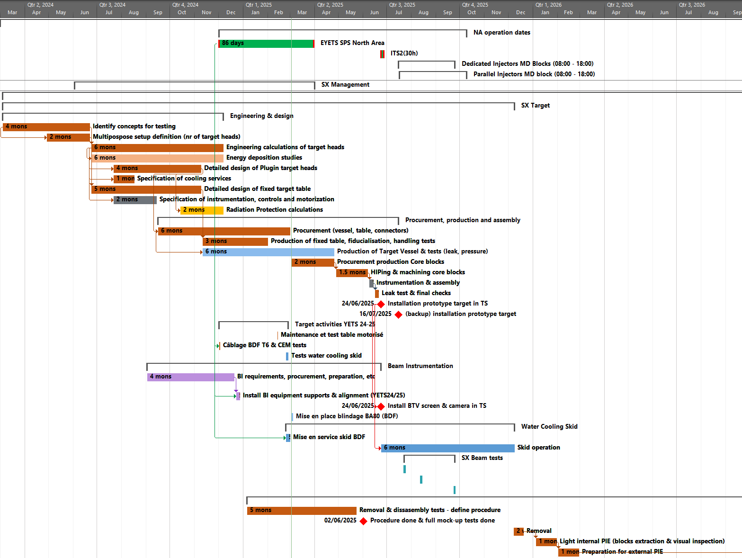
FMEA
Expected Steps
FMEA was performed for HL-LHC beam dump – this model and experience will be used as a guide for performing FMEA of BDF target
At beginning of process – very much ongoing
Systems description
  Interviews
  lists
  Interfaces
Functional requirements
Functional modeling
  Systems tree functions
  Systems context diagrams
Failure modes and effects
  Workshop
  FMEA results
System breakdown (optional)
Quality Function Deployment analysis (optional)
FMEA example: HL-LHC-beam dump
Timeline
Systems description
Production Phase…
Review & FMEA
Review, Systems breakdown & QFD analysis
Functional requirements & modelling

Slide 30
Target failure scenarios
Severity
Low
Moderate
High
Unacceptable
FMEA to be done in future
Main concerns shown here
Failure decscripiton | System requirement affected | Consequence | Likeli-hood | Severity | Action to compensate?
Target core delamination / disintegration… |  | 5. Hotter block – target damage, Major increased species release, target disintegration | 2 | 10 | Experiment affected / replace target
Tungsten chip / dust release into helium |  | 5. Major increased species release | 2 | 10 | Monitor / replace target
 | System requirement affected | Consequence | Likeli-hood | Severity | Action to compensate?
Target core delamination / disintegration… |  | 5. Hotter block – target damage, Major increased species release, target disintegration | 2 | 10 | Experiment affected / replace target
Tungsten chip / dust release into helium |  | 5. Major increased species release | 2 | 10 | Monitor / replace target
Cooling channel blockage | Reduced target cooling efficiency | 4. Hotter block – target damage, increased species release | 1 | 4 | Reduce beam power
Helium leak path in target | Reduced target cooling efficiency | 2. Hotter block – target damage, increased species release | 4 | 8 | Reduce beam power
Small helium leak to vacuum vessel | Reduced cooling efficiency | 2. Hotter block – target damage, increased species release | 4. | 8 | Increase helium ‘top up’. Reduce beam power.
Major helium leak to vacuum vessel | Reduced cooling efficiency | 4. Hotter block – target damage, increased species release | 2 | 8 | Experiment affected / replace target
 | System requirement affected | Consequence | Likeli-hood | Severity | Action to compensate?
Target core delamination / disintegration… |  | 5. Hotter block – target damage, Major increased species release, target disintegration | 2 | 10 | Experiment affected / replace target
Tungsten chip / dust release into helium |  | 5. Major increased species release | 2 | 10 | Monitor / replace target
Cooling channel blockage | Reduced target cooling efficiency | 4. Hotter block – target damage, increased species release | 1 | 4 | Reduce beam power
PRELIMINARY
DRAFT

Slide 31
Further work ongoing
What ifs? – Cladding
  What if material results / Ta interlayer is particularly weak?
  What if core blocks are prone to delayering?
  What if highly irradiated W crumbles?
Areas for more detailed study in the coming months
  LOCA
  Continue Cladding plasticity
  Fatigue
  w.r.t shear/lamination planes
    Is σ_{max principal} direction same as greatest σ_{a}?
  16mm beam - include lower dpa! of 1.2!
  Pulse structure (4 revolutions /s) contribution to fatigue →waterfall analysis
  Mechanical calculations of wider assembly:
    Vessel & Beam window calculations
    Weight of assembly, rollers etc
  CFD of full model (ongoing)
    Optimise fluid channel temperature step changes
    Include gradient of HTC & He temperature on Stress calcs
  Realistic pulse supercycles
  Work so far shows detrimental contribution to fatigue
Future optimisation process
Material testing results & initial 2025 prototype results
re-optimsation of core thicknesses, channel structure, & number of channels
Possibly adjust blocks to be repeated thicknesses, all 15mm in shower for example
- re-run of T, σ, fatigue analysis

Slide 32
Summary – Key takeaways (TLDR!)
Helium Target
Cladding & Block Material structure
Helium Modelling Assumptions & Design Methodology
Helium Simulation Results
  Target size & beam parameters
  Radiation damage – stress
  Radiation damage – Fatigue
Helium & Water Target
Comparison
Helium target ‘Backup’ options
FMEA
Further work
Key takeaways
→ Lasagna structure. Helium maybe not clad.
→Stress, fatigue, temperature limits were based on literature.
  →Larger beam size very good. Larger target good. Higher intensity likely not possible unless beam size >8mm
  →DPA map approach developed.
  →Mixed picture, needs more study
→Helium cooled target is current preferred option
→To be done in near future
→Lots! first is updating & incorporating CFD, & Cladding
→When initial material testing results / prototype results known, target geometry will be re-optimised
→Several options exist for easing target conditions

Slide 33
Many thanks

Slide 34
Comments on verbal questions at TSAC

Slide 35
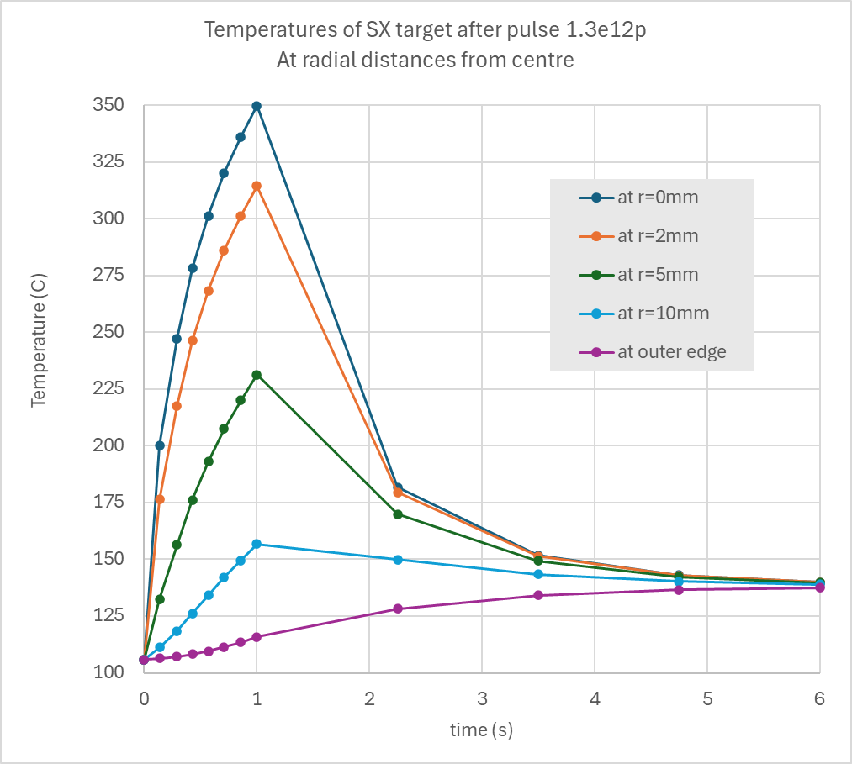
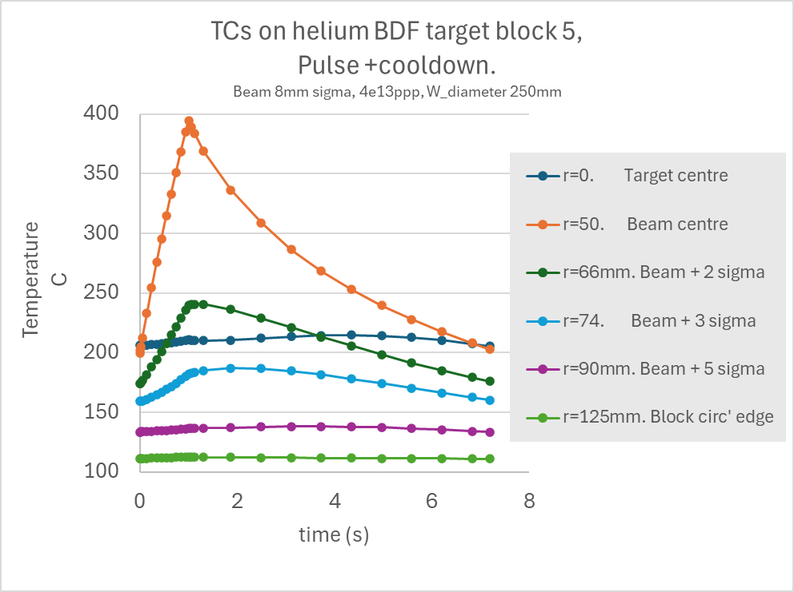
Thermocouple location at various depths
Prototype
Full target
TC location 5-10mm from centre sees ΔT>25°C rise due to pulse - (easily detectable)
Die sink tests managed a hole all the way to centre.
r= 66mm (beam sweep+2 sigma) sees ΔT=67°C & peaks at 0.2s after pulse end.
r= 74mm (beam sweep+3 sigma) sees ΔT=28°C & peaks at 0.9s after pulse end.
r= 90mm (beam sweep+5 sigma) sees ΔT=5°C & peaks at 2.5s after pulse end.

Slide 36
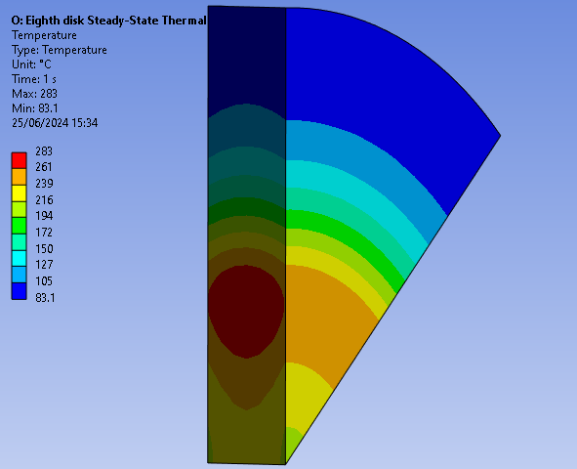
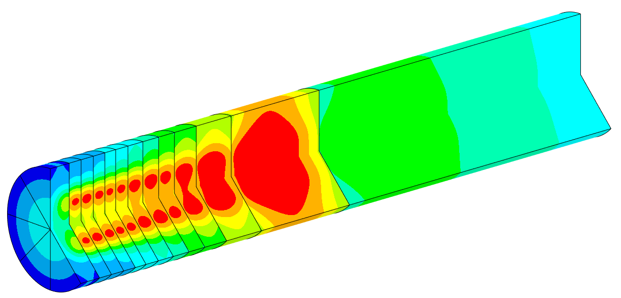
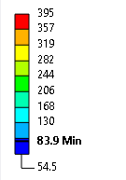
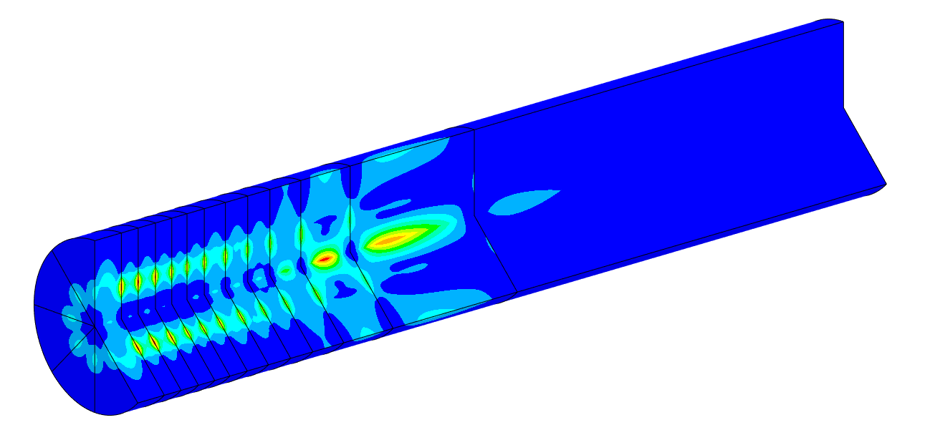
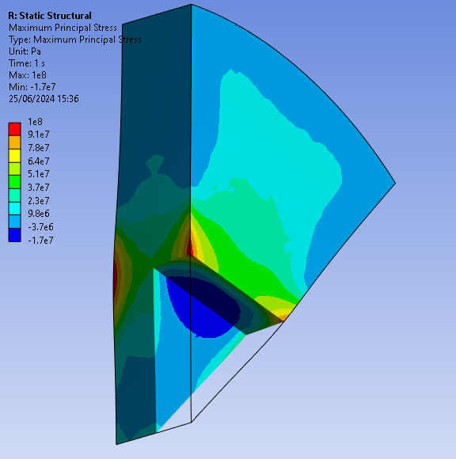

1/8th pie slices target pictures
Temperature
(°C)
different beam parameters to the simulation on the left but show the stress distribution
Geometry: 30 July 2024
16mm beam
Max Principal Stress (MPa)
Shown here with sharp edges. peak stresses are actually slightly mitigated by having small radii on edges of blocks

Slide 37






TDR to protype target stress states
Out of plane stresses TDR block
Matching prototype block
TDR block
x (circumferencial) 128MPa
y (radial) 0.08MPa
z(out of plane) 0.06MPa
out of plane stresses not a concern here.
x (circumferential) 27MPa
y (radial) 3MPa
Largest tensile stresses in prototype & TDR are in the same direction (circumferencial direction) – this was planned. With compressive stresses in radial direction
However the larger stress magnitudes in the prototype are largely locally confined to the flat faces. – magnitudes are quite different at the circumferencial edge.
The prototype has much larger compressive stresses (at centre)
Out of plane stress levels not a concern.

Slide 38


1/8 slices target has different stress state.
Could be tested in 2026 prototype with semicircle blocks that match the stress state very well.
Matching prototype block
1/8th slices TDR block

