Slide 2
Beam target tests in TCC2
1st Beam Dump Facility (BDF) Targetry Systems Advisory Committee (TSAC)
4th – 6th March 2025
Rui F. Ximenes on behalf of WP3 & HI-ECN3 Project team
04/03/2025
https://hiecn3.web.cern.ch

Slide 3
Take-home objectives of this talk
Recap material challenges and pair importance of material characterization w/ beam tests
Show when (& why), where (& why) we will do beam tests
Present the strategy and motivation for staged testing
Overview of the 2025 prototypes target design & scope of testing (& PIE). What will we learn
Overview of the 2026 prototype target testing & scope of testing (& PIE). What more will we learn
Reflection if more (or different) beam tests should be carried out (e.g. post LS3) particularly balancing the risks in the current timeline

Slide 4
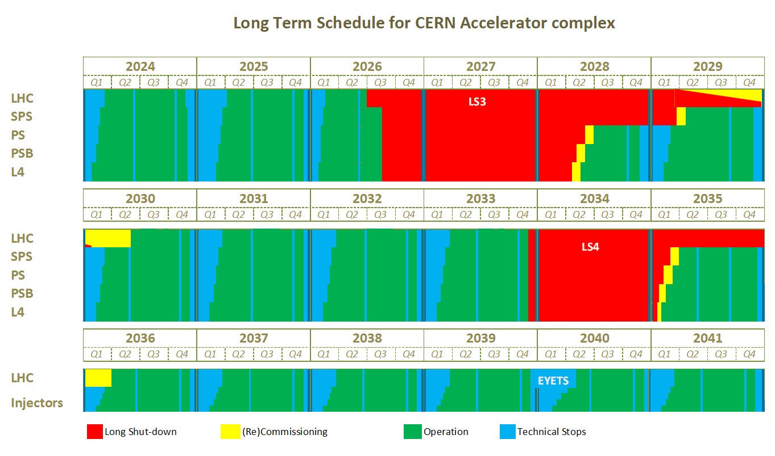
CERN’s accelerator schedule & Timeline constrain
Today
SPS & NA commissioning for HI-ECN3
SHiP commissioning & intensity ramp-up
Beamline upgrades for HI-ECN3
BDF commissioning
Remaining beam time in CERN’s Run 3
Only time-compatible opportunity to test prototypes with beam at CERN and feed lessons learnt into final design is in Run3 → 2025 & 2026
Given that the project was approved in March 2024, timeline for beam testing is very challenging!

Slide 5
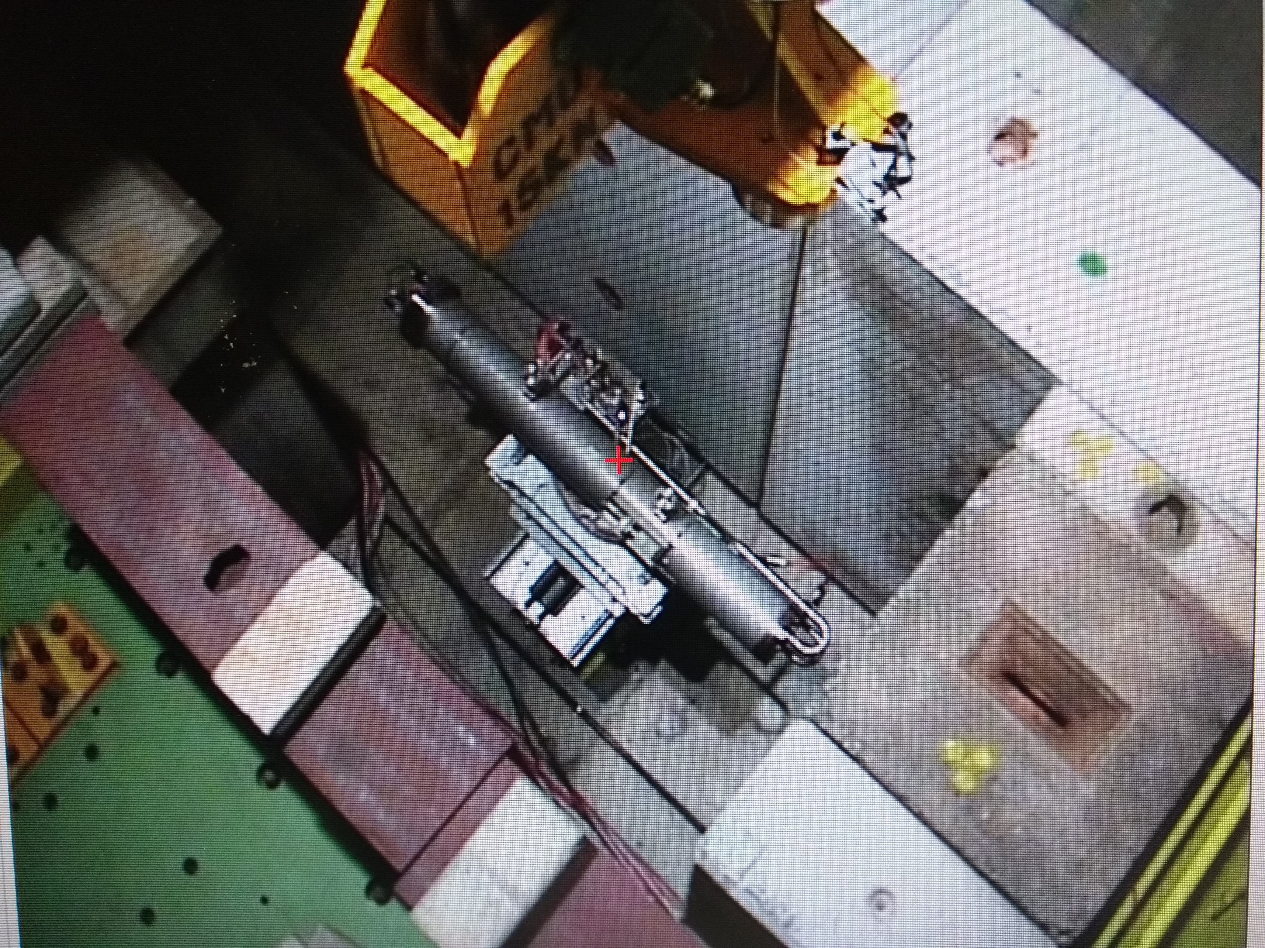
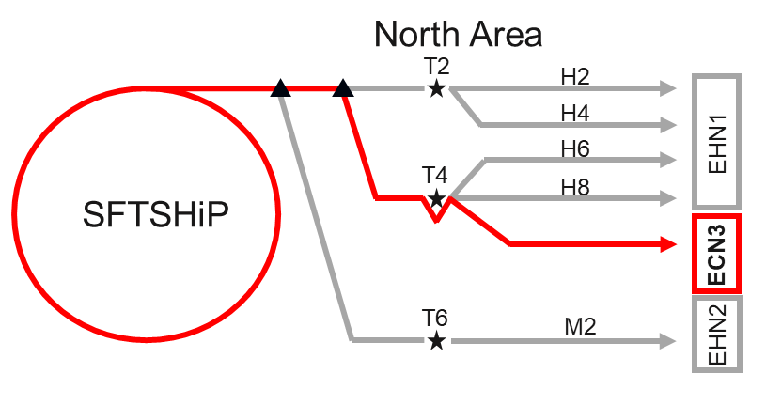
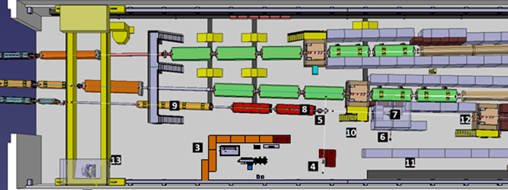
North Area Slow-eXtraction Test-bench
T6 SX test-bench
→ Ease with beam parameters
  400GeV/c beam as for BDF.
  Slow-extracted with same spill/cycle time structure
  Small and undiluted beam to match energy density
  High pulse intensity (up to 1.5e13) and average power (~15kW w/ current water skid).
  High number of shots, 10000(O) (depending on MD).
Existing test-bench adapted to BDF-like prototypes.
e.g HiRadMat
→ Non-ideal beam parameters
  440GeV/c beam as for BDF.
  High pulse intensity & fast extraction (288 b @ 2.1e11ppb in 8us) & small beam spotsize (~1mm)
  Matching energy density would be easy, but would induce dynamic effects → BDF has no dynamic stresses
  Small nr of shots 10(O) & low frequency rate → cannot reach steady-state conditions
Multi-purpose tanks, but would require substantially more design work to adapt

Slide 6
BDF Prototype Target & importance of beam testing
T6
Tested in NA T6 on the existing SX test-stand
Staged approach with tests in 2025 and then 2026:
P+
2025 – Static He, 2x W Targets
Few O(50) shots/target → pulse temperature & stress conditions. Low activation.
W-W integrity
Thermocouples performance
FEM benchmark
(possibly) outgassing measurement
Light PIE in YETS25/26
2026 – Actively He-cooled, W Target
O(2000-3000) shots→ SS + pulse temperature & stress conditions. More data.
W-W integrity (complementary, building up on 2025 tests & material R&D). Low cycle fatigue.
He skid operational experience.
High speed He +Temperature effects on W
FEM/CFD benchmark
Outgassing/contamination measurements
Comprehensive PIE >2026
2025 provides pre-validation and earlier inputs for technical specification & ensures at least some level of testing is done (2026 is a short run!)
2026 builds on top of 2025 material R&D and beam tests. Provides a comprehensive testing/validation of the target core & cooling system

Slide 7
2025 Prototype Target(s)

Slide 8
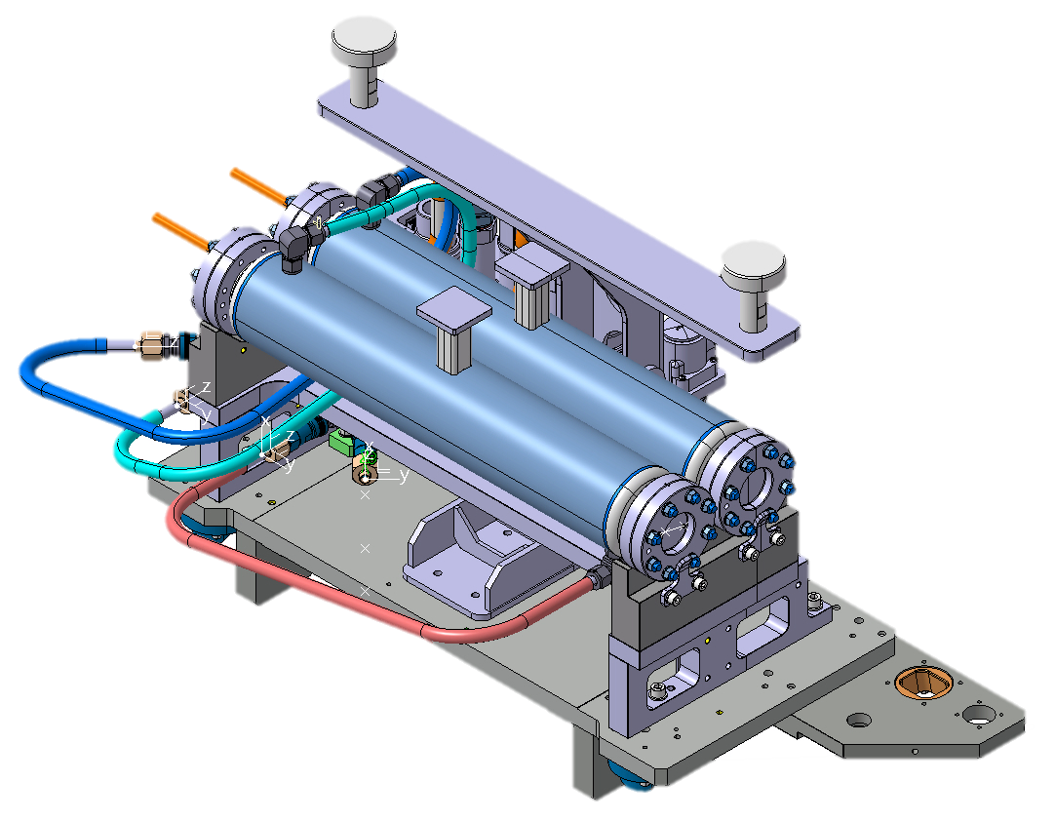
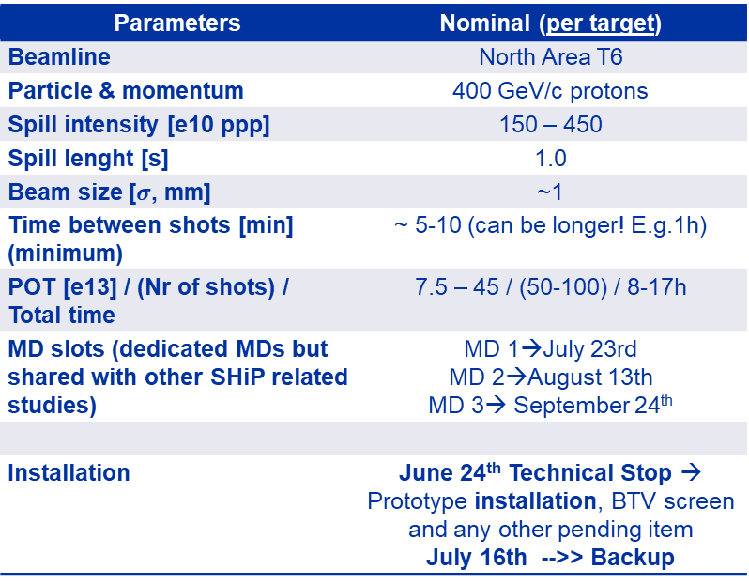
2025 Prototype Target(s)
Static He pinch-off
Target heads
Lifting fixture
Cooling & electric plugin-connections
Parameters | Nominal (per target)
Beamline | North Area T6
Particle & momentum | 400 GeV/c protons
Spill intensity [e10 ppp] | 150 – 450
Spill lenght [s] | 1.0
Beam size [$σ$, mm] | ~1
Time between shots [min] (minimum) | ~ 5-10 (can be longer! E.g.1h)
POT [e13] / (Nr of shots) / Total time | 7.5 – 45 / (50-100) / 8-17h
MD slots (dedicated MDs but shared with other SHiP related studies) | MD 1→July 23rd MD 2→August 13th MD 3→ September 24th
Installation | June 24th Technical Stop → Prototype installation, BTV screen and any other pending item July 16th -->> Backup
Out-beam axis
T#1 & T#2 in-beam axis
Water cooling
Base plate
Prototype plugin table (lower table allows transversal horizontal movement)

Slide 9
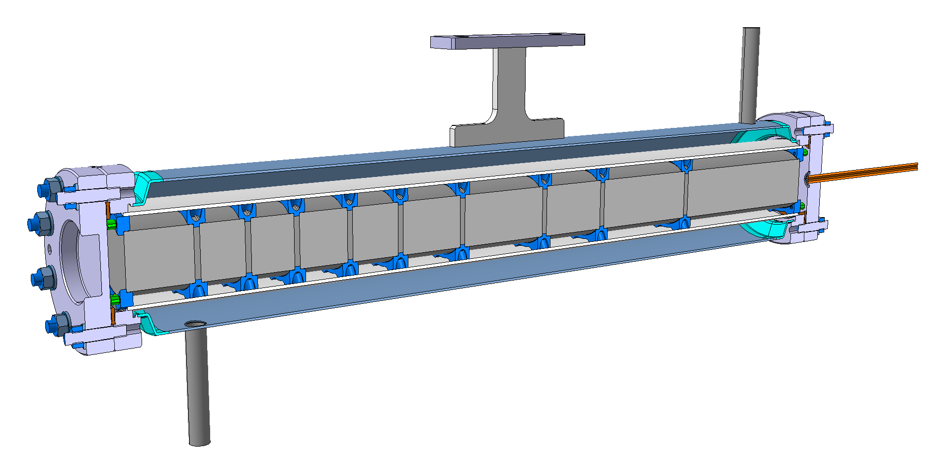
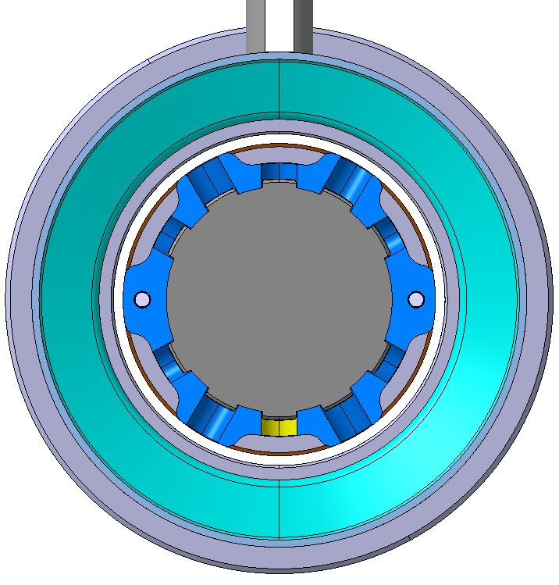
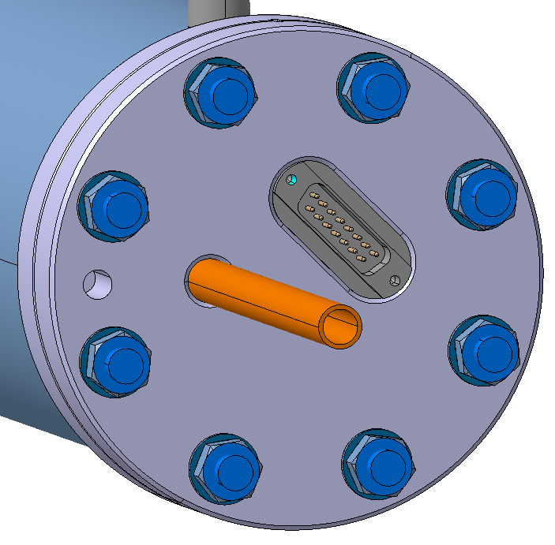
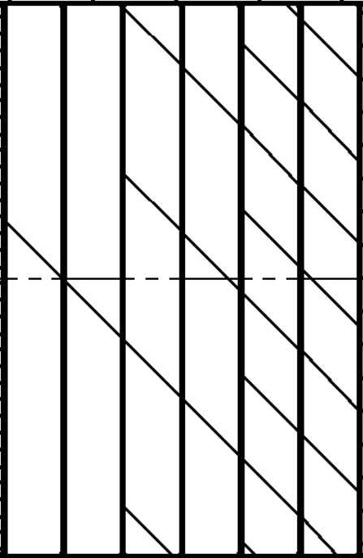
2025 Prototype Target(s)
Water outlet
Full W, Static Helium, indirect cooling
Design
  → W in static Helium.
  → Indirectly cooled with a water jacket
  → 3 Thermocouples per Target (+1 extra)
  → Block spacing defined to match maximum stresses and temperatures and stress type.
    Beam σ 1 – 3 mm, Intensity 5e11 - 2e13 ppp
      Poor cooling → low pulse frequency and POT
Main objective
  → W-W Interface & cladding test @ different stress/temperature conditions + “Light” PIE / visual inspection
  3 different core block combinations
P+
Thermocouples feedthrough
Water inlet
Core blocks
Centering washers
Static He
Indirect water cooling
Coolant: flowing water
Steel can
Static helium
He pinch-off
W
Core ø50mm
Hiped W plates (no-clad)
Hiped W w/ cladding
Hiped W w/ partial cladding
~600mm

Slide 10
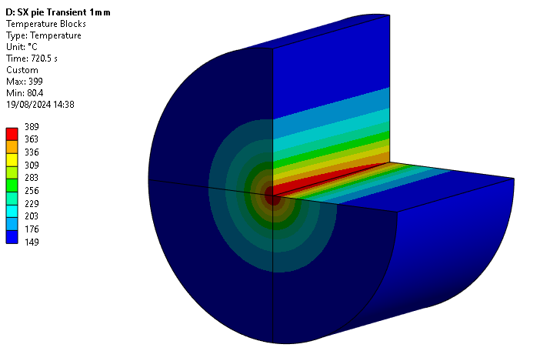
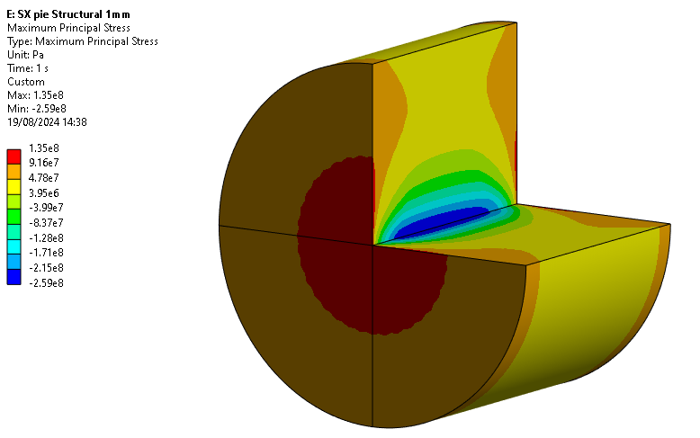
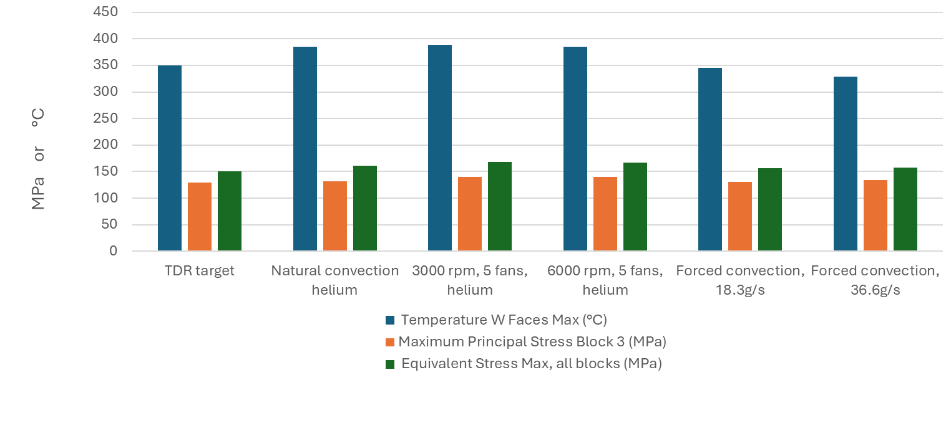
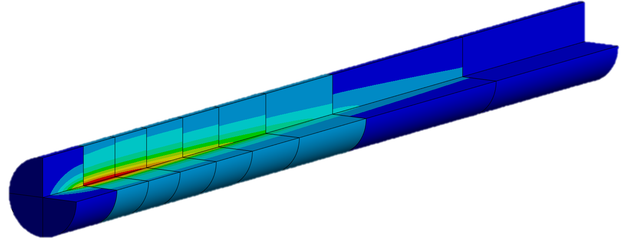
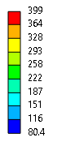
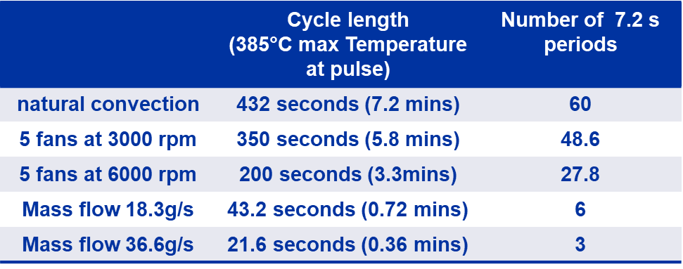
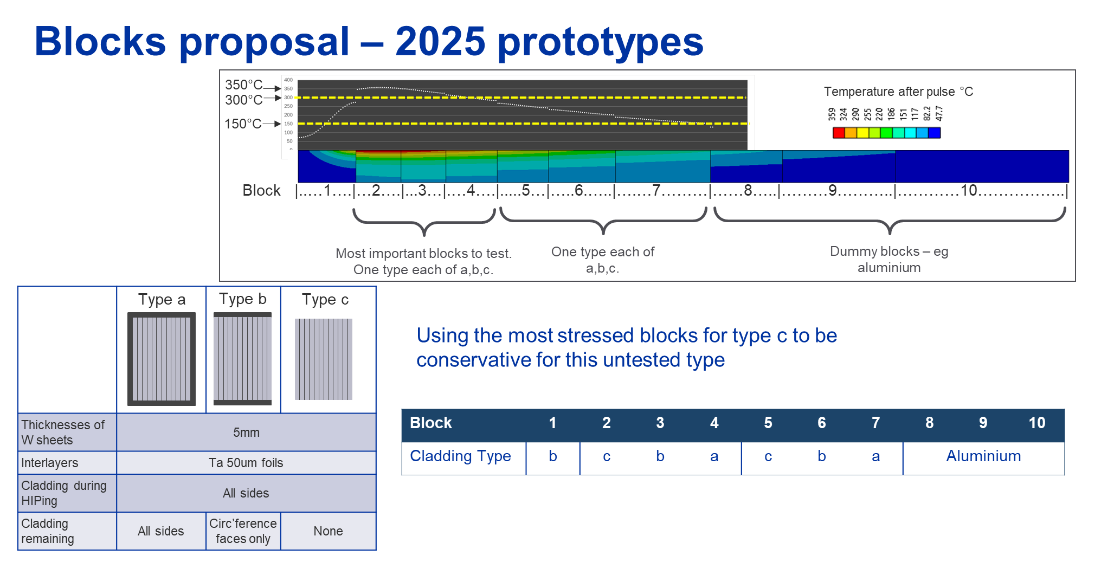
2025 Prototype Target(s)
Temperature (°C)
Max P stress (MPa)
Thermo-mechanical conditions
HTC = 10 W/m²/K
1.3e12ppp. 720s/c
Sigma?
Final Target
~2026 proto
2025 proto
P+
c1 c2 b1 a1 c3 b2 a2 b3

Slide 11
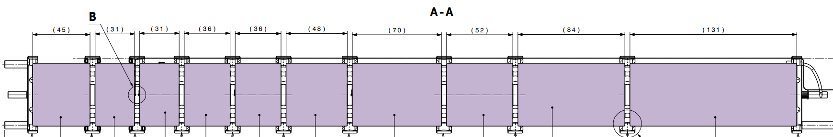
2025 Prototype Target(s)
Cladding type a
Cladding type b
Cladding type c
Tungsten
Tantalum
foils
Core combinations
3 block types & 2 Targets
Can probe multiple temperature and stress levels along the target’s length
50mm
Tantalum
cladding
Cladding : c1 c2 b1 a1 c3 b2 a2 b3 aluminum (buffer space to add extra blocks)
type
1
2
3
4
5
6
7
8
9
Drawing from BDFTARBDP0231 30/1/25
Testing strategy → by playing with pulse intensity & multi-target setup
Target #1
C
B
A
Stress & temperature == Final Target
+
Stress & temperature == 1st block final Target
+
Stress & temperature << Final Target
C
B
A
Stress & temperature < Final Target
C
B
Target #2
C
B
A
Stress & temperature > (x2) Final Target
+
C
Stress & temperature <(x2) 1st block final Target
+
B
Stress & temperature >= Final Target
C
B
A
Final Target < Stress & temperature < (x2) Final Target

Slide 12
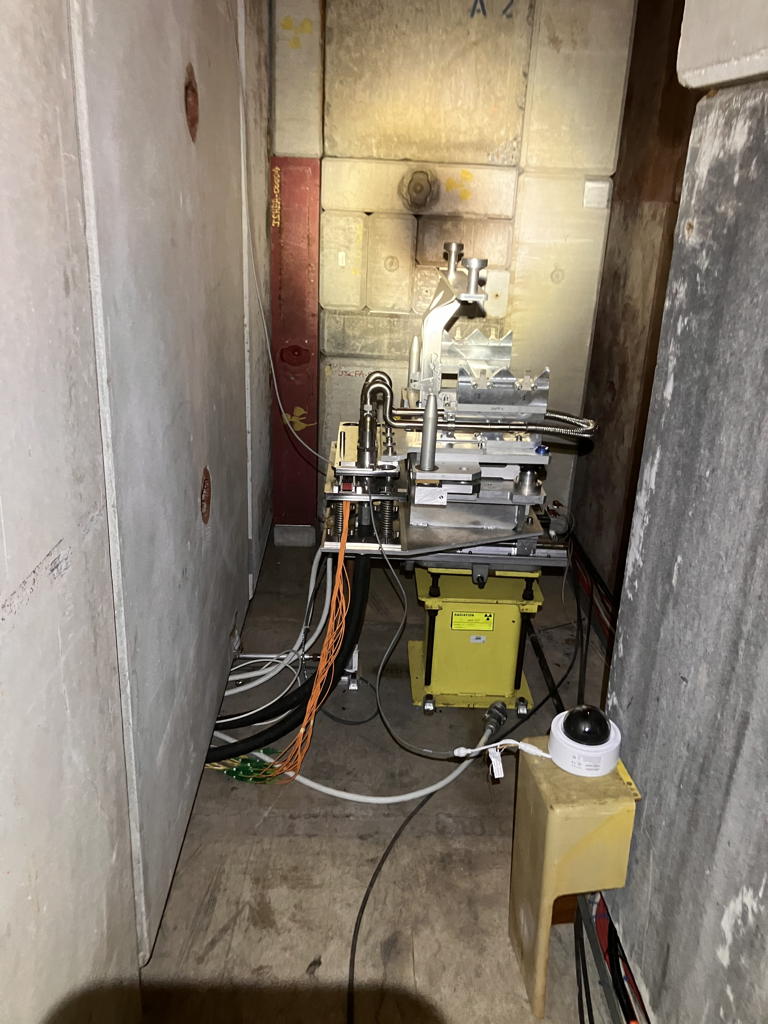
2025 Prototype Target(s) - Status
Planning dates
Fixed SX setup refurbished & re-cabled – done
Water skid re-commissioning – ongoing
Target table re-used and adapted – almost done
BTV setup preparation – end YETS24/45
Pre-alignment – ongoing
Target vessel in production – April
Core blocks procurement – now
Core blocks manufacturing – ~May
Instrumentation & assembly – June
Target and BTV installation – 24th of June
Installation backup – 16th of July
Beam Tests MDs – 23/7, 13/8, 24/9
Removal and “light” inspection – YETS25/26
Planning criticality: OK, Critical, Very Critical

Slide 13
2026 Prototype Target

Slide 14
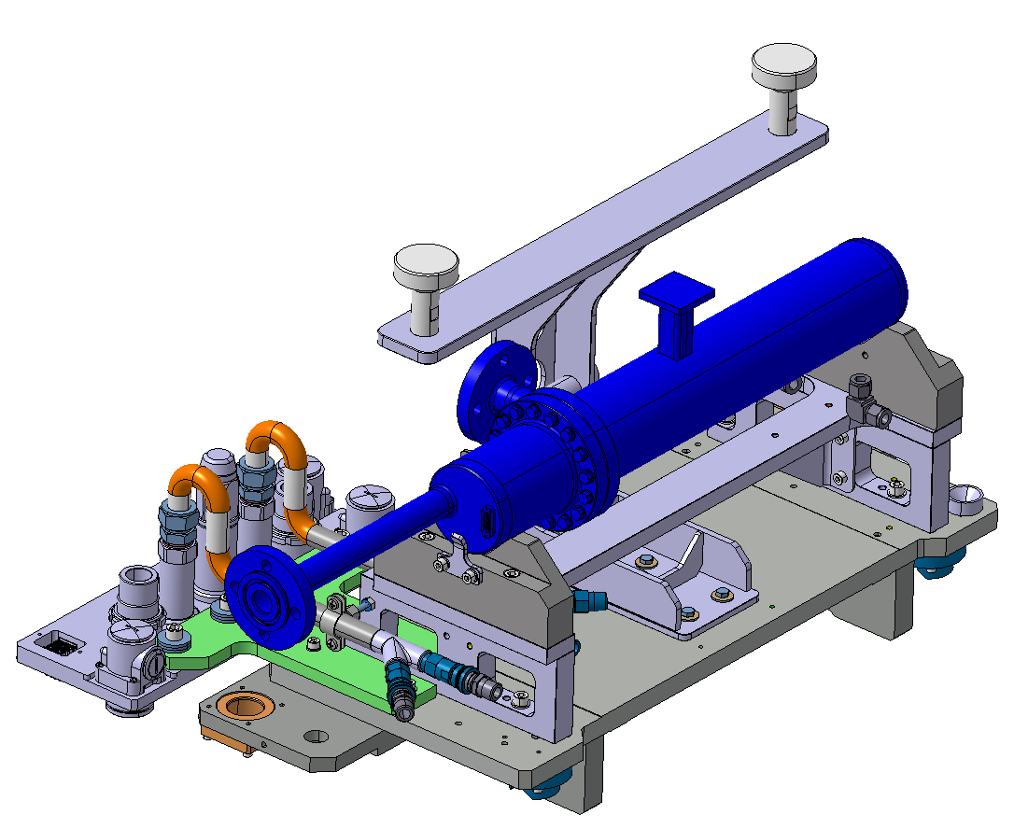
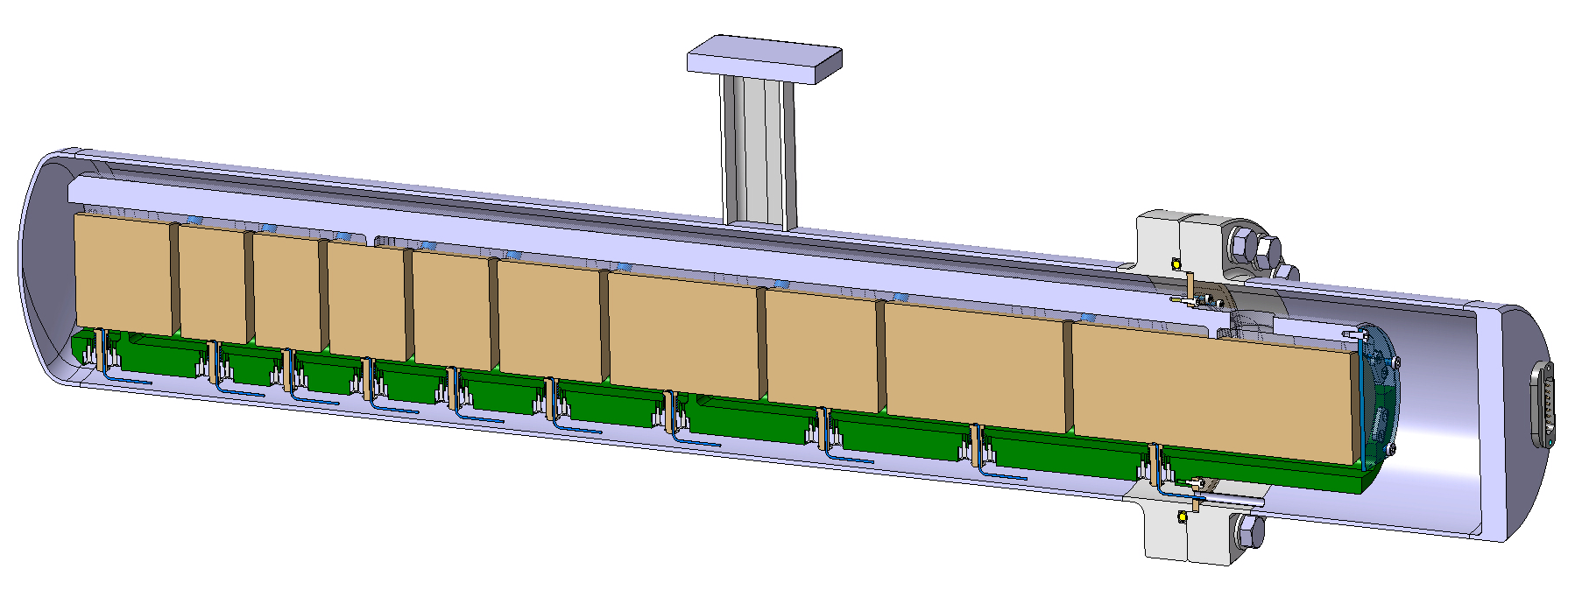
2026 target
Full W, He-cooled
Design – work in progress
1x Target
Small-scale. Design as close as possible to final He-cooled concept
Likely same core/cladding configuration as 2025 target(s)
Possibly beam parameters tunned for slightly above/below temperature & stress conditions
High POT, O(1000s) pulses
(main) Objectives
Benchmark of models
He skid operational experience
Material testing build-up on top of 2025 tests
Followed by more extended PIE (possibly together with 2025 blocks)
More details in Luca’s presentation, to make parallel with Final target design

Slide 15
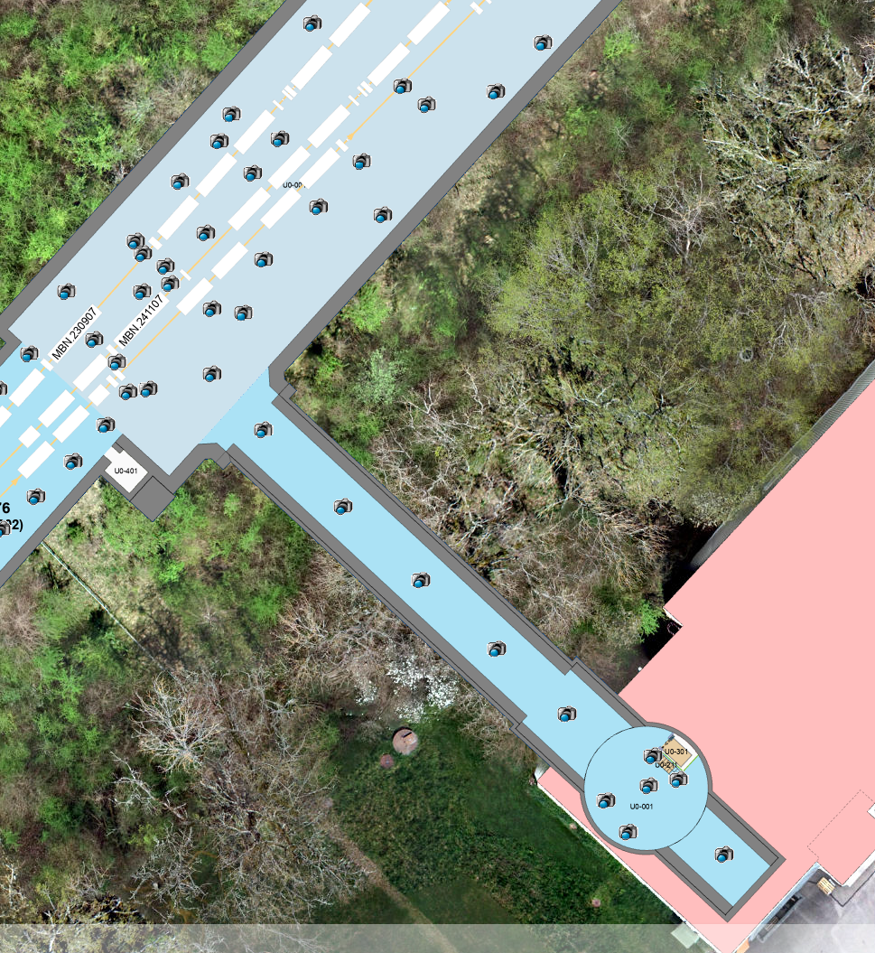
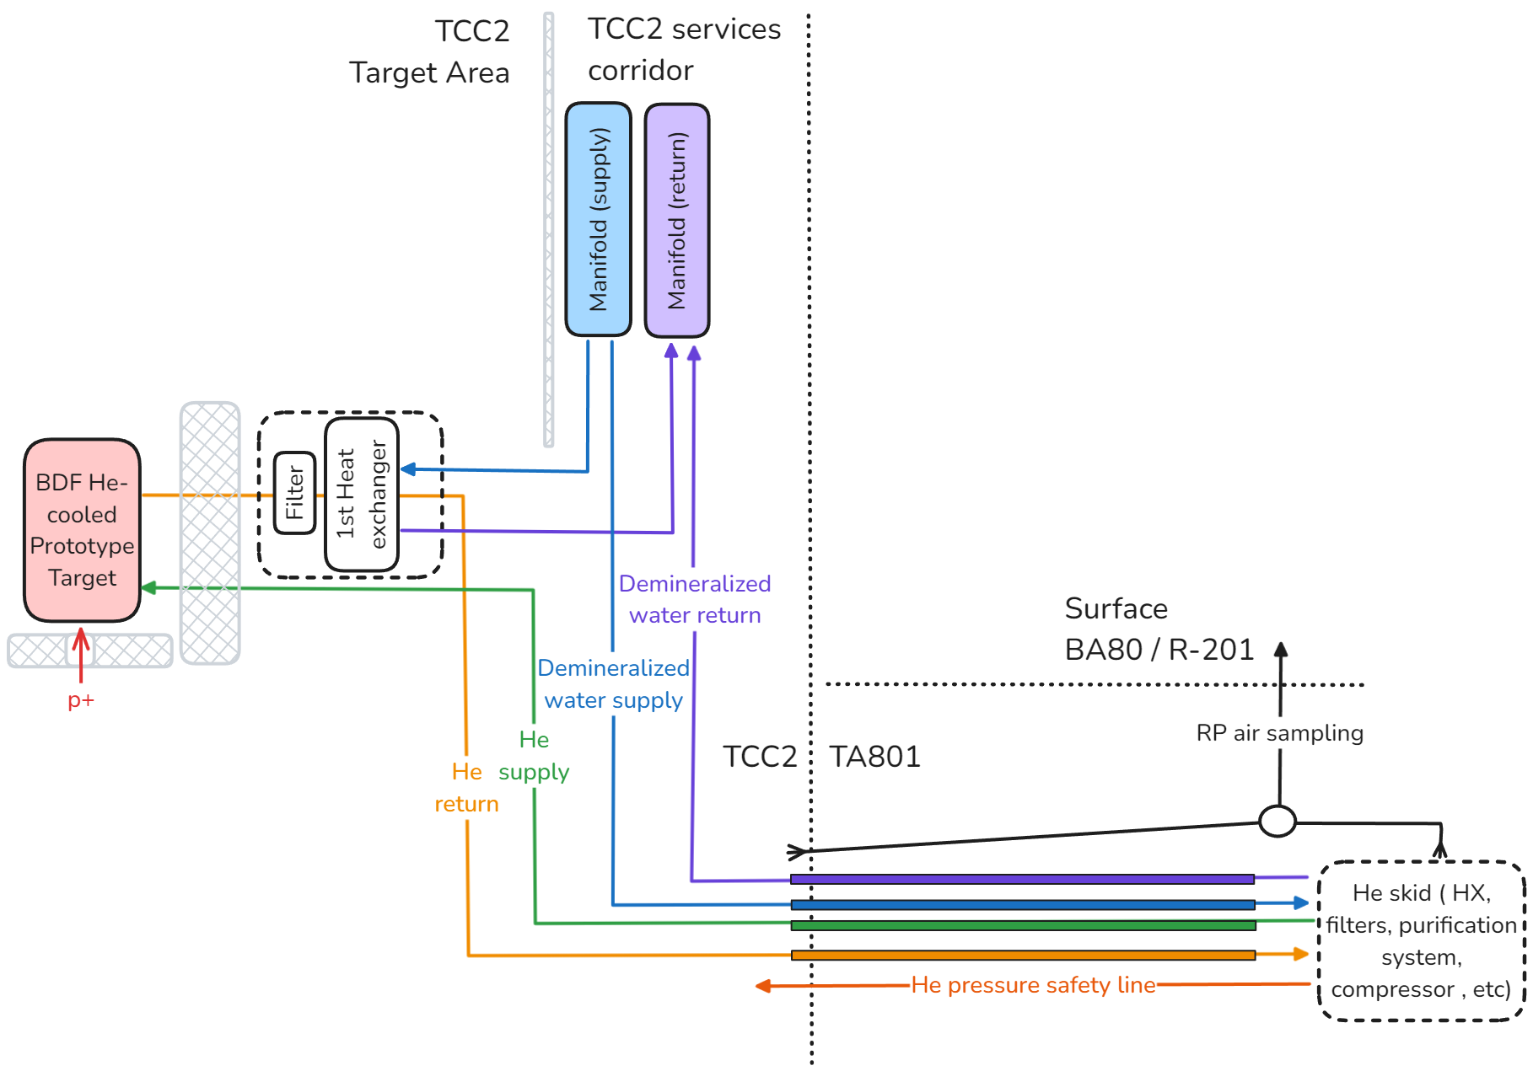
Layout BDF prototype setup in 2026
TCC2
TA801
BA80

Slide 16
Conclusions

Slide 17
Conclusions & brief comments on risks
Staged testing choice requires extra resources but provides valuable & highly complementary data while mitigating risks on both prototype runs (2025 & 2026)
2025 prototype(s)
  2025 prototype(s) aim at scanning stress & temperature conditions, both above and below design values.
  Mostly a beam material testing campaign of the different core manufacturing ideas
  Design done with production ongoing but in the (very) critical path
  What if we cannot make it on time?
  Blocks can be used in 2026 and in offline material characterization campaigns.
  Upgrades and refurbishment of the SX testbench are applicable to 2026, as well as BTV and cabling.
2026 prototype
  Builds on top of 2025 material testing with higher POT
  Brings a much closer to final target design, operational experience with He cooling systems. Allows exhaustive FEA benchmark and possibly RP studies.
  Currently designing (tight timeline!) & cooling skid procurement ongoing
  What if we cannot make it on time? (e.g. either planning or risks associated to having a short 6 months run)
  Skid can be used for offline testing & can be employed as economy/safety skid for the final facility
  Target manufacturing exercise will provide valuable experience in all cases
What if non of the tests happen?
  We would likely have to test at the start of Run4 and “try” to workout the planning to have a change to feed the lessons learnt into the final design

Slide 18
Thank you

