Slide 2
Target materials R&D & procurement
Ongoing and required material R&D to meet the project requirements
Palette of tests for the material target – and why
Explain the choice of hot rolled W as baseline, procurement considerations
Radiation damage considerations on materials – do we care?
Stefano Sgobba, Katie Elizabeth Buchanan, Patrick Michael Curran, Enrique Rodriguez Castro, Ignacio Aviles Santillana, Ana Teresa Perez Fontenla, Marlini Simoes
04/03/2025
1st Beam Dump Facility (BDF) Targetry Systems Advisory Committee (TSAC)
https://hiecn3.web.cern.ch

Slide 3
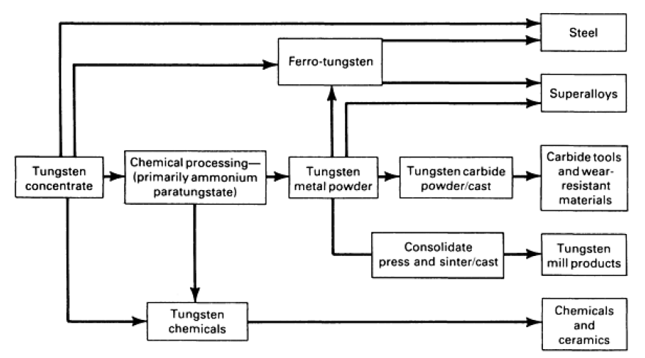
Pure W - Metallurgy and processing background
Tungsten mill products divided into three distinct groups on the basis of recrystallization behavior:
EB-melted, zone-refined, or arc-melted unalloyed tungsten
  Exhibit equiaxed grain structures upon primary recrystallization.
  Recrystallization T and grain size both decrease with increasing deformation
  In EB-melted tungsten wire, the recrystallization T can be 900 °C or lower
Commercial grade or undoped P/M tungsten, sensitive to purity
  Like the first group, these materials exhibit equiaxed grain structures, but their recrystallization temperatures are higher than those of the first-group materials.
  Also, these materials do not necessarily exhibit decreases in recrystallization temperature and grain size with increasing deformation
  In commercially pure (undoped) tungsten Recrystallization T can be as high as 1205 to 1400 °C
3) The third group of materials consists of doped tungsten
Source: ASM Handbook
Courtesy of Plansee SE

Slide 4
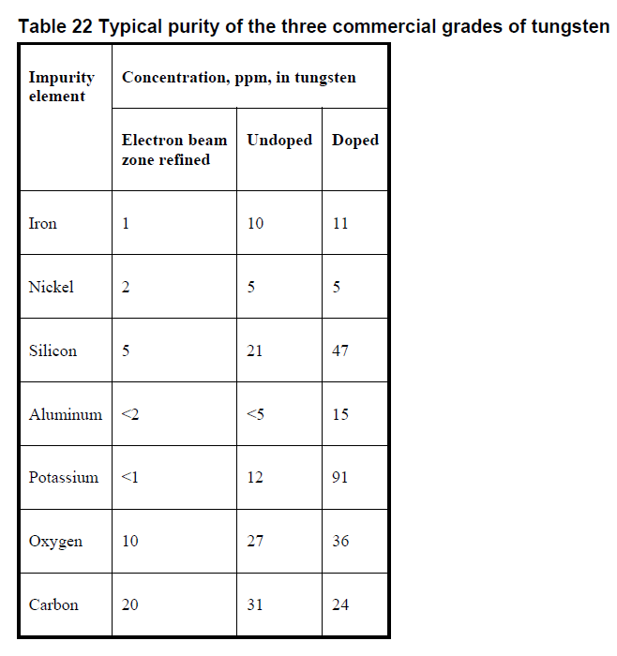
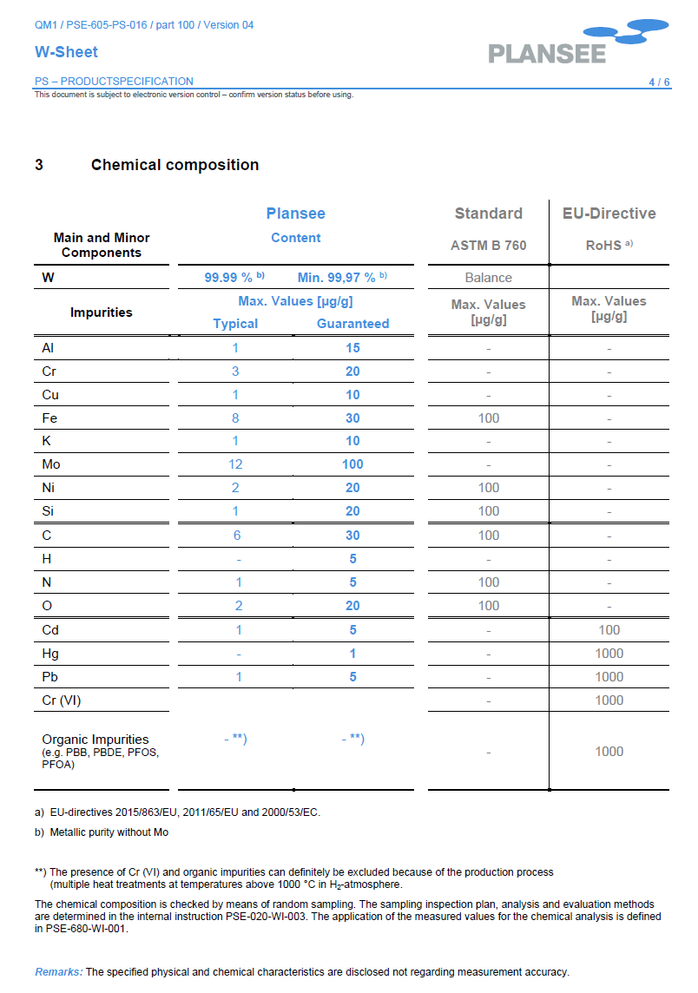
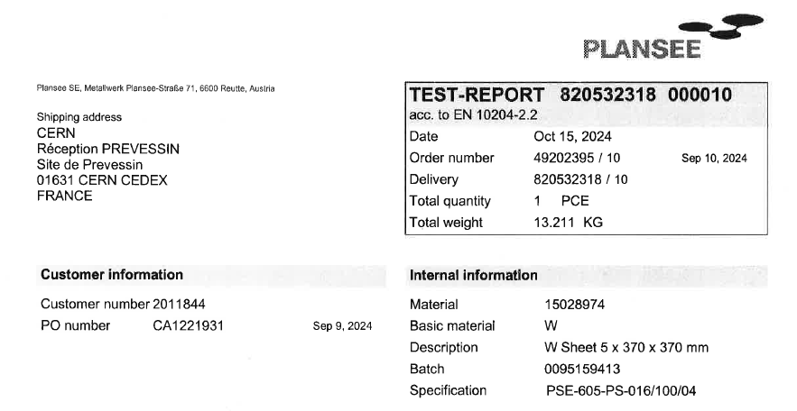
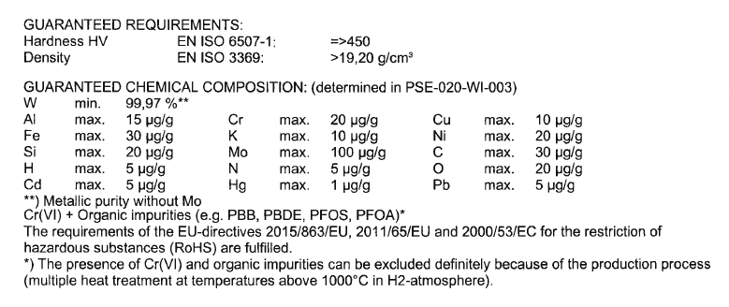
Pure W - Metallurgy and processing background
  HR product ordered in 5 mm and 17 mm thickness
  Limited availability in heavy gauges with guaranteed properties - due to a minimum reduction to be provided to achieve final properties

Slide 5
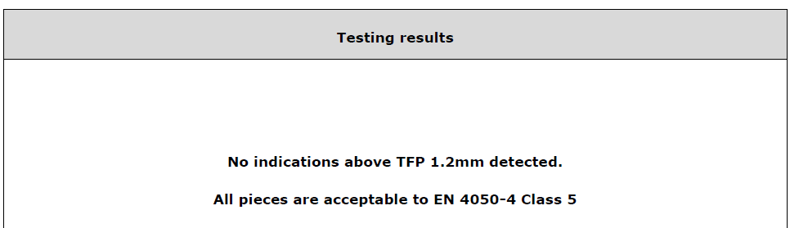
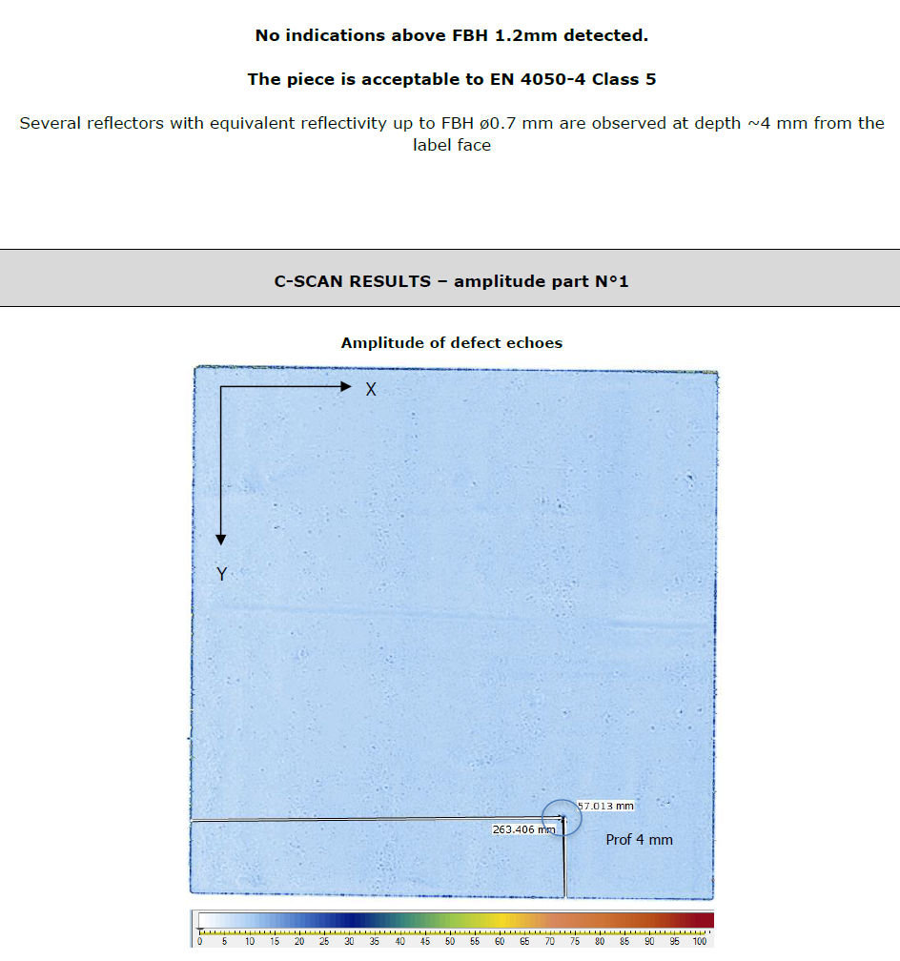
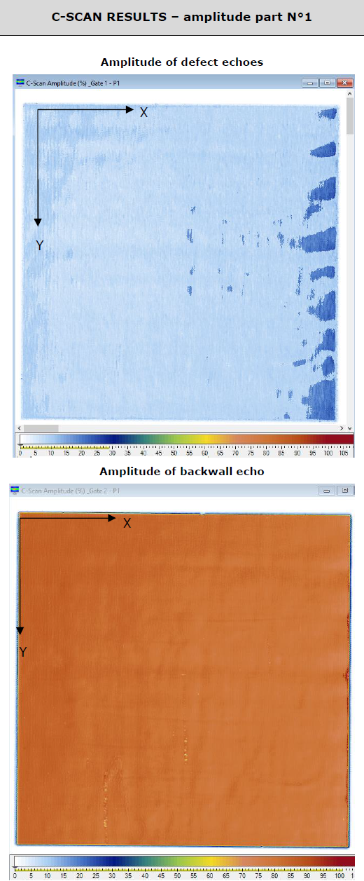
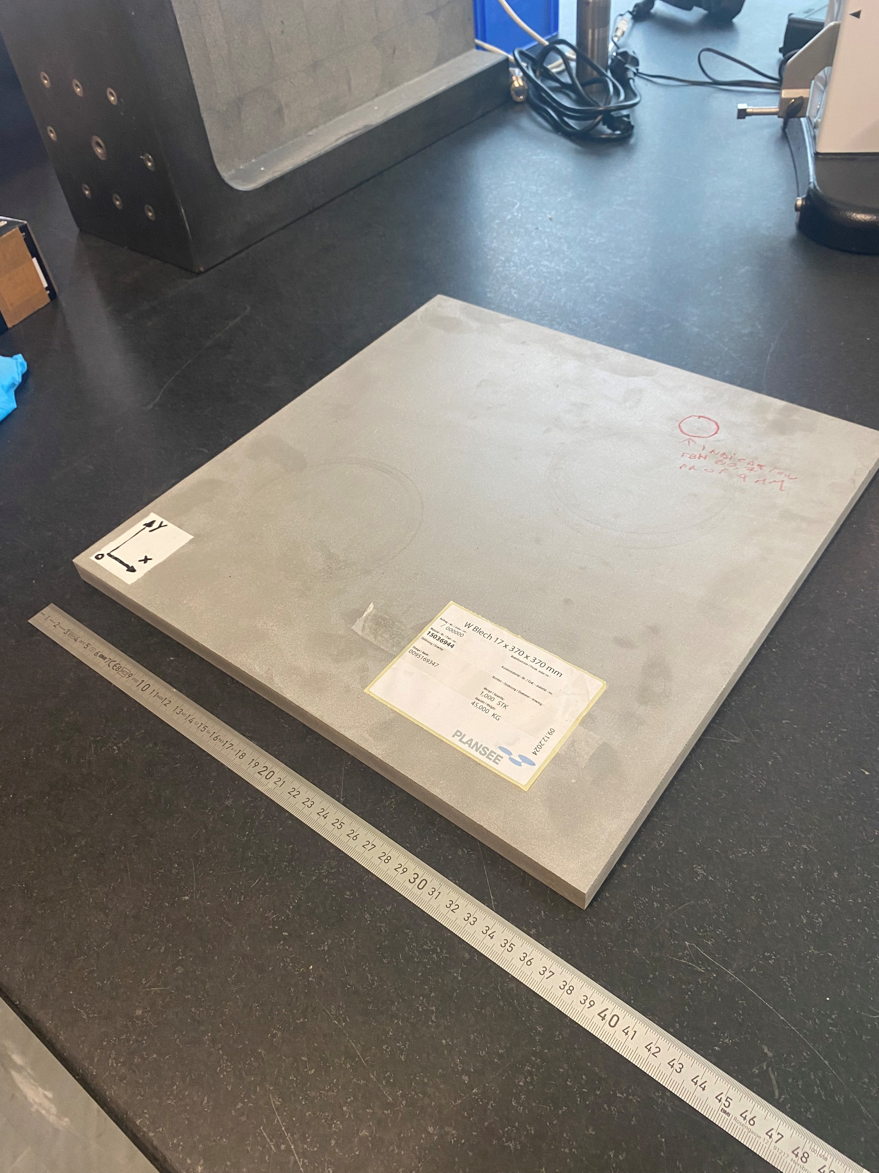
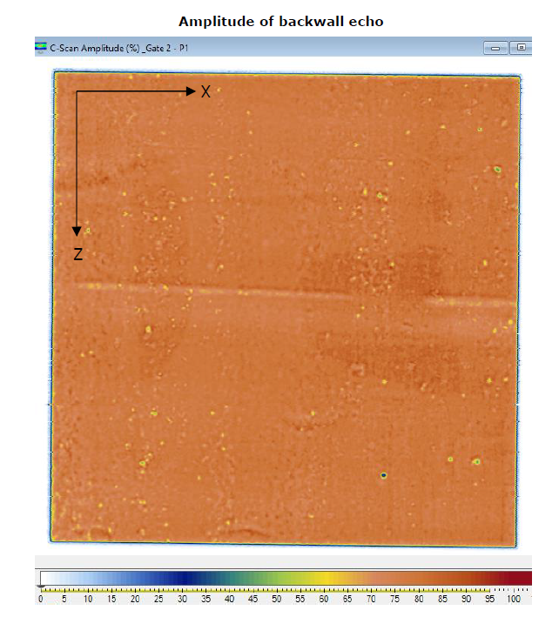
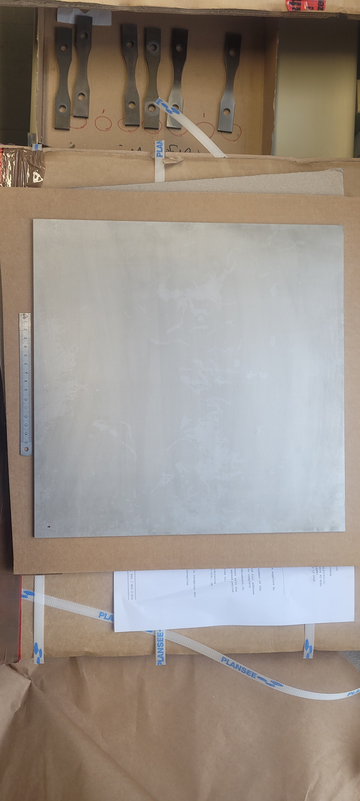
Pure W - Metallurgy and processing background
  To the extent of the inspections performed, dimensions and tolerances conforming to ASTM B760, see EDMS 3180443
  HR 5 mm ↓ and 17 mm thick → plates ordered and received from Plansee
  ⇑ UT results on the 17 mm plate: excellent homogeneity and high acceptance level (to 0.8 mm FBH equivalent), EDMS 3237640
  ⇑ UT results on the 5 mm plate: excellent homogeneity and high acceptance level (to 1.2 mm FBH equivalent), EDMS 3190589

Slide 6
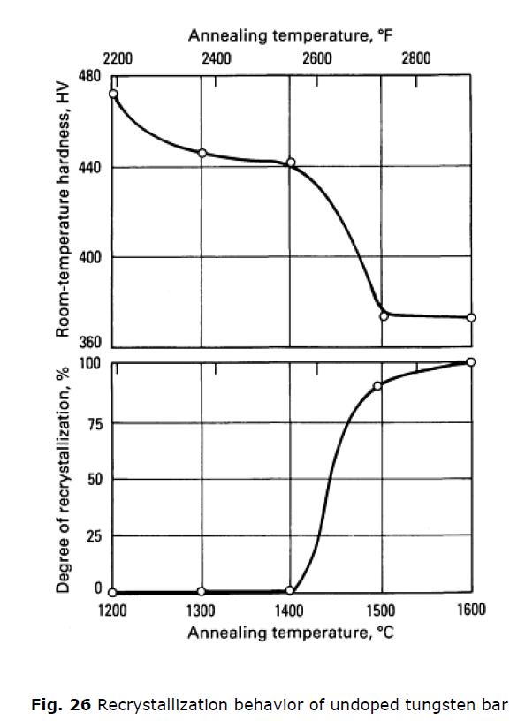
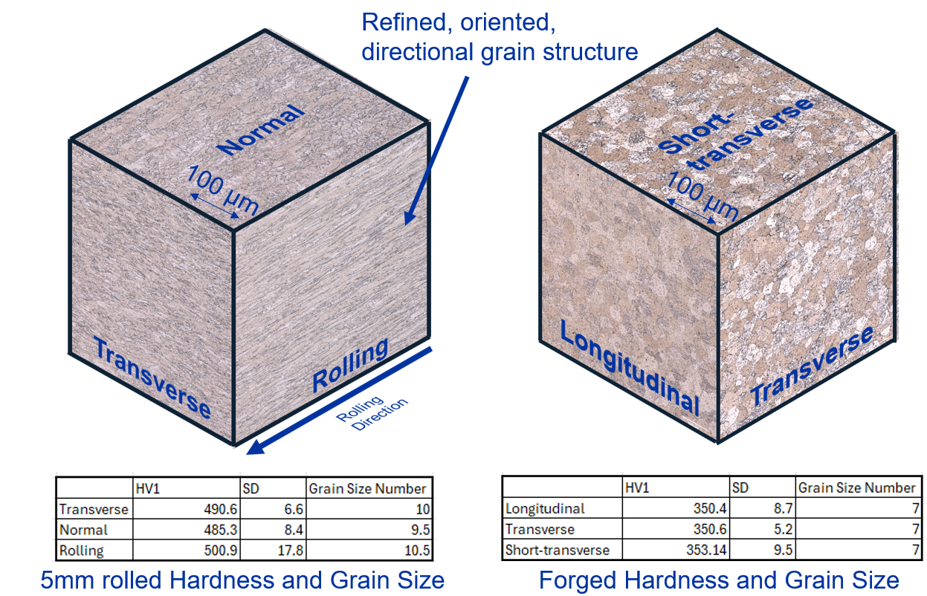
Pure W - Metallurgy and processing background
Benjamin Corbett, https://indico.cern.ch/event/1480601/

Slide 7
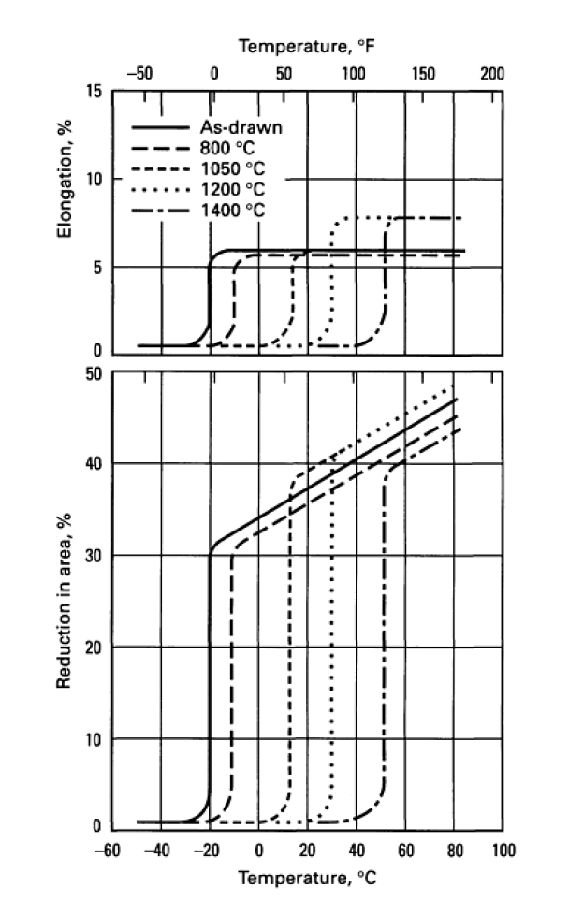
Pure W - Metallurgy and processing background
Previous tests on HIPed W:
DBTT between 350 °C and 450 °C
Recrystallized tungsten undergoes a ductile-to-brittle transition above 205 °C .
Only by heavy warm or cold working is the DBTT lowered to below room temperature
Annealing raises the DBTT of cold-worked tungsten until it approaches that of recrystallized material
The exact ductile-to-brittle transition temperature is influenced by many factors, including grain size, strain rate, and impurity levels
The DBTT decreases with grain size unless the grains are larger than 1 mm in diameter.
The DBTT also drops with increases in strain rate, but it climbs rapidly as impurity levels increase.
Like all brittle metals, tungsten is very notch sensitive. Therefore, removal of even minute surface flaws by grinding, oxidizing, or electrolytic polishing prior to service improves ductility and lowers the DBTT

Slide 8
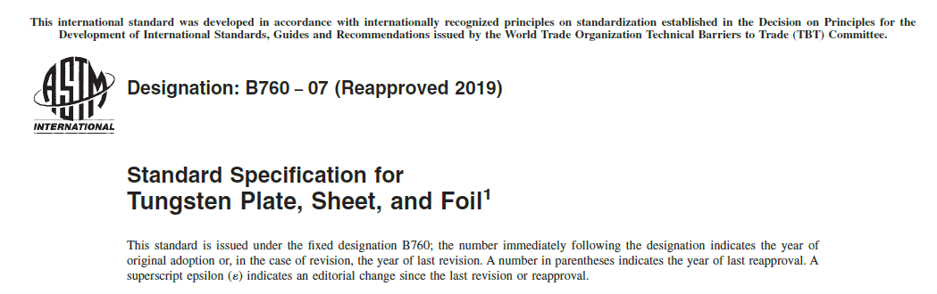
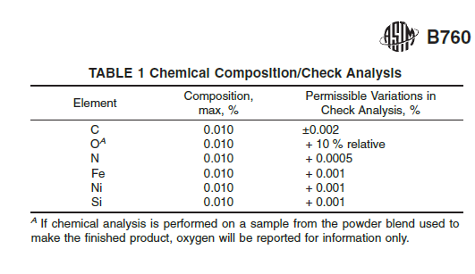
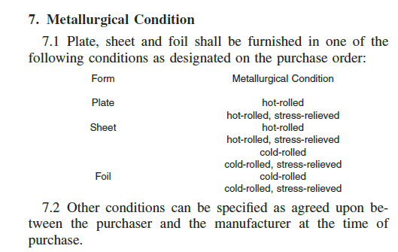
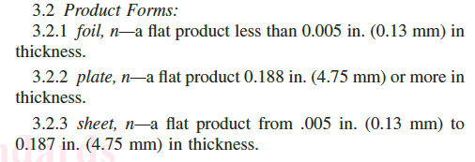

Pure W flat products – Standard framework

Slide 9
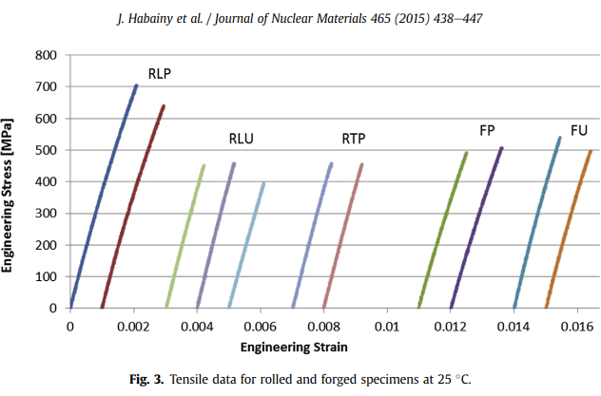
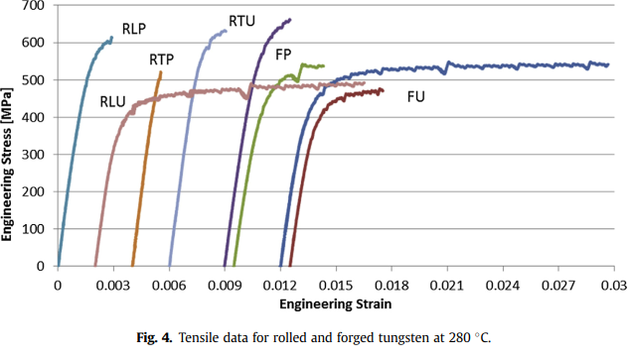
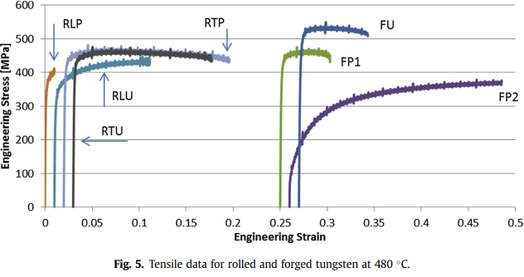
Ongoing and required material R&D to meet the project requirements
Operating conditions:
  RT to 400°C
  Stresses: -100 MPa to 150 MPa
  Fatigue life of 10⁷ cycles
  Irradiation: approximately 1.2 - 1.6 dpa (< 2 dpa)
  Individual block height: 17 mm (as HR?) to 350 mm (as HIPed) thick and 250 mm diameter (present baseline)
  Chemical additions from He: 143-220 ppm(at)
  Beam Parameters: sigma 8 mm (possibly 16 mm)
  As HR and HR + HIPed properties are relevant
  HR product form looks a reasonable choice – availability in heavy gauges with guaranteed properties limited

Slide 10
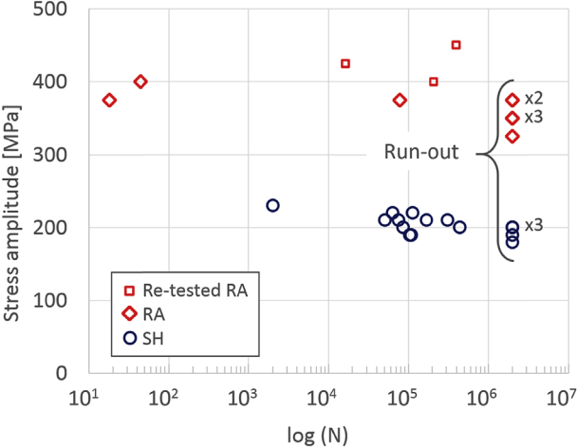
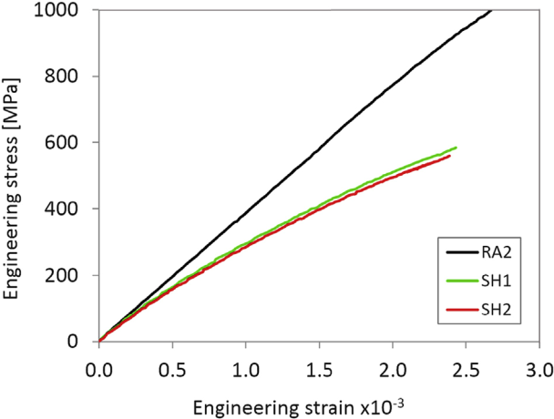
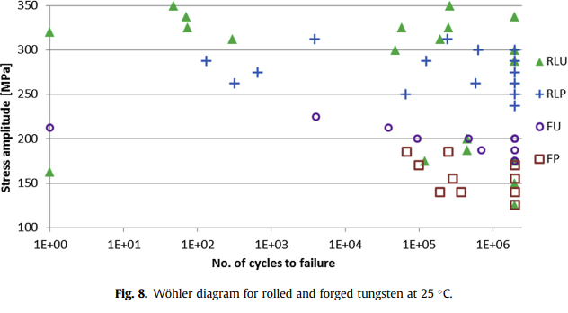
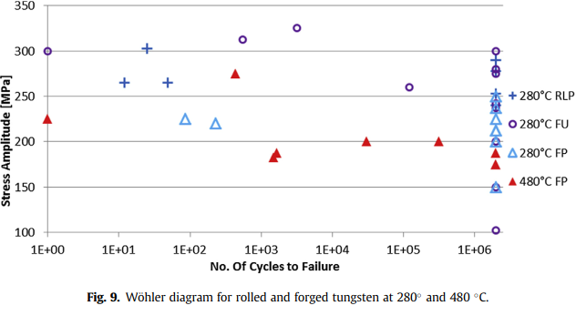
Ongoing and required material R&D to meet the project requirements
Limited mechanical properties in SH material
  Limited fatigue endurance limit
  Limited yield
RT
J. Habainy, S. Iyengar, Y.Lee, Y.Dai.
https://doi.org/10.1016/j.jnucmat.2017.10.061
300 MPa
Safety factor = 2
150 MPa
In service
300 MPa
Safety factor = 2
150 MPa in service
J. Habainy, Y. Lee, Y. Dai, S. Iyengar,
https://doi.org/10.1016/j.jnucmat.2015.06.032

Slide 11
Ongoing and required material R&D to meet the project requirements
Axial forging is possible but there is a limitation:
  Maximum of 110 mm heigth with 260 mm diameter
  From this dimensions reduced mechanical properties as no more axial nor radial deformation can be done.
Rolled tungsten:
  Shows superior fatigue properties than forged and PM HIPed tungsten
  However, it has nearly zero ductility at room temperature and is highly anisotropic
  The orientation of the rolled tungsten bricks with respect to the proton beam needs to be carefully considered.
  The post-pulse maximum stress should be below 100 MPa, and the post-pulse peak stress amplitude lower than 50 MPa (see J. Habainy, Y. Lee, Y. Dai, S. Iyengar, https://doi.org/10.7566/JPSCP.28.031004)

Slide 12
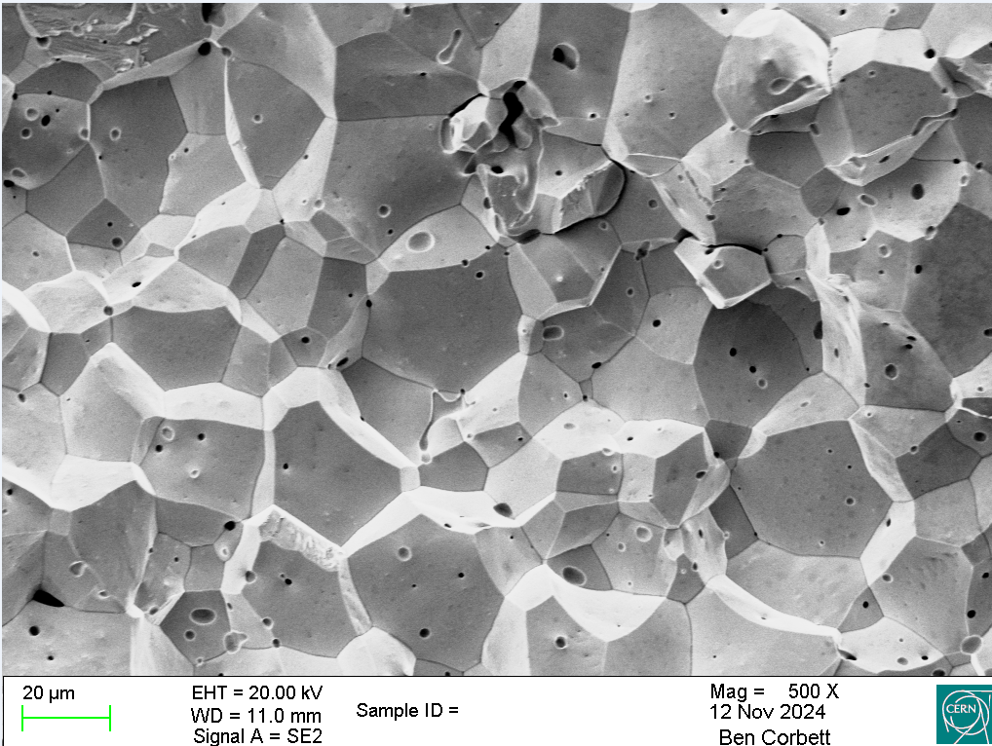
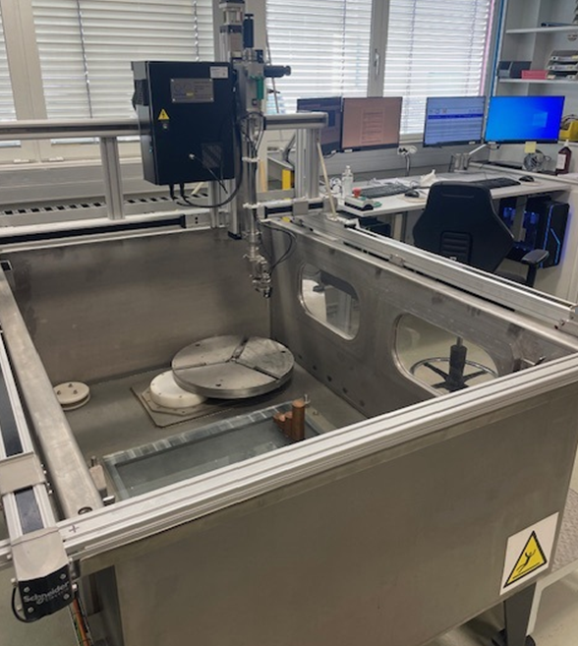
Palette of tests for the material target – and why
Mechanical testing:
  Charpy impact toughness testing of the base material, from RT to 600 ºC
  RT & high T tensile testing with possibility of an inert or vacuum atmosphere
  As above, fatigue testing
  Tensile testing of the adhesion strength of the HIP bonded plates W-W & W-Ta-W.
  Material hardness (as a function of T?)
Material characterization
  Ongoing in house on HR plates:
  A complete grain size analysis
  Grain orientation analysis
  Recast layer analysis & post cut processing
  Density evaluation
  Microstructural changes of the base material during the heating exposure/HIPing process
Metrology & NDT
  Immersion UT of all incoming plates EN 4050-4
  Flatness evaluation ASTM B760-07
  Roughness evaluation
  Oxidation studies:
  in relation to NDT
  and operating environment

Slide 13
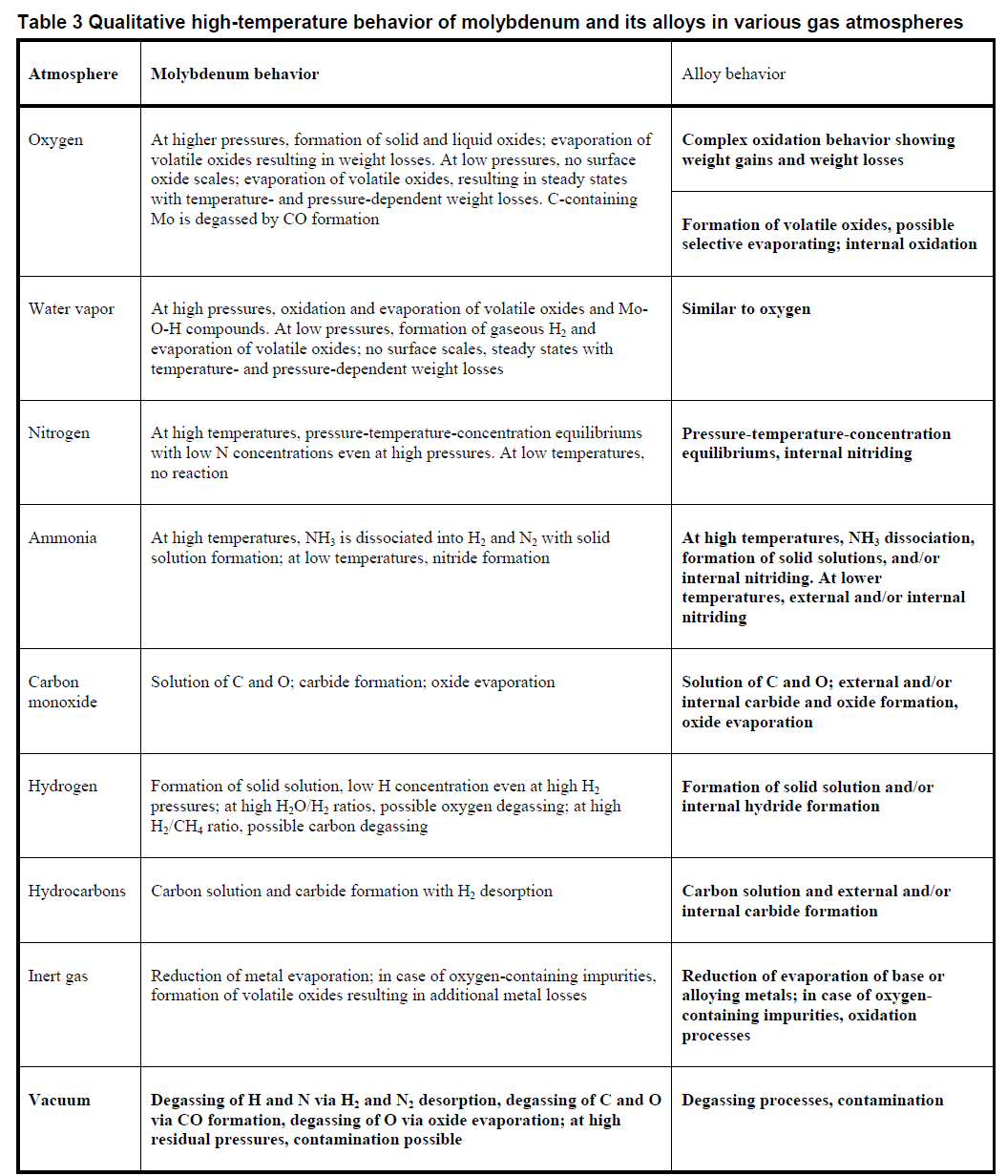
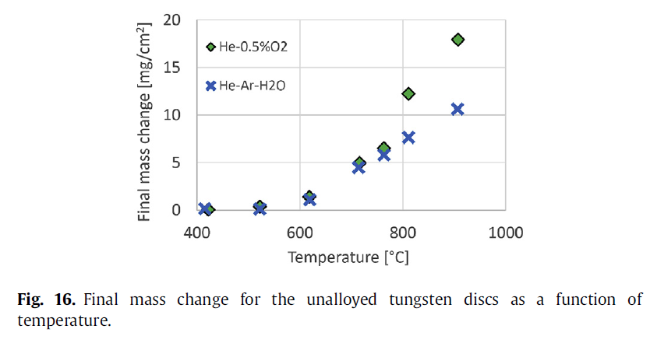
Palette of tests
  Oxidation studies vs. operating environment
similar behaviour expected as reported for Mo ⇒
cleaning of W is desirable to remove compounds that could cause carbon contamination during exposure to a heat cycle
a variety of cleaning agents may be used to remove oils and hydrocarbons (vapor degreasing and hand or automatic washing with detergent solutions)
chemical cleaning only needed for heavily oxidised surfaces
See J. Habainy et al., Formation of oxide layers on tungsten at low oxygen partial pressures:
In Ar gas with a maximum oxygen partial pressure of 5 ppm, a thin and adherent oxide film was observed to form on the surface of tungsten specimens even at 500 °C
For the operation of the ESS spallation facility, it is important to note that tungsten can be oxidized in environments with low oxygen partial pressures at T as low as 400 °C
Below 500 °C it is expected that the oxide formed will be of the protective type
However, considering that the tungsten will be cooled by a massive helium flow with a flux of 3 kg/s at 1.1 MPa, surface erosion of the oxide scale was a concern
Erosion experiments were performed to study the adhesion of the oxide formed on tungsten at 500 °C
The sample, pre-oxidized for 1 h in a He-0.5%O2 gas mixture, showed no signs of erosion caused by the helium jet
Still, the spalling of the oxide layer due to beam pulse and beam trip induced thermal cycling, and fatigue, during five years of target lifetime, remains an issue
Also of concern is the possibility of tungsten oxide sublimation in accidental cases such as over-focused beam combined with loss of helium confinement.
To minimize such risks, the target primary cooling loop will be purified and the impurity levels will be monitored during operation.

Slide 14
Palette of tests for the material target – and why
Tensile testing
Fatigue testing
Charpy testing
 | CERN | NLR | Lucideon | SincoTec | Amentum | Nordmetall
Country | Switzerland | Netherlands | United States | Germany | United Kingdom | Germany
Test types | Tensile test & Fatigue test | Tensile, Fatigue & Density | Fatigue & Tensile | Fatigue | Fatigue | Charpy impact
Samples | Open | 6 Samples 2x Tensile 2x Fatigue 2x Density | 6 Samples 2x Tensile (RT &HT), 6 x Fatigue (3x air 3x argon) | 30 samples RT & HT, spread TBD by CERN | 20 samples | 46 Samples 6x Reference 40x Room –> high temperature (~600˚C)
Sample geometry | Fatigue- L- 135 mm, W 100 mm | Tensile - L100 mm, G 25 mm, W 6 mm Fatigue - L 134 mm, Density- 10 mm x 10 mm x 5 mm (L x W x T) | TBD | L 160 mm, W 30 mm 16 per plate | L- 134 mm, W30 mm | 10 mm x 10 mm x 55 mm
Machining | EDM-CERN | EDM-CERN | EDM-CERN | Machined-SincoTec | EDM-CERN | EDM-CERN
Machine parameters | Testing up to 20 Hz | Testing up to 100 Hz | Frequency to be determined | Testing up to 80Hz | Testing up to 20 Hz | Testing in increasing increments from room temperature to 600 ˚C
Heating & atmosphere | Room temperature only in atmosphere | Furnace heated in argon oven (Experienced in this testing) | Information not given | Induction heating in argon test chamber. (Experience in this testing) | Furnace heated (including grips) Static argon during test (no experience in this testing) | Information not given
Duration | 6 days per sample fatigue | 12 days | 11-12 weeks | ~ 6-7 weeks | 17 weeks | 4 weeks
Price | EDM cost only | €40, 400.00 | £23,280.00 | €51,786.00 | £104,681.11 | €4,600.00

Slide 15
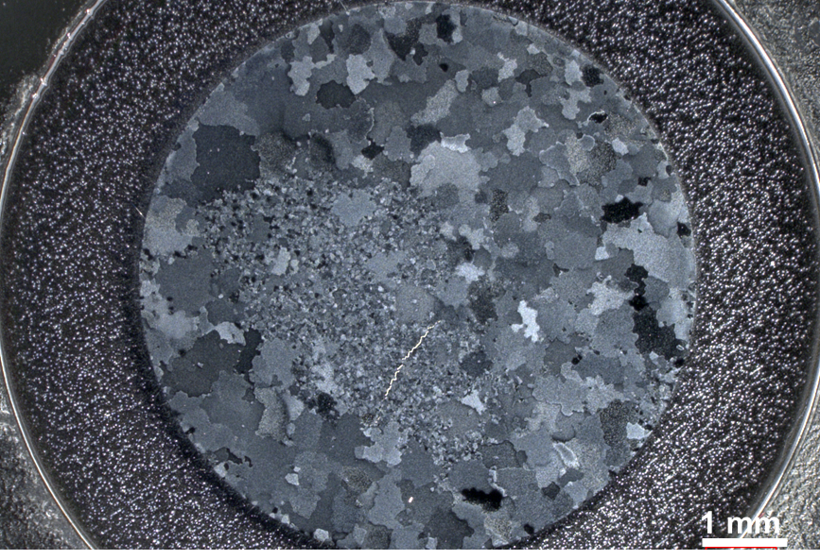
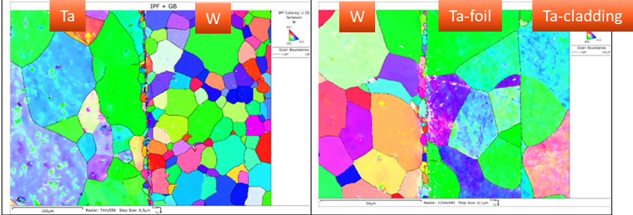
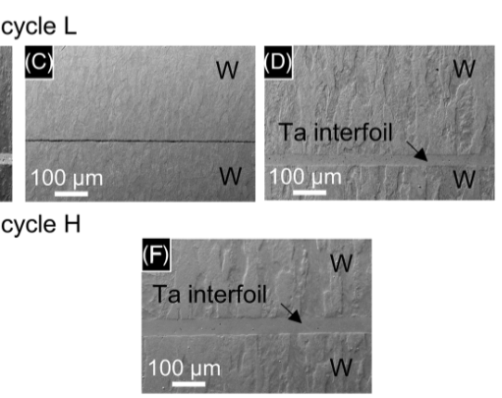
[1] 2018 → Recent developments on the application of Hot Isostatic Pressing (HIP) technologies for proton beam targets at CERN with Fraunhofer J. Busom et al.
[2] 2024 → PIE of a prototype tantalum-clad target in collaboration with Framatome T. Griesemer et al.
Palette of tests for the material target – and why
Previous work: Cladding
  HIP has been proven as a valid technique to bond W to Ta and W to W (through a Ta interfoil): erosion-corrosion resistant claddings in representative geometries of the ﬁnal target
Homogeneous bonding
  With stronger interfaces and theoretical thermal conductivities were achieved in Ta-TZM, Ta-W, and Ta2.5W-TZM. Ta2.5W-W showed 70% of the cladding material's strength [1] [2]
  Checked by NDT, microstructural and mechanical characterization on unirradiated and irradiated components
HIP cladding ⇑
Other methods like CVD and sleeve-in were unsuccessful
Ta-cladding by HIPing exhibited reliable and good bonding quality (Ta to W with and without foils and W/Ta/W)
Robust heat transfer from core to cooling water
More studies are needed to complete assessment mechanical strength

Slide 16
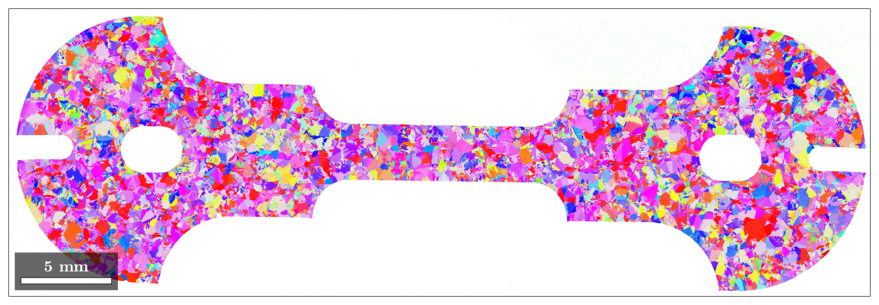
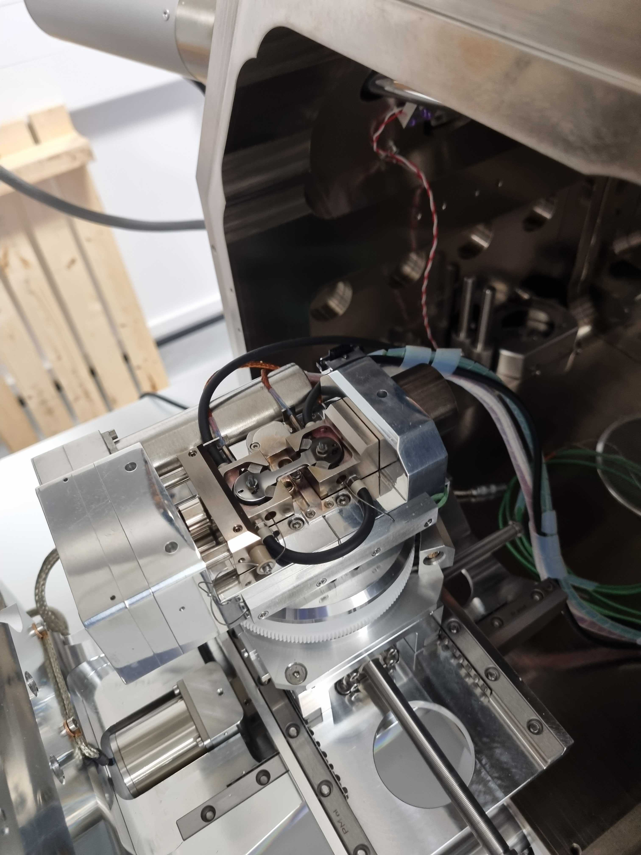
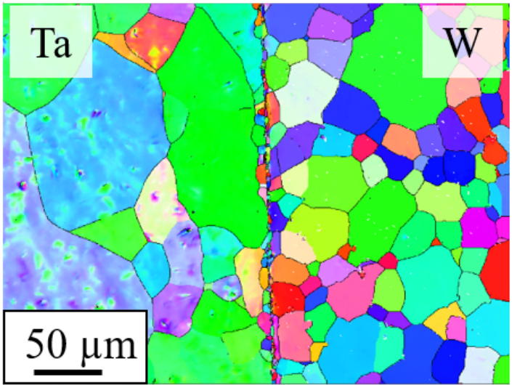
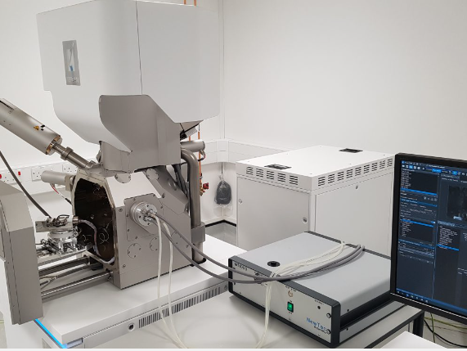
Palette of tests for the material target – and why
  In-situ proposal
  Collaboration with the University of Manchester, experts in this field
  Mechanical testing inside SEM
  Well adapted to test interfaces (W/Ta/W)
  RT and high temperature in-situ
  SEM vacuum environment
  Cost: ≈ 6000 CHF per test

Slide 17
  Profilometry – based indentation plastometry
Palette of tests for the material target – and why
The system allows obtaining stress–strain curves (up to uniform elongation) based on indentation + profilometry data
We (EN-MME) have benchmarked it with a ‘blind test’ on a variety of materials (stainless steel P506, Nb RRR 300, electroformed Cu) with very consistent results (difference in Rp_{0.2} and Rm < 10%)
The HT option has been validated for pure tungsten up to 800°C
Estimated 131 kCHF
In-SEM also being evaluated for specific tests (collaboration Prof. Kermouche / Ecole des Mines de Saint Etienne) and own equipment (200 kCHF)

Slide 18
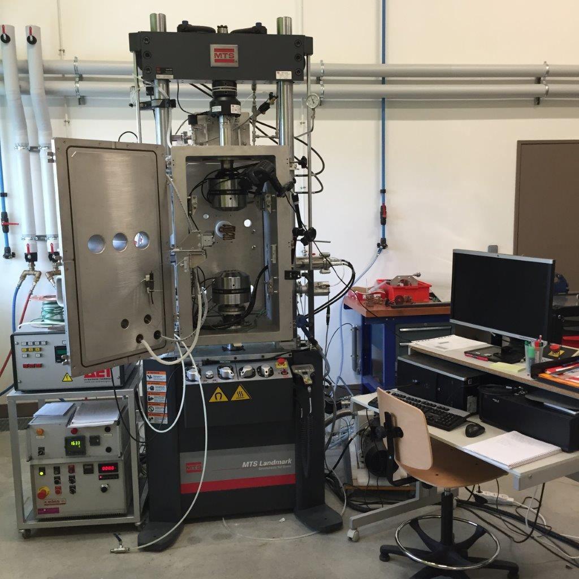
Palette of tests for the material target – and why
High T (1200°C) + vacuum Universal Testing System
  Scarce availability
  High (and highly scattered) cost of high cycle fatigue testing at high temperature under vacuum or protective atmosphere
  Equip ourselves with state–of–the–art HT fatigue testing device?
  Two potential suppliers: Instron /UK & MTS/USA
  Both suppliers work with a French partner which is a reference of vacuum furnaces: AET
  Seamless integration with the unit, vacuum environment to avoid oxidation, and the whole specimen is at HT
  The system could eventually be installed in an extension of our current mechanical testing laboratory
  Both machine and vacuum furnace would be in the range of 550 – 600 kCHF, including grips and extensometers

Slide 19
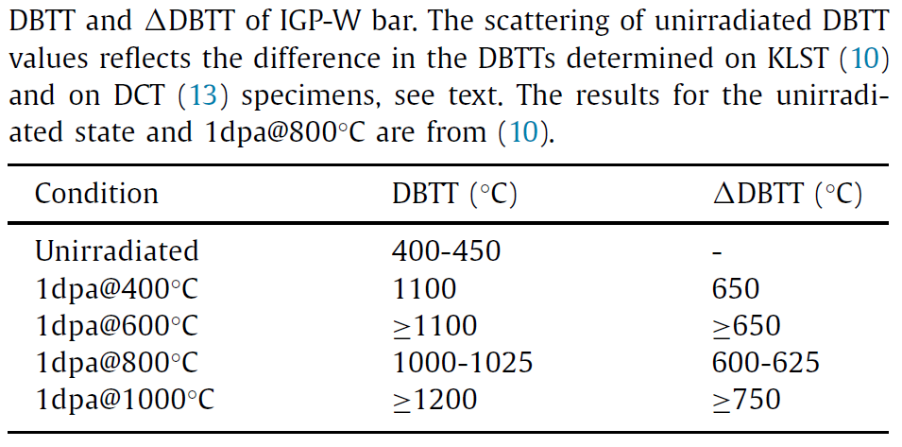
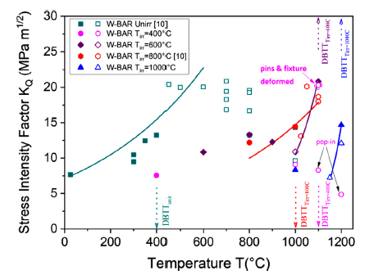
Radiation damage considerations on materials – do we care?
  General outcome: increase in the DBTT of irradiated samples
  The increase of the DBTT depends on fluence and irradiation temperature & it is pronounced even for doses as low as ~1 dpa
  Early works report DBTT of sintered unirradiated W ~ 400°C and of irradiated W ~ 600°C (ITER Materials Assessment Report (MAR), ITER Doc. G 74 MA 10 01-07-11 W0.3)
  Recent works confirm that irradiation strongly impacts the fracture-mechanical behaviour of wrought W irradiated to 1 dpa
  Depending on the irradiation temperature, the DBTT increases by about 650 °C or even higher
Gaganidze E., et al (2021). Effect of irradiation temperature on the fracture-mechanical behaviour of tungsten irradiated to 1 dpa, Journal of Nuclear Materials, 556 https://doi.org/10.1016/j.jnucmat.2021.153200
  Tungsten wires irradiated at 0.2, 1, and 10 dpa and tested at RT. No significant change in the ductility of both irradiated and non-irradiated wires was found - Lürbke, R. et al. (2025), https://doi.org/10.1016/j.nme.2024.101858

Slide 20
Conclusions
The selected metallurgical route, form of product (HR plates), HIP diffusion bonding techniques are promising, based on previous assessments and ongoing tests
However, an extensive material characterisation and assessment of mechanical properties at intermediate temperature is still needed to support this material choice
Testing campaigns are extensive, complex and costly → consider developing in-house test facilities
Critical points are the limitation of the thickness: a HIP cycle required, equivalent to an annealing, that might raise the DBTT
Irradiation hardening and embrittlement are potential concerns (primary degradation phenomena of W):
  hardness and yield strength increase, ductility loss at high doses, shift of DBTT
  Large DBTT shift expected even at a low dose of 1 dpa
  Brittle regime in all temperature range eventually expected, no self-recovery
Thermomechanical processing techniques, such as rolling and forging and/or additives/dopants can reduce the DBTT of W, even down to RT. Nevertheless, both approaches have proven to be less effective when W is subjected to high-temperature annealing or irradiation

