Slide 1
BDF target cooling concepts
BDF Targetry Systems Advisory Committee - TSAC
F. Dragoni
04/03/2025
https://hiecn3.web.cern.ch

Slide 2
Agenda
BDF Target/Proximity Shielding Cooling requirements
Water vs Helium – cooling
Operational considerations
BDF Prototype Helium Skid
Conclusions

Slide 3
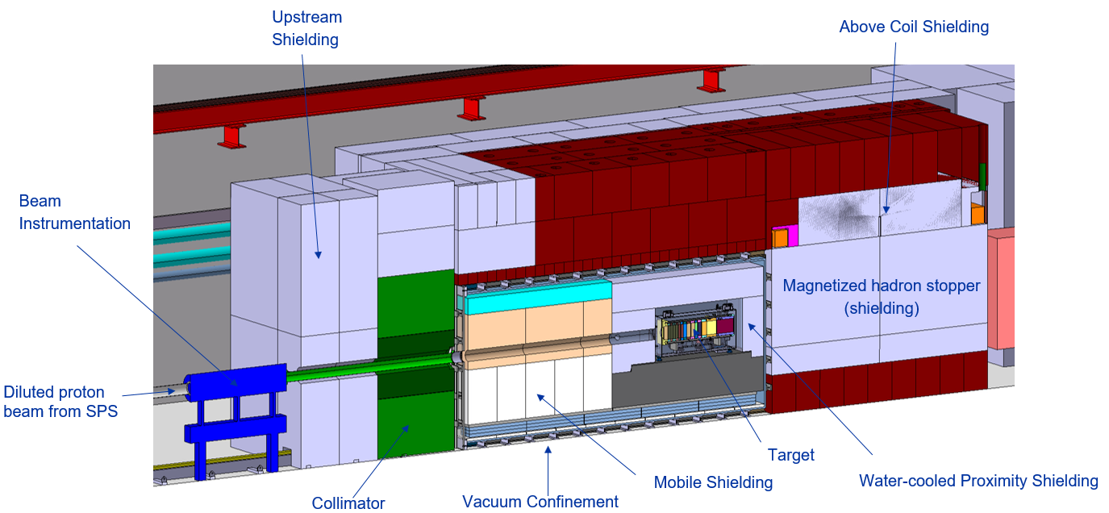
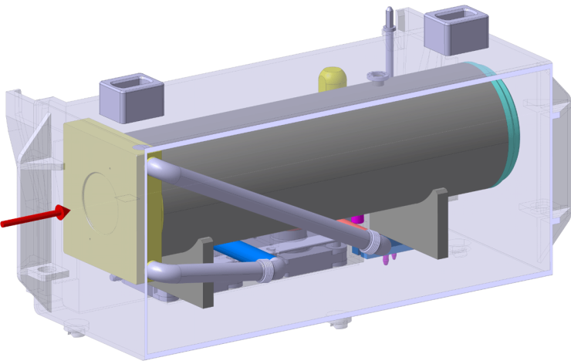
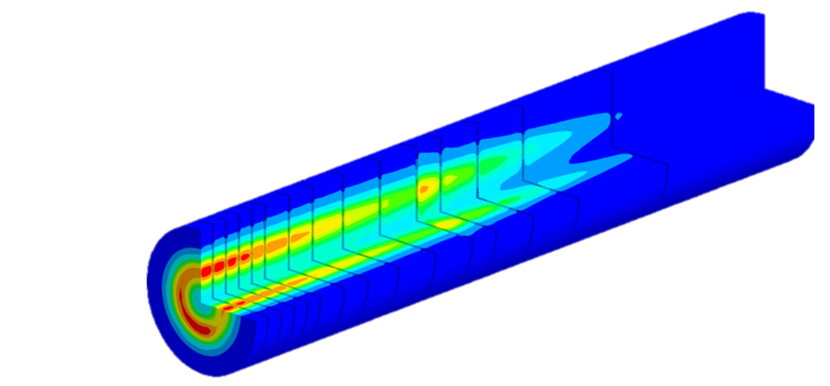
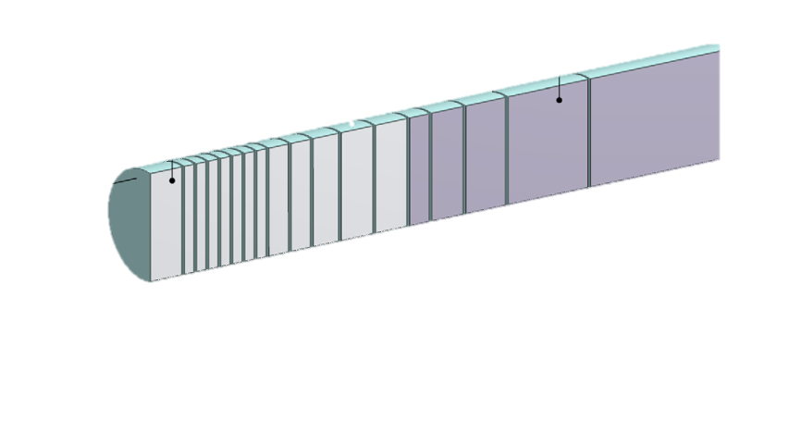
BDF Target/Proximity Shielding - Requirements
3 equipment requiring cooling:
  Target
  Proximity shielding
  Hadron stopper (5 kW – outside shielding)
Target user requirements
  Target deposited power: 305 kW
  Cooling medium inlet temperature: 30 °C + 3 K
  Pressure rating: 10⁻⁴ mbar(a) to PN25
Proximity shielding user requirements
  Deposited power: 20 kW
  Cooling medium inlet temperature: 30 °C + 3 K
  Pressure rating: 10⁻⁴ mbar(a) to PN25
Functional requirements
  Compressor redundancy (pending)
  Operation 24/7 for 365 days – reduced mode during YETS
350 kW-class Target

Slide 4
Cooling possibilities: Water vs Helium
Demineralised Water Cooling
Helium Gas Cooling
Main parameters
    Water supply temperature: 30 °C ± 3 K
    Water flow rate: 45 m³/h (target) + 6 m³/h (proximity)
    Pressure rating: PN25
  Characteristics
    Supply pressure: 22 bar(g) (target) / 5 bar(g) (proximity)
    Differential temperature (after/before user): < 10K
    1 heat exchanger
    Water activation + tritium production + potential water contamination if cladding is damaged + water radiolysis
    9 ion exchanger cartridges (6+1 for target and 1+1 for proximity shielding)
Main parameters
    He(g) supply temperature: 30 °C ± 3 K
    He(g) flow rate: 400 g/s (target + proximity)
    Pressure rating: PN25
    Helium purity: > 99.9999% (Helium 60)
  Characteristics
    Supply pressure: 16 bar(a)
    Differential temperature (after/before user): 170 K
    3 heat exchangers
    Tritium produced + possible outgassing (H₂O, CO, CO₂, O₂ , H₂)

Slide 5
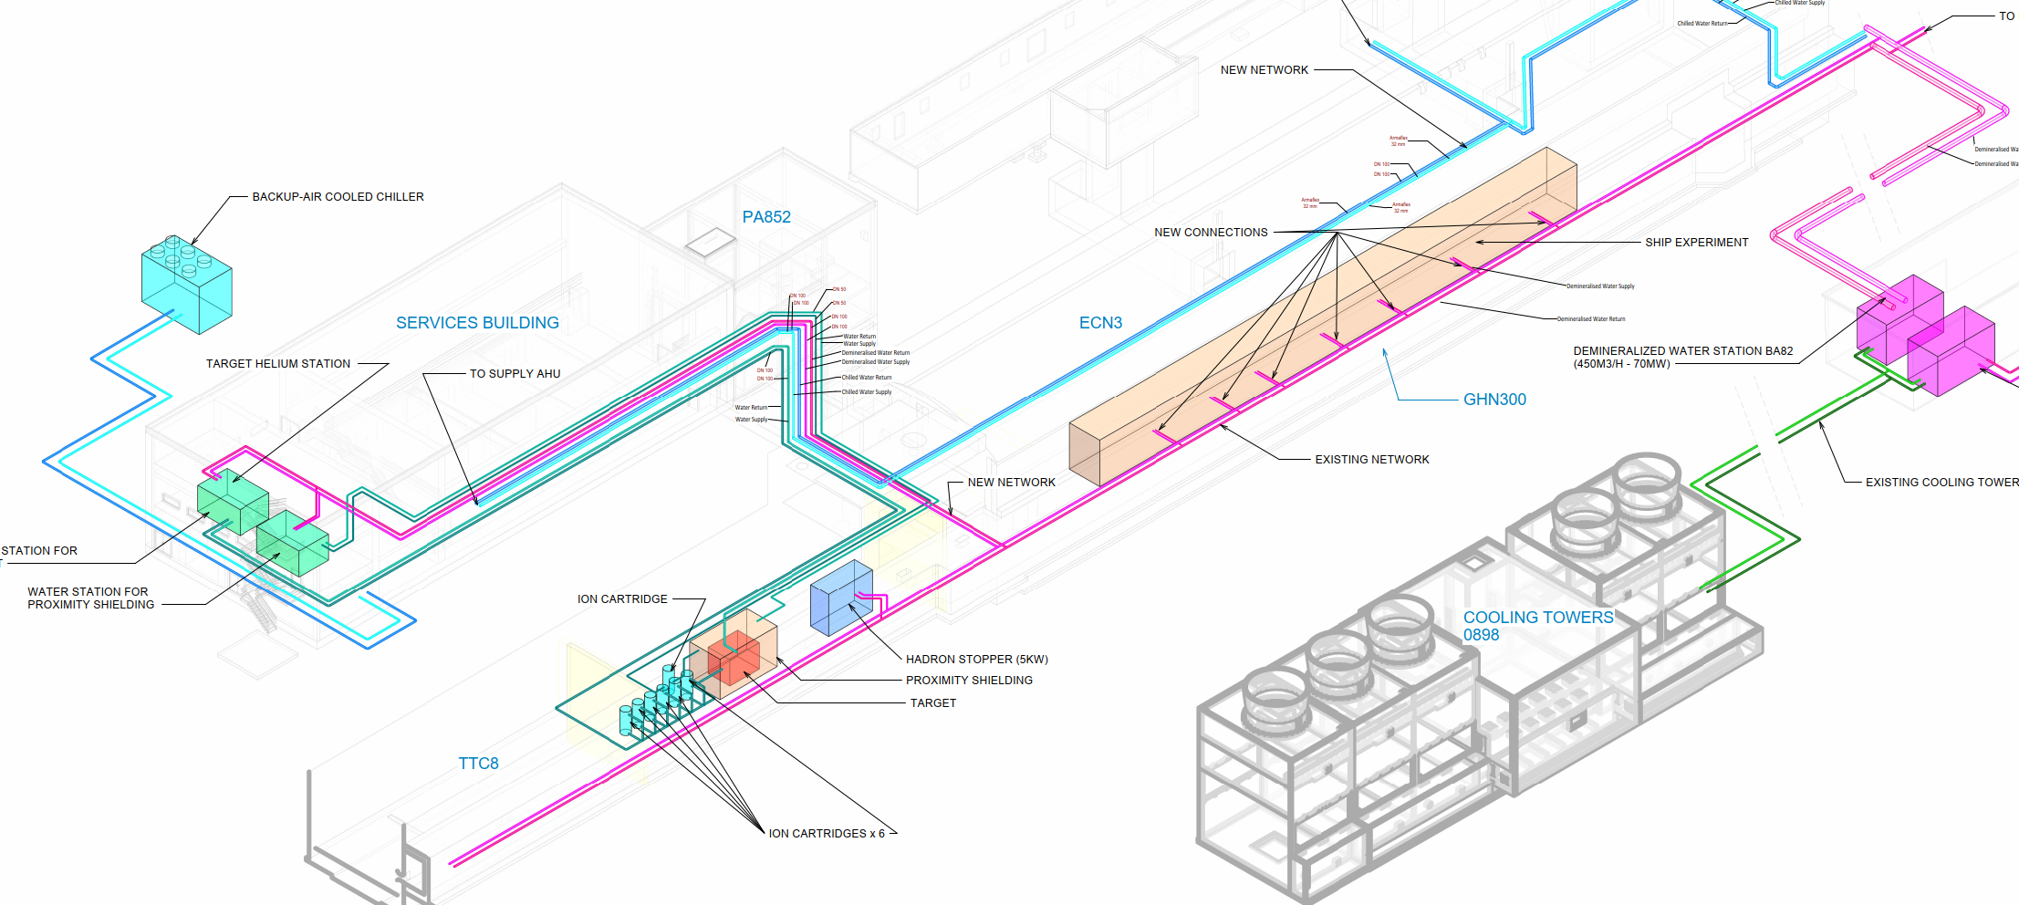
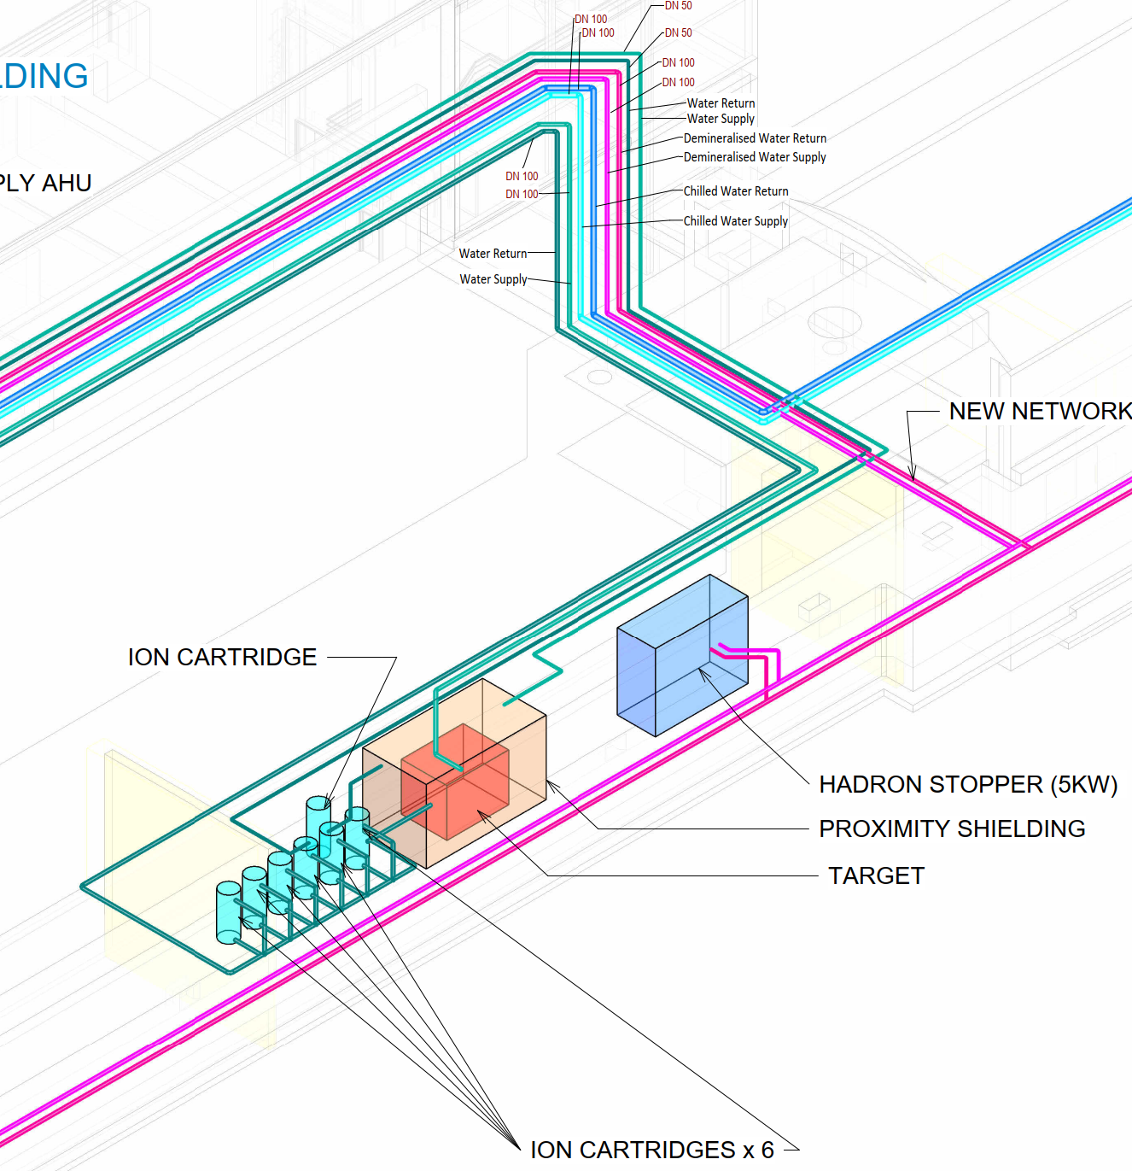
Cooling possibilities: 3 configurations
Configuration #1
Target: water cooled
Proximity: water cooled
Configuration #2
Target: helium cooled
Proximity: water cooled
Configuration #3
Target: helium cooled
Proximity: helium cooled

Slide 6
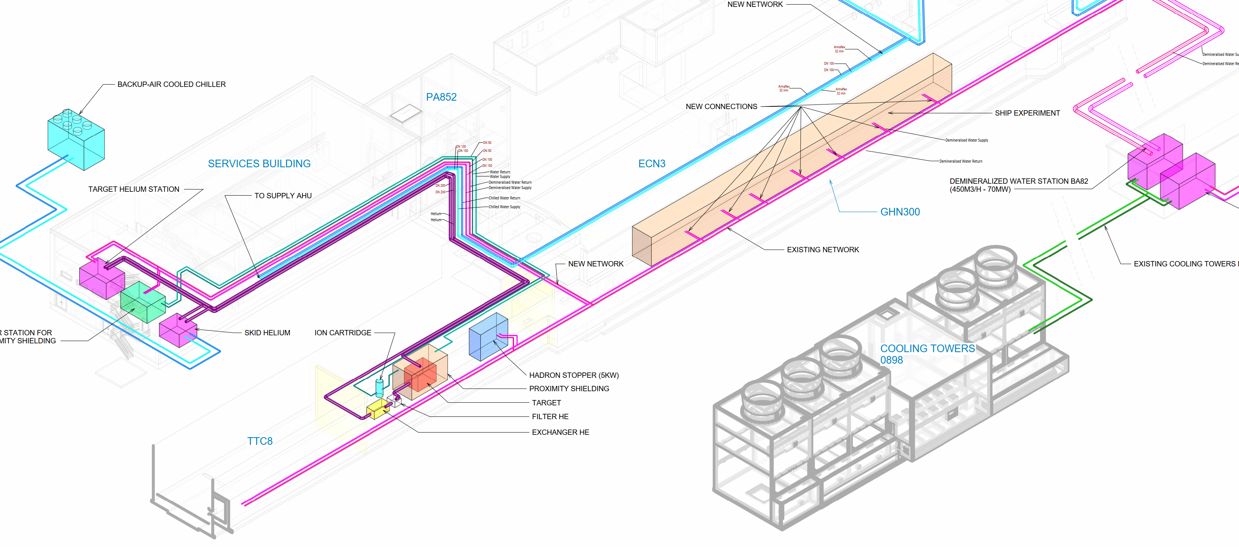
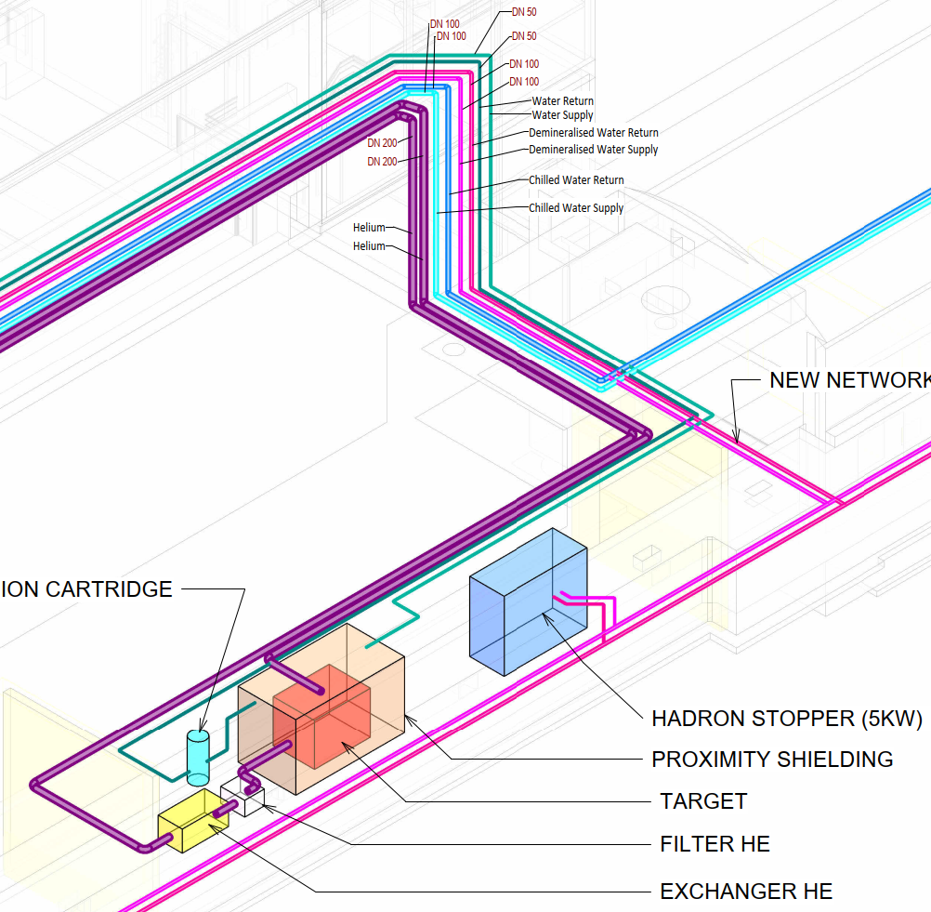
Cooling possibilities: 3 configurations
Configuration #1
Target: water cooled
Proximity: water cooled
Configuration #2
Target: helium cooled
Proximity: water cooled
Configuration #3
Target: helium cooled
Proximity: helium cooled

Slide 7
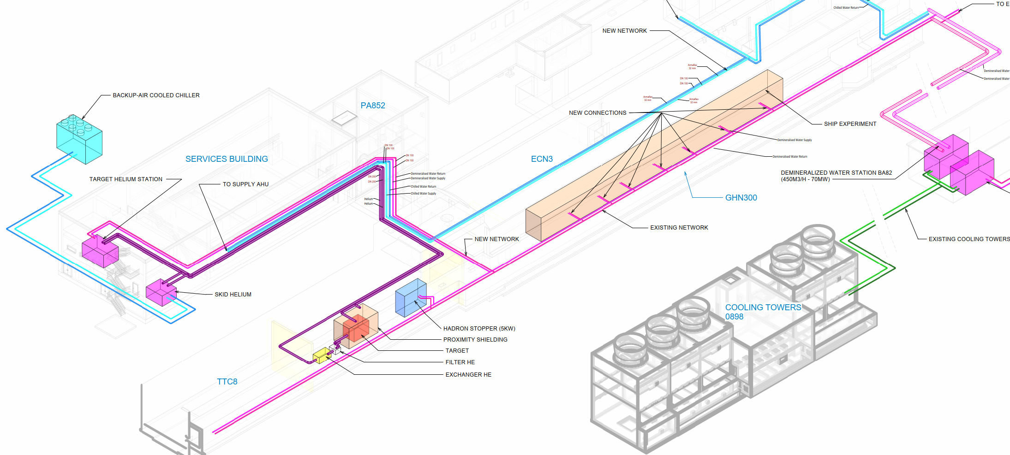
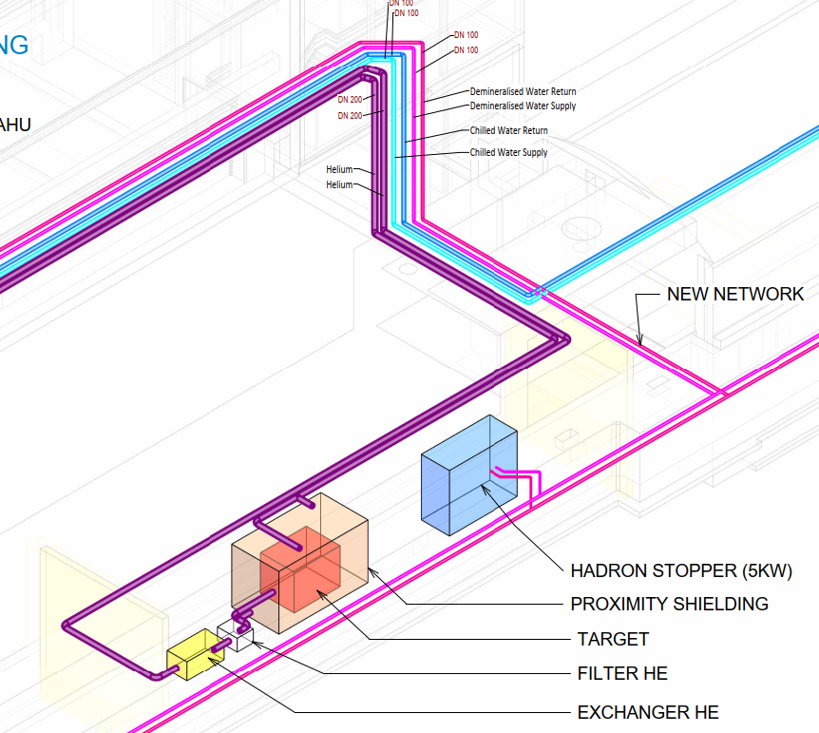
Cooling possibilities: 3 configurations
Configuration #1
Target: water cooled
Proximity: water cooled
Configuration #2
Target: helium cooled
Proximity: water cooled
Configuration #3
Target: helium cooled
Proximity: helium cooled

Slide 8
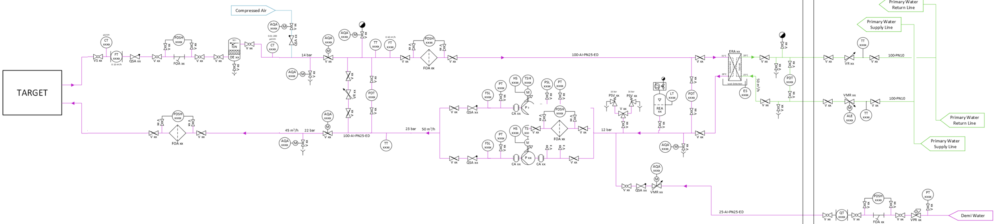
Water Cooling – Technical Solution – P&ID
1 cooling circuit for target and 1 circuit for proximity shielding
Pumping group – 1+1 redundancy
1 Heat exchangers (Water/Water)
  Gasketed Plate Heat– safety type
  Demineralised water on primary side
Filtration
  Cartridge filters 20/50 µm
Ion Exchange Cartridge – 200 L
  6+1 cartridges (target)
  1+ 1 cartridges (proximity shielding)
  Nuclear grade resin
Filling and pressure maintenance system
  Helium bottle racks with precision pressure reducers

Slide 9
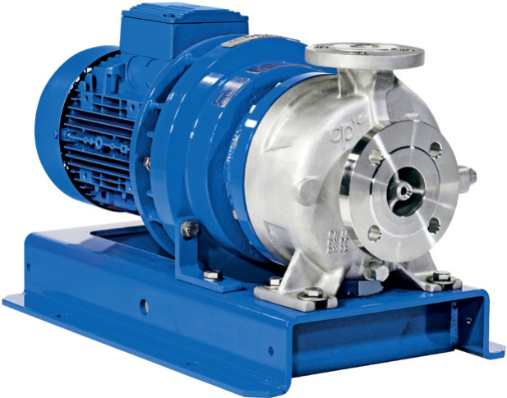
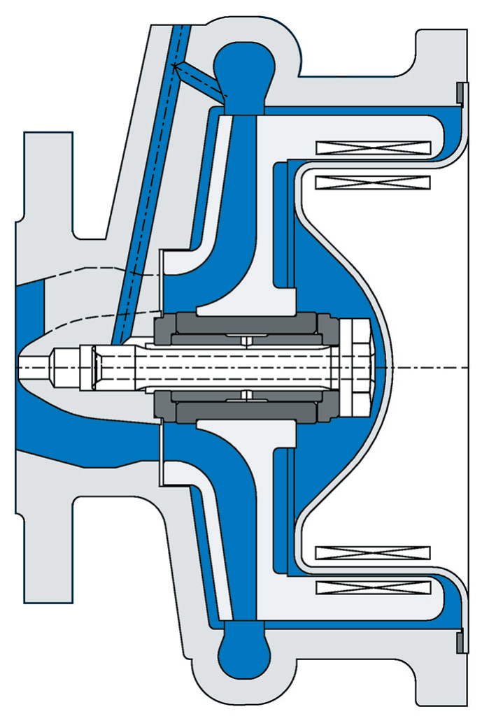
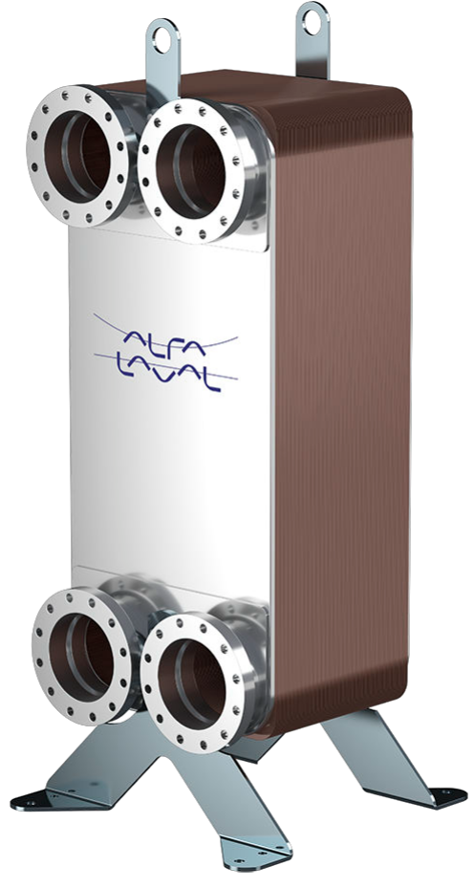
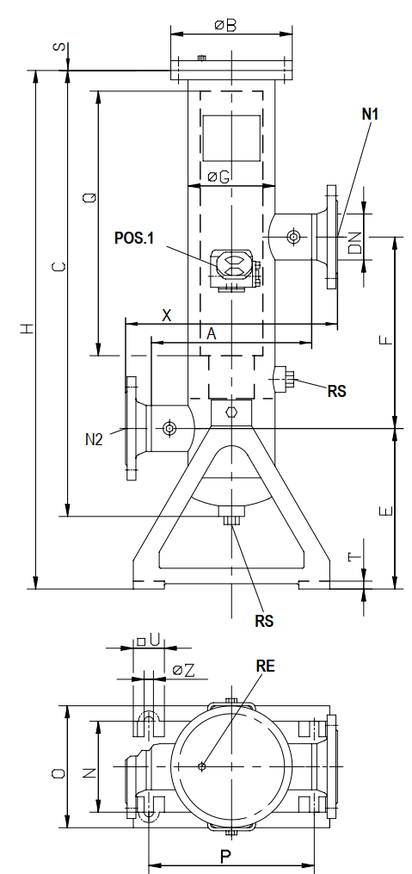
Water Cooling – Pump, heat exchanger, filters
Pumps
  Magnetic Drive Centrifugal Pumps
  Stainless steel
  Hydro-lubricated bearings
  Manufacturer: CP Pump®
Heat exchanger
  Gasketed plate heat exchanger
  Double wall construction possible
  Flanged connections
  Manufacturer: Alfa Laval®
Filter
  Multi cartridge type
  Filtration grade: 20/50 µm
  Manufacturers: Bollfilter®

Slide 10
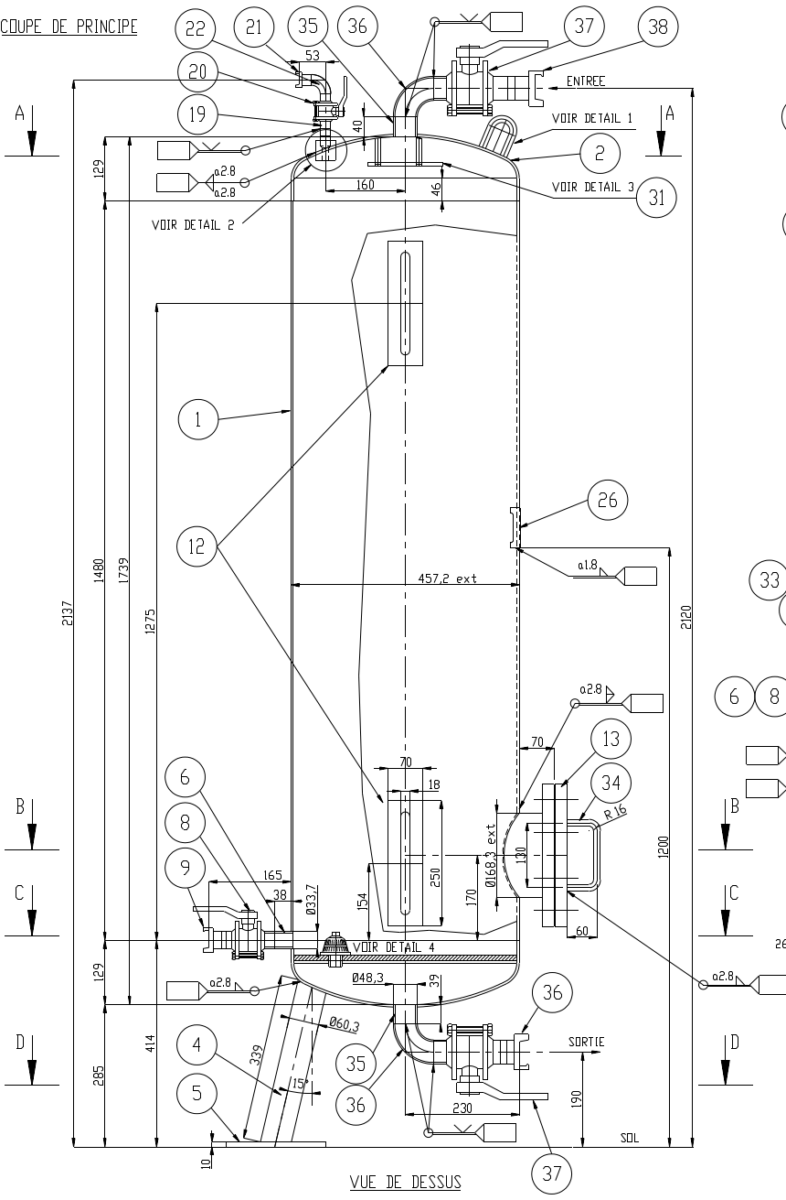
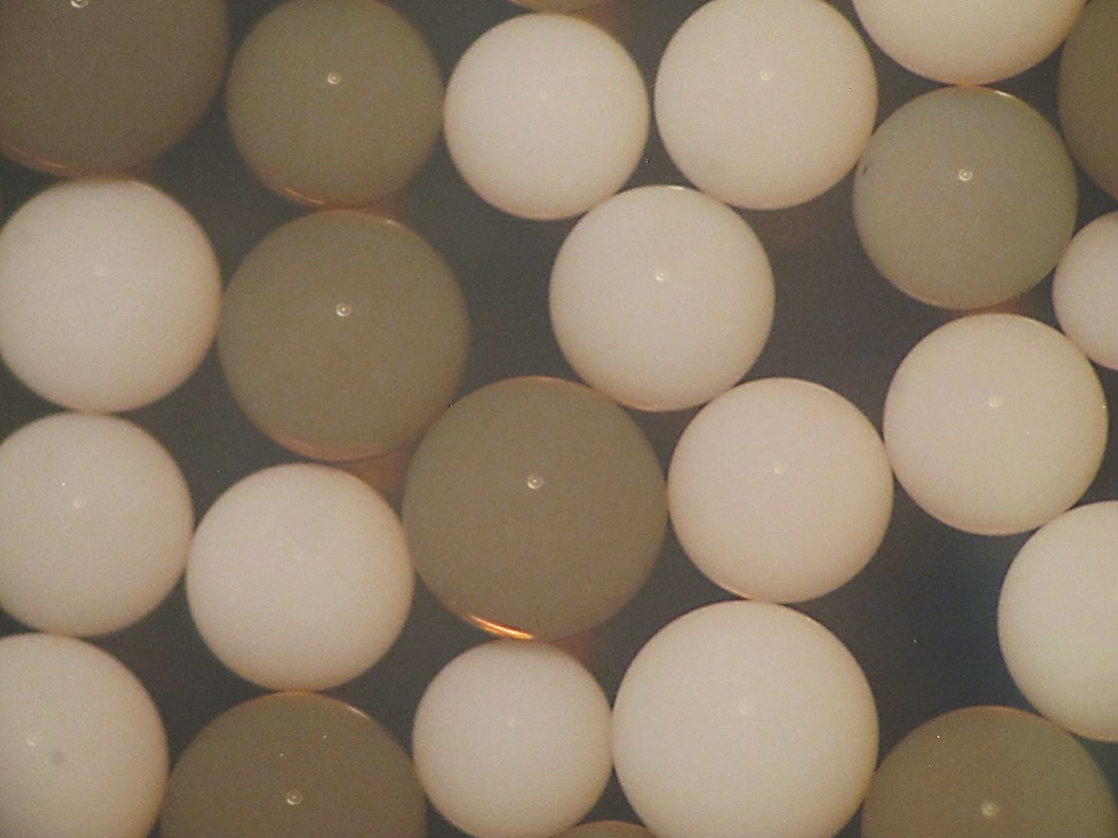
Water Cooling – Water purification
Ion Exchange Cartridges
Max cartridge flow rate: 8 m³/h
Number of cartridges: 6+1 (target) / 1+1 (proximity)
Nuclear grade resin: AmberLite® IRN9882
High activation expected
Technology
  Mixed bed: 40% cation resin
  60% AmberLite ® IRN9766 OH resin
Manufacturer: Dupont®

Slide 11
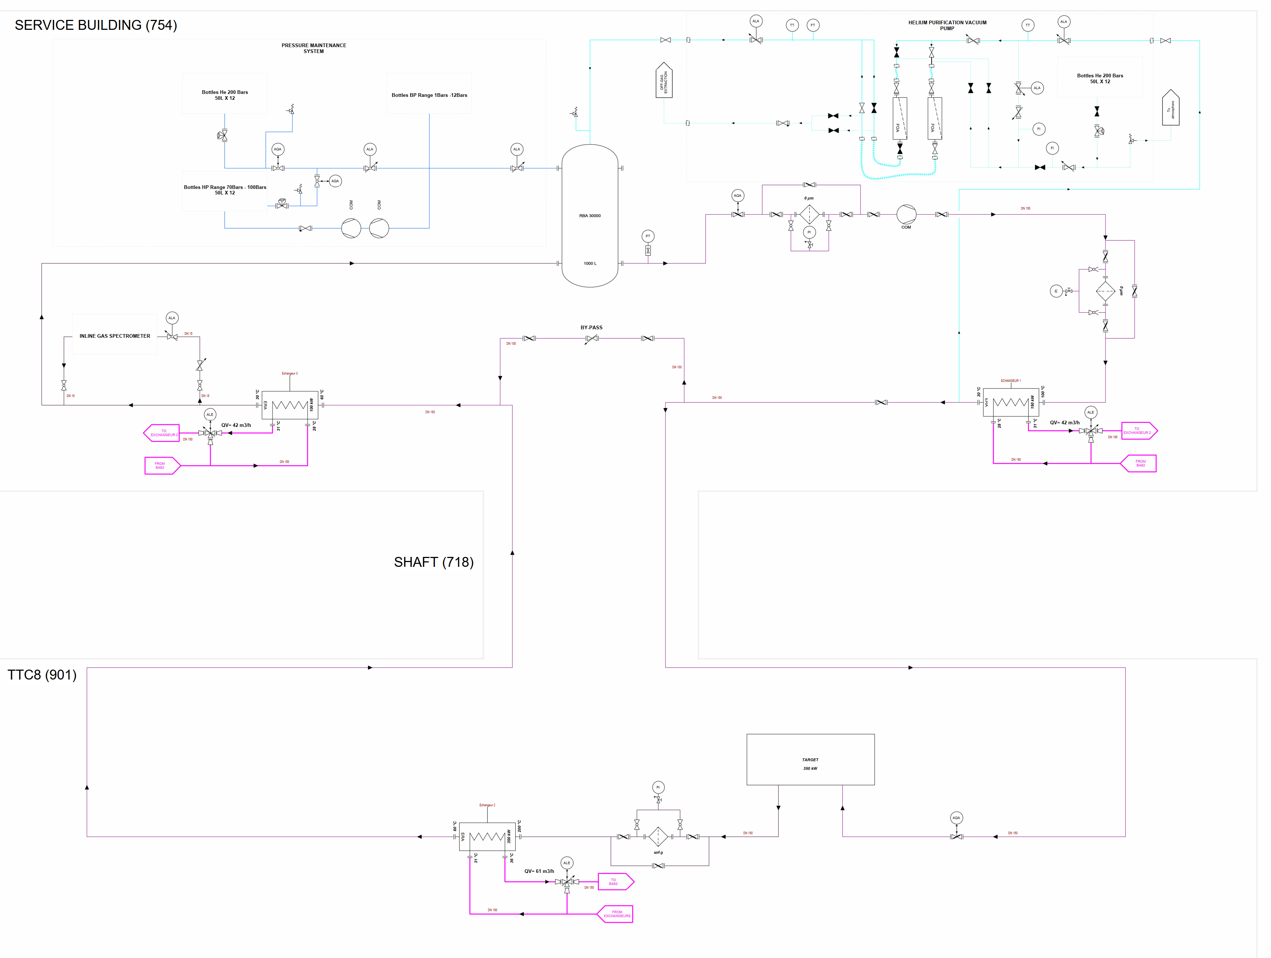
Helium Cooling – Technical Solution – P&ID
1 cooling circuit for target and proximity shielding
Compressor skids - 12/15 bar(g)
3 heat exchangers (Water/He_{(g)})
  Shell and tube construction – safety type
  Demineralised water on primary side
Filtration
  HEPA gas filters
  Chemical getters for impurities absorption
Filling and pressure maintenance system
  Helium bottle racks with precision pressure reducers
Inline gas spectrometer
  Continuous sampling machine
Vacuum pumps
  To remove air from the circuit for subsequent filling

Slide 12
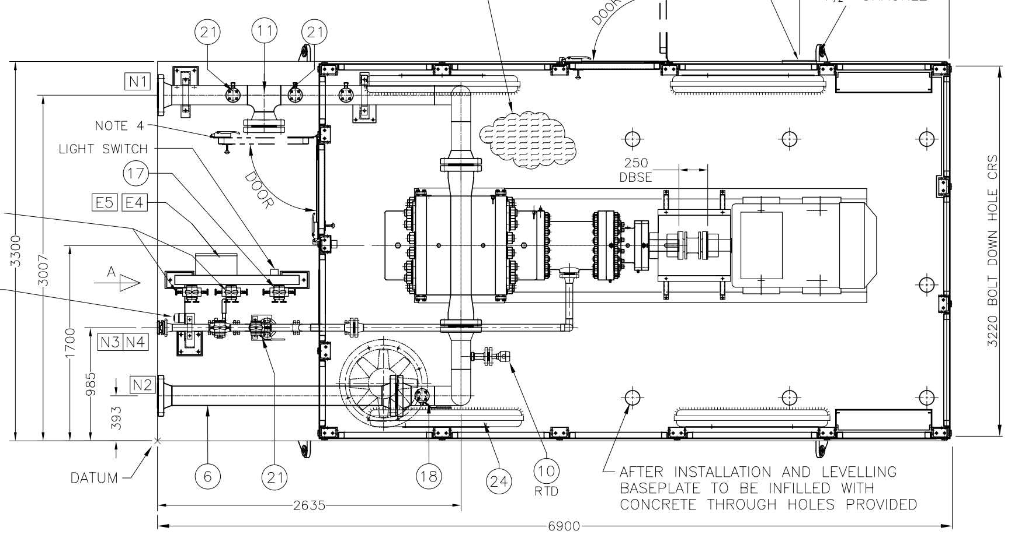
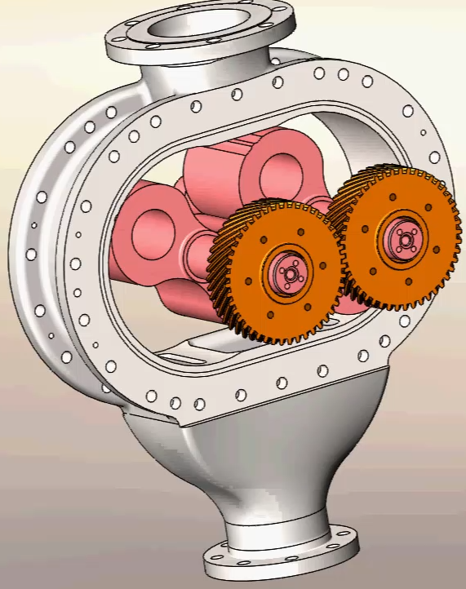
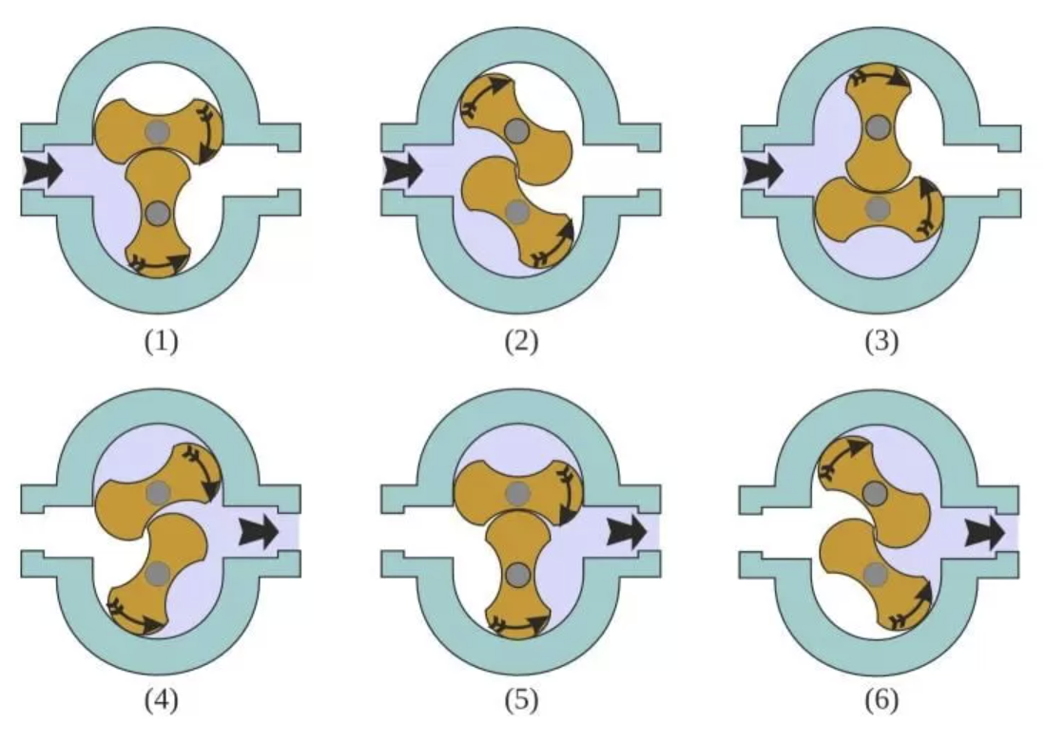
Helium Cooling – Compressor
13.0/16.0 bar(a) – 160 kW – 6.9m x 3.2m
Rotary lobe compressor
Pressure regime : 13.0/16.0 bar(a)
Working pressure range: -1/80 bar(g)
Helium leak tightness: <10⁻⁶ mbar/(l × s)
Shaft seal options
  Magnetic coupling
  Hermetic solution
Oil lubrication: Oil free
Pulsation dampened via silencer on outlet
Manufacturers: Roots (UK)
Other contacted manufacturer:
  Aerzen (DE) – dry screw compressor – used at ESS – big footprint – the roots machine is more compact
  Ateko (CZ) - two-stage turbo-circulator equipped with radial and axial air bearings – used at ESS – however our maintenance team prefers to remain in low range of rotation speed
  Kaeser (DE) – screw compressor derived from production line
Lobe compressor

Slide 13
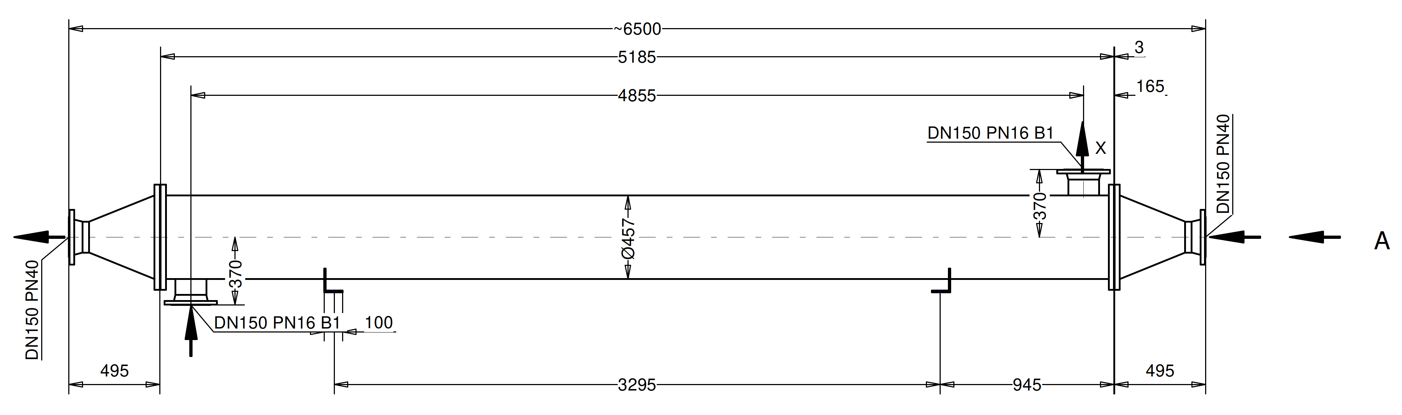
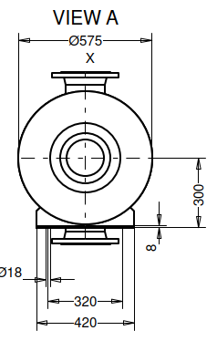
Helium Cooling – Heat exchangers and Filters
Shell/Tube type – common design for all
Temperature rating: up to 250 C
Pressure rating: PN25
Single pass
Double wall - Safety configuration
  Helium as interstitial gas
Pressure drop (gas side): 0.05 bar
Manufacturers: Funke (DE), ETS(CH), MTA(IT)
Cartridge filter type
Welded construction
Filtration: 0.1 µm
Pressure rating: PN25
Pressure drop: 0.05 bar
Flange connections
Manufacturer: Bollfilter (DE)

Slide 14
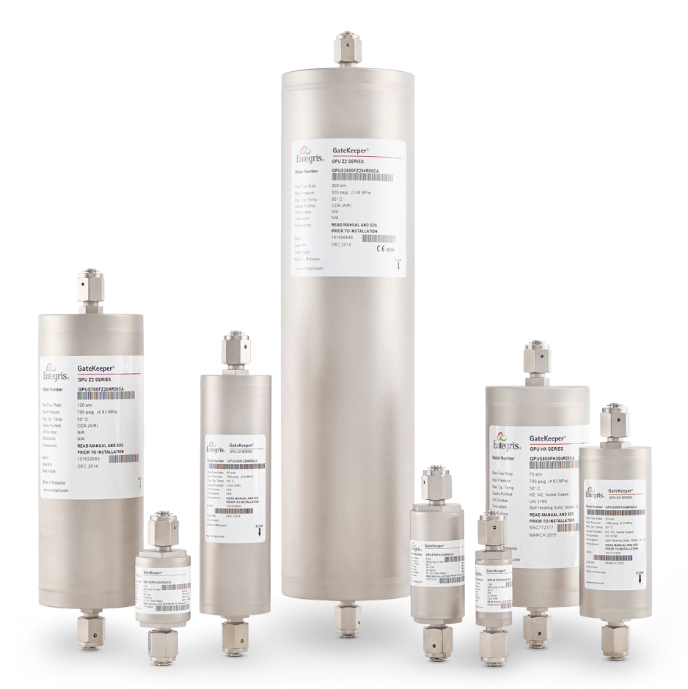
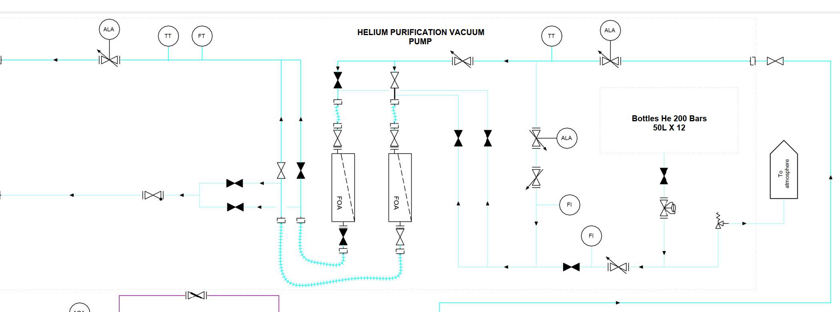
Helium Cooling – Helium purification
Gas purifier IX Media – same solution used at ESS
Technology
  Absorption by chemical media
  Impurities permanently trapped
  Achieved purity: H₂O, O₂, CO, CO₂, H₂ (<100 pptV each), Sulfur Compounds (<1 ppbV)
2% overall flow rate circulated through them
  Manufacturer: Entegris®

Slide 15
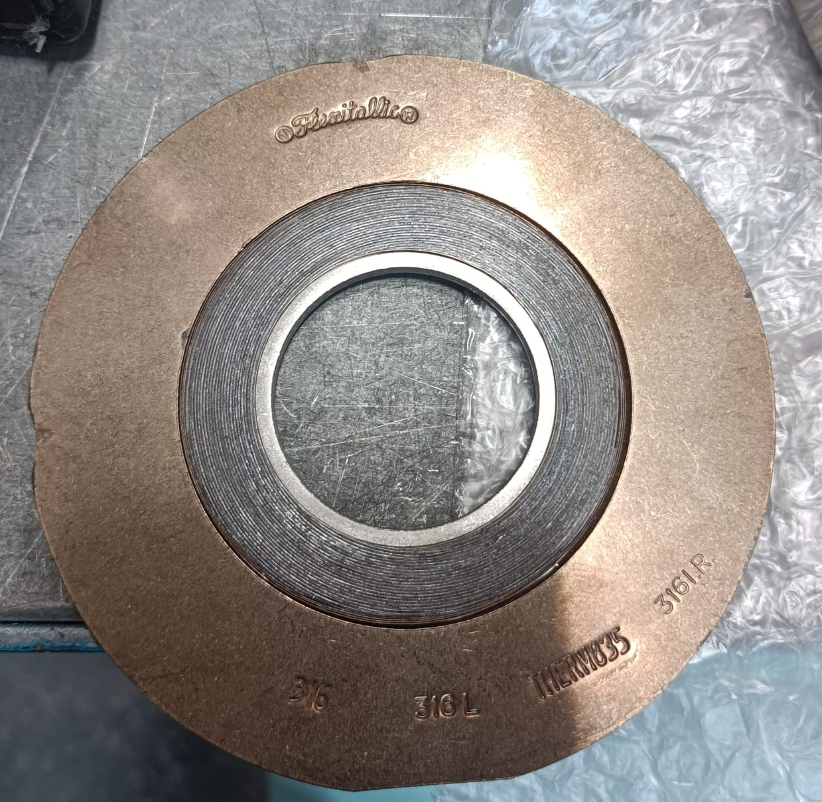
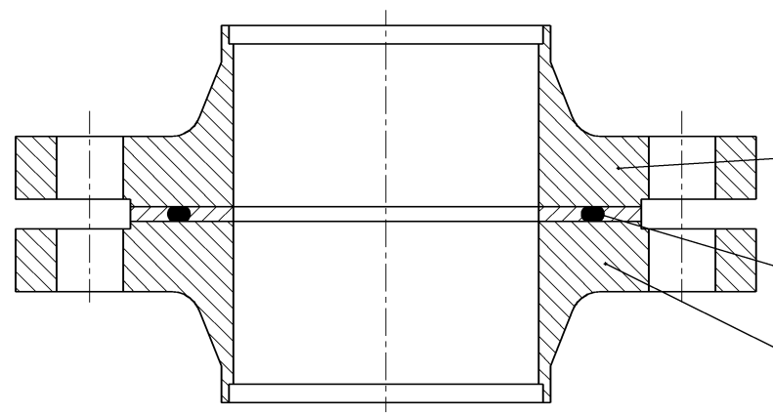
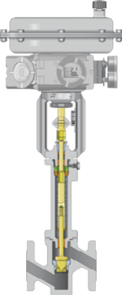
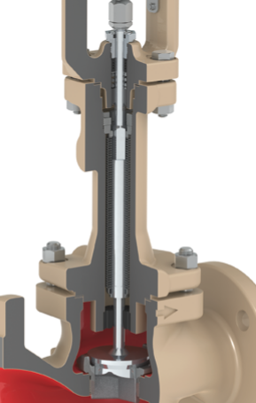
Helium Cooling – Pipework, flanges and fittings
Flange gaskets
Pipework
  TIG butt-welded stainless steel pipework (AISI 304L)
  Warm target outlet: vacuum insulated pipe
  Degreased and cleaned for rough vacuum
Flanges
  EN 1092-1 B2 flanges. Two choices of gaskets:
    Spiral wound gasket (Flexitallic®)
    Captive gaskets
  ISO 10423 (API 6A) Flanges with metal gasket (Helikoflex®)
Valves
  Globe valves with bellow inserts
  Good variety of pressure and temperature ratings
  Flanged or welded
  Manufacturers: Samson®/Flowserve®
Valves with Bellow seals

Slide 16
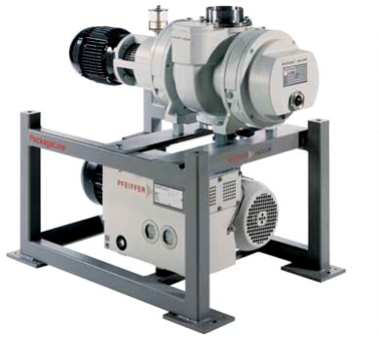
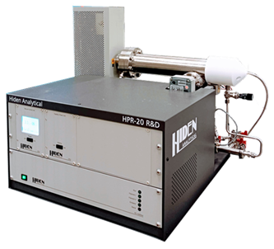
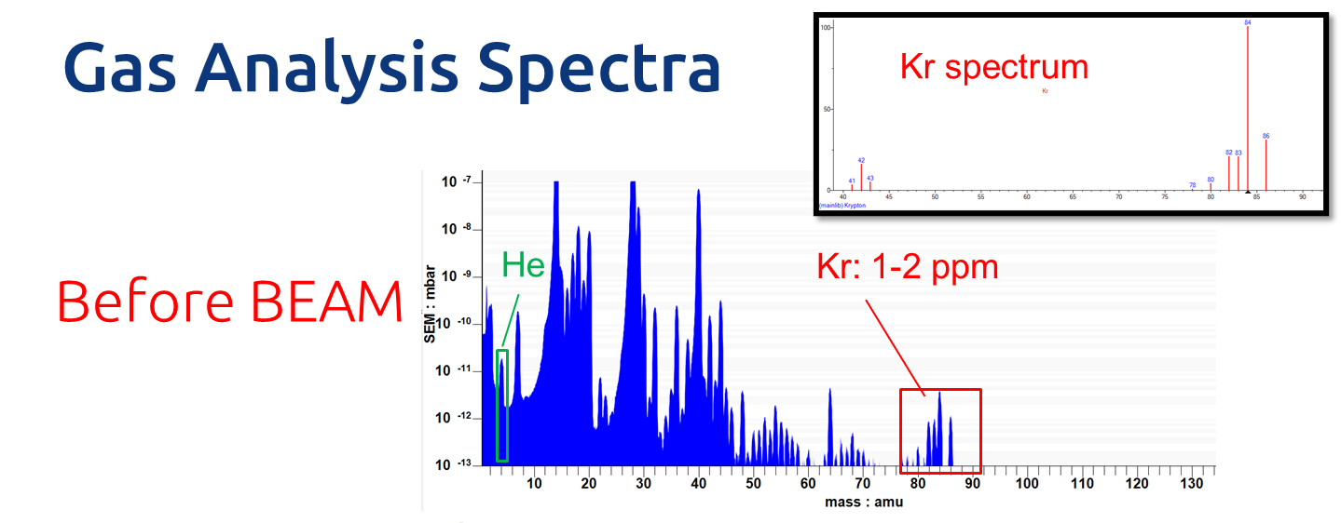
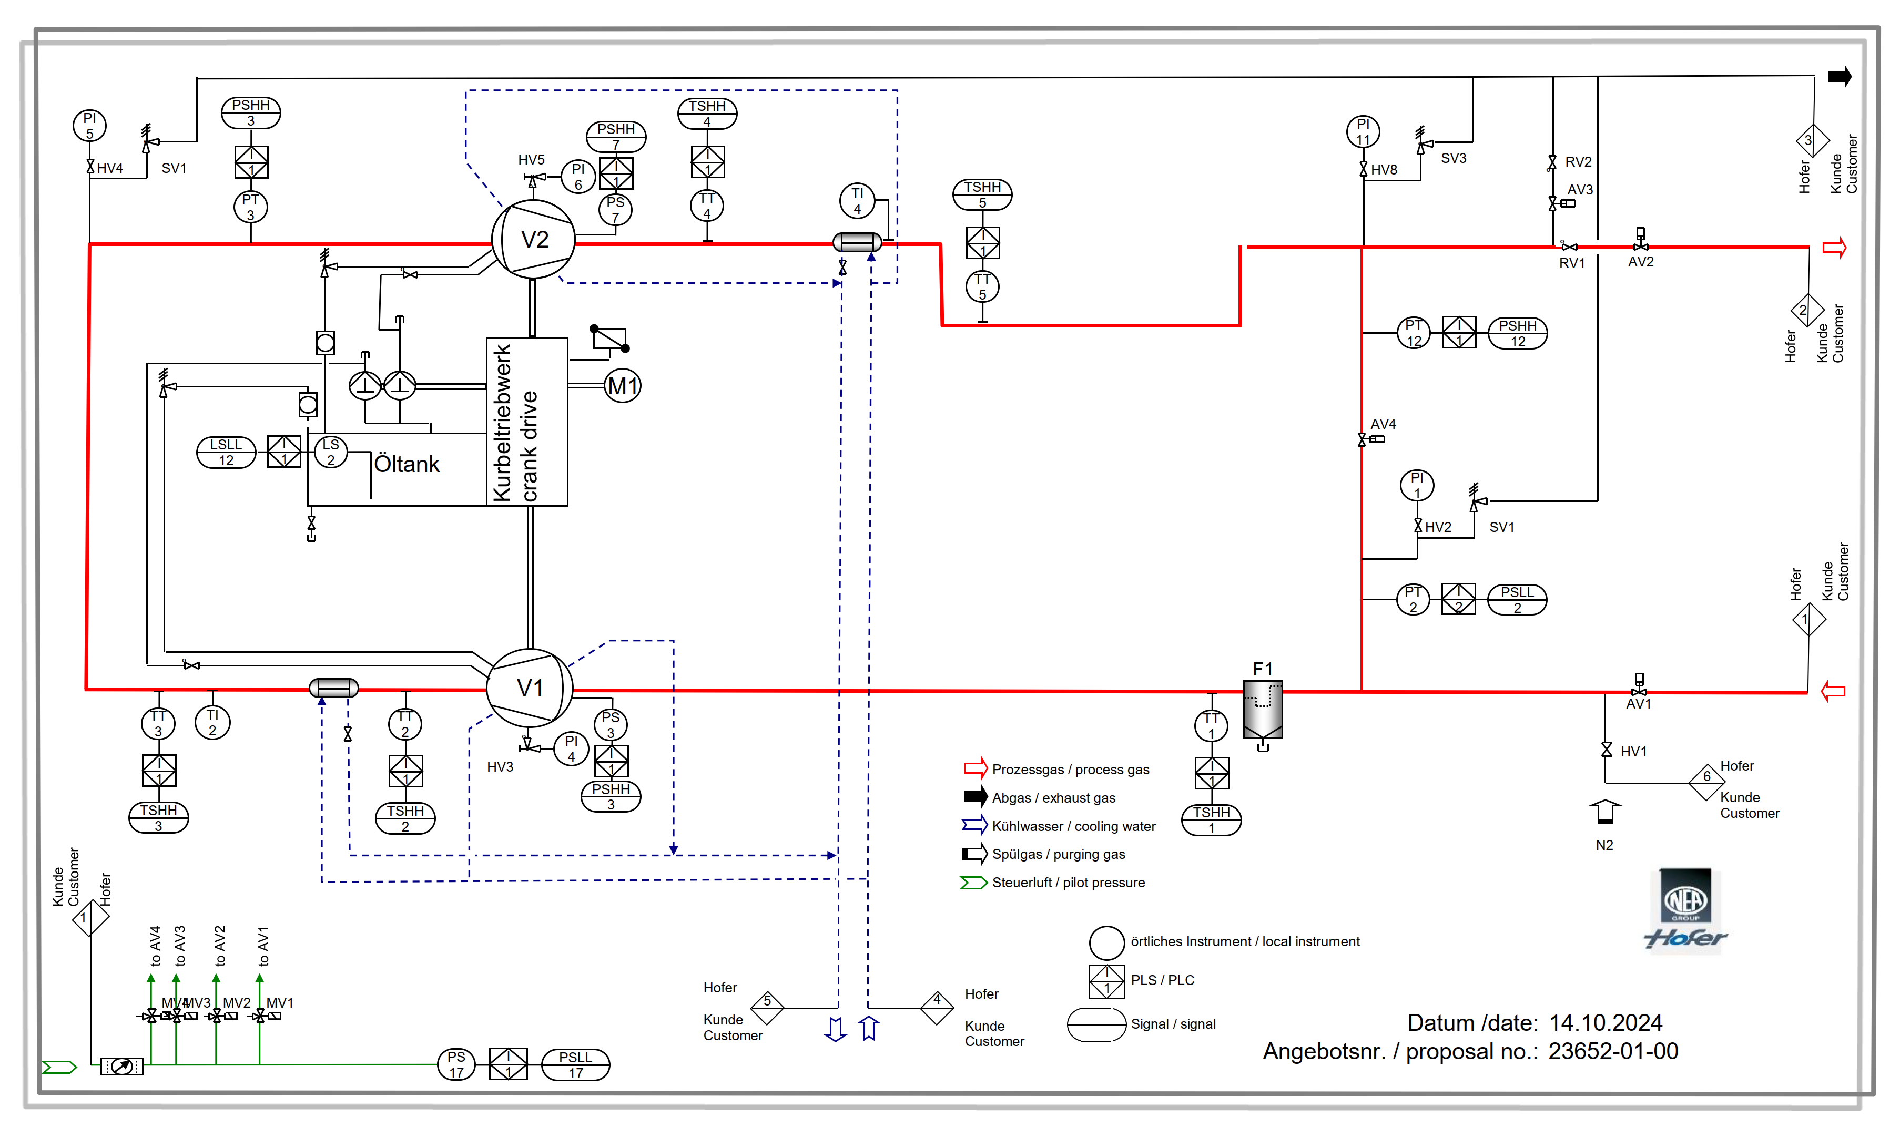
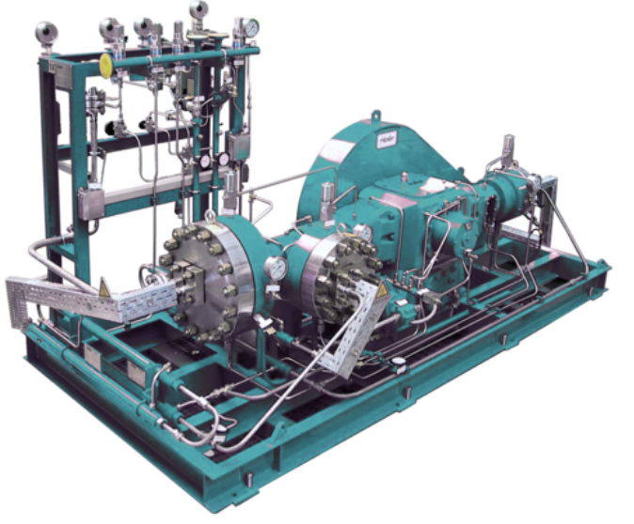
Helium Cooling – Additional considerations
Circuit Filling
  Create vacuum in circuit (10⁻³ mbar)
  Series of rough vacuum and turbomolecular pumps
  Helium filling from bottles
Inline gas spectrometer
  HIDEN HPR-20 Gas analyser
  Inlet pressure range -0.9/2bar(g)
  PPB precision
  Already installed at CERN
He recovery skid
  Oil-free diaphragm pumps
  Helium from circuit sent to secondary storage
  Used both in operations and when stopped
  Manufacturers: Sera®, Hofer®

Slide 17
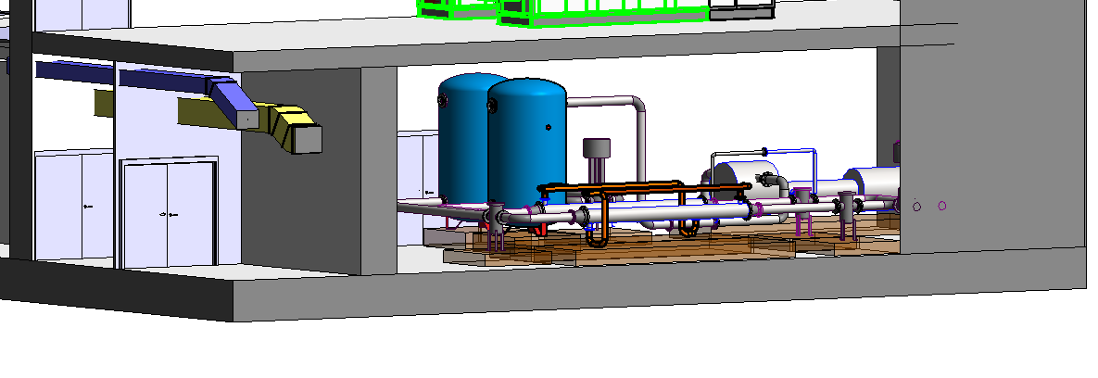
Helium Cooling – Initial Integration

Slide 18
Operation consideration: Water vs Helium
Demineralised Water Cooling
Helium Gas Cooling
Advantages
    Known architecture: years of operational experience
    Lower differential temperature – no need of vacuum insulated pipework
    Easier leak tightness
  Disadvantages
    Higher supply pressure: 22 bar(g)
    Water activation/tritium production
    Higher level of radioactive waste (ion exchange cartridges, resins)
    Need space in TTC8 outside target shielding to store filters and all cartridges (in-line configuration)
    Leaks will require decontamination
    Requires H₂ recombination system
Advantages
    Easy removal of H₂, CO, CO₂, O₂
    Lower supply pressure: 16 bar(a)
    Helium leaks in dynamic confinement and can be monitored
  Disadvantages
    No operational experience (Helium skid will help)
    Tritium production/outgassing
    Need specialist maintenance on lobe compressor
    Need of vacuum insulated pipework between target outlet and heat exchanger installed in TCC8
    Need space in TCC8 outside target shielding to store filter and heat exchanger
    More challenging leak tightness

Slide 19
Operation considerations: Helium gas leaktigthness
Design for minimal leak paths
  Maximise welded joints (100% X-rays in critical areas)
  Globe valves with bellows, VCR® fittings
  Metallic gaskets for flanged joints
Leak testing in vacuum and pressurised conditions
  Outside-in (vacuum inside, helium spray on outside joints) at 10⁻⁴ mbar(a)
  Inside-out (pressure inside, filled with helium) at 15 bar(g)
Pressure testing at 1.43 x Nominal pressure
Max leak rate joint< 10⁻⁶ mbar l/s → 3.6 x 10⁻⁶ L/h → 6.4 x 10⁻⁷ g/h joint
Assuming 50 flanged joints → 0.28 g/year

Slide 20
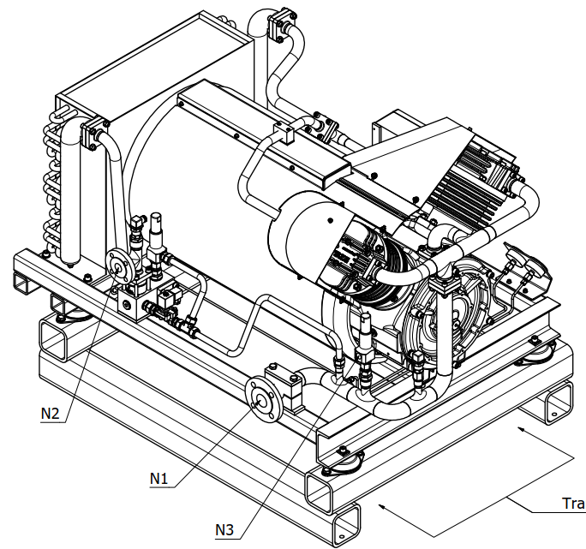
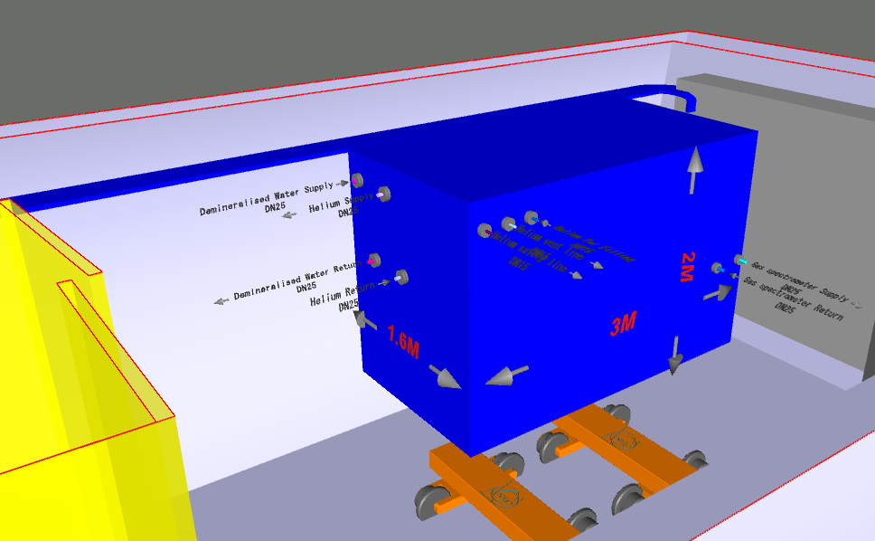
Helium skid – BDF Prototype in TCC2
Test skid – representative elements
  Compressor: piston compressor (different technology however same pressure range 13/16 bar(a))
  Filters: same as target station
  Heat exchangers: non safety but similar type shell/tube (cannot validate HX leak detection)
  Chemical getters and gas purification: same as target station
  Flanges: EN 1092-1 B2 with captive gaskets
  Valves: welded valves + globe valves with bellows + VCR® fittings in helium purification circuit
  Vacuum pumps: scroll pump (same vacuum range)
  Instrumentation: same as target station
  Cold source: same as target station (demineralised water)
  Control system: same as target station
Test skid – non-representative elements
  No helium recuperation skid
  No regulation on heat exchanger downstream the target
Skid Test
  100% VT and X-rays
  Leak rate tests: vacuum test and pressure test
  Pressure test

Slide 21
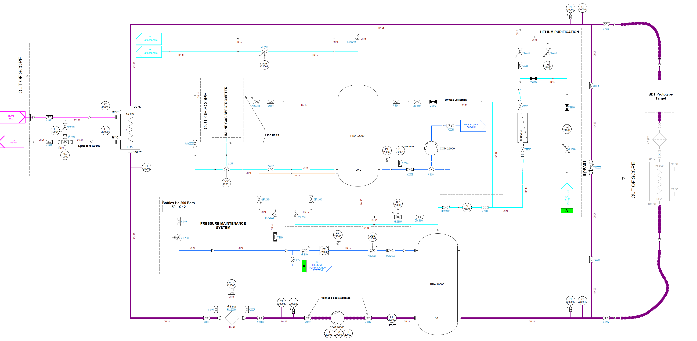
Helium skid – BDF Prototype in TCC2 – P&ID

Slide 22
Conclusions and open questions
Target and proximity cooling station
  3 technical solutions possible and quite well defined
  Equipment selection
    Demineralised water cooling: on CERN long operational experience
    Helium gas cooling: based on similar facilities at ESS and KIT
Helium skid
  Technical solution defined currently in procurement
  Representative of most technological solutions
  Possibility to reuse as backup in final station

Slide 23
Conclusions and open questions
Safety valve release: need for additional extraction flow rate?
  Small confined volume kept in underpressure with high flow rate?
Flanged joints
  Any suggestion beyond what is proposed?
Contamination risks
  Permeability of Tritium through SS 304L at 30/200 °C and low partial pressure can be estimated
  HT, T2 or HTO dominant?
  Any recommendation on SS treatment post installation? Baking and purge after installation?

