Slide 2
Target Instrumentation
Beam Dump Facility (BDF)
Targetry Systems Advisory Committee (TSAC) #1 https://indico.cern.ch/event/1488161/
Mike Parkin, Rui Franqueira Ximenes, Alvaro Romero Francia, Truls Kolstad
With contributions from many others
04/Mar/2025
https://hiecn3.web.cern.ch

Slide 3
Summary – Instrumentation for TARGET health
Beam monitoring for physics and non-target equipment damage are not covered in this talk
Sensors used for:
  Beam Interlocks (machine protection)
  Alarms (Operation team, Equipment owner, Piquet team)
  Logging (Online & Offline monitoring of target health & conditions)
The design in these slides is preliminary
Formal FMEA being performed is foreseen to generate additional monitoring requirements or backups
In 2025, planned work includes investigating and comparing the approach and sensors to ESS, ISIS-I TS1, ISIS-II, SNS.
See talk: Beam delivery to target (inc. final focus system: instrumentation and dilution), Laurie Nevay
Sensor strategy
Primary monitoring (direct)
Temperature of target.
TCs on Target Core Blocks
Secondary monitoring
(indirect)
Helium conditions:
Detrimental to target
Indicative of target damage
Beam monitoring
(monitored for multiple hardware)
Several beam parameters monitored

Slide 4
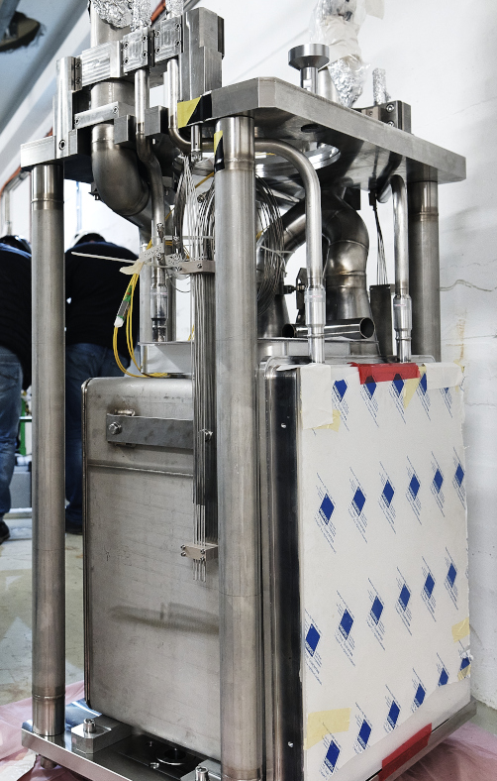
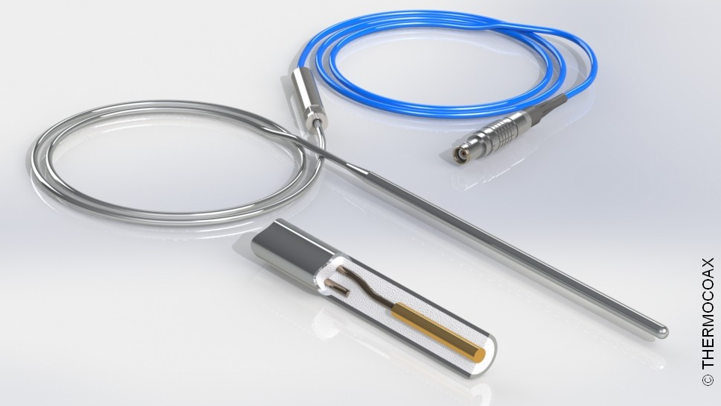
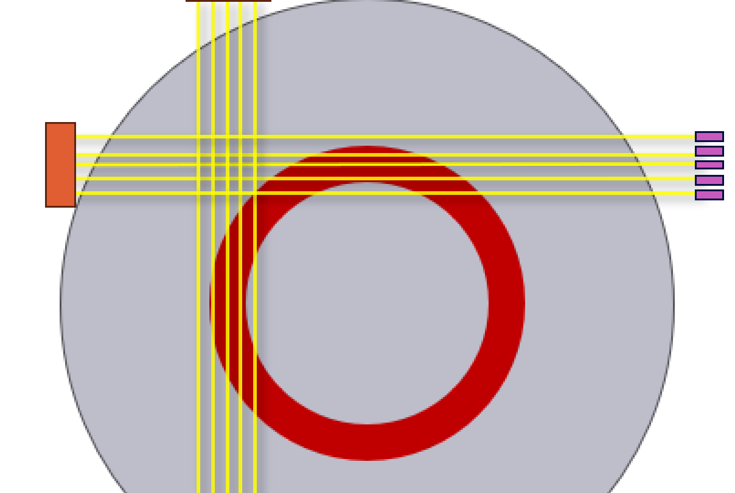
Target monitoring requirements
Preliminary
Sensors on Target | Sensors on Cooling Station | Sensors detecting Beam
Item num’ | State to monitor | Sensor | Monitoring description | Off-normal states to detect | Status | Precision in monitored units | Precision in x,y,z | Precision in time | Inter-lock to beam?
1 | Core blocks temperature | Thermocouples (K type, Inconel sheath) | 2 or 3 per block. One per block embedded in hole from curved outer face, embedded deep into block. One per outer curved face of block | High W temperatures. Margin on T(°C) dependent stress, strain limits. Damage scenarios: delamination, large cracks, blocked cooling channel. Target health: radiation damage, micro cracks, thermal conductivity. Oxidation temperatures. | Required | ~ ± 5°C | ~ ± 1mm | ~2s | Yes
2 | Neutronic production | Self Powered Neutron Detector (SPND) | Situated to side of target. Monitors change in fluence | Damage scenarios: delamination, loss of material, large cracks, blocked cooling channel. | Required | 1%. Requires study | TBD. Requires study | TBD. Requires study | No
3 | T distribution in target | TPT type device | In beam, upstream & close to target. Continuously in beam. | Temperature distribution in target Long timescale | Optional. Very preliminary | TBC Requires study. | TBC Requires study. | >30s | No
Item num’ | State to monitor | Sensor | Monitoring description | Off-normal states to detect | Status | Precision in monitored units | Precision in x,y,z | Precision in time | Inter-lock to beam?
Self Powered Neutron Devices (SPND)
Target position thermometer (TPT) device concept
Measure neutron fluence
To be placed around the external target vessel
We have agreement with DONES to develop them with competence to perform data analysis.
TCs on rods
Long characteristic timescale
Prototypic and under analysis whether is needed or not
SPNDs on n_ToF target

Slide 5
Target monitoring requirements
Preliminary
Sensors on Target | Sensors on Cooling Station | Sensors detecting Beam
Item num’ | State to monitor | Sensor | Monitoring description | Off-normal states to detect | Status | Precision in monitored units | Precision in x,y,z | Precision in time | Inter-lock to beam?
1 | Core blocks temperature | Thermocouples (K type, Inconel sheath) | 2 or 3 per block. One per block embedded in hole from curved outer face, embedded near centre of block. One per outer curved face of block | High W temperatures. Margin on T(°C) dependent stress, strain limits. Damage scenarios: delamination, large cracks, blocked cooling channel. Target health: radiation damage, micro cracks, thermal conductivity. Oxidation temperatures. | Required | ~ ± 5°C | ~ ± 1mm | ~2s | Yes
2 | Neutronic production | Self Powered Neutron Detector (SPND) | Situated to side of target. Monitors change in fluence | Damage scenarios: delamination, loss of material, large cracks, blocked cooling channel. | Required | 1%. Requires study | TBD. Requires study | TBD. Requires study | No
3 | Beam size & location | TPT type device | In beam, upstream & close to target. Continuously in beam. | Beam spot size & sweep location drift Long timescale | Optional | TBC Requires study. | TBC Requires study. | >30s | No
4 | Downstream helium temperature | Thermocouple (K type, SS sheath) | In downstream helium flow; in pipework external to vacuum vessel. | Insufficient target cooling. Change to heat transfer rates due to target damage. | Required | ~ ± 2.5°C | - | ~5s | Yes
5 | Inlet Helium temperature | Thermocouple (K type, SS sheath) | In upstream helium flow; in pipework external to vacuum vessel. | Insufficient target cooling. | Required
6 | ΔP across target | Pressure sensors | Upstream and downstream of target helium flow | Changes to pressure drop or elevated pressure drop caused by target damage: Channel blockage, delamination. | Required | 50 mbar | - | 5s | No
7 | Helium flow rate | Mass flow meter, e.g. wire meter. | In helium system. In compressor room. | Insufficient target cooling. Large blockage caused by target damage. | Required | 3g/s | - | 5s | No
8 | Pressure of helium circuit | Pressure sensor | In helium system. In compressor room. | Insufficient target cooling. | Required | 50 mbar | - | 5s | No
9 | Impurities in Helium system. | Mass spectrometer in Helium circuit. | Detect Tungsten Oxides in helium system. | Oxidation/degradation of Tungsten blocks via presence of WO_{x}. High W surface temperature. | Optional (WO_{x} likely to be gettered by heat exchanger. | 1appm | - | 1min | No
10 | Beam size & location | Current meters | Current check on dilution system magnets | Beam spot size damaging to target. Beam sweep accident damaging to target. | Required | Requires study. ± 1mm? | ±5mm? | 0.05s? Delay =0.1s? | Yes
11 | Beam size & location | Harp / Grid / Emittance monitor TBC | In beam, upstream of target. Continuously in beam. | Beam spot size damaging to target. Beam sweep accident damaging to target. Information for monitoring target health over time. | US of target Required. DS optional. | Requires study. ± 1mm? | ±5mm? | 0.05s? Delay =0.1s? | No
Item num’ | State to monitor | Sensor | Monitoring description | Off-normal states to detect | Status | Precision in monitored units | Precision in x,y,z | Precision in time | Inter-lock to beam?
1 | Core blocks temperature | Thermocouples (K type, Inconel sheath) | 2 or 3 per block. One per block embedded in hole from curved outer face, embedded near centre of block. One per outer curved face of block | High W temperatures. Margin on T(°C) dependent stress, strain limits. Damage scenarios: delamination, large cracks, blocked cooling channel. Target health: radiation damage, micro cracks, thermal conductivity. Oxidation temperatures. | Required | ~ ± 5°C | ~ ± 1mm | ~2s | Yes
2 | Neutronic production | Self Powered Neutron Detector (SPND) | Situated to side of target. Monitors change in fluence | Damage scenarios: delamination, loss of material, large cracks, blocked cooling channel. | Required | 1%. Requires study | TBD. Requires study | TBD. Requires study | No
3 | Beam size & location | TPT type device | In beam, upstream & close to target. Continuously in beam. | Beam spot size & sweep location drift Long timescale | Optional | TBC Requires study. | TBC Requires study. | >30s | No
4 | Downstream helium temperature | Thermocouple (K type, SS sheath) | In downstream helium flow; in pipework external to vacuum vessel. | Insufficient target cooling. Change to heat transfer rates due to target damage. | Required | ~ ± 2.5°C | - | ~5s | Yes?
5 | Inlet Helium temperature | Thermocouple (K type, SS sheath) | In upstream helium flow; in pipework external to vacuum vessel. | Insufficient target cooling. | Required |  |  |  | No?
6 | ΔP across target | Pressure sensors | Upstream and downstream of target helium flow | Changes to pressure drop or elevated pressure drop caused by target damage: Channel blockage, delamination. | Required | 50 mbar | - | 5s | Yes
7 | Helium flow rate | Mass flow meter, e.g. wire meter. | In helium system. In compressor room. | Insufficient target cooling. Large blockage caused by target damage. | Required | 3g/s | - | 5s | Yes
8 | Pressure of helium circuit | Pressure sensor | In helium system. In compressor room. | Insufficient target cooling. | Required | 50 mbar | - | 5s | Yes
9 | Impurities in Helium system. | Mass spectrometer in Helium circuit. | Detect Tungsten Oxides in helium system. | Oxidation/degradation of Tungsten blocks via presence of WO_{x}. High W surface temperature. | Optional (WO_{x} likely to be gettered by heat exchanger. | 1appm | - | 1min | No
Item num’ | State to monitor | Sensor | Monitoring description | Off-normal states to detect | Status | Precision in monitored units | Precision in x,y,z | Precision in time | Inter-lock to beam?
1 | Core blocks temperature | Thermocouples (K type, Inconel sheath) | 2 or 3 per block. One per block embedded in hole from curved outer face, embedded deep into block. One per outer curved face of block | High W temperatures. Margin on T(°C) dependent stress, strain limits. Damage scenarios: delamination, large cracks, blocked cooling channel. Target health: radiation damage, micro cracks, thermal conductivity. Oxidation temperatures. | Required | ~ ± 5°C | ~ ± 1mm | ~2s | Yes
2 | Neutronic production | Self Powered Neutron Detector (SPND) | Situated to side of target. Monitors change in fluence | Damage scenarios: delamination, loss of material, large cracks, blocked cooling channel. | Required | 1%. Requires study | TBD. Requires study | TBD. Requires study | No
3 | T distribution in target | TPT type device | In beam, upstream & close to target. Continuously in beam. | Temperature distribution in target Long timescale | Optional. Very preliminary | TBC Requires study. | TBC Requires study. | >30s | No
Item num’ | State to monitor | Sensor | Monitoring description | Off-normal states to detect | Status | Precision in monitored units | Precision in x,y,z | Precision in time | Inter-lock to beam?

Slide 6
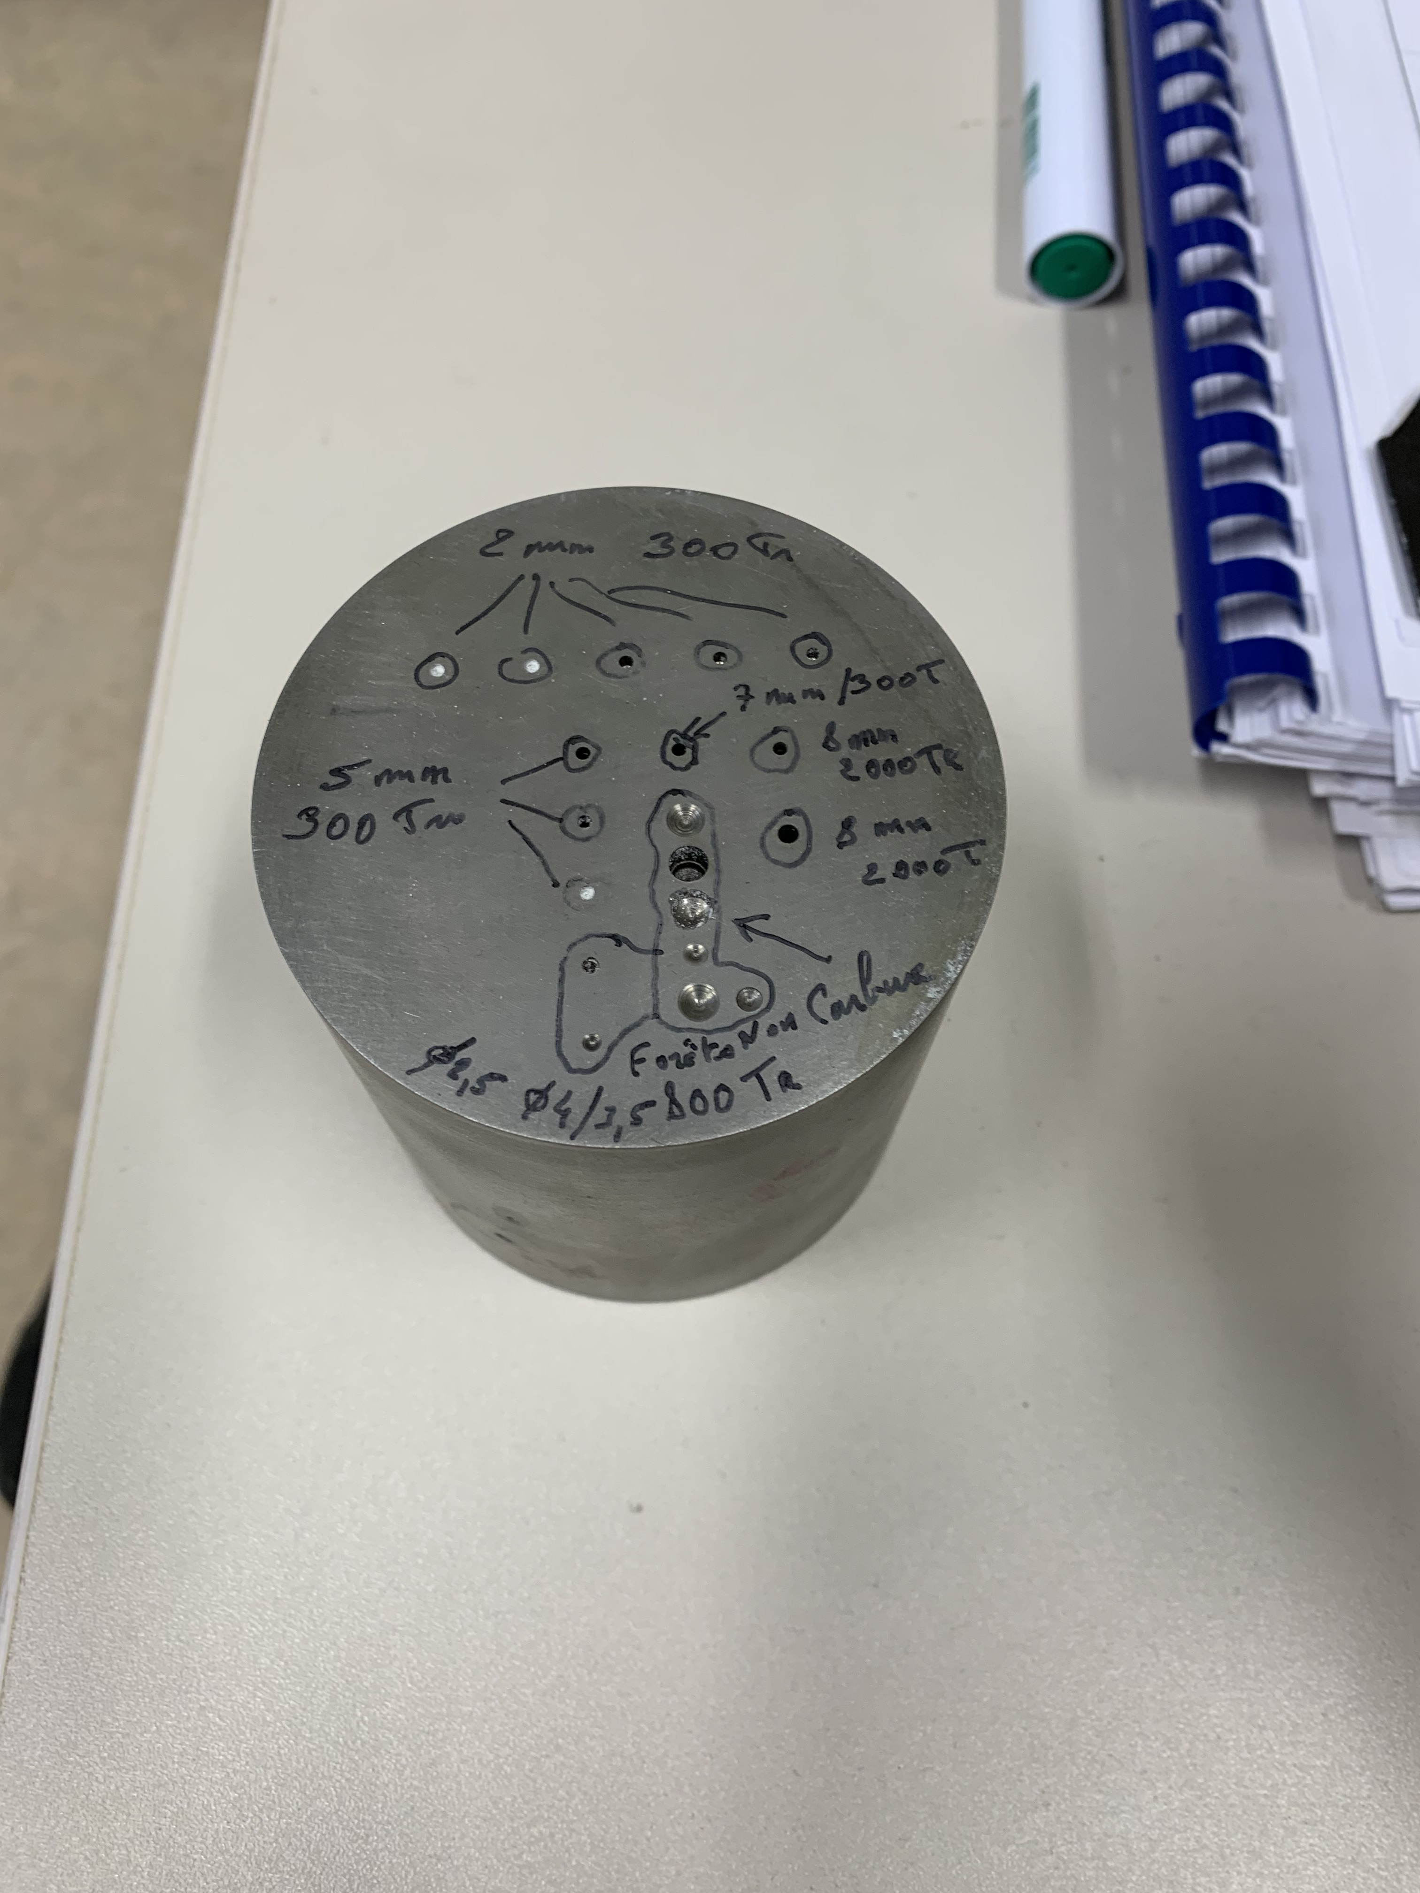
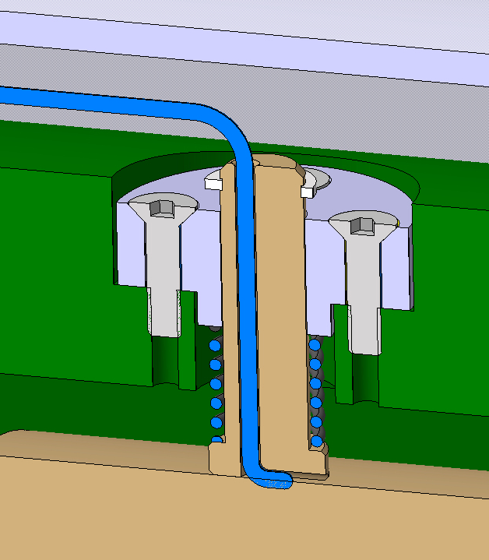
R&D of Target Thermocouples
Drilling tests - Prototypes
Fixation design
Drilling tests – full target
Drilling tests to be performed on full size blocks (die sink)
    Company contacted
Holes: Ø2mm
Drilling tests performed on prototype blocks
Holes: Ø2mm | depth 25mm
Drilling unsuccessful > 5mm
Die sinking successful
Work is ongoing to characterise the profile shape of the holes.
Sprung fixations for TCs on side of blocks.
Further work to be done on similar design for TCs at centre of blocks.
For water cooled concept, hole will need to be clad (similar to ISIS)
For helium design with or without cladding, hole can potentially be unclad.

Slide 7
Many thanks

Slide 8
Sensor loss [Backup Slide]
Sensor loss is part of ongoing FMEA exercise
Item num’ | State to monitor | Sensor | Fault | Probability 1=very unlikely 5=highly likely | Effect 1=minor 5=Severe | Severity 1=minor 5=Severe | Intervention | Duration of intervention | Preventative action
1 | Core blocks temperature | Thermocouples (K type, Inconel sheath) | Inaccurate reading. Dead TC. TC moved. | 3 | 5 | 15 | Use redundancy from multiple TCs per block. Sensor replacement not possible on highly activated target. | - | 3 TCs per block gives redundancy. Test of TC mounting method. Construction by checklist. Test TC readings after construction.
2 | Neutronic production | Self Powered Neutron Detector | ? | 3? | 5 | 15
3 | Beam size & location | TPT type device | Sensor loss | 3 | 2 | 6
4 | Downstream helium temperature | Thermocouple (K type, SS sheath) | Sensor loss. | 1 | 3 | 3 | Use redundancy from #1,#2,#5. Cross reference to helium circuit readings. Replace TC. | 2 hours, wait for access could be weeks? | Use multiple TCs for redundancy. Replace sensors after X years.
5 | Inlet Helium temperature | Thermocouple (K type, SS sheath) | Sensor loss | 1 | 4 | 4 | Cross reference to helium circuit readings. Replace TC. |  | Replace sensors after X years.
6 | ΔP across target | Pressure sensors | Inaccurate reading / Sensor loss. | 1 | 2 | 2 | Use redundancy from #1,#3. Cross reference to helium circuit readings. Replace TC. |  | Replace sensors after X years.
7 | Helium flow rate | Mass flow meter, e.g. wire meter. | Inaccurate reading. High flutter. Sensor loss. | 2 | 2 | 4 | Use redundancy from #7. Cross reference to helium circuit readings. Replace TC. | Hours. | Implement both #6 and #7. Replace sensors after X years.
8 | Pressure of helium circuit | Pressure sensor | Inaccurate reading. Sensor loss. | 1 | 2 | 2 | Use redundancy from #6, Cross reference to helium circuit readings. Replace TC. | Hours. | Implement both #6 and #7. Replace sensors after X years.
9 | Impurities in Helium system. | Mass spectrometer in Helium circuit. | WO_{x} plates HX, not reaching spectrometer. | 2 | 4 | 8 | - | - | Obtain mass spectrometer sensitive to <1appm.
10 | Beam size & location | Current meters | Sensor loss. | 2 | 5 | 10 | Stop beam, replace monitor. | 1 days? | Replace / test sensor yearly.
11 | Beam size & location | TBC. Harp / Grid / Emittance monitor | Sensor loss. | 2 | 5 | 10 | Stop beam, replace sensor | 2 days? | Replace / test monitor yearly.

