Slide 1
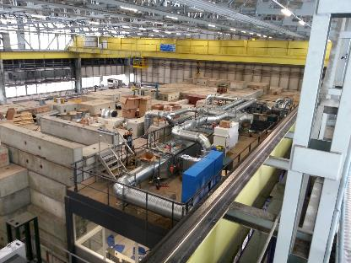
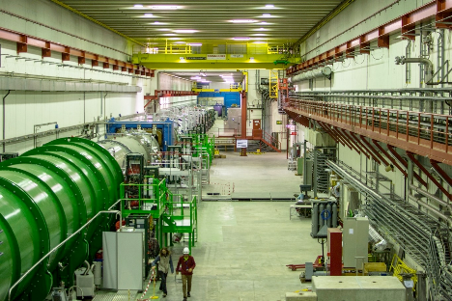
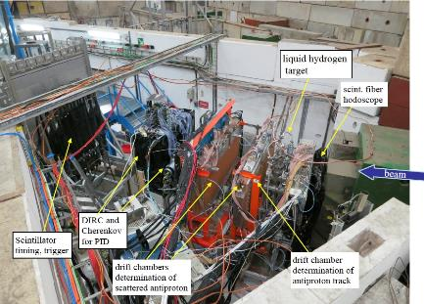
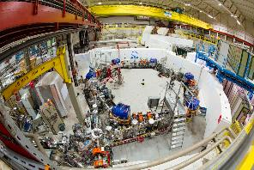
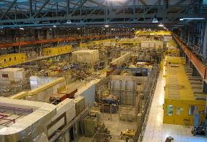
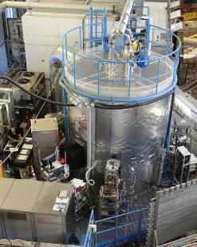
HI-ECN3 Target station shielding
Requirements, design, sustainability
François BUTIN BE-EA
Credits to G. Humphreys, B. Martinez, C. Ahdida, L. Esposito, JL Grenard, R. Jacobson, M. Lazzaroni

Slide 2
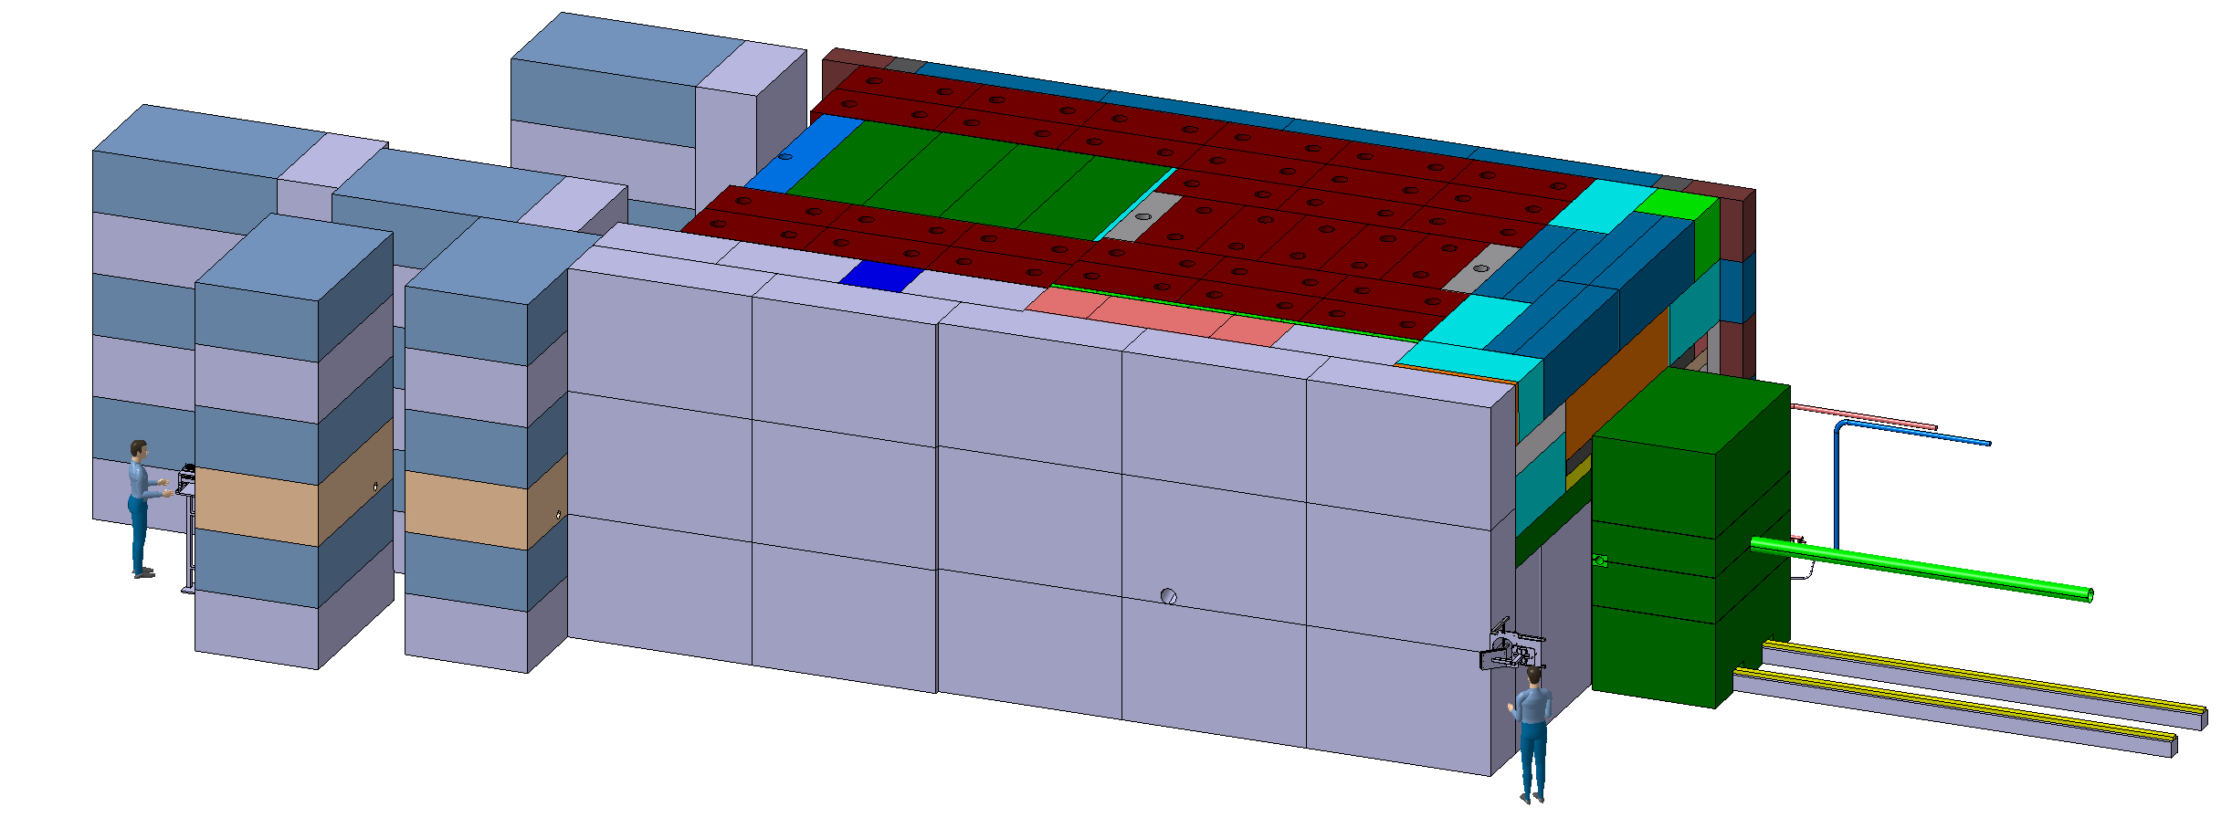
Introduction: what for ?
New target station installed in TCC8 for BDF/SHIP requires large amount of shielding (cast iron, concrete and marble)
~180 m³ of cast iron + US1010 (magnetic iron)
~400 m³ of concrete / marble
~4,8m
~12m
~8m

Slide 3
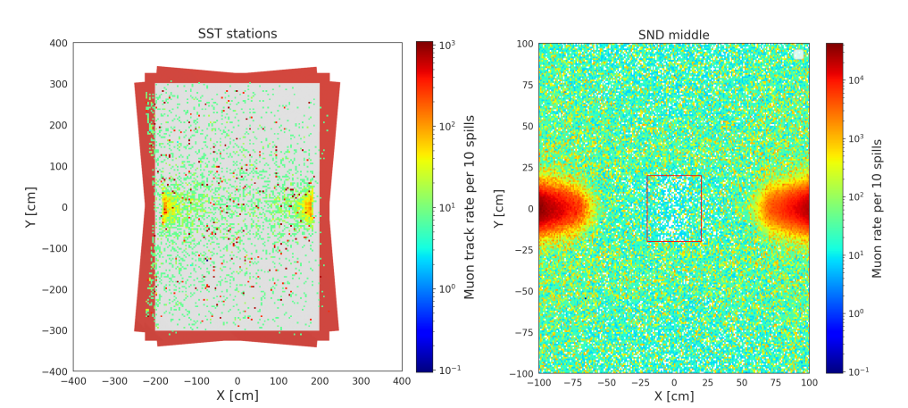
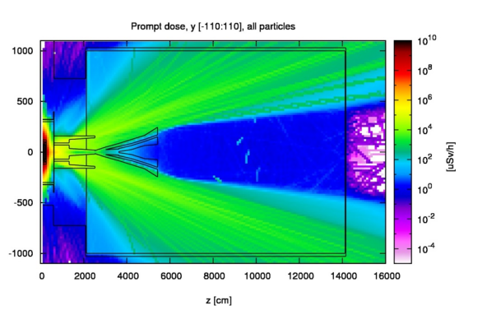
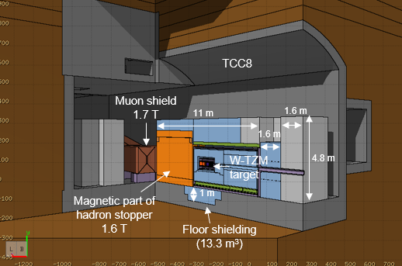
Shielding Requirements - 1
1. Experiments requirements
Keep the flux of particles emerging from the target station into the detector as low as possible (complex optimum to be reached)
Limit the flux into (possibly) super conducting magnets of the magnetic muon shield
Ref: CERN-SPSC-2023-033

Slide 4
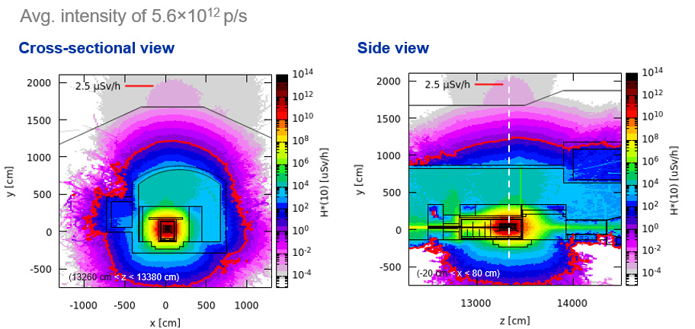
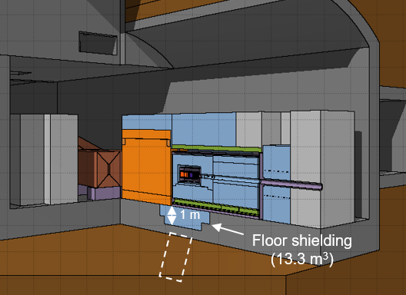
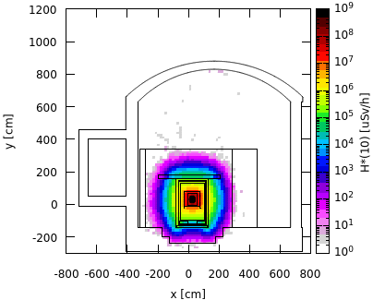
Shielding Requirements- 2
2. RP requirements
Keep surface within non-designated limits (2.5 μSv/h) during operation
Keep residual radiation downstream target station (SHiP environment) within supervised area limit (15μSv/h)
Limit environmental impact (soil + air activation)
See C. Ahdida’s talk for RP details

Slide 5
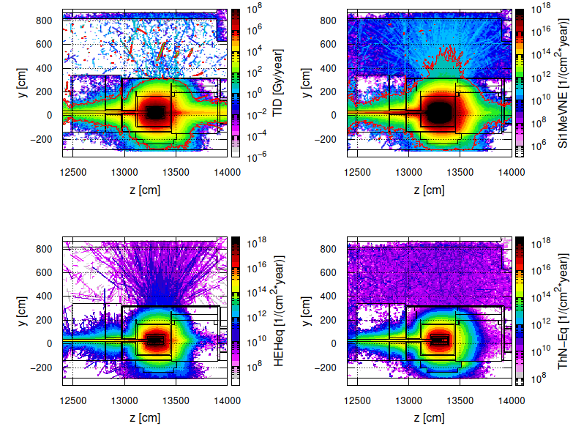
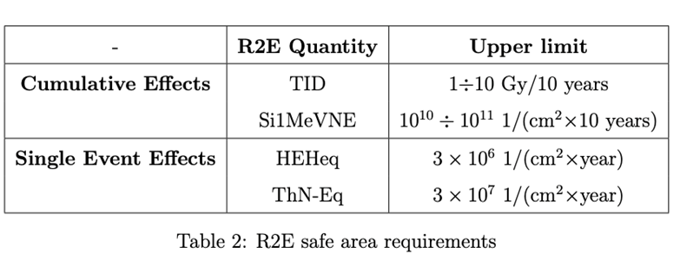
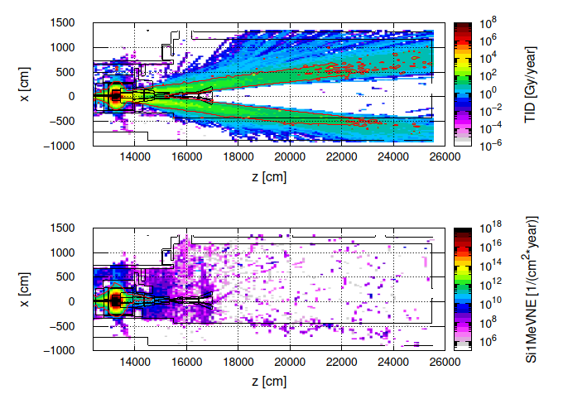
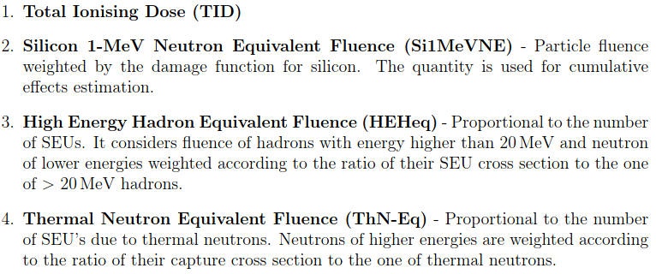
Shielding Requirements- 3
3. R2E requirements
Keep radiation dose within limits of «standard electronics» limits
Credit: Luigi Esposito

Slide 6
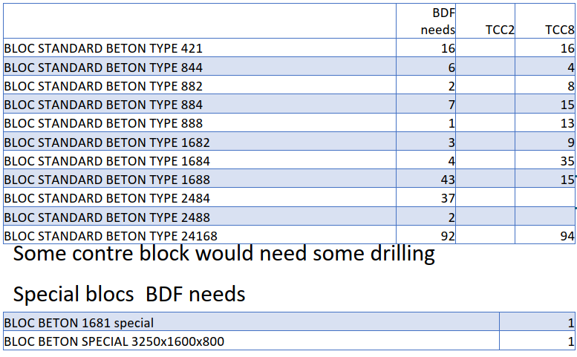
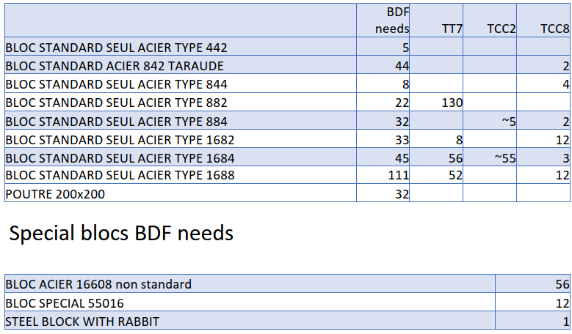
Required Shielding blocks listing
Concrete blocks: ~400 m3
Iron blocks: ~180 m3
Special blocks: holes, round shape, specific dimensions etc. : to be produced on demand
Installation layout not finalized yet

Slide 7
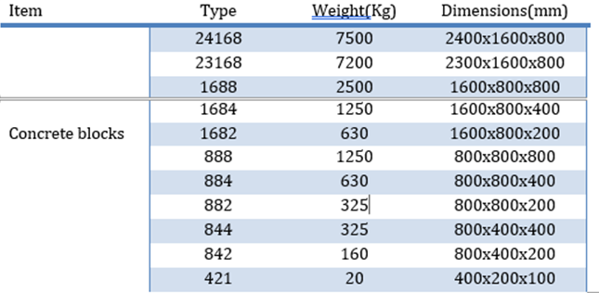
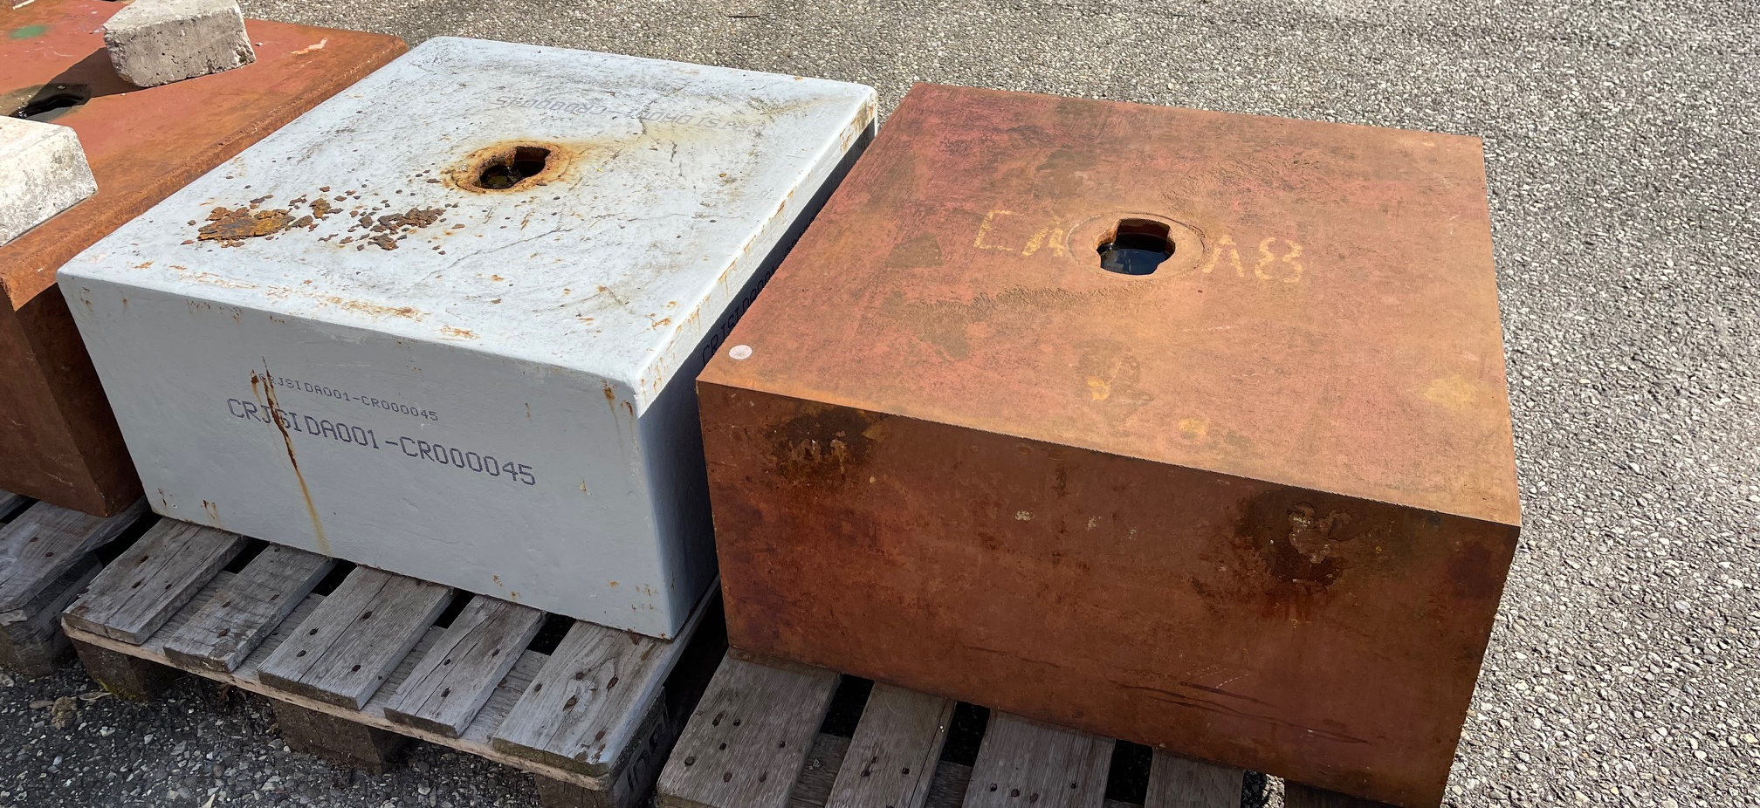
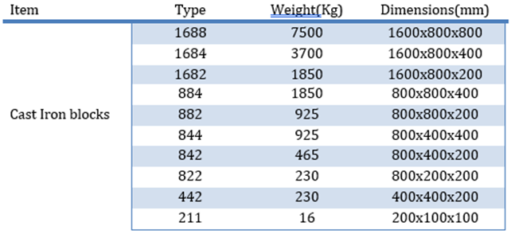
CERN Standard shielding blocks
Raw material specs:
Concrete: according to the standard EN 206
Limit to absolute minimum Natrium, Manganese, Magnesium, Cobalt, Europium, Caesium, Hafnium, Iridium, Silver, and Scandium
Cast iron: spheroid-graphite cast iron EN-GJS-400-18U-RT: Better resilience than Laminal Graphite cast iron.
Maximum cobalt content below 0.10%
All iron blocks need to be painted (corrosion protection) and identified
Unique ID

Slide 8
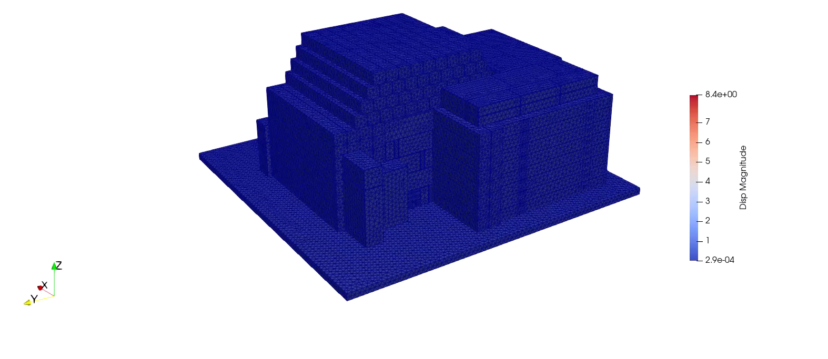
Stability assesment of the shielding assembly
The assembly scheme will be subject to Finite Element Analysis for seismic assessment by CERN safety department
Complex calculation due to nature of pile-up (no mechanical link only friction)
Example: AD-GBAR LINAC bunker Configuration
Identification of the most vulnerable mechanisms
EQ3 – PGA scaled to 0.5 g
04.03.2025
M. Andreini

Slide 9
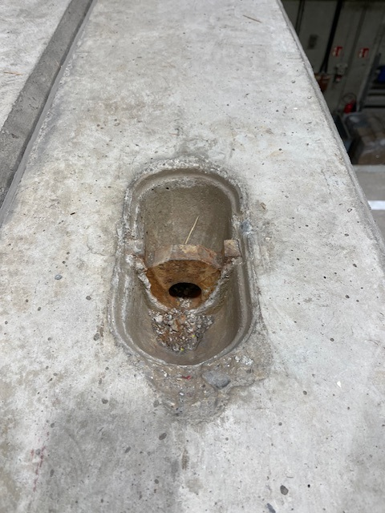
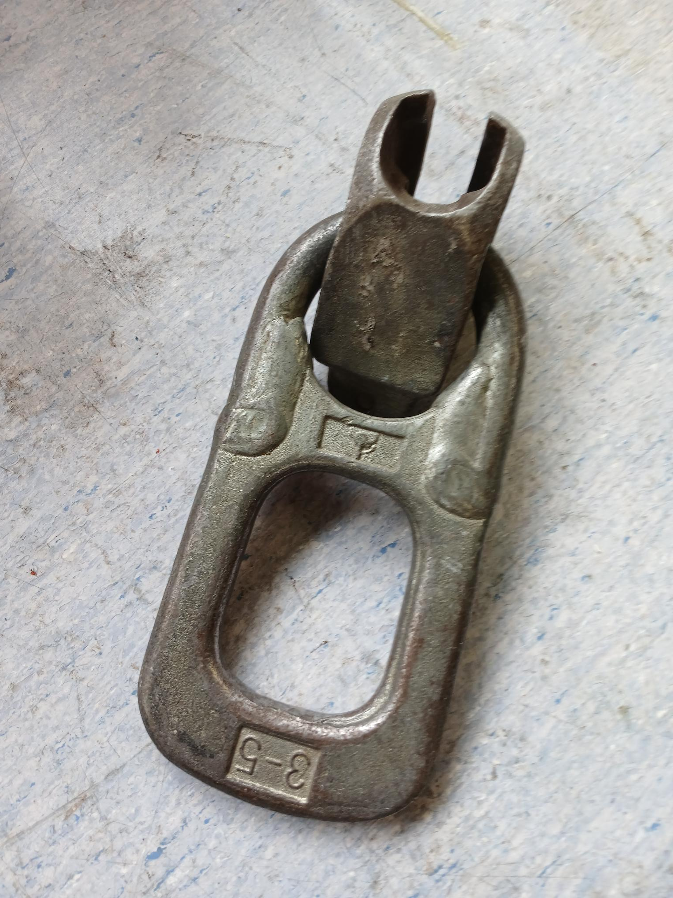
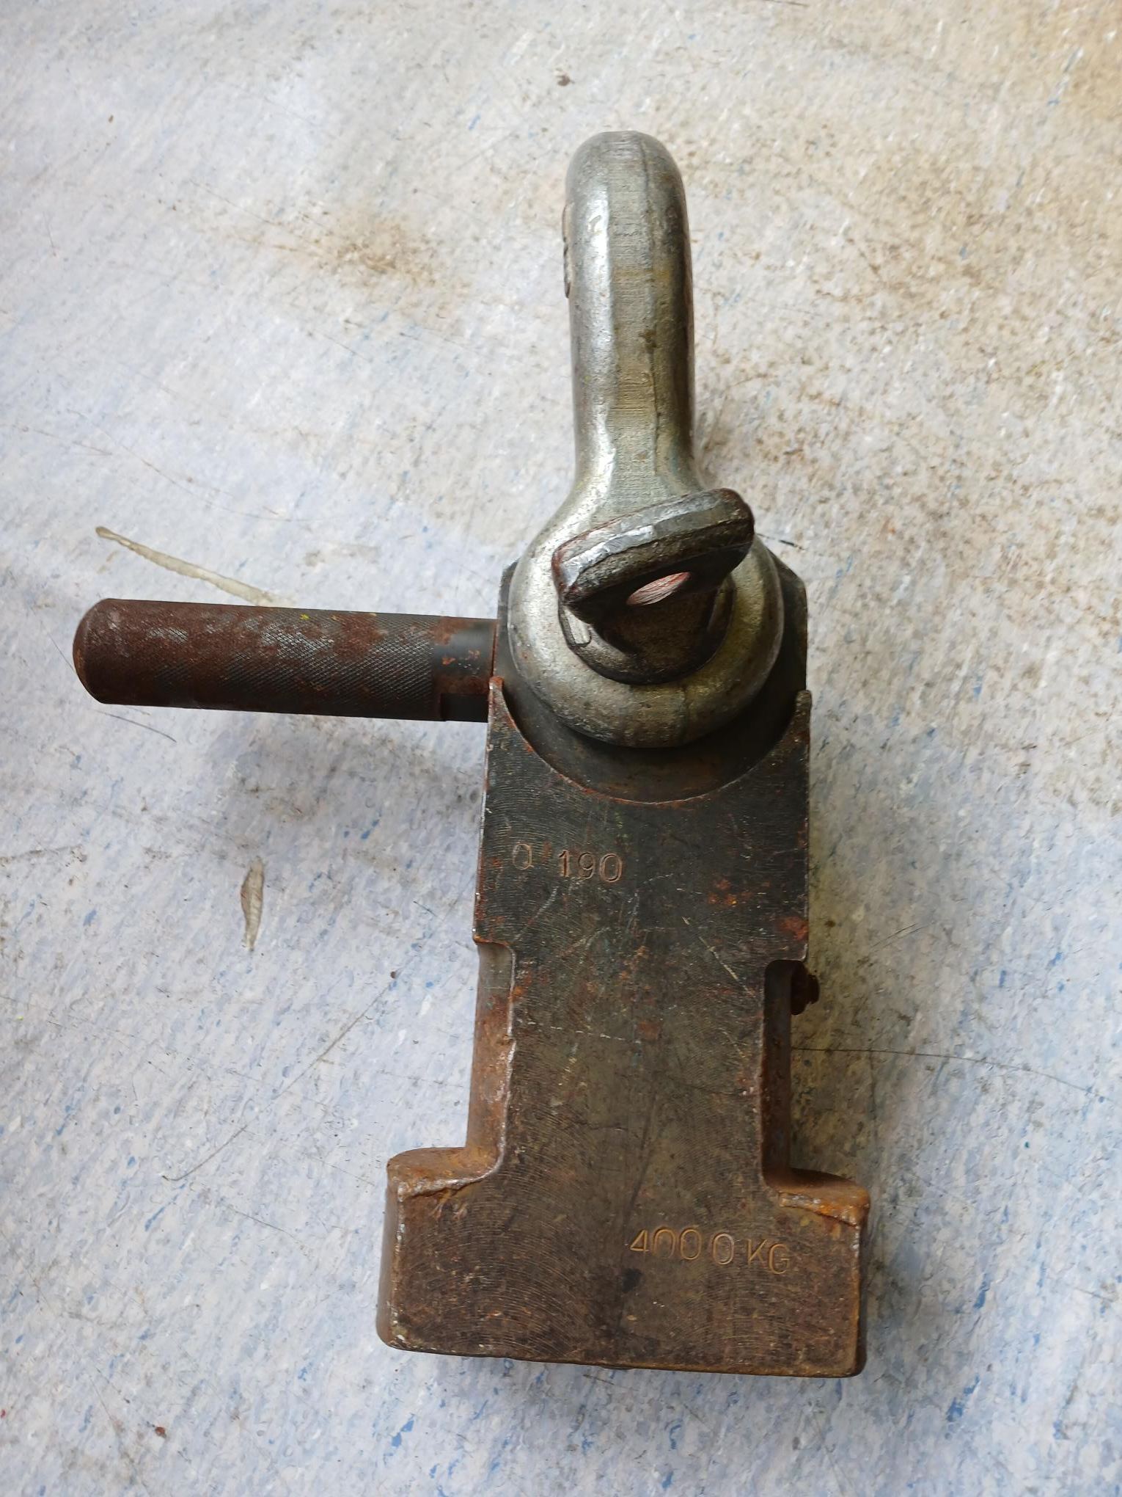
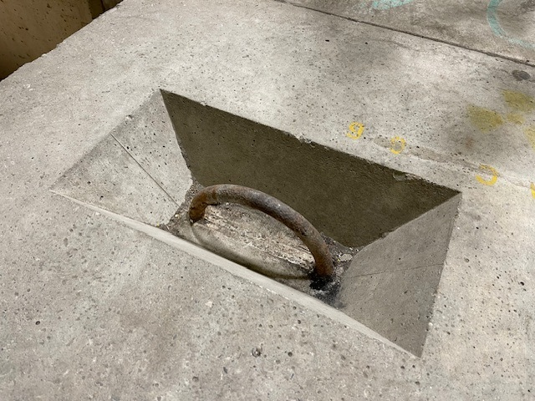
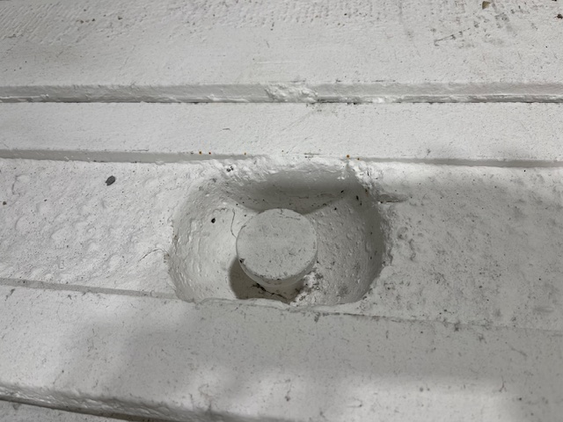
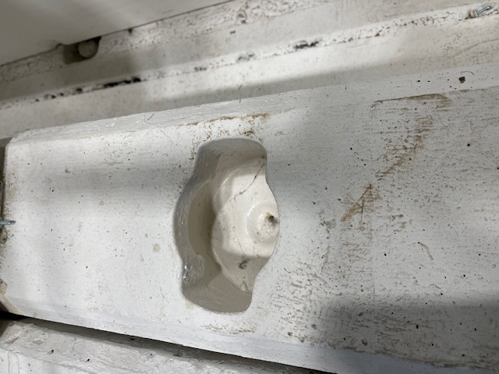
Most common lifting systems (non exhaustive…)
Twist lock lifting jig (CERN specific)
Cast-in loop (plus shackle)
Spherical head anchors
See C. Duran’s talk for handling details

Slide 10
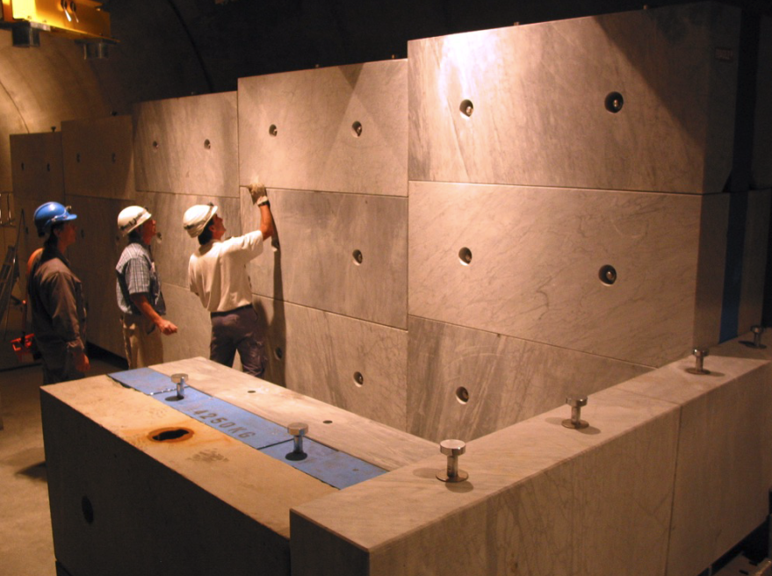
Considered shielding supply sources
Main source is recovery from decommissioned projects:
-Stocks of clean / slightly activated iron and concrete blocks are centrally managed at CERN.
Limited quantities can be made available at a cost
-Other recovery possibilities:
Shielding / dump assemblies exist throughout CERN, that can be interesting to recover after decommissioning or reconfiguration:
CNGS target, TCC2, TT7 dump, T10 shielding etc.
-Purchase for special cases: Specific dimensions / shapes / large quantities etc.
CNGS target blocks to be possibly recovered

Slide 11
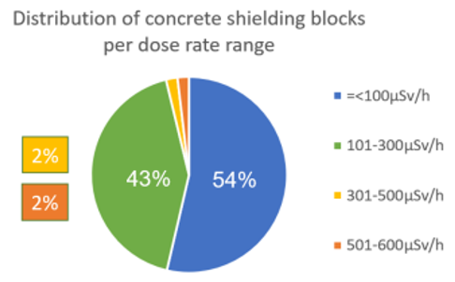
Sustainability of the projet:
Strong effort to re-use existing activated blocks (economical / environmental interest)
Financial aspect: limit number of new blocks to be purchased
Sustainability aspect: avoid generating more future activated
waste by re-using already slightly activated blocks
Intelligent arrangement «hiding» the more activated blocks
Main sources for BDF project: Recover ancient blocks from decommissioned project: -TT7 neutrino beam line dump (iron)
-T10 target station in TCC8 (concrete + iron)
-TCC2 (iron, quantity TBC)
-CNGS target (concrete + marble)
-Radio-active waste recovery
Expected savings, still tentative:
~150 m3 out of 180 m3 of iron
~350 m3 out of 400 m3 of concrete

Slide 12
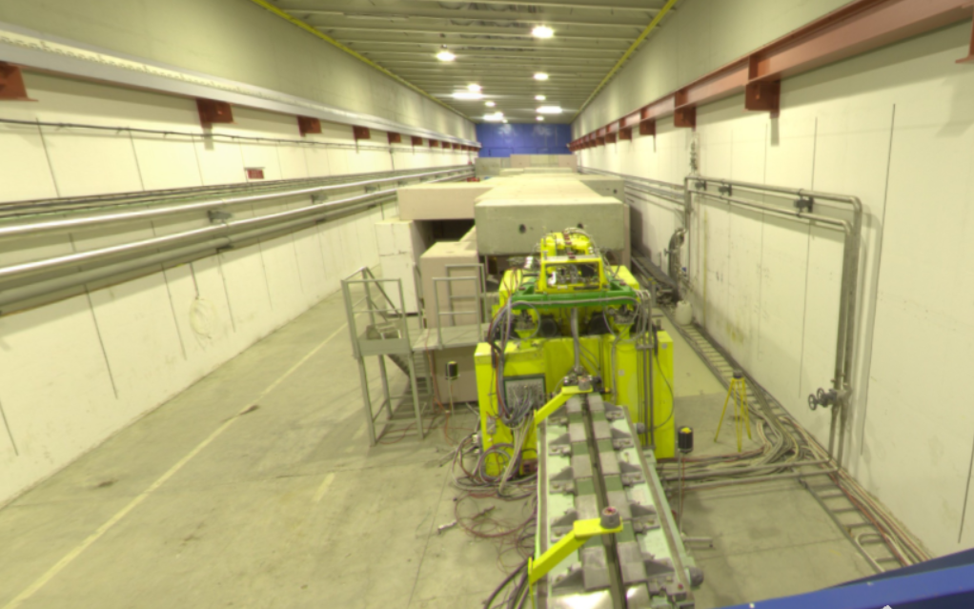
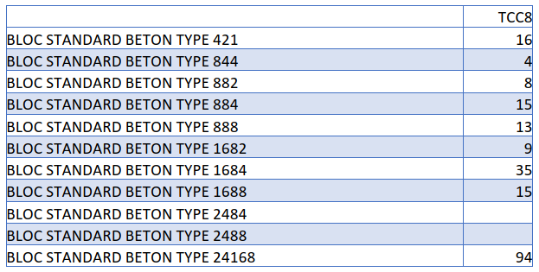
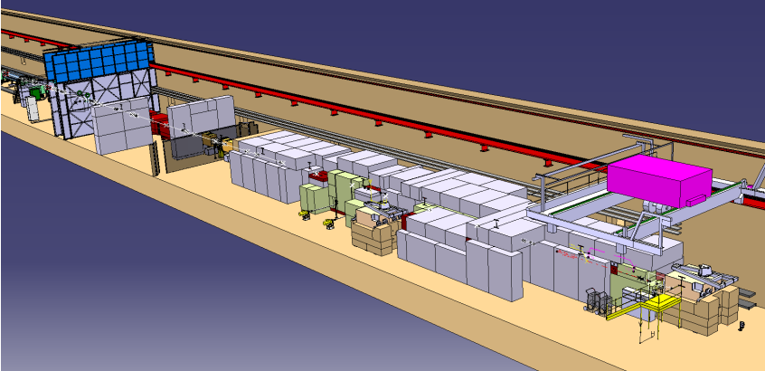
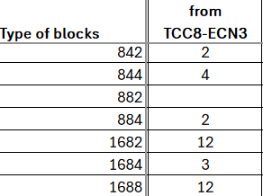
Recovery from current T10 target station (TCC8)
~15 m³ of standard cast iron blocks (activated)
~400 m³ of standard concrete blocks (activated)
Not all can be re-used (special shales needed).
Max dose rate 160 μSv/h.
Most will be re-used in situ
Concrete
Iron

Slide 13
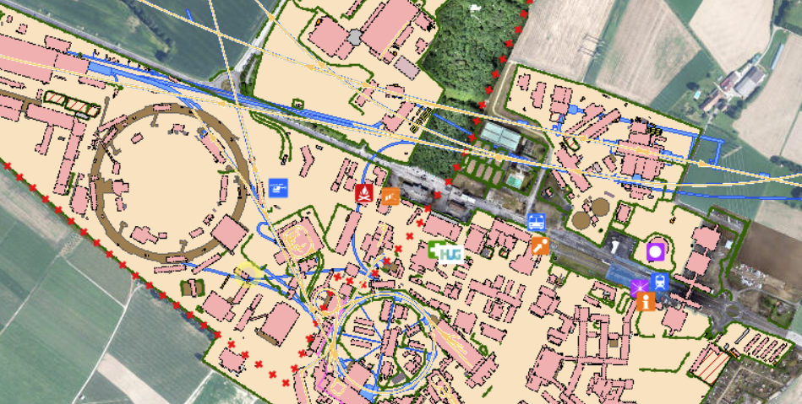
TT7 dump recovery project
Unused shielding blocks left on “old” CERN locations, among which TT7 dump
TT7 PS neutrino facility

Slide 14
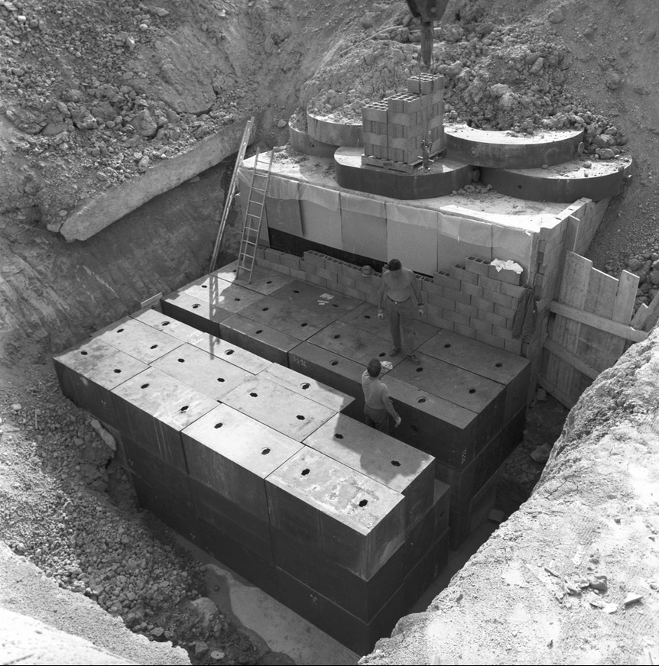
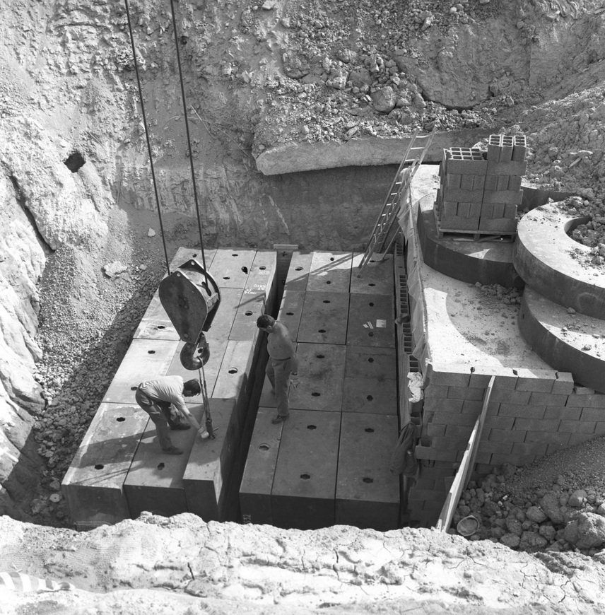
What to expect

Slide 15
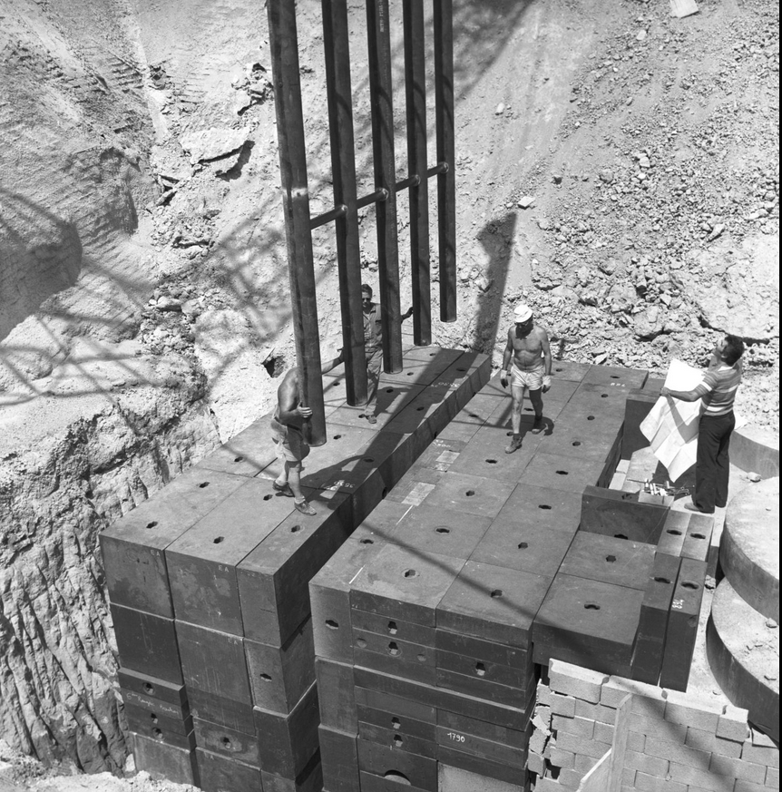
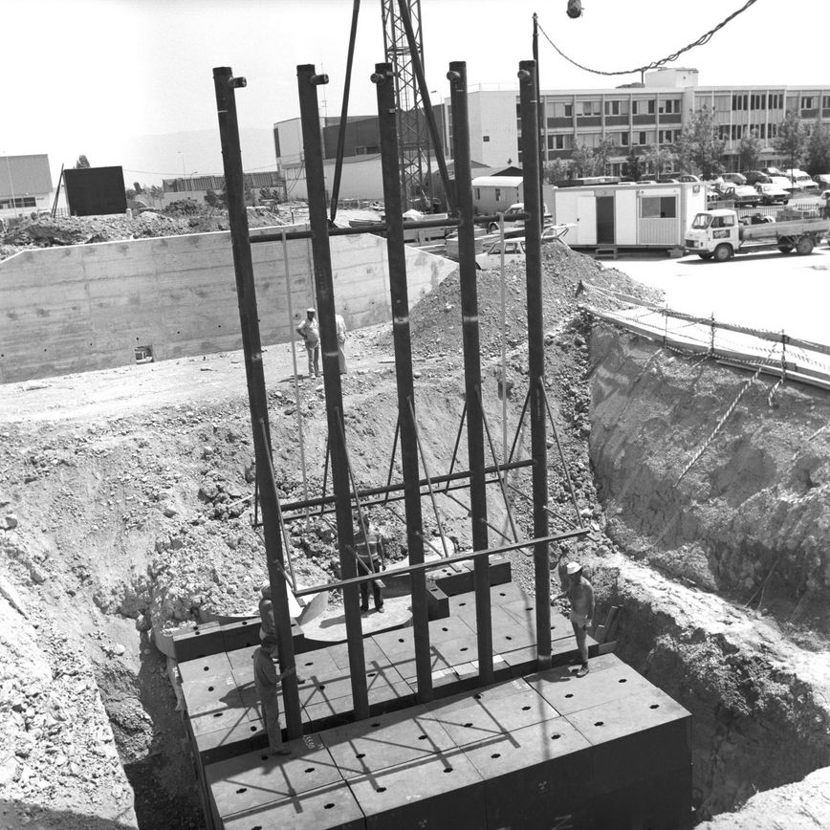
What to expect

Slide 16
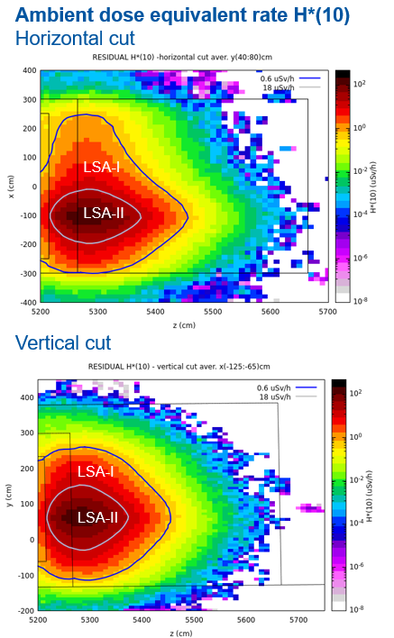
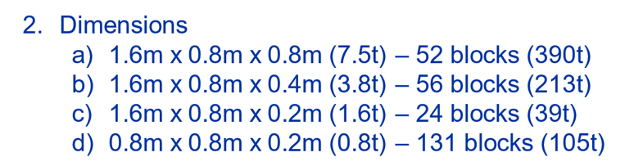
The scope of the TT7 recovery project
100m³ of standard cast iron blocks (+non-standard cast iron blocks)
Activated blocks (dose rate TBC after extraction, expected to be rather low for vast majority of blocks)
Excavation of backfill mound required + rerouting of networks; recovery of the blocks + transport to NA
Scraping + painting process to be finalized
TBC after extraction (end 2025) !

Slide 17
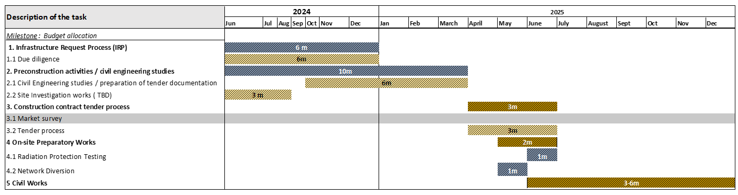
Status / planning
Objective : Project completed before LS3 – Number + condition + dimension of blocks to be known before end 2025
Budget secured
Tender document produced, in approval loop before being sent out
Courtesy Tamara Bud

Slide 18
Conclusion
About 180m³ of cast iron and 400 m³ of concrete / marble shielding block will be required for the BDF target station
Most of the required blocks will be retrieved from existing stocks and ancient facilities (TCC8, TT7, CNGS target, TCC2), essentially already activated
This will result in large savings in terms of money but also in terms of future radioactive wastes for the future
The fraction to be purchased (essentially non-standard blocks) remains to be clearly defined, linked to the detail design of the shielding layout, yet to be finalized

