Slide 2
Radiation protection considerations for the target complex
C. Ahdida, P. Bertreix, G. Dumont, F. Malacrida, G. Mazzola, O. Pinto, C. Theis, Hl. Vincke, Hz. Vincke, P. Vojtyla
1st BDF Targetry Systems Advisory Committee (TSAC)
4-6th March 2025

Slide 3
Outline
Overview of RP Challenges at HI-ECN3
Target Complex Design Optimization
Target Studies
Service building considerations

Slide 4
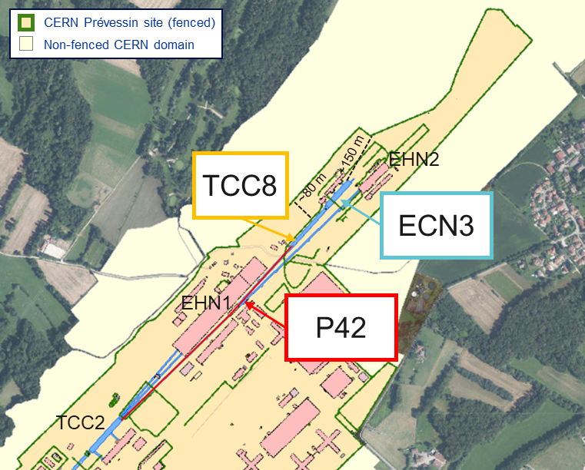
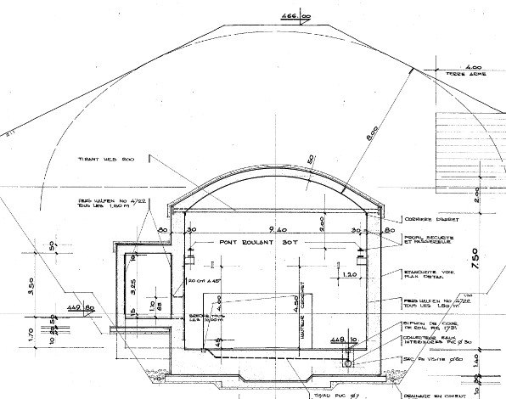
HI-ECN3 at ECN3
CERN’s SPS North Area
TCC8 cross-section
Key beam parameters of BDF/SHiP
 | BDF
Intensity (p/spill) | 4×10¹³
Spill duration (s) | ≥1
Cycle length (s) | ≥7.2
Avg. beam power (kW) | 356
Average intensity (p/s) | ≤5.6×10¹²
Annual POT | 4×10¹⁹
Duration (years) | 15
Total POT | 6×10²⁰
8m soil
RP challenges
    High beam energy and intensity as well as high POT leading to high prompt radiation and activation levels
    Proximity to surface, experimental and public areas
    Losses during beam transfer (not covered here)
HI-ECN3: a state-of-the-art high intensity experimental facility in ECN3 with RP optimization for full lifecycle
Advantage of underground cavern with shielding created by the soil and beam dump concept

Slide 5
Target Complex Optimization

Slide 6


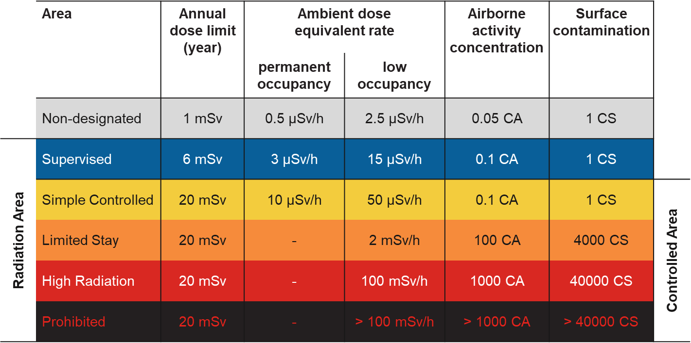
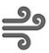

BDF/SHiP design optimization
RP studies based on FLUKA MC simulations were performed for a design optimization of BDF/SHiP@HI-ECN3
ALARA approach
Optimization required to ensure that exposure of personnel to radiation and radiological impact on environment are As Low As Reasonably Achievable
Prompt radiation
Reduce prompt radiation to comply with radiation area classification in the surrounding accessible areas as well as the 1 mSv limit at the CERN fence
CERN’s radiation area classification
residual radiation
Limit activation of target and experimental area to reduce residual dose rates to be compatible with an adequate area classification
Air and soil activation
Reduce activation of air and its releases into the environmental. Limit soil activation (³H<1000 Bq/kg, ²²Na<50 Bq/kg) and transfer to groundwater
Environmental impact
Reduce environmental impact from prompt radiation and releases of activated air to fulfill CERN’s dose optimization objective for the public of <10 uSv/year

Slide 7
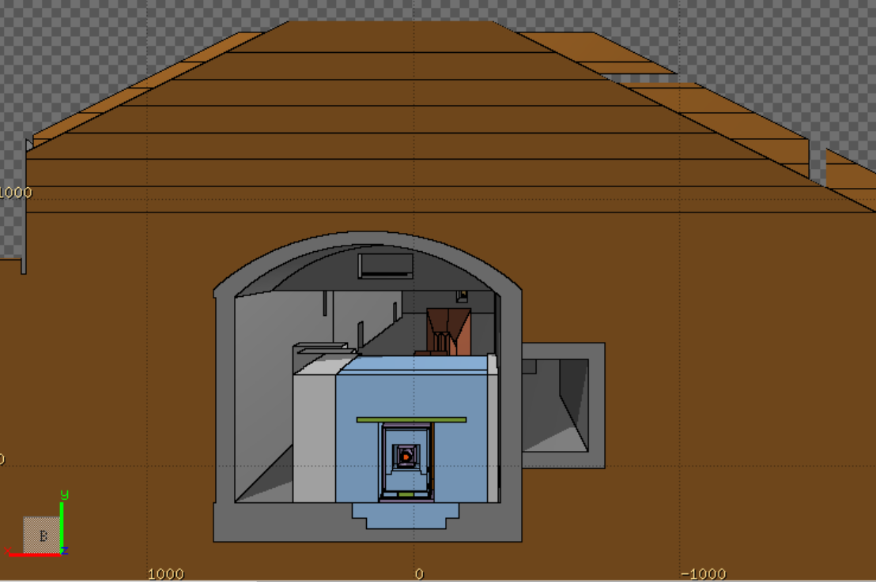
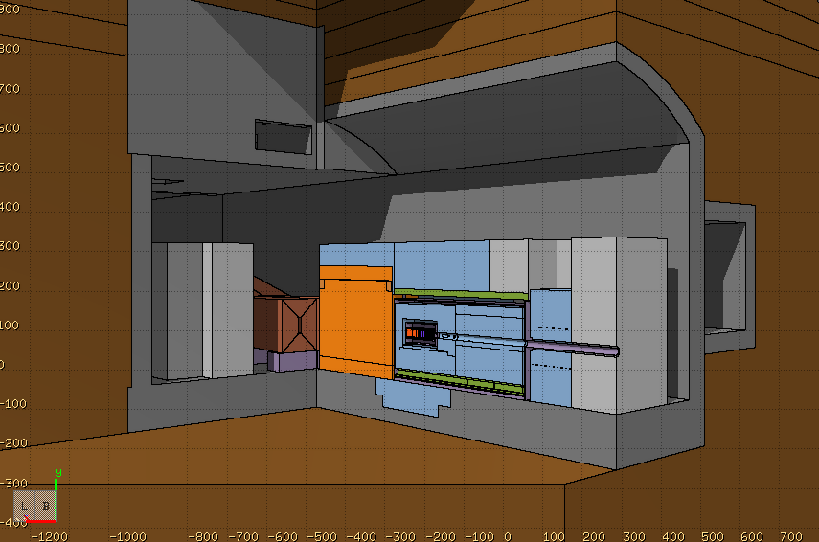
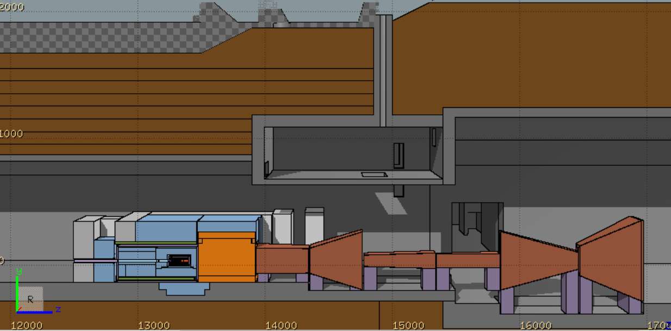
BDF/SHiP FLUKA model
FLUKA hosted by CERN [1-3]
Target complex & muon shield, Created using FLAIR [4]
A detailed BDF/SHiP target complex together with the muon shield was implemented in FLUKA [1-3]
Optimization of BDF shielding and re-use of existing, already activated TCC8/TT7 shielding blocks, while maintaining SHiP physics performance
Shielding embedded in vacuum vessel allowing to reduce air activation
Floor shielding reinforcement to limit soil activation
FLUKA geometry includes the full underground TCC8/ECN3 cavern and surrounding galleries, tunnels, rooms, etc.
Ground profile data from CERN’s Geographic Information System and technical drawings were used to model the surrounding ground
Moraine
8 m
TCC8
Muon shield
1.7 T
1.6 m
Vacuum vessel
11 m
1.6 m
W-TZM target
4.8 m
Magnetised Hadron Stopper (MHS)
1.6 T
1 m
Muon shield
ECN3
Floor shielding (13.3 m³)
Stainless steel
US1010
~180 m³ of cast iron + US1010
~360 m³ of concrete
Concrete
Moraine
Cast iron

Slide 8
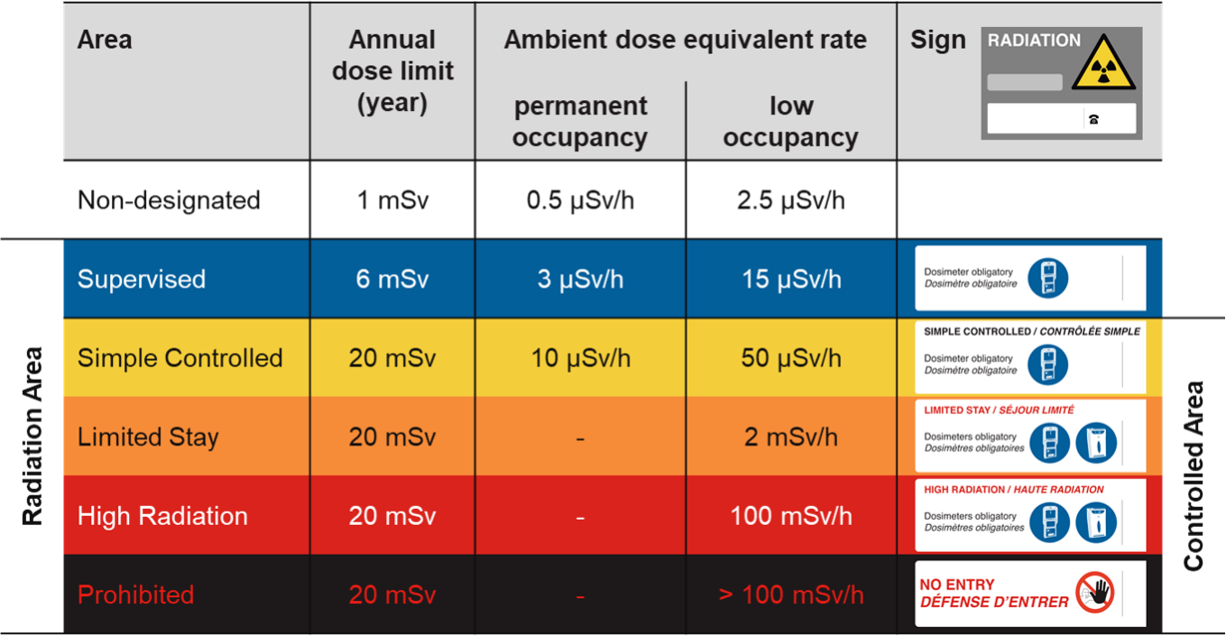
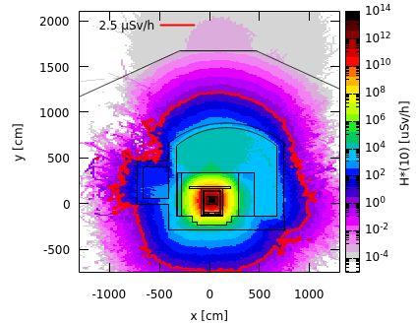
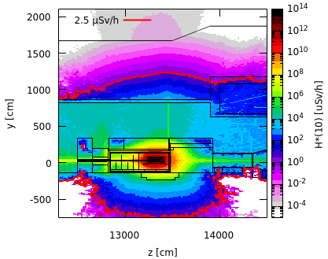
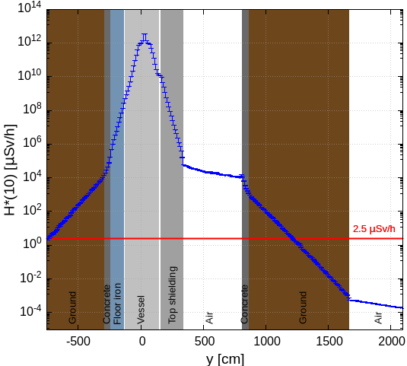
Prompt radiation in target area
Avg. intensity of 5.6×10¹² p/s
Cross-sectional view
Side view
Along y-axis
(-20 cm < x < 80 cm)
(13260 cm < z < 134380 cm)
(13260 cm < z < 13380 cm)
(-20 cm < x < 80 cm)
Shielding design is well optimized for the prompt radiation
Annual limit of Non-designated Area on CERN domain

Slide 9
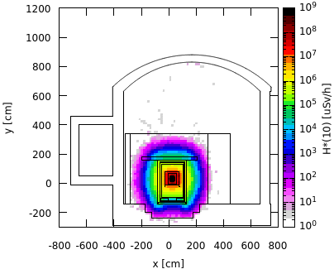
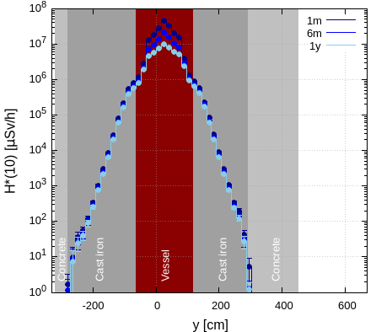
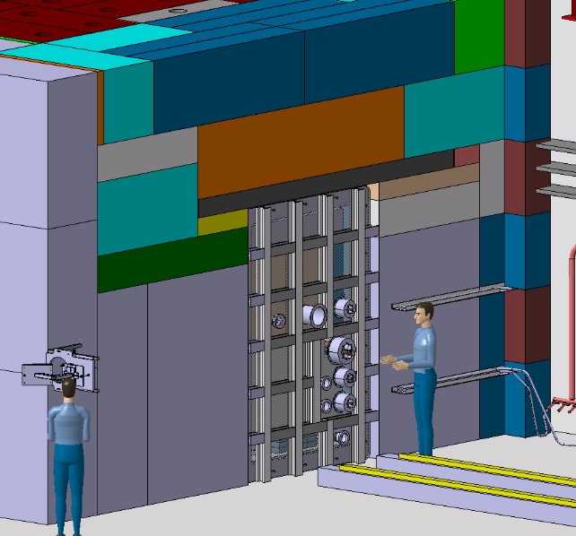
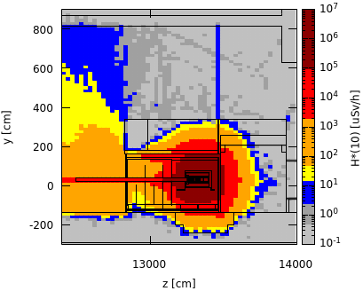
Residual radiation in target area
Total PoT 6×10²⁰ (15 years)
Cross-sectional view, target level
Along x-axis, working height
Upstream of vessel w/o upstream shielding
Preliminary worst case manual intervention scenario
1 month cool-down
(13240 cm < z < 13390 cm)
1 month
(15 cm < y < 45 cm)
(13240 cm < z < 13390 cm)
(-15 cm < x < 80 cm)
Shielding removed
x [0,40]
x_beam = 26 cm
After removal of the shielding upstream of the vessel, residual dose rates of several 100 µSv/h are expected
Supervised Radiation Area on the sides
Further optimization by movable shielding
Future detailed handling studies planned
The shielding design contains well the high residual dose rates reaching in the central target region several 10 Sv/h after 1 month of cool-down requiring remote handling
The residual dose rates outside the shielding are < 1 µSv/h
100 rem = 1Sv

Slide 10
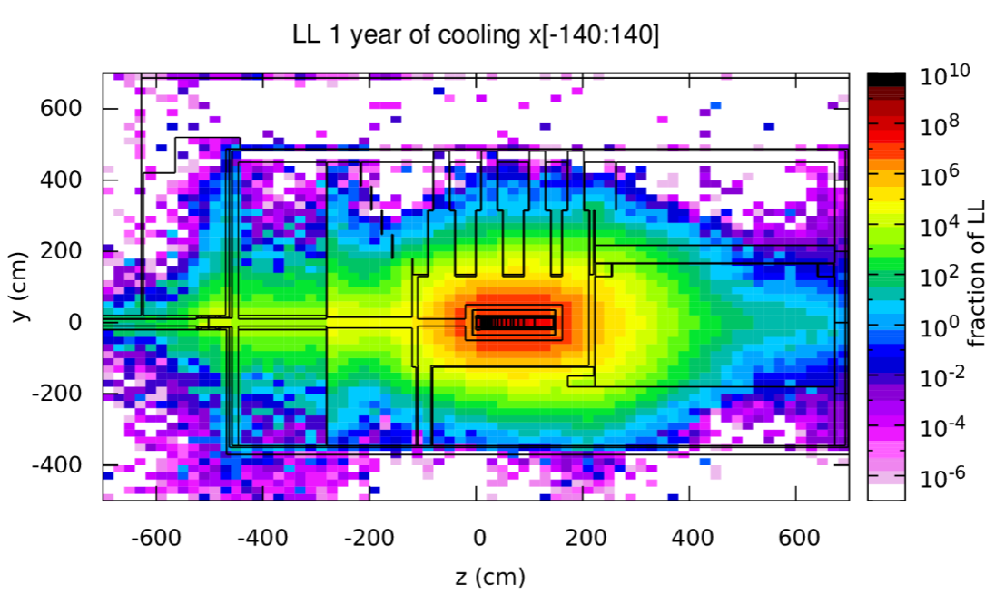
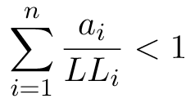
Radioactive waste production
To distinguish areas of radioactive waste from conventional ones the Swiss clearance limits (LL) were used
The following sum rule was applied for material containing a mixture of radionuclides
The most activated parts are the target and the iron shielding elements (also for 30 years of cooling)
The minimisation of radioactive waste is being considered in the shielding design by having a modular shielding such that activated parts can easily be separated from non-radioactive parts
1 year of cooling (CDS design)
a_{i} - specific activity (Bq/g) of the i^{th} radionuclide
LL_{i} - respective Swiss clearance limit for the radionuclide i
n - number of radionuclides present
SPS Beam Dump Facility - Comprehensive Design Study, CERN-2020-002

Slide 11
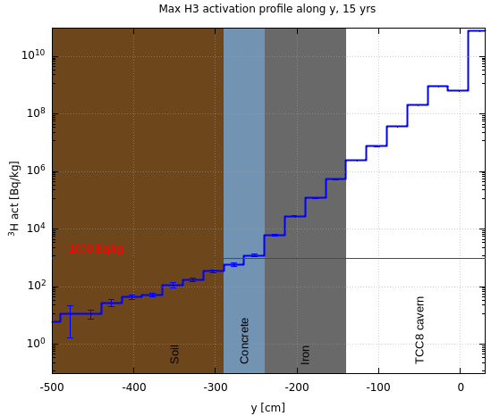
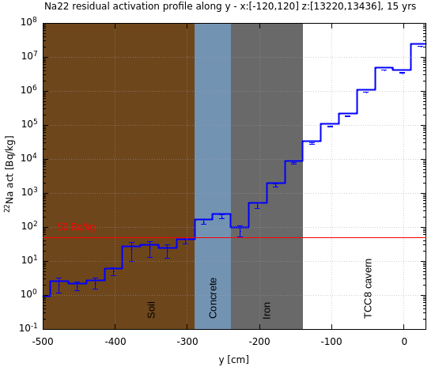
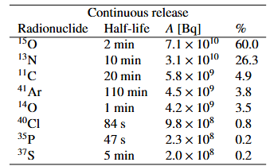

Soil and air activation
Total PoT 6×10²⁰
PoT 4×10¹⁹ per year
Specific activity of ³H and ²²Na in the soil below TCC8 (most critical area)
Air activation
Activation of air in target complex area were studied
Production of radionuclides evaluated with FLUKA in combination with ActiWiz [5]
³H
²²Na
¹
Air recycling: build-up of radionuclides during operation w/o air extraction and 30 min cooldown time before air release
Continuous release: long-term continuous releases without delay (very conservative for environmental impact)
Thanks to floor iron shielding, ³H and ²²Na activity concentrations in the soil are below respective design limits
A hydro-geological study is underway, which will allow to refine the design limits and possibly allow to reduce the required shielding
Flush of target complex with fresh air before any access will further reduce specific airborne radioactivity
H-3 out-diffusion/ejection nor potential leakage of He-cooling system not yet considered here
¹ Person working 40h/w, 50w/y with standard breathing rate in activated air with CA = 1 receives 20 mSv

Slide 12
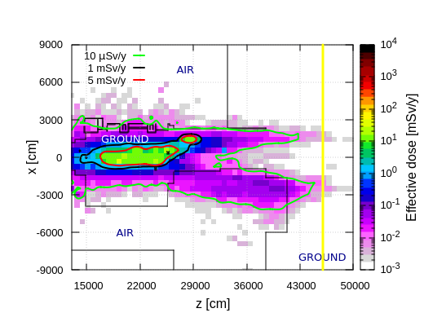
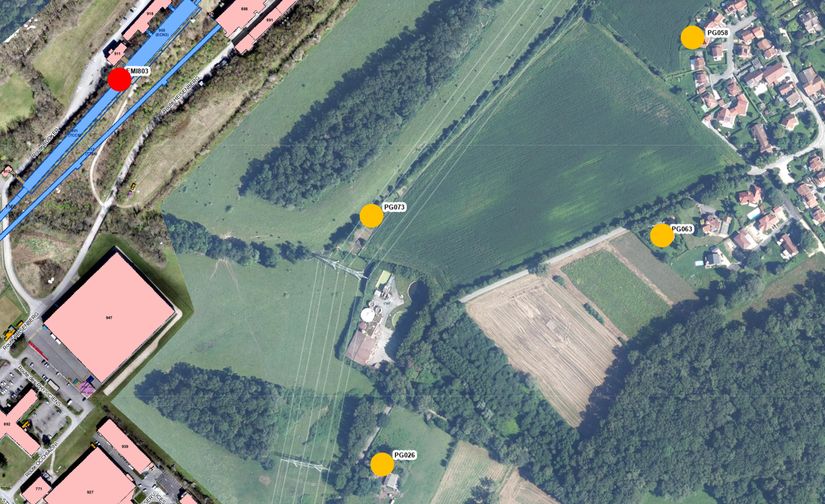

Environmental impact
PoT 4×10¹⁹ per year
Dose from air releases
Dose from stray radiation
Used max. dose coefficients from different age groups [6]
Annual effective dose
Positions of nearby population groups
Effective dose estimates
CERN fence
Release point
Prompt radiation aboveground downstream ECN3
H-3 release due to air activation of ~80 kBq (w/o out-diffusion)
Continuous air release yields 3 nSv/year (main contributors: N-13, Ar-41, C-11, O-15) and is thus well below the annual dose optimization objective of CERN
Additional contribution from H-3 out-diffusion/ejection and potential leakage of He-cooling system to be quantified
Annual limit of Non-designated Area on CERN domain and at CERN fence (1 mSv/y) as well as dose optimization objective for members of the public (10 uSv/y) are by far met
100 rem = 1Sv

Slide 13
BDF Target Studies

Slide 14
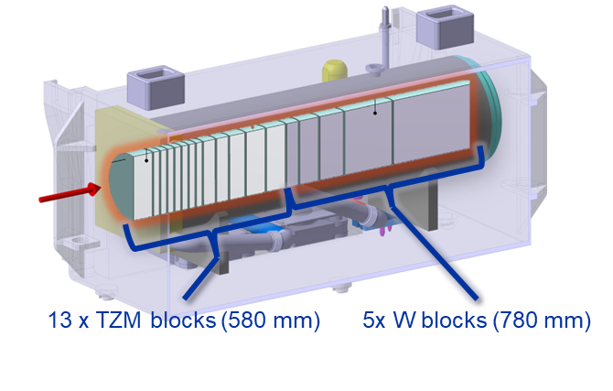
CDS target design
Water-cooled W + TZM target (136 cm) cladded with Ta2.5W
Pursued during the comprehensive design phase → C. Ahdida et al., SPS Beam Dump Facility - Comprehensive Design Study, CERN-2020-002
Prototype + test with beam + post irradiation examination (see talk R. Ximenes)
~ 1500 mm
D 250 mm

Slide 15
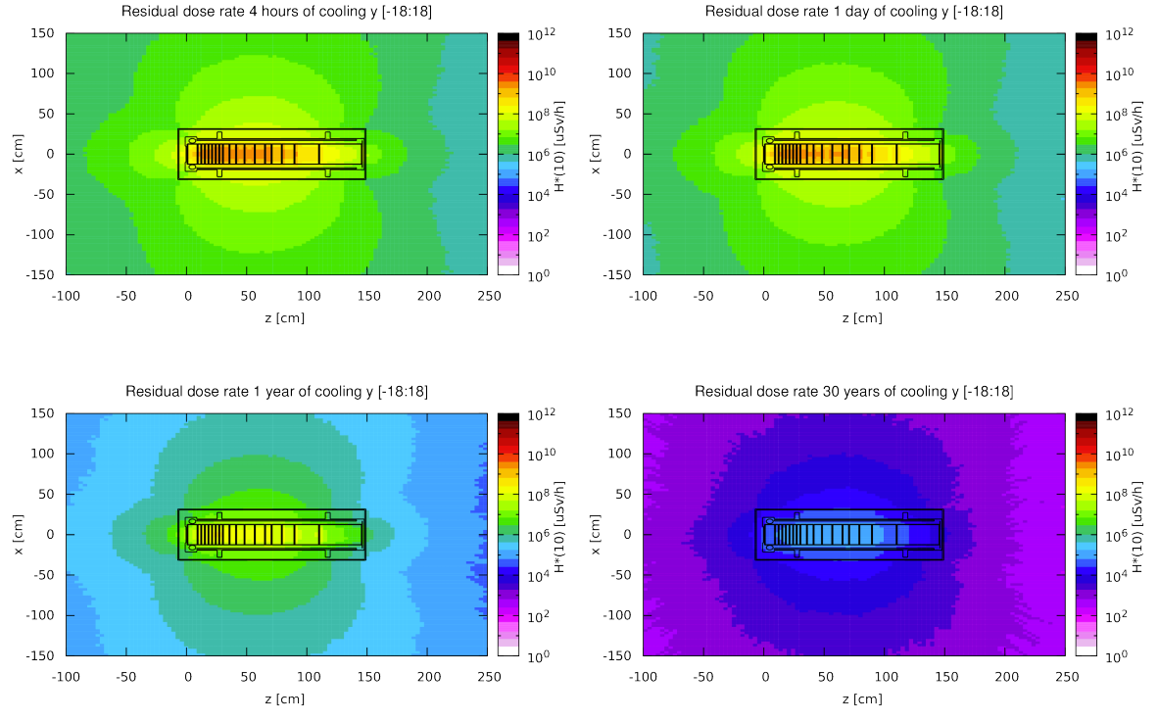
CDS target – Residual radiation
Total PoT 4×10¹⁹ (5 yrs)
Longitudinal cut along the target
The residual dose rates of the target were studied for 5 years of operation and different cool-down times
The highest dose rates are in the order of
100 Sv/h after 4 hours of cooling and a
few Sv/h after 1 year
Even after 30 years, dose rates at 40 cm still of the order of a few mSv/h
Shielding cask for handling to be designed allowing to also contain potential contamination
Shielded storage area and service cell to be designed
Shielding further to be foreseen for transport and final disposal (< 2 mSv/h)
4 hours cool-down
1 day cool-down
1 year cool-down
30 years cool-down

Slide 16
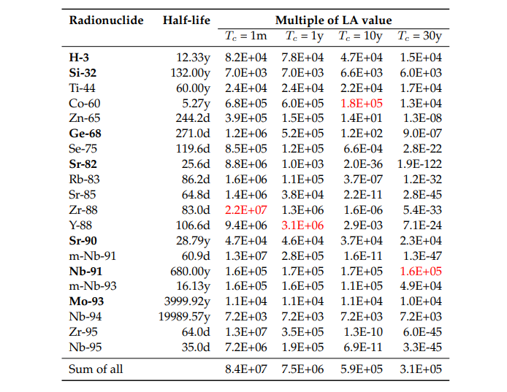
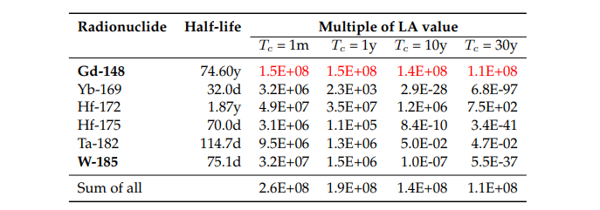
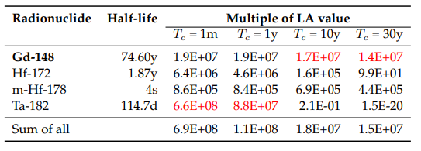
CDS target – Radionuclide inventories
Total PoT 2×10²⁰ (5 yrs)
LA multiples of CDS target materials
TZM
Main contributors (>1%), sum for all radionuclides
W
Ta
Pure alpha/beta emitters are shown in bold
Dominant radionuclide is shown in red
Total PoT 2×10²⁰ (5 yrs) + 1 month cool-down
Target | Material | Mass [kg] | Multiple LL | Multiple LA | A [Bq]
CDS | W | 695 | 1.9E+08 | 2.6E+08 | 9.2E+14
 | TZM | 271 | 1.1E+09 | 8.4E+07 | 1.8E+14
 | Ta | 28 | 1.7E+11* | 6.9E+08 | 9.8E+14
Authorization Limit (LA) means the value corresponding to the abs. activity level of a material above which handling of this material is subject to mandatory licensing. It is based on the risk of inhalation.
Clearance Limit (LL)
*Dominated (99.9%) by Ta-182 (115 d half-life)

Slide 17
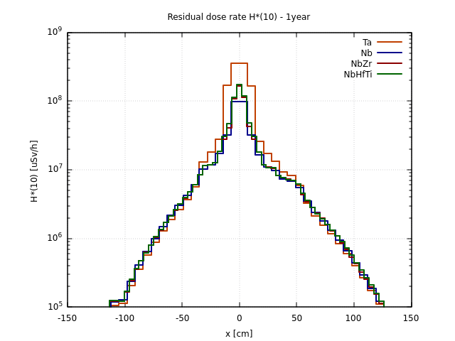
CDS target – Alternative Claddings
Cladding materials:
  Tantalum –16.6 g/cm3
  Nb (ASTM R04210 – Type 2) – 8.6 g/cm3
  Nb-1Zr (ASTM R04261 – Type 4) – 8.6 g/cm3
  Nb-10Hf-1Ti (ASTM R04295) – 8.86 g/cm3
Total PoT 2×10²⁰ (5 yrs), 1y cool-down
Residual dose rates (uSv/h)
Total PoT 2×10²⁰ (5 yrs)
Includes residual dose rates from surrounding material
Nb-94 half-life of 20300 yrs
Waste classification as FA-MA¹ waste to be disposed of in Switzerland (no open pathway so far for such activation of Ta/Nb)
No difference in the residual dose rates for the various Nb claddings
LMA: Acceptance Activity Limits, if activity levels < LMA candidate for elimination in France
¹ Low and intermediate activation waste for elimination in Switzerland

Slide 18
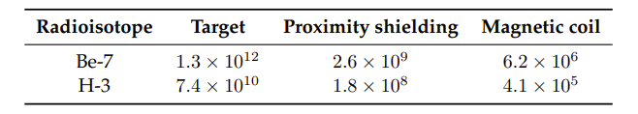
CDS target – Water activation
Activation of water from cooling circuits was estimated
Shielding estimate around demineralization cartridges was performed assuming Be-7 to be stopped, but no target debris
  → 50 cm cylindrical concrete shielding was foreseen and for the roof of the area 165 cm concrete
Remaining water in circuit mostly contains H-3 with a concentration of around 20 MBq/l per year of operation (~4000 litres)
High production of H-3 in target materials (~15 TBq during 5 years of operation)
Quantification of out-diffusion/ejection with given operational conditions are crucial for evaluating the actual amount of H-3 activity in the cooling water
PoT 4×10¹⁹ (1 yr), 4 hours cool-down
Total Activity (Bq) for H-3 and Be-7
Results above do not take out-diffusion from target / shielding into account

Slide 19
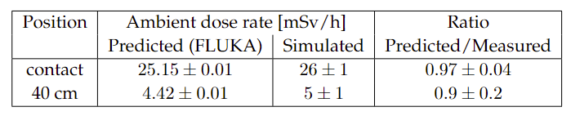
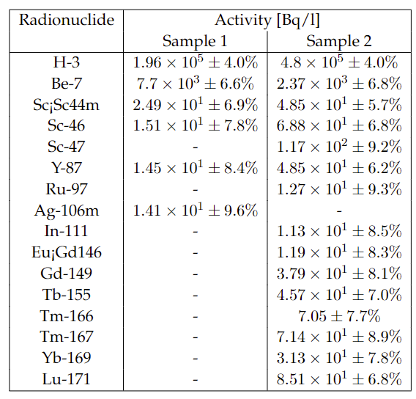
CDS target – Prototype tests
Benchmark of residual dose rates (mSv/h)
BDF target prototype w/ in total 14 h irradiation in TCC2, leading to 2.4E16 PoT
Target activation was measured and compared to FLUKA simulations showing excellent agreement
Cooling water activation was estimated with FLUKA
Estimated residual dose rate after 1h of cooling at 40 cm from the cartridge is 18.7 mSv/h, while the PMI monitor measured 16.9 mSv/h
Both samples showed the presence of high-Z spallation products some of them could have been produced in the target materials
Water-cooling filter with debris was analysed via EDX
  No peaks were found for Ta, W, Mo or Ti
  Metallic particle (Al, Ca, Fe, Cl, Fe, Cr)
Radionuclides in water samples
Water samples were analysed by liquid scintillation and gamma spectrometry

Slide 20
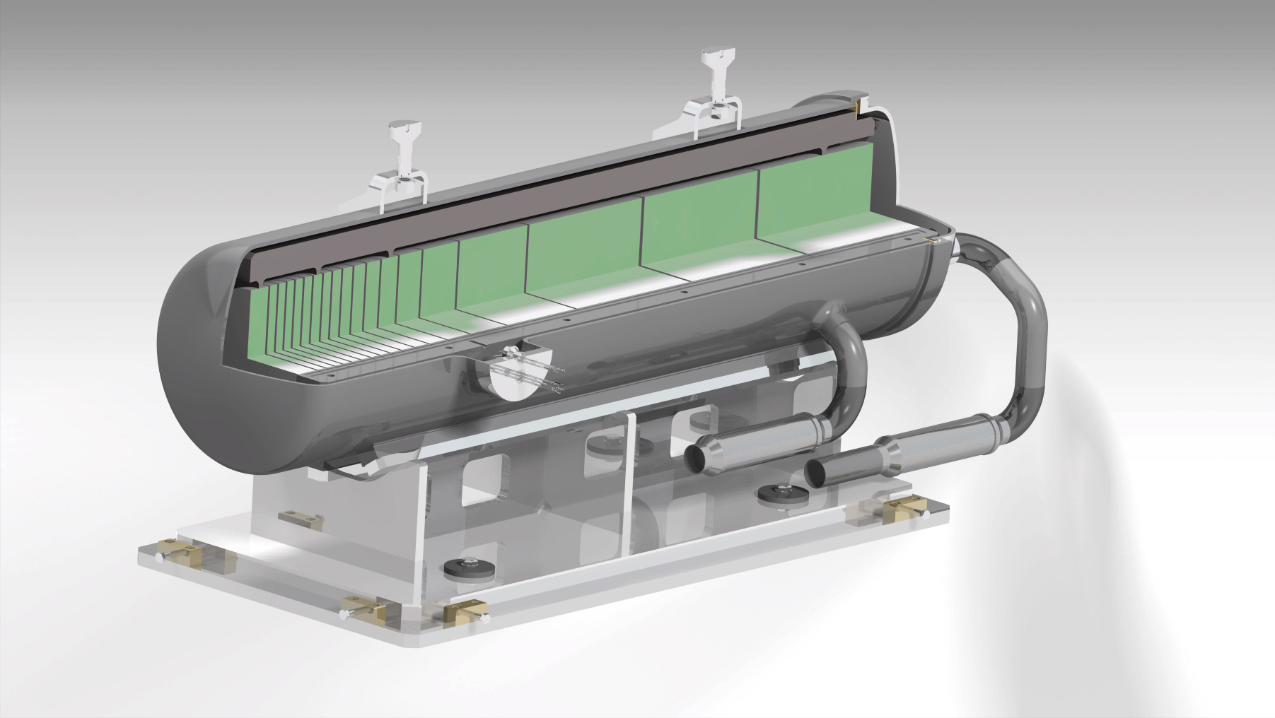
W target design
He-cooled, Pure W Core, potentially cladded (tbd)
Improved physics performance (see talk G. Mazzola)
Prototype and beam testing in 2025 and 2026 (see talk R. Ximenes)
P⁺
He
cooling
19x W blocks (L1500 mm) (D250 mm)

Slide 21
W target – Radionuclide inventories
Total PoT 2×10²⁰ (5 yrs), 1 month cool-down
LA multiples of W target
Main contributors (>1%), sum for all radionuclides
Investigation of outgassing of radionuclides (incl. H-3) and possible formation of volatile chemicals ongoing → important for understanding of radiological risks connected to He-cooling circuit
  Measurements during prototype target tests (e.g. analysis of filters/cartridge, quantification of contamination, H-3 measurements, inline gas spectrometer, etc.) are to be defined
Radionuclide | Half-life | Multiple of LA | Contribution
Gd-148 | 74.60 y | 4.8E+08 | 59%
Hf-172 | 1.87 y | 1.5E+08 | 18%
W-185 | 75.1 d | 8.8E+07 | 11%
Ta-182 | 114.7 d | 2.7E+07 | 3%
Yb-169 | 32.0 d | 9.7E+06 | 1%
Hf-175 | 70.0 d | 9.2E+06 | 1%
Sum of all |  | 8.0E+08
Pure alpha/beta emitters are shown in bold
Dominant radionuclide is shown in red
Comparison to CDS target
Target | Material | Mass [kg] | Multiple LL | Multiple LA | A [Bq]
W target | W | 1420 | 2.7E+08 | 8.0E+08 | 2.6E+15
CDS target | W | 695 | 1.9E+08 | 2.6E+08 | 9.2E+14
 | TZM | 271 | 1.1E+09 | 8.4E+07 | 1.8E+14
 | Ta | 28 | 1.7E+11* | 6.9E+08 | 9.8E+14
LA for short-cool-down times:
For 1h (4h), Hf-178m (4s half-life) produced via Ta-178m (2.36h half-life) is dominant
For 1d, Gd-148 (74y half-life) becomes most important (as for 1 month)
*Dominated (99.9%) by Ta-182 (115 d half-life)
Authorization Limits (LA)
Swiss Clearance Limits (LL)

Slide 22
Surface building

Slide 23
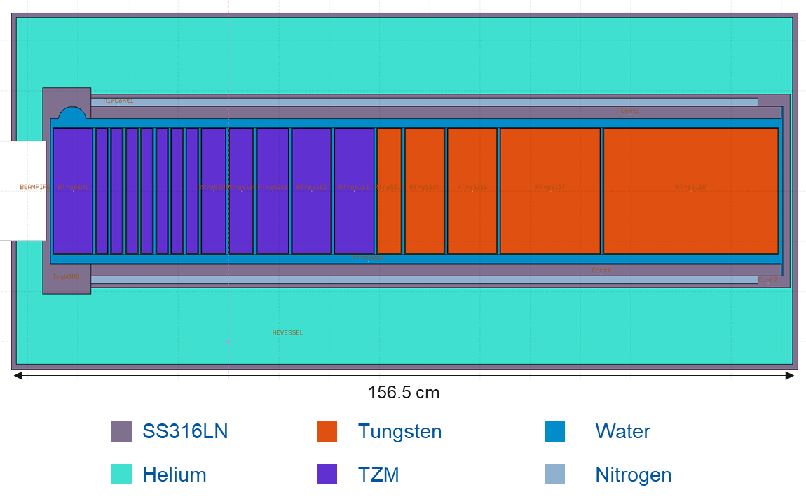
RP considerations for service cell
A HI-ECN3 service cell is crucial for safe packaging and disposal of highly radioactive equipment, as mandated by French and Swiss authorities
The only available disposal pathway for the BDF target currently involves cutting it to fit within a KC-T12 container designated for disposal in Switzerland
Alternatives such as transport to external facilities would require significant investments in transport casks and infrastructure, expected to cost several MCHF
The cutting of the BDF target vessel requires a destructive technique (e.g. cable saw) causing contamination
The total resuspended activity was estimated by assuming that
4 cuts on the vessel (stainless steel/Inconel) removing ~7.8 kg
Resuspended activity
Total PoT 2×10²⁰ (5 yrs) + 1 y cool-down
Material | Multiple LA
Inconel | 1.2E+06
Stainless steel | 1.3E+05

Slide 24
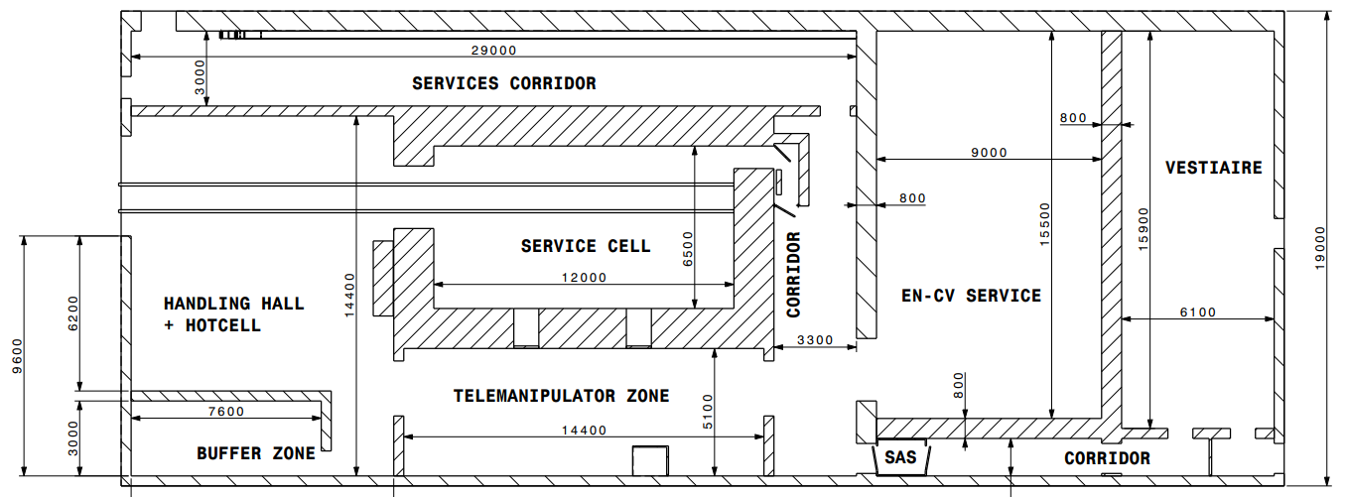
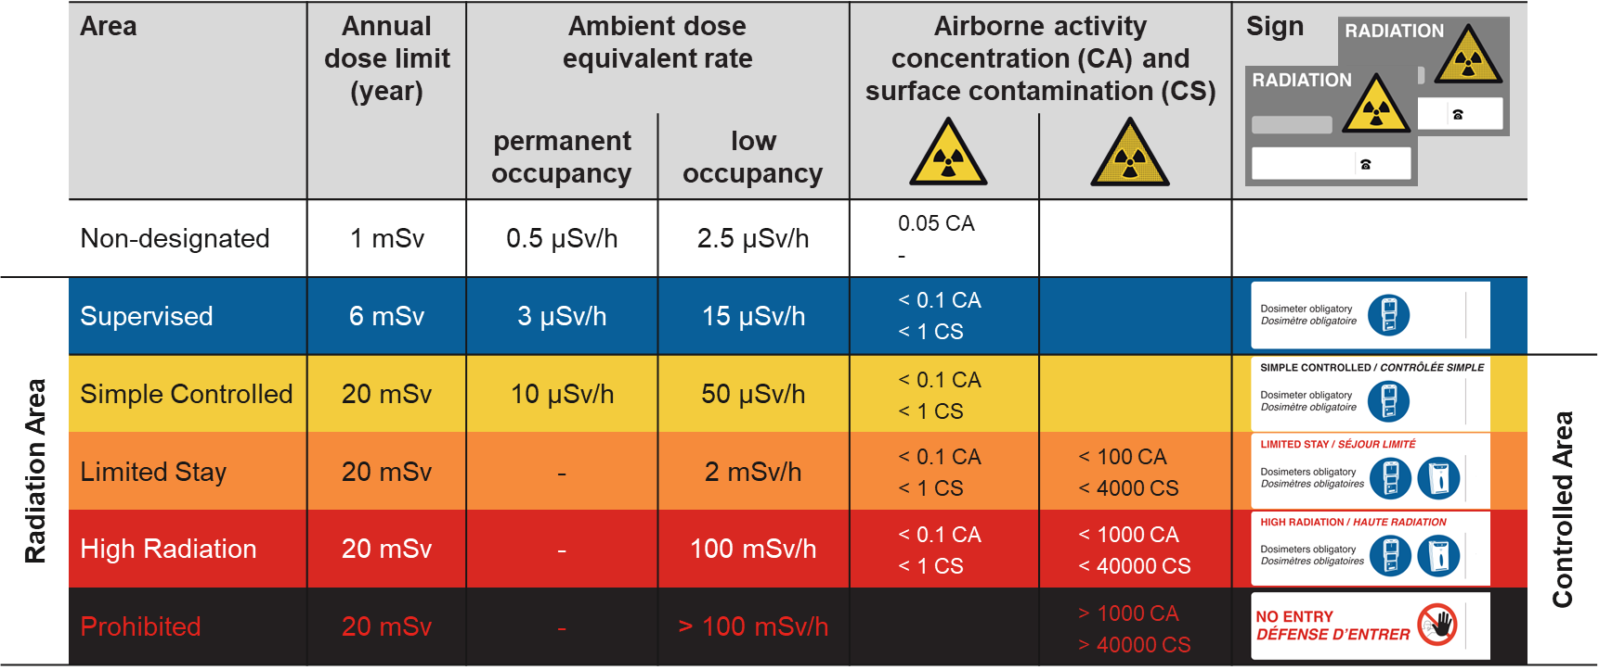
Service building area classification
At CERN, laboratories or working areas in which radioactive substances are manipulated are classified according to the Swiss Radiological Protection Ordinance (RPO)
This area classification is in addition to the standard CERN area classification
The work sector classification is based on the radionuclide dependent authorization limit LA
→ Specific working area requirements, e.g. ventilation, filters, fire resistance, decontami-nation possibilities, changing rooms, etc.
EN-CV service for cooling system:
  He-cooling: system with filters. In underground target area already HEPA filters + heat exchanger
  Water-cooling: ion exchanger cartridges w/ shielding underground
Ongoing design definition together with FIRIA
Simple Controlled or Limited Stay Radiation Area with Contamination Risk
Controlled Radiation Area with Contamination Risk
A
C
Simple Controlled or Limited Stay Radiation Area with Contamina-tion Risk
If required, dedicated room for hotcell
C
C
Class A and C working areas will in addition have a Controlled Radiation Area classification with contamination risk (Limited Stay or High Radiation Area)
Work sector | Maximum Activity
Normal | LA
Type C | 1E+02 LA
Type B | 1E+04 LA
Type A | Depending on authorization

Slide 25
Conclusions and outlook
Main radiological aspects regarding an implementation of BDF/SHiP in ECN3 were investigated
First shielding design for an optimization of exposure of personnel to radiation and radiological impact on environment
Further detailed studies and optimization in the Technical Design Phase including amongst others:
  BDF handling studies and target cask requirements
  Service building and service cell studies including shielding requirements (walls, storage, waste container, etc.)
  Evaluation of risks related to H-3 out-diffusion/ejection, and volatile radionuclides in the He-cooling system

Slide 27
Bibliography
[1] Website: https://fluka.cern
[2] C. Ahdida, D. Bozzato, D. Calzolari, F. Cerutti, N. Charitonidis, A. Cimmino, A. Coronetti, G. L. D’Alessandro, A. Donadon Servelle, L. S. Esposito, R. Froeschl, R. García Alía, A. Gerbershagen, S. Gilardoni, D. Horváth, G. Hugo, A. Infantino, V. Kouskoura, A. Lechner, B. Lefebvre, G. Lerner, M. Magistris, A. Manousos, G. Moryc, F. Ogallar Ruiz, F. Pozzi, D. Prelipcean, S. Roesler, R. Rossi, M. Sabaté Gilarte, F. Salvat Pujol, P. Schoofs, V. Stránský, C. Theis, A. Tsinganis, R. Versaci, V. Vlachoudis, A. Waets, M. Widorski, New Capabilities of the FLUKA Multi-Purpose Code, Frontiers in Physics 9, 788253 (2022)
[3] G. Battistoni, T. Boehlen, F. Cerutti, P.W. Chin, L.S. Esposito, A. Fassò, A. Ferrari, A. Lechner, A. Empl, A. Mairani, A. Mereghetti, P. Garcia Ortega, J. Ranft, S. Roesler, P.R. Sala, V. Vlachoudis, G. Smirnov, Overview of the FLUKA code, Annals of Nuclear Energy 82, 10-18 (2015)
[4] V. Vlachoudis, FLAIR: A Powerful But User Friendly Graphical Interface For FLUKA, in Proc. Int. Conf. on Mathematics, Computational Methods & Reactor Physics (M&C 2009), Saratoga Springs, New York (2009)
[5] H. Vincke, C. Theis, ActiWiz – optimizing your nuclide inventory at proton accelerators with a computer code, Progress in Nuclear Science and Technology (2014)
[6] P. Vojtyla, Models for assessing the dosimetric impact of releases of radioactive substances from CERN facilities to the environment – Air, CERN Internal report (2021)

Slide 28
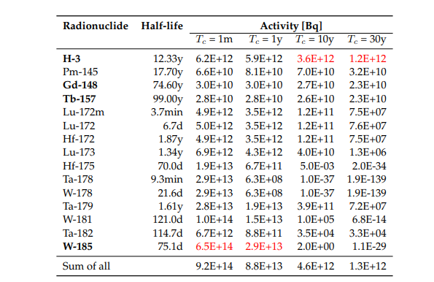
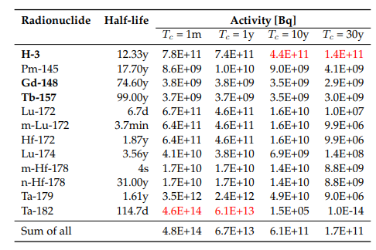
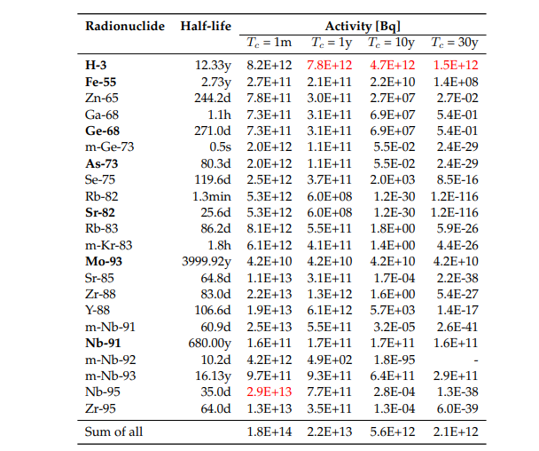
Activities multiples – CDS target
Total PoT 2×10²⁰ (5 yrs)
Activities of BDF target materials
W
Ta
TZM
Pure alpha/beta emitters are shown in bold
Dominant radionuclide is shown in red
Main contributors (>1%), sum for all radionuclides

Slide 29
Radionuclide inventory of W target
D = 25 cm, L = 150 cm
Total PoT 2×10²⁰ (5 yrs) + 1 month cool-down
Tungsten – Total Activity (Bq)
Tungsten – Multiple of LL
Tungsten – Multiple of LA
H-3 |  | 2.23E+13
W-185 | 67%, | 1.75E+15
W-181 | 13%, | 3.49E+14
Ta-178 | 3%, | 8.80E+13
W-178 | 3%, | 8.79E+13
Ta-179 | 3%, | 8.34E+13
Hf-175 | 2%, | 5.54E+13
Sum of all |  | 2.60E+15
H-3 |  | 1.57E+05
Ta-182 | 49% | 1.32E+08
Hf-175 | 15% | 3.90E+07
W-181 | 9% | 2.45E+07
Lu-173 | 5% | 1.46E+07
Lu-172 | 4% | 1.06E+07
Ta-178 | 2% | 6.19E+06
W-178 | 2% | 6.19E+06
Ta-179 | 2% | 5.87E+06
Re-184m | 2% | 4.53E+06
Eu-146 | 1% | 3.06E+06
Gd-146 | 1% | 2.77E+06
Sum of all |  | 2.69E+08
H-3 |  | 2.23E+05
Gd-148 | 59% | 4.78E+08
Hf-172 | 18% | 1.48E+08
W-185 | 11% | 8.77E+07
Ta-182 | 3% | 2.68E+07
Yb-169 | 1% | 9.67E+06
Hf-175 | 1% | 9.23E+06
Sum of all |  | 8.03E+08

Slide 30
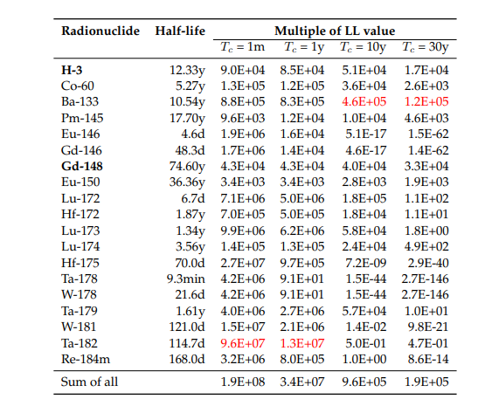
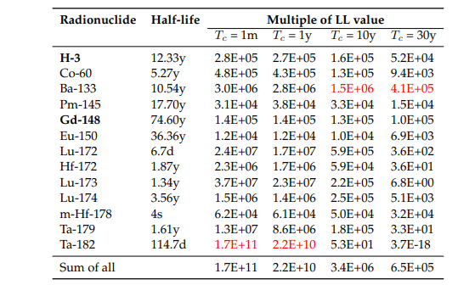
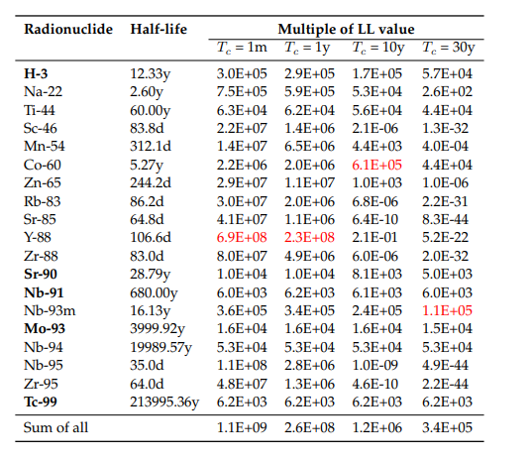
Multiples of Swiss Clearance Limits (LL)
CDS Target
Total PoT 2×10²⁰ (5 yrs)
LL multiples of BDF target materials
W
Ta
TZM
Pure alpha/beta emitters are shown in bold
Dominant radionuclide is shown in red
Main contributors (>1%), sum for all radionuclides

Slide 31
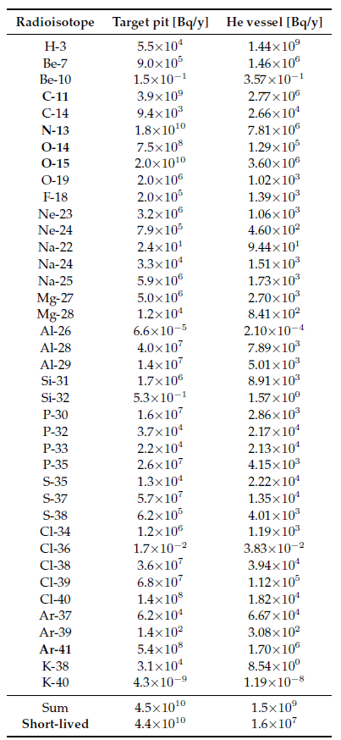
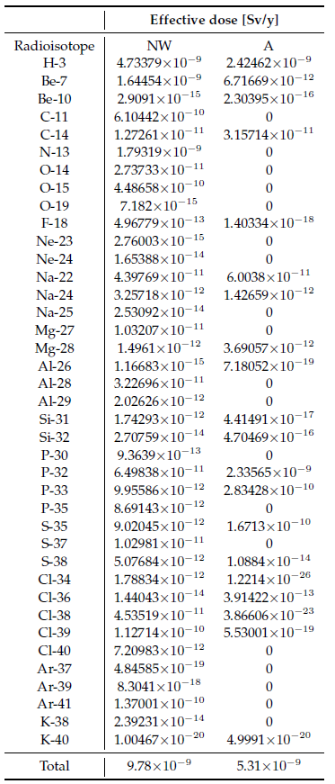
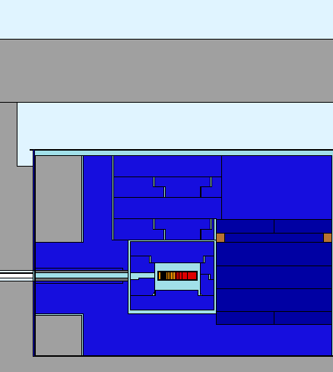
CDS air and He activation
Air and He regions in the target complex
Annual releases from the target pit and the He vessel
Effective dose to reference groups
Target pit
He vessel
1.4 GBq H-3 released to the air would lead to 5 nSv
A helium purification system provides a purity of at least 99.9% He (<0.1% air contamination)

Slide 32
Alternative cladding materials
Material: |  | Niobium | Nb-1Zr | Nb-10Hf-1Ti
 |  | (ASTM R04210 | (ASTM R04261 | "C103"
 |  | Type 2) | Type 4) | (ASTM R04295)
Density (g/cm3): |  | 8.6 | 8.6 | 8.86
Composition: | C | 0.01 | 0.01 | 0.015
Max Weight % | N | 0.01 | 0.01 | 0.01
 | O | 0.025 | 0.025 | 0.025
 | H | 0.0015 | 0.0015 | 0.0015
 | Zr | 0.02 | 0.8-12 | 0.7
 | Ta | 0.3 | 0.5 | 0.5
 | Fe | 0.01 | 0.01 | -
 | Si | 0.005 | 0.005 | -
 | W | 0.05 | 0.05 | 0.5
 | Ni | 0.005 | 0.005 | by difference
 | Mo | 0.02 | 0.05 | -
 | Hf | 0.02 | 0.02 | 9-11"
 | Ti | 0.03 | 0.03 | 0.7-1.3"
Reference: |  | [1] | [2] | [3]
[1] | https://www.navstarsteel.com/niobium-sheet.html
[2] | https://www.tantalum-niobium.com/niobium/nb-1zr-wire-rod.html
[3] | Ximenes Franqueira R., Internal communication, (2021)

Slide 33
Target vessel materials
Inconel - AW3.7 - 8.4 g/cm3
ALUMINUM | 1.15E-02
BORON | 6.00E-05
CARBON | 8.00E-04
CHROMIUM | 2.10E-01
COBALT | 1.00E-02
COPPER | 8.00E-03
IRON | 1.11E-01
MANGANESE | 3.50E-03
MOLYBDENUM | 3.30E-02
NICKEL | 5.50E-01
NIOBIUM | 5.50E-02
PHOSPHORUS | 1.50E-04
SILICON | 3.50E-03
SULFUR | 1.50E-04
TITANIUM | 3.00E-03
SS316LN - AW3.7 - 8 g/cm3
CARBON | 3.00E-04
COBALT | 1.00E-03
CHROMIUM | 1.73E-01
IRON | 6.39E-01
MANGANES | 2.00E-02
MOLYBDEN | 2.50E-02
NITROGEN | 1.70E-03
NICKEL | 1.30E-01
PHOSPHO | 2.25E-04
SULFUR | 7.50E-05
SILICON | 1.00E-02

Slide 34
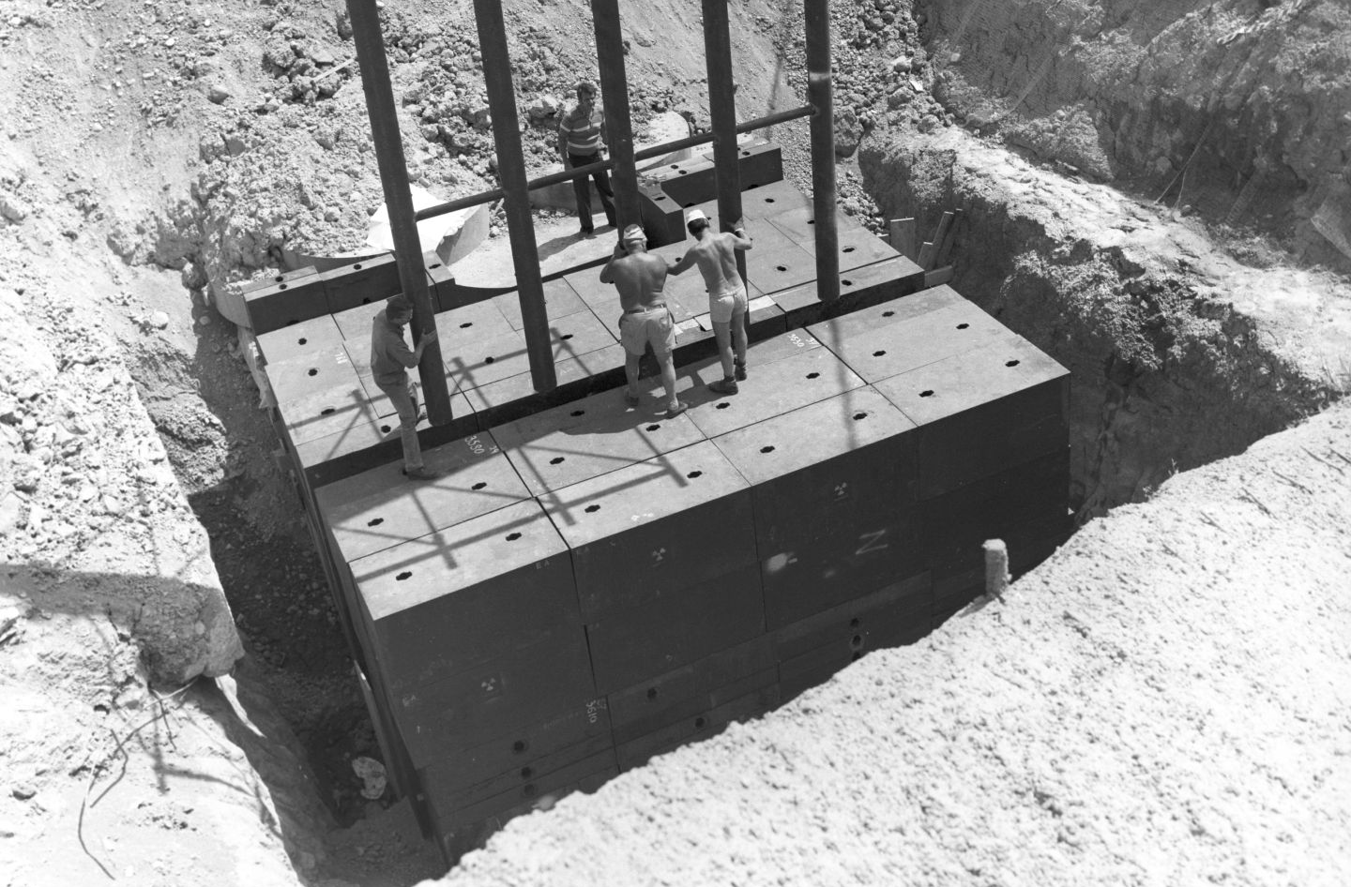
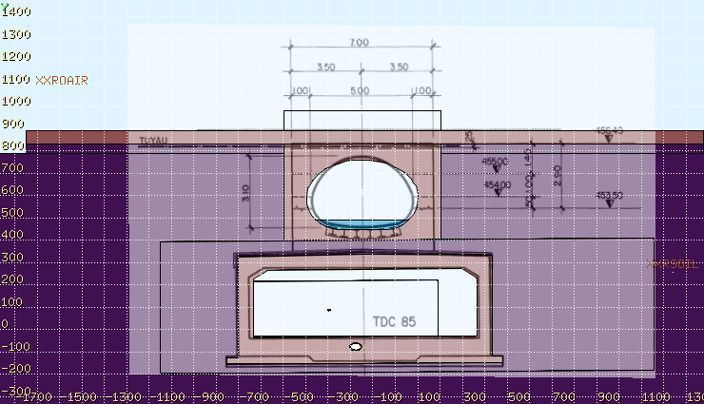
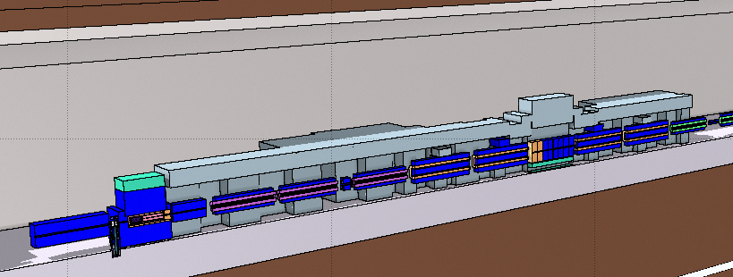
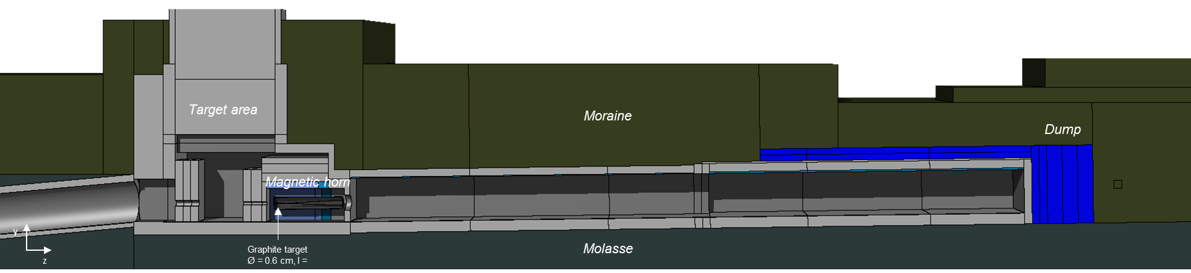
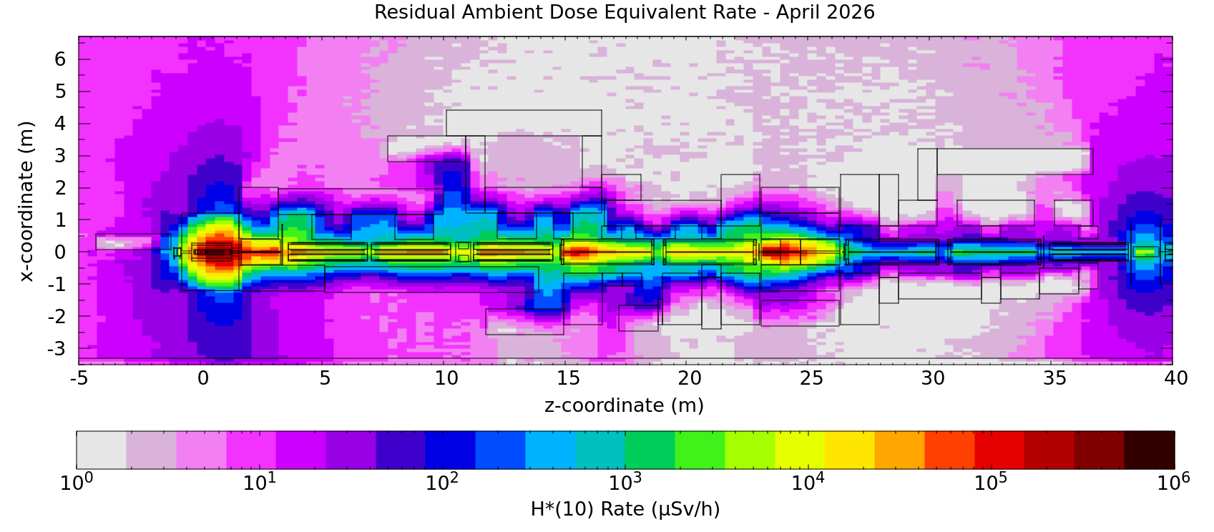
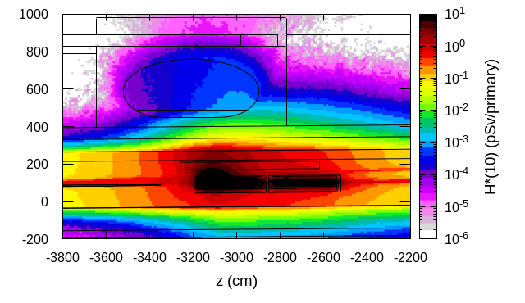


Some additional studies
Beam transfer
TT7 shielding recovery
TCC8 dismantling
Several RP studies for the high intensity SPS-ECN3 beam transfer were performed
This includes studies for a bridge above the TDC85 transfer tunnel near ECN3
Shielding recovery from discontinued CERN PS Neutrino Facility (PSNF)
Dismantling of the highly radioactive TCC8 target area in 2026
Evaluation of residual dose rates and radio-nuclide inventories for operational RP as well as radioactive transport and waste studies
~100 m³ std. cast iron blocks
~50 m³ non-std cast iron blocks
~3 MCHF, investment <1/3
TCC8
Residual H*(10)
Prompt H*(10)
Residual H*(10)
Radioactive waste zoning
Various beamline and shielding configurations were investigated

Slide 35



Optimization of MHS length
Ongoing optimization of MHS length to enhance SHiP’s physics performance, while maintaining optimization goals for radiation (RP, radiation to material) in the downstream area
FLUKA model
w/ reduced MHS length
Prompt radiation
Residual radiation
Along z-axis
Along z-axis
<X> = [-12:12] cm, <Y> = [-20:15] cm
<X> = [-12:12] cm, <Y> = [-13:15] cm​
40 cm distance
1.5 m
2.3 m
Preliminary
Preliminary
25 cm
MHS length and dump reduced from 4.5 m to 2.3 m with full W target and Cu plug
Prompt dose rate for the reduced length is ~7 times higher than for the longer version
Along beamline dose rates are compatible with Supervised Radiation area after 1 day. On sides expected to be lower

Slide 36



Radioactive Material
When is a material radioactive?
Specific and total activity exceed clearance limits (LL values)
as given in the Annex of EDMS 942170 (adopted from Swiss legislation)
OR
Net ambient dose equivalent rate > 0.1 µSv/h in 10 cm distance
OR
Surface contamination exceeds limits
as given in the Annex of EDMS 942170 (> 1 CS)
Examples: 0.1 Bq/g for ²²Na, ⁵⁴Mn, ⁶⁰Co
1000 Bq/g for ⁵⁵Fe
Sum rule for mixture
of radionuclides:
Sum rule for mixture
of radionuclides:

