Slide 2
Target Systems ventilation system integration
1st Beam Dump Facility (BDF) Targetry Systems Advisory Committee (TSAC)
F.Dragoni, N.Zaric
05/03/2025
https://hiecn3.web.cern.ch

Slide 3
Agenda
Review of confinement consumptions in ventilation systems
  Reference documents
New service building
  Ventilation systems & pressure cascade
  Preliminary failure modes and impacts
Underground area
  Ventilation systems
F. Dragoni, N. Zaric | Target Systems ventilation system integration
4-6 March 2025

Slide 4
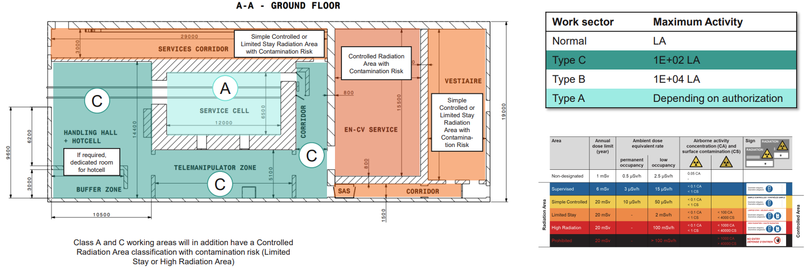
New service building – ventilation system
RP input document: EDMS 3237086
F. Dragoni, N. Zaric | Target Systems ventilation system integration
4-6 March 2025

Slide 5
New service building – ventilation system
RP input document: EDMS 3237086
  Class A requirements:
  - min. fresh air: 5 ach
  - min. ΔP: -50Pa
  - extraction must be guaranteed in case of power cut → Redundant power supply
  Class C requirements:
  - no min. fresh air requirements
  - needs for underpressure level, but no min. requirements
  - no needs for redundant power supply
F. Dragoni, N. Zaric | Target Systems ventilation system integration
4-6 March 2025

Slide 6
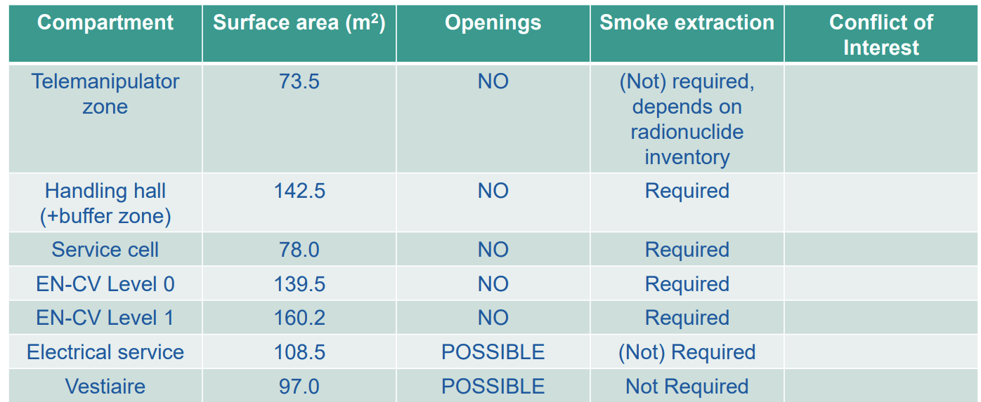
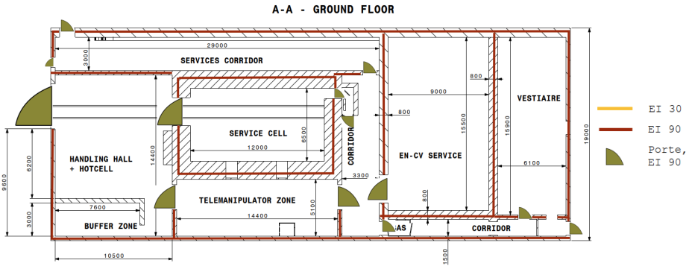
New service building – ventilation system
FIRIA input document: EDMS 3237086
  Fire compartments
  Smoke extraction zones
  Filtration needed for CLASS A (service cell)
F. Dragoni, N. Zaric | Target Systems ventilation system integration
4-6 March 2025

Slide 7
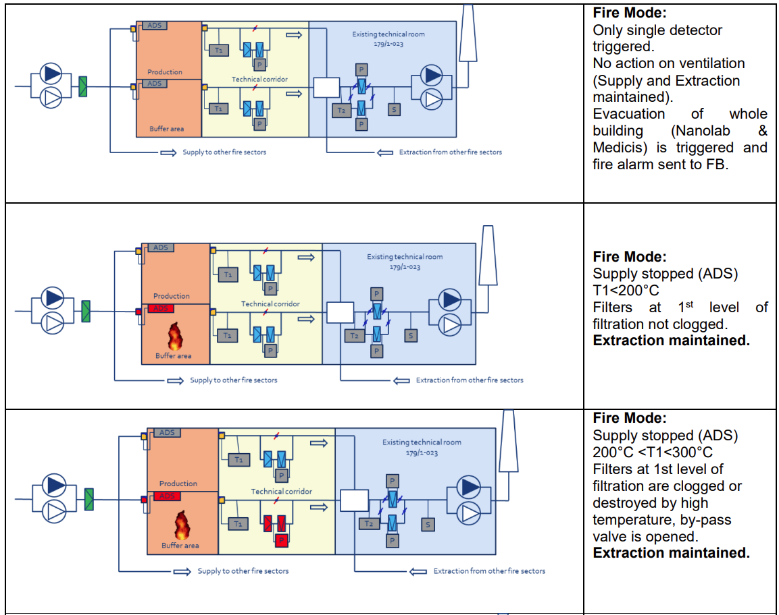
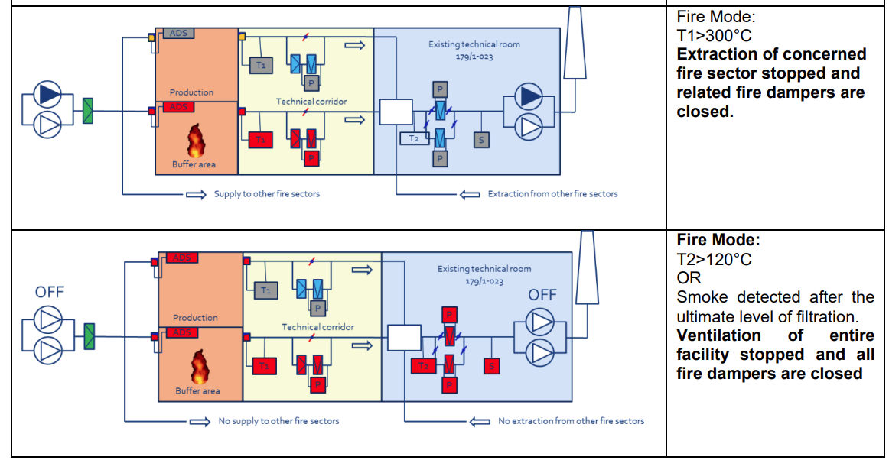
New service building – ventilation system
FIRIA input document: NANOLAB example
F. Dragoni, N. Zaric | Target Systems ventilation system integration
4-6 March 2025

Slide 8
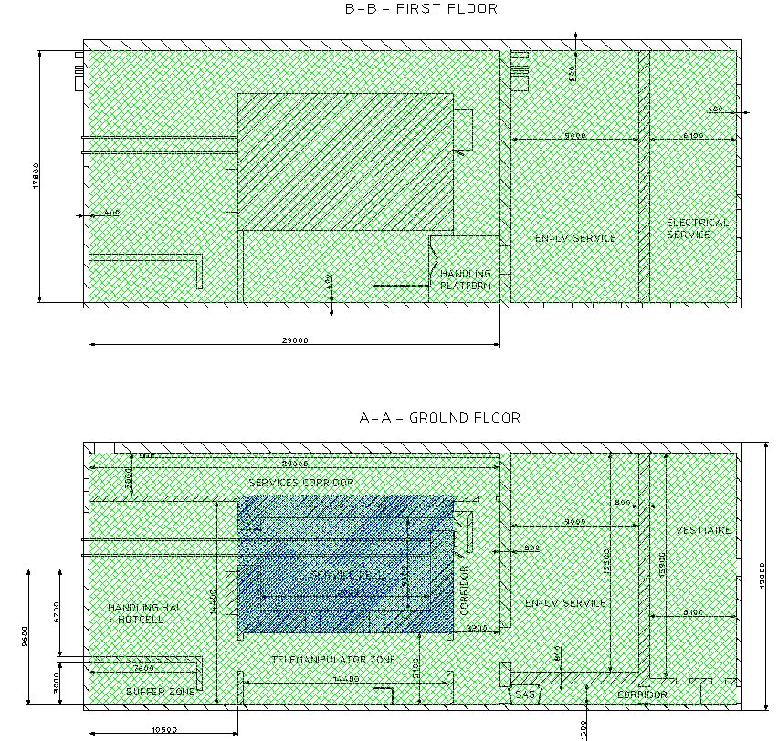
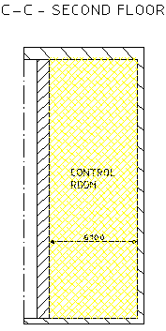
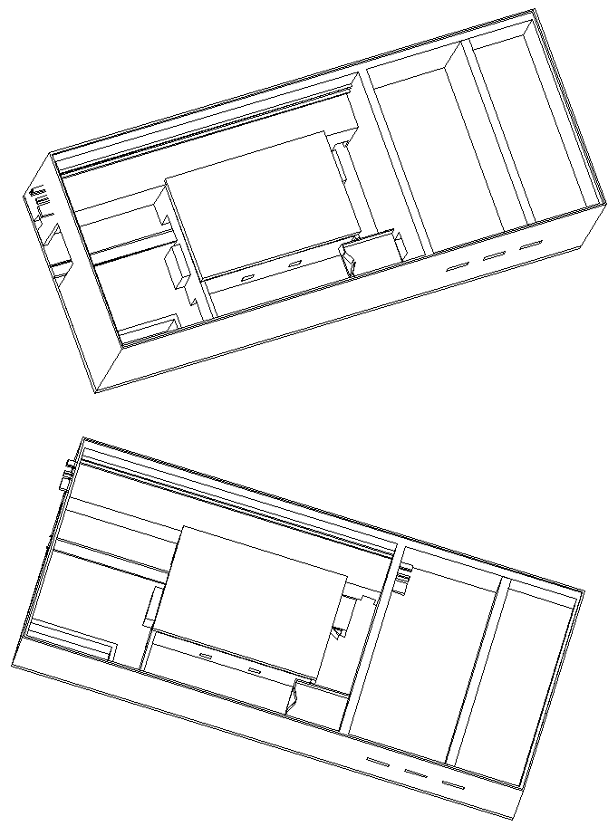
New service building – ventilation system
S-1 Zone
Full fresh air ~ 2,300 m3/h
N+1 redundancy
Filters nearby Service Cell and in filter room
0Pa
-20Pa
0Pa
S-2 Zone
Full fresh air ~ 12,660 m3/h
No redundancy
Filters in filter room
-10Pa
-30Pa
-30Pa
-10Pa
-50Pa
S-3 Zone
~ 1,000 m3/h
No redundancy
0Pa
-10Pa
-10Pa
-10Pa
+30Pa
0Pa
F. Dragoni, N. Zaric | Target Systems ventilation system integration
4-6 March 2025

Slide 9
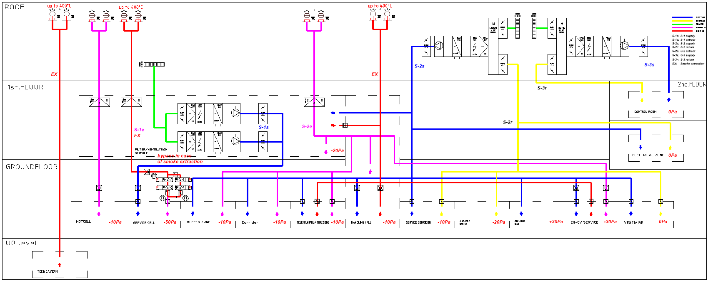
New service building – ventilation synoptics
F. Dragoni, N. Zaric | Target Systems ventilation system integration
4-6 March 2025

Slide 10
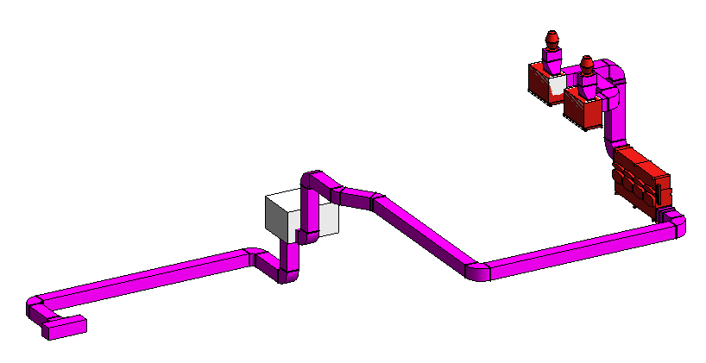
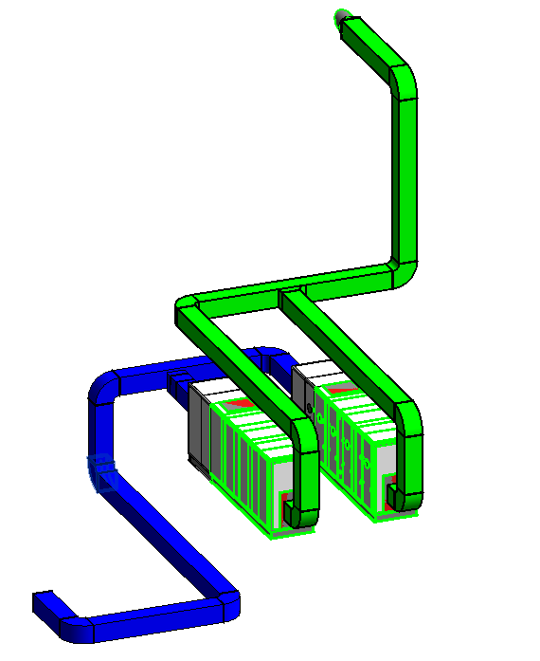
New service building – ventilation synoptics
(Smoke)
extractors
Service Cell
  2,300 m3/h full fresh air supply unit
  Extractor rated at 400 ̊C /2h + → maintenance of -50 Pa as required
  → this system will be on Redundant power supply
  Two level of exhaust air filtration
1st level of filtration
2nd level
of filtration
Fresh air
intake
AHUs
S-1 supply
F. Dragoni, N. Zaric | Target Systems ventilation system integration
4-6 March 2025

Slide 11
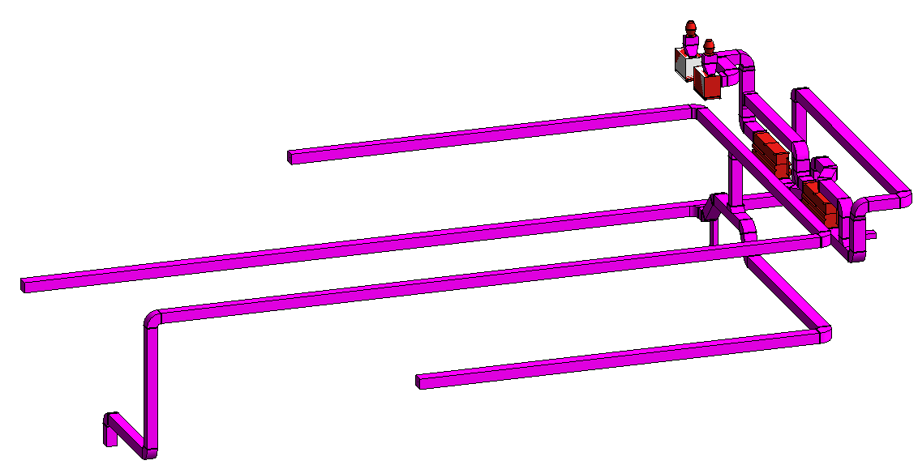
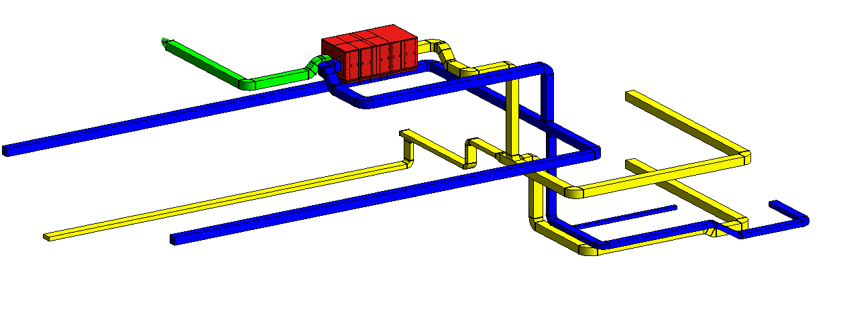
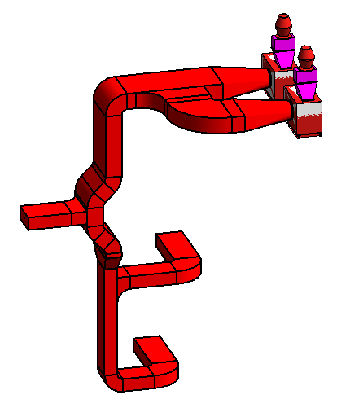
New service building – ventilation synoptics
Extractors
ALL OTHER ROOMS except Control room
  12,660 m3/h full fresh air unit
  Recirculation of air possible for some rooms → using less energy for treating fresh air
  Smoke extraction for some zones, extractors rated at 400 ̊C /2h
  One level of exhaust air filtration
S-2 exhaust
Filters
Fresh air
intake
AHU
S-2 return
S-2 supply
Smoke
extractors
Smoke extraction system
F. Dragoni, N. Zaric | Target Systems ventilation system integration
4-6 March 2025

Slide 12
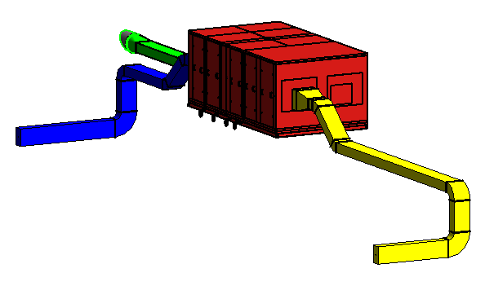
New service building – ventilation synoptics
Control room
  1,000 m3/h unit
  Recirculation of air → using less energy for treating fresh air
  No needs for mechanical smoke extraction
  Only fresh air is filtrated
Fresh air
intake
AHU
S-3 supply
S-3 return
F. Dragoni, N. Zaric | Target Systems ventilation system integration
4-6 March 2025

Slide 13
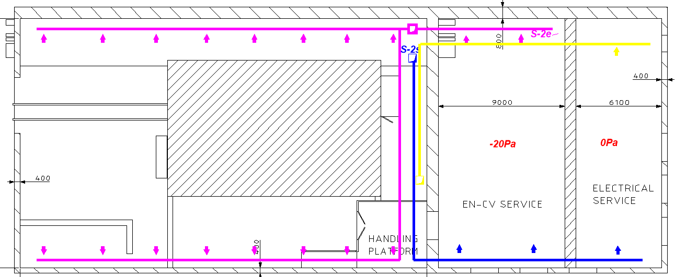
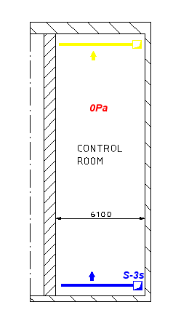
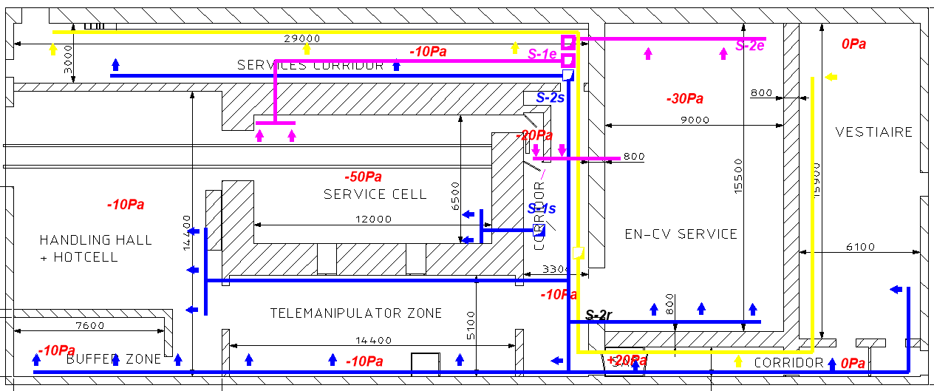
New service building – ventilation ductwork and integration
1st floor
2nd floor
Groundfloor
F. Dragoni, N. Zaric | Target Systems ventilation system integration
4-6 March 2025

Slide 14
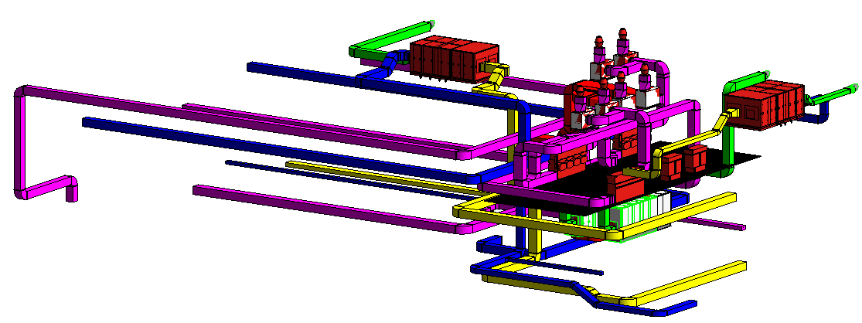
New service building – ventilation ductwork and integration
S-2 AHU
Smoke extractors
S-3 AHU
Filters
S-1 AHUs
F. Dragoni, N. Zaric | Target Systems ventilation system integration
4-6 March 2025

Slide 15
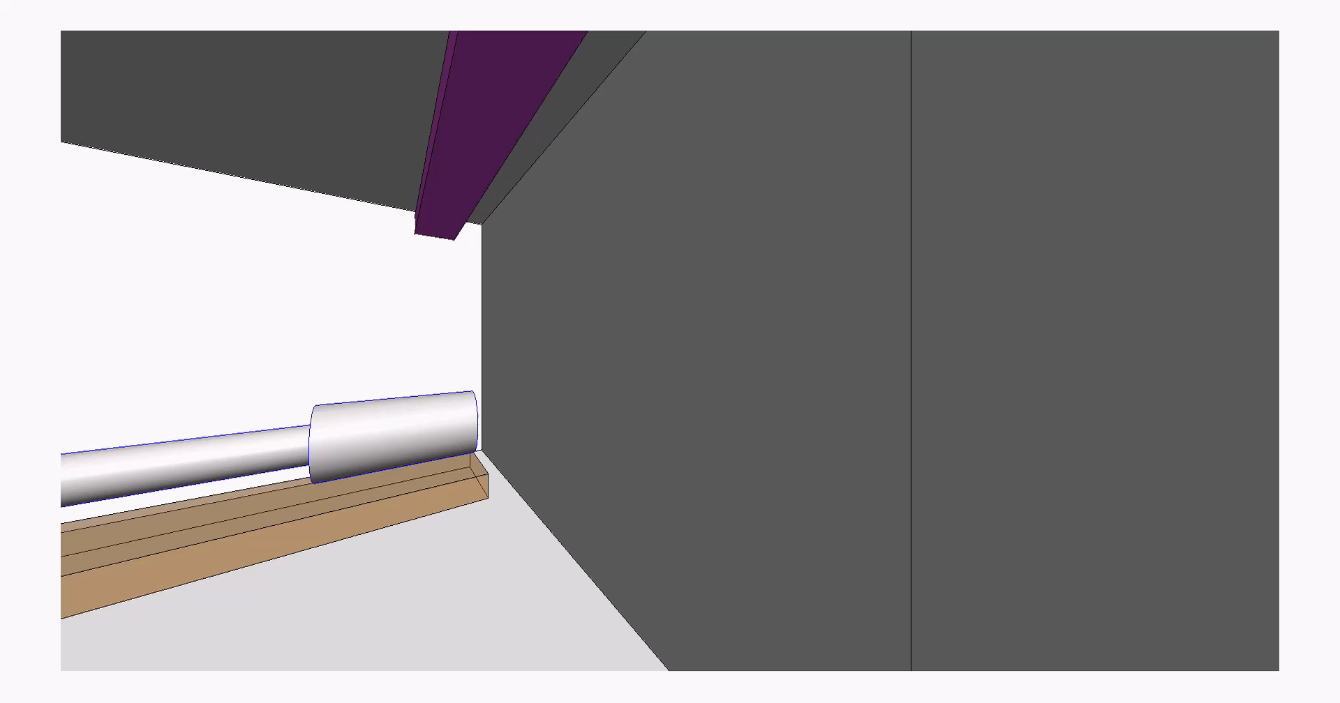
New service building – ventilation ductwork and integration
F. Dragoni, N. Zaric | Target Systems ventilation system integration
4-6 March 2025

Slide 16
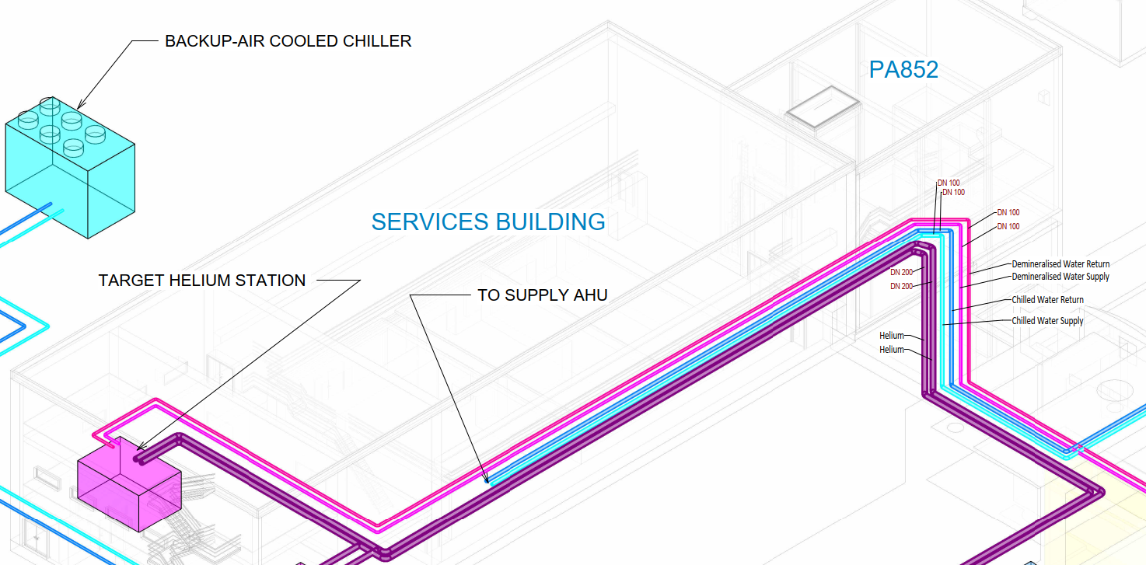
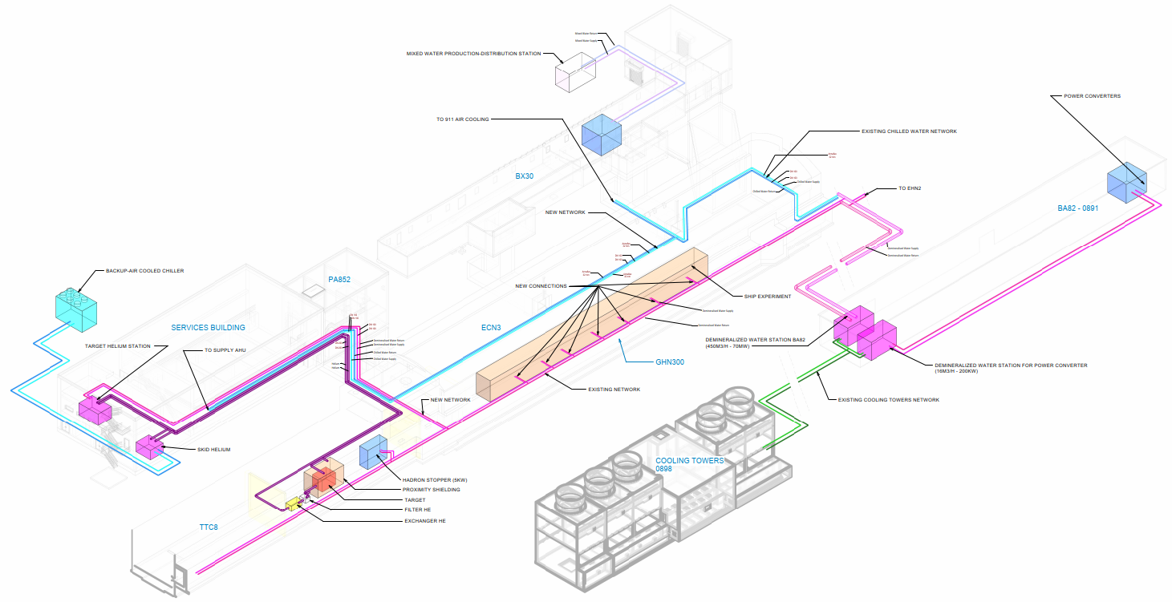
Demineralized & Chilled water synoptics
New service building: 250 kW load on chilled water for AHUs
F. Dragoni, N. Zaric | Target Systems ventilation system integration
4-6 March 2025

Slide 17
New service building – ventilation system
New service building – ventilation system
Preliminary failure modes and impacts – Service cell
SERVICE CELL
DOOR
HANDLING HALL
AHU
DYNAMIC CONFINEMENT
EXTRACTOR
AHU
EXTRACTOR
POWER CUT
REDUNTANT POWER SUPPLY
F. Dragoni, N. Zaric | Target Systems ventilation system integration
4-6 March 2025

Slide 18
New service building – ventilation system
New service building – ventilation system
Preliminary failure modes and impacts – ALL OTHER ROOMS except Control room
ROOMS
DOOR
(4m x 5.5m)
BLD.911
EXTRACTOR
DYNAMIC CONFINEMENT
AHU
EXTRACTOR
SMOKE EXTRACTOR
POWER CUT
SMOKE EXTRACTOR
REDUNTANT POWER SUPPLY
F. Dragoni, N. Zaric | Target Systems ventilation system integration
4-6 March 2025

Slide 19
New service building – ventilation system
New service building – ventilation system
Preliminary failure modes and impacts – Control room
CONTROL ROOM
DYNAMIC CONFINEMENT
AHU
POWER CUT
F. Dragoni, N. Zaric | Target Systems ventilation system integration
4-6 March 2025

Slide 20
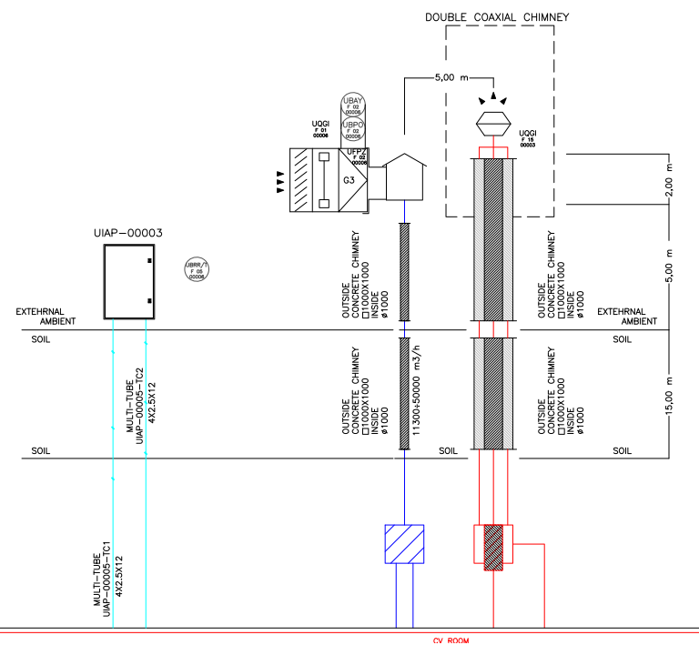
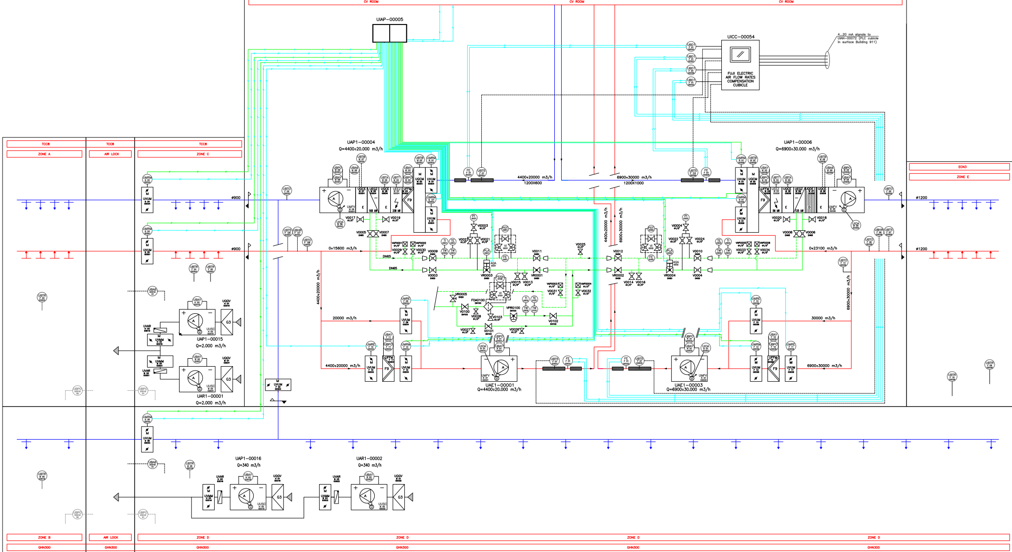
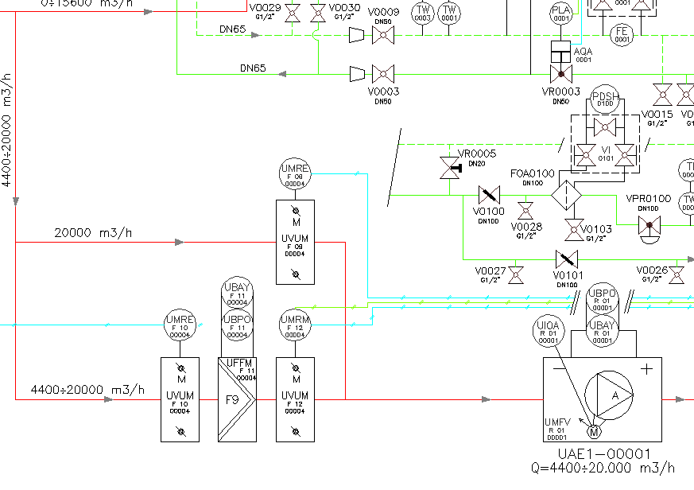
Underground cavern – TCC8 & ECN3
  ECN3: Cooling capacity: 125kW
  Flow rate: 30.000m3/h
  TCC8: Cooling capacity: 168kW
  Flow rate: 20.000m3/h
F. Dragoni, N. Zaric | Target Systems ventilation system integration
4-6 March 2025

Slide 21
Underground cavern – TCC8 & ECN3
F. Dragoni, N. Zaric | Target Systems ventilation system integration
4-6 March 2025

Slide 22
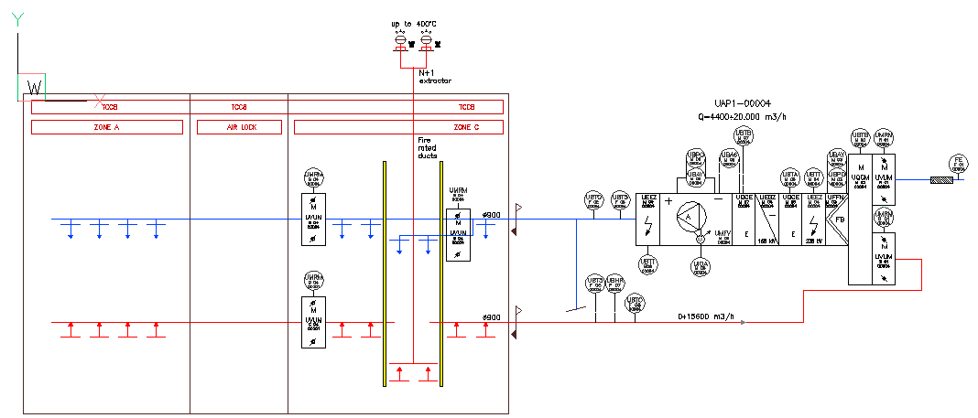
Underground cavern – TCC8
Fire rated smoke extraction ducts, up to 240 min
Class “D” leakage rate ducts
Extractors will be placed on the roof of service building
F. Dragoni, N. Zaric | Target Systems ventilation system integration
4-6 March 2025

