Slide 1
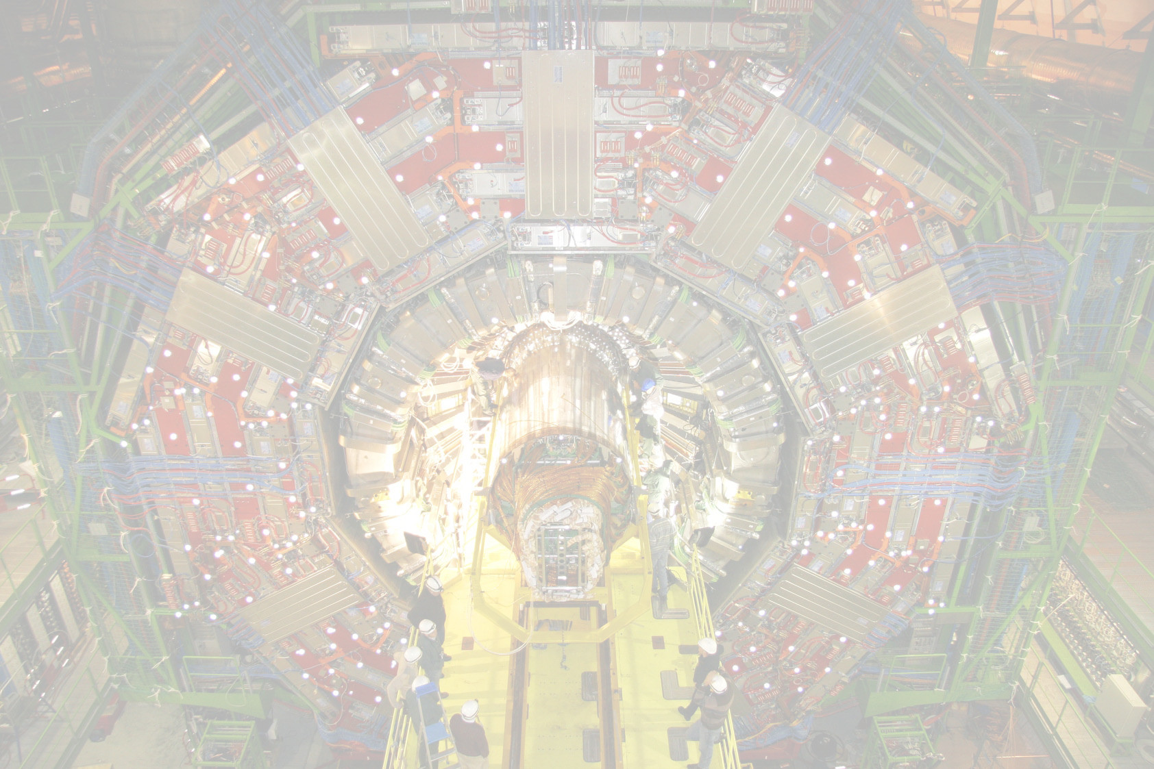


Radiation Damage in the CMS Strips Tracker
Christian Barth on behalf of the CMS Tracker Collaboration

Slide 2
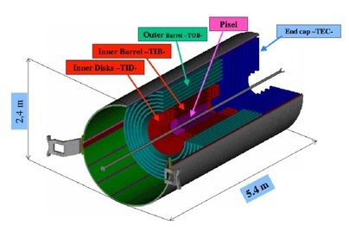
The CMS Strips Tracker
200 m² active silicon sensor area (p-on-n)
About 6000 sensors of 300µm
20000 sensors of
500µm
Currently operated at 300V bias voltage
Expected fluence exposure: up to 2x10¹⁴ 1MeV neutron equivalent

Slide 3
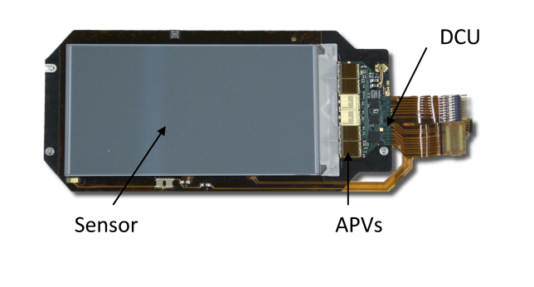
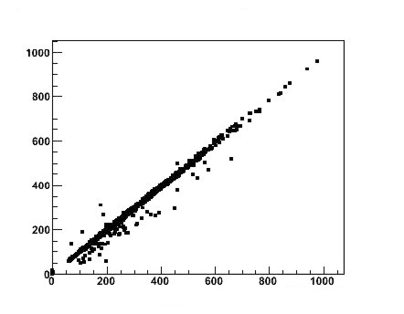
DCU
DCU readout of the leakage current vs. the corresponding power supply measurements after 4.7fb⁻¹.
DCU
readout
The detector control unit is a ASIC sitting on each of the tracker modules, with the ability to measure the temperature at different positions of the module as well as the leakage current and LV voltages applied.
Power Supply Readout
Each high voltage line of our power supply system is connected to 3-12 modules, to achieve higher granularity we need to use the DCU information.

Slide 4
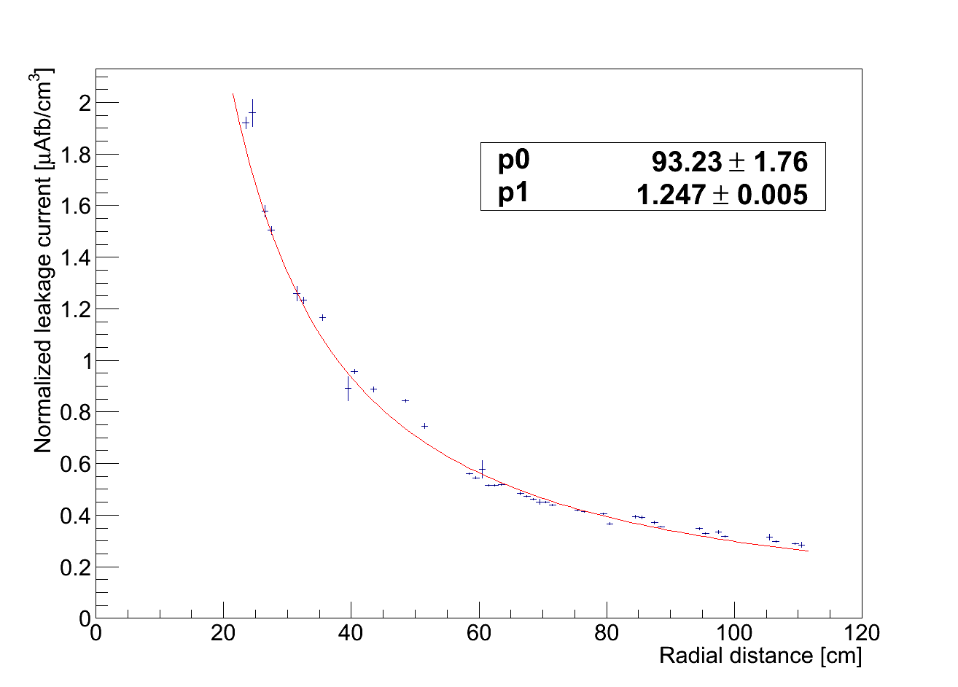
Radial Dependency of Leakage Current Measurements
Slope of leakage current increase per fb-1 after 4.7 fb-1
normalized to 1cm³ and 0°C
The normalized leakage current is averaged within each bin of a given radial distance r

Slide 5
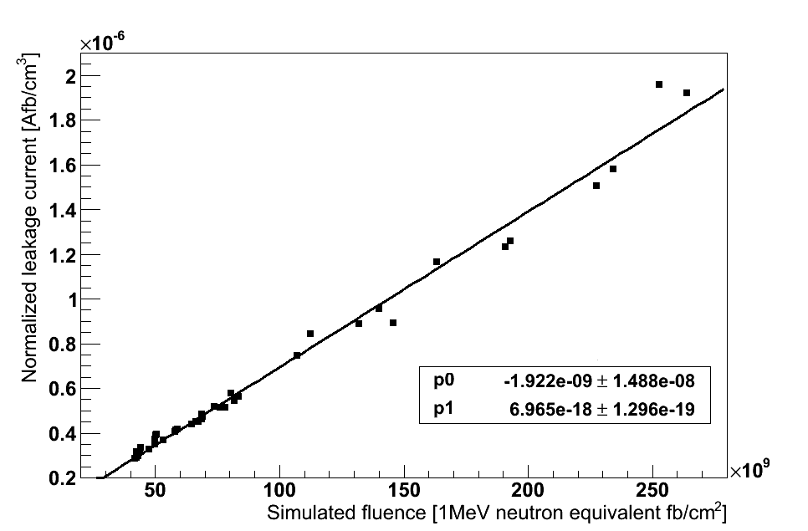
Normalized Leakage Current Measurements vs. Fluence Simulation
Slope of leakage current increase per fb-1 after 4.7 fb-1
normalized to 1cm³ and 0°C
The slope of the fit is a measure of the effective alpha factor (scaled to 0C).
Rescaled to 20°C this leads to 4.66 e-17 A/cm
Fluence derived from 7TeV FLUKA simulation scored to 1MeV neutron equivalent.
Notes:
To say: Fluence value corresponding to a point in space (module) which is a linear interpolation from the FLUKA grid values of a granularity of 2.5x2.5 cm
Say: Mind radiation damage and annealing happens simultaneously

Slide 6
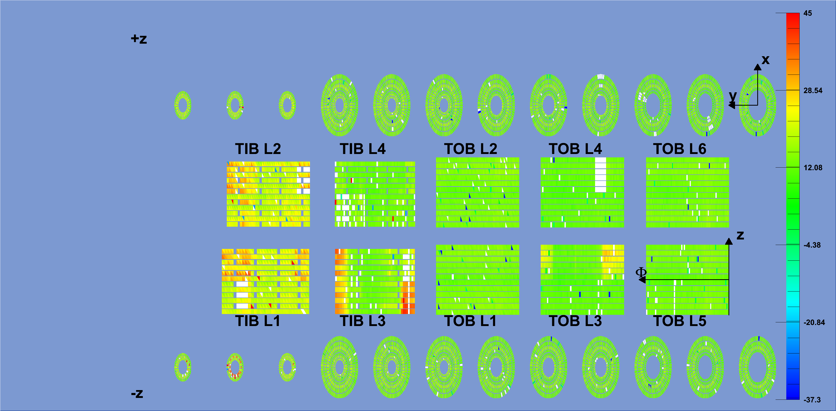
Real Temperature Distribution within the Tracker
Quite high temperature spread within the tracker (some elements un-cooled)
Current normalization is needed to allow comparison
Simulate the leakage current on module granularity
Radiation damage and annealing processes are simultaneously present
➔ develop a tool on module granularity and work on a day by day basis in an integral way

Slide 7
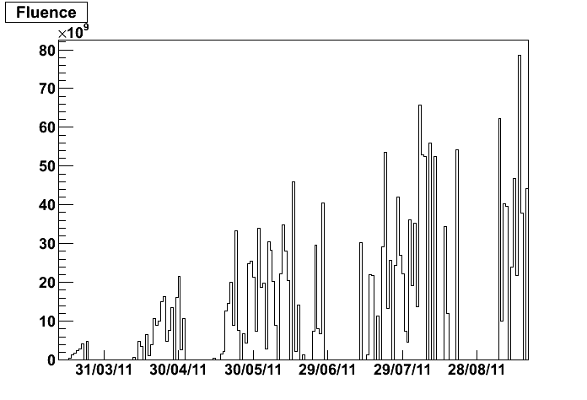
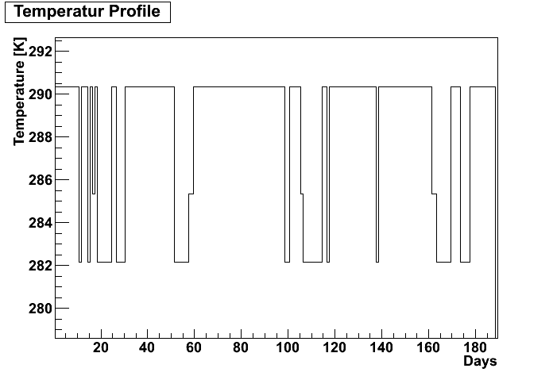
Simulation
Inputs:
Fluence at the module position
  Linear interpolation of Fluka grid values (& integrated luminosity)
Temperature of the modules
  Measured by DCU
Method/Tools:
Histograms filled with one bin per day for the temperatures and fluences
Afterwards the impact of each day’s fluence to all consecutive days is computed with the annealing time constants based on the given temperature at the respective day.
The integrated sum over all days gives the result
Output
leakage current
  Leakage current of modules for comparison
    Measured by DCU, cross checked by PS values
Depletion voltage
  Tools to determine Vdep in-situ exists
    Changes are still within measurement precision
Day x-fluence
Impact based on respective temperature
. . .

Slide 8
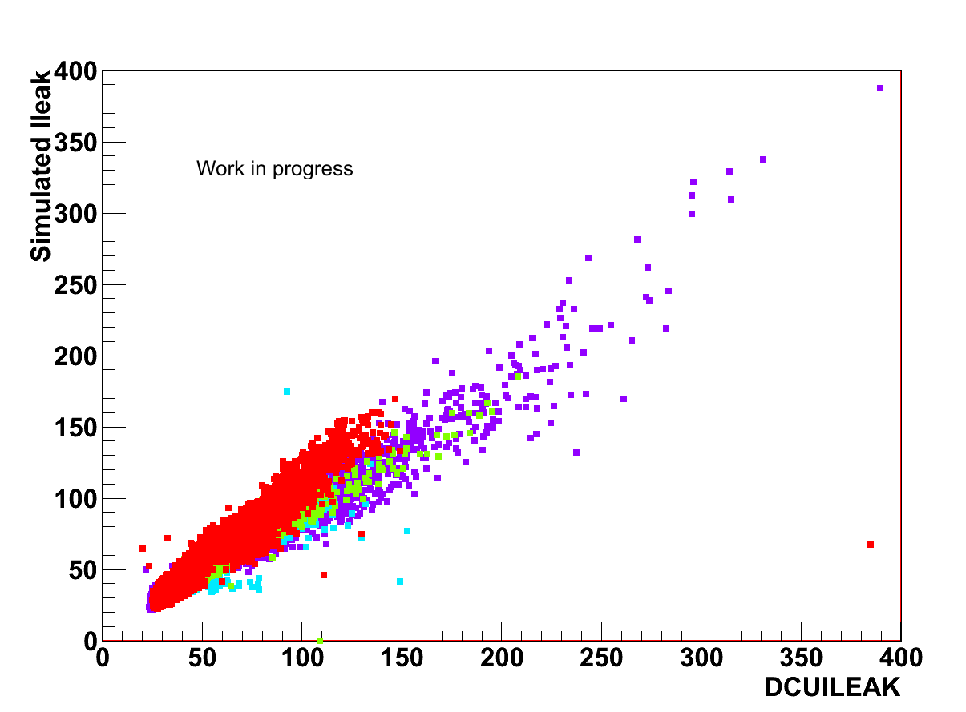
Cross Check the Simulations
The correlation plot shows in total a good agreement between simulation and measurement after 5fb⁻¹
(red=TEC, green=TOB, teal=TID, purple=TIB)

Slide 9
Depletionvoltage Measurements
CMS currently uses two different measurement types:
The Noise Scan - performed during interfill periods
The Signal Scan - monthly performed for 5 power groups (37 modules out of 15000) - twice a year for the whole tracker

Slide 10
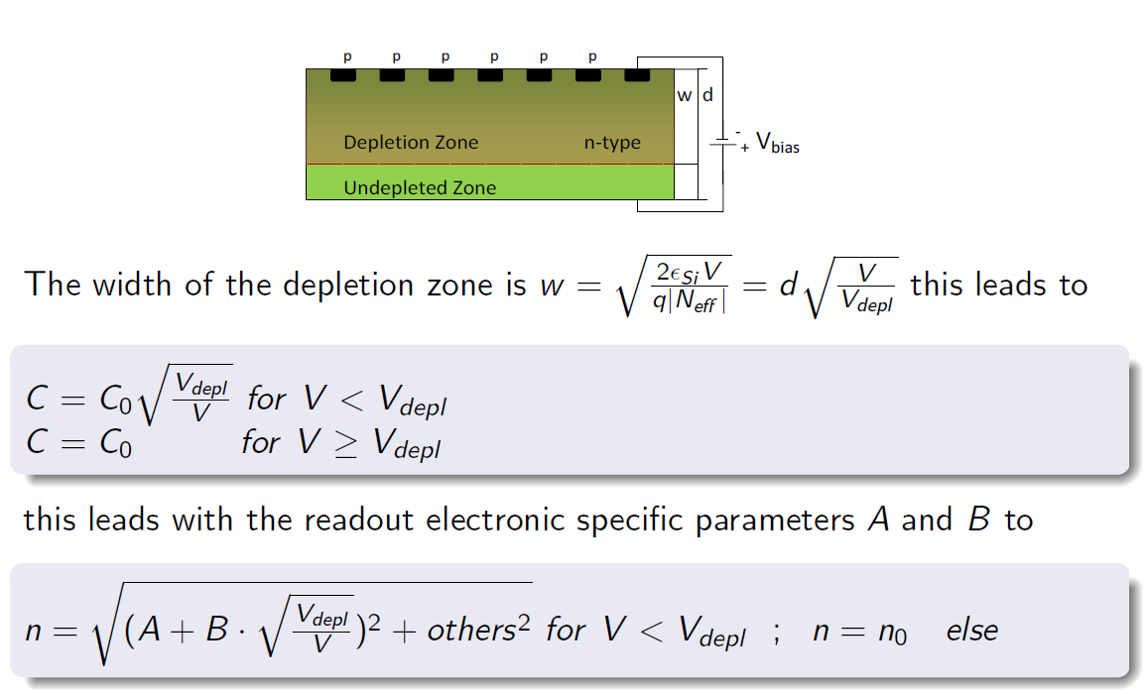
Principles of the Noise Method

Slide 11
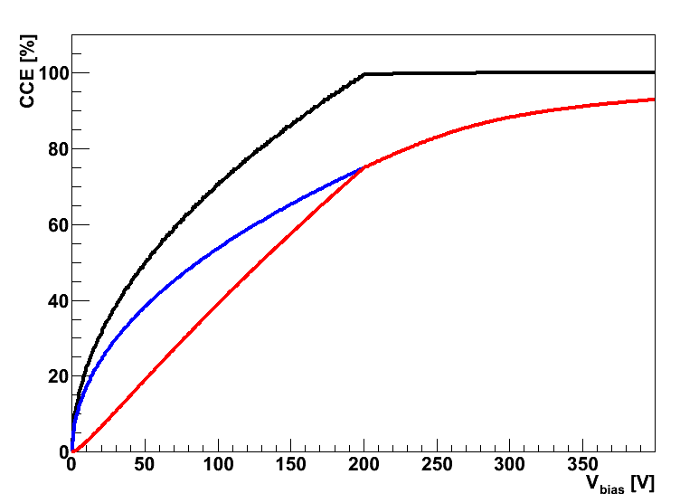
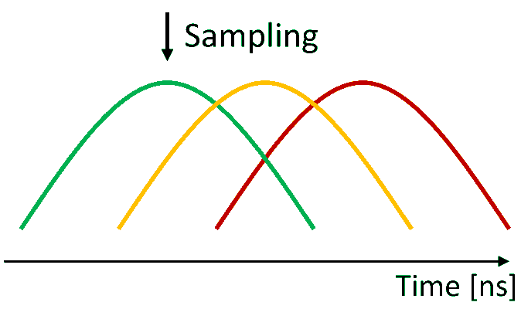
The Signal Method
Only effect 1
Three effects are taken into account with our model:
Variation of depletion zone width
Change in the mobility of charge carriers
Change in the load capacitance of the APV leading to a suboptimal sampling
Effect 1 and 2
All three effects

Slide 12
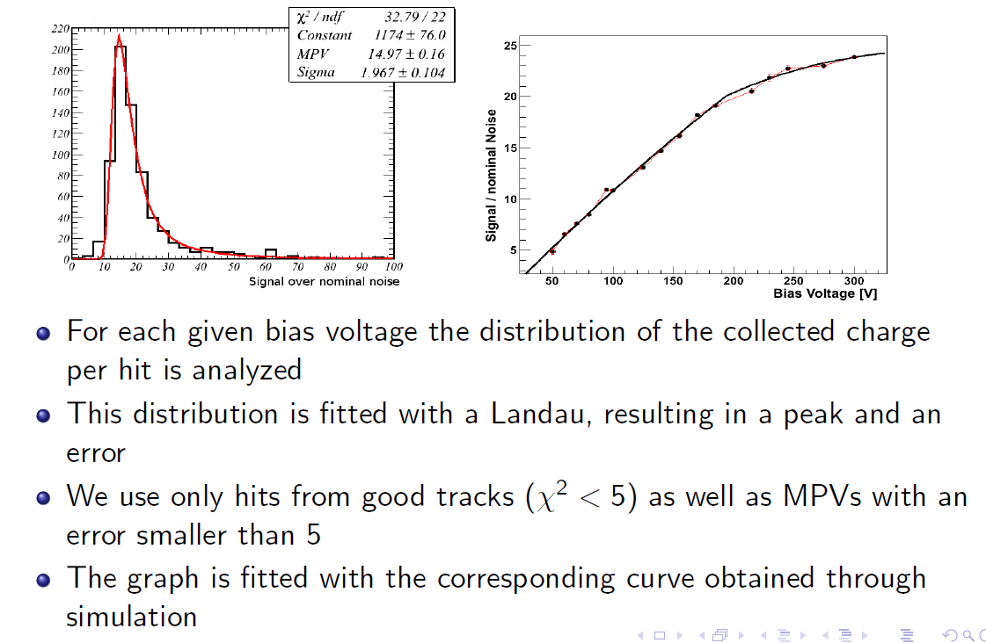

Approach of the Signal Method

Slide 13
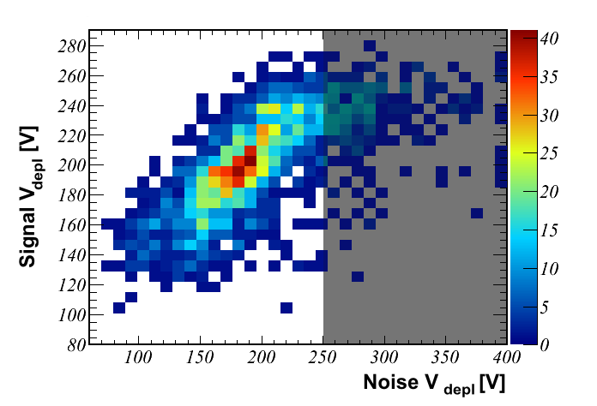
Method Compatibility
Correlation plot between the results of the signal method vs the noise method in the tracker outer barrel partition.
The comparison between noise derived values or signal derived values also match quite well with the original lab (CV) measurements
Notes:
Mention comparison to initial measurements!!

Slide 14
Depletion Voltage Changes
So far there is no change in depletion voltage visible exceeding the accuracy of the measurement.
From simulation we expect a change up to 5V for the 5fb⁻¹ delivered so far.
Thus for strips we cannot yet validate the simulation with data.

Slide 15
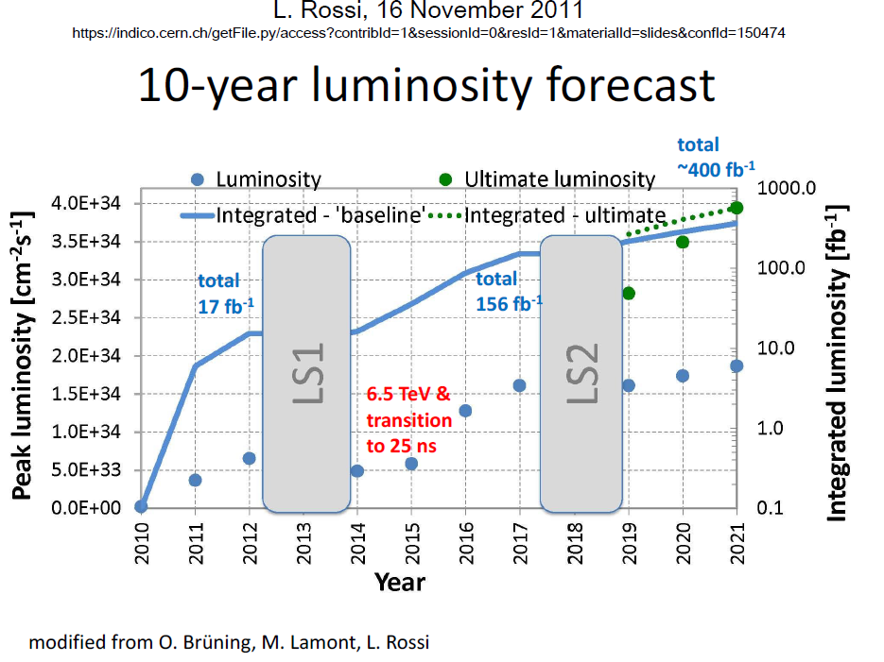
Assumed Luminosity Profile
Agreed Scenario within the inter-experiment working group

Slide 16
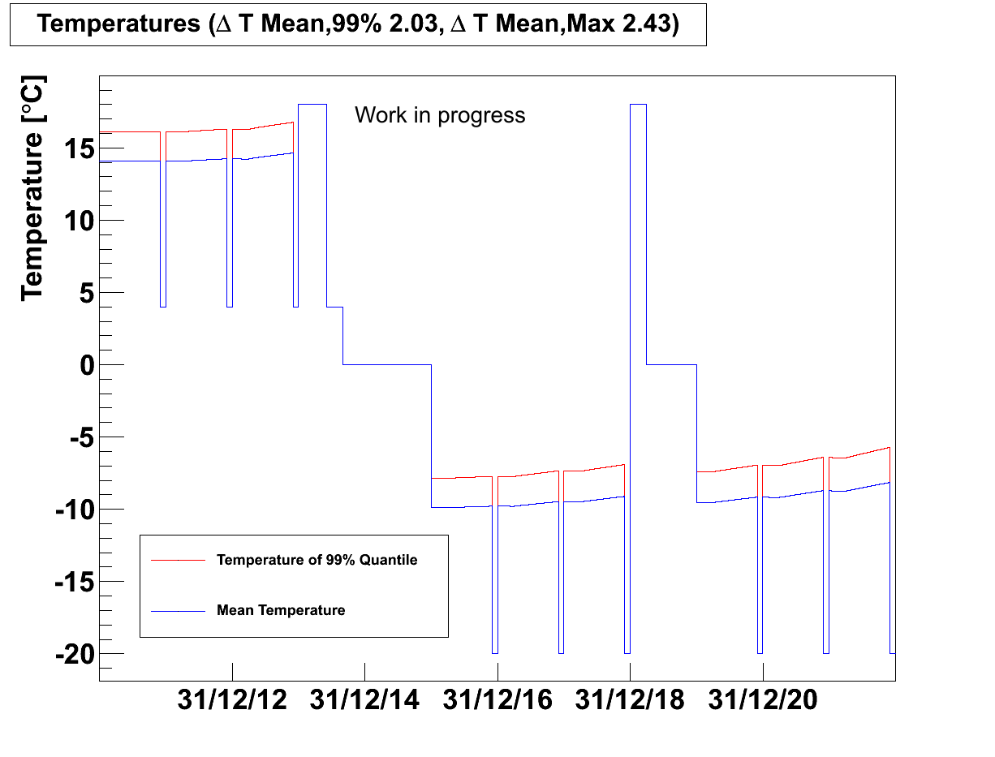
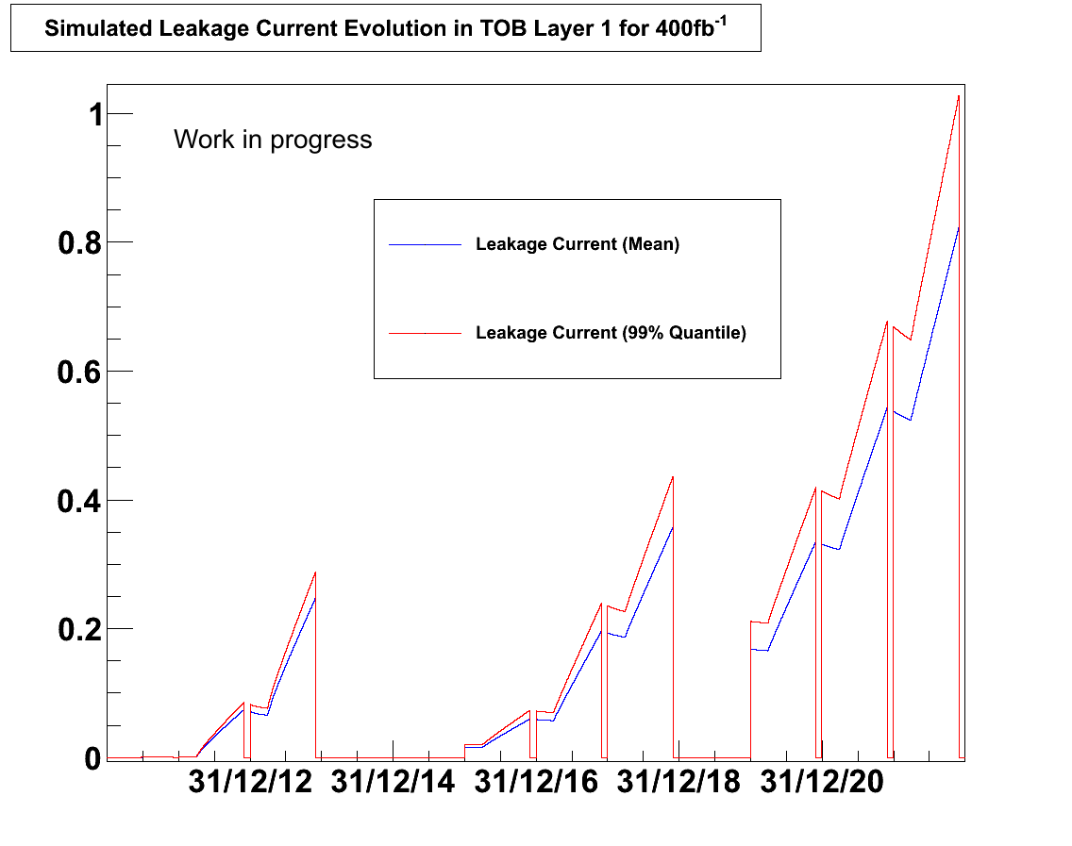
Tool to evaluate
Future Evolution of Leakage Currents
We developed a tool to evaluate different temperature scenarios throughout the lifetime of the CMS – understand shut down periods
The tool example shows the leakage Simulation for Tracker Outer Barrel Layer 1 (at around r=58.5cm):
  One can see the average (blue) and the 99% quantile cases (red)
  Current is shown for a two sensor module (Si volume: 18.6x9.36x0.05 cm³)
The tool also takes the radiation, annealing and also self-heating into account
We validated the tool with the 5fb⁻¹ collected so far -> see slide 8
Notes:
refer to 5fb comparison done before

Slide 17
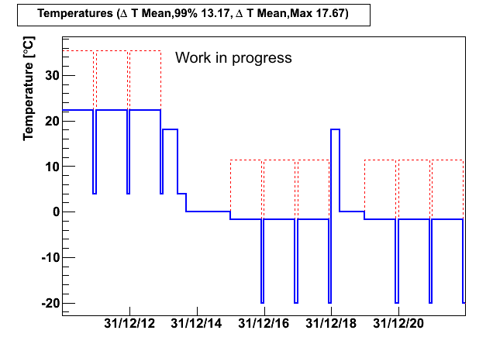
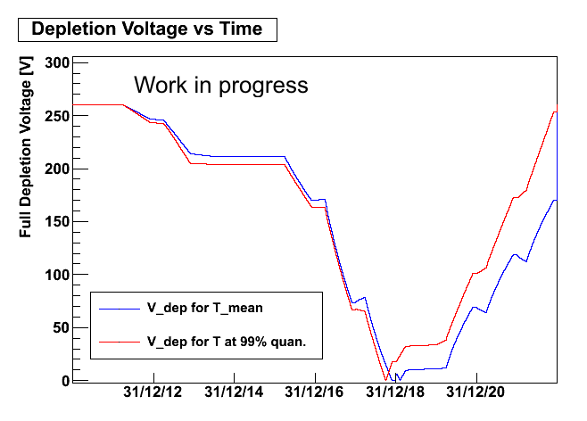
Tool to evaluate
Future Evolution of Depletion Voltage
We developed a tool to evaluate different temperature scenarios throughout the lifetime of the CMS – understand shut down periods
The tool example shows the Simulation of depletion voltages for Tracker Inner Barrel Layer 1 ( closest to the interaction at around r=24cm) for the aforementioned scenario:
  One can see the average (blue) and the 99% quantile cases (red) which lost cooling
We use CMS specific parameters, derived during the QA of construction
  The tool takes radiation and annealing effects into account
  Tool also gives beneficial, reverse annealing and stable damage part separately

Slide 18
Summary
Tools have been developed to simulate leakage current and depletion voltage
  Radiation damage, annealing, self-heating are taken into account
  Tool uses historic daily information and the “integrates” on a day-by-day basis
We validated the tool against the measured leakage currents at 5fb⁻¹
Work is on-going to validate also with the help of our LHC colleagues – see inter-experiment working group
We developed tools to determine the depletion voltages in-situ
  Interfill – Noise vs. bias
  Stable Beam – Signal vs. bias
  No comparison with data possible yet

Slide 19
BACKUP

Slide 20
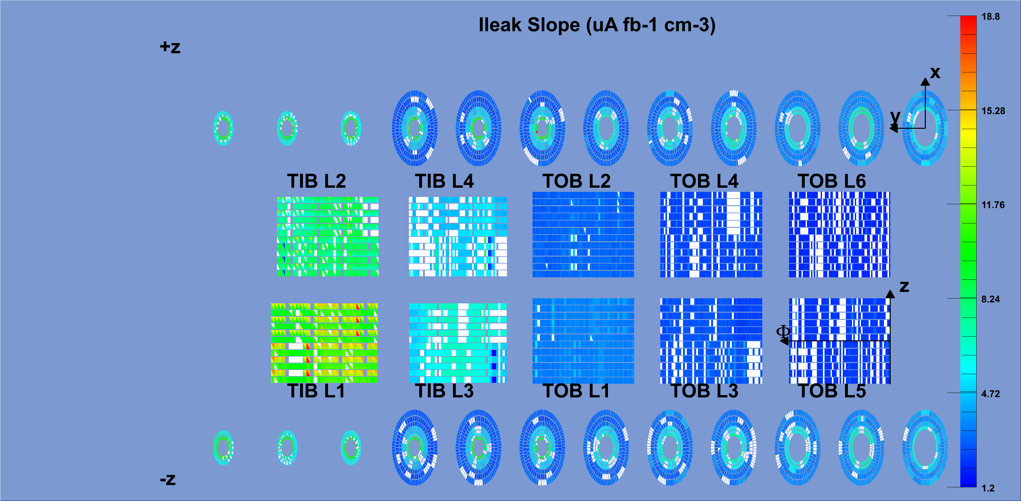
Radial Dependency Tracker Map
Tracker map of the leakage current change per fb⁻¹ normalized to 1cm³ and to 20°C.
We can clearly see the radial dependency over the different layers.

Slide 21
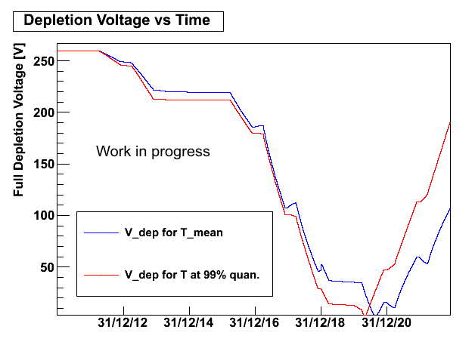
Future Evolution of Vdepletion
Simulation for Tracker Inner Barrel Layer 1 with:
High temperatures
High fluence exposure (nearest to IP at r=24cm)
Using the aforementioned scenario with a total luminosity of 400fb⁻¹
Using the model & constants proposed in M. Moll’s Ph.D. Thesis chap. 5
(DESY-THESIS-1999-040, December 1999, ISSN 1435-8085)
The tracker specific constants used in the plot on slide 16 is presented in A. Dierlamm’s Ph.D. Thesis chap. 3 (IEKP-KA/03-23)

Slide 22
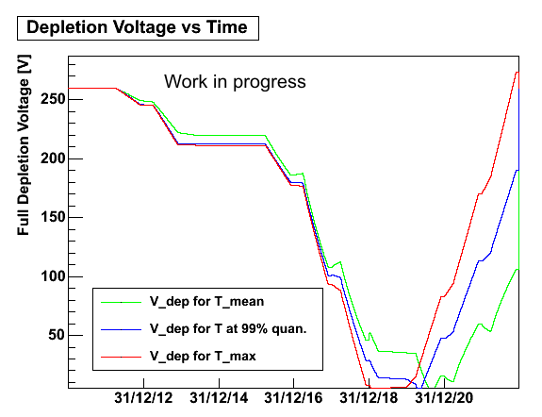
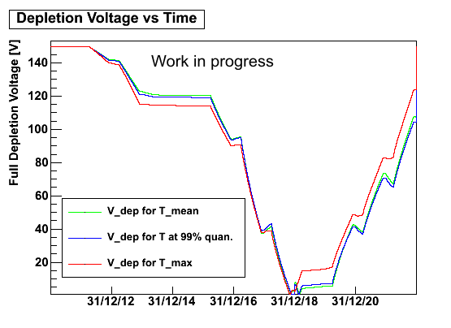
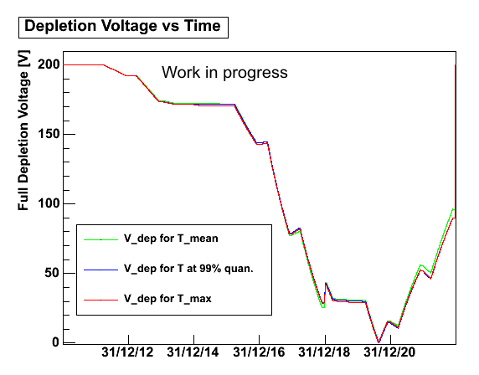
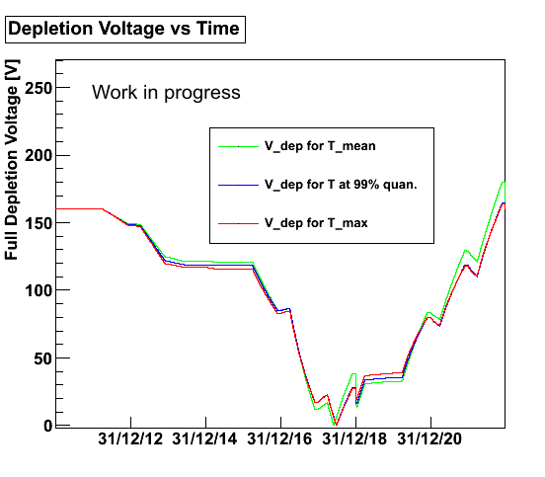
Future Evolution of Vdepletion
Tracker Inner Barrel Layer 2
Tracker Inner Disk 1 Ring 1
Exemplary selection of full depletion voltage evolutions at different location within the tracker. Computed with the corresponding temperature distributions (not shown here).
Tracker Outer Barrel Layer 1
Tracker End Cap Wheel 1 R1

Slide 23
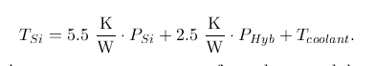
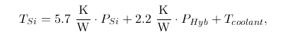
Power Scan
Thermal Contact
TDR
k_{sensor}
k_{hybrid}
Hybrid
End-cap
Barrel
Changing the power on the hybrid via VPSP results in a Temperature change on the hybrid
This dT/dP is taken as an approximation for the dT/dP of the sensor
FEA is planed to improve the approximation taking also the Tsil into account

Slide 24
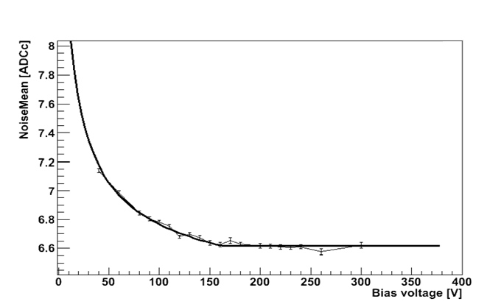
Fitting Noise Data
The noise value is fitted with
for V<V_{depl}; n=n₀ else.

Slide 25
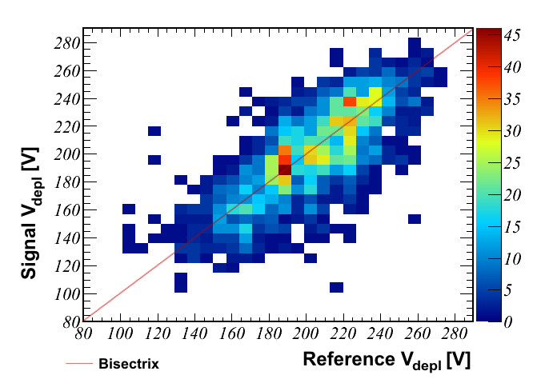
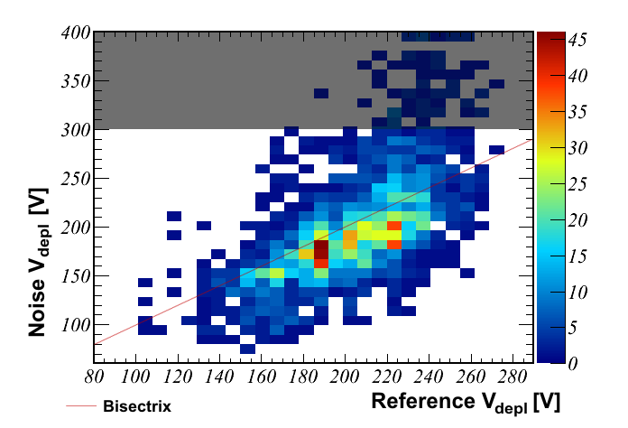
Depletion Voltage Measurements vs Production Measurements

