Slide 1
Summary of measurements after first irradiation of HPK samples
19th RD50 Workshop
21-23 November 2011 CERN
Joachim Erfle
University of Hamburg
On behalf of the CMS Tracker Collaboration
Notes:
1

Slide 2

Overview
introduction to the HPK-campaign
results of first irradiations
    dark current
    effective doping concentration
    signal collection
conclusions
courtesy of A. Dierlamm, KIT
Notes:
2

Slide 3
Goals of the HKP-campaign
The main challenges of the HL-LHC will be:
    higher radiation damage
    higher occupancy
therefore we want to find the best suiting material and layout for the coming tracking sensors.
To achieve that we investigate a large variety of materials and structures that are irradiated and measured.
The first step is to check, if at low fluences everything is compatible with available data. After that we will go to higher fluences.

Slide 4
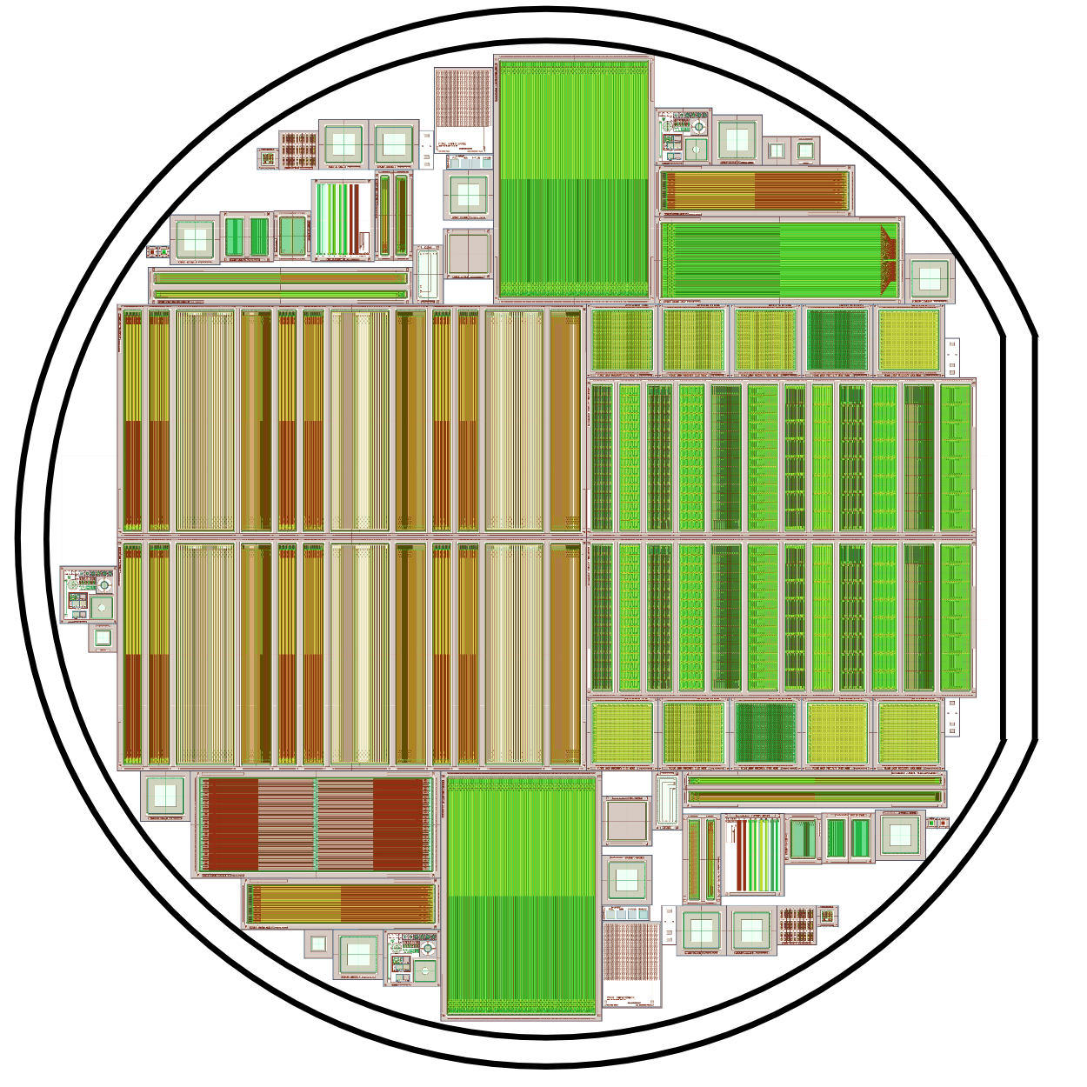
Wafer overview
structure | to study
diodes | material
baby strip sensor | reference design / material
baby with integrated pitch adapter | design
pixel sensor | reference Design / material
multigeometry pixel | layout parameters
multigeometry strips | layout parameters
baby strixel | design
teststructures | process parameters
Notes:
4

Slide 5
Material
material | thinning method | active thickness | physical thickness
FZ | deep diffusion | 120,200,300 μm | 320 μm
FZ | --- | 200 μm | 200 μm
FZ | handling wafer | 120 μm | 320 μm
MCz | --- | 200 μm | 200 μm
Epi | handling wafer | 50,100 μm | 320 μm
of each material there are 3 different types:
  n-type (N)
  p-type with p-stop (P)
  p-type with p-spray (Y)

Slide 6
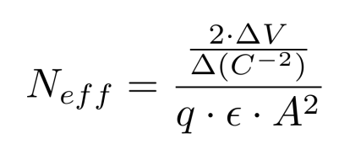
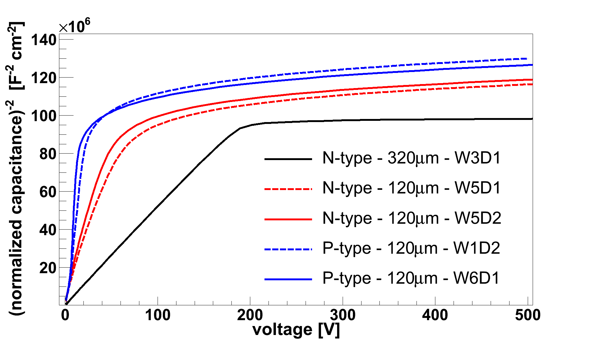
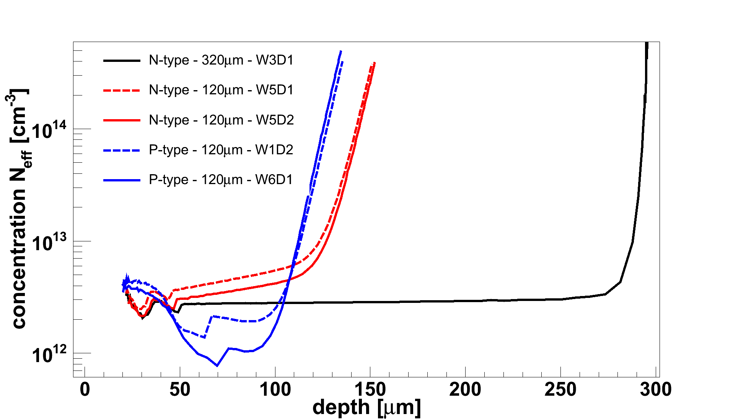
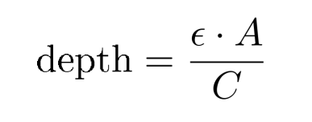
Material characteristics of thin FZ: deep diffusion
Concentration profile from CV-curve:
120-P µm
120-N µm
320-N µm
J. Erfle, UHH
Diodes behave like parallel-plate capacitors
→ measure capacitance vs voltage to determine depletion depth and charge carrier concentration
front
J. Erfle, UHH
Deep diffusion influences effective doping

Slide 7
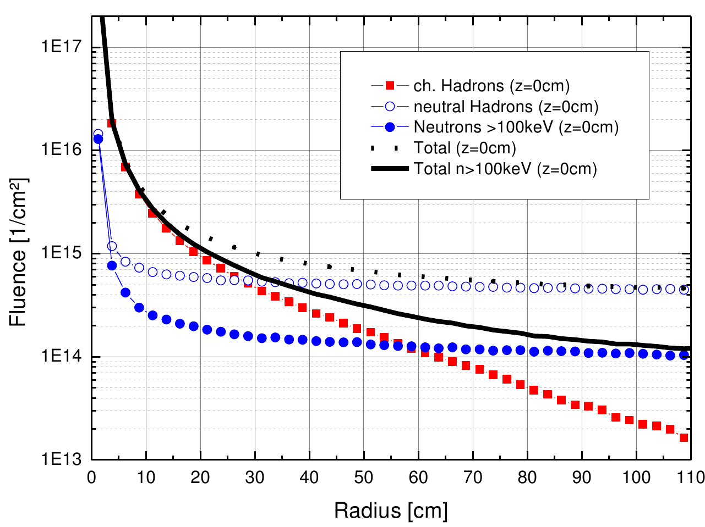
Irradations
HL-LHC: L_{int}=3000 fb⁻¹
neutrons: 1 MeV (TRIGA Reactor Ljubljana)
protons: 25 MeV (Karlsruhe Synchrotron)
courtesy of S. Müller, KIT
radius | protons Φ_{eq} [cm⁻²] | neutrons Φ_{eq} [cm⁻²] | total Φ_{eq} [cm⁻²] | active thickness
40 cm | 3 ∙ 10¹⁴ | 4 ∙ 10¹⁴ | 7 ∙ 10¹⁴ | ≥ 200 μm
20 cm | 1 ∙ 10¹⁵ | 5 ∙ 10¹⁴ | 1.5 ∙ 10¹⁵ | ≥ 200 μm
15 cm | 1.5 ∙ 10¹⁵ | 6 ∙ 10¹⁴ | 2.1 ∙ 10¹⁵ | ≥ 200 μm
10 cm | 3 ∙ 10¹⁵ | 7 ∙ 10¹⁴ | 3.7 ∙ 10¹⁵ | ≤ 200 μm
5 cm | 1.3 ∙ 10¹⁶ | 1 ∙ 10¹⁵ | 1.4 ∙ 10¹⁶ | < 200 μm

Slide 8
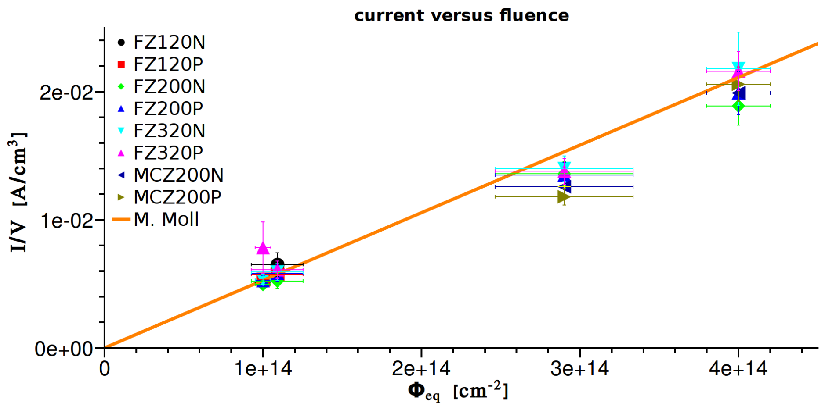
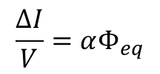
Volume current versus fluence:
$$\frac{ΔI}{V}=αΦ_{eq}$$
protons
neutrons
neutrons
protons
currents are measured after annealing of 10 min@ 60°C at 0°C and scaled to 20°C
J. Erfle, UHH
currents match expected value from M.Moll‘s thesis within the uncerntainties.
-> dose measurements are ok.

Slide 9
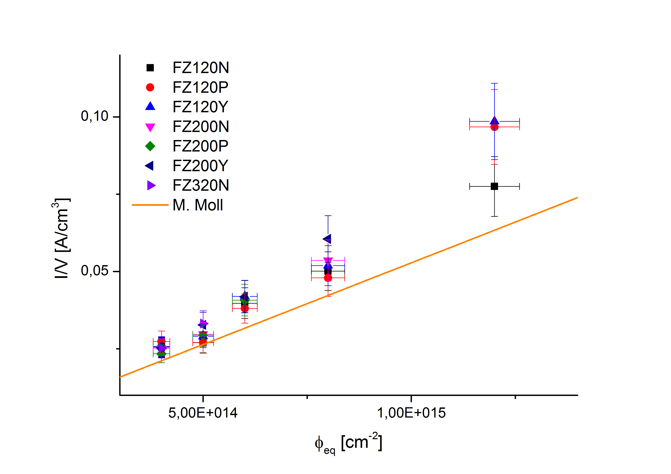
Volume current versus fluence:
Baby sensors
neutron irradiated Baby sensors
First Baby sensors show higher currents than diodes
-> maybe a surface effect?
currents are measured after annealing of 10 min@ 60°C at -20°C and scaled to 20°C
courtesy of A. Nürnberg, KIT

Slide 10
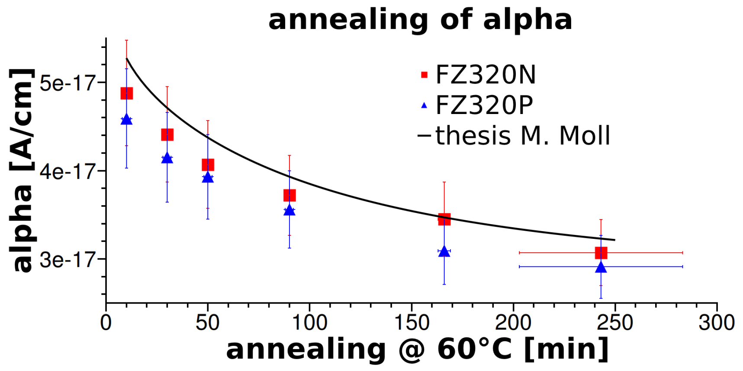
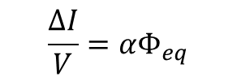
Annealing behaviour of dark current
p@3E14
$$\frac{ΔI}{V}=αΦ_{eq}$$
results for neutron irradiation coming soon
80°C
J. Erfle, UHH
measurements are performed at 0°C and scaled to 20°C
the annealing of alpha matches the expected curve from M.Moll‘s thesis.

Slide 11
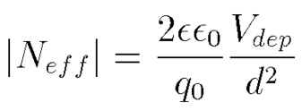
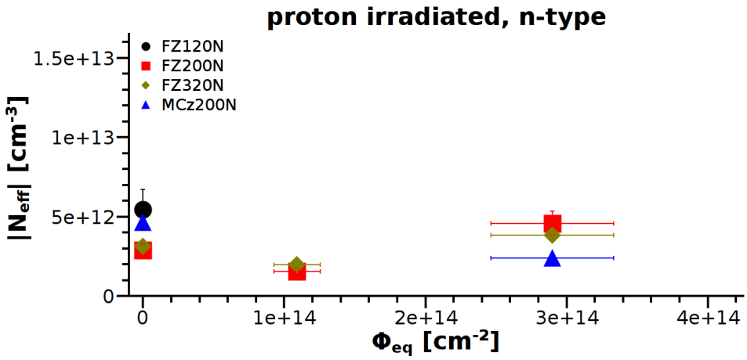
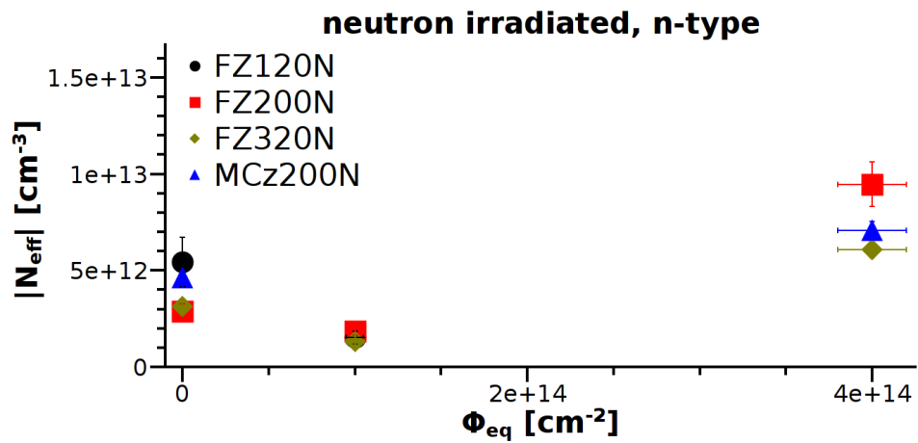
N_{eff} for different materials / irradiations
n-type
protons
the FZ and the MCz n-type materials are type-inverted after neutron or proton irradiation.
J. Erfle, UHH
neutrons
J. Erfle, UHH
capacitances are measured at 0°C, 1KHz after annealing of 10min@60°C

Slide 12
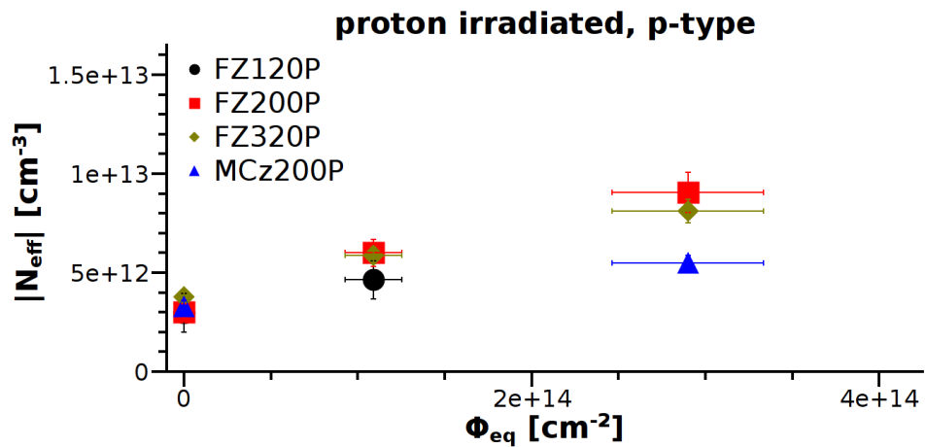
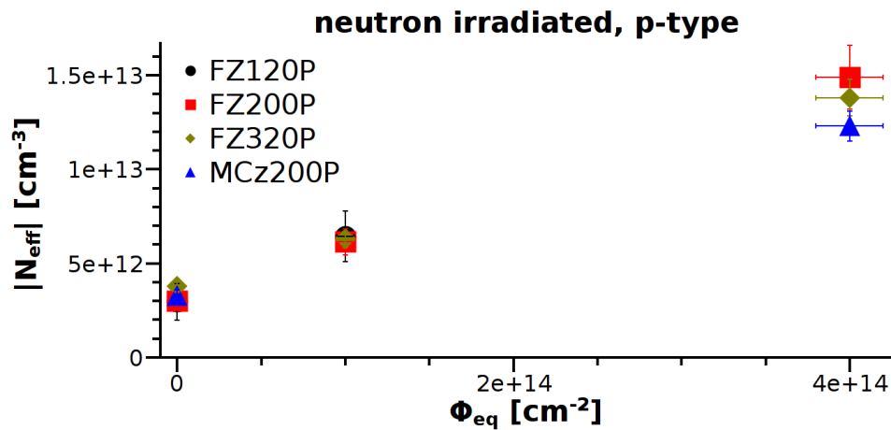
N_{eff} for different materials / irradiations
n-type
p-type
protons
J. Erfle, UHH
J. Erfle, UHH
neutrons
J. Erfle, UHH
J. Erfle, UHH
capacitances are measured at 0°C, 1KHz after annealing of 10min@60°C
MCz: lowest increase in N_{eff}.

Slide 13
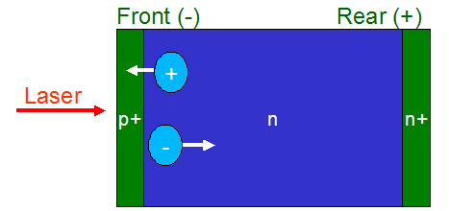
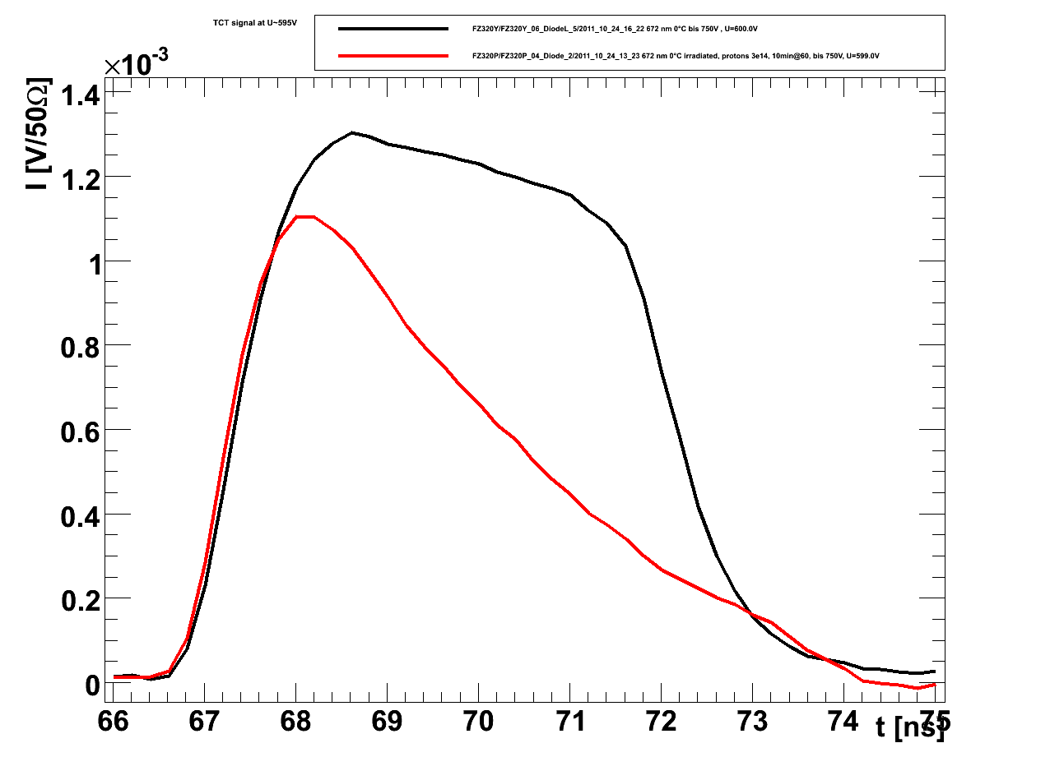
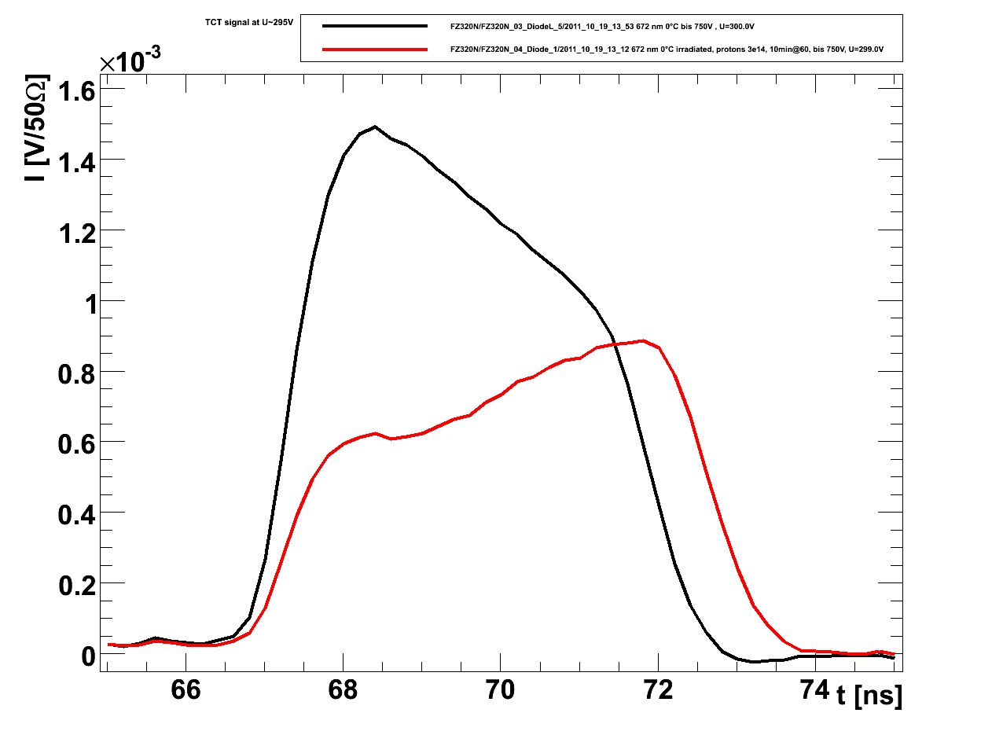
Time resolved charge collection measurement with Transient Current Technique (TCT)
TCT curves show type inversion
FZ320P
- holes
FZ320N
- electrons
courtesy of J. Lange
unirradiated
p@3E14
Laser: 672 nm, red
courtesy of T. Pöhlsen, UHH
courtesy of T. Pöhlsen, UHH
not type inverted
U=600V
type inverted
U=300V
type inversion of FZ and MCz n-type materials is confirmed by TCT.
capacitances are measured at 0°C, 1KHz after annealing of 10min@60°C

Slide 14
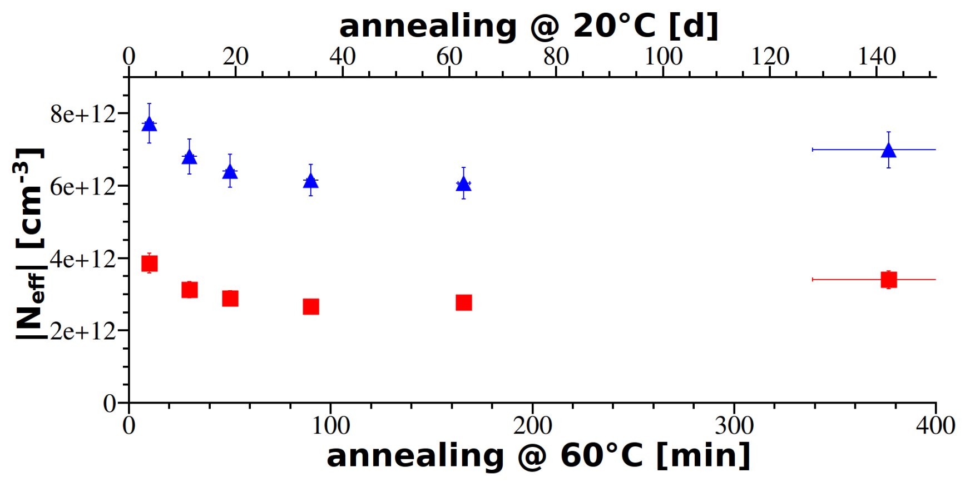
Annealing beaviour of N_{eff}
p@3E14
FZ320P
unirradiated
unirradiated
FZ320N
80°C
J. Erfle, UHH
N_{eff} changes of FZ320N typical for type inverted material. FZ320P behaviour looks similar but is not type inverted: not completely understood yet.
measurements are performed at 0°C (1KHz)

Slide 15
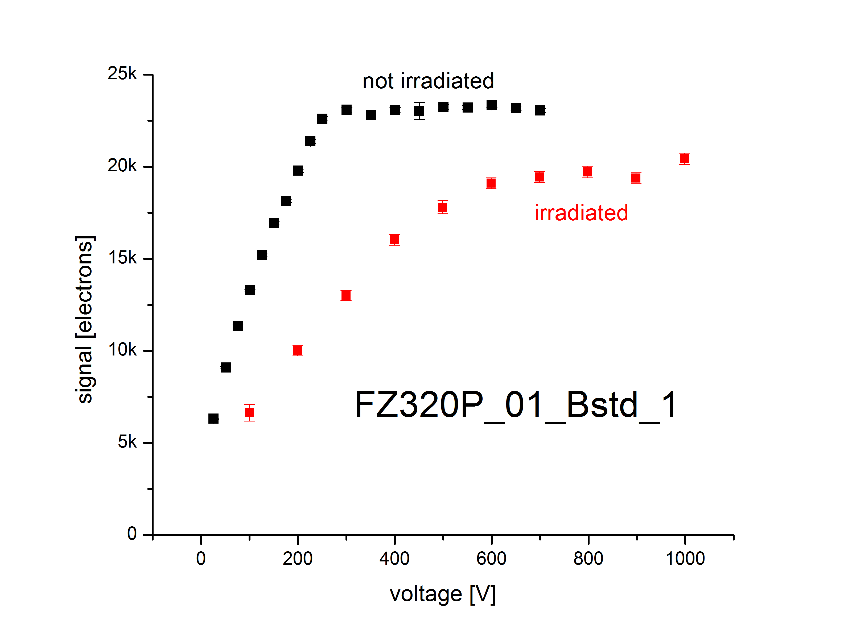
Signal of FZ320P baby sensor, after p@3E14
signal induced by a ⁹⁰Sr source, readout by ALiBaVa
V_{depl}
CCE of FZ320 p-type is about 87% at p@3E14, compared to non-irradiated
courtesy of K. Hoffman, KIT
measurements are performed at -20°C

Slide 16
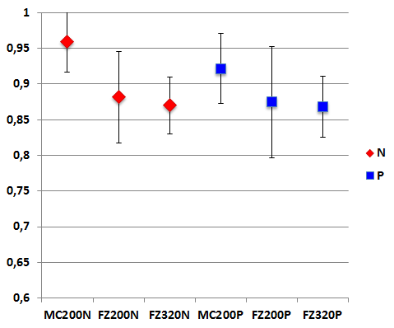
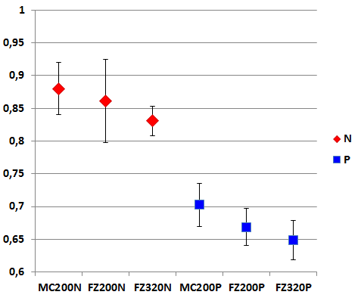
CCE of diodes, after p@3E14
infrared laser
red laser, front injection
courtesy of J. Lange
unirradiated
n-type:
electron
collection
p-type:
hole
collection
n-type
p-type
courtesy of T. Pöhlsen, UHH
courtesy of T. Pöhlsen, UHH
measurements are performed at 0°C and 600V, with 20ns integration time
infrared laser: CCE is about 90%
electrons only: CCE ~ 85%, holes collection only: CCE ~ 67%

Slide 17
Conclusions and outlook
CMS silicon measurement campaign is gaining speed, analysis tools are up and running
Trying to understand material properties in detail
Comparison shows currents as expected -> dose measurement ok
N_{eff} compared before and after irradiation
CCE with baby sensors and diodes investigated
More irradiations to come
Full annealing studies to be done
Notes:
17

Slide 18
Backup

Slide 19
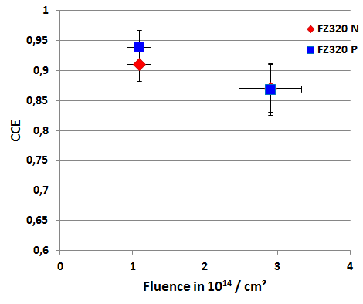
CCE of FZ320 after proton irradiation
courtesy of T. Pöhlsen
measurements are performed at 0°C

Slide 20
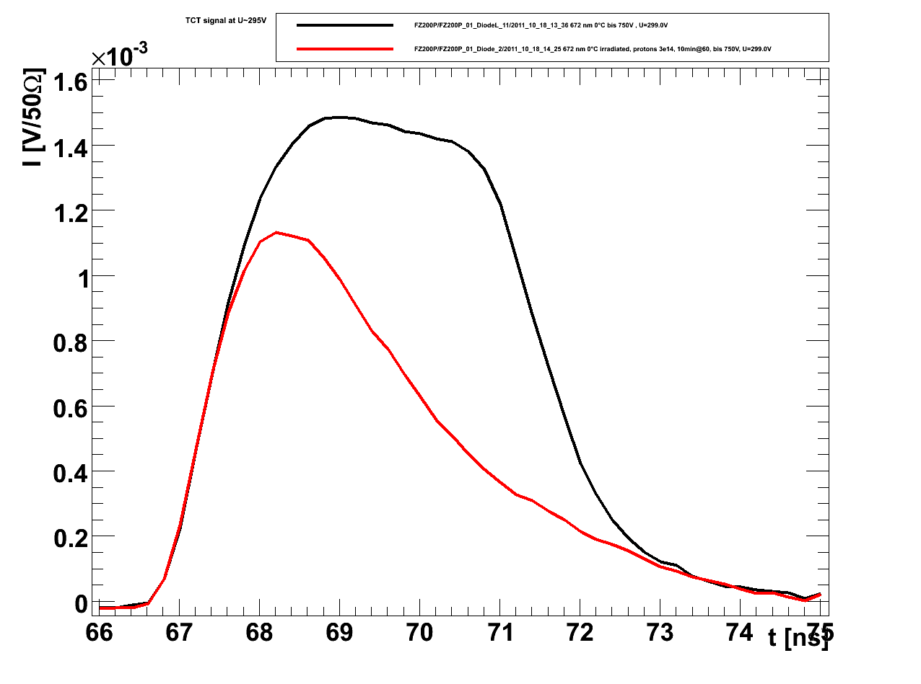
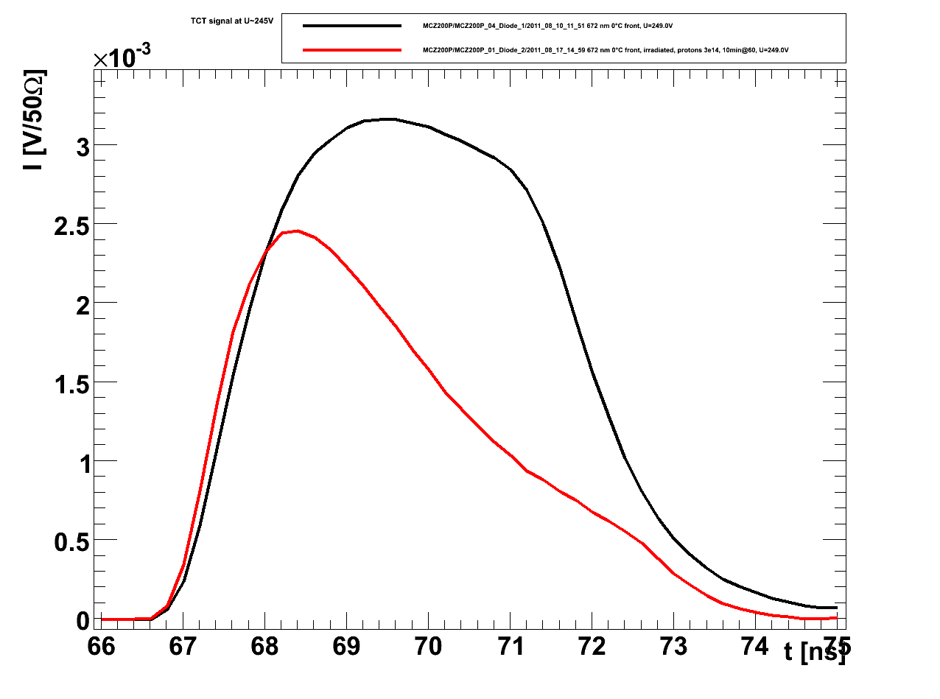
TCT pulses – p-type
FZ200P
FZ320P
MCZ200P
courtesy of T. Pöhlsen
courtesy of T. Pöhlsen
courtesy of T. Pöhlsen
300V
600V
250V
measurements are performed at 0°C, using a red laser
not type inverted

Slide 21
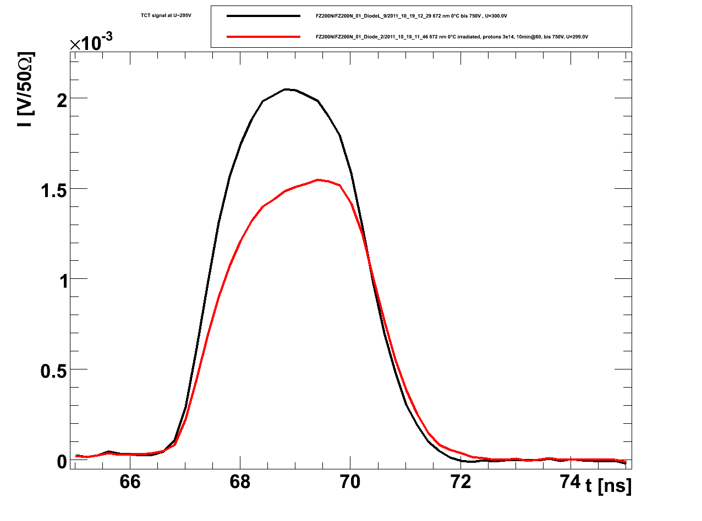
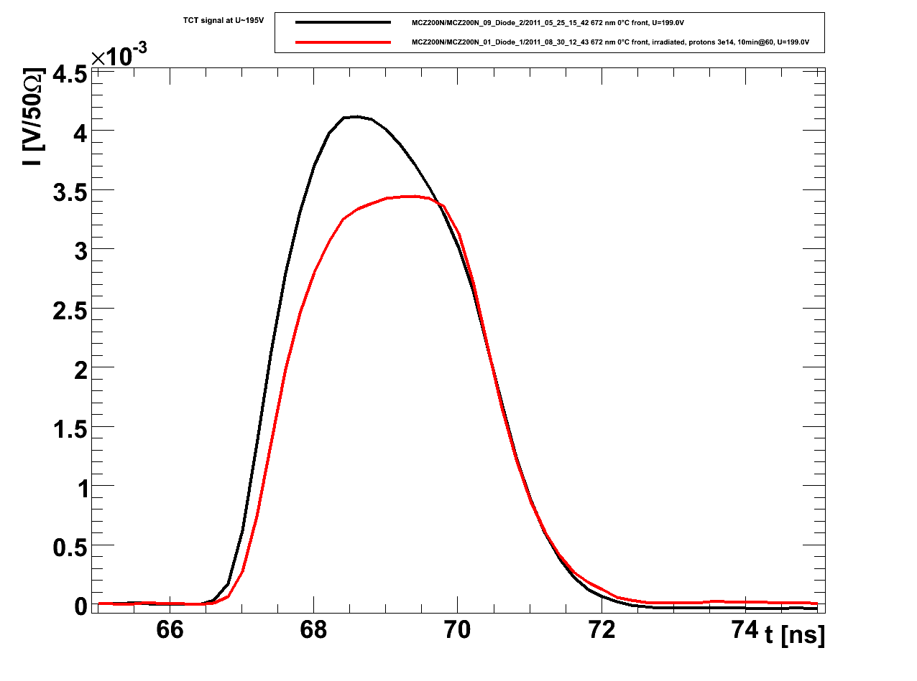
TCT pulses – n-type
FZ200N
FZ320N
MCZ200N
courtesy of T. Pöhlsen
courtesy of T. Pöhlsen
courtesy of T. Pöhlsen
300V
300V
200V
measurements are performed at 0°C, using a red laser
type inverted

Slide 22
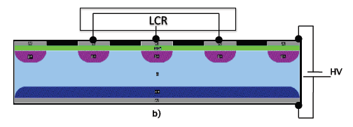
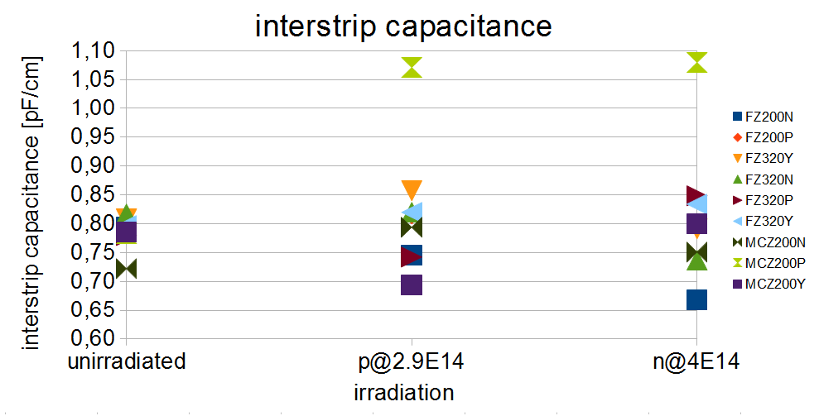
Interstrip capacitance on teststructure after neutron and proton irradiation
low
high
low
Bias
TS_CAP_AC
courtesy of M. Bernard-Schwarzz, HEPHY
courtesy of M. Bernard-Schwarzz, HEPHY
measurements are performed at -20°C, 1MHz
Interstrip capacitance also is stable

Slide 23
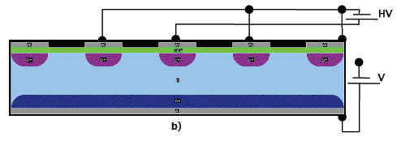
Interstrip resistance on teststructure
V
unirradiated
Bias
GOhm
TS_CAP_DC
courtesy of M. Bernard-Schwarzz, HEPHY
courtesy of M. Bernard-Schwarzz, HEPHY
interstrip resistance in unirradiated material is pretty good.
measurements are performed at -20°C

Slide 24
Strip structures: measurement of basic properties
characteristic | unirradiated | p@3E14
coupling capacitance | 43.4 ± 1.8 [pF/cm] | 44.4 ± 0.7 [pF/cm]
dielectric breakdown | 249 ± 2 [V] | 244 ± 6 [V]
material | unirradiated | p@3E14 | n@4E14
aluminum | 22 ± 2 mOhm/sq | 20 ± 1 mOhm/sq | 22 ± 1 mOhm/sq
poly | 3.7 ± 0.8 kOhm/sq | 3.9 ± 1 kOhm/sq | 4 ± 1.2 kOhm/sq
p+ | 120 ± 10 Ohm/sq | 160 ± 10 Ohm/sq | 120 ± 10 Ohm/sq
n+ | 29 ± 2 Ohm/sq | 26 ± 6 Ohm/sq | 28 ± 2 Ohm/sq
courtesy of M. Bernard-Schwarz, HEPHY
Basic properties don‘t change at these fluences
measurements are performed at -20°C, (1kHz)

Slide 25
Interstrip resistance on TS
proton irradiated
unirradiated
MOhm
courtesy of M. Bernard-Schwarzz, HEPHY
GOhm
courtesy of M. Bernard-Schwarzz, HEPHY
neutron irradiated
MOhm
interstrip resistance on teststructures drops from >200GOhm to <200MOhm after irradiation
courtesy of M. Bernard-Schwarzz, HEPHY
measurements are performed at -20°C
resistances on baby sensors in similar range

Slide 26
oxygen content
material | bulk resistivity | oxide concentration
FZ320P | 3-8 | 3,50E+016
FZ200P | 3-8 | 3,00E+017
FZ120P | 3-8 | 5,00E+017
FZ320N | 1.2-2.4 | 1,80E+016
FZ200P | 1.2-2.4 | 3,00E+017
FZ120P | 1.2-2.4 | 5,00E+017
MCZ200P | >2 | 3,75E+017
MCZ200N | >0.5 | 3,00E+017

Slide 27
fluence computed from data with a fixed alpha
neutrons, 4E14
protons, 2.9E14
protons, 1.1E14
neutrons, 1E14
currents are measured at 0°C and scaled to 20°C

Slide 28
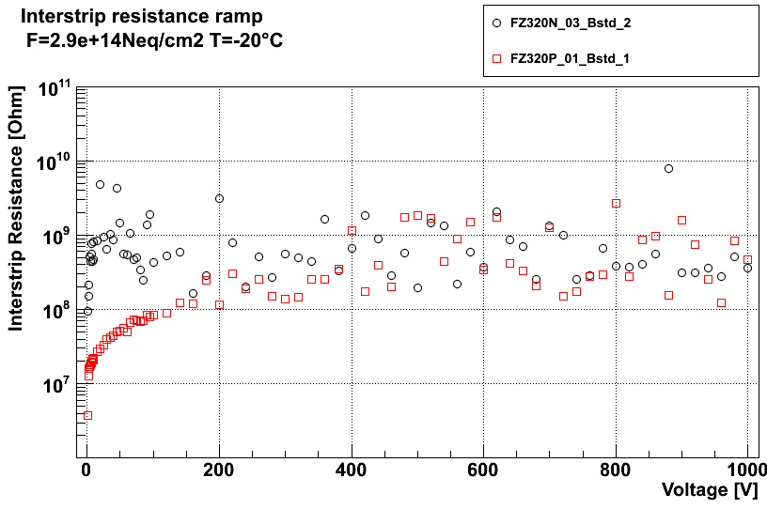
interstrip resistance on baby sensor
proton irradiated
proton irradiated
FZ320P
courtesy of M. Bernard-Schwarz
FZ320N
neutron irradiated
courtesy of K. Hoffmann
interstrip resistance drops on baby sensors from >100GOhm to >100MOhm
courtesy of M. Bernard-Schwarz
measurements are performed at -20°C

