Slide 1
First Results from the Online Radiation Dose Monitoring System in ATLAS Experiment
I. Mandićª, V. Cindroª, I. Dolencª, M. Deliyergiyevª, A. Gorišekª, G. Krambergerª, M. Mikuž^{a,b},
J. Hartert^{c}, S. Franz^{d}
ªJožef Stefan Institute, Jamova 39, Ljubljana, Slovenia
^{b}Faculty of Mathematics and Physics, University of Ljubljana, Jadranska 19, Ljubljana, Slovenia
^{c}Physikalisches Institut Universität Freiburg, Hermann-Herder-Str. 3, Freiburg, Germany
^{d}CERN, Geneva, Switzerland
FLUKA simulations by:
I.Dawson, L. Nicolas, P. Miyagawa et al.,
University of Sheffield, UK
Lot of work with radiation sensors (characterization, selection, calibration, annealing
studies etc...) was done by F. Ravotti, M. Glaser, M. Moll et al. from the CERN RADMON team
http://lhc-expt-radmon.web.cern.ch/lhc-expt-radmon/
______________________________________________________________________________________________________
I. Mandić, 19th RD50 Workshop, CERN, 21 – 23 November 2011 1

Slide 2
Introduction
detectors and electronics in ATLAS experiment will be exposed to large doses of radiation
continuous monitoring of doses necessary to understand performance of the detector
online radiation dose monitoring system measures accumulated ionizing dose in Si0₂,
displacement damage in silicon and fluences of thermal neutrons.
doses are monitored at 14 locations in the Inner Detector and at 48 locations at larger
radii
sensors are read out every 60 minutes and readings are stored in the database.
➔ results of dose measurements after 2 years of ATLAS data taking are presented
More information about the monitoring system in:
Mandić et al.,“Online integrating radiation monitoring system for the ATLAS detector at the large hadron collider,” IEEE Trans. Nucl. Sci., vol. 54, no. 4, pp. 1143–1150, Aug. 2007.
J. Hartert et al., “The ATLAS radiation dose measurement system and its extension to SLHC experiments,” in Proc. Topical Workshop Electronics for Particle Physics, Naxos, Greece, ,2008,
http://indico.cern.ch/getFile.py/access?contribId=121&sessionId=15&resId=0&materialId=paper&confId=21985
https://twiki.cern.ch/twiki/bin/viewauth/Atlas/AtlasInDetRadMon
______________________________________________________________________________________________________
I. Mandić, 19th RD50 Workshop, CERN, 21 – 23 November 2011 2

Slide 3
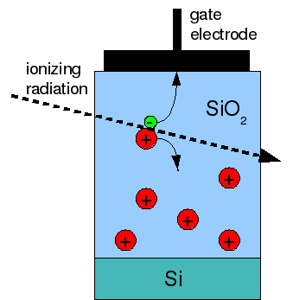
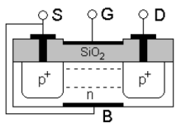
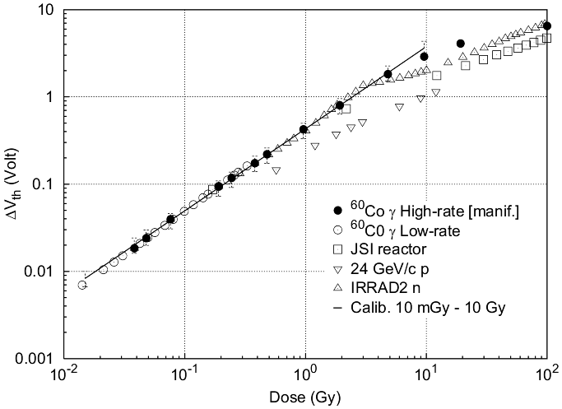
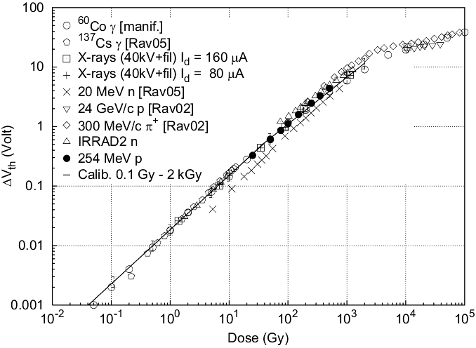
TID measurements with RadFETs
RadFETs: p-MOS transistor
radiation induced holes trapped in the gate
oxide:
➔ increase of threshold voltage with dose:
ΔV = a x (TID)^{b}
sensitivity and dynamic range depend on
oxide thickness:
Inner detector:
3 RadFETs at each monitoring
location:
LAAS 1.6 µm; REM 0.25 µm;
REM 0.13 µm
Other locations (lower doses):
LAAS 1.6 µm
LAAS, 1.6 µm
REM, 0.25 µm
Radfet calibration curves (F. Ravotti ,PhD thesis, CERN-THESIS-2007-013)
______________________________________________________________________________________________________
I. Mandić, 19th RD50 Workshop, CERN, 21 – 23 November 2011 3

Slide 4
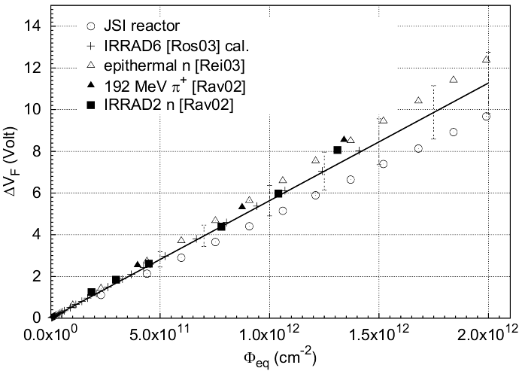
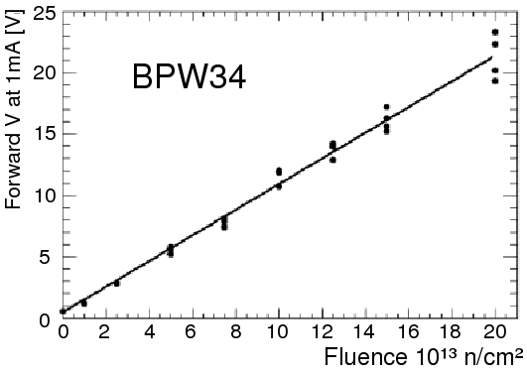
NIEL measurements with diodes
bulk damage in silicon consequence:
increased resistance, reduction of carrier lifetime, increase of reverse current
➔ forward bias: voltage at given forward current increases
➔ reverse bias: reverse current increases
Forward bias
linear response ΔV = k ·Φ_{eq}
high sensitivity diode (CMRP, University of Wollongong, AU) 10⁹ to ~10¹² n/cm²,
commercial (Osram) silicon PIN photodiode BPW34F 10¹² to ~10¹⁵ n/cm²
CMRP
(F. Ravotti at al.)
______________________________________________________________________________________________________
I. Mandić, 19th RD50 Workshop, CERN, 21 – 23 November 2011 4

Slide 5
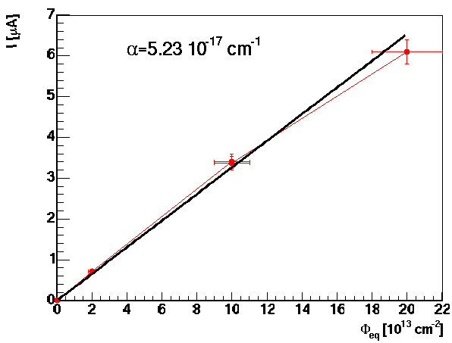
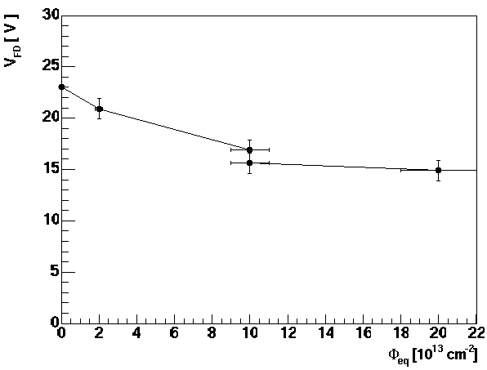
NIEL measurements with diodes
Reverse bias
Reverse current proportional to fluence ΔI = Φ_{eq}/αV
25 µm x 0.5 cm x 0.5 cm pad diode with guard ring structure processed
on epitaxial silicon
➔ thin epitaxial diode can be depleted with V_{bias} < 30 V also after irradiation
with 10¹⁵ n/cm²
➔ in this fluence and time range V_{bias} does not increase with annealing
- suitable to measure fluences from 10¹¹ n/cm² to 10¹⁵ n/cm²
25 µm
Epi, 25 µm
______________________________________________________________________________________________________
I. Mandić, 19th RD50 Workshop, CERN, 21 – 23 November 2011 5

Slide 6
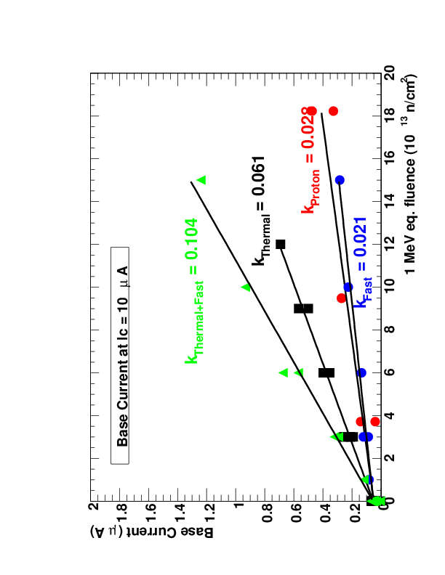
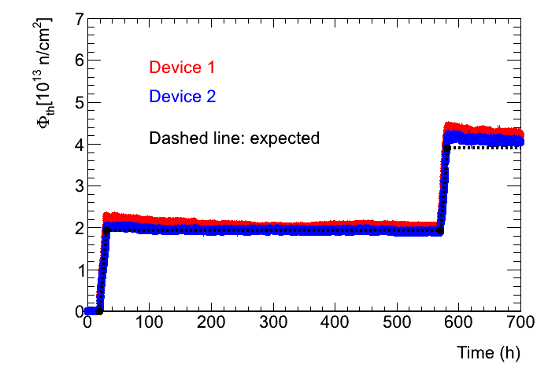
Thermal neutrons
bipolar transistors (DMILL) used in front end ASICs
measure base current at given collector current
➔ monitor status of front end electronics
➔ sensitive to fast and thermal neutrons
ΔI_{b}/I_{c} = k_{eq}·Ф_{eq} + k_{th} ·Ф_{th ;} k_{eq}, k_{th} and Ф_{eq} known → Ф_{th} can be determined
Response to thermal neutrons (reactor)
______________________________________________________________________________________________________
I. Mandić, 19th RD50 Workshop, CERN, 21 – 23 November 2011 6

Slide 7
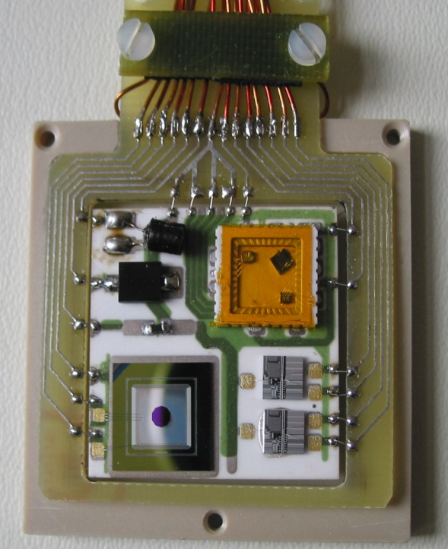
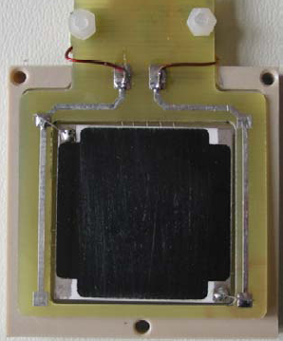
Radiation Monitor Sensor Board (RMSB)
Inner Detector
for dose monitoring in the Inner Detector:
- large range of doses
- no access in 10 years
➔ need many sensors
large temperature variations (5 to 20°C)
at different locations
➔ stabilize temperature to 20 ± 1°C by
heating back side of the ceramic hybrid
Thick film resistive layer R = 320 Ω
CMRP diode
Radfet package:
0.25 µm SiO₂
1.6 µmSiO₂
0.13 µmSiO₂
BPW34 diode
Thermistor
Bipolar transistors
Ceramic hybrid
(Al₂O₃)
epi diode
4 cm
Back side
______________________________________________________________________________________________________
I. Mandić, 19th RD50 Workshop, CERN, 21 – 23 November 2011 7

Slide 8
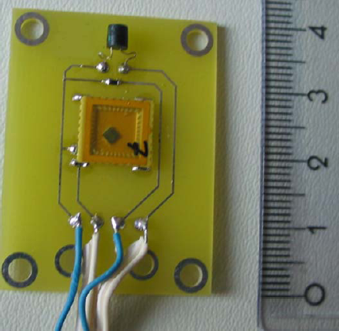
Radiation Monitor Sensor Board (RMSB)
Other locations
lower dose ranges
➔ mGy to 10 Gy, 10⁹ to ~10¹² n/cm²
no temperature stabilization
➔ correct read out values with known
temperature dependences
CMRP diode
Thermistor
LAAS radfet
(1.6 µmSiO₂ )
______________________________________________________________________________________________________
I. Mandić, 19th RD50 Workshop, CERN, 21 – 23 November 2011 8

Slide 9
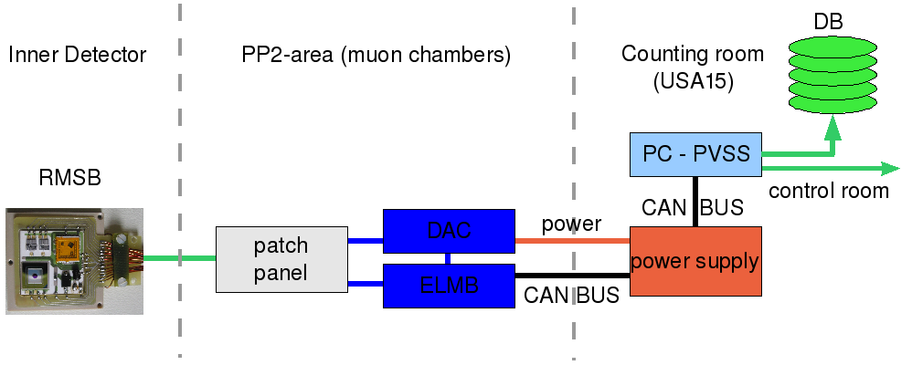
Readout
use standard ATLAS Detector Control System components
  ELMB:
  - 64 ADC channels
  - can bus communication
  ELMB-DAC:
  - current source, 16 channels (I_{max} = 20 mA, U_{max} = 30 V)
sensors are biased only during readout (~ few minutes every hour)
software written in PVSS
readout values available in the ATLAS control room and archived for offline analysis
Cable length
~ 18 m
Cable length
~ 100 m
______________________________________________________________________________________________________
I. Mandić, 19th RD50 Workshop, CERN, 21 – 23 November 2011 9

Slide 10
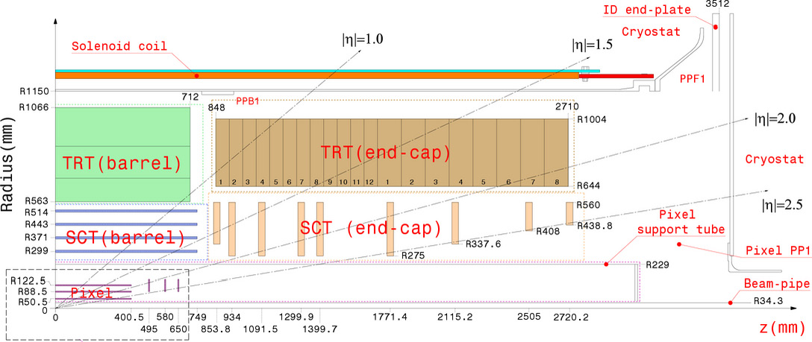
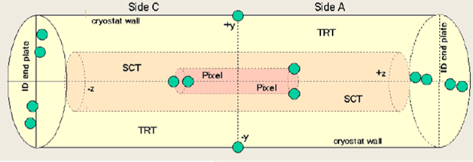
Monitoring Locations
14 monitors in the Inner Detector
Location | r (cm) | |z| (cm)
Pixel Support Tube (PST) | 23 | 90
ID end plate small r | 54 | 345
ID end plate large r | 80 | 345
Cryostat Wall | 110 | 90
______________________________________________________________________________________________________
I. Mandić, 19th RD50 Workshop, CERN, 21 – 23 November 2011 10

Slide 11
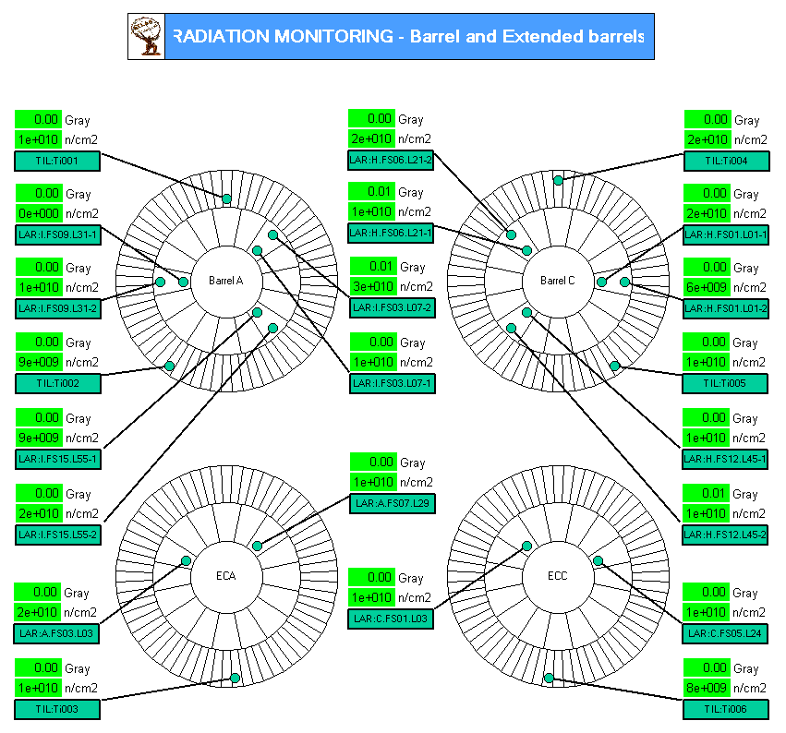
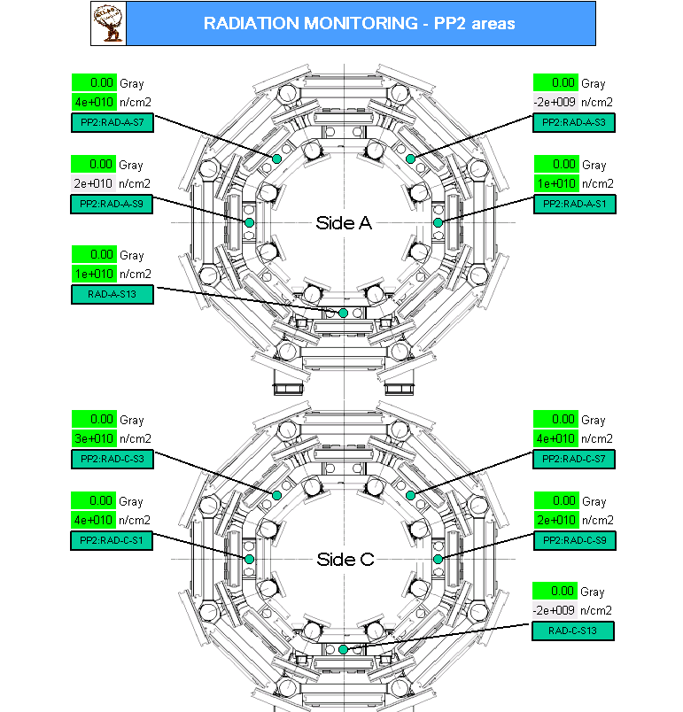
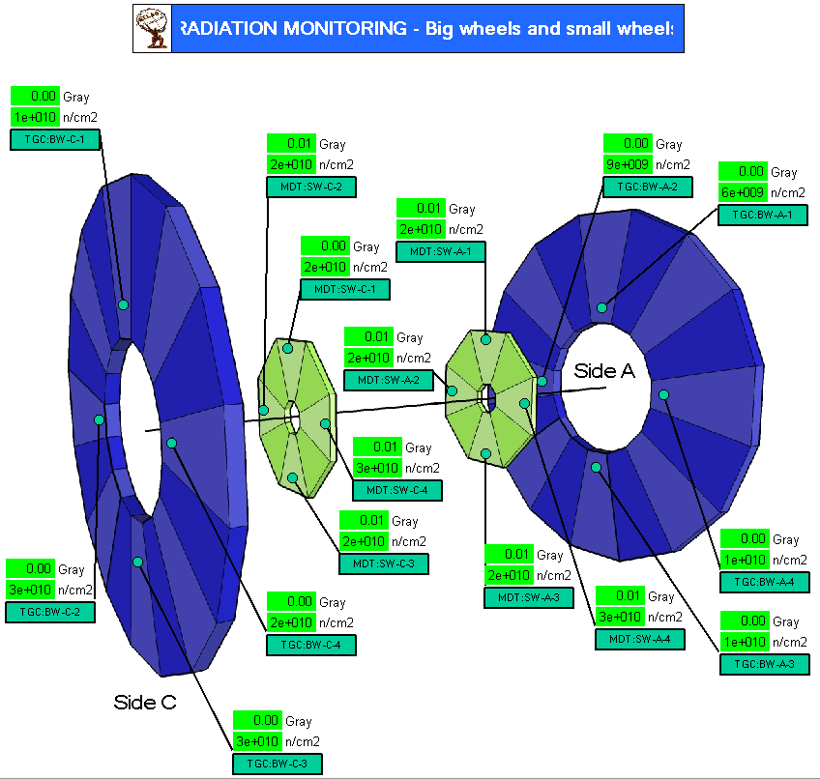
Monitoring Locations
48 locations at larger radii
2 monitors near ALFA (z = 240 m, r = 0.2 m)
Calorimeters: 22
Muon detectors: 16
PP2: 10
______________________________________________________________________________________________________
I. Mandić, 19th RD50 Workshop, CERN, 21 – 23 November 2011 11

Slide 12
FLUKA Simulations
More in:
I. Dawson and C. Buttar, ”The radiation environment in the ATLAS inner detector”, Nucl. Inst. Meth. A453,pp. 461-467, 2000.
M. Bosman, I. Dawson, V. Hedberg, M. Shupe, “ATLAS Radiation Background Taskforce Final Summary Document”, ATL-GEN-2005-001.
I. Dawson et al., “Fluence and dose measurements in the ATLAS inner detector and comparison with simulation.”
ATL-INDET-INT-2011-004 http://cdsweb.cern.ch/record/1322208
https://twiki.cern.ch/twiki/bin/viewauth/Atlas/BenchmarkingAtTheLHC
FLUKA particle transport code
PHOJET event generator
simulations done for √ s = 7 TeV assuming a proton-proton inelastic cross section 77.5 mb as predicted by
PHOJET
Doses and fluences per fb⁻¹ of integrated luminosity
Location | Coordinates | Dose (Gy) | 1 MeV equivalent neutron fluence (10¹¹ n/cm⁻²)
Pixel support tube | r= 23 cm |z| = 90 cm | 110 | 2.22
Inner Detector End Plate – small radius | r = 54 cm |z| = 345 cm | 55.4 | 2.24
Inner Detector End Plate - large radius | r = 80 cm |z| = 345 cm | 27.0 | 1.35
Cryostat Wall | r = 110 cm |z| = 0 cm | 4.9 | 0.45
______________________________________________________________________________________________________
I. Mandić, 19th RD50 Workshop, CERN, 21 – 23 November 2011 12

Slide 13
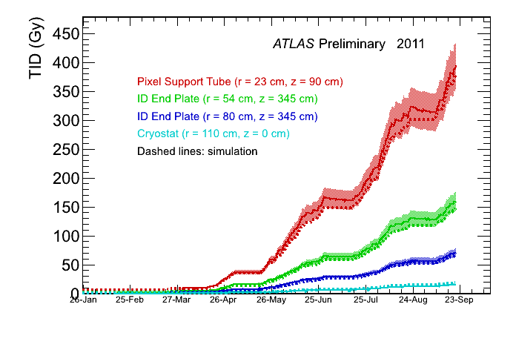
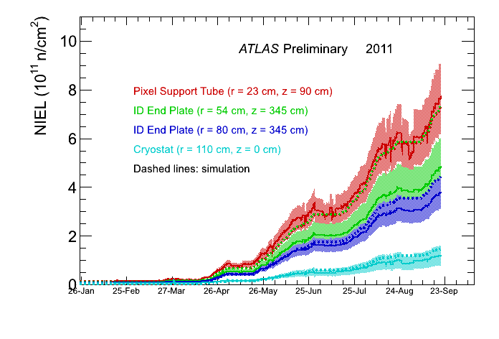
Results ID
data up to 20th September
→ integrated luminosity ~ 3.4 fb⁻¹
TID measured with 0.13 um RadFET
(low sensitivity)
Fluence measured with CMRP diode
(high sensitivity, forward bias)
averages of measurements with sensors at similar locations shown
➔ excellent agreement with predictions!
______________________________________________________________________________________________________
I. Mandić, 19th RD50 Workshop, CERN, 21 – 23 November 2011 13

Slide 14
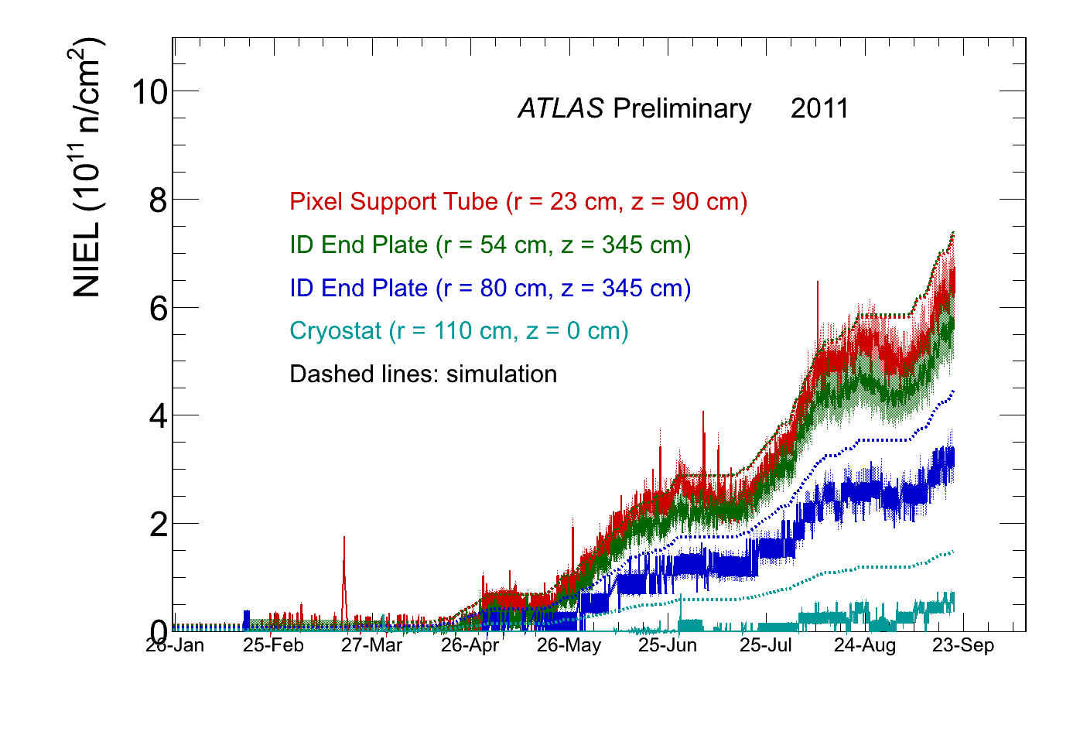
Results with EPI diode
NIEL measurements with EPI diode: Φ_{eq}= αVI
→ use α = 3.5e-17 A/cm, no annealing corrections
➔ good agreement with simulations
→ annealing corrections to be implemented
Epi diode, no annealing correction
______________________________________________________________________________________________________
I. Mandić, 19th RD50 Workshop, CERN, 21 – 23 November 2011 14

Slide 15
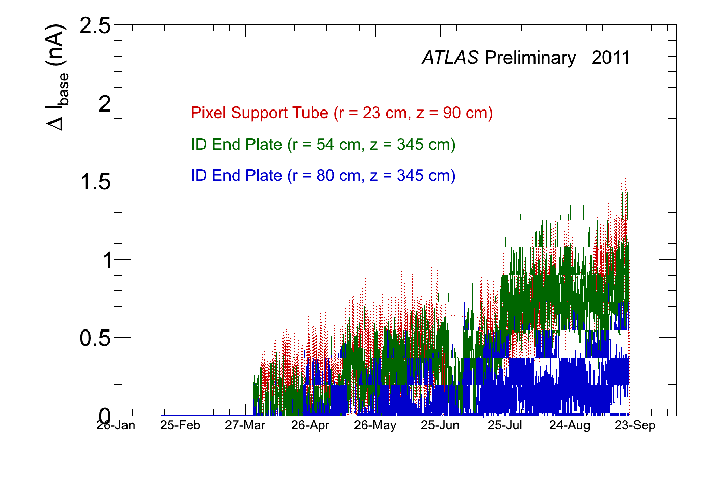
Results ID
first signs of base current increase in DMILL bipolar transistors
current increase consistent with thermal neutron fluence of the order of 1e11 n/cm2
→ in agreement with FLUKA
______________________________________________________________________________________________________
I. Mandić, 19th RD50 Workshop, CERN, 21 – 23 November 2011 15

Slide 16
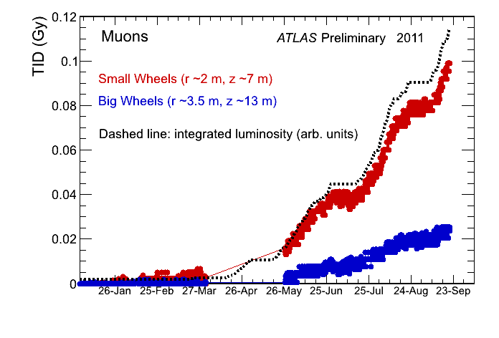
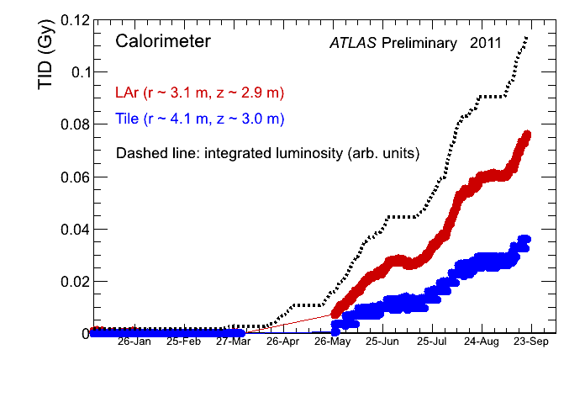
Results out of ID
outside of ID doses still very low, on the limit of sensitivity
accumulated dose proportional to integrated luminosity
neutron fluences too low for reliable measurements
______________________________________________________________________________________________________
I. Mandić, 19th RD50 Workshop, CERN, 21 – 23 November 2011 16

Slide 17
Conclusions
doses and fluences proportional to integrated luminosity
in the Inner Detector excellent agreement with predictions from FLUKA simulations
→ important for prediction of future detector performance
→ and predictions for HL-LHC
______________________________________________________________________________________________________
I. Mandić, 19th RD50 Workshop, CERN, 21 – 23 November 2011 17

Slide 18
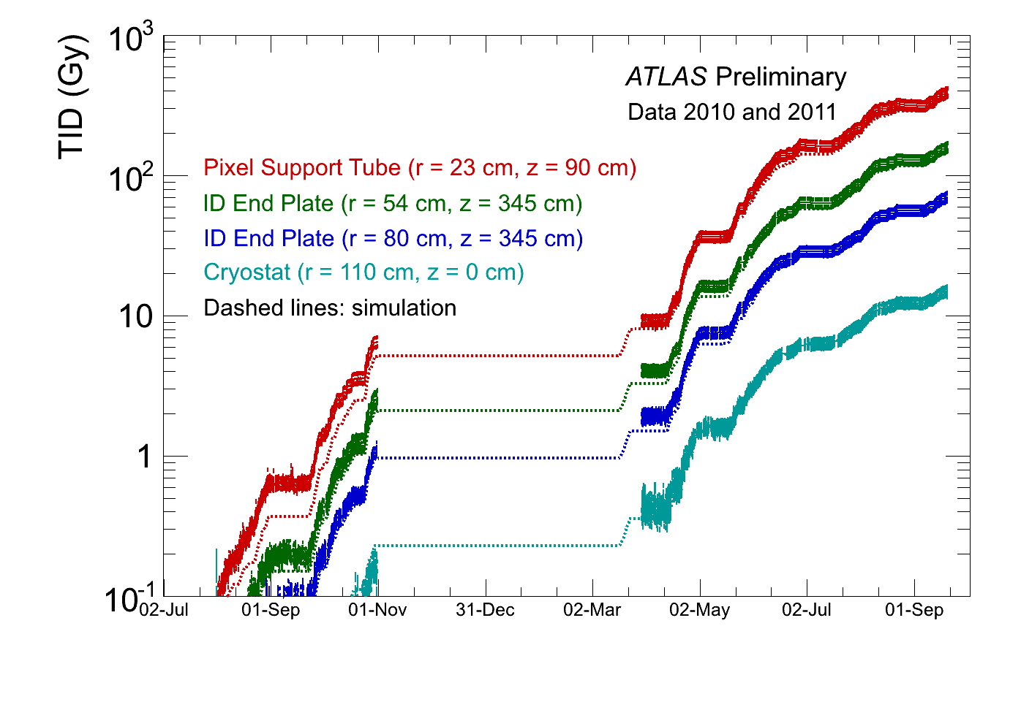
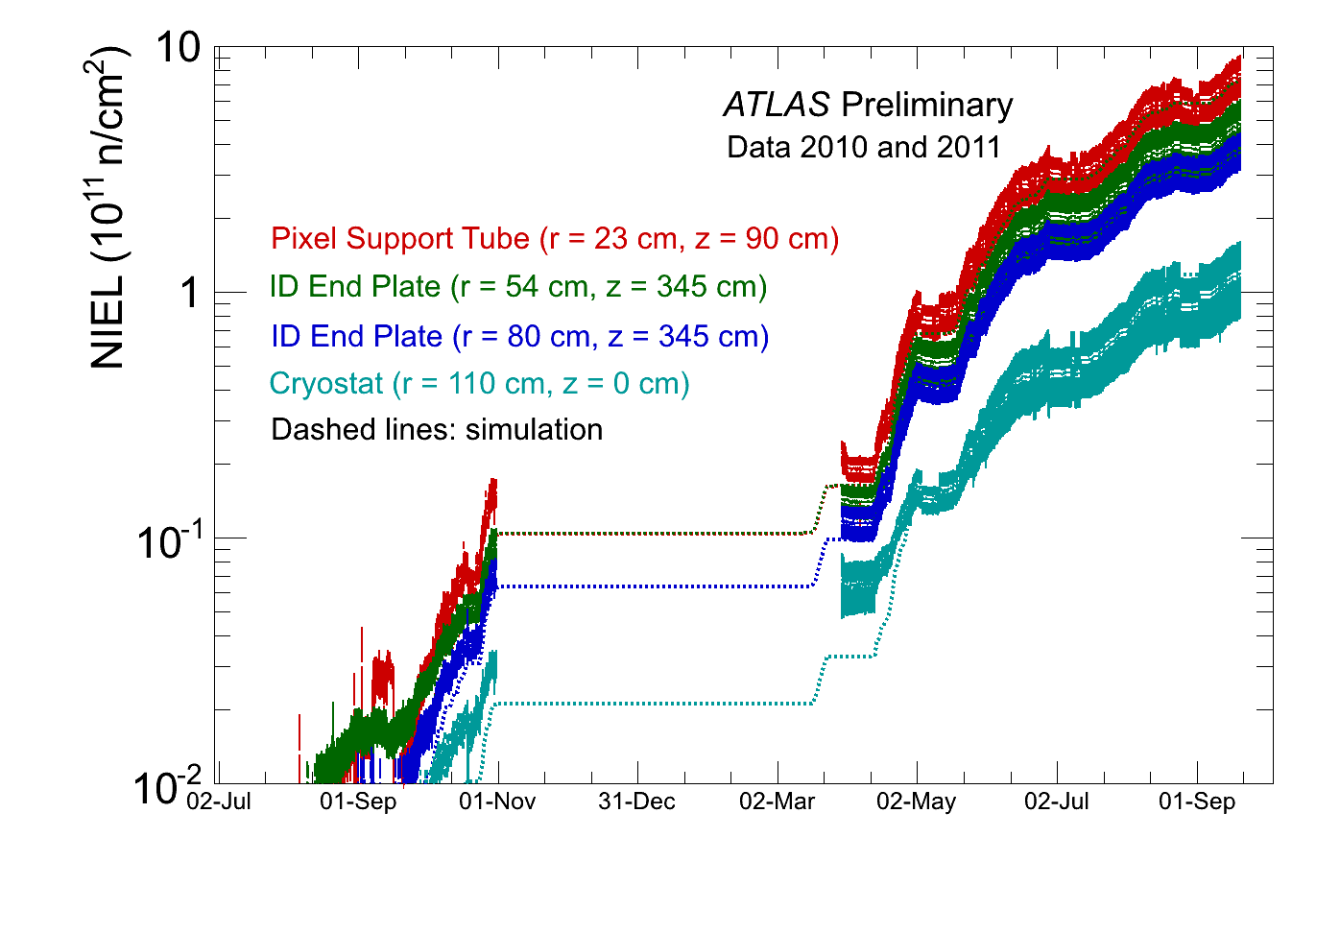
Add.1
TID and NIEL for 2010 and 2011 in log scale
______________________________________________________________________________________________________
I. Mandić, 19th RD50 Workshop, CERN, 21 – 23 November 2011 18

