Slide 1
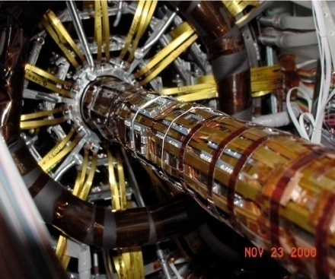
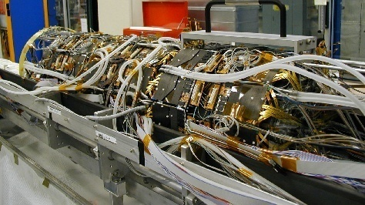
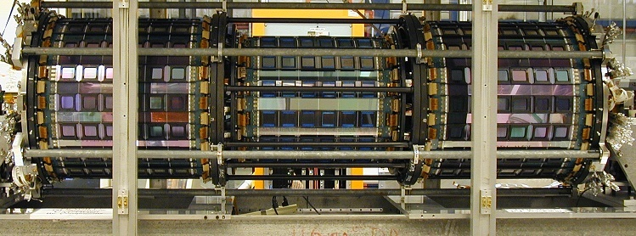


CDF Run-II Silicon Detector: Operations and Aging
Michelle Stancari
Fermi National Accelerator Laboratory
(on behalf of the CDF-II Silicon group)

Slide 2
Outline
Introduction to CDF Run-II Silicon Detector
Radiation Field Measurement
Aging Studies
  Bias Currents
  Signal to Noise Ratio
  Depletion Voltage
Double Junction Observations
Conclusions

Slide 3
Introduction

Slide 4
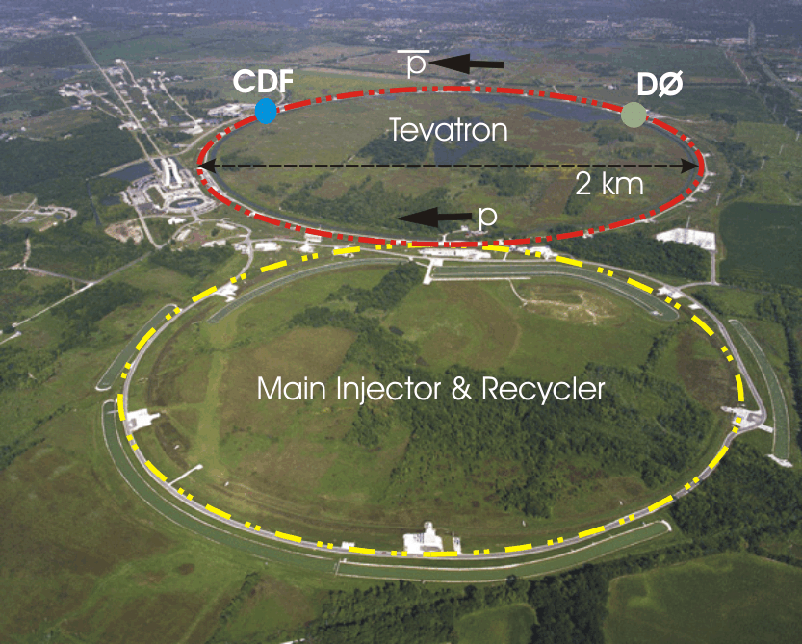
The Tevatron at Fermilab
proton-antiproton collider at √s = 1.96 TeV
Two multi-purpose detectors: CDF & DØ
~55 pb⁻¹/week, ~2.5 fb⁻¹/year
Antiproton Accumulation rate:
  ~25x10⁺¹⁰ particles/hour
Initial luminosity record:
  4.31 x10³² cm⁻² s⁻¹ (May 3, 2011)
Record week: 85 pb⁻¹
Run II: 2001-2011
  12 fb⁻¹ delivered
  10 fb⁻¹ recorded

Slide 5
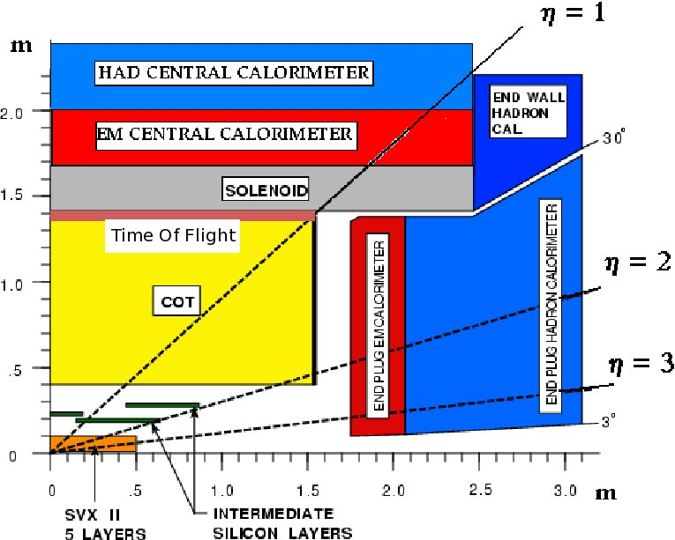
CDF-II Detector

Slide 6
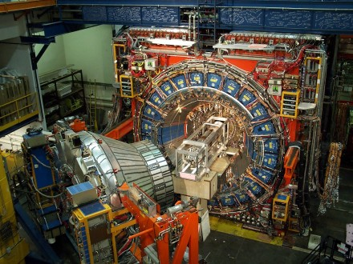
Notes:
Define ladder here

Slide 7
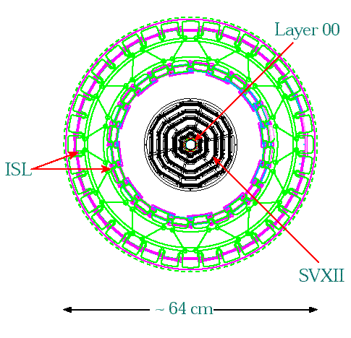
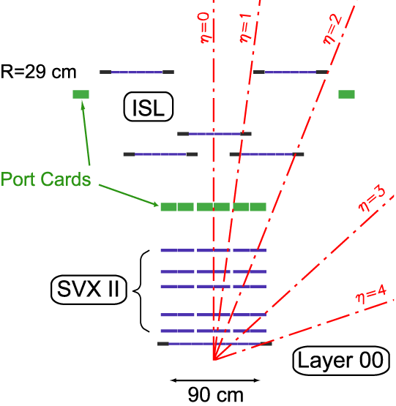
CDF-II Silicon Strip Detectors
10.10 cm
8.22
6.52
4.12
2.54
1.35/1.62
8 Layers, 704 ladders, 722432 Channels
Layer 00 (L00): 1 Single Sided Layer
SVXII: 5 Double Sided Layers
ISL: 2 Double Sided Layers

Slide 8
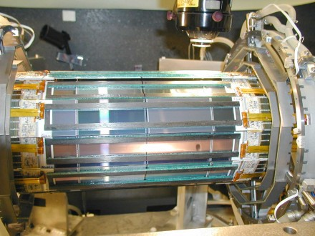
SVX during assembly
JARGON
Ladder
2 double-sided silicon sensors
strips united by wire bonds
single bias voltage
single communication path
Hybrid
Beryllium substrate where readout chips are coupled to sensors
Layers
0,1,3 – Hamamatsu
2,4 - Micron
15 cm

Slide 9
L00 and SVX

Slide 10
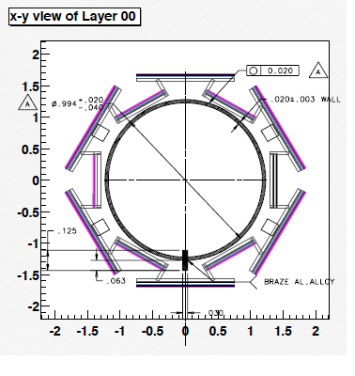
L00 geometry
“Wides” at r=1.62 cm made by Hamamatsu
“Narrows” at r=1.35 cm made by SGS Thompson
** 2 of 12 ladders are special oxygenated sensors from Micron for R&D
SVX-L0 r=2.54 cm

Slide 11
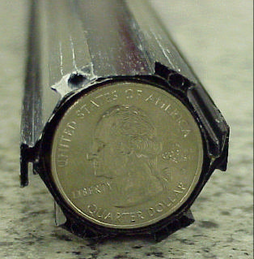
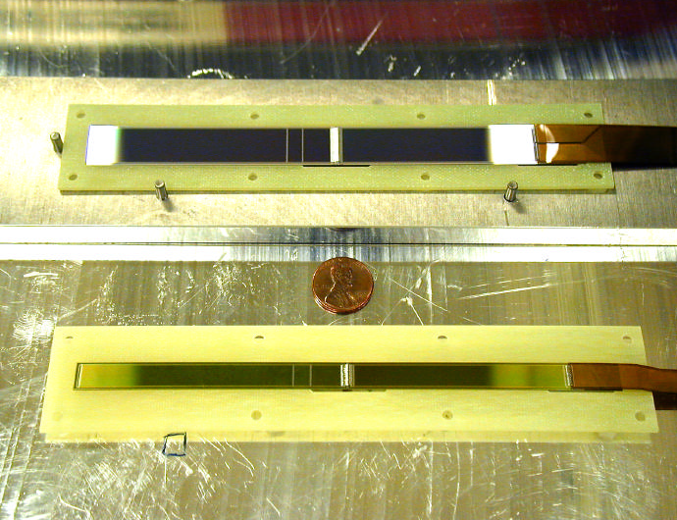
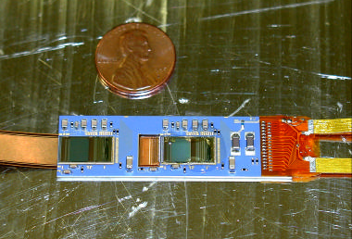
L00 photo album

Slide 12
Sensor Comparison
L00
p+ strips on n bulk
  single-sided
<100>-orientation
Sensor breakdown >600 V
  Power supplies <500 V
Operating temp: -5 °C
Shutdown temp: 0 °C
Hybrids outside tracking volume
1/6 are oxygenated sensors
SVX
p+ strips on n bulk
  double-sided
<111>-orientation
Sensor breakdown
  170-200 V
Operating temp: ~8°C
Shutdown temp: ~0-5 °C
Hybrids attached to sensors
Displaced vertex trigger
L00 designed to outlast SVX-L0

Slide 13
Extended lifetime of L00
Same design rules as CMS strip sensors
Single sided sensors – bias voltage not limited by coupling capacitor
Active cooling – smaller bias currents
Hybrids outside tracking volume – reduces noise growth in readout chips

Slide 14
Design Considerations
COT does excellent tracking
SVX main purpose: B-tagging (identify displaced vertices)
  L2 trigger requiring two tracks with displaced vertices. Readout + decision in ~40 μs.
    Nearest neighbor readout and DPS necessary
    Fast and deadtime-less readout necessary
    Simple wedge geometry
Original plan was to replace SVX and L00 after ~3 years/2 fb⁻¹

Slide 15
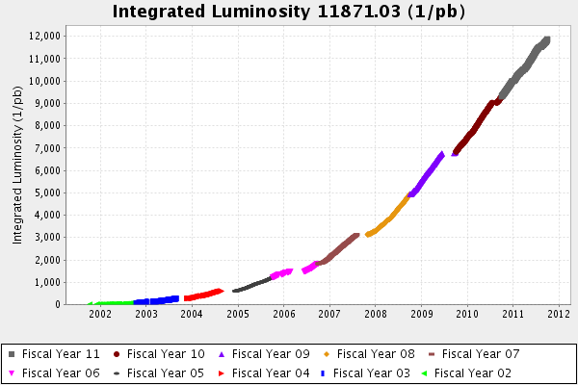
Run 2
Voltage increases every 3-6 months
First voltage increases needed

Slide 16
Radiation Field Determination

Slide 17
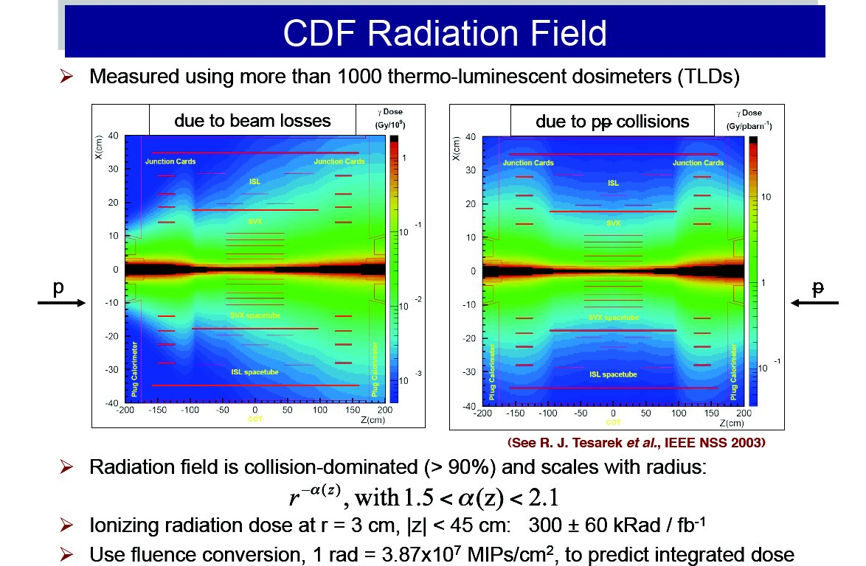
Measured Radiation Field
NIM A514 (2003) 188

Slide 18
Measured Radiation Field
TLD measurement:
dose (Mrad/fb⁻¹) = (1.5±0.3)/r^{1.5} (r in cm)
assume cylindrical symmetry and extrapolate inside the silicon detector
Use measured bias currents to verify r-dependence
Convert to 1 MeV neutron equivalent by assuming
  that contributions of photons and low energy neutrons to the TLD measurements are negligible
  all CDF MIPs are pions which do half the damage of a 1 MeV neutron
1Mrad = 1.935 ± 0.387x10¹³ neq/cm² (20% uncertainty)
NIM A514 (2003) 188

Slide 19
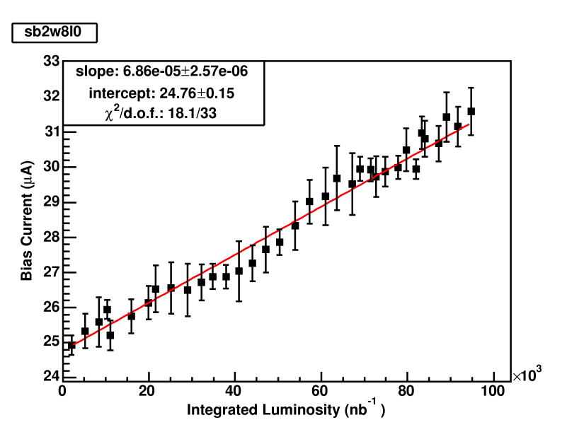
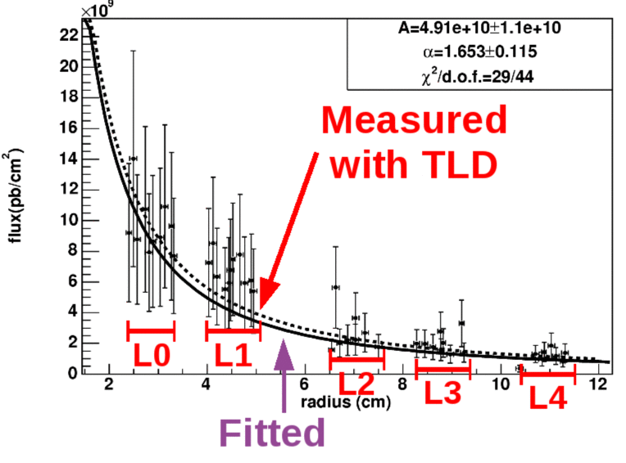
Evolution of Bias Currents
Using a 95 pb-1 sample, the slope of current vs lumi was extracted for each sensor
Thermal model used to correct currents to 20°C
the r dependence of the TLD-measured field was verified
Sensor temperature uncertainty is large

Slide 20
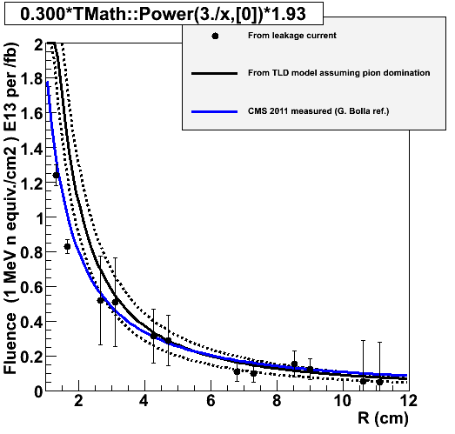
TLDs and bias currents
Plot by Ignacio Redondo
Bias currents
Consistent with CMS, considering the 20%+20% systematic error on vertical scale for TLD and currents
Errors on currents reflect uncertainty of sensor temperature
TLD measurement
CMS 2011 measured
(G. Bolla, priv. comm.)

Slide 21
Aging studies: Bias Currents

Slide 22
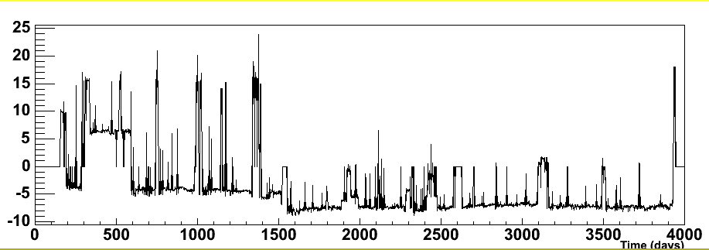
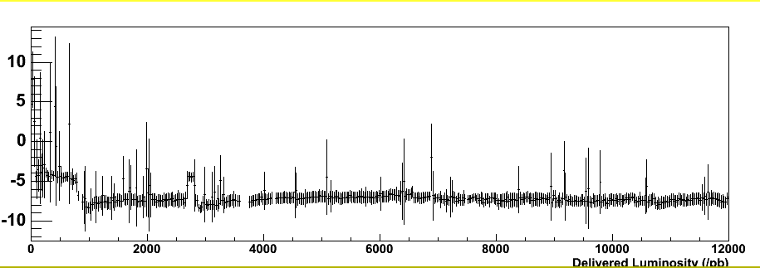
L00 temperature
24 days annealing at 18°C
Shutdowns 0 °C
Colliding
Beams
-6 °C
Cooling line temperature (°C)
Time (days)
Delivered Luminosity (pb⁻¹)

Slide 23
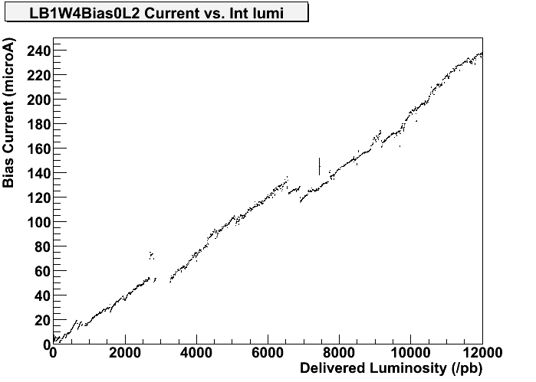
Bias currents during operation
L00 example
?
Operating temperature
change
ISL cooling repair

Slide 24
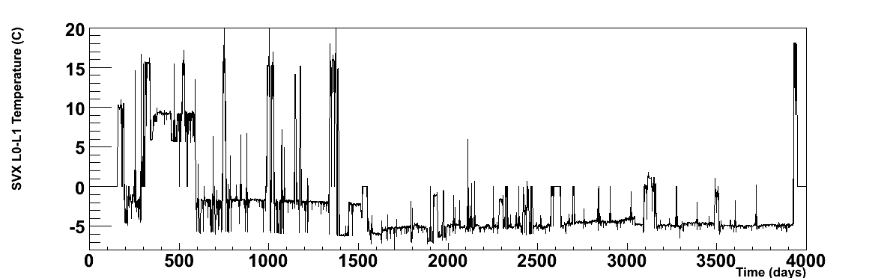
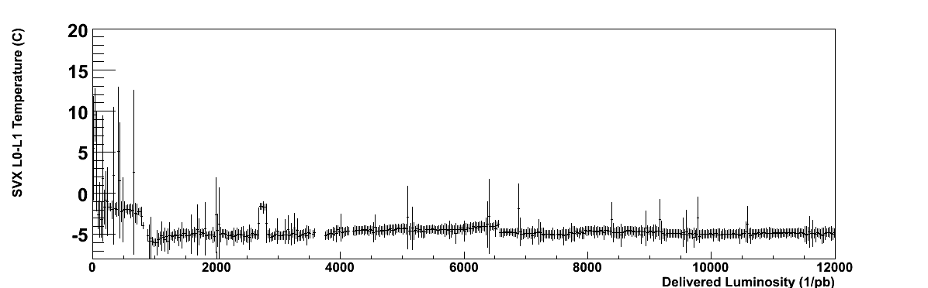
SVX temperature
24 days annealing at 17-18°C
Operating : ~7°C
(sensors are 12°C warmer than bulkheads)
Shutdowns: ~0-5°C
Bulkhead temperature (°C)
Time (days)
Delivered Luminosity (pb⁻¹)

Slide 25
Bias currents during operation
SVX example
Bias current (μΑ)
Integrated luminosity (pb⁻¹)

Slide 26
Bias currents
I/V after 12 fb⁻¹
Annealing for 25 days at 18°C
Raw currents - no annealing corrections
Average over all sensors in same layer assuming same dose and same temperature
Error bars from sensor temperature uncertainty
Horizontal axis scale uncertainty:
  ±20% ±20%
I/V at 0 °C (μA/cm³)
PRELIMINARY

Slide 27
Aging Studies: S/N

Slide 28
Signal / Noise Measurements
Signal from J/ψ → μ⁺μ⁻ tracks – total cluster charge
Noise measured bi-weekly with beam
Extrapolations assume fully depleted sensors
SVX p-side
PRELIMINARY
SVX n-side

Slide 29
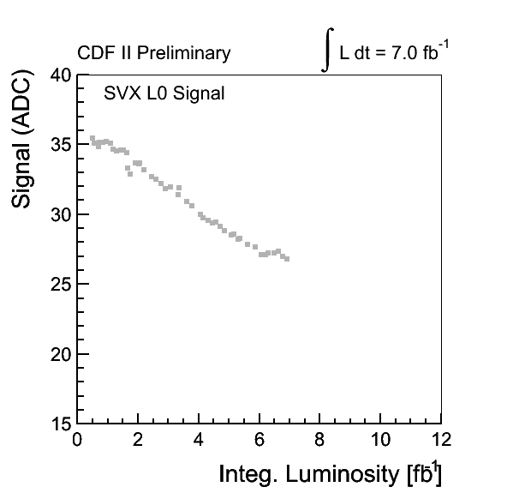
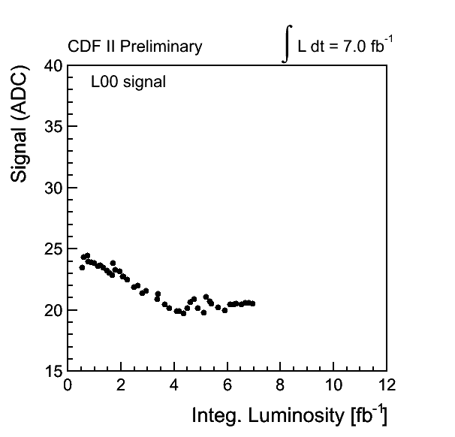
20% Signal decrease
SVX L0
L00
PRELIMINARY
PRELIMINARY
0.072x10¹⁴ neq/fb⁻¹
0.16x10¹⁴ neq/fb⁻¹
Sum charge over strips that form cluster

Slide 30
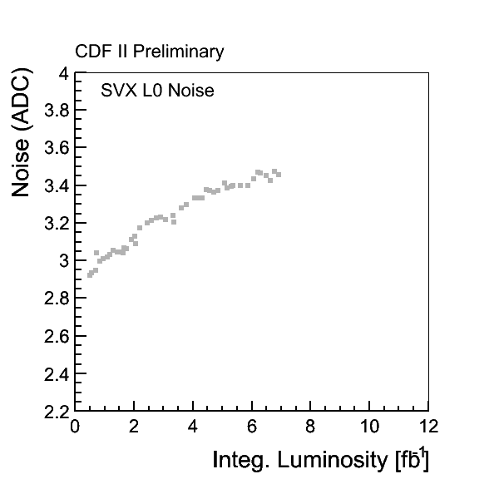
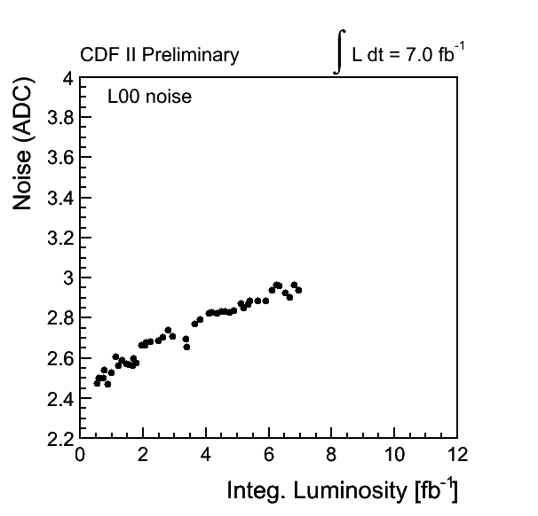
20% Noise Increase
SVX L0
L00
PRELIMINARY
PRELIMINARY
0.072x10¹⁴ neq/fb⁻¹
0.16x10¹⁴ neq/fb⁻¹
Average noise over strips that form cluster

Slide 31
SVX-L0 efficiency
Efficiency = fraction of COT tracks with silicon clusters where expected
10% efficiency loss in SVX-L0 from decreasing S/N.
Much less in other layers, even L00.
CHOSE not to decrease clustering and readout thresholds
The lifetime of your detector depends how you use it!!
Trigger? Tracking?
B-tagging?

Slide 32
Aging Studies: Depletion Voltage

Slide 33
Depletion Voltage Measurement
Use outer tracking detectors to define tracks intersecting the silicon ladder under study
Plot peak charge for offline clusters as a function of bias voltage
CDF defines depletion voltage as the minimum voltage that collects 95% of the charge at the plateau
130 V
30 V

Slide 34
Operational Perspective
L00 narrow 4.04 fb⁻¹
“S” portion of S/N
Standard offline
clustering threshold
(depends on measured noise of individual strips)
Probability to find a cluster for a given track

Slide 35
Depletion Voltage Measurement
Plot collected charge for different bias voltages
Determine depletion voltage as the minimum voltage that collects 95% of the charge at the plateau
Extrapolate into the future -
  linear fit after inversion point
130 V
30 V
0.185x10¹⁴ neq/fb⁻¹

Slide 36
Depletion Voltage Projections
0.185x10¹⁴ neq/fb⁻¹
0.141x10¹⁴ neq/fb⁻¹

Slide 37
Depletion Voltage Projections
0.072x10¹⁴ neq/fb⁻¹
0.035x10¹⁴ neq/fb⁻¹

Slide 38
Comparing different layers
0.194x10¹⁴ neq/Mrad
Depletion voltage is averaged over all sensors in a layer assuming all have the same dose (beam in center of detector) and same temperature.

Slide 39
Slope comparison with HM
SUPER-PRELIMINARY
FZ with no annealing
HM (t=0,Φ−>∞,g_{c}=0.015,g_{a}=0.018)
SVX-L0
Oxyg. with no annealing
HM (t=0,Φ−>∞,g_{c}=0.006,g_{a}=0.018)
L00 wide
SVX-L1
FZ with max ben. annealing
HM (t=0,Φ−>∞,g_{c}=0.015,N_{a}=0)
L00 narrow
Oxyg. with max ben. annealing
HM (t=0,Φ−>∞,g_{c}=0.006,N_{a}=0)
oxygenated
Scale uncertainty: ±20% ±20%

Slide 40
Double Junction

Slide 41
Double Sided Sensors
6.88 fb⁻¹
6.88 fb⁻¹
Qualitative observation
The (heavily irradiated) sensors are depleting from the two sides toward the center
Consistent with a doubly-peaked electric field
Notes:
Efficiency

Slide 42
L00 evolution
0.39 fb⁻¹
0.65 fb⁻¹
0.94 fb⁻¹
After inversion, sensors still have signals when under-depleted!
1.55 fb⁻¹
2.04 fb⁻¹

Slide 43
L00 evolution
0.39 fb⁻¹
2.04 fb⁻¹
4.53 fb⁻¹
7.03 fb⁻¹
9.01 fb⁻¹
10.63 fb⁻¹

Slide 44
To Do List
Calculate fluence ladder by ladder using measured beam offsets
Analysis of sensor temperature measurements => fine tune thermal model
Use individual sensor temperatures for bias current analysis
Analyze I-V curves from annealing studies

Slide 45
Summary and Conclusions
There is a big step from operating a detector to extracting information about radiation damage . . .
Tevatron data offer unique measurements of radiation damage in silicon detectors.
Efforts to reduce S/N loss in L00 were successful!
Our heavily irradiated sensors are behaving differently than expected:
Significant signal loss (20%) for innermost sensors
Slightly underdepleted sensors still give good data on both sides of the sensor.
Qualitative confirmation of double-peaked electric field inside heavily irradiated sensors

Slide 46
Backup Slides

Slide 47
Noise Scans
Measure noise (rms of the ADC counts) as function of bias voltage
no beam wasted
only works for SVX sensors before inversion
n-side noise
p-side noise

Slide 48
Noise Scans

Slide 49
Noise Scans – compare 3 layers
PRELIMINARY
SVX-L0
SVX-L1
SVX-L3

Slide 50
Bias Currents at 18°C
6 SVX sensors

Slide 51
Bias Currents at 18°C
2 L00 sensors

Slide 52
I-V curves from V_{dep} meas
Current (uA)
V_{dep} =186 V
180 V
169 V
150 V
--------
135 V
120 V
Voltage (V)
From signal scans 2010 & 2011, LB0W1L3

Slide 53
I-V curves at 18°C

Slide 54
Annealing: 24 days at 18°C
4. Measure IV curves daily
12 groups of 2 L00+6 SVX ladders
6. Undo Power Supply modifications
2. Power Supply Modifications
7. Measure noise and bias currents
3. Discover cooling limitations
Measure bias currents for temperature map
1. Measure noise and bias currents
°
10/4/2011
11/1/2011
9/30/2011
10/27/2011
Operating (-10 °C)
chips on, bias on
warm (+18°C)
chips off, bias off
Cold (-5°C)
chips off, bias off

Slide 55
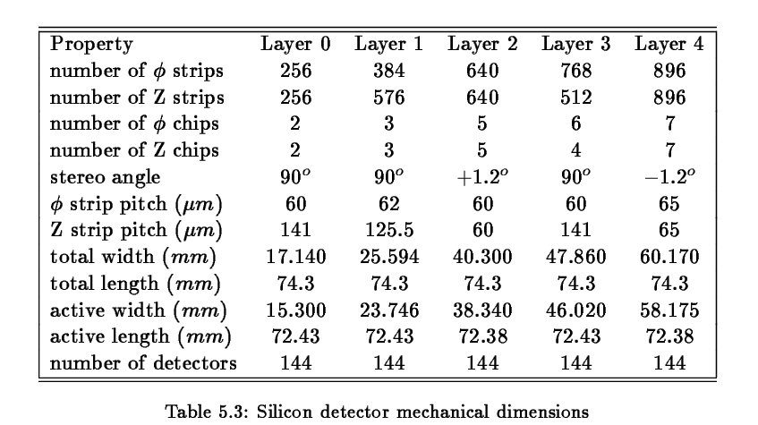
SVX details
NIM A514 (2003) 188
NIM A514 (2003) 188

Slide 56
Operations

Slide 57
Operational Challenges
Chips require keep alive (frequent trips)
Chip damage after quenches/beam aborts (new collimator installed)
Wire bond resonances (limit level 1 trigger rate and event size for SVX)
L00 noise (offline correction event-by-event)
SEU requires module reset (PS and readout) and trip recovery
ISL cooling line corrosion
Power supply voltage droop

Slide 58
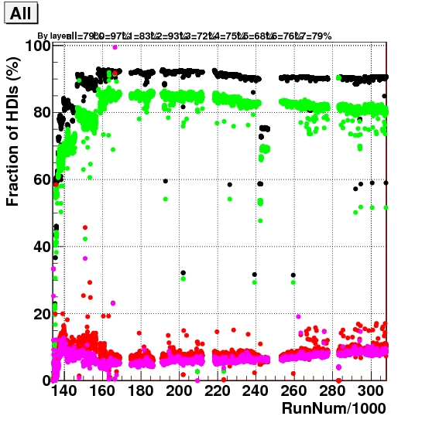
No ladder left behind!
~90% ladders integrated
~80% good (< 1% error rate)
~10% bad, average error rate of 10%
3 fb⁻¹
7 fb⁻¹
Optical transmitter (DOIM) failure rate is very small (<1%) mostly single bits with low light
Small rate of single chip failures
Stuck or random buffer ID
general garbage data,
bit errors local to chip

Slide 59
Chip Accounting - SVX
Common failure modes:
Detector includes port cards, junction cards, cables, power supplies, and the sensors themselves.
Optical is bit errors and failures from the internal DOIM data transmitters
Jumper is SVX3D chip failures due to wire bond resonances
AVDD2 is a SVX3D chip failure mode caused by beam incidents and thermal cycles
Other SVX3D includes all other chip failure modes (internal)
Fraction of bad chips
SVX
z-side

Slide 60
Run 2
Voltage increases every 3-6 months
First voltage increases needed

Slide 61
Staying Depleted
Measuring the depletion voltage was expensive
  2 hours of collisions not used for physics (per layer measured)
  Black box to analyze data quickly is essential!
  Black box needs adjusting as sensors age!
Raising the voltages was time consuming
  small voltage steps
  handful of ladders at a time to minimize risk
  monitor for damage and noise afterward
  Power supplies have internal protection limits for bias voltages, must be removed from collision hall to change
  In 2010, 3 of 15 L00 power supplies failed when raised from 250V to 350V and needed repairs (originally tested to 500 V).

Slide 62
Chip accounting - ISL
Fraction of bad chips
No jumper failures for ISL because readout happens only after L2 accept
No AVDD2 failures because of warmer temperature than SVX
Sensor recovery after JC pushes (disconnected cables)
Long history of cooling problems
  2003 – unblocked cooling lines
  2007 – major leak repaired

Slide 63
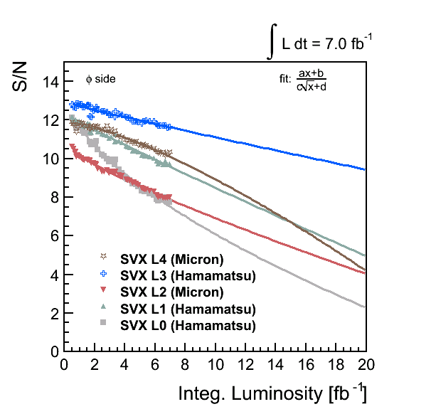
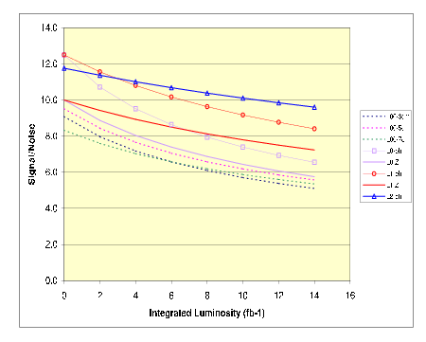
Expected S/N
CDF note 6673 (2003)
S/N predictions assumed increase in noise and no change in signal
SVX p-side
SVX phi
L00 (dashed lines) and SVX-L0 (grey lines) predictions roughly match data?

Slide 64
SVX3d chip
Analog Front End and Digital Back End
  Compatible with 396/132 nsec bunch spacing
  FE has relatively low noise integrator with 128 channels and 46 cell analog pipeline with 4 buffer cells
  BE has a comparator, 8-bit Wilkinson ADC, and sparse readout with nearest-neighbors
Dead-timeless
  Capable of analog operations during digitization and readout
Dynamic Pedestal Subtraction
  Enables on-chip common mode noise suppression
Fabricated with Honeywell 0.8 μm rad hard process

Slide 65
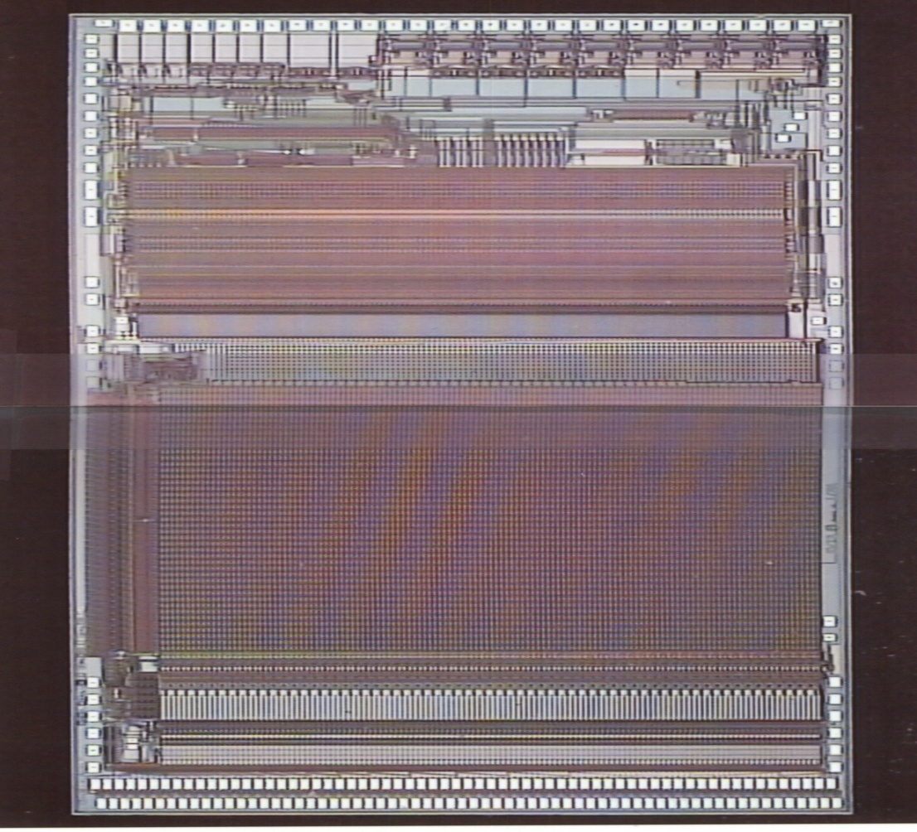
SVX3d chip
Fabricated in the Honeywell 0.8μm rad.hard process
46 pipeline cells
128 channels

