Slide 1

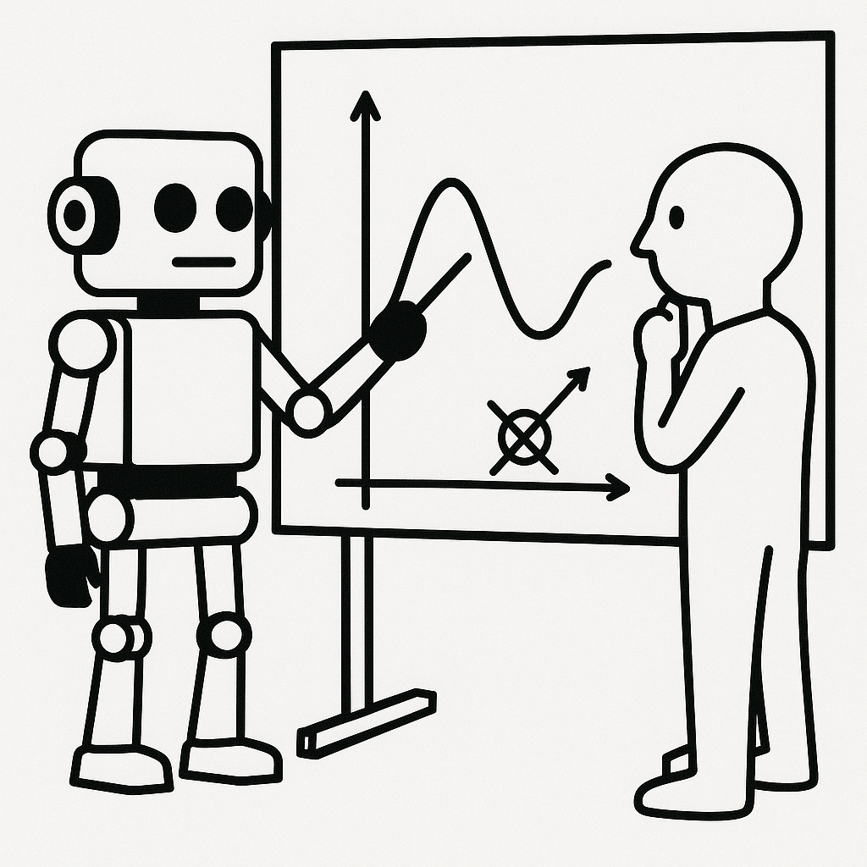



Using Large Language Models to Accelerate Access to Physics
G. Watts (U. Washington/Seattle)
Rūta Lomsargytė (Vilnius University)
Supported by NSF PHY-2323298

Slide 2
Motivation
“…maybe we will go from solving high-energy physics one year to beginning space colonization the next year…”
– S. Altman, June 10
The ever-increasing prompt size – we can now prompt a modern large LLM with a novel.
Code agents (like github co-pilot) can write fairly complex code.

Slide 3
Walk before we run
Most basic: make a plot!
(see me ask ChatGPT-5 cold to write an analysis to measure the top mass in back up slides)

Slide 4
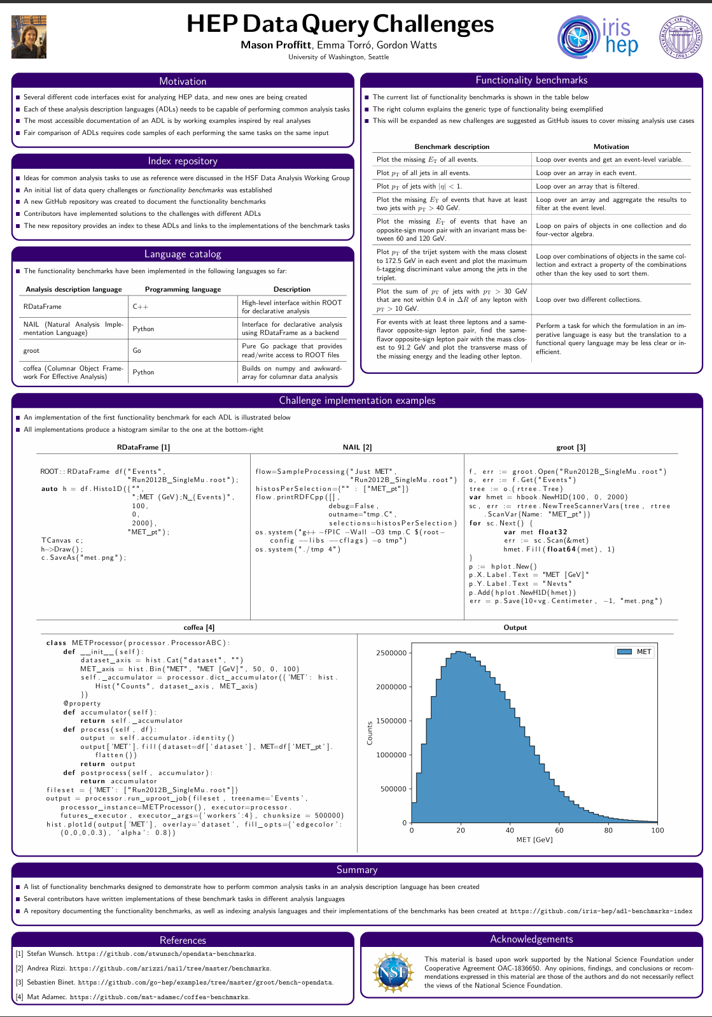
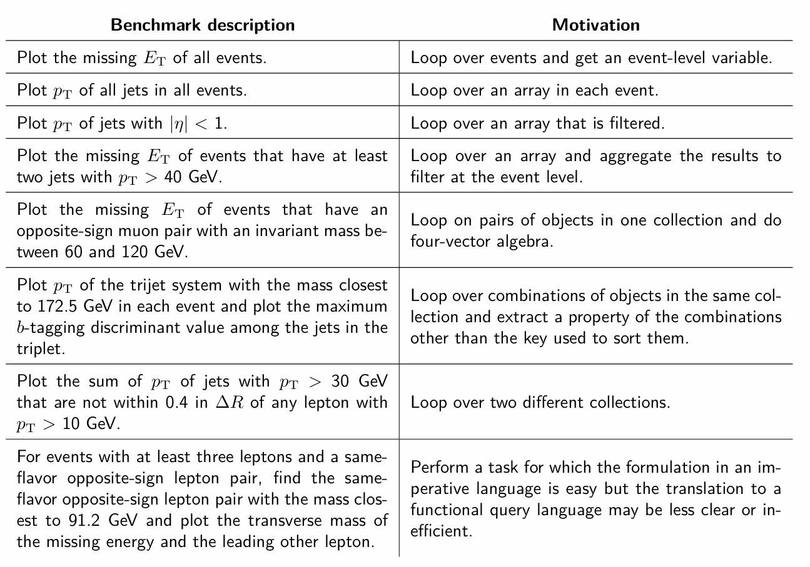
Analysis Description Language Benchmark Questions
M. Proffit – CHEP 2019

Slide 5
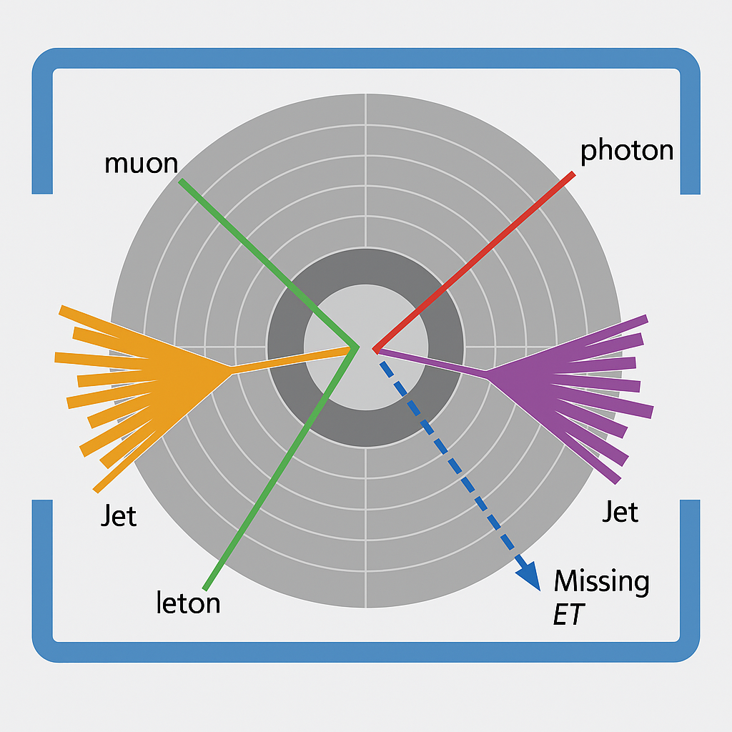
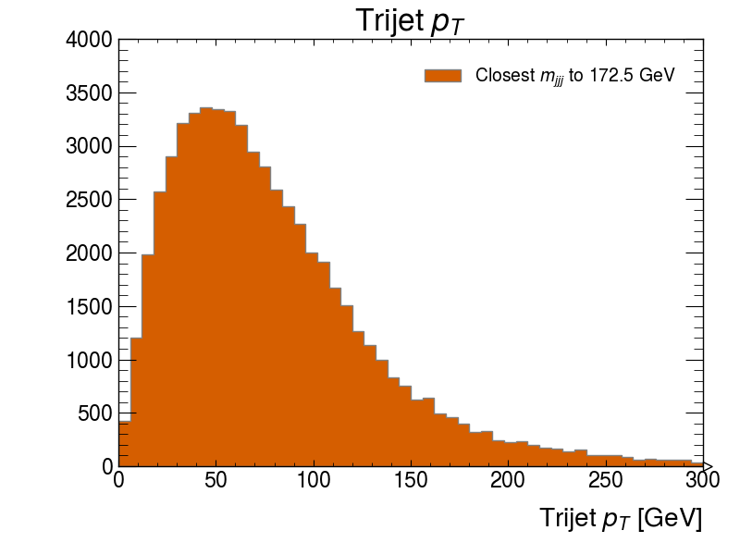
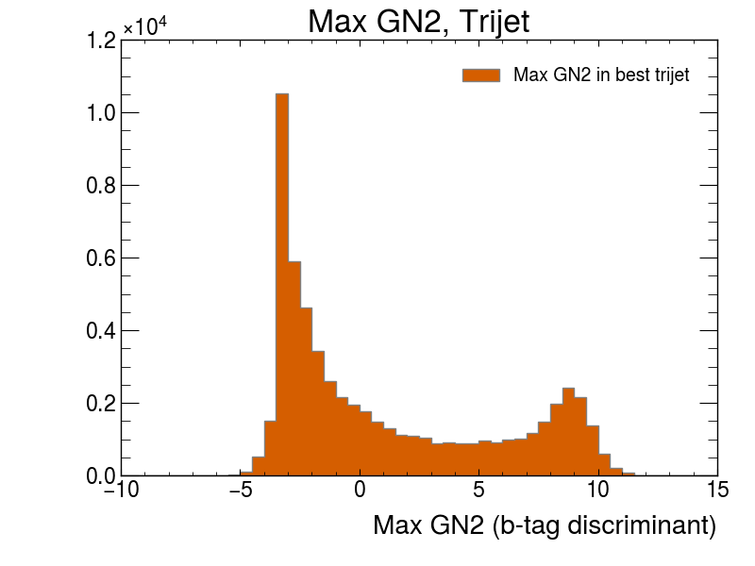
Experimental Particle Physics as a Big-Data Problem
Collision #1
Question 6: For events with at least three jets, plot the pT of the trijet four-momentum that has the invariant mass closest to 172.5 GeV in each event and plot the maximum b-tagging discriminant value among the jets in this trijet
Collision #2
Loop over all the events
Require the event to have three jets
Fetch the jets
Form all 3-pair combinations
Pick the 3-pair combination closest to mass 172.5 GeV (top mass)
Fill an appropriately defined histogram
Fetch the b-tagging discriminate for all three jets
Fill an appropriately defined histogram with the largest discriminate value.
Plot the histograms
Collision #3
Collision #4
Loop over combinations of objects in the same collection and extract a property of the combinations other than the key used to sort them.
Collision #5

Slide 6




Get data off the GRID and convert it to a columnar format in a scalable way.
Workflow
Manipulate columns, filter, 4-vector algebra, etc.
“numpy” for jagged data
Histogram manipulation, plotting (matplotlib), HEP formatting, etc.

Slide 7
Hint Text
ServiceX
Different hint files for different workflows…
Different prompts for different tasks/workflows
Awkward Array
Prompt
Question
Large Language Model
Vector
Hist
Same for all questions
ATLAS xAOD Data

Slide 8
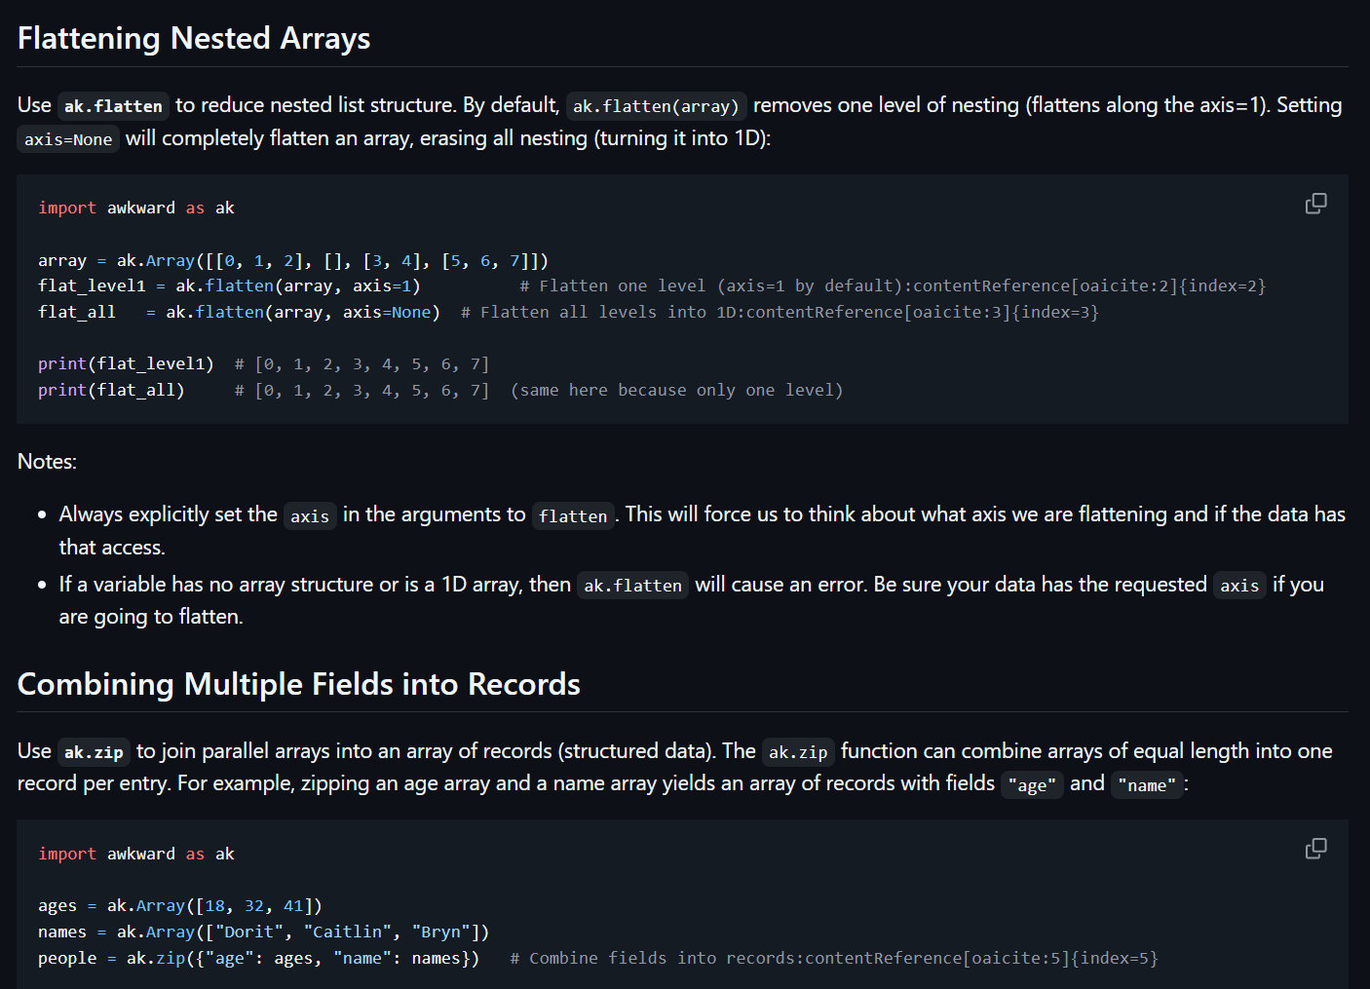
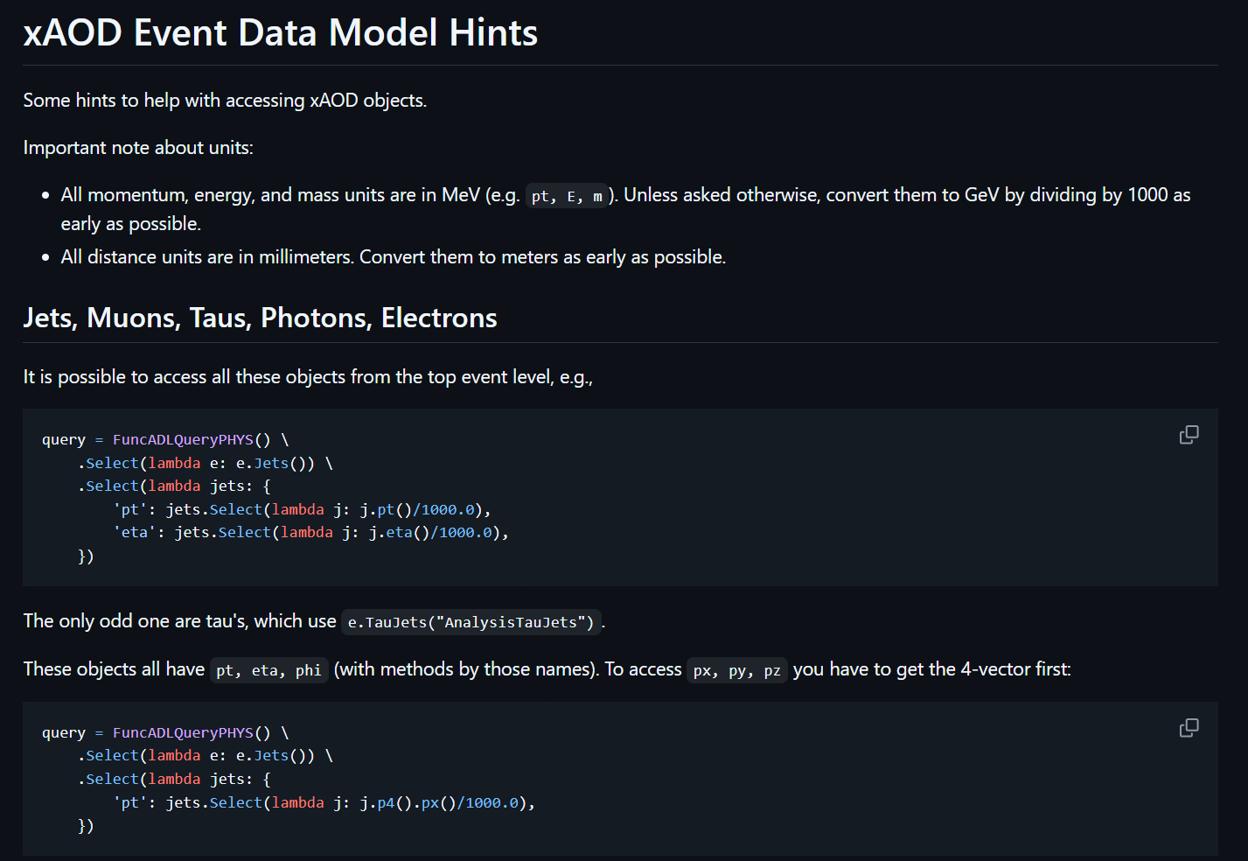
Github with all hint files
Awkward Array Hints File
ATLAS xAOD Data Model
Factorized by topic
(hint text on github)

Slide 9
Github with all hint files
Awkward Array Hints File
ATLAS xAOD Data Model
Writing Hint Files
Used a LLM to draft many of the bigger ones first (“deep research”)
Wrote some by hand (e.g. xAOD Data Model) – no good public source of documentation
Iterate – when the LLM gave a confusing answer, could often trace it to incorrect or unclear hint files! [Found some errors in source documentation]
These hint files end up being quite useful for humans (FAQ’s)
Factorized by topic
(hints on github)

Slide 10
You will be asked to write python code that will access ATLAS data, extract some items, and then make one or more plots.
If the user's prompt doesn't fit that request, please complain. Generate code using ServiceX to fetch the data,
Awkward array to manipulate the data that comes back (with vector for doing any physics calculations like
invariant mass), and Hist to generate and plot the histogram. Write the histogram/plots to `png` files.
If hints contain instructions to tell the user some bit of information, make sure to do that. If you are manipulating
from ServiceX, use only Awkward array - do not use python lists, etc. Just give the user the code, do not try
to create a pull request in any repo.
** Hints **
{hints}
** User Question **
{question}
** Final Instructions **
Please reply in the following format:
>>start-reply<<
<text describing what you have done as a bulleted list>
```python
<code>
```
>>end-reply<<
Added to clean up the output!
Modern LLM’s are fine-tuned to explain – if you don’t give them an outlet, they will just write it anyway!
Prompt
All you actually want…
Full prompt in github

Slide 11
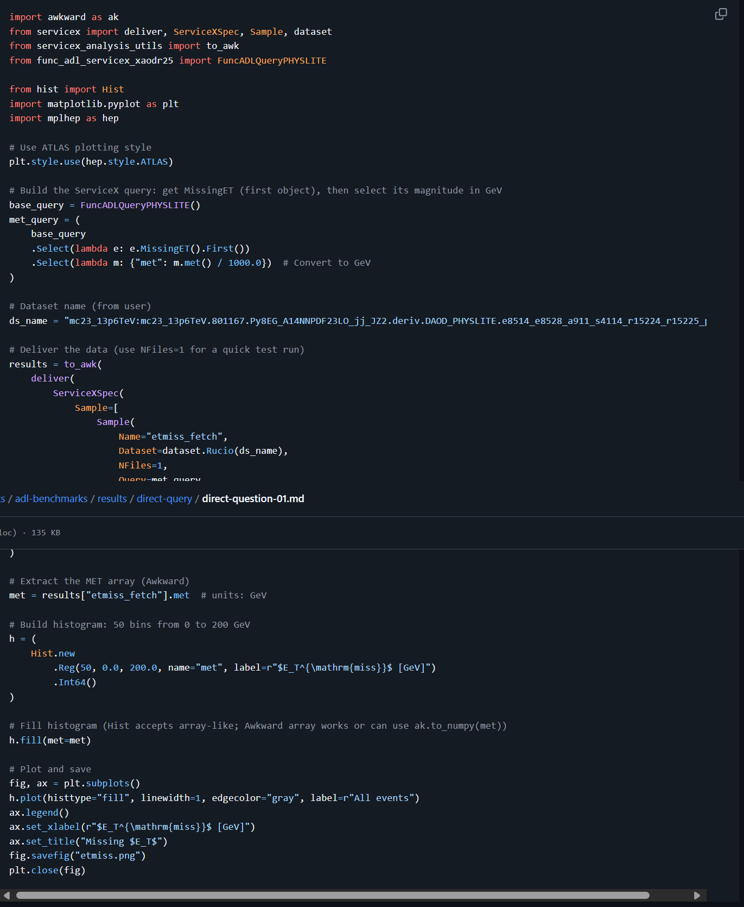
Question 1: Plot the ETmiss of all events
Code is very straight forward
Template code from hint files are accurately copied over, and filled in, extended, etc.
All LLM Models on Question 1

Slide 12
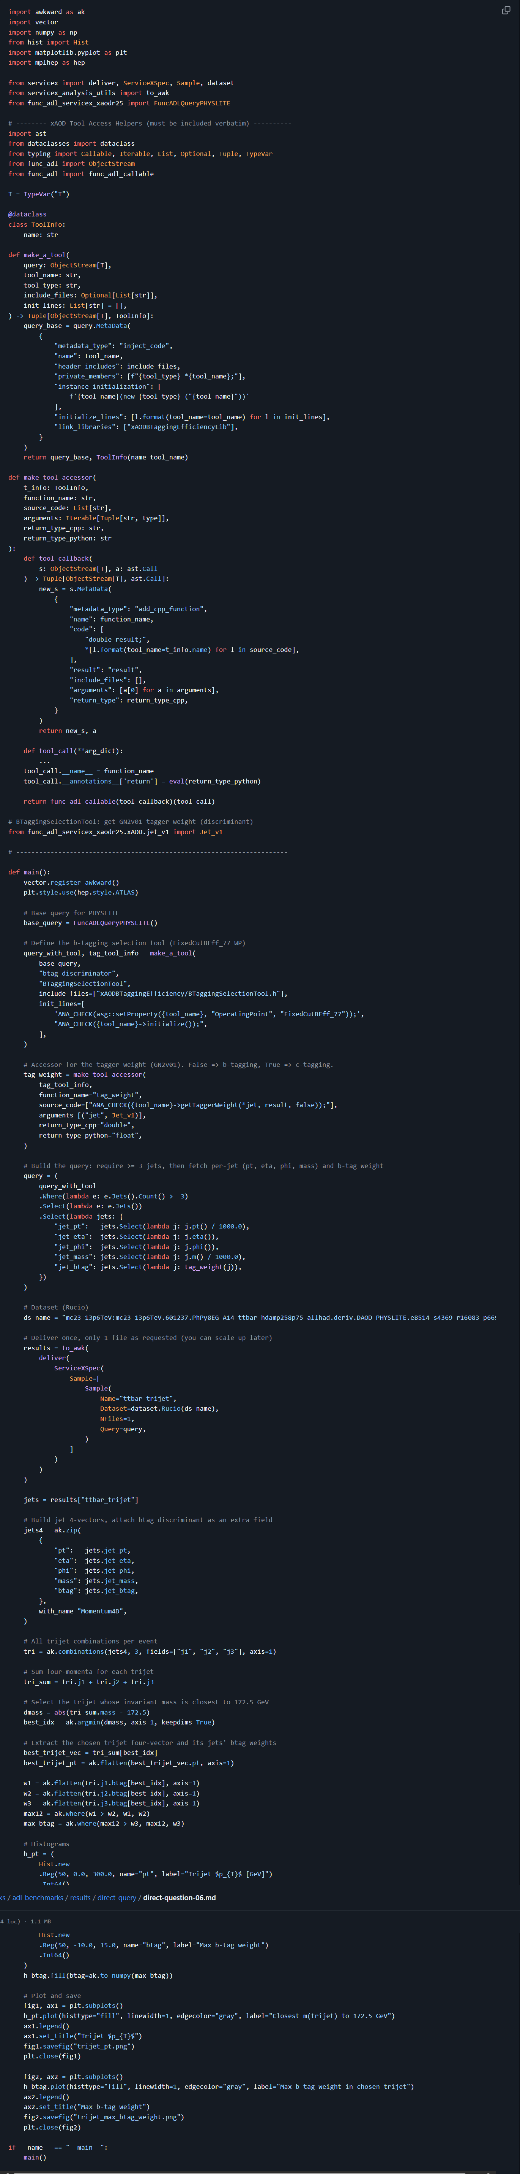
Question 6: For events with at least three jets, plot the pT of the trijet four-momentum that has the invariant mass closest to 172.5 GeV in each event and plot the maximum b-tagging discriminant value among the jets in this trijet
Code is considerably more complex
Some of the LLM notes are informative…
Sometimes the LLM uses an odd way to do something
The code isn’t always the most straight forward
Perhaps update hint files to guide it?
Example Excerpt from GPT-5 LLM Notes:
Builds Awkward Momentum4D vectors, forms all trijet combinations per event, selects the combination with invariant mass closest to 172.5 GeV, then:
Plots the pT of the selected trijet four-momentum.
Plots the maximum b-tagging discriminant among the three jets in the selected trijet.
Note: Only one file is processed (NFiles=1) here; when you are ready, you can scale up yourself.
All LLM Models on Question 6

Slide 13
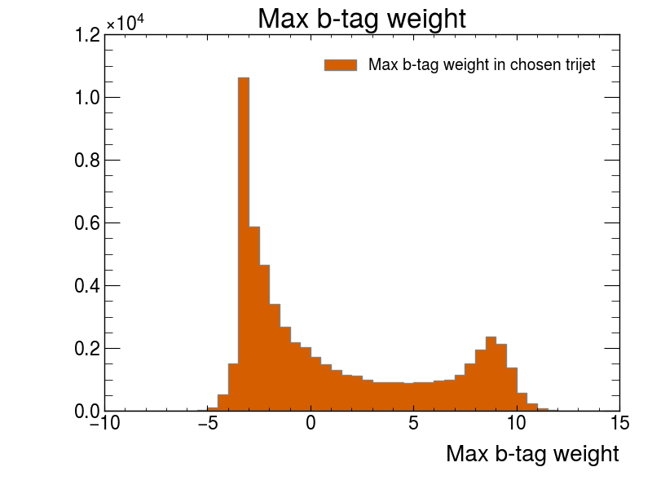
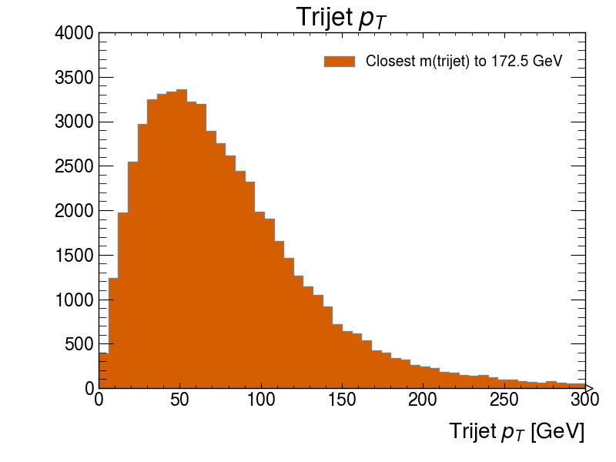
Got it!

Slide 14
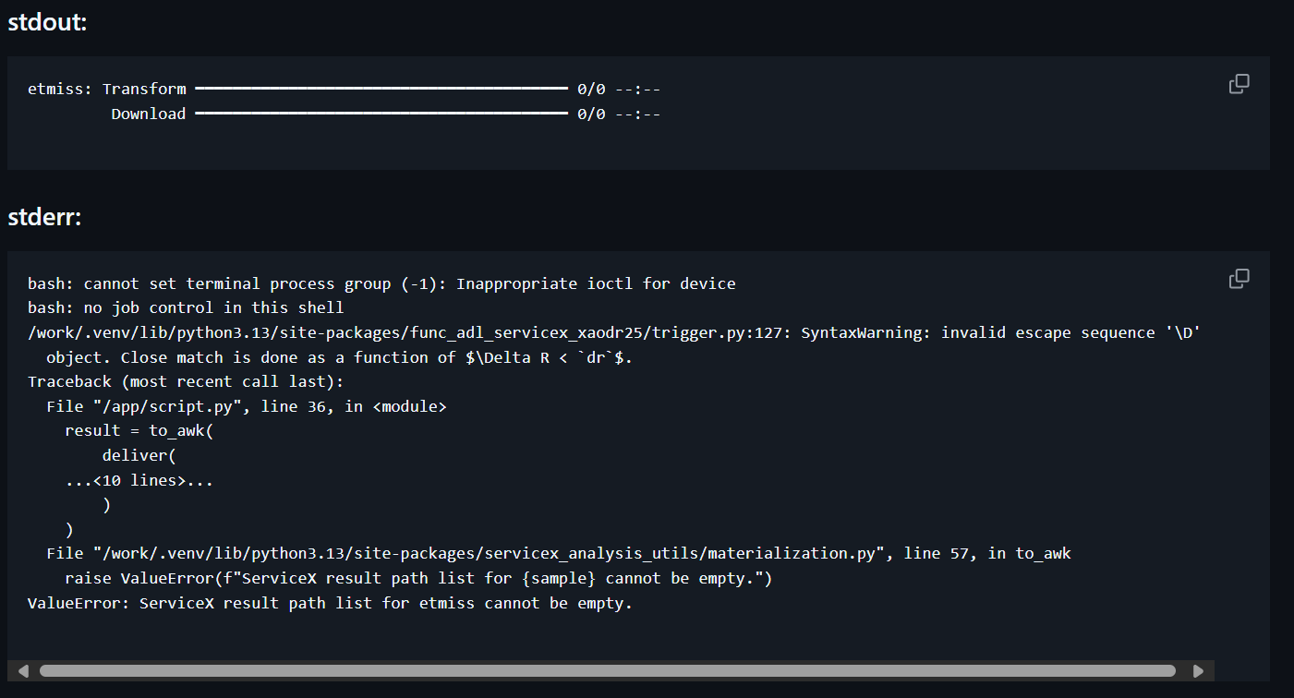
What about errors?
This is a crash in ServiceX
No data was returned
Note the “0/0” – no files were found for ServiceX to process.
This means that the dataset name is likely bad.
BUG:
Note there is no informative error message…
I had to use my expert knowledge of the system to realize what was going on.

Slide 15
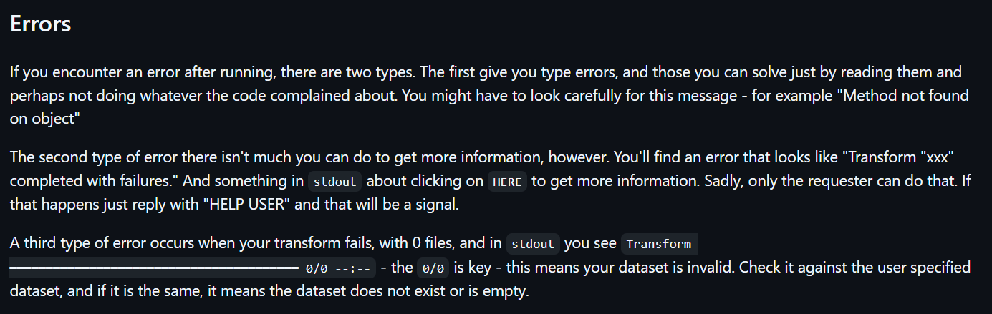
Add my expert knowledge to the hint files

Slide 16
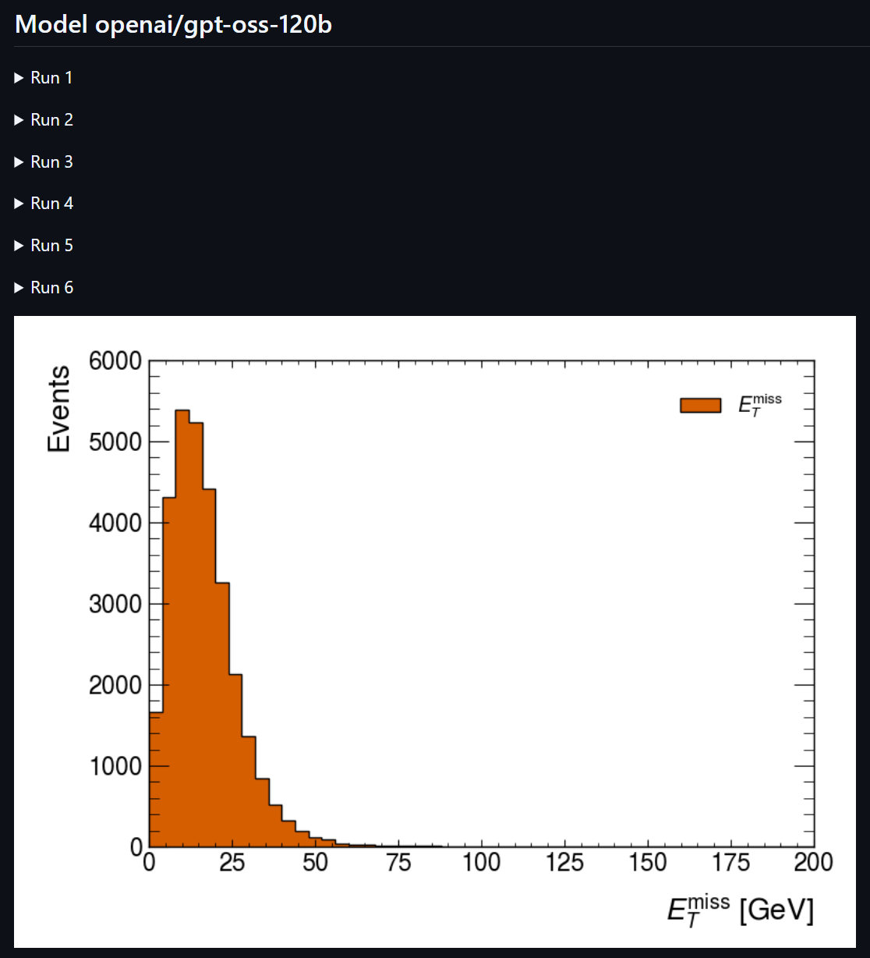
Prompt + Question + Hint files
Fix It Prompt is very similar to first prompt
Includes old code
stderr, stdout
Iterations are allowed up to some limit
In general, smaller models have more trouble than larger models!
LLM
Fix It Prompt + Question + Hint files + Previous Version of Code + stderr/out
Run Code
(in docker)
Took 6 tries on Q1!!!
Did Code Fail?
Y

Slide 17
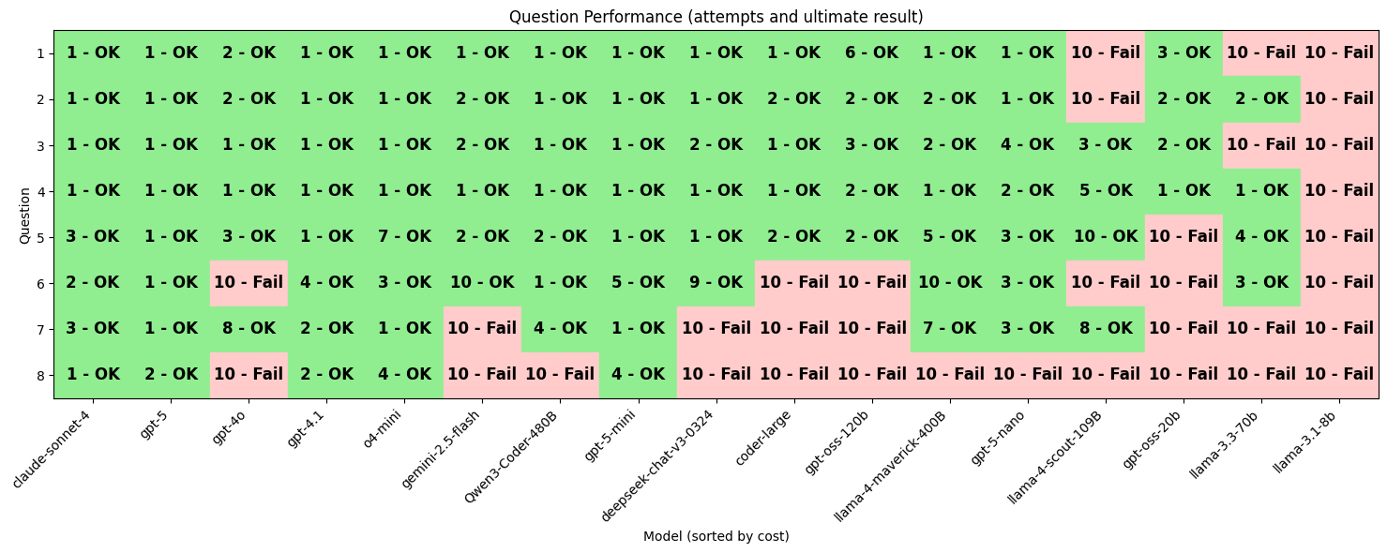
Number of Tries…
Models are sorted by cost…

Slide 18
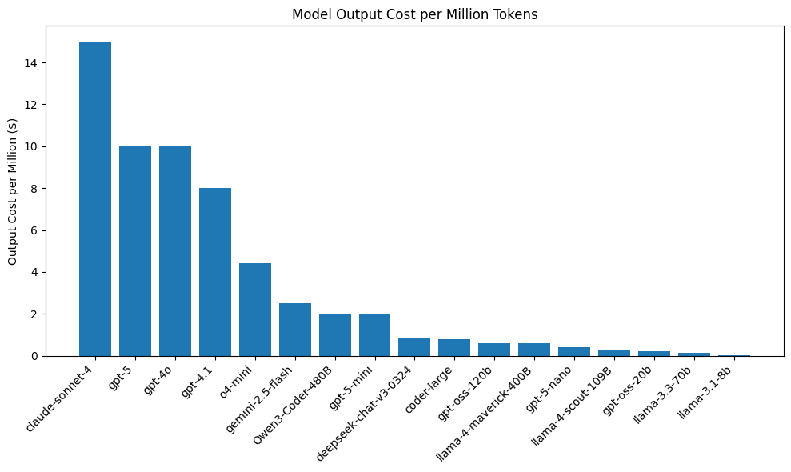
Models are sorted by cost of output tokens

Slide 19

Hallucinations
Boat-Bar Crossing Bridge In Munich
Alte Utting

Slide 20
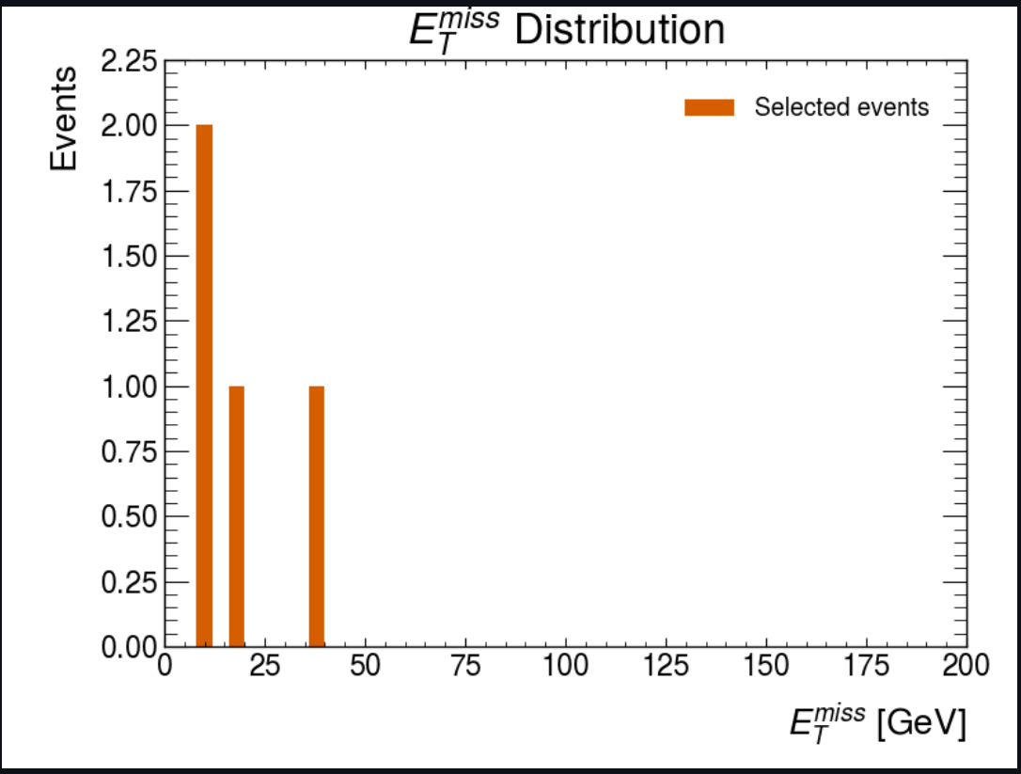
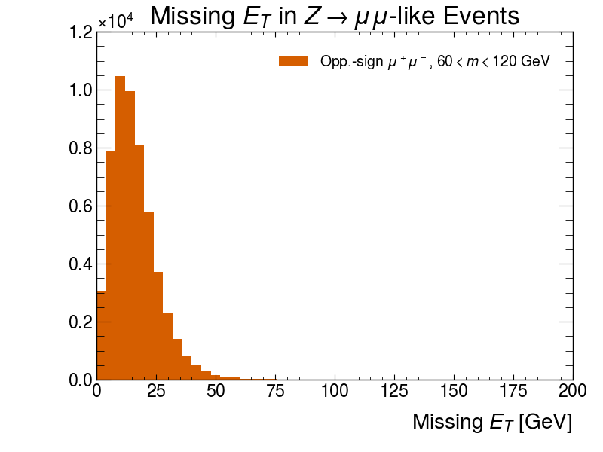
gpt-4o Question 5
Correct Question 5 Answer
All models answers to question 5
Analysis Of Errors

Slide 21
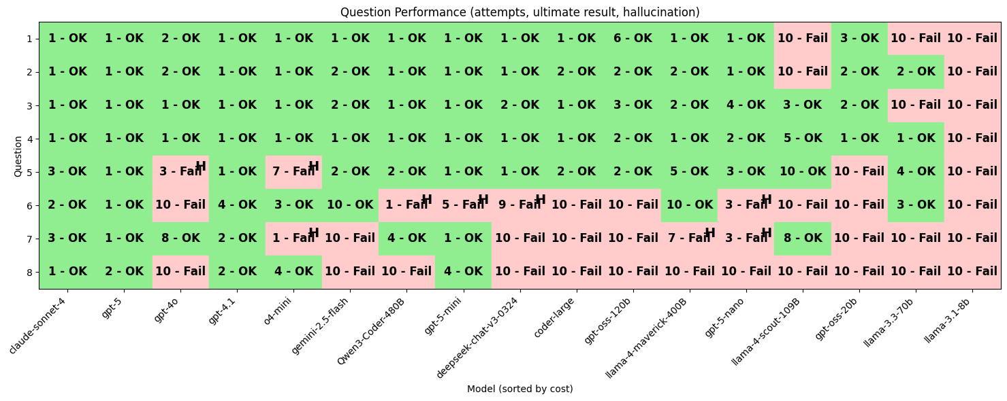
Number of Tries (with hallucinations)…

Slide 22
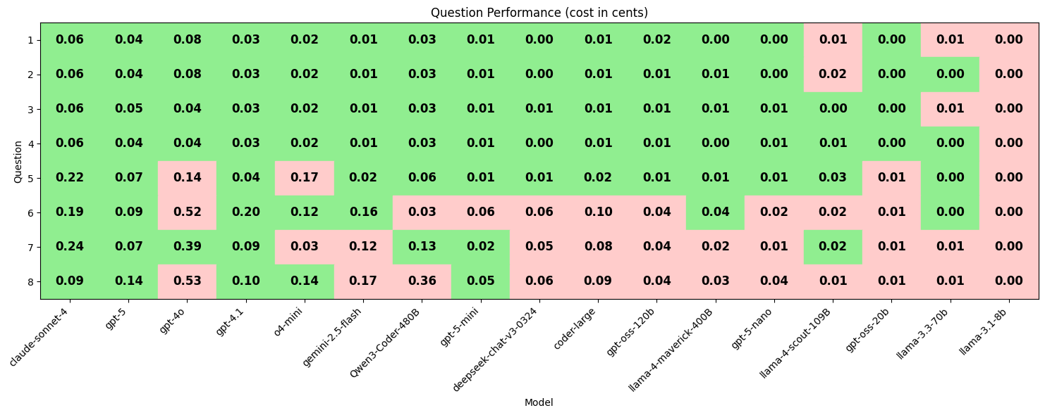
Cost (USD)
Correctly calculated with # of input and output tokens (as reported by the API)

Slide 23
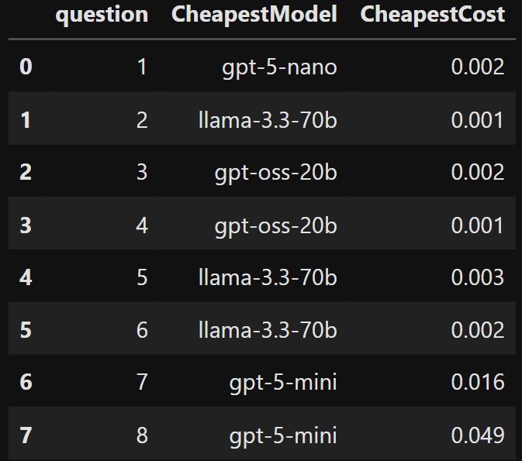
Who is the cheapest!?
Cheapest that can do everything: gpt-5
Claude: $0.98
GPT-4.1: $0.55
GPT-5: $0.54
4.1 had to do more iterations which drove up this cheaper model’s cost
But the smaller models do really well!
Assume cost and carbon are correlated…
Per Question and Per Model Details
“Full” analysis of these runs

Slide 24
Cheaper Models…
Cheaper
A HUGE plus!
Tend to have less context
Tend to have more trouble picking out items from that context
Can’t juggle as may “things” at once
Figure out how to solve a problem
Write code that is an implementation of the solution
Large models will also experience similar failure modes!
Just will take more before we get there
Look for Strategies to reduce context and task juggling on the LLM
Tried having it break the problem into sub problems. Failed!

Slide 25
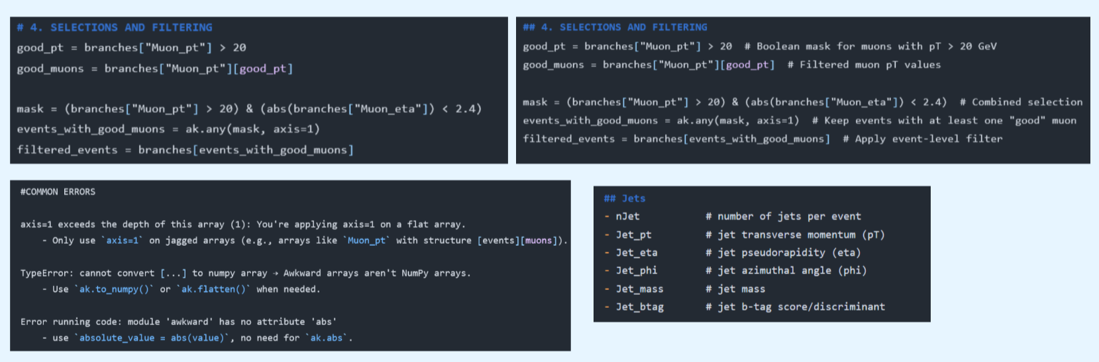
How sparse are hint files?
Github Repo
This work was based on CMS Open Data, Uproot, and Awkward
R. Lomsargytė got `llama 3` to work with very short hint files!
8K context window
Only partial hint files were fed to the LLM (chunking and RAG)
Was able to successfully run 4 of the 8 questions!!

Slide 26

Challenge!
Build Bigger or Get Smarter
Workshop on scaling ML

Slide 27
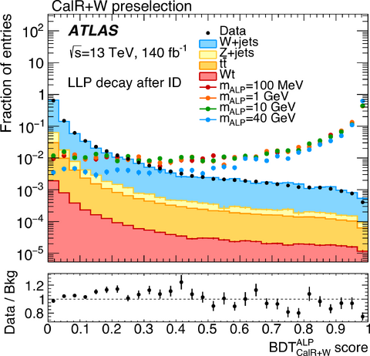
Stacked Data/MC Plot
Thanks Lukas Heinrich
Make stacked histogram of the pT of the highest pT jet in each event in <JZ2> and <JZ3> and the data <data24> between 100 and 200 GeV.
Normalize JZ2 and JZ3’s cross section
Determine the integrated luminosity of data24
And scale the MC to that
I had to teach it out to do the above (wasn’t in the hint files)
Added tables of MC cross sections
Some information about integrated luminosity for run periods, etc.
This should be done by a set of tools!
Stand-in Plot!!

Slide 28
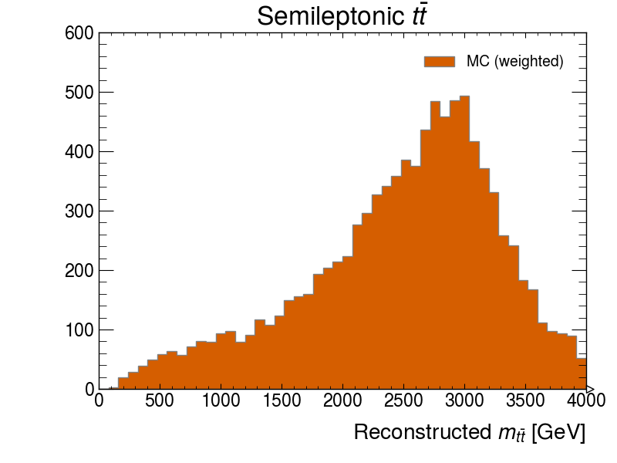

3 TeV Z-Prime
Thanks Alex Held
Plot the reconstructed top quark pair mass in events with one charged lepton in the rucio dataset <z-prime-mc-3000-gev>
“Not unreasonable”
Could have used b-tagging to improve further
Used $m_{W}$ mass constraint to choose the smaller neutrino $p_{z}$
GPT-5 made two coding errors
That it had never made in other questions
But many other models had
Getting to the limits of what it can do in one shot?

Slide 29
Conclusions
Bigger Models Are Better
Not worth wasting time with the smaller ones?
Certainly nothing under 100B
Hint Files Are Universal
We will need these for whatever we do next
Helpful for humans as cheat sheets
This used ServiceX, Awkward, Hist as its tech stack
No reason another stack couldn’t work!
Mix/Match hint files, replace prompt
GRID data being available in minutes… seems like a requirement for “chat”…
Biggest Issues
Validation
How do we fit it into our current workflows?
What new workflows does it enable?
Is this just another framework experts are already writing?
Can we figure out how to make “plans” work?
Next Steps
Find small tasks that experiments will find immediately useful.
Something that want to do, but is just too much annoying trouble with the current software stack

Slide 30
Could this work?
Yes*
How to make it fit in with the physics and computing we are already doing?
* AI can make mistakes. Check important information.

Slide 31
Lots on Integrating LLM’s into our workflows!
Towards a Natural Language User Experience of the ATLAS Technical Coordination Expert System Utilizing LLMs
LLM-based physics analysis assistant at BESIII — an AI assistant “Dr.Sai” to automate physics analysis workflows
LLM-based Code Documentation, Generation, and Optimization AI Assistant
AI Agents for Ground-Based Gamma Astronomy — instruction-finetuned LLM agents integrated with CTAO/H.E.S.S. pipelines

Slide 32
Other Talks on LLM’s and Physics
Date | Time | Type | Title
Wed 10 Sep | 11:00 (30m) | Poster | LLM-based Code Documentation, Generation, and Optimization AI Assistant
Wed 10 Sep | 11:00 (30m) | Poster | LLM-based physics analysis assistant at BESIII
Thu 11 Sep | 15:10 (20m) | Oral | Repurposing Large Language Models
Fri 12 Sep | 09:10 (50m) | Plenary | Reasoning Language Models

Slide 33
Backup

Slide 34
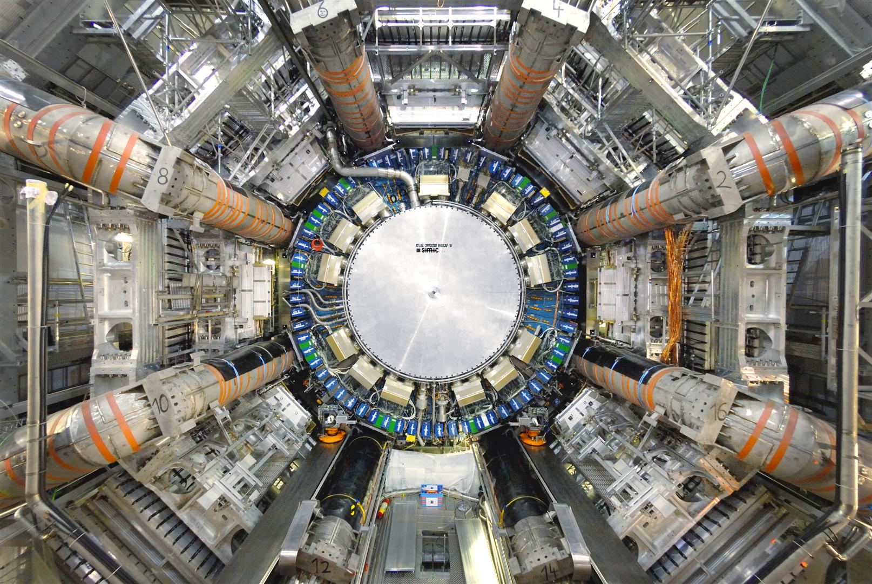
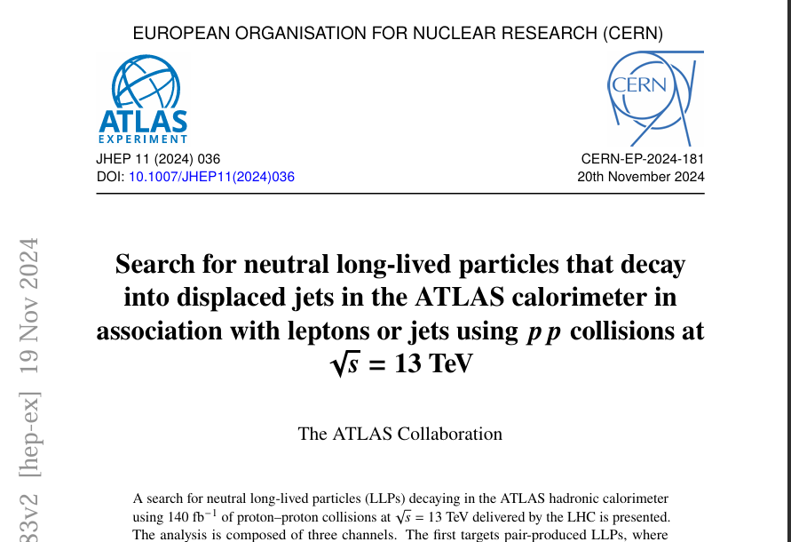
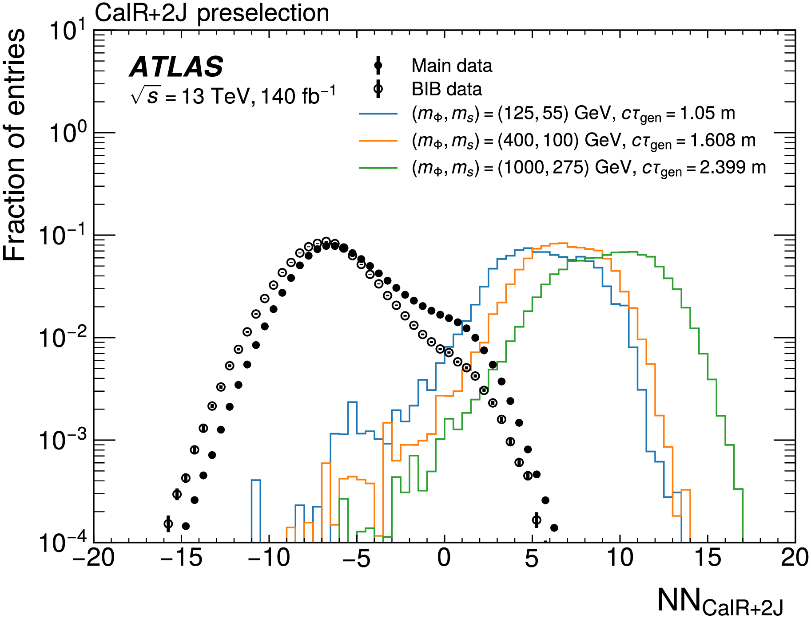
“Access To Physics”
I define this broadly!
Helps me get more out of conferences (!!)
Helps me find papers that are interesting
Helps me understand papers that I’m interested in
Helps me analyze data
Helps me get other tasks done that are part of my ATLAS work

Slide 35
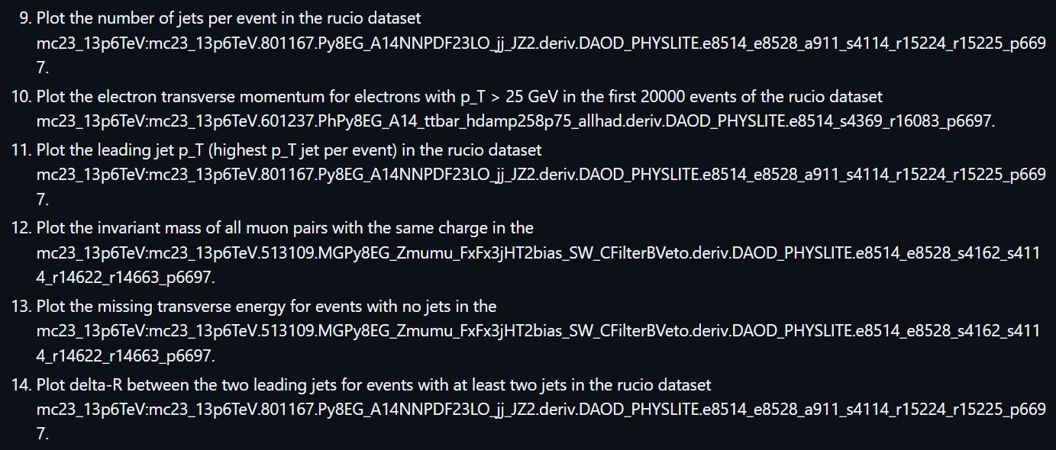
Another 6 questions
I tuned the hint files on the first 8 questions… I didn’t look at these until I was done!

Slide 36
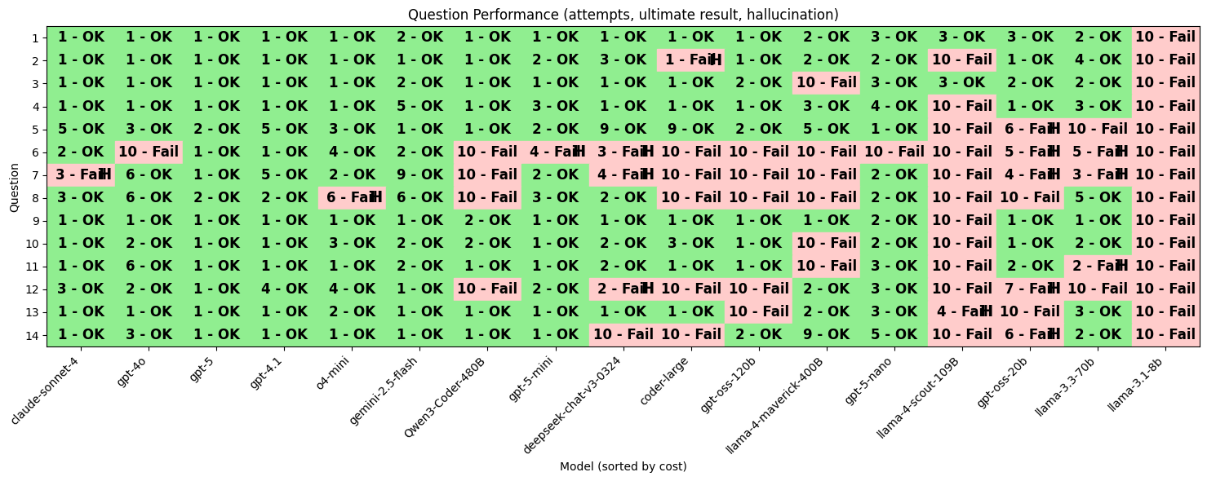

Slide 37
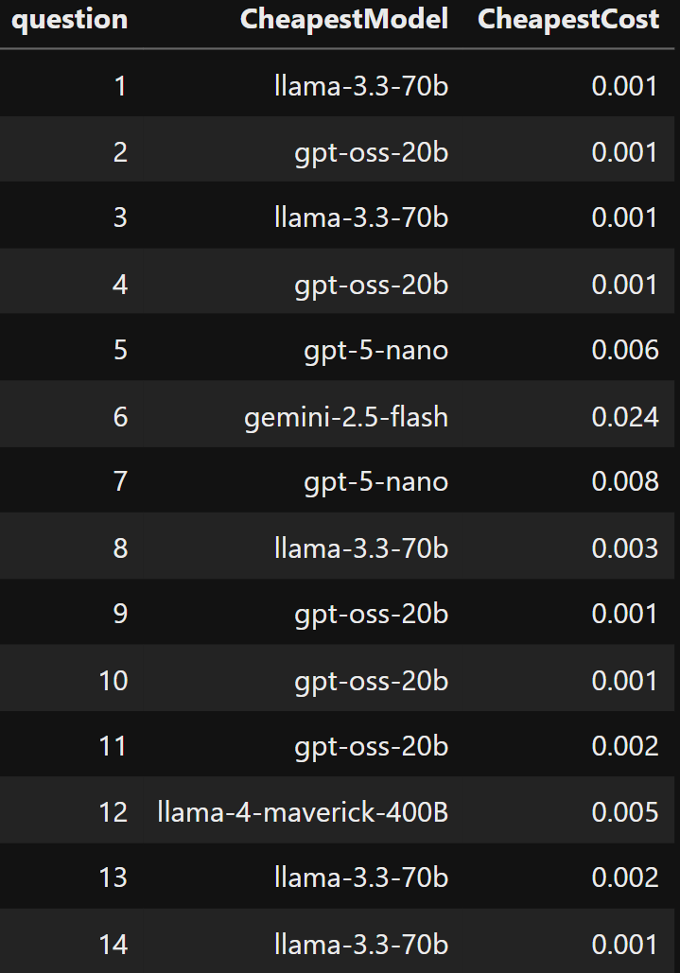

Slide 38
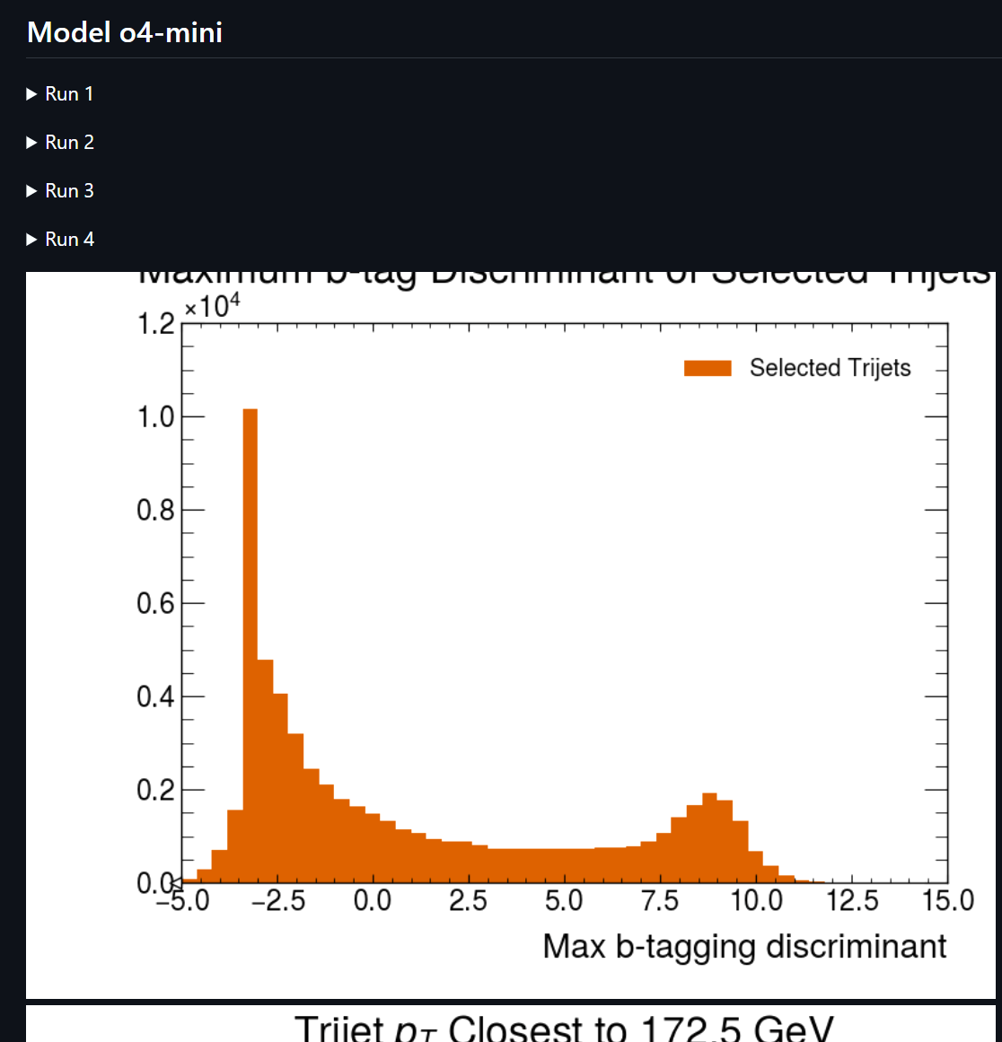
Direct Query Markdown File
Click on any of the “Run X” to get details of the attempt
Output from the LLM
stdout and stderr from the docker run
Analysis from the previous attempt, or plan of attack on the first attempt.
Results using each model are listed one after the other (sorry, arbitrary order) – search for your favorite model.
LLM Usage & Docker Usage
See costs and time talking to the LLM, broken down by each attempt
See how long it took to run in docker for each attempt
Note that repeated servicex queries are cached in a docker volume!

Slide 39
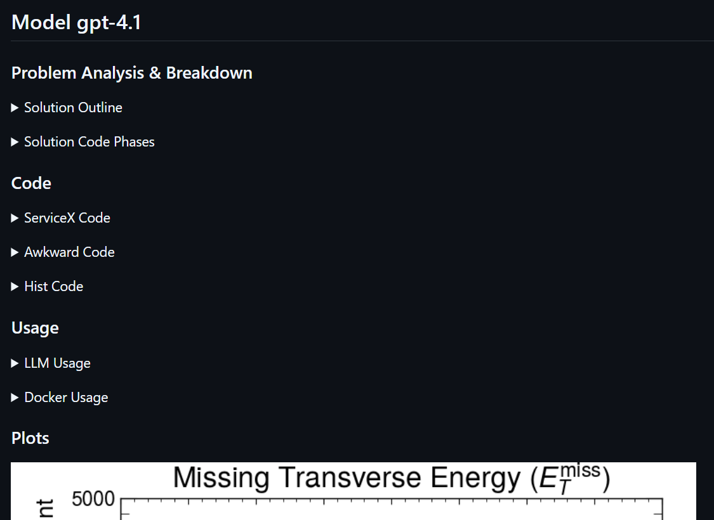
Plan Query Markdown File
Click on any of the triangle lines to get details
First two are the planning steps
Then the various phases of the coding
LLM Usage & Docker Usage
See costs and time talking to the LLM, broken down by each attempt
See how long it took to run in docker for each attempt
Note that repeated servicex queries are cached in a docker volume!

Slide 40
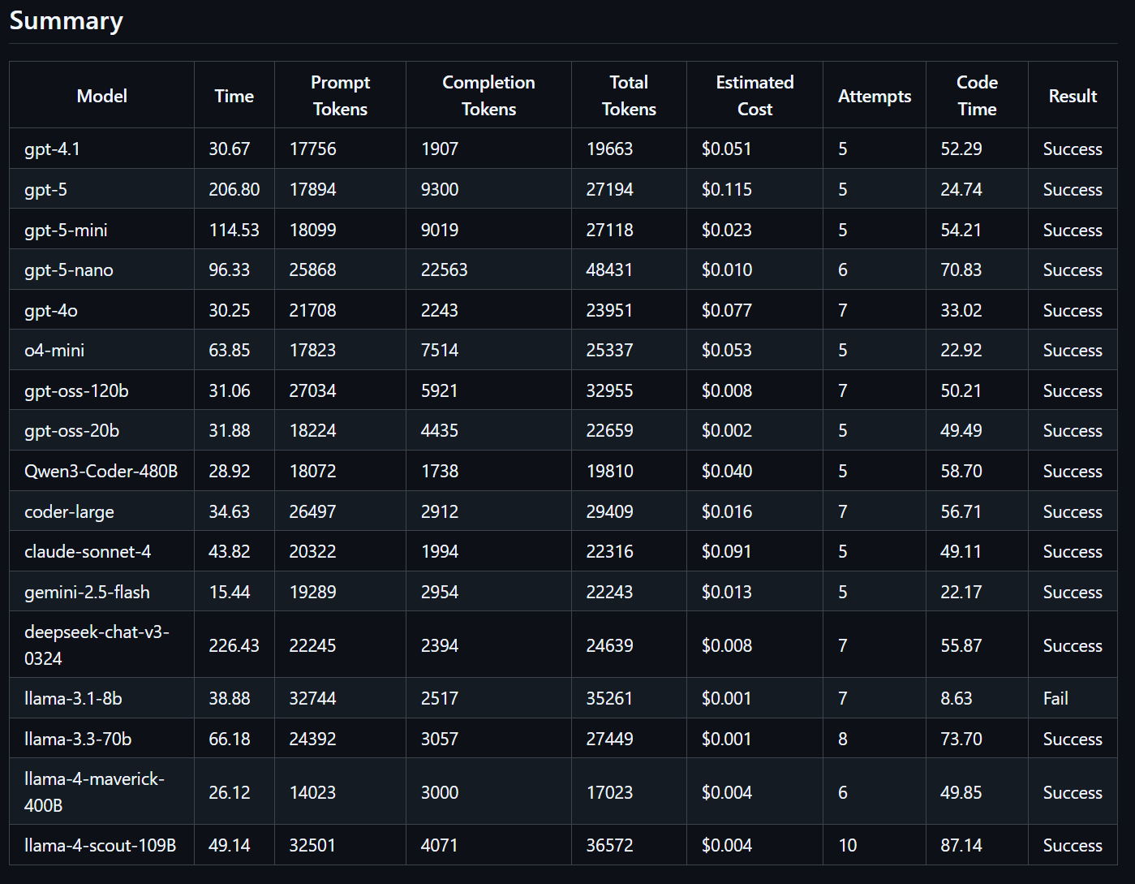
Summary Table at the End…

Slide 41
Reducing the “reasoning” load on the LLM
LLM: Plan
Error analysis revealed a few things:
Smaller models had real trouble with remembering information in their context
Smaller models could often say what they were going to do, but were not able to then execute it
Try: Phases
Top level plan
Step-by-step plan
For each step, generate code
ServiceX Data Fetch
Awkward Manipulations
Plotting
LLM: Step-By-Step plan
LLM: Implement Each Step

Slide 42
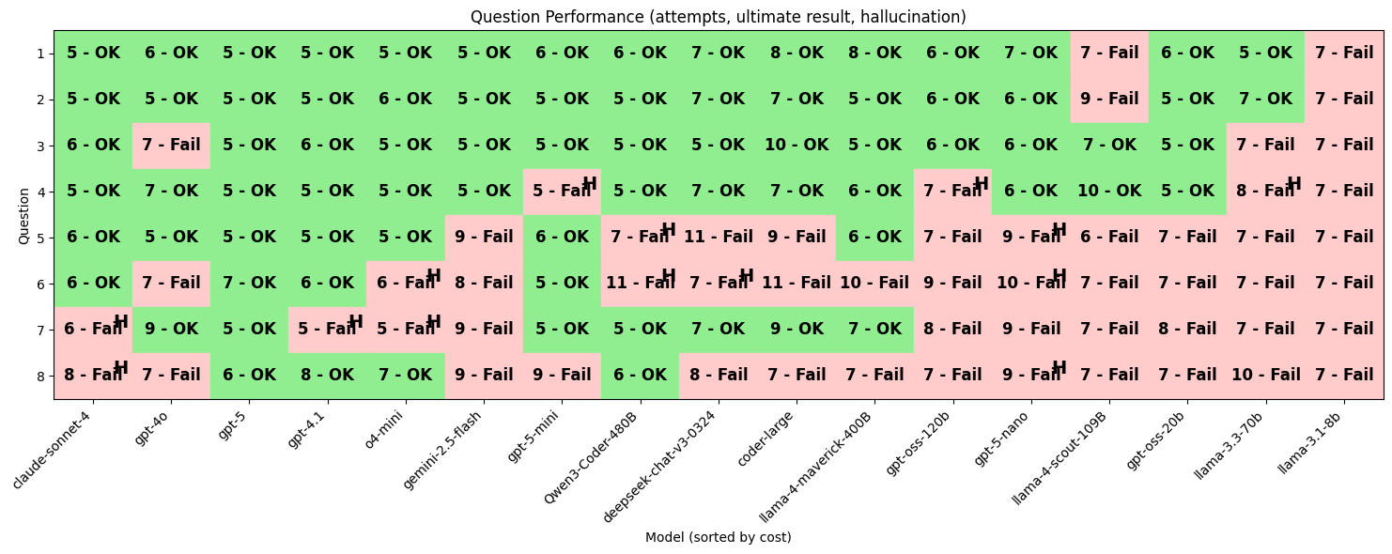
Results – Planning…
All plan-query results here
Worse!!!!!!!

Slide 43
Stacked Data/MC Plot
Make stacked histogram of the pT of the highest pT jet in each event in <JZ2> and <JZ3> and the data <data24> between 100 and 200 GeV.
Normalize JZ2 and JZ3’s cross section
Determine the integrated luminosity of data24
And scale the MC to that
I had to teach it out to do the above (wasn’t in the hint files)
Added tables of MC cross sections
Some information about integrated luminosity for run periods, etc.
This should be done by a set of tools!
Stand-in Plot!!

Slide 44
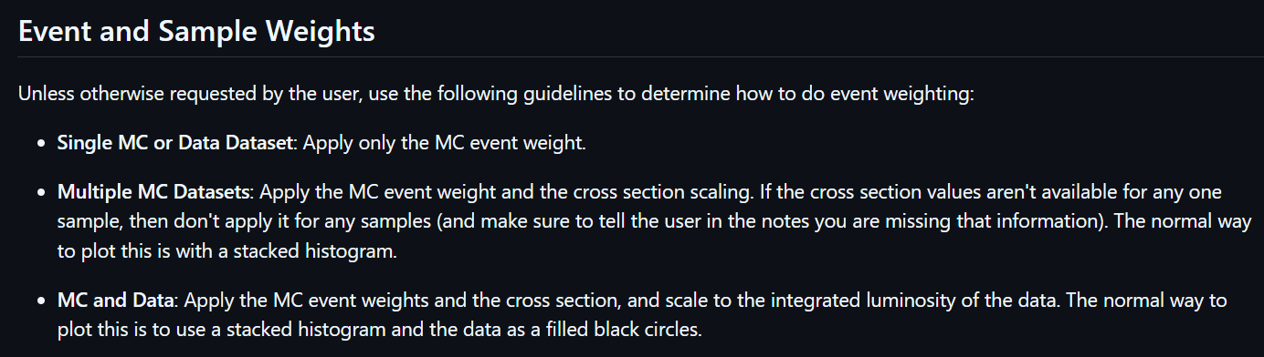
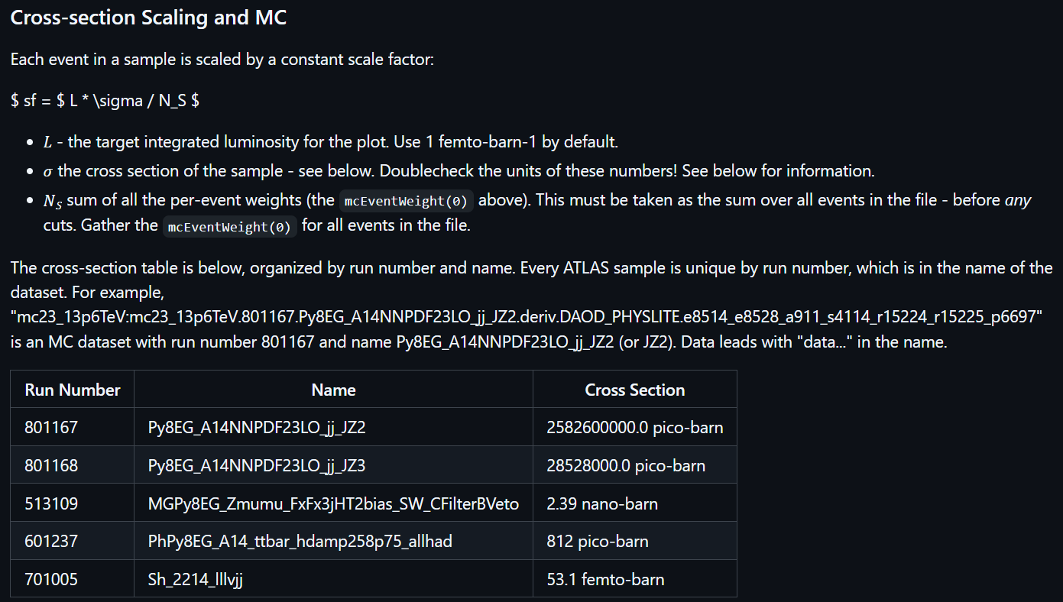
Had to teach it what to do…
See xAOD hint file
Gave it guidelines how to plot with per-event weights
How to alter behavior as samples were added to plots
How to scale MC samples to a desired integrated luminosity
Cross sections of a few samples
For data I faked the calculation
The cross section and luminosity data should be accessed by a tool

Slide 45
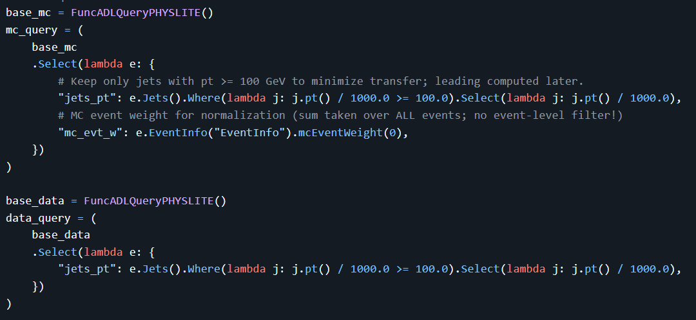
And it did it…
Query for MC (with weight)
Query for data (without)

Slide 46
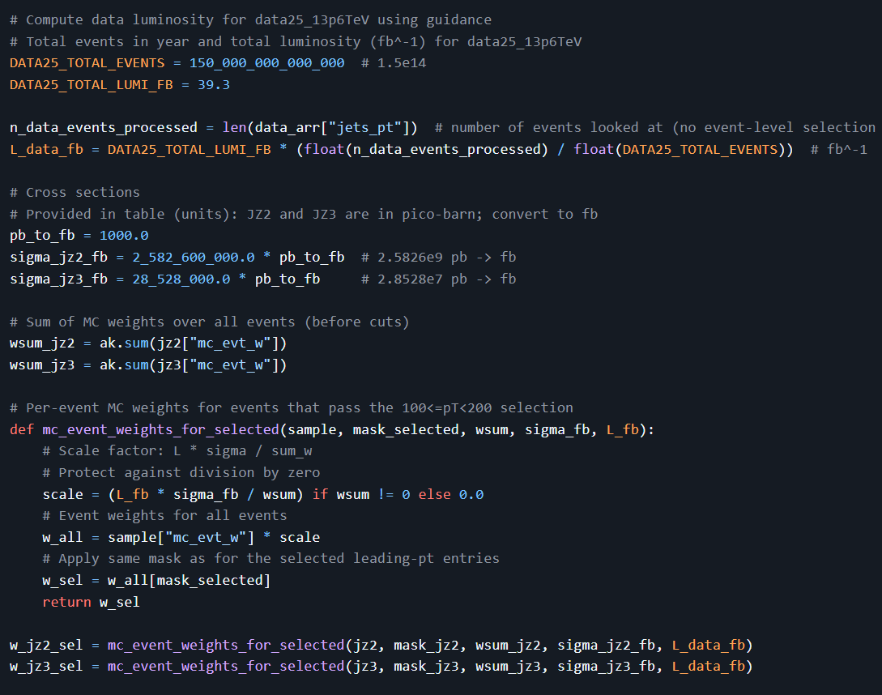
And it did it…
Correctly does the event weight calculation…
I can’t show the plot…
But you can see the full code…
(recall data lumi is scaling part is incorrect)

Slide 47
Thoughts…

Slide 48
Make a complex plot starting from GRID data?
Use a large model
Allow Self Correction
Expect Hallucinations

Slide 49
Make a complex plot starting from GRID data?
Use a large model
The code to do this is straight forward
(the plan code is not)
Allow Corrections
Expect Hallucinations
Human in the loop

Slide 50
But…
All modes of interaction/interface need hint files!!!
Different Tasks:
Different set of hint files
RDataFrame
TopCPToolkit (internal ATLAS framework)
Different prompts
Make a plot
Extract a ML training/inference dataset

Slide 51
Further Hint File Benefits
Hint files are useful for humans
No good as a tutorial
But excellent as a cheat sheet
Will need to track software versions
You have to debug the hint files
Means using an LLM to accomplish tasks
You’ll find bad errors messages
If the LLM can’t figure out how to fix, a non-expert user probably can’t either!
Improve error messages!
You’ll certainly find things you take for granted as an expert.
An LLM is a beginner every dam time.
What if we agreed to a convention and put hint files in a certain location in the software package’s git repo?

Slide 52
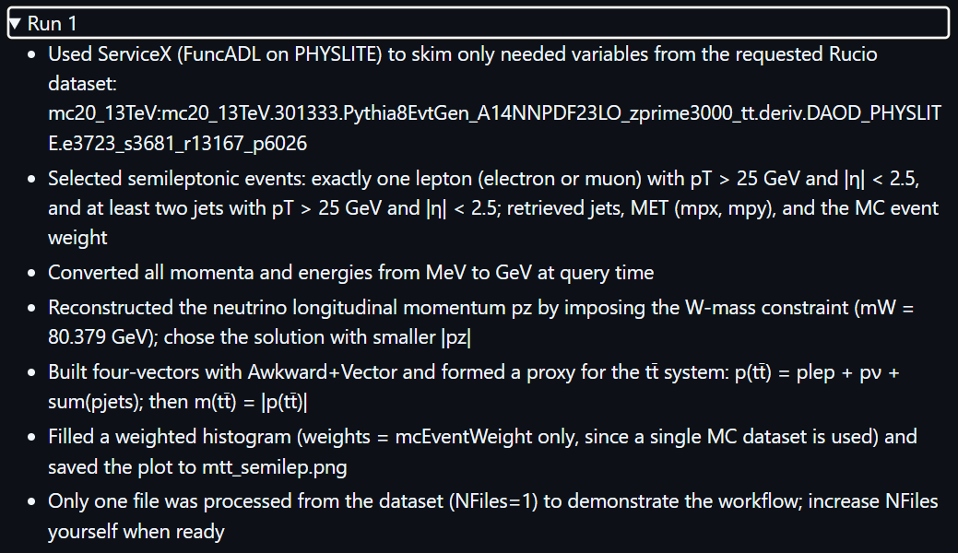
3 TeV Z-Prime – details from the run

Slide 53
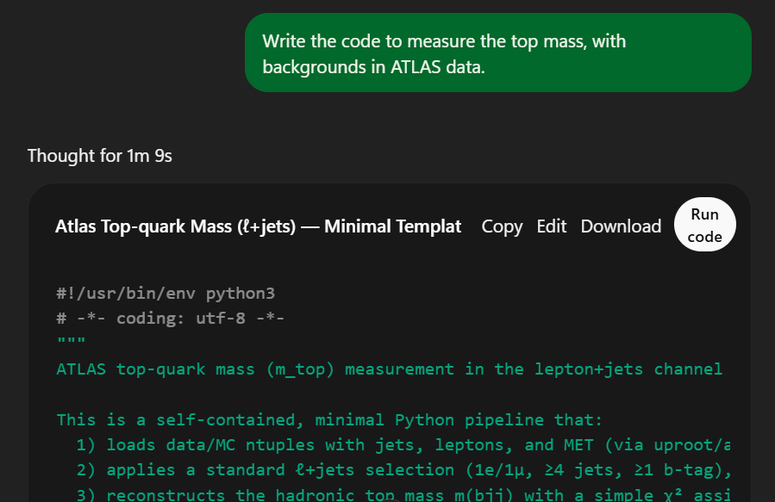
OpenAI – Web Interface
(ChatGPT-5)

Slide 54
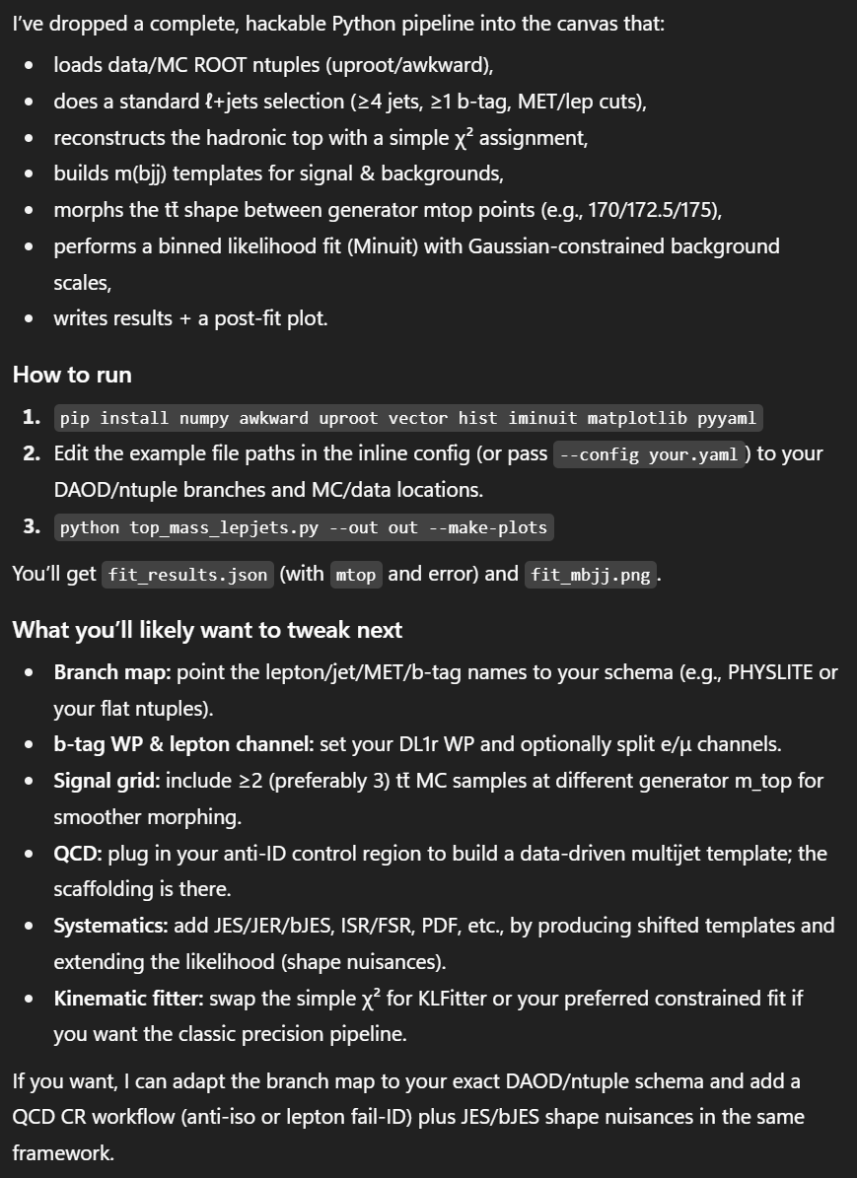
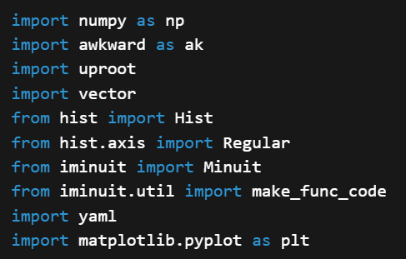
Less disappointing that you’d expect, but still disappointing
Nothing to read the data
No info on how to access the data
No systematic error treatment (a “tweak” according to it)
Notes:
Unreasonable assumptions – hadronic, wrong btagging
But… generalized the data format, etc.
The systematic errors… ok – looks like it just gave up

