Slide 1
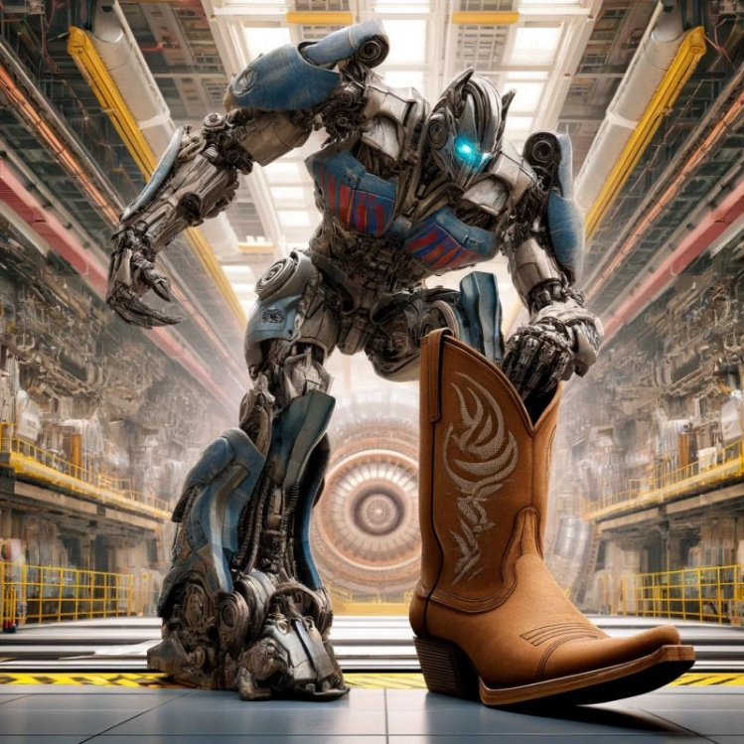


Transformers for Scattering Amplitudes
Lance Dixon (SLAC)
T. Cai, K. Cranmer, F. Charton, LD, G. Merz, N. Nolte, M. Wilhelm, 2405.06107 [cs.LG], 2501.05743 [hep-th]
ACAT 2025
8 September 2025

Slide 2
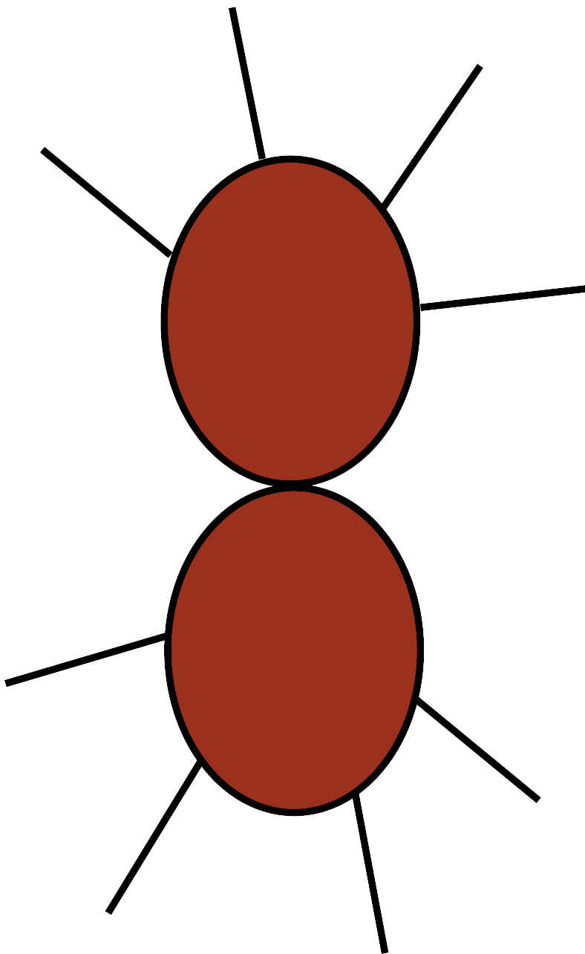
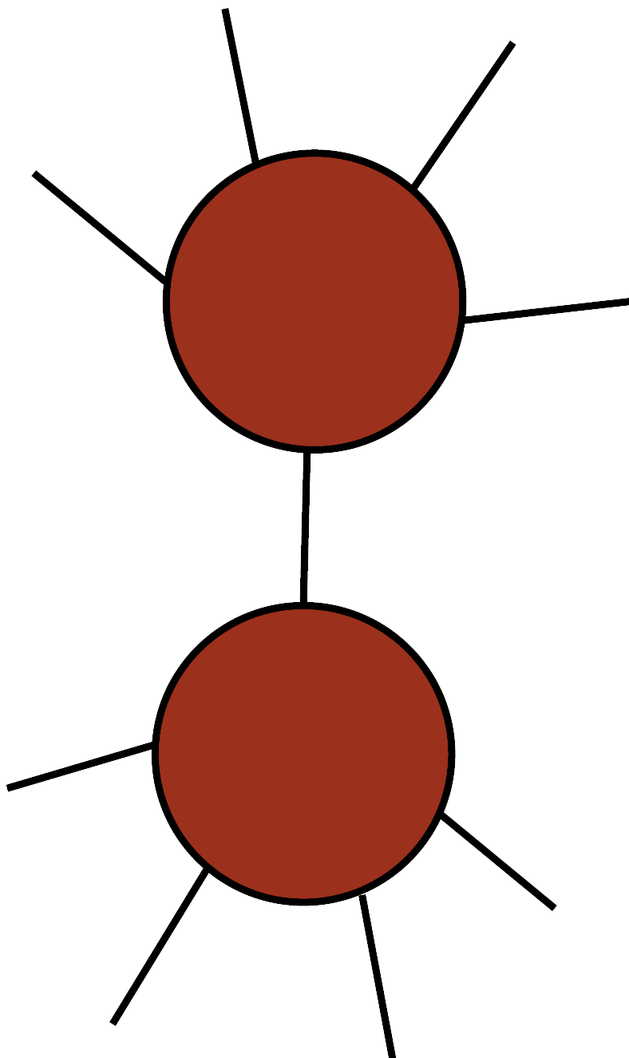

Scattering Amplitudes Are Smooth, Analytic Functions of Kinematics
They also fall apart – factorize –
into simpler amplitudes in special limits.
We can use this information to construct
them without using Feynman diagrams:
Bootstrap

Slide 3
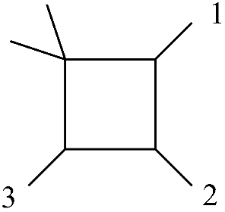
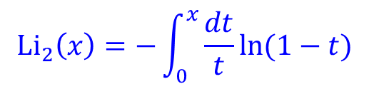
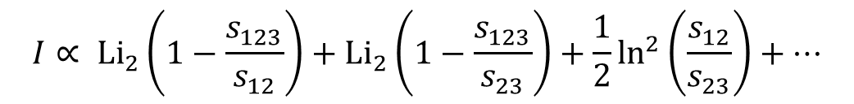
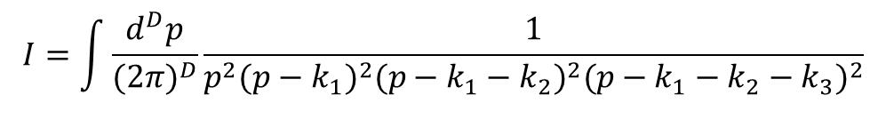
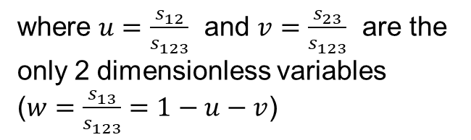
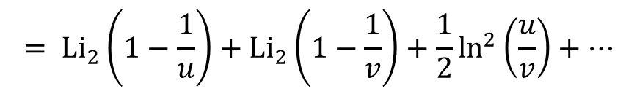
Loop amplitudes contain transcendental functions from performing Feynman integrals
For example, one-loop box integral for gg → Hg in $m_{t}→∞$ limit
H
g
$$I=\int{\frac{d^{D}p}{{(2π)}^{D}}\frac{1}{p^{2}{(p−k_{1})}^{2}{(p−k_{1}−k_{2})}^{2}{(p−k_{1}−k_{2}−k_{3})}^{2}}}$$
$$I∝ {Li}_{2}\left(1−\frac{s_{123}}{s_{12}}\right)+{Li}_{2}\left(1−\frac{s_{123}}{s_{23}}\right)+\frac{1}{2}\ln^{2}\left(\frac{s_{12}}{s_{23}}\right)+…$$
g
g
$$= {Li}_{2}\left(1−\frac{1}{u}\right)+{Li}_{2}\left(1−\frac{1}{v}\right)+\frac{1}{2}\ln^{2}\left(\frac{u}{v}\right)+…$$
where $u=\frac{s_{12}}{s_{123}}$ and $v=\frac{s_{23}}{s_{123}}$ are the
only 2 dimensionless variables
($w=\frac{s_{13}}{s_{123}}=1−u−v$)
$${Li}_{2}\left(x\right)=−\int_{0}^{x}{\frac{dt}{t}ln⁡(1−t)}$$

Slide 4
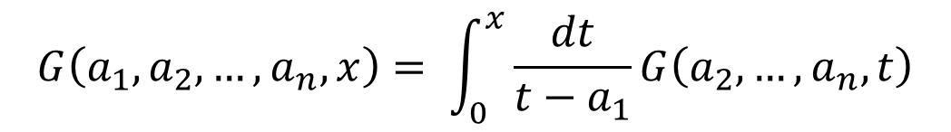
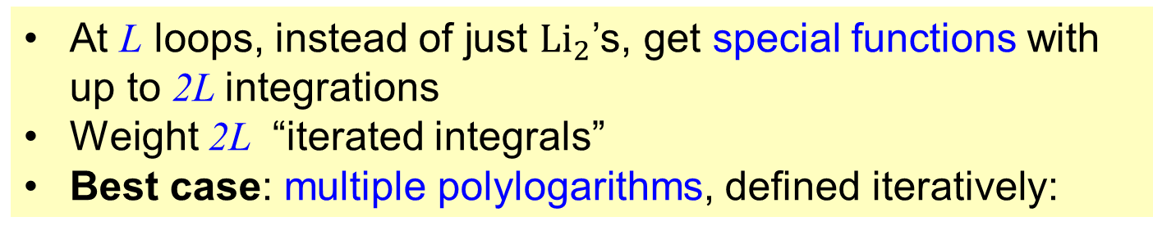
Multi-loop transcendental structure
At L loops, instead of just ${Li}_{2}$’s, get special functions with up to 2L integrations
Weight 2L “iterated integrals”
Best case: multiple polylogarithms, defined iteratively:
$$G\left(a_{1},a_{2},…,a_{n},x\right)= \int_{0}^{x}{\frac{dt}{t−a_{1}}G\left(a_{2},…,a_{n},t\right)}$$
Still very intricate multi-variate functions, but can be understood very systematically
Have to proceed process by process
Much computation required at state-of-art, e.g. all massless 2 → 4 at two loops, or 2 → 3 with 1 or 2 external masses (W,Z,H)

Slide 5
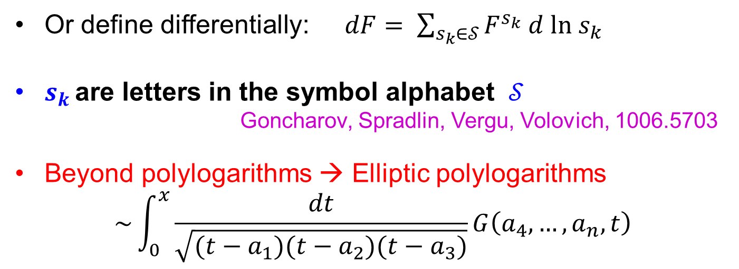
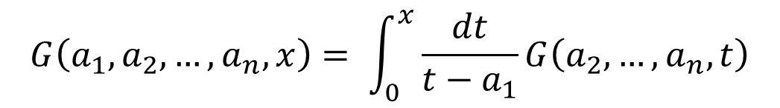
Multiple polylogarithms
Chen, Goncharov, Brown,…
Iterated integrals, e.g.
$$G\left(a_{1},a_{2},…,a_{n},x\right)= \int_{0}^{x}{\frac{dt}{t−a_{1}}G\left(a_{2},…,a_{n},t\right)}$$
one
weight
lower
Or define differentially: $dF= \sum_{s_{k}∈𝒮}{F^{s_{k}} d ln s_{k}}$
$s_{k }$are letters in the symbol alphabet $𝒮$
Goncharov, Spradlin, Vergu, Volovich, 1006.5703
Beyond polylogarithms → Elliptic polylogarithms
$$\sim \int_{0}^{x}{\frac{dt}{\sqrt{(t−a_{1})(t−a_{2})(t−a_{3})}}G\left(a_{4},…,a_{n},t\right)}$$
elliptic curve

Slide 6
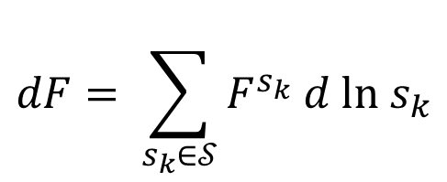
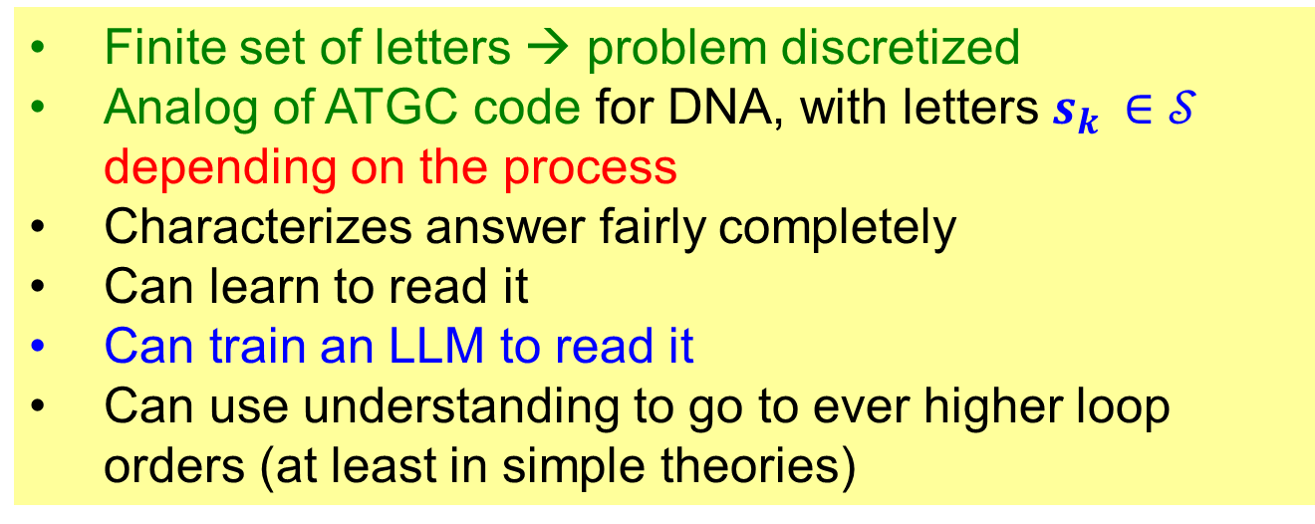
Symbol for multiple polylogarithms ~ DNA Code
Complexity encoded in words written in alphabet defined by iterative differentiation
$$dF= \sum_{s_{k}∈𝒮}{F^{s_{k}} d ln s_{k}}$$
Finite set of letters → problem discretized
Analog of ATGC code for DNA, with letters $s_{k }∈𝒮$ depending on the process
Characterizes answer fairly completely
Can learn to read it
Can train an LLM to read it
Can use understanding to go to ever higher loop orders (at least in simple theories)

Slide 7
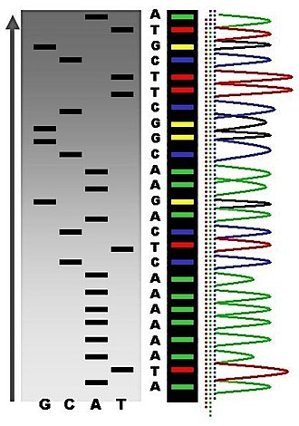
Building symbol like sequencing DNA
chemical reaction cleaves
A,G,T,C off end of string
Taking derivative
of function exposes
last letter of string
Iterate 2L times to
obtain symbol of
generalized polylogarithm
of weight 2L

Slide 8
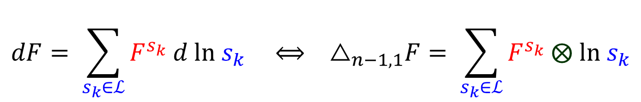
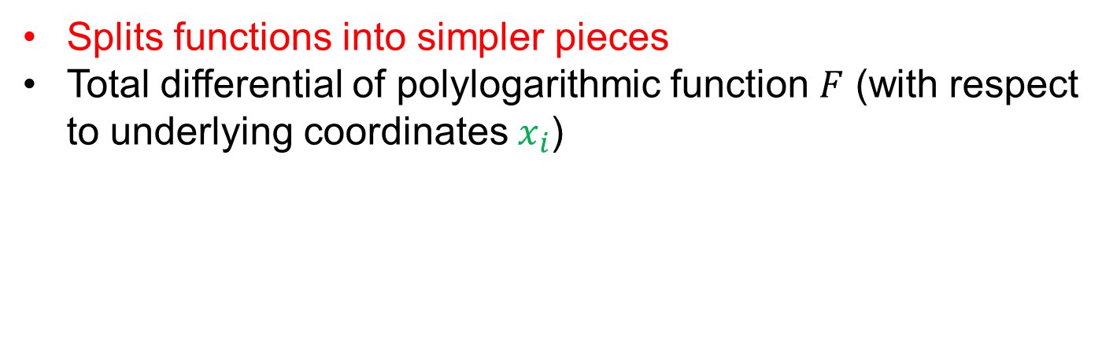
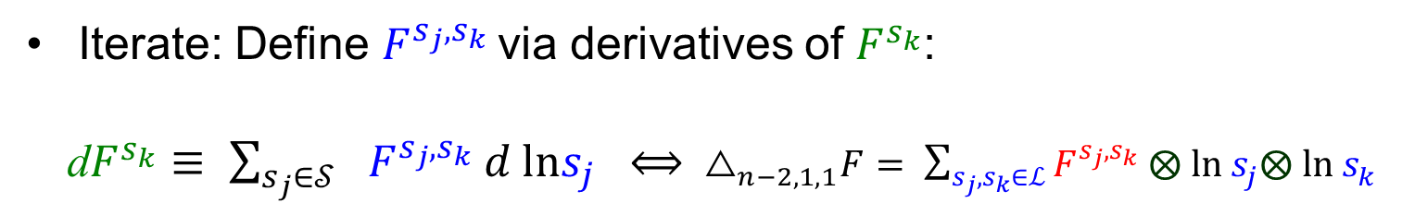
Hopf algebra “coacts”
Splits functions into simpler pieces
Total differential of polylogarithmic function $F$ (with respect to underlying coordinates $x_{i}$)
$$dF= \sum_{s_{k}∈ℒ}{F^{s_{k}} d ln s_{k}} ⟺ { △}_{n−1,1}F= \sum_{s_{k}∈ℒ}{F^{s_{k}} ⨂ ln s_{k}}$$
part of Hopf algebra coaction
Iterate: Define $F^{s_{j},s_{k}}$via derivatives of $F^{s_{k}}$:
d$F^{s_{k}}$ $≡ \sum_{{s_{j}∈𝒮}_{}}{F^{s_{j},s_{k}} d lns_{j}} ⟺{ △}_{n−2,1,1}F= \sum_{s_{j},s_{k}∈ℒ}{F^{s_{j},s_{k}} ⨂ ln s_{j}⨂ ln s_{k}}$
another part of Hopf algebra coaction

Slide 9
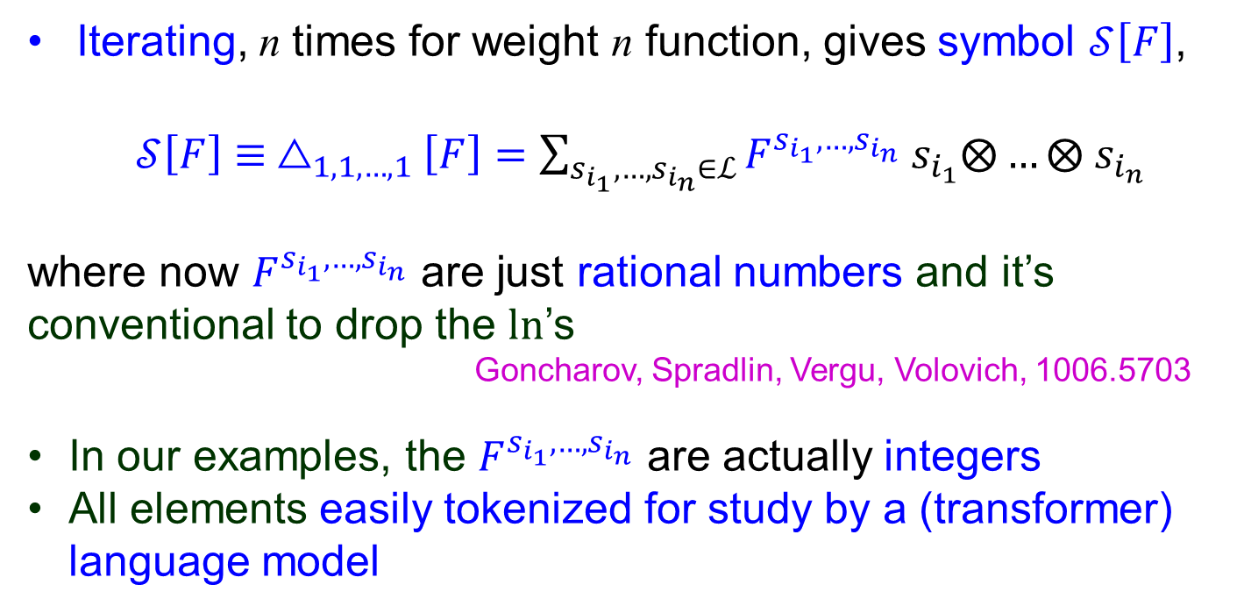
Maximal iteration → symbol
Iterating, n times for weight n function, gives symbol $𝒮\left[F\right]$,
$𝒮\left[F\right]≡ △_{1,1,…,1}\left[F\right]=\sum_{s_{i_{1}},{…,s}_{i_{n}}∈ℒ}{F^{s_{i_{1}},…,s_{i_{n}}} s_{i_{1}}⨂…}⨂ s_{i_{n}}$
where now $F^{s_{i_{1}},…,s_{i_{n}}}$ are just rational numbers and it’s conventional to drop the ln’s
Goncharov, Spradlin, Vergu, Volovich, 1006.5703
In our examples, the $F^{s_{i_{1}},…,s_{i_{n}}}$ are actually integers
All elements easily tokenized for study by a (transformer) language model

Slide 10
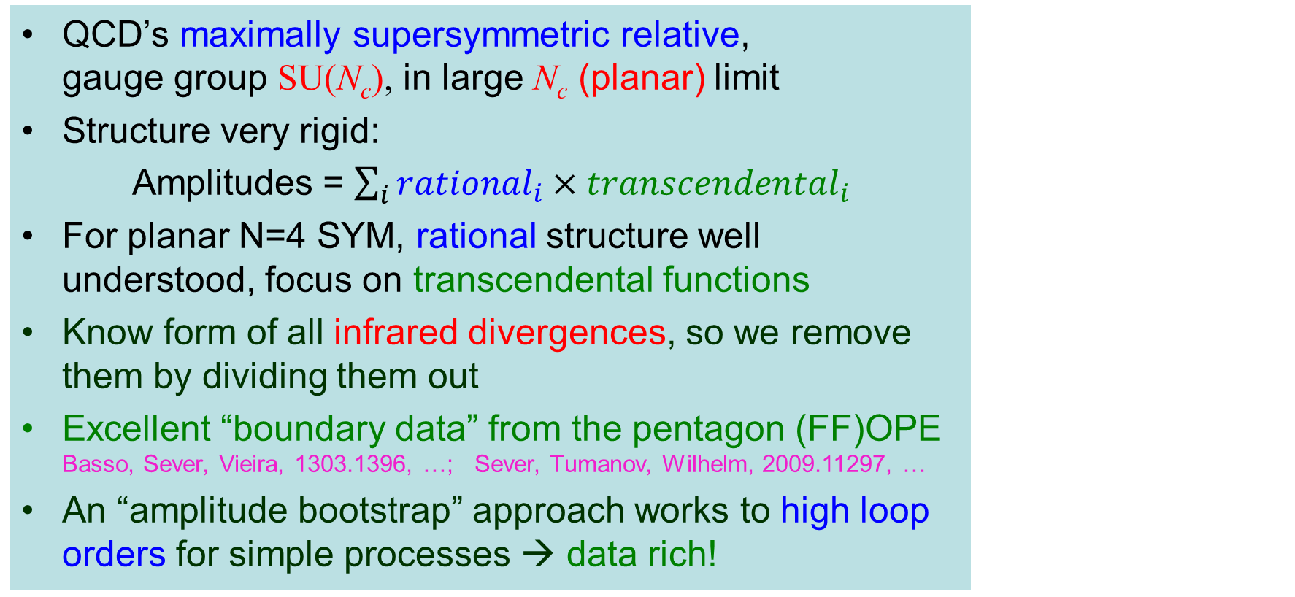
Planar N=4 SYM
QCD’s maximally supersymmetric relative, gauge group SU(N_{c}), in large N_{c} (planar) limit
Structure very rigid:
Amplitudes = $\sum_{i}{{rational}_{i}{×transcendental}_{i}}$
For planar N=4 SYM, rational structure well understood, focus on transcendental functions
Know form of all infrared divergences, so we remove them by dividing them out
Excellent “boundary data” from the pentagon (FF)OPE Basso, Sever, Vieira, 1303.1396, …; Sever, Tumanov, Wilhelm, 2009.11297, …
An “amplitude bootstrap” approach works to high loop orders for simple processes → data rich!

Slide 11
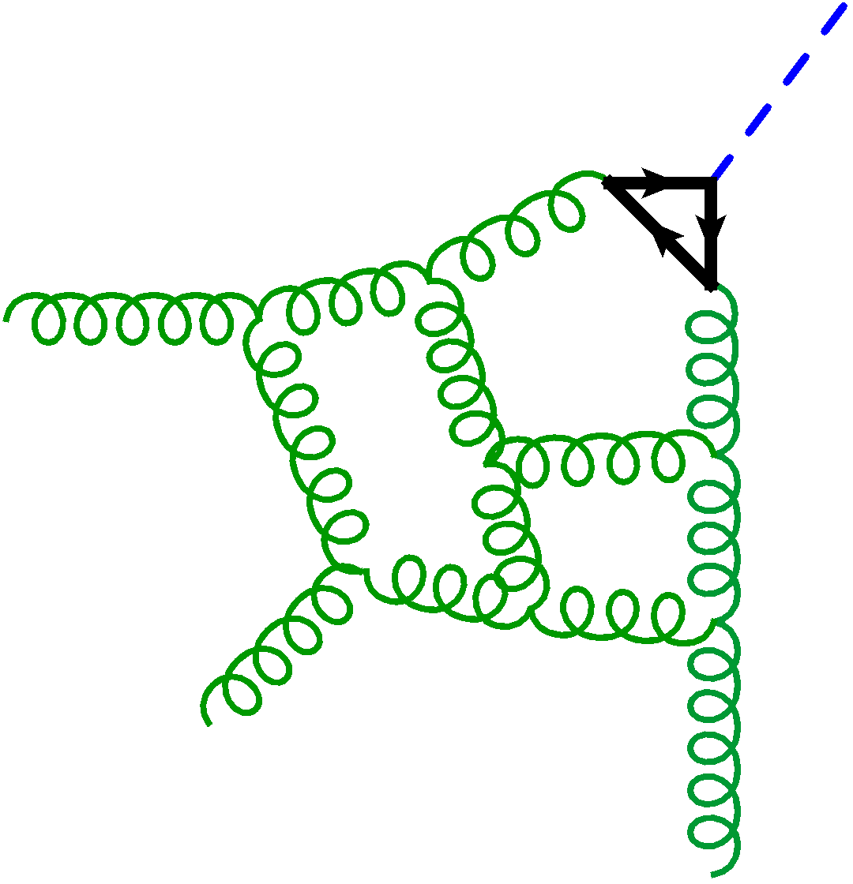
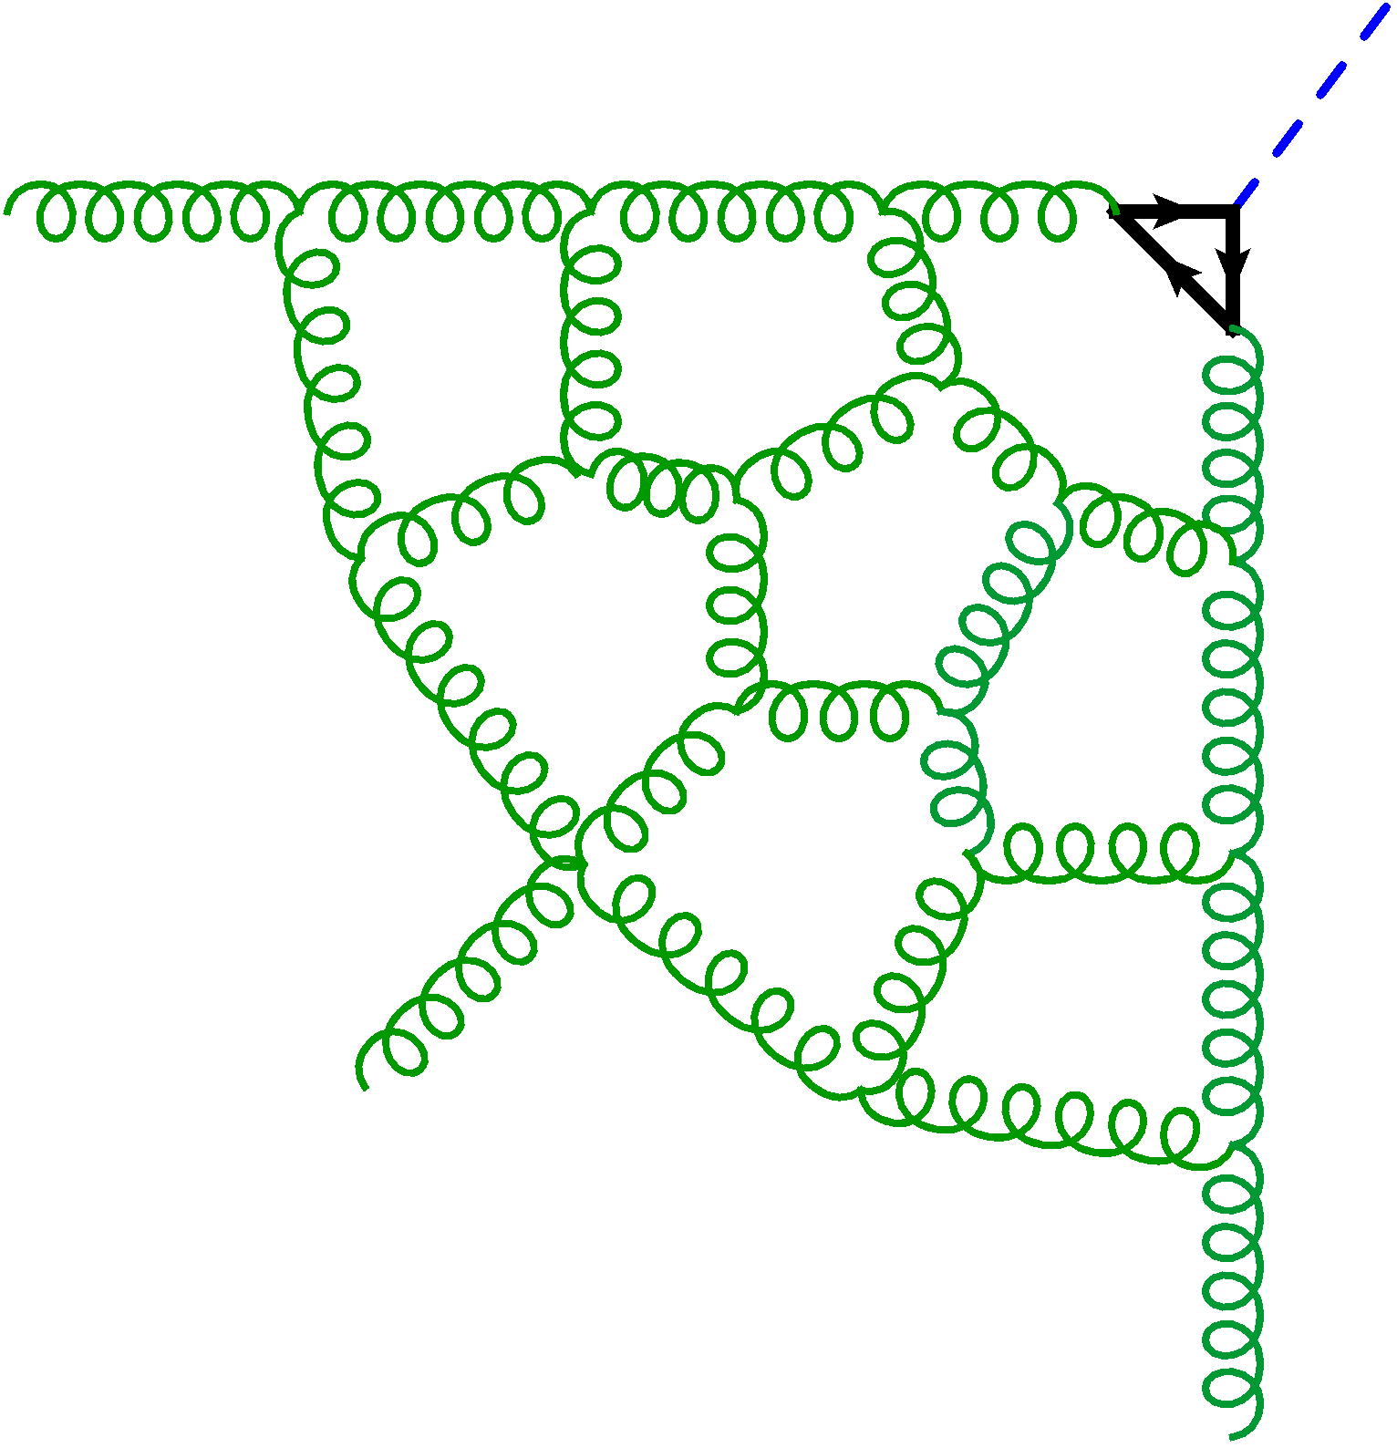
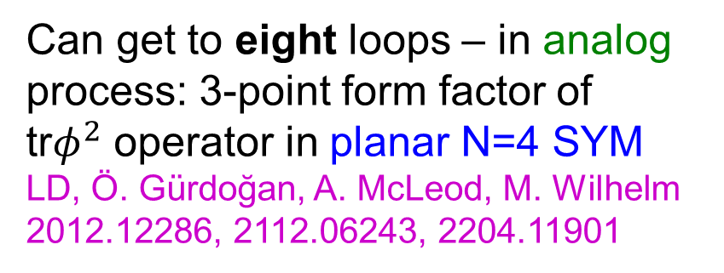
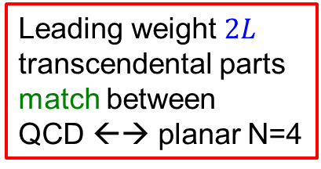
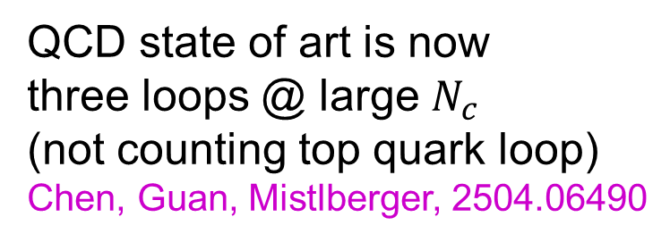
“Goldilocks Process” ~ gg →Hg
QCD state of art is now
three loops @ large $N_{c}$
(not counting top quark loop)
Chen, Guan, Mistlberger, 2504.06490
Can get to eight loops – in analog process: 3-point form factor of tr$φ^{2}$ operator in planar N=4 SYM
LD, Ö. Gürdoğan, A. McLeod, M. Wilhelm
2012.12286, 2112.06243, 2204.11901
H
H
g
t
t
g
Leading weight $2L$
transcendental parts
match between
QCD ←→ planar N=4
g
g
g
g

Slide 12
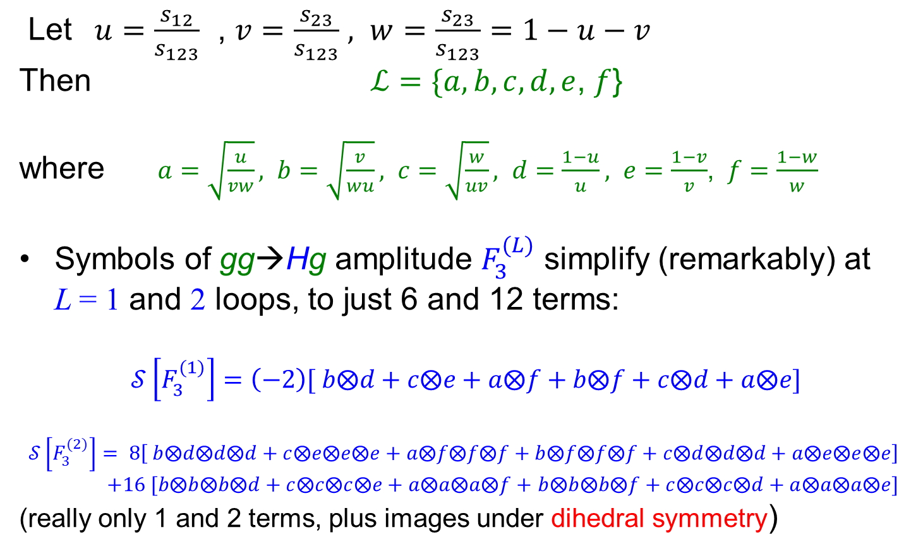
Alphabet for planar N=4 gg → Hg
Let $u=\frac{s_{12}}{s_{123}}$ , $v=\frac{s_{23}}{s_{123}}$ $, w=\frac{s_{23}}{s_{123}}=1−u−v$
Then $ℒ=\{a, b, c, d, e$, $f$}
where $a=\sqrt{\frac{u}{vw}}, b=\sqrt{\frac{v}{wu}}, c=\sqrt{\frac{w}{uv}}, d=\frac{1−u}{u}, e=\frac{1−v}{v}$, $f=\frac{1−w}{w}$
Symbols of gg→Hg amplitude $F_{3}^{(L)}$ simplify (remarkably) at L = 1 and 2 loops, to just 6 and 12 terms:
$$𝒮\left[F_{3}^{(1)}\right]=\left(−2\right)[ b⨂d+c⨂e+a⨂f+b⨂f+c⨂d+a⨂e]$$
$$𝒮\left[F_{3}^{(2)}\right]= 8\left[ b⨂d⨂d⨂d+c⨂e⨂e⨂e+a⨂f⨂f⨂f+b⨂f⨂f⨂f+c⨂d⨂d⨂d+a⨂e⨂e⨂e\right]$$
$+16 [b⨂b⨂b⨂d+c⨂c⨂c⨂e+a⨂a⨂a⨂f+$ $b⨂b⨂b⨂f+c⨂c⨂c⨂d+a⨂a⨂a⨂e]$
(really only 1 and 2 terms, plus images under dihedral symmetry)

Slide 13
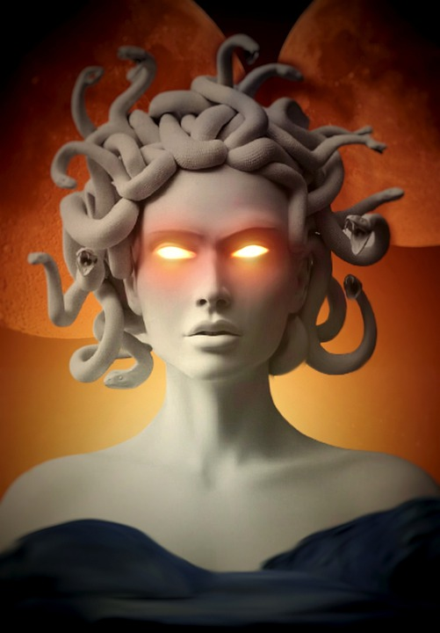
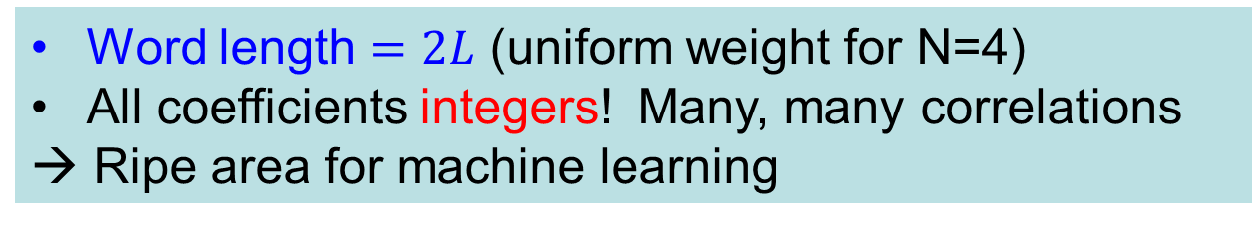
N=4 gg→Hg symbol terms per loop
Not advisable to look at
full symbol directly
without eye protection!
However, there is a
lot of data to be mined
from it!
Word length $=2L$ (uniform weight for N=4)
All coefficients integers! Many, many correlations
→ Ripe area for machine learning

Slide 14

Examples of patterns
Every term in symbol starts with $a,b,c$; never $d,e,f$
Physical reason for start related to causality, which dictates where branch cuts can appear: only for ${(p_{i}+p_{j})}^{2}\sim 0$
12 pairs of adjacent letters are forbidden:
$$…a⨂d…, …b⨂e…, …c⨂f…$$
$$…d⨂a…, …e⨂b…, …f⨂c…$$
$$…d⨂e…, …e⨂f…, …f⨂d…$$
$$…e⨂d…, …f⨂e…, …d⨂f…$$
Also, gg→Hg symbol turns out to be the same as symbol of 6-gluon gg→gggg MHV amplitude written backwards (antipodal duality)!! 2112.06423, 2212.02410
What other surprises lurk within this data?
Can they be used to predict the next loop order?

Slide 15
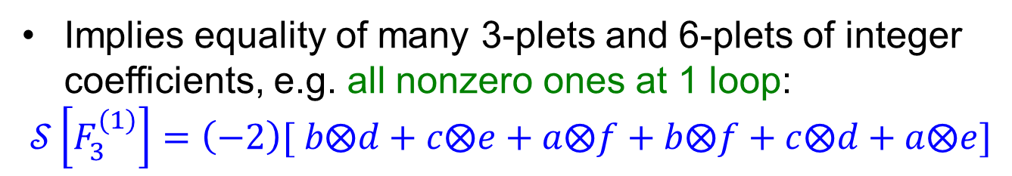
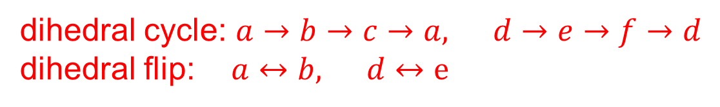
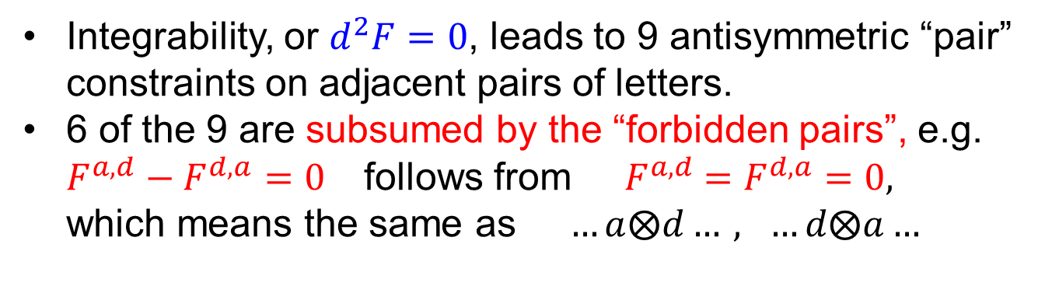
3-gluon form factor linear relations
dihedral cycle: $a→b→c→a, d→e→f→d$
dihedral flip:$a↔b, d↔e$
Implies equality of many 3-plets and 6-plets of integer coefficients, e.g. all nonzero ones at 1 loop:
$$𝒮\left[F_{3}^{(1)}\right]=\left(−2\right)[ b⨂d+c⨂e+a⨂f+b⨂f+c⨂d+a⨂e]$$
Integrability, or $d^{2}F=0$, leads to 9 antisymmetric “pair” constraints on adjacent pairs of letters.
6 of the 9 are subsumed by the “forbidden pairs”, e.g. $F^{a,d}−F^{d,a}=0$ follows from ${ F}^{a,d} =F^{d,a}=0,$ which means the same as $…a⨂d…, …d⨂a…$

Slide 16
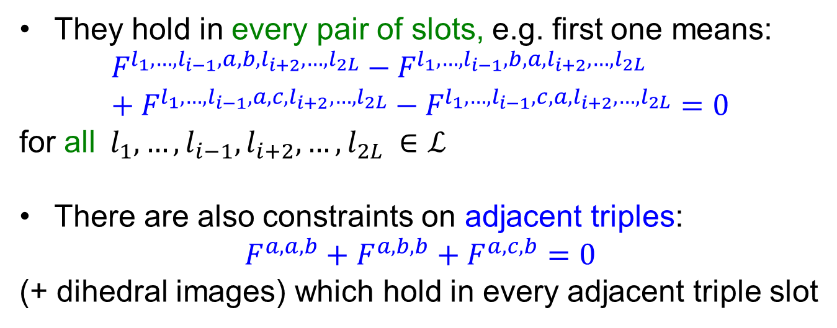
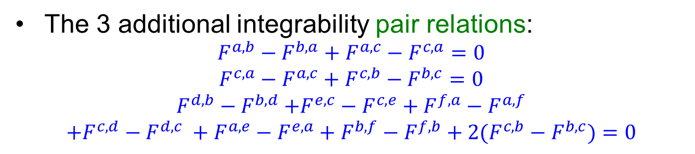
3-gluon form factor linear relations (cont.)
The 3 additional integrability pair relations:
$$F^{a,b}−F^{b,a}+F^{a,c}−F^{c,a}=0$$
$$F^{c,a}−F^{a,c}+F^{c,b}−F^{b,c}=0$$
$$F^{d,b}{− F}^{b,d}+F^{e,c}−F^{c,e}+F^{f,a}−F^{a,f}$$
$$+F^{c,d}−F^{d,c} +F^{a,e}−F^{e,a}+F^{b,f}−F^{f,b}+2(F^{c,b}−F^{b,c})=0$$
They hold in every pair of slots, e.g. first one means:
$$F^{l_{1},…,l_{i−1},a,b,l_{i+2},…,l_{2L}}−F^{l_{1},…,l_{i−1},b,a{,l}_{i+2},…,l_{2L}}+F^{l_{1},…,l_{i−1},a,c,l_{i+2},…,l_{2L}}−F^{l_{1},…,l_{i−1},c,a{,l}_{i+2},…,l_{2L}}=0$$
for all${ l}_{1},…,l_{i−1},l_{i+2},…,l_{2L} ∈ℒ$
There are also constraints on adjacent triples:
$$F^{a,a,b}+F^{a,b,b}+F^{a,c,b}=0$$
(+ dihedral images) which hold in every adjacent triple slot

Slide 17
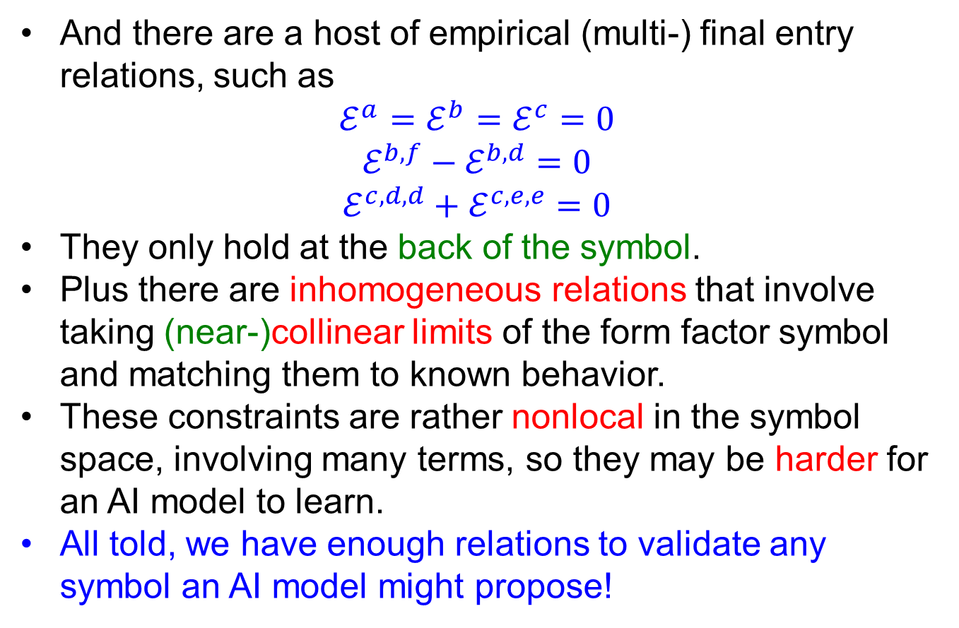
3-gluon form factor linear relations (cont.)
And there are a host of empirical (multi-) final entry relations, such as
$$ℰ^{a}=ℰ^{b}=ℰ^{c}=0$$
$$ℰ^{b,f}−ℰ^{b,d}=0$$
$$ℰ^{c,d,d}+ℰ^{c,e,e}=0$$
They only hold at the back of the symbol.
Plus there are inhomogeneous relations that involve taking (near-)collinear limits of the form factor symbol and matching them to known behavior.
These constraints are rather nonlocal in the symbol space, involving many terms, so they may be harder for an AI model to learn.
All told, we have enough relations to validate any symbol an AI model might propose!

Slide 18




Adjacency rules → “trivial zeros”
But still half of the remaining terms are zero:
Nonzero coefficients’ magnitudes grow with loop order:
$$L=4$$
$$L=5$$
$$L=6$$
$$\log_{10}|coeff.|$$

Slide 19
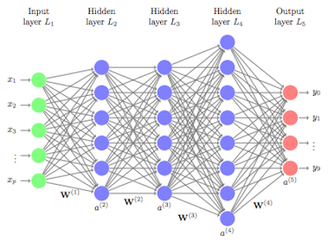
Deep learning = feed-forward neural network
Weights determine output as a function of input.
Millions to billions of parameters.
Train on GPUs to minimize a “loss function” by gradient flow.

Slide 20
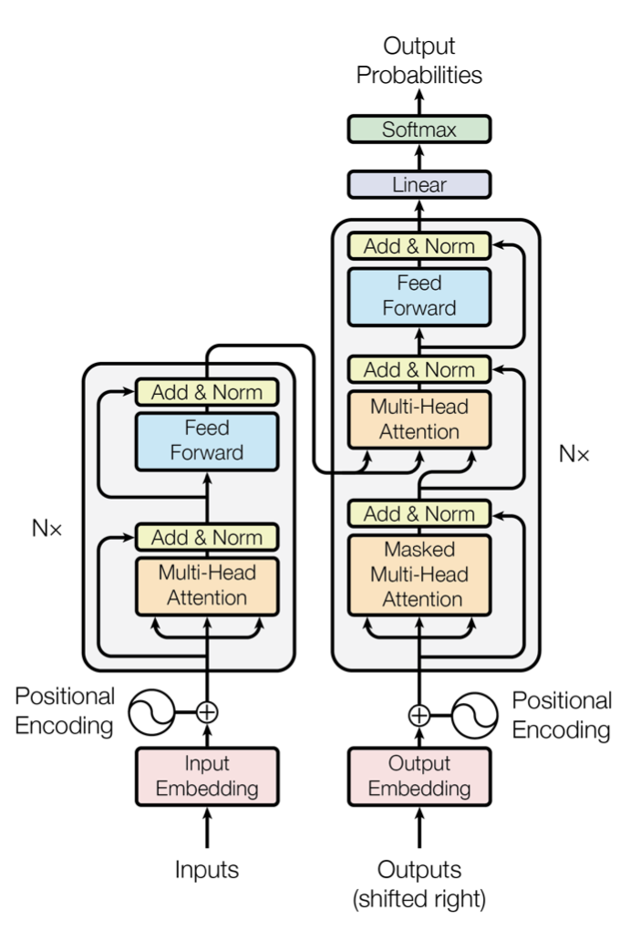
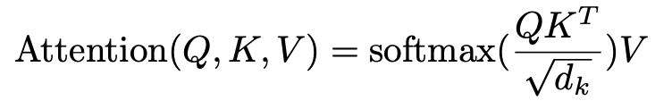

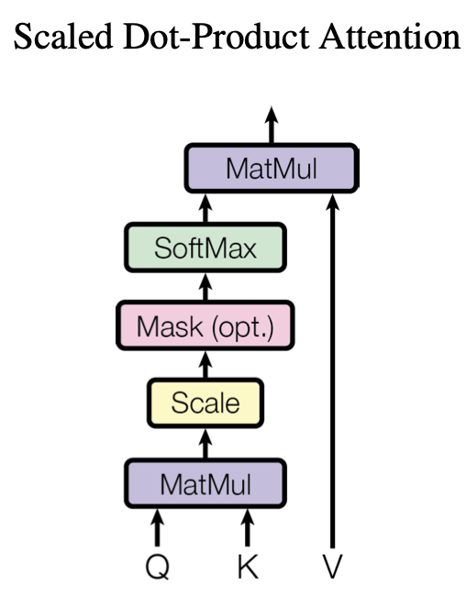
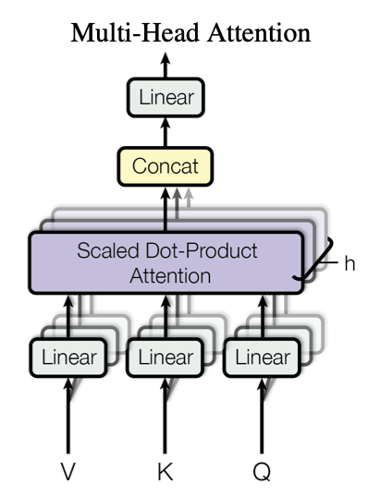
Transformers: Use “Attention” to add “context”
The Beast with Many Heads!
Attention:
Queries
Keys
Values
From Attention Is All You Need.
All learnable vectors.
Vaswani et al., 1706.03762
Transformers underlie all large language models, like ChatGPT, GPT-4, …
now entering much ML for science

Slide 21
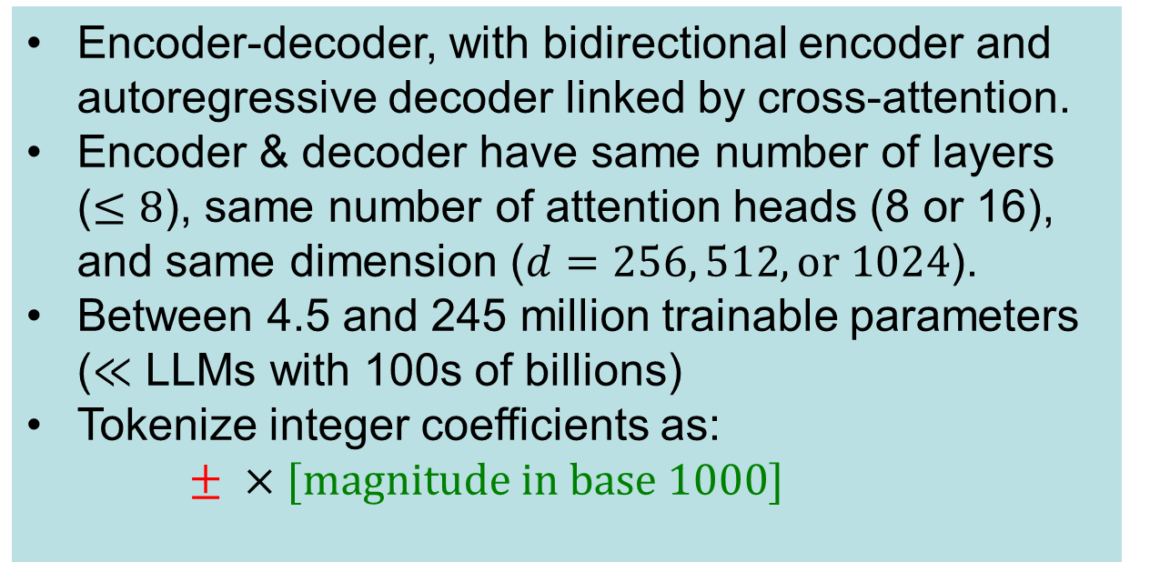
Our Transformer Models
Encoder-decoder, with bidirectional encoder and autoregressive decoder linked by cross-attention.
Encoder & decoder have same number of layers ($≤8$), same number of attention heads (8 or 16), and same dimension ($d=256, 512, or 1024$).
Between 4.5 and 245 million trainable parameters ($≪$ LLMs with 100s of billions)
Tokenize integer coefficients as:
$± ×[magnitude in base 1000]$

Slide 22
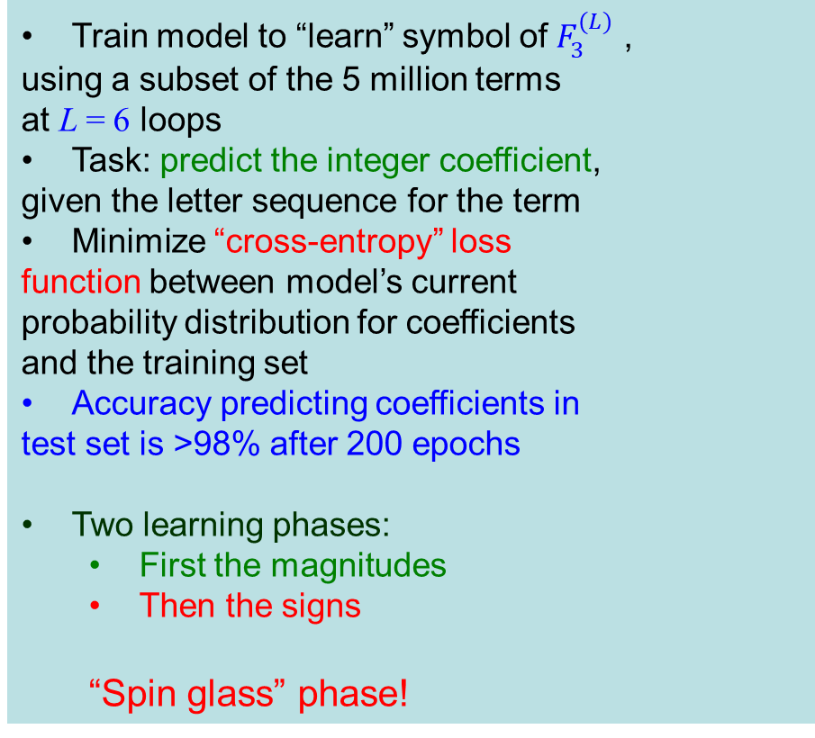
First “experiment”: coefficient-from-word
Train model to “learn” symbol of $F_{3}^{(L)}$ ,
using a subset of the 5 million terms
at L = 6 loops
Task: predict the integer coefficient,
given the letter sequence for the term
Minimize “cross-entropy” loss
function between model’s current
probability distribution for coefficients
and the training set
Accuracy predicting coefficients in
test set is >98% after 200 epochs
Two learning phases:
First the magnitudes
Then the signs
“Spin glass” phase!

Slide 23
Linear relations learned at different rates
2 term, same sign
2-3 terms, opposite signs
4 terms, mixed signs

Slide 24
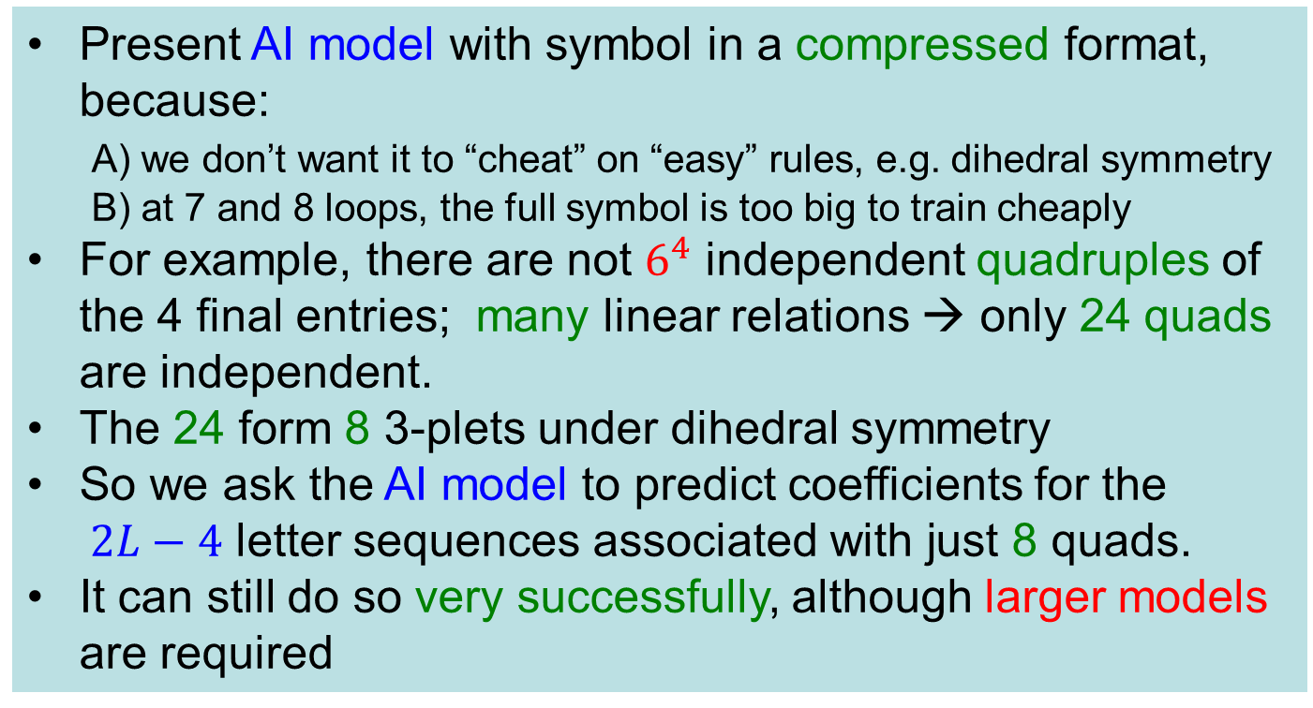
More compressed “data” still works
Present AI model with symbol in a compressed format, because:
A) we don’t want it to “cheat” on “easy” rules, e.g. dihedral symmetry
B) at 7 and 8 loops, the full symbol is too big to train cheaply
For example, there are not $6^{4}$ independent quadruples of the 4 final entries; many linear relations → only 24 quads are independent.
The 24 form 8 3-plets under dihedral symmetry
So we ask the AI model to predict coefficients for the $2L−4$ letter sequences associated with just 8 quads.
It can still do so very successfully, although larger models are required

Slide 25
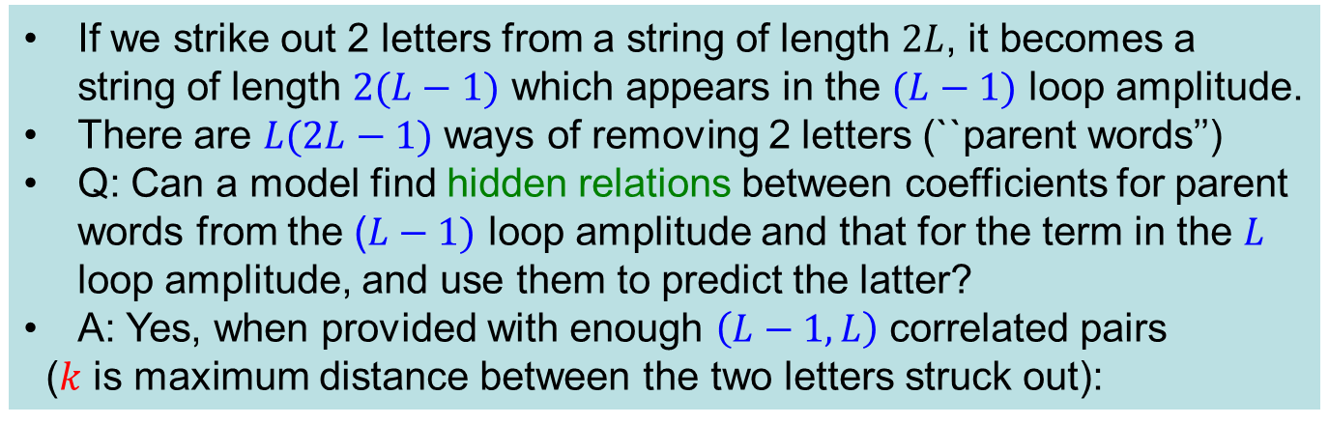
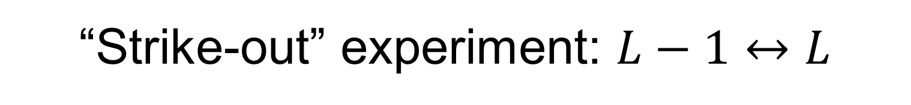
“Strike-out” experiment: $L−1↔$ $L$
If we strike out 2 letters from a string of length $2L$, it becomes a string of length $2(L−1)$ which appears in the $(L−1)$ loop amplitude.
There are $L(2L−1)$ ways of removing 2 letters (``parent words’’)
Q: Can a model find hidden relations between coefficients for parent words from the ($L−1)$ loop amplitude and that for the term in the $L$ loop amplitude, and use them to predict the latter?
A: Yes, when provided with enough $\left(L−1,L\right)$ correlated pairs
($k$ is maximum distance between the two letters struck out):

Slide 26
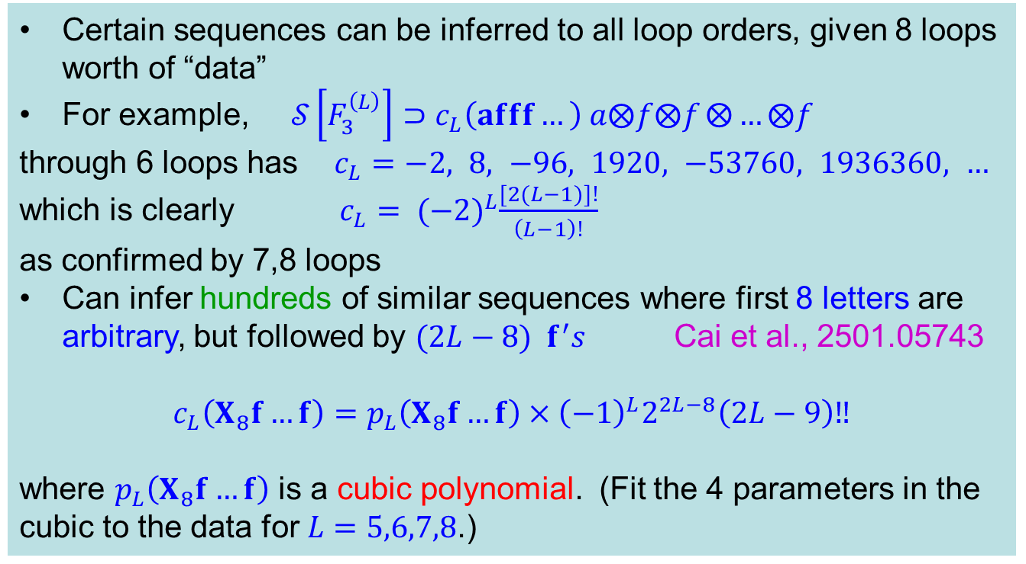
“Seed” sequences
Certain sequences can be inferred to all loop orders, given 8 loops worth of “data”
For example, $𝒮\left[F_{3}^{\left(L\right)}\right]⊃c_{L}\left(afff…\right) a⨂f⨂f⨂{…⨂f}$
through 6 loops has $c_{L}=−2, 8, −96, 1920, −53760, 1936360, …$
which is clearly $c_{L}= {(−2)}^{L}\frac{[2(L−1)]!}{\left(L−1\right)!}$
as confirmed by 7,8 loops
Can infer hundreds of similar sequences where first 8 letters are arbitrary, but followed by $(2L−8) f^{′}s$ Cai et al., 2501.05743
$$c_{L}\left(X_{8}f…f\right)=p_{L}\left(X_{8}f…f\right)×{\left(−1\right)}^{L}2^{2L−8}\left(2L−9\right)‼$$
where $p_{L}\left(X_{8}f…f\right)$ is a cubic polynomial. (Fit the 4 parameters in the cubic to the data for $L=5,6,7,8$.)

Slide 27
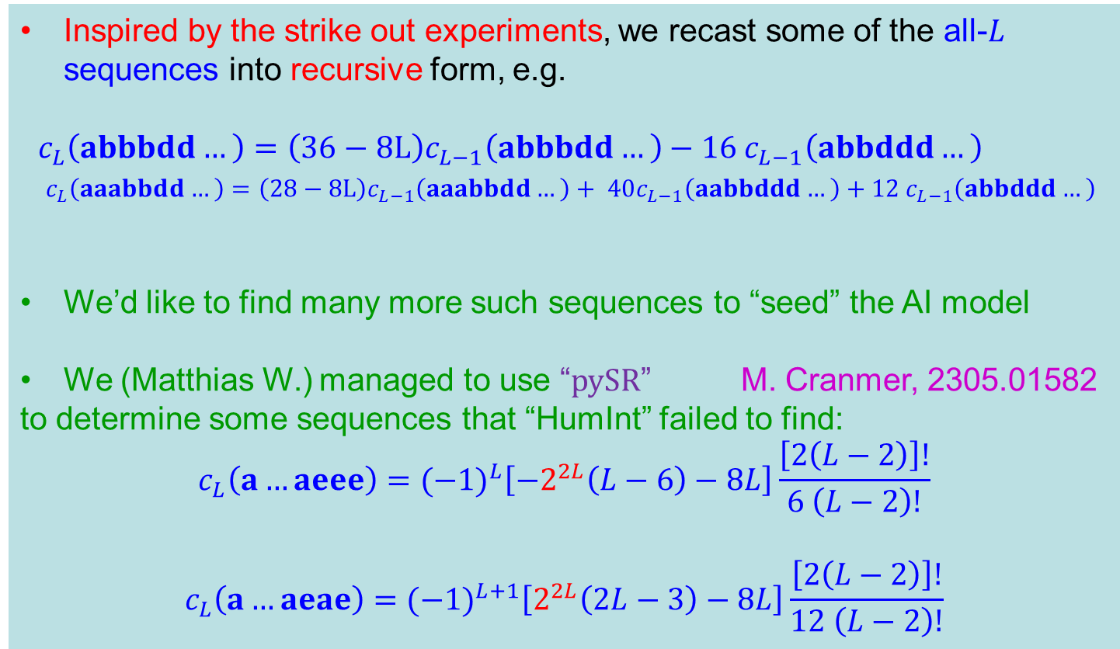
“Seed” sequences (cont.)
Inspired by the strike out experiments, we recast some of the all-$L$ sequences into recursive form, e.g.
$c_{L}\left(abbbdd…\right)=$ $\left(36−8L\right)c_{L−1}\left(abbbdd…\right)−16 c_{L−1}\left(abbddd…\right)$
$c_{L}\left(aaabbdd…\right)=$ $\left(28−8L\right)c_{L−1}\left(aaabbdd…\right)+ 40c_{L−1}\left(aabbddd…\right)+12 c_{L−1}\left(abbddd…\right)$
We’d like to find many more such sequences to “seed” the AI model
We (Matthias W.) managed to use “pySR” M. Cranmer, 2305.01582
to determine some sequences that “HumInt” failed to find:
$$c_{L}\left(a…aeee\right)={(−1)}^{L}\left[−2^{2L}\left(L−6\right)−8L\right]\frac{\left[2\left(L−2\right)\right]!}{6 \left(L−2\right)!}$$
$$c_{L}\left(a…aeae\right)={(−1)}^{L+1}\left[2^{2L}\left(2L−3\right)−8L\right]\frac{\left[2\left(L−2\right)\right]!}{12 \left(L−2\right)!}$$

Slide 28
On to next phase
Initially, we won’t know most of the symbol at the next loop order
But we do know all the linear relations
We are now training models on the relations instead of on individual coefficients, using compressed forms
Will also include the “seed” data
And we will look for more seeds

Slide 29
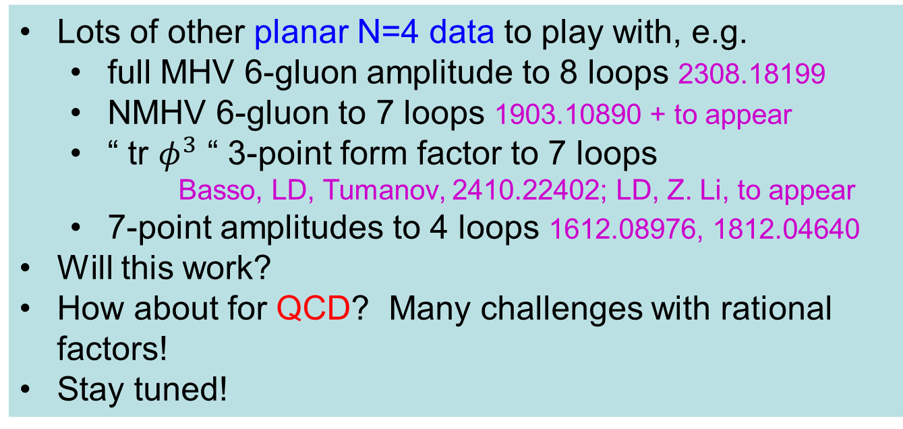
Other future directions
Lots of other planar N=4 data to play with, e.g.
full MHV 6-gluon amplitude to 8 loops 2308.18199
NMHV 6-gluon to 7 loops 1903.10890 + to appear
“ tr $φ^{3}$ “ 3-point form factor to 7 loops
Basso, LD, Tumanov, 2410.22402; LD, Z. Li, to appear
7-point amplitudes to 4 loops 1612.08976, 1812.04640
Will this work?
How about for QCD? Many challenges with rational factors!
Stay tuned!

Slide 30
Extra Slides

Slide 31
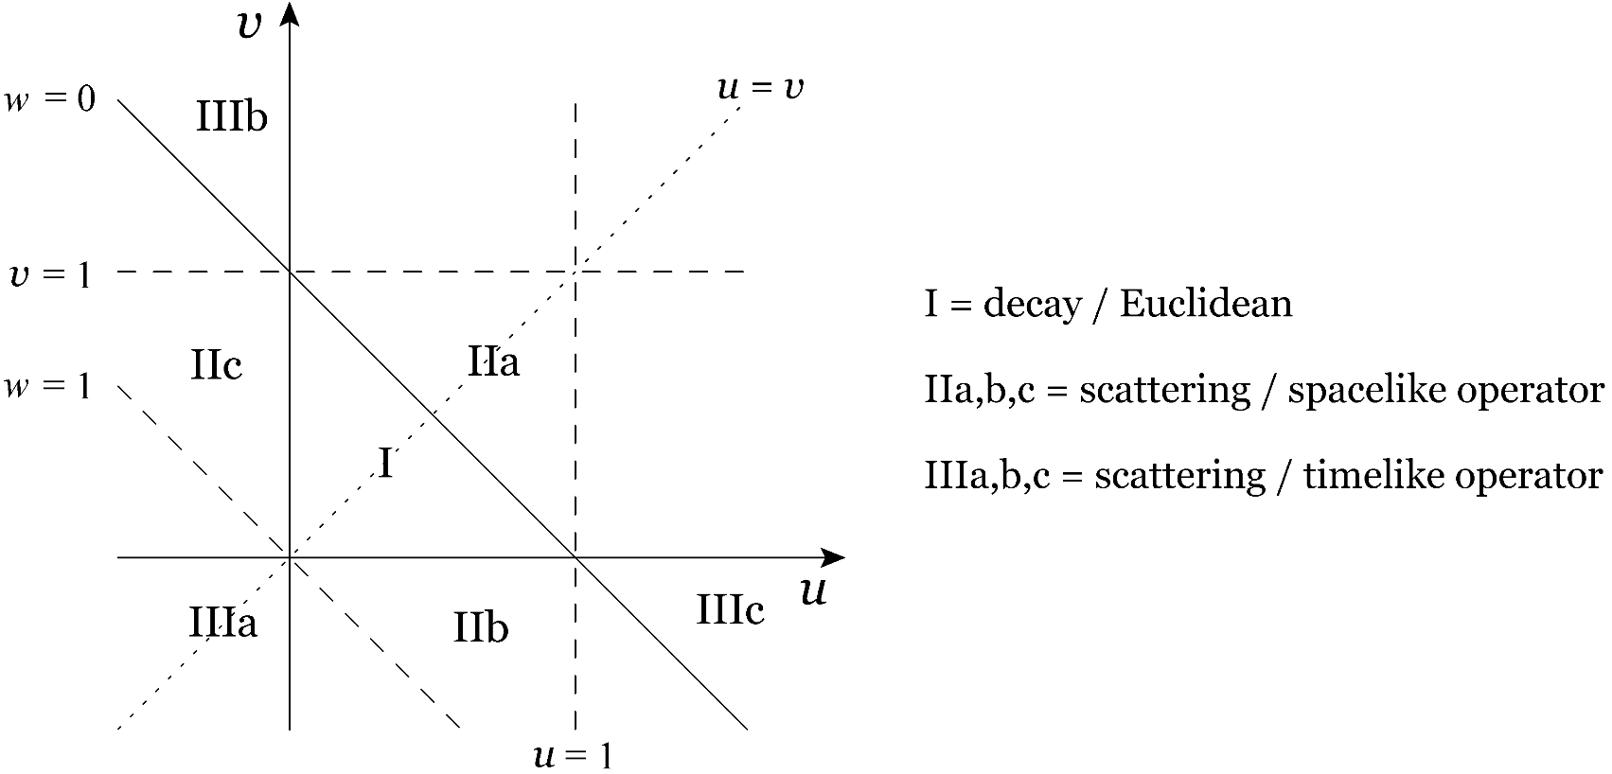







Hggg kinematics is two-dimensional
$$k_{1}+k_{2}+k_{3}=−k_{H}$$
$s_{ij}=(k_{i}+k_{j})^{2} k_{i}^{2}=0$
$$s_{123}=s_{12}+s_{23}+s_{31}=m_{H}^{2}$$
$$u=\frac{s_{12}}{s_{123}} v=\frac{s_{23}}{s_{123}} w=\frac{s_{31}}{s_{123}}$$
$$u+v+w=1$$
${D_{3}≡S}_{3}$ dihedral symmetry generated by:
cycle: $i→i+1 (mod 3)$, or
$$u→v→w→u$$
b. flip: $u↔v$
N=4 amplitude is
$S_{3}$ invariant

Slide 32


Visualizing dihedral symmetry
Tokens mapped into vector space in “embedding layer” of the transformer.
Plot leading 3 PCA (principal component analysis) components for positions of $\left\{a,b,c,d,e,f\right\}$ in the embedding space:
$L=5 \left(64\% of variance in 3D\right) L=6 (82\% of variance in 3D)$
In full space, dihedral symmetry holds for both$L=5 and L=6:$
all angles close to $60°$. For $L=5,$not apparent in projection to 3D

Slide 33
QCD vs. N=4 SYM
QCD: gluons, plus quarks in fundamental rep. of SU(N_{c})
N=4: Replace quarks with 4 copies of fermions in adjoint rep. (gluinos) and add 6 real adjoint rep. scalars
All in same supermultiplet (like one particle)
Feynman vertices:
QCD
N=4 SYM

Slide 34











Different “HI” routes to perturbative amplitudes
Draw all Feynman
graphs $G_{i}$
Evaluate all unitarity
cuts $C_{α}$
Bootstrap: Guess
${A=\sum_{m}{c_{m}F_{m}} }_{}$
$F_{m}$ known functions
$c_{m}∈ℚ$ unknown
constants
Evaluate all Feynman rules: $I_{i}$
Construct local: integrand $I_{}$
Solve constraints,
linear equations
for $c_{m}→r_{m}$
Perform all loop integrations: $A_{i}$
Perform all loop integrations: $A_{α}$
$${A=\sum_{i}{A_{i}}}_{}$$
$${A=\sum_{α}{A_{α}}}_{}$$
$${A=\sum_{m}{{r_{m}F}_{m}}}_{}$$

Slide 35


Known Planar N=4 SYM $n$-Point Amplitudes
loop
order
=
+…
>221
sum all planar Feynman graphs with
L loops and n external lines

Slide 36
Heuristic view of function space
weight
$$∫∫∫∫∫∫$$
…
derivatives
$$∫∫∫∫∫$$
4
$$∫∫∫∫$$
3
Li₃(1-1/u_{i}),
true 2D HPLs, …
2
Li₂(1-1/u_{i}) ln²u_{i} lnu_{i} lnu_{i+1} - ζ₂
1
lnu
lnv
lnw
1
0

Slide 37

Example: Harmonic Polylogarithms in one variable (HPL{0,1})
Remiddi, Vermaseren, hep-ph/9905237
Generalize classical polylogs
Define HPLs by iterated integration:
$H_{0,\vec{w}}\left(x\right)=\int_{0}^{x}{\frac{dt}{t}}$ $H_{\vec{w}}\left(t\right)$, ${ H}_{1,\vec{w}}\left(x\right)=\int_{0}^{x}{\frac{dt}{1−t}}$ $H_{\vec{w}}\left(t\right)$
Or by derivatives:
$dH_{0,\overset{⃑}{w}}\left(x\right)=H_{\overset{⃑}{w}}\left(x\right)d\ln{x}$ $dH_{1,\overset{⃑}{w}}\left(x\right)={−H}_{\overset{⃑}{w}}\left(x\right)d\ln{(1−x)}$
Symbol alphabet: $𝒮=\{x,1−x\}$
Weight n = length of binary string $\overset{⃑}{w}$
Number of functions at weight n = 2L is number of binary strings: 2^{2L}
Branch cuts dictated by first integration/entry in symbol
Derivatives dictated by last integration/entry in symbol

Slide 38



Simplest analytic form is for $v→∞$
→ Harmonic polylogarithms $H_{\overset{⃑}{w}} ≡H_{\overset{⃑}{w}}(1−\frac{1}{u})$
8 loop result has $\sim 2^{2×8−2}=16,384$ terms

Slide 39


Number of (symbol-level) linearly independent $\left\{n,1,…,1\right\}$ coproducts ($2L−n$ derivatives)
Properly normalized $L$ loop N=4 form factors $ℰ^{(L)}$ belong to a small space $𝒞$, dimension saturates on left
$ℰ^{(L)}$ also obeys multiple-final-entry relations,
saturation on right

Slide 40

Removing Amplitude (or Form Factor) Infrared Divergences
On-shell amplitudes IR divergent due to long-range gluons
Polygonal Wilson loops UV divergent at cusps, anomalous dimension $Γ_{cusp}$
– known to all orders in planar N=4 SYM:
Beisert, Eden, Staudacher, hep-th/0610251
Both removed by dividing by BDS-like ansatz Bern, LD, Smirnov, hep-th/0505205, Alday, Gaiotto, Maldacena, 0911.4708
Normalized [MHV] amplitude is finite, dual conformal invariant, also uniquely (up to constant) maintains important symbol adjacency relations due to causality (Steinmann relations for 3-particle invariants):
$$ℰ_{6}\left(u_{i}\right)=\lim_{ε→0}{\frac{𝒜_{6}(s_{i,i+1},ε)}{𝒜_{6}^{BDS−like}(s_{i,i+1},ε)}}=exp⁡[\frac{Γ_{cusp}}{4}ℰ_{6}^{(1)}+R_{6}]$$
remainder function

Slide 41
BDS & BDS-like normalization for $ℱ_{3}$
BDS ansatz
remainder function only a
function of $u,v,w;$
vanishes in all collinear limits,
but no adjacency constraints
split 1-loop amplitude judiciously:
Now divide by:
$$⇒$$

