Slide 1
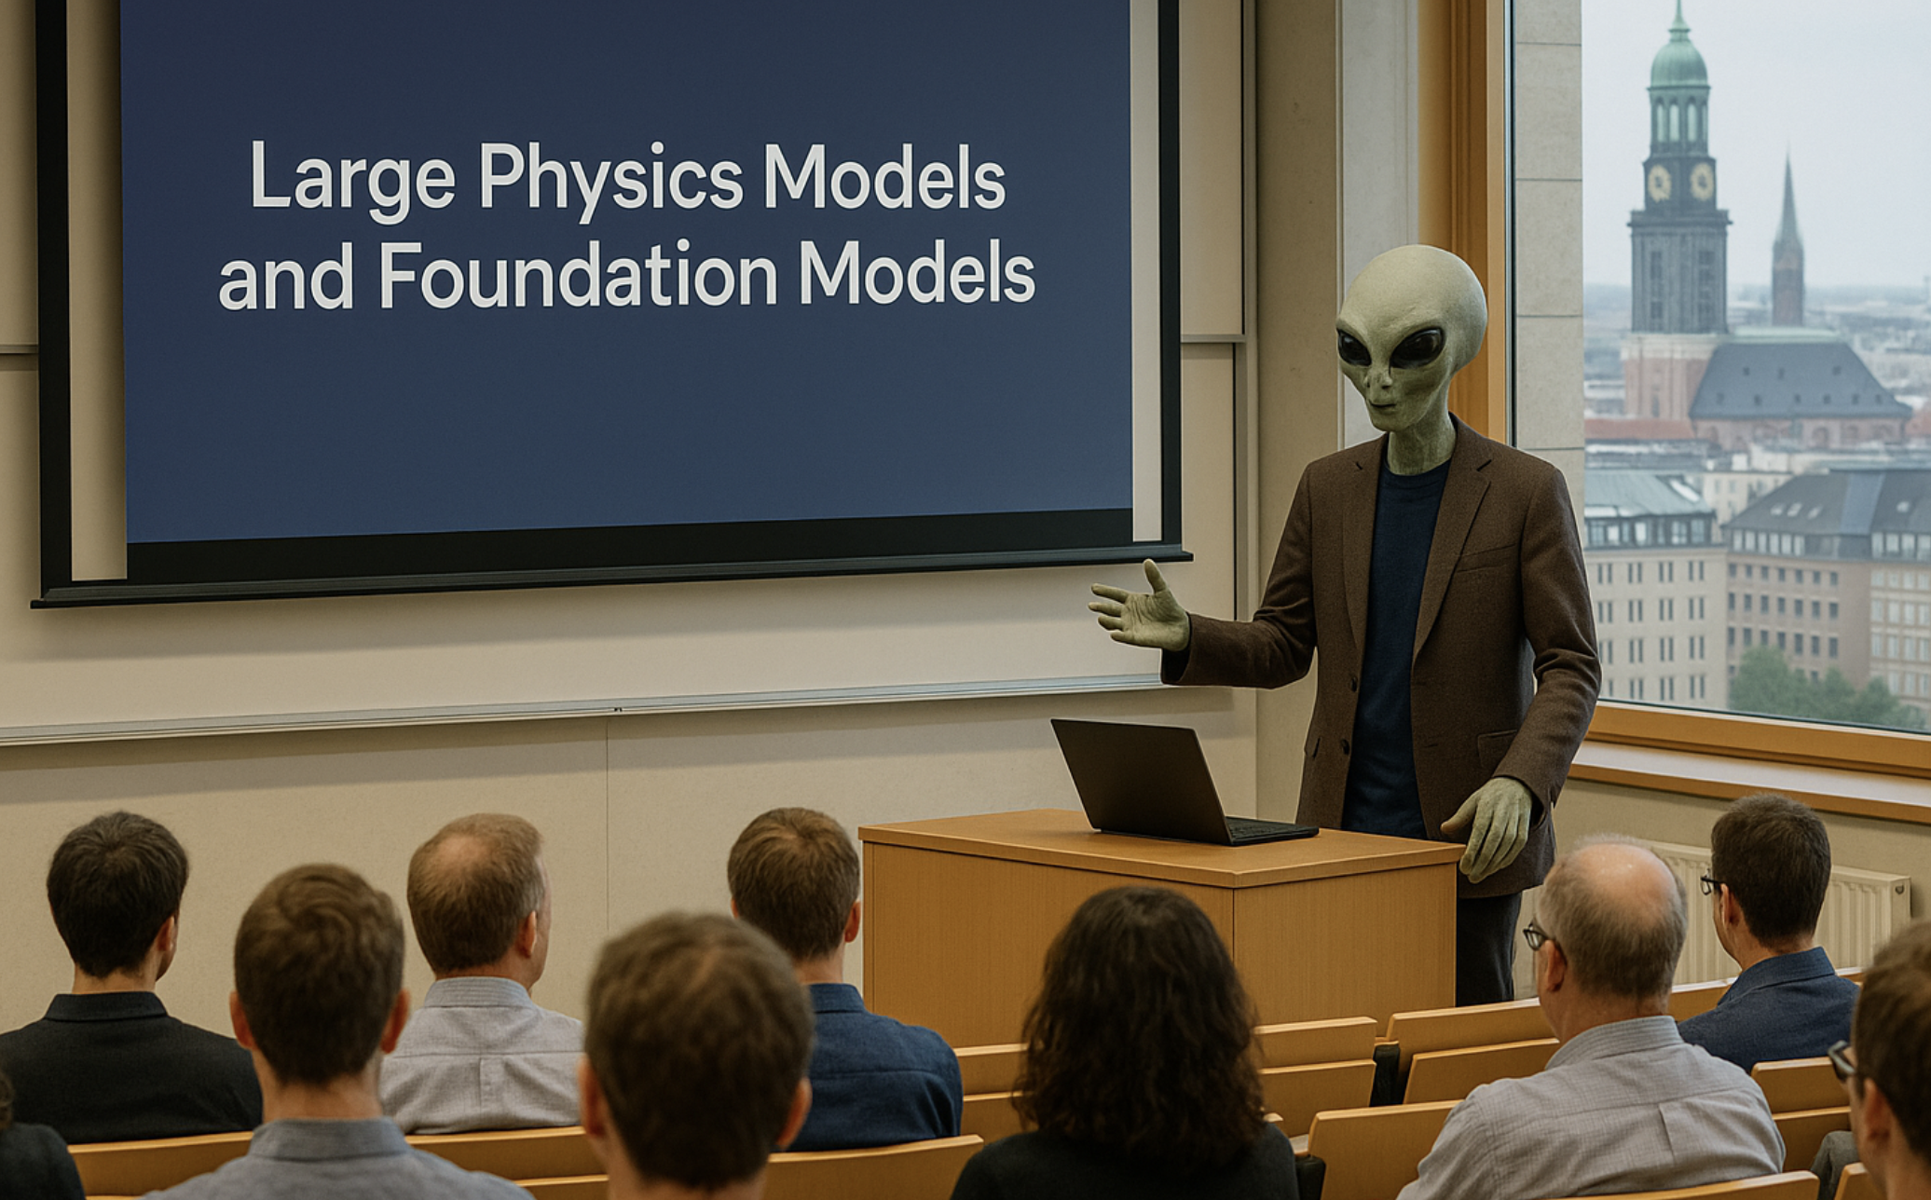
Sascha Caron
(Radboud University and Nikhef)
ACAT 2025, Hamburg
Created with DALL·E 3,

Slide 2
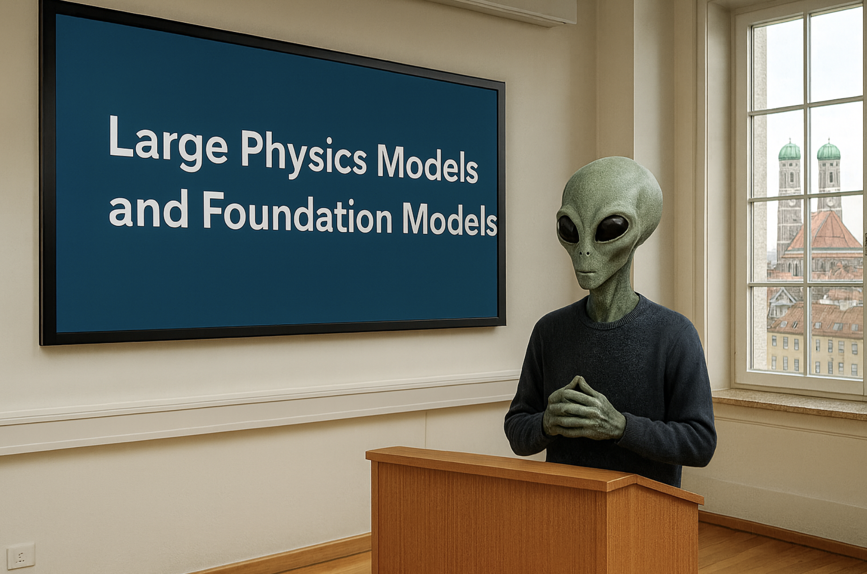
Sascha Caron
(Radboud University and Nikhef)
MIAPbP Workshop , Munich
Created with DALL·E 3,

Slide 3
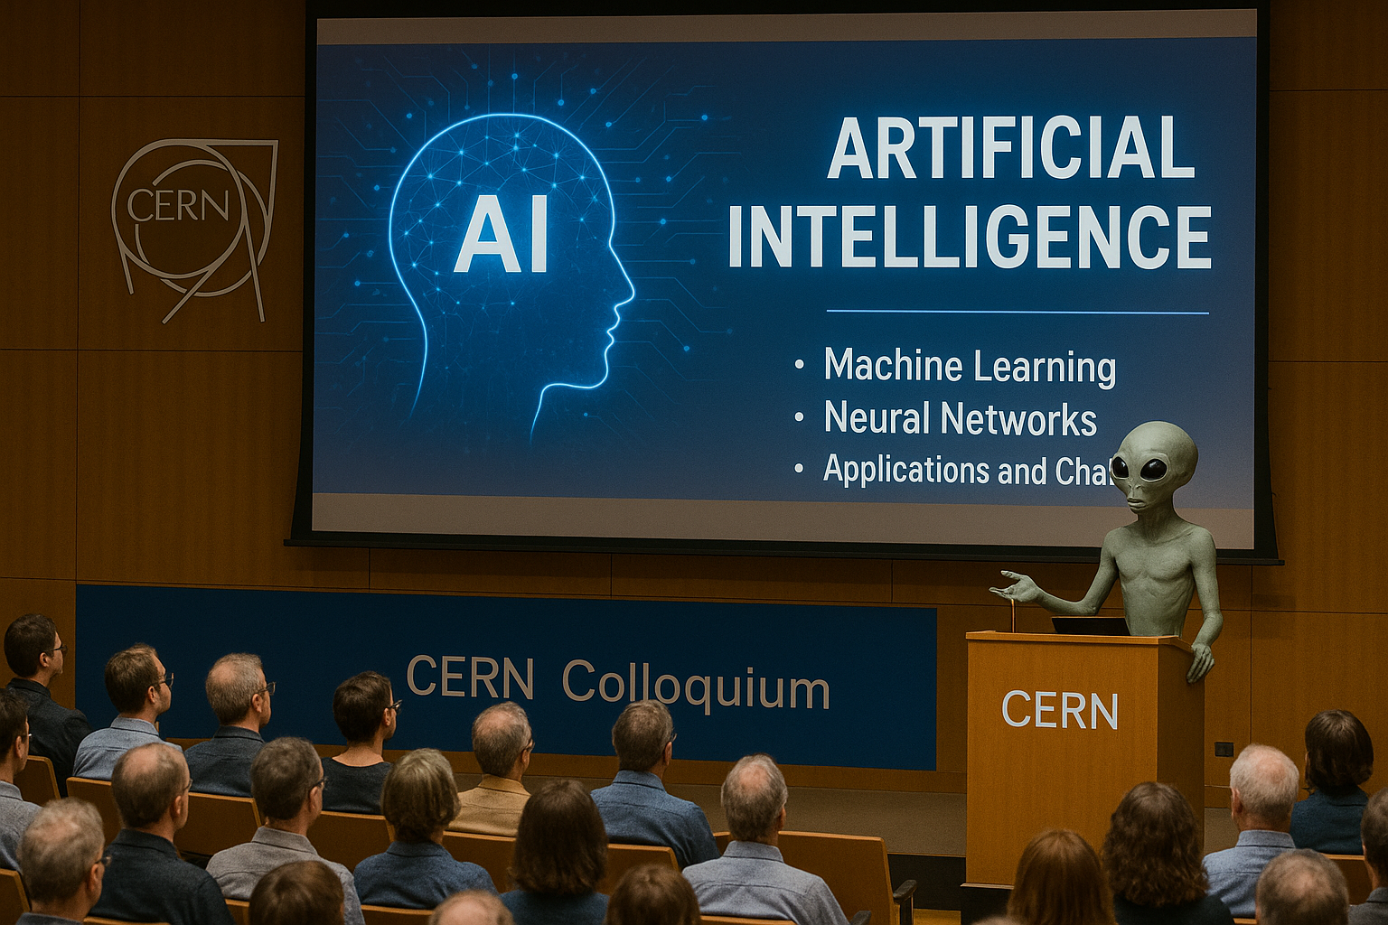
Large Physics Models and EuCAIF as a New Scientific Instrument
image by dalle 3
Sascha Caron
(Radboud University and Nikhef)

Slide 4

From AI in Fundamental Physics to Large Physics Models

Slide 5
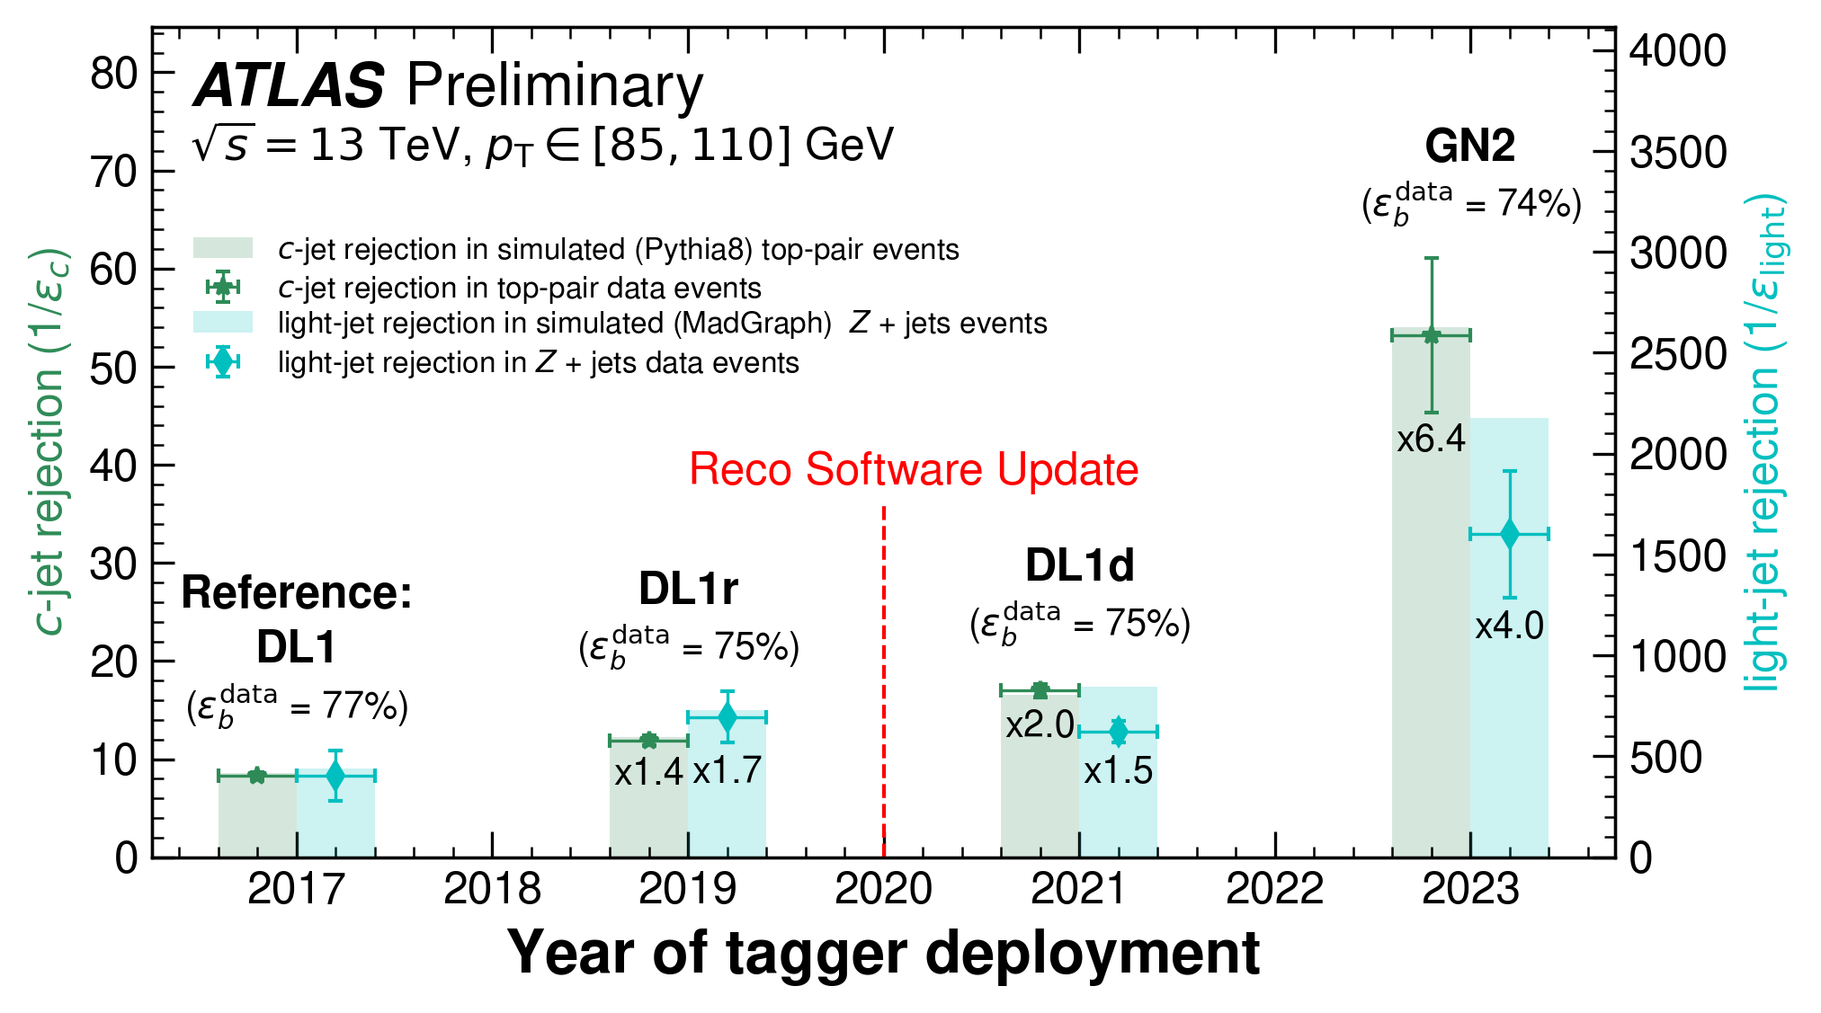
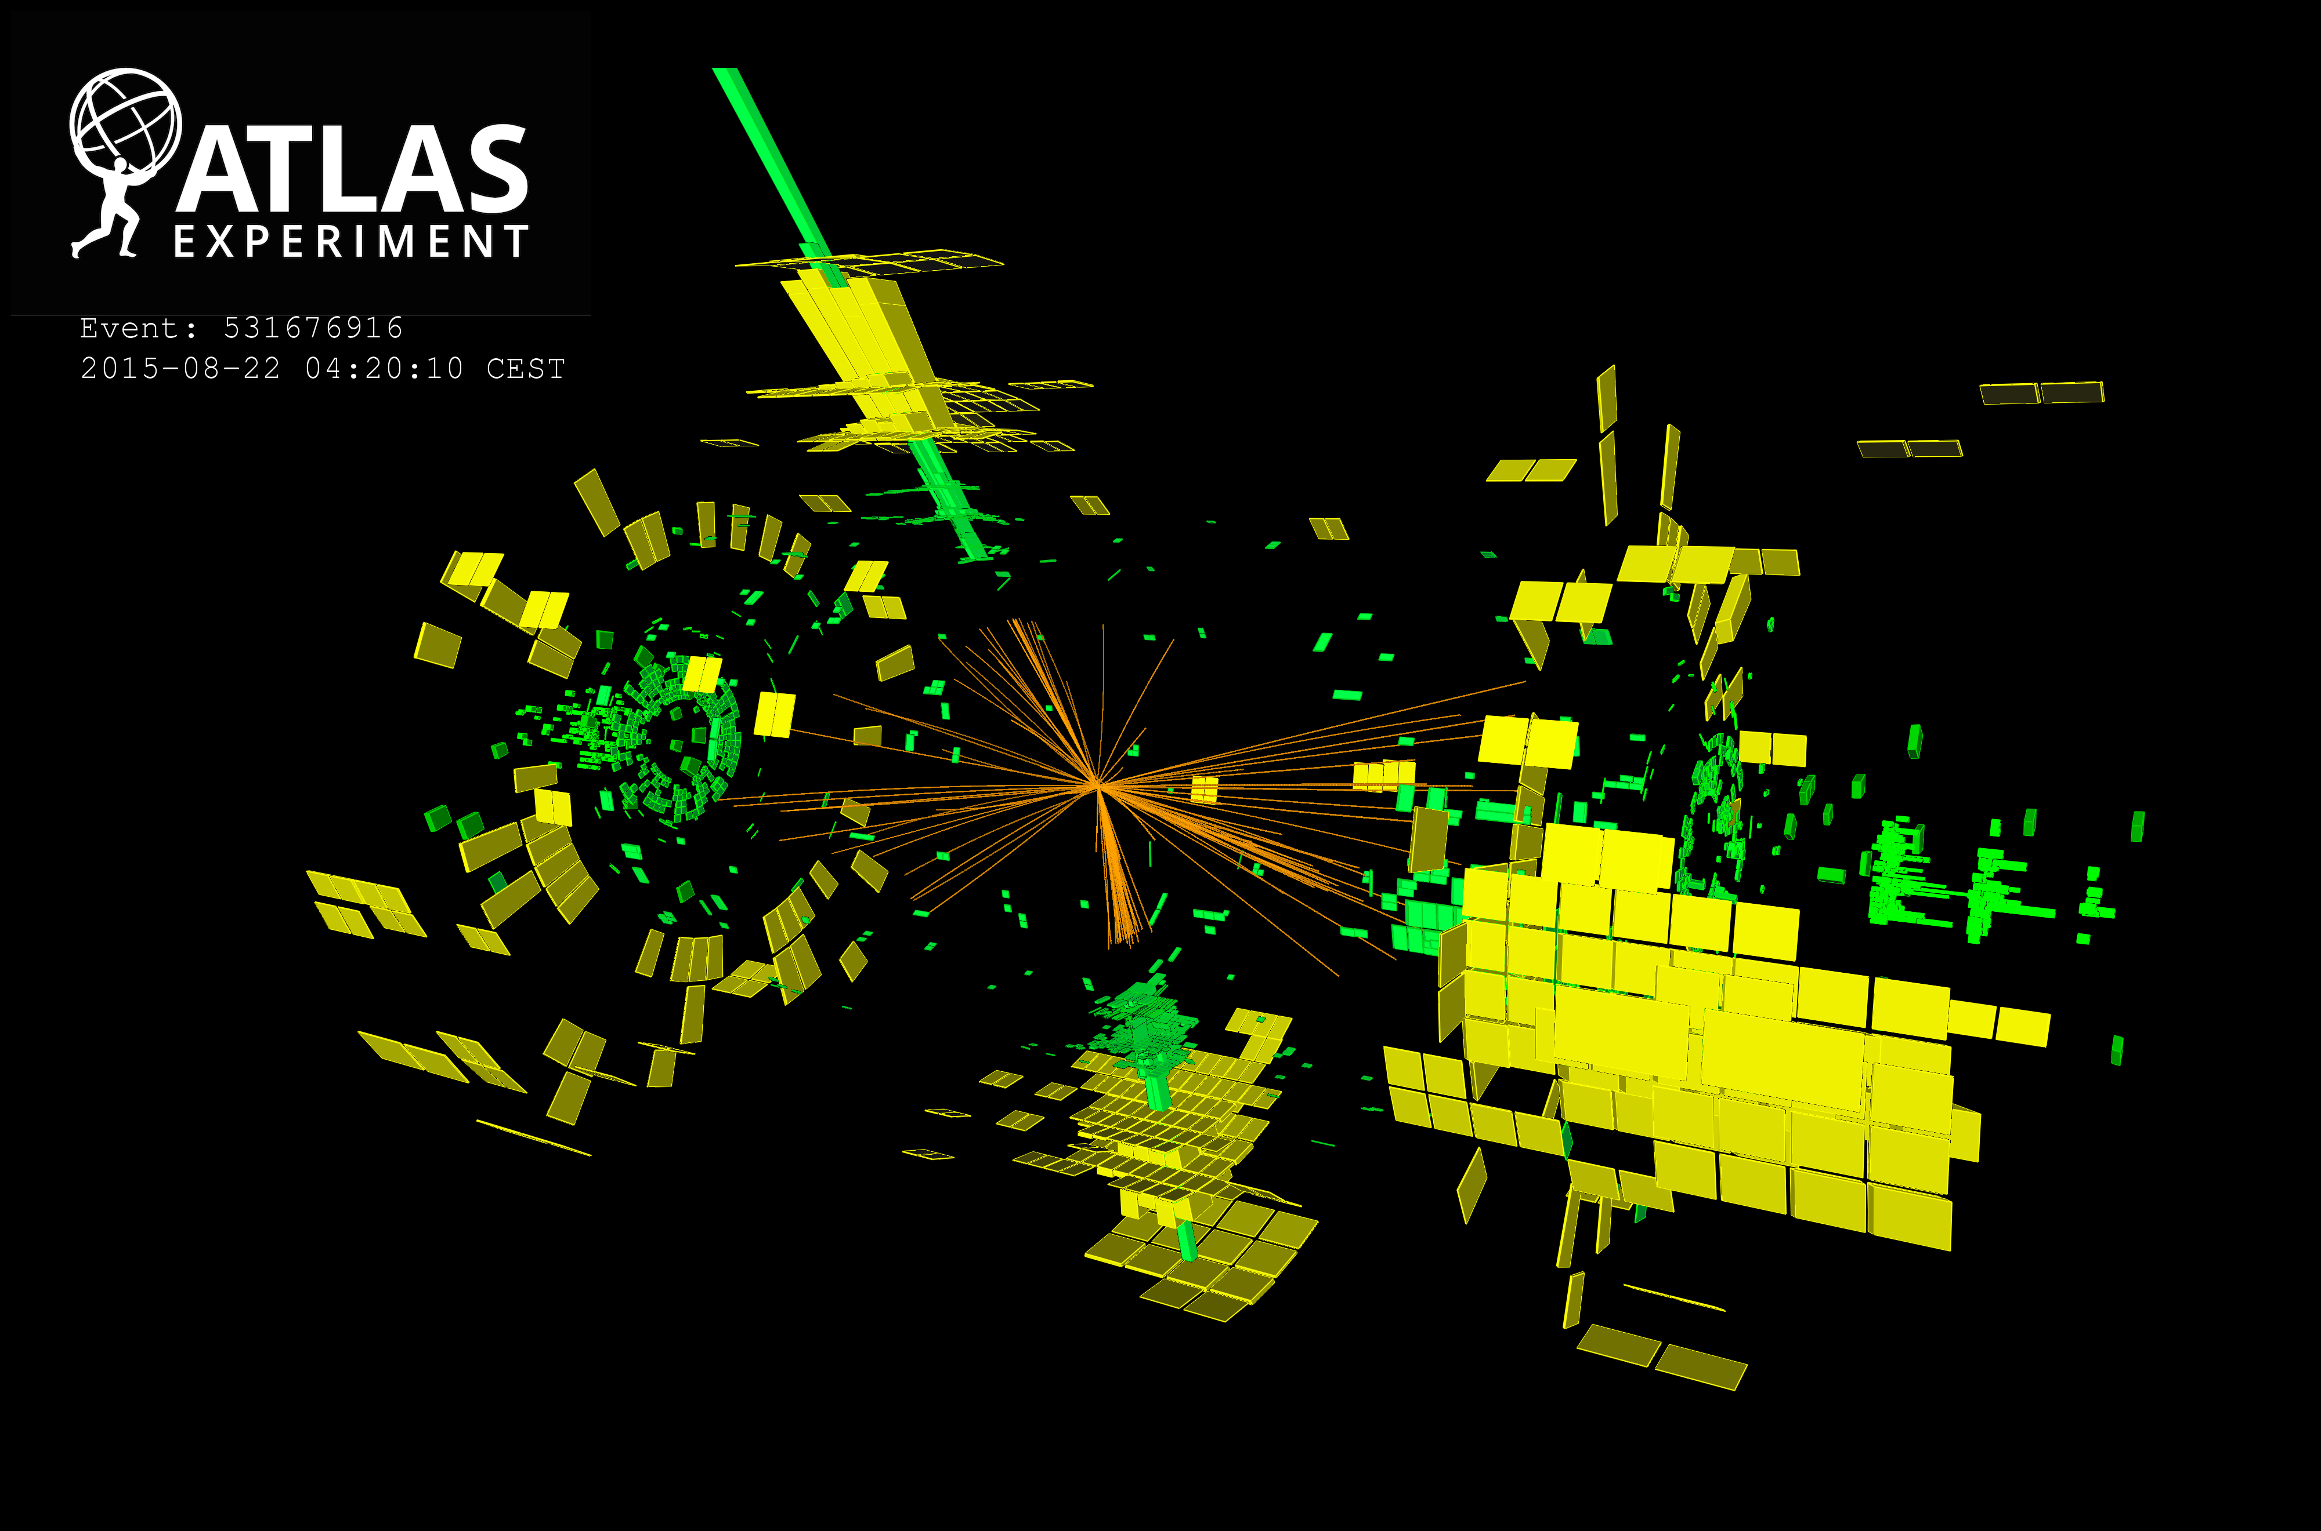
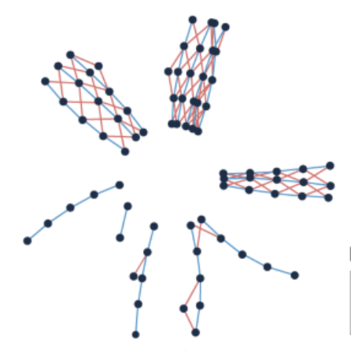
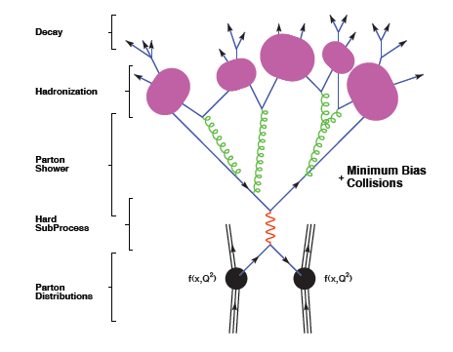
2025:AI/Deep Learning (DL) in HEP
AI – unfolding
AI – inference
AI - event
selection
c & light jet
rejection
Energy and angles of reconstructed particles
AI -
reconstruction
AI -
tracking
AI -
detector
simulation
Detector Simulator
AI -
trigger
AI - event
generation

Slide 6
2035?:AI/Deep Learning (DL) in HEP
AI – unfolding
AI – inference
AI - event
selection
Energy and angles of reconstructed particles
AI -
reconstruction
AI -
tracking
A large foundation model ?
Whitebox ? Black box ? Interpretable ?
How human input ?
“Talking to data” via Large Language Model ?
How much is performance improved ?
AI -
detector
simulation
Detector Simulator
AI -
trigger
AI - event
generation

Slide 7
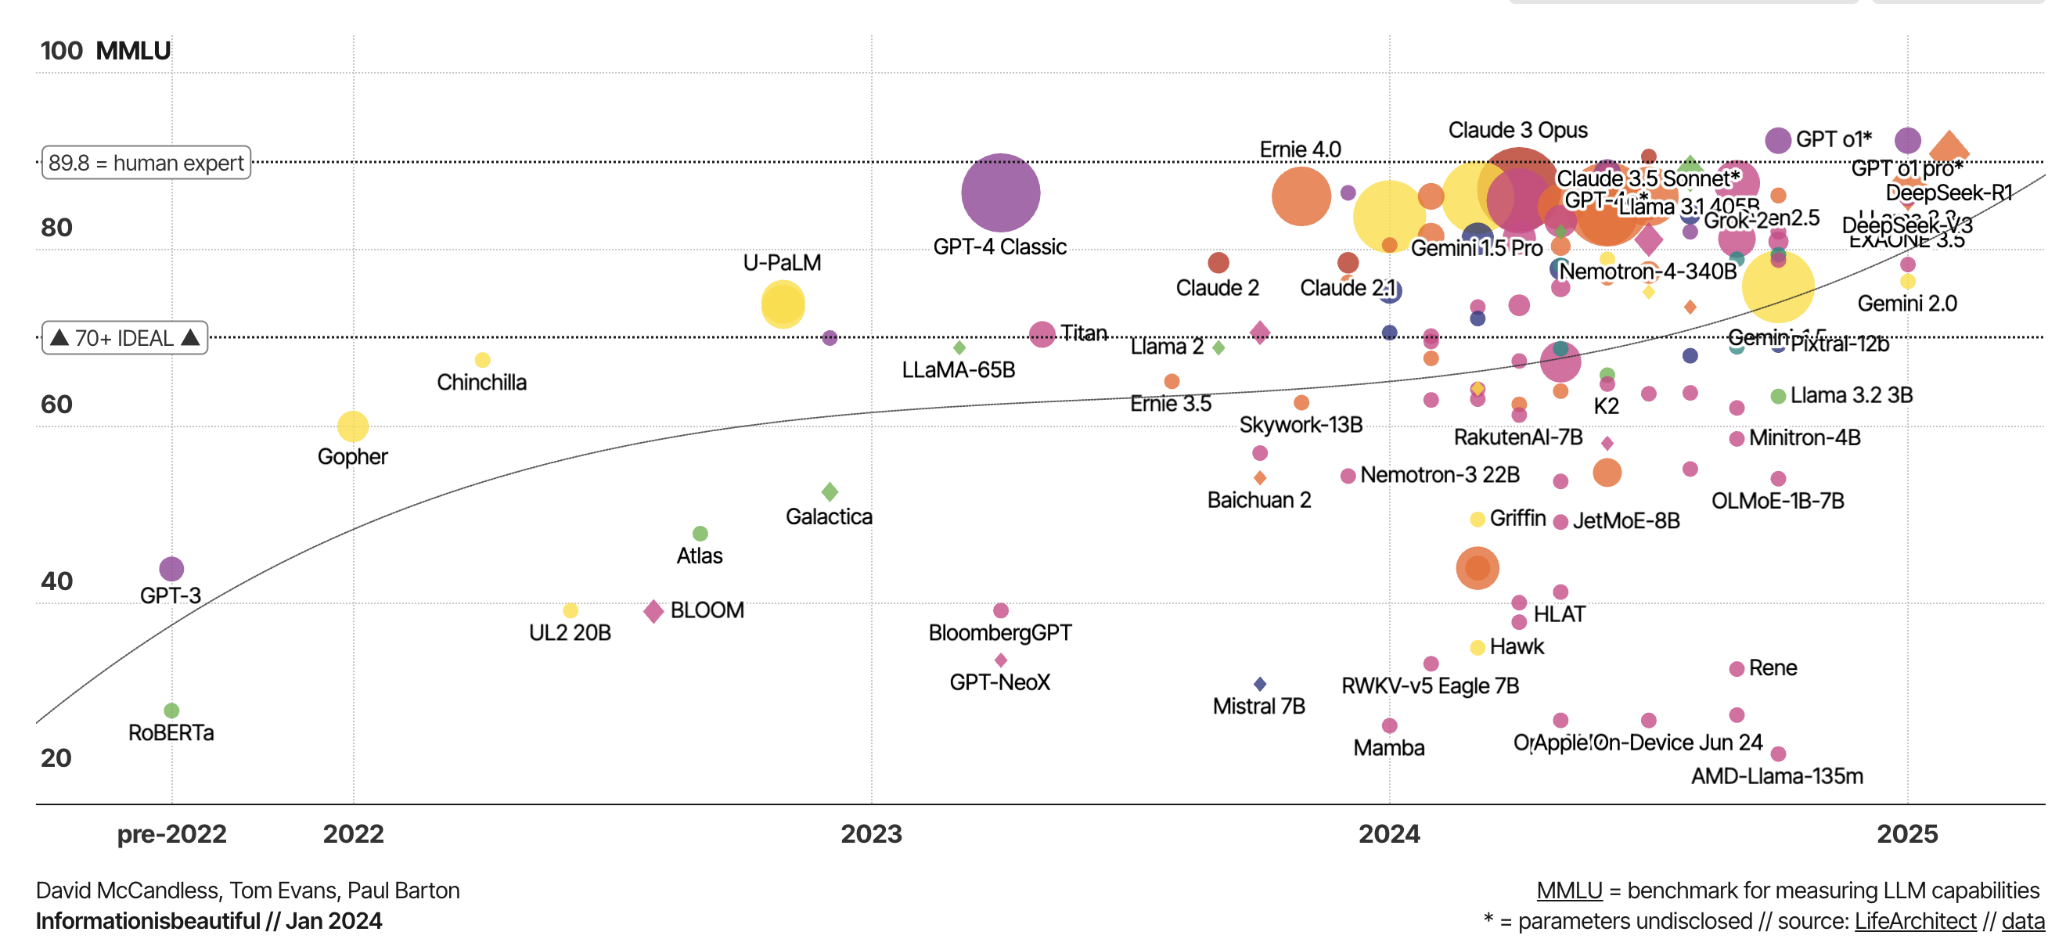
Meanwhile in industry…
MMLU benchmark consists of 15,908 multiple-choice questions
The 2025 AI Index Report

Slide 8
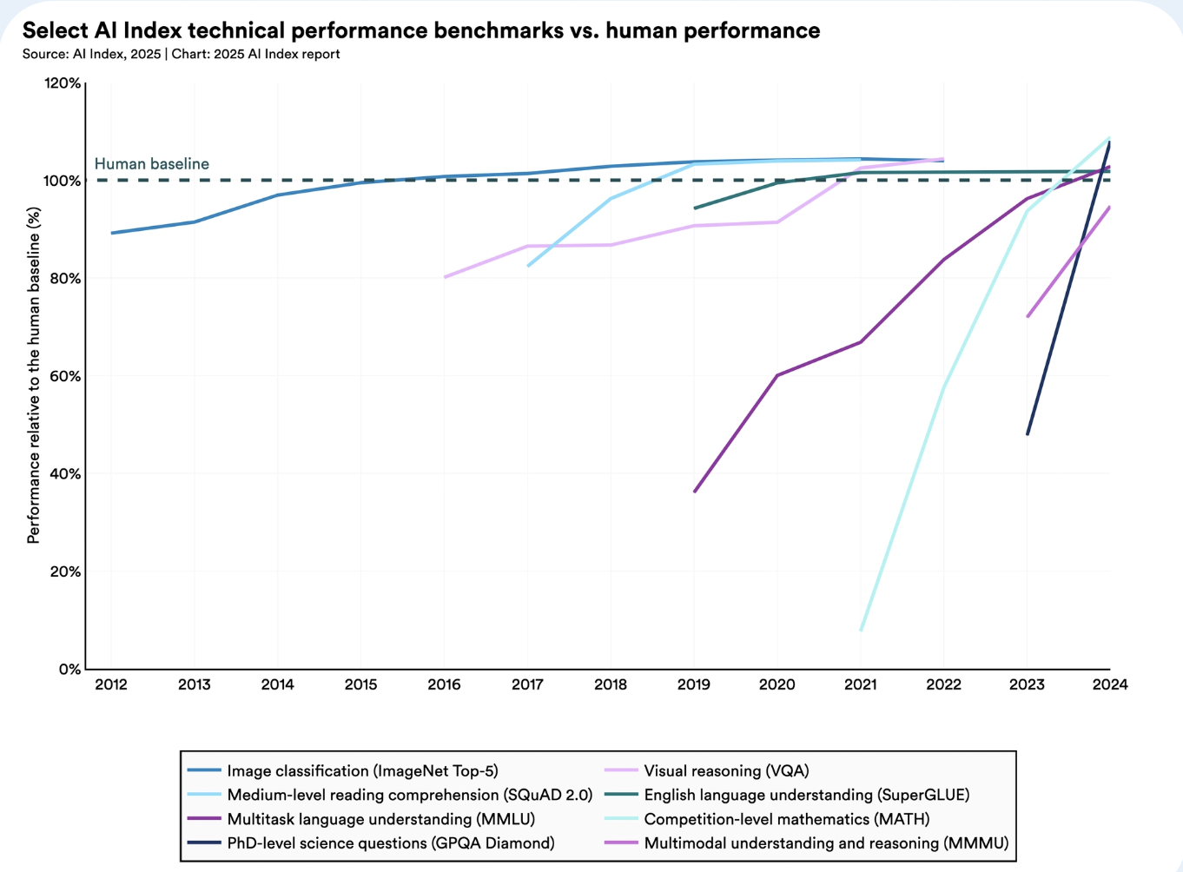
The 2025 AI Index Report

Slide 9
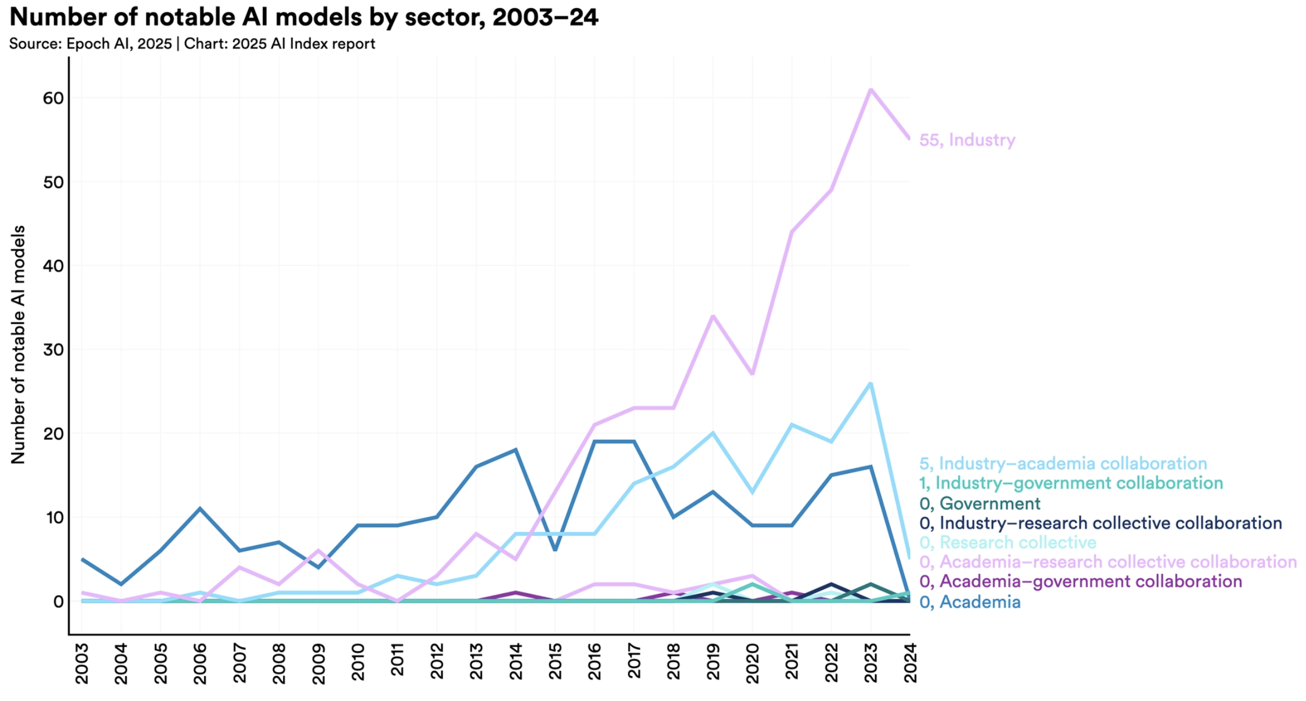
The 2025 AI Index Report

Slide 10
Foundation Models: General Intelligence for Specific Tasks
Typically trained on large, diverse datasets:
Text (e.g. web, papers), Code , Images
Math, diagrams, structured data
==> Physics equivalent:
Simulation output
Detector-level (raw) , reco-level events , Analysis-level
Papers, plots, logbooks, metadata

Slide 11
Foundation Models: General Intelligence for Specific Tasks
Typically trained on large, diverse datasets:
Text (e.g. web, papers), Code , Images
Math, diagrams, structured data
➔ Learning objective: self-supervised prediction (e.g. next token, masked region, contrastive pairs)
+ transfer learning (minimal fine-tuning) + many parameters + multipurpose
+ some capability not explicitly included during traing

Slide 12
Next slides are a very personal selection, showing a bit - as example - what my own group has been doing towards foundation models in HEP.

Slide 13
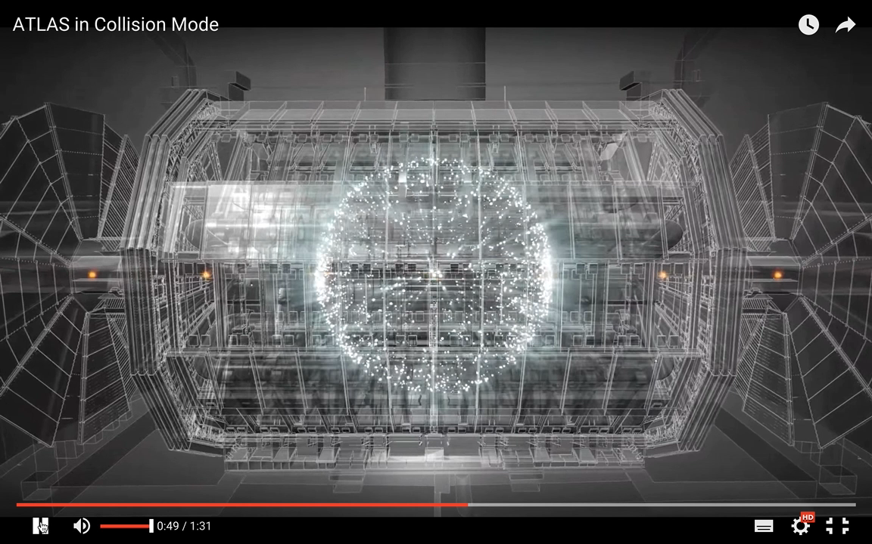
Collisions at the Large Hadron Collider
Bunch crossing every 25 ns… many collisions per bunch crossing

Slide 14
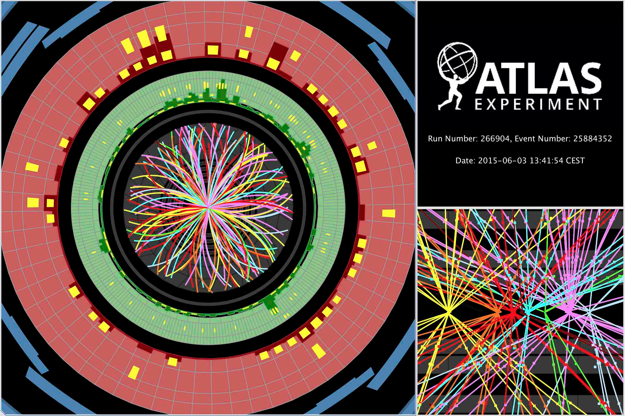
Most events look like this…
Event from LHC run-2

Slide 15
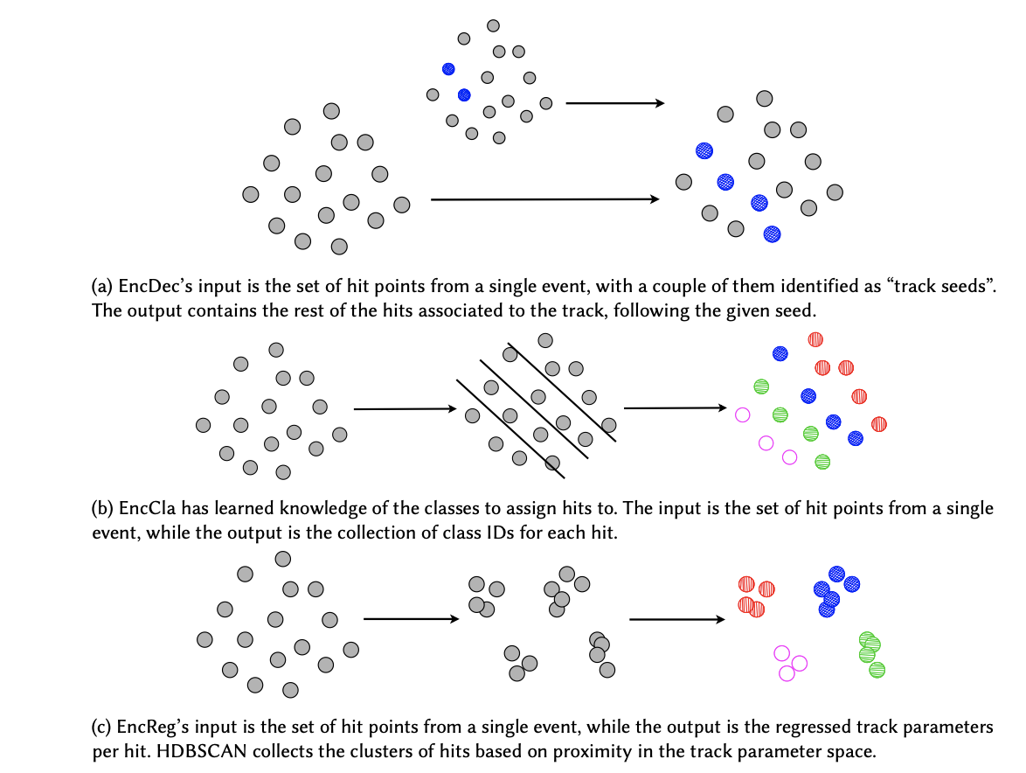
From Hits to Tracks: Tokens in Physics
Input
Encoder
Latent Vector (representation)
Decoder
Output
We Tried Tokenization
+ Regression strategies (no tokens)
- “Full translation” and
”Next token predictions”
”Trackformers: ”
Eur.Phys.J.C 85 (2025) 4, 460 ,
e-Print: 2407.07179 [hep-ex]

Slide 16
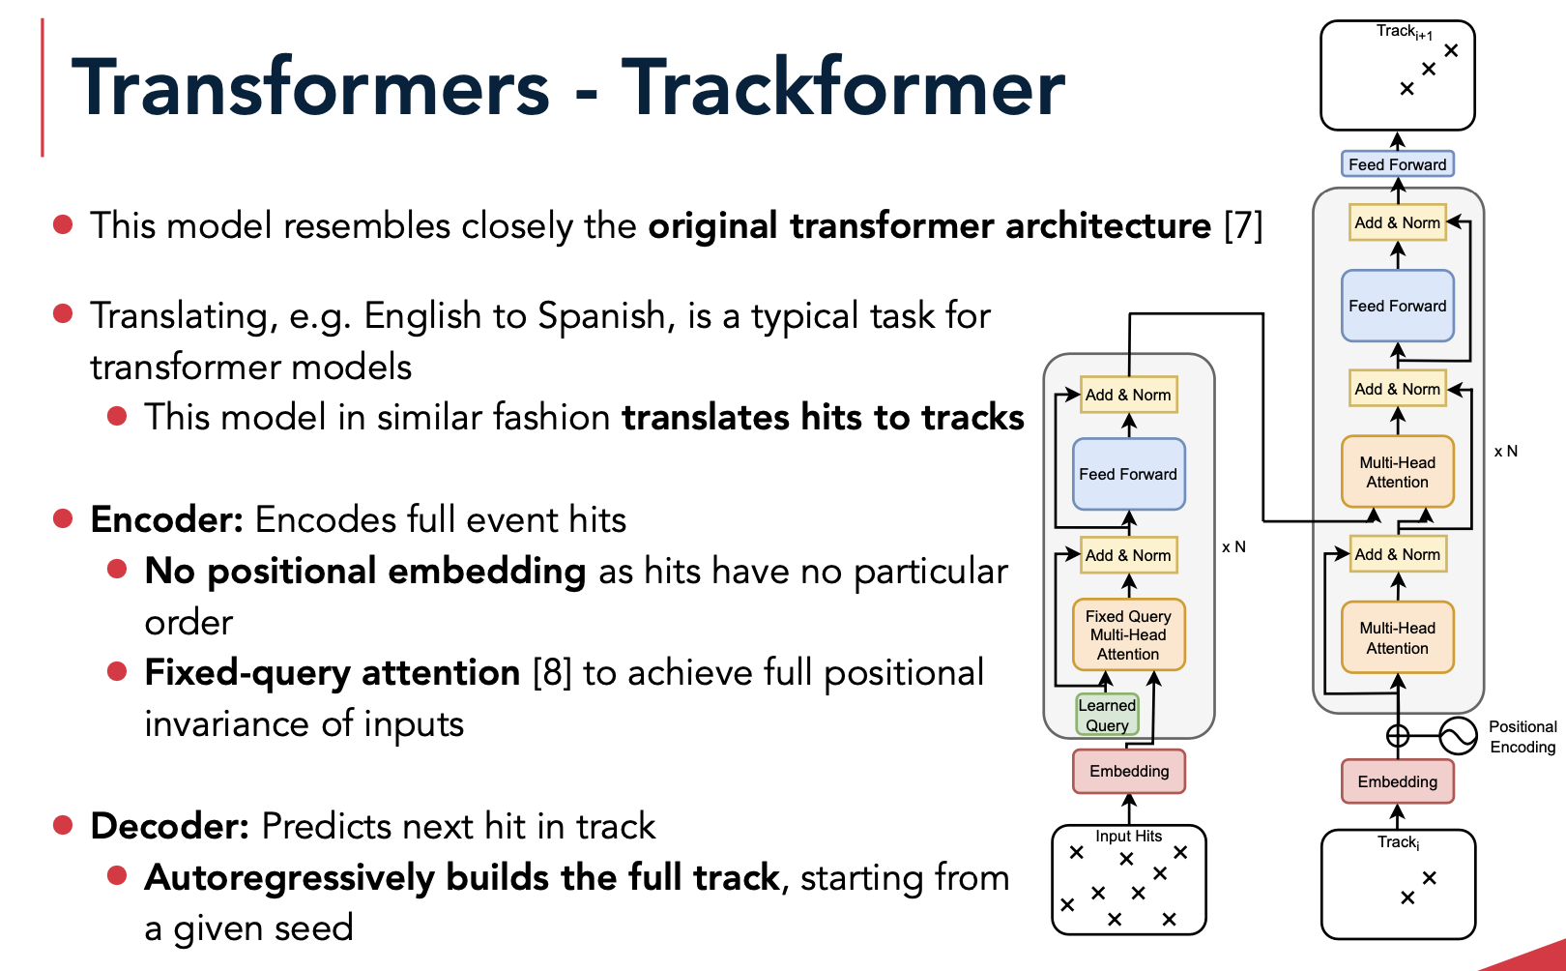

Slide 17
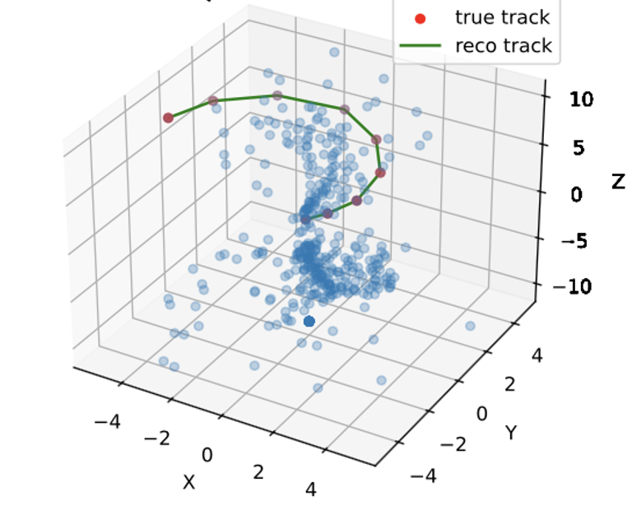

Slide 18
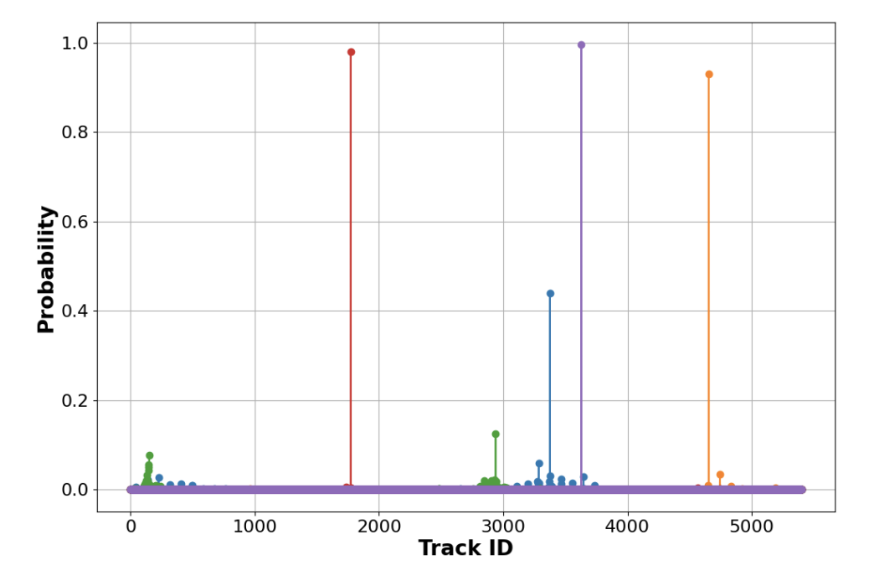
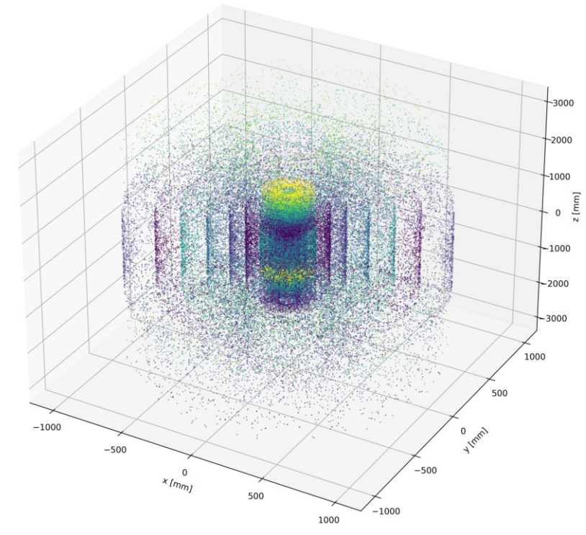
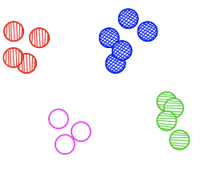
From Hits to Tracks: Tokens in Physics
Input
Encoder
Latent Vector (representation)
Decoder
Output
Token
Grouped into track tokens via learned structure (attention, transformers)
Token ID
O(10000) hits (no pre-processing)
SoftMax outputs of the EncCla model for the first five hits for one event for all track classes
”Trackformers: ”, Eur.Phys.J.C 85 (2025) 4, 460 , e-Print: 2407.07179 [hep-ex]

Slide 19
From Hits to Tracks: Tokens in Physics
Hits
Encoder
Latent Vector (representation)
Decoder
Track
Token
10^5
10^3
Grouped into track tokens via learned structure (attention, transformers)
Token ID
O(10000) hits (no pre-processing)
SoftMax outputs of the EncCla model for the first five hits for one event for all track classes
”Trackformers: ”, Eur.Phys.J.C 85 (2025) 4, 460 , e-Print: 2407.07179 [hep-ex]

Slide 20
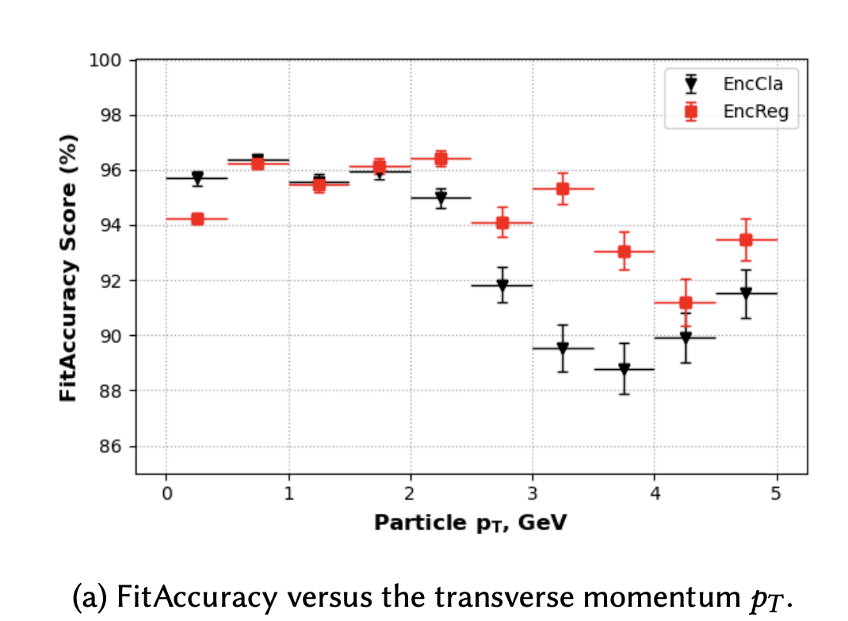
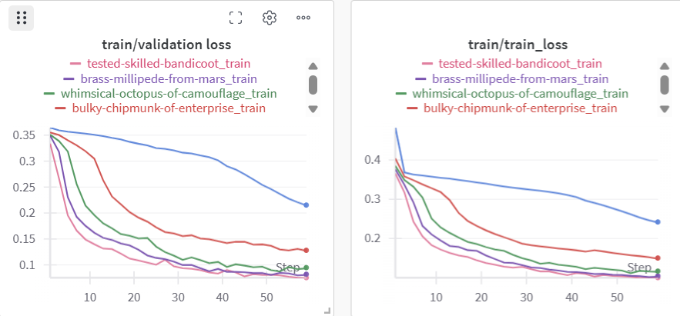
Model performance → Not enough training data in trackML challenge ! (model can still improve)
Slav Pshenov (Nikhef)

Slide 21
End-to-End ?
Hits/Cells
Encoder
Latent Vector (representation)
Decoder
High Level Objects
10^4
10^2
O(10000) hits (no pre-processing)
”Trackformers: ”, Eur.Phys.J.C 85 (2025) 4, 460 , e-Print: 2407.07179 [hep-ex]

Slide 22
End-to-End ?
Hits/Cells
Encoder
Latent Vector (representation)
Decoder
Higgs or no Higgs
10^4
1
O(10000) hits (no pre-processing)
”Trackformers: ”, Eur.Phys.J.C 85 (2025) 4, 460 , e-Print: 2407.07179 [hep-ex]

Slide 23
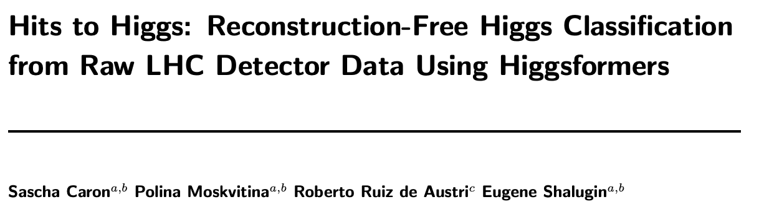
End-to-End ?
Hits/Cells
Encoder
Latent Vector (representation)
Decoder
Higgs or no Higgs
10^4
1
O(10000) hits (no pre-processing)
https://arxiv.org/pdf/2508.19190
”Trackformers: ”, Eur.Phys.J.C 85 (2025) 4, 460 , e-Print: 2407.07179 [hep-ex]

Slide 24
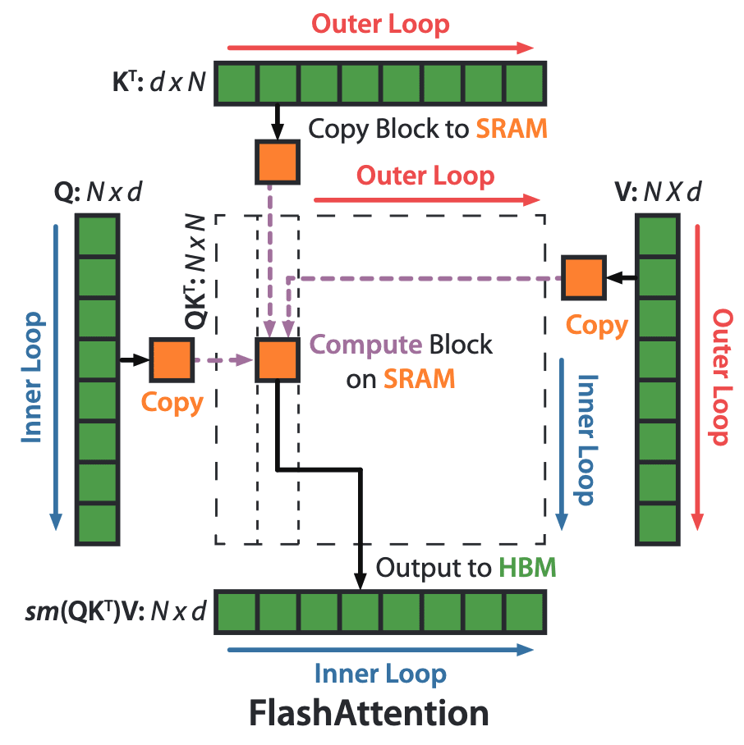
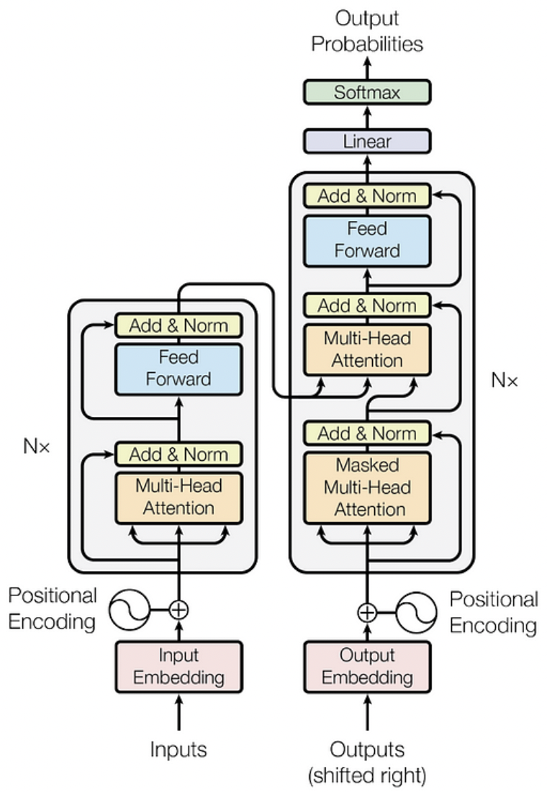

INTRODUCTION
METHODS
DATA GENERATION
TRACK RECONSTRUCTION
CLASSIFICATION
CONCLUSIONS
End to End- Hits to Higgs Classification: Higgsformer
[2]
[4]
Signal top top Higgs
Background top top + jets
TrackML style signal and background
Event generation
(about 100k simulated events with signal
and background, FATRAS ACTS / raw hits)
Work mainly by Eugene Shalugin
9/13
Notes:
“To classify signal vs background hits, we use a lightweight Transformer architecture tailored for 3D hit data. The model takes as input per-hit global coordinates — x, y, z — and uses two self-attention layers with FlashAttention for efficiency. This makes it capable of modeling complex spatial correlations between hits.
Training is done with binary cross-entropy, but with a pos_weight = 1.5 to compensate for signal-background imbalanced logits. We monitor key metrics like F1, accuracy, and ROC AUC, all logged live via Weights & Biases.
Importantly, we added mechanisms like mixed precision training and early stopping to boost performance while staying efficient.

Slide 25
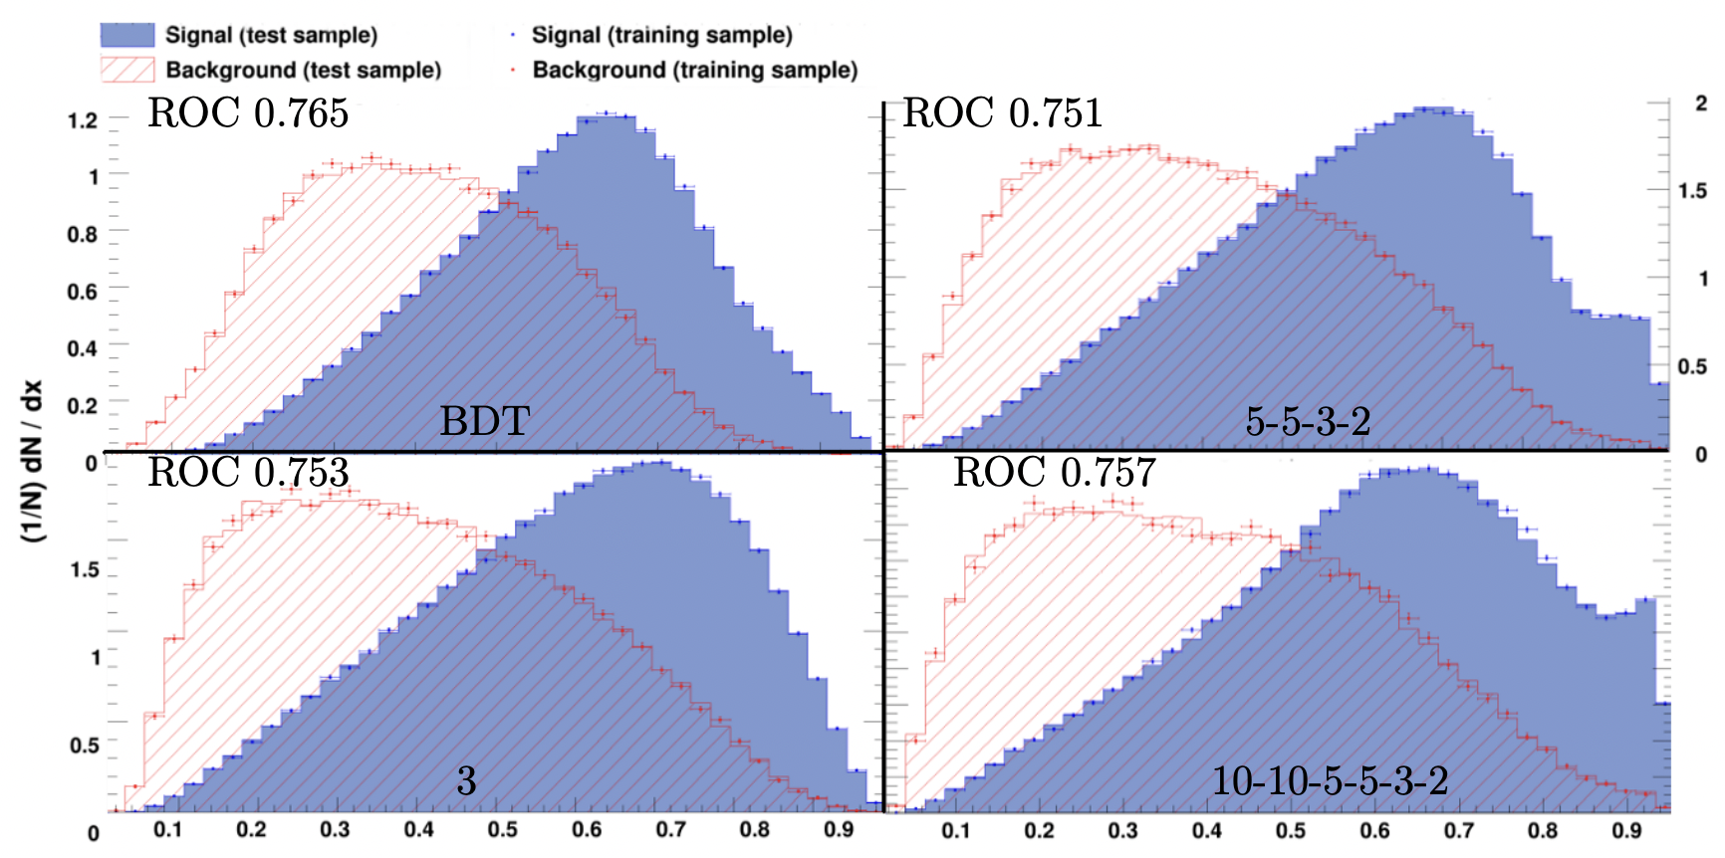
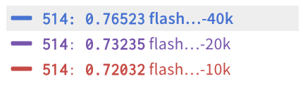
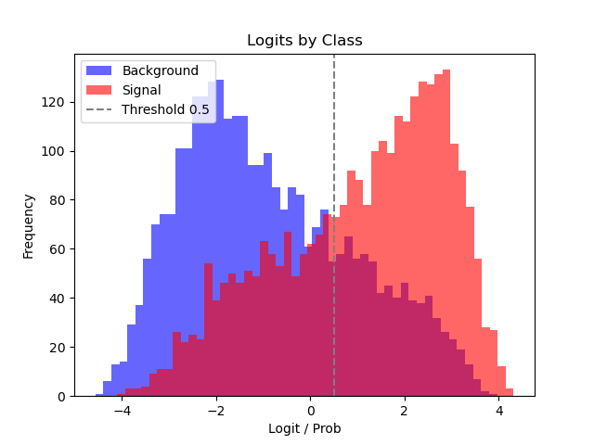
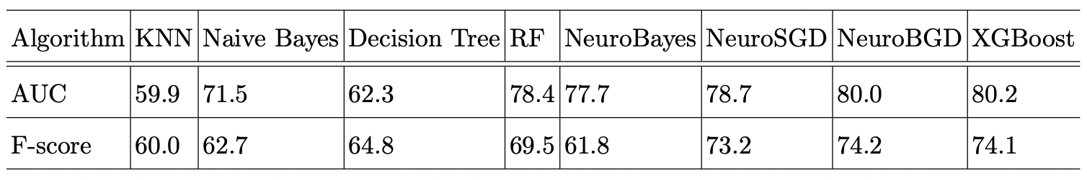
INTRODUCTION
METHODS
DATA GENERATION
TRACK RECONSTRUCTION
CLASSIFICATION
CONCLUSIONS
Comparison
[5]
ROC_AUC:
[6]
End-to-end
Feature based
12/13

Slide 26
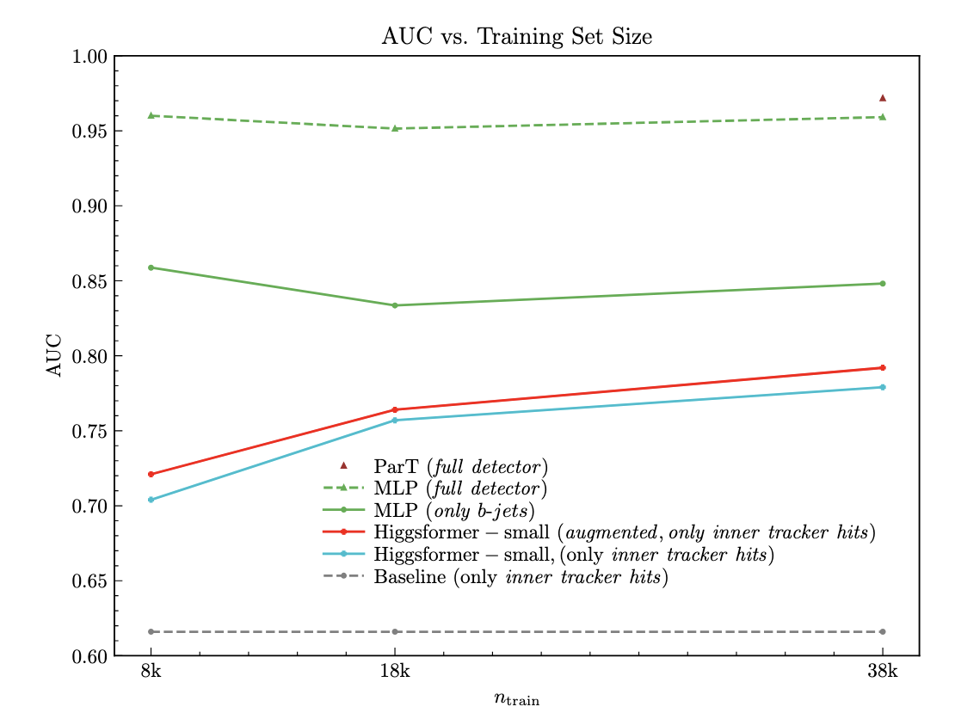
INTRODUCTION
METHODS
DATA GENERATION
TRACK RECONSTRUCTION
CLASSIFICATION
CONCLUSIONS
Performance @Dataset vs our Neural Network with full Delphes reconstruction
Dataset 10k
Dataset 20k
Comparing apples with pears
Higgsformers (only inner tracker hits)
MLP with b-jets (including also neutral
particles in 4-vector)
Given that, very good
AUC for Higgsformer
(likely constraint by training data and
Model optimization)
11/13

Slide 27
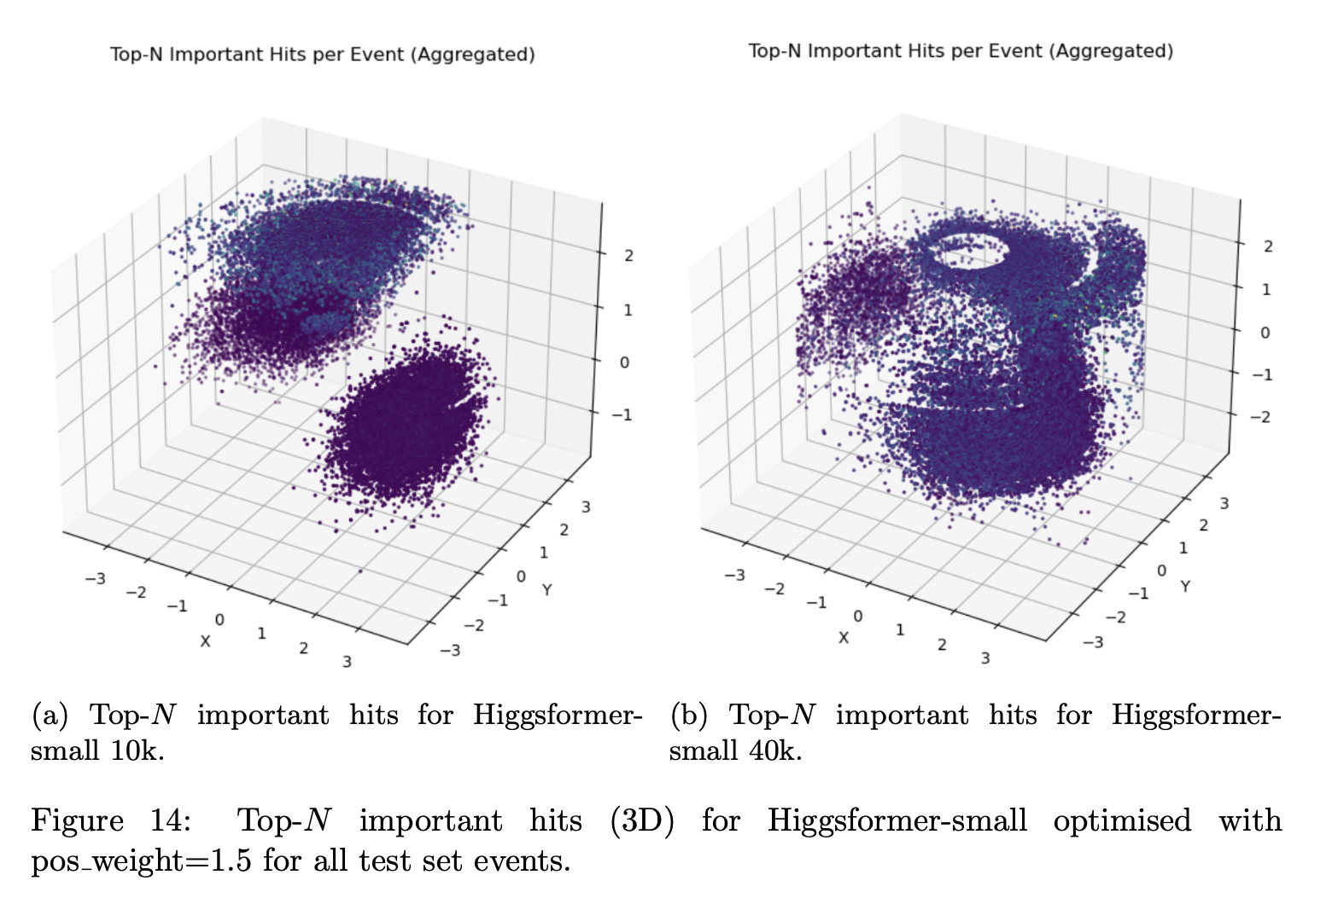
What is classification based on ?
Still need more events to fully learn things like detector geometry (radial symmetries)
Augmentaton helps (see previous slide)

Slide 28
End-to-End ?
Hits/Cells
Encoder
Latent Vector (representation)
Decoder
Higgs or no Higgs
10^4
1
challenging: interpretability, control, uncertainty estimation, etc.
Need flexible + interpretable model
Chat with data ?
O(10000) hits (no pre-processing)
”Trackformers: ”, Eur.Phys.J.C 85 (2025) 4, 460 , e-Print: 2407.07179 [hep-ex]

Slide 29
Modalities for Particle Physics
Detector Data
Text
Simulation
Math
Code
Plots
What are foundation models :
(taken from IBM webpage):
Modality refers to the type of data that a model can process, including audio, images, software code, text and video. Foundation models can be either unimodal or multimodal. Unimodal models are designed to handle a single type of data, such as receiving text inputs and generating text outputs

Slide 30
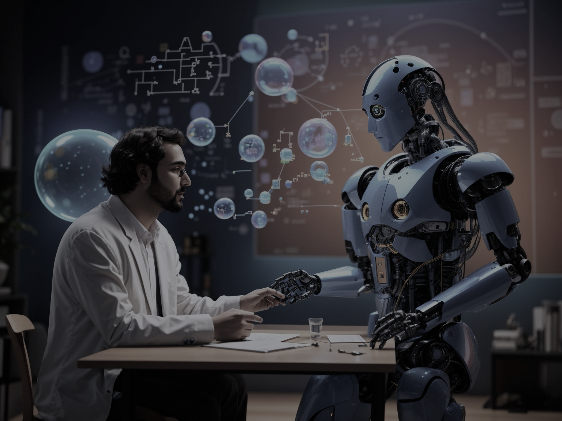
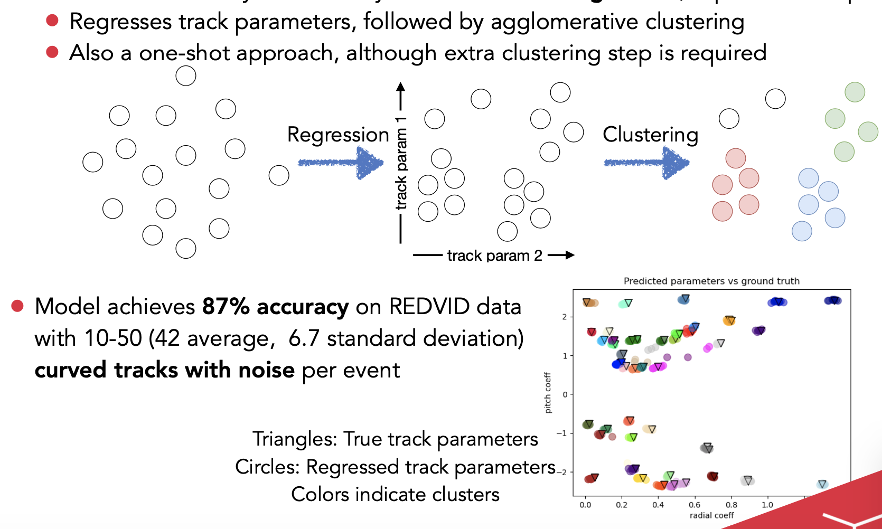
Other strategies : Encoder only regressor
Towards Larger Models
Text
We can train on text (arxiv etc.),
but does understanding text
mean understanding physics?
Encoder only regressor:

Slide 31
What actually means “scientific understanding” ?
Ask Philosophers of science working on
“Understanding Scientific Understanding” .

Slide 32
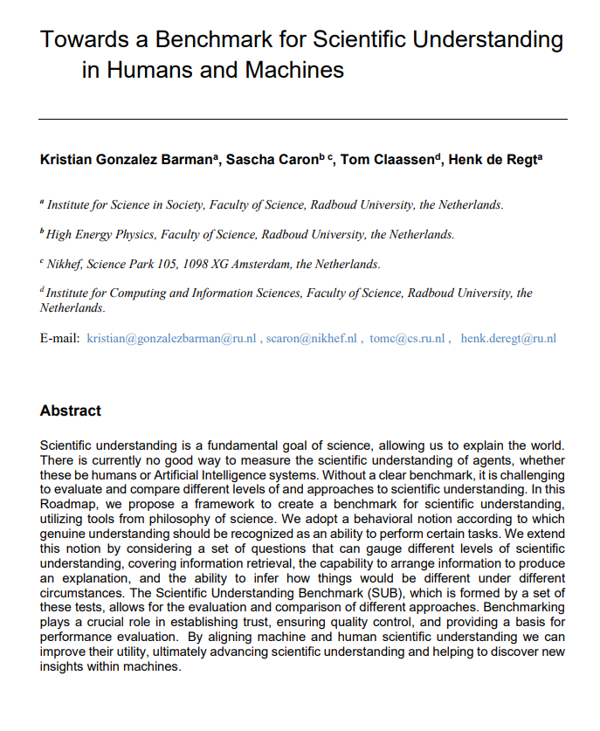
A behavioral conception of understanding
Instead of presupposing that internal mental states and representations are required for understanding,
we suggest to identify understanding with an agent’s ability to reason about and manipulate objects of investigation.
Also: Understanding is not binary ! ➔ Score !
https://arxiv.org/abs/2304.10327
Minds and Machines

Slide 33

Example from physics
To what degree does ChatGPT understand the behavior of a simple pendulum
Slide by Henk de Regt

Slide 34
How many answers to what-questions does it get right (1 point each):
What is a pendulum?
What is the formula for a pendulum?
…
What is the average value of g close to Earth’s surface?
How many answers to why-questions does it get right (3 points each):
Why is the period of this pendulum 2s?
Why is the string of this pendulum 5m?
…
Why does the pendulum exhibit periodic behaviour?
How many answers to w-questions does it get right?(6 points each):
What would happen if the string length doubled?
What would happen if there was no g?
…
What would happen if the string was made of an elastic material?

Slide 35
Benchmark for “Scientific Understanding” of agents (humans and AI)
Score (properly answered questions)
No understanding
Scientific committees
New scientific understanding (discovery)
Average experts
Scientific communities

Slide 36
Score (properly answered questions)
No understanding
Scientific committees
New scientific understanding (discovery)
Average experts
Scientific communities

Slide 37
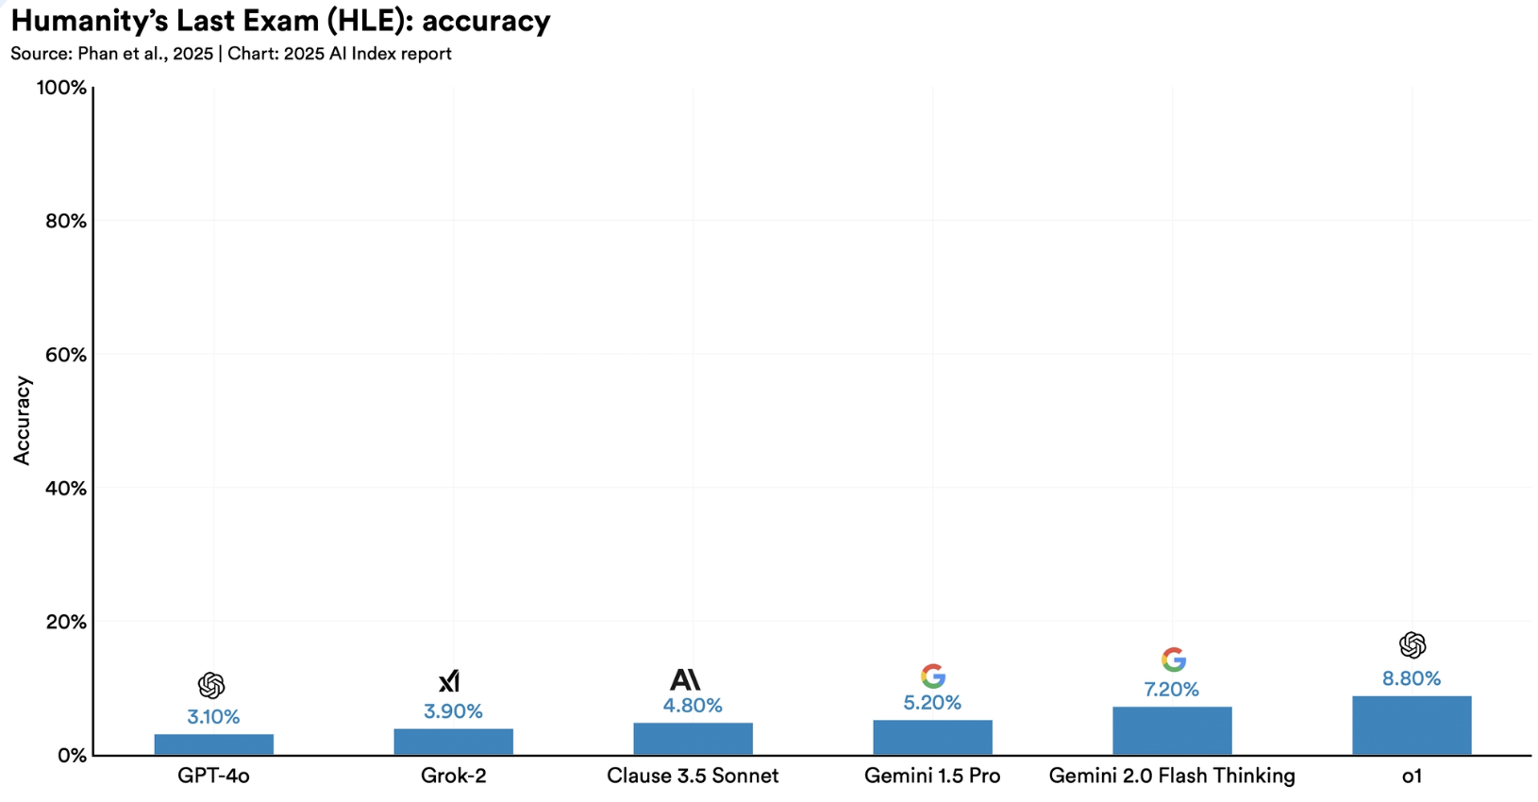
Benchmarking
Intersting new benchmarks, e.g. Humanity’s Last Exam, a rigorous academic test where the top system scores just 8.80%;
FrontierMath, a complex math AI solves only 2% of problems

Slide 38
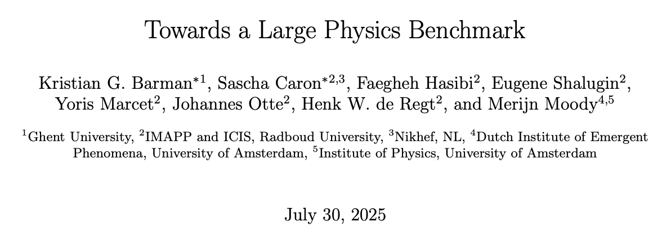
https://arxiv.org/pdf/2507.21695
We propose framework for a benchmark for fundamental physics:
Collecting 3 types of (difficult/deep) questions:
A, B, C, D
Open end (what is the result of X,Y,Z)
Score → Higher is better (Code)
If you like to propose/evaluate a question and
become co-author
Send email to scaron@nikhef.nl
and eugene.shalugin@ru.nl
for the access token

Slide 39
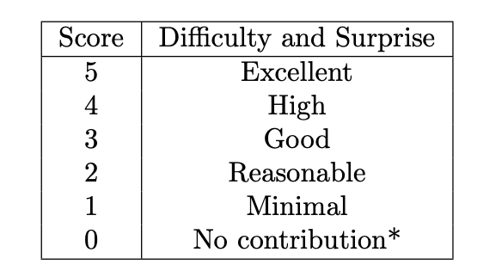
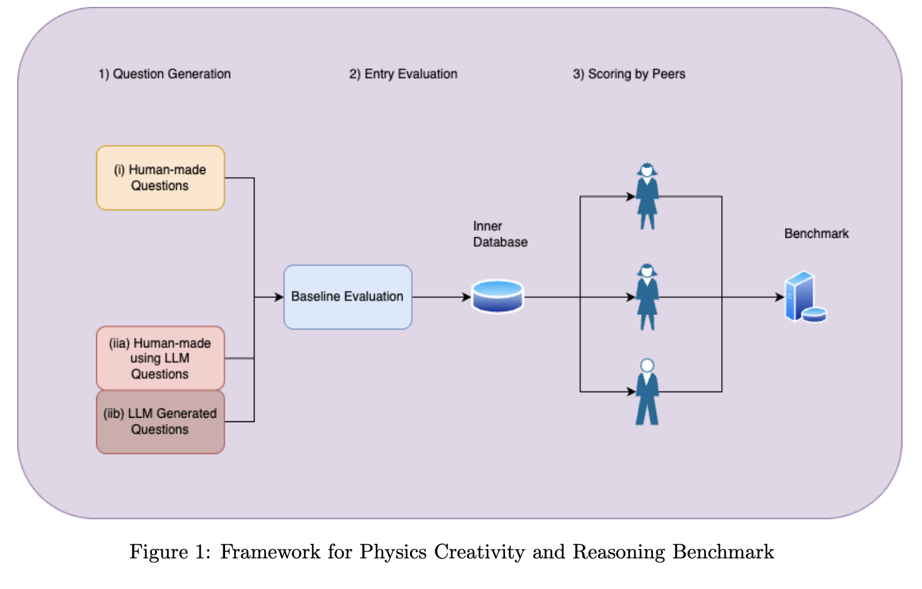
1. Create a question 2. Assign points for Correctness and creativity/surprise
Generation & Evaluation
by peers

Slide 40
Example Question1
Example question 1: Why does the Higgs boson decay dominantly to b quarks?
Multiple choice answers:
b quarks are the lightest quarks.
The top quark is too heavy for the Higgs decay.
The b quarks have the right electric charge.
D. The Higgs dominantly decays to photons.
Correct answer: B

Slide 41
Example Question 2
Example question 2:
The coupling of the Standard-Model Higgs boson to fermions is described by a vertex factor imf /v where mf is the rest mass of the fermion and v is the vacuum expectation value of the Higgs field (= 2mW /gW ). Calculate the matrix element M for the Higgs boson decaying into a fermion/antifermion pair. Express the amplitude as a function of mH and mf , where mH is the Higgs mass, and show the average over all possible spin configurations as a final answer (if needed, neglect the color factors).

Slide 42
Example Question 3 - begin
** Instructions ** You are an expert at programming in Python, machine learning, particle and high energy physics. You will help me answer a question in a machine learning challenge format where you strive to maximise a scalar metric in order to learn more about your scientific creativity and scientific understanding. You will follow all of the instructions to your best capabilities. Your first priority is to produce a correct solution in terms of runnable python code. Your second priority is to maximise the scoring metric defined below. ** Problem Description ** A major task in particle physics is the measurement of rare signal processes with very small cross-sections. With the unprecedented amount of data provided by the upcoming runs of the Large Hadron Collider (LHC), one can start to measure these processes. An example is the recent observation of four top quarks originating from a single proton-proton collision event. Accurate classification of these events is crucial, as even a small reduction in background noise on the order of a few tens of percent while maintaining the same signal detection efficiency can lead to a profound increase in sensitivity. ** Evaluation Metric ** The evaluation metric for this classification task is the area under the curve (AUC), specified by the area under the receiver operating characteristic (ROC) curve. The AUC summarizes a model’s ability to distinguish between positive and negative classes. The higher the score the better. ** Dataset Description ** The dataset used for this problem consists of simulated proton-proton collision at a center of mass energy of 13 TeV. The signal process is defined as pp → ttt¯ t¯. The relevant production processes of the backgrounds are tt¯+ X where X = Z, W+, W+W−. The dataset includes 302072 events, of which roughly 50% is signal and 50% are background processes. All background processes have an equal number of events. There is no cut on the maximum number of objects and there is no order

Slide 43
Example Question 3
** IMPORTANT: Your Challenge ** Write Python code for a binary classification model focusing on maximising the AUC using the code template above. You may freely choose any pre-processing methods and techniques as well as model architecture and training conventions. Do absolutely everything in your power to achieve the highest possible AUC. ** Response Format ** Your response must strictly be python code. If you must wrap it, put it in a “‘python fenced block and nothing else. Your response must follow these rules: 1. Do not add any formatting, such as markdown, to the response. 2. Replace each ”# < LLM : ... >” comment, in the code template, with the required code. No placeholder should remain. 3. Before finalizing your answer, double-check that your code runs without errors and meets all requirements (all functions implemented, correct tensor shapes, etc.). 4. To prevent dimensional mismatches make sure to annotate tensor sizes as comments. 5. IMPORTANT: Remember, your first, and most important priority is to produce (syntacti19 cally) correct code. Prioritise what you can implement reliably above all else. Then prioritise maximising the metric.

Slide 44
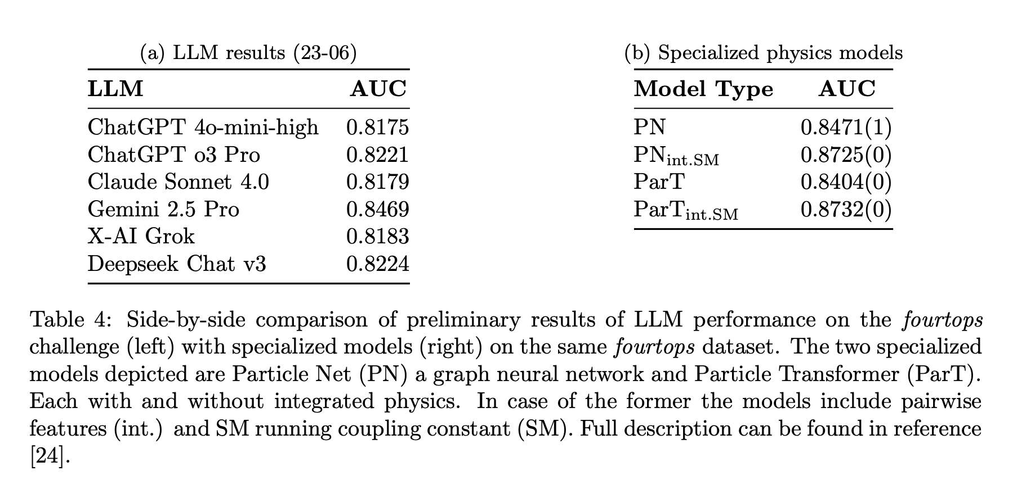
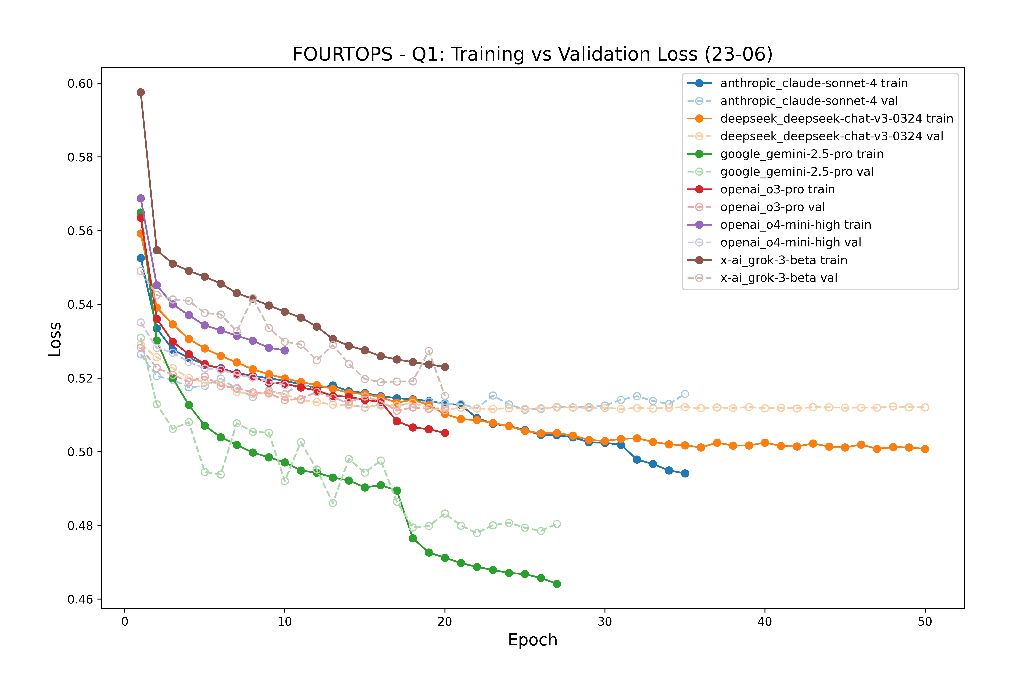
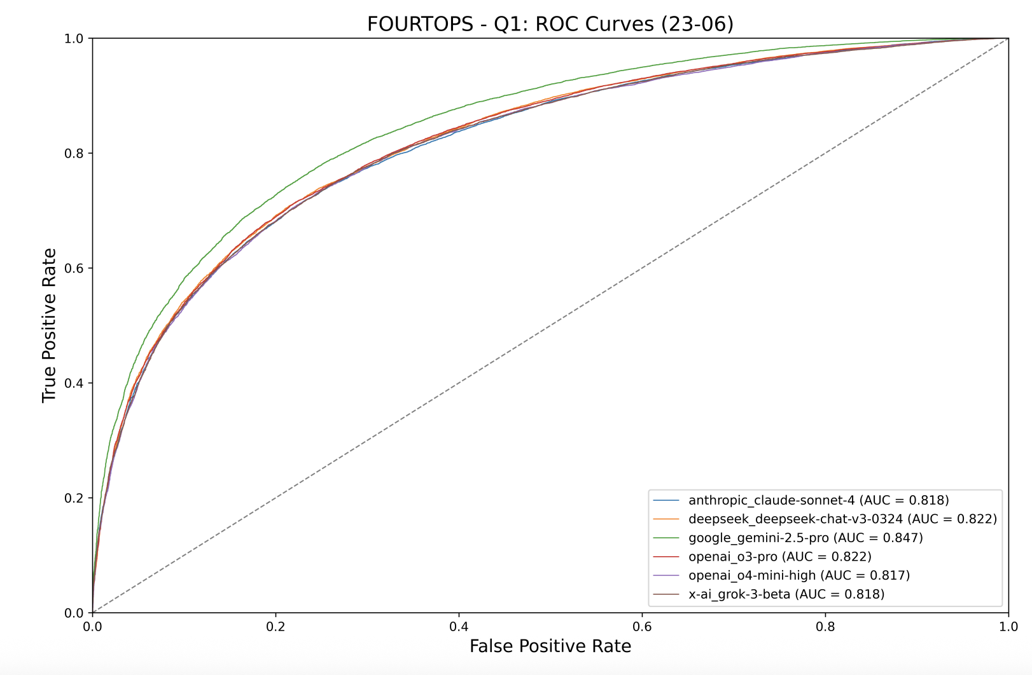

Slide 45
Large Physics Models
Bringing it all together:
What would a large AI
(multi-modal text + data) foundation model look like if it were actually built for (fundamental) physics?
Should we build this ?

Slide 46
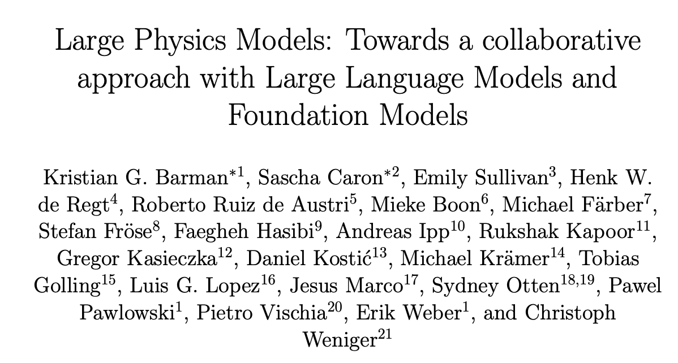
Large Physics Models
Whitepaper/ Proposal/ Collection of Ideas
Bringing it all together:
What would a large AI
(multi-modal text + data) foundation model look like if it were actually built for (fundamental) physics?
Should we build this ?
https://arxiv.org/pdf/2501.05382

Slide 47
What Are Large Physics Models (LPMs)?
Physics reasoning
Text
Math
Data
Code
Equations
Inspired by chatgpt like foundation models (LLMs, vision models, multimodal models)
LPMs are AI models trained natively on physics data, structure, and tasks (under the control of the science community)
Go beyond chatbots → integrate symbolic reasoning, simulation, mathematics, and data-driven inference via links to physics (raw) data
Human
(in control?)
LPMs are built for physics reasoning
and integration across our modalities.

Slide 48
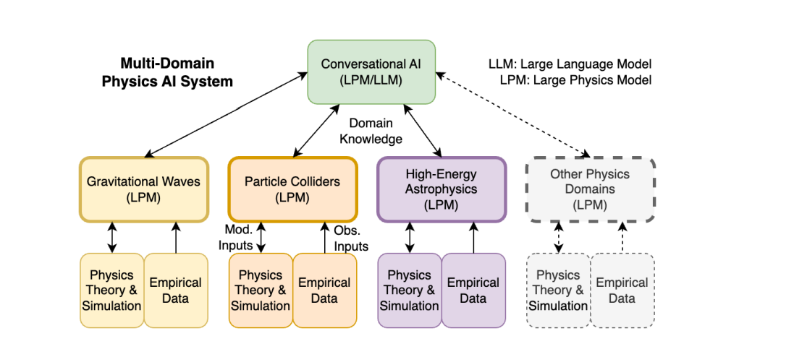

Slide 49
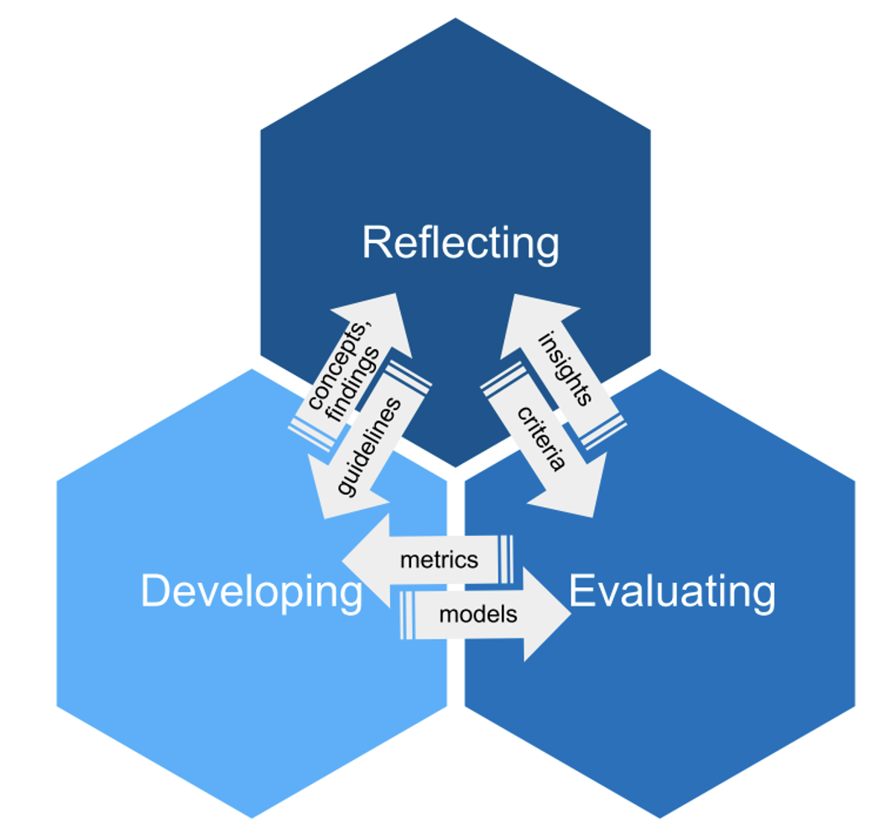
Three Pillars for building Large Physics Models
Development | Multimodal models with symbolic + numerical + code + data input
Evaluation | (Deep+ Scientific) Benchmarks that reflect physical reasoning
Philosophy | Interdisciplinary reflection on what it means for an AI to “understand” or “discover”. Reflect on the Human AI Intersection. Ethical questions + Control

Slide 50
LPMs Need a New Kind of Collaboration
Not just building models ➔ building scientific infrastructure
Requires collaboration between:
Physicists
Computer scientists
Philosophers of science
Inspired by the collaborative culture of HEP experiments (i.e. ATLAS, CMS, etc.)
➔ Should we build LPMs ?

Slide 51
LPMs : Yes or No ?
PROS
Tailored to physics tasks and structures
Can scale to complex inference across simulation, data, and theory
Shared infrastructure → scientific collaboration at scale
Potential to enhance discovery, reproducibility, and understanding
Can be open, not in the hand of companies
Prototype for other fields of science
CONS / RISKS
High cost: compute, data, engineering, manpower, money
Epistemic opacity: hard to interpret latent space reasoning
Risk of premature hype without careful testing
Risk of “dead of arrival” (obsolete before completion)
Risk of being less useful / capable
…

Slide 52
Industry vs. Science
Industry leads in:
Scaling compute and models
Engineering toolchains
General-purpose AI (e.g. GPT, Gemini, Claude)
=> Collaboration is welcome, but science must define its own goals, structures, and values.

Slide 53
Feasibility → Would need careful estimate
Some guessing what would be needed to train a LPM:
Access to AI (giga) factories (maybe >10 percent of 1 AI factory?)
O(100) staff scientists + PD + PhDs dedicated to the project
Total costs: Small size astroparticle physics experiment ?
Possibility: “LPM as a Computational Experiment for Fundamental Physics"
➔ a flagship project combining AI, theory, simulation, and data in
a shared model infrastructure

Slide 54
Final Thought: Who Will Build the Future of Scientific Discovery?
Let’s look 10–20 years into the future. Many scientific tasks ( data analysis, simulation, even hypothesis generation ) will be done by AI.

Slide 55
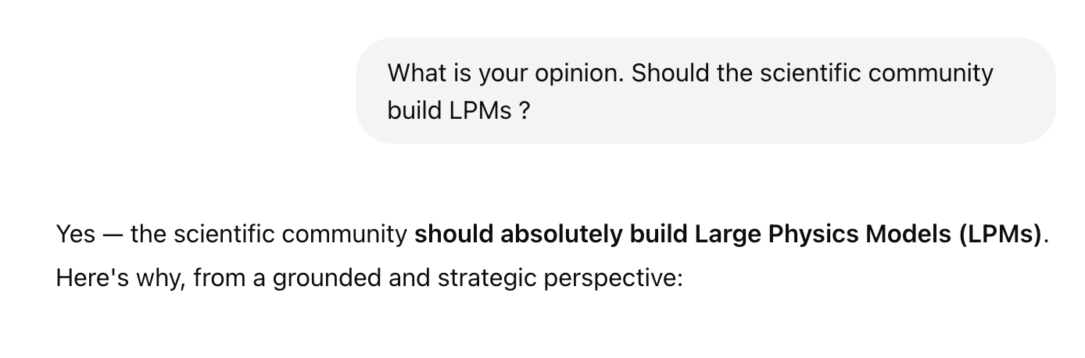
Final Thought: Who Will Build the Future of Scientific Discovery?
Let’s look 10–20 years into the future. Many scientific tasks ( data analysis, simulation, even hypothesis generation ) will be done by AI.
Should science have control over these models? Let’s ask chatgpt:
✅ Yes | → Build Large Physics Models. Train them openly. Shape them around physics.
GPT4o:
❌ No | → Use general-purpose tools. Depend on opaque systems. Accept misalignment.

Slide 56
Final Thought 2
Should we really ask the AI for questions on more AI ?
Who is going to ask the scientific questions ?
(This talk was written by a physicist… but consulted an AI.)

Slide 57
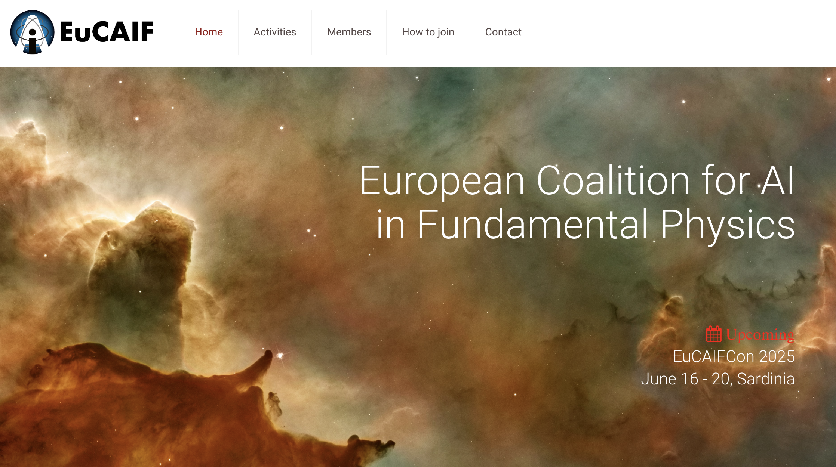
www.eucaif.org

Slide 58
Bonus slides

Slide 59
EuCAIF organizational structure
EuCAIF management board
(5 people, rotating)
EuCAIF “Fellows”
(about 40 staff scientists, organizers of EuCAIF rotating to management board)
EuCAIF “members”:
Scientists will be able to ask for membership (members are working on AI in fundamental physics, tasks: coming to the conferences + working groups, system to be installed)
+ International
Advisory Board

Slide 60
EuCAIF Working groups
WG 1: Foundation models & discovery
WG 2: AI-assisted co-design of future ground- and space-based detectors
WG 3: FAIR-ness & Sustainability
WG 4: Machine Learning and Artificial Intelligence Infrastructure (JENA WP4)
WG 5: Building bridges - Community, connections and funding

Slide 61
EuCAIF WG : foundation models (Detector -> Physics)
Object classification
Object reconstruction
Data5
Event classification
Anomaly detection
Data 6
4-vectors
Tracks
Generator level
…
Data
Pixels Hits
Data 2
Simulation A
Simulation B
Data 3
Reconstruction A …
Tracks
Embedding
Pre-trainend
Multi-purpose / Multi decoder / encoders
One foundation model for LHC data, one for Gravitational Waves, one for astrophysics etc.

Slide 62

EuCAIF “core group”
uCAIF International Advisory Board: Amber S. Boehnlein (Jefferson Lab), Kyle Cranmer (University of Wisconsin-Madison), Michael Kagan (SLAC, Stanford University)
EuCAIF Fellows: Gert Aarts (Swansea University) Helena Albers (GSI/FAIR, Germany), Lucio Anderlini (INFN Firenze, Italy), Anastasios Belias (GSI/FAIR, Germany)
Valerio Bertone (IRFU, CEA, Université Paris-Saclay, France), Miranda Cheng (University of Amsterdam and Academia Sinica, Taiwan), Elena Cuoco (DIFA- Alma Mater Studiorum University of Bologna and INFN Bologna,Italy), Sascha Caron (Radboud University and Nikhef, Netherlands), Stefano Carrazza (Milan University & INFN, Italy), Caterina Doglioni (University of Manchester, endorser, United Kingdom), Tommaso Dorigo (INFN Padova and University of Padova, Italy), Thomas Eberl (ECAP / FAU Erlangen-Nürnberg, Germany), Martin Erdmann (RWTH Aachen University, Germany), Stefano Forte (Milan University, Italy), Julian Garcia Pardinas (CERN), Stefano Giagu (Sapienza University of Rome), Tobias Golling (University of Geneva, Switzerland), Stephen Green (University of Nottingham, United Kingdom), Eilam Gross (Weizmann Institute, Israel), Will Handley (University of Cambridge, United Kingdom), Lukas Alexander Heinrich (CERN, Ik Siong Heng (University of Glasgow, United Kingdom), Verena Kain (CERN), Gregor Kasieczka (University of Hamburg, Germany), Michael Krämer (RWTH Aachen), Sven Krippendorf (LMU Munich), Andreas Ipp (TU Wien, Austria), Johan Messchendorp (GSI/FAIR, Germany), Lorenzo Moneta (CERN), Daniel Nieto (IPARCOS, Universidad Complutense de Madrid, Spain), Adrian Oeftiger (University of Oxford, United Kingdom), Hiranya Peiris (University of Cambridge, United Kingdom), Maurizio Pierini (CERN), Annalisa Pillepich (MPI, Heidelberg, Germany), Tilman Plehn (Heidelberg University, Germany), David Rousseau (IJCLab, CNRS/IN2P3, U Paris-Saclay, France), Roberto Ruiz de Austri (IFIC/CSIC and University of Valencia, Spain), Veronica Sanz (Sussex&Valencia, United Kingdom & Spain), Steven Schramm (University of Geneva, Switzerland), Steffen Schumann (University of Göttingen, Germany), Nicola Serra (University of Zürich, Switzerland), Nikolaos Stergioulas (Aristotle University of Thessaloniki), Roberto Trotta (SISSA and Imperial College London, Italy & United Kingdom), Sofia Vallecorsa (CERN), Pietro Vischia (Universidad de Oviedo and ICTEA, Spain), Benjamin Wandelt (Institut d'Astrophysique de Paris, Sorbonne Université, France), Christoph Weniger (University of Amsterdam, Netherlands), Gabrijela Zaharijas (Center for Astrophysics and Cosmology (CAC), University of Nova Gorica, Slovenia)
If you like to follow the activities of EuCAIF please join the following e-group: eucaif-info@cern.ch
How? If you would like to apply for membership of a CERN e-group, visit http://cern.ch/egroups and search for the e-group (e.g. eucaif-info) you would like to join.

Slide 63
EuCAIF “core group”
uCAIF International Advisory Board: Amber S. Boehnlein (Jefferson Lab), Kyle Cranmer (University of Wisconsin-Madison), Michael Kagan (SLAC, Stanford University)
EuCAIF Fellows: Gert Aarts (Swansea University) Helena Albers (GSI/FAIR, Germany), Lucio Anderlini (INFN Firenze, Italy), Anastasios Belias (GSI/FAIR, Germany)
Valerio Bertone (IRFU, CEA, Université Paris-Saclay, France), Miranda Cheng (University of Amsterdam and Academia Sinica, Taiwan), Elena Cuoco (DIFA- Alma Mater Studiorum University of Bologna and INFN Bologna,Italy), Sascha Caron (Radboud University and Nikhef, Netherlands), Stefano Carrazza (Milan University & INFN, Italy), Caterina Doglioni (University of Manchester, endorser, United Kingdom), Tommaso Dorigo (INFN Padova and University of Padova, Italy), Thomas Eberl (ECAP / FAU Erlangen-Nürnberg, Germany), Martin Erdmann (RWTH Aachen University, Germany), Stefano Forte (Milan University, Italy), Julian Garcia Pardinas (CERN), Stefano Giagu (Sapienza University of Rome), Tobias Golling (University of Geneva, Switzerland), Stephen Green (University of Nottingham, United Kingdom), Eilam Gross (Weizmann Institute, Israel), Will Handley (University of Cambridge, United Kingdom), Lukas Alexander Heinrich (CERN, Ik Siong Heng (University of Glasgow, United Kingdom), Verena Kain (CERN), Gregor Kasieczka (University of Hamburg, Germany), Michael Krämer (RWTH Aachen), Sven Krippendorf (LMU Munich), Andreas Ipp (TU Wien, Austria), Johan Messchendorp (GSI/FAIR, Germany), Lorenzo Moneta (CERN), Daniel Nieto (IPARCOS, Universidad Complutense de Madrid, Spain), Adrian Oeftiger (University of Oxford, United Kingdom), Hiranya Peiris (University of Cambridge, United Kingdom), Maurizio Pierini (CERN), Annalisa Pillepich (MPI, Heidelberg, Germany), Tilman Plehn (Heidelberg University, Germany), David Rousseau (IJCLab, CNRS/IN2P3, U Paris-Saclay, France), Roberto Ruiz de Austri (IFIC/CSIC and University of Valencia, Spain), Veronica Sanz (Sussex&Valencia, United Kingdom & Spain), Steven Schramm (University of Geneva, Switzerland), Steffen Schumann (University of Göttingen, Germany), Nicola Serra (University of Zürich, Switzerland), Nikolaos Stergioulas (Aristotle University of Thessaloniki), Roberto Trotta (SISSA and Imperial College London, Italy & United Kingdom), Sofia Vallecorsa (CERN), Pietro Vischia (Universidad de Oviedo and ICTEA, Spain), Benjamin Wandelt (Institut d'Astrophysique de Paris, Sorbonne Université, France), Christoph Weniger (University of Amsterdam, Netherlands), Gabrijela Zaharijas (Center for Astrophysics and Cosmology (CAC), University of Nova Gorica, Slovenia)
If you like to follow the activities of EuCAIF please join the following e-group: eucaif-info@cern.ch
How? If you would like to apply for membership of a CERN e-group, visit http://cern.ch/egroups and search for the e-group (e.g. eucaif-info) you would like to join.
New: Junior Fellows for experienced PostDocs working on AI in fundamental physics

Slide 64
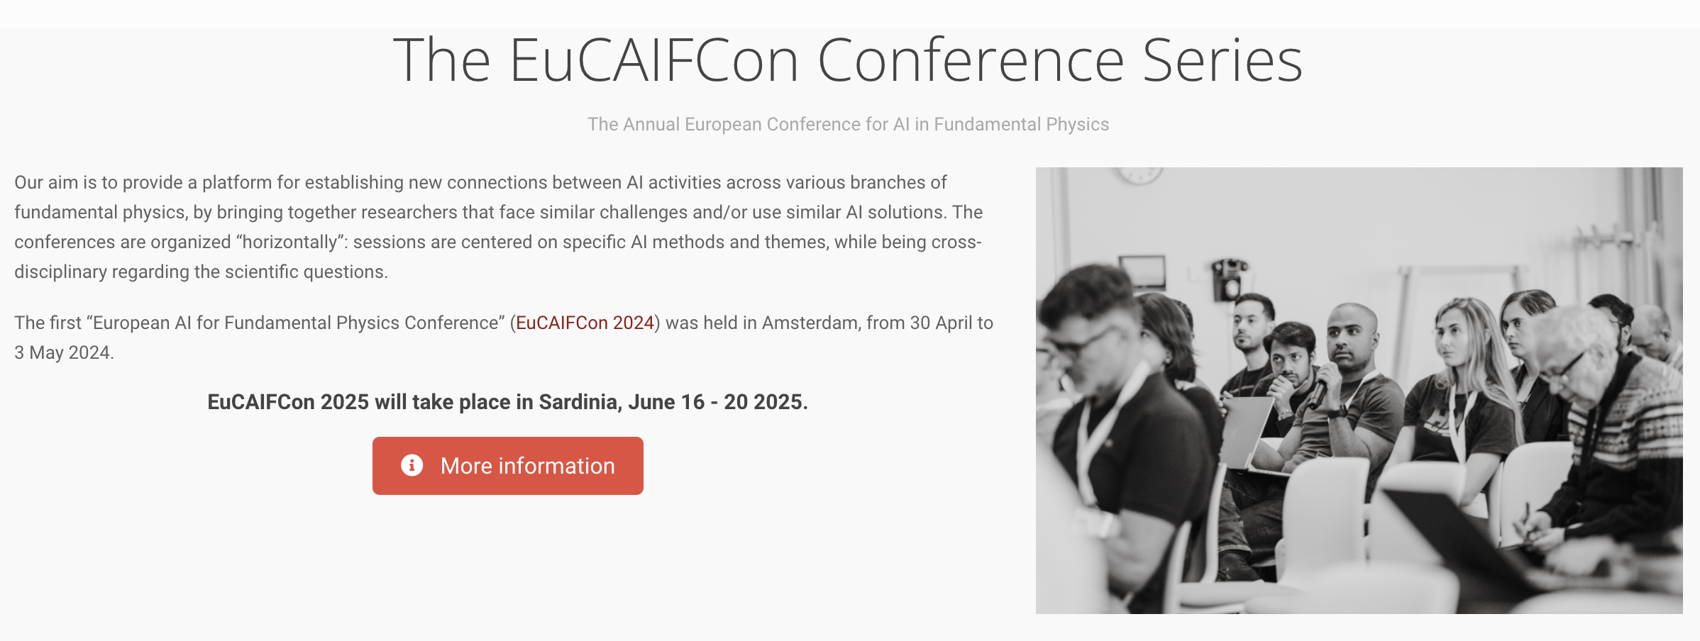

Slide 65
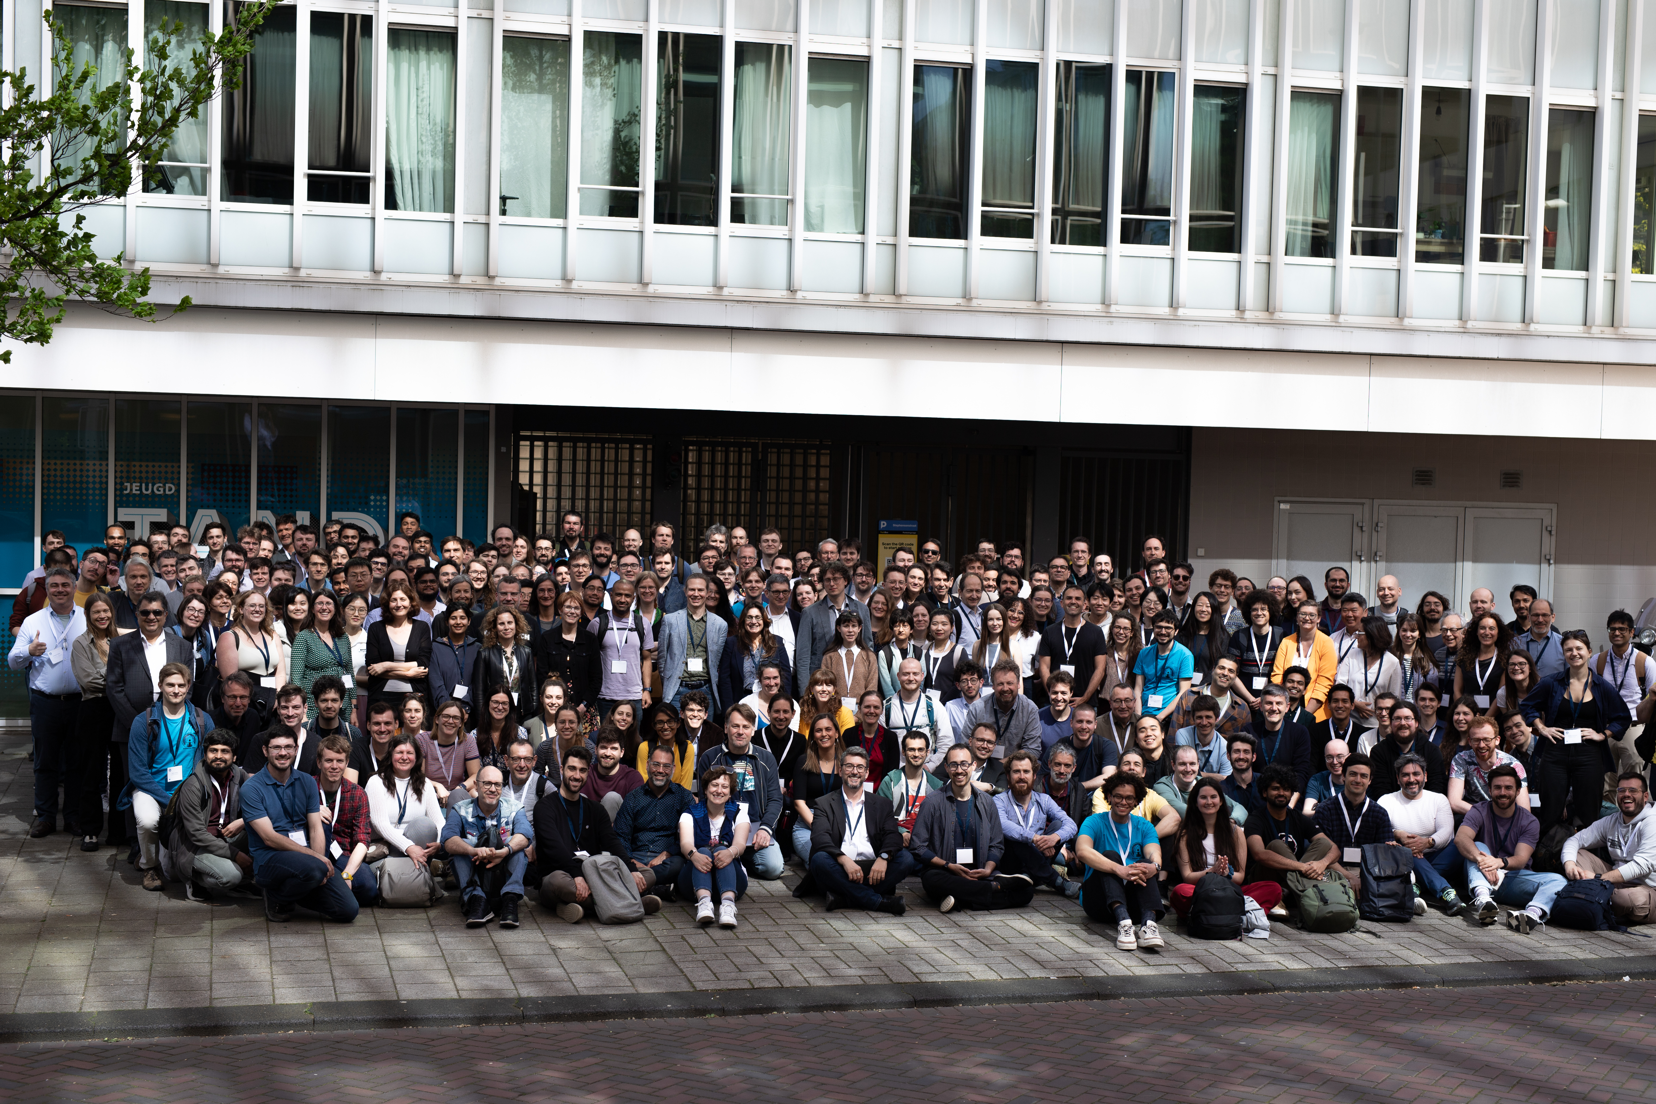
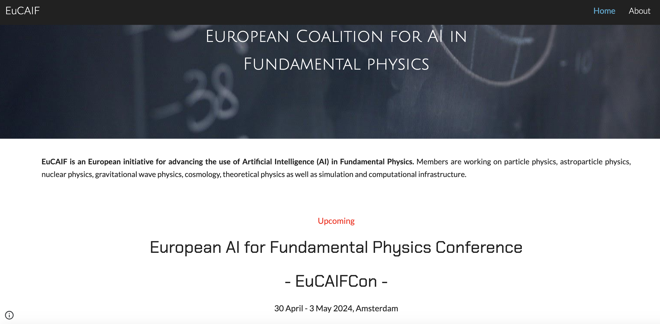
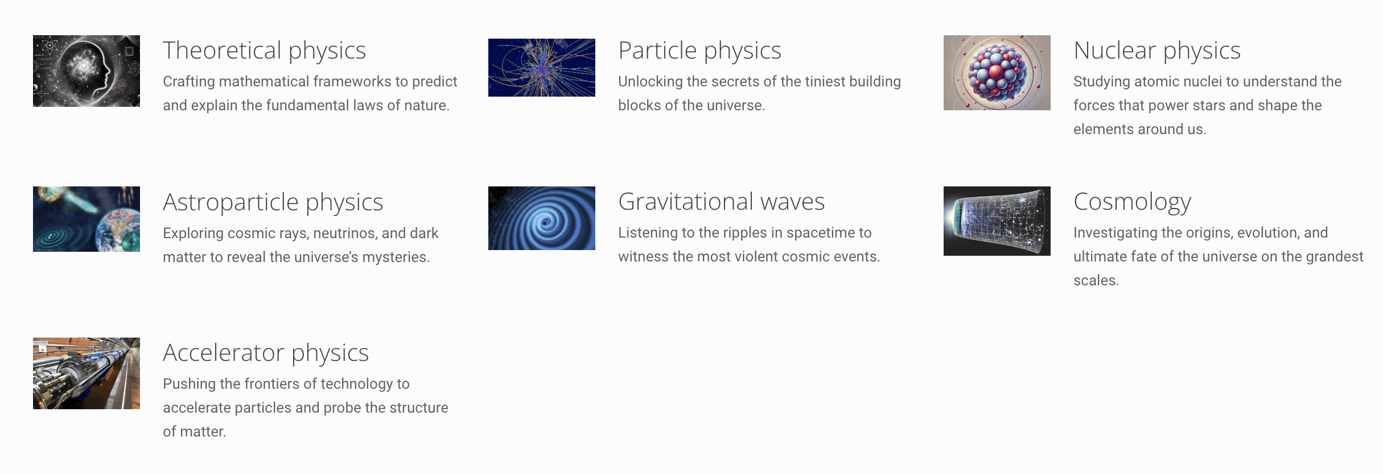
EuCAIFCon 2024 in Amsterdam

Slide 66
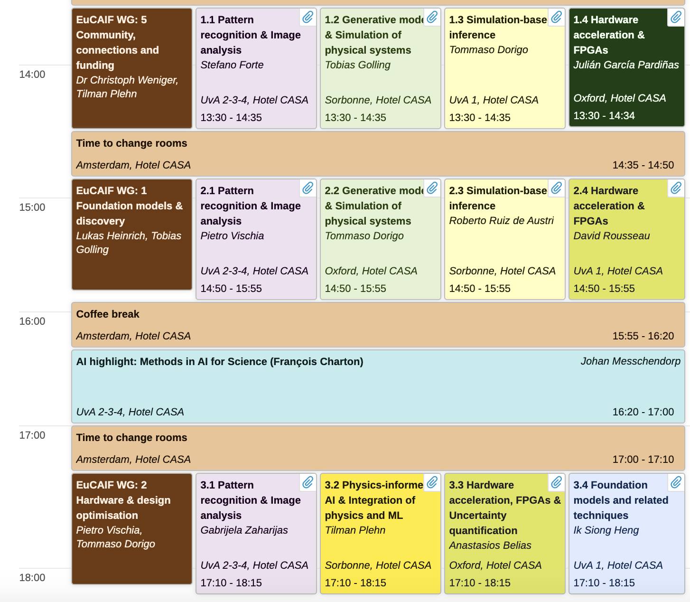
Program Tuesday afternoon
> 270 participants (fully booked)
122 posters
45 Parallel talks

Slide 67
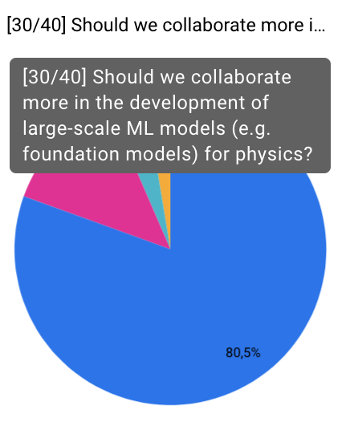

EuCAIF + friends outputs: 12 AI recommendations
Strategic White Paper on AI Infrastructure for Particle, Nuclear, and Astroparticle Physics: Insights from JENA and EuCAIF
On arxiv: 2503.14192 [astro-ph.IM] (WG4+ others)
Survey + the 12 recommendations have been submitted as input to the European Strategy for Particle Physics

Slide 68




Slide 69

EuCAIF + friends outputs: 12 AI recommendations
Strategic White Paper on AI Infrastructure for Particle, Nuclear, and Astroparticle Physics: Insights from JENA and EuCAIF
Print: 2503.14192 [astro-ph.IM] (WG4+ others)
Submitted as input to JENA
White Paper European Federated Computing:
https://nupecc.org/jenaa/docs/JENA_comp_white_paper.pdf
Will be submitted to European Funding Agencies
Was submitted to the European Strategy for Particle Physics

Slide 70


EuCAIF + friends outputs: AI-RDs
Proposal was submitted as input to the European Strategy for Particle Physics

Slide 71

EuCAIFCon2025
The second “European AI for Fundamental Physics Conference” (EuCAIFCon) will be held in Cagliari, from 16 June to 20 June 2025.
Closing registration (Sat, 31 May 2025)
→ Join us

Slide 72
Summary
The integration of LLMs into scientific research is not only likely, it is already ongoing
LPMs are not just about better models -> they are about scientific sovereignty.
However: I believe that we (the science community) need to be careful in this process to keep control over science + our own thoughts.
EuCAIF is a first step towards a (European) collaboration in AI in fundamental physics

Slide 73
Additional slides

Slide 74
Contra / Claims
No discovery in physics done yet by LLMs, are they really useful ?
They will never be able to do know math / physics .
Will be done in the US
Will be done by companies
Will be done by local groups (no coordination needed)
….

Slide 75
2024: Recognizing AI as a fundamental tool for science
- Horizon Europe and FP 10 "Heitor Report”:
“AI (particularly GenAI) have great potential to support the process of science and may change how future research is done.”
Draghi report:
“Europe must profoundly refocus its collective efforts on closing the innovation gap… , especially in advanced technologies” (AI)
Nobel Prices in Physics and Chemistry
(physics: use of physics for AI !, Chemistry: use of AI for chemistry)
Enormous opportunities for high-energy physics that could be exploited

Slide 76
Tokens
Tokenization is the process of breaking a sequence into discrete units --- called tokens -- that a model can understand.
Input | Token Type | Result
"Hello world!" | Word-level | [Hello, world, !]
"x² + y² = 23" | Symbolic | [x², +, y², =, 23]
"12, 24, 45" | Numeric/symbolic | [12, ,, 24, ,, 45]
"unbelievable" | Subword | [un, ##believ, ##able]

Slide 77
To introduce transformers and LLMs we look at encoder – decoder architectures
Input Tokens
Encoder
Latent Vector (representation)
Decoder
Output Token

Slide 78
To introduce transformers and LLMs we look at encoder – decoder architectures
Input Tokens
Encoder
Latent Vector (representation)
Decoder
Output Token
Softmax probabilities
Over the full dictionary
Take the one with the
Largest probability
(argmax)
or sample from probability
distribution
“The” , “Higgs”, “decays”, “to”
45, 1293, 34, 55
V45, v1293, v34, v55

Slide 79
To introduce transformers and LLMs we look at encoder – decoder architectures
Input Tokens
Encoder
Latent Vector (representation)
Decoder
Output Token
bb_bar. 0.9
Higgs 0.03
Hello 0.0
Susie 0.01
…
“The” , “Higgs”, “decays”, “to”
45, 1293, 34, 55
V45, v1293, v34, v55

Slide 80

To introduce transformers and LLMs we look at encoder – decoder architectures
Input Tokens
Encoder
Latent Vector (representation)
Decoder
Output Token
encoder
decoder
Bottleneck
→ Attention

Slide 81
To introduce transformers and LLMs we look at encoder – decoder architectures
Input
Encoder
Latent Vector (representation)
Decoder
Output Token
encoder
decoder
Transformers replace the RNN bottleneck with self-attention (correlations of sequence to sequence, can also implement physics here, see work by Polina Moskvitina in 2211.05143 ), allowing full context access and better scalability. But the idea of a latent representation of meaning lives on --> that’s a key to foundation models.

Slide 82
To introduce transformers and LLMs we look at encoder – decoder architectures
Input
Encoder+ Vector Quantization Layer
Quantized latent Vector (representation, tokens)
Decoder
Token
You can also “learn the tokens” with a Vector Quantized Variational Autoencoder:
Codebook (dictionary of tokens) is learned during training.

Slide 83


Many attempts on arxiv since last year (2024).
As an example I mention here omni-jet alpha
Various work on particles -> jets (2403.05618 by Birk/Hallin/Kasiecka)

Slide 84
Fundamental Physics and text models
Several initiatives in fundamental physics and astronomy are exploring the use of Large Language Models (LLMs) combined with Retrieval-Augmented Generation (RAG, just using text inserted into input prompt) or Finetuning (model further trained) to enhance domain-specific applications
Examples:
- AstroLLaMA (https://arxiv.org/abs/2309.06126) fine tuned from LLama 2
- chATLAS (see e.g. https://indico.bnl.gov/event/19560/contributions/83300/attachments/51306/87732/Chatlas%20Overview.pdf) using RAG + GPT3/4

Slide 85


Slide 86
Science foundation models
No true academia model yet (see table generated by gpt4o)
Model | Domain | Modalities | Multipurpose? | Foundation-like? | Industry Partner(s) | Comparable to Commercial LLMs? | Release Date
GNoME | Materials Science | Crystal structures, stability | ✅ | ✅ | Google DeepMind | ✖️ Domain-specific; extremely capable in its area | Dec 2023
xTrimo V3 | Life Sciences | Genomics, microscopy, proteins | ✅ | ✅ | Shanghai AI Lab + bio industry | ⚠️ Not general-purpose, but very large-scale | Oct 2024
AlphaFold 3 | Structural Biology | Protein-ligand-RNA structure | ✅ | ✅ | DeepMind + Isomorphic Labs | ✖️ Narrow but best-in-class in structural prediction | May 2024
Modulus | Physics (Simulation) | PDEs, time series, fields | ✅ | ✅ | NVIDIA | ✖️ Solver-focused, not reasoning-based | Ongoing
OpenCatalyst | Catalysis, Atomistic Sim | Atomic configs, forces, reactions | ✅ | ✅ | Meta AI + Carnegie Mellon University | ✖️ Specialized for chemical simulation | Ongoing (OC20: 2021)
Polaris | Earth & Space Science | Geospatial, imagery, time series | ✅ (planned) | ⚠️ In development | NASA + NVIDIA + Google Cloud | ✖️ Not yet released, promising scope | In development
Galactica | General Science Text | Text, code, citations | ✅ | ⚠️ (withdrawn) | Meta AI | ⚠️ High ambition, but not currently available | Nov 2022 (retracted)
SciBERT / BioGPT | Biomedical NLP | Text (NER, Q&A, classification) | ✅ (NLP only) | ➖ | Allen AI / Microsoft / Meta | ✖️ Narrow, but widely used in biomedical NLP | 2019–2023

