Slide 1
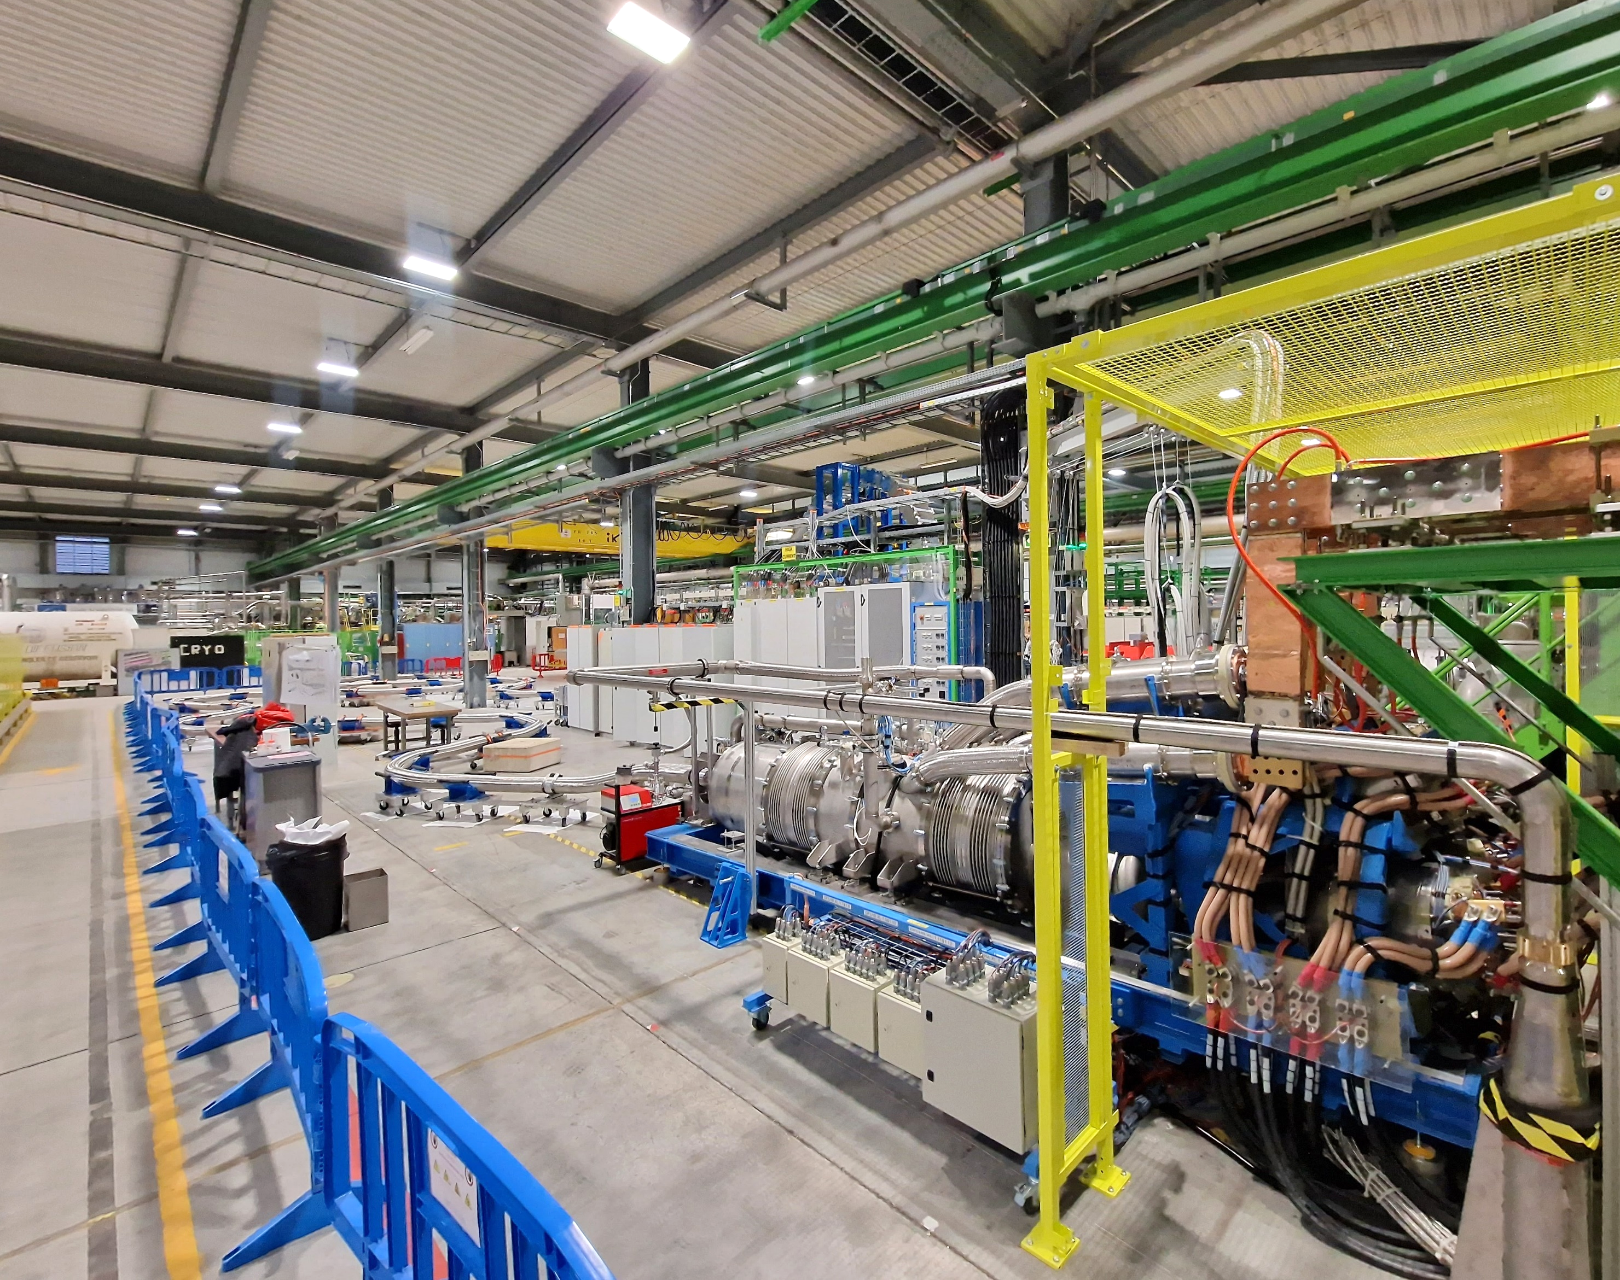
Cold Powering System for HL-LHC
Y. Leclercq, C. Barth, A. Ballarino
G. Willering & V. Gahier
on behalf of WP6a and all
collaborators
TE-TM meeting 13.01.2025

Slide 2
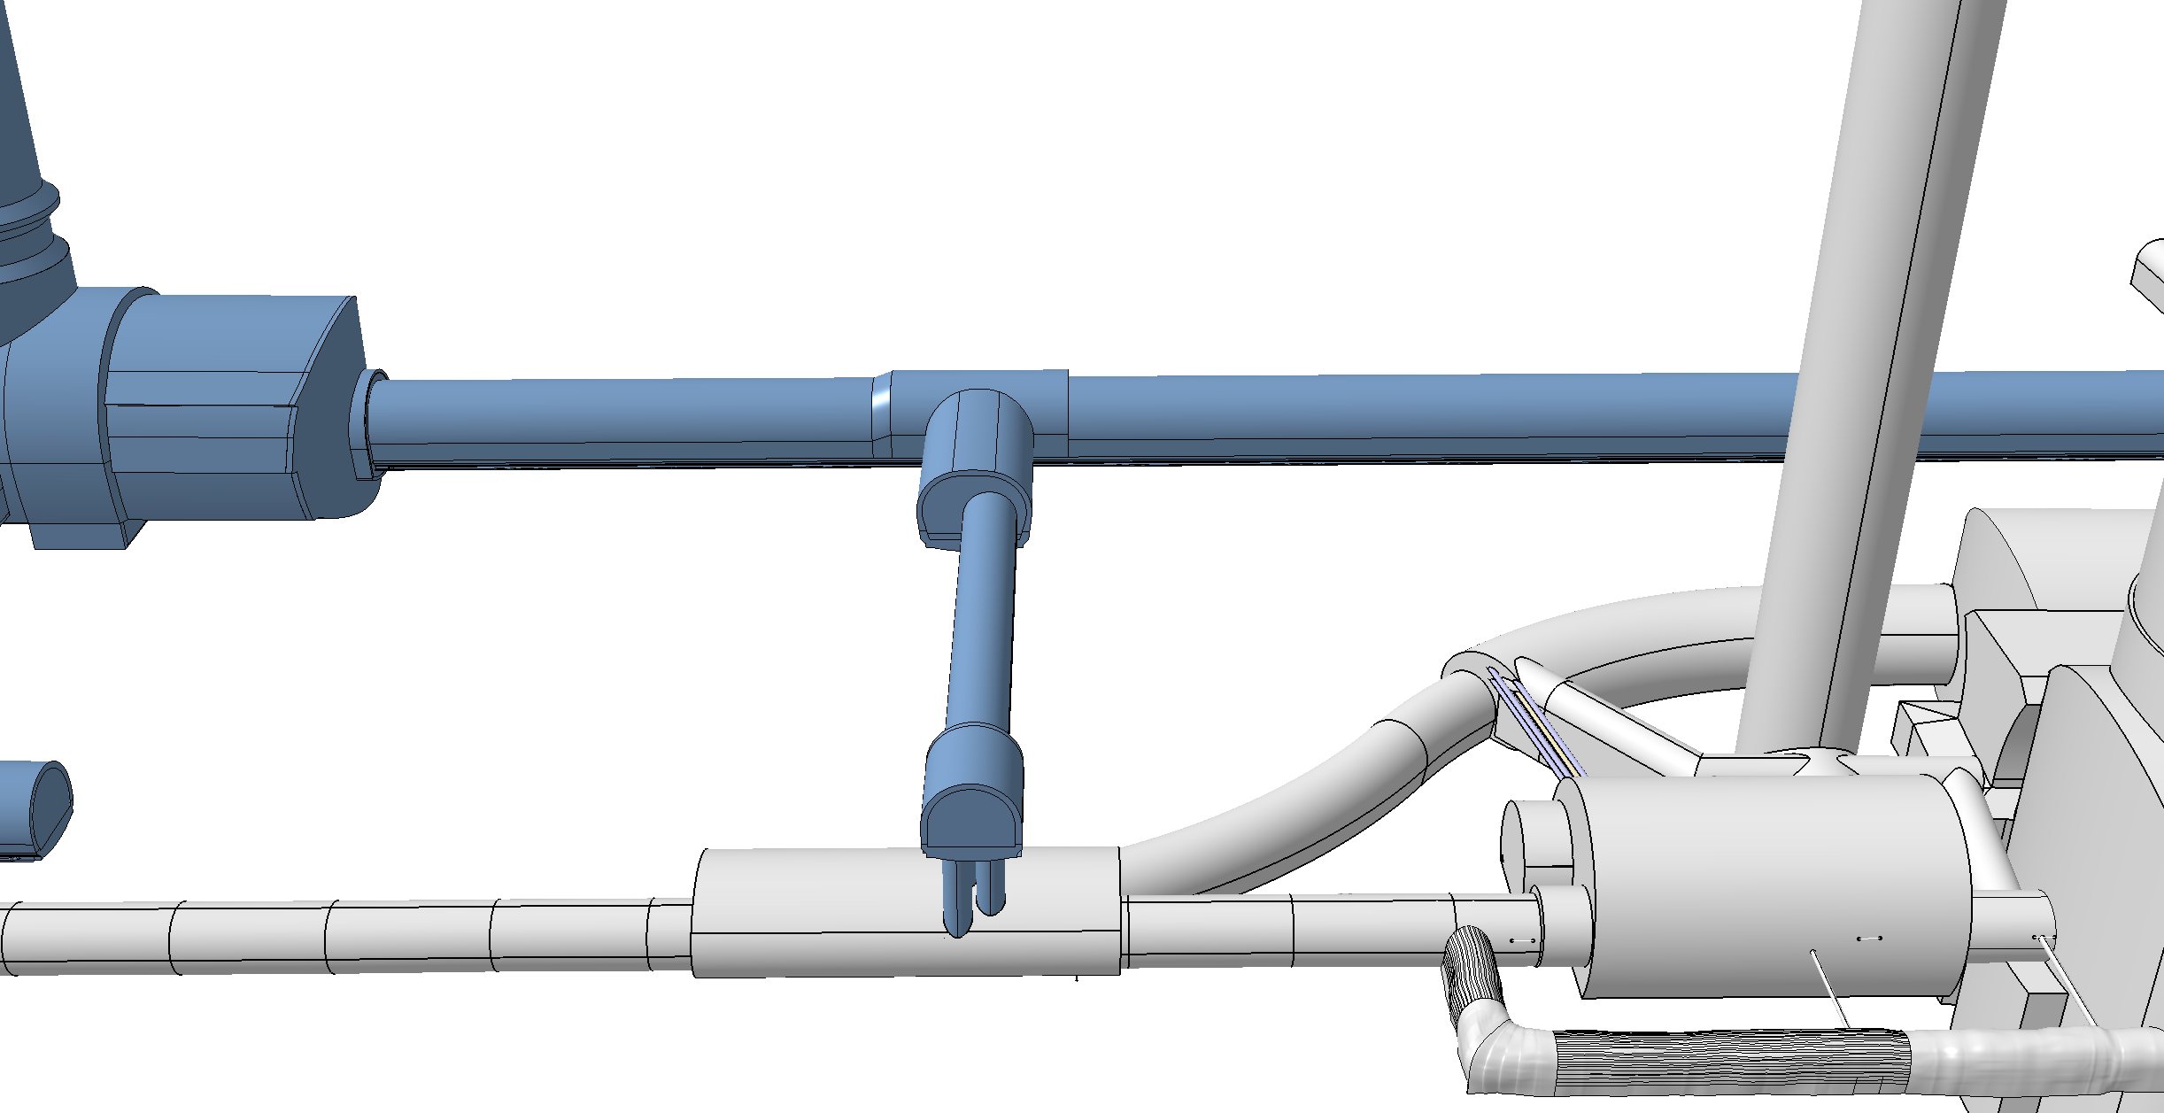
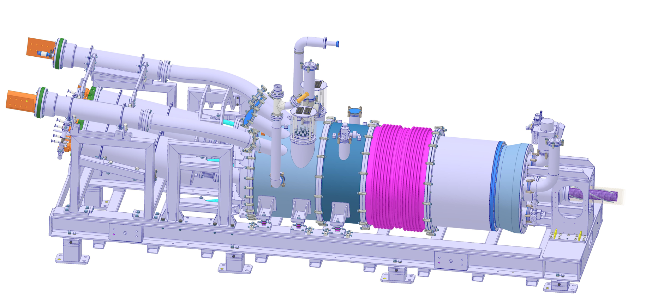
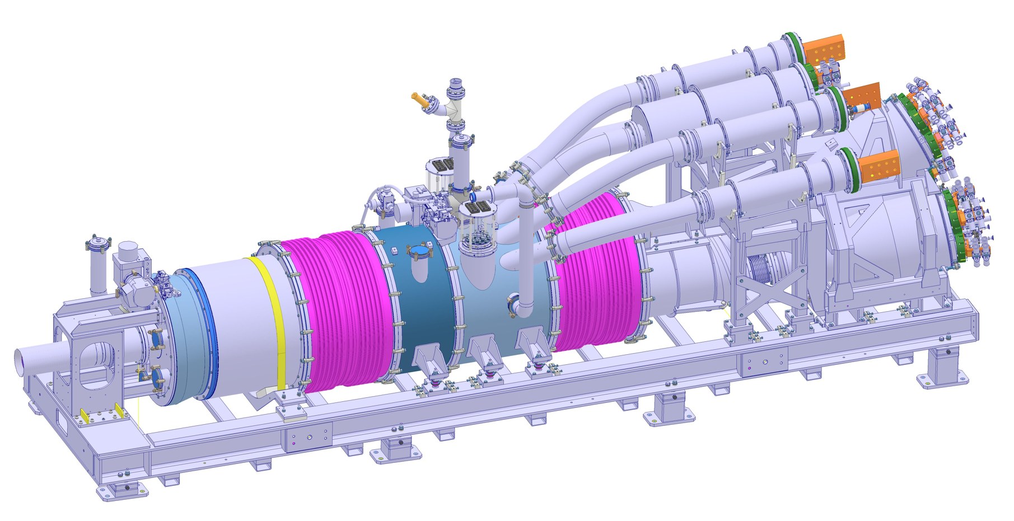
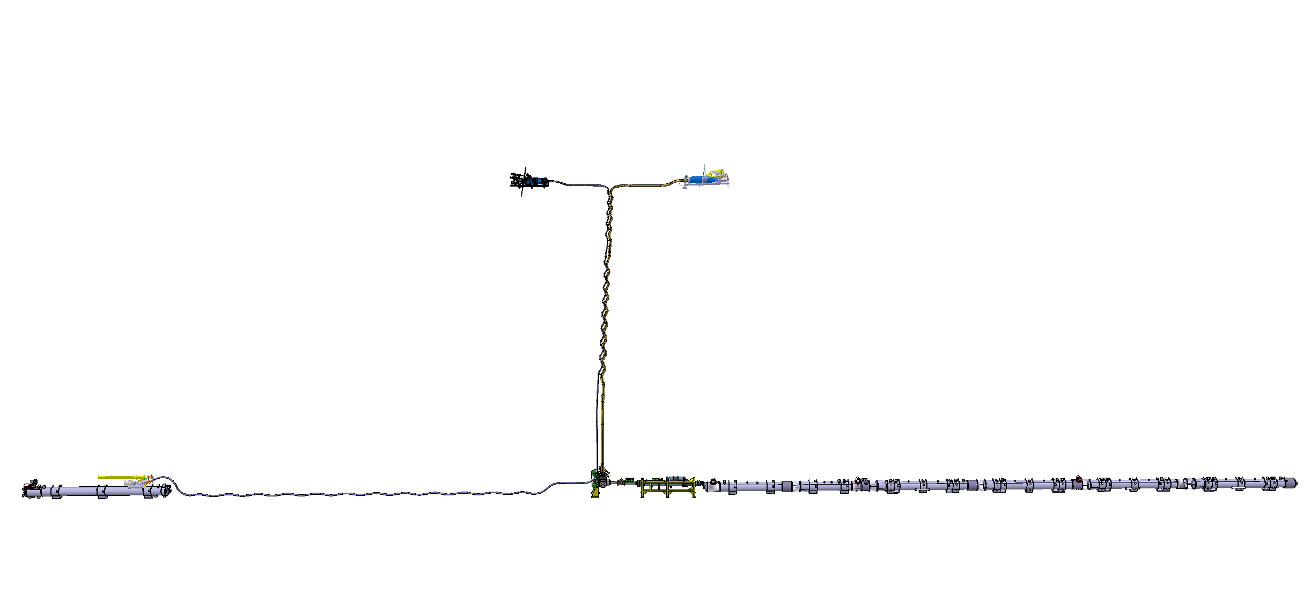
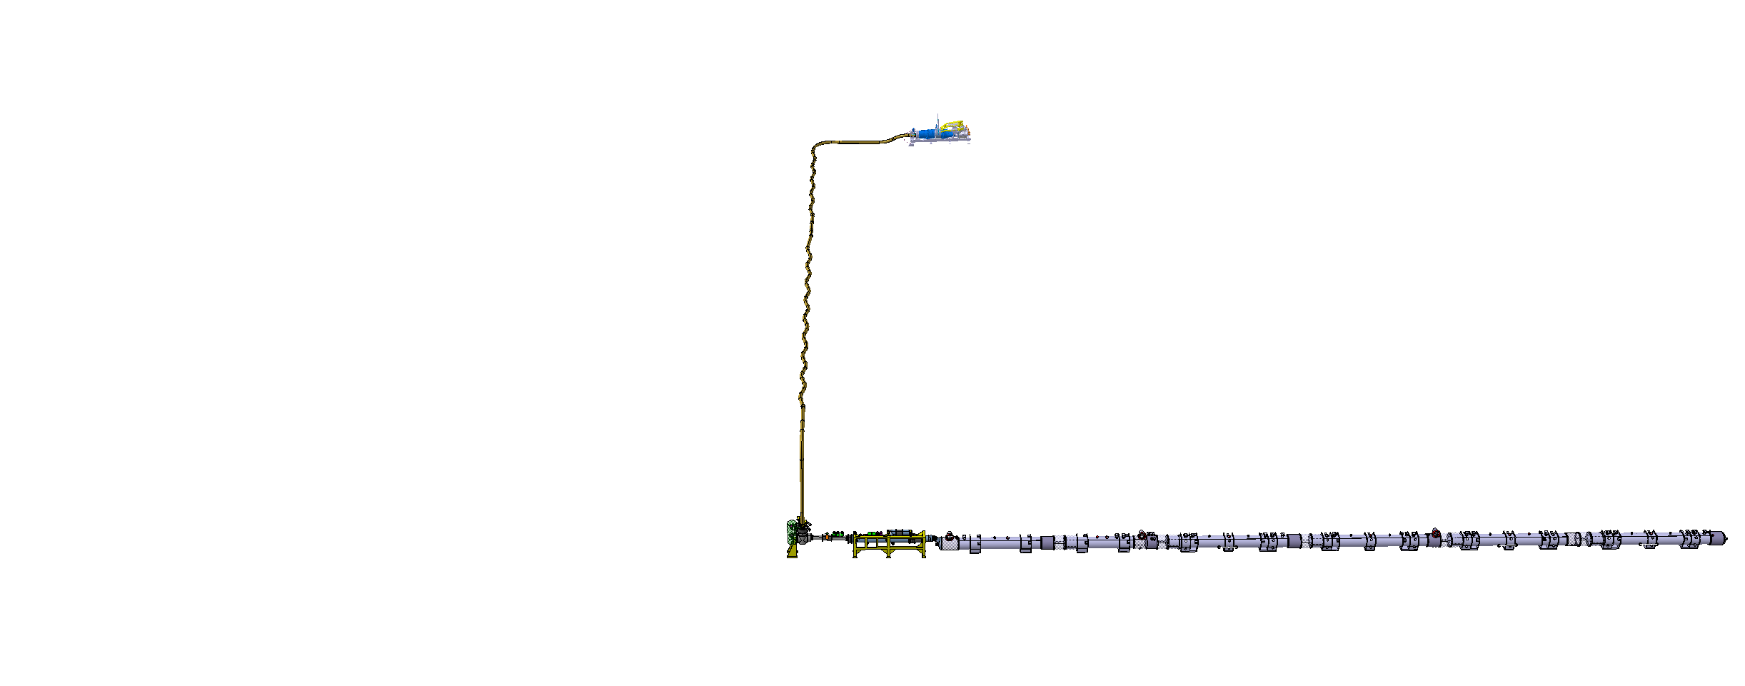
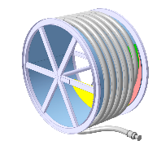
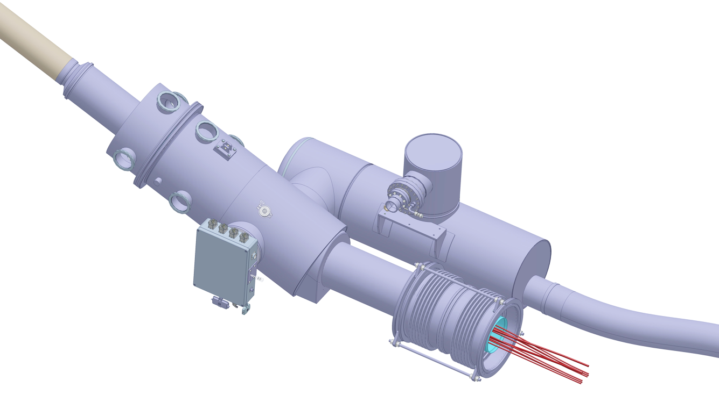
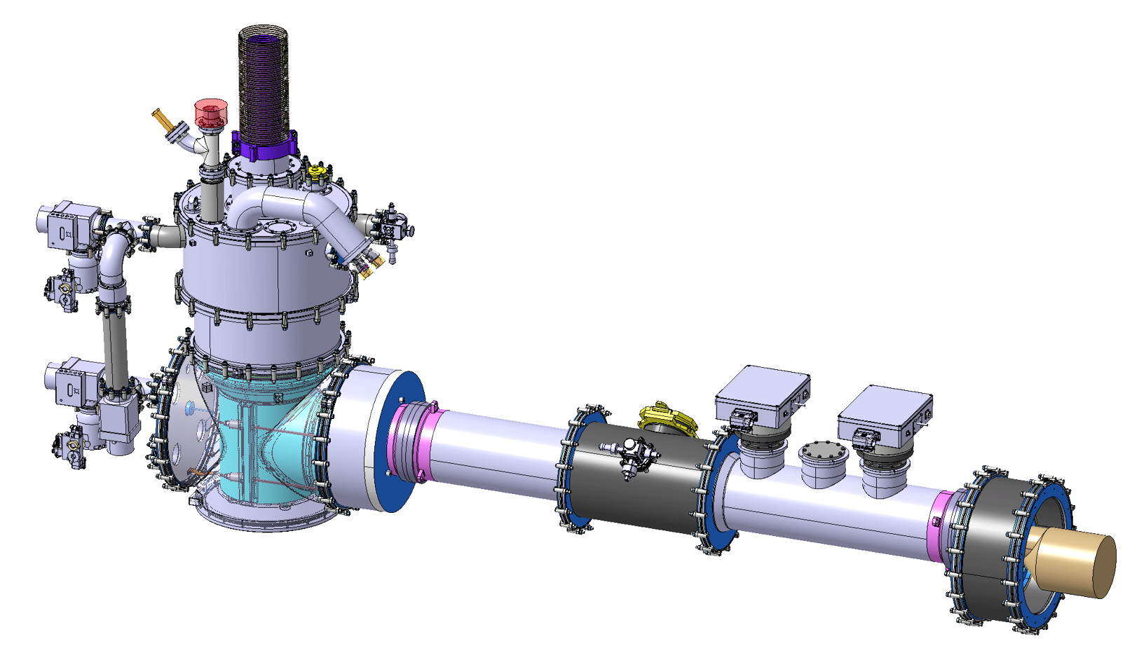
Motivation : HL-LHC Cold Powering
HL-LHC layout: IT & MS magnets powered with power converters located in new galleries 50 metres away
Cold Powering Key Function: Electrical connection between magnets in LHC tunnel and power converters in service gallery
8 (+2 spares) Systems required
Two types :
  X for Triplets
  M for Matching Sections
3 cryostats in series per system :
  DFX-SCLinkX-DFHX
  DFM-SCLinkM-DFHM
Temperature range 4.5 K to 300 K
3 superconductors types
  Nb-Ti
  MgB₂
  REBCO
300 K
60 K
60 K
300 K
20 K
20 K
DFHM
DFHX
Power Converters
Power Converters
Service Galleries UR
Matching Sections (M):
120 m long
|40| kA DC
SCLinkM
SCLinkX
Triplets (X):
74.5 m long
|117| kA DC
LHC tunnel
IP ➔
MS magnets
IT magnets
DFM
DFX
4.5 K
4.5 K

Slide 3
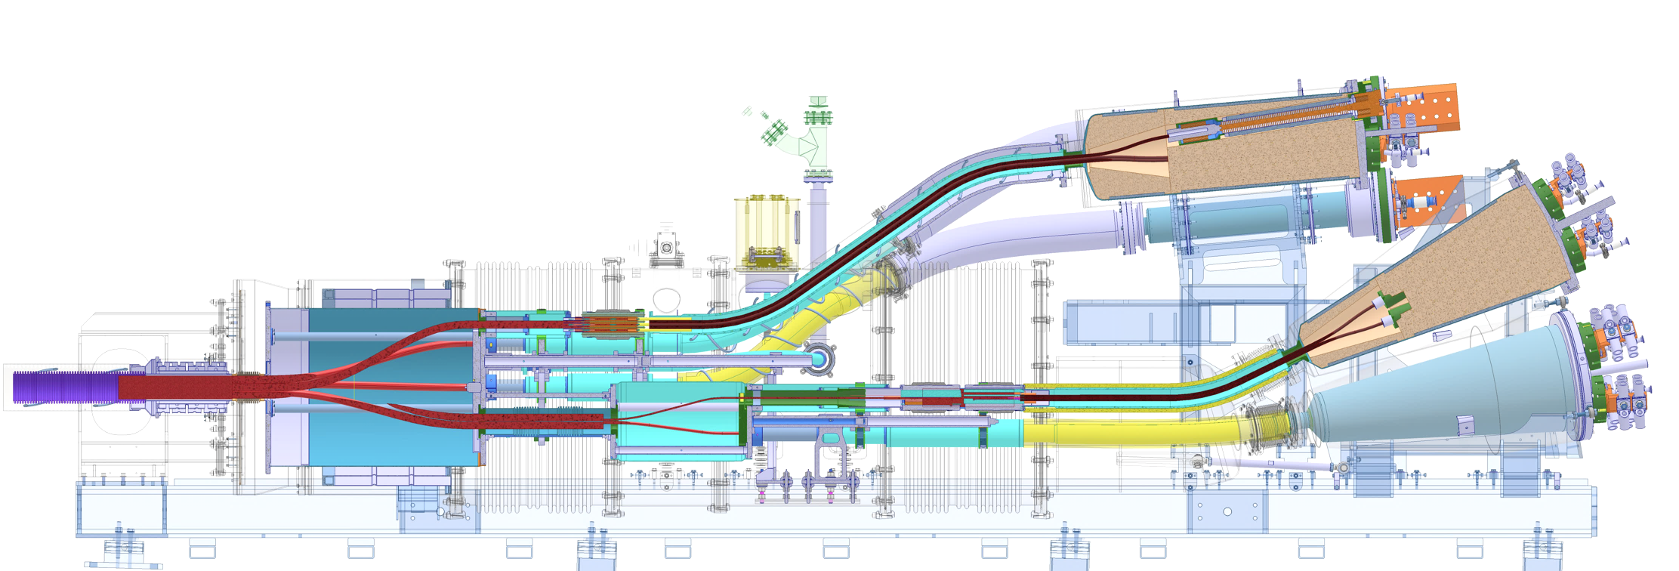
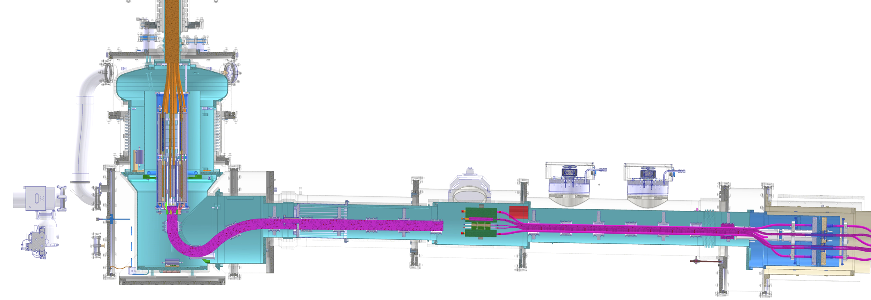
Overview of the IT Cold Powering system
Electrical
19 branches from 2 to 18 kA
Total rated up to |117| kA DC
Nb-Ti busbars through λ-Plate & DFX
  Immersed in Lhe @ 4.5 K
MgB₂ cable from DFX to DFHX
  In gaseous mass flow < 20 K
REBCO cables : DFHX to Current leads
  Cable & splices convective cooled < 60 K
To PC
DFHX
< 60K
300 K
< 20K
Splice
Gas flow
Splice
SCLink
Gaseous Helium
Cryogenics
DFX liquid helium bath ≈ 400 l
200 W Heaters in DFX produce a controlled gaseous mass flow through SCLink
Mass flow adapted to current leads needs
MgB₂ & REBCO cables and splices convective cooled
Current leads convective cooled
Electrical
Heater
NbTi-MgB₂ splices
Liquid
Helium : 4.5K
Superfluid
Helium : 1.9K
NbTi-NbTi
splices
To IT magnets
DFX

Slide 4
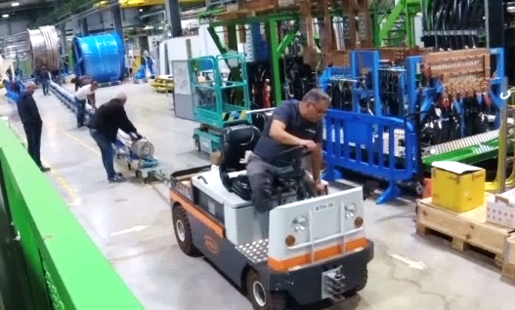
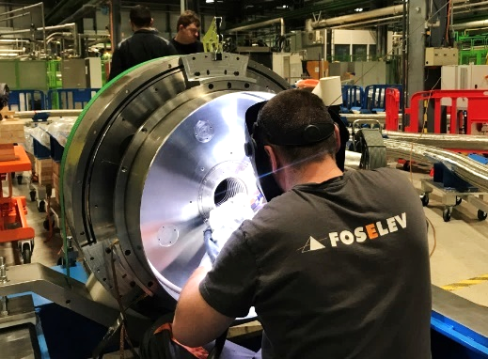
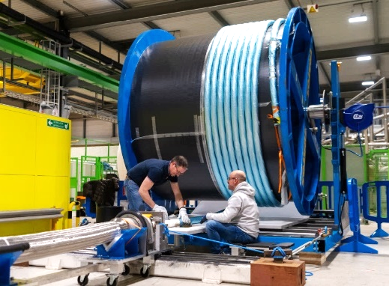
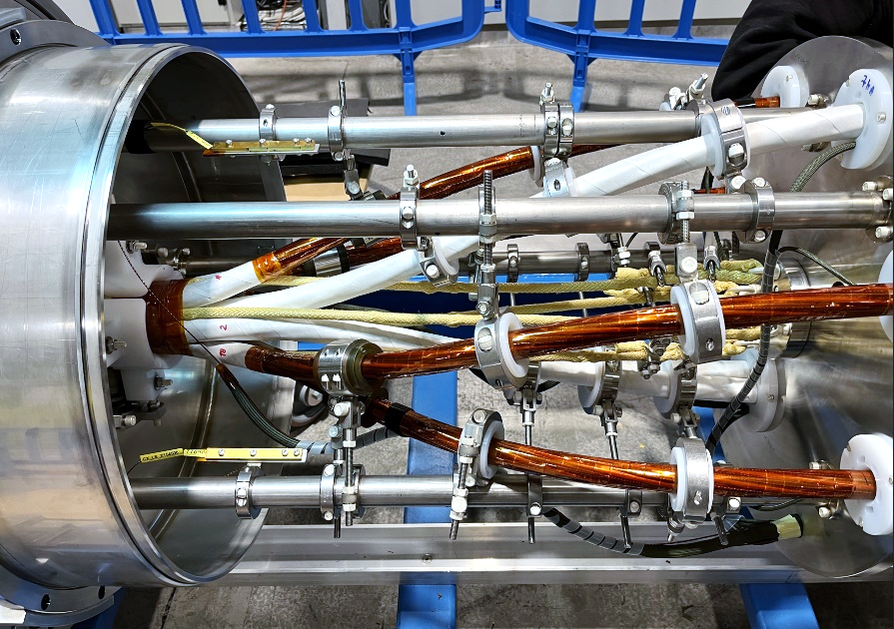
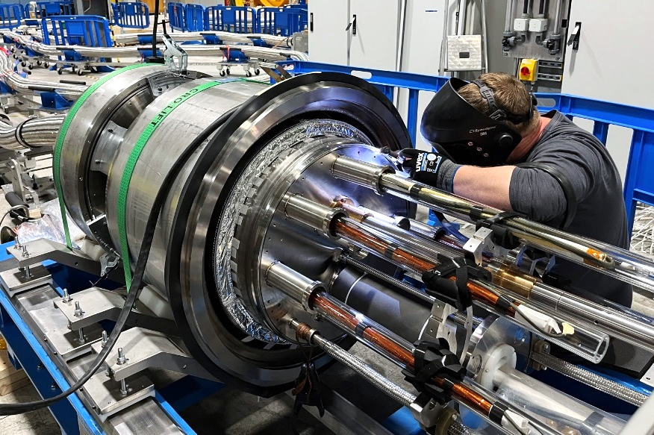
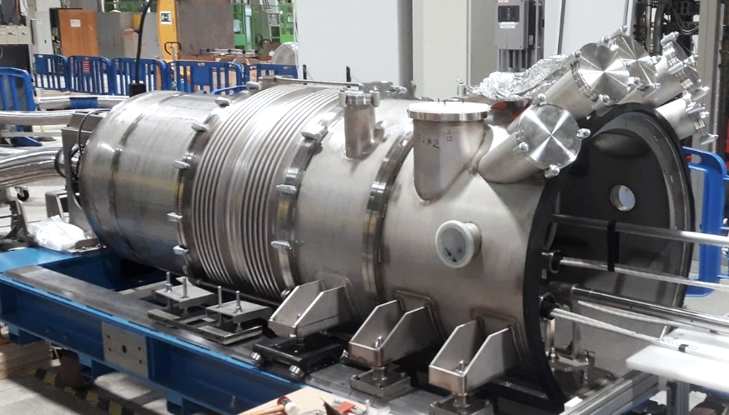
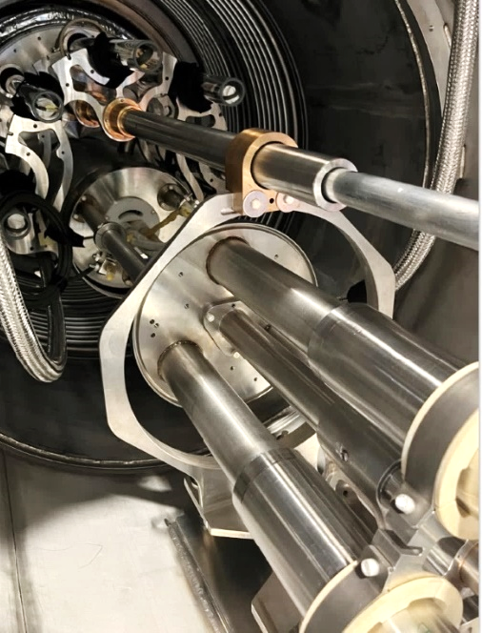
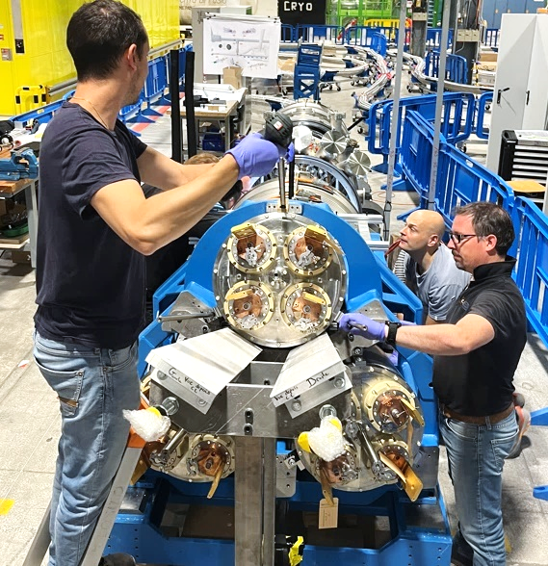
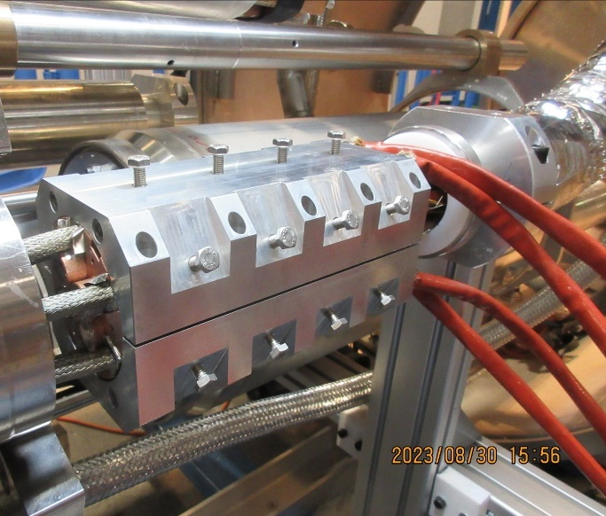
Cold Powering System : Assembly of SCLink+DFHX
10 months assembly duration
Various electromechanical activities : welding, handling, splicing, forming, adjusting, QC
Flex cryostat Unspooling
MgB₂ Cable Shuffling
Cryostats connections
Cable insertion
Shuffling box welding
High current cryostat assembly
Cold mass structure assembly
2 kA CL assembly
2 kA MgB₂-REBCO splices

Slide 5
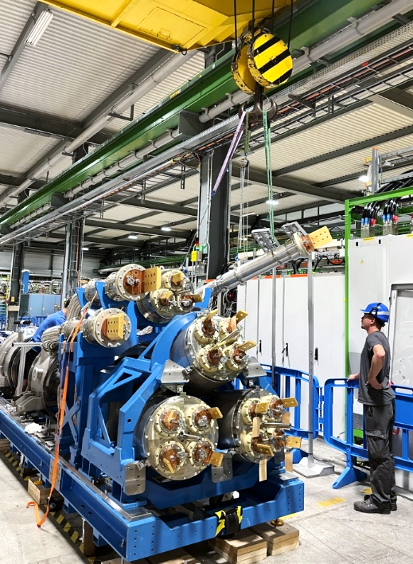
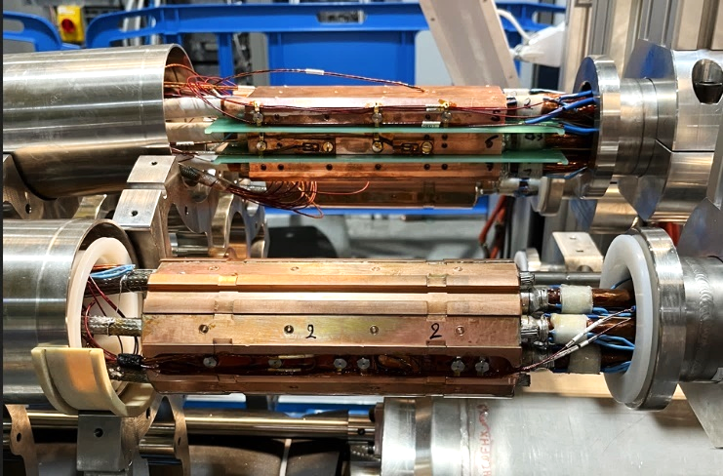
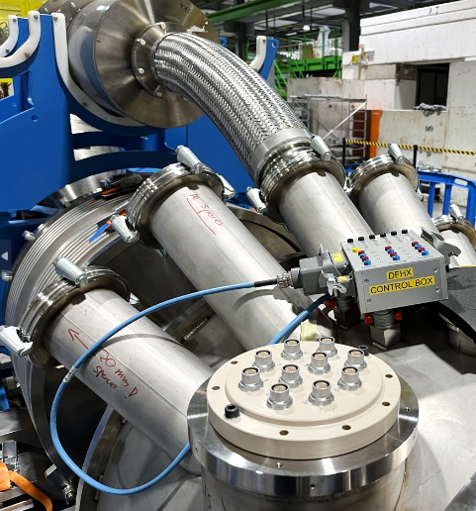
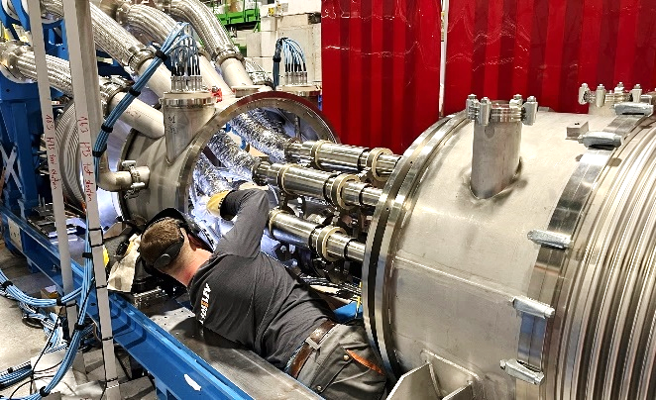
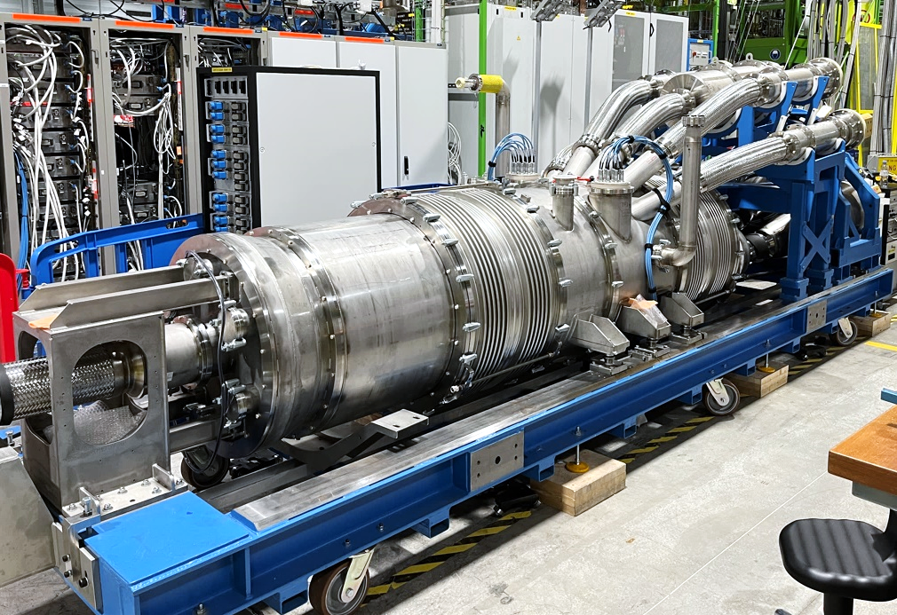
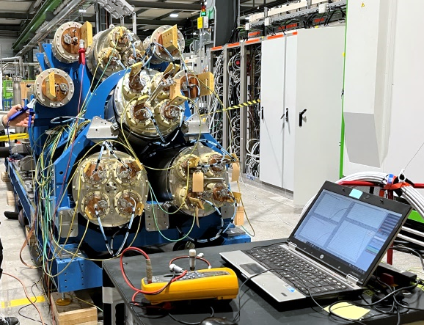
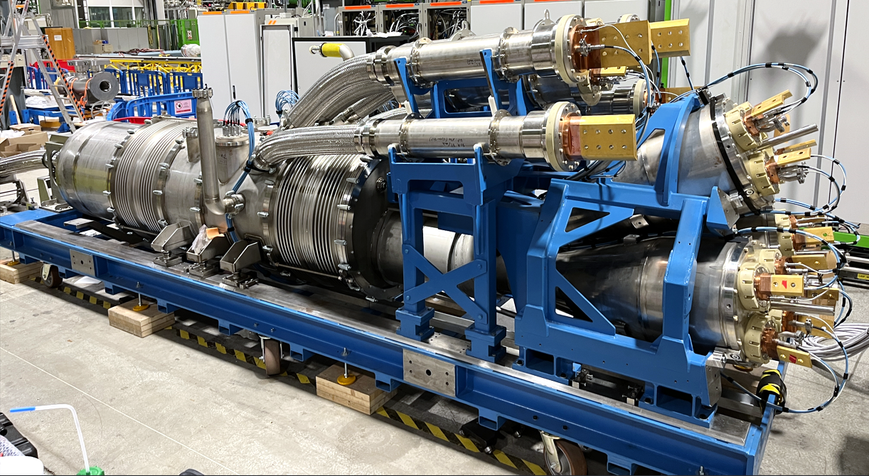
Cold Powering System : Assembly of SCLink+DFHX
18 kA CL assembly
18 kA MgB₂-REBCO splices
Ancillaries
Cold mass closure
Vacuum vessel closure
Quality Controls
SCLink+DFH assembly

Slide 6
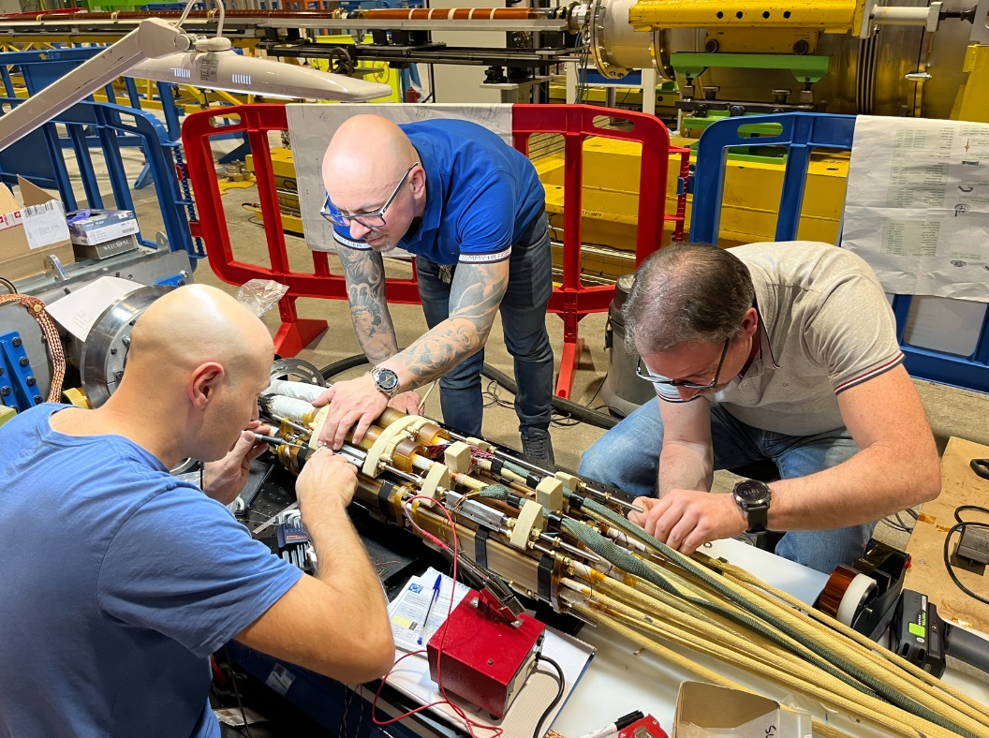
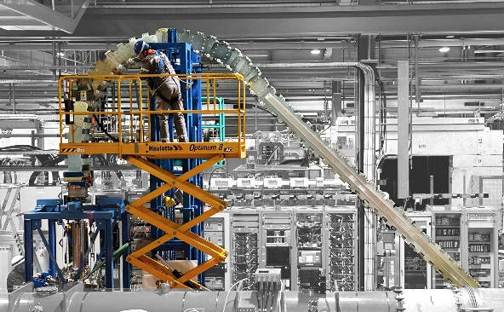
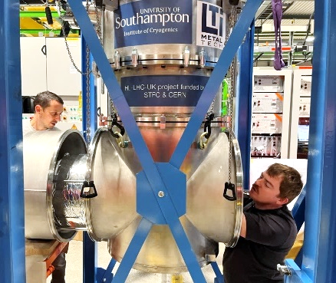
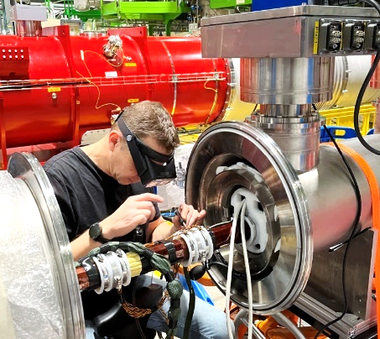
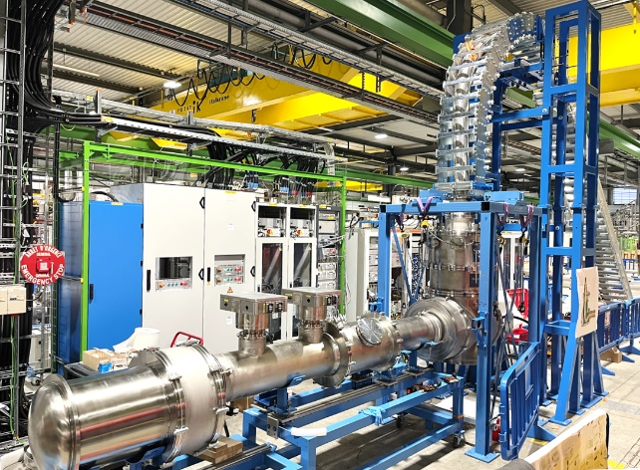
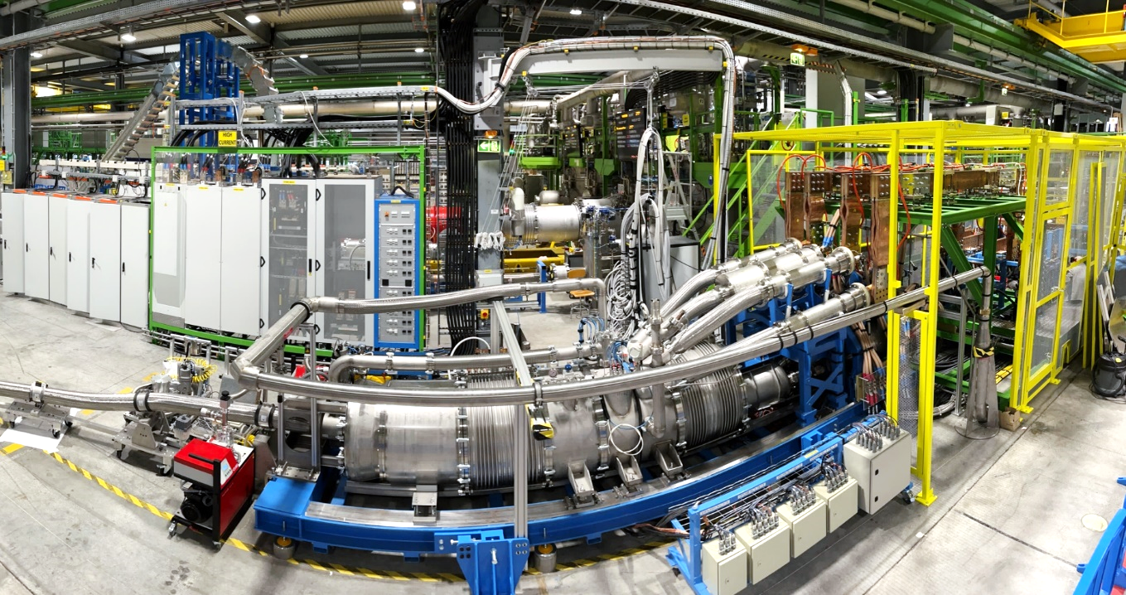
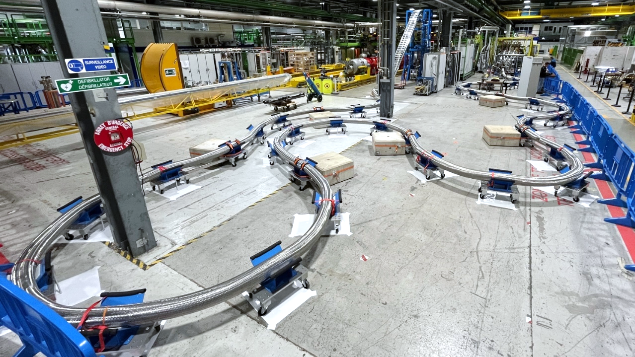
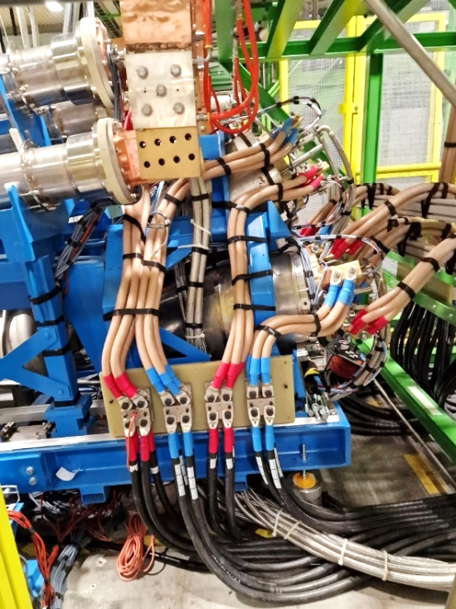
Cold Powering System : Connection to F2 test bench
DFX end assembly
Cryogenic & electrical connections
MgB₂-Nb-Ti connections
Electrical shortcuts
SCLink forming
DFX assembly
DFX connection to F2
DFHX connection to F2
Quality Controls

Slide 7
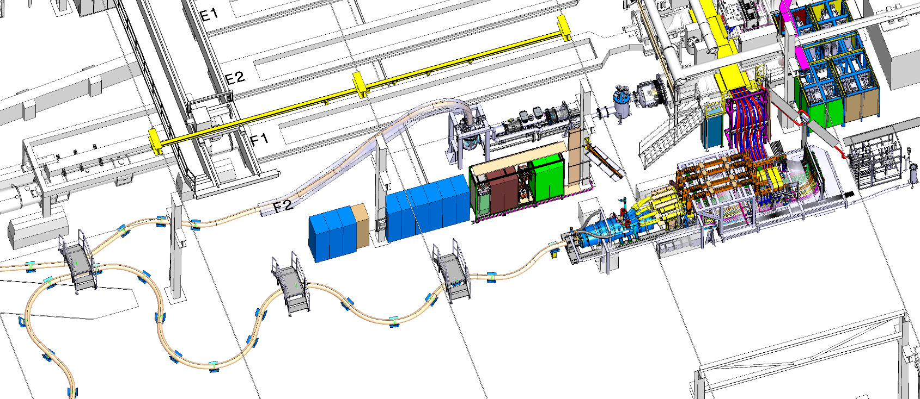
Cold Powering System test bench
SM18 facility : new dedicated F2 bench
Liquid helium injected in DFX, recovered at 300 K at DFHX end
Electrical powering from DFHX, electrical shortcuts at DFX end
LHe
DFX
GHe recovery
DFHX
Superconducting Link
Powering 18 kA, 15 kA, 2 kA, 2 kA

Slide 8
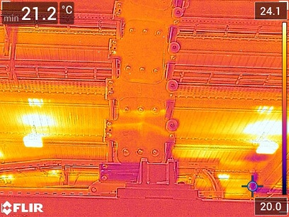
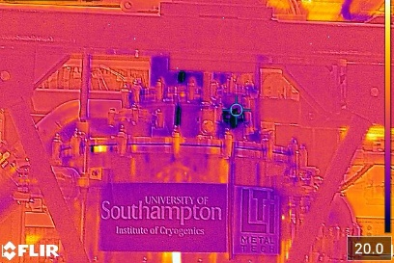
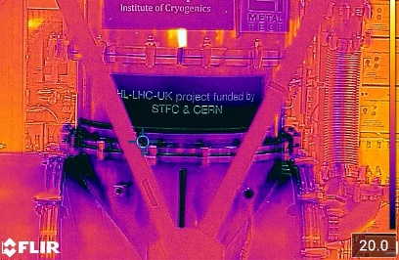
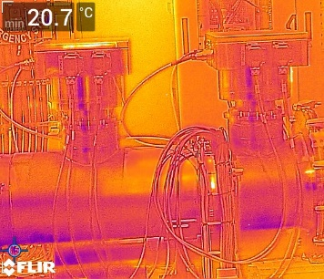
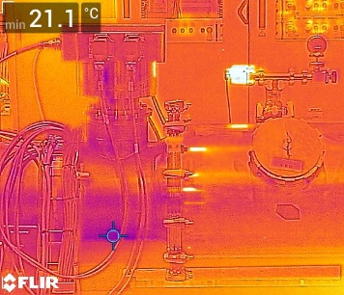
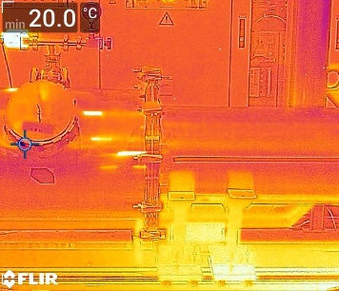
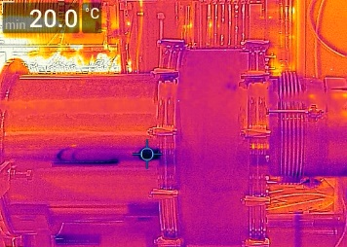
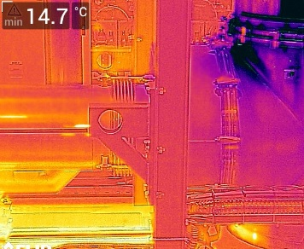
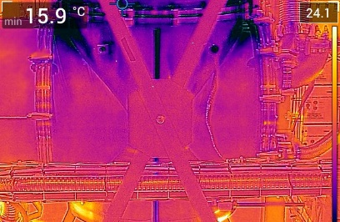
Cold Test : Cryogenics performances
Cool-Down:
To nominal cryogenic conditions < 1 week
Mass flow < 3.0 g/s
300K to 100K : T_{DFHX}-T_{DFX} <50K then 70K
< 100K, injection of LHe
Cryostats performance:
General
  No condensation
  Mass flow production in DFX validated up to 10 g/s
  10 min nominal conditions maintained in case of Liquid helium supply stop : confirmed
DFX static heat loads : 67 W, +30W extra heat loads due to MLI installation, no impact on operation
SCLink linear heat load : 2.0 W/m
DFHX : no cold point, no measurable pressure drop up to splices, splices convective cooling
DFX : MLI installation leading to colder surfaces

Slide 9
Cold Test : Thermal Contractions
Waves with regular fixed points to allow movement
Two thermal cycles (RT → cryogenic conditions) followed by powering of all circuits
Repetitive performance with local displacement < 30 mm.
Movements
(up to 3 cm)
F = Fixed Point

Slide 10
Cold Test : Powering Scheme
+ & - of each circuit in shorted @ 4.2 K
Similar circuits connected in series @ RT
Maximum current delivered by the power converters: 94 kA
Four power converters:
18 kA: I_{nominal} = 16.23 kA (MQXF)
15 kA: I_{nominal} = 12.11 kA (Dipole)
2 kA: I_{nominal} = 2 kA (Trim)
2 kA: I_{nominal} = 1.74 kA (Correctors)

Slide 11
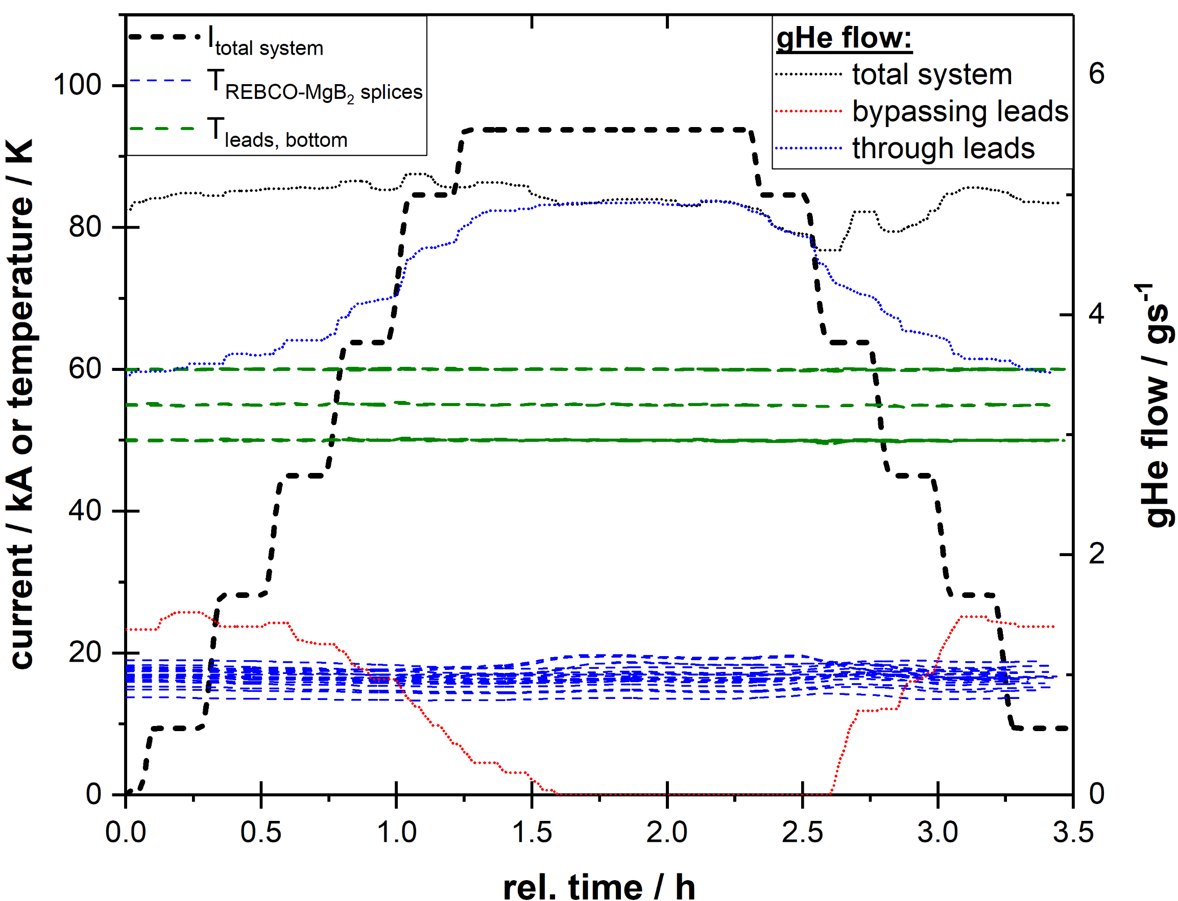
Cold Test : Flow & Temperatures
1st full X-type Cold Powering System successfully cold tested:
Transported 94 kA @ 5.0 g/s gHe flow
Within specifications:
  79.2 kA (I_{nominal} of HL-LHC magnets)
  @ 5.5 g/s
Avg. current lead:
  gHe flow: 50 mg·s⁻¹· kA⁻¹
REBCO cable splice & lead temp. stable
Splice temp. limit: 25 K
Lead temp. setpoints:
  18 kA: 50 K
  15 kA: 55 K
  2 kA: 50 – 60 K

Slide 12
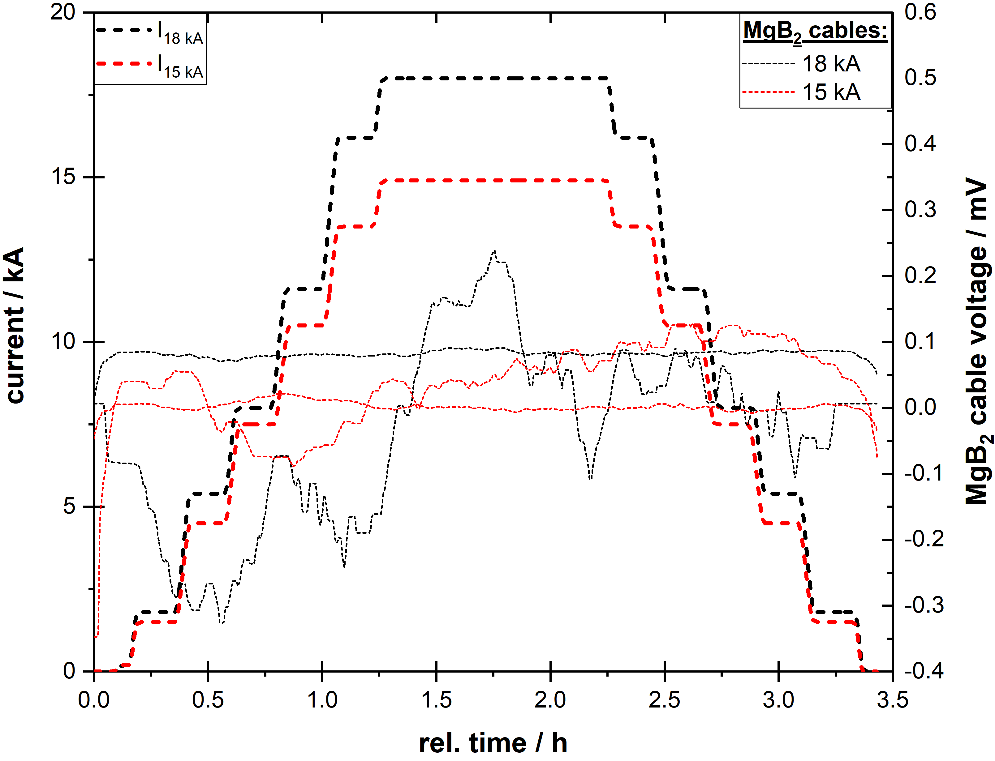
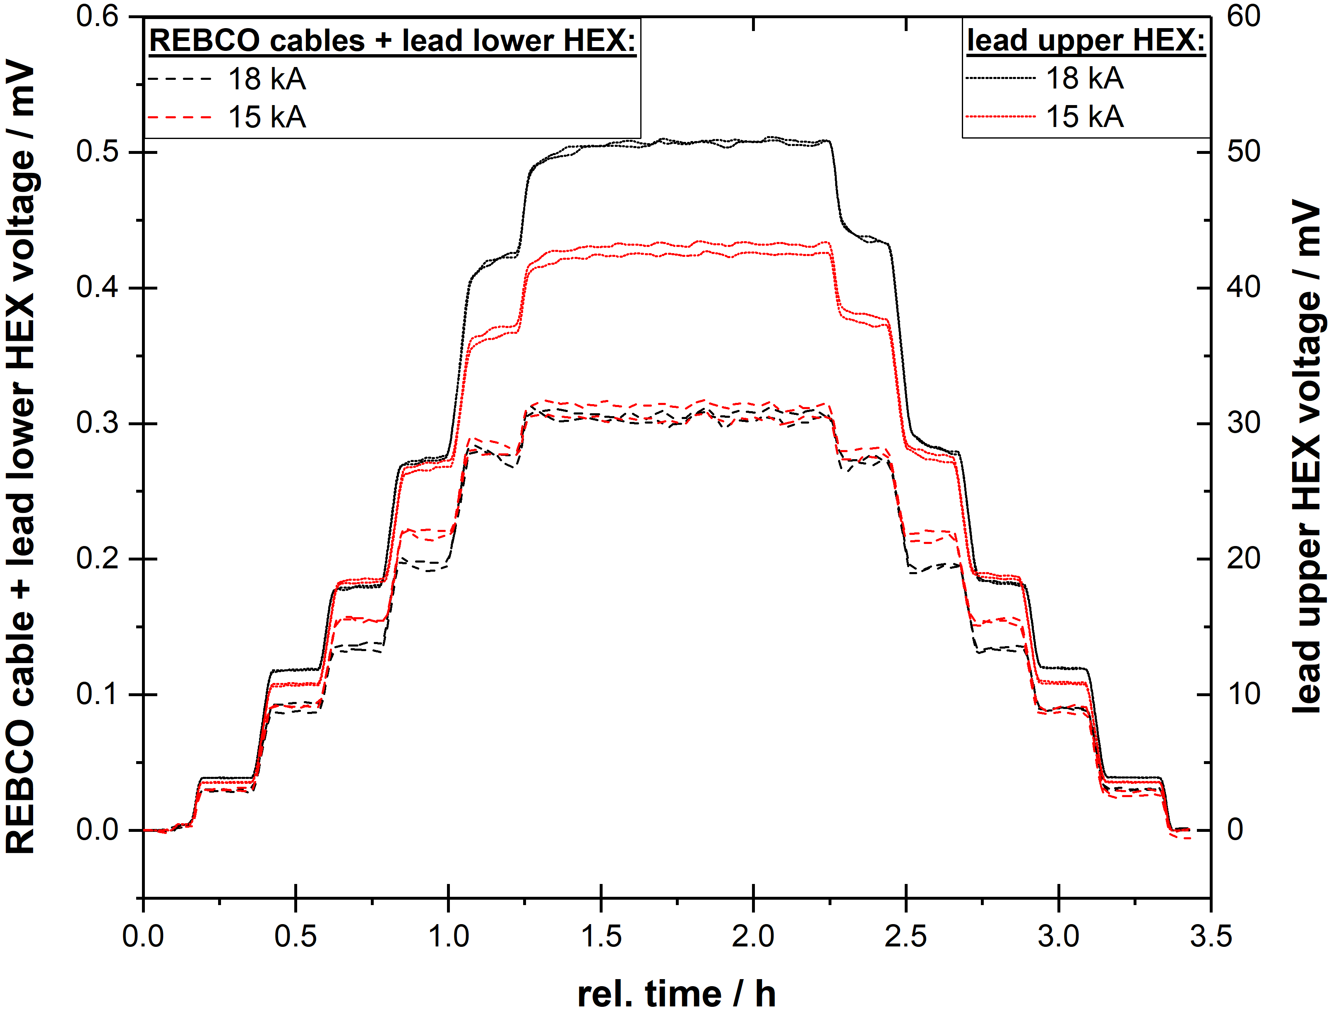
Cold Test : Superconductors cables
75 m
U_{MgB}
₂
REBCO cables
lower lead HEX
MgB₂
cable
current lead
RT terminal
U_{splice}
U_{REBCO+ lower HEX}
15 / 18 kA circuits: MgB₂ cables
15 / 18 kA circuits: REBCO cables + lower lead HEX
Stable, no transition, x10 – x100 below QD threshold*
*QD threshold: 5 mV

Slide 13
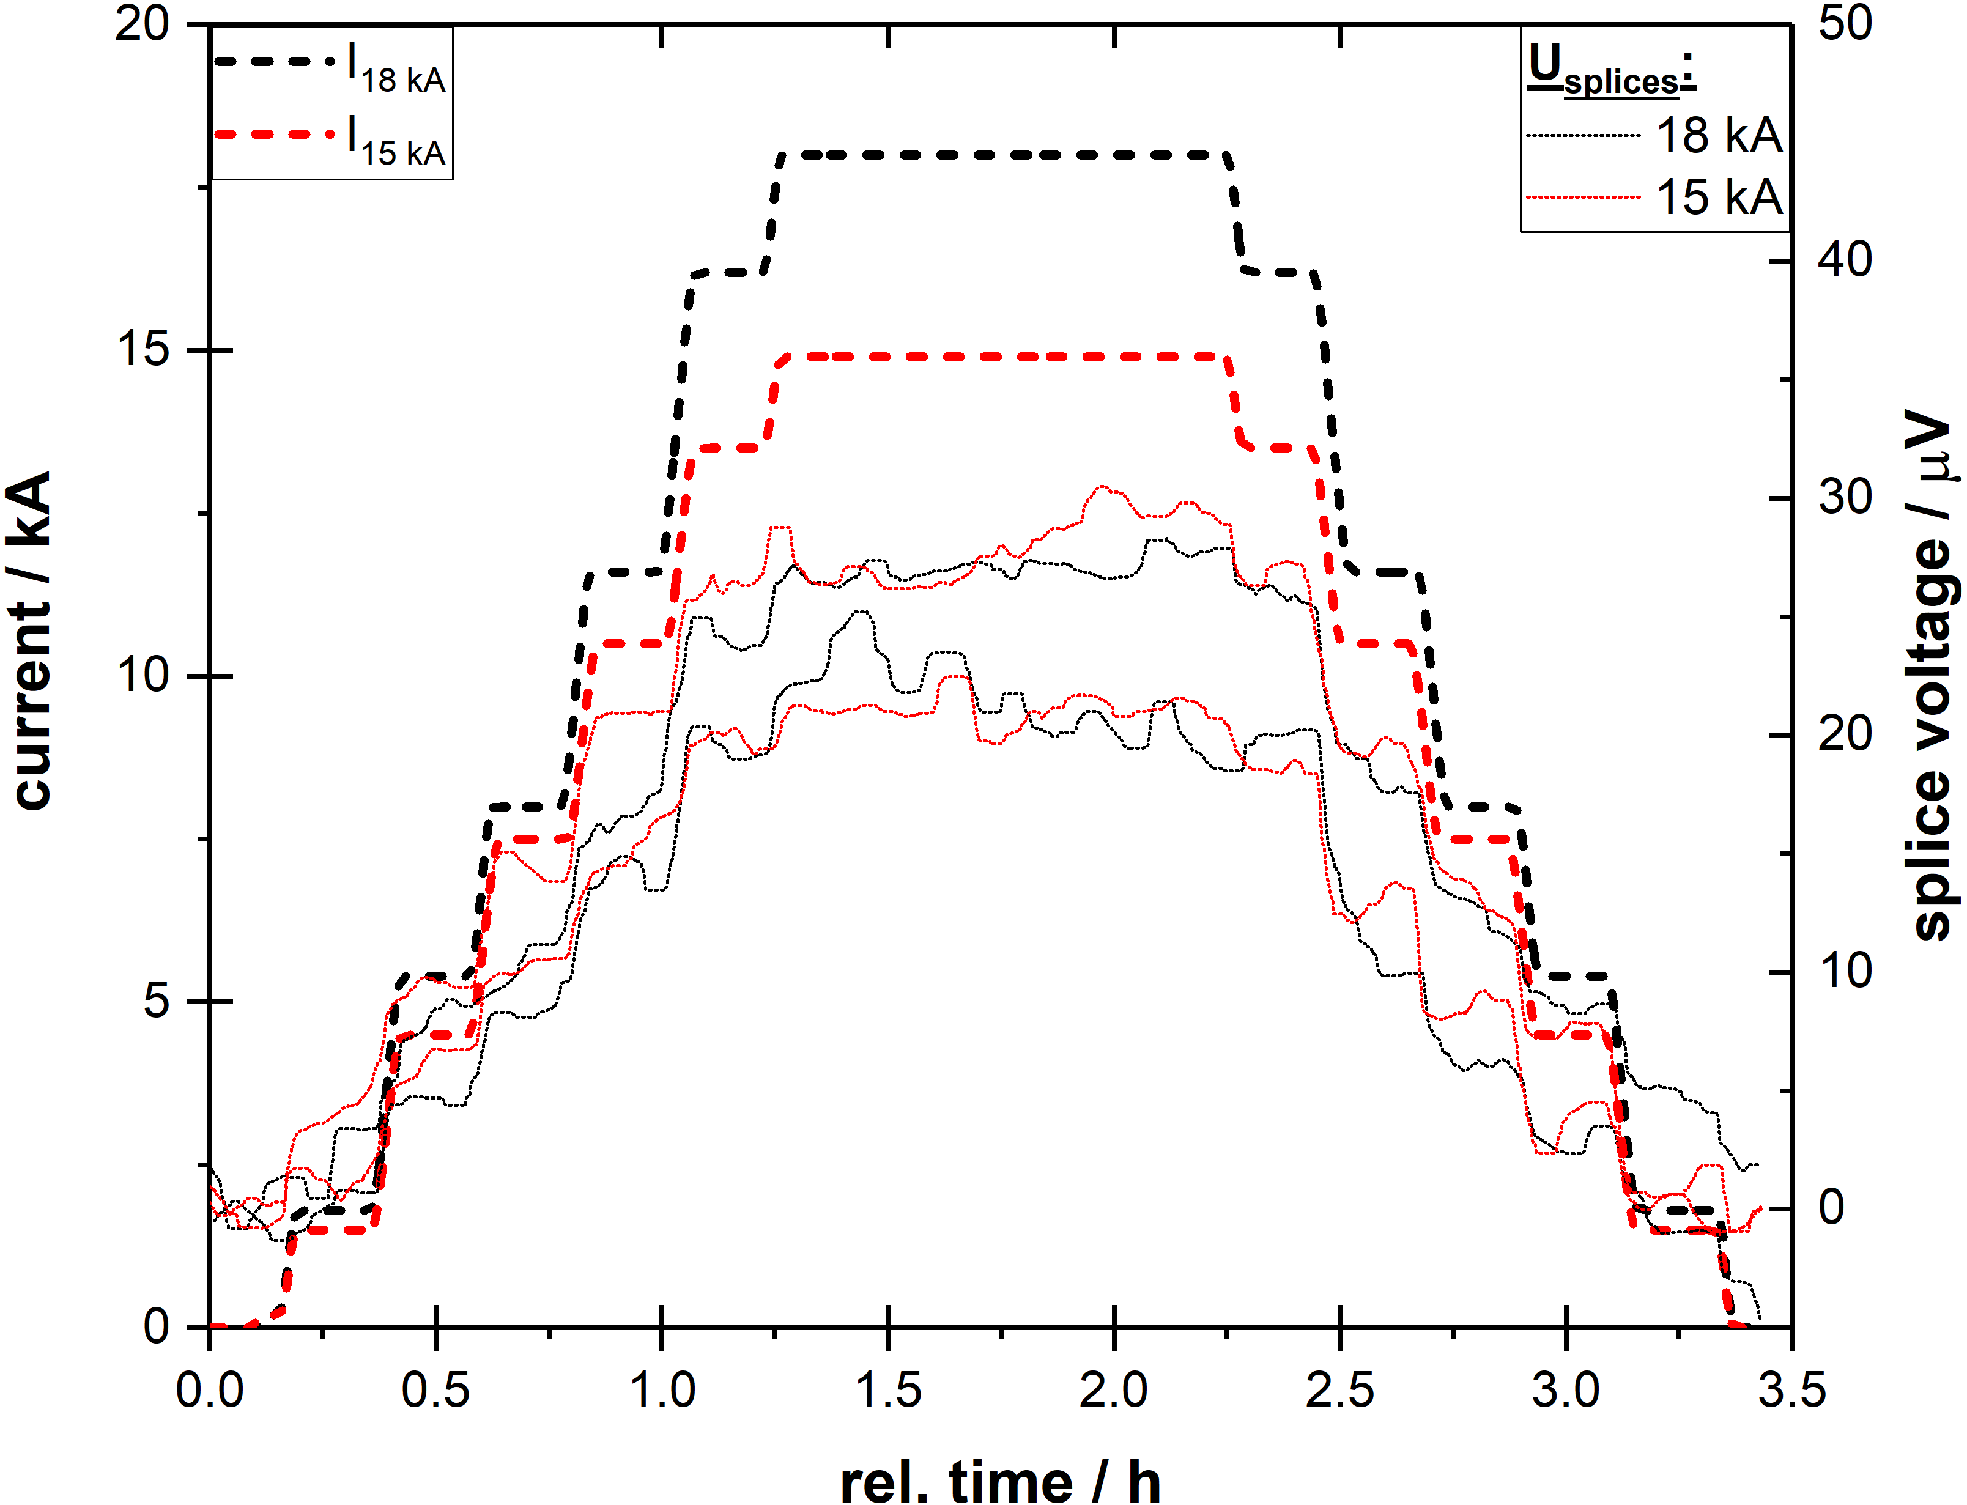
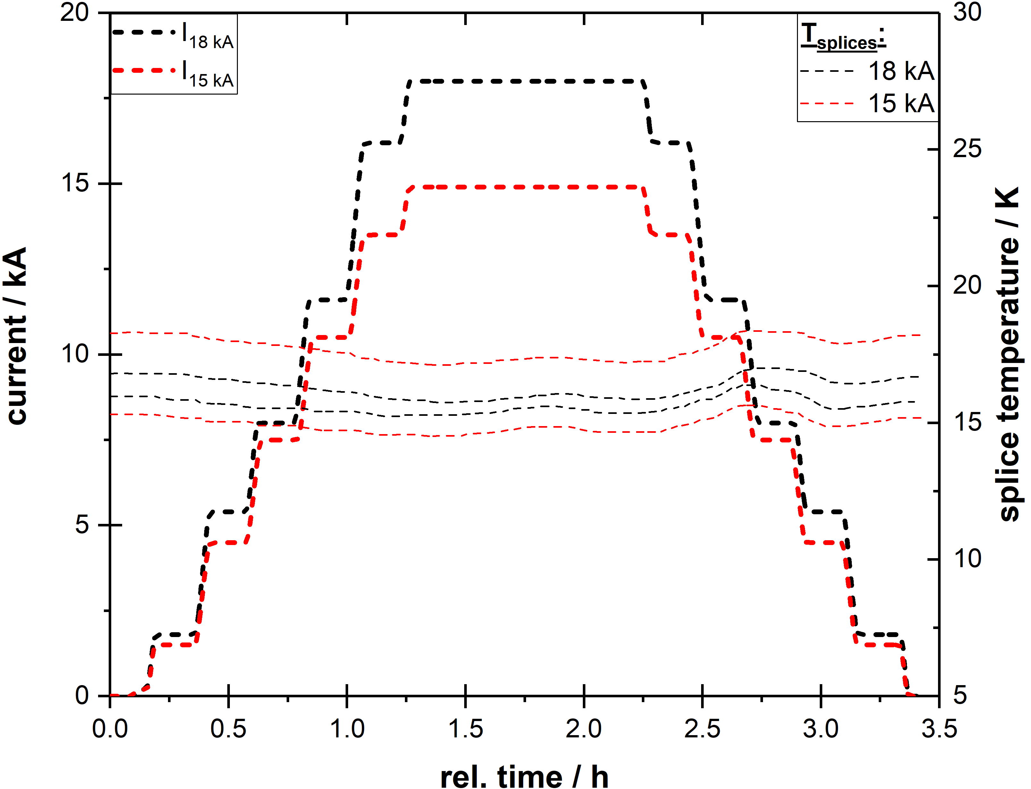
Cold Test : Splices
REBCO to MgB₂, GHe @ 20 K
MgB₂ to Nb-Ti, LHe @ 4.5 K
Nb-Ti to Nb-Ti, LHe @ 4.5 K
U: 15 / 18 kA circuits: REBCO to MgB₂
T: 15 / 18 kA circuits: REBCO to MgB₂
Stable, T_{splice} independent of current (± 1 K)

Slide 14



Cold Test : High Voltage
At nominal operating
conditions & warm gHe
HV between all circuit
combinations and PE
*accepted leakage current: ≤ 10 µA
HV tests successfully passed, NOC leakage x100 below limit

Slide 15



Cold Test : Transient behavior & Handling
Transient behaviour validated:
  Circuit cross-talk (< 50 µH coupling) allowing 100 A/s ramps
  Quenches of 2 kA - Corrector circuits do not trigger QD of any of the other circuits
    Very low inductance (0.03 µH) due to coaxial layout
Handling of Cold Powering Systems validated:
Spooling & transportability (incl. crane) demonstrated
Circuit | Test current (kA) | Ramp rate (A/s) | Inductive coupling (µH)
 |  |  | 18 kA | 15 kA | 2 kA - Trim | 2 kA - Correctors
18 kA | 18 | 100 | 31.0* | 8.1 | 15.0 | 2.3
15 kA | 15 | 100 | 0.1 | 0.1* | 18.0 | 0.03
2 kA - Trim | 2 |  |  |  | *
2 kA - Correctors | 2 | 50 | 0.03 | 0.03 | 0.02 | 1.5*
*self inductance

Slide 16
Summary
The first Cold Powering System for the HL-LHC Triplets has been successfully validated:
  Cryogenic, electrical and mechanical performance all met design parameters
  Robustness of system in different operating modes was proven
The system transferred |94| kA* in DC mode with 5.0 g/s gHe:
  MgB₂ @ 20 K (Operation of MgB₂ cable possible up to 29 K)
  REBCO cables @ 60 K (Operation of REBCO cables possible up to 70 K)
  → ∼ 10 K temperature margin
Spooling & transportability (incl. crane) demonstrated
Components industrialized after intensive R&D at CERN
Systems in advanced phase of series production
Installation in the LHC underground is planned to start 2028

Slide 17

Thank you for your attention !

