Slide 1

ECR/Documents for Information and Approval
Giulia Romagnoli and Natalya Kahn for BE-EA, 2024-12-17
EA Documents - Agile Board - CERN Central Jira

Slide 2
LIST OF DOCUMENTS for Info
FOR INFORMATION EATM
Summary | Reporter | EA Projects | EDMS number | EDMS Status
Clean Room Functional Specification | Krystian Sidorowski | North Area | 3189466 – SPSX-J-SPC-0004 | Under Approval
GHN2 Fire Protection Safety Tests | Filipa Duque Carvalho | North Area | 3203830 – SPSX-S-RPT-0006 | Under Approval
FISC Motor Consolidation | Inaki Ortega Ruiz | North Area, NACONS | 3173084 | Under Approval
Multi-Wire Proportional Chambers - Critical Spares | Inaki Ortega Ruiz | North Area, NACONS | 3173094 | Under Approval
MarXdiscap Power Converter for AD injection SMI5306 septum | Todor Todorcevic | AD | 2679021 – AD-R-ES-0006 | Engineering check
Assembly Procedure for the Fast FISC | Eva Kamenicka | Experimental Areas | 3178861 | Under Approval
Finite Element Analysis for the MCB vacuum chamber in F61 | Angelo Petrellese | Experimental Areas | 3162570 | Under Approval
Integration Study of the Cooling Cells Demonstrator in TT7 | Lukasz Krzempek | Experimental Areas | 3200071 | Engineering check

Slide 3
LIST OF DOC for FUTURE APPROVAL
ECR INFO/FUTURE APPROVAL EATM
Summary | Reporter | EA Projects | EDMS number | EDMS Status
Low-energy Beams in the T10 Beamline of the East Area | Maarten Van Dijk | East Area | 3174332 – PSZ-L-EC-0003 | In Work
Creation of New Lorry and Personnel Doors in Building 911 | Jean-Louis Grenard | North Area, HI-ECN3 | 3173295 – SPSX-J-EC-0008 | Engineering check
GIF++ extension | Sylvain Girod | North Area |  | In Work
GIF++ gas balcony | Sylvain Girod | North Area |  | In Work
Installation of a New Hydrogen Buffer outside EHN1 for the NA61/SHINE Experiment | Bartosz Maksiak | North Area | 3197663 – SPSX-J-EC-0009 | In Work
Additional Platform above ALPHA Local Control Room in AD Hall | Francois Butin | AD | 2897943 – AD-LJ-EC-0023 | Engineering check

Slide 4
LIST OF DOCs for APPROVAL
ECR APPROVAL EATM
Summary | Reporter | EA Projects | EDMS number | EDMS Status
AUG installation EHN2+ AUL removal EHN1, GIF++/H8 and EHN2/M2/BA82 | Marcin Szewczyk | North Area | 3178530 - SPSX-SF-EC-0016 | Under Approval
PPE144 patch panel installation with passarelle modification | Sylvain Girod | North Area – NACONS | 3121860 – SPSX-J-EC-0006 | Under Approval
Asset Replacement Request - Magnet replacement | Philip Schwarz | North Area | 3168416 – SPSX-M-ARR-0002 | Under Approval

Slide 5
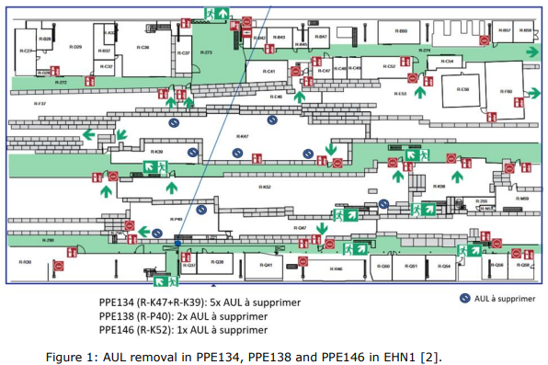
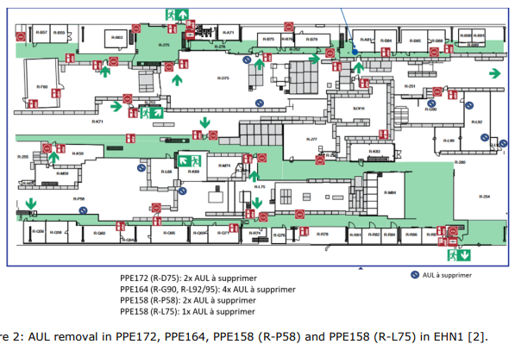
ECR for Approval
SPSX-SF-EC-0016
Version 0.2
AUG installation EHN2+ AUL removal EHN1, GIF++/H8 and EHN2/M2/BA82
By Marcin Szewczyk
“Arrêts d’urgence locaux” (AUL) will be removed from EHN1 and EHN2 and its security function will be replaced by existing “arrêts d’urgence généraux” (AUG). In EHN2, new AUG buttons will be added.
In line with the strategy agreed with HSE, EP, EN-EL and BE-EA, AULs are being removed and replaced by AUGs. In EHN1 and EHN2 in particular, this is due to faulty MN coils and non-compliance with IS-5 requirements. Obsolete NANO PLC systems will also be removed.

Slide 6
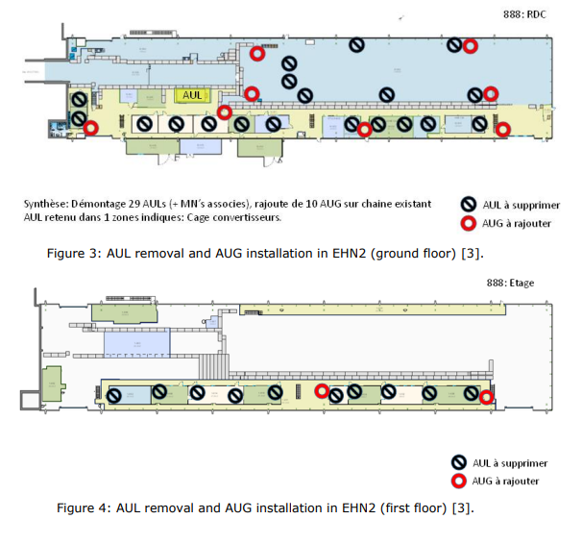
ECR for Approval
SPSX-SF-EC-0016
Version 0.2
AUG installation EHN2+ AUL removal EHN1, GIF++/H8 and EHN2/M2/BA82
By Marcin Szewczyk
In EHN2, one AUL zone will be retained (marked in Figure 3).
The short power cuts needed to remove MN coils may affect AMBER equipment operation in EHN2.

Slide 7
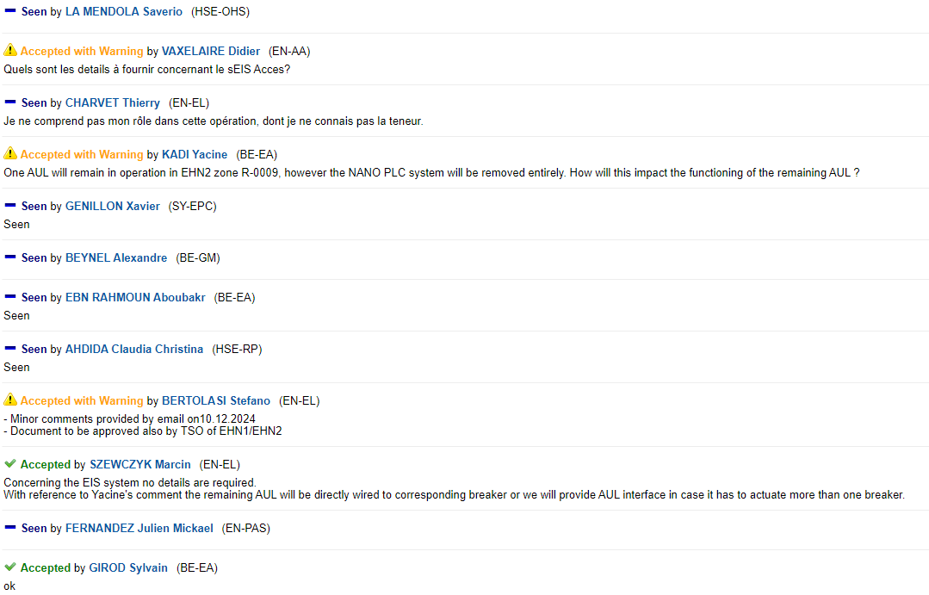
ECR for Approval
SPSX-SF-EC-0016
Version 0.2
AUG installation EHN2+ AUL removal EHN1, GIF++/H8 and EHN2/M2/BA82
By Marcin Szewczyk
Seeking approval from EATM

Slide 8
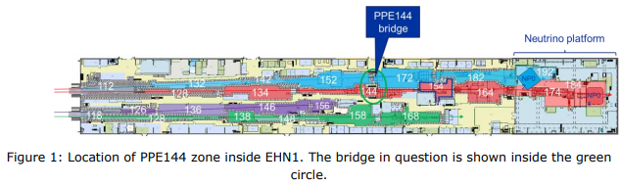
ECR for Approval
SPSX-J-EC-0006
Version 0.2
PPE144 patch panel installation with passarelle modification
By Sylvain Girod
This document describes the modification of the shielding bridge inside the PPE144 experimental area in order for NA64 experiment to install big detectors.
The bridge in question is the one leading to PPE144 transversing also PPE152 and PPE172 on the Jura side of the building.
This change will allow a large straw tracker station to be moved closer to the third magnet of the NA64 experiment and significantly increase their acceptance for dimuons.
Additional space will be also free for the installation of the new moveable platform that will reduce the time needed for the HCAL calibration.
The safety of personnel against ionizing radiation will be improved.

Slide 9
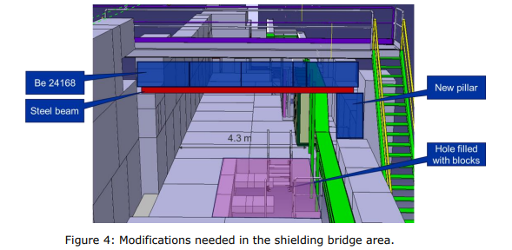
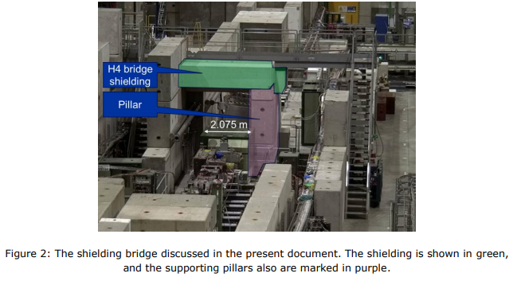
ECR for Approval
SPSX-J-EC-0006
Version 0.2
PPE144 patch panel installation with passarelle modification
By Sylvain Girod

Slide 10
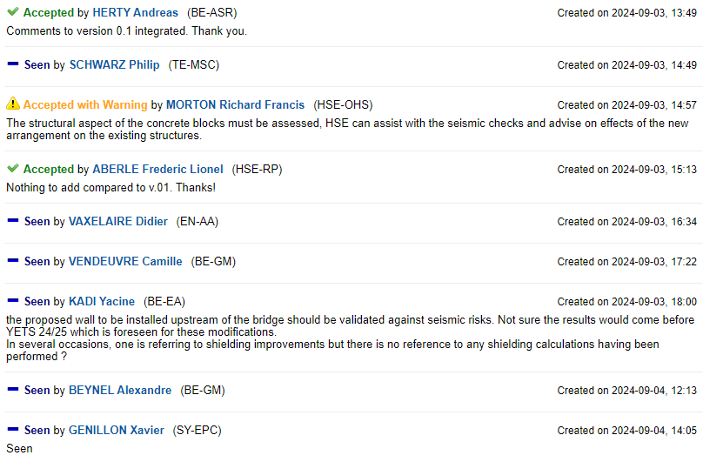
ECR for Approval
SPSX-J-EC-0006
Version 0.2
PPE144 patch panel installation with passarelle modification
By Sylvain Girod
Seeking approval from EATM

Slide 11
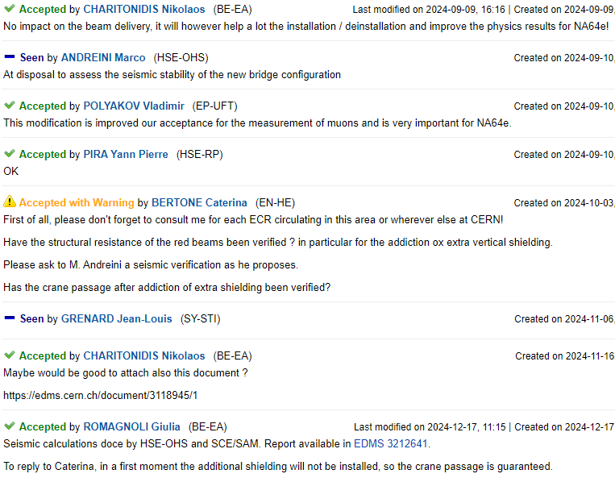
ECR for Approval
SPSX-J-EC-0006
Version 0.2
PPE144 patch panel installation with passarelle modification
By Sylvain Girod
Seeking approval from EATM

Slide 12
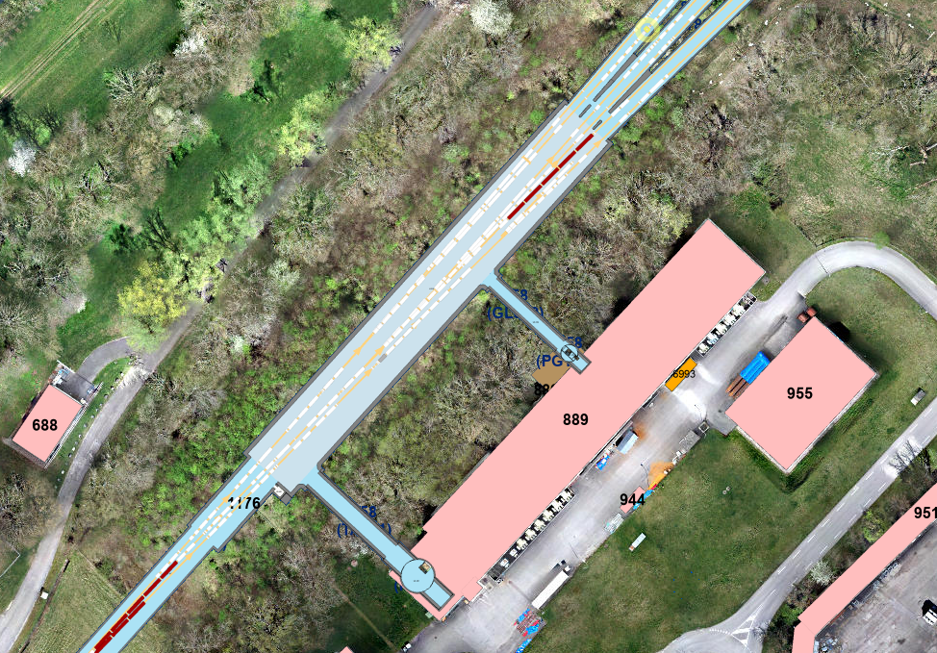
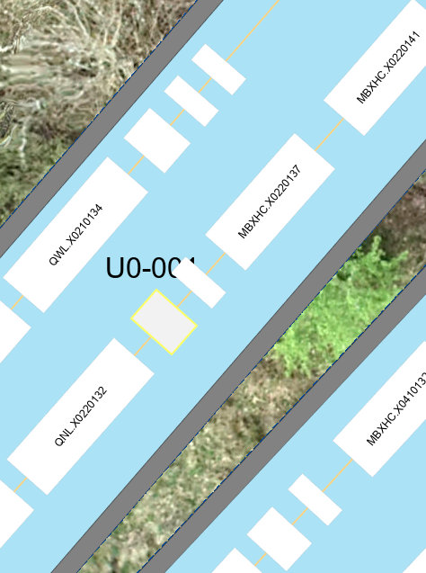
ARR for Approval
SPSX-M-ARR-0002
Version 0.1
Asset Replacement Request - Magnet replacement
By Philip Schwarz
Due to a coil leak, LSX.X0220134 must be replaced.

Slide 13
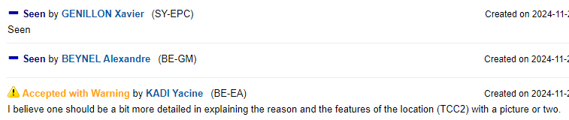
ARR for Approval
SPSX-M-ARR-0002
Version 0.1
Asset Replacement Request - Magnet replacement
By Philip Schwarz
Seeking approval from EATM

Slide 14
Thank you!

