Slide 1
Bunch rotation studies in the PS and SPS
MD Days 04/02/2025
Jake Flowerdew, Alexandre Lasheen, Ivan Karpov,
Heiko Damerau
Acknowledgements:
PSB, CPS and SPS operators, MD coordinators

Slide 2
Outline
Bunch rotation in the PS: PS-to-SPS transfer studies
  RF parameter scans for LHC-type beam at LIU intensities.
  Tomography as a prediction tool.
Bunch rotation in the SPS for short AWAKE bunches
  First implementation of ‘Quadrupole pumping’ bunch rotation scheme at CERN.

Slide 3
Bunch rotation in PS:
PS-to-SPS transfer studies

Slide 4
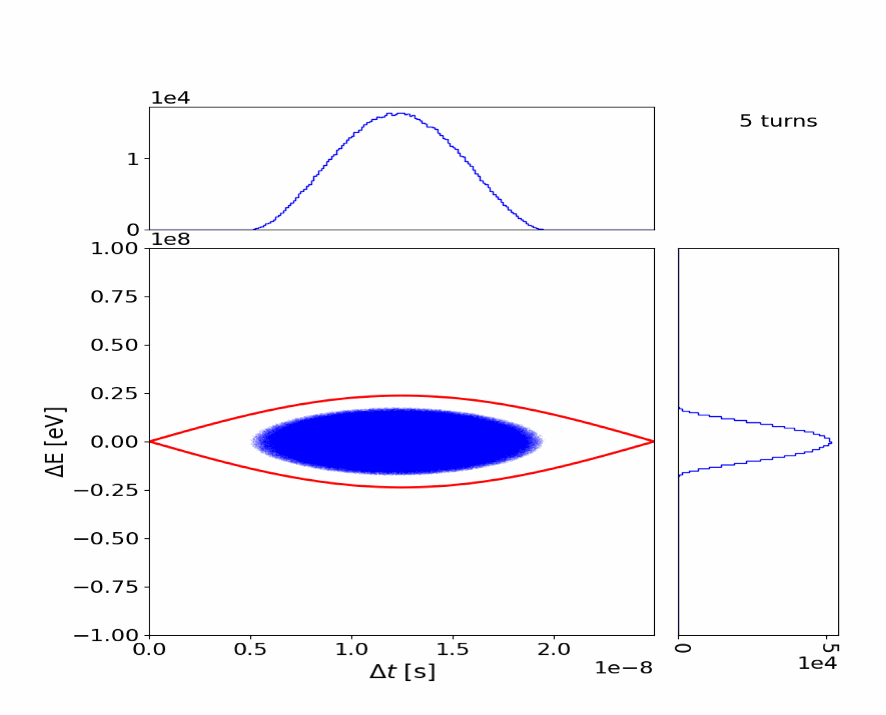
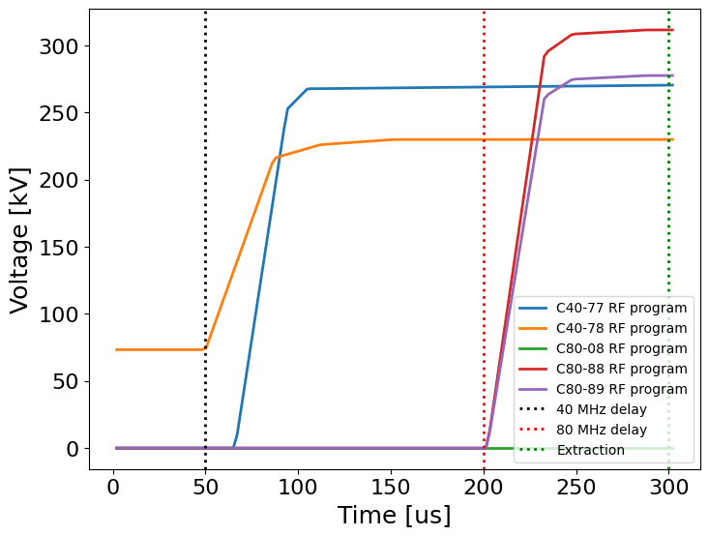
Bunch rotation in the PS
PS-to-SPS transfer involves handing over from 40 MHz RF (PS) to 200 MHz RF (SPS).
Need to fit a 14 ns bunch in a 5 ns bucket.
40 MHz delay
80 MHz delay

Slide 5
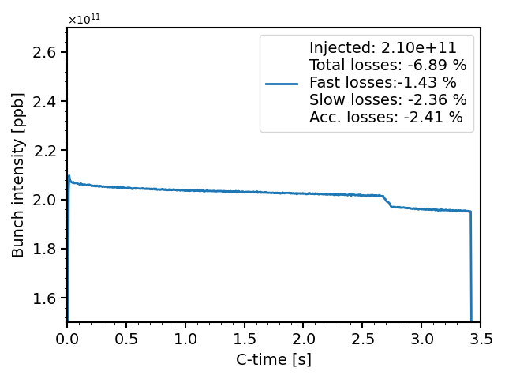
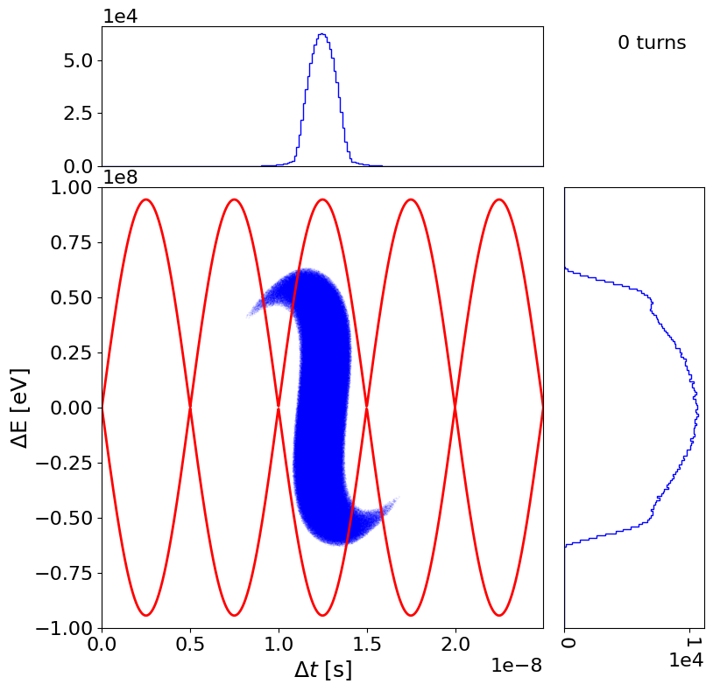
Definition of losses in the SPS
Fast losses: Losses observed at injection (first 50 ms)
Slow losses: Flat bottom losses
Acceleration losses: Uncaptured beam, lost at start of ramp.
Uncaptured beam
SPS DC BCT
SPS
Fast losses
Acceleration losses
Slow losses

Slide 6
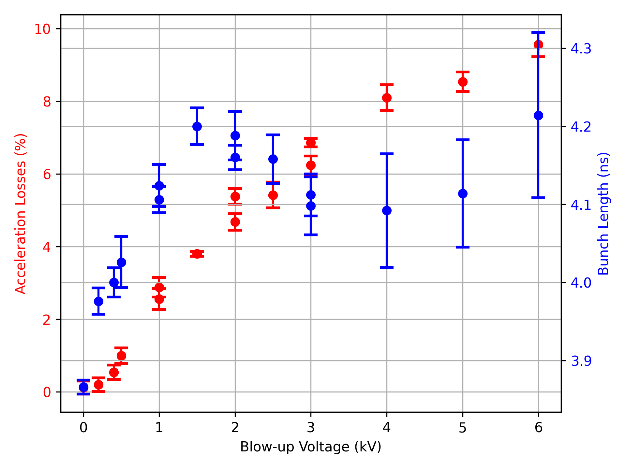
Definition of losses in the SPS
Fast losses: Losses observed at injection (first 50 ms)
Slow losses: Flat bottom losses
Acceleration losses: Uncaptured beam, lost at start of ramp.
Uncaptured beam
Single bunch
Emittance blow-up
SPS
SPS DC BCT
Fast losses
Acceleration losses
Slow losses

Slide 7
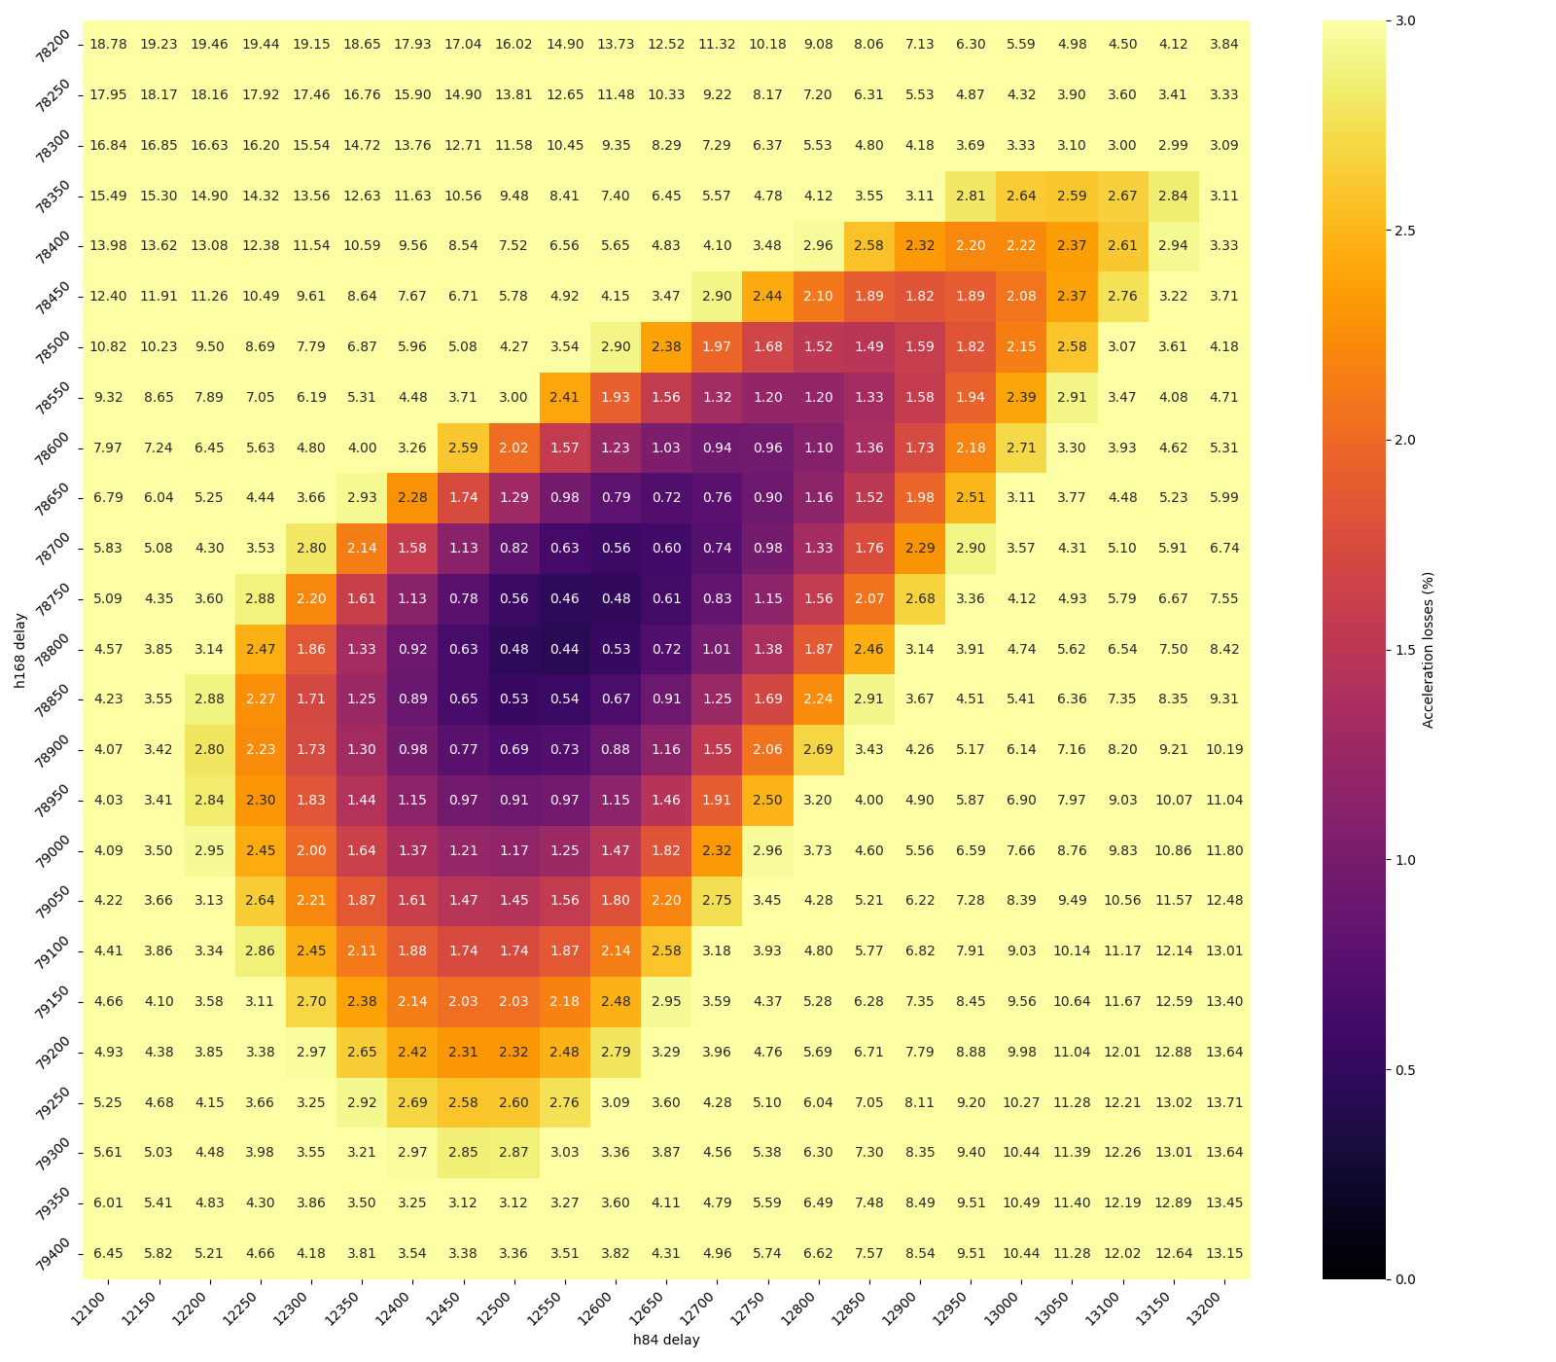
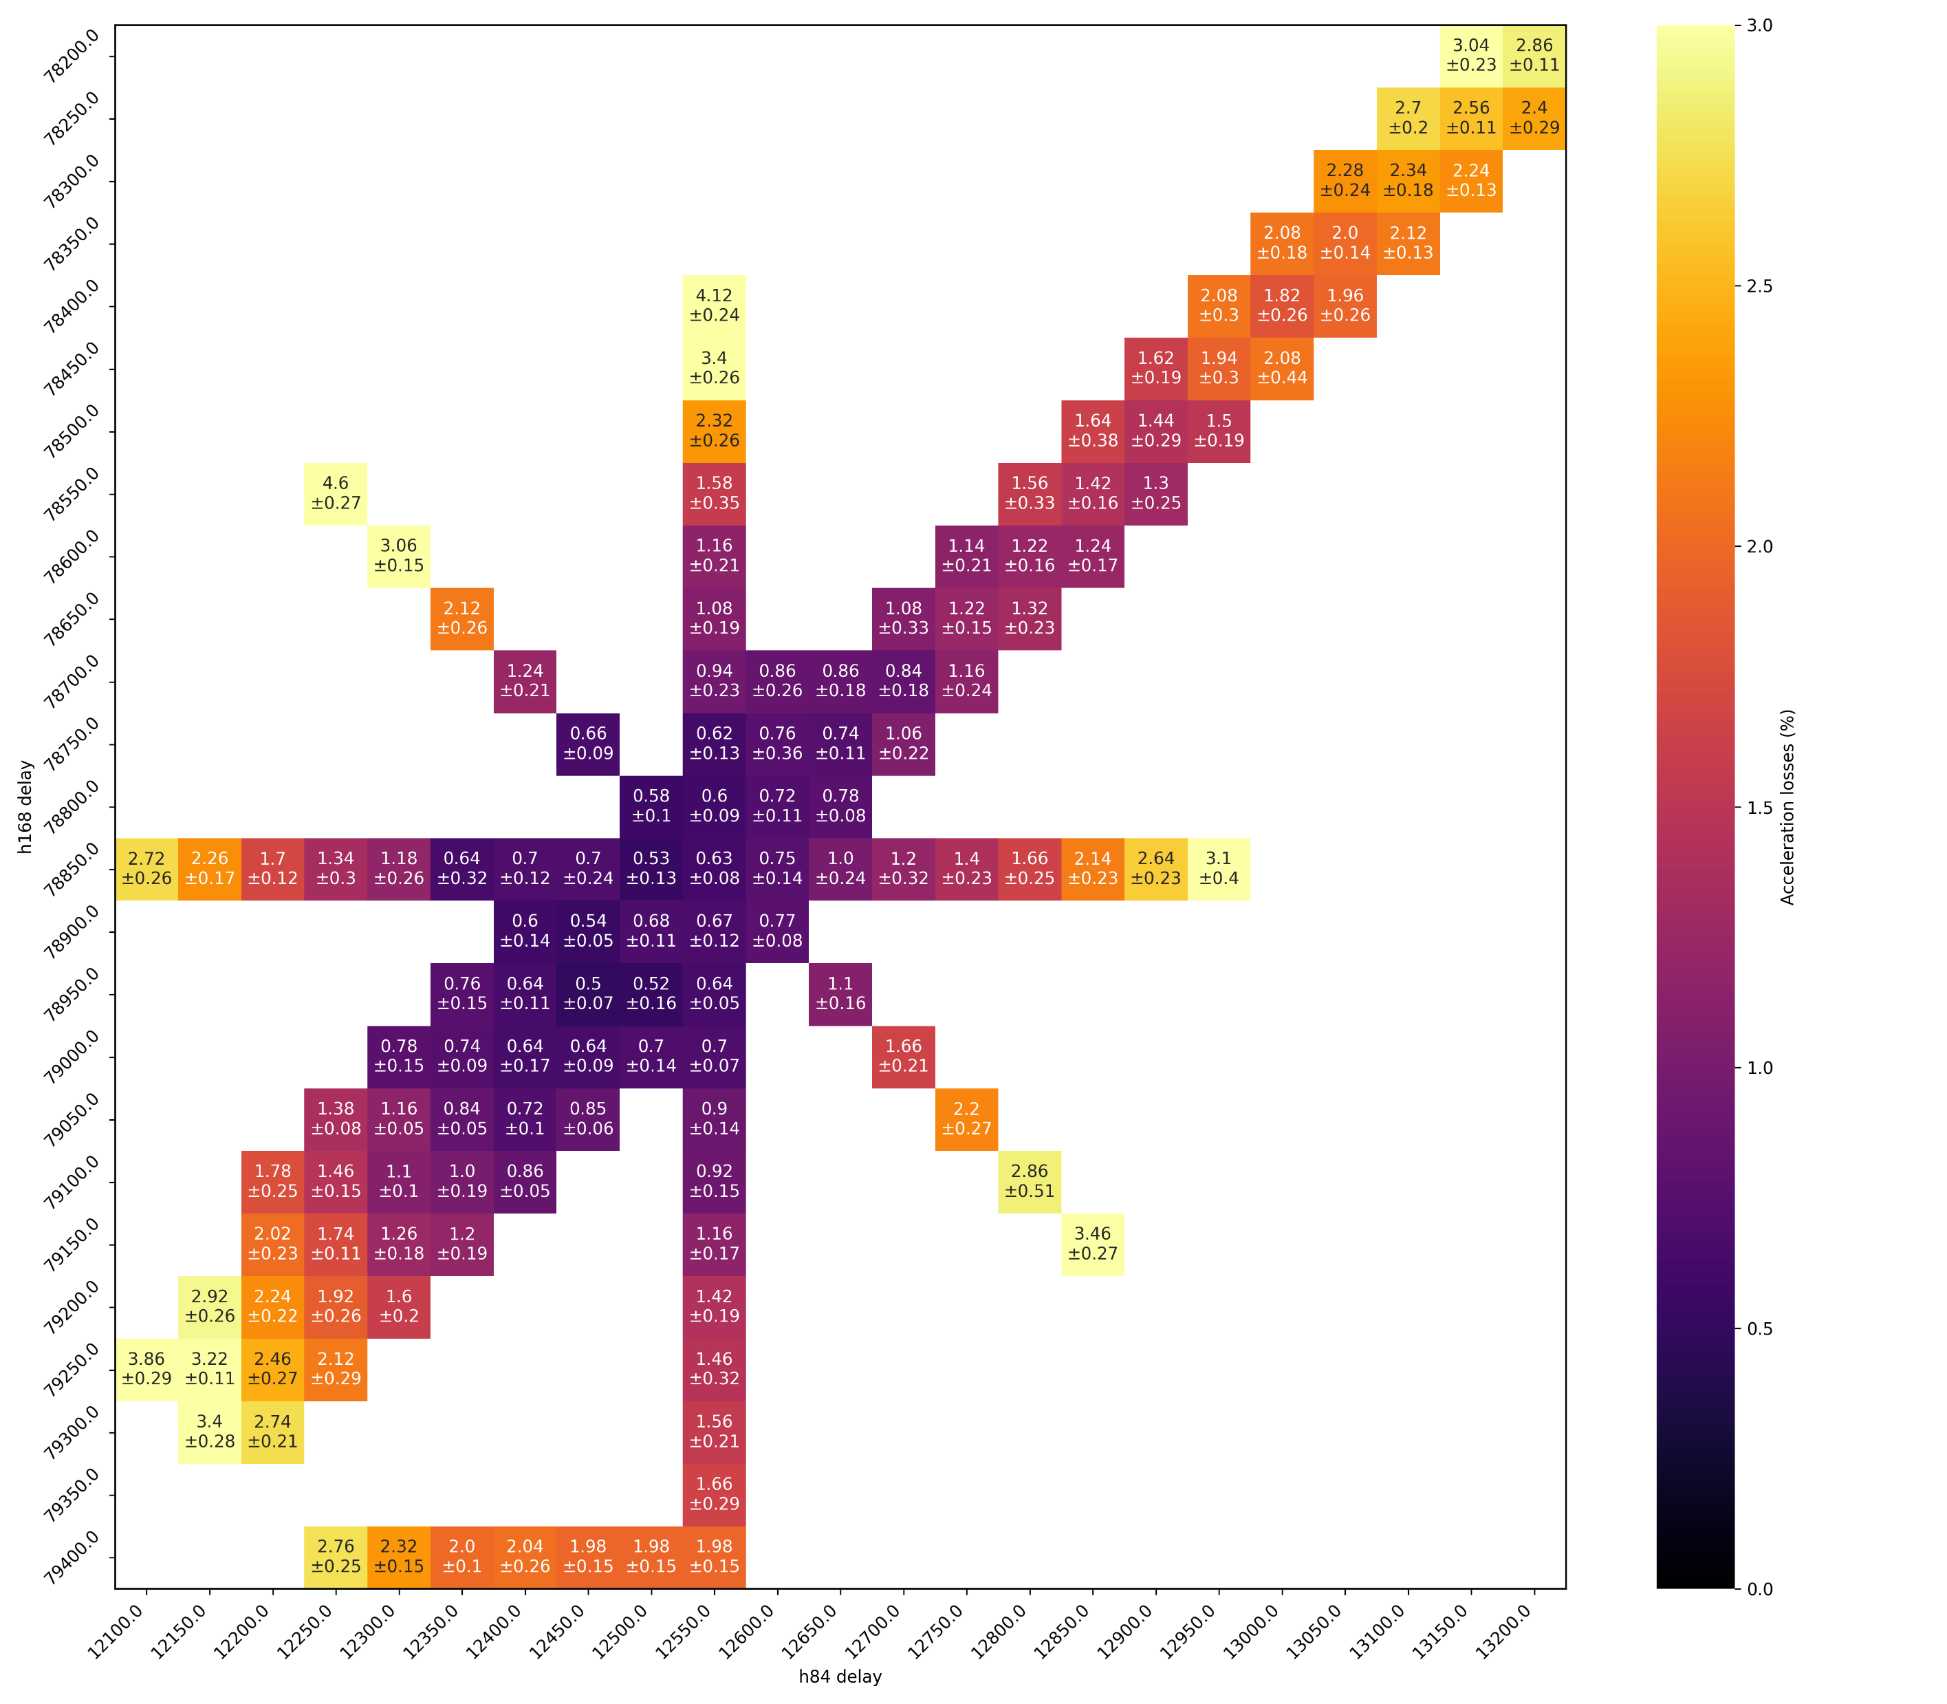



Bunch rotation parameter scans at LIU intensity
MD with LHC-type beam at $2.6×{10}^{11}$ ppb, 72 bunches – scan 40 & 80 MHz delays
$<1 \%$ acceleration losses at LIU intensities.
Simulation (BLonD)
Measurement
Simulation optimum: $0.60±0.09 \%$
Acceleration losses (%)
Acceleration losses (%)
80 MHz delay
80 MHz delay
Opperational:
$0.63±0.08 \%$
Measured optimum: $0.50±0.07 \%$
40 MHz delay
40 MHz delay

Slide 8
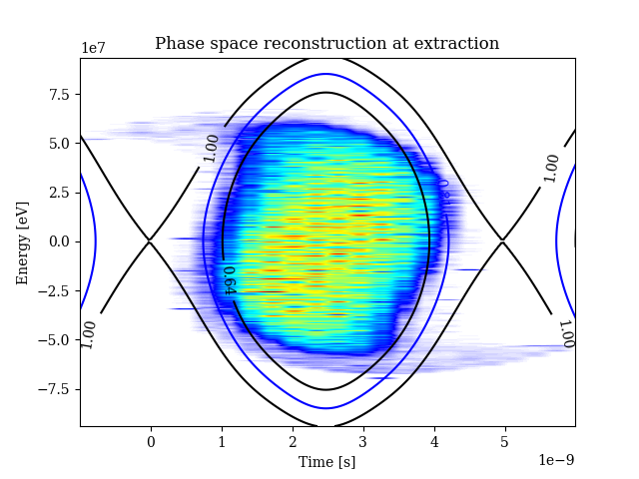
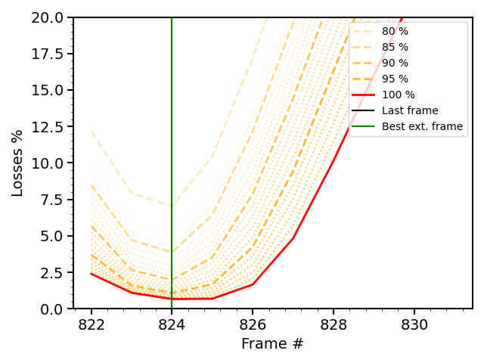
Tomography during bunch shortening in PS
Analysis ongoing to use tomography in the PS to predict acceleration losses in the SPS.
Projection of acceleration losses
PS
SPS

Slide 9
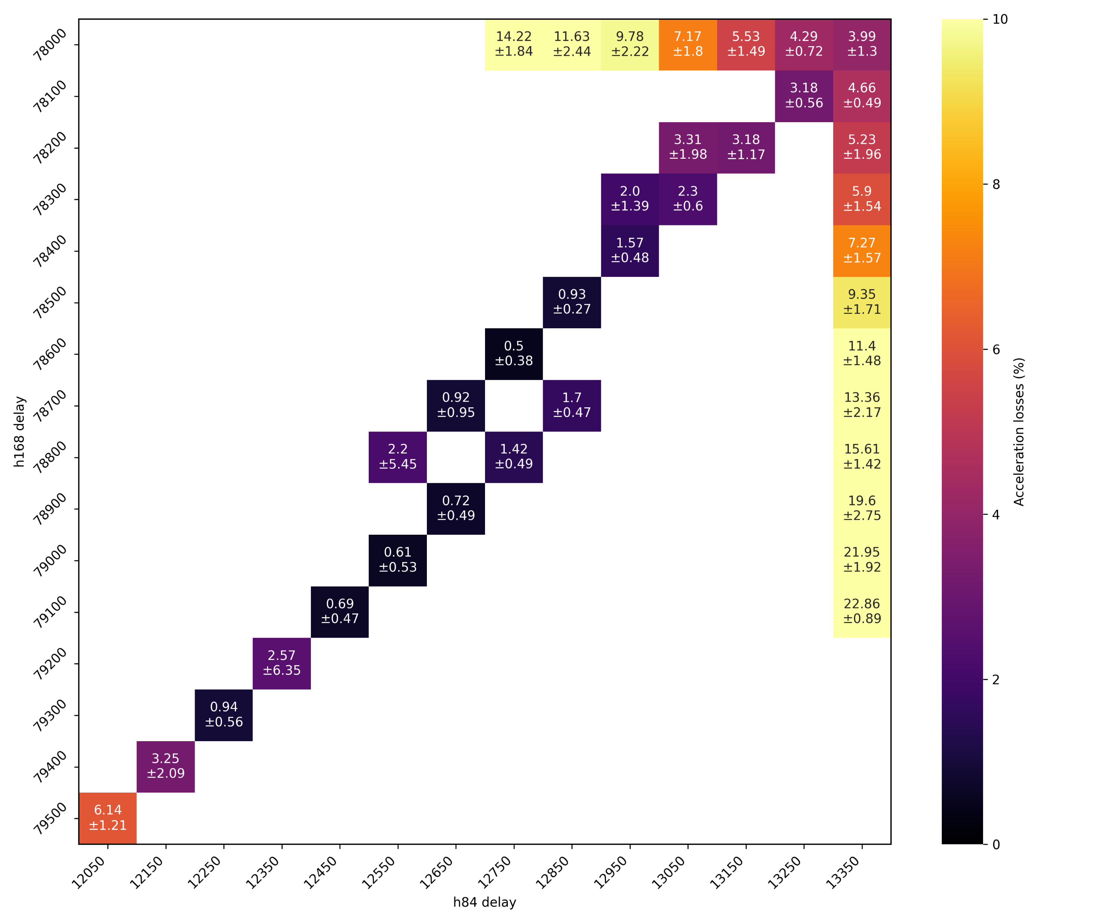
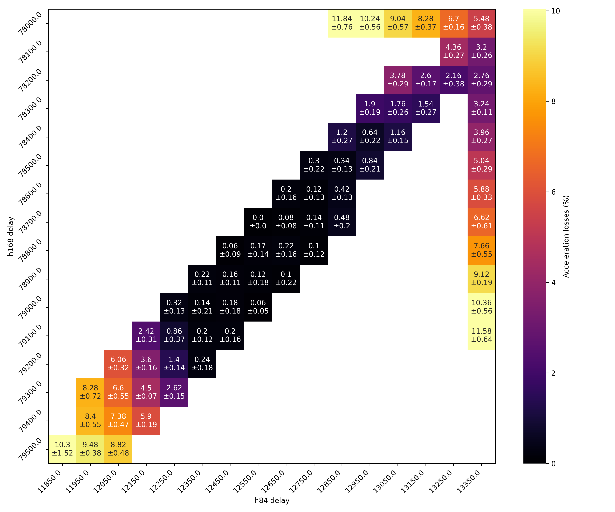
Tomography during bunch shortening in PS
Analysis ongoing to use tomography in the PS to predict acceleration losses in the SPS.
Good agreement between tomography prediction and measurement for single bunch.
  Extending analysis to multi-bunch (ongoing – more details at IPP).
Projection of acceleration losses
Tomography
prediction
Measurement
Single bunch
Single bunch

Slide 10
Bunch rotation in SPS:
Short bunches for AWAKE

Slide 11
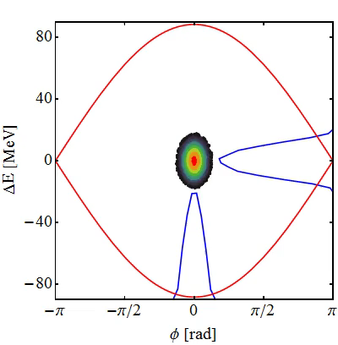
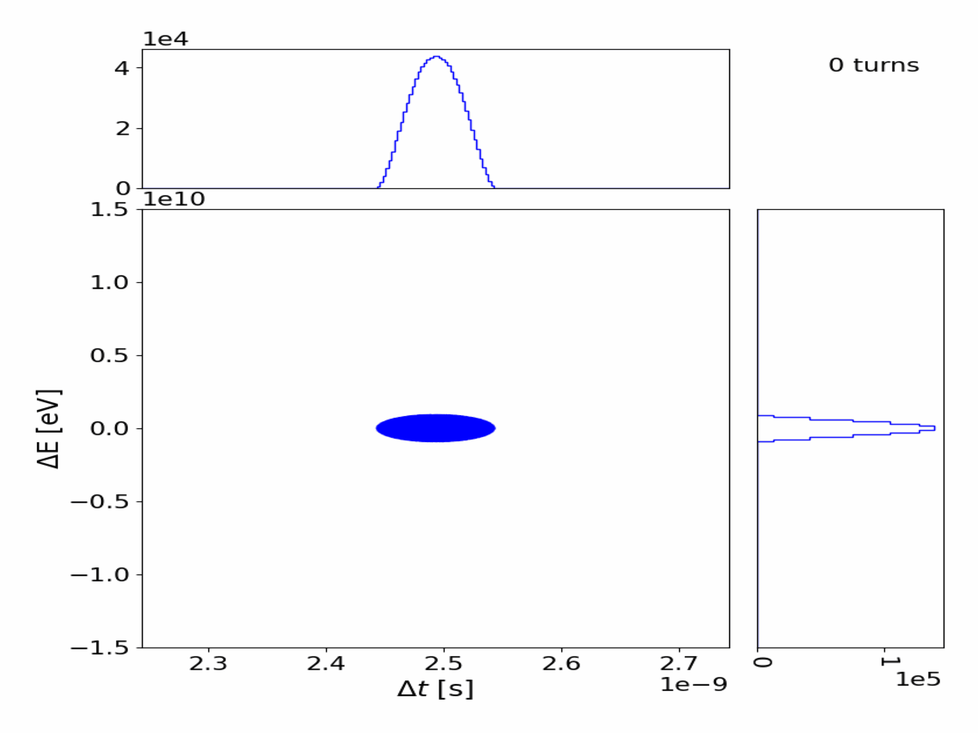
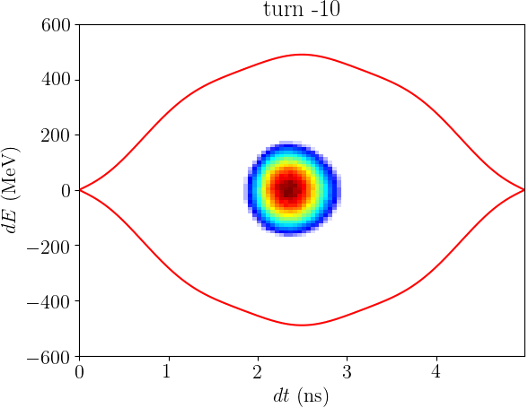

Bunch rotation schemes
Double voltage jump
(Operational for AWAKE)
Phase jump
to unstable fixed point
Quadrupole pumping*
*F. Willeke
$$V_{RF}∝V_{pk}\sin{2f_{s}}$$
I. Karpov, IPP 2024
H. Damerau, CAS 2023
J. Flowerdew, PEEP 2024

Slide 12
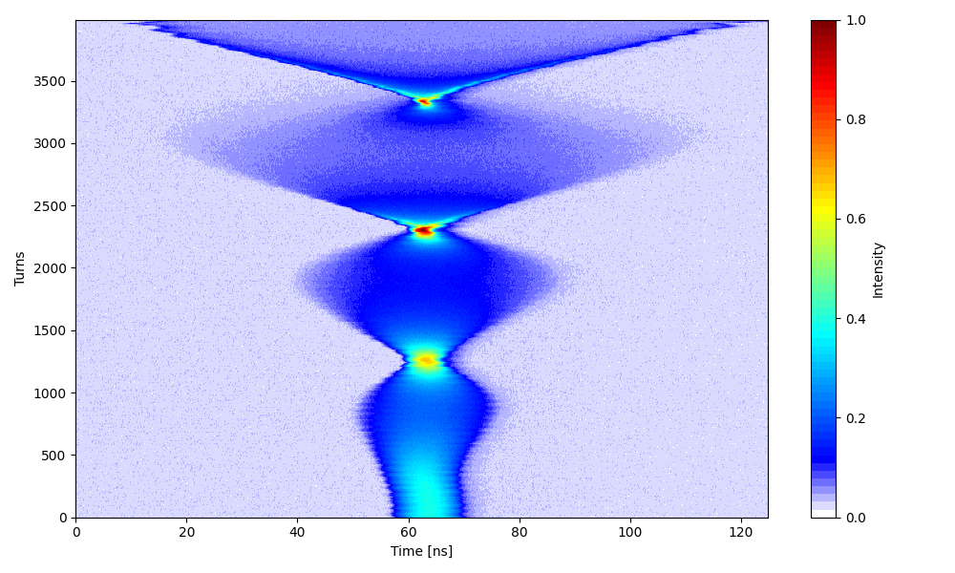
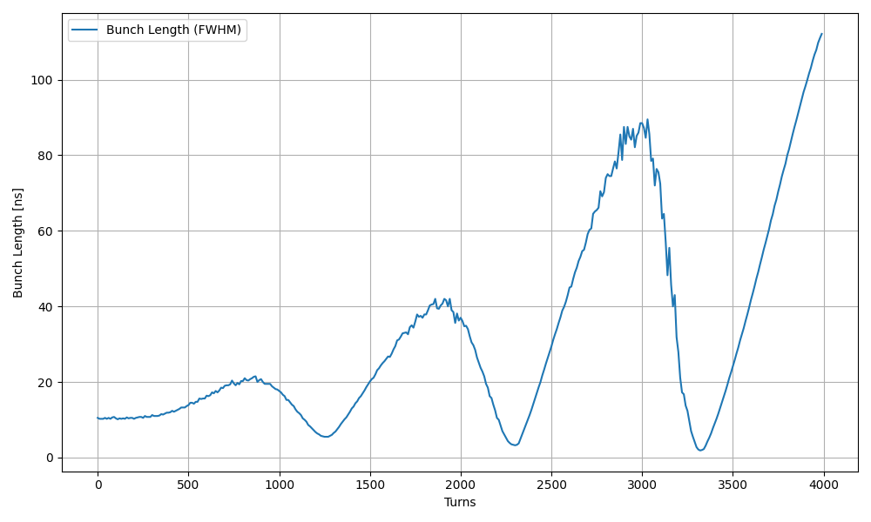
Quadrupole pumping in the PS
PS
Compression factor of 5.5
10.5 ns
1.9 ns
Proof-of-principle demonstration of quadrupole pumping in the PS (Sep. 2024).
Single bunch, moderate intensity (no RF linearization).
First time at CERN!

Slide 13
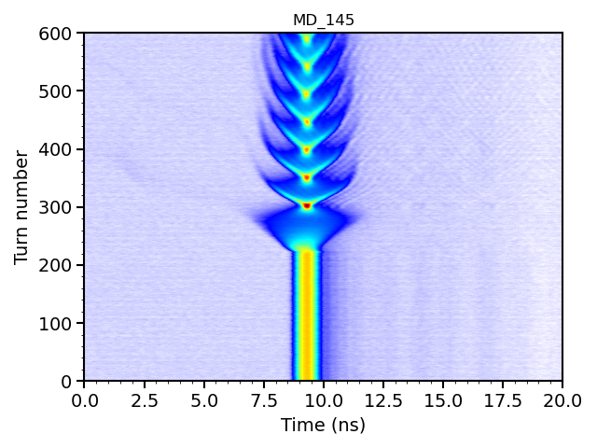

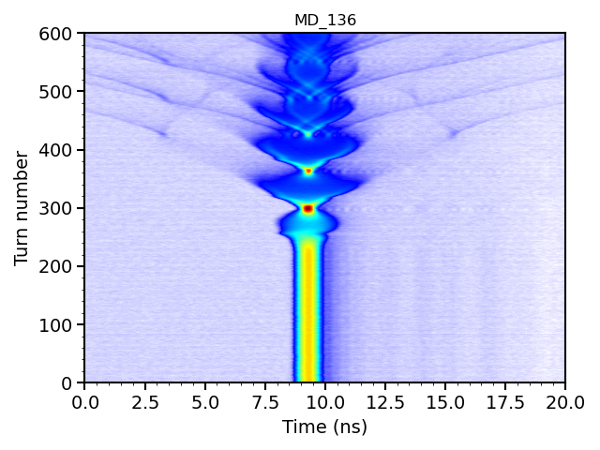
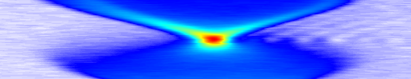
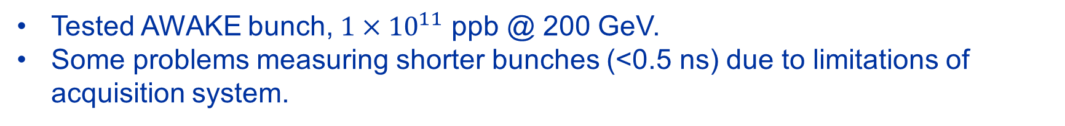
Comparison of bunch rotation schemes in the SPS
Phase jump
to unstable fixed point
Double voltage jump
Quadrupole pumping
SPS
SPS
SPS
Extraction
Extraction
Extraction
Tested AWAKE bunch, $1×{10}^{11}$ ppb @ 200 GeV.
Some problems measuring shorter bunches (<0.5 ns) due to limitations of acquisition system.

Slide 14
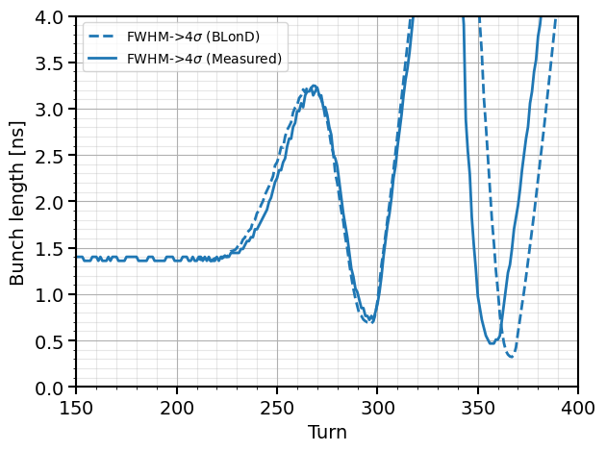
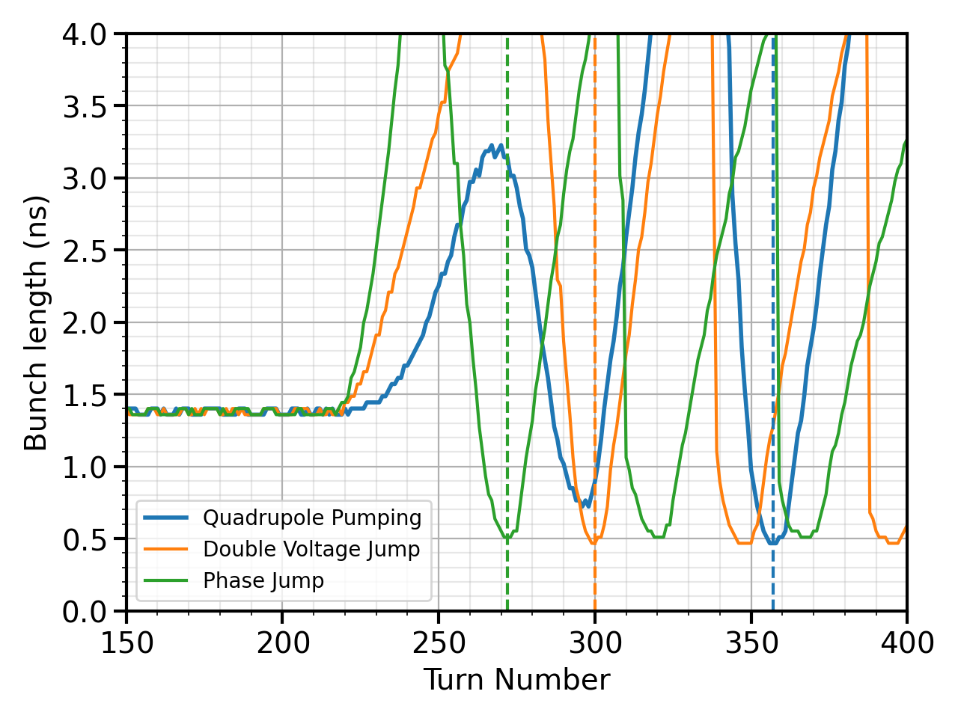
Quadrupole pumping for AWAKE?
Measurement vs simulation
Comparison of schemes
Analysis still ongoing…
No significant improvement over the double voltage jump or phase jump.
However, quadrupole pumping needs shorter initial bunches to stay within linear region.
Measurements with streak camera.

Slide 15
Conclusions
PS-to-SPS studies & Bunch Rotation (MD12244)
  Issues: No blocking issues.
  Status: Ongoing, reduced MDs in 2025 (multiple batches).
  Problem is understood, resources should be focused on observation/ monitoring.
Quadrupole Pumping for Bunch Shortening in SPS (MD14123)
  Issues: MD scope acquisition limitations for bunches < 0.5 ns.
  Status: Measurements complete, analysis ongoing. Streak camera measurements would be needed to take scheme further.
  Quadrupole pumping technique demonstrated, further work needed to see benefits.

Slide 16
Back up slides

Slide 17
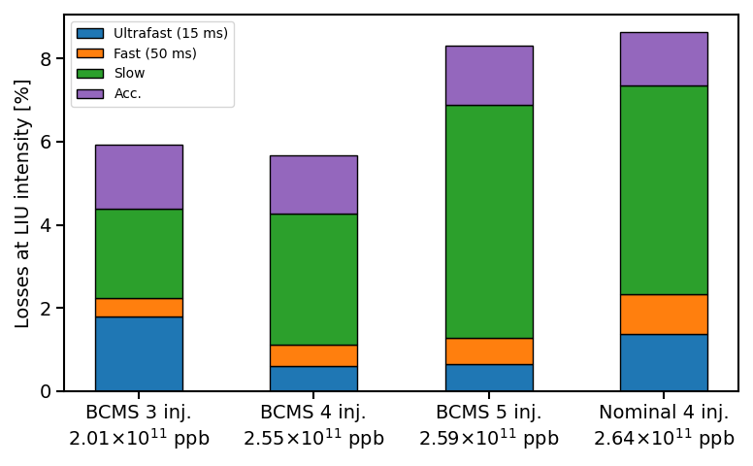
PS-to-SPS losses 2024

Slide 18
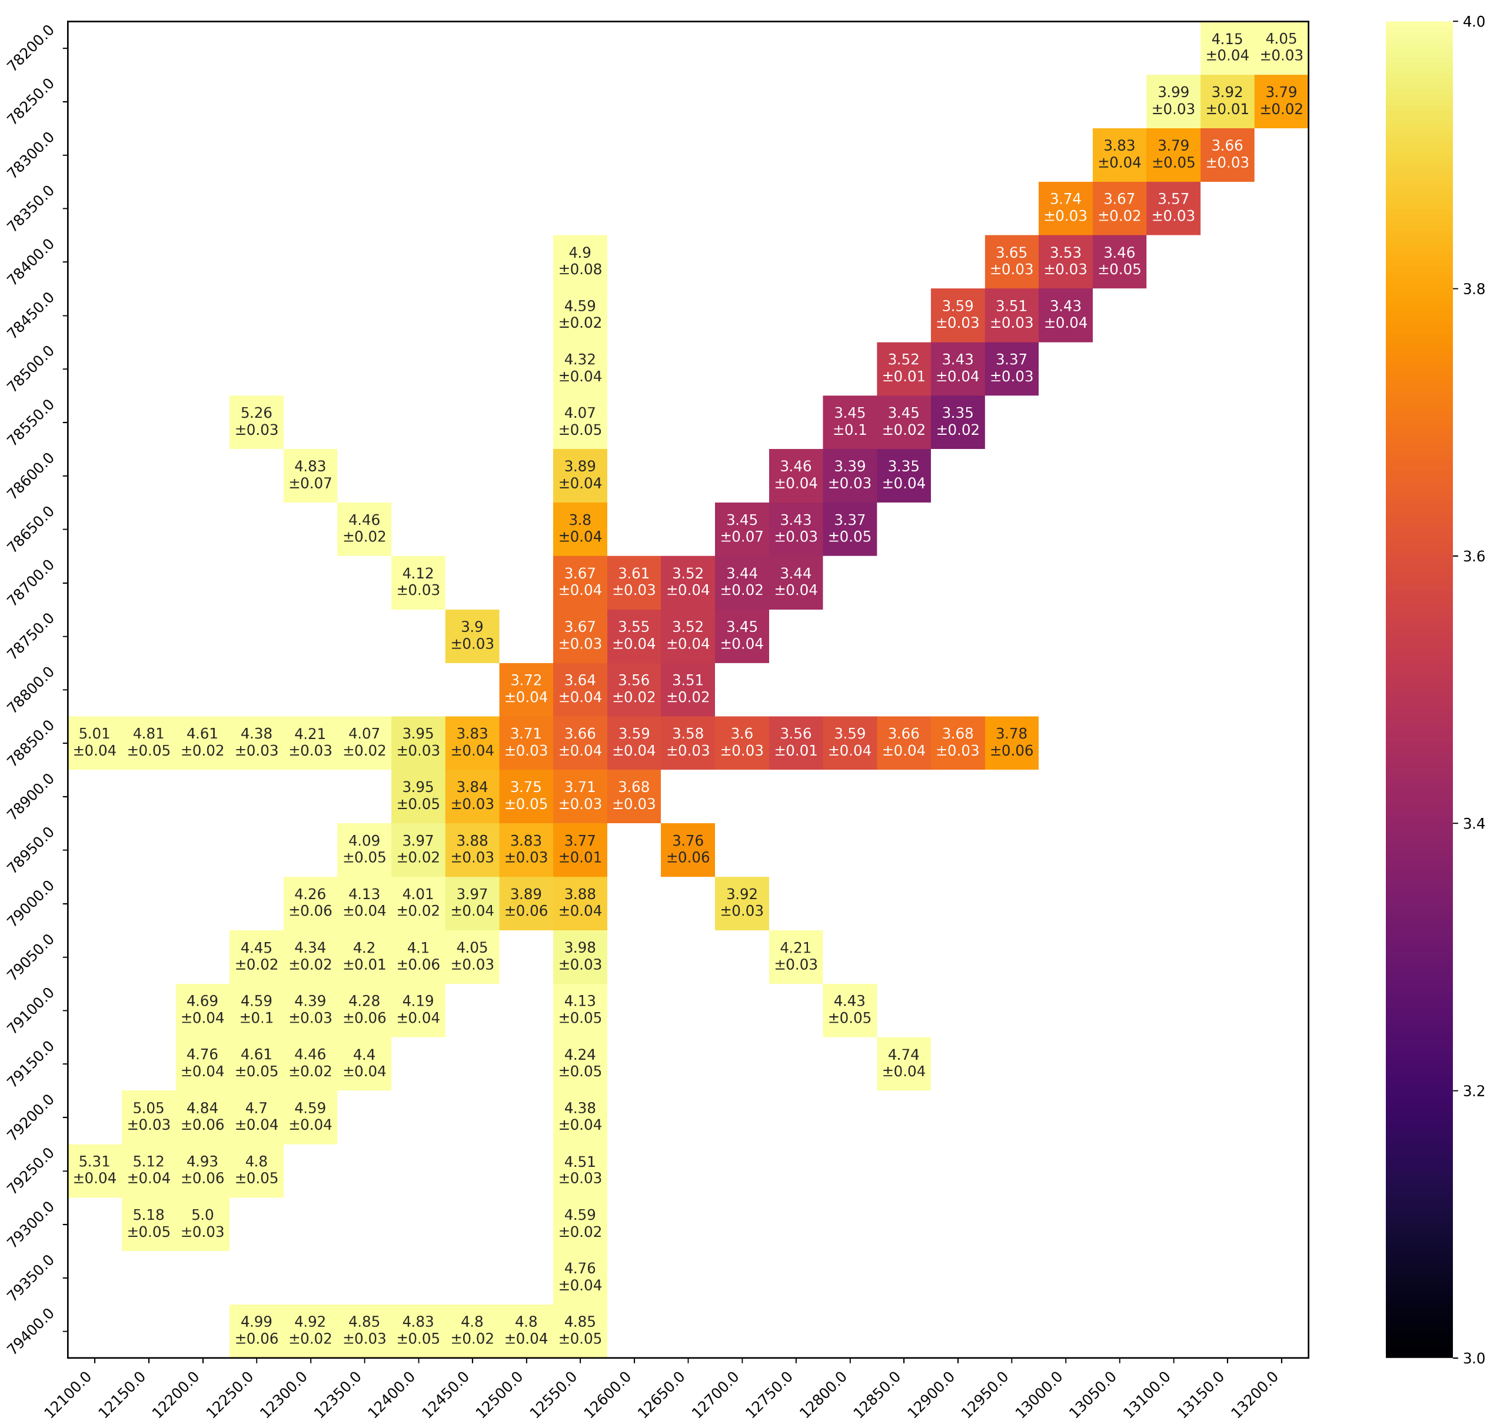




Acceleration losses and bunch length
Acceleration losses
Bunch length
80 MHz delay
$1.30±0.25 \%$
$3.35±0.02$ns
80 MHz delay
Acceleration losses (%)
Bunch length (ns)
$0.50±0.07 \%$
$3.88±0.03$ns
40 MHz delay
40 MHz delay

Slide 19
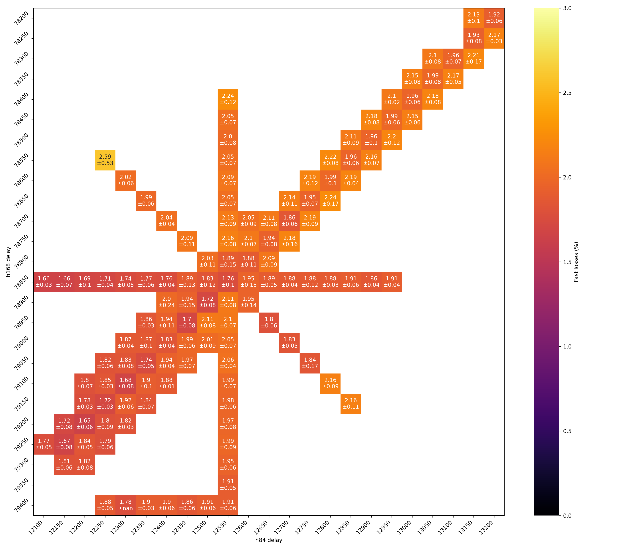
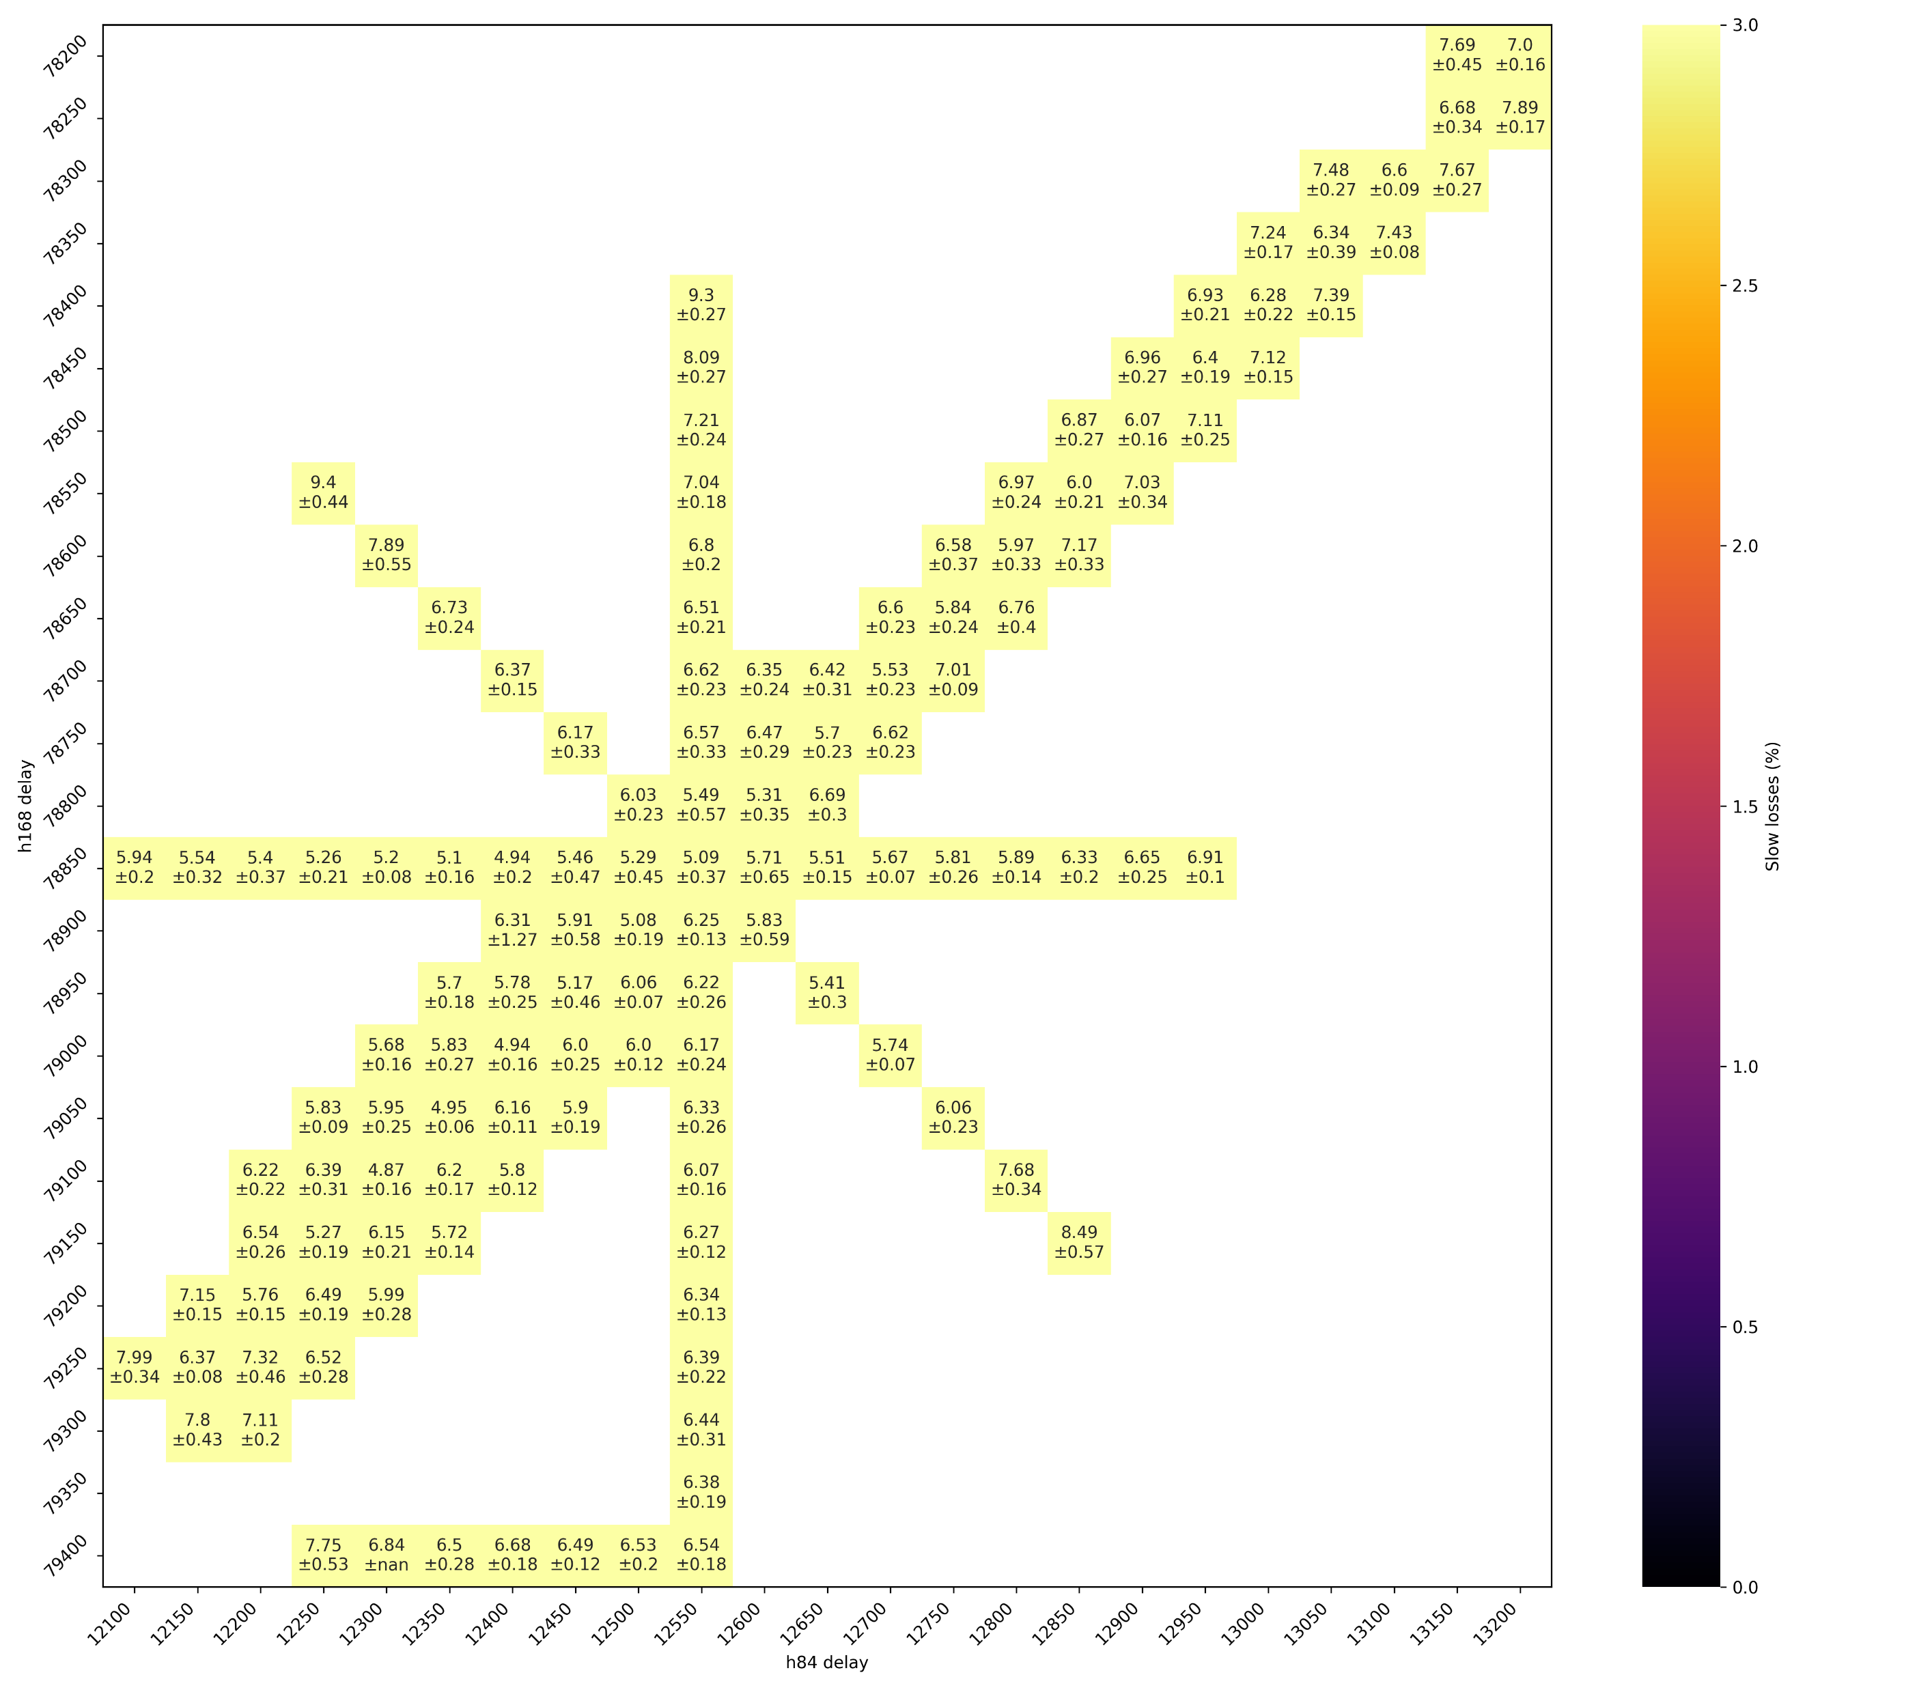
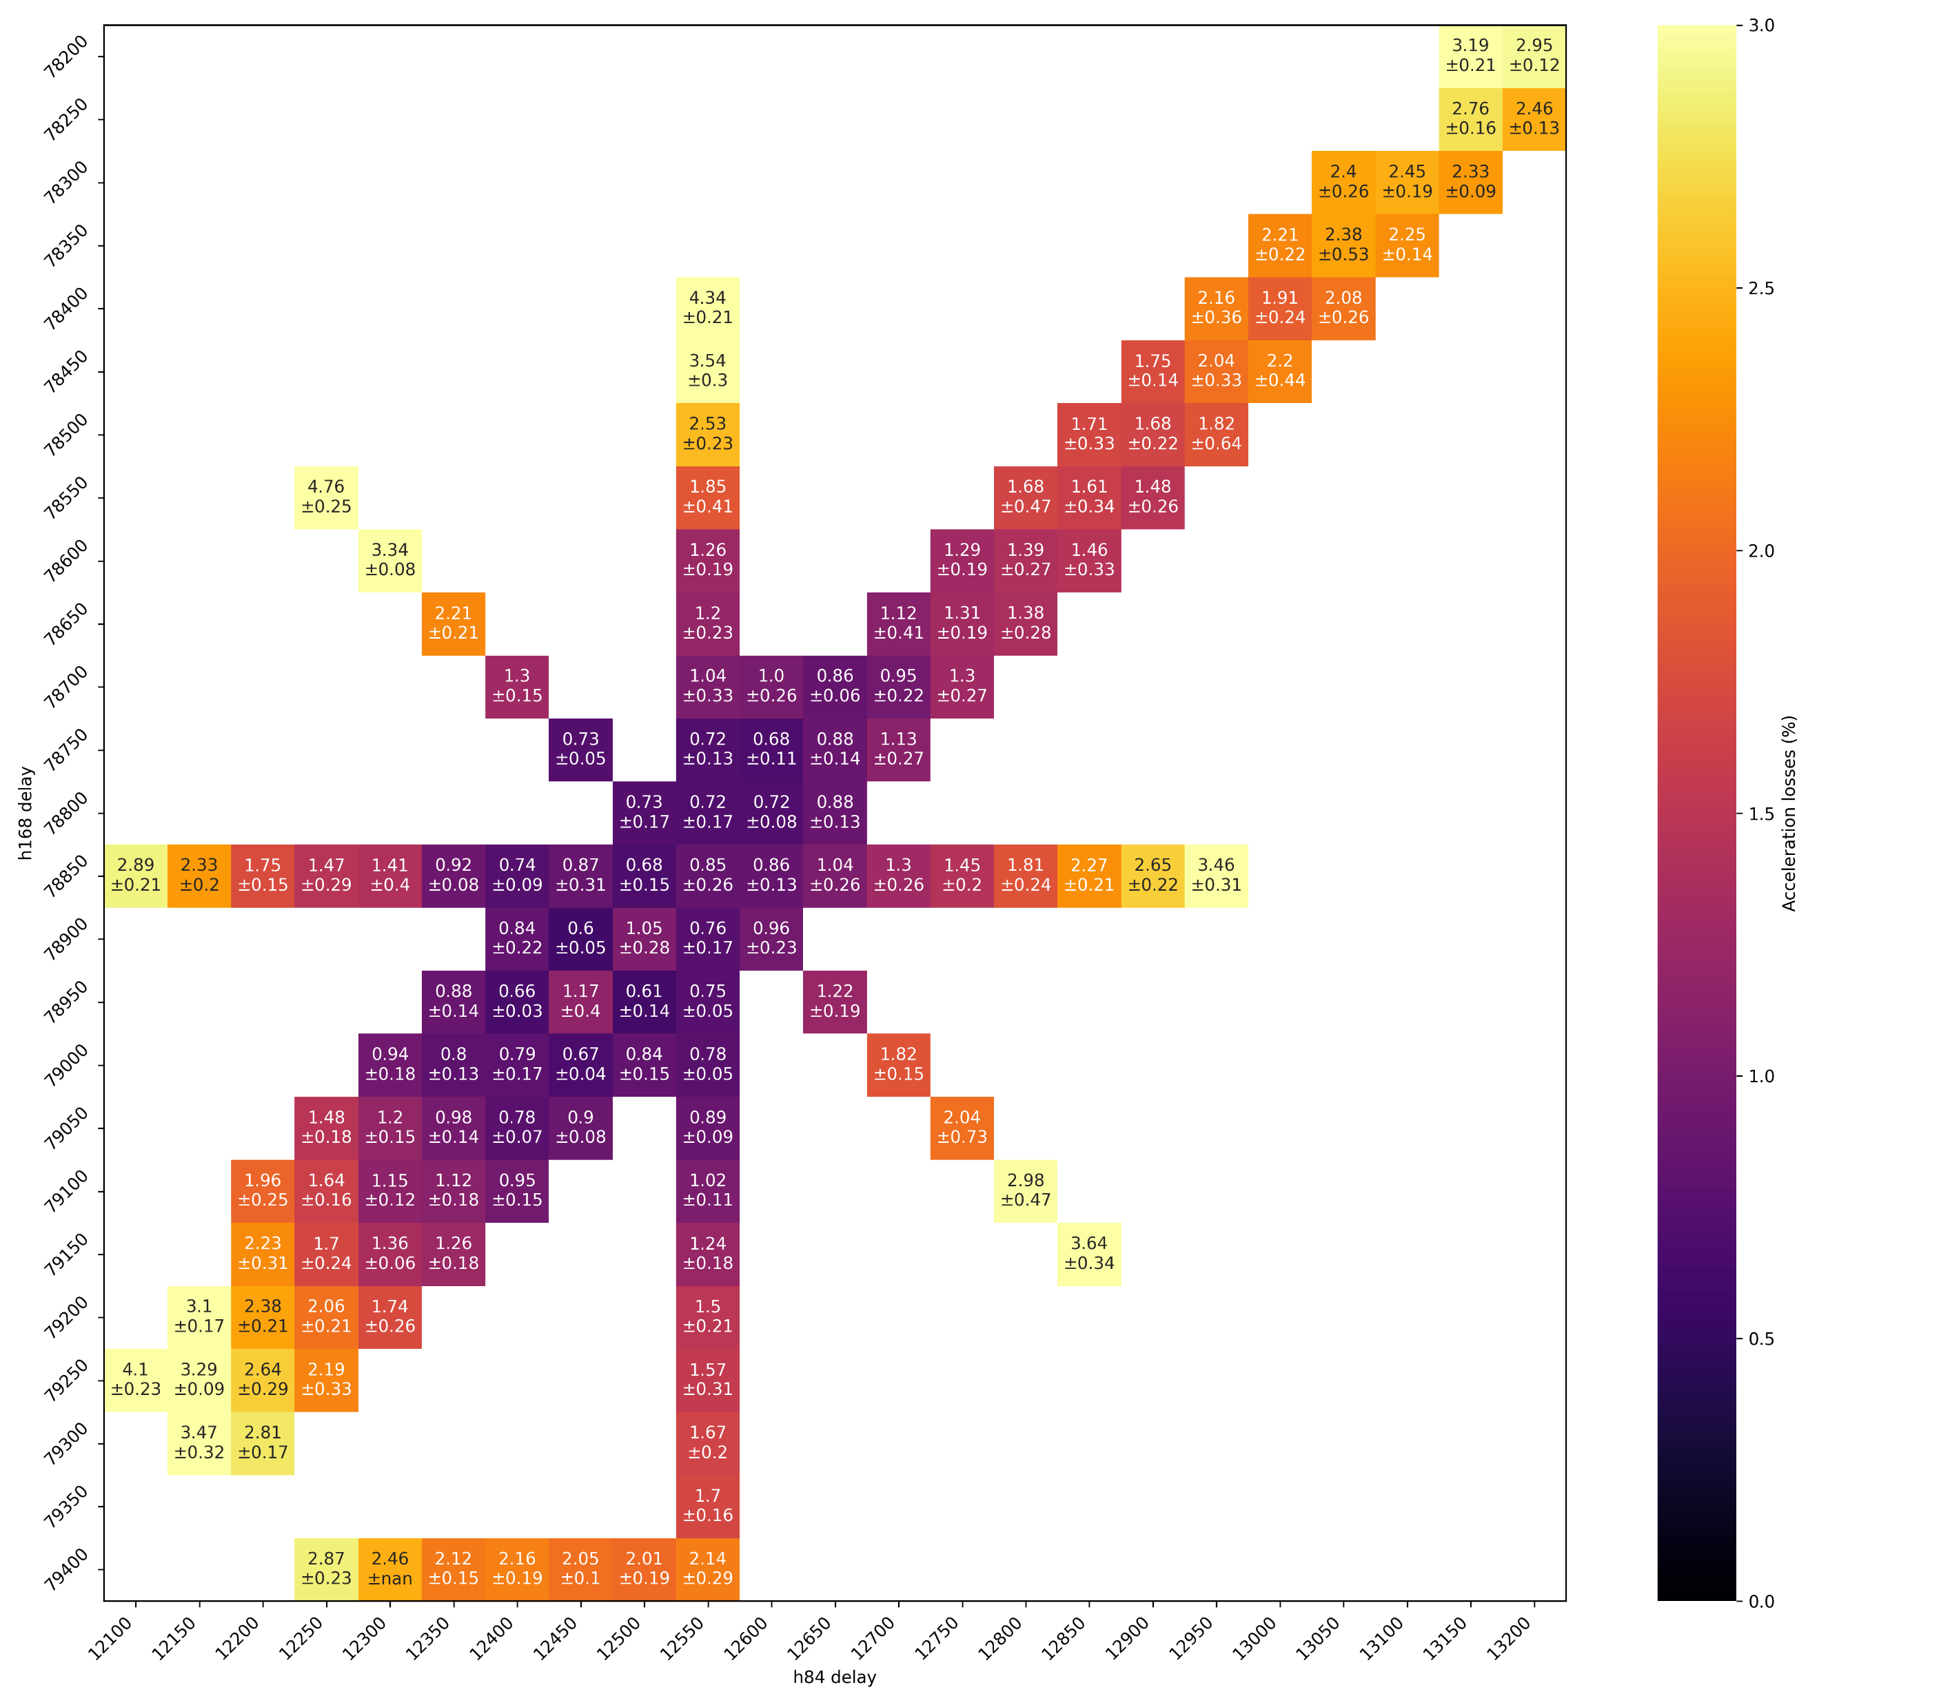
Comparison of Fast, Slow and Acceleration losses
Fast losses
Slow losses
Acceleration losses

Slide 20
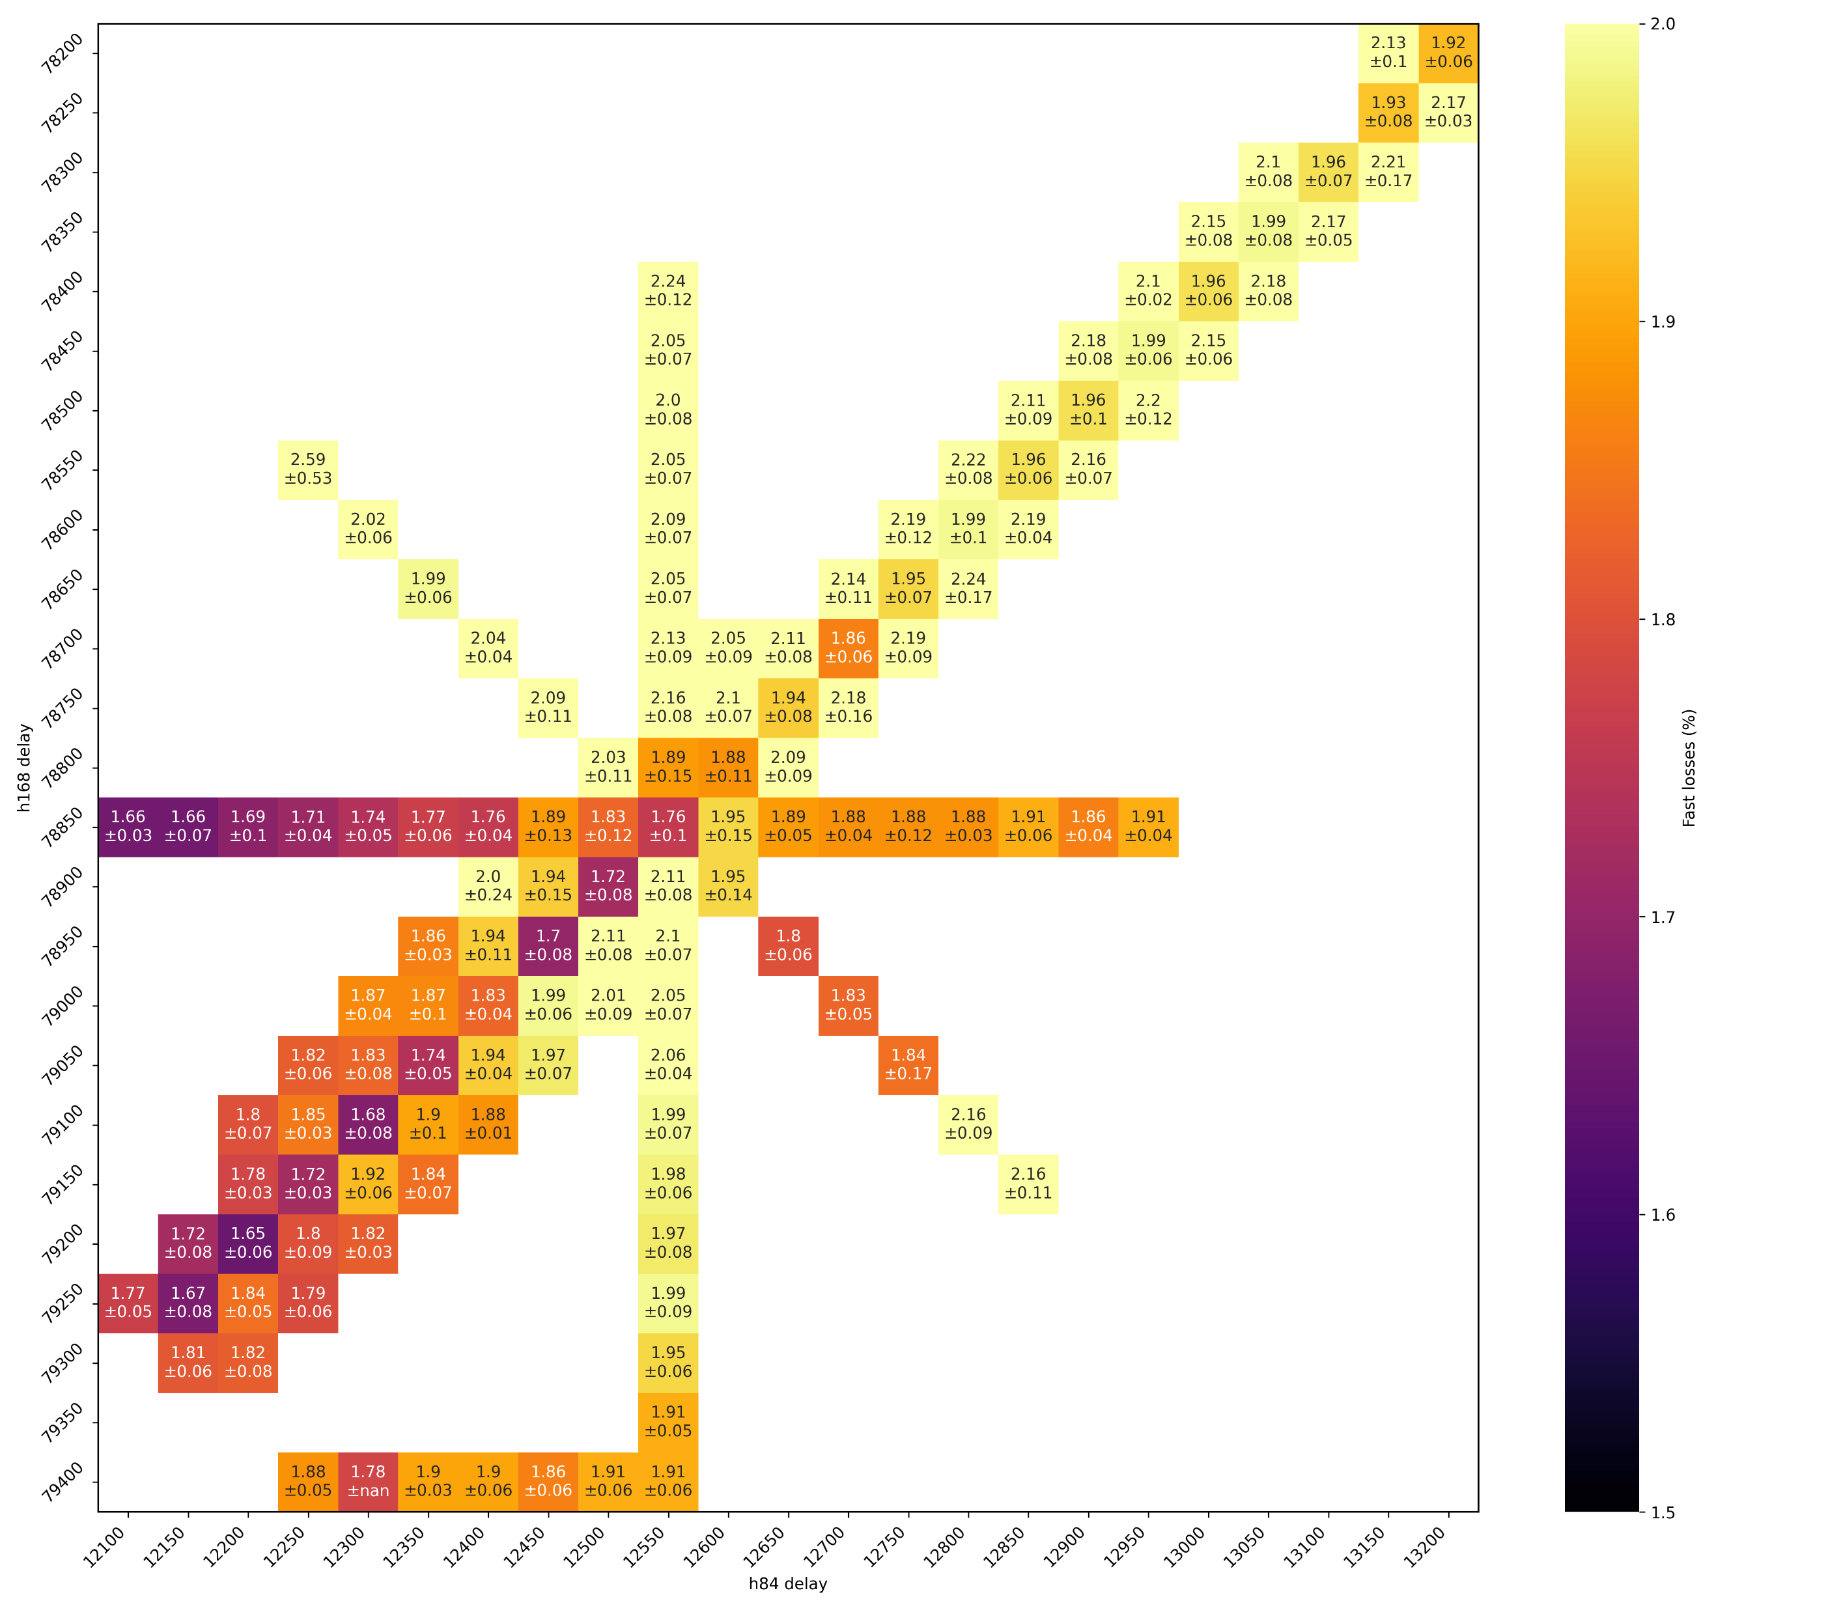
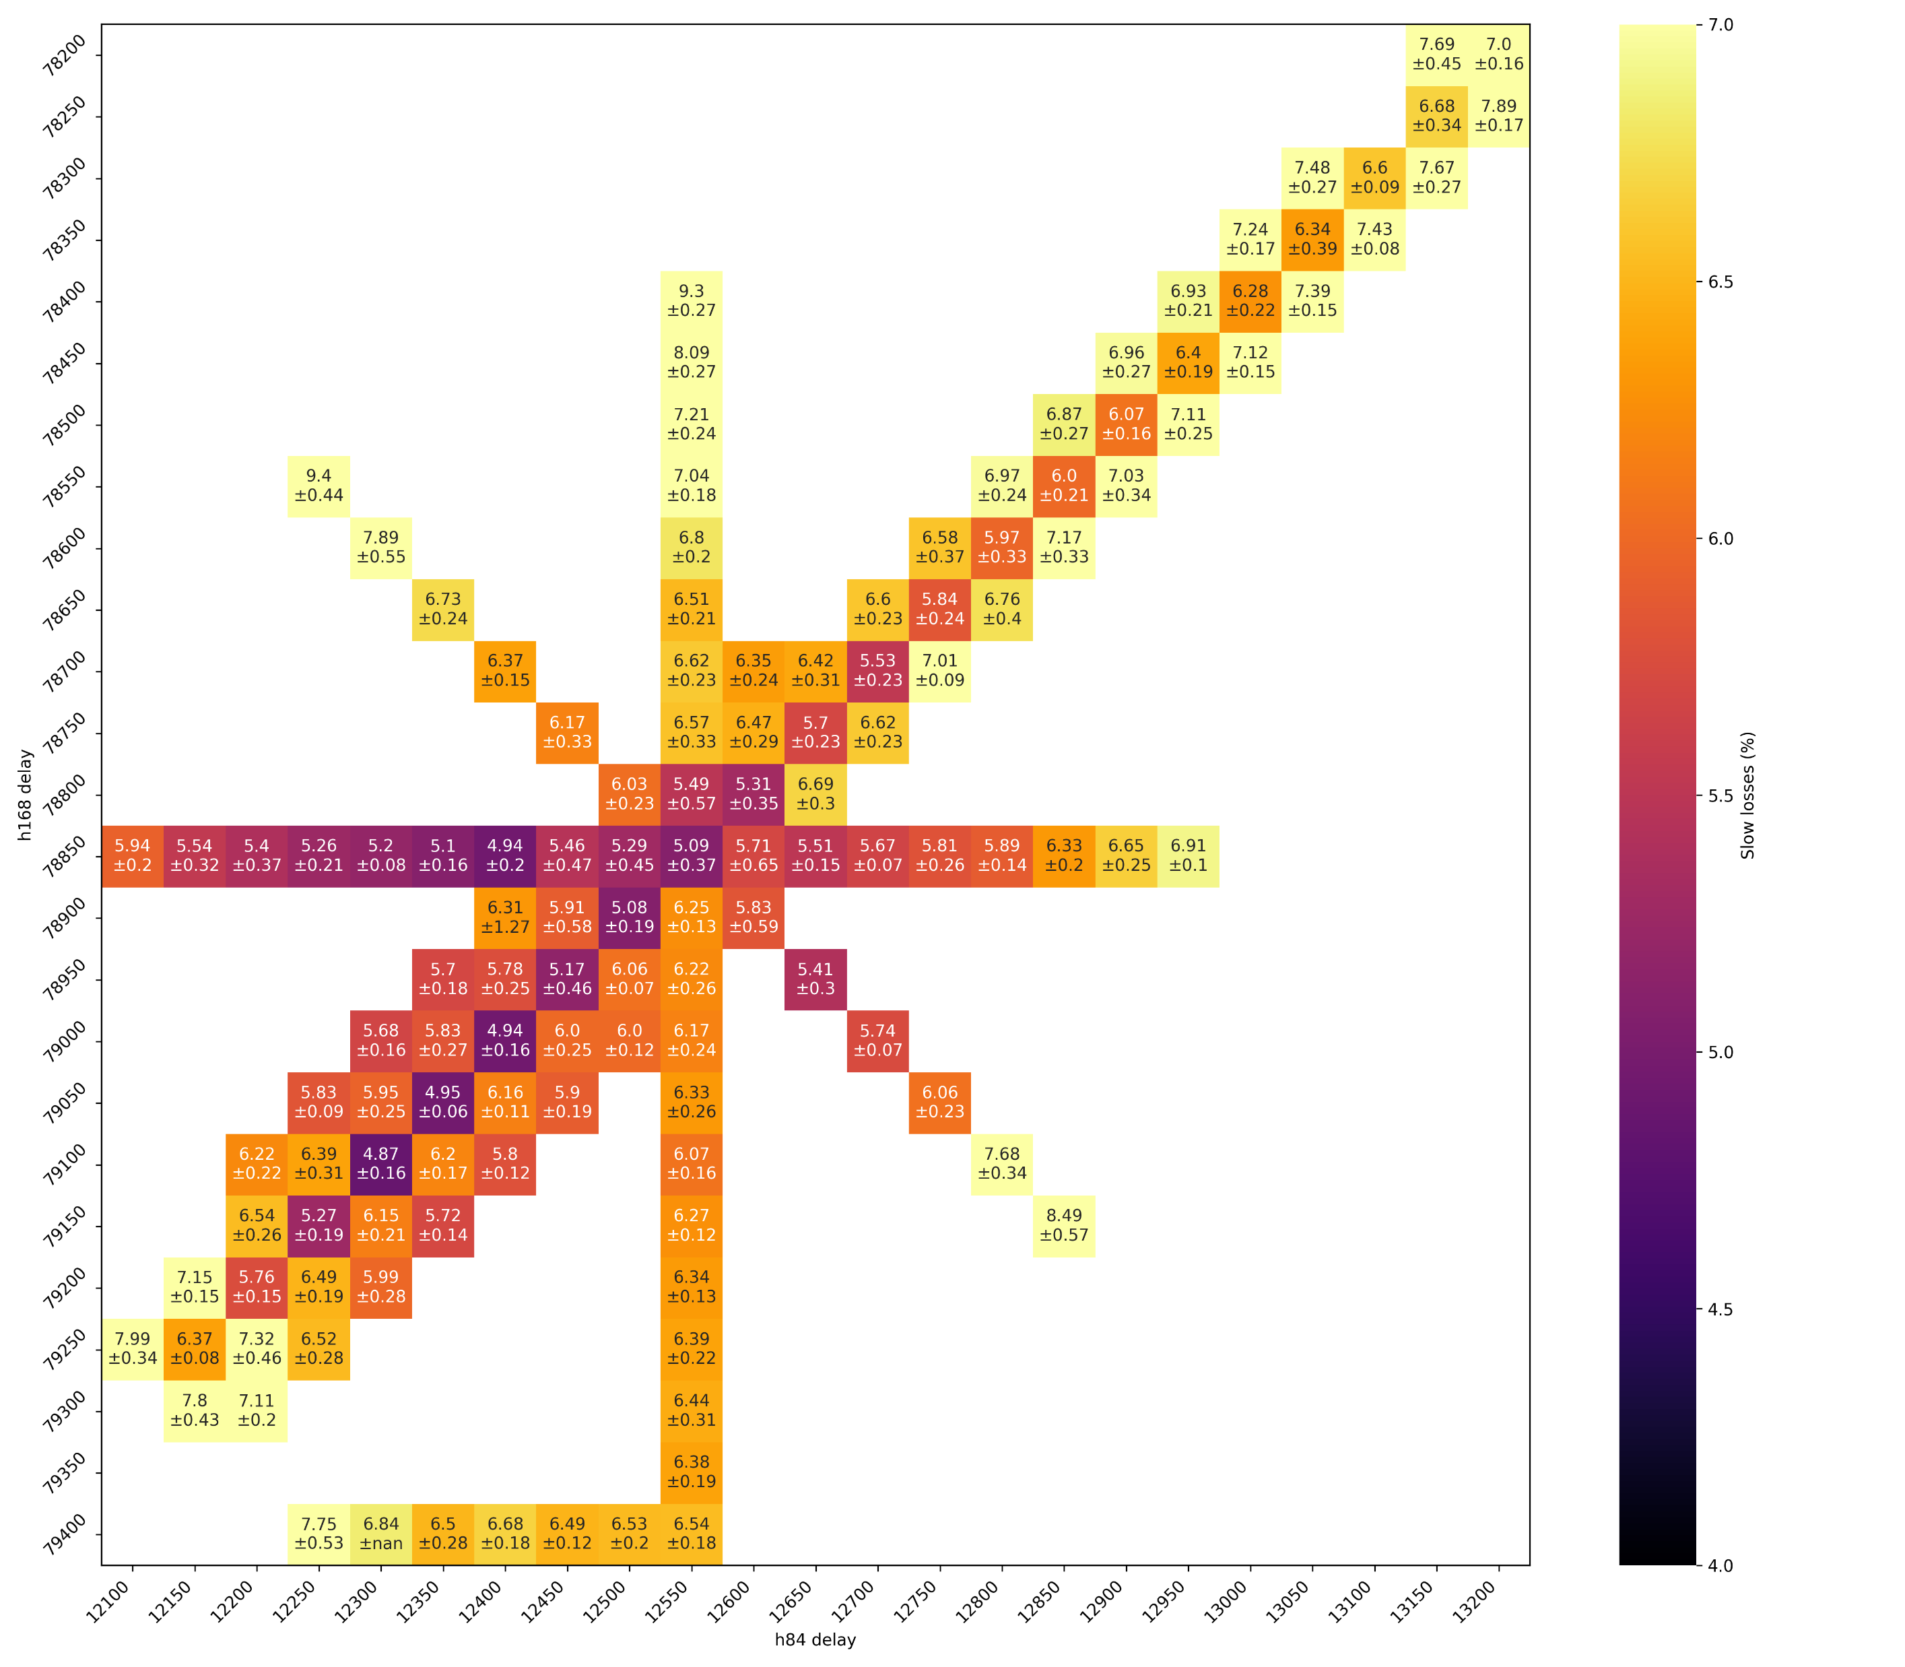
Fast and Slow losses
Fast losses
Slow losses

Slide 21
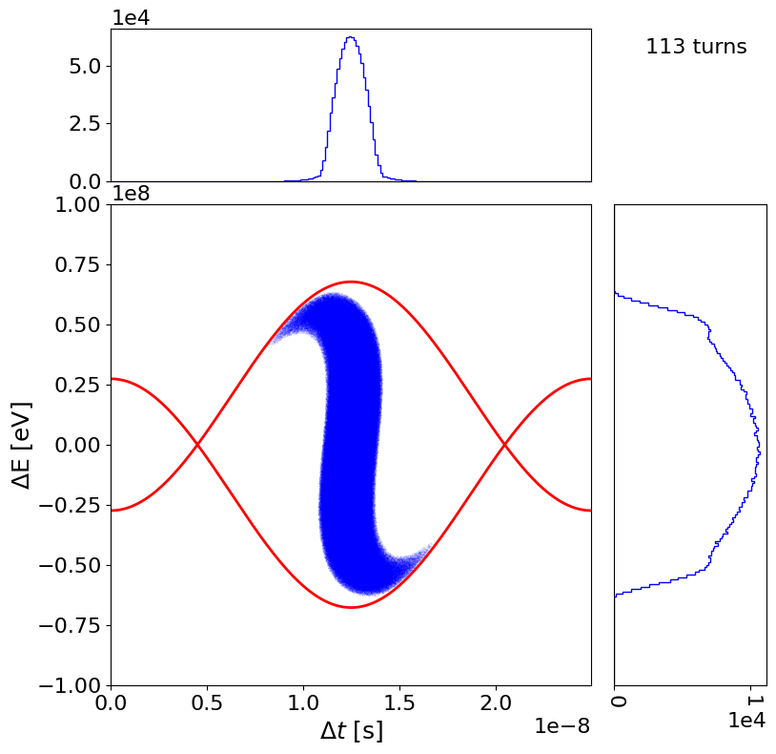
Bunch rotation in the PS
PS extraction
SPS injection
Cannot just optimise for bunch length, need to consider tails!

Slide 22
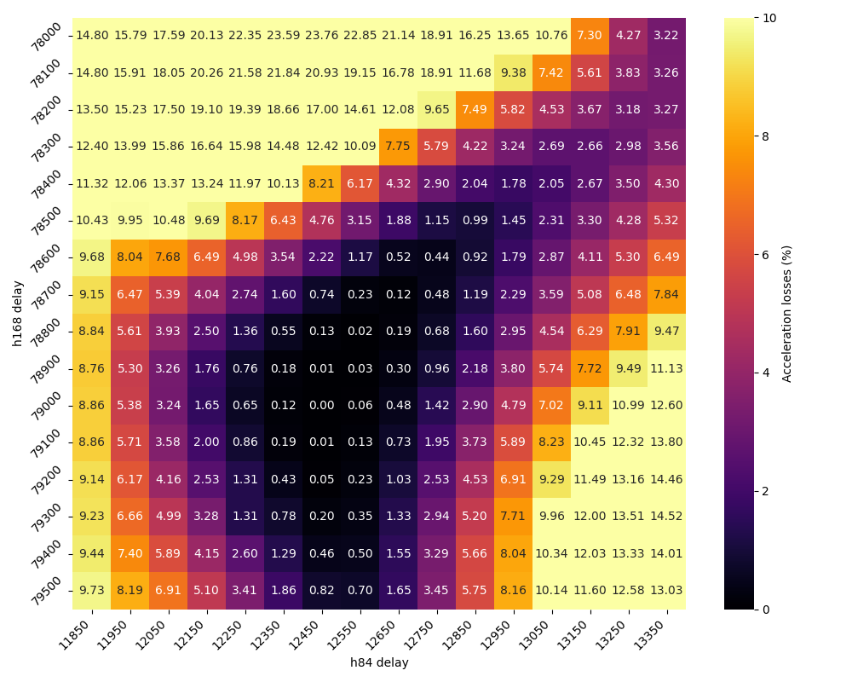
Bunch rotation analysis – single bunch
Simulation
Tomography prediction
Measurement

Slide 23
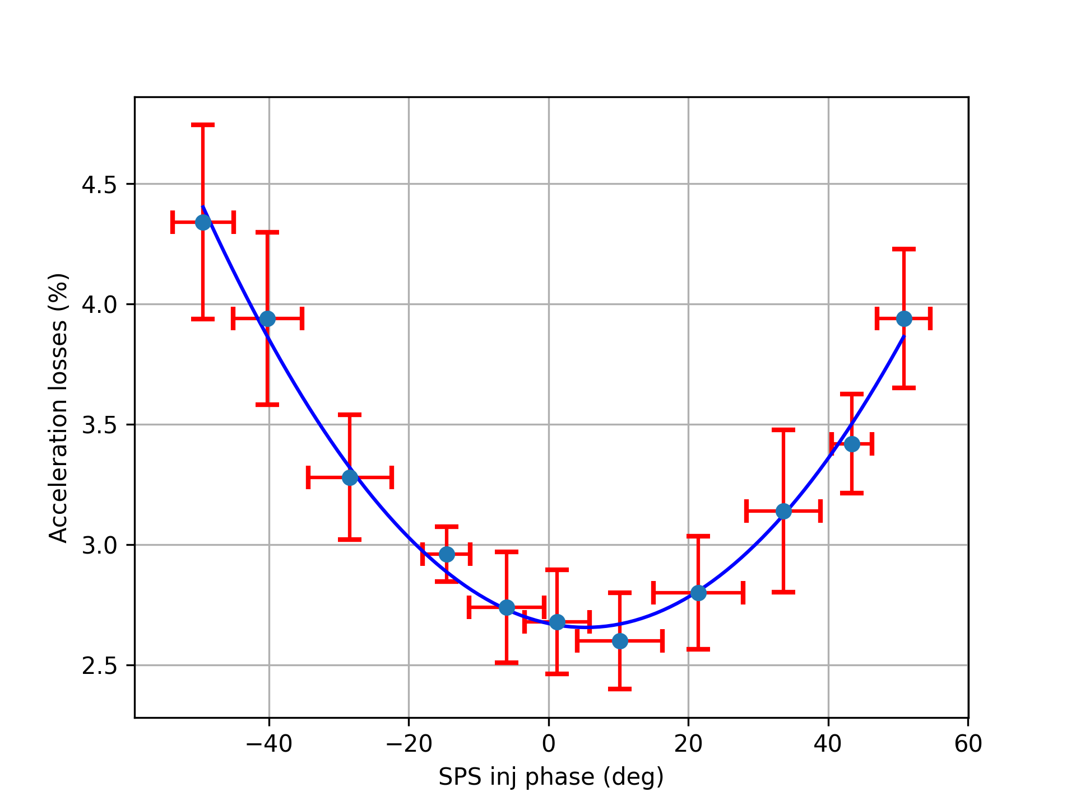
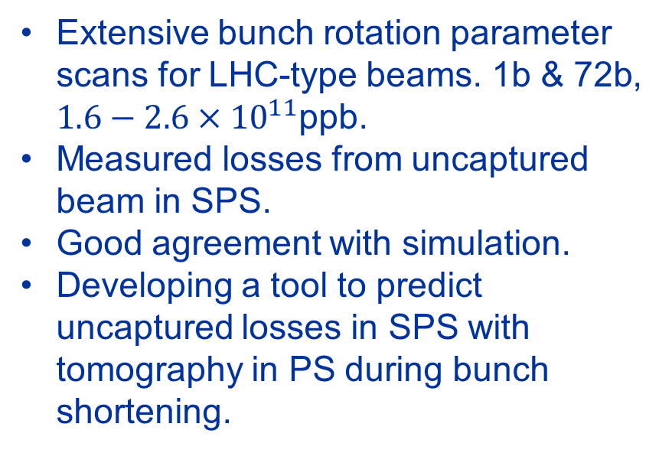
MD12244: PS-to-SPS studies & Bunch Rotation
MD slots: 14 parallel slots in SPS (half days)
Issues: Only a few slots lost to SPS and injector complex downtime.
Status: Measurements complete, analysis ongoing, reduced MDs in 2025
Simulation
Measurement
Extensive bunch rotation parameter scans for LHC-type beams. 1b & 72b, $1.6−2.6×{10}^{11}$ppb.
Measured losses from uncaptured beam in SPS.
Good agreement with simulation.
Developing a tool to predict uncaptured losses in SPS with tomography in PS during bunch shortening.
*1b with 1kV 200 MHz blow-up
Further information: https://indico.cern.ch/event/1440739/

Slide 24
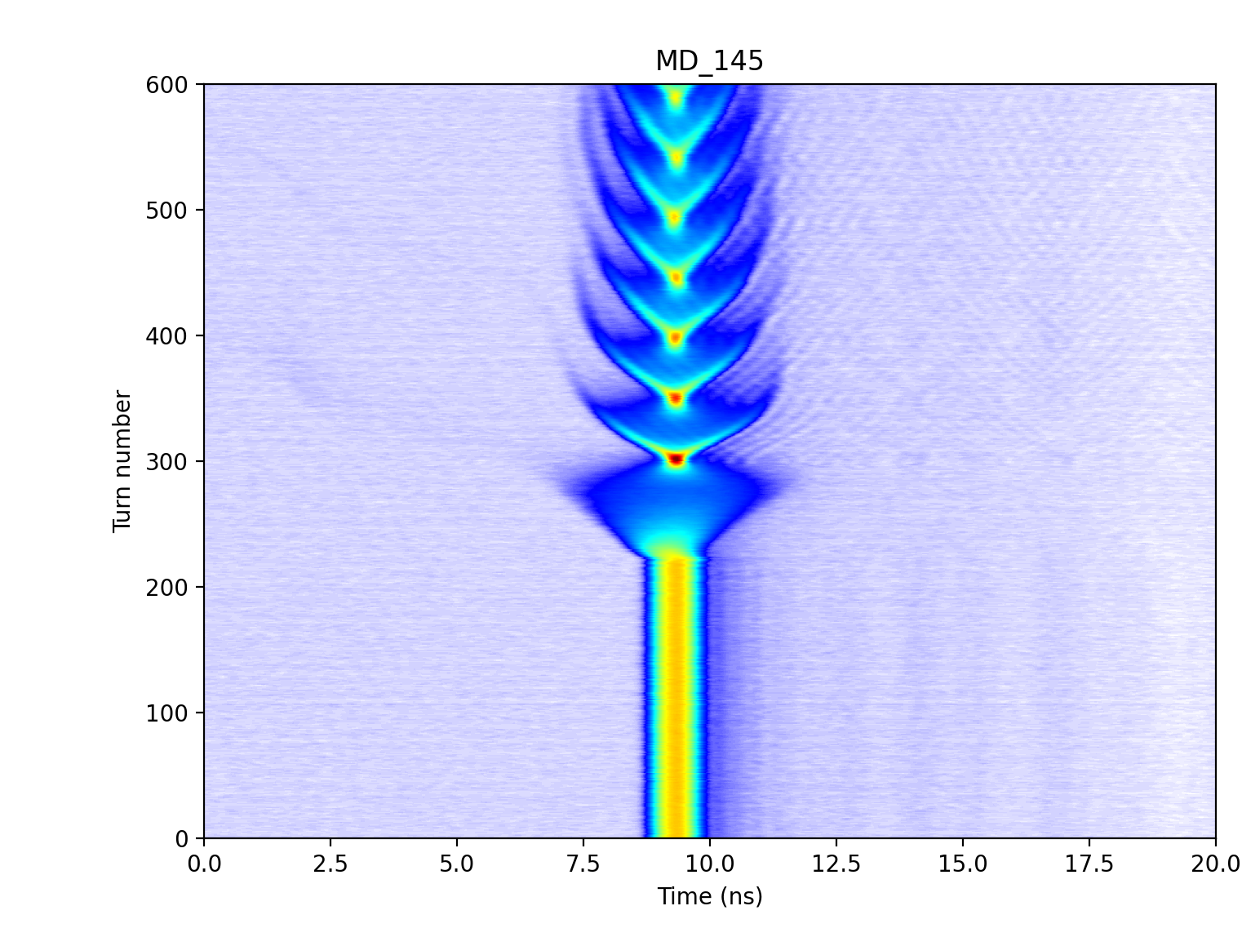
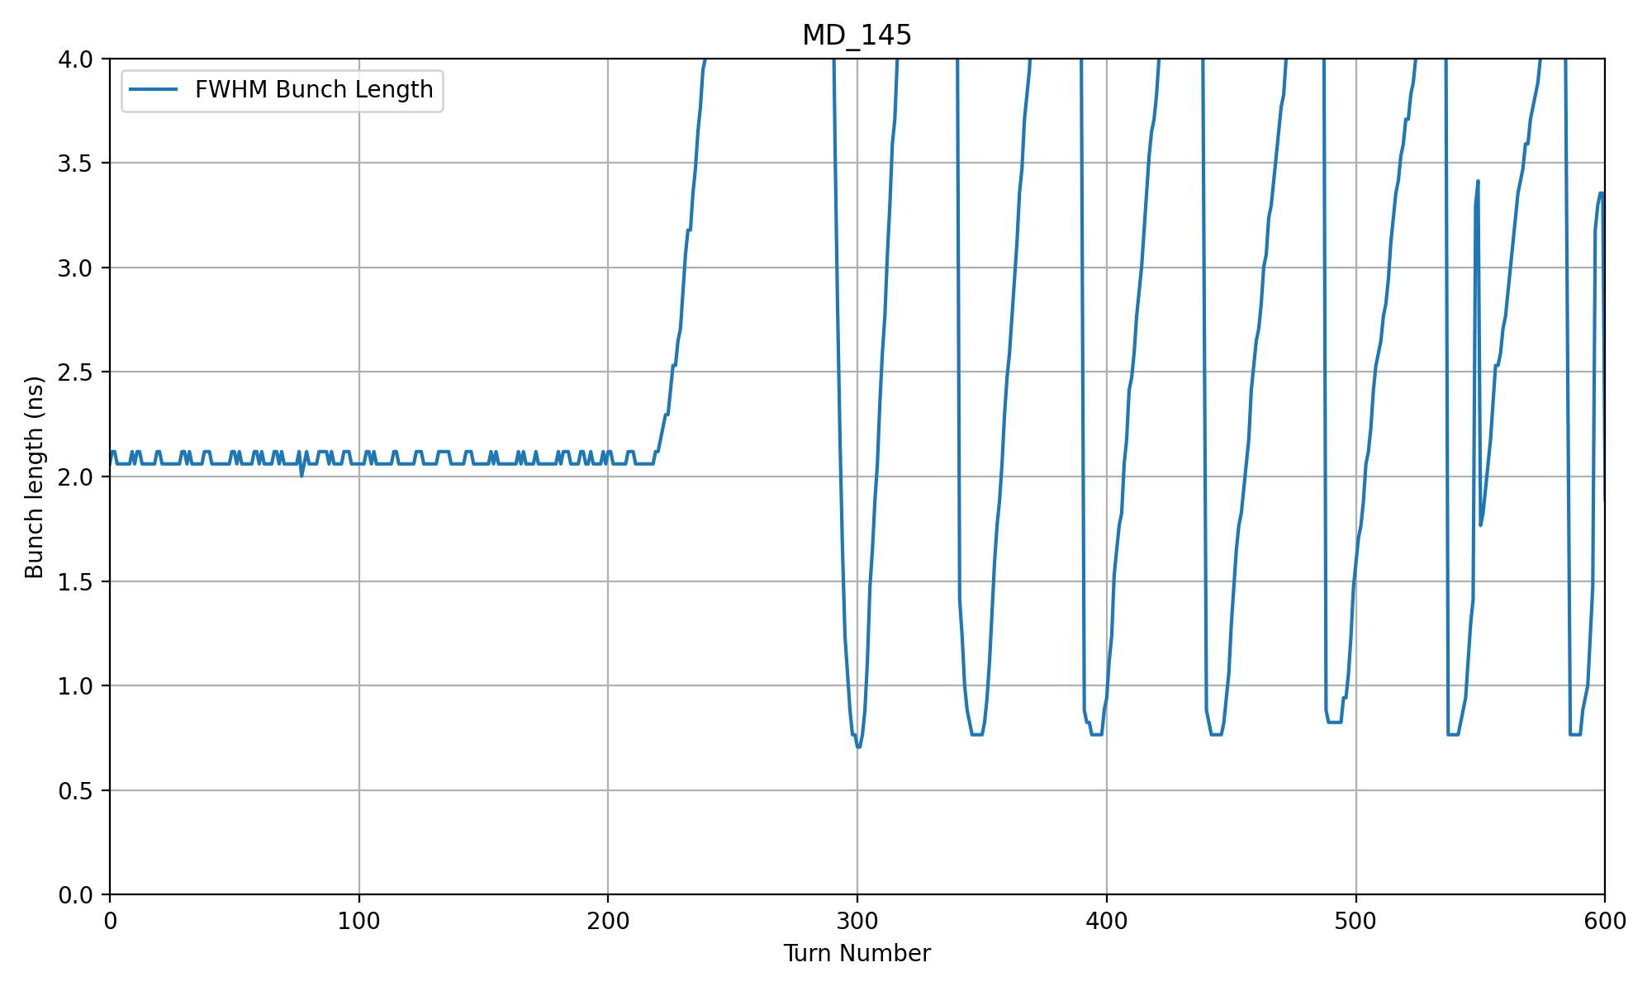
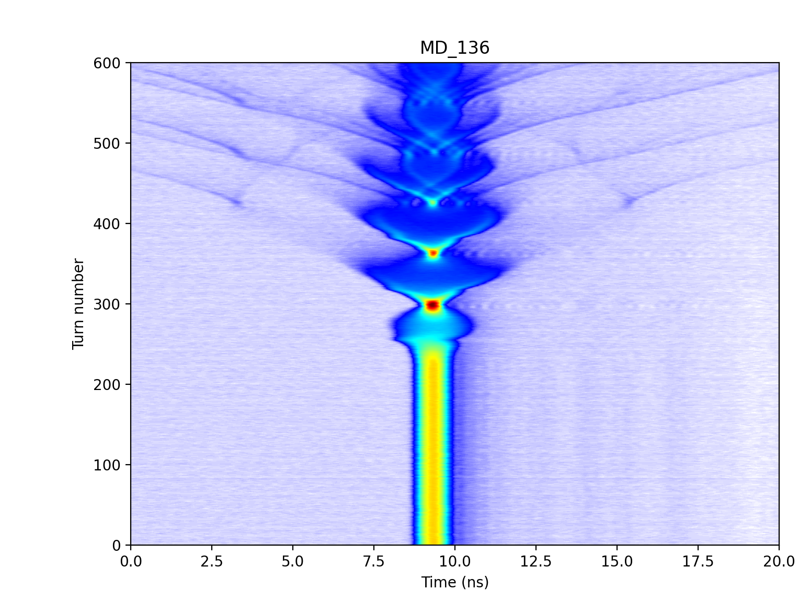
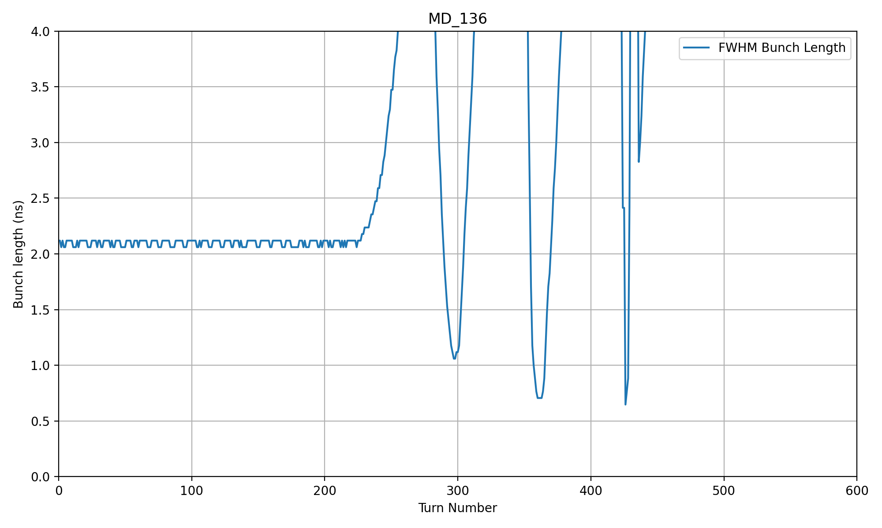


MD14123: Quadrupole Pumping for Bunch Shortening in SPS
MD slots: 2 parallel slots in SPS (half days)
Issues: MD scope aqc. Card saturating for bunches < 0.5 ns FWHM
Status: Measurements complete, analysis ongoing
Double non-adiabatic voltage jump (nominal)
Testing a bunch rotation technique for short AWAKE bunches.
Modulated RF frequency to excite quadrupole oscillations.
Compared bunch shortening technique to the double voltage jump and phase jump.
Extraction
$$4σ=0.7 ns$$
Quadrupole pumping
Extraction
$$4σ=0.7 ns$$
Further information: https://indico.cern.ch/event/1458898/contributions/6142372/

