Slide 1
Ion MDs summary
IPP MD days 2025
Elias Waagaard
Acknowledgements: Reyes Alemany Fernandez, Theodoros Argyropoulos, Foteini Asvesta, Hannes Bartosik, Nicolò Biancacci, Roderik Bruce, Sofia Kostoglou, Jakob Olsen, Konstantinos Paraschou, Maciej Slupecki, Felix Soubelet, Michail Zampetakis, SPS & PS OP Teams

Slide 2
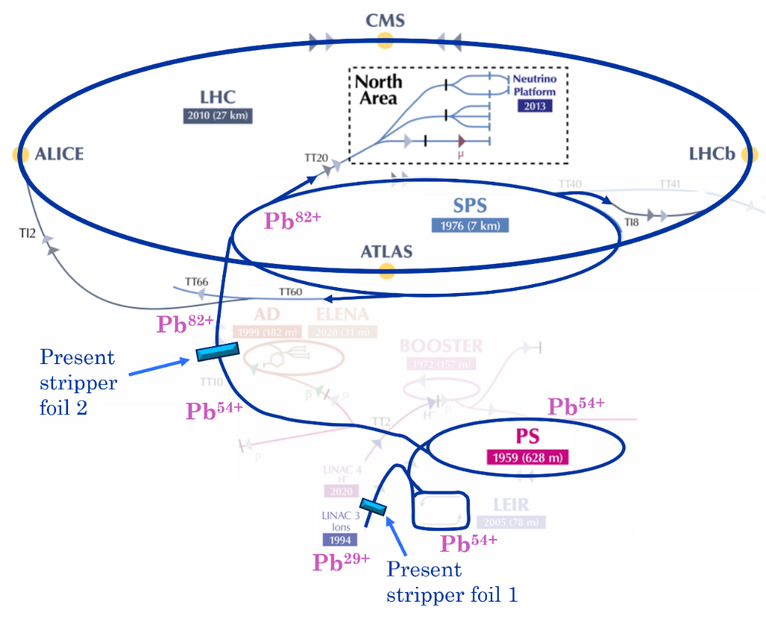
Overview
Strong emittance blow-up and intensity losses of Pb beams in LEIR, PS, SPS – especially SPS flat bottom
Main question we address: (1) performance reach of Pb ion and (2) future ions beams in ion injectors?
Main goal of long SPS ion MD studies:
  Measure SPS Pb beam parameters during SPS flat bottom – focus on emittance and intensity evolution
  Optimize SPS Pb beam quality and intensity: “as much as LHC could take”
  Use results to develop simulation models of performance-limiting effects for present and future ion beams – space charge, IBS, residual gas

Slide 3
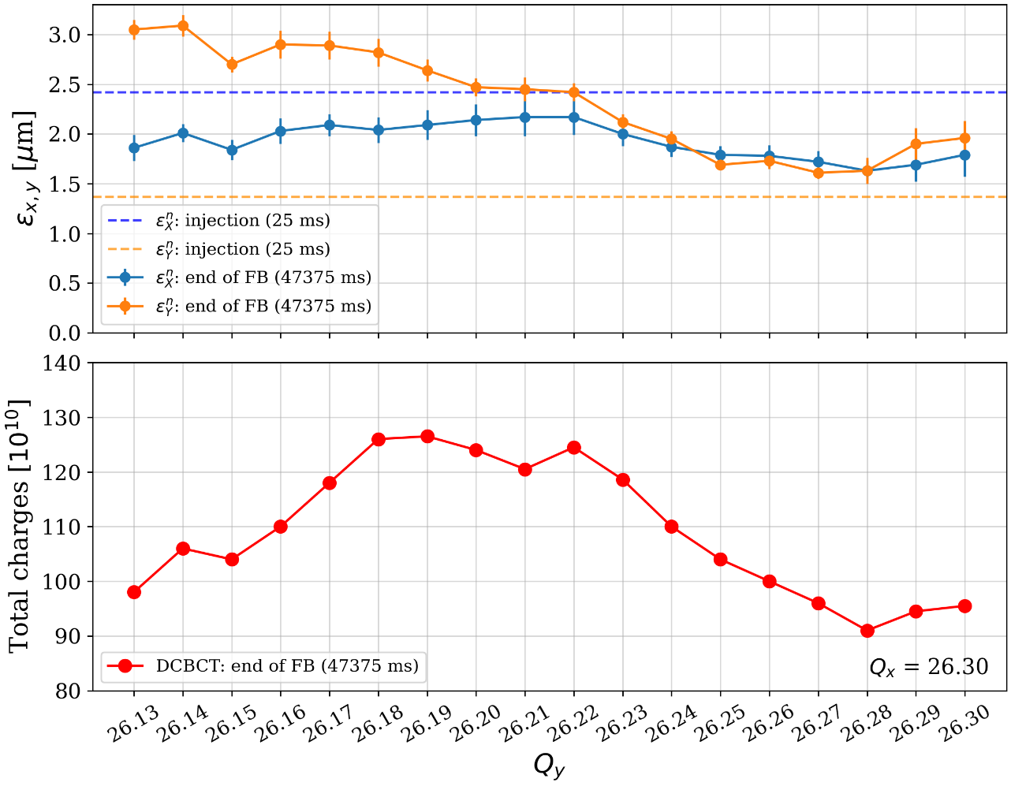
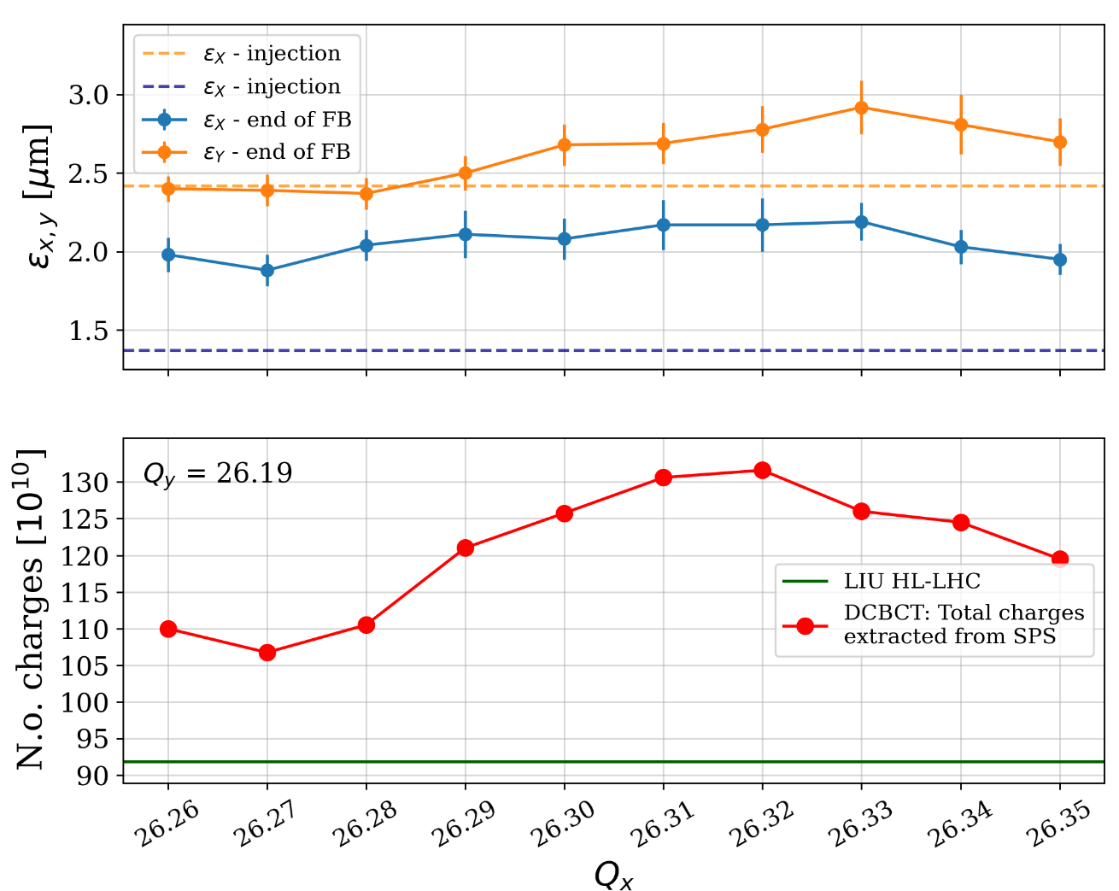
SPS settings optimization (1): tunes
Tune optimization in Y and X for nominal SPS Pb cycle
Q_{x,y} = 26.31,/26.32, 26.19 gave best transmission

Slide 4
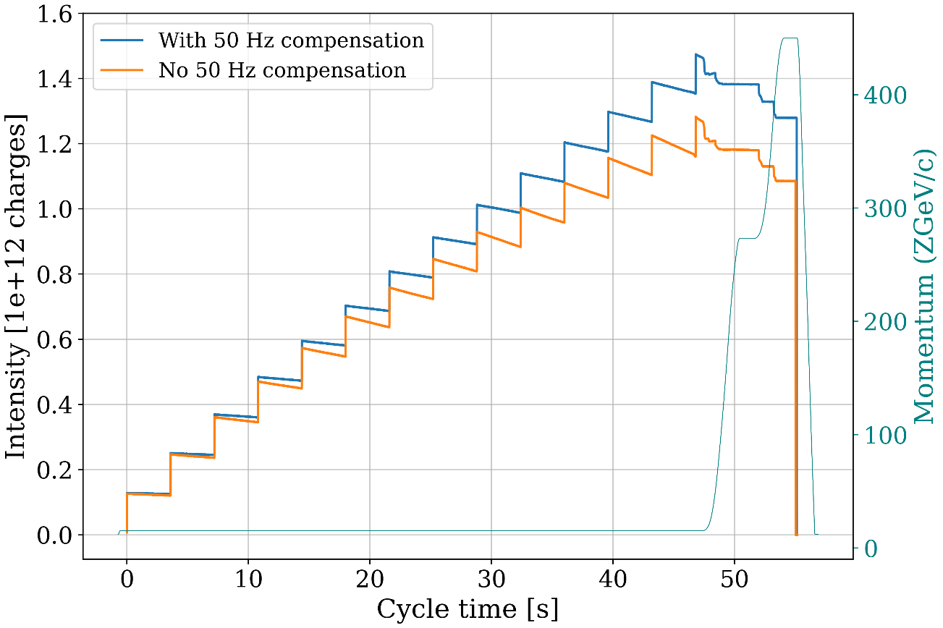
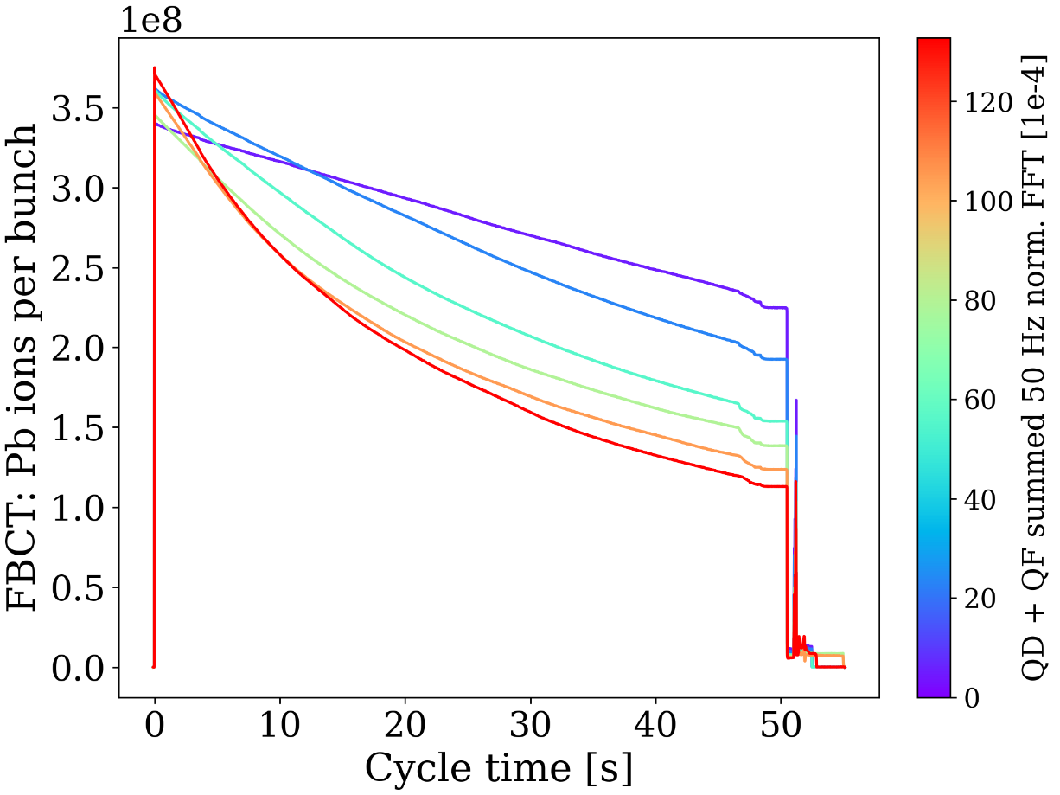
SPS settings optimization (2): 50 Hz noise compensation
Impact from 50 Hz components as measured in DCCT clearly affecting SPS Pb transmission
Keep normalized FFT 50 Hz component < 5e-4 → improves transmission by 15-20%
Intentionally increasing 50 Hz component → clear increase in losses!

Slide 5
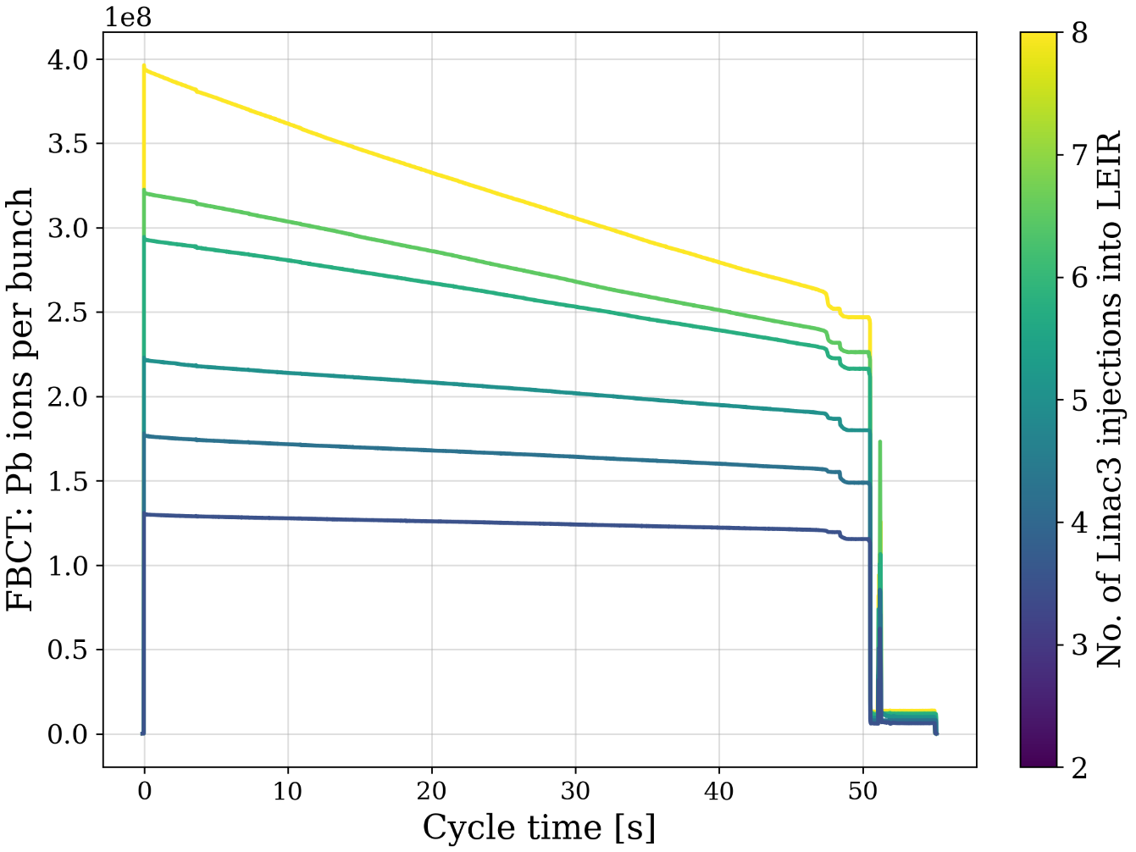
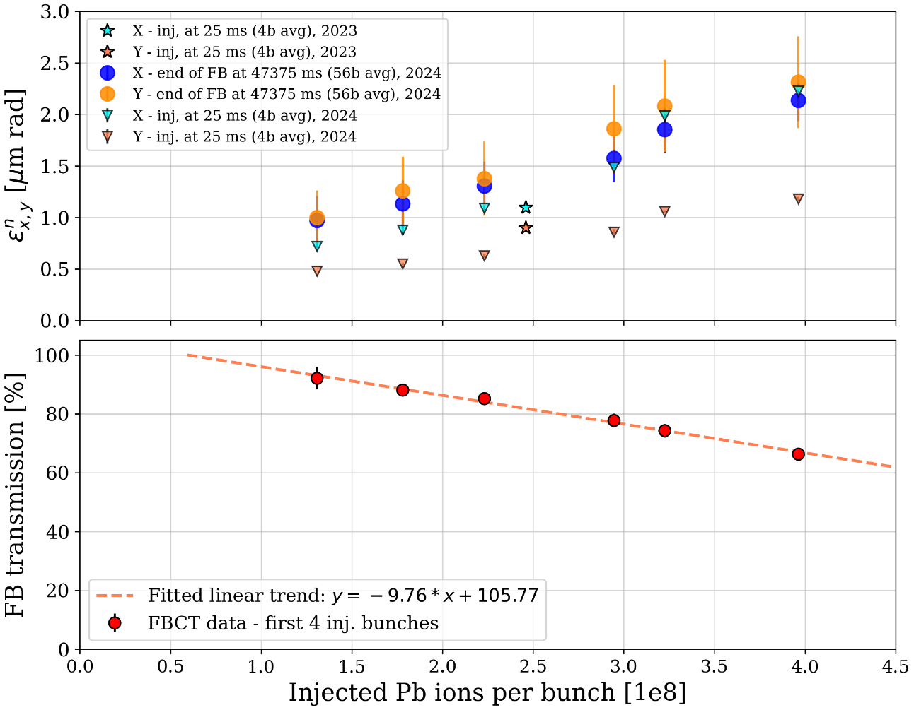
SPS bunch intensity scan
How does injected Pb bunch intensity affect flat-bottom transmission?
Varied number of LEIR injections → linear reduction of FBCT transmission as a function of ion intensity

Slide 6
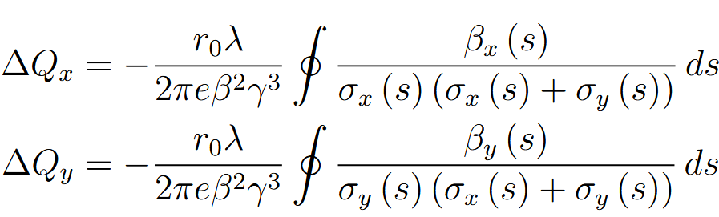
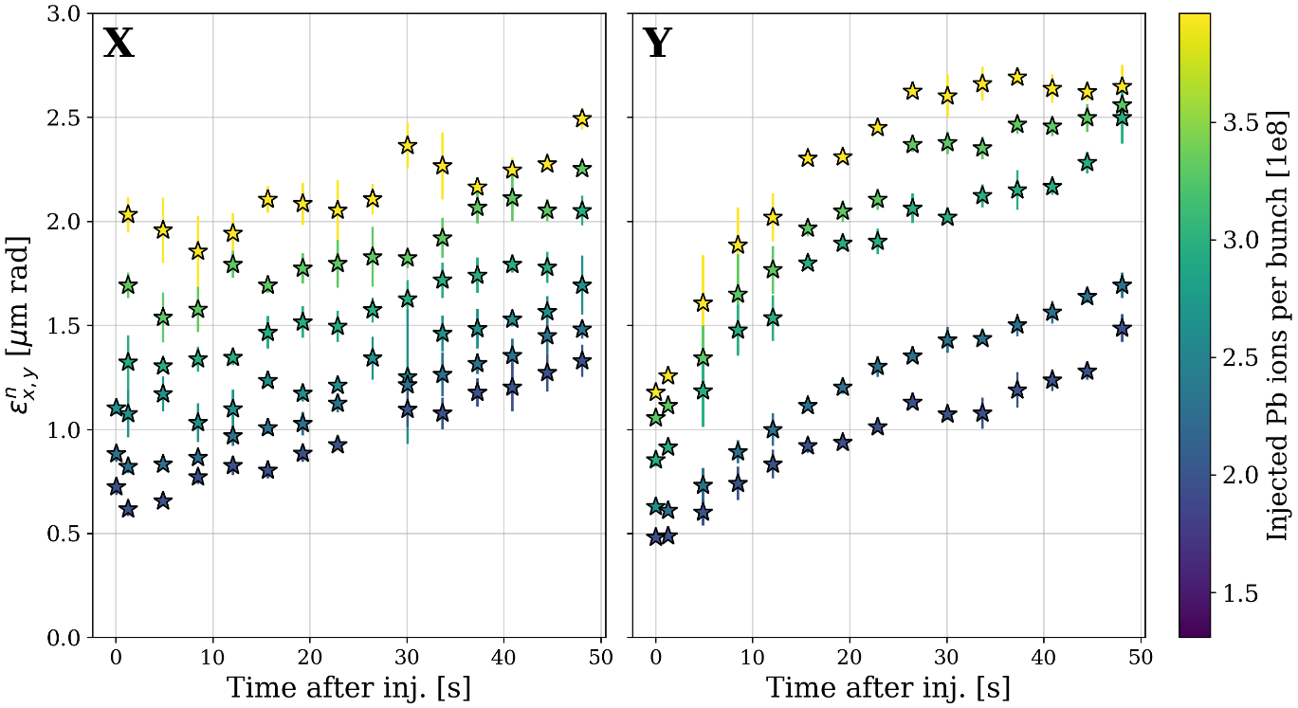
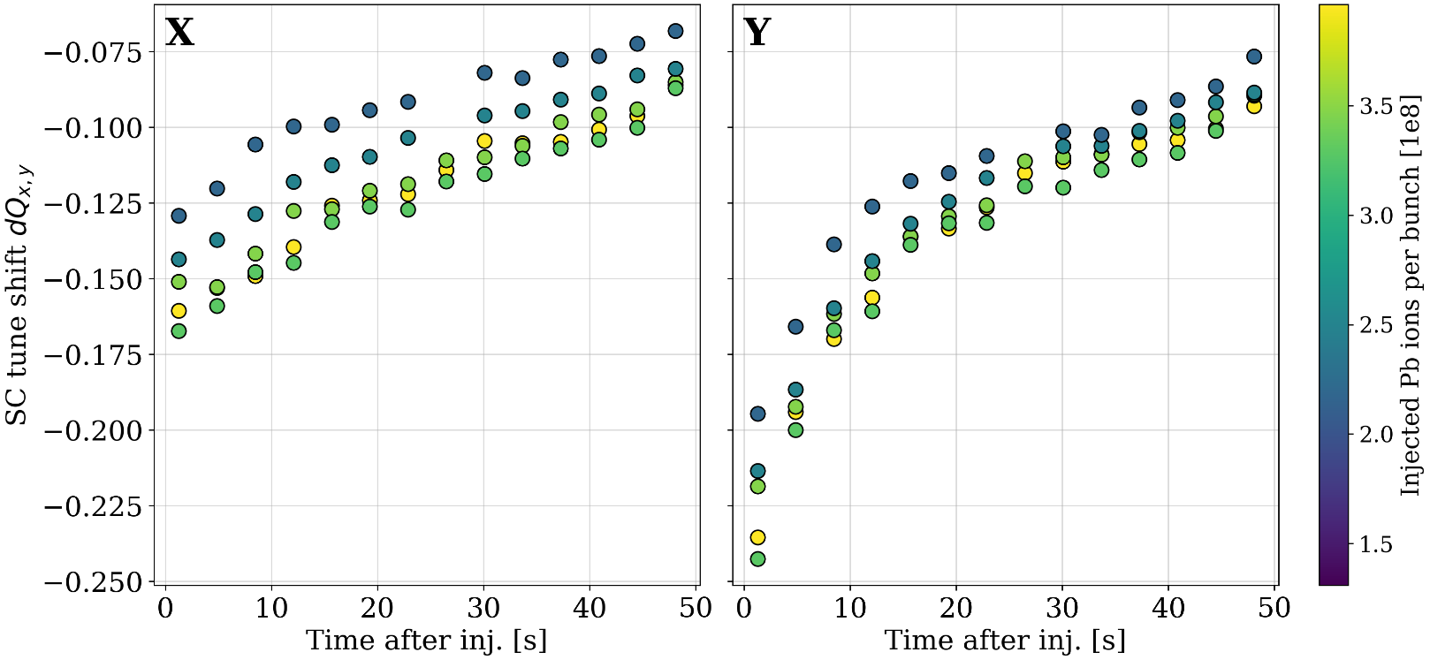
SPS bunch intensity scan – emittance and space charge
How does the SPS flat bottom space charge tune shift dQx,y evolve for different injected intensities?
Measure emittance with wire scanner, also use FBCT intensities to compute dQx,y
Similar tune shift trends, especially in Y

Slide 7
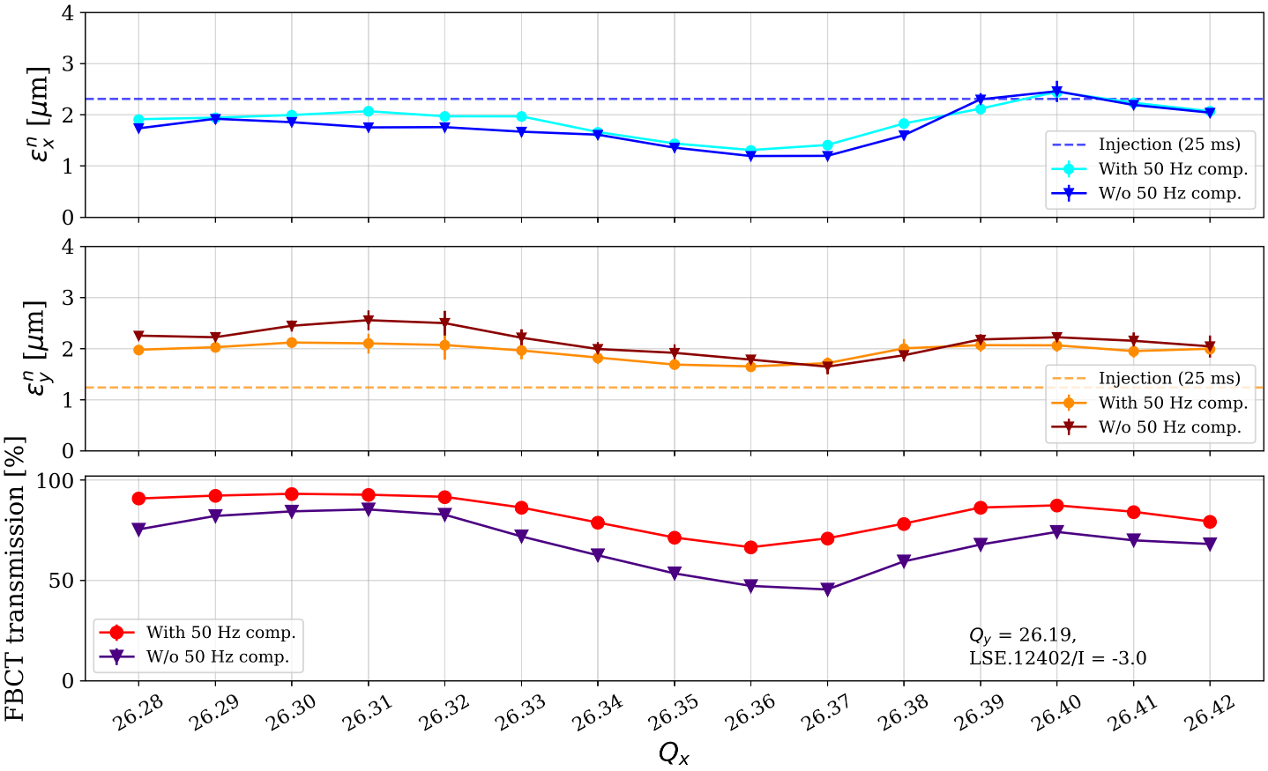
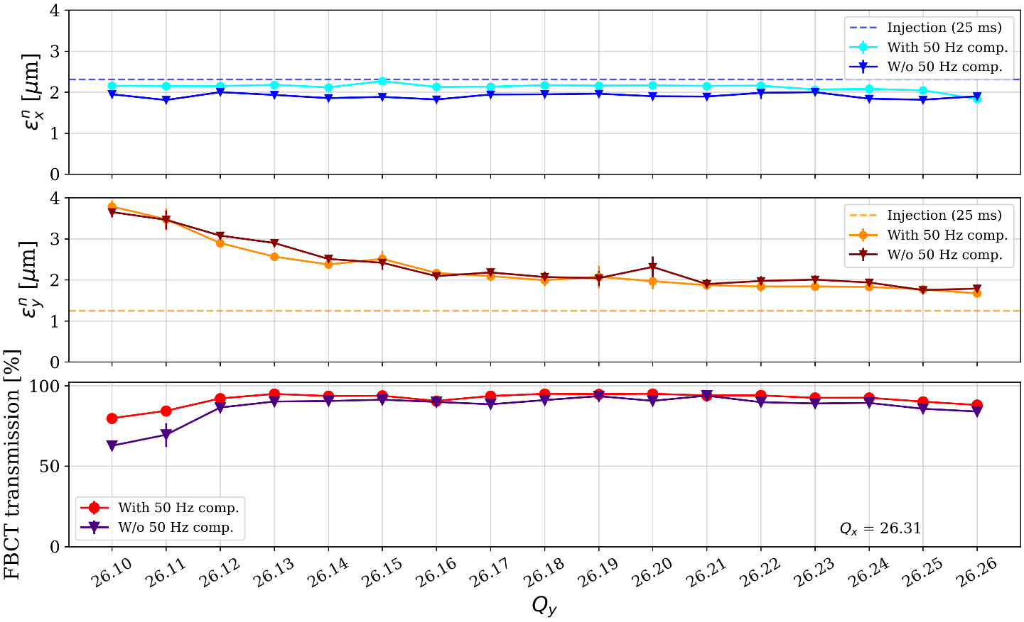
SPS short cycle: Qx scan with excited sextupole and Qy scan
Additional data to validate space charge and IBS models with tune scans
  Qx in [26.28, 26.42], Qy = 26.19, over third-order resonance Qx = 26.33, with LSE sextupole excited
  Qy in [26.10, 26.26], Qx = 26.31
Ongoing simulation studies, but 50 and 150 Hz noise + space charge seem to be main loss driver

Slide 8
Oxygen ion MD desiderata for 2025
Oxygen run presents unique opportunity to gather data with a light ion species
  Ongoing effort to characterize beam dynamics limitations across ion injector chain in the Future Ion WG
  Oxygen would allow first experimental validation of models previously relying on extrapolations from Pb ion beam observations
  LEIR:
    Schottky ML studies, beam lifetime studies
  PS
    Beam-gas interaction with oxygen beams in the presence of injected Ar or He gas
  SPS
    Tune scans, resonance crossing, intensity scan, 50 Hz noise level scans, no PS bunch splitting if time allows, in:
    Parallel MD with short 1-inj
    Dedicated MD multiple-injection cycle (6 or 7 inj, same cycle as for proposed p-O) during long flat bottom

Slide 9
Conclusions
The Pb 2024 run was a record-breaking year for the CERN ion injectors, partially leveraging on our MD results
Experimental studies enabled detailed mapping of transmission and beam profiles scanning e.g.
  (1) Tunes
  (2) Injected bunch intensities
  (3) Compensated and amplified 50 Hz noise levels
Ongoing simulation studies with beam profile and loss data
2025 oxygen pilot run will present unique opportunity to verify predictions for light-ion models

Slide 10
Thank you for your attention!

