Slide 1

TT20 / TT24 / P42 MDs
L. Nevay on behalf of L. Dyks, M. Fraser, A. Gorn, F. Metzger, F. Velotti,
3rd February 2025

Slide 2
Summary
2024 Summary:
  TT20 optics measurements
  TT24 / P42 optics measurements
  Wobbling
2025 Request:
  Wobbling MD
  Dedicated optics measurement with new transfer functions

Slide 3
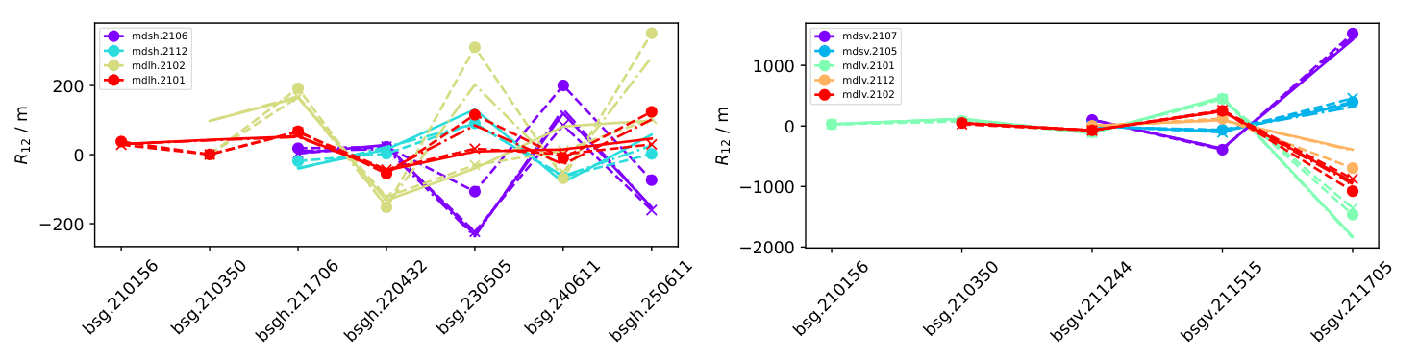
TT20 Optics Measurements
F. Velotti
Legend:
Solid: model
Dashed: corrected model new TF
Dashed circles: data with old TF
Dashed with crosses: data with new TF
New TF tested both in simulations and with kick response measurements ⇒ can get very good agreement with data!
  Improvement visible for all optics (still missing measurements on dedicated optics for SHiP → only model)
Qsplit

Slide 4
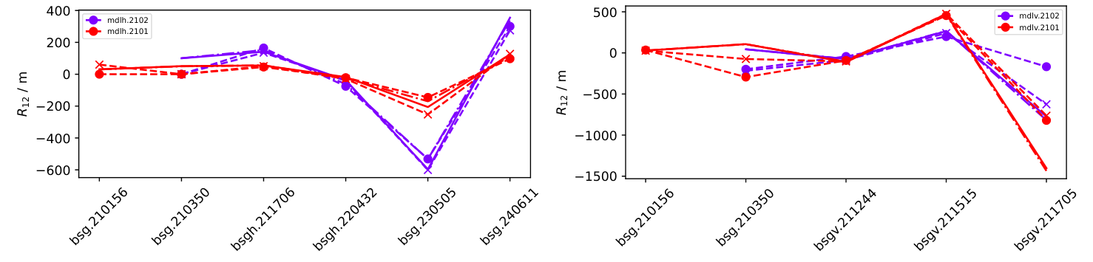
TT20 Optics Measurements
F. Velotti
Legend:
Solid: model
Dashed: corrected model new TF
Dashed circles: data with old TF
Dashed with crosses: data with new TF
New TF tested both in simulations and with kick response measurements ⇒ can get very good agreement with data!
  Improvement visible for all optics (still missing measurements on dedicated optics for SHiP → only model)
NoQsplit

Slide 5
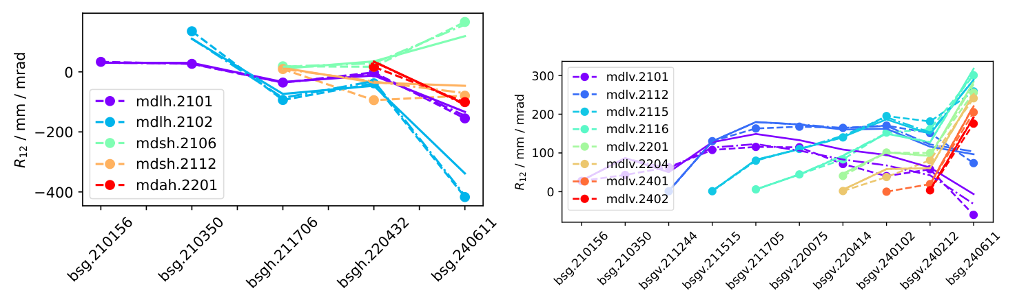
TT20 Optics Measurements
F. Velotti
Legend:
Solid: model
Dashed: corrected model new TF
Dashed circles: data with old TF
Dashed with crosses: data with new TF
New TF tested both in simulations and with kick response measurements ⇒ can get very good agreement with data!
  Improvement visible for all optics (still missing measurements on dedicated optics for SHiP → only model)
Unsplit

Slide 6
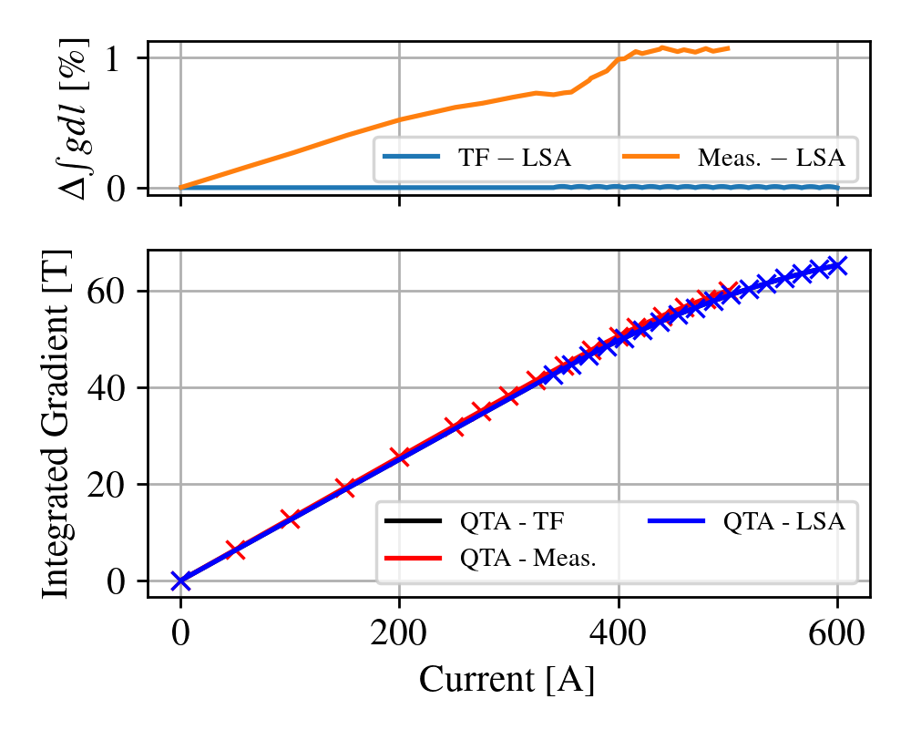
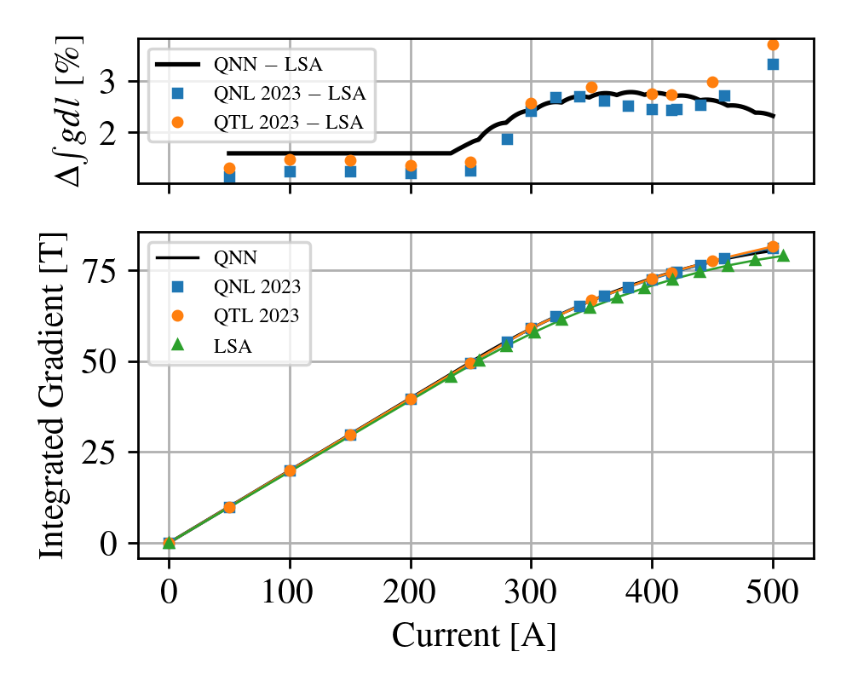
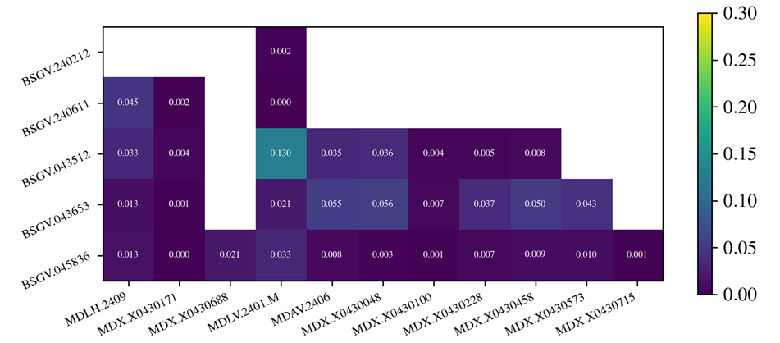
TT24-P42 Optics – Kick Response
L. Dyks
QTA measurements
QTL-QNL measurements
Study in 2023 showed errors mostly in TT24
  QTL, QNL, QTA magnet transfer function error
New Magnet Transfer functions measured
Further kick response studies in 2024
With shared optics: P42 only
  Confirming good agreement with design
With dedicated optics: TT24 + P42
  Optics much closer to model
2024 – New TF

Slide 7
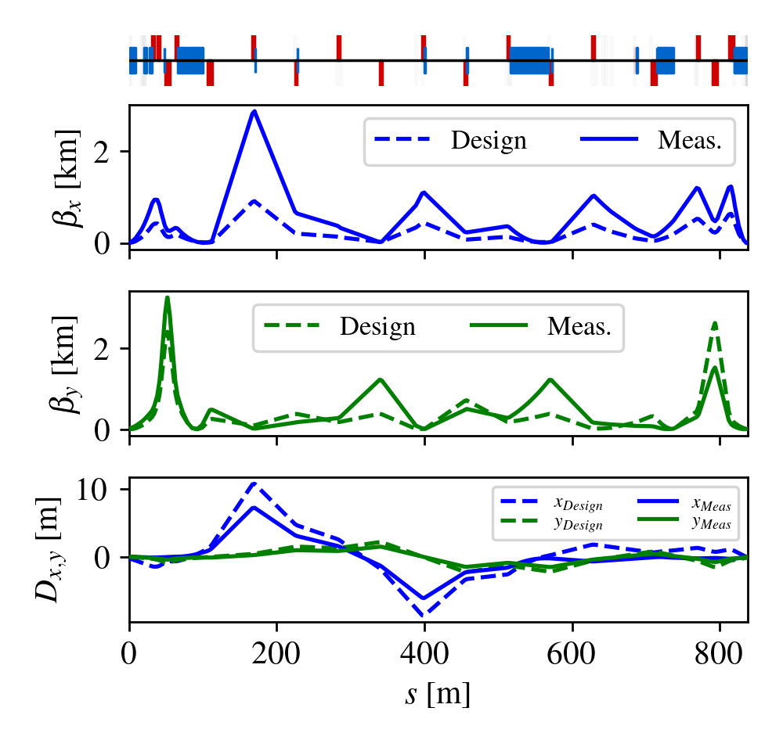
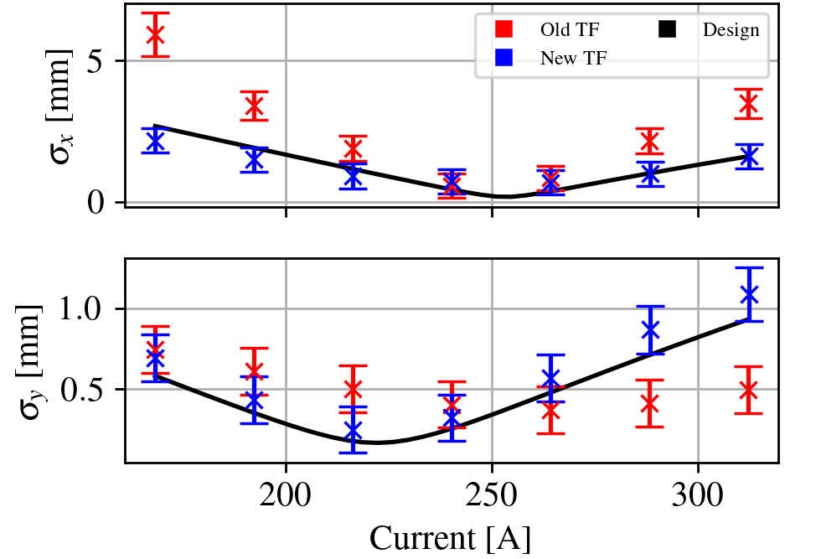
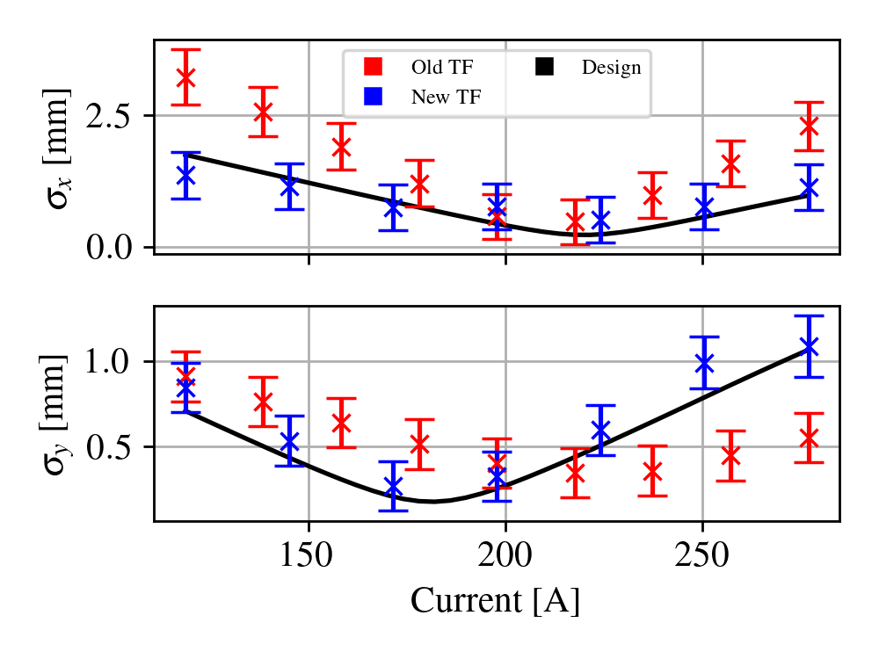
TT24-P42 Optics – Quad Scan
Quad scan performed fitting initial conditions at T4 with dedicated optics
  2023 showed big discrepancy to model
  Caused by TF issue across TT20
  Profiles on some grids too large to measure size
New TF tested in 2024
Quad scan shows much better
agreement with model
Beam profile can be measured
with all monitors
Actual optics vs design 2023
L. Dyks

Slide 8
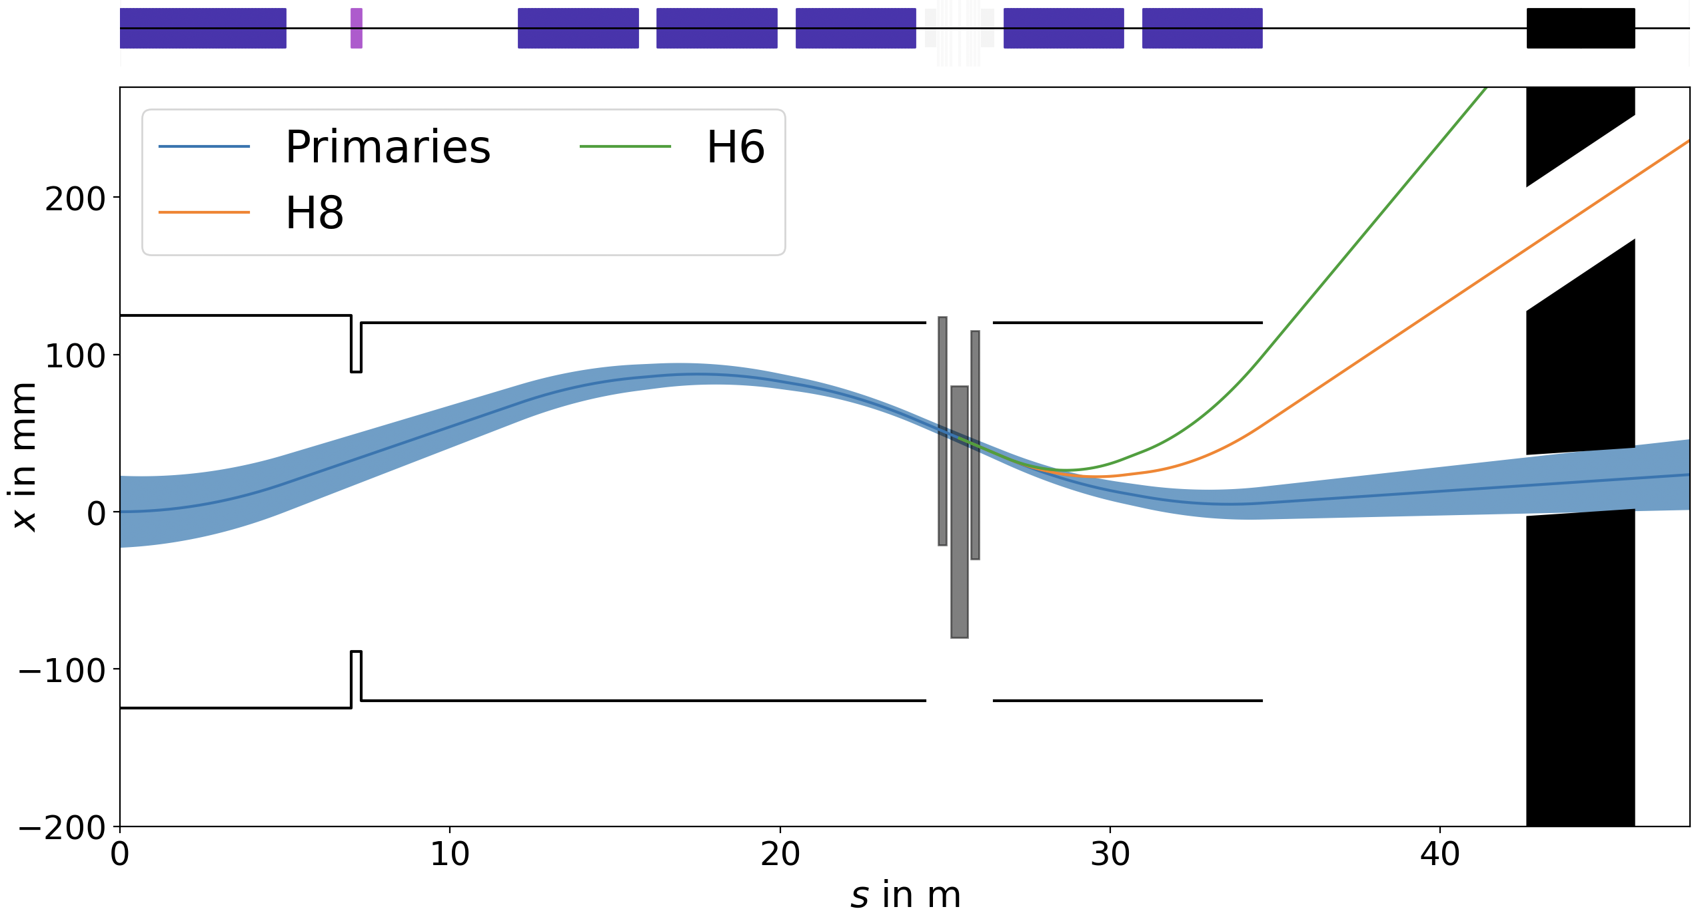

T4 Wobbling MD 17.07.2024
F. Metzger, L. Nevay
With the wobbling, we bend the beam
significantly to generate offsets at T4 of the
order of 3 cm for generating secondary beams
  we typically change from one side to
  another ~15x / year
Each change requires re-steering in P42
Goal for HI-ECN3 is to make these transparent
During the MD, we tested different wobbling settings based on different calculations to find the source of the changes in P42
  Difficult to disentangle the effect of the wobbling and the auto-steering in T4 (wobbling change requires movement of TBIU and TBID) → We took measurements for fixed wobbling with and without auto-pilot
Simultaneously, measured sources of muons to EHN1 vs. target length. Found muons are well-correlated with targets - but disagrees with operational difficulties earlier in year.
$$μ± 7σ$$

Slide 9
T4 Wobbling MD Request for 2025
Goal is to ensure T4 wobbling is passive to P42 as practice for BDF/SHiP operation
Look for small changes in orbit but will frequently inhibit extraction → request dedicated MD
Repeat of last year’s measurement with new transfer functions, hysterisis compensation, better control over auto-steering
  Auto-steering reacts on measurement of the split foils → TBIU and TBID need to be moved to the horizontal position corresponding to the horizontal beam position of the split foils
  Hysterisis isn’t accounted for, but we need to switch polarities of the wobbling magnets to achieve positive or negative secondary beams in H6 and H8
  Recent measurements of the hysterisis of the MTNs imply percent-level differences to a degaussed magnet (up to 70µrad for 400GeV/c)
  Transfer function for MTNs has been measured, too - up to 50µrad for 400GeV/c
Different wobbling also imply different dispersion at T4 → simultaneous measurement of dispersion in T4 / P42 (for input to dispersion-dominated losses downstream)

Slide 10
HI-ECN3 Dedicated Optics Request
Request 1x day MD to complete dedicated optics measurements throughout TT20 → P42
  kick responses and quad scans
Will repeat some measurements with new TFs and validate

