Slide 1
Slow extraction w/ transverse noise
P. Arrutia, T. Levens
IPP MD days 2025
03/02/2025

Slide 2
Intro
In PS, a small Transverse FeedBack (TFB) excitation is added to EAST during slow extraction to improve spill quality:
  M. Delrieux: “intuitively it makes sense”
Motivations of SPS dedicated MD:
  Implement similar approach to SPS SFTPRO.
  Better understand why/how this works.

Slide 3
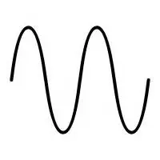
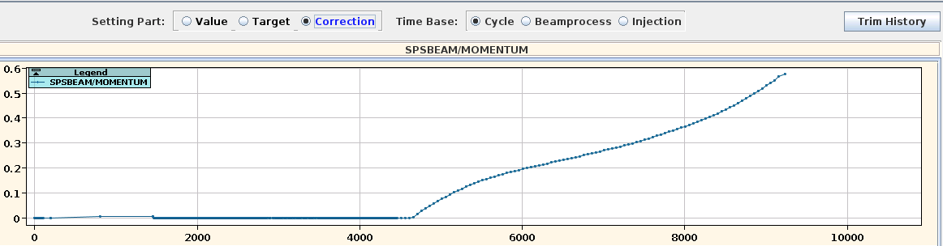
Concept: OP
We use: nominal SFTPRO cycle w/ momentum ramp to push beam into resonance
We add: horizontal sinusoidal excitation w/ TFB at freq. approx betatron tune, ⅓*frev) ~ “AC Dipole”, but on debunched beam.
(frequency, amplitude)

Slide 4
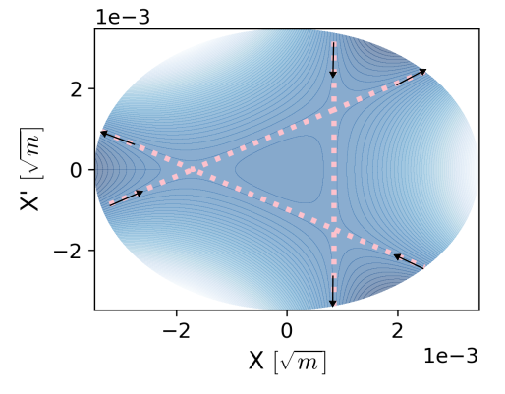
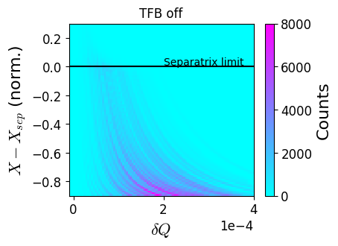
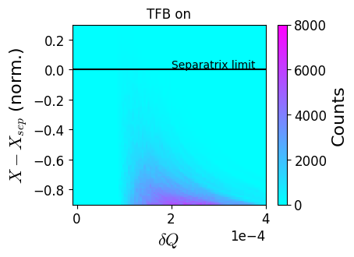
Concept: beam dynamics
The TFB kicks help particles cross into the resonance -> tune ripple has less impact on extraction rate.
Beam tracking sim.
Ripple
Ripple
Separatrix
TFB tune

Slide 5
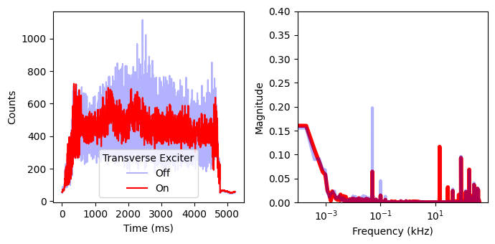
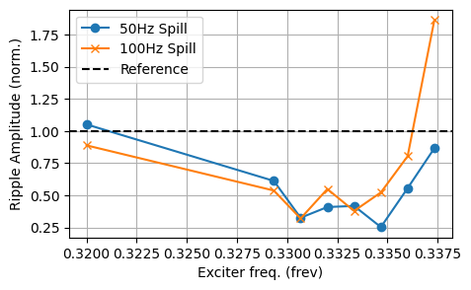
Results (i)
Clear spill quality improvement observed, in particular at low frequencies: 50Hz, 100Hz, …
Setting (a): Spill quality improvement
Reduction of 50,100Hz ripple
TFB frequency

Slide 6
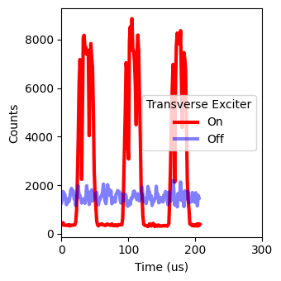
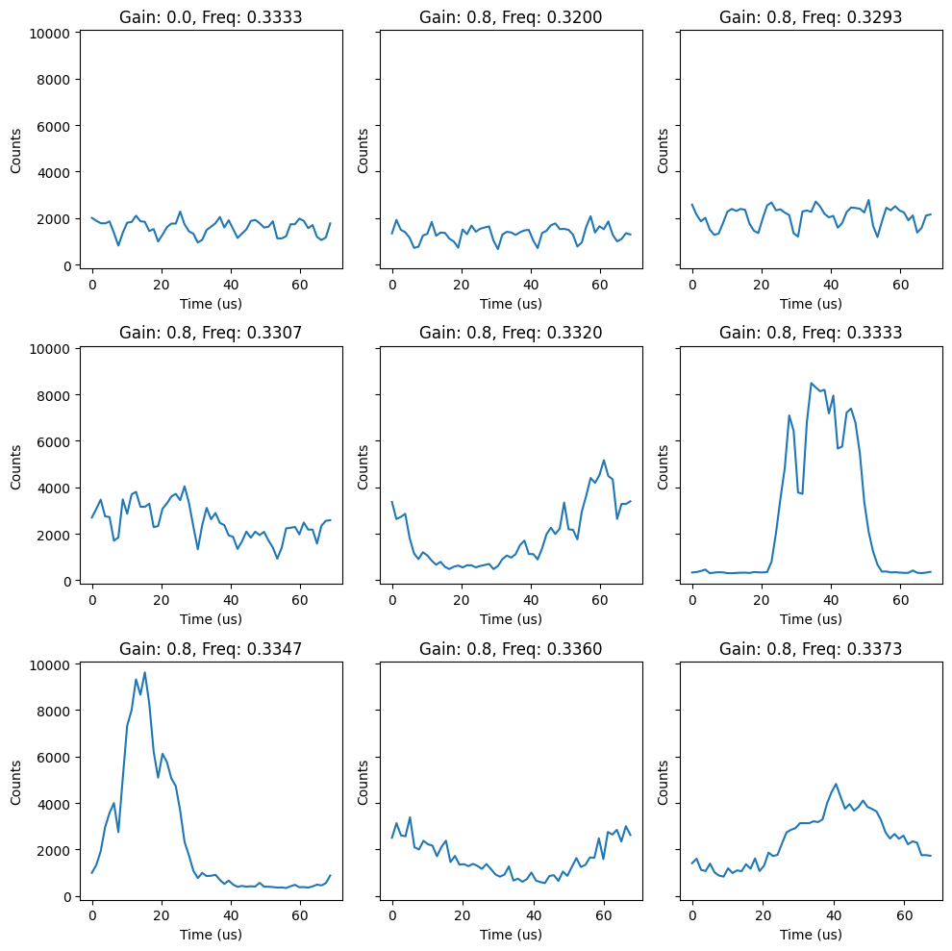
Results (ii)
Setting (b): bunched beams
Technique can also be used to give bunched structure to the spill (starting from a debunched beam).
Provides flexible way to create an “extinction region” for time of flight discrimination (could interest SHiP, alternative mode of operation).
(...)
Continues for full spill
TFB freq
Q=1/3

Slide 7
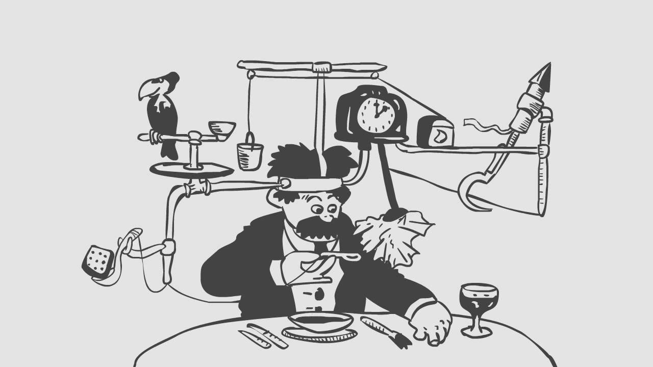
Wishes
SY-BI: the new spill monitor (OTR-PMT) with 200MHz sampling acquisition. During 2024 MD, up to 800kHz, but not enough to probe 40MHz TFB limit.
SY-RF: Controls Interface to program sinusoidal excitations on the TFB. During 2024 MD, excitation injected via BBQ channel using signal generator -> not viable long term.

Slide 8
Plans
Push bandwidth limit of the TFB -> for spill quality, interesting to test higher harmonics of betatron tune.
Study interplay between this manipulation and empty-bucket channelling -> potential to combine them or to replace EBC (possibly easier to set up and maintain)
Request: 1 dedicated MD slot

Slide 9
Extra slides

Slide 10
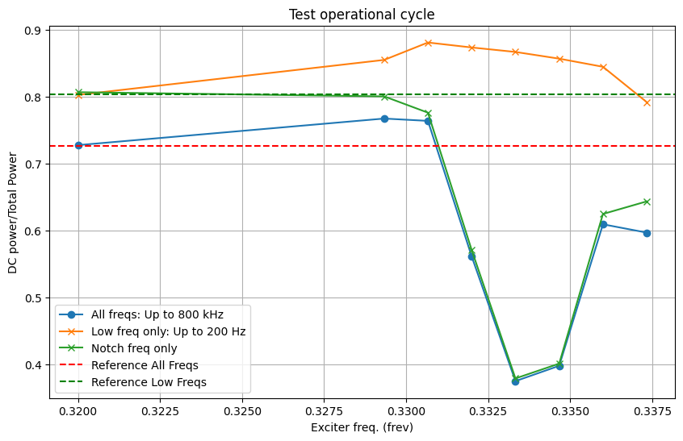

Slide 11
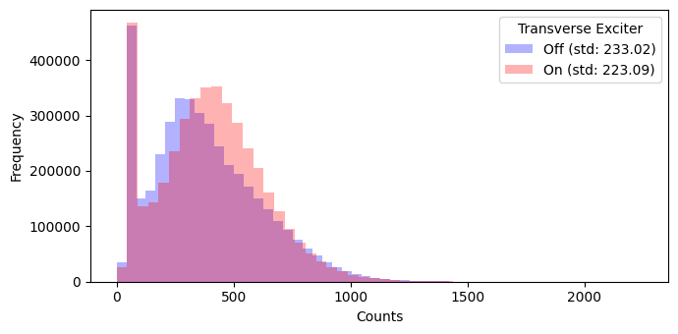

Slide 12
