Slide 2
Test of new BB Finemet
controller
T. Gavric, B. Woolley, H. Damerau, Y. Brischetto, M. Vadai
IPP MD Days
05/02/25
Many thanks to PSB/PS operations team

Slide 3
Outline
Previous work
Synchronization scheme
New features
Change in the current setup
Plans for 2025
MD topics

Slide 4
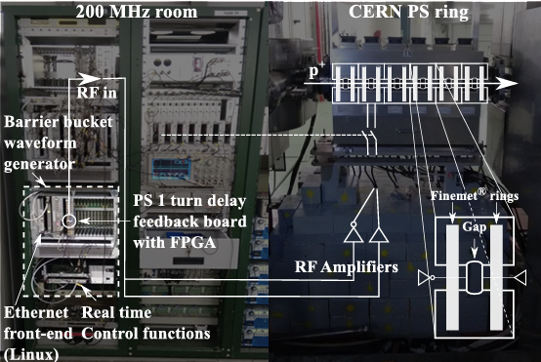
Previous work
Barrier-bucket MTE scheme significantly reduces beam loss in PS extraction region
Non-PPM barrier waveform
  Lacked flexibility
2 consolidation boards
  h16 measurement
  h1 measurement
Diagram from M. Vadai, A. Alomainy, H. Damerau: Barrier Bucket Studies in the CERN PS (CC-BY 3.0) - https://doi.org/10.18429/JACoW-IPAC2019-MOPTS106

Slide 5
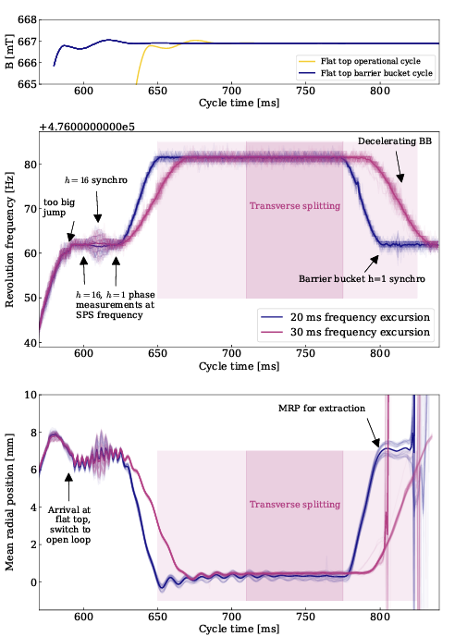
Synchronization scheme
Conventional synchronisation not possible
  RF voltage of the wide-band cavity generating the BB would be too low for a conventional synchronisation
Synchronisation concept in use:
  Synchronising in h16 using feed-forward cogging
  Lower accuracy sufficient for barrier buckets
  Synchronisation in h1: phase measurement and communicating phase information within a cycle to set the correct barrier position
Notes:
590-600 Loops off,ℎ16 phasemeasurement
600 ℎ1 phase measurement
600-620 Cogging
620-650 Radial steering to central orbit
650-770 Constant offset for MTE
770-800 Radial steering to extraction orbit
800-815 Hand-over ℎ16 to barrier bucket
800-815 Debunching
835 Extraction

Slide 6
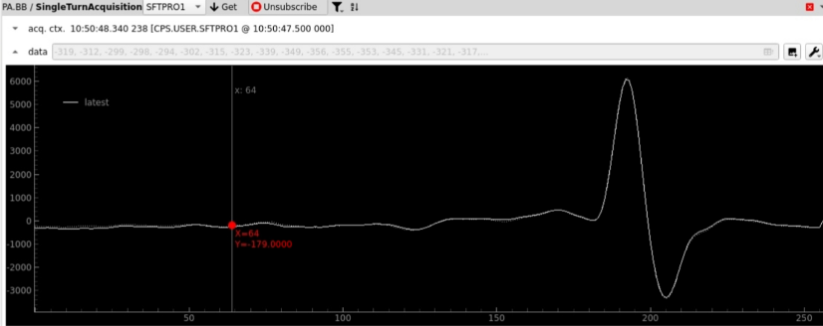
New features (1)
Full control of RF drive voltage
  PPM
  Arbitrary waveform
  16-bit waveform memory
Acquisition of gap voltage
  Single turn
  Hard trigger (from CTRV through backplane)
    PAX.SACQ-ALLRFM
Arbitrary gain function of the waveform
  FGC: Internal function generator – new preferred option (makerule from old function)
  CVORB

Slide 7
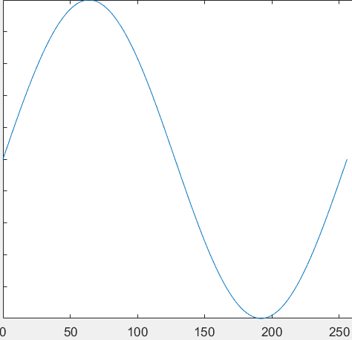
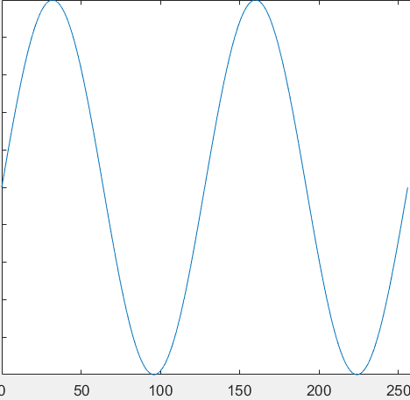
New features (2)
Following features are yet to be tested with the beam:
New extraction synchro for PS: h1 measurement w.r.t. SPS derived h1
  Updates BB azimuth during the cycle (C620 ms)
PS acquisition core
  Gain function
  h1 measurement – phase between SPS derived h1 and PS h1
Accordion sweep of the waveform
  Time in which sweep happens can be set
    Used for smooth batch compression – interesting for possible ion chain upgrade

Slide 8
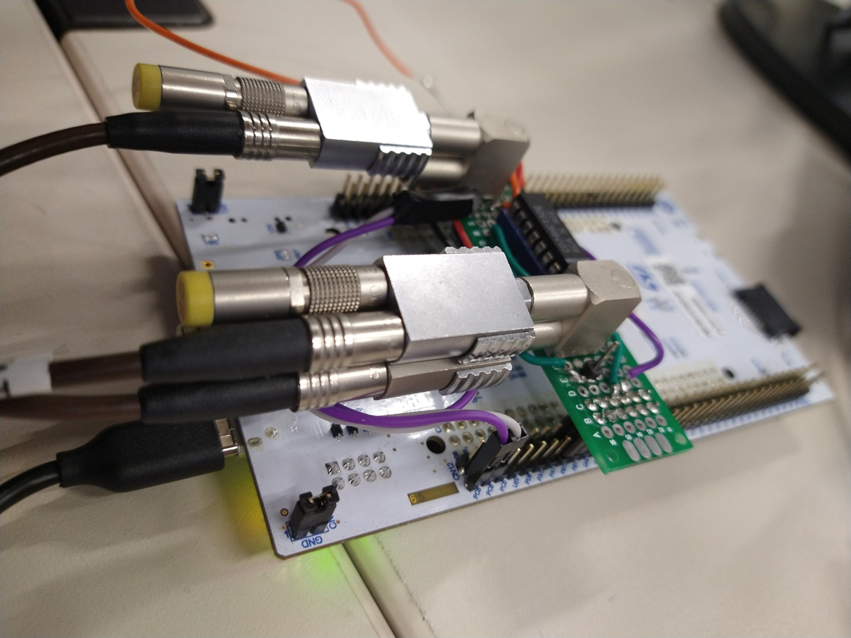


Change in h1 measurement
h=1 controller measures
the phase w.r.t. SPS and
sends it real-time via C programs on front-ends
to the barrier bucket drive
PS h=1 RF
h=1
controller
SPS h=1 RF
Network
φ_{h1} mod h16
BB
drive
To wideband
cavity
New Finemet cavity
controller
Non-standardized hardware removed
Enables remote intervention
h=1 diagram: M. Vadai, H. Damerau, M. Giovannozzi, A. Huschauer, A. Lasheen:
IMPLEMENTATION OF SYNCHRONISED PS-SPS TRANSFER WITH BARRIER BUCKET (CC-BY 4.0)
https://arxiv.org/abs/2210.05416
Notes:
- Hardware only used for synchronization.
- Hand-made electronics, conforms to no
rack standard.
- Power and comms: FEC via USB.

Slide 9
Plans for 2025
Deploy new firmware during commissioning period
Deploy operational FESA class for the new cavity controller during 24/25 YETS
Increase number of turns acquired – up to 16 turns
Test new features with the beam
Add relay for remote interventions on NIM crate powering h16 controller??
Develop BB IP as a part of new digital PS beam control
  Removes remaining controller used for h16 measurement

Slide 10
MD topics
Explore the benefits of Finement cavity with new software and firmware beyond barrier buckets
  Transient beam loading compensation
  Smooth batch compression (h21 → h42) for Oxygen ion run

