Slide 1
Welcome to the injector MD days 2025!
February 3rd 2025
Foteini Asvesta and Benoit Salvant for the injector MD team

Slide 2
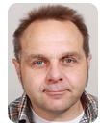

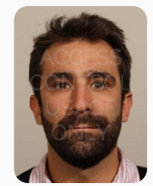
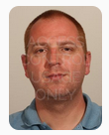
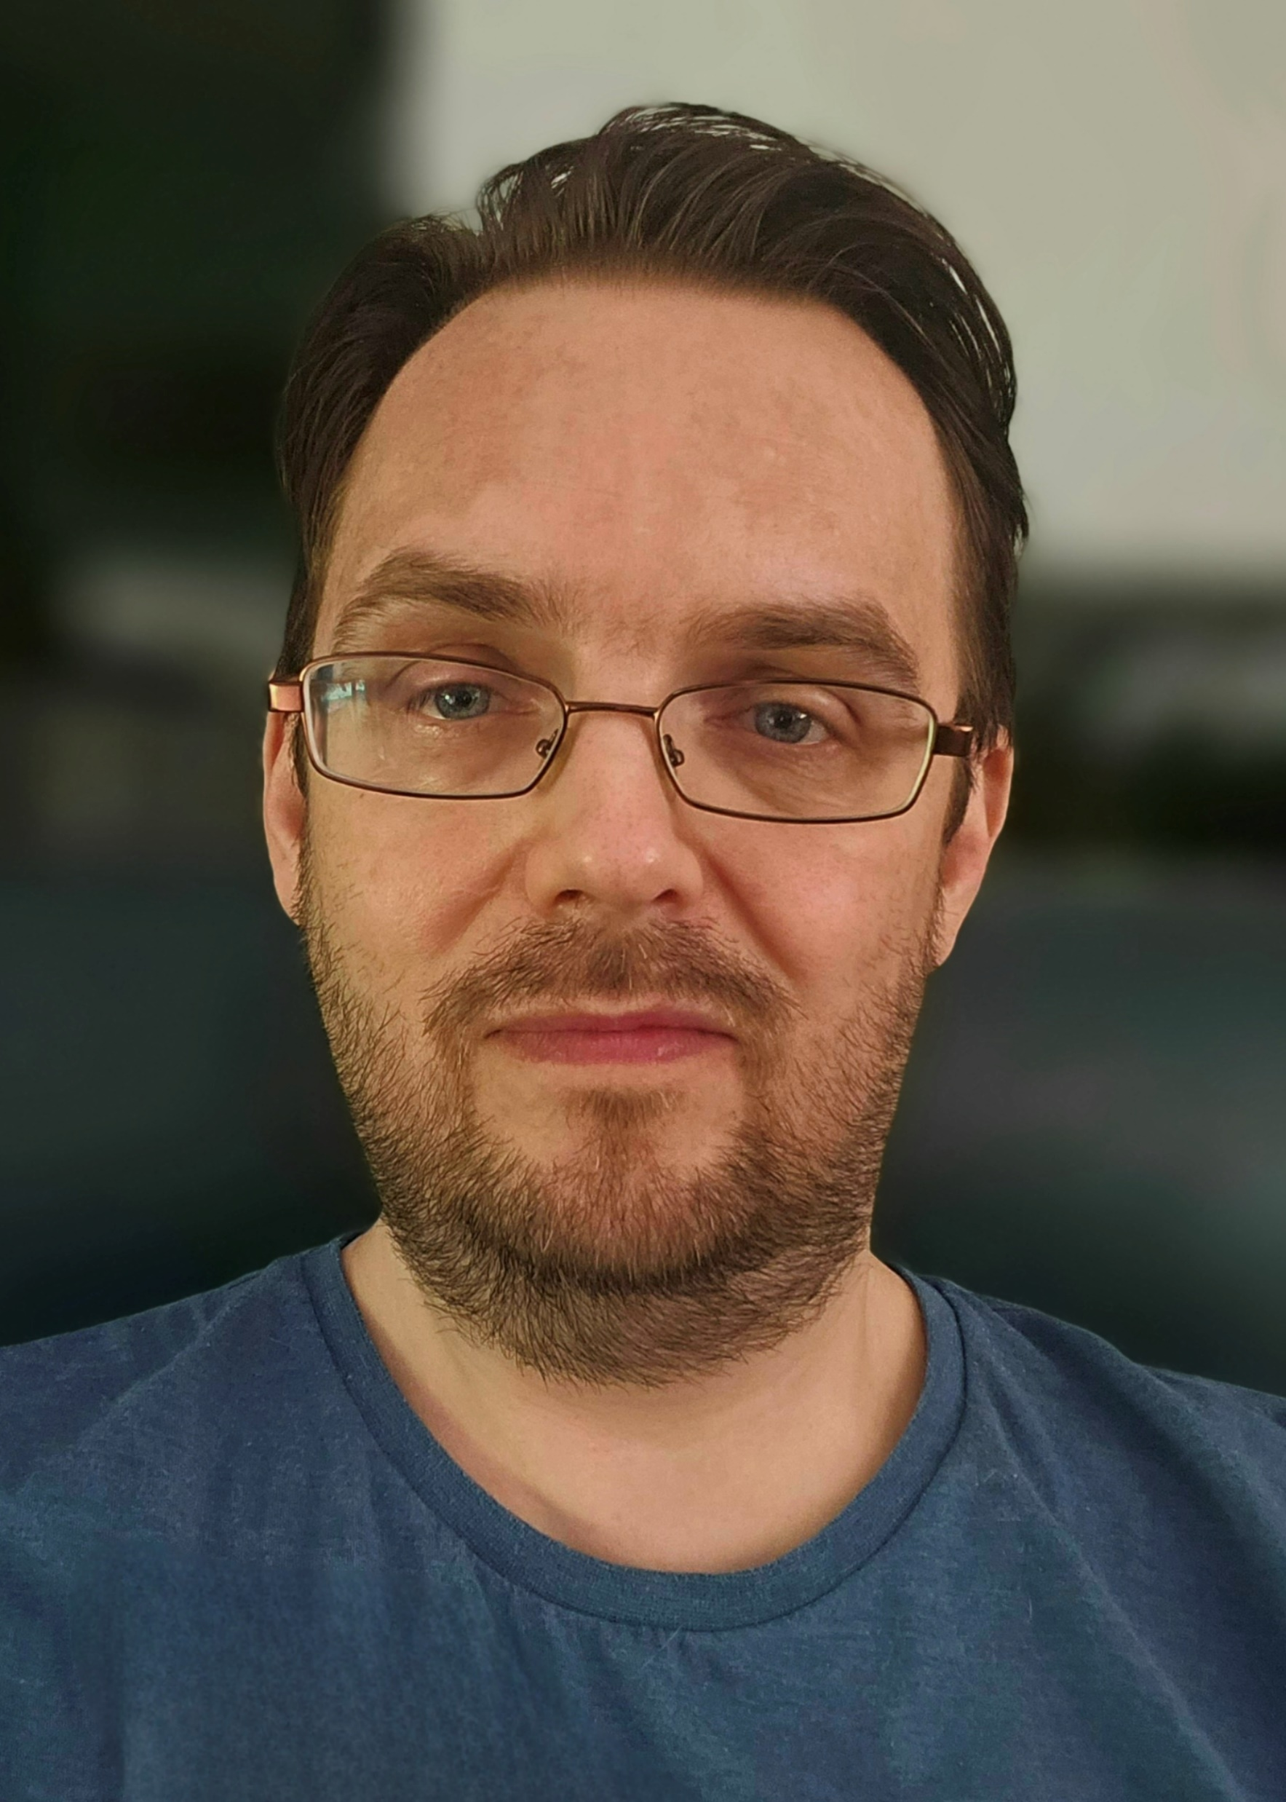
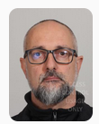
Injector MD team
OP MD linkpersons:
  - CPS : Fabrice Chapuis, Oliver Hans, Gil Imesch
  - SPS: Johan Dalla-Costa, Chris Wetton
ASM support:
  - Emanuele Matli

Slide 3
Main objectives for these MD days
Discuss and converge on the provisional dedicated MD planning for 2025
Identify:
  issues experienced during 2024 MDs
  special wishes for 2025 MDs
  bottlenecks for planning in 2025/2026
Check that the major topics from JAPW’24 and Cham’25 are covered

Slide 4
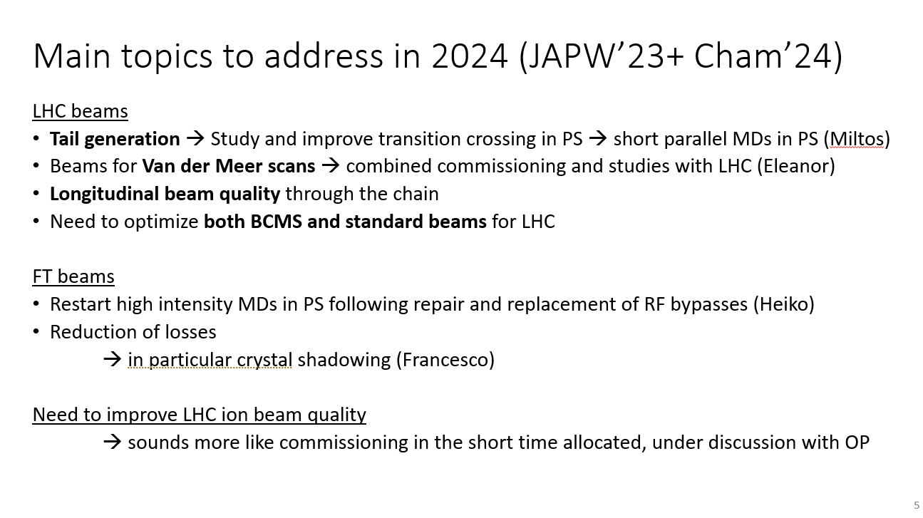
A look back to 2024 objectives
Done
Done and operational
Lots of improvements, to be continued
Done for BCMS, and almost to target
Done
Studies done, operational implementation planned for 2025
Done
Excellent improvements throughout the year
Congratulations to all MD users

Slide 5
Main topics to address in 2025 (JAPW’24+ Cham’25)
LHC beams
  Complete the push to LIU nominal performance for standard filling scheme
  Brightness & tail characterisation and optimisation
  Reliability and reproducibility (proposal of LIU reliability run in 2026)
  Operational margin?
FT beams
  SHiP cycle, beam, extraction and target tests
  Loss reduction and extraction optimization
HL-LHC project:
  Crab cavity beam tests (new RFD cryomodule now installed in SPS)
  Prepare all beam variants for HL-LHC MDs
Automation:
  Hysteresis studies to avoid degaussing cycles
Long parallel MDs
Dedicated MDs

Slide 6
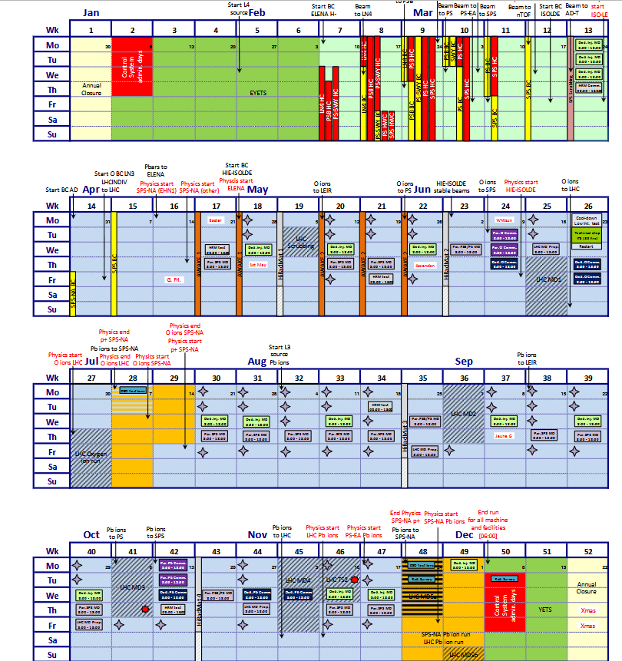
MD planning 2025
15 dedicated slots (10h)
  3 slots (too) early during SPS scrubbing (!)
  3 slots in May
  3 slots during Summer
  3 slots in September
  2 slots mid-November
  1 slot during the ion run
24 h cooldown before TS
  Dedicated low intensity tests (with LHC in TS)
  RP constraints to be clarified

Slide 7
MD planning 2025
15 dedicated slots (10h)
  3 slots (too) early during SPS scrubbing (!)
  3 slots in May
  3 slots during Summer
  3 slots in September
  2 slots mid-November
  1 slot during the ion run
24 h cooldown before TS
  Dedicated low intensity tests (with LHC in TS)
  RP constraints to be clarified
13 long parallel slots
Short parallel MDs:
  Only few slots in October/November

Slide 8
Rules for the MD days
Talks of 8’ (sharp)
7’ of discussion
1 talk per MD user
Focus on 2023 results/issues and 2024-25 wishes/plans

Slide 9
Many thanks to the friends of the apéro for the help:
Chiara, Vera, Lucie
Many thanks to Lucie for the logistical support
Many thanks to IEFC and ATS for the financial support

Slide 11
Dedicated MD requests for 2025
SHIP → 10 slots
Crab cavities → 6 slots
COLDEX → 2 slots
ABT (non-SHIP) → 4 slots
EPA → 3 slots
Collimation → 2 slots
ABP (non-SHIP) → 2 slots
RF → 1 slot
Ions (O, Pb) → 3 slots
→ 36 slots (360 h requested) for 150h available

Slide 12
Dedicated MD requests for 2025
SHIP → 10 slots
Crab cavities → 6 slots
COLDEX → 2 slots
ABT (non-SHIP) → 4 slots
EPA → 3 slots
Collimation → 2 slots
ABP (non-SHIP) → 2 slots
RF → 1 slot
Ions (O, Pb) → 3 slots
SHIP → 5 slots
Crab cavities → 4 slots
COLDEX → 1 slot
ABT (non-SHIP) → 1 slots
EPA → 2 slots
Collimation → 1 slots
ABP (non-SHIP) → 1 slots
RF → 0 slot
Ions (O, Pb) → 1 slot
→ 34 slots (340 h requested) for 150h available…

Slide 13
Very draft proposal for dedicated MDs
March 24: crab cavities
March 25: ABP
March 26: ABT + 3h EPA
April 28: crab cavities + 3h EPA
May 14: Collimation
May 28: SHiP + 3h EPA
Cooldown + TS: COLDEX+ crab cavities +3 h EPA
July 23: SHiP +3h EPA
July 30: SPARE
Aug 13: SHiP +3h EPA
Sep 10: crab cavities + 3h EPA
Sep 24: SHiP
Sep 31 : SPARE
Nov 12 (no LHC): crab cavities
Nov 19: SHiP +3 h EPA
Dec 1: ions
→ To be discussed further!

