Slide 1
Beam based measurements of cavities impedance (C80, C10)
Mathieu Taquet
Acknowledgments : A. Lasheen, B. Woolley, V. Desquiens, PS operators
05/02/2025

Slide 2
Outline
Introduction
Measurement principle
C80
C10
Conclusions

Slide 3

Introduction
Is the new PSpice model of the amplifier chain reproducing the beam cavity interaction throughout the complete power range?
C80
Measure the system with the beam until it starts to compress
C10
What are the dynamics of the impedance when the gap relay is switched on ?
Is the shunt impedance with wideband feedback around 500 Ω ?

Slide 4
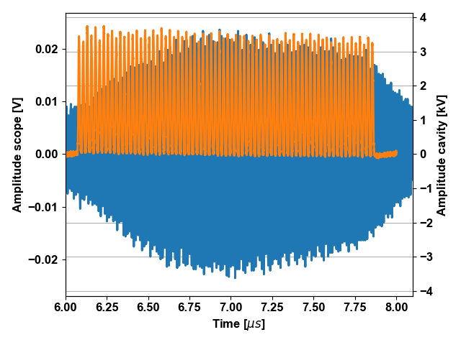
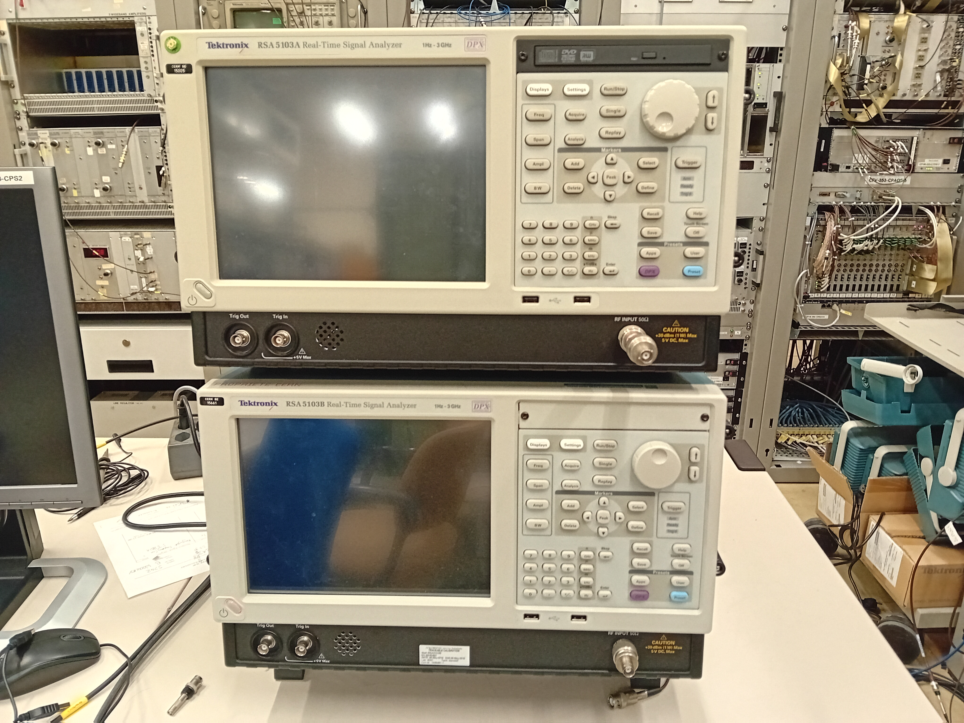

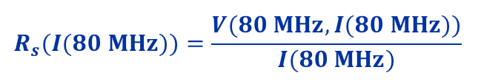



Measurement principle (for C80-88)
While the 40 MHz cavities and C80-89 and C80-08 follow the bunch rotation program
Current calibration
$$∝I(80 MHz)$$
$$I(80 MHz)$$
Voltage Calibration
$$∝V(80 MHz,I(80 MHz))$$
$$V(80 MHz,I(80 MHz))$$
$$R_{s}(I(80 MHz))=\frac{V(80 MHz,I(80 MHz))}{I(80 MHz)}$$

Slide 5
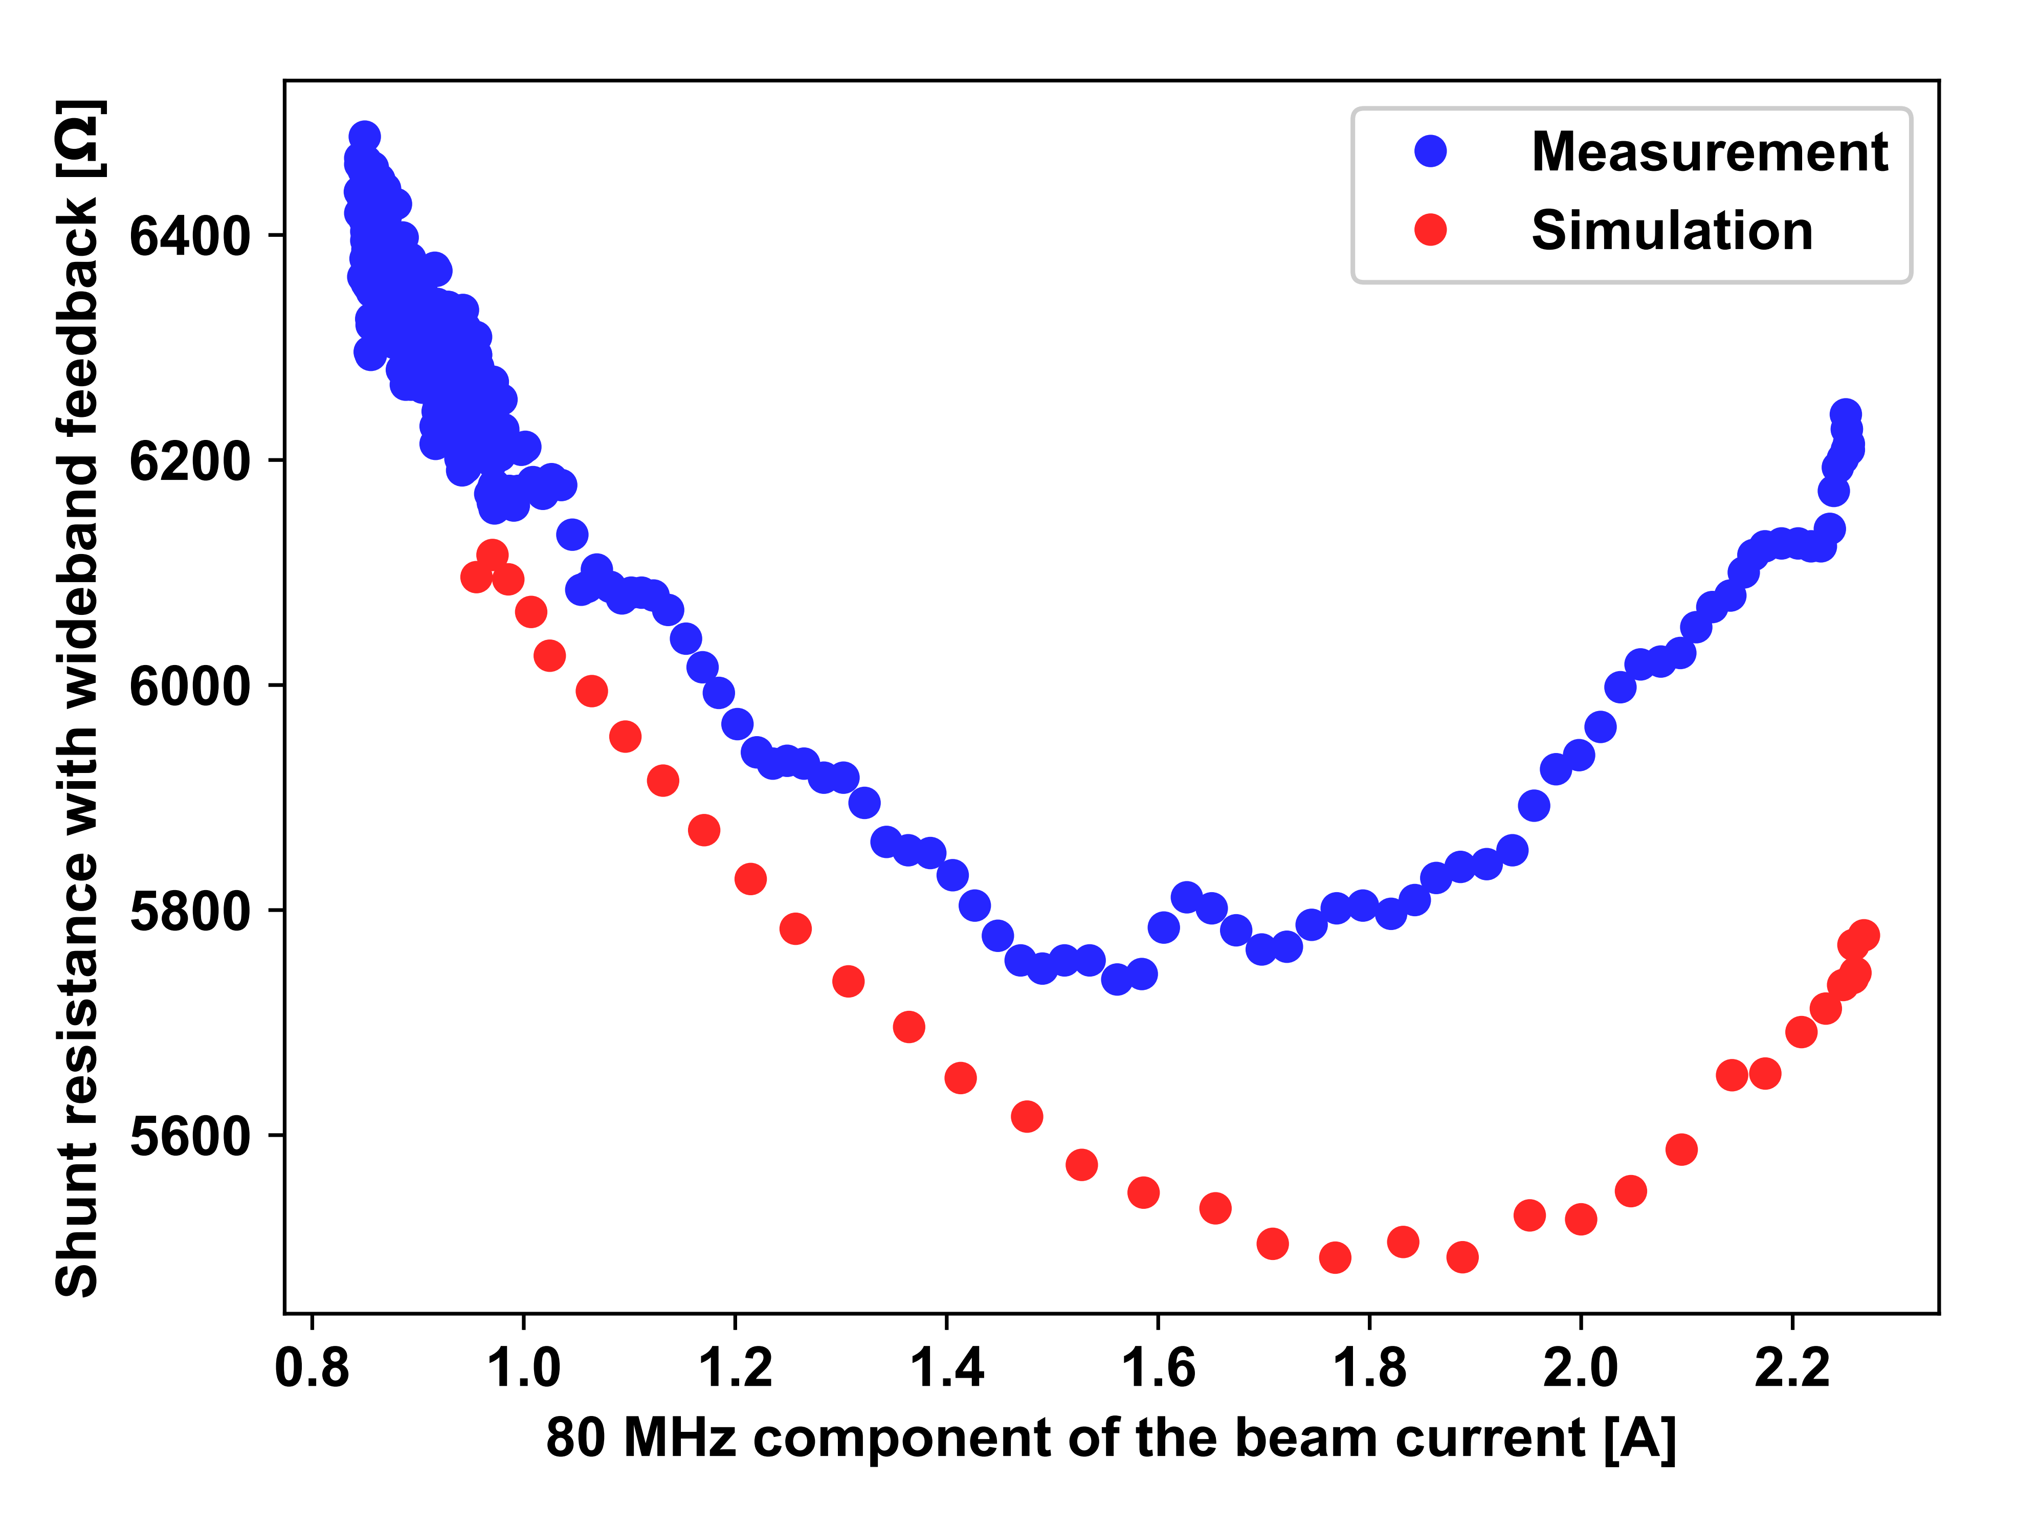
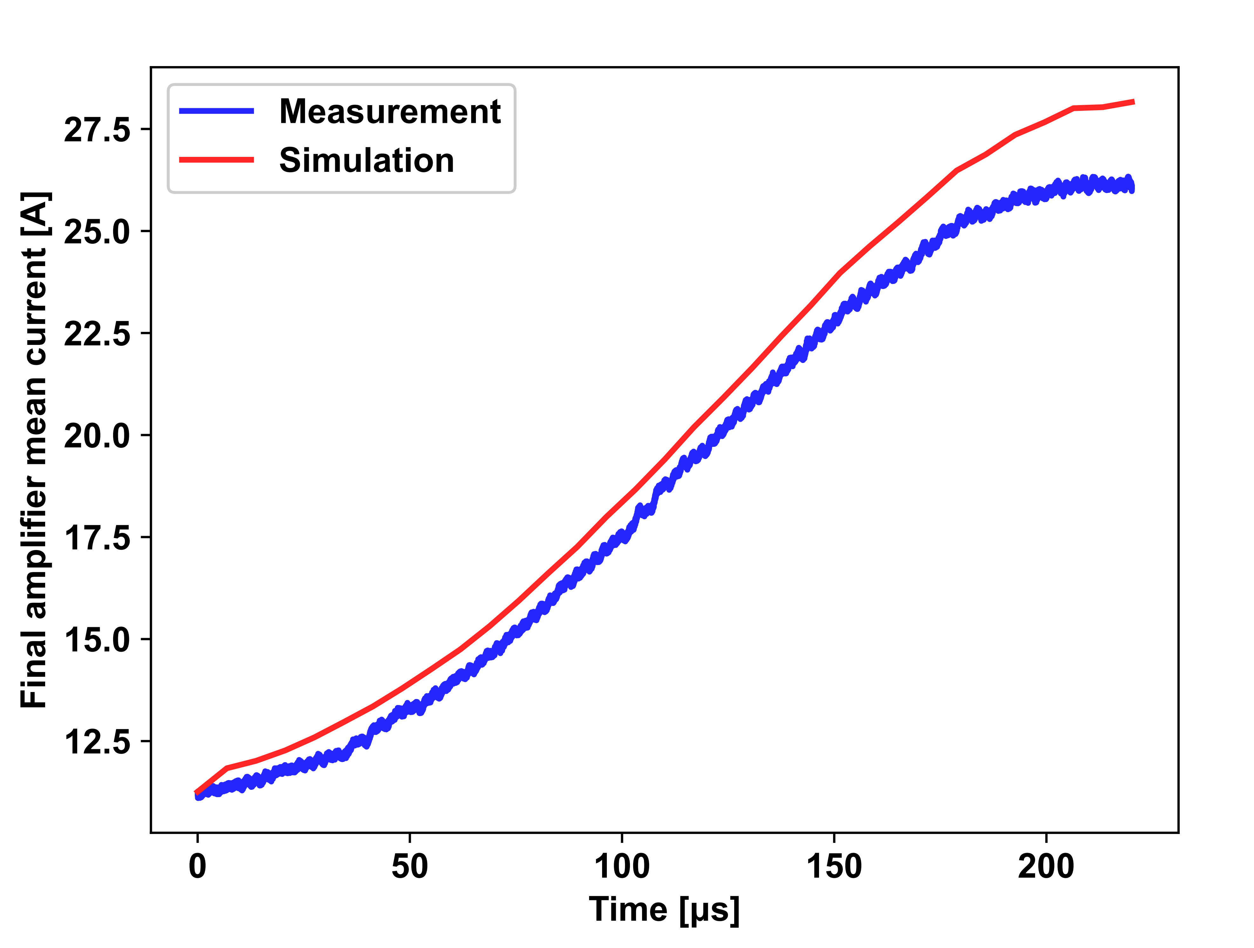
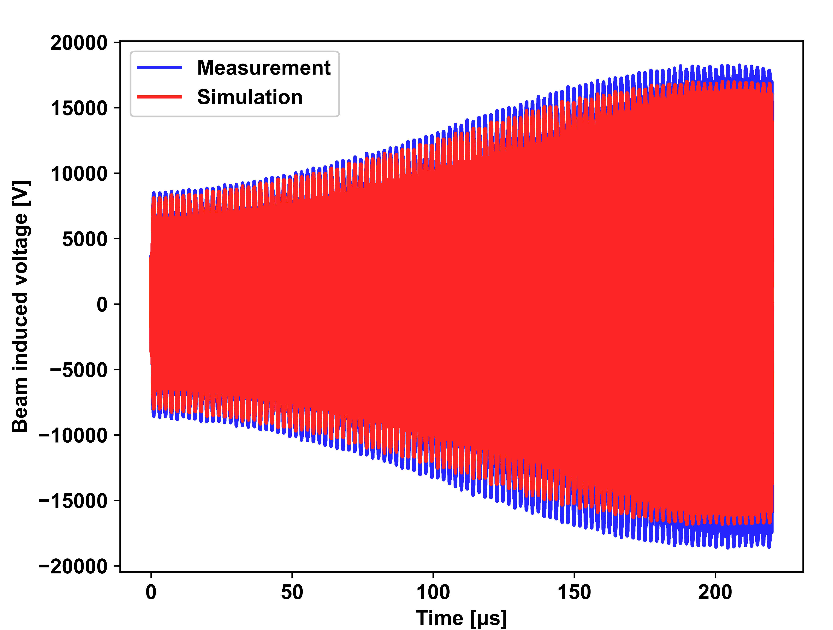
Results (for C80-88)
Compression of the shunt resistance
Anodic current during BR
Induced voltage in C80-88 during BR

Slide 6
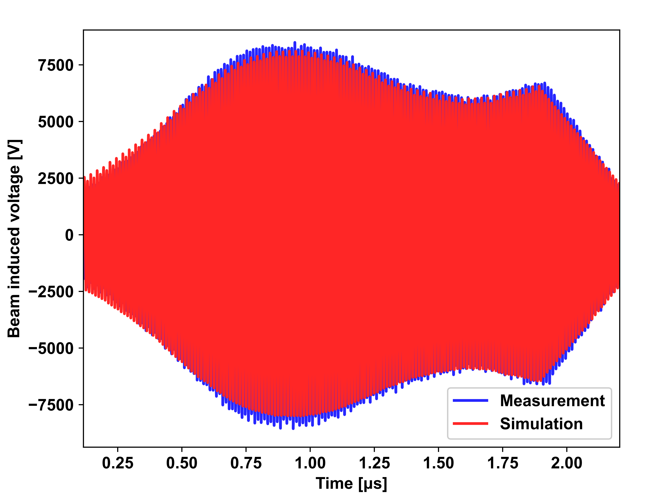
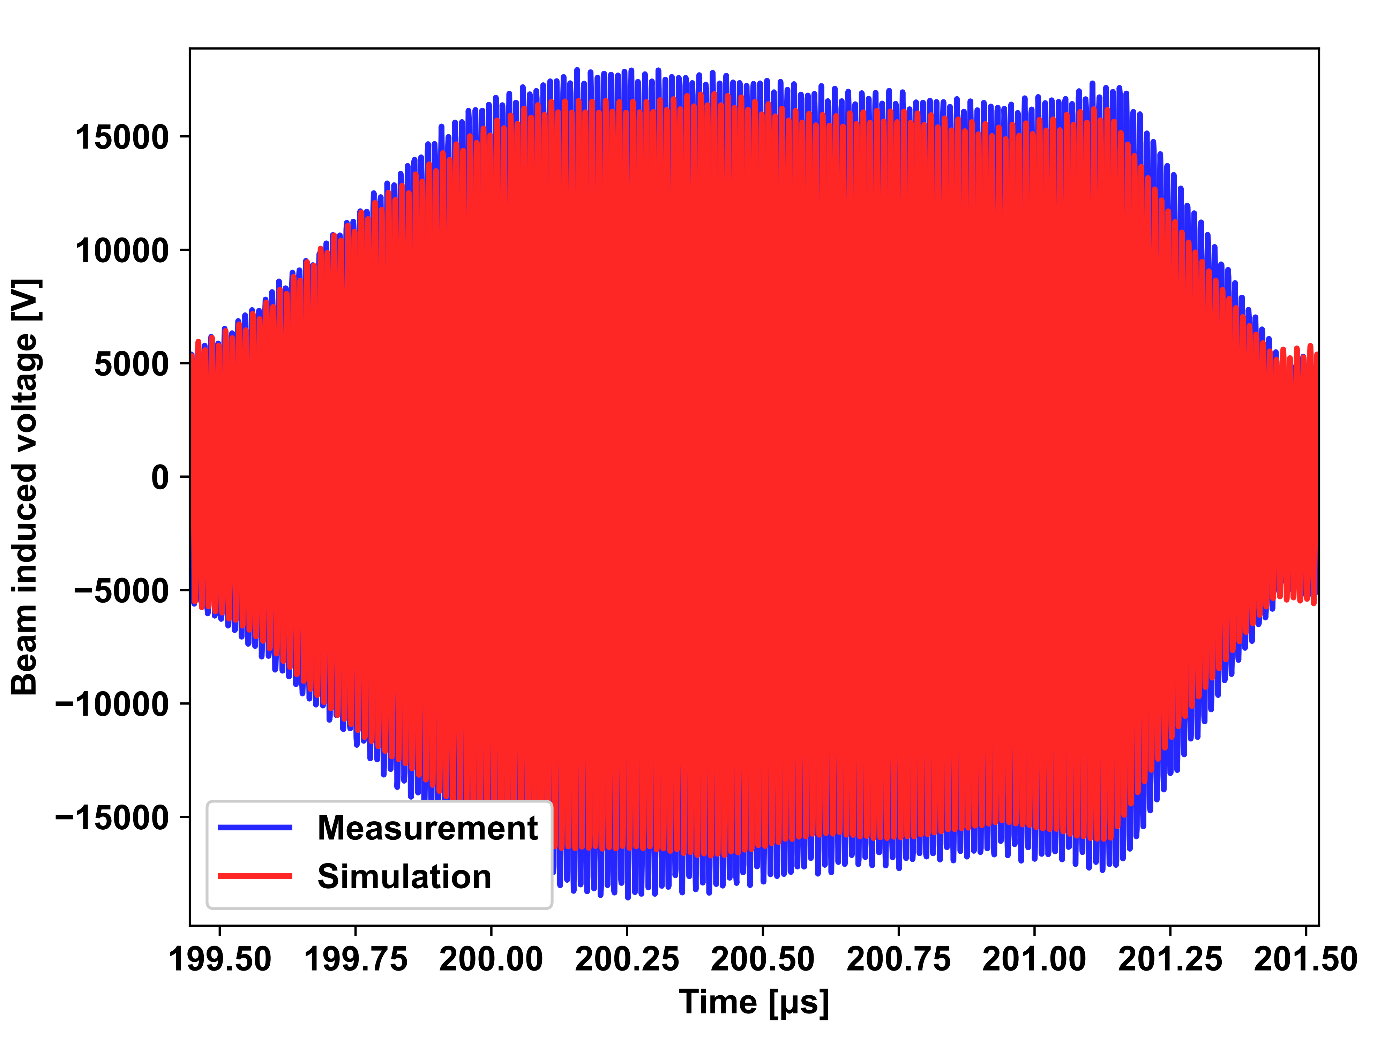
Results (for C80-88)
All good !!

Slide 7





Measurement principle (for C10)
While the gap relays are switched on
Current calibration
$$∝I(⍵)$$
$$I(⍵)$$
Voltage Calibration
$$∝V(⍵)$$
$$V(⍵)$$
$$Z(⍵)=\frac{V(⍵)}{I(⍵)}$$

Slide 8
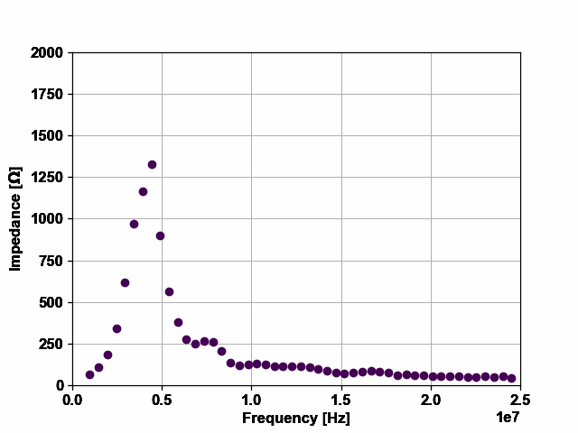
Results: Dynamic impedance behavior
Example of cavity 56 – tuned on h8

Slide 9
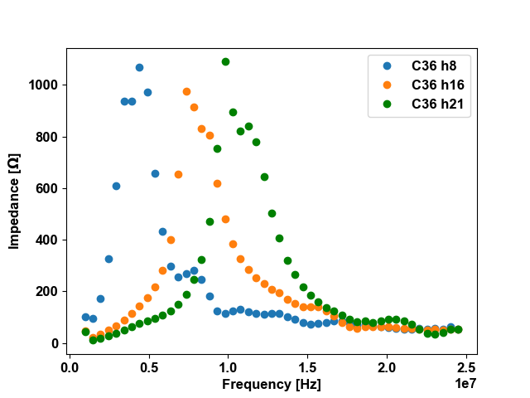
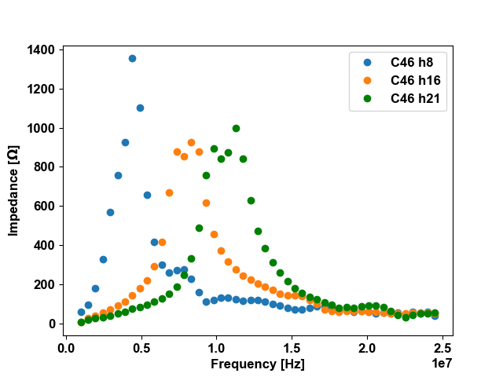
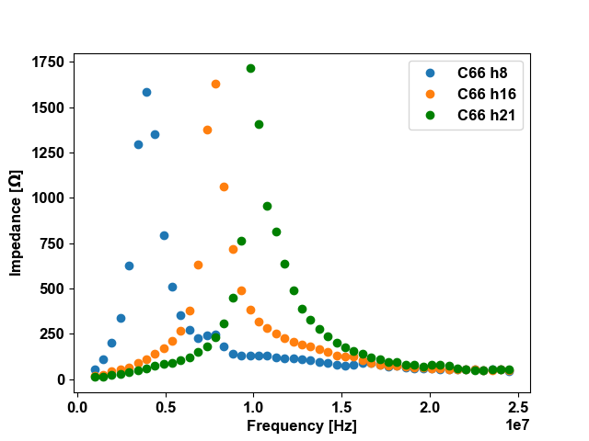
Results: wideband feedback only
A few cavities for illustration
1
Impedance is too high!! Factor 2-3, depending on cavities
Impedances of C10 have been measured, but some issues to be tackled/understood next year
2
Issues with calibration of voltage due to cable compensator: measurements to be repeated but central frequency is reliable

Slide 10
Conclusion
The new PSpice model reproduces correctly the dynamic impedance behavior
C80
No more measurement to be redone
C10
Impedance is too high: work will be done on the RF side to better estimate the impedance and tune the loop
Need to remeasure the impedances
In general, we did not experience any relevant problem

Slide 11
Backup Slides

Slide 12
Pspice model (for C80-88)

Slide 13
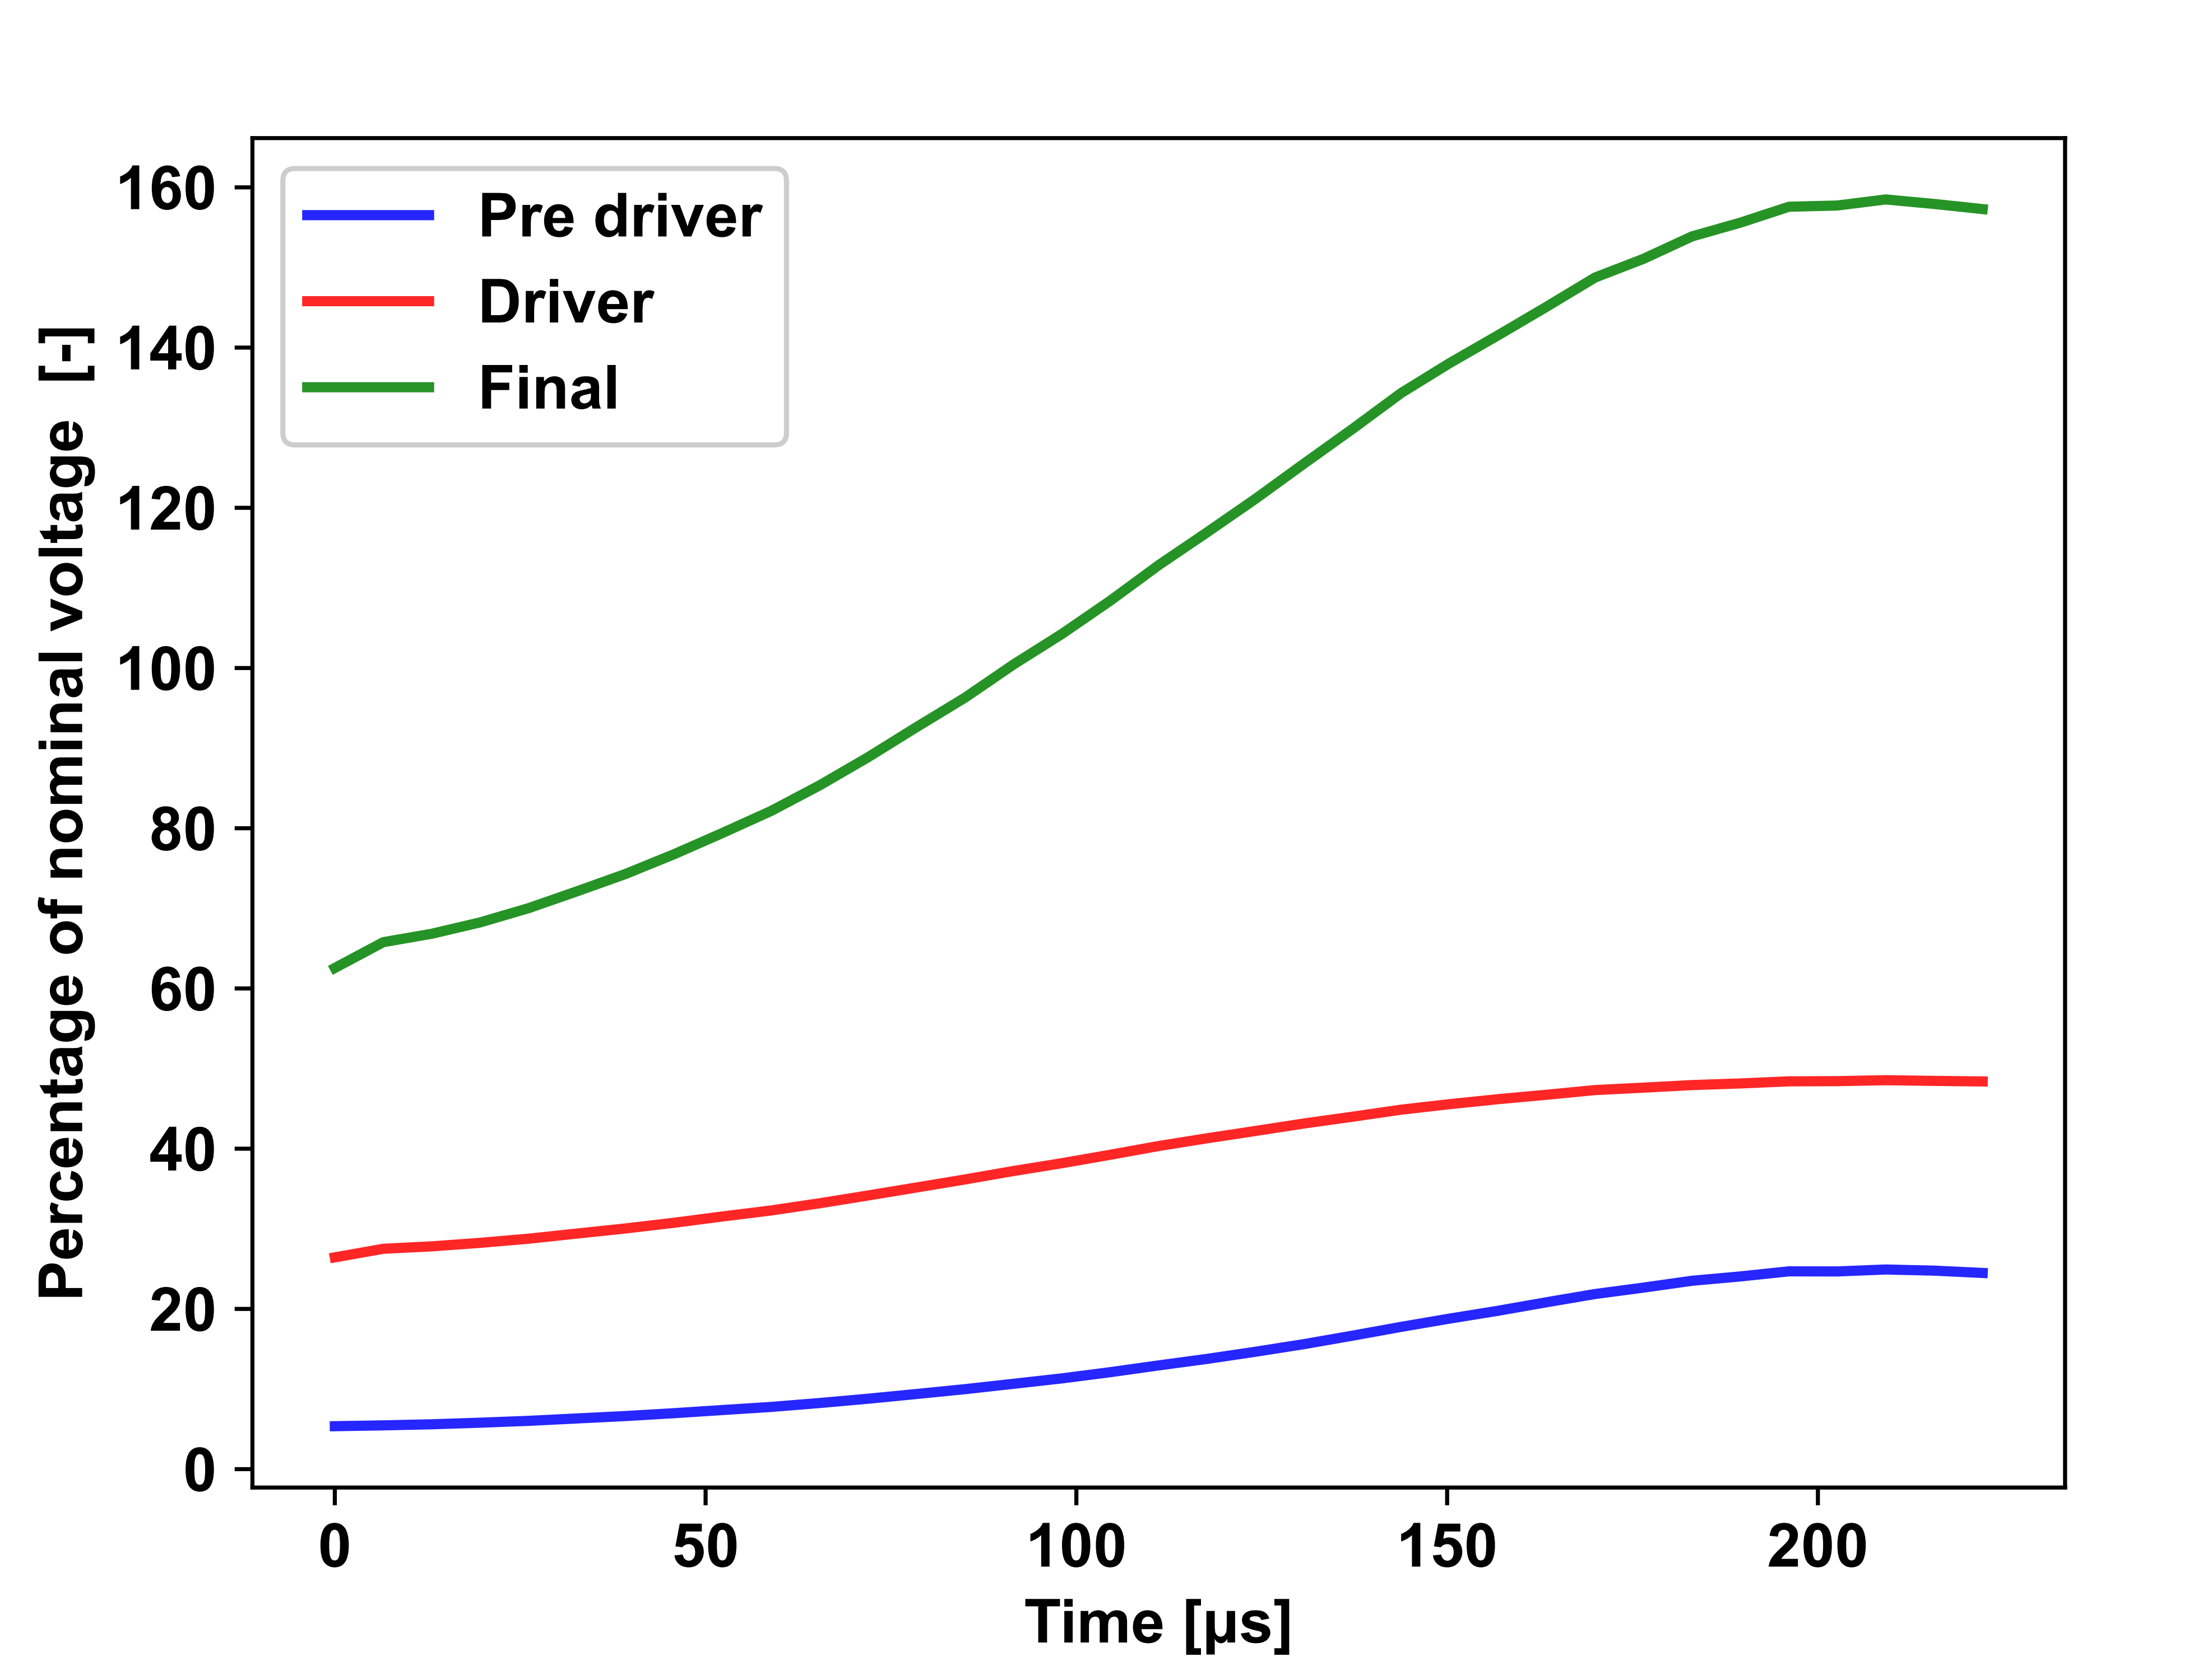
Power limitations (for C80-88)

