Slide 1
Updating automatic RF triple splitting optimizations in the PS
Injector performance Panel MD days 2025
Acknowledgements:
A. Lasheen, A. Beeckman
G. Trad, H. Pahl, M. Schenk,
PS Operators and coordinators
Presenter: Joel Wulff
Date of presentation: 05/02/2025

Slide 2
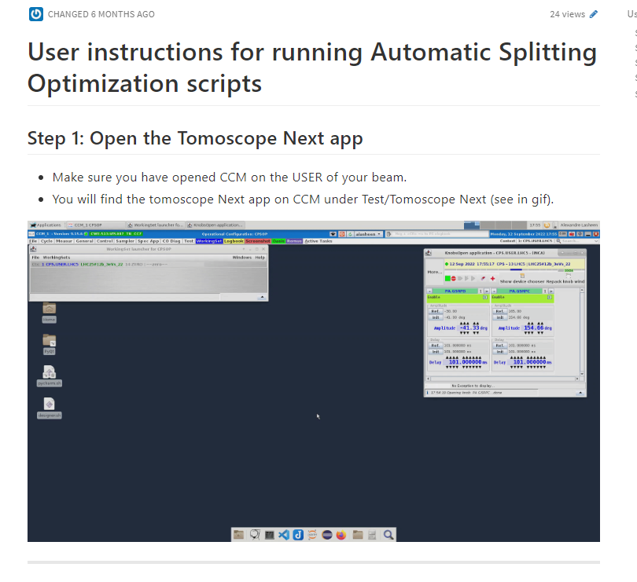
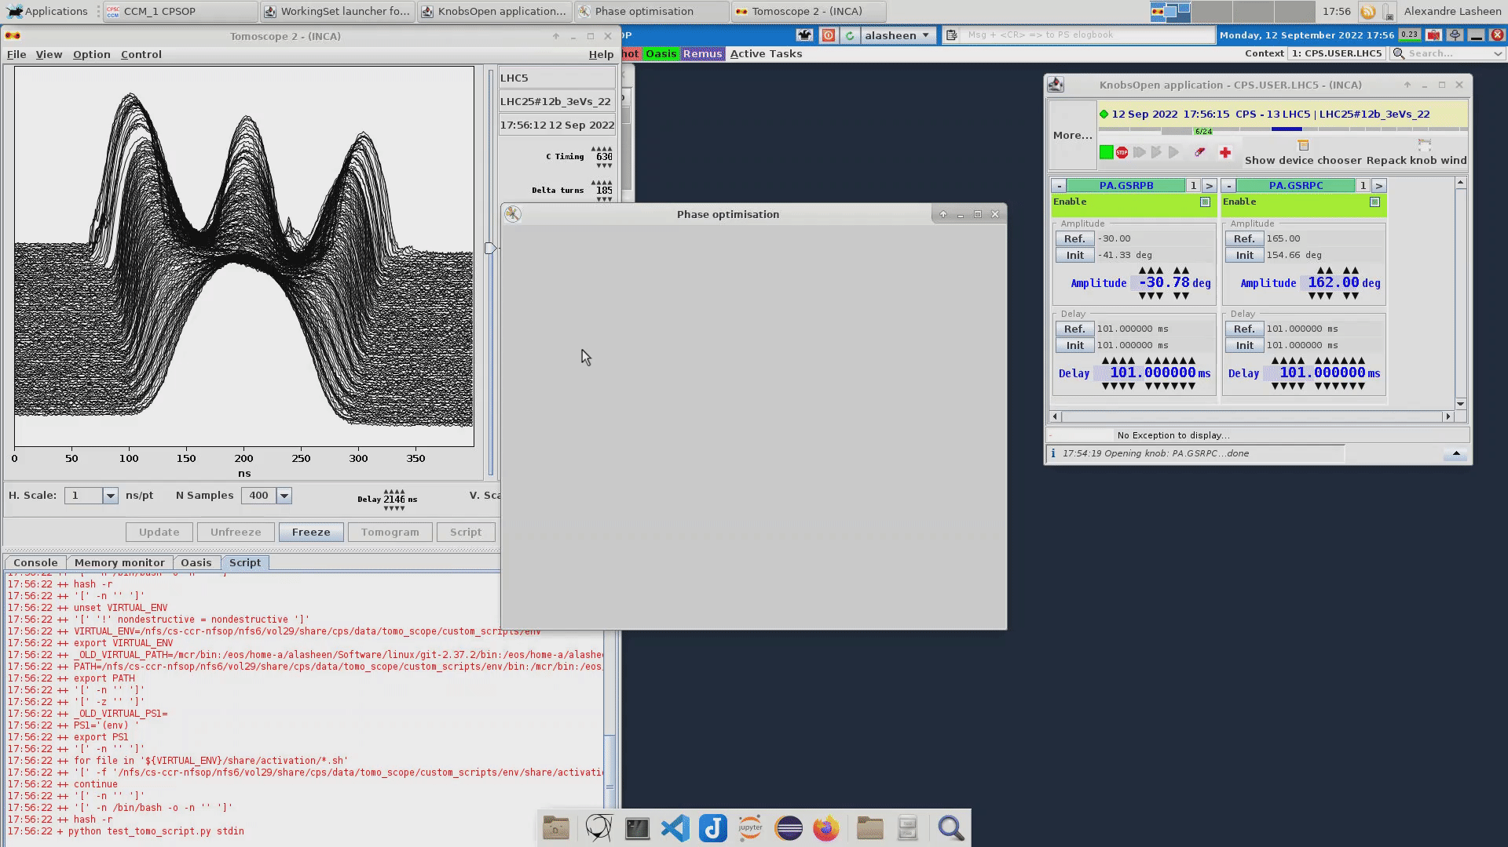
Introduction
Main activites
Updating the CNN + RL based optimization of RF triple splittings in the PS for autonomous operation
Continued on work from 2022/23: IPP MD days 2023
Motivation
Solution from 2023 very limited:
Script launched from tomoscope application: codimd
Useful for MDs, but inflexible. Several key issues,

Slide 3
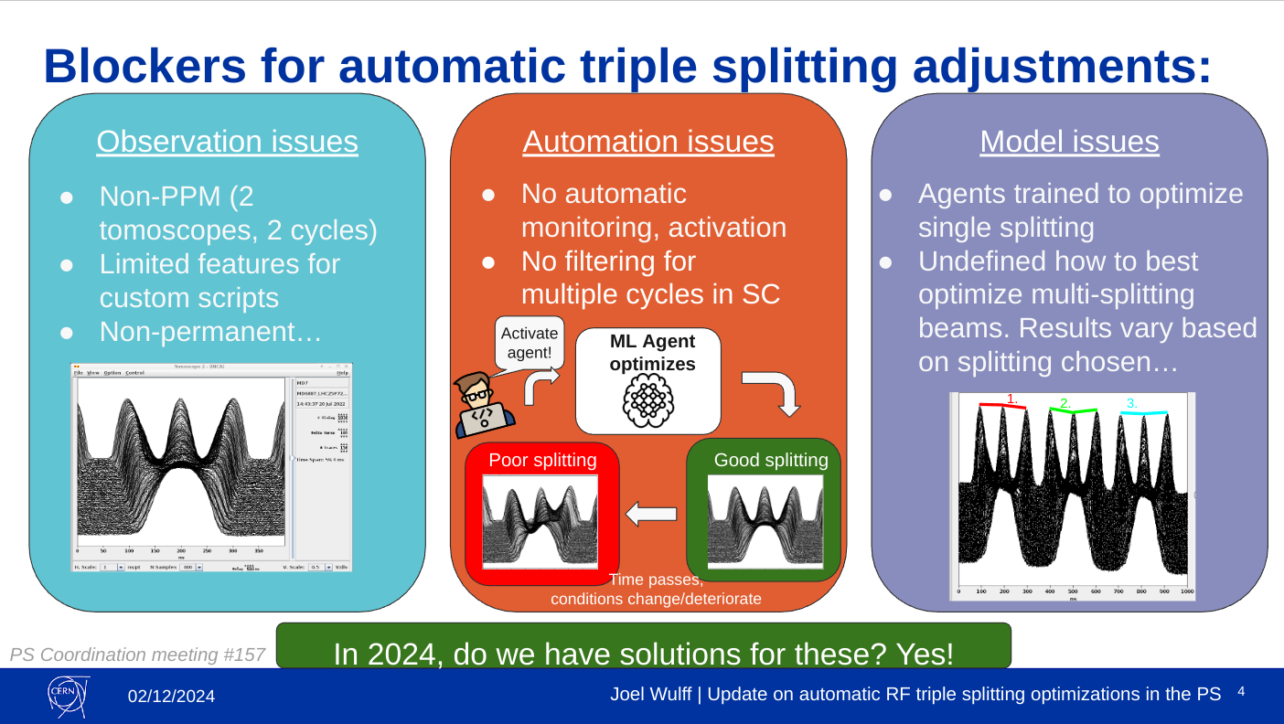
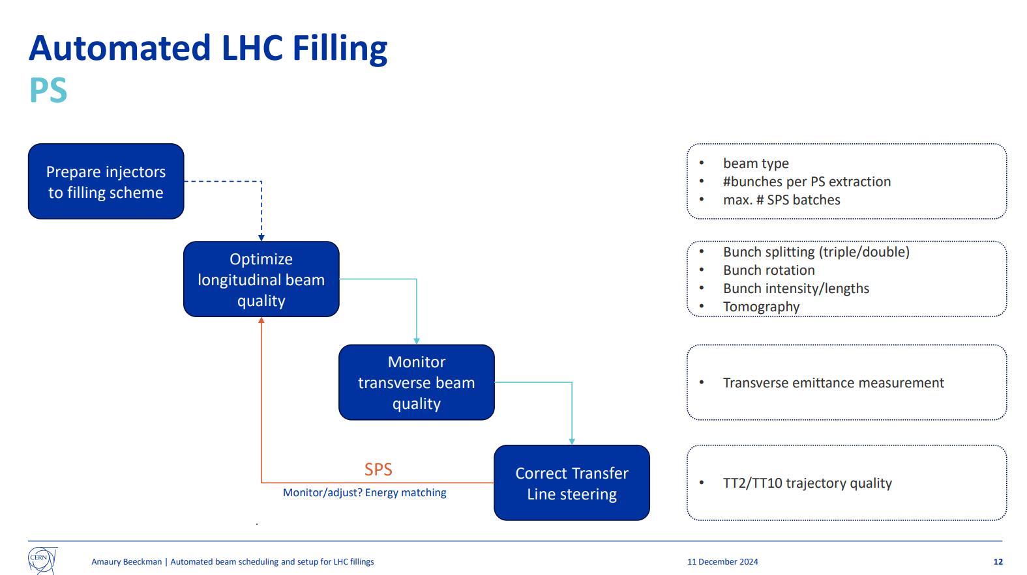
Introduction
Main activites
Continued on work from 2022/23: IPP MD days 2023
Updating the CNN + RL based optimization of RF triple splittings in the PS for autonomous operation
Motivation
Solution from 2023 very limited:
Script launched from tomoscope application: codimd
Useful for MDs, but inflexible. Several key issues,
PS MPC #157, Triple splitting on LHC type beam, J. Wulff
Non-permanent, non-ppm observations
No automatic triggering, monitoring
Inconsistent performance for high transient beam loading regimes, e.g. 36b BCMS.
Solving these issues necessary for automated splitting optimizations
→ Needed for automated LHC fillings (EPA WP2)
Dynamic beam scheduling and automated LHC filling, A. Beeckman, JAPW2024

Slide 4
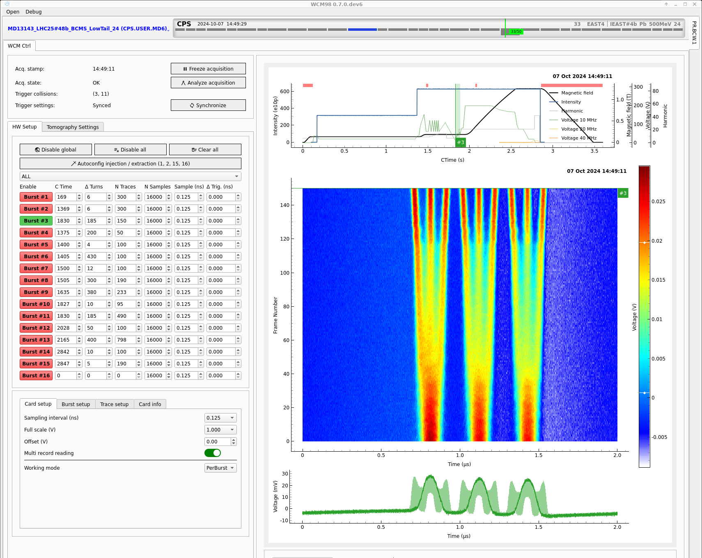

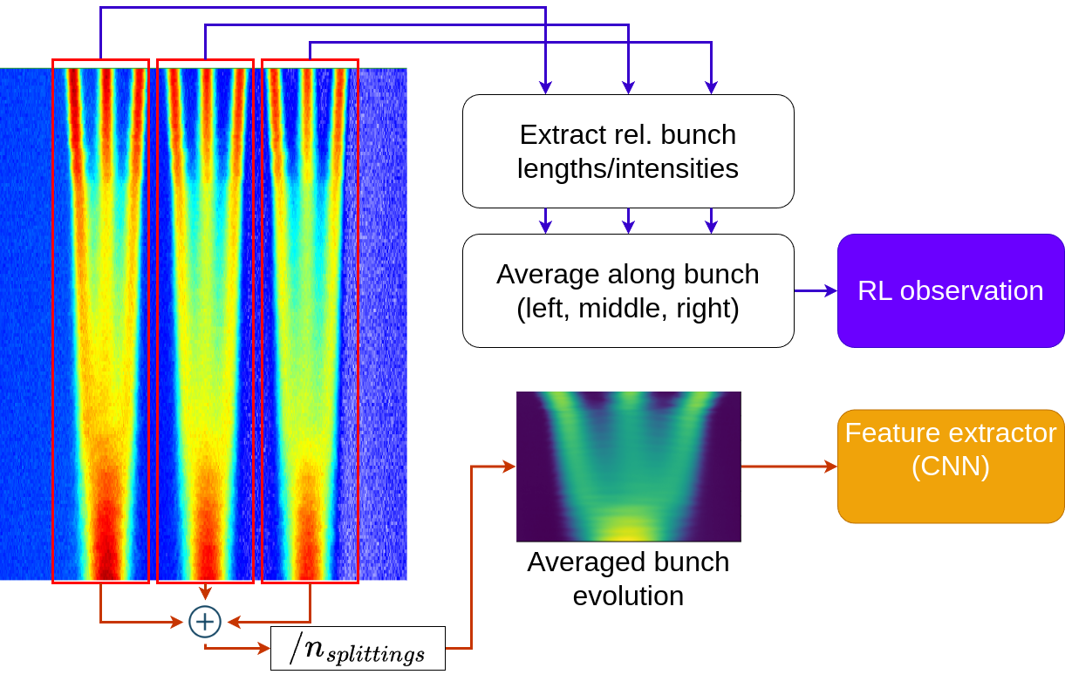
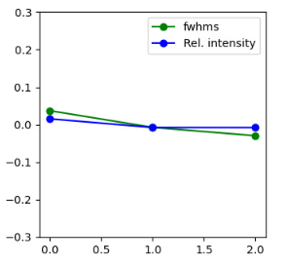
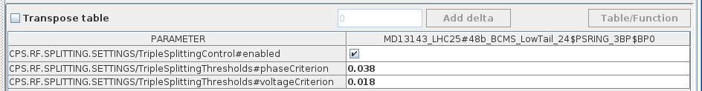
Main 2024 developments
BCWLBO
More info in talk from A. Beeckman, PS Co. Meeting #144
Observation per USER
Observation:
  Migration from tomoscope → BCWLBO
    PPM, Permanent
Automation:
  UCAP + LSA implementation replacing script
  Automatically monitor, activate optimization, PPM
Act on cavities
RF Cavities
Performance:
  Optimize the average splitting rather than splitting of interest
  Updated optimization criterion
LSA
Check if enabled and above criterion
Extracted features → less sensitive to alignment
More interpretable!
LSA settings (PPM)

Slide 5
2024 MD purpose and experience
Goals and purpose
Test and aid in development of new software implementations
  UCAP + LSA setup
Check performance on 36b BCMS
  Did averaging/updated criterion improve it?
Availability and support
Good availability, many successful MDs!
  Only a few lost hours due to LHC filling and LHC ION beams
  Very good support from PSOP
5
Notes:
Novel criterion used for determining optimized splitting
Define mathematically criterion
limits experimentally tested (to see what is achievable) and set to:
For phase opt.: 0.038
For voltage opt: 0.018 (meaning optimized state)
In 6 runs on 36b BCMS operational beam, 6 of 6 runs were successfully optimized.
Logbook entry
Mention working 72b nominal beam for LIU intensities (at slightly lower criterion)

Slide 6
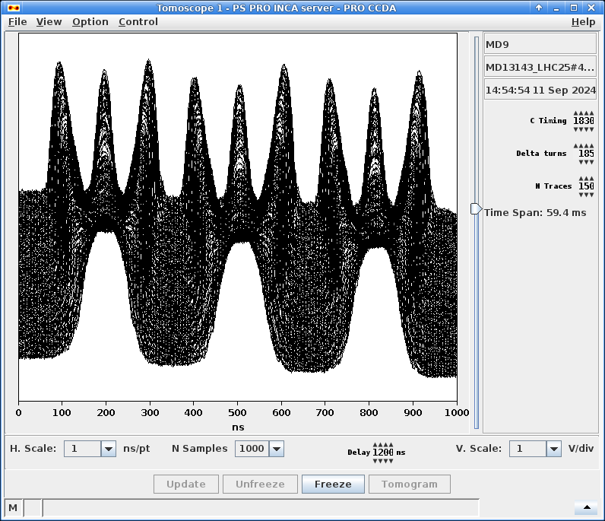
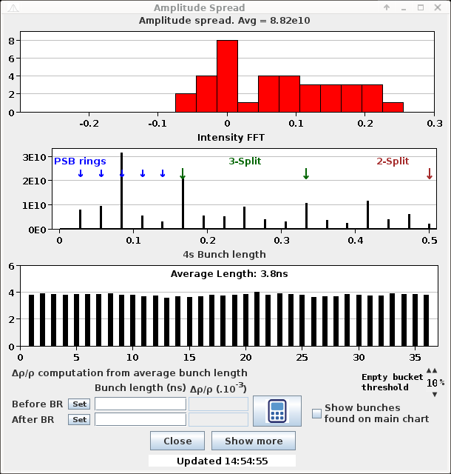
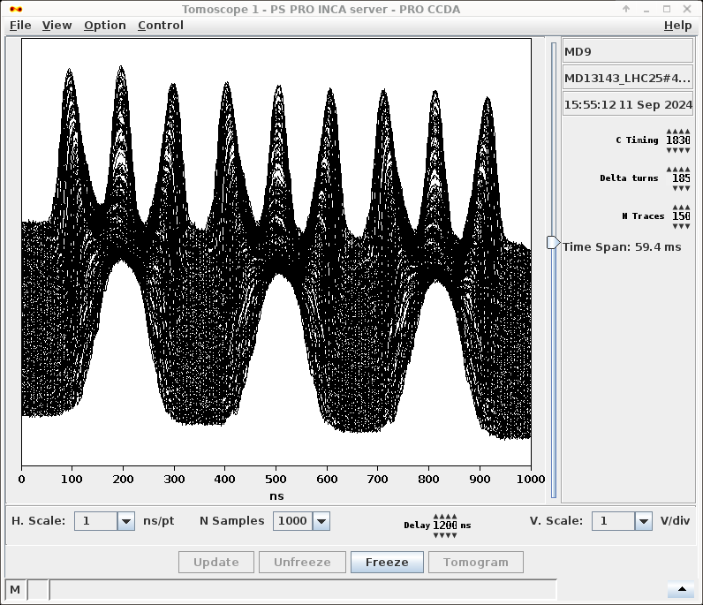
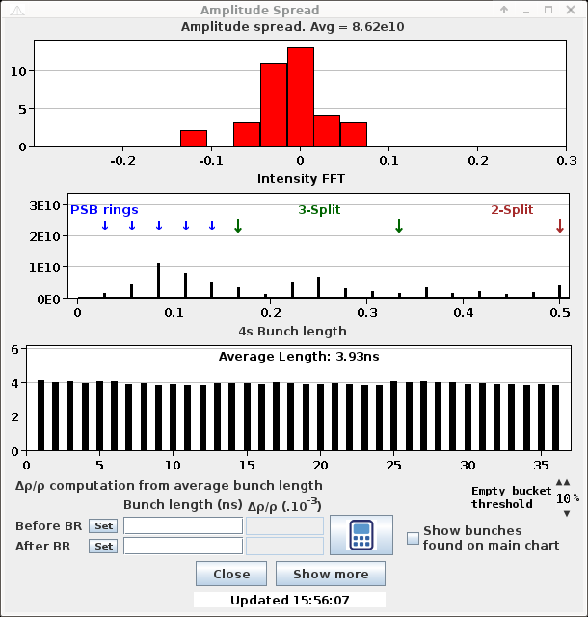
MD results and takeaway
36b BCMS: Initial state
36b BCMS:
6/6 test runs on operational beam successful (varying initial conditions).
  Logbook entry
72b Nominal (HL-LHC intensity):
11 episodes run, all successful.
  Logbook example
36b BCMS: Final state
Main takeaways
Current implementation shows promise
Main blockers from 2023 solved
Well poised for operational testing in 2025!
6
Notes:
Novel criterion used for determining optimized splitting
Define mathematically criterion
limits experimentally tested (to see what is achievable) and set to:
For phase opt.: 0.038
For voltage opt: 0.018 (meaning optimized state)
In 6 runs on 36b BCMS operational beam, 6 of 6 runs were successfully optimized.
Logbook entry
Mention working 72b nominal beam for LIU intensities (at slightly lower criterion)

Slide 7
Looking forward in 2025: Operational testing
First half of 2025
Deploy to operations
Iterative MDs
Operational testing
Final testing/developing UCAP implementation
Use in operational LHC fills
Tuning optimization criterions
Monitor performance (and log to NXCALS)
Simultaneous optimization of double and triple splittings
Gather feedback and experience
Evaluate and improve
Notes:
If current UCAP + LSA implementation was deployed to operations, how would it be controlled?
Start and configure a UCAP node running a single UCAP device
UCAP device json defines which burst # to listen to. Device must be reloaded to switch! Listens to all users and attempts to calculate loss
Calculated loss is sent to the optimization controller converter:
If LSA setting …/TripleSplittingControl#enabled is True → Is phase loss > criterion (.../TripleSplittingThresholds#PhaseCriterion) → optimize phase, otherwise is voltage loss > criterion (.../TripleSplittingThresholds#PhaseCriterion) → optimize voltage,

Slide 8
Thank you for listening! Questions?

Slide 9
Links and contact information
Additional information available in:
Triple splitting on LHC type beam, J. Wulff, PS Coordination Meeting #157, 2024
Reinforcement Learning applied to RF manipulation optimization in the PS. J. Wulff, 2023 RF Seminar
Reinforcement Learning Applied to Optimization of LHC Beams in the CERN Proton Synchrotron, J. Wulff, 3rd ICFA Beam Dynamics Mini-Workshop on Machine Learning Applications for Particle Accelerators
Progress with RL for controlling RF manipulations in the PS, J. Wulff, 2022 ML community forum
Reinforcement learning applied for RF manipulations in the PS, J. Wulff, 2021 ML Coffee
Contact information
Authors: Joel Wulff, joel.wulff@cern.ch or joel.wulff@hotmail.com,

Slide 10
Example performance: MD results for 36b BCMS
Final bunch-by-bunch parameters differ depending on which splitting is observed:
First splitting often ~±5% intensity spread
Splitting 2 and 3 intensity/length spread < ±2 %
 | First splitting |  | Splitting 2 and 3
Episode | Rel. BI spread | Rel. BL spread | Rel. BI spread | Rel. BL spread | Phase opt. steps | Volt. opt. steps
1. | ± 5% | ± 3% | ± < 3% | ± < 3% | 14 | 2
2. | ± 3% | ± < 2% | ± < 2% | ± < 2% | 14 | 2
3. | ± < 2% | ± < 2% | ± < 2% | ± < 2% | 11 | 7
4. | ± 6% | ± 4% | ± < 2% | ± < 2% | 1 | 16
5. | ± 5% | ± 3% | ± < 2% | ± < 2% | 22 | 3
6. | ± 5% | ± 2% | ± < 2% | ± < 2% | 5 | 5
Is it good enough? Needs operational testing to truly determine… but probably.
Note: Spread estimations based on plots from logbook, since raw data was not saved during this MD
10
Notes:
Novel criterion used for determining optimized splitting
Define mathematically criterion
limits experimentally tested (to see what is achievable) and set to:
For phase opt.: 0.038
For voltage opt: 0.018 (meaning optimized state)
In 6 runs on 36b BCMS operational beam, 6 of 6 runs were successfully optimized.
Logbook entry
Mention working 72b nominal beam for LIU intensities (at slightly lower criterion)

Slide 11
Looking forward in 2025: Operational testing
First half of 2025
Beyond 2025
Maintainability?
Handling re-training of ML models?
Deploy to operations
Iterative MDs
Operational testing
Final testing/developing UCAP implementation
Use in operational LHC fills
Tuning optimization criterions
Monitor performance (and log to NXCALS)
Simultaneous optimization of double and triple splittings
Gather feedback and experience
Evaluate and improve
Notes:
If current UCAP + LSA implementation was deployed to operations, how would it be controlled?
Start and configure a UCAP node running a single UCAP device
UCAP device json defines which burst # to listen to. Device must be reloaded to switch! Listens to all users and attempts to calculate loss
Calculated loss is sent to the optimization controller converter:
If LSA setting …/TripleSplittingControl#enabled is True → Is phase loss > criterion (.../TripleSplittingThresholds#PhaseCriterion) → optimize phase, otherwise is voltage loss > criterion (.../TripleSplittingThresholds#PhaseCriterion) → optimize voltage,

