Slide 1
Online Longitudinal Beam Measurement on OP/MD cycles
Beam Current Wall Longitudinal Beam Observation (BCWLBO) FESA Class
Amaury Beeckman with input from A. Huschauer, A. Lasheen, G. Trad, H. Pahl, M. Jaussi, D. Lampridis, M. Cejp, G. Papotti, T. Argyropoulos, S. Albright, and many others…
5th February 2025

Slide 2
How the FESA class works
Fully multiplexed class & high flexibility of use-cases
  Every trace can be set differently
Start Acquisition Event
    Timing / On-demand event that starts one acquisition
End Acquisition Event
    Timing / On-demand event from which we abord the “wait” acquisition
The device publishes as soon as data is available
FESA Class directly linked to the HW cards for acquisitions
    Rely on OASIS Scope (on the FESA layer) & COHAL Layer (for generic purposes) (@Martin & Dimitris)
    But fully independent from the OASIS server (removing master/slave)

Slide 3
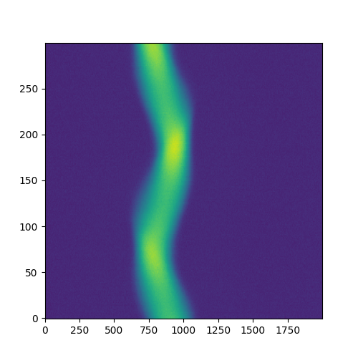
Input interface
Each trace is associated with:
  One group: Publication of the FESA Class is done by groups
  One burst:
    Corresponds to 1 burst LTIM settings (@PS & @PSB)
    Corresponds to 1 train of triggers VTU settings (@SPS & @LHC)
Each trace has its settings:
  Sampling interval
  Trigger delays
  Number of samples

Slide 4
Acquisition modes
Burst vs trace vs continuous acquisition

Slide 5
Burst/Trace Mode
Publishing at end of acquisition
Purpose:
Tomography
Bunch length
Burst #1
Burst #2
Burst #3
Burst #4
Burst #5
Time
START TIME
PUBLISH
END TIME

Slide 6
Continuous Mode
Publishing the same set of traces every x ms within a cycle
Purpose:
Analysis a soon as possible
Long cycles (SPS - LHC)
Trigger
Trigger
Trigger
Trigger
Trigger
Trigger
Trigger
Trigger
Trigger
Trigger
Trigger
Trigger
Time
START TIME
PUBLISHING
PUBLISHING
PUBLISHING
PUBLISHING
PUBLISHING
PUBLISHING
PUBLISHING
PUBLISHING
PUBLISHING
PUBLISHING
PUBLISHING
PUBLISHING
END TIME

Slide 7
Integration in the OP environment
In the @CPS (expected to be extended in the PSB and SPS)

Slide 8
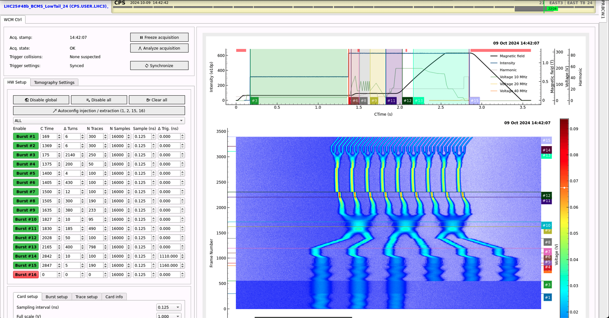
WCM application
Settings
Acquisition

Slide 9
WCM application
Settings Configuration
Bursts 1 & 2: injection timing
Bursts 3 to 14: setup by user
  Bunch length evolution
  Tomography reconstruction
Bursts 15 & 16: extraction timing
Directly linked to
  Trigger card
  BCWLBO class

Slide 10
WCM application
Acquisition Measurement
Cycle-by-cycle observation update
Bursts are highlighted
Will replace the Tomoscope application

Slide 11
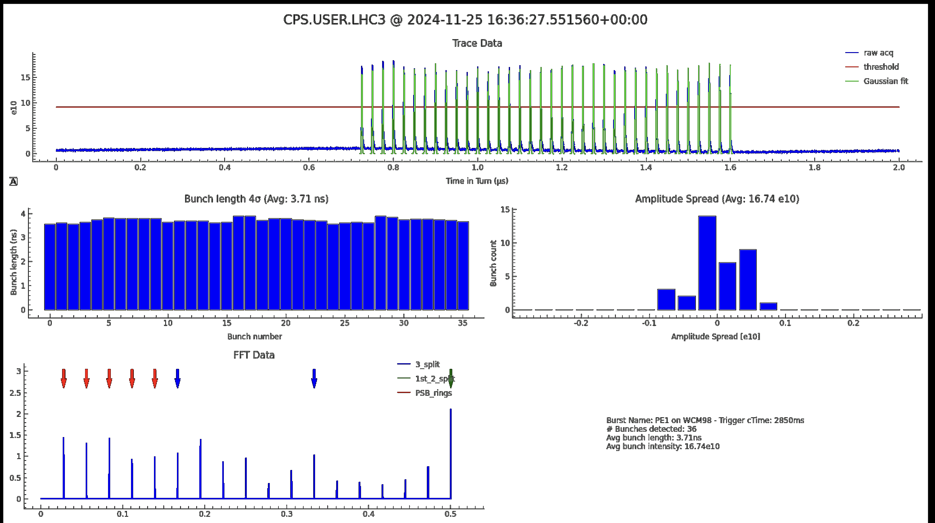
WCM application
Raw acquisition post-processing (via UCAP)
Use of this BCWLBO class for the last-turn logging (replacement of the BSM app)

Slide 12
WCM application
Raw acquisition post-processing (via UCAP)
Use of this BCWLBO class for measuring bunch length evolution, bunch by bunch intensity evolution, etc.

Slide 13
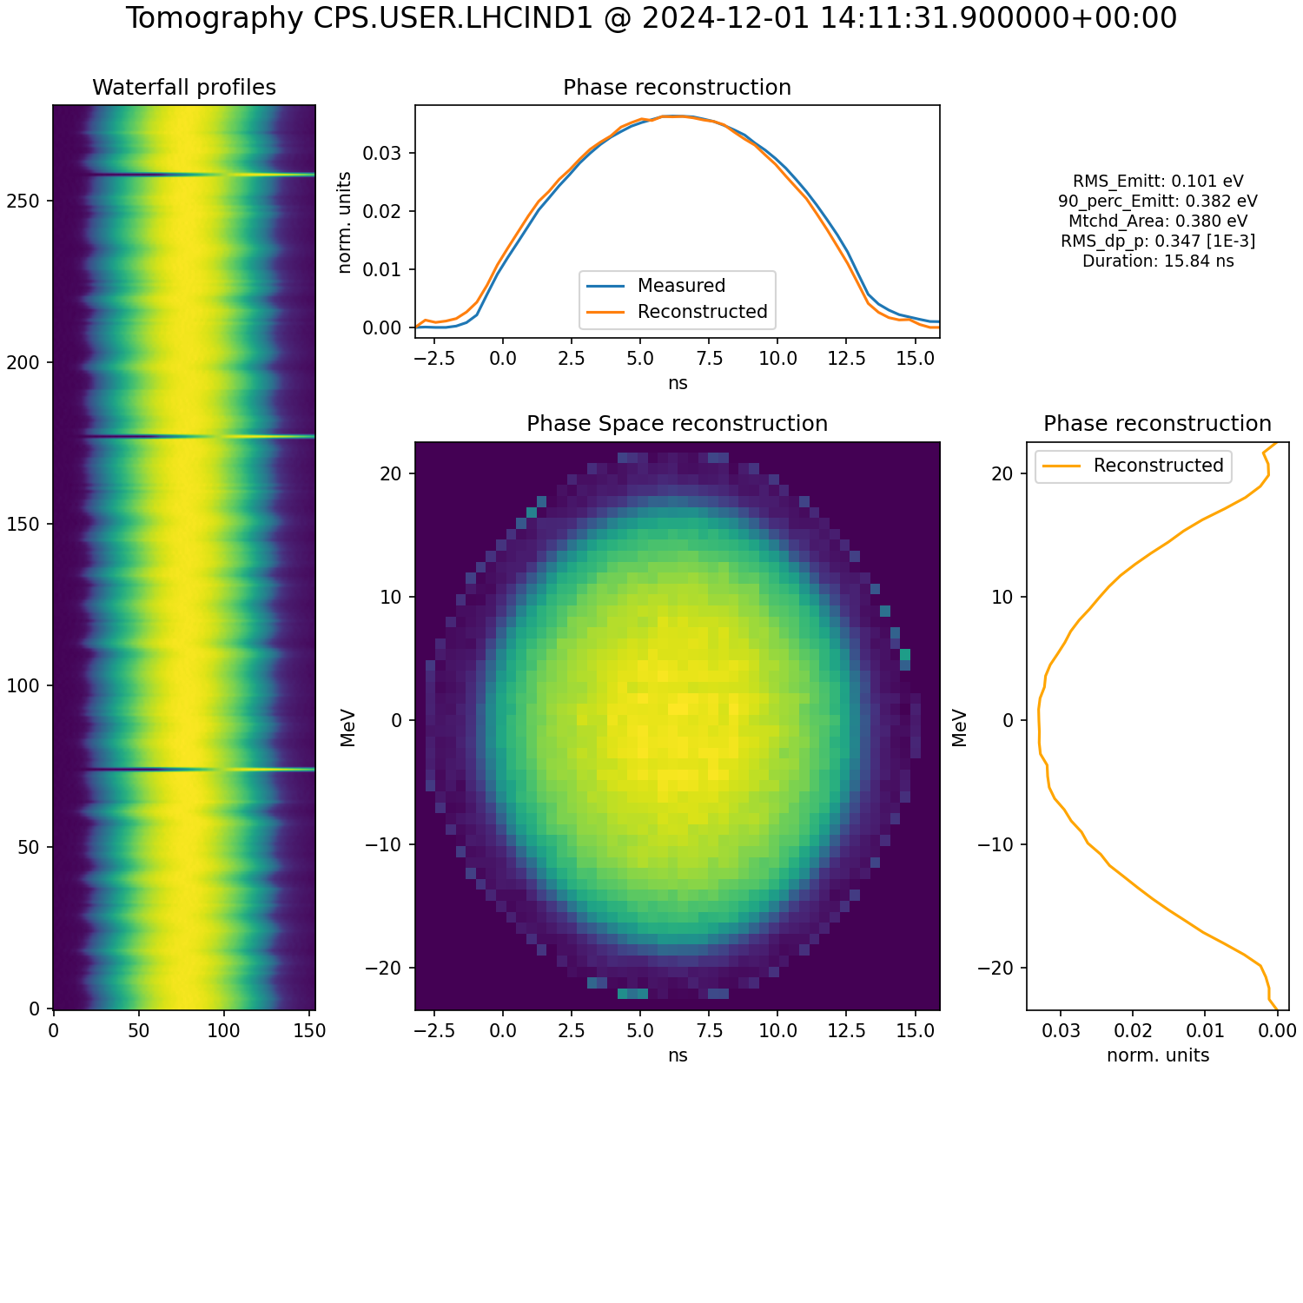
WCM application
Raw acquisition post-processing (via UCAP)
Use of this BCWLBO class for automated tomography reconstruction
  Gathering of machine parameters
  Tracking reused between similar cycles
  Tomographic reconstruction
Available capabilities in the application
  Setup of the tomography parameters
  Display results of the reconstruction

Slide 14
Outlook
New FESA Class for online acquisition available in PSB, PS, SPS & LHC
  Enables permanent longitudinal beam data acquisition (with PPM settings)
OP application available in the PS
Post-processing layers (UCAP)
  Bunch length analysis
  Bunch by bunch intensity
  Tomographic reconstruction
One card is available for MD configuration in the PS !!
More information:
  IPP meeting (Oct 2024)
  JAPW 2024
To be extended operationally
to the PSB & SPS

Slide 15

Thank you for listening
Any questions

Slide 16
Burst/Trace Mode
Multiple publications within the same cycle
Bursts 1-3 are in group Id 0, bursts 4-5 are in group Id 1:
Between group 0 publication and next acquisition start:
- Rearming time = 100 ms
Only if #samples or #traces are different
Burst #1
Burst #2
Burst #3
Burst #4
Burst #5
Purpose:
Allows more flexibility on long cycle
Multiple timings for processing
Time
START TIME
PUBLISH GROUP 0
PUBLISH GROUP 1
END TIME

Slide 17
Class interface (Multiplexed)
 | Burst Acquisition | Trace Acquisition | Continuous acquisition
GroupId | ✅ | ✅ | ❌
BurstId | ✅ | ✅ | ❌
NumberOfSamples | ✅ | ✅ | ✅
TriggerDelayNs | ✅ | ✅ | ✅
SampleIntervalNs | ✅ | ✅ | ✅
NumberOfTraces | ✅ | ❌ | ❌
All traces in a burst
have same settings

Slide 18
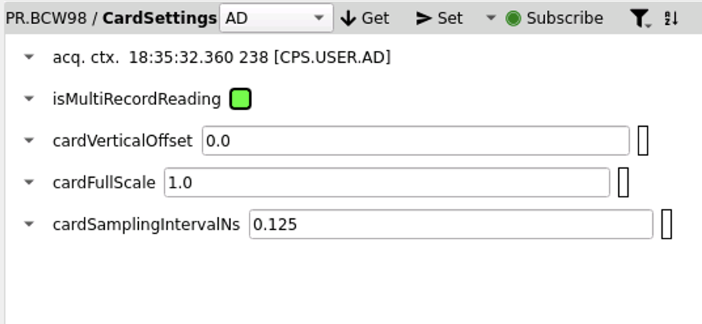
Card Sampling interval (Multiplexed)
Change device sampling interval
It changes the max sampling rate of the card
  Decimation
Then the samplingIntervalNs cannot go higher than this value
  Averaging

Slide 19
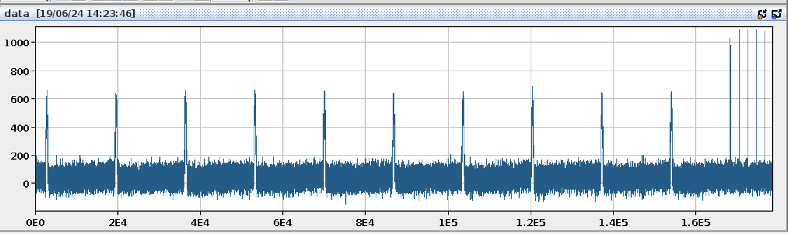
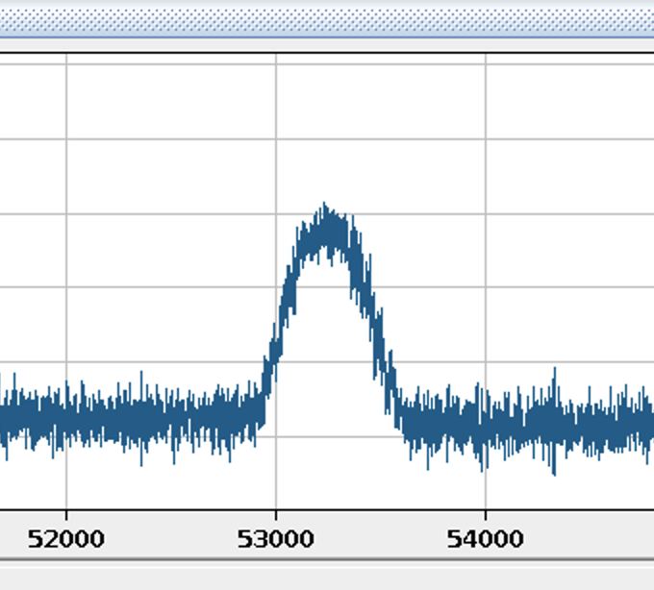
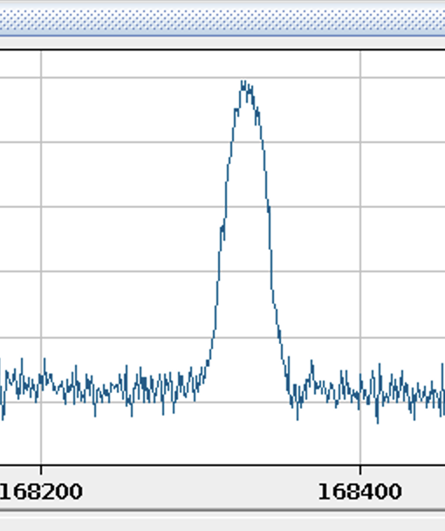
FESA average sampling Interval
8GS/s
1GS/s

Slide 20
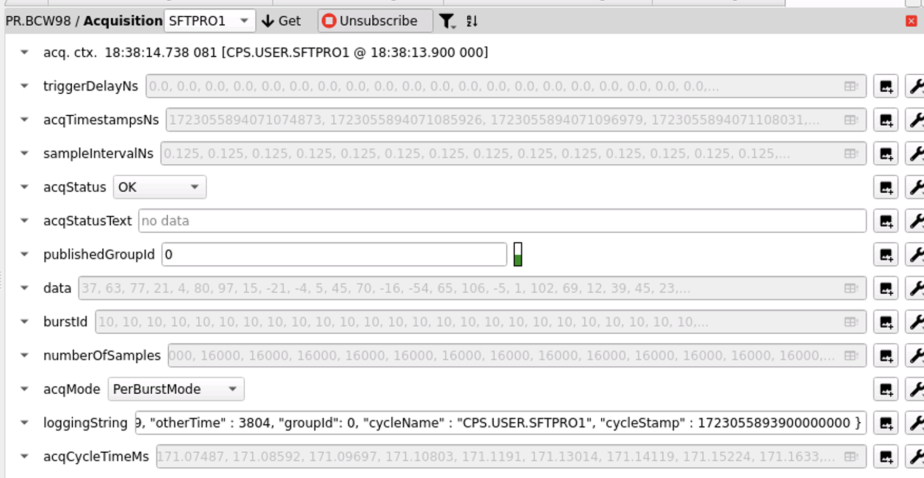
Acquisition data
1D data array

Slide 21
Acquisition data
Size depending on the settings (number of traces)

Slide 22
Acquisition data
Size depending on the number of traces acquired

Slide 23
Acquisition data
Acquisition Status
OK
WARNING
    Not all traces have been recorded
ERROR
    Error in the acquisition process
      Like no data in the buffer of the cards

Slide 24
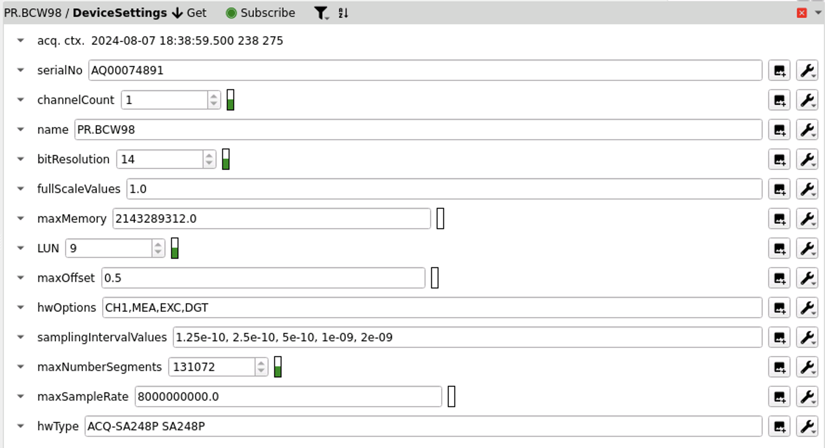
Device data

Slide 25
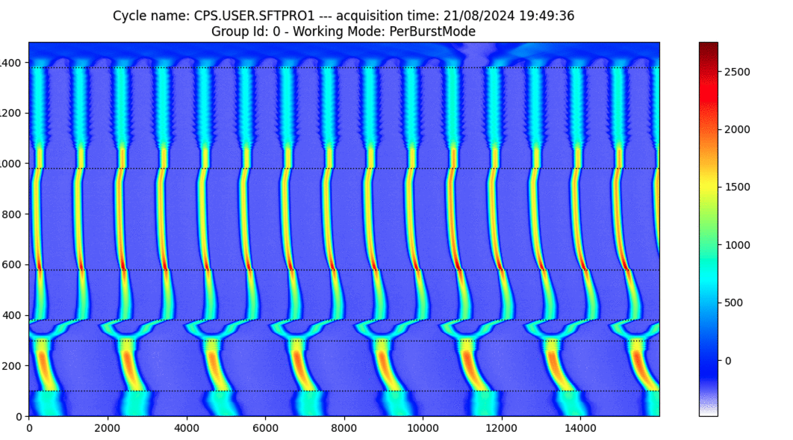
Online Acquisition

Slide 26
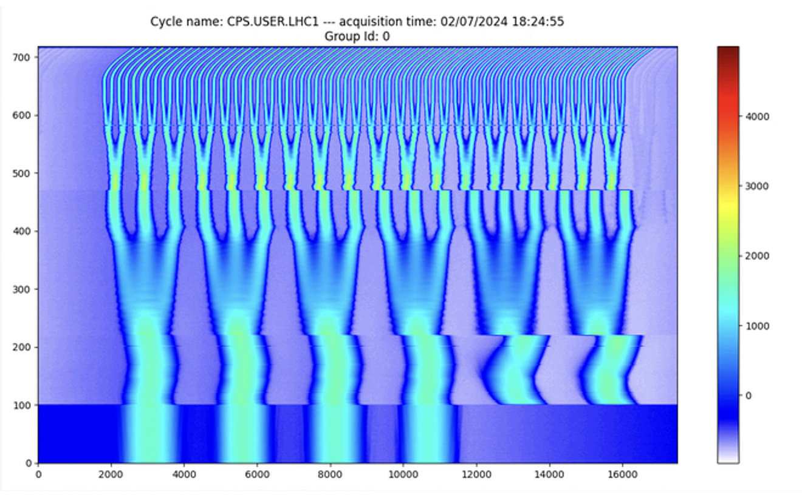
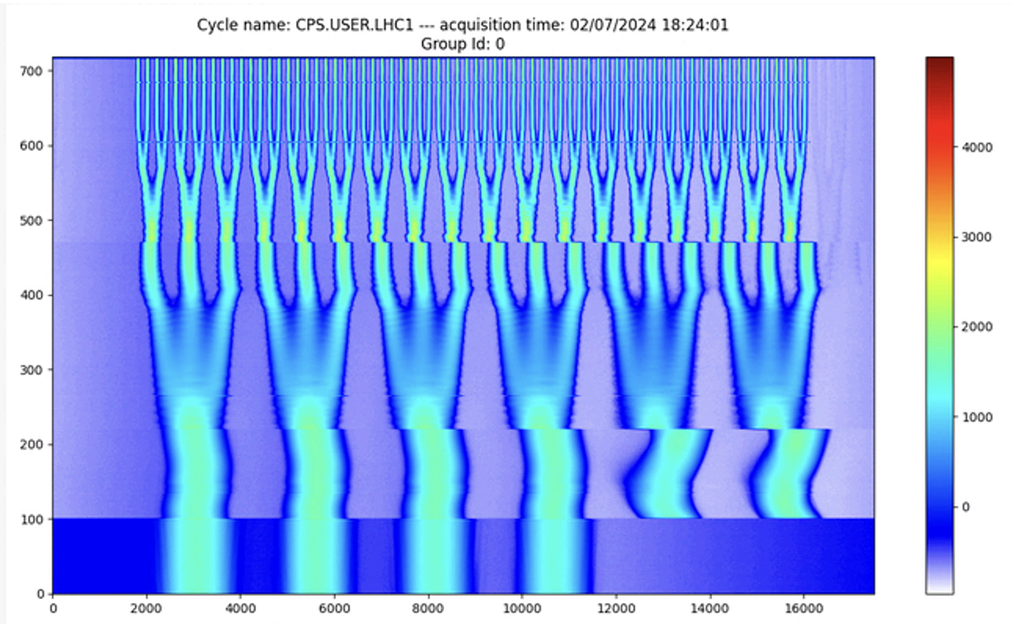
LHC Beam (extraction bump correction)
Settings without correction
Burst mode
Extraction bump delay correction
Trace Mode

