Slide 1

Plans for Crab cavities in 2025-26
HL-LHC WP4
IPP MD Days, 3-Feb-2025

Slide 2
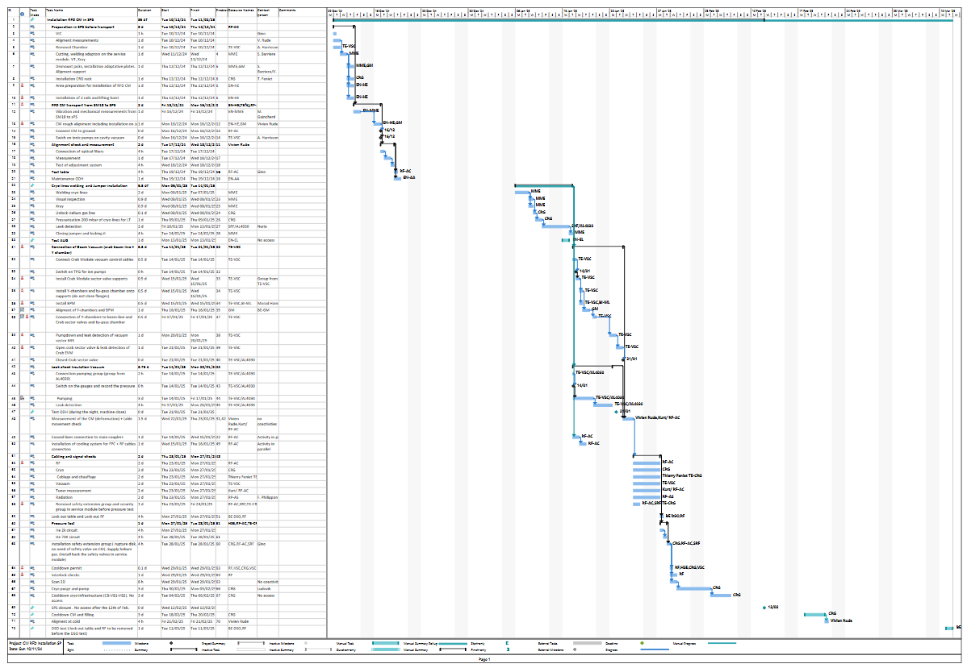
Installation Schedule
Disconnection & removal of DQW (4 weeks)
Installation in SPS
(4 weeks)
Cryogenic lines welding
Vacuum connections
Alignment & activties
Cabling connections
SPS closure & cool-down

Slide 3
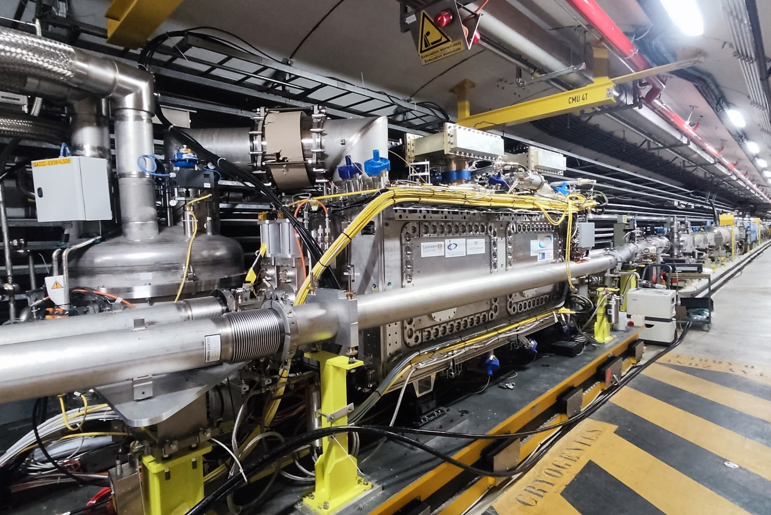
RF Dipole in the SPS
Cool-down starts
12h today
No access to BA6 until 06-Feb
Closure as foreseen with final cool-down 18-Feb

Slide 4
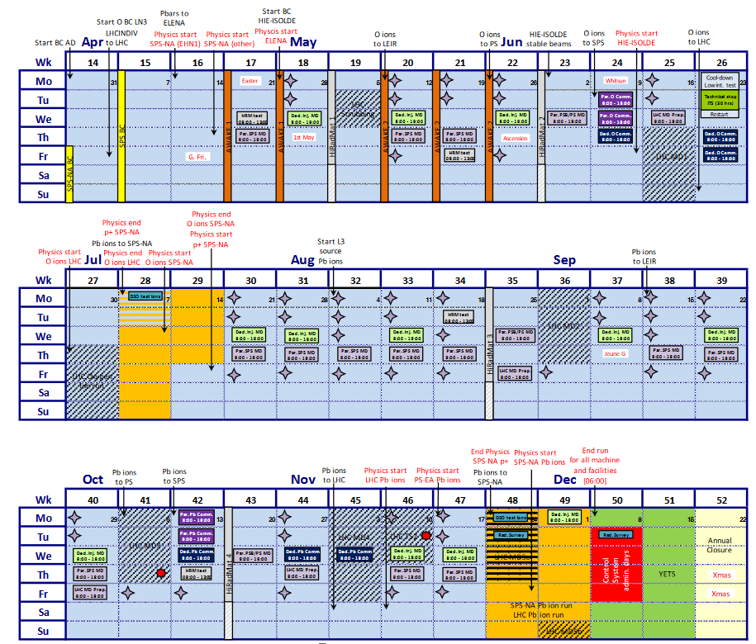
2025 Draft Schedule: SPS
RF conditioning to start as soon as cryo-ok end-Feb. Crab line in the beam for scrubbing (wk 13)
Request to host 3+3 MDs with a standby period in Aug (one before TS)
MD#1 dedicated to cavity setup with beam, phasing, HT monitor measurements. Maybe not compatible with scrubbing in wk 13
Request for a dedicated MD with protons in Oct

Slide 5
RFD-tests in 2025
MD #1 | Beam setup with horizontal crabbing, RF-ON sequence, direct beam coupling, tuner control, crab instrumentation
MD #2 | High intensity with RFD at injection & cavity alignment
MD #3 | Emittance growth with phase/amplitude noise, 270 COAST
 | Standby
MD #4 | Fundamental mode stability with batches (48 or 72)
MD #5 | Fundamental mode stability studies II
MD #6 | High intensity ramp, machine protection, LLD in longitudinal plane, collimation studies, RF multipoles

