Slide 2
Higher-intensity
barrier-bucket MTE
H. Damerau, T. Gavric, A. Huschauer, A. Lasheen
IPP MD Days
05/02/25
Many thanks to Simon Albright, Foteini Asvesta
and PSB/PS operations teams

Slide 3
Menu from 2024 MD Days
Open issues for 2024
  Benchmark impact of 10 MHz cavity impedance → quick check without 1 turn delay feedback
  Transition crossing optimization → remains sensitive
  Increase intensity up to 4 ∙ 10¹³ p/p → remains sensitive
  RF voltage pre-distortion for flat bunch at highest intensity → first tests during second half of 2024
  Intensity scan of transverse beam parameters → 2025
  Optimization of PS-SPS transfer → 2025

Slide 4
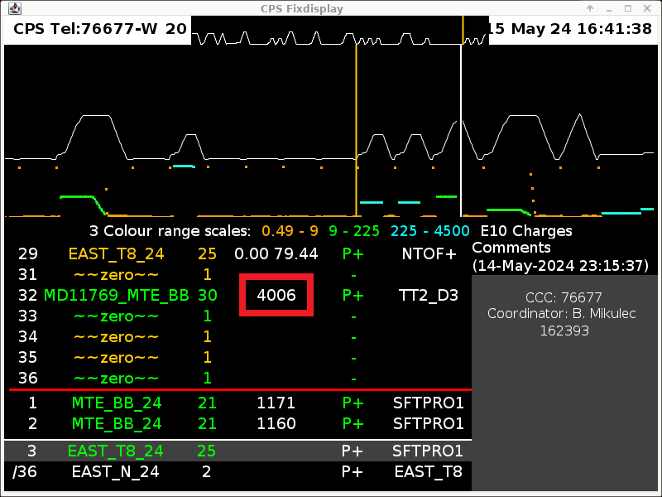
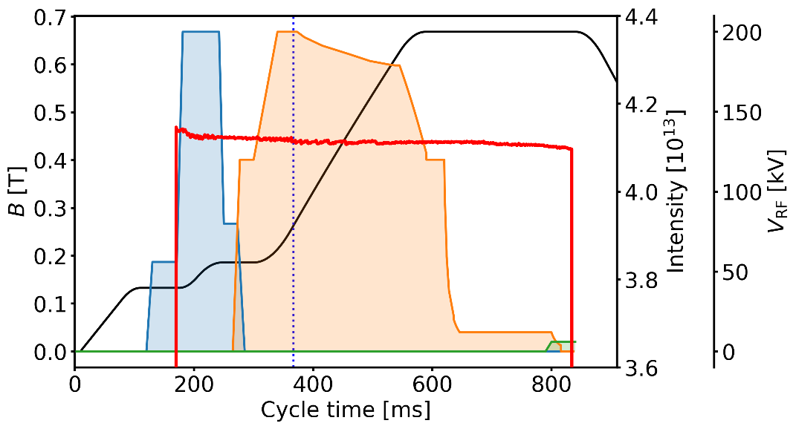
Highest intensity ever accelerated
Longitudinal stability demonstrated up to maximum intensity
Highest intensity ever accelerated in PS beyond 4 ∙ 10¹³ p/p
Intensity during record cycle

Slide 5
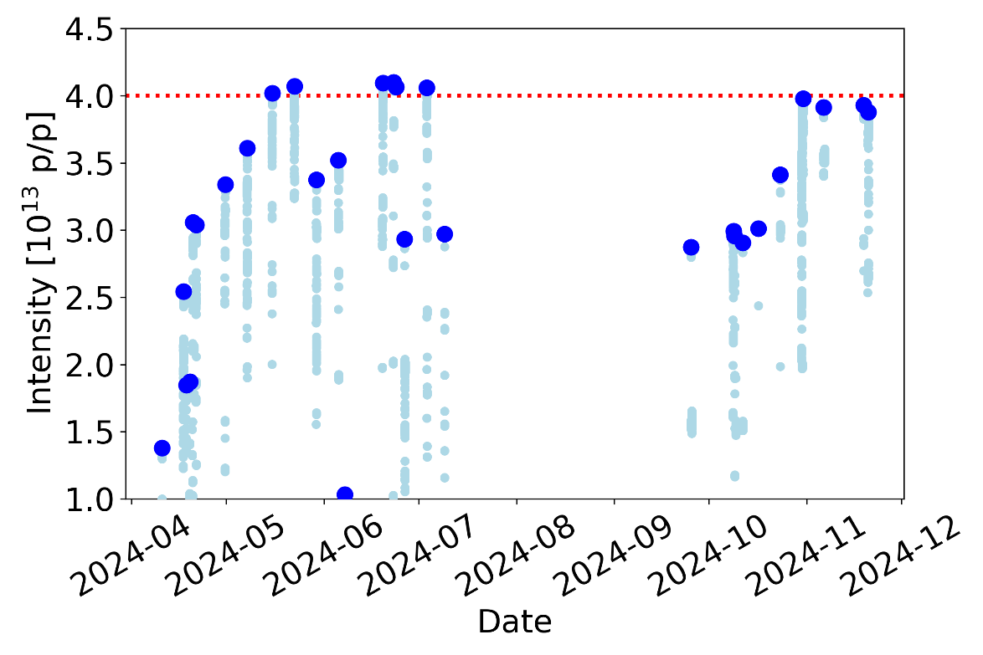
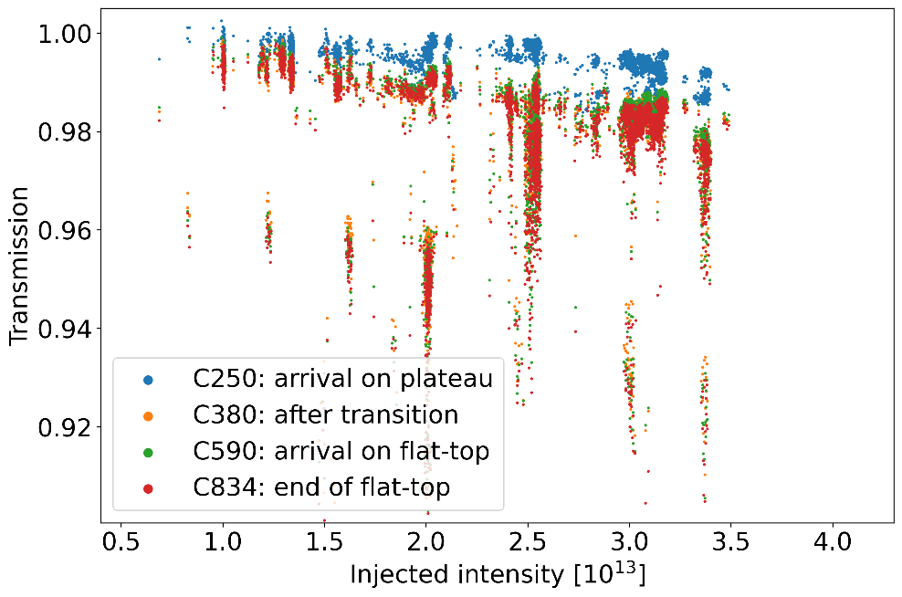
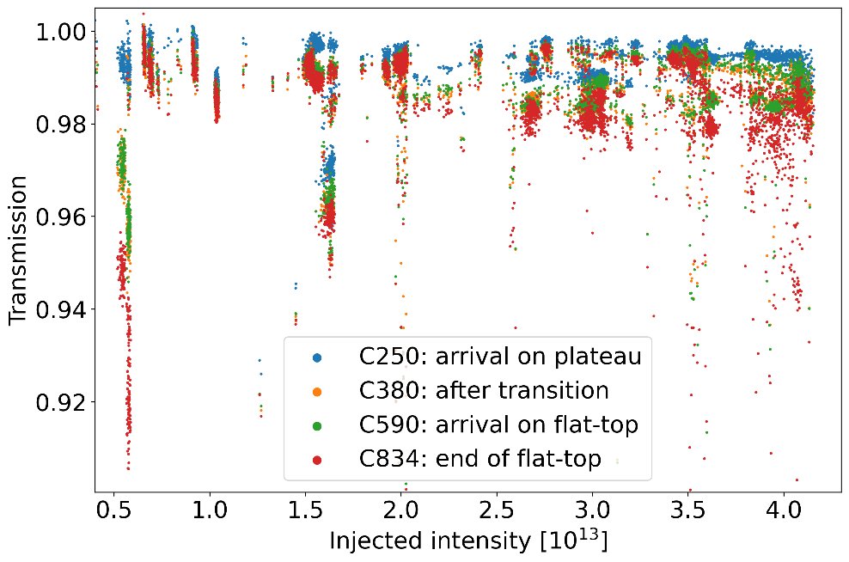
Intensity and transmission in PS
Highest intensity in 2024: Barrier-bucket MTE with up to 4.1 10¹³ p/p extracted
No motivation to push higher → above beam dump intensity limit in SPS
Intensity ramp-up
Transmission 2023
and 2024
Intensity reach
New barrier-
bucket controller

Slide 6
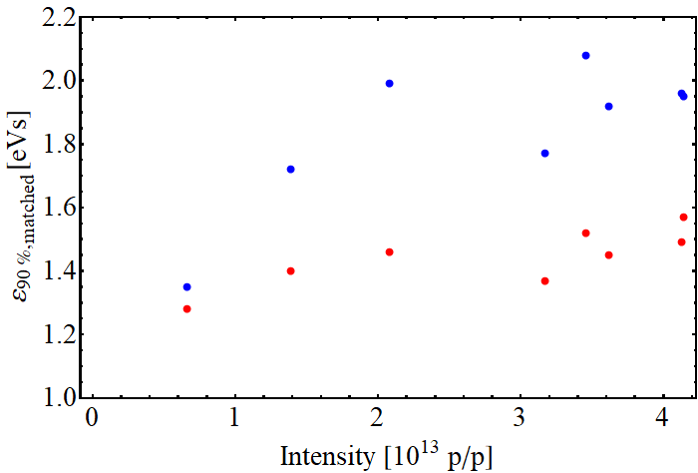
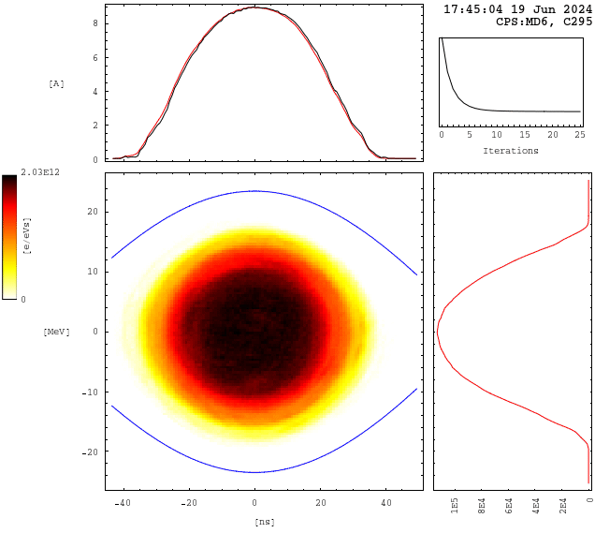
Longitudinal emittance versus intensity
Increased longitudinal blow-up required to cross transition energy
Transition crossing limited by losses due to transverse instabilities
~20-30% larger longitudinal emittance (90%, RMS) required
at ~4 ∙ 10¹³ p/p (with respect to operational beam)
~4 ∙ 10¹³ p/p
ε_{matched}
ε_{90%}
Operational MTE 2024

Slide 7

Optimization of barrier RF voltage
Mid-2024: new barrier-bucket controller firmware (→Toma Gavric)
  Full PPM control of RF drive voltage during the turn
  Internal synchronized acquisition of gap voltage
Forward path
transfer function
Finemet cavity
controller
Power amplifier
Cavity
Drive
Acquisition
Gap voltage
divider
Beam
Return path
transfer function

Slide 8
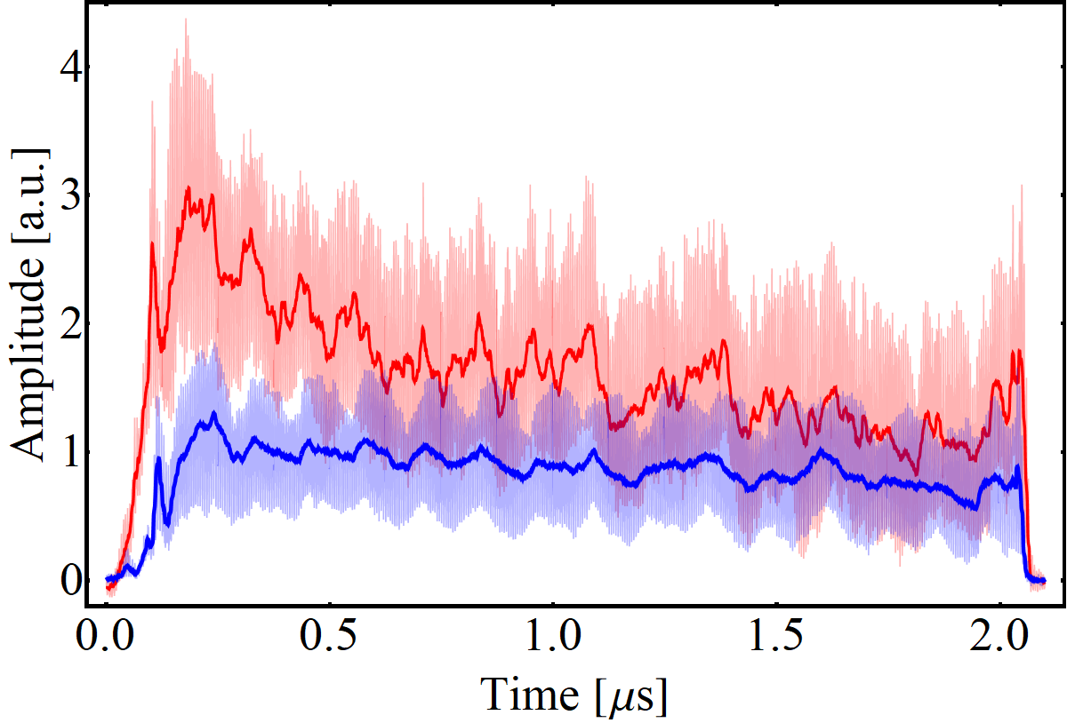
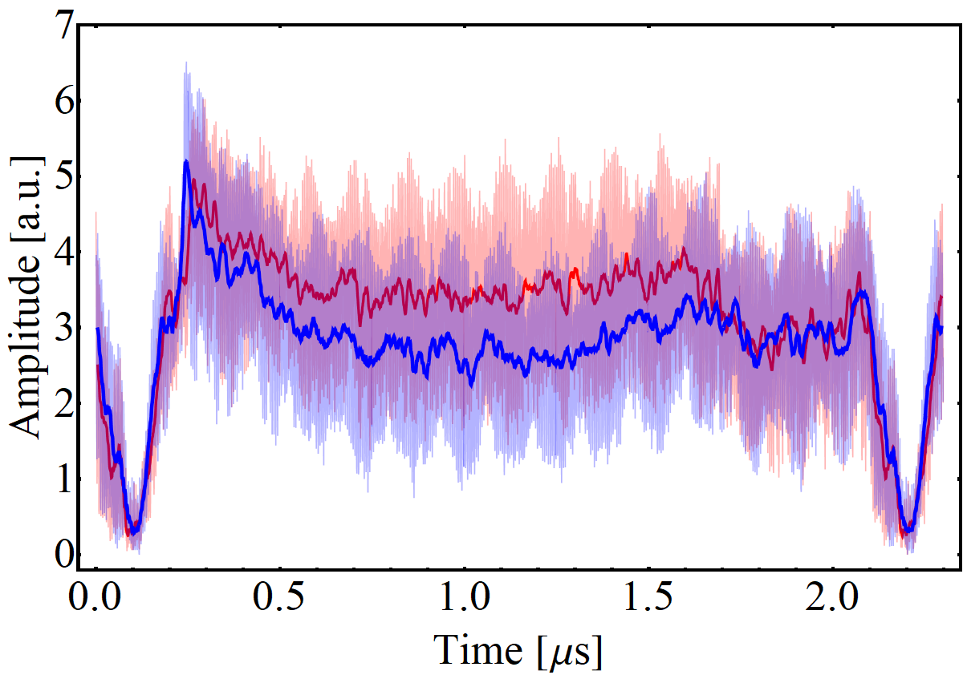
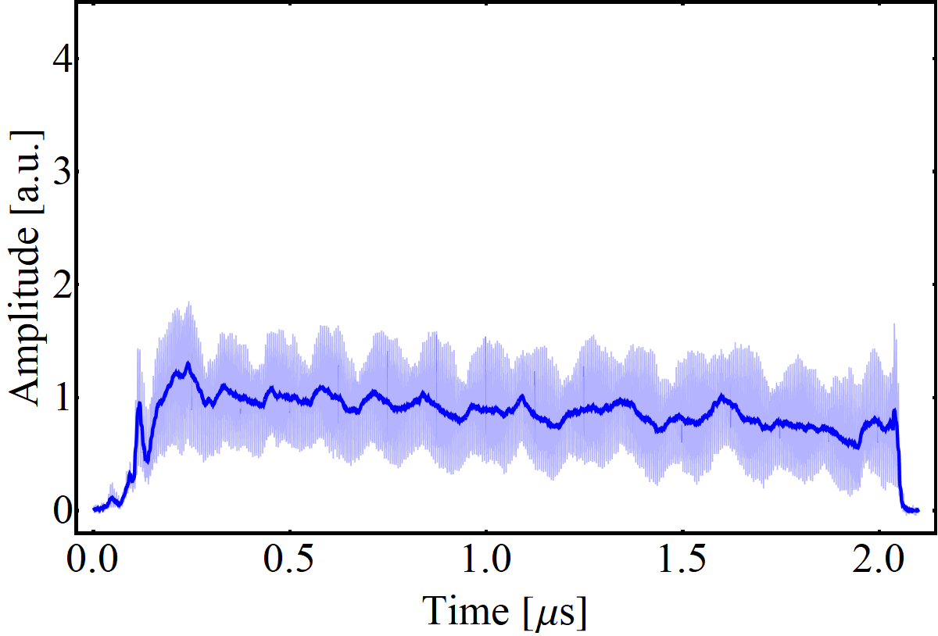
Bunch shape at extraction – is it flat?
Longitudinal bunch profile before extraction
2023
3.9 ∙ 10¹³ p/p
2024
Optimized
3.0 ∙ 10¹³ p/p
Initial
1.2 ∙ 10¹³ p/p
Flat-bunches at operational intensity, asymmetric when increasing intensity
Barrier voltage pre-distortion to compensate with limited improvement → Beam is only reliable observable
Increased longitudinal emittance pushes particles into gap, but mainly lower RF voltage: understood and corrected on 06/11

Slide 9
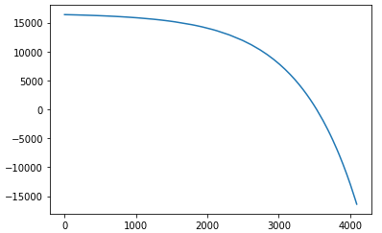
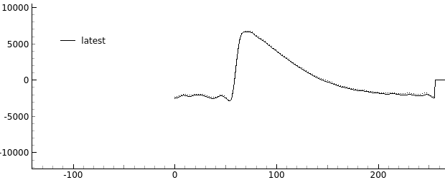
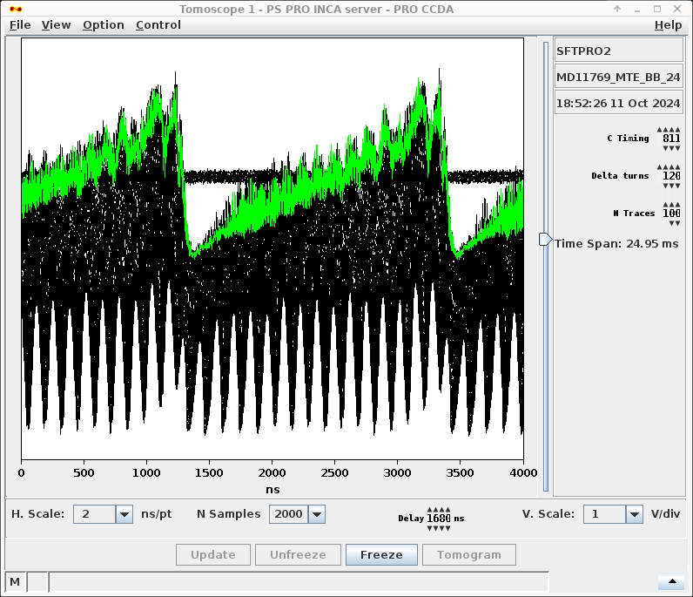
Exotic bunch shapes
New Finemet controller → Full control of RF voltage function during a turn
Future applications of PS wide-
band cavity
Transient beam loading compen-
sation (Alexandre Lasheen)?
Finemet cavity gap voltage
DAC bins
Drive function (1 turn)
Clock samples (h₂₅₆)

Slide 10
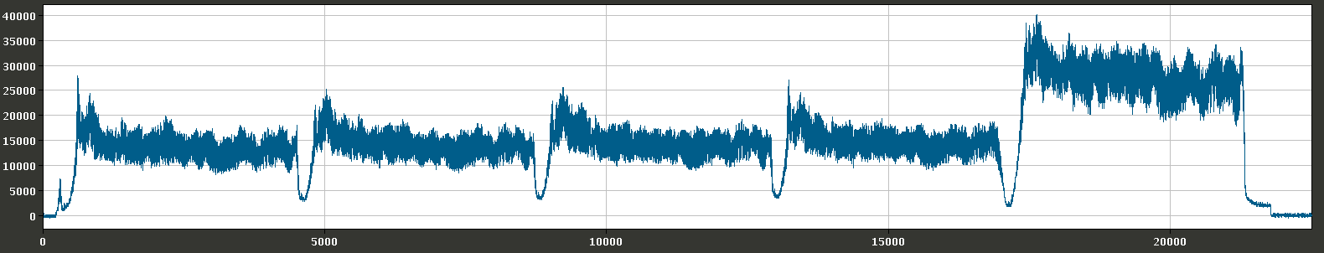
Summary and 2025 MD priorities
Above 4 ∙ 10¹³ p/p accelerated: longitudinally stable at flat-top
  Larger longitudinal emittance to pass transition energy
  Gaps of Finemet cavity trip due to excessive beam loading
Open issues for 2025
  RF voltage pre-distortion optimization at highest intensity
  Depletion of gap versus longitudinal emittance and intensity
  Intensity scan of transverse beam parameters
  Optimization of PS-SPS transfer
No incentive to push intensity even higher (SPS dump limit)
Series of parallel MDs at about 3 ∙ 10¹³ p/p → stable conditions
Transfer higher-intensity to SPS: few turns are sufficient
3.8 ∙ 10¹³ p/p
Straightforward to correct

