Slide 2
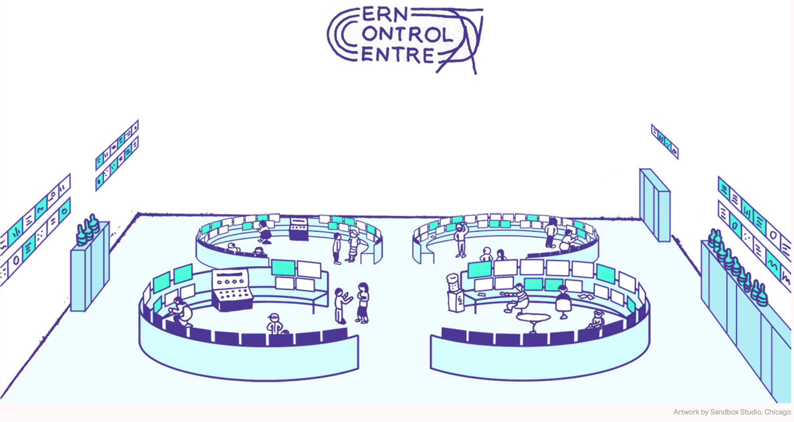
Feedback from Linac4/PSB/PS/SPS OP
https://www.symmetrymagazine.org

Slide 3
Overview
Overall, 2024 went well for MD’s, ASM was very useful to prepare beams and sequences.
Our feedback includes:
Some statistics
Positive points
Points for improvement
Some gentle reminder
  MD request (PS/PSB and SPS)
  Scripts
Reminders for Booster/PS MD cycle clean-up

Slide 4
Some statistics over 2024

Slide 5
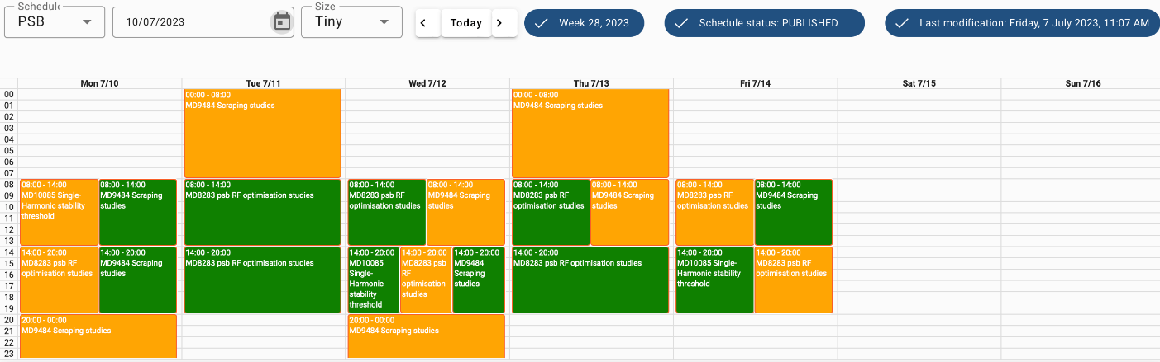
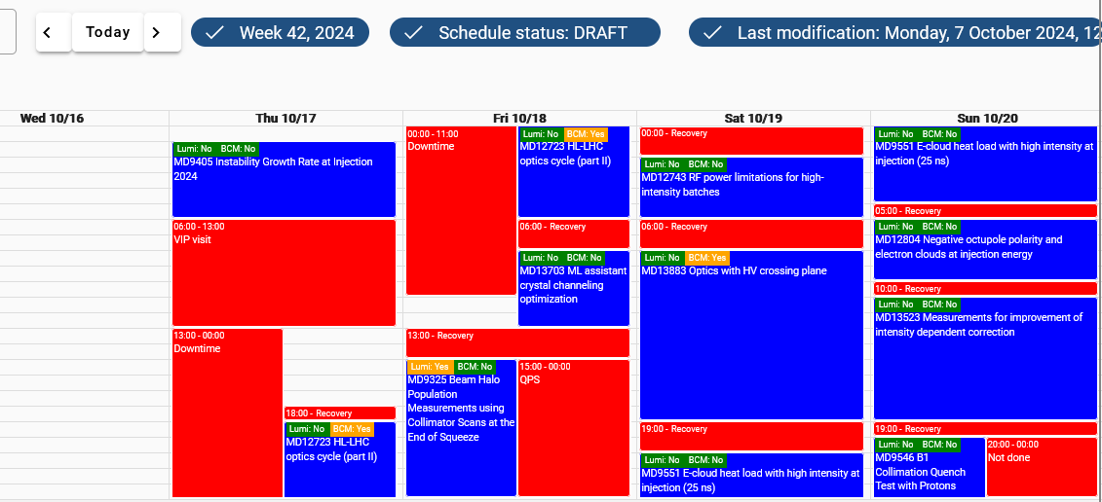
Positive Points
  MD-user autonomy during their MD.
  MD-user informed operation crew upon completion of their session.
  MD-information available in ASM.
  A weekly MD coffee discussion was introduced every Friday
  Good improvement of the LHC MD block preparation

Slide 6
Points for improvement
  Reminder : Use ASM to express special needs, such as:
        Required number of (SPS)-injections
        Need for instrumentation (Tomoscope, WS…)
        MD could affect the physics (being at the limit of BLM, RF power,...)
  Fill in ASM earlier, ideally by Wednesday evening for upcoming week.
    If you don’t know which cycle you have to enter, contact MD link person
  Keep the same MD number during the year for a same subject of study

Slide 7

Some gentle reminder
Parallel MDs in all machines take place every weekday during working hours (08:00-20:00). There is always one available MD cycle in PSB, PS and SPS
Having a cycle assigned as “spare” does not guarantee to have it played
When LHC is filling, even in dedicated, MD beams could be affected
Don’t hesitate to contact the MD link person for specific needs or questions
Inform the CCC when you need your beam and when you have finished
For preparation, specific/exotic beams required a minimum of 15 days to be generated and tested.
Inform via email the MD link person or MD coordinators as early as possible
Also, keep in mind that some longer preparation times are expected at the beginning of the year, as the 2024 cycles are expected to be slightly different after the restart.

Slide 8
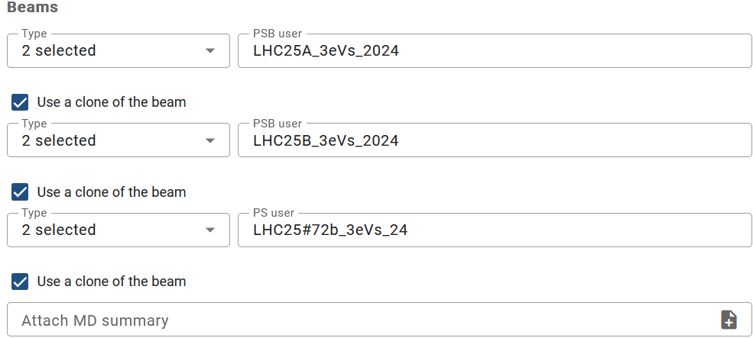
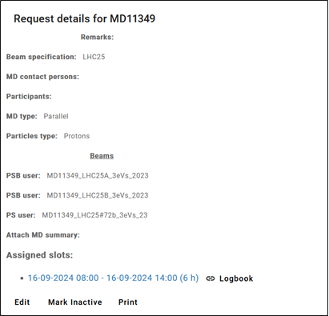
MD request (PS/PSB)
Create your request and select the beam you need; it can be an operational beam or an existing MD beam
If in doubt, contact the MD link person
Use a clone of the required beam when creating the request.
MD link person will then create the clone with the right MD number and correct the MD request with the new name

Slide 9
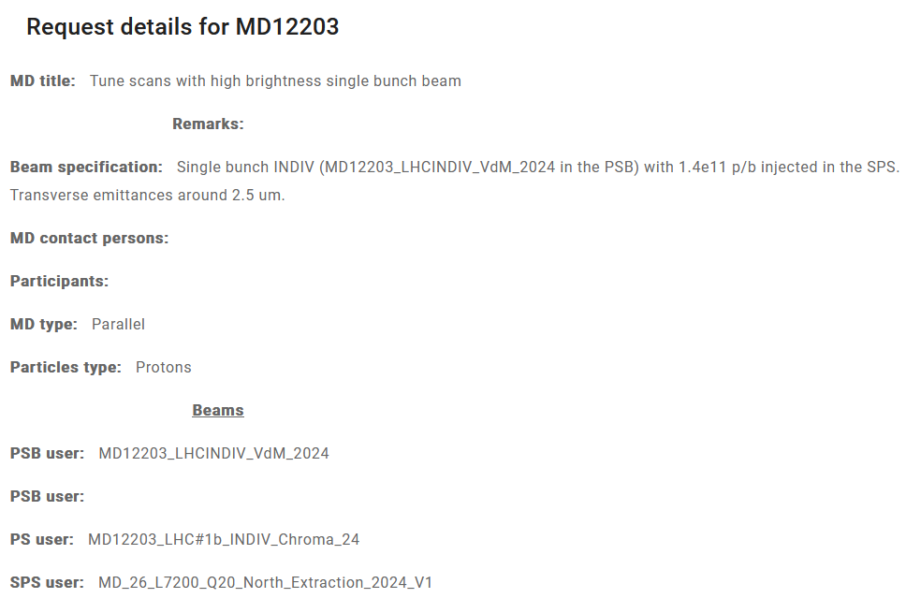
MD request (SPS)
The more details we have, the more efficient we will be
Give as much information as possible :
number of injections, number of bunches, intensities…
Use a clone of the required beam for the PS and PSB.
For SPS, don’t use the clone, only few users have a clone (only physic user like SFT and Awake for dedicated MD, but not the short MD cycles)

Slide 10
MD running with scripts
Communication between participant and operators
  What the script is doing
  “How to” guide, in case
  End of script notification
Leave a note on the console that runs the script
MD request should be done for script running overnight on MD
For UCAP developers
If you have developed a UCAP to assist with your MD analysis that could benefit OP, your code may be of interest to some UCAP developers on the OP team
Feel free to reach out to the MD link person to be connected with our development team

Slide 11
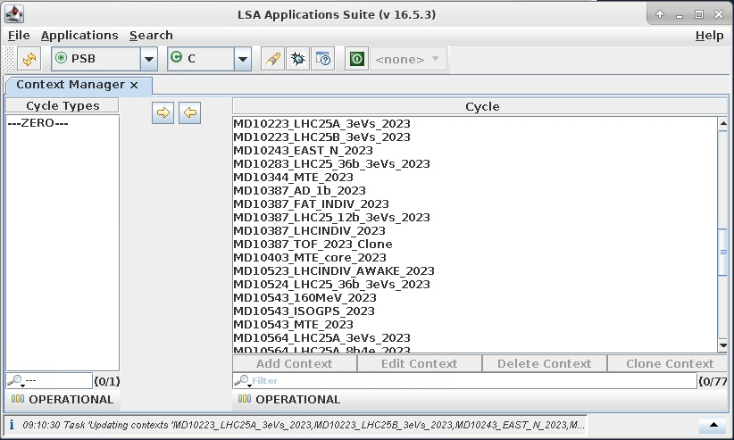
Booster/PS MD Cycles Clean-Up
  LSA_db is made up of 6 directories:
    MD / Operational / Test / Archived / Reference / Obsolete
LSA_GUI
Directory
  During the RUN, MD Cycles are saved in LSA_db → in MD or OPERATIONAL Directory.

Slide 12
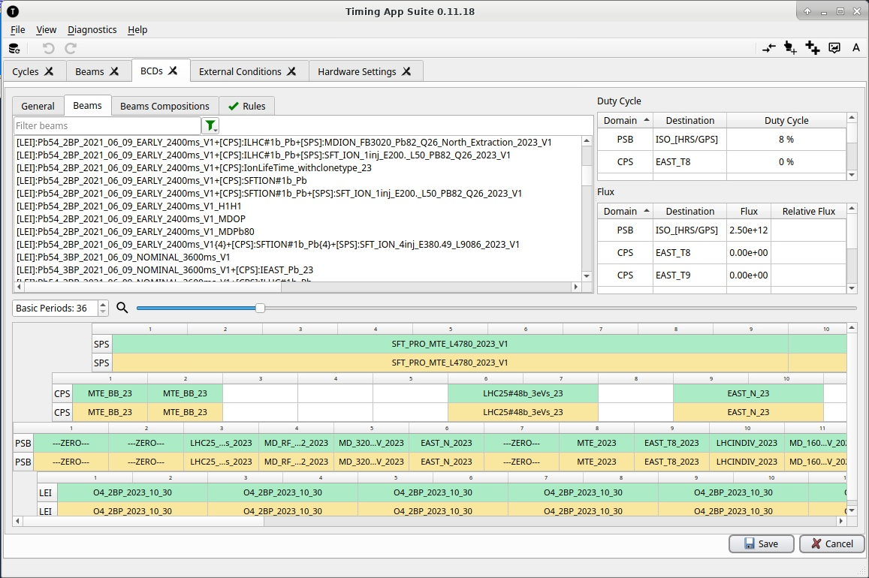
Booster/PS MD Cycles Clean-Up
  Every end of RUN a clean-up of the Operational directory is made:
    ease the daily work of the operation team during the next Run;
    MD users use fresher setting after the YETS, EYETS break;
    avoid LSA-db overload ( in Timing App Suit as well);
  Your obsolete MD Cycles are not lost, however.
Current Run MD_Cycles → RUN_2025
Obsolete
Run(-1) MD_Cycles back-up→ RUN_2024
Archived
Run(-2/3/4/5) MD_Cycle back-up→ RUN_2023 / 22 / 21…
Operational

Slide 13
Question ?

