Slide 1
Pushing intensity with LHC-type beams the longitudinal side
03-02-2025, IPP MD Days
Giulia Papotti for SPS RF
acks: F. Ten Broeke, R. Calaga, S. Calvo, G. Cipolla, H. Damerau, F. Killing, L. Intelisano, I. Karpov, E. Montesinos, S. Pitman
+ all colleagues in the transverse plane!

Slide 2
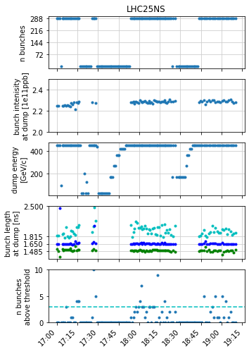



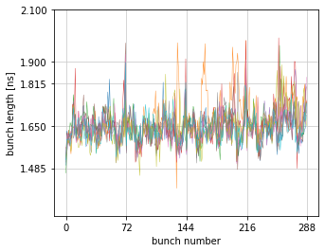
2024 achievements with beam
28.03, LIU parameters demonstrated
  4x72b 2.3e11 ppb in 1.65 ns +/-10%
  V200 = 9 MV
I.K. at SPS MPC on 09.04, G.P. at SPS MPC on 24.09

Slide 3
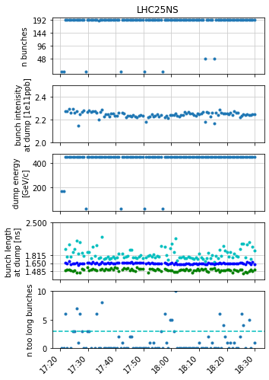
2024 recap
03.10
hardware performance shaped the longitudinal developments
  slow progress during scrubbing due to abundant vacuum activity, mostly in cavity 3
  reduced power from August (HOM coupler failure in cavity 3, Thales amplifier spare availability)
nevertheless, reduced power allowed
  long trains with reduced intensity
    12.09: 4x72b 2.0e11 ppb ok, 2.2e11 ppb ~ok
  shorter trains at nominal intensity
    03.10: 4x48b 2.25-2.3e11 ppb ~ok
    15.10: 1x56b 2.4e11 ppb 8b4e ok
  i.e. we have some margins

Slide 4
plans for 2025
main focus: repeatability and operability
  achieve specs on longer timescales
  ideally with operational margin on intensity
  moving towards less expert support (see LIU Reliability Run)
on the hardware side
  sufficient spares for Thales amplifiers available for 2025 and 2026 operation
    also moving to ceramic transistors
    see G. Cipolla at IPP on 19.07
  during YETS: overdrive protection upgrade, new loads, revise matching step of cavity 3, new gain/phase adjustment, added measurement capability to 938 MHz couplers
  during HWC: cavity conditioning via LSA function
    should reduce vacuum activity during scrubbing
    mostly during nights, both SFTPRO and LHC-type

Slide 5
extras

Slide 6
2024 timeline
13 March (during scrubbing): TWC200 C3 vacuum spike
  and about 20 SSPA modules broken
28 March: LIU intensity and bunch length demonstrated
18 May: TWC200 C1 elbow arcing
  see F. Killing at SPS MPC on 30.07
15 June: TWC200 C6 loads breakage
  and about 100 SSPA modules broken over several weeks
  see S. Pitman at JAP24
11 July: TWC200 C3 HOM coupler burnt
  and about 15 SSPA modules broken
  see G. Papotti at IPP on 19.07
  followed by “summer MD pause” to prioritize LHC luminosity production
  one more discovered during YETS inspection
13 August: TWC200 C3 combiner load failure (see next slide)
  had been arcing
  then replaced 5 out of 36
12 and 19 September: LIU MDs resumed, but with limited RF power in C3
  amplifier module failures throughout the year (see G. Cipolla at IPP on 19.07)

Slide 7
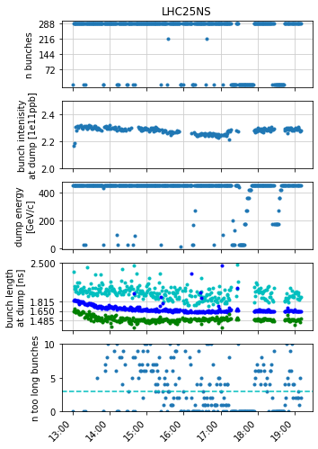
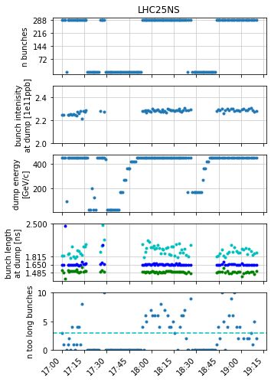
LIU parameters demonstrated (28 March)
4x72b 2.3e11 ppb in 1.65 ns +/-10%
  see also I.K. at SPS MPC #59
on the RF system settings
  TWC200 up to 9.2 MV
  TWC800 < 10% at the flat bottom
  sensitivity to blow up frequency band
within BQMSPS acceptance (loose) thresholds
  with non-rigid dipole oscillations to be investigated, and ideally solved
focus then to move to repeatability and operability

Slide 8
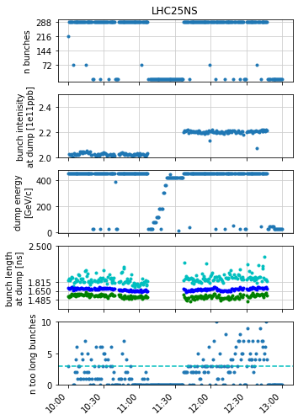
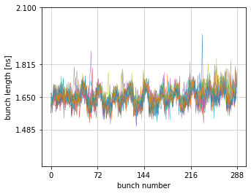
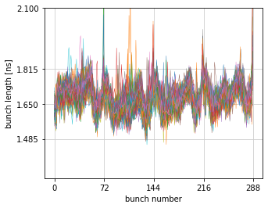
pMD of 12 Sept
4x72b 2.0e11ppb decent, out of the box
  25 cycles
  no settings changed since before the summer!
4x72b 2.2e11ppb mostly ok
  only shift down of blow-up frequency band by 2%
  last bunch of trains at times unstable
  V200 = 7.5 MV
4x72b 2.4e11ppb: could not stabilize
  often last bunches of trains unstable (but not only)
  missing power: max ~7.5 MV
    with abundant clamping by LLRF
  in addition, 4 vacuum spikes at TWC200 C1, likely needs (more gentle) conditioning
2.0e11 ppb
2.2e11 ppb

Slide 9
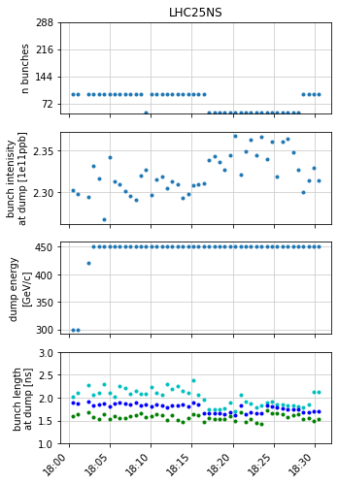
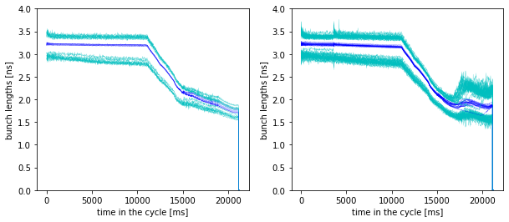
pMD of 19 Sept
only a short time with 2x48b 2.3e11 ppb at 450 GeV/c
clear evidence that 1 batch is stable, 2 batches not
  with the same settings
for re-obtaining LIU parameters, need the extra power

Slide 10
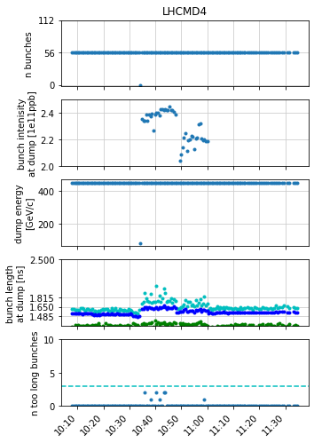
15 October, 8b4e
one batch only

Slide 11
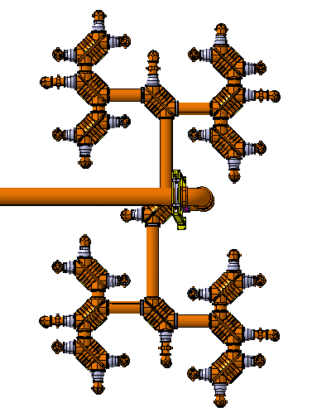
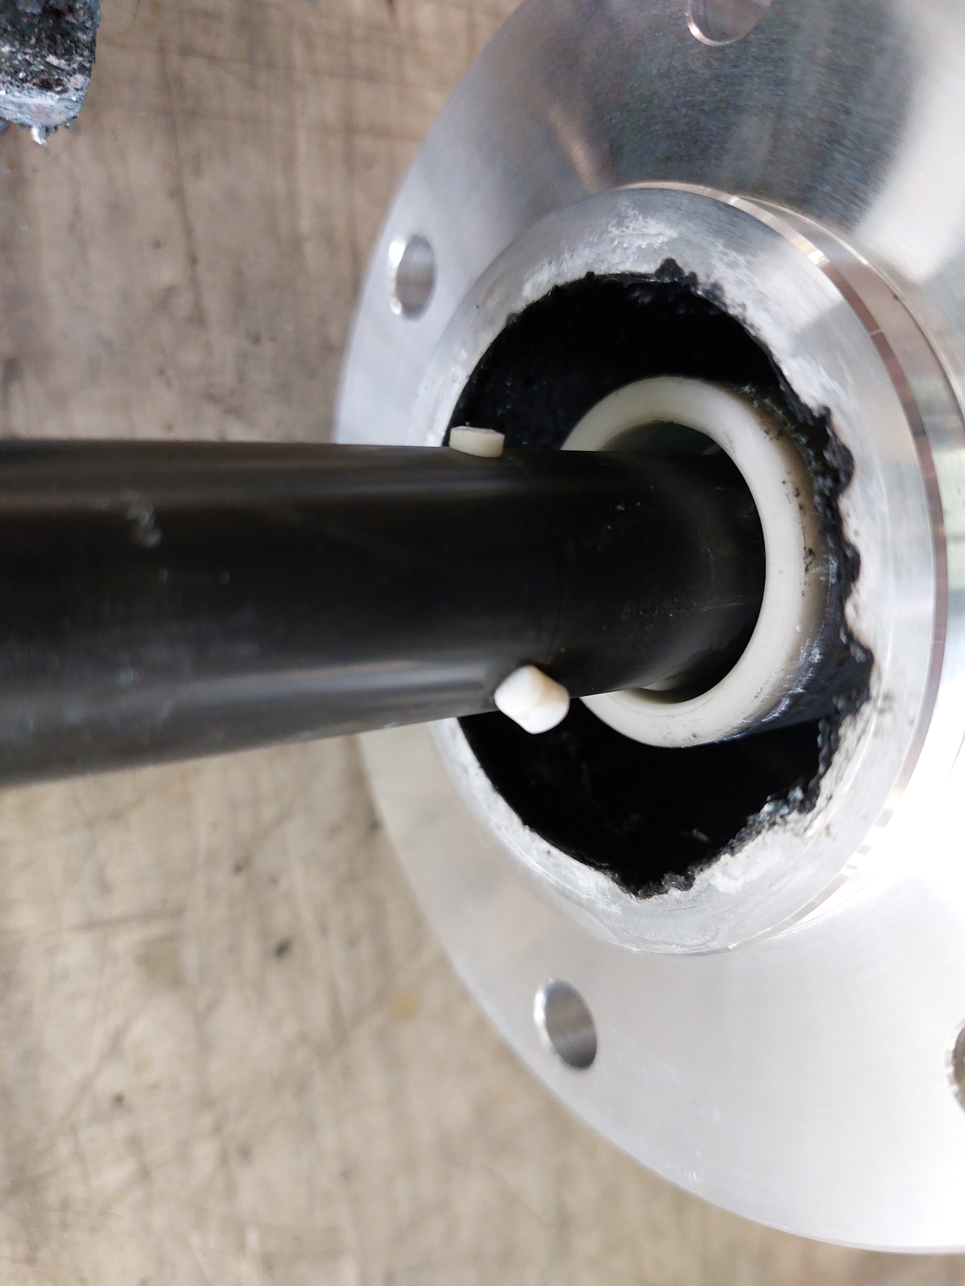
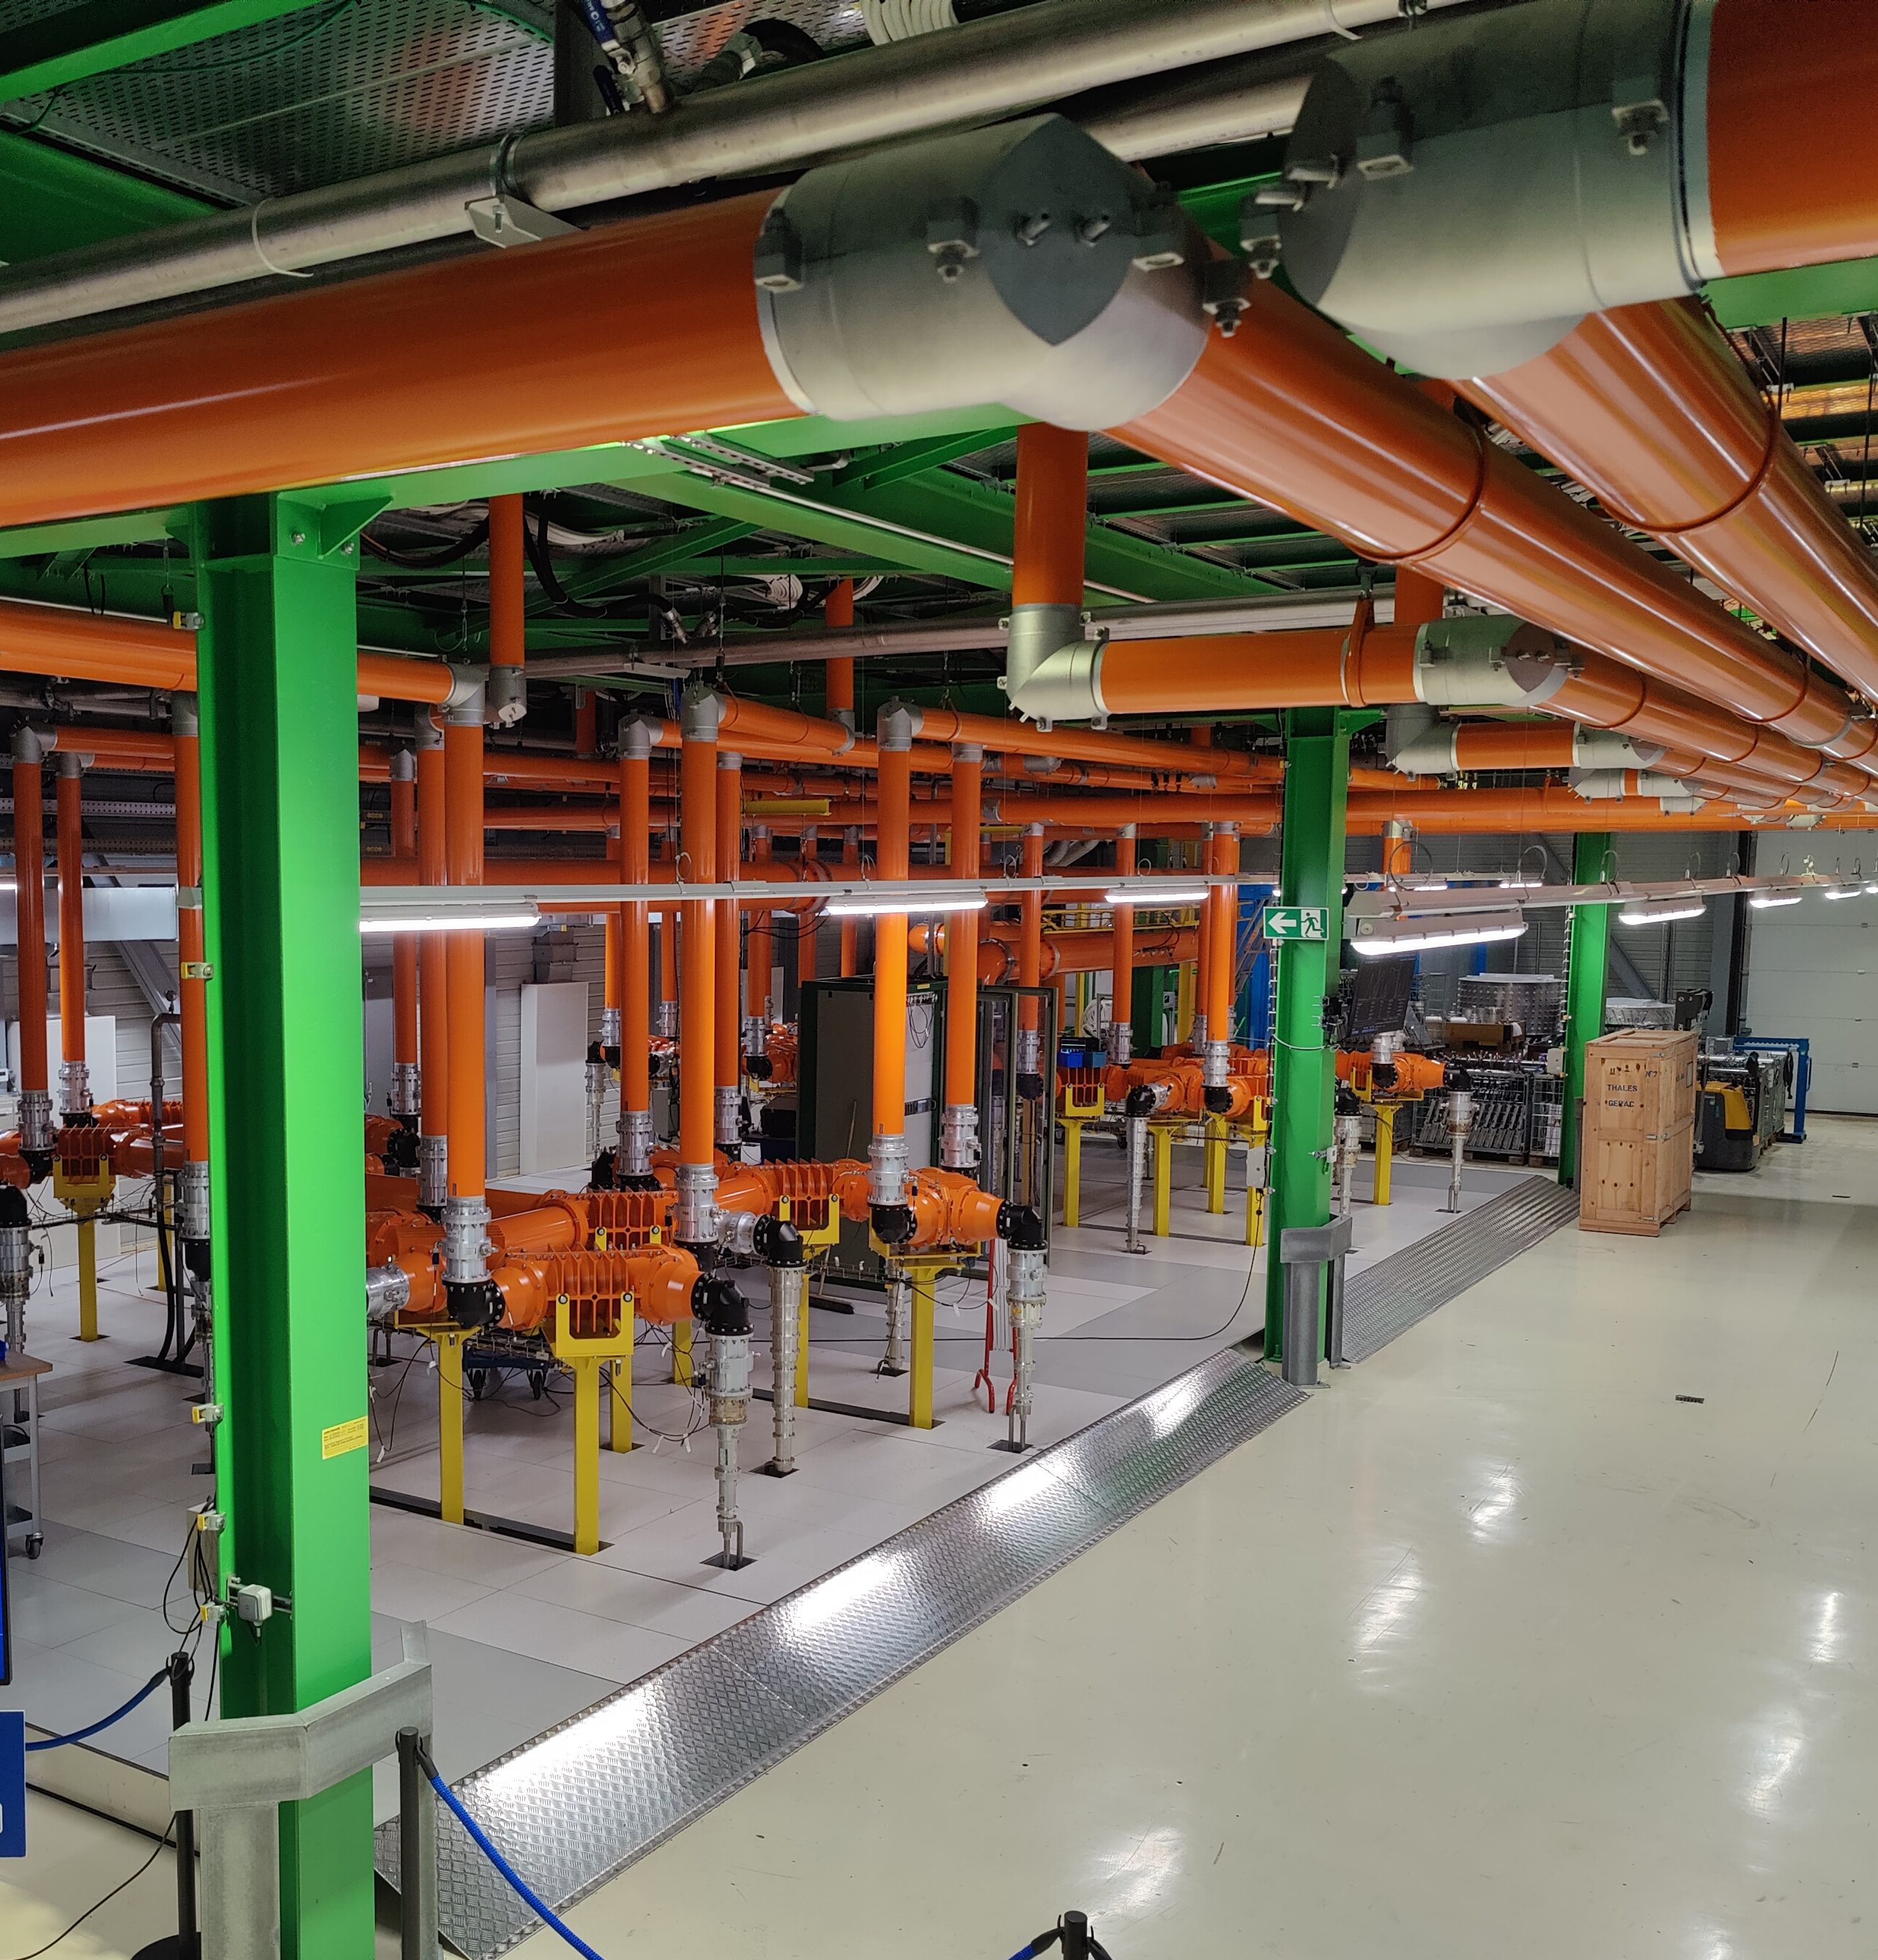
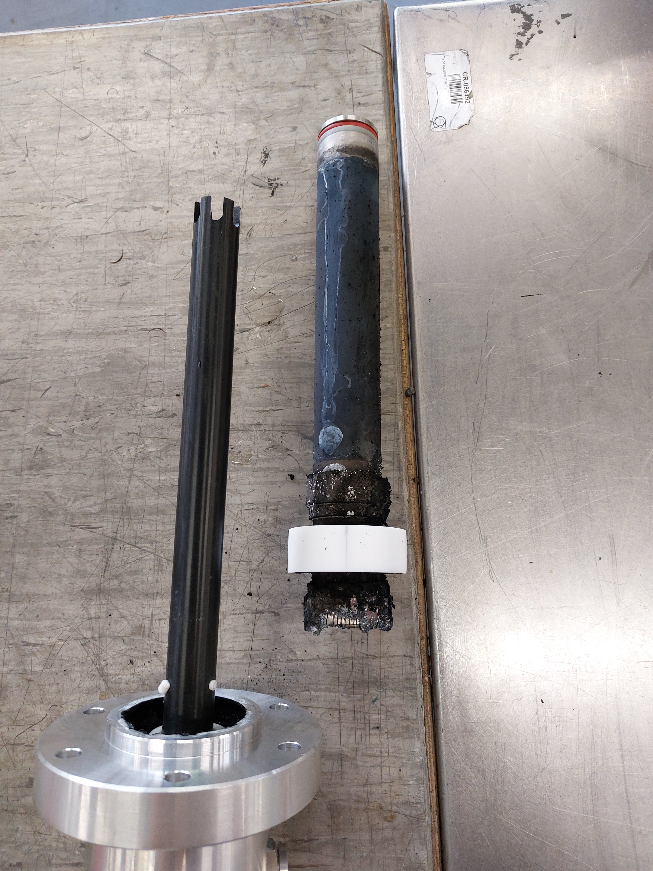
combiner load failure (13 Aug)
courtesy F. Ten Broeke, SY-RF-AC
load between T14 and T12 failed, signs of arcing
  T14 had high failure rate before (even at low power), after load exchange SSPA module breakages reduced
ongoing campaign to replace loads and reduce failures
  status of loads is difficult to determine in situ

Slide 12
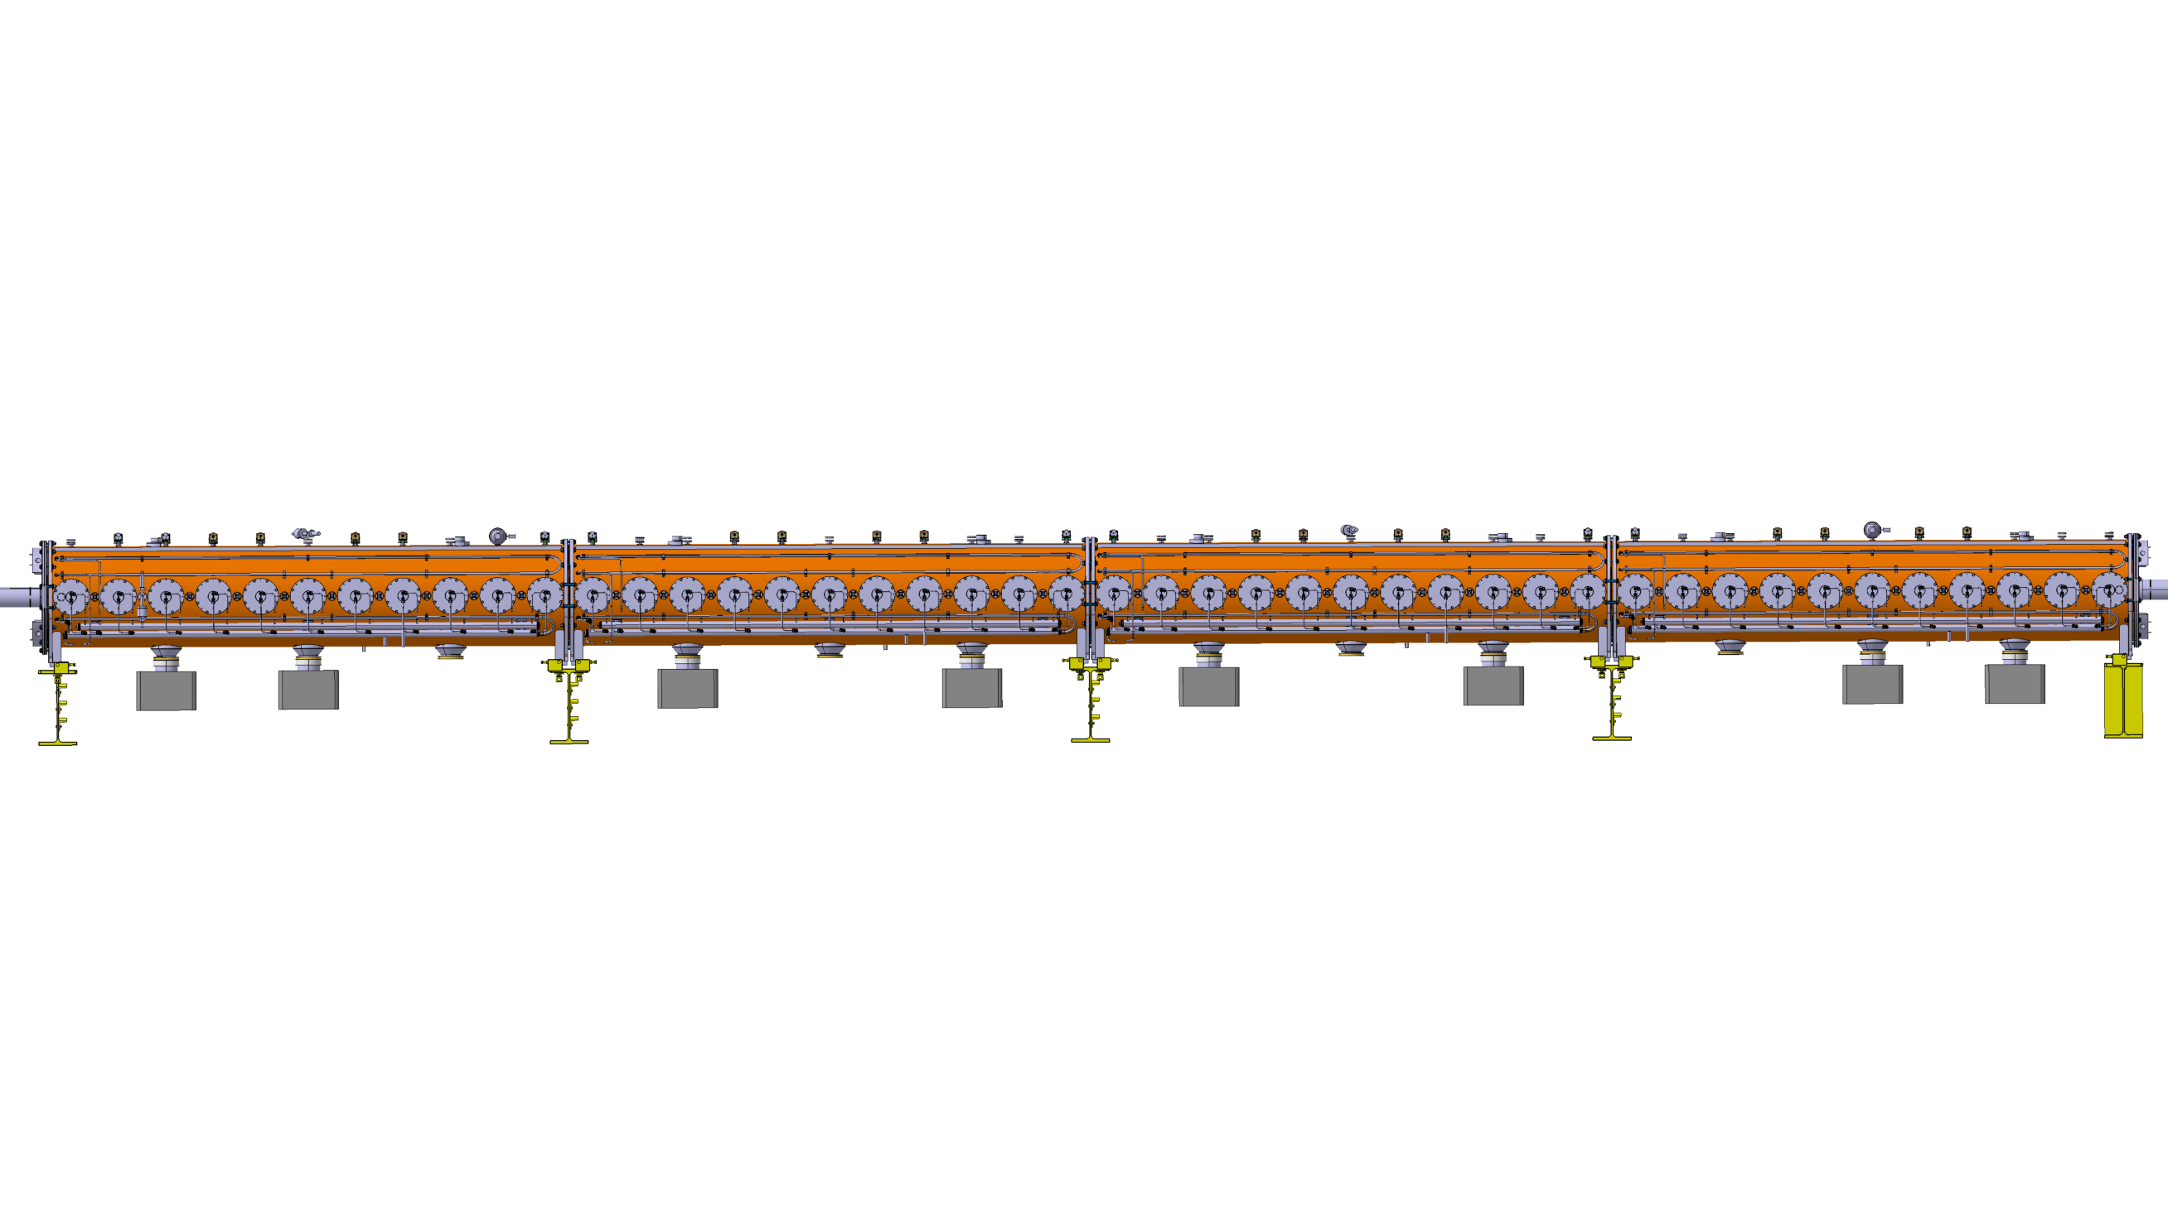
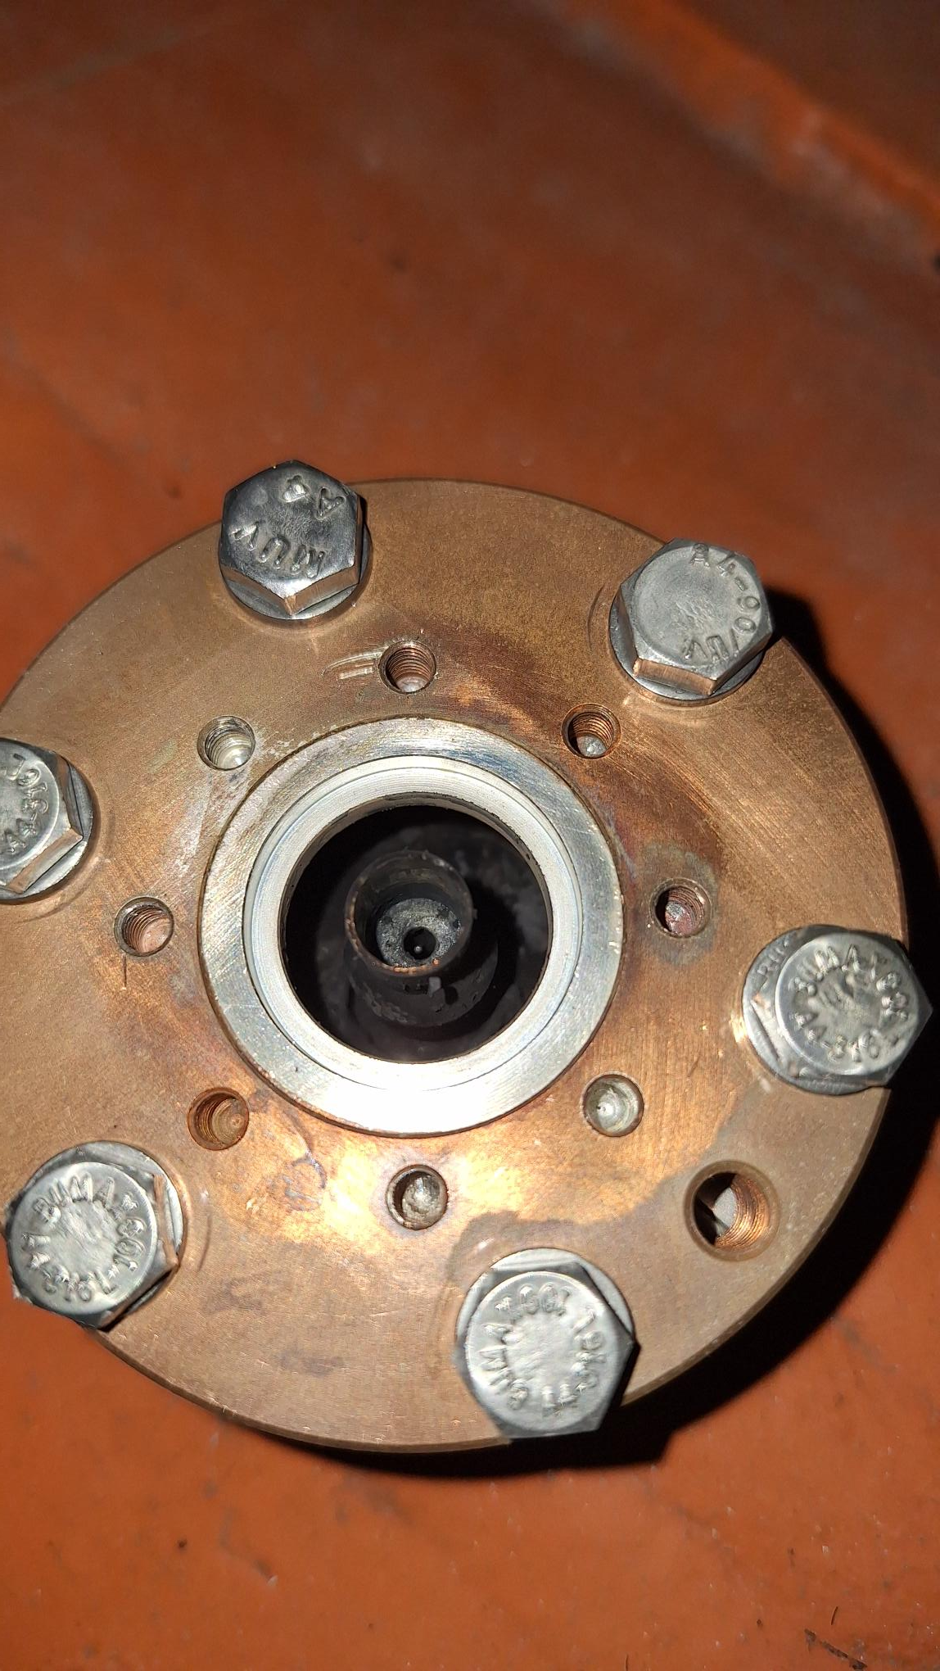
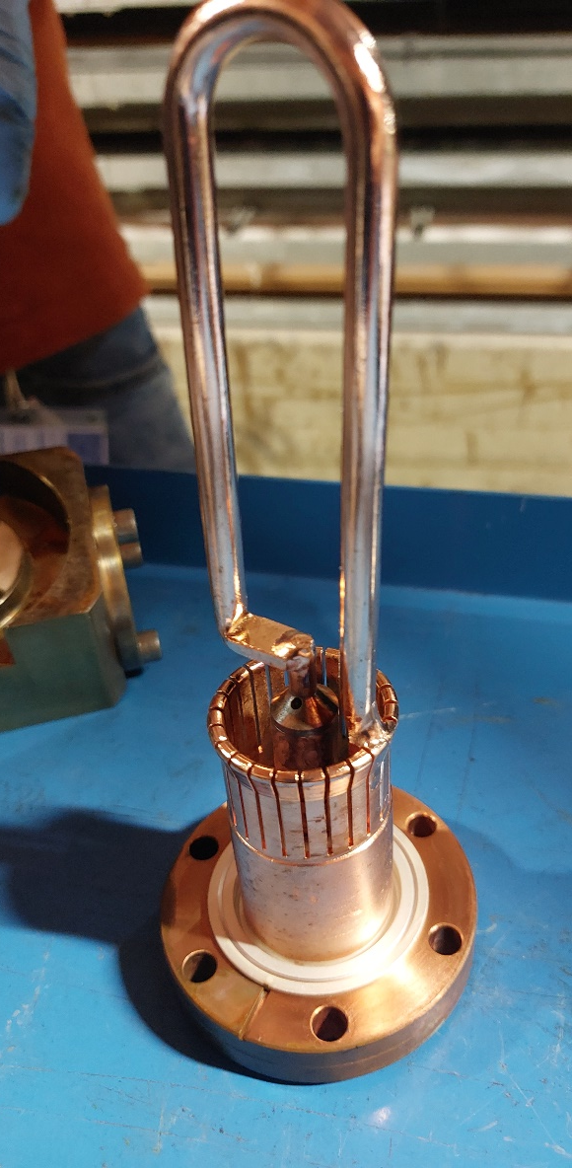
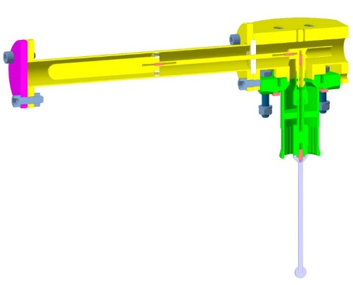
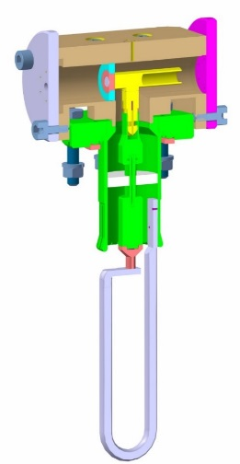
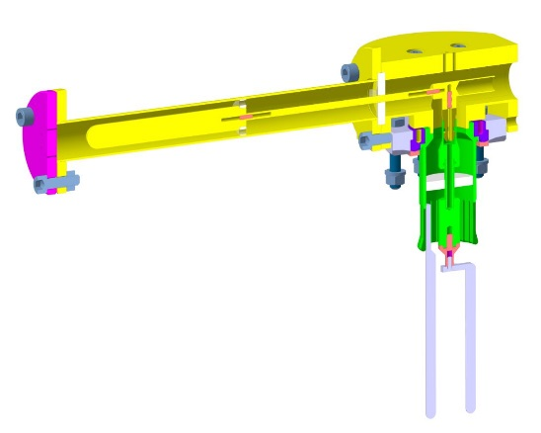
July 24
Yets24/25
1
2
4
5
6
7
8
10
11
12
13
14
15
16
18
19
22
23
24
26
27
28
29
30
32
33
34
35
37
38
39
40
41
44
8 x 628 MHz version B (forks)
16 x 628 MHz
6 x 938 MHz
Vacuum Gauges 1 – 6 – 39 – 44
628 MHz HOM coupleur bride Fixe/tourante
938 MHz HOM coupleur bride Fixe
8 x 628 MHz
version B (forks)
SY-RF-AC

Slide 13
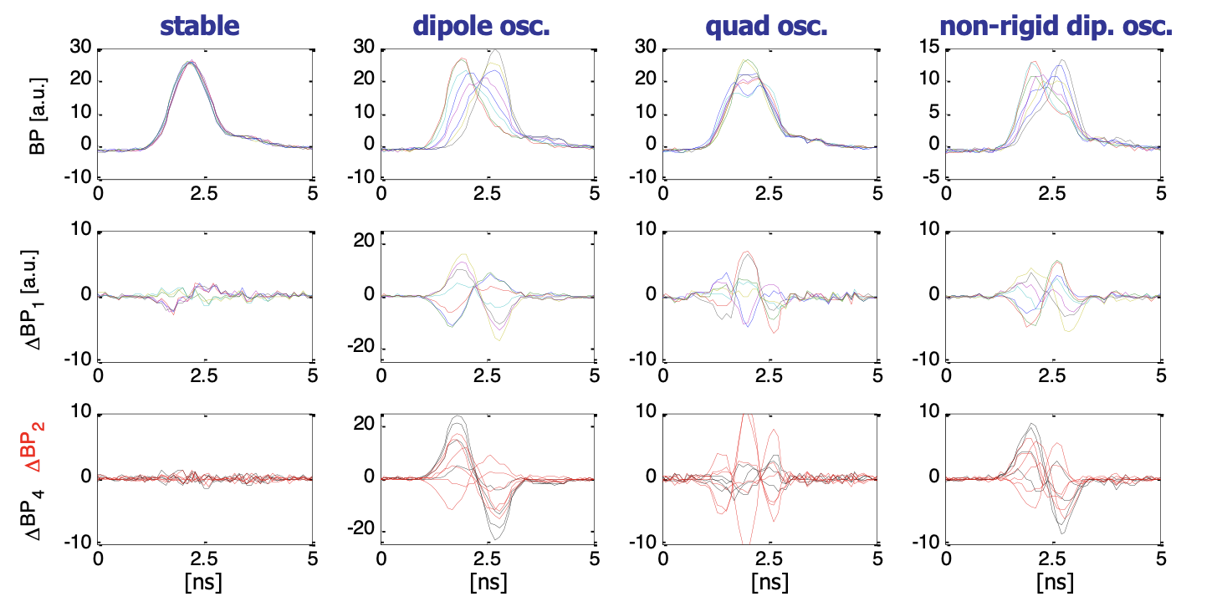
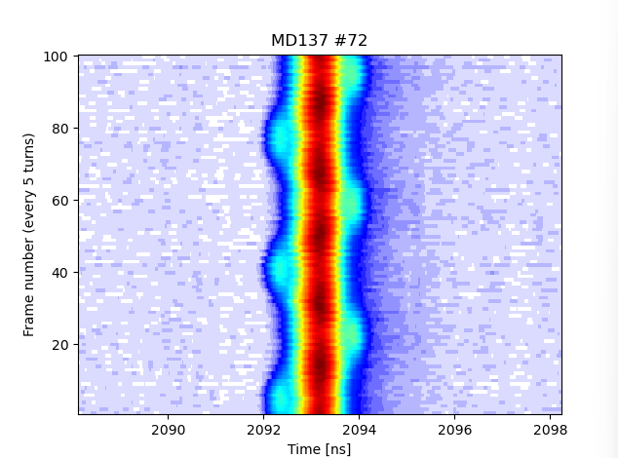
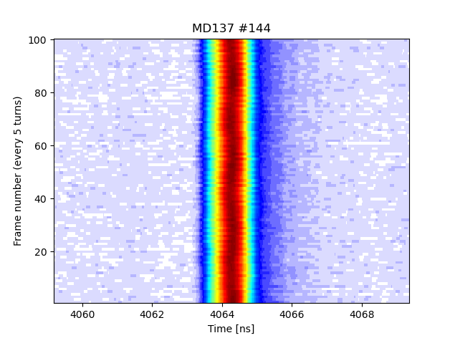
non-rigid dipole oscillations and op. measurements
op measurements improvement: addition of fwhm 20% cut?
  can easily be added to ABWLM, at system renovation
  for BQM, need to verify impact on evaluation duration
    15-20 ms max from measurement to dump/not decision
for BQM, can use existing stability detection algorithms
image from 2008!

