Slide 1
Pushing intensity with LHC-type beams
H. Bartosik, I. Karpov, I. Mases, L. Mether, G. Papotti, K. Paraschou, G. Rumolo, C. Zannini,
F. Asvesta, X. Buffat, H. Damerau, A. Lasheen, K. Li, M. Barnes, R. Calaga,
E. de la Fuente, G.P. Di Giovanni, A. Huschauer, G. Iadarola, V. Kain, B. Mikulec, B. Salvant,
M. Schenk, F.M. Velotti, PSB-PS-SPS OP teams

Slide 2
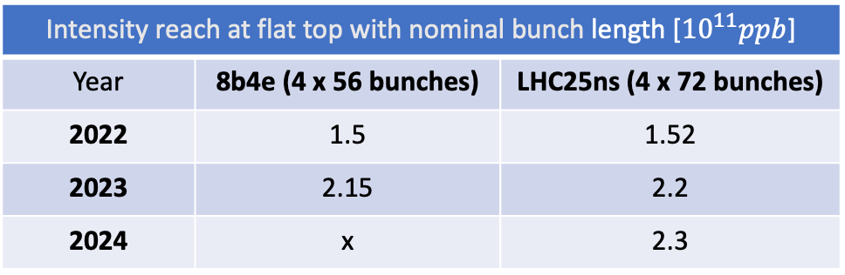
Intensity reach in the last three years
Intensity reach at flat top with nominal bunch length [${10}^{11}ppb$]
Year | 8b4e (4 x 56 bunches) | LHC25ns (4 x 72 bunches)
2022 | 1.5 | 1.52
2023 | 2.15 | 2.2
2024 | x | 2.3
During 2024 scrubbing we demonstrated the LIU intensity
LIU beam (288 bunches with ~2.3e11 ppb and ~1.6ns bunch length) accelerated to 450 GeV
LIU beam at 2.3e11 ppb never fully restored
Beam availability during MDs, struggling with RF cavity limits, beam readiness from injectors after long gaps, magnet exchanges, ….
Consolidation of LIU beam and exploration of intensity limits with 8b4e beam
Key to be well prepared for the 2026 reliability run

Slide 3
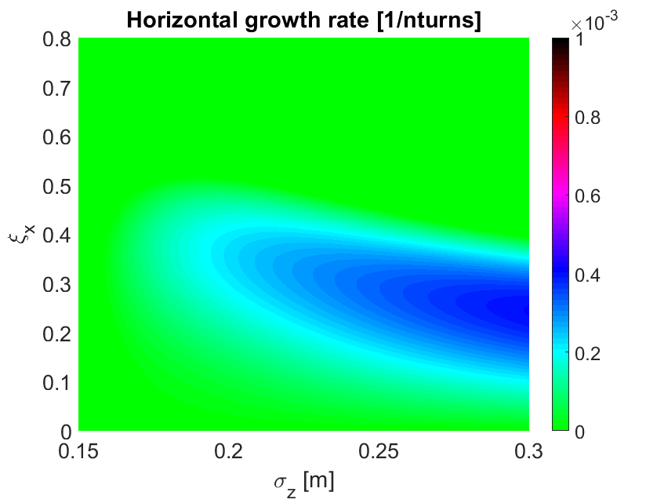
Trasverse stability at injection energy
Horizontal instability studied in detail in 2018 for 1.8e11 p/b
  Mitigation strategy developed in simulations: high chromaticity + octupoles
Extremely fast vertical coupled bunch instability predicted in simulations
  Threshold depends on the set vertical tune and chromaticity
Criticality of short bunches at injection (<4 ns) to ensure stability, also confirmed in simulations

Slide 4
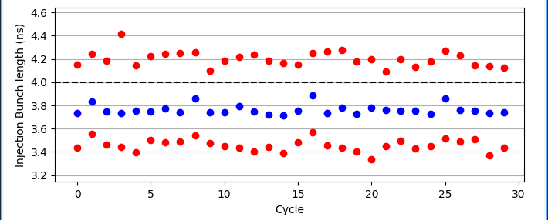
Trasverse stability at injection energy
Horizontal instability studied in detail in 2018 for 1.8e11 p/b
  Mitigation strategy developed in simulations: high chromaticity + octupoles
Extremely fast vertical coupled bunch instability predicted in simulations
  Threshold depends on the set vertical tune and chromaticity
Criticality of short bunches at injection (<4 ns) to ensure stability, also confirmed in simulations
With some exceptions 2024 bunch lengths from PS were consistently below 4 ns
Transverse stability successfully tested in 2024 (~30h with ~2.7e11 ppb injected and 4 x 72 bunches)

Slide 5
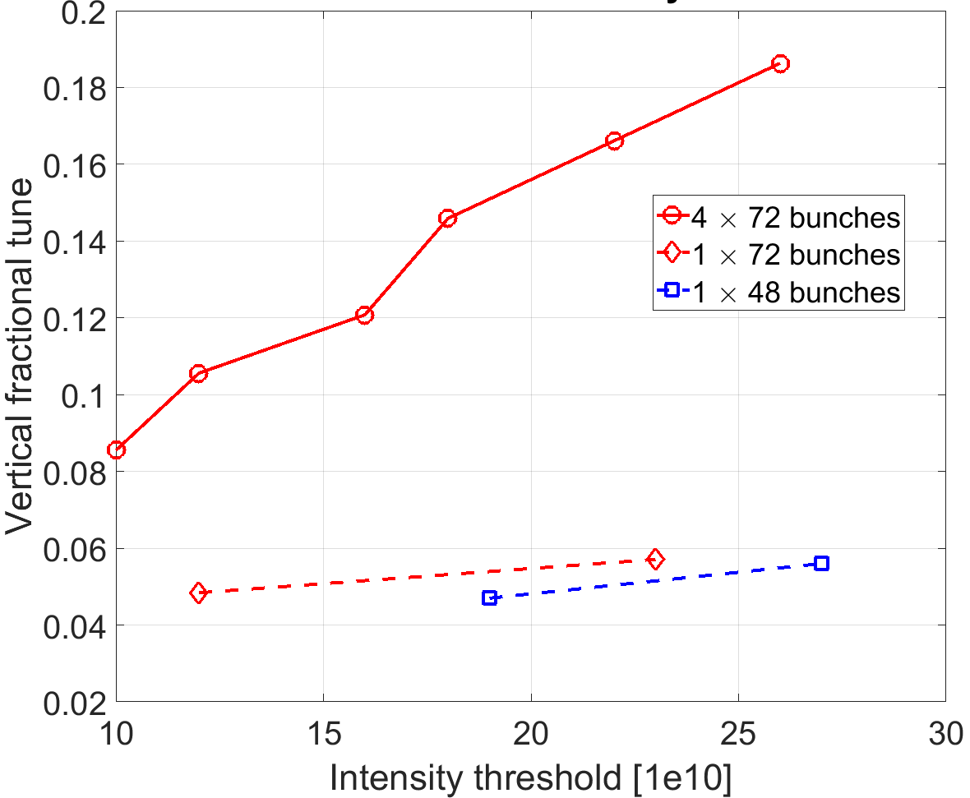
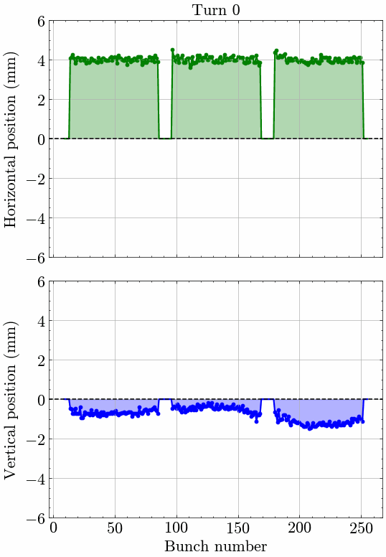
Observation of vertical instability
  Studies with 4 batches in 2024
Plot of I. Mases
  Experimentally confirmed with 1 batch and low intensity in 2021 and 2022
At tune Qv = 20.18, and QPV = 0.6 (knob),
we reduced gradually the gain of the damper
SCAN OF THE VERTICAL CHROMATICITY AT NOMINAL DAMPER GAIN
Vertical chromaticity (knob) needs to be QPV >= 0.6

Slide 6
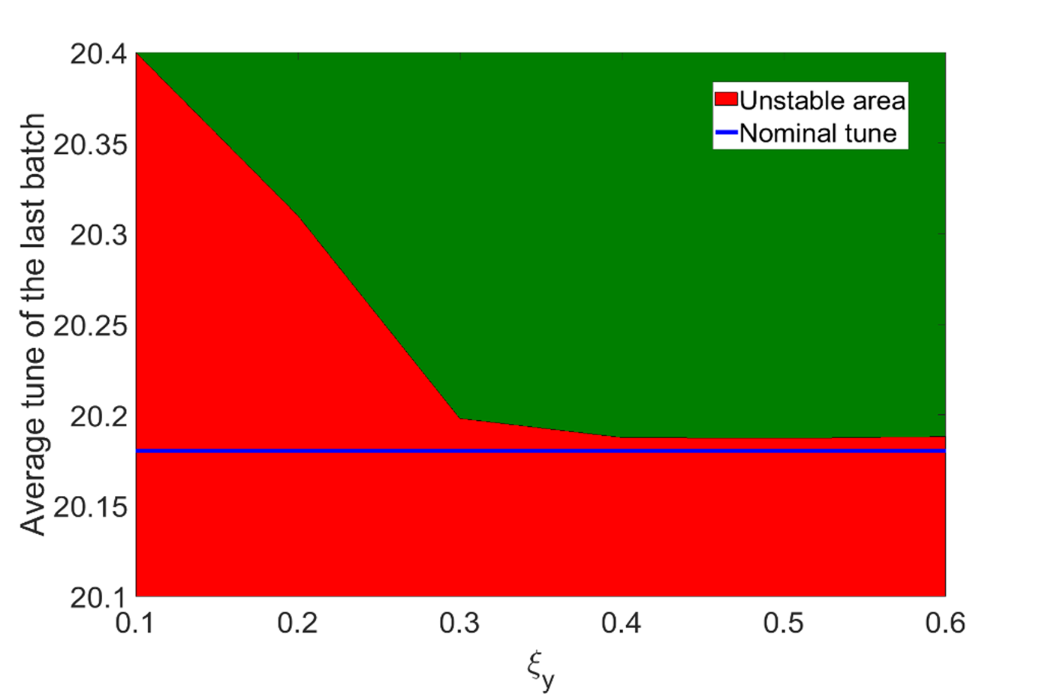
Observation of vertical instability
4 x 72bunches, N = 2.6e11 p/b
Plot of I. Mases
At tune Qv = 20.18, and QPV = 0.6 (knob),
we reduced gradually the gain of the damper
SCAN OF THE VERTICAL CHROMATICITY AT NOMINAL DAMPER GAIN
Vertical chromaticity (knob) needs to be QPV >= 0.6

Slide 7
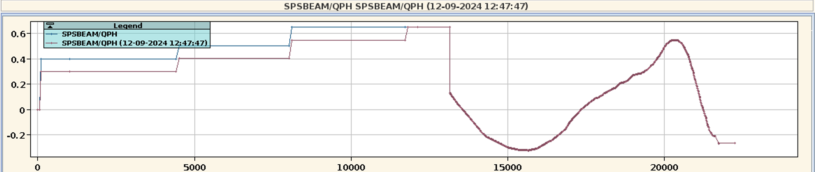
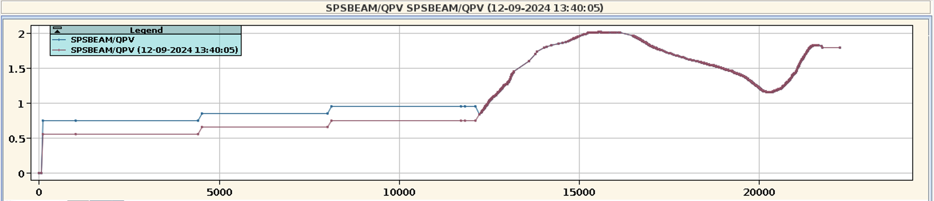
Horizontal and vertical chromaticity
Standard beam
BCMS beam
BCMS beam
Standard beam
Higher chroma needed for transverse stability with BCMS beam in both planes due to the smaller emittances
Could Q22 optics help to reduce the needed chromaticity for transverse stability?
Investigation with Q22 optics revealed that indeed horizontal stability can be improved as predicted by Xavier (stability reached for a 0.1-0.15 lower H chromaticity). Stability become more critical in the vertical plane (0.1-0.15 higher V chromaticity)

Slide 8
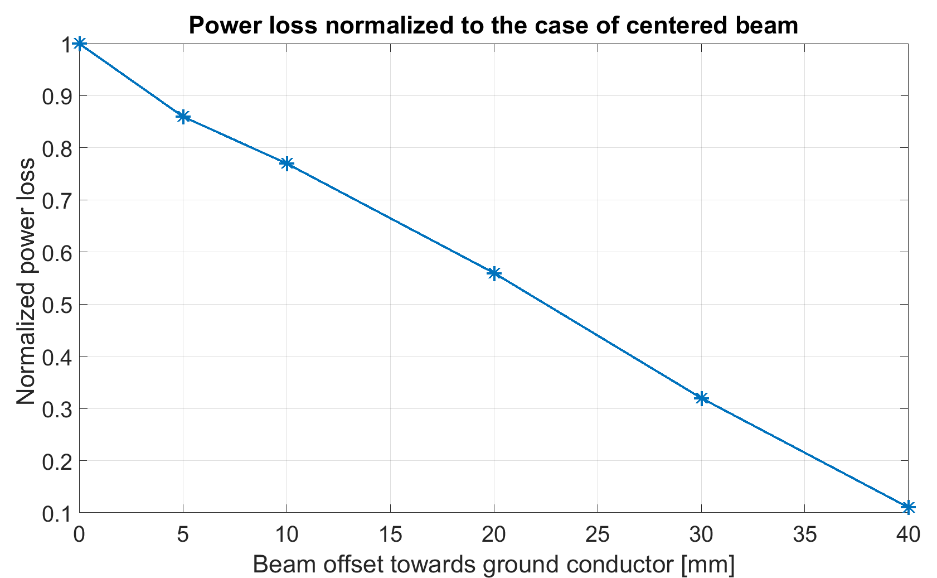

SPS injection kicker beam induced heating mitigation
After the optimization of the MKP-L, MKP-S became the major bottleneck in term of beam induced heating
Scrubbing run 2023 and 2024 had to be modulated to accommodate cool down of the MKP-S magnet
Offsetting the circulating beam towards the ground conductor is expected to be beneficial in terms of beam induced heating
Ground conductor
Experimental verification with orbit bump during scrubbing run 2024
Circulating
beam

Slide 9
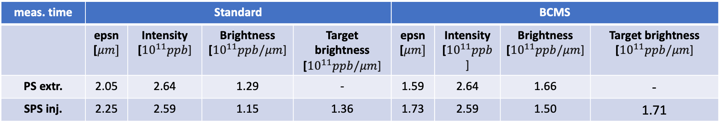
Desiderata for 2025
Consolidation of LIU beam (scrubbing + at least 4-5 MD slots)
  Starndard (during scrubbing) and BCMS (dedicated MD cycle)
Exploration of intensity margins for LIU beam – at least 2-3 MD slots
Pushing intensity with 8b4e beam (goal is to give 2.3e11 ppb to LHC for 2026 high intensity studies) - at least 2 MD slots
Beam quality optimization (emittance, tails, batch-by-batch tune correction)
Minimization of PS-SPS mismatch (tuning of transfer line optics)
meas. time | Standard |  |  |  | BCMS
 | epsn [$μm]$ | Intensity [${10}^{11}ppb$] | Brightness [${10}^{11}ppb/μm$] | Target brightness [${10}^{11}ppb/μm$] | epsn [$μm]$ | Intensity [${10}^{11}ppb$] | Brightness [${10}^{11}ppb/μm$] | Target brightness [${10}^{11}ppb/μm$]
PS extr. | 2.05 | 2.64 | 1.29 | - | 1.59 | 2.64 | 1.66 | -
SPS inj. | 2.25 | 2.59 | 1.15 | 1.36 | 1.73 | 2.59 | 1.50 | 1.71

Slide 10
Thank you for your attention

Slide 11
Additional studies

Slide 12
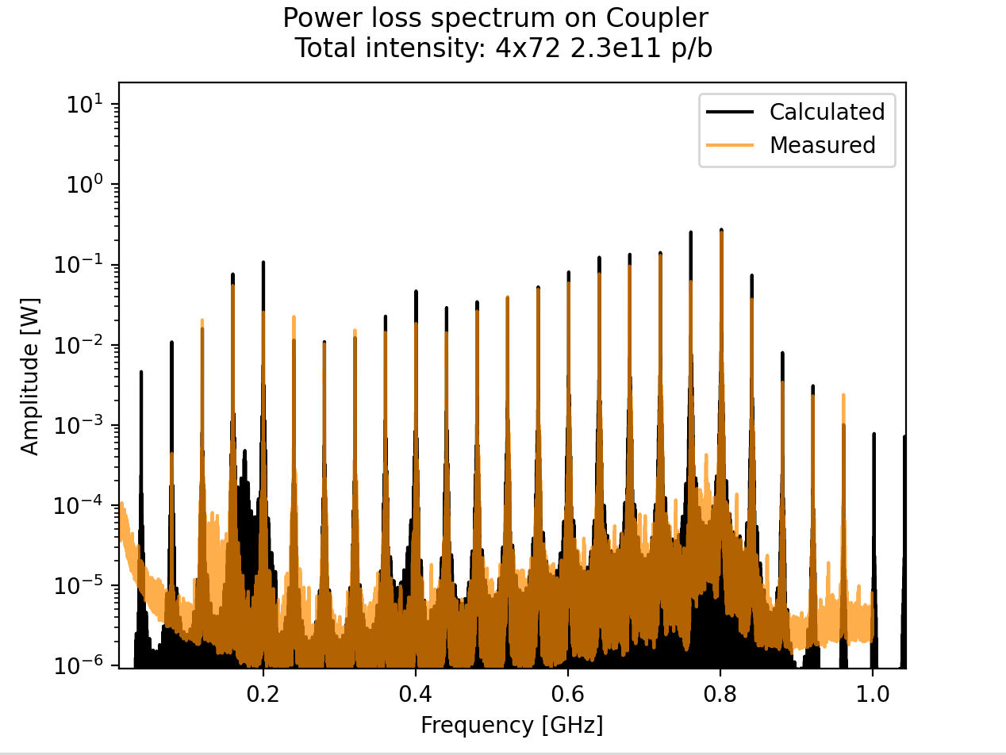
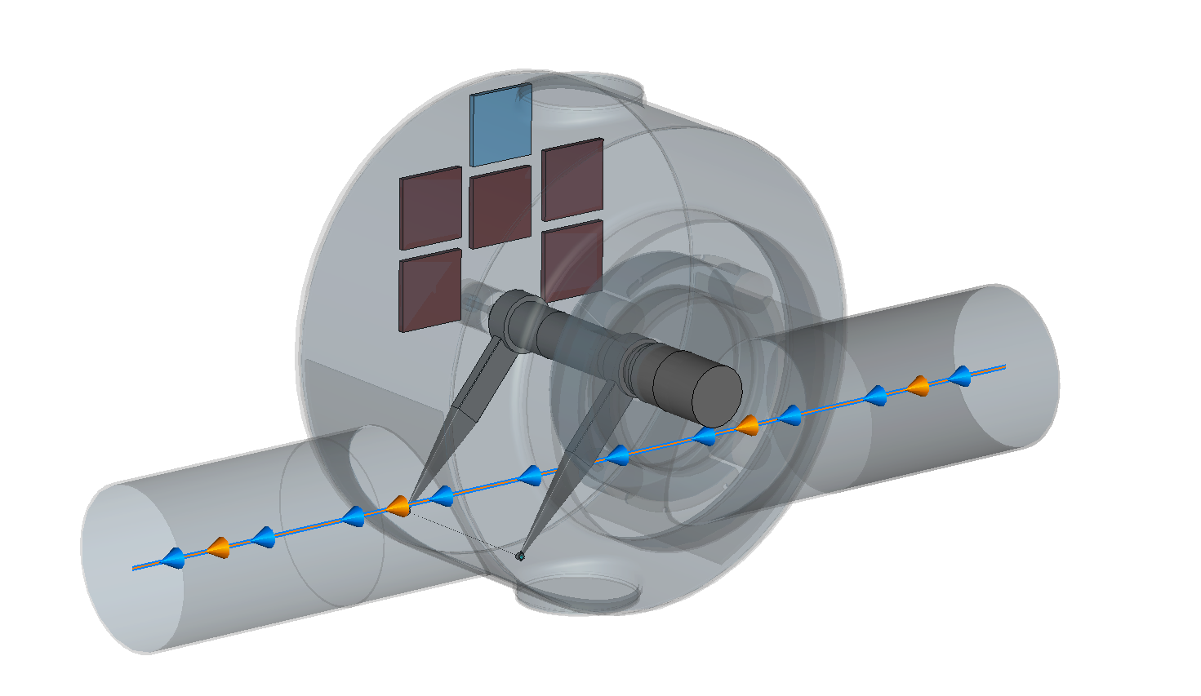
SPS Wire scanner failure
YETS 23/24: installation of ferrites and coupler in all 4 wire scanners tanks
As predicted from power loss calculations, no issues observed in parking position up to LIU intensities
Development of an advanced model that can reproduce the beam induced power loss over the relevant frequency range
An SPS wire scanner get stuck close to beam halo during 2024 operation
Breakage expected for >6.5 W
L. Sito, E. de la Fuente
Beam type | Parking position [W] | Stuck position [W]
Operational | <0.9 | <4.5
MD beam (breakage) | <2.4 | >6.8
LIU | <5 | >14
The stuck wire broke with significantly lower intensity than LIU, consistently with the advanced model predictions

Slide 13
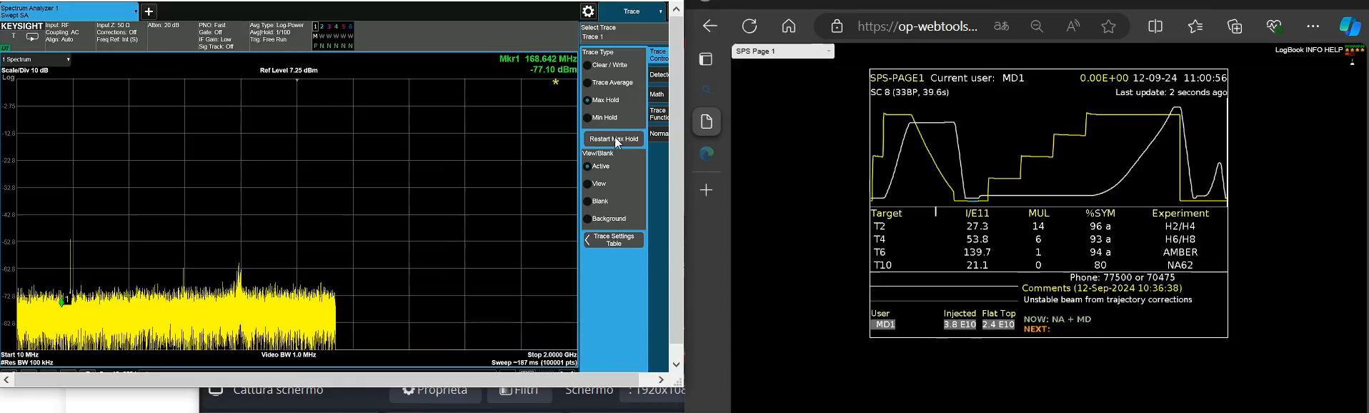
SPS Wire scanners: expectations for coming years
YETS 23/24: installation of ferrites and coupler in all 4 wire scanners tanks
From power loss calculations, no issues are expected if considering
peak power on the wire along the cycle.
L. Sito, E. de la Fuente
800 MHz

Slide 14
Appendix

Slide 15
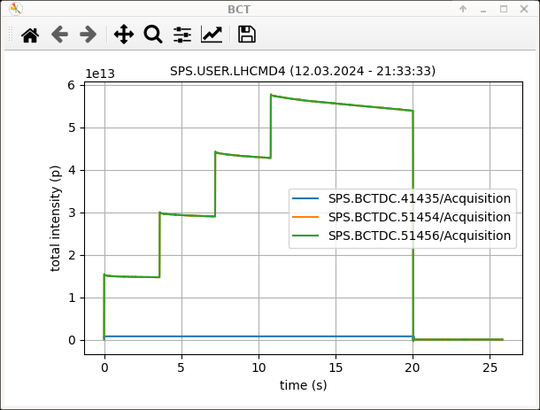
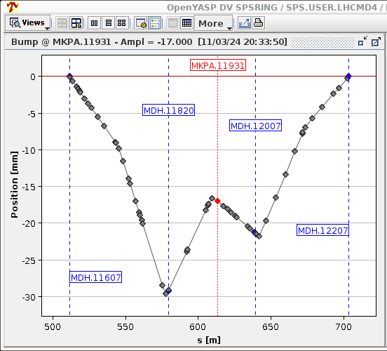
MKP-S beam induced heating mitigation

Slide 16
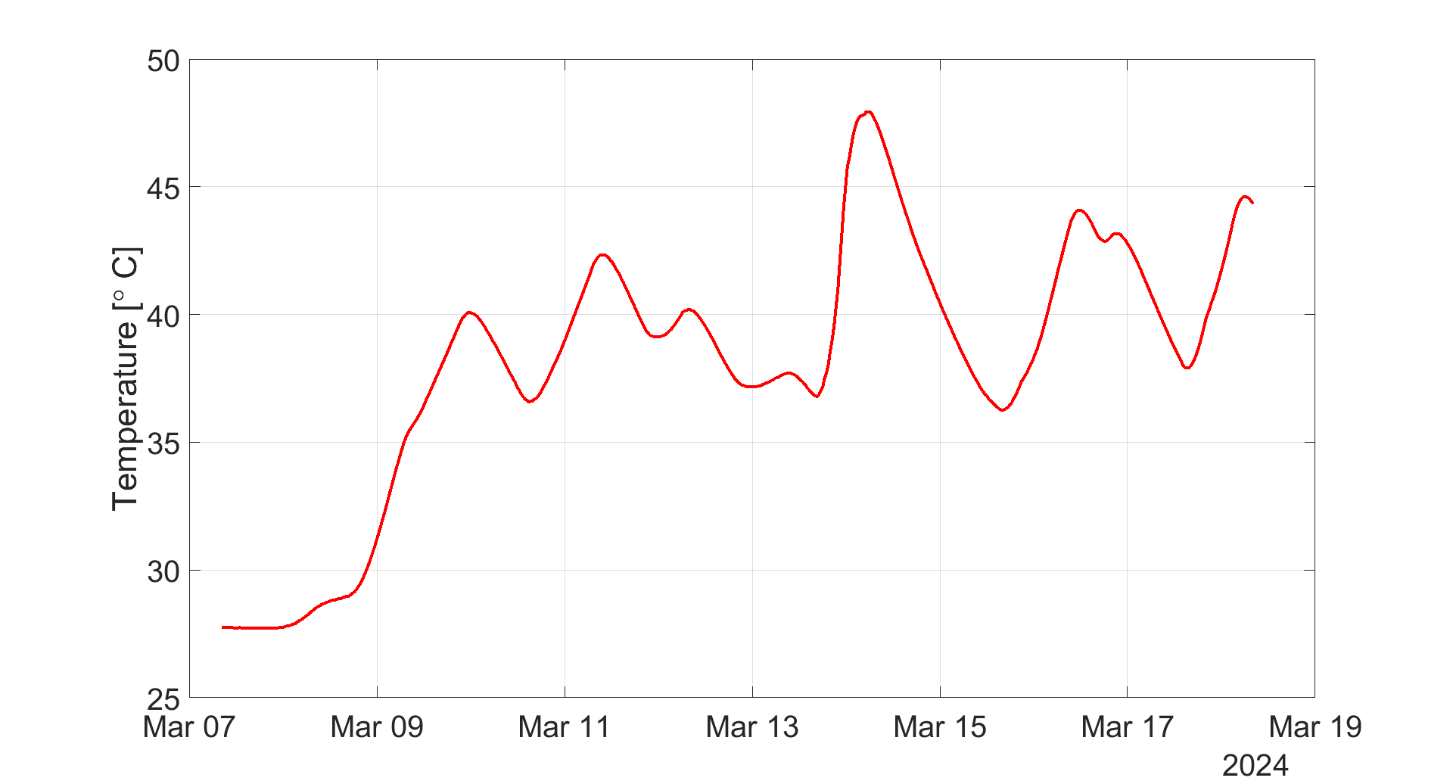
MKP-S beam induced heating mitigation

Slide 17
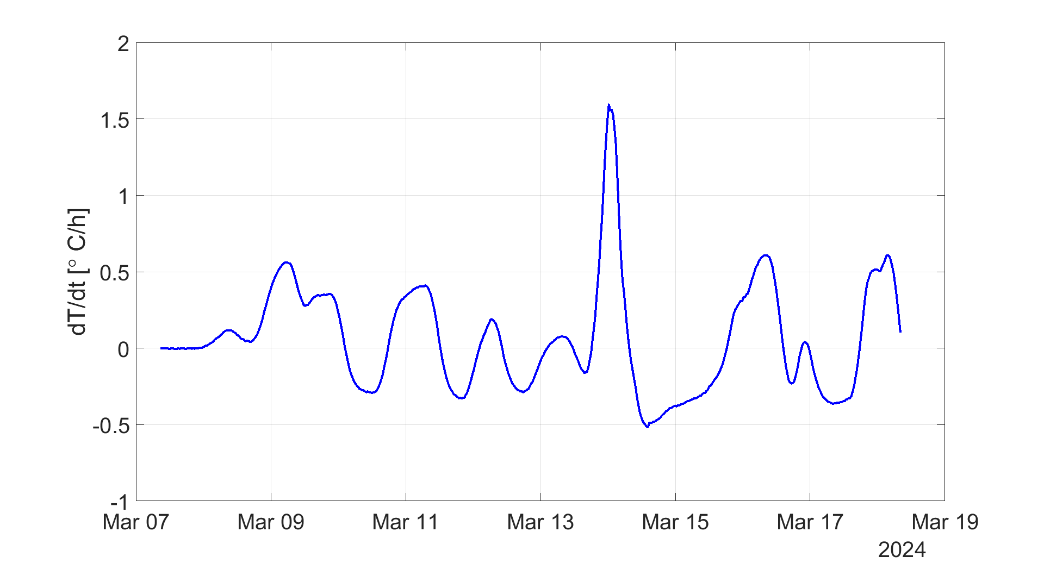
MKP-S beam induced heating mitigation

Slide 18
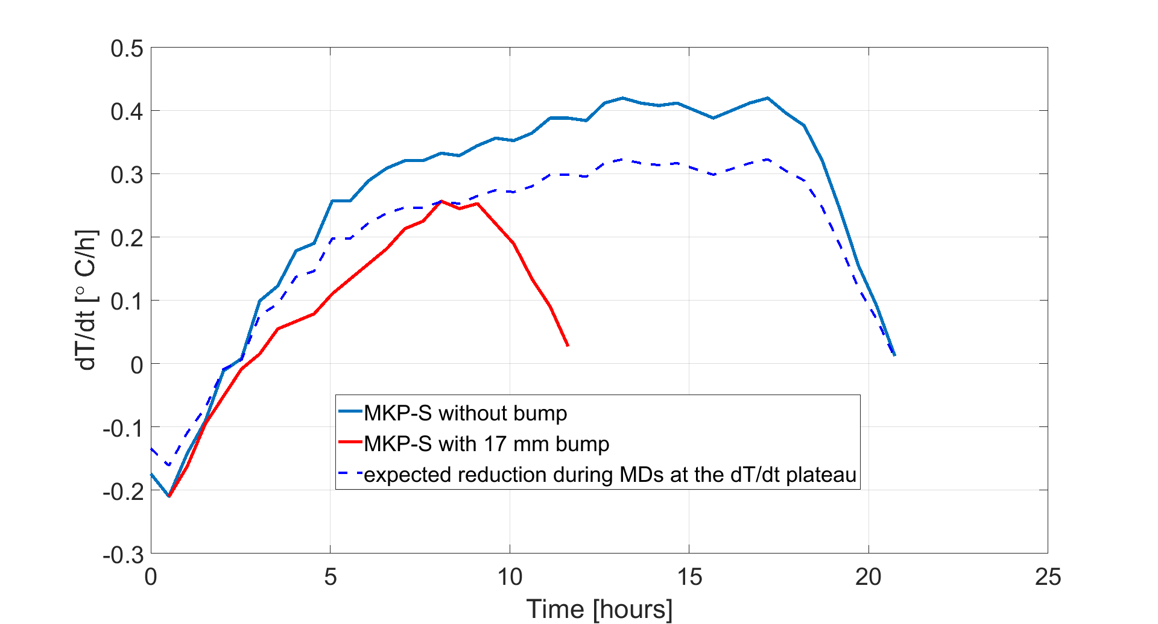
MKP-S beam induced heating mitigation
Projection on limitations during scrubbing

Slide 19
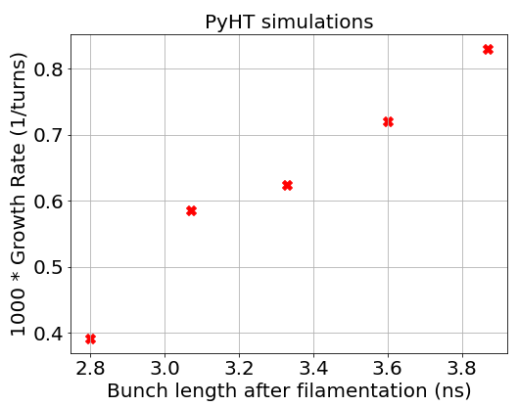
SPS transverse stability
Horizontal instability @26 GeV studied in detail in 2018 for 1.8e11 p/b
  Mitigation strategy developed in simulations: high chromaticity + octupoles
Extremely fast vertical coupled bunch instability @26 GeV predicted in simulations
  Threshold depends on the set vertical tune and chromaticity
Criticality of short bunches at injection (<4 ns) to ensure stability, also confirmed in simulations
Courtesy of I. Mases
With some exceptions 2024 bunch lengths from PS were consistently below 4 ns

Slide 20
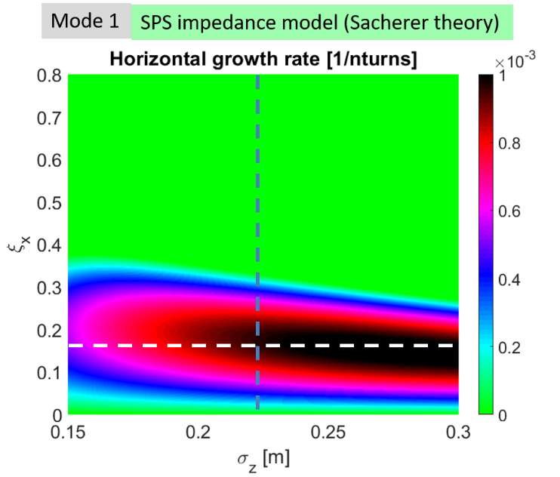
Trasverse stability at injection energy
Horizontal instability studied in detail in 2018 for 1.8e11 p/b
  Mitigation strategy developed in simulations: high chromaticity + octupoles
Extremely fast vertical coupled bunch instability predicted in simulations
  Threshold depends on the set vertical tune and chromaticity
Criticality of short bunches at injection (<4 ns) to ensure stability, also confirmed in simulations
Transverse stability successfully tested in 2024 (~30h with ~2.7e11 ppb injected and 4 x 72 bunches)

