Slide 1
Ideas for a NXCALS API based on Pandas-on-Spark
Vito Baggiolini, with work from Michi Hostettler
and input from Guido , Riccardo, Foteini, Alex,
and the NXCALS team

Slide 2
What is this API?
Purpose:
  Make it easier for people to use NXCALS
  Enable the use of Pandas on the NXCALS cluster
  Achieve better performance thanks to this
What is Pandas-on-Spark?
  An implementation of the Pandas API on top of (Py)Spark
  A tool to process data on the NXCALS cluster using the Pandas API
And this API?
  Methods to load different kinds of data into Pandas-on-Spark DataFrames
  Built on a library that Michi Hostettler has developed, using PySpark
  Used by ~15 people from OP and ABT in the Beam Performance Tracking (BPT) project
  Adapted to use Pandas-on-Spark for this Proof-of-concept prototype
  Extended to also provide “beam_info” to do cross-machine correlation

Slide 3
What is this API not?
It’s not (yet) a product:
  The API (style, method names, arguments, etc) has to be reviewed with you as users
  The implementation has to be reviewed by the team and adapted
  It is not (yet) optimized for performance
It should not end up as YANAPI (“yet another NXCALS API”)
  → Integrate it into PyTimber as a Pandas-on-Spark Flavour?

Slide 4
Typical steps in using the API
Create a Spark session and use it to create an NxcalsExtractor:
Initialize a query object that defines the time frame
Load variables into a Spark-on-Pandas DataFrame
Use Pandas API to work with the data

Slide 5
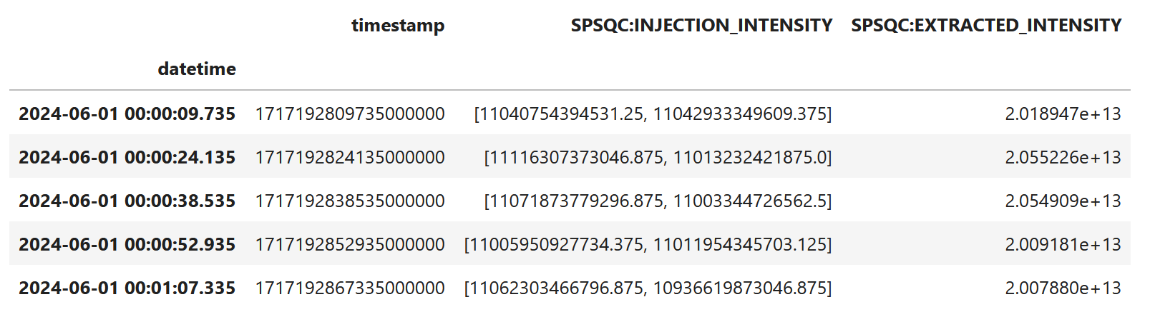
How does the Data look like?
All data is contained in Pandas-on-Spark DataFrames
DataFrame columns represent named values (e.g. Variables)
Rows represent time (e.g. one row per cycle)
NXCALS arrays and matrices are converted to arrays in the cells

Slide 6
Code examples: API + Pandas-on-Spark
Overview of the new API calls
Get PSB intensities sent to ISO
Aggregate PS intensity statistics per USER
“Approximative” merging of cyclestamp with acqStamp
Cross-accelerator correlation: intensities for MTE Beam instances
Disclaimer: I’m not a Pandas expert at all (but ChatGPT is)

Slide 7
1. Overview of the API calls
Get values for Variables
Get values for Device/Properties
Get Fundamentals
Get LSA Trims
Get LHC Fills and Modes

Slide 8
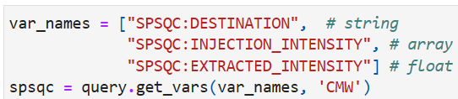
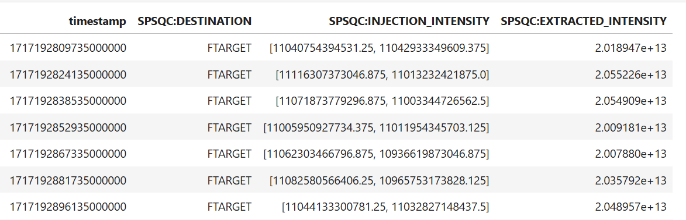
Get values for NXCALS variables in a p-o-s DataFrame

Slide 9

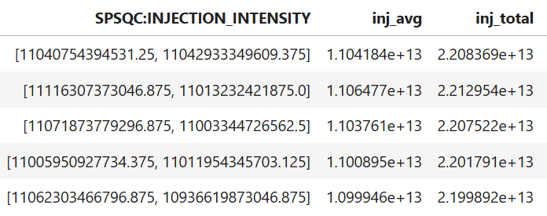

Slide 10
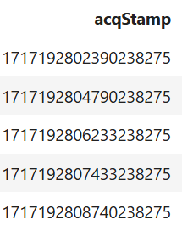
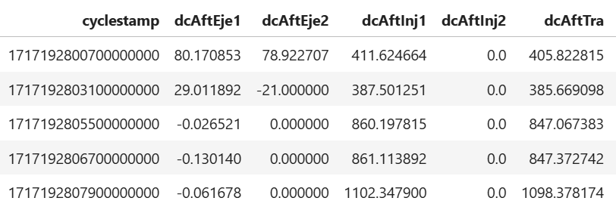
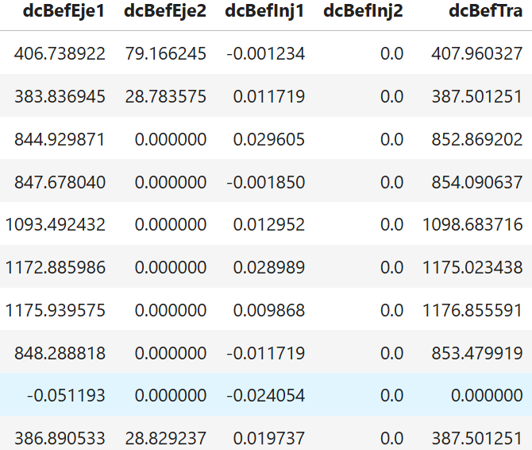
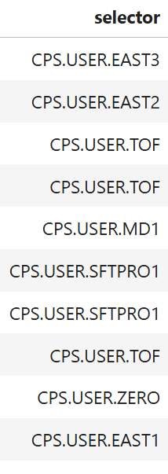
Get values for device/properties in a p-o-s DataFrame

Slide 11
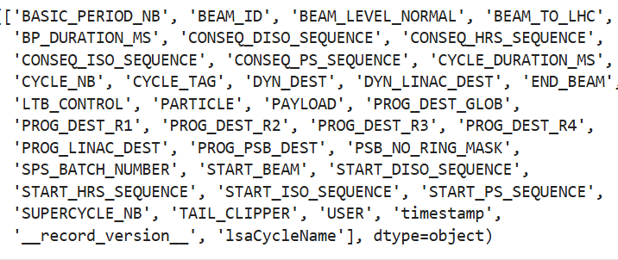
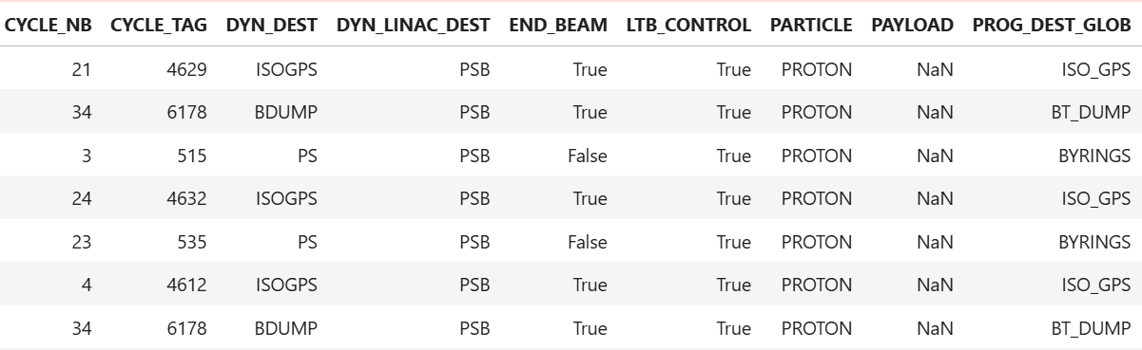
Get Fundamentals in a p-o-s DataFrame

Slide 12
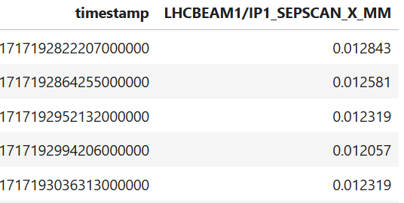
Get LSA Trims in a p-o-s DataFrame

Slide 13
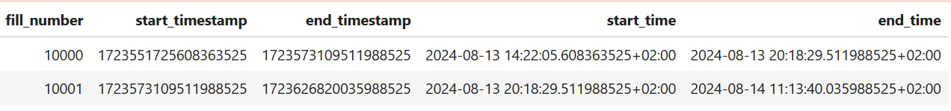
Get Fills in a p-o-s DataFrame

Slide 14
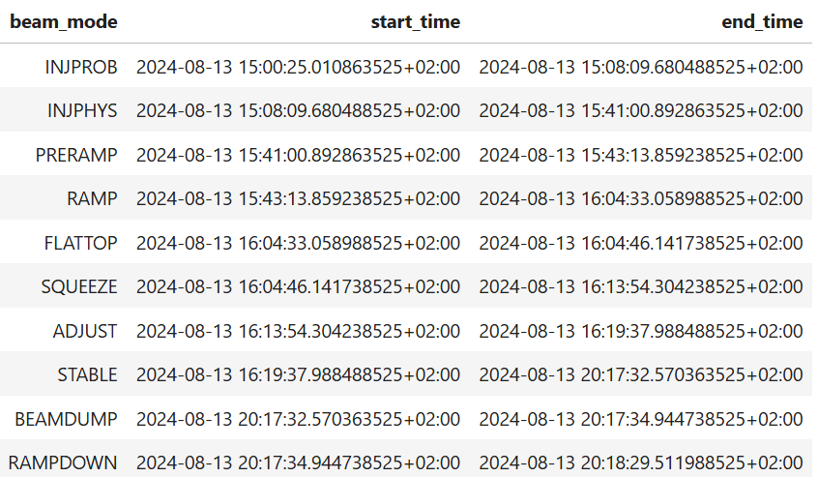
Get Modes in a p-o-s DataFrame

Slide 15
2. Get PSB intensities sent to ISO
Get PSB intensities
Get Fundamentals and filter for ISO
Merge fundamentals with PSB intensities to keep only ISO values

Slide 16
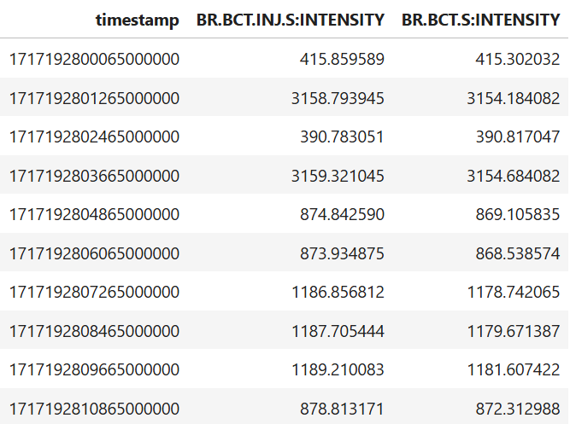

Slide 17
Already seen

Slide 18
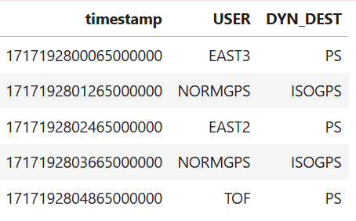
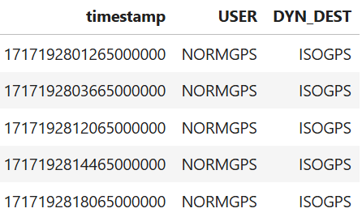

Slide 19




Slide 20
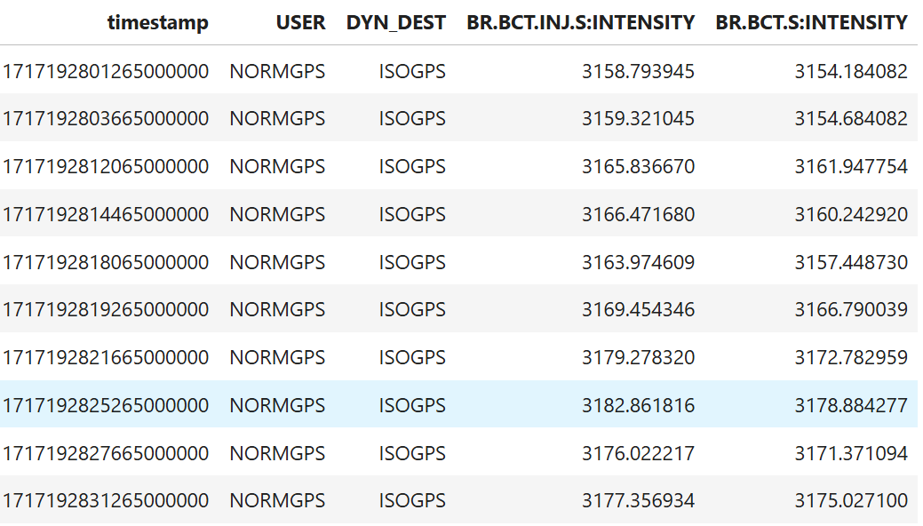

Slide 21
3. PS intensity Statistics per USER
Get Intensities values and Selectors from PR.BCT/HotspotIntensity
Filter out CPS.USER.ZERO
Calculate transmission
Group by selectors and aggregate

Slide 22
Already seen

Slide 23
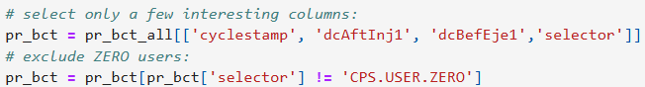
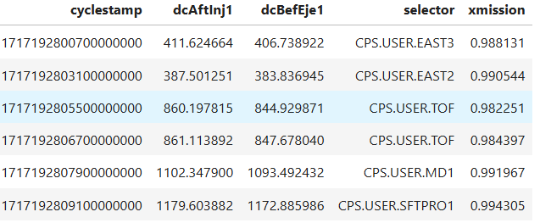
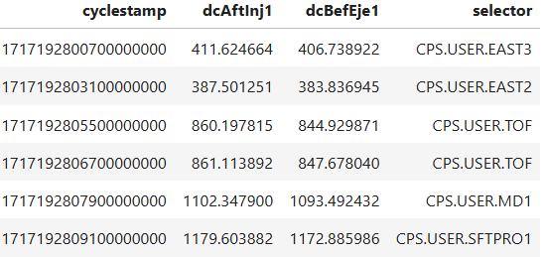

Slide 24

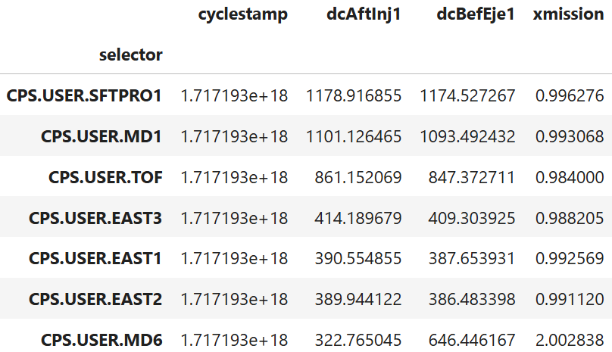

Slide 25
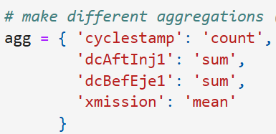
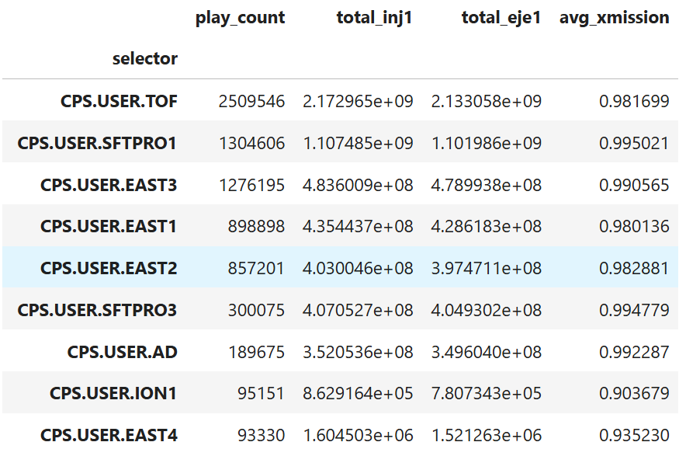

Aggregated
over one year

Slide 26
4. Approximative merging of cyclestamp with acqStamp
Artificially create two DataFrames (one with cyclesamp, one with acqStamp) by selecting column from PR.BCT/HotspotIntensity
Use merge_asof() to correlate the two DataFrames by cyclestamp with acqStamp

Slide 27
Already seen

Slide 28
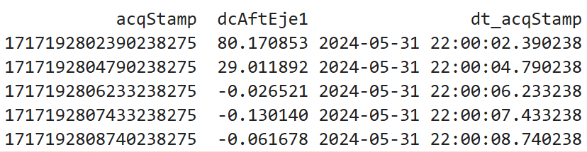
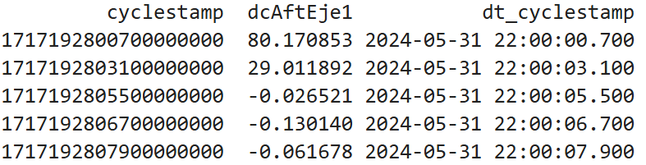
field dcAftEje1
with time stamps
field with
cyclestamp and
date_time
field with
acqStamp and
date_time
cyclestamp < acqStamp

Slide 29



Slide 30
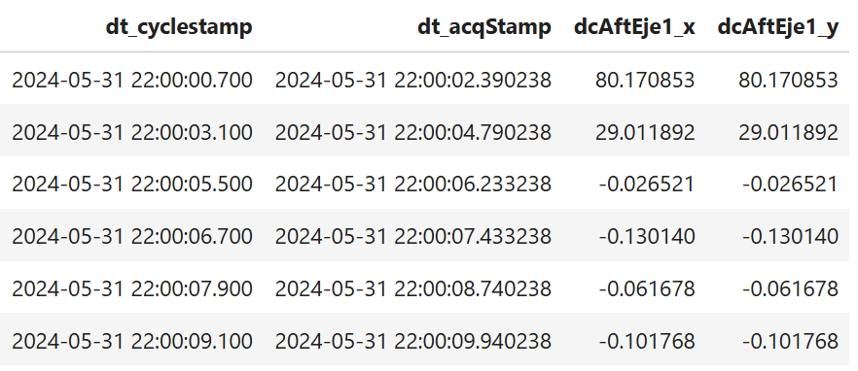

Slide 31
5. Cross-accelerator correlation: intensities for MTE Beam instances
Get “beam_info” data describing the BCD and filter out MTE beams
Get Intensities for PSB, PS and SPS
Use “beam_info” data to filter out intensities for MTE beam instances

Slide 32
Cross-accelerator analysis
Example: BCD with two MTE beam instances
Need to extract data belonging to each beam instance in all machines
Obtain cyclestamps belonging to the MTE beam in each machine
Each beam instance has a unique BeamStamp
CS
BS
MTE
B
MTE
MTE
B
CS
CS
CS
CS
CS
t
MTE
MTE
E
E
MTE
MTE
G
G
CS
E
E
B
MTE
MTE
B
CS
CS
CS
CS
MTE
MTE
E
E
MTE
MTE
G
E
E
B
K
MTE
MTE
G
B
K
BS
BS
t

Slide 33
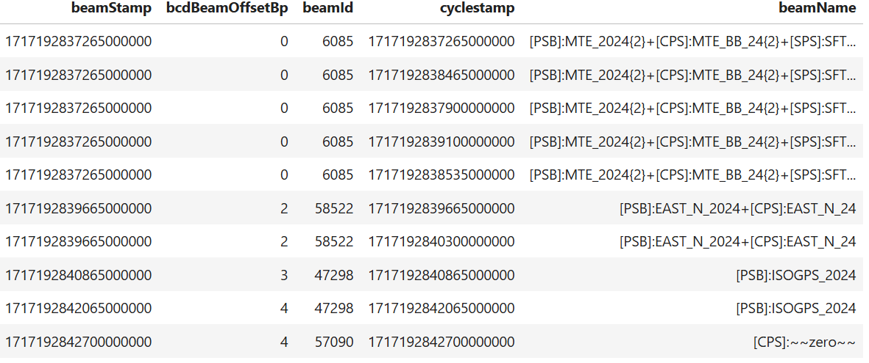
BS
CS

Slide 34
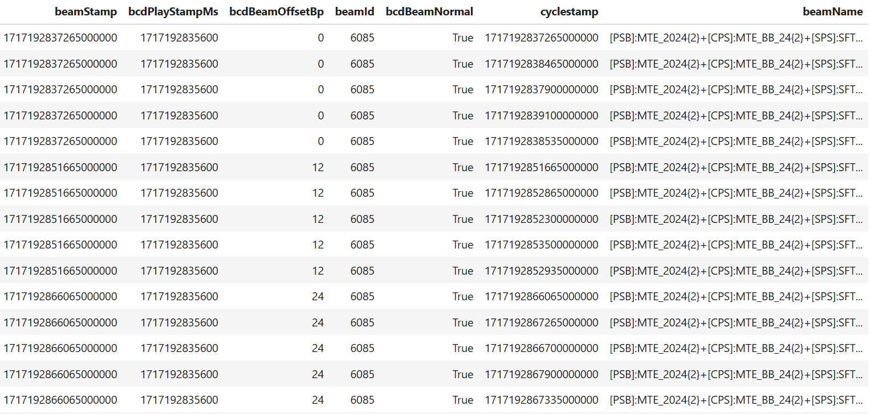
BS
CS

Slide 35
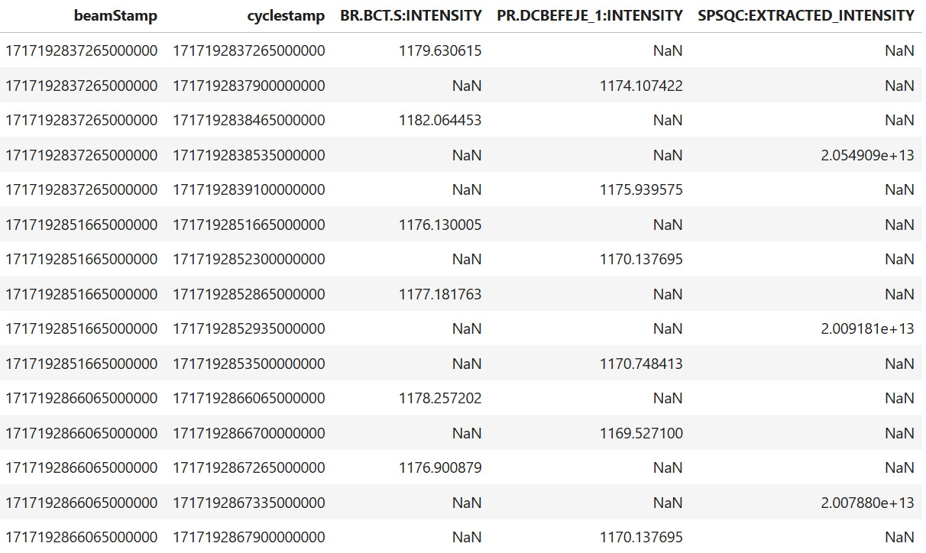
BS
CS

Slide 36
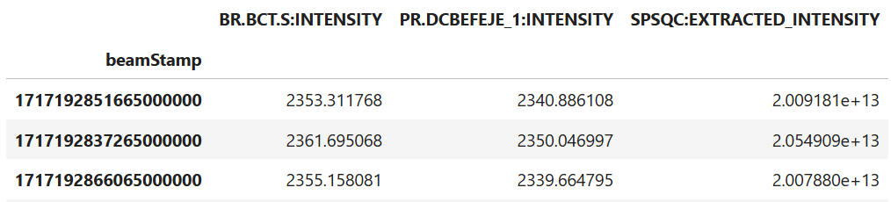
BS

Slide 37
[End of code examples]

Slide 38
Timestamps
Problem: NXCALS works with UTC, while users think in local time
  Both do so for a good reason
API accepts different formats for timestamps:
  NXCALS String “2024-06-01 10:53:16.300”
  ISO 8601 String “2024-06-01T10:53:16.300“
  ISO 8601 with UTC TimeZone “2024-06-01T08:53:16.300+00”
  NXCALS nanoseconds 1717231996300000
  Python milliseconds 1717231996.3
  Python datetime object
API accepts timestamps without a TimeZone as local time
API internally uses timestamps with TimeZone information
  API immediately adds TimeZone information
  Results have TimeZone information

Slide 39
Caveats, open questions and next steps
Caveats
  Pandas API implementation on PySpark is not yet complete but growing
  (it is always possible to use PySpark for unsupported methods)
  Performance benefit from keeping data on the cluster, but can’t do wonders
Open questions:
  Review of API methods and implementation
  How to avoid that this API becomes yet another NXCALS API?
  → Somehow integrate into PyTimber?
Next steps
  We need to discuss the API and the open points with you
  Eat our own dogfood by using this API in the BPT project

Slide 40
Other requirements we are aware of
Additional data partitionings to increase loading speed
  Additional partitioning by individual VARIABLES (class/property/field)?
  LHC LuminosityFollowUp with data partitioned by Fills&Modes
Additional functionality
  Store data in NXCALS cluster (PyTimber page-store)
  Ingest data
  Handle versioned data more easily
  On-demand logging
  Loading data from local storage into a Spark session
All this has to be seen in a broader context than just NXCALS
It is being followed-up in the Data Processing Platform Project c.f. Marcin’s JAP24 Presentation

Slide 41
Summary
API makes data analysis on the NXCALS cluster easier and faster
  All data is presented as Pandas-on-Spark DataFrames
  VECTOR data is already converted to arrays in the cells
  Data analysis is done using Pandas API
  Data is processed on the NXCALS cluster, only result is extracted
Have a look yourself: acc-bpt-nx-api · GitLab
There are still several open points we need to discuss
Other requirements are followed up in the DPP project

