Slide 1
Data analysis for SPS e-clous monitor scanning B-field
Data from hijacked MD 29.08.2024
Holger Neupert, TE-VSC, In-situ a-C coating and LESS for LHC beam screens #130, 03.09.2024

Slide 2
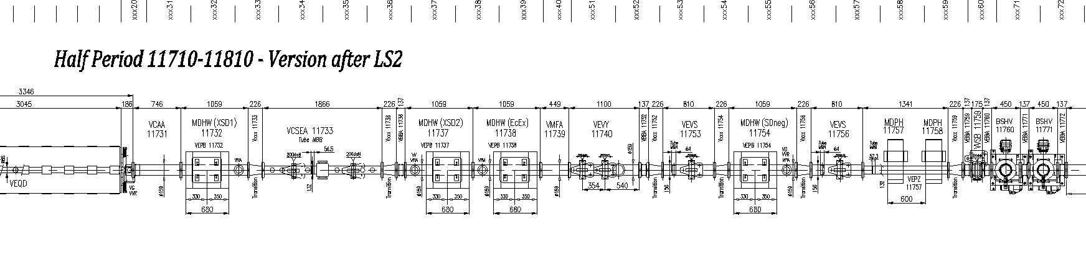
E-cloud monitor layout in SPS-BA1
Drawing number: SPSLNINS0142
E-cloud monitors
SEY drum
Mobile sample, can be transferred under vacuum for SEY and surface Analysis (XPS)
RGA

Slide 3
E-cloud monitors 2024
Liner configuration with new name
VECM11732 is the new name in NXCALS to unify with the naming of the magnet
Installation 17.01.2024
To be discussed:
VECM11732: second LIPSS on Cu from Leipzig
VECM11737: new copper liner to compare to ECM1
VECM11738: CNe13 long term stability a-C coating
VECM11754: a new Stainless Steel (304) liner to compare to SPS’ vacuum chambers
BESCLD_
VECM11732
BESCLD_
VECM11737
BESCLD_
VECM11738
BESCLD_
VECM11754
Cu LIPSS 2
fresh
Cu MBB
Profile, fresh
CNe13 since 2008 in SPS
SS MBB
Profile fresh
03/02/2025
Holger Neupert TE/VSC

Slide 4
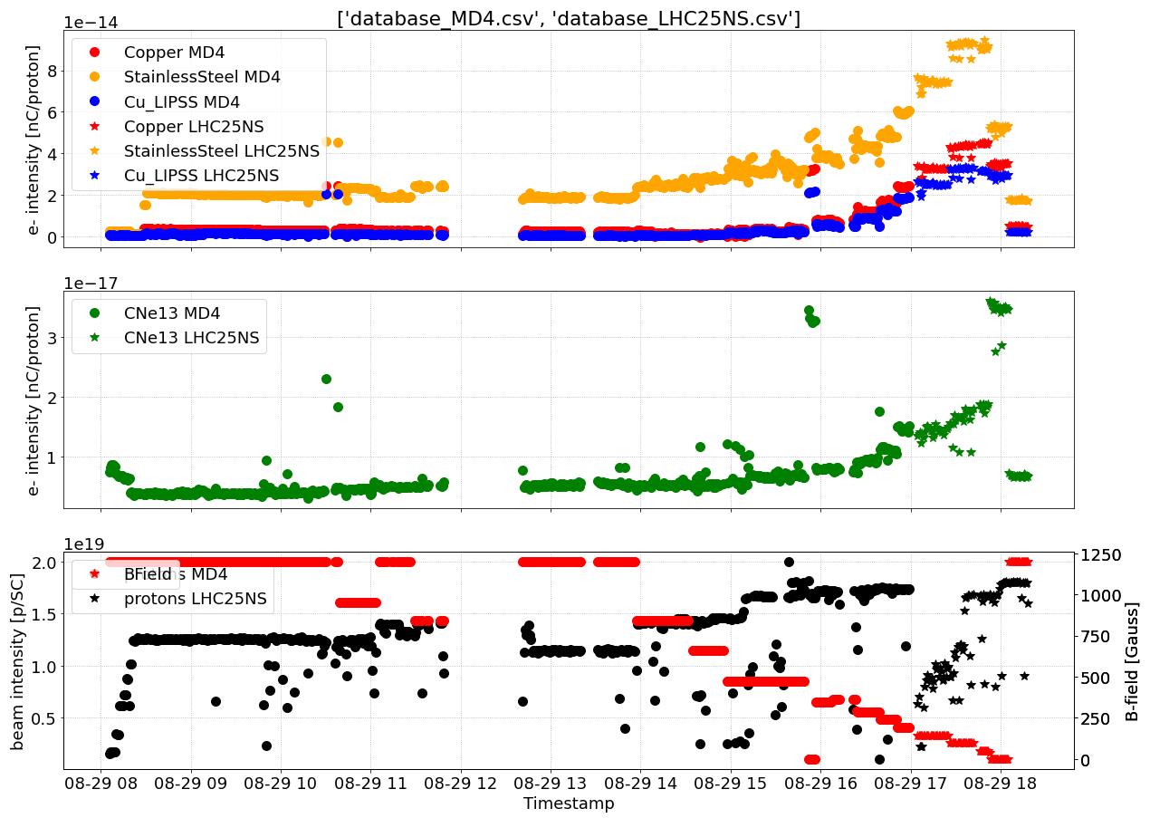
Scan B field from 0G to 1200G
MD5, scrubbing cycle «flat bottom» without acceleration, 4x72 bunches 25ns bunch spacing
Differences between MD5 and LHC25NS despite the claim that these are twins with a different name

Slide 5
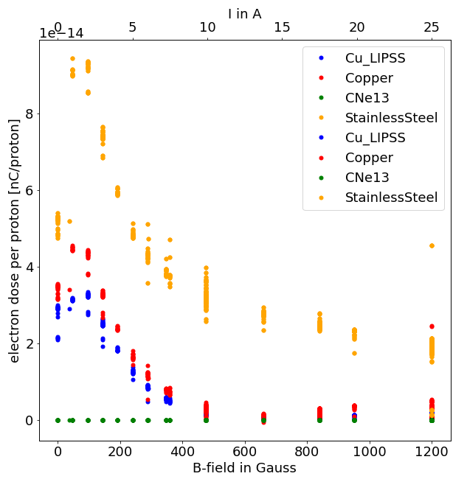
Scan B field from 0G to 1200G
MD5, scrubbing cycle «flat bottom» without acceleration, 4x72 bunches 25ns bunch spacing
Only secondary user on MD5
Changes in emittance and intensity for other studies

Slide 6
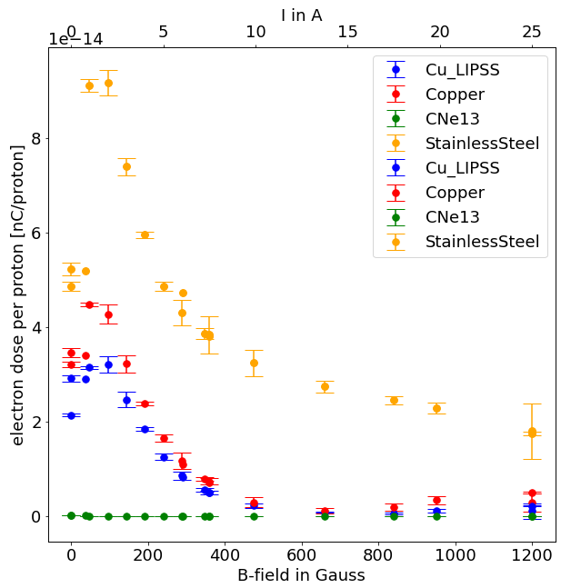
Scan B field from 0G to 1200G
MD5, scrubbing cycle «flat bottom» without acceleration, 4x72 bunches 25ns bunch spacing
Only secondary user on MD5
Changes in emittance and intensity for other studies

Slide 7
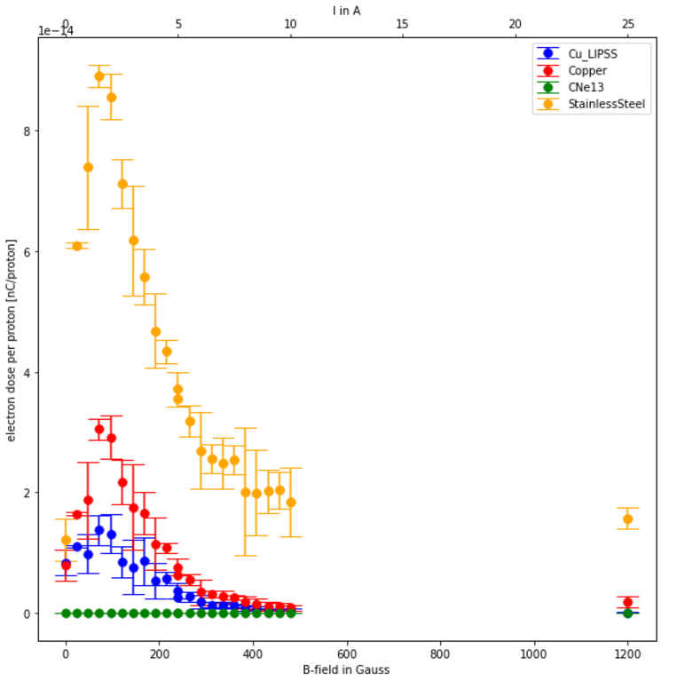
Scan B field from 0G to 1200G
29.10.2024 scan b-field to find better resolution around 5A (200G - 400G)
LHCMD1, with acceleration, 36 bunches in one batch, 25ns bunch spacing, up to 5 batches per injection
1.5-1.7*10¹¹ protons per bunch
No way to see the «bump around » 250G (see next slide)

Slide 8
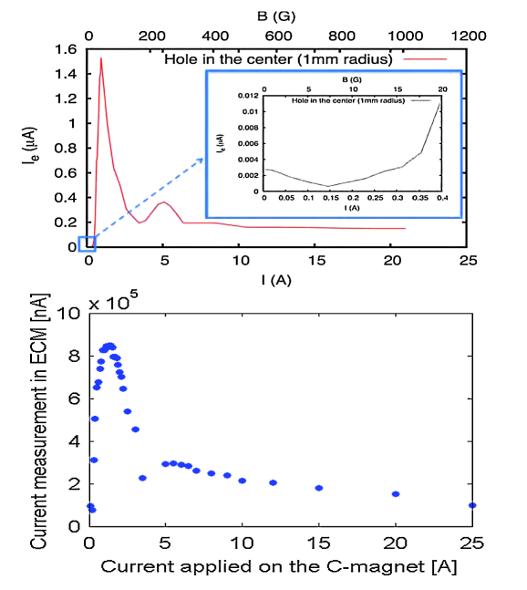
Old data from 2010/2011
https://journals.aps.org/prab/pdf/10.1103/PhysRevSTAB.14.071001

Slide 9
Conclusions
Scanning the B-field on the MDHW magnets works as 10 years ago
Need to have a dedicated cycle with stable beams to produce cleaner data
August 2024 session confirmes e-cloud signal difference between Cu and CuLIPSS but to a lesser extent -> needs some more data analysis, not sure why
Future
Scanning the B-field on the MDHW magnets works during filling cycles LHC all along LHC run 2025
Need to change current in MDHW magnets accumulating data with good statistics for each data point
Counting on stable conditions for each single injection cycle towards LHC during the whole year
Goal would be to develop a model to predict SEY from e-cloud data

