Slide 1
Injector Controller Studies
Continual optimisation of injection in the PSB
F. Huhn, C. Bracco, F. M. Velotti 2025/02/05

Slide 2
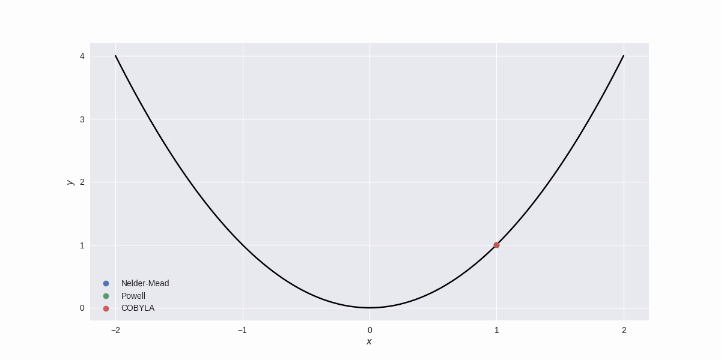


Common problem
Minimise some quantity f, dependent on:
  p, parameters, i.e. things we can change
optimiser ⇨ p_{opt}
  s, state variables, i.e. things we can't change
    e.g.: machine drifts, stray fields
Classical optimisers only handle s = {} or s₀
⇒ Time-varying Bayesian optimisation^{[1]}
[1] Bogunovic et al, 2016 -- https://arxiv.org/abs/1601.06650

Slide 3
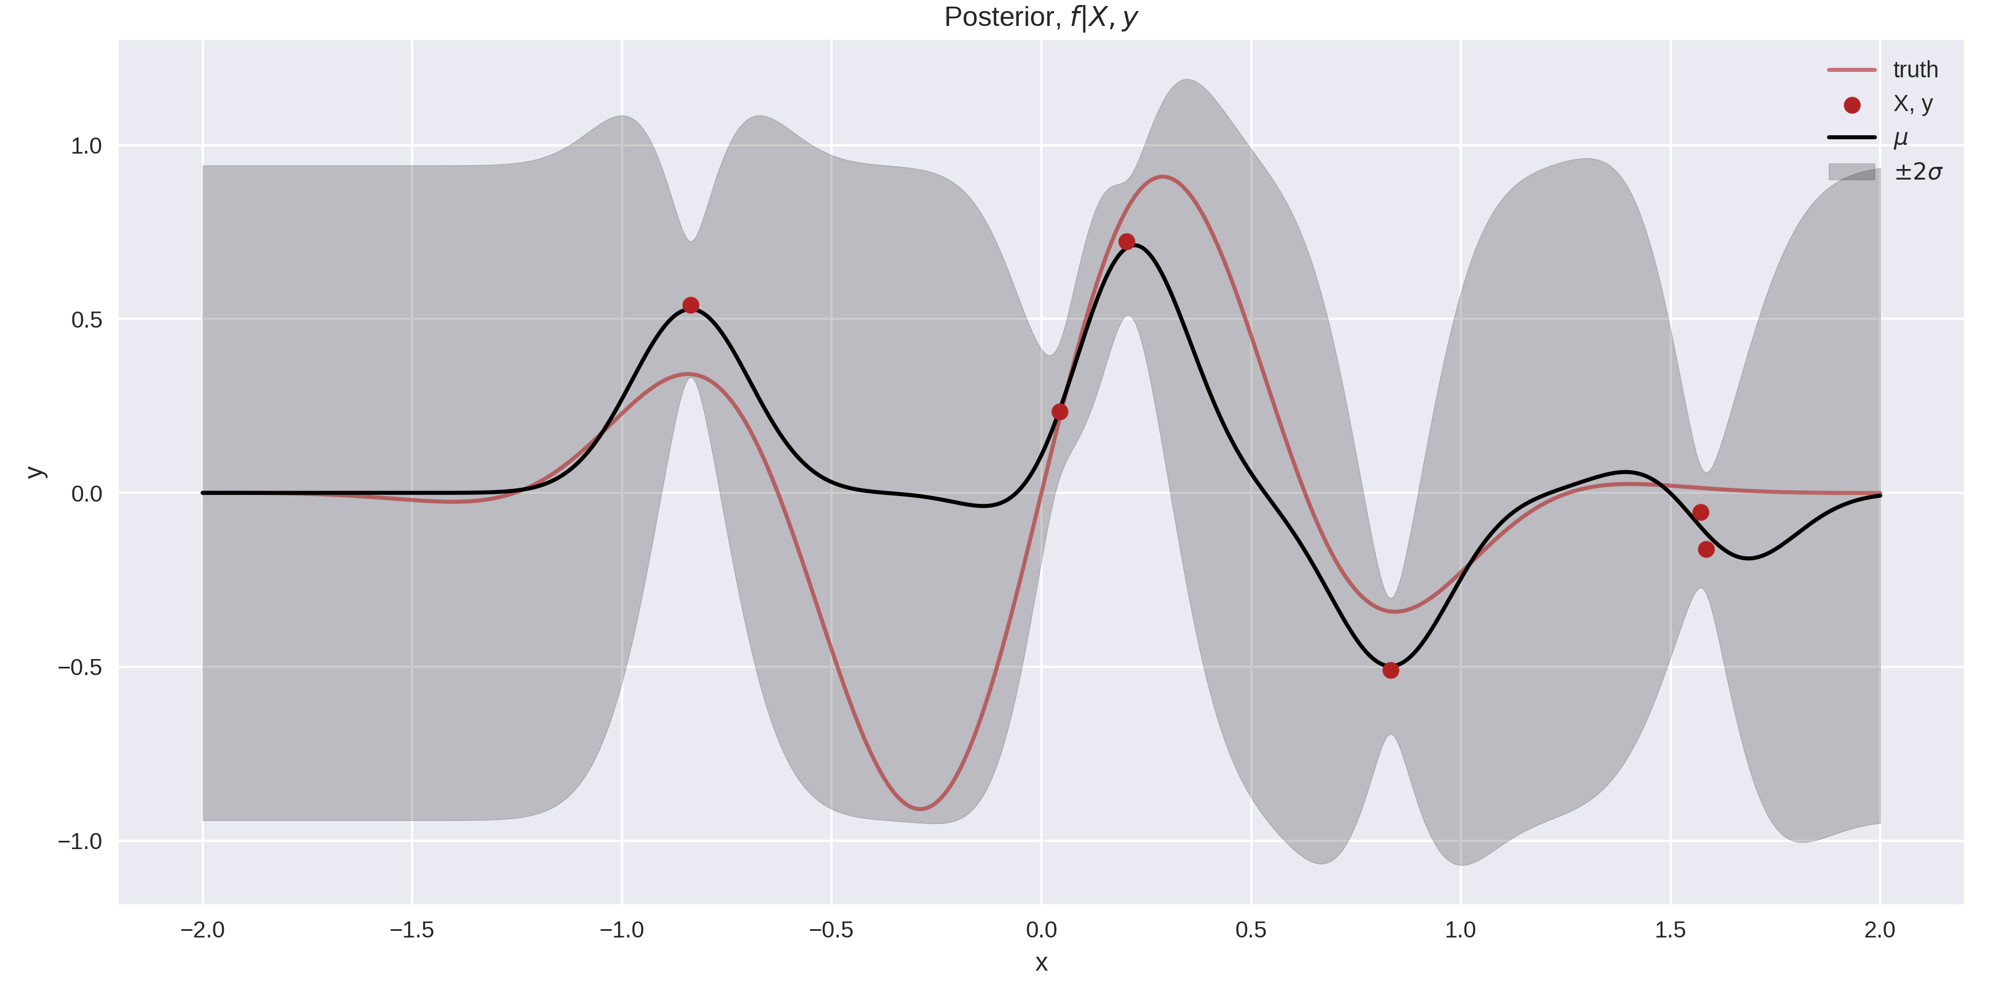
Gaussian process
Probabilistic model:
For any x, we have a mean estimate µ, and uncertainty σ.

Slide 4
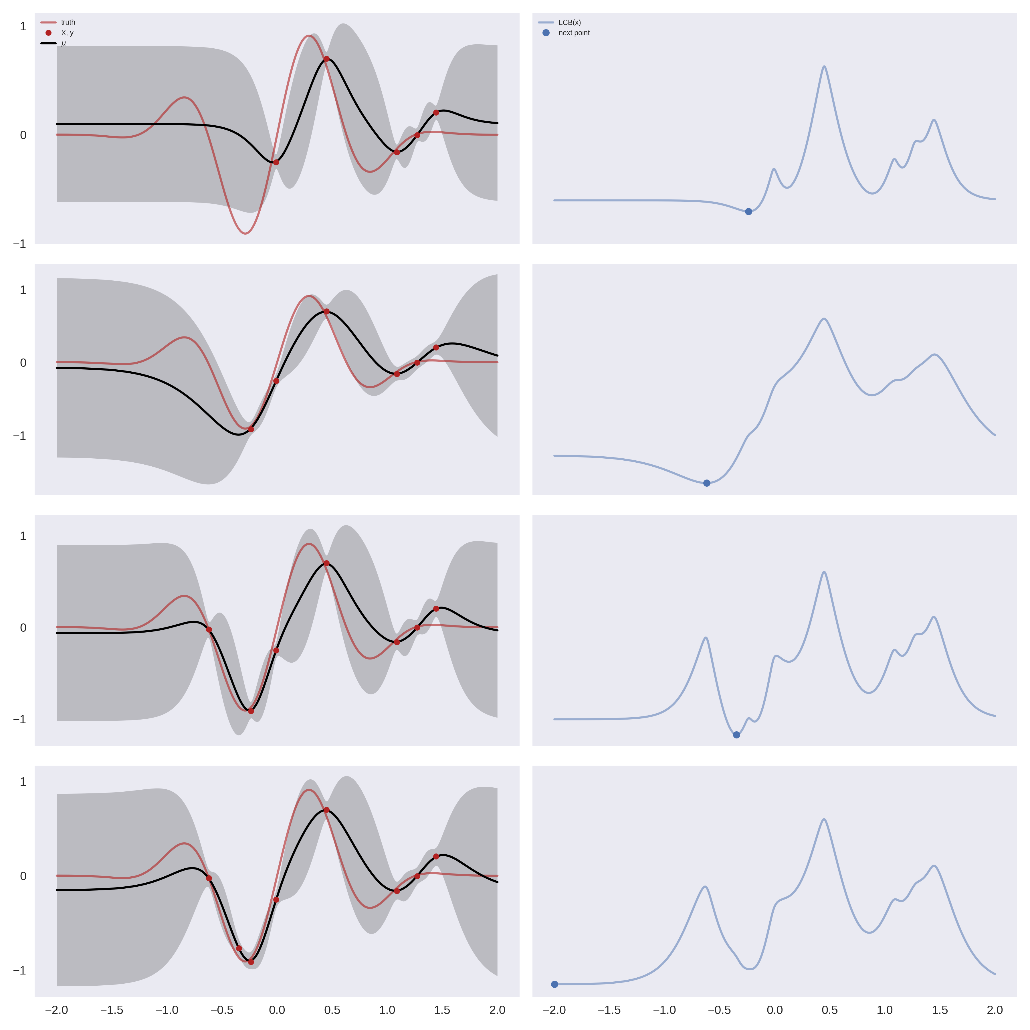
Bayesian optimisation
Procedure
  Pick next point to observe: x
  Get observation: y
  Update posterior: µ, σ
Picking next point
  Acquisition function: combine µ (exploitation) and σ (exploration)
    e.g. LCB(x) = µ(x) - β σ(x)
  Minimum of acquisition function = next point

Slide 5
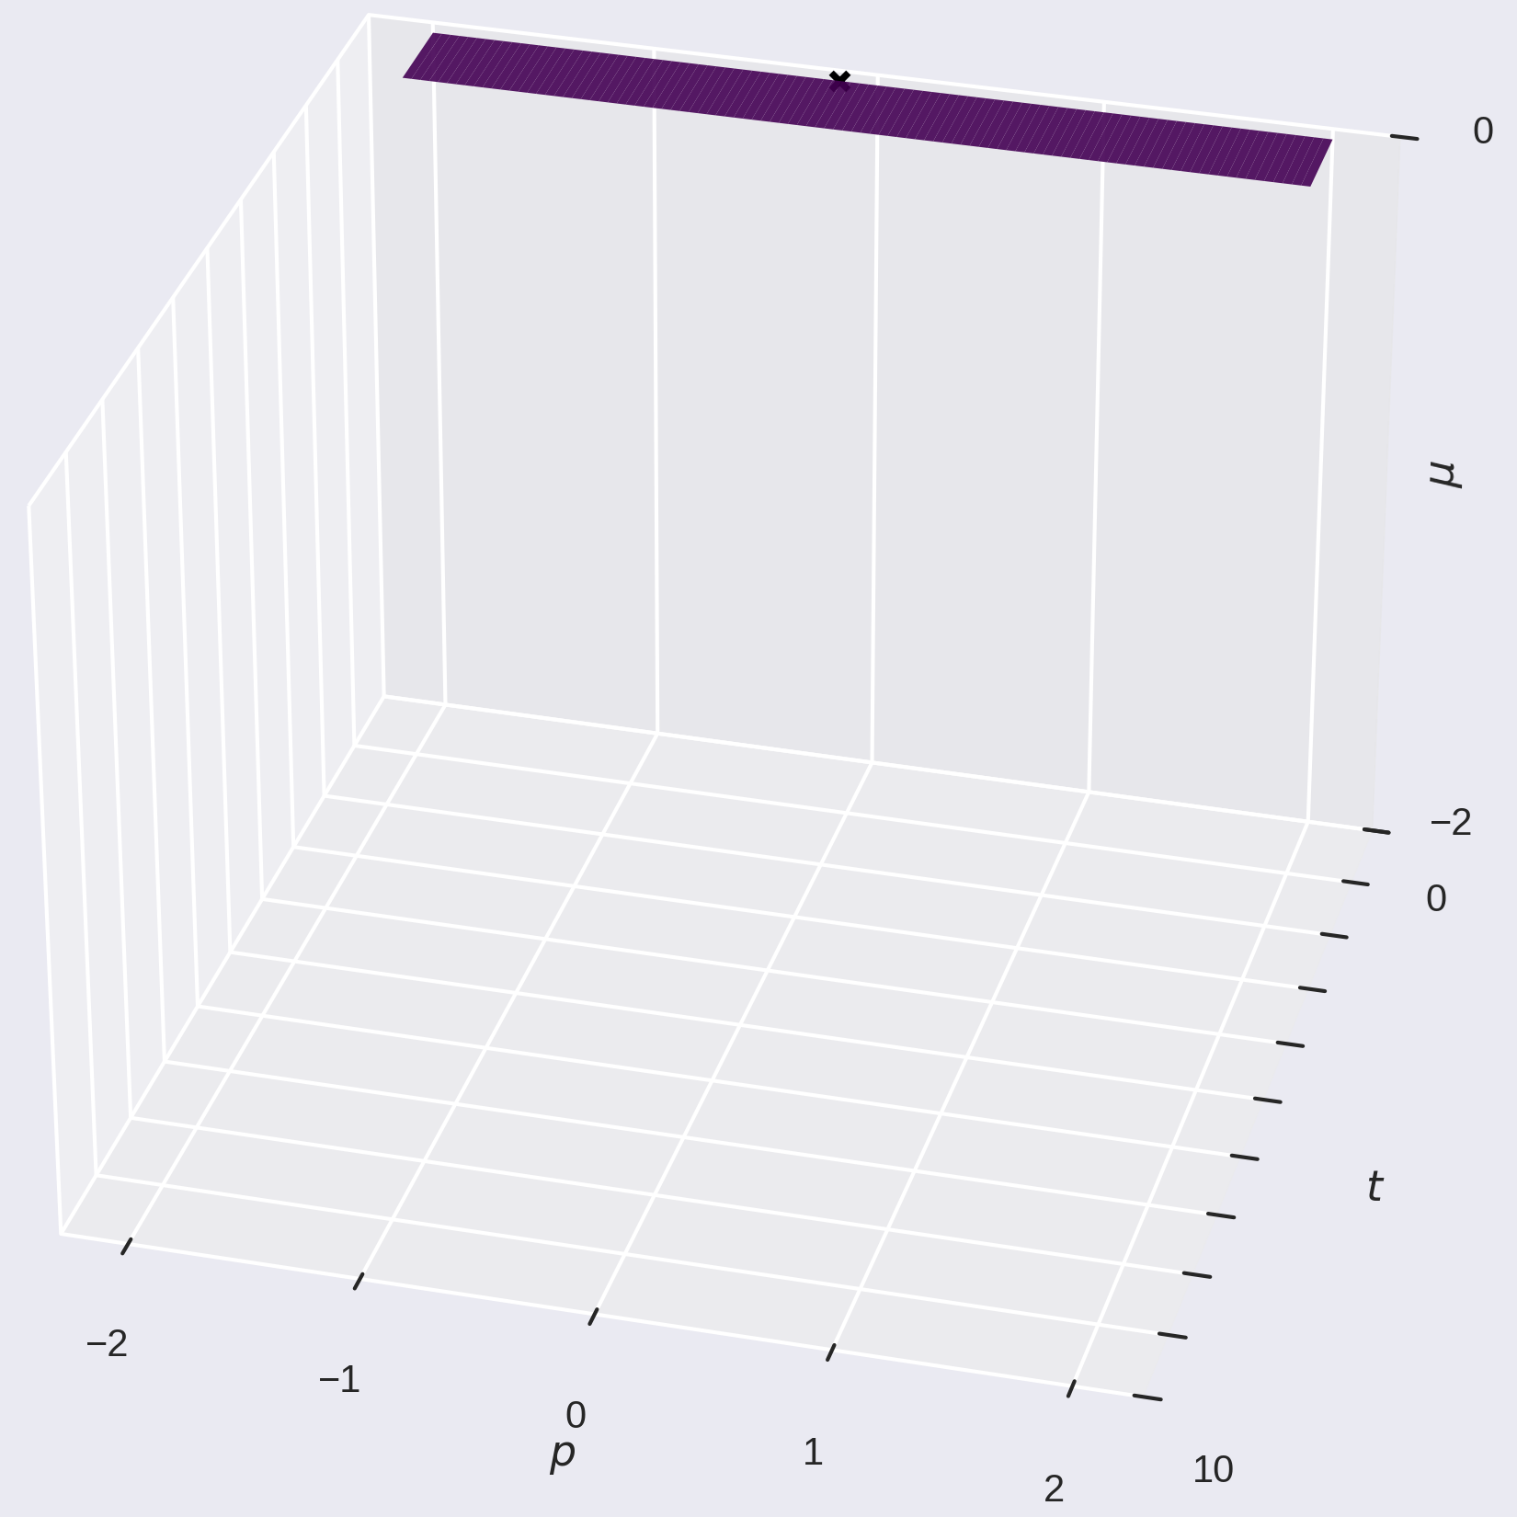
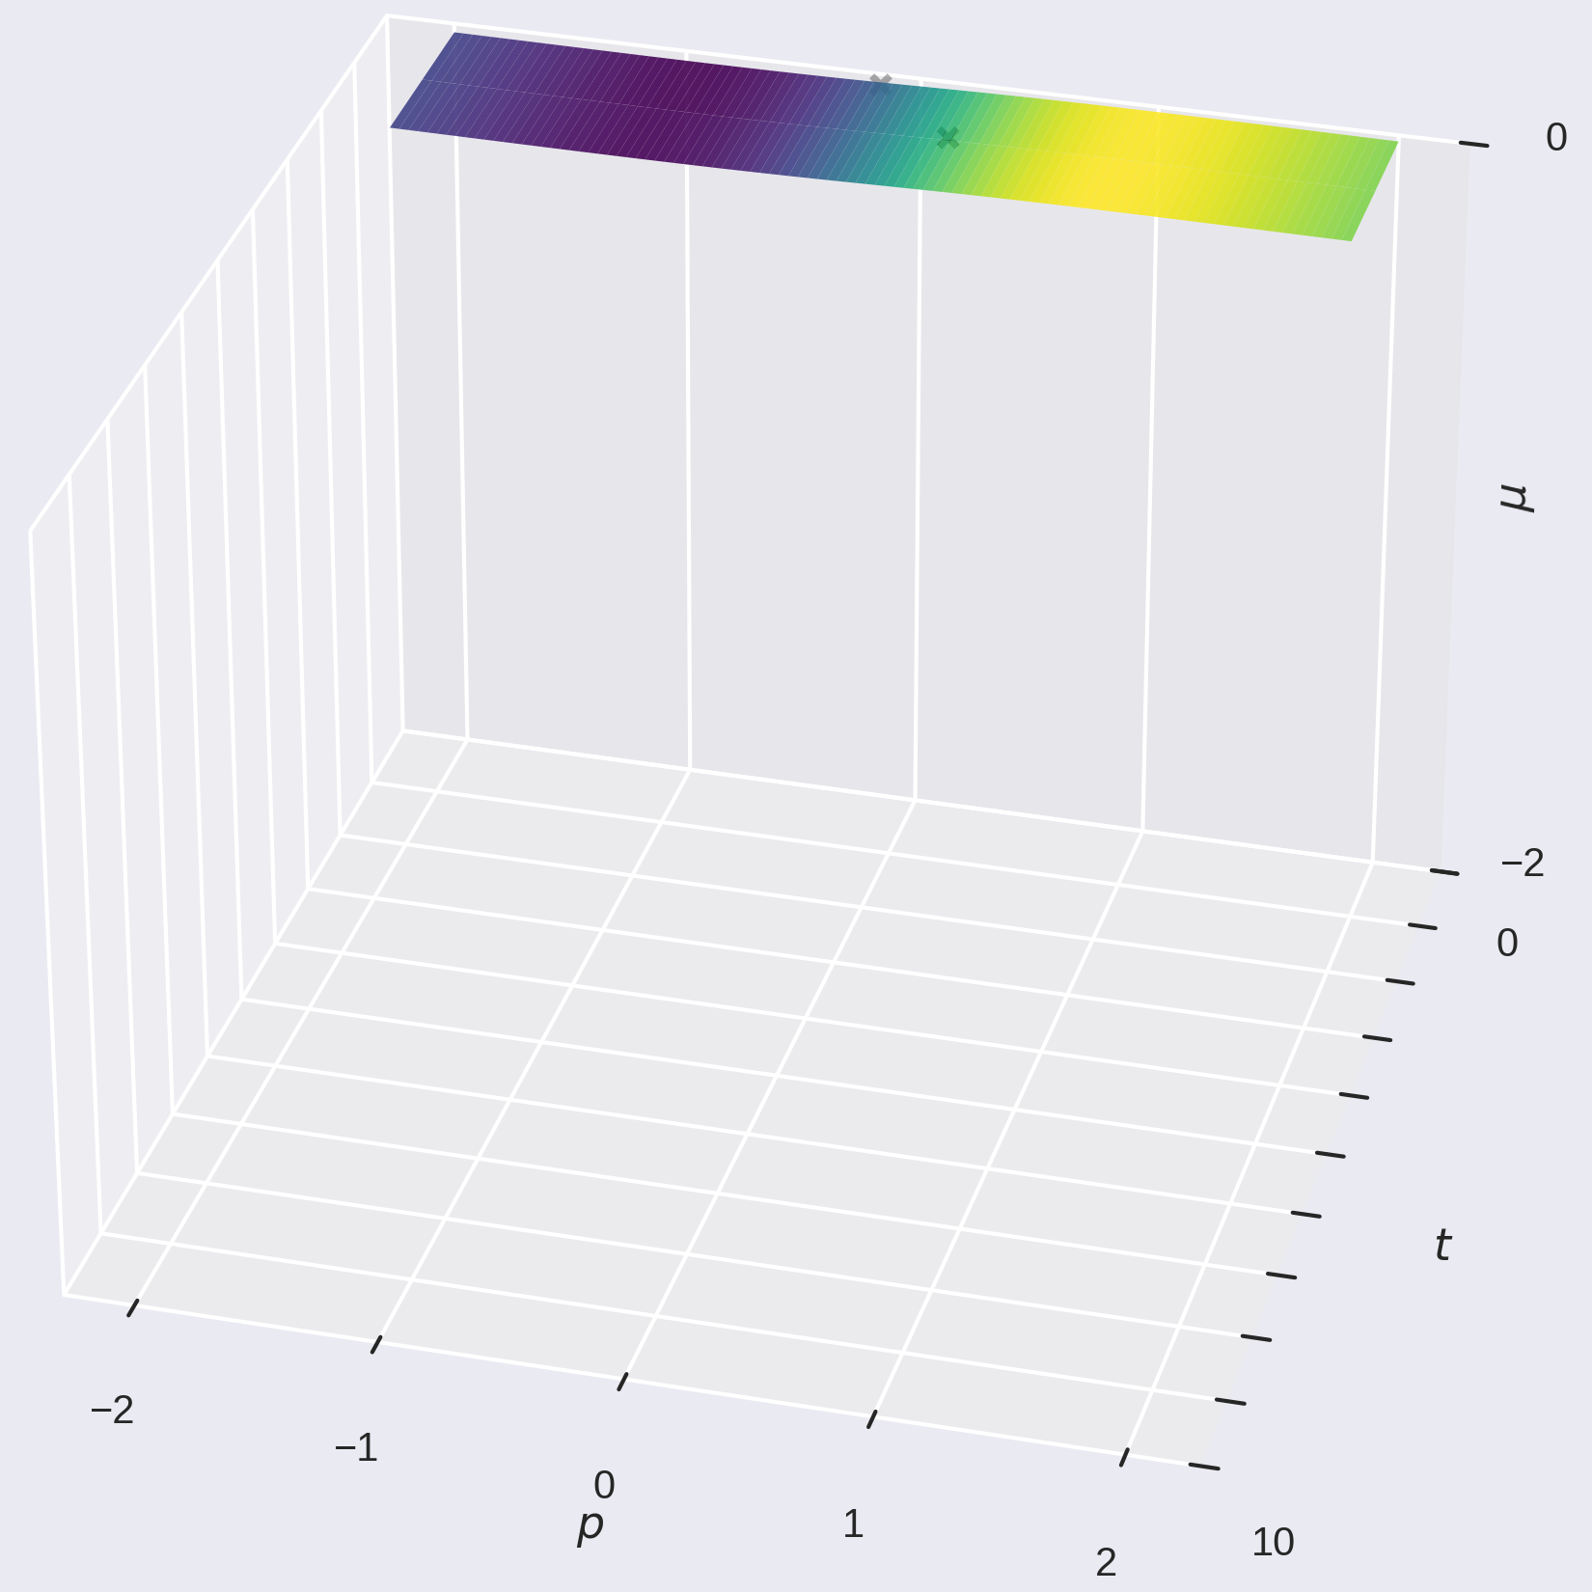
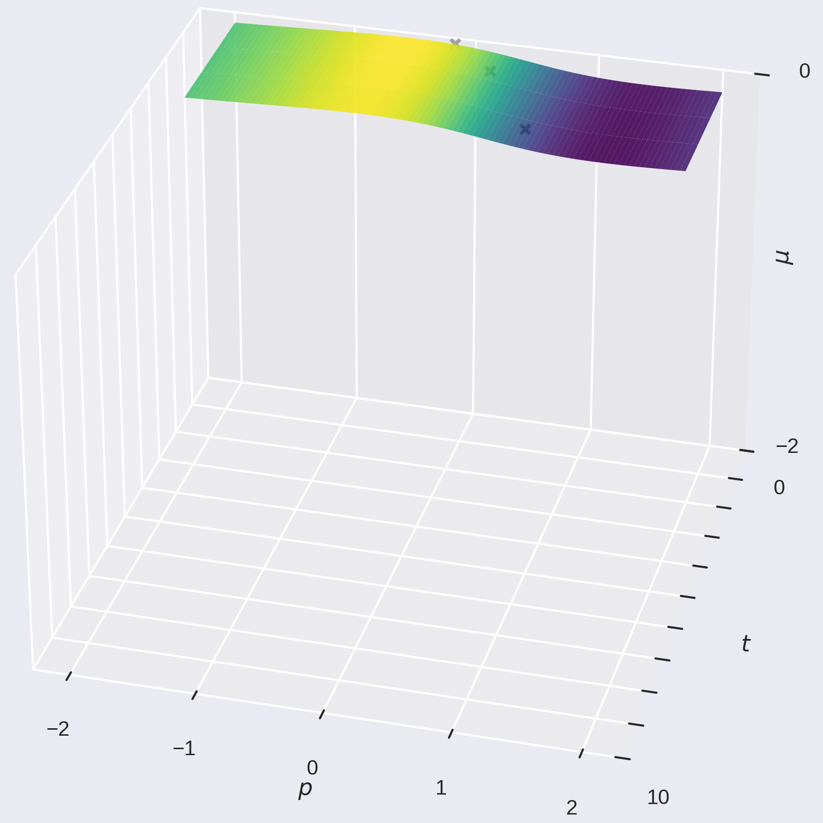
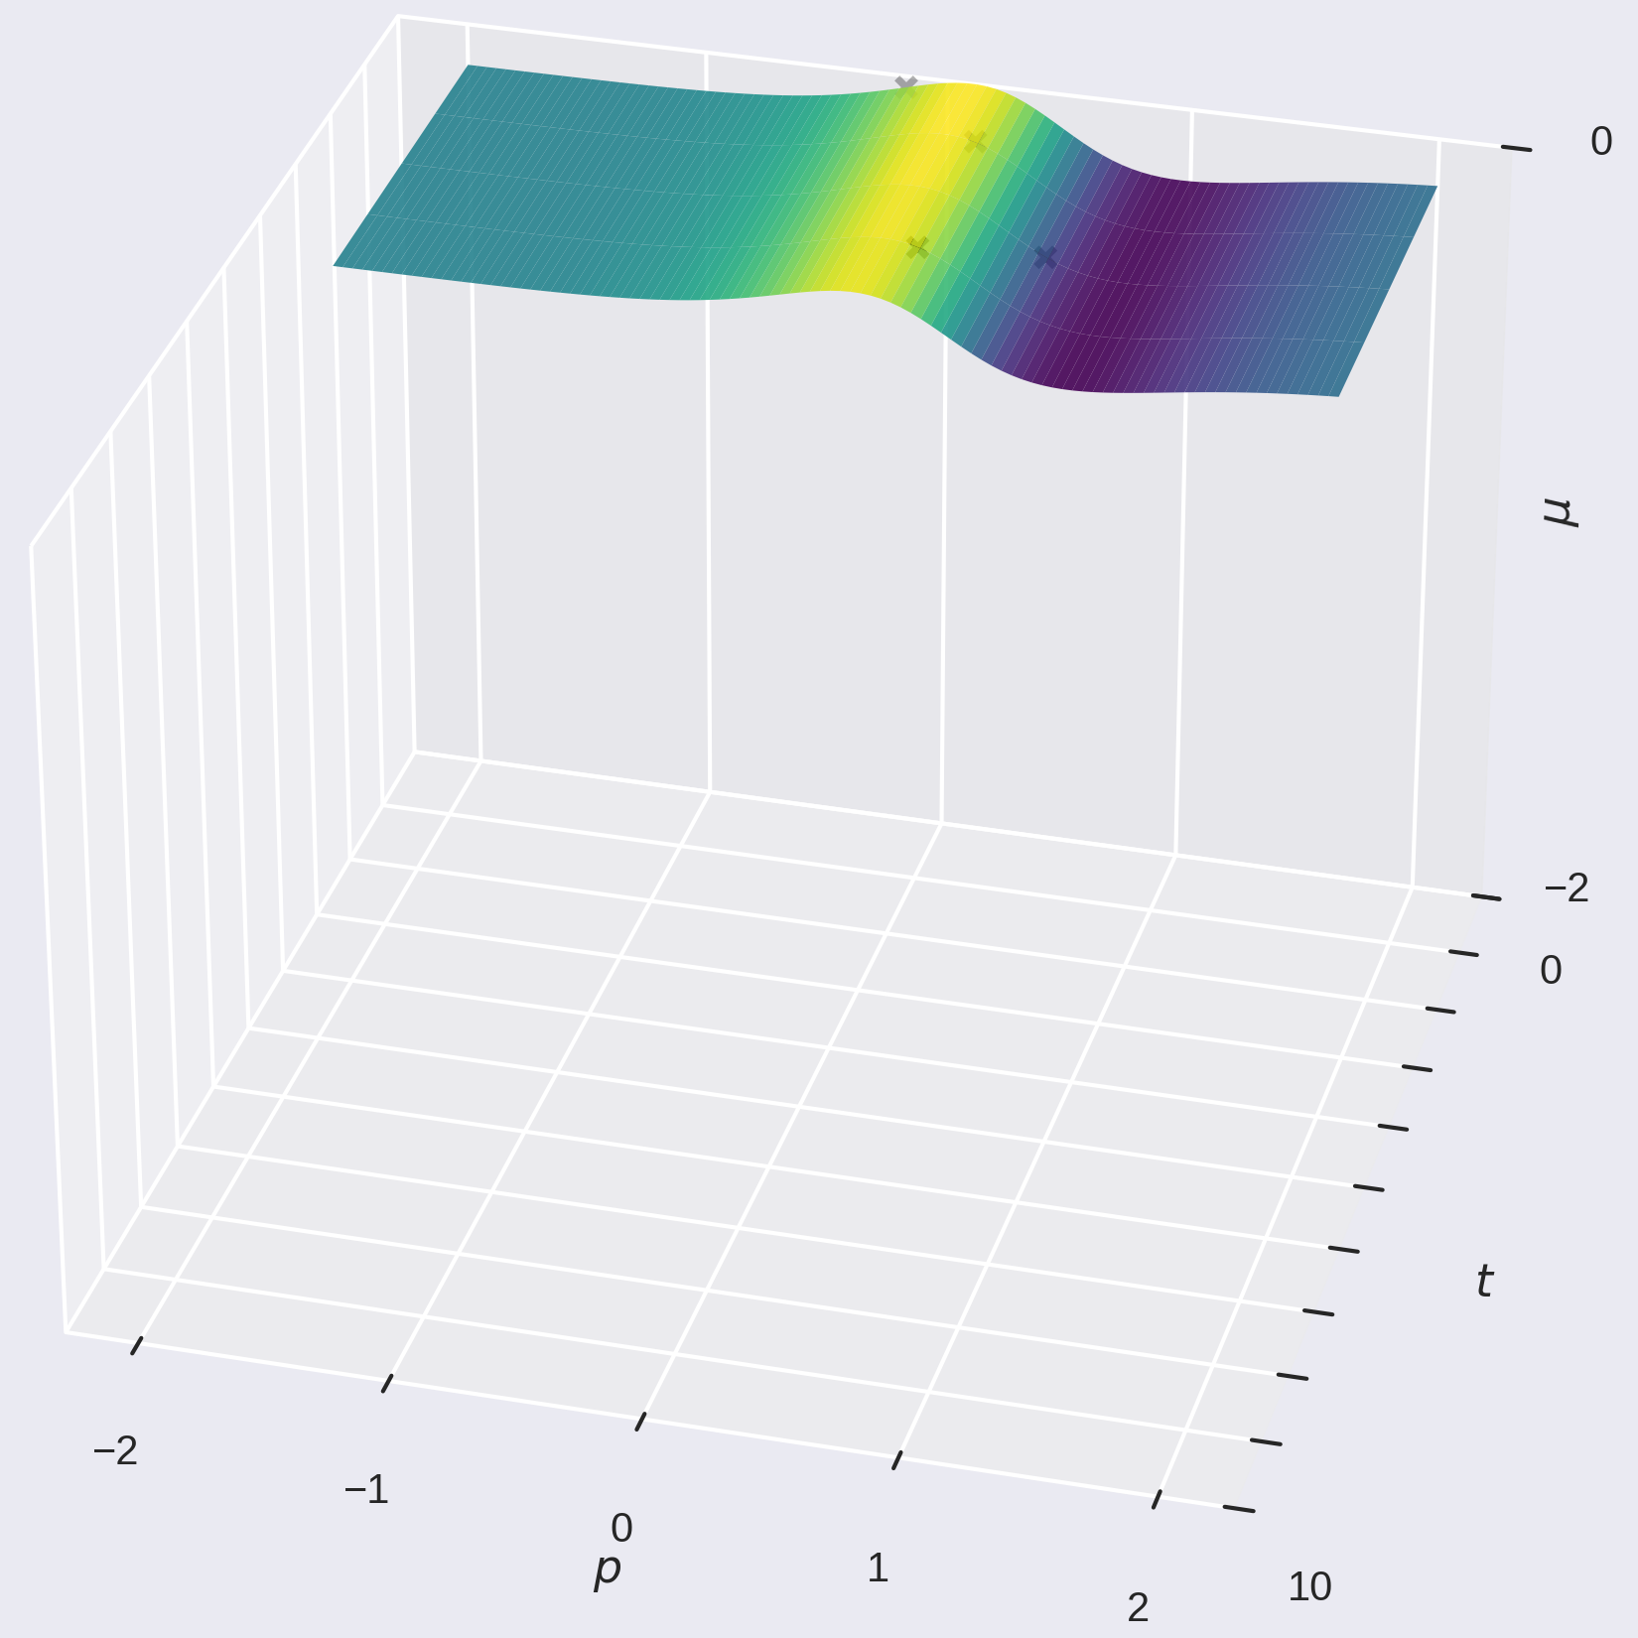
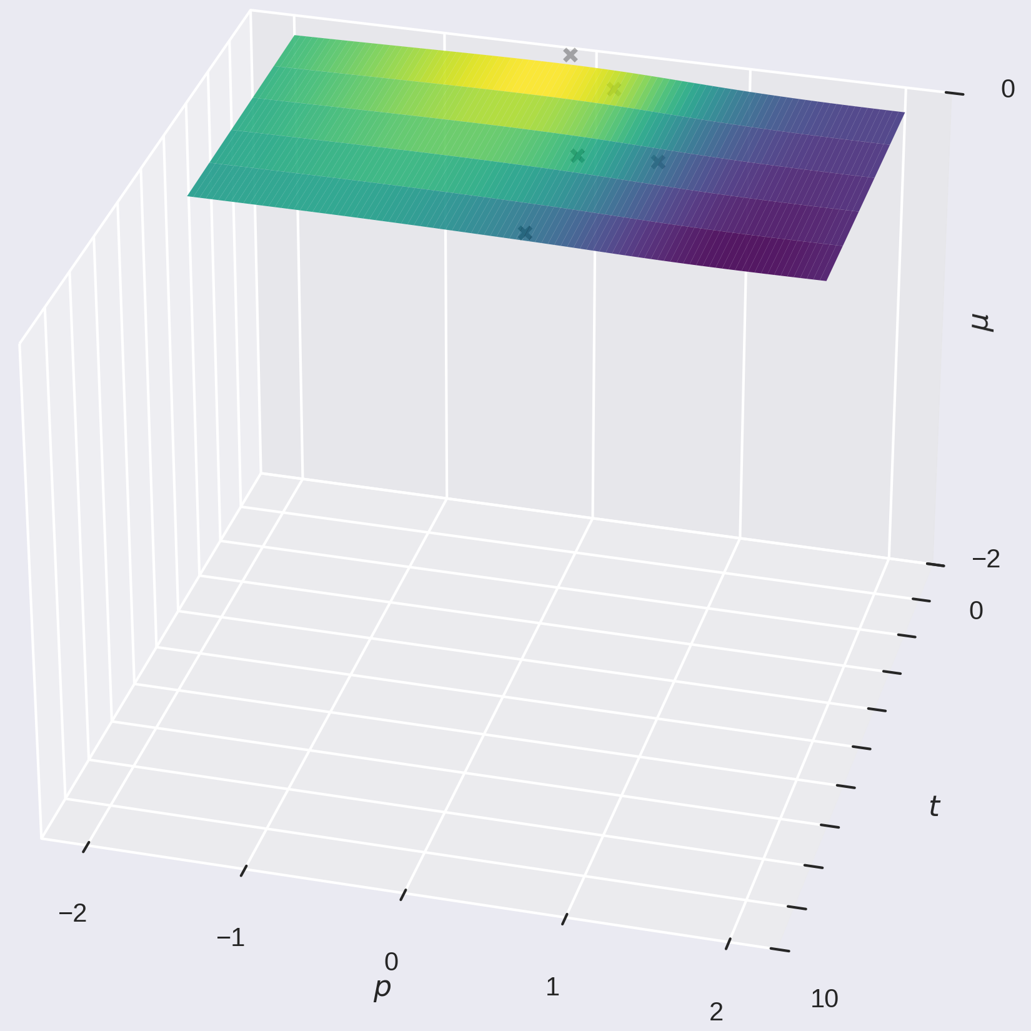
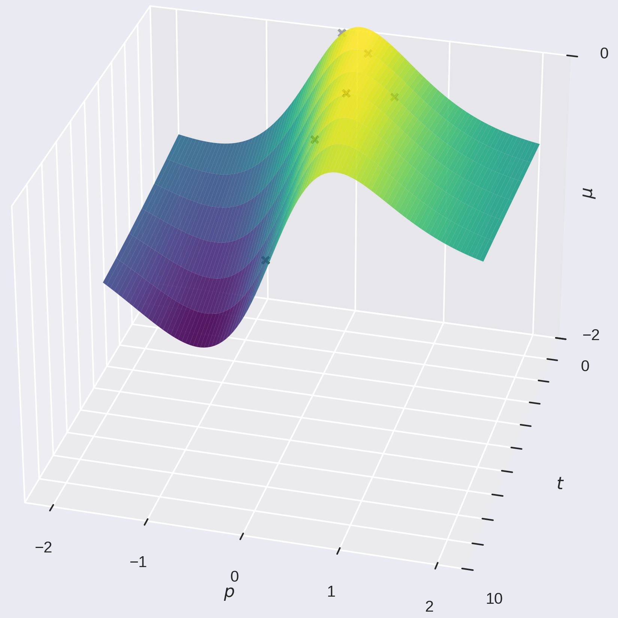
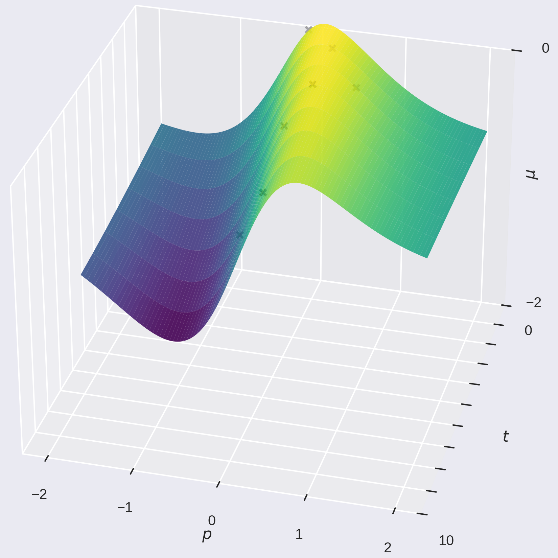
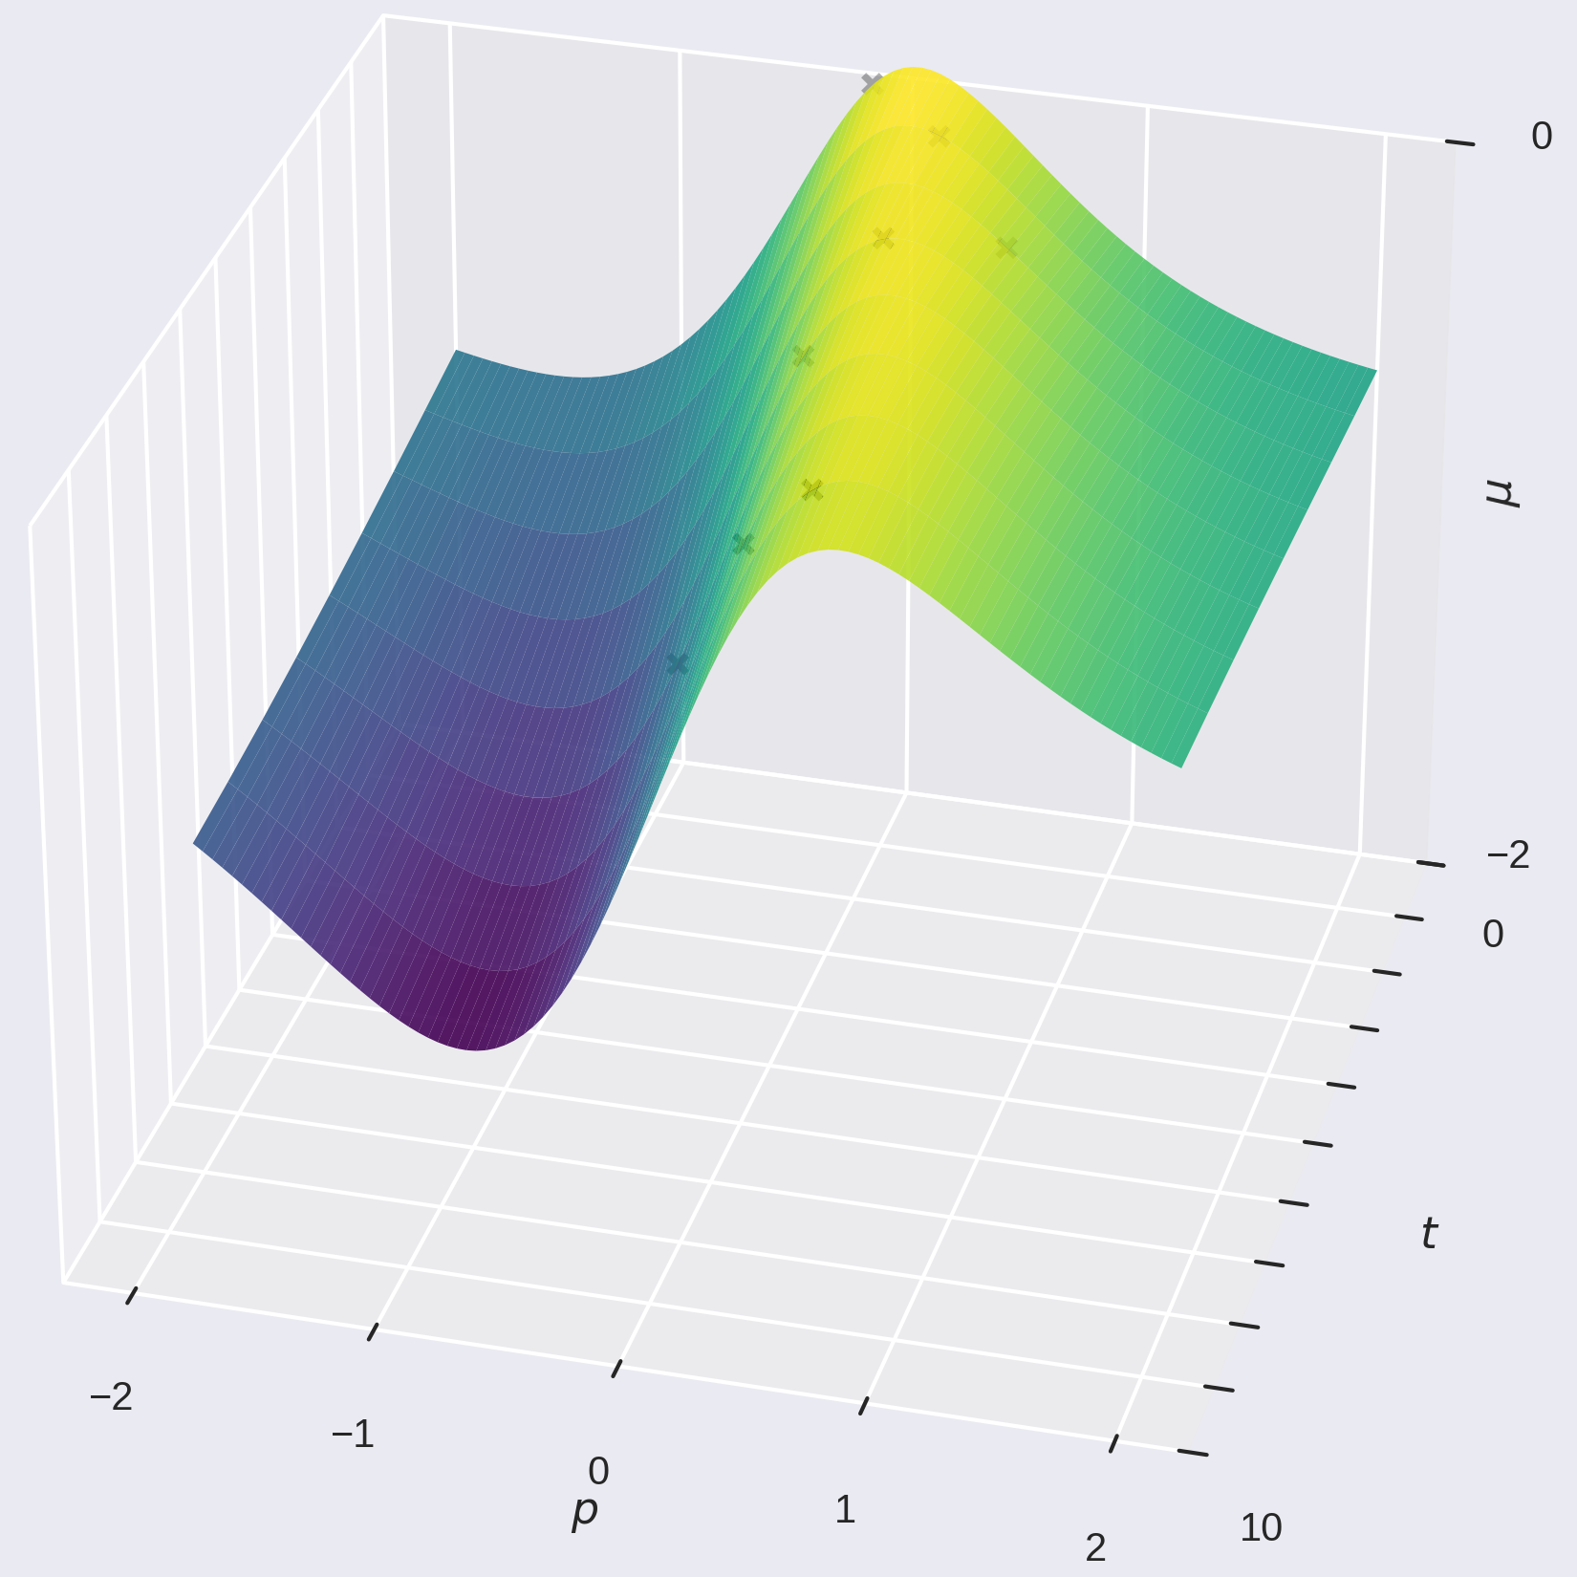
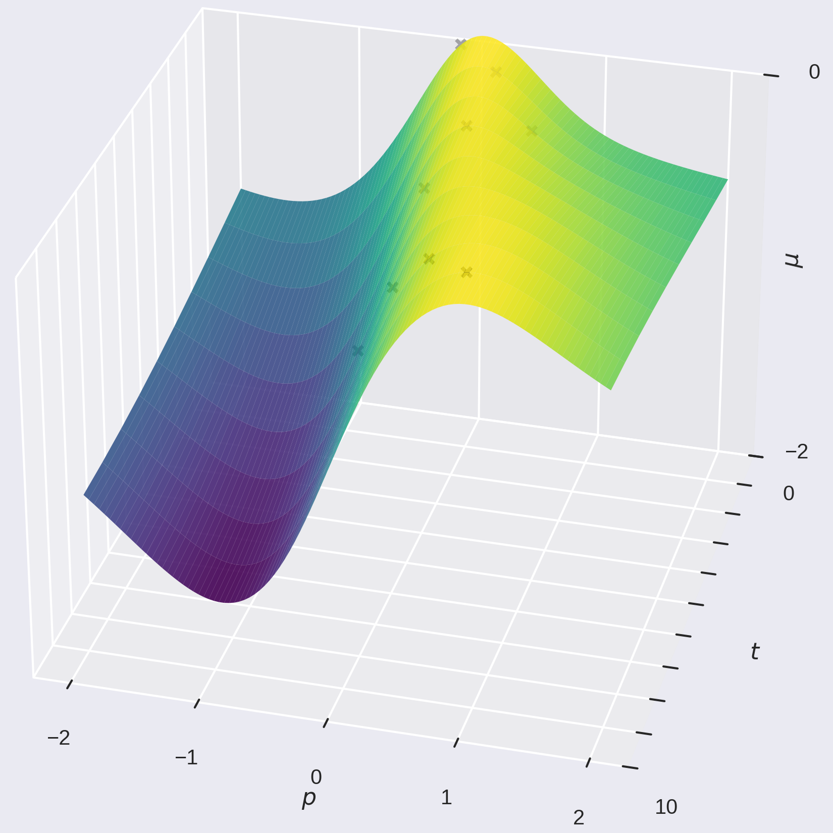
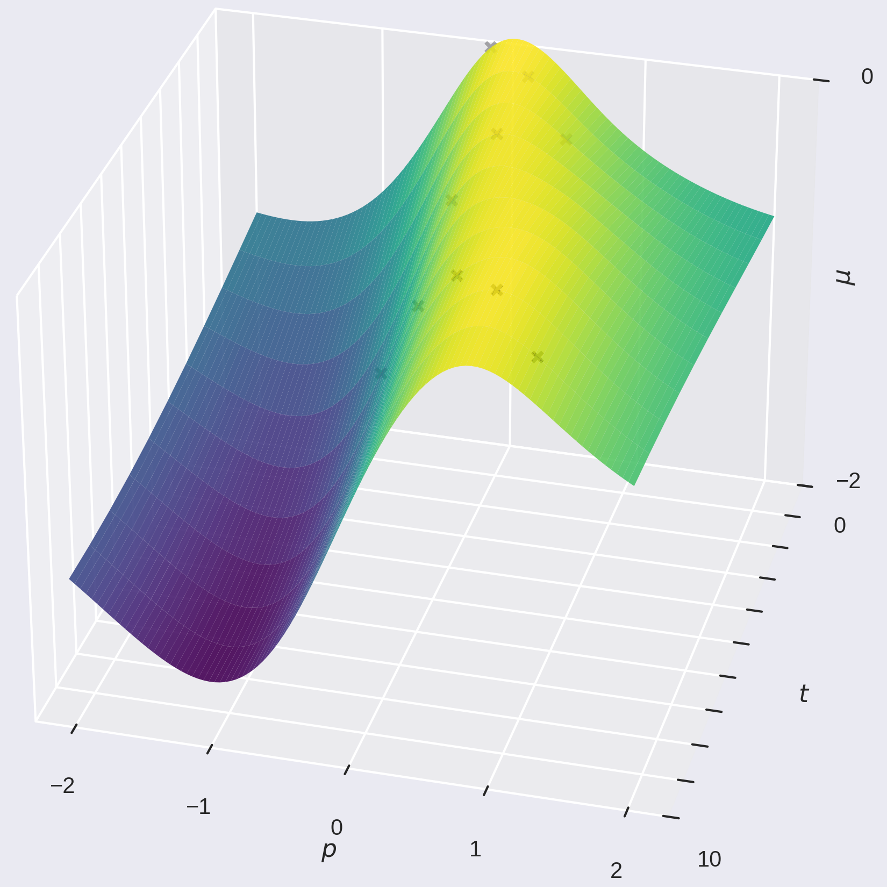
Time-varying Bayesian optimisation
In addition to the parameters p, we add time, t, as a variable of the GP.
  t is a proxy for the state s.
Choose next point with t fixed to the next time (e.g. cycle timestamp).
Avoiding large changes in parameters:
  Proximal biasing
  Proximal constraining
biasing
constraining

Slide 6
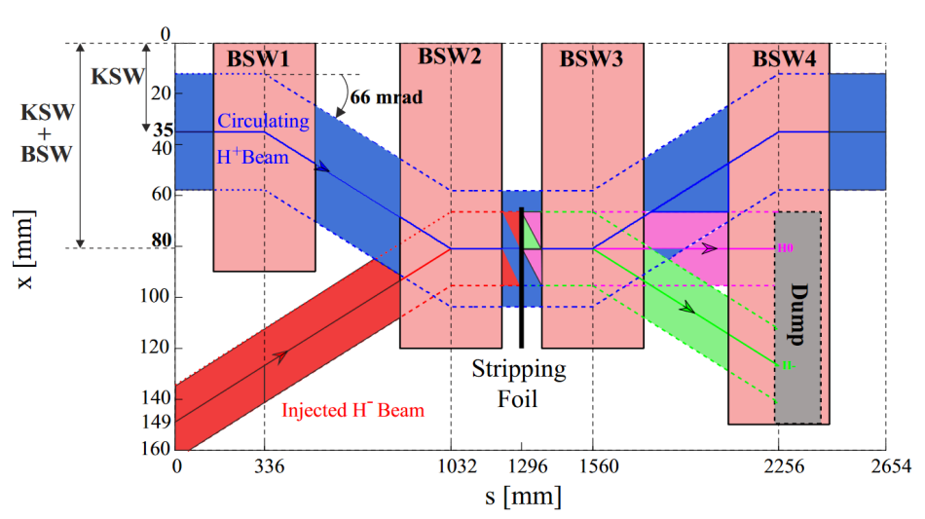
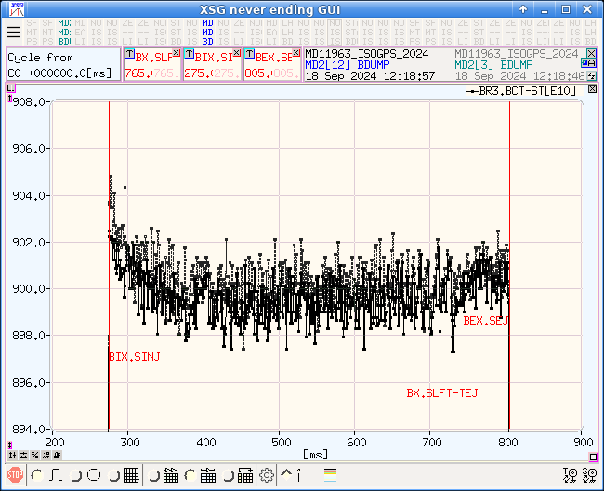
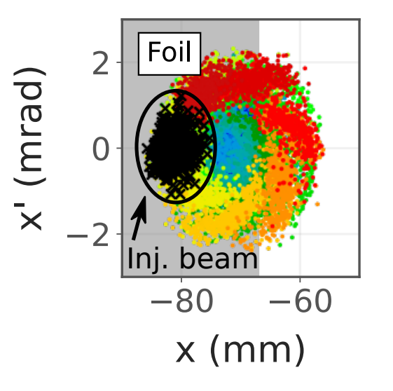
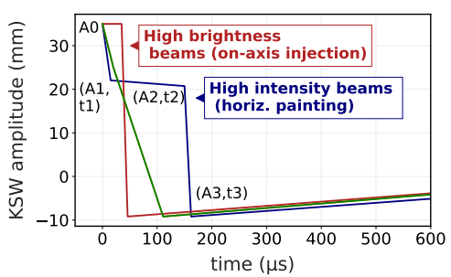
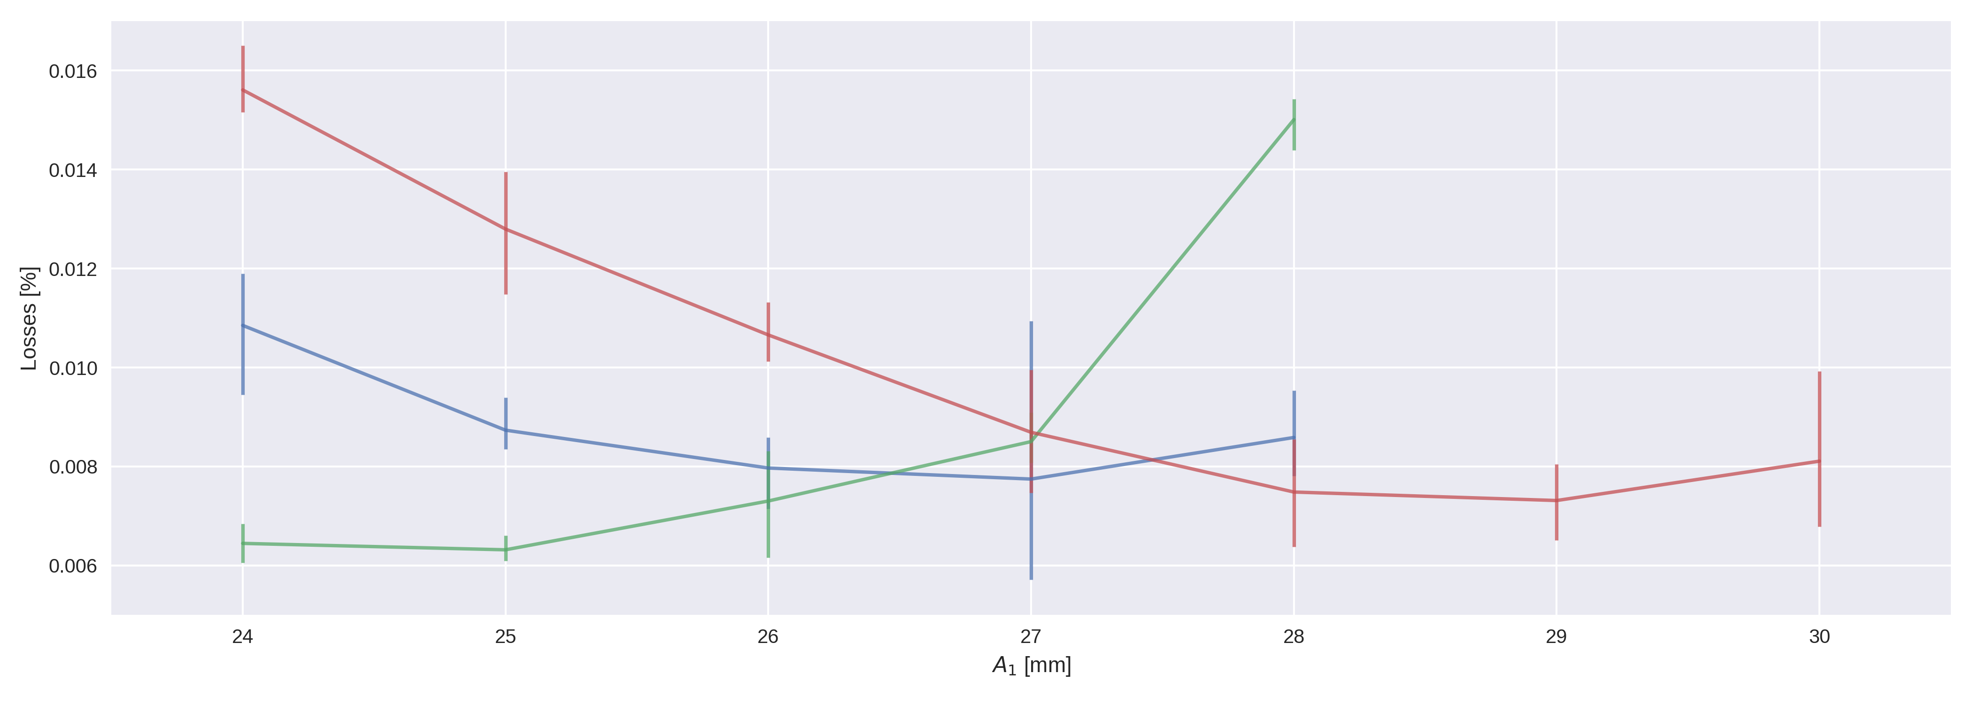
PSB Transverse Painting
[2] Renner, 2022 https://cds.cern.ch/record/2843059m
LN4 injects H⁻, which pass through a stripping foil, resulting in H⁺, H⁰, H⁻.
Space-charge losses
  Minimise by sweeping the injected beam horizontally (painting) with the KSW.
Match injection location with closed orbit (orthogonal steering vs KSW bump)

Slide 7
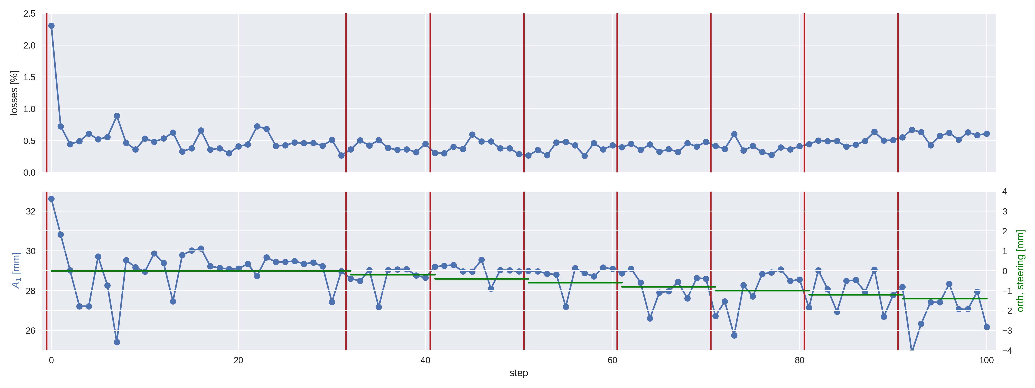
Results – drift

Slide 8
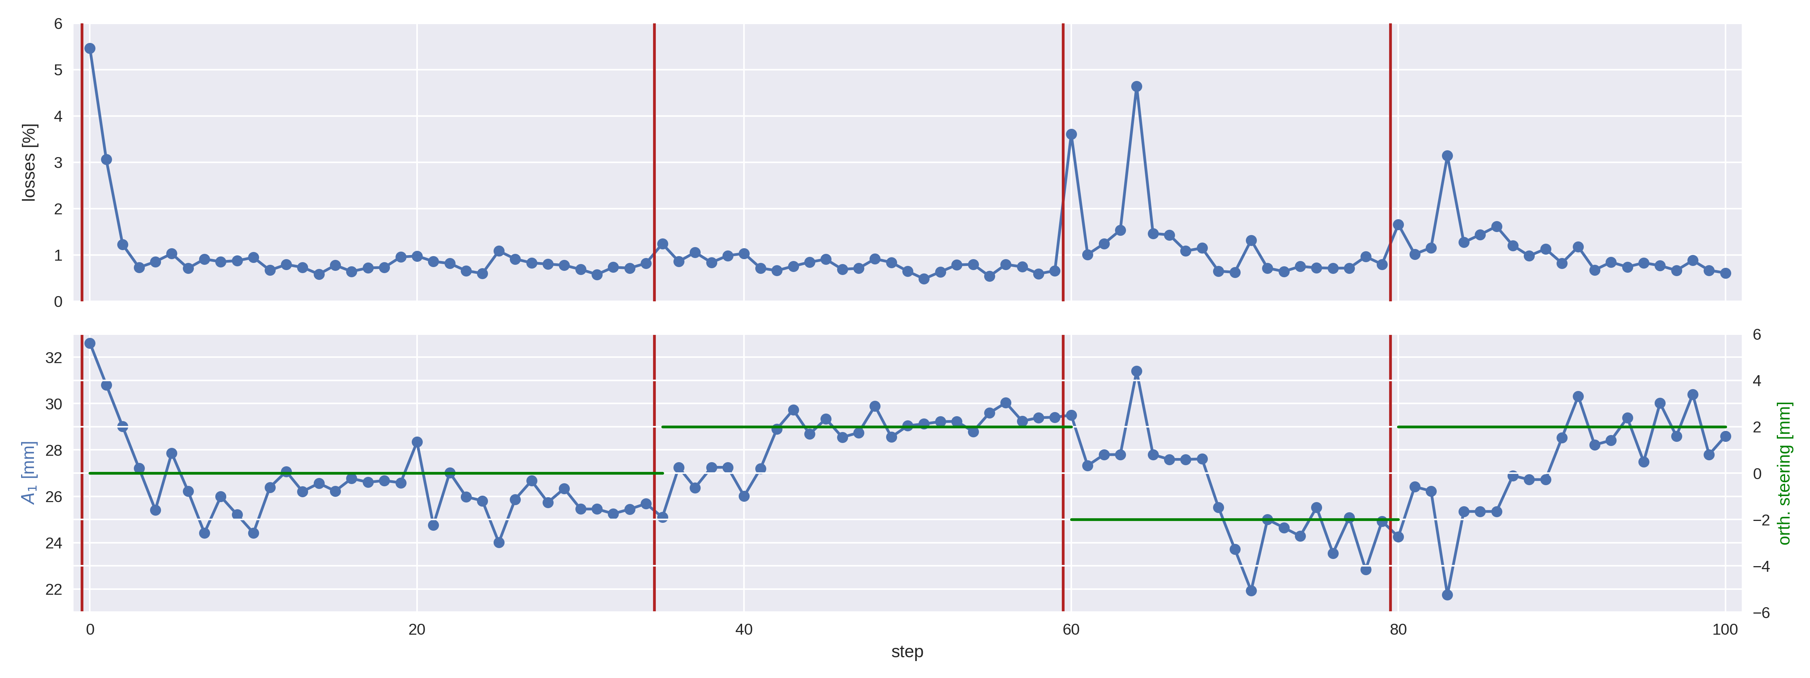
Results – jumps

Slide 9
Conclusion & Future
Conclusion
Future
TVBO successfully optimises objective vs slow and fast time-variations in state
UCAP device and acc-geoff4ucap agent developed
TVBO available as another optimiser that can be readily used by others
TVBO running continually via acc-geoff4ucap
Fully configurable and supervised by OP/experts, e.g. via LSA settings
Test acc-geoff4ucap on long MD (days, perhaps weeks)

Slide 11
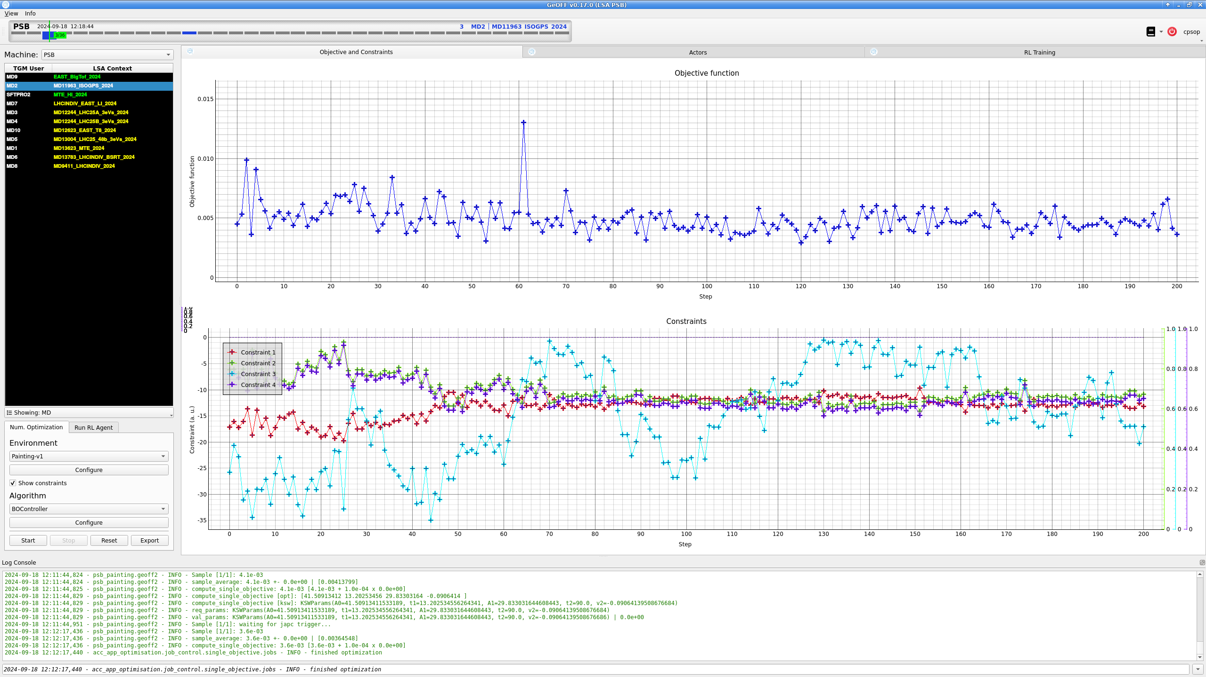
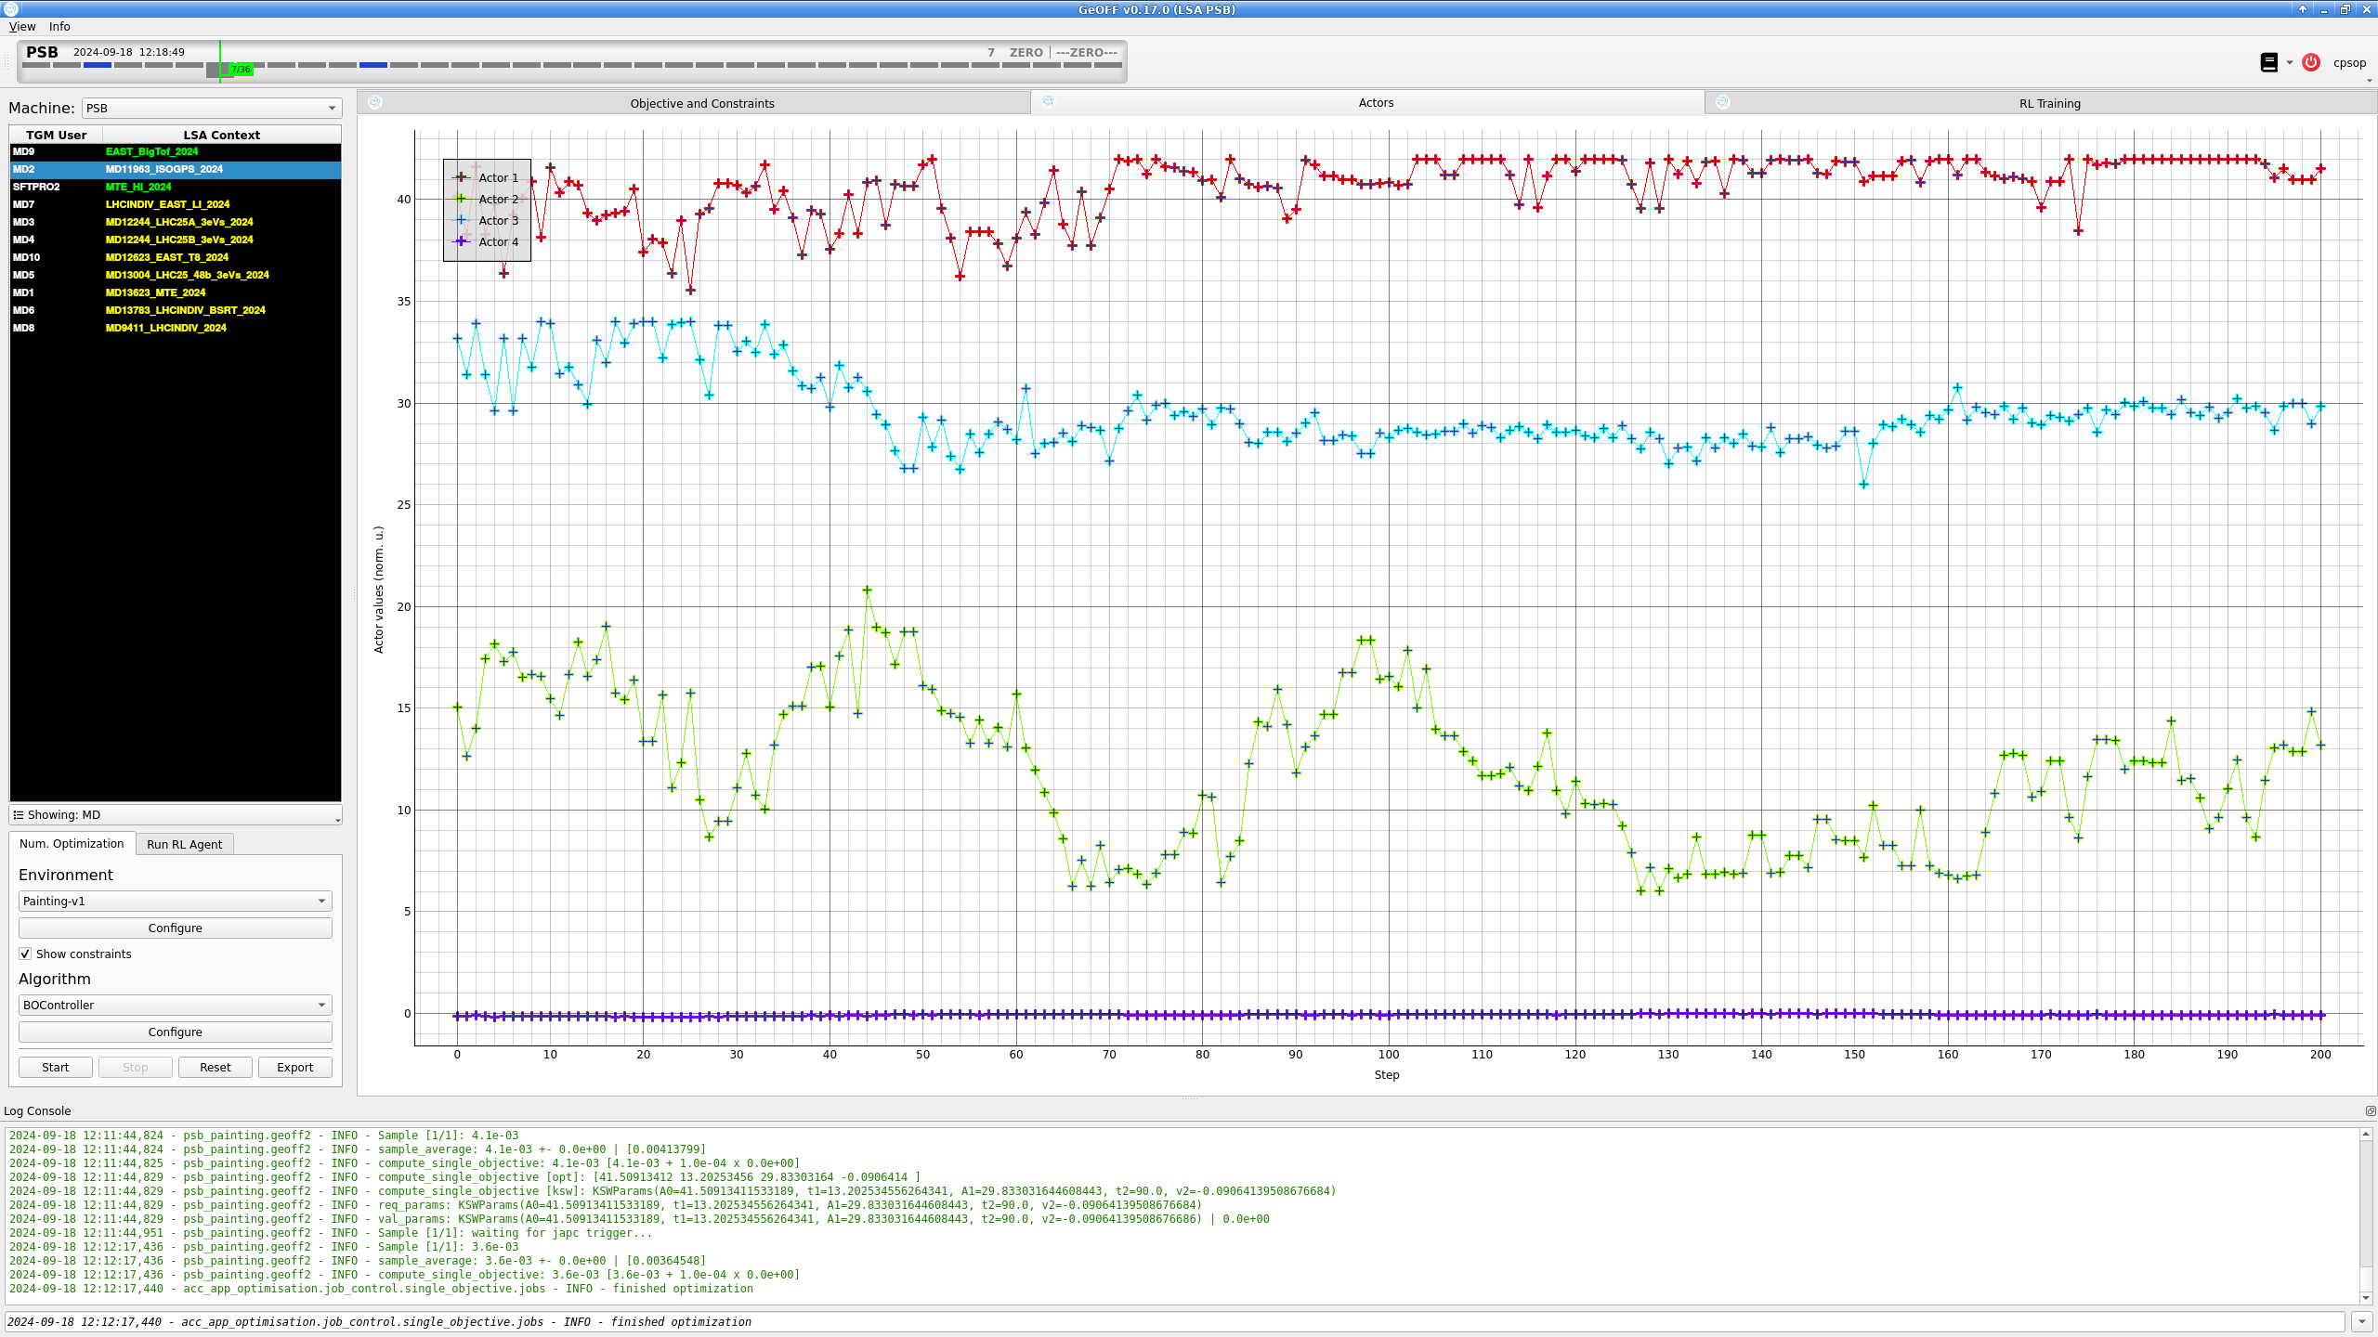
Results – multiple parameters

