Slide 2
WS and SEM-grid study of beamtails
M. Remta
Many thanks to the OP-Team for the support!

Slide 3
Goals
Compare measurements of beamtails between SEM-Grids and Wirescanners.
Explore super-resolution of tails by increasing gains of the grids.

Slide 4
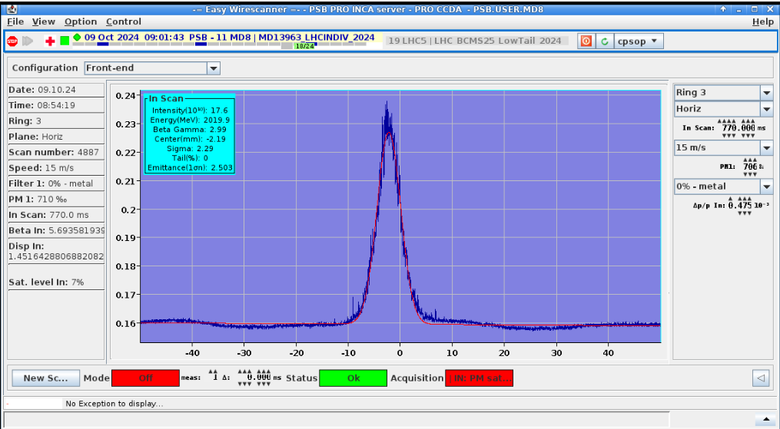
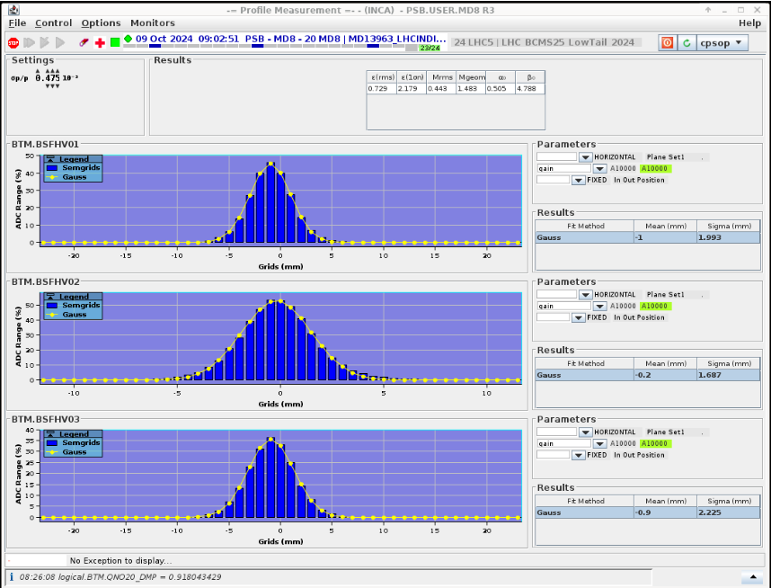
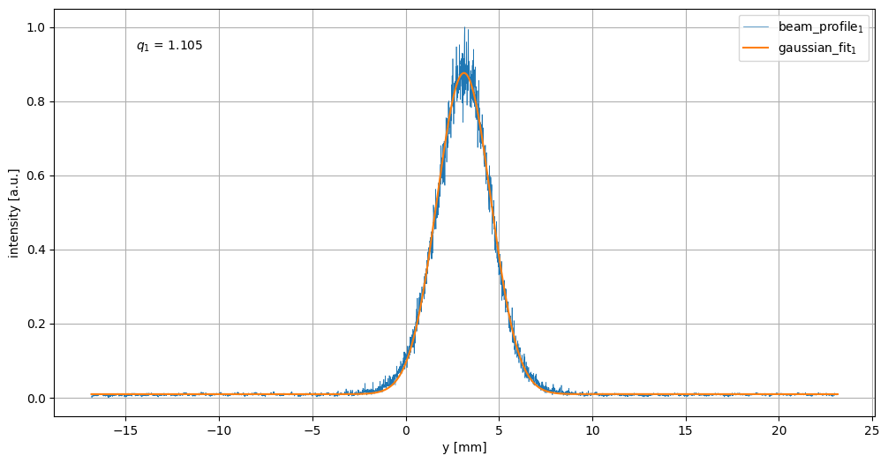
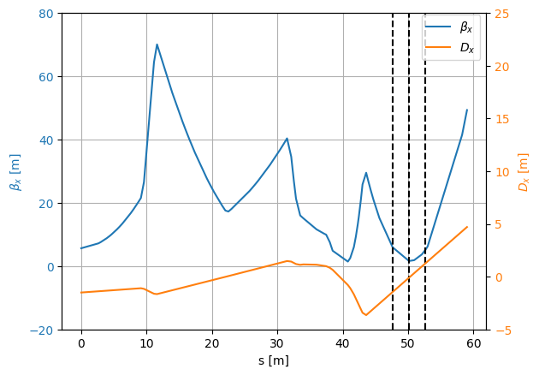
Introduction
Wirescanner
Secondary-Emission-Grids (SEM)

Slide 5
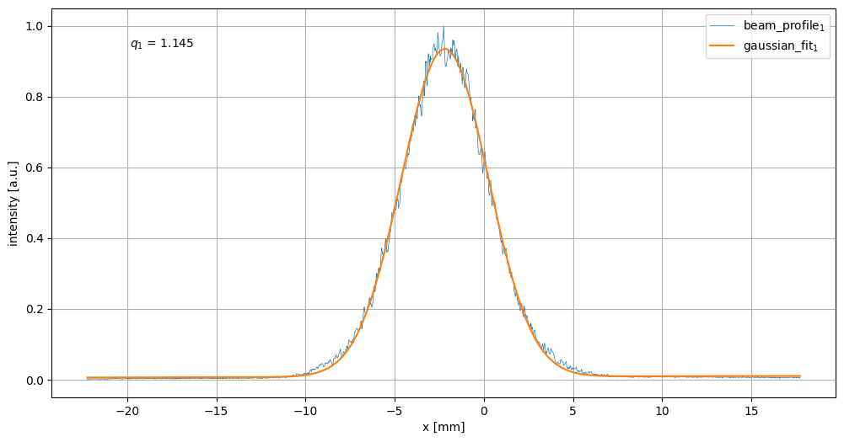
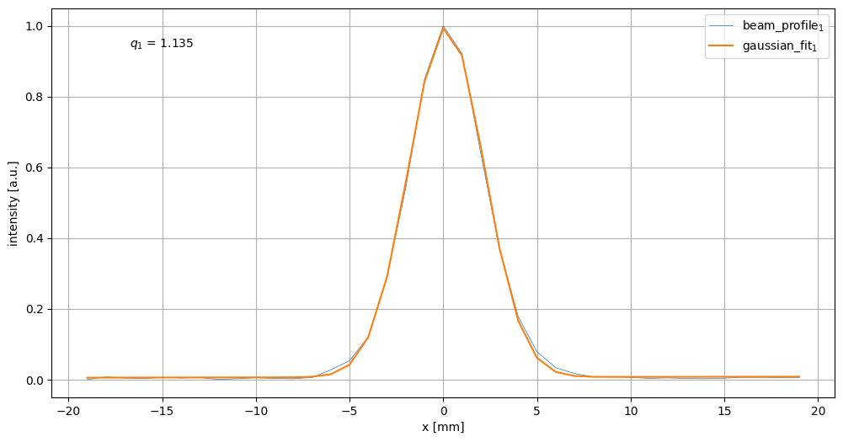
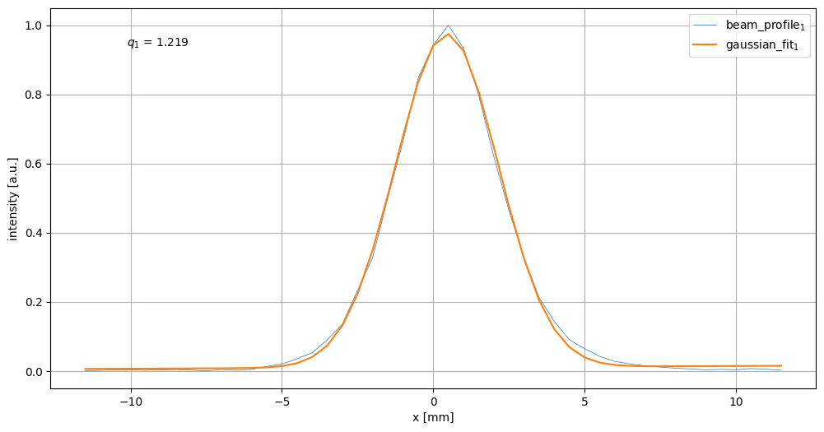
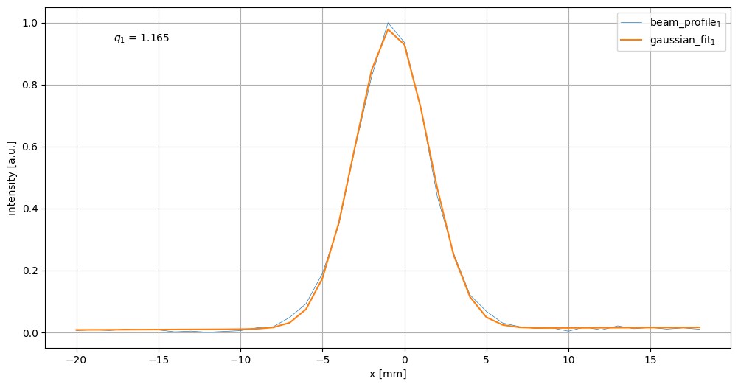
WS vs SEM: q-Gaussian fit
BTM.BSFHV01 BTM.BSFHV02 BTM.BSFHV03

Slide 6
Methods
Baseline: Wirescanner measurements
Two consecutive SEM-grid measurements:
  Highest possible gain without oversaturation.
  Increase gain by one step, oversaturating the grid at the beam core.
  Fit measurements together

Slide 7
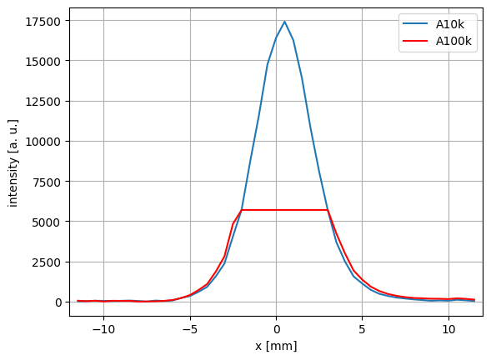
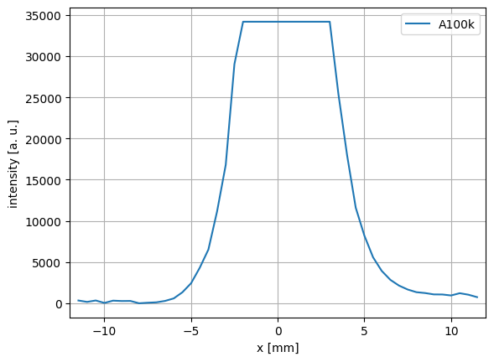
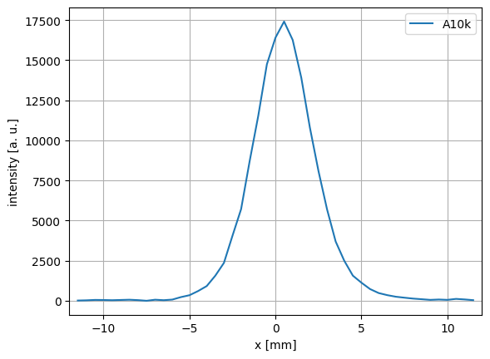
Fitting method

Slide 8
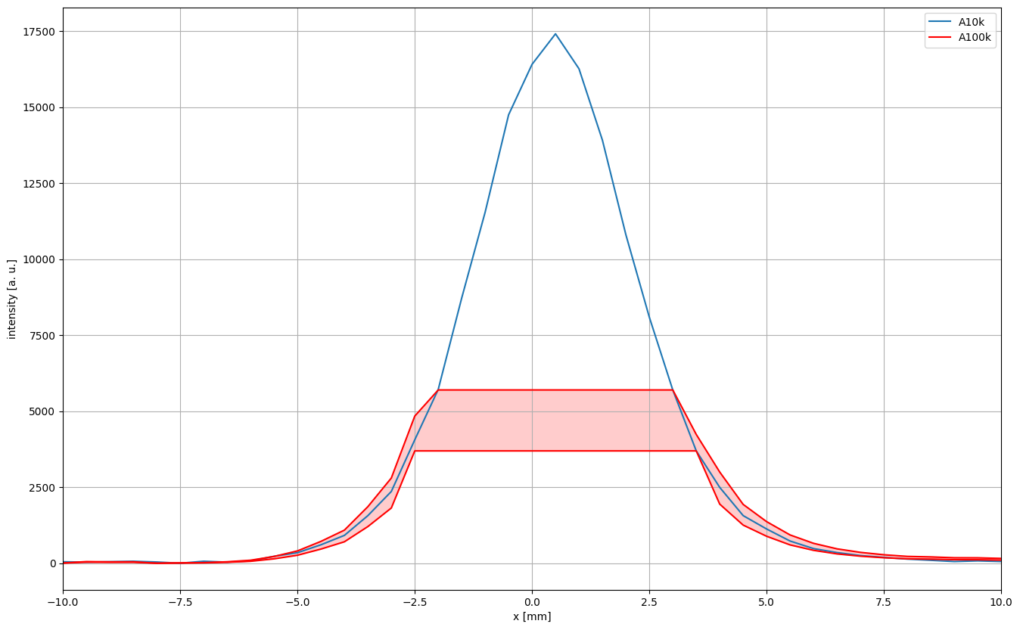
Uncertainty in grid measurements
Spacing between wires is 0.5 mm (central grid) or 1 mm (other)

Slide 9
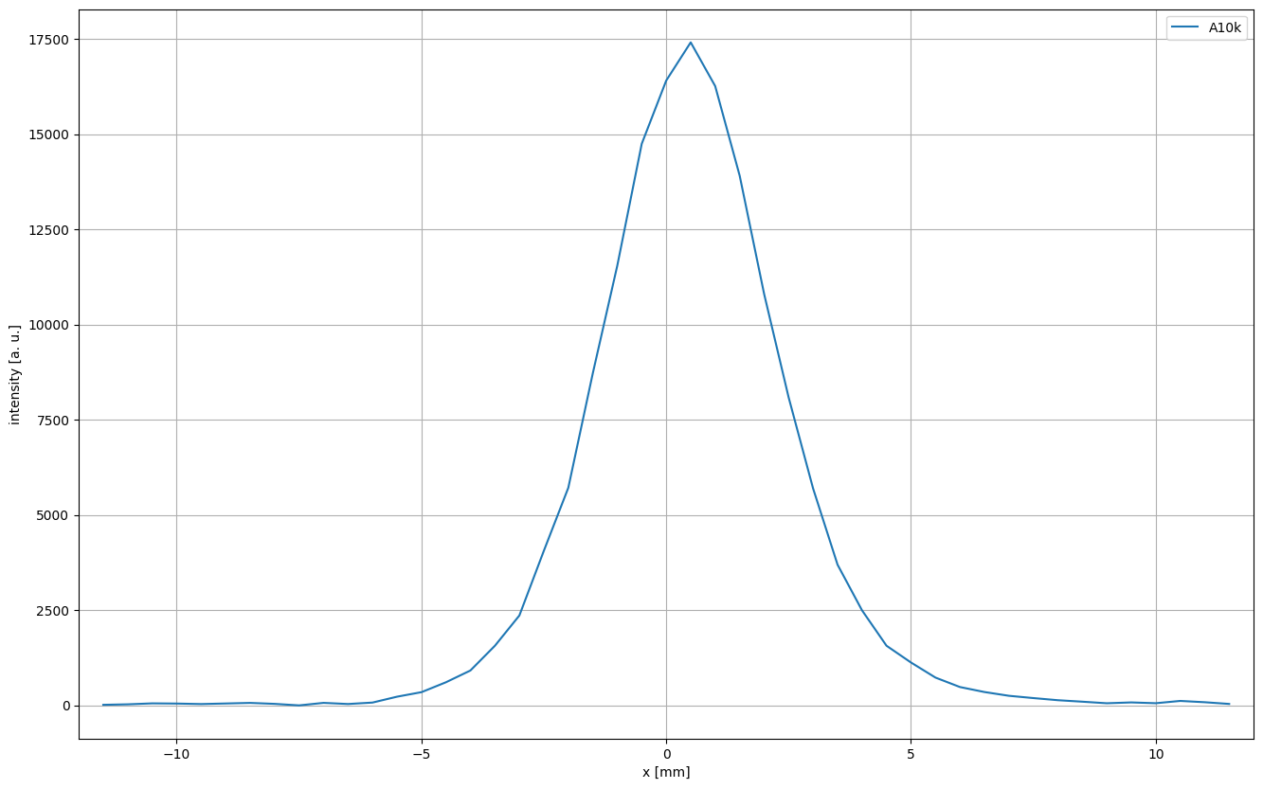
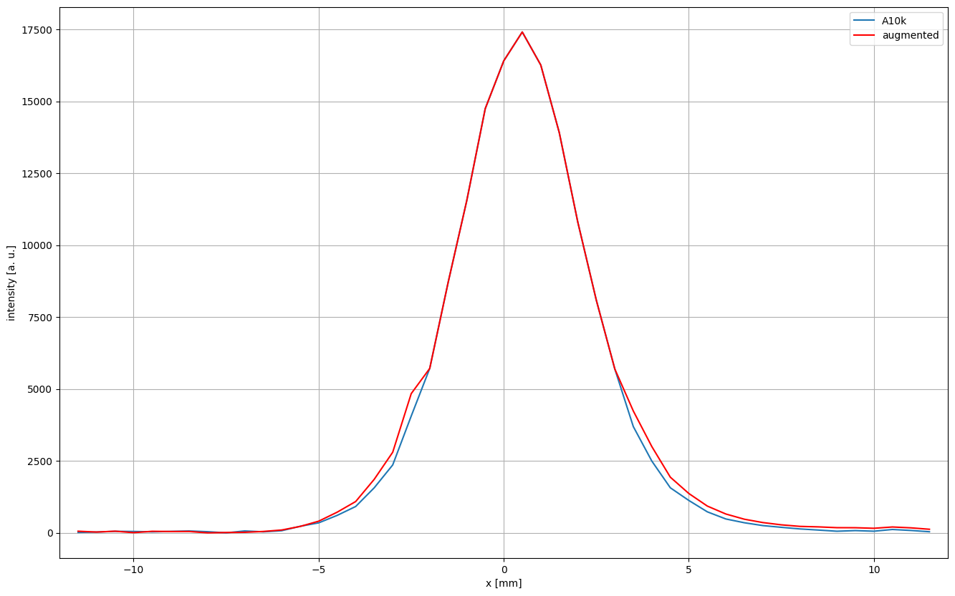
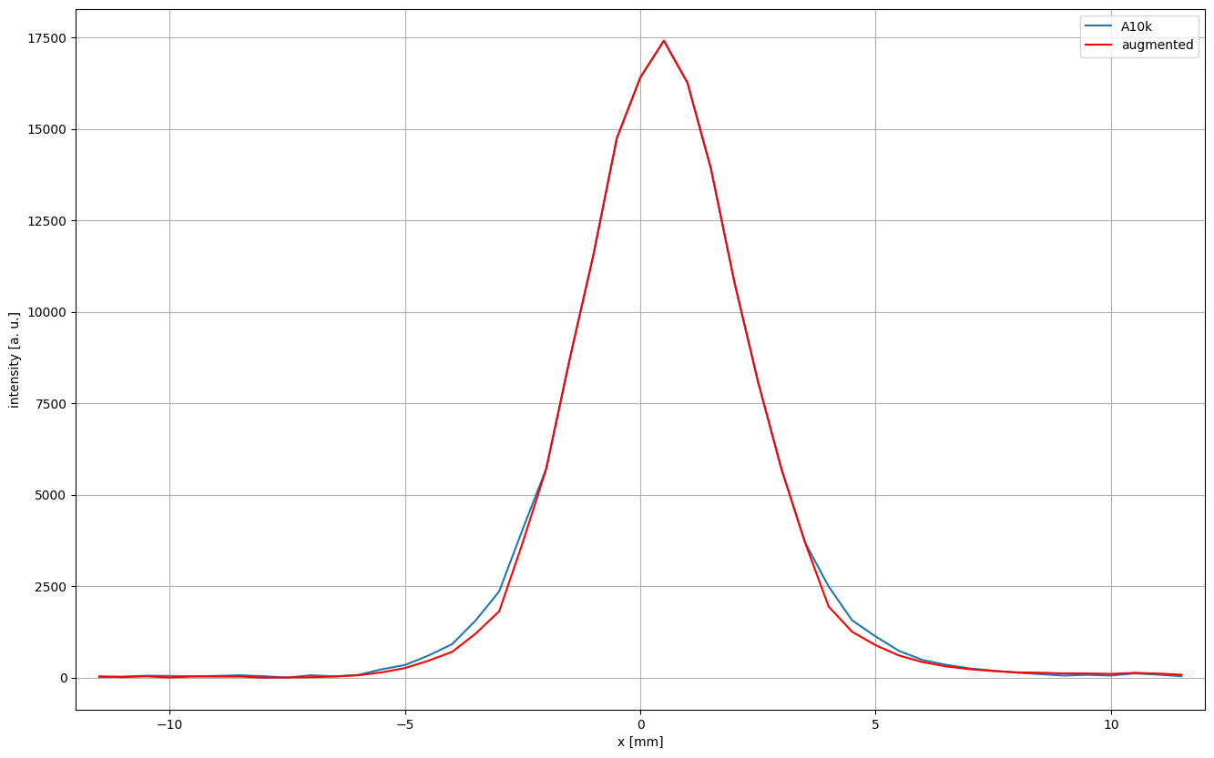
Confidence band for q-Gaussian fit
q₁ = 1.323
q₂ = 1.219
q₃ = 1.101
q_{ws} = 1.145

Slide 10
Conclusion
Super-resolution of beam tails is hindered by uncertainty in the fitting method (spacing of the wires)
Confidence bands can be used as sanity check for other tail measurements (such as the WS)

Slide 11
Plans for 2025
Study manipulations of beam tails/distributions for fixed target experiments
  Focus: nTof, North Area
  Benchmark simulations against beam profile measurements
MDs in PS, SPS

Slide 12
Questions, Comments, Suggestions?

