Slide 1
LEIR cooling studies
(magnesium + lead)
Peter Kruyt, Davide Gamba, and Nilanjan Banerjee (Fermilab)
February 4th 2025
Acknowledgements: LEIR OP and Felix Carlier

Slide 2
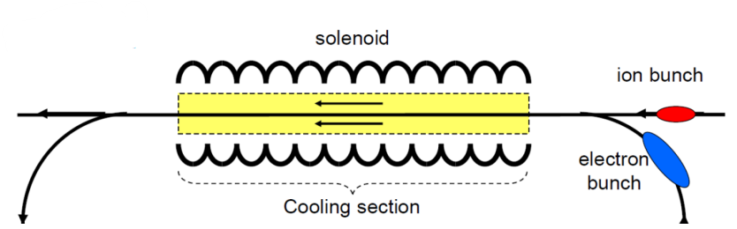
Electron cooling introduction
Goal: reduce emittance and momentum spread
Electron cooling is the process of exchanging thermal energy between an ion beam and a co-propagating electron beam moving at the same average velocity
Hot electrons are diverted and refreshed by new cold electrons
large momentum (hot)
small momentum (cold)
Solenoid guides electrons to improve cooling efficiency

Slide 3
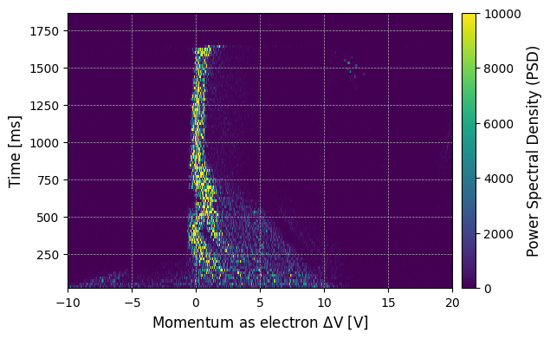
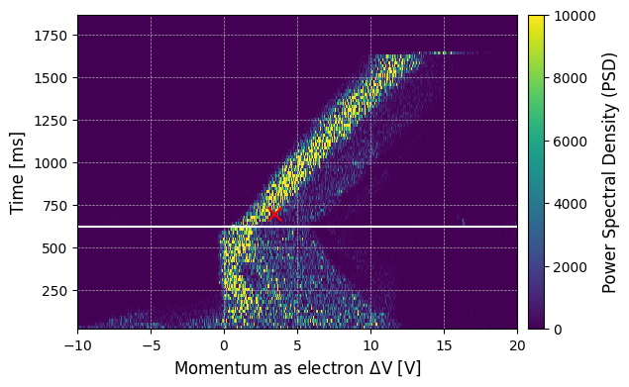
Magnesium 7+ measurement
Goal of MD: measure cooling performance for different voltages.
0V
45V

Slide 4
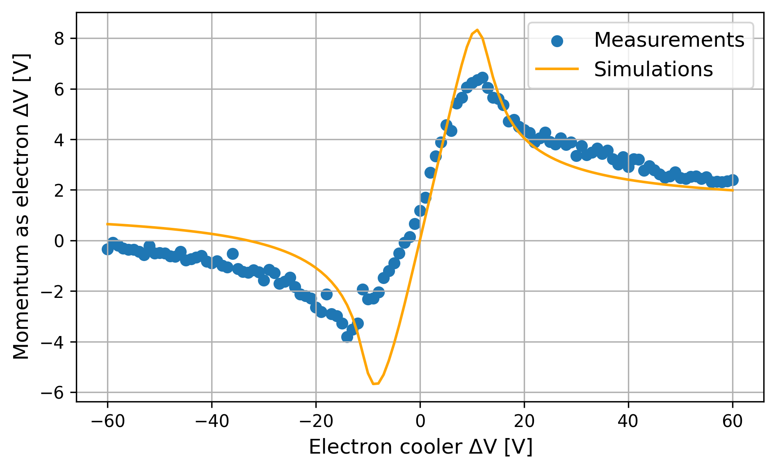
Magnesium 7+ cooling performance
repeat for each voltage
Simulations with Parkhomchuk model in Xsuite

Slide 5
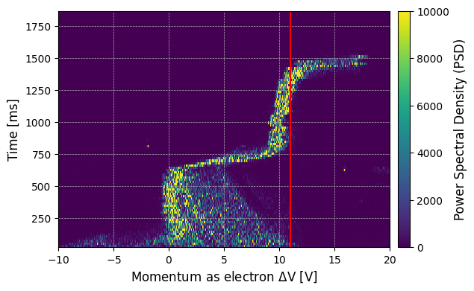
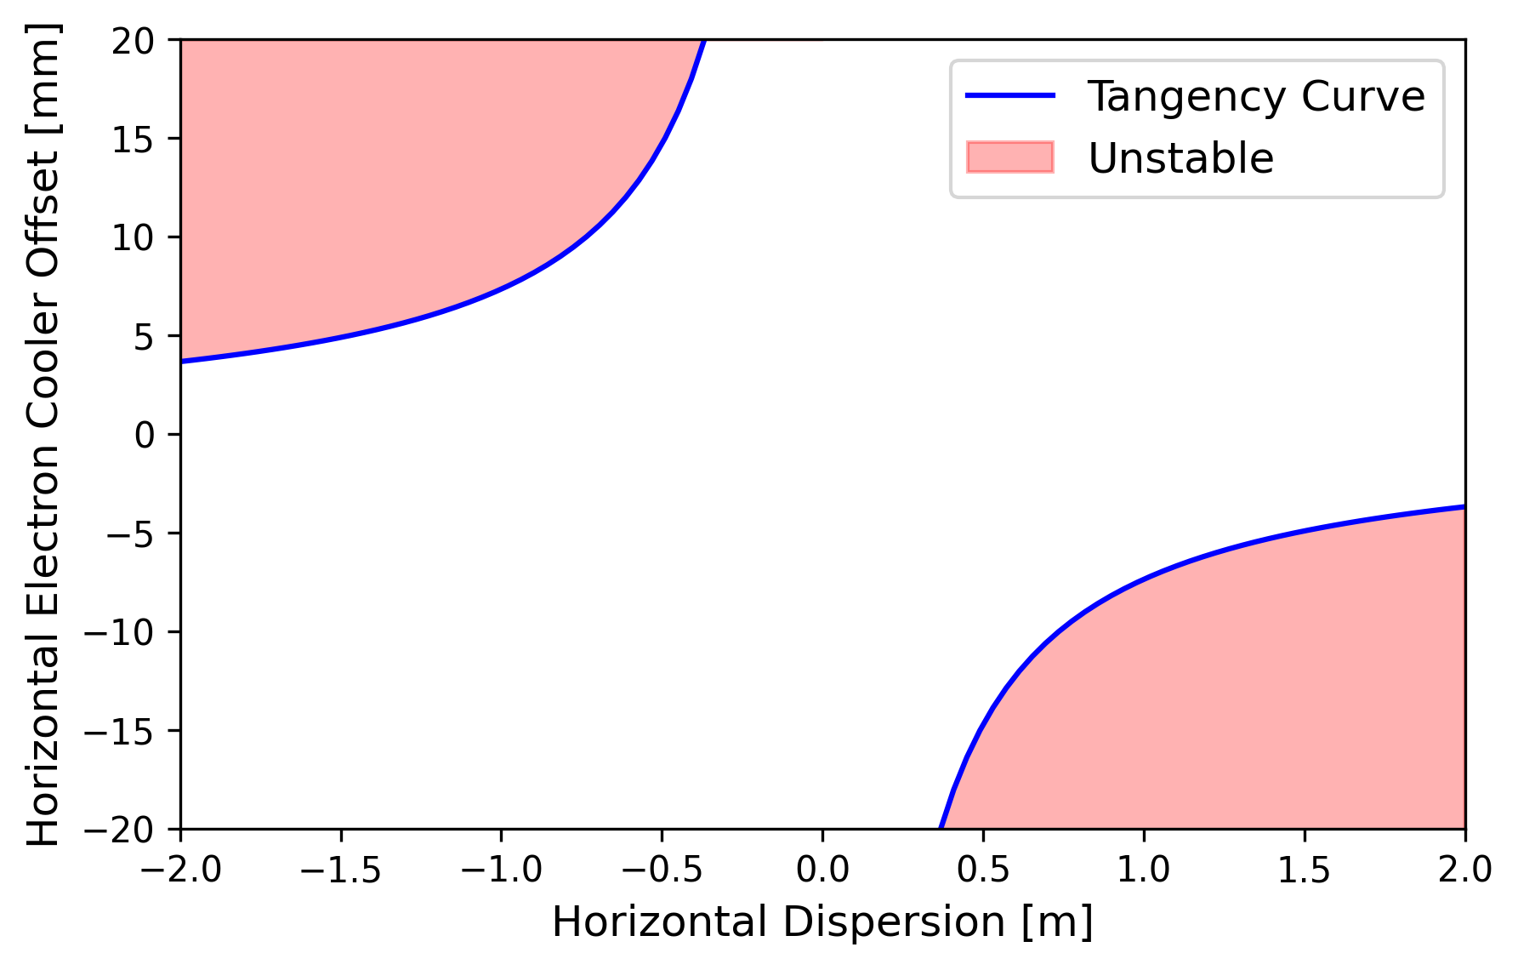
Unexplained Instability
Beam velocity exceeds electron velocity!
Possible explanation: high dispersion
Question: can we find the instability for lead?

Slide 6
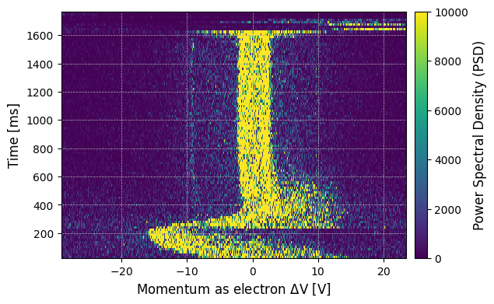
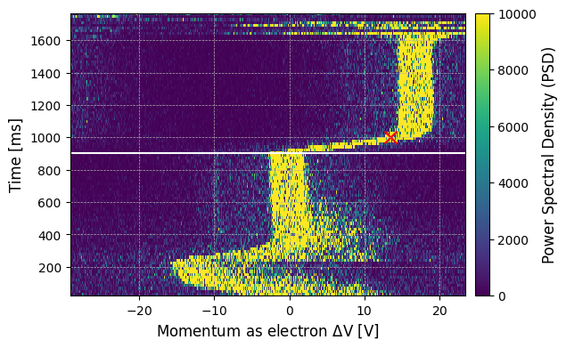
Measurement lead 54+
0V
17V

Slide 7
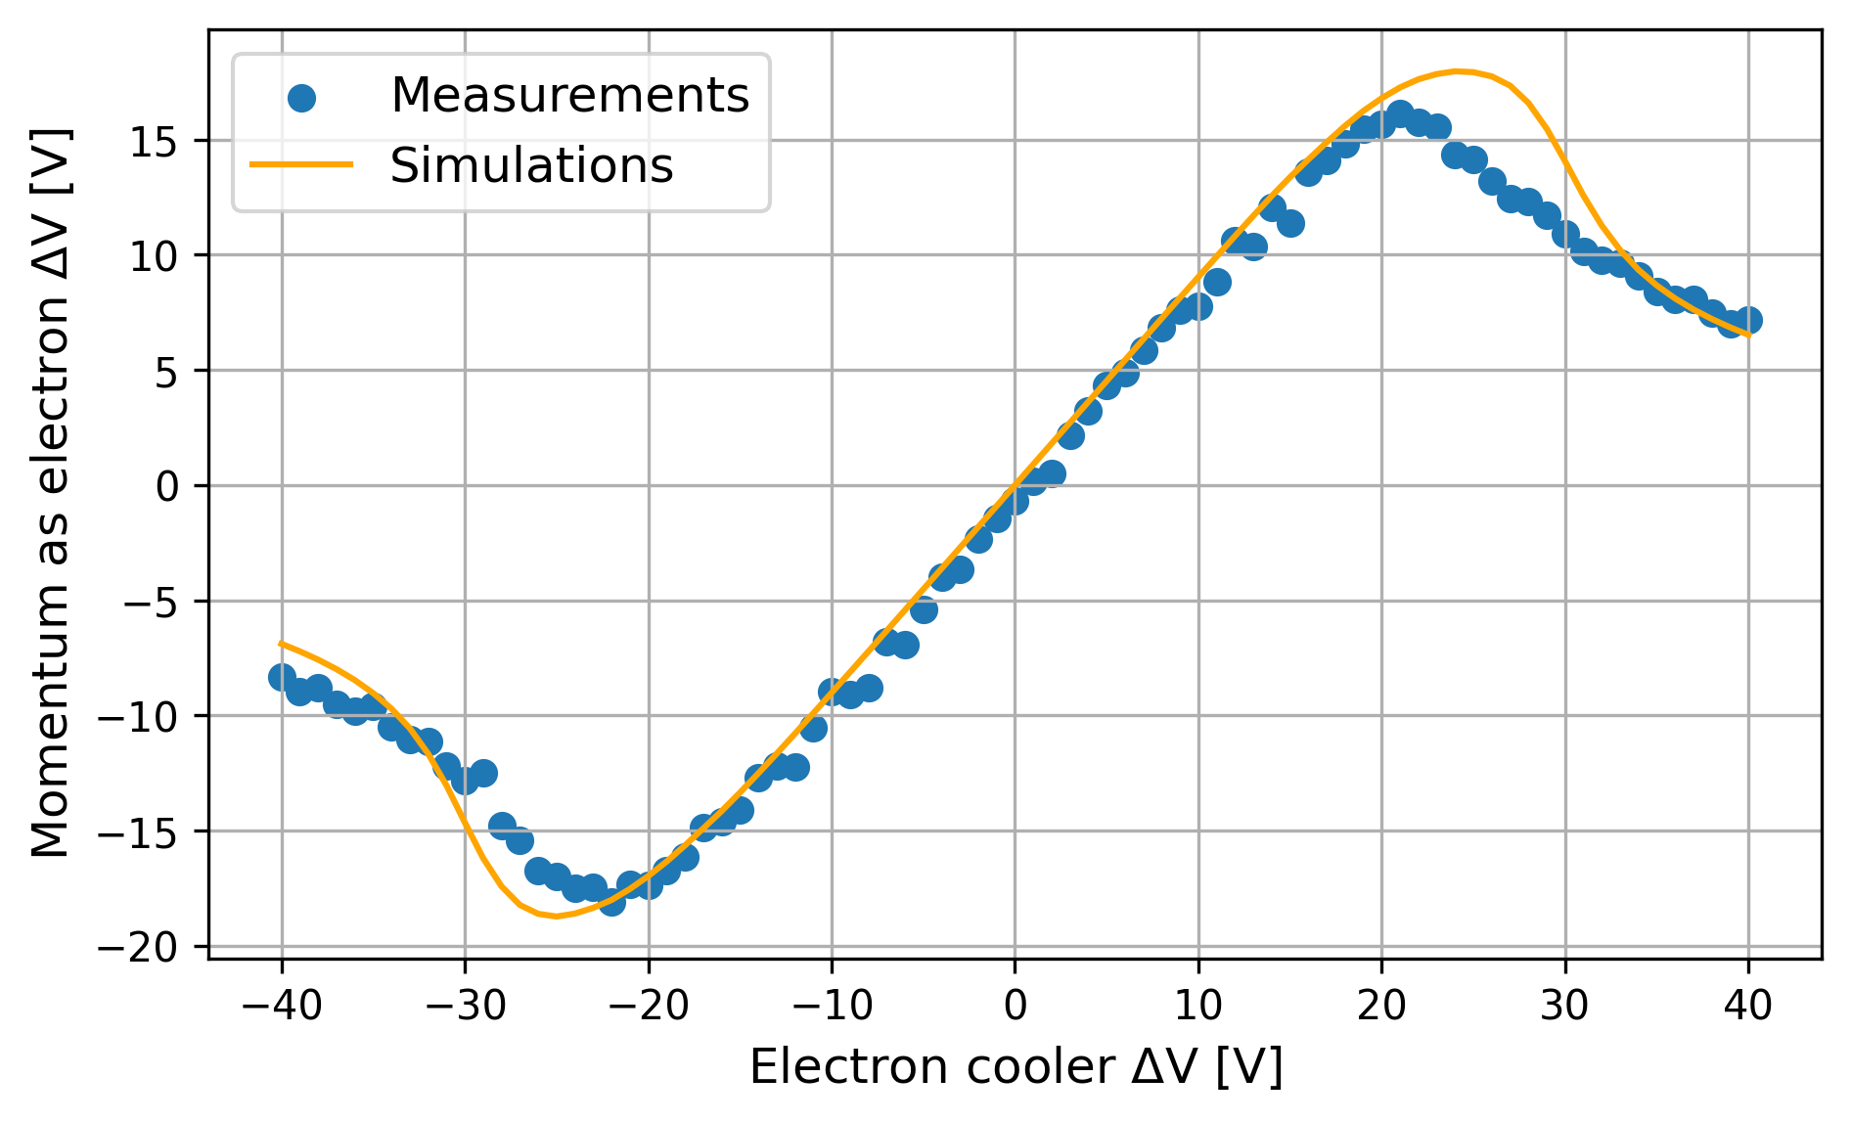
Cooling performance comparison
magnesium
lead
In future: longer pre-cooling

Slide 8
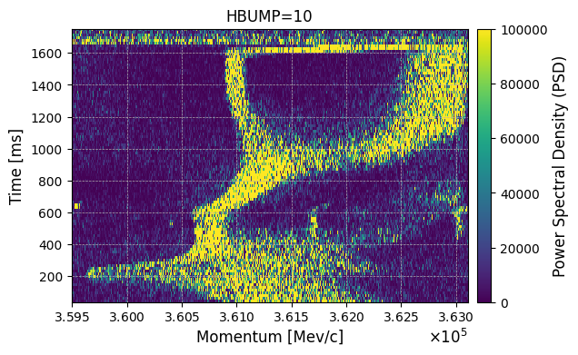
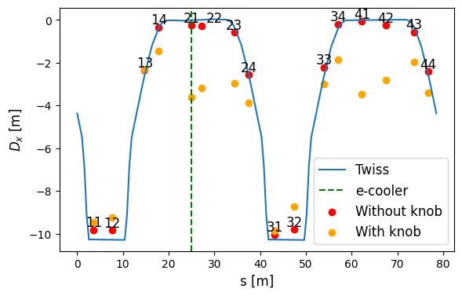
Probing the instability
Try to probe instability on purpose
We never found the instability for lead
Use high dispersion at e-cooler
Courtesy of F. Carlier

Slide 9
Future MD’s
Future MD’s:
Try to recreate unexplained magnesium instability
Measure cooling performance for other ions (oxygen)
MD specifications:
Ensure long pre-cooling time
Preferably, low intensity single injection to avoid any heating effects

Slide 10
Backup

Slide 11
LEIR dispersion measurement
look for instability with dispersion knob

Slide 12
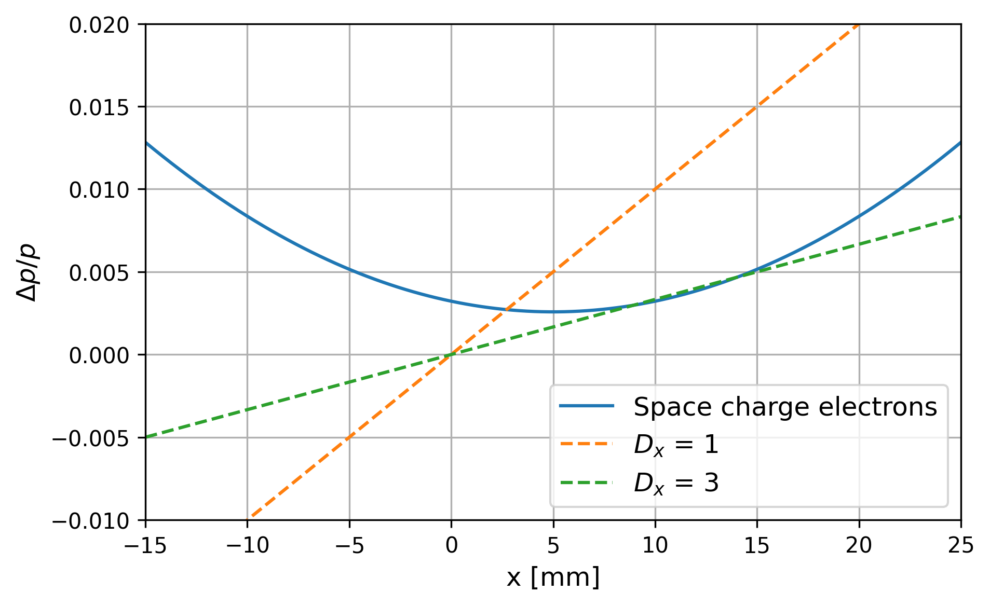

Slide 13
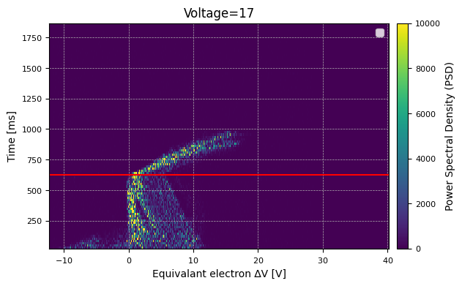
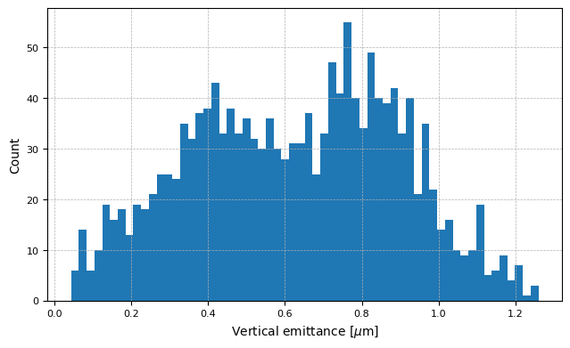
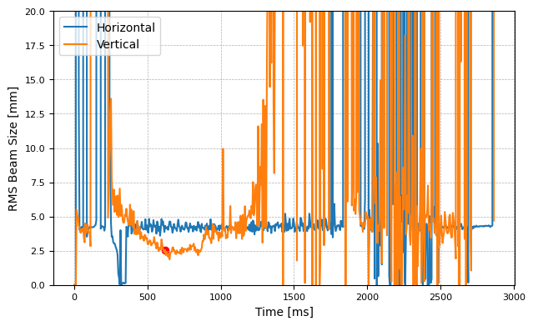
IPM data
Question: what is starting emittance of simulation?
Distribution over all measurements
simulations done with mean(0.6)
No, x so assume round beam

Slide 14
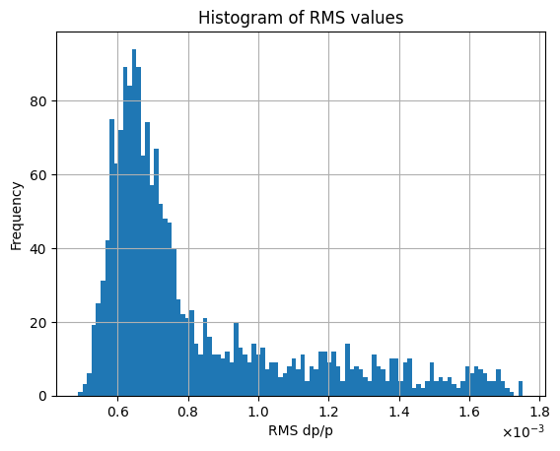
Schottky data
Distribution over all measurements
simulations done with most frequent value (0.6)

Slide 15
