Slide 1
PSB horizontal instabilities: beam observables and model predictions
Chiara Antuono, Foteini Asvesta, Carlo Zannini
Acknowledgements : S. Albright, M. Barnes, G.P. Di Giovanni, L.M. Feliciano, E.K. Platia, G. Rumolo, and the PSB operation team
IPP-MD days 2025
02/05/2025

Slide 2
Outline
Introduction
Observation after LIU
  A new horizontal instability
Horizontal instability studies
  Test with kicker terminations
  Expectations from the model
  Additional verification of the model
Conclusions and outlook

Slide 3
Outline
Introduction
Observation after LIU
  A new horizontal instability
2023-24 horizontal instability studies
  Expectations from the model
  Test with kicker terminations
  Additional verification of the model
Conclusions and outlook

Slide 4
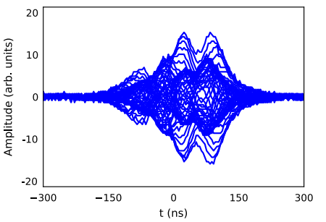
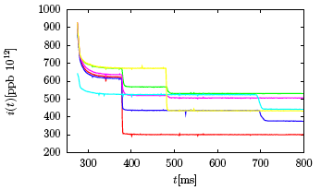
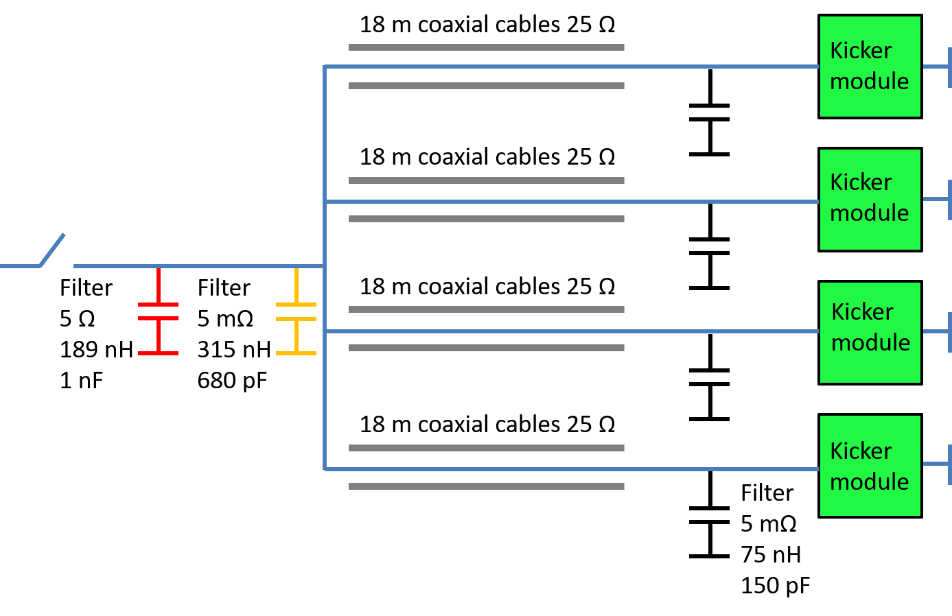
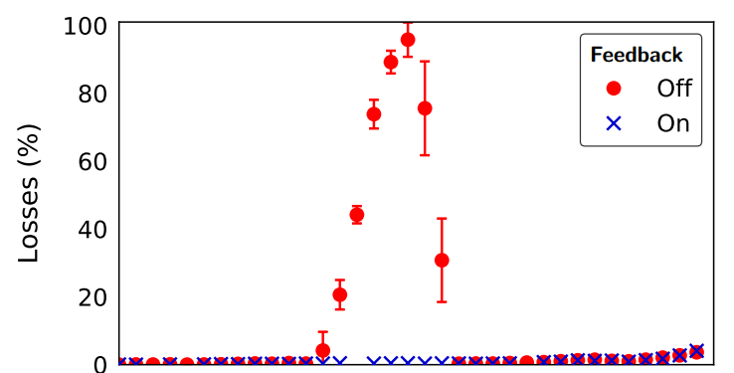
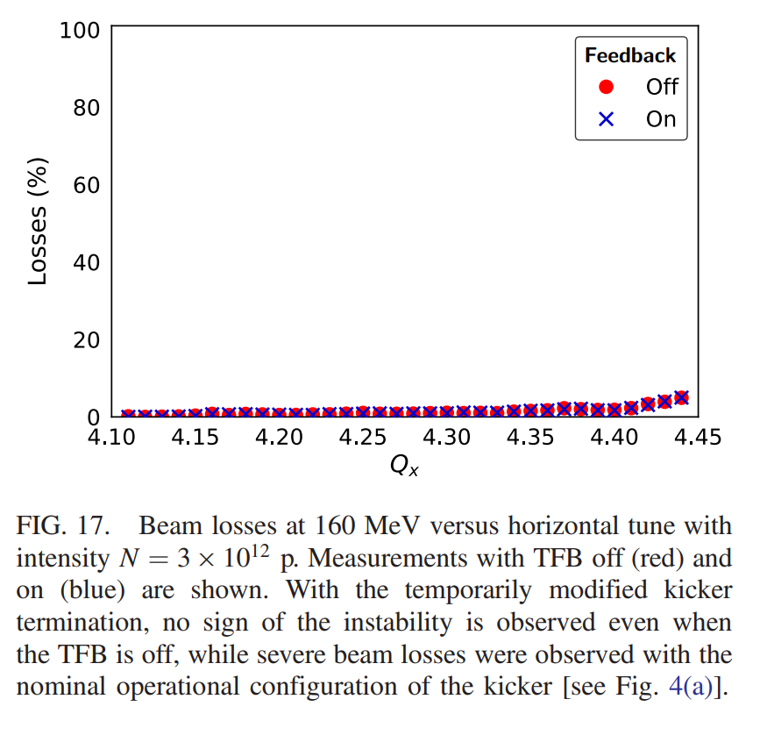
Horizontal instabilities at the PSB
A horizontal head-tail instability has been observed for more than 40 years in the PSB at about ∼160 MeV, 330 MeV, 1.3 GeV [1]
Although the instability was fully controlled in everyday operation by the TFB, its source and mechanism remained unknown
Simulations and theoretical analysis predicted as a source the unmatched impedance cables of the extraction kicker [1]
  In 2018 before LS2, experimental test confirmed the involvement of the extraction kicker cable
160 MeV
330 MeV
1.3 GeV
High impedance
Short circuit termination
Before LIU
All three experimentally observed instabilities were predicted and explained either by the first or the second kicker resonance
  Good agreement between model and beam-observables
Unmatched impedance cable
Matched impedance cable
The instability is not observed!
[1] E.K. Platia et al., Source of horizontal instability at the CERN Proton Synchrotron Booster, 2019, PRAB

Slide 5
Outline
Introduction
Observation after LIU
  A new horizontal instability
Horizontal instability studies
  Expectations from the model
  Test with kicker terminations
  Additional verification of the model
Conclusions and outlook

Slide 6
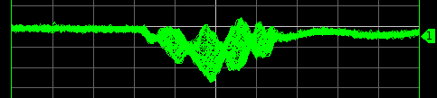
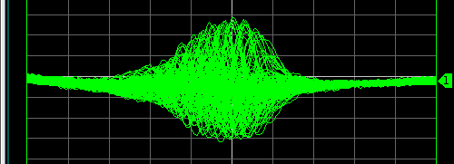
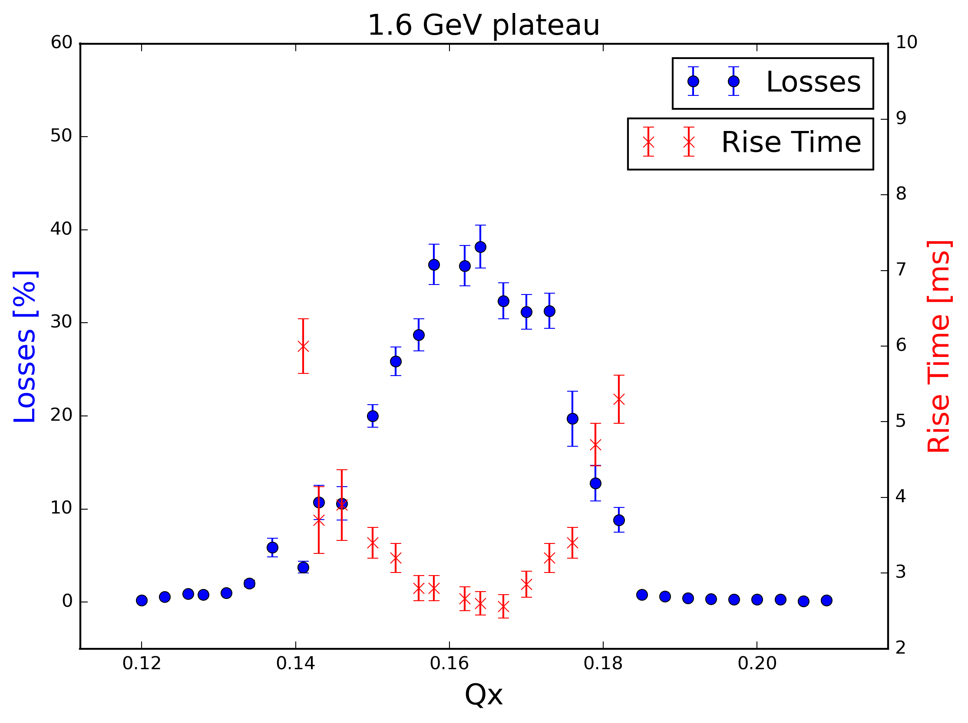
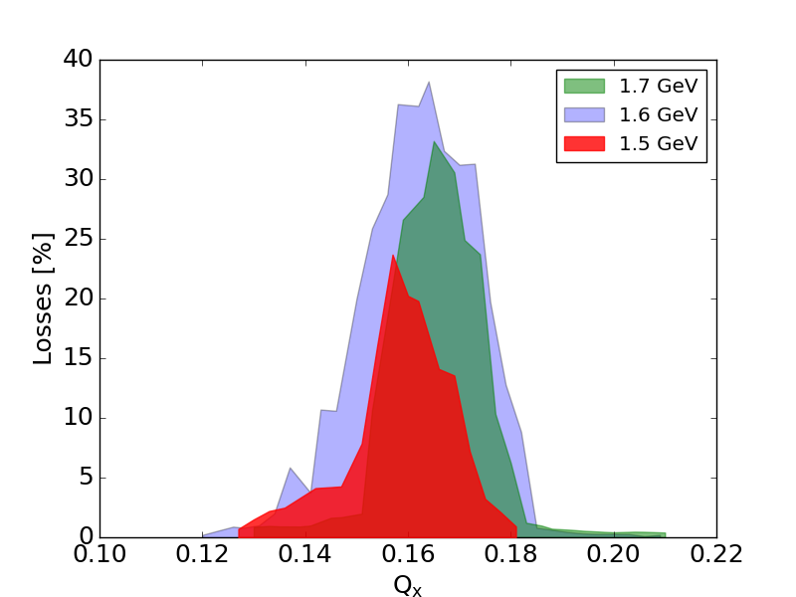
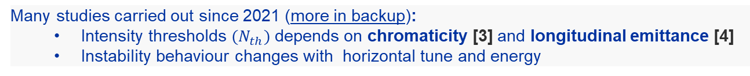

A new horizontal instability after LIU
Unknown horizontal instability observed in 2021 for the first time with high energy beam and with TFB on, for intensities above $500⋅{10}^{10}$ ppb [2]
Mitigation strategy identified using linear coupling and QSKHO quadrupoles [2]
  Accelerated more than 1000e10 protons!
Many studies carried out since 2021 (more in backup):
  Intensity thresholds $(N_{th})$ depends on chromaticity [3] and longitudinal emittance [4]
  Instability behaviour changes with horizontal tune and energy
Energy-tune dependance
higher energy $→$ higher critical $Q_{x}$
Following some beam observables the suspect on the extraction kicker terminations arose again
[2] F. Asvesta et al., High intensity studies in the CERN proton synchrotron booster, IPAC’22
[3] C. Zannini, PSB reference measurements, CEI section meeting
[4] C. Antuono et al, Status of the PSB impedance model and instability studies, IPP MD days 2023

Slide 7
Outline
Introduction
Observation after LIU
  A new horizontal instability
Horizontal instability studies
  Expectations from the model
  Test with kicker terminations
  Additional verification of the model
Conclusions and outlook

Slide 8
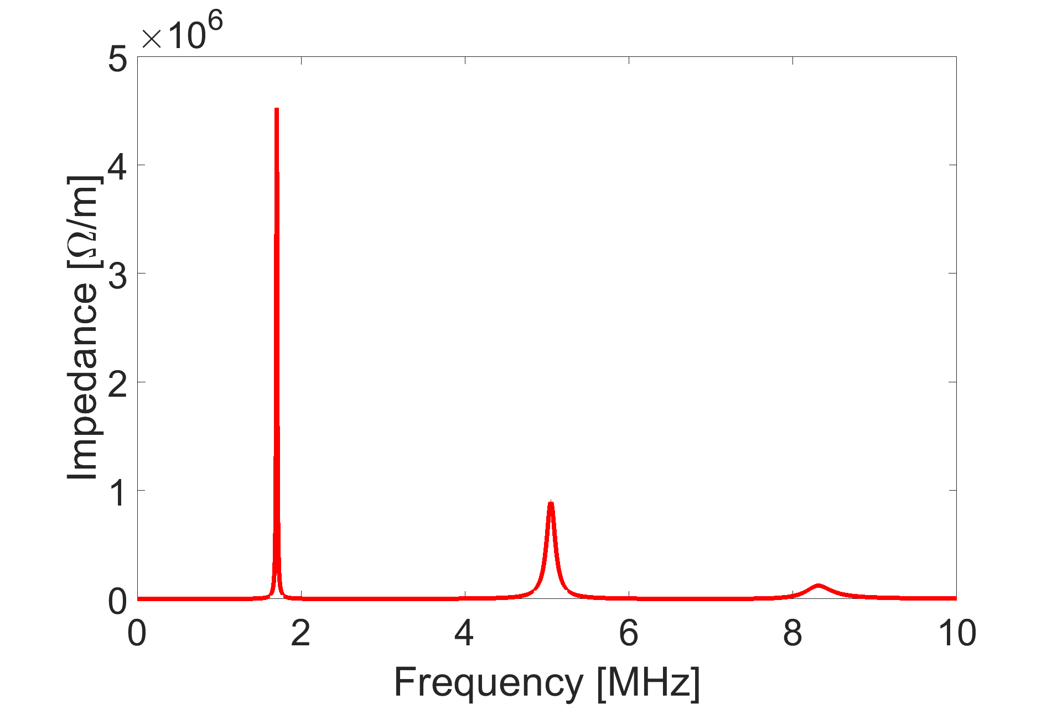
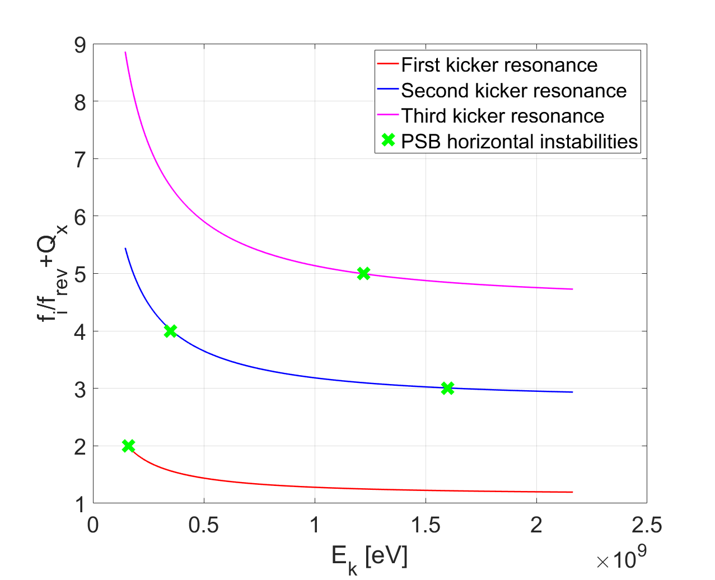
Expectations from the model
With the latest impedance model of the PSB and with the operational tune $Q_{x }$~ 0.17
  We can plot the Sacherer stability criteria as a function of the energy
$$\frac{f_{i}}{f_{rev}}+Q_{x}=n$$
Latest impedance model based on more precise extraction kicker circuit info (including filters)[5]
Summary:
all the observed instabilities are explained:
  ∼ 160 MeV by the first kicker resonance
  ∼ 1.2 GeV by the third kicker resonance
  ∼ 330 MeV and ∼ 1.6 GeV by the second kicker resonance
1.2 GeV
330 MeV
1.6 GeV
160 MeV
[5] C. Zannini et al., LOW IMPEDANCE DESIGN WITH EXAMPLE OF KICKERS (INCLUDING CABLES) AND POTENTIAL OF METAMATERIALS, Zermatt 2019 MCBI proceeding

Slide 9
Expectations from the model
With the latest impedance model of the PSB and with the operational tune $Q_{x }$~ 0.17
  We can plot the Sacherer stability criteria as a function of the energy
$$\frac{f_{i}}{f_{rev}}+Q_{x}=n$$
Latest impedance model based on more precise extraction kicker circuit info (including filters)[5]
Summary:
all the observed instabilities are explained:
  ∼ 160 MeV by the first kicker resonance
  ∼ 1.2 GeV by the third kicker resonance
  ∼ 330 MeV and ∼ 1.6 GeV by the second kicker resonance
Others instability are also predicted and could be checked in the future
1.2 GeV
330 MeV
1.6 GeV
160 MeV
[5] C. Zannini et al., LOW IMPEDANCE DESIGN WITH EXAMPLE OF KICKERS (INCLUDING CABLES) AND POTENTIAL OF METAMATERIALS, Zermatt 2019 MCBI proceeding

Slide 10
Outline
Introduction
Observation after LIU
  A new horizontal instability
Horizontal instability studies
  Expectations from the model
  Test with kicker terminations
  Additional verification of the model
Conclusions and outlook

Slide 11
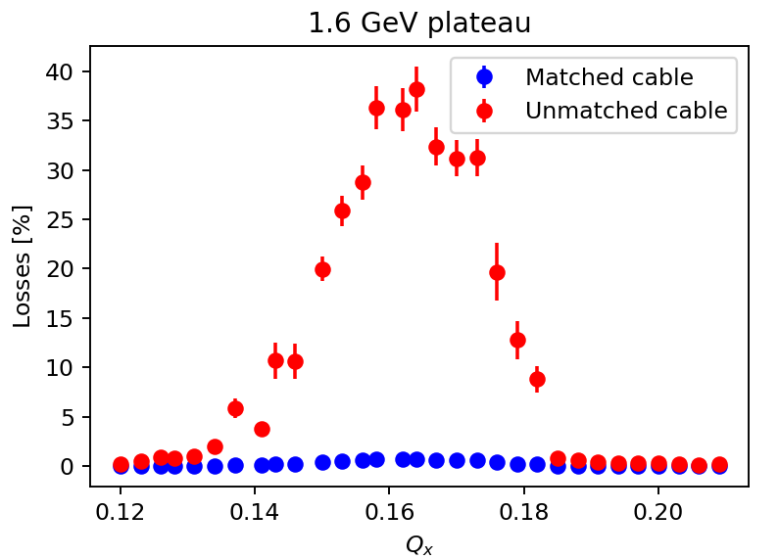
Experimental verification
A dedicated test at the end of the 2023 Run with two kicker terminations was performed
Last test on 31/10/23
When the termination is matched the resonances almost disappear [5]
Operational termination -> unmatched kicker cable
Modified termination -> matched kicker cable
The cause of the instability is clearly identified
  losses disappear when the kicker termination is matched
[5] C. Zannini et al., LOW IMPEDANCE DESIGN WITH EXAMPLE OF KICKERS (INCLUDING CABLES) AND POTENTIAL OF METAMATERIALS, Zermatt 2019 MCBI proceeding

Slide 12
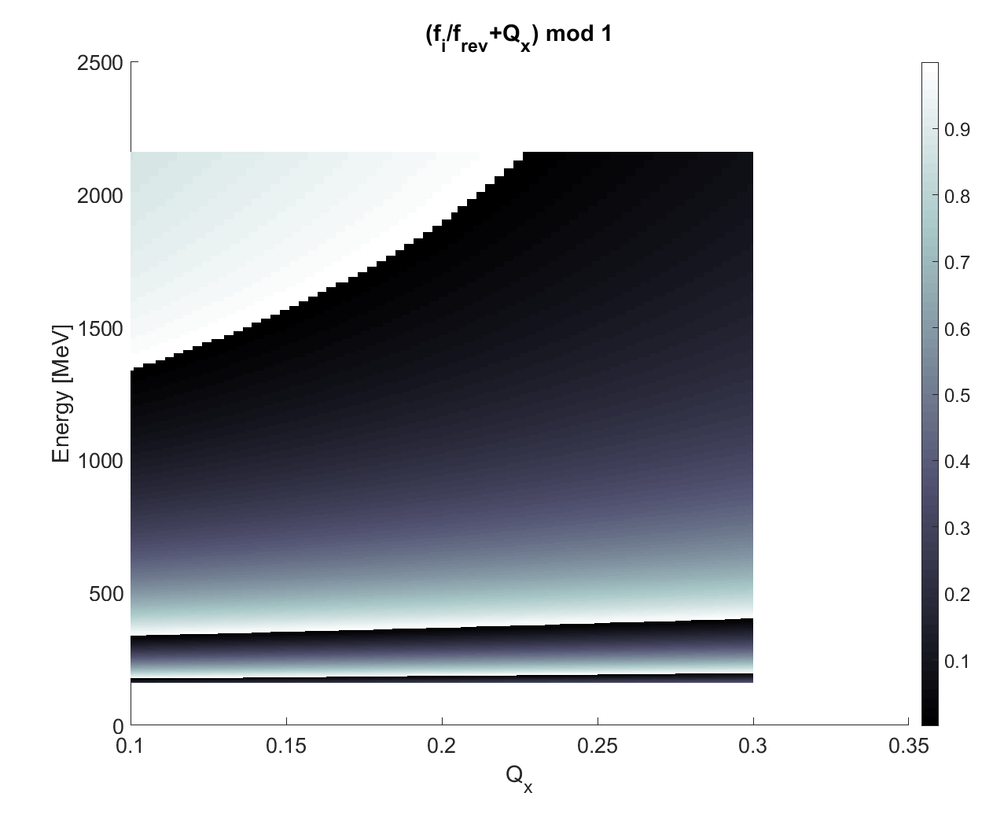
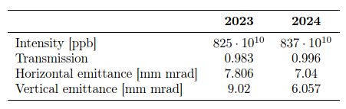
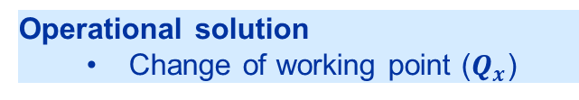
Cure of the instability
Studies with the latest impedance model and
Sacherer stability criteria : $\frac{f_{i}}{f_{rev}}+Q_{x}=n$
Instability occur$→$ sharp change from black to white
Second kicker resonance
Operational solution
  Change of working point ($Q_{x}$)
Above the PSB extraction energy!
1600
Successfully tested in 2024 operation
Instability not observed without TFB and linear coupling
Lower emittance and almost perfect transmission
Improved beam quality and overall performance
0.17
Op. tune
Increase of $Q_{x}$: instability pushed beyond 2 GeV

Slide 13
Outline
Introduction
Observation after LIU
  A new horizontal instability
Horizontal instability studies
  Expectations from the model
  Test with kicker terminations
  Additional verification of the model
Conclusions and outlook

Slide 14
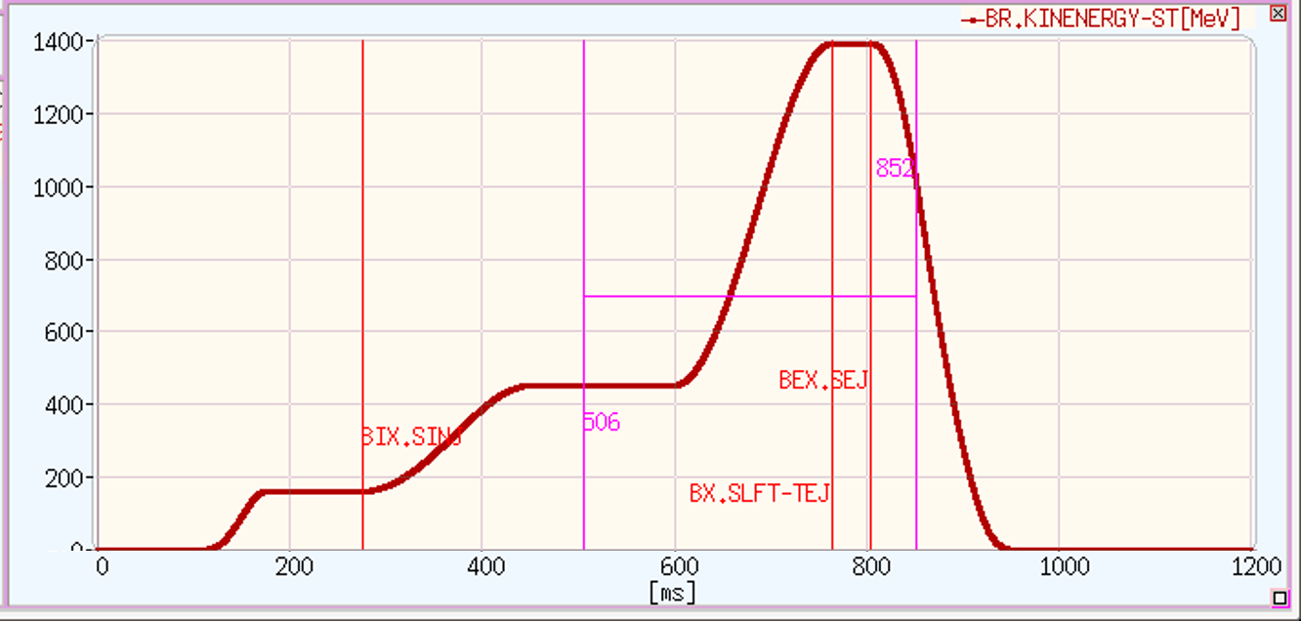
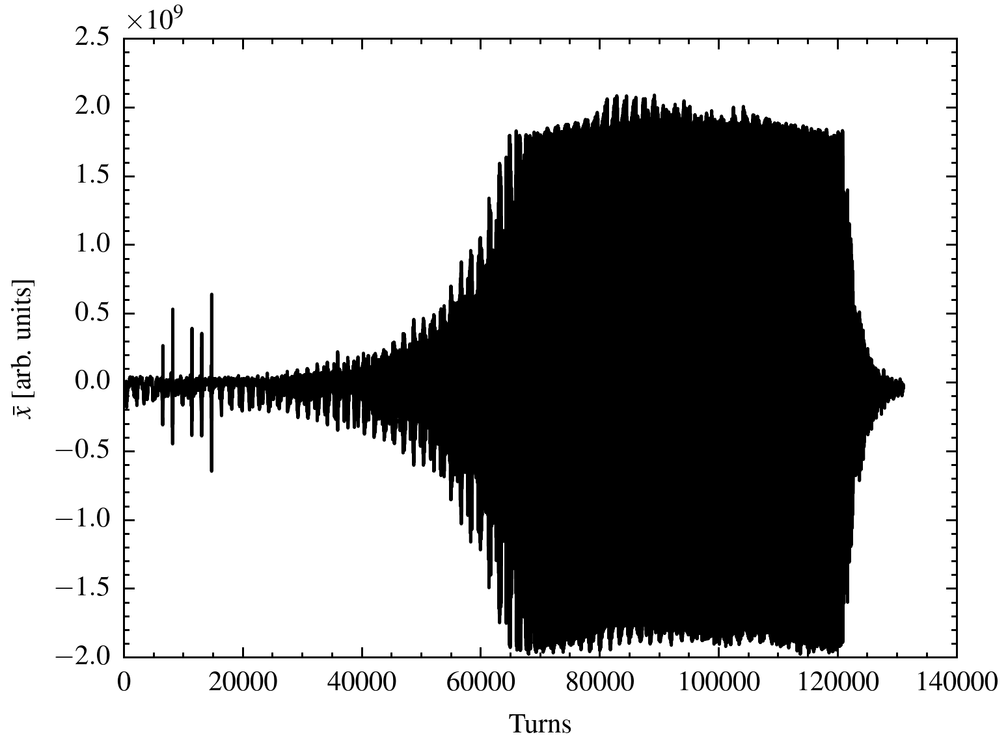
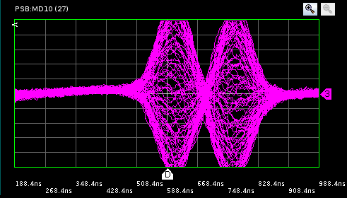
Additional verification of the PSB model
A specific MD cycle was implemented to measure the instability at 470 MeV
470 MeV
470 MeV
1.2 GeV
330 MeV
1.6 GeV
160 MeV
The 470 MeV was detected, further validating the PSB impedance model
Accurate measurement of these instabilities is challenging

Slide 15
Outline
Introduction
Observation after LIU
  A new horizontal instability
Horizontal instability studies
  Expectations from the model
  Test with kicker terminations
  Additional verification of the model
Conclusions and outlook

Slide 16
Conclusions and outlook
Horizontal instability observed at the PSB for the first time after LIU with:
  high energy beam (~1.6 GeV)
  TFB on
  for intensities above 500e10 ppb
Predictions with the latest impedance model suggested the involvement of the unmatched impedance termination of the extraction kicker
  Experimentally confirmed in 2023 in a dedicated MD
  Proposed a mitigation strategy successfully tested during the PSB operation
The latest impedance model can explain all the observed instabilities
    Additional instabilities are also predicted
      MDs in 2024 confirmed the presence of the instability at about 470 MeV
      Further investigation of predicted instabilities could be nice but not straightforward

Slide 17
Thank you!

Slide 18
Backup

Slide 19
Impedance model of the extraction kicker
Latest impedance model based on more precise kicker circuit info (including filters) [3]
Resonant frequencies in very good agreement with the 2018 measurements. Slight differences with the legacy model for the resonant frequency of the second and third resonance
[3] C. Zannini et al., LOW IMPEDANCE DESIGN WITH EXAMPLE OF KICKERS (INCLUDING CABLES) AND POTENTIAL OF METAMATERIALS, Zermatt 2019 MCBI proceeding

Slide 20
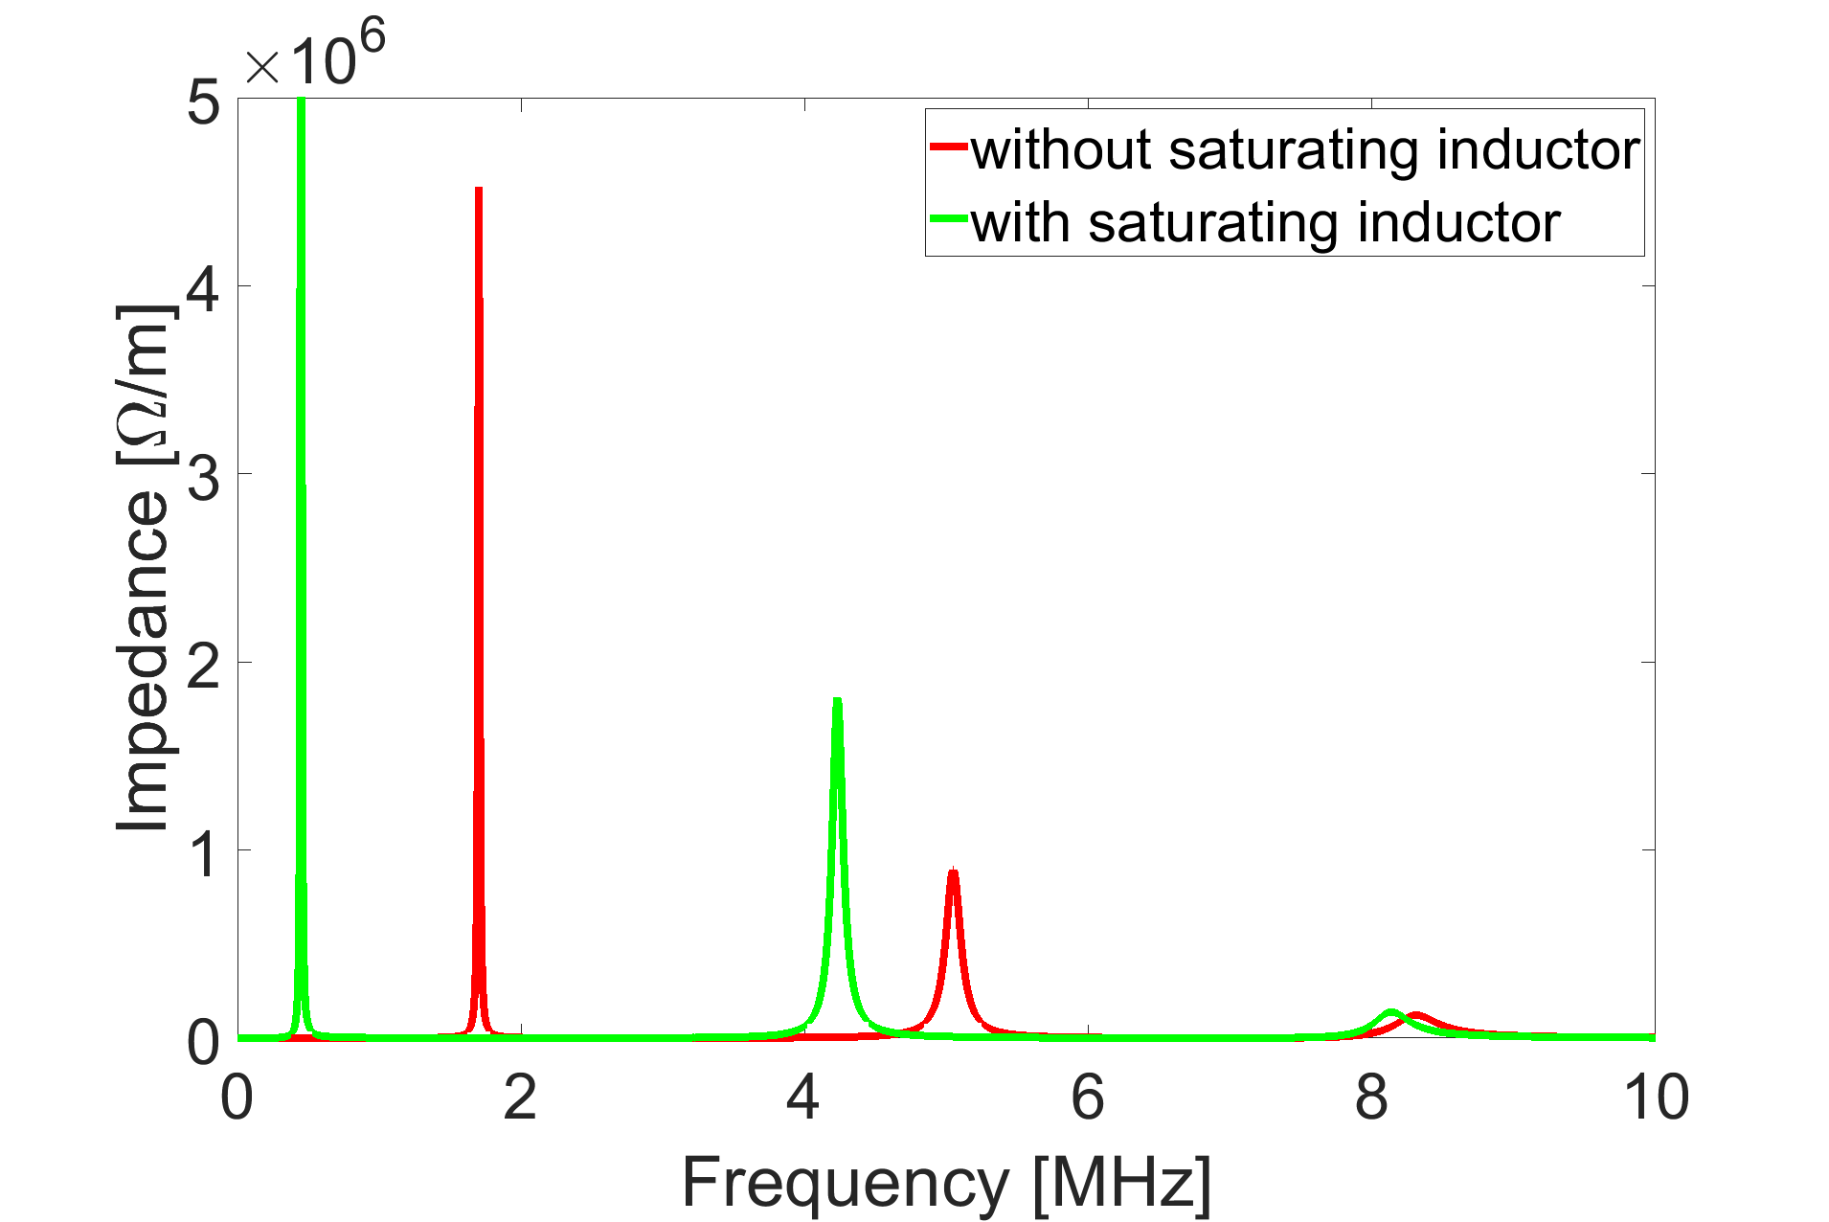
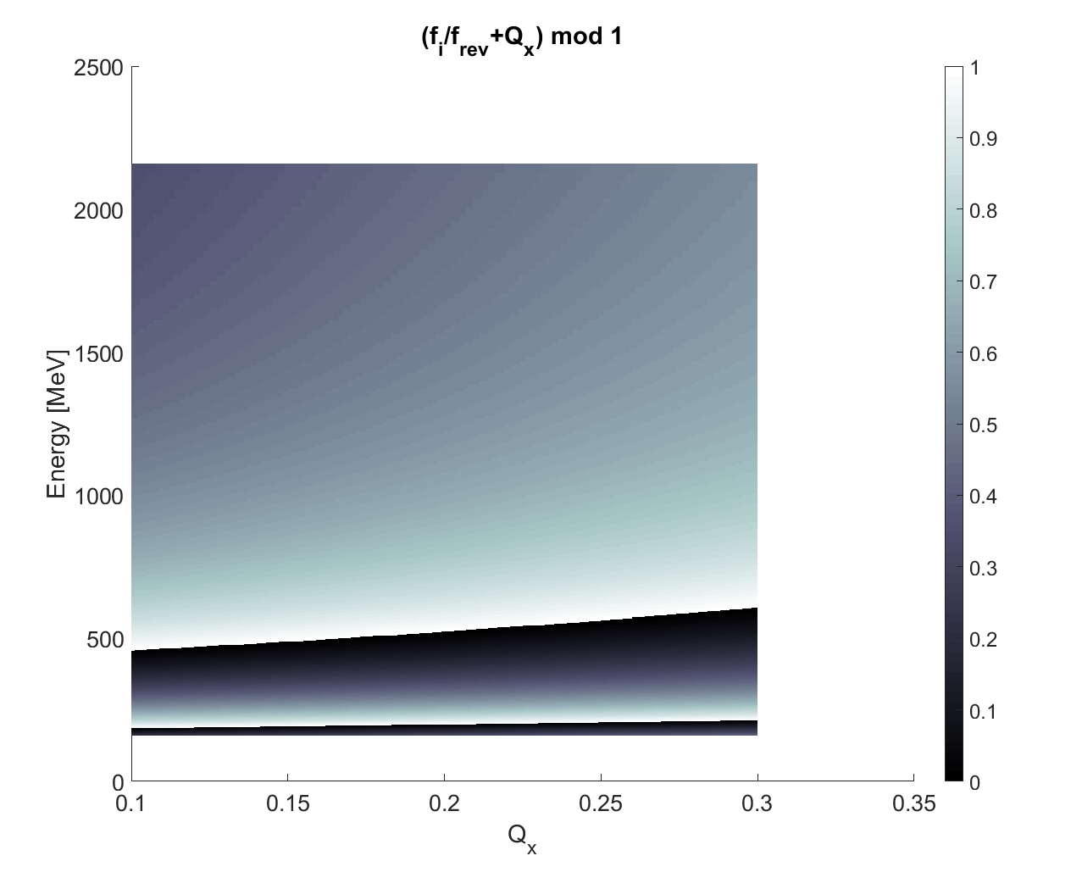
Expectations from the model: could we cure the instability?
Two possible solutions to suppress the 1.6 GeV instability: further and dedicated studies are needed
2. Long-term hardware solution
  Insertion of a saturating inductor
Case study investigated for the suppression of the 160 MeV instability
Expectation considering the second kicker resonance
without saturating inductor
with saturating inductor
1.6 GeV instability is suppressed
1.6 GeV instability
saturating inductor in the kicker circuit (between the kicker and the transmission lines) as proposed by M. Barnes

Slide 21
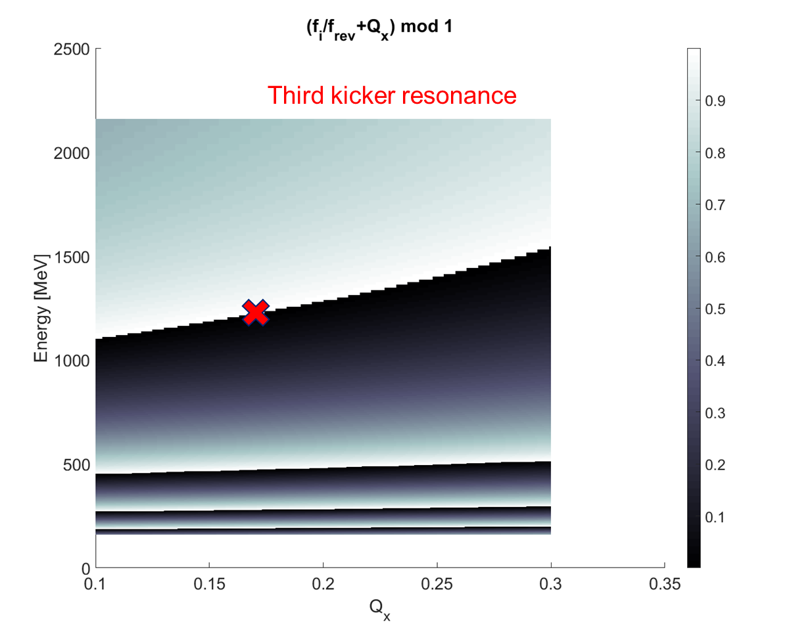
Possible future limitations
PSB horizontal kicker instability
-Not limited 2024 Run
-However, with the aim of increasing intensity (and the energy , e.g. ISOLDE) both the instabilities at 1.6 GeV and 1.3 GeV might be a limitation
Activity already observed during measurements for the 1.3 GeV instability increasing the intensity up to 1.28e13 p/b with the TFB on.
The change of tune for the 1.3 GeV to mitigate the instability (as for 1.6 GeV) cannot be done easily since the curve of energy with tune is quite flat
  tune has to change a lot to push the instability!

Slide 22
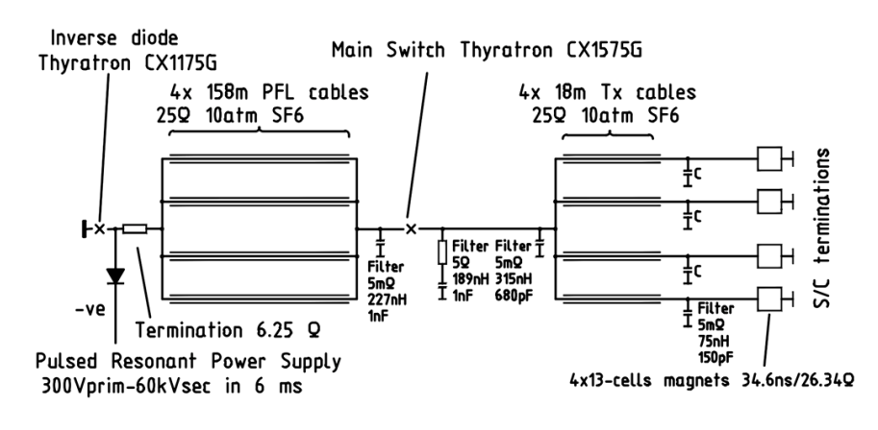
Kicker circuit

Slide 23
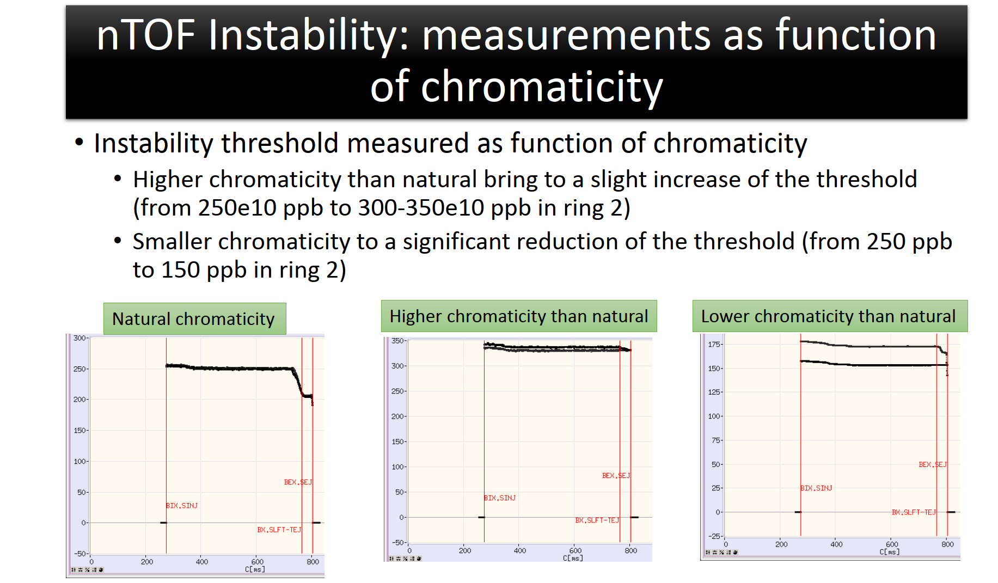
A new horizontal instability
Horizontal instability observed in 2021 for the first time with high energy beam with TFB on, for intensities above 500e10 ppb
  Many studies carried out since 2021 *:
    Instability behaviour remained unchanged over the years
    Intensity threshold depends on chromaticity
C. Zannini, CEI section meeting, 12/08/2021
Intensity threshold with TFB off
Ring TFB off | 2021
R1 | ~250e10 ~C740 ms
R2 | ~250e10 ~C700 ms
R3 | ~350e10 ~C720 ms
R4 | ~350e10 ~C720 ms
  Mitigation strategy identified: currently cured using linear coupling and QSKHO quadrupoles
    Accelerated more than 1000e10 protons!

Slide 24
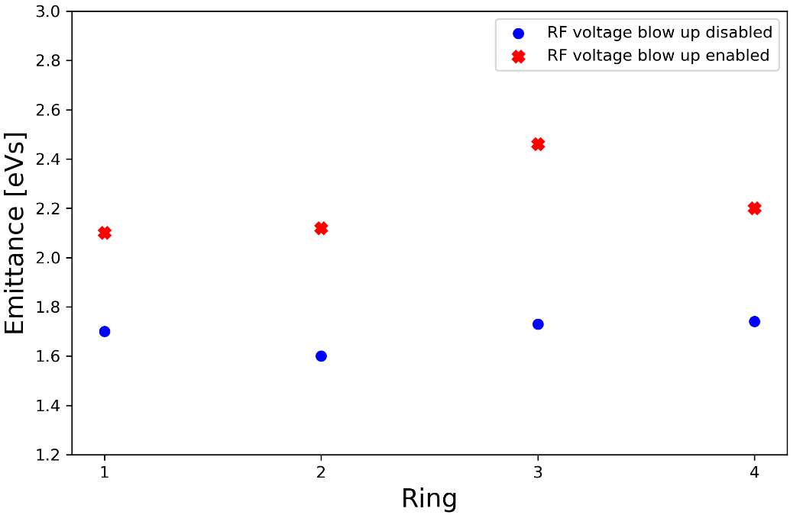
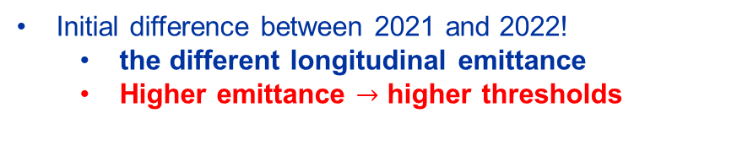
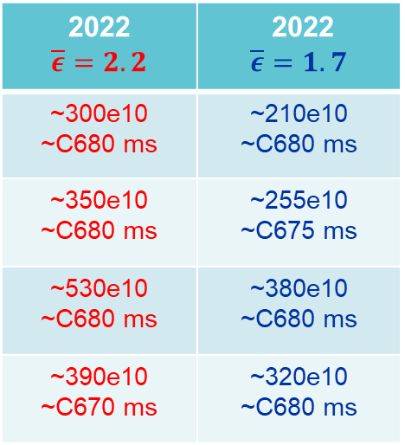
Observation in 2022 : Nth dependence with emittance
Ring TFB off | 2021 | 2022
R1 | ~250e10 ~C740 ms | ~300e10 ~C680 ms
R2 | ~250e10 ~C700 ms | ~350e10 ~C680 ms
R3 | ~350e10 ~C720 ms | ~530e10 ~C680 ms
R4 | ~350e10 ~C720 ms | ~390e10 ~C670 ms
RF blow-up enabled in 2022
2022 $$\overline{ε}=2.2$$ | 2022 $$\overline{ε}=1.7$$
~300e10 ~C680 ms | ~210e10 ~C680 ms
~350e10 ~C680 ms | ~255e10 ~C675 ms
~530e10 ~C680 ms | ~380e10 ~C680 ms
~390e10 ~C670 ms | ~320e10 ~C680 ms
Initial difference between 2021 and 2022!
  the different longitudinal emittance
  Higher emittance $→$ higher thresholds
Similar Nth
Unchanged behaviour with time of the instability:
  Similar intensity threshold
  Same behaviour with chromaticity

Slide 25
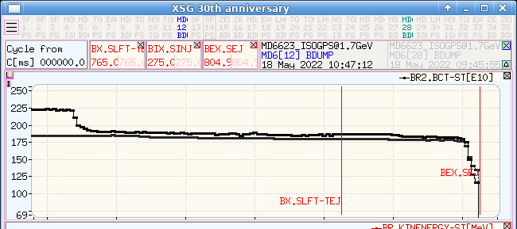
Observation in 2022 : test changing tune and intensity
We changed the tune to see how the Nth changes
We turned off the TFB from C600 ms
We increased the intensity step by step
Instability around C685 ms
Ring TFB off | 1.7 GeV cycle
R1 | ~175e10 ~ C695 ms
R2 | ~160e10 ~ C690 ms
R3 | ~400e10 ~ C670 ms
R4 | ~210e10 ~ C675 ms
685 ms

Slide 26
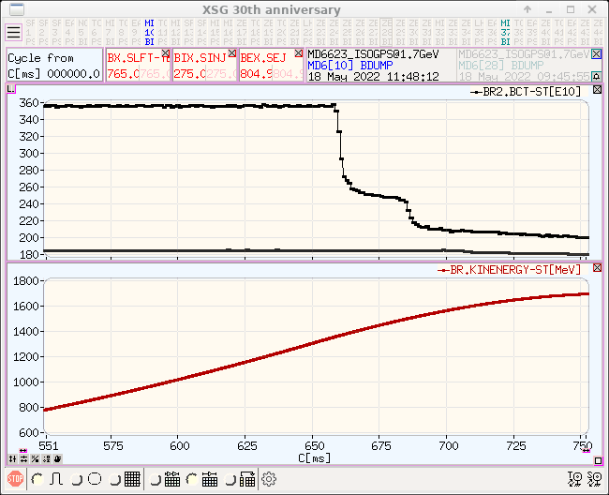
Observation in 2022 : test changing tune and intensity
We changed the tune to see how the Nth changes
Further increasing the intensity the instability around 1.3 GeV is observed
Ring TFB off | 1.7 GeV cycle
R1 | ~175e10 ~ C695 ms
R2 | ~160e10 ~ C690 ms
R3 | ~400e10 ~ C670 ms
R4 | ~210e10 ~ C675 ms
energy of the observed kicker instability ∼ 1.3 GeV
660 ms
685 ms
The instability behaviour is complex
The intensity thresholds could change with the energy and the tune as well
Again, the suspect of an involvement of the kicker termination arose

Slide 27
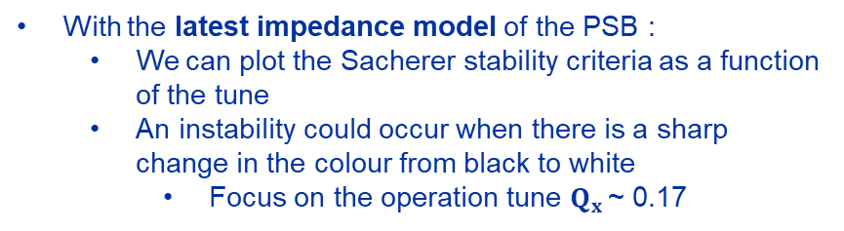
Expectations from the model
With the latest impedance model of the PSB :
  We can plot the Sacherer stability criteria as a function of the tune
  An instability could occur when there is a sharp change in the colour from black to white
    Focus on the operation tune $Q_{x }$~ 0.17
Second kicker resonance
~ 1.6 GeV instability observed without/with horizontal feedback
~330 MeV instability observed without horizontal feedback
~180 MeV expected instability from second kicker resonance

Slide 28
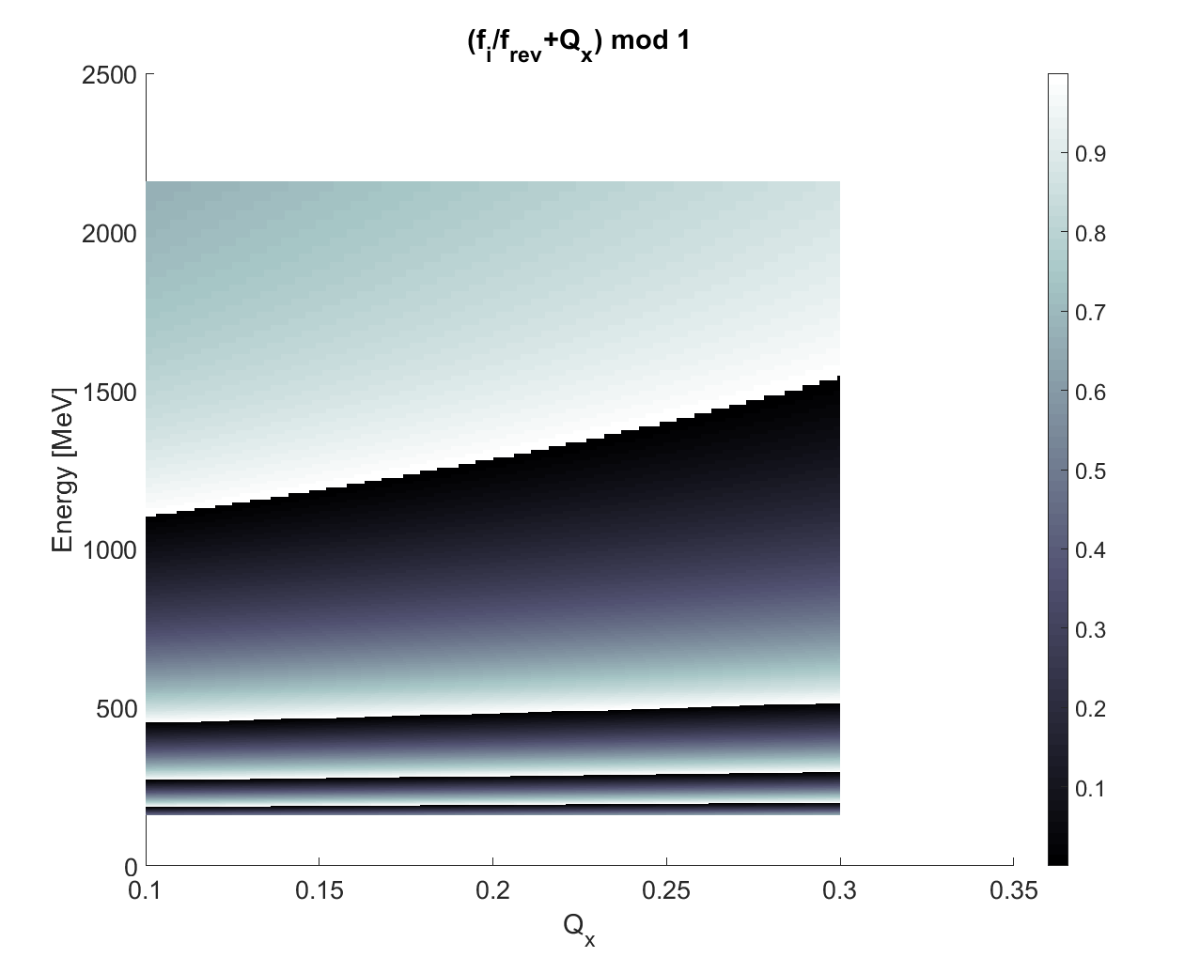
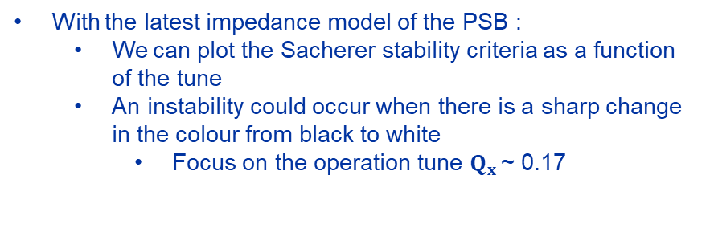
Expectations from the model
With the latest impedance model of the PSB :
  We can plot the Sacherer stability criteria as a function of the tune
  An instability could occur when there is a sharp change in the colour from black to white
    Focus on the operation tune $Q_{x }$~ 0.17
Third kicker resonance
1.2 GeV predicted by the third kicker resonance
  Similar to beam observations (see slide 10) at about 1.3 GeV
  The instability introduced by the third resonances should be weaker and indeed the 1.3 GeV instability appears at higher intensities
Additional instabilities expected from the third kicker resonance

Slide 29
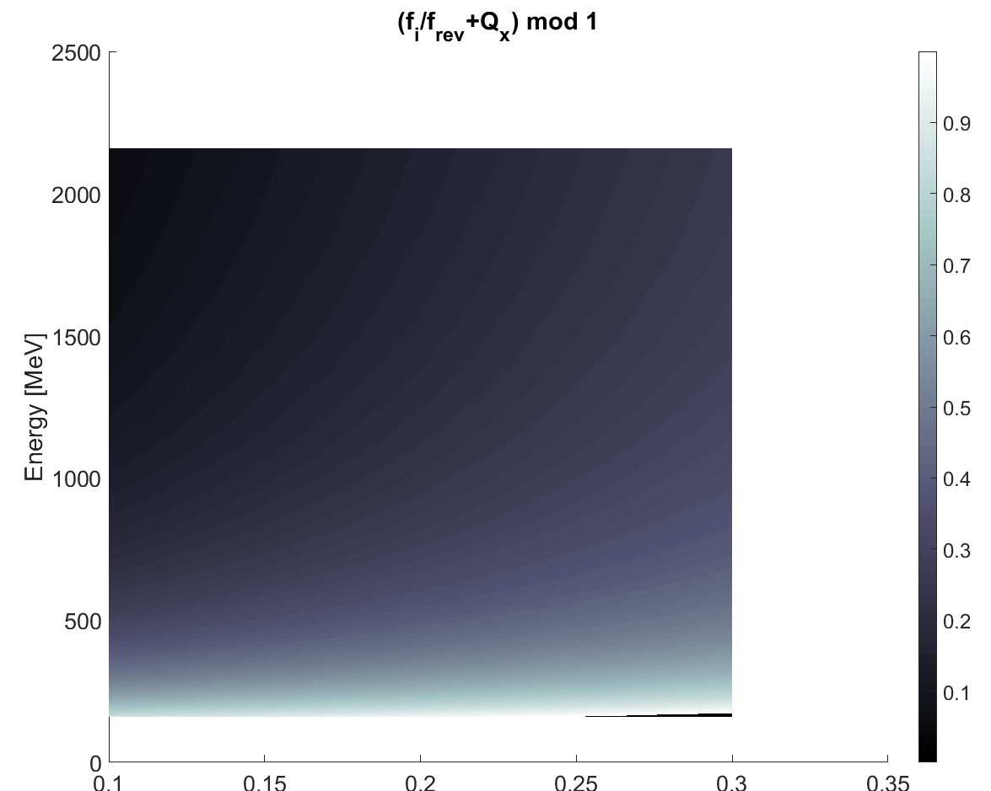
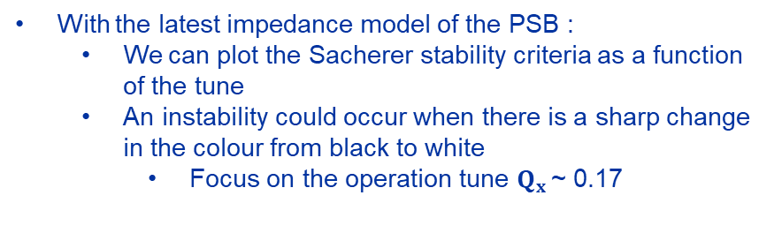
Expectations from the model
With the latest impedance model of the PSB :
  We can plot the Sacherer stability criteria as a function of the tune
  An instability could occur when there is a sharp change in the colour from black to white
    Focus on the operation tune $Q_{x }$~ 0.17
First kicker resonance
Instability observed at injection energy (160 MeV) without horizontal feedback

Slide 30
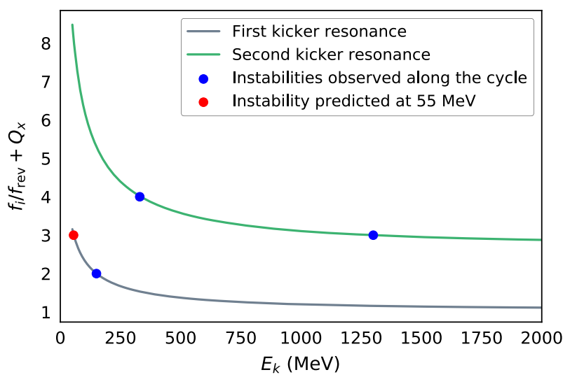
Prediction with old impedance model

Slide 31
