Slide 1
AD: Quest for dbars
D. Gamba for the AD/ELENA team et al.
07/02/2025 – IPP MD Days 2025

Slide 2
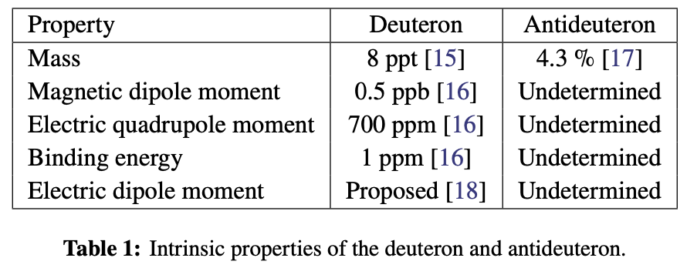
Why dbars?
Next simplest anti-nucleus we can produce: one n-bar + one p-bar
Not much physics quantities well measured compared to “normal” deuteron:
Growing interest in AD/ELENA user community
  It is a ”convenient” (charged particle) way to get access to the anti-neutron
Interest from high-energy physics community
  They are used to produce dbars with p or ions at high energy in LHC, which they model well, but there is much uncertainty on production cross-section at low energy
R. Caravita
EXA-LEAP2024

Slide 3
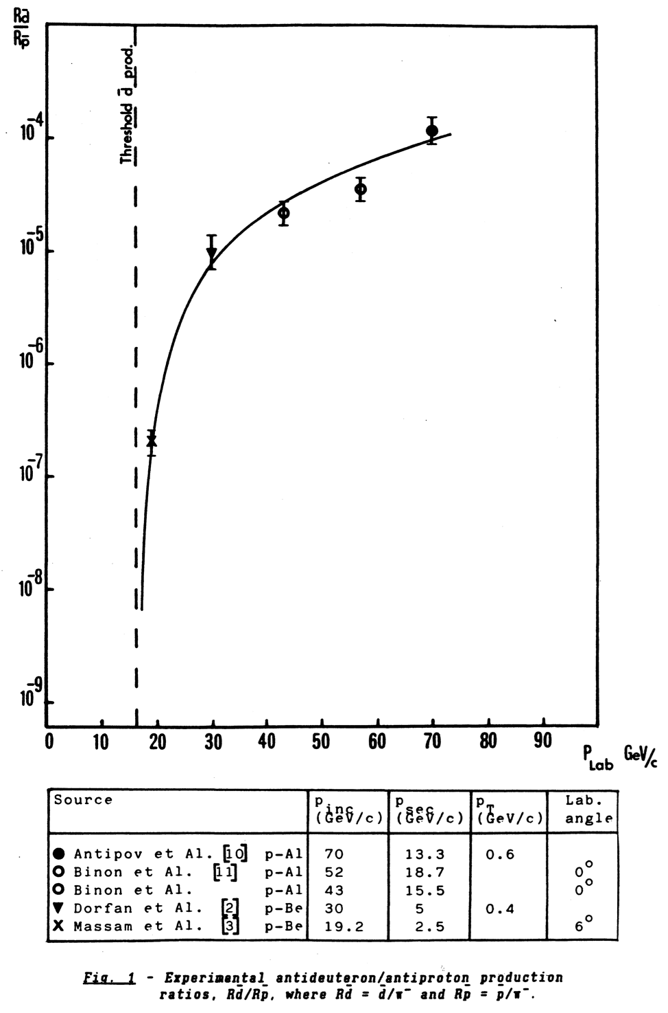
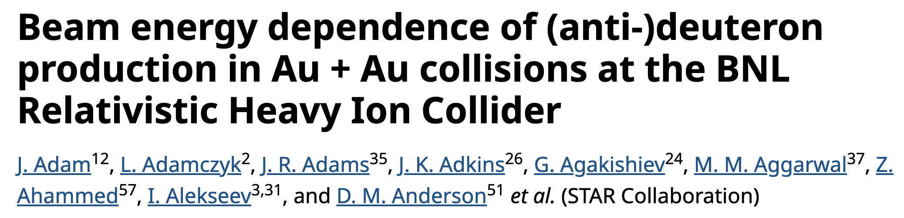
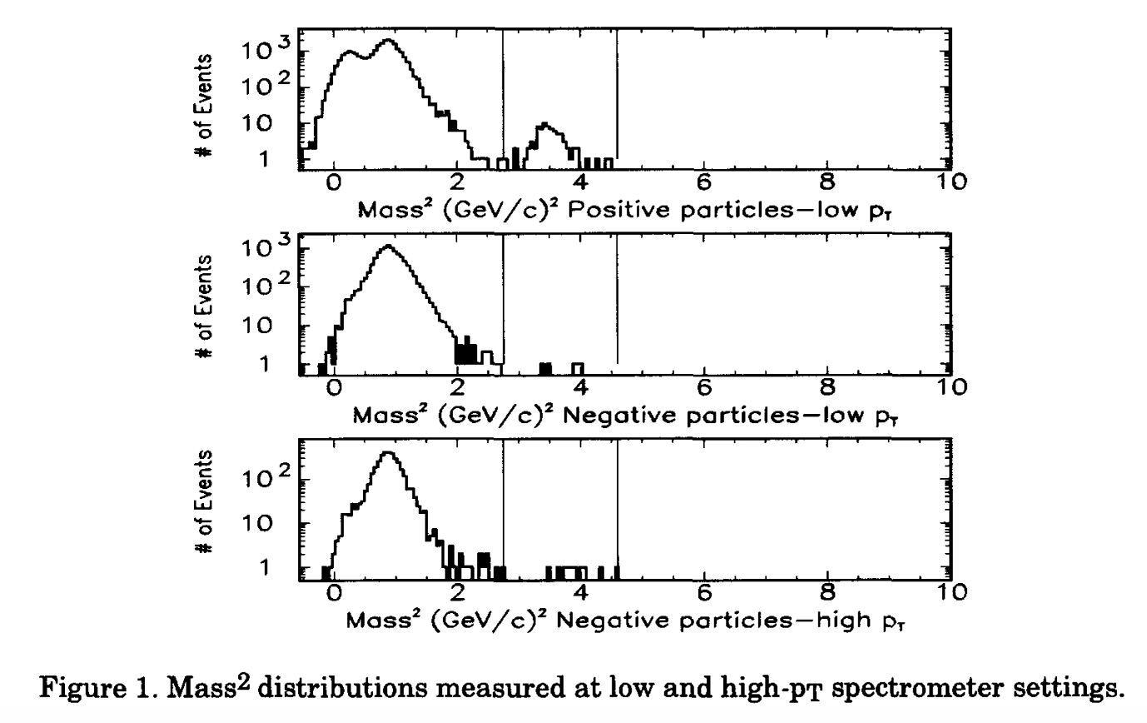
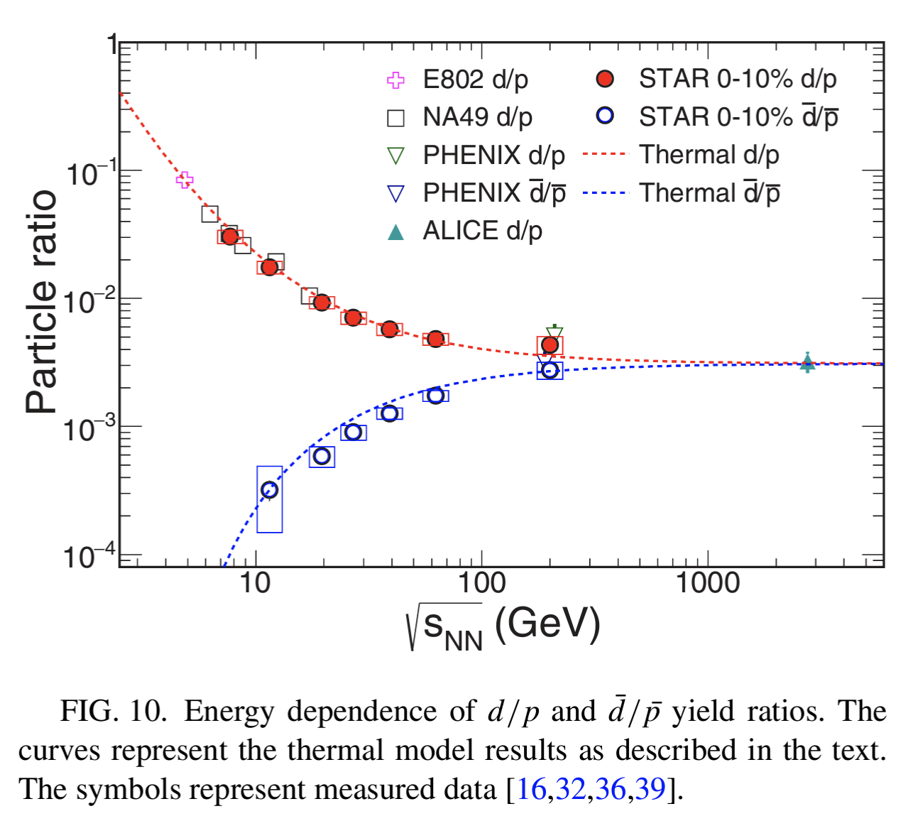
How many dbar/pbar to be expected? In literature:
p_{lab} 450 GeV/c @ NA44
AD ￫ 2e-6
10⁻³?
J. Simon-Gillo et al. – Nucl.Phys.A 590(1995)
https://doi.org/10.1103/PhysRevC.99.064905
C.D. Johnson et al. – CERN-PS-88-05-AR

Slide 4
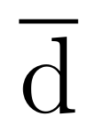
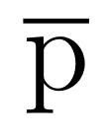
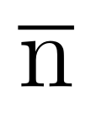


a FLUKA simplified model [PRELIMINARY!!!]
By F. Salvat Pujol et al. – 2024 - indico
Coalesce
p
p
(26 GeV/c)
𝛄 = ~28
p
p
Pb
𝛄 = ~7.42
$$π^{−}$$
Ir
A_{res}, Z_{res}
$$π^{+}$$
FLUKA nuclear inelastic interaction
Confirming 1988 expectations: ~2e-6 dbar/pbar => only about 50-100 dbars in AD (?)
What if we were using Pb as primary? ~1e-4 dbar/pbar (but Pb/p ~5e-5 …)

Slide 5
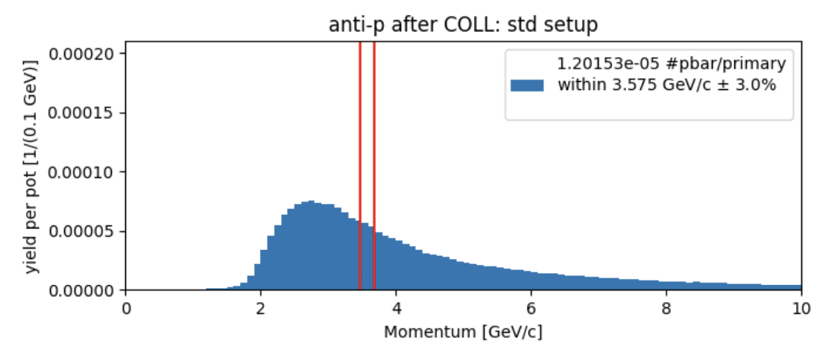
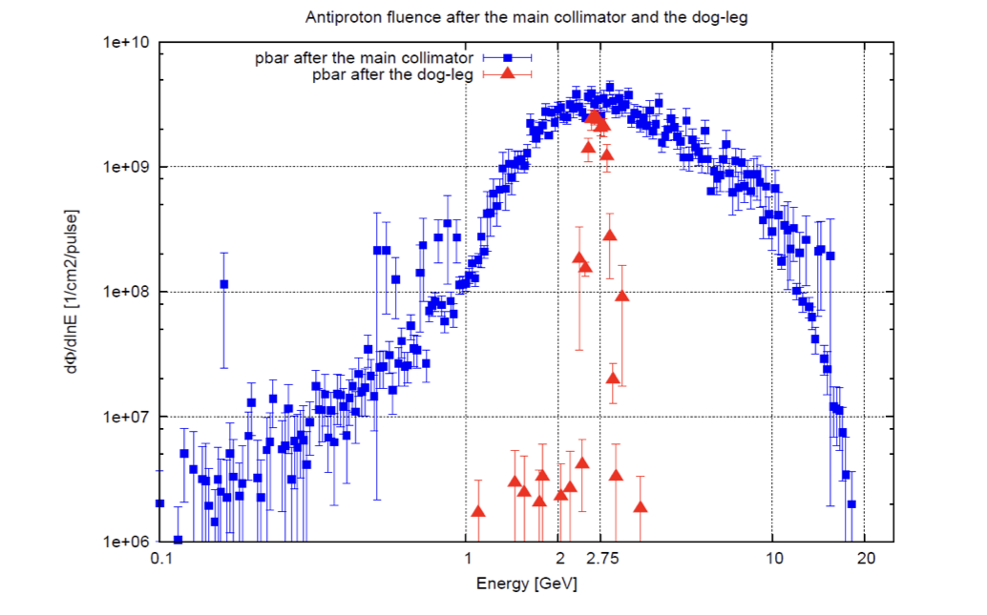
Tests we started doing in AD
Check if we see something already now on Schottky at frev=1.45509226 MHz (instead of 1.589328 MHz of pbars)
  [done] – nothing seen
Try to re-bunch at anti-deuteron frequency, start deceleration (to kill the pbars), then scrape the leftovers: do we “kill” something else, i.e. anti-deuteron??
  [partially done] - no signal visible.
Try to configure s-cooling notch filter to cool (longitudinally) anti-deuteron
  Maybe possible with old 2 GeV/c notch filter
Inject in AD at different (lower) momentum
  Kind of check for expected pbar distribution
Try to inject at p=2.781 GeV/c
  This corresponds to C10 h=7 for anti-deuteron: maybe possible to see a coherent signal at injection?
… Develop/install resonant Schottky monitor like the one used in GSI for single particle measurements?
  Started to think about it in AFMD-6
L. S. Esposito – SY-STI – FLUKA simulations April 2024
From ATS_Note_2012_069_TECH

Slide 6
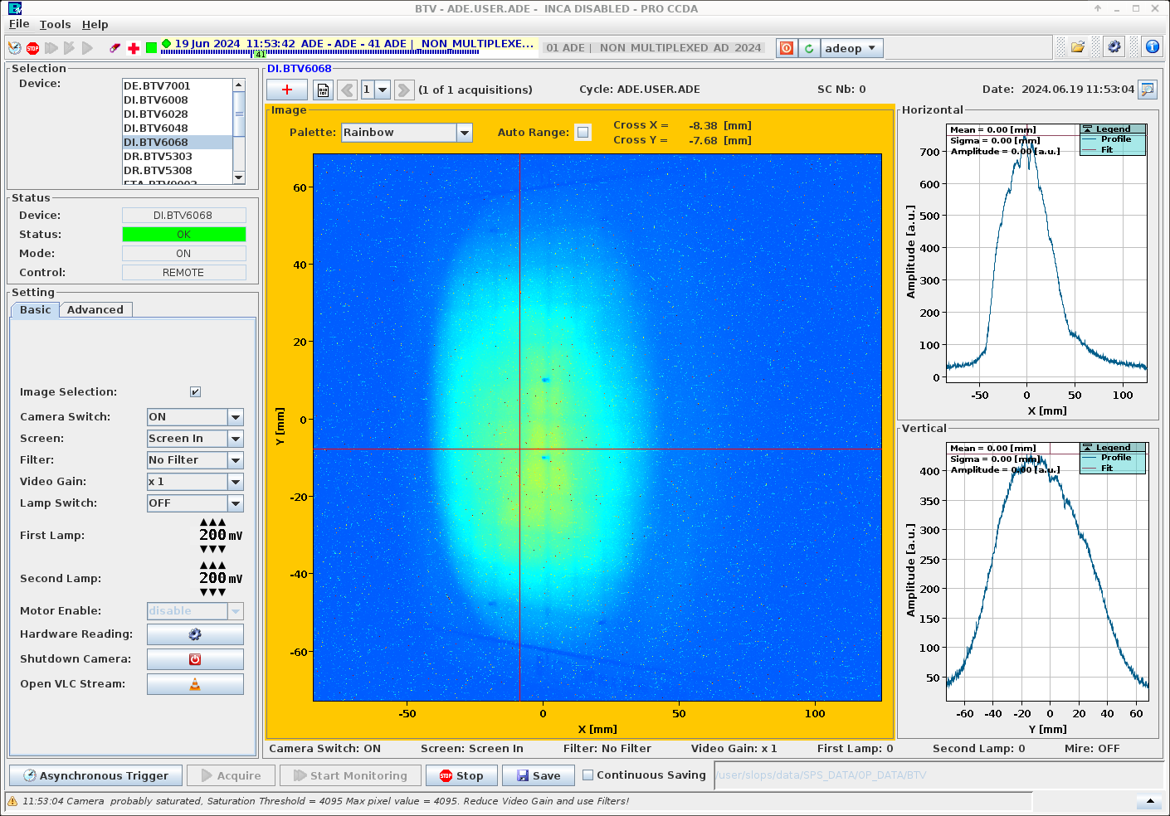
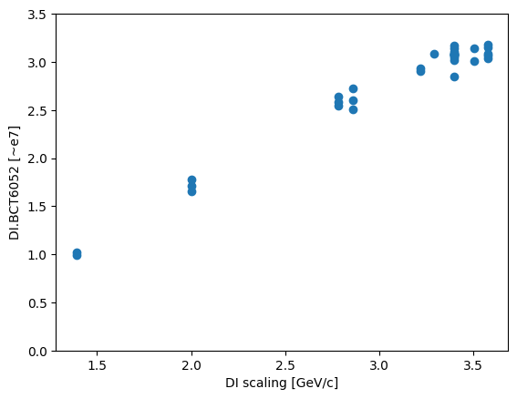
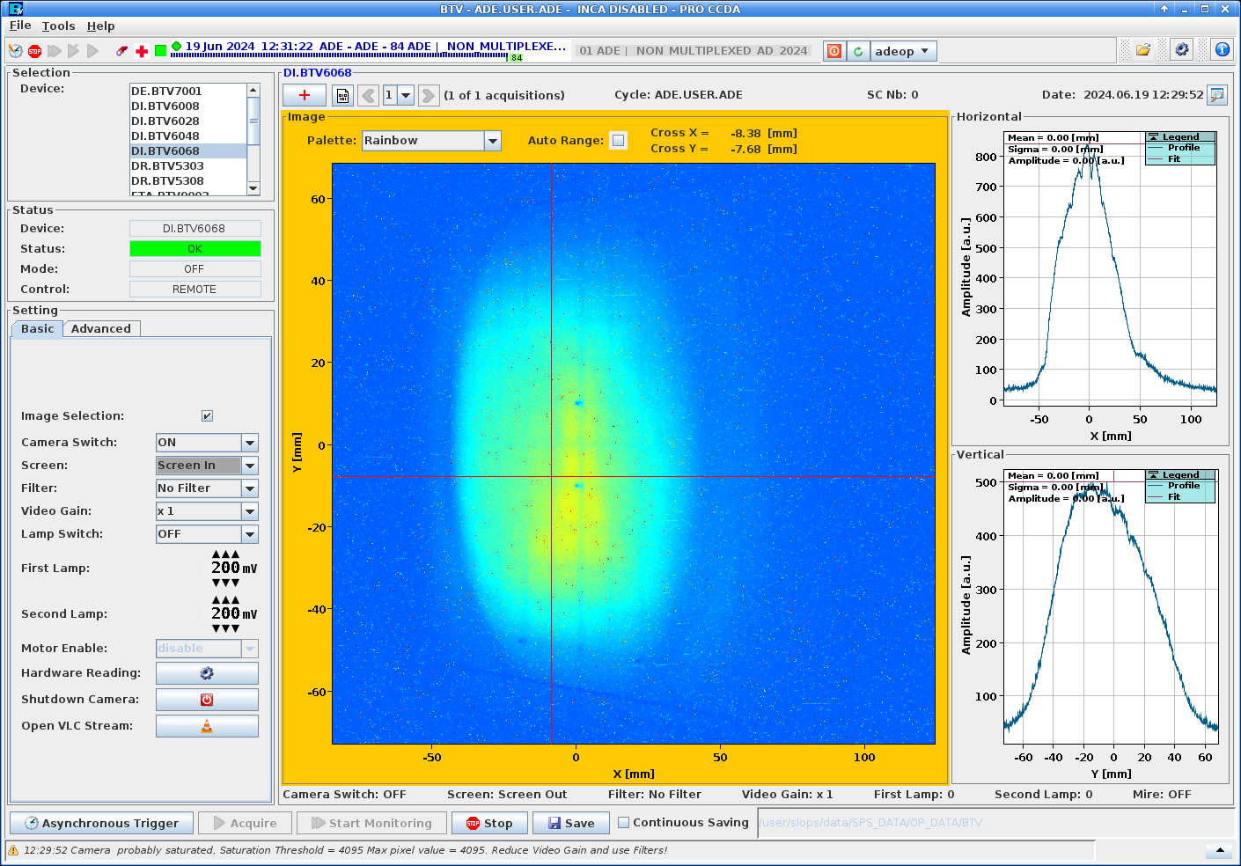
Some 2024 tests: pbars(?) momentum distribution measurement
Scaling of DI line (from horn to AD injection septum and kickers) to see if we could potentially inject lower momentum pbars (and other particles) – see logbook
First attempt shows that enough negatively charged particles would reach the ring…
Note 1: most points obtained with -150A offset removed to the settings on DI.BHZ24/25, starting from p=2.7 GeV/c, then “linearly” lower offset for p values close to 3.57 GeV/c. This is a “known” effect of those two initial dipoles in the line.
Note 2: spot on BTV6068 seems very similar: some hope for a reasonable matching with AD.
WARNING! At this location we measure all particles! We don’t know the pbar content here!

Slide 7
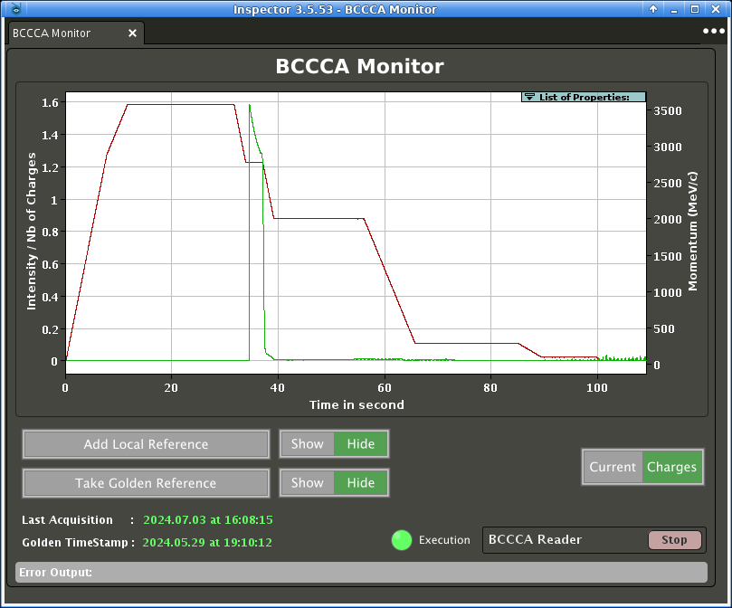
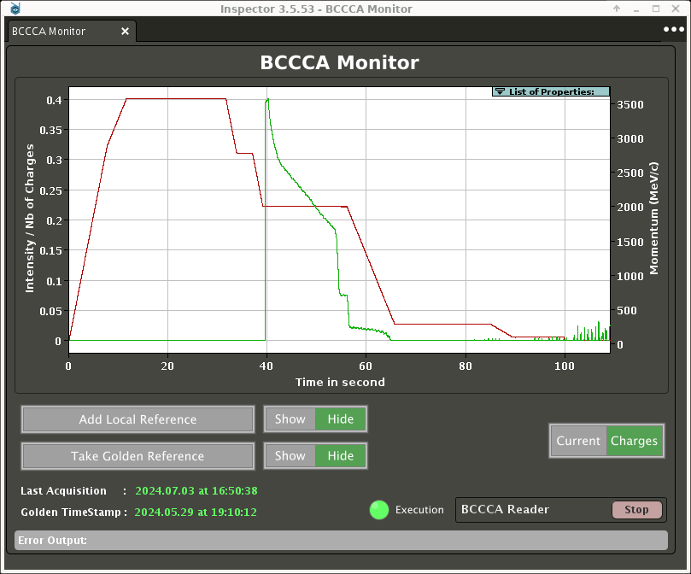
Some 2024 tests: injecting pbars at different momenta in AD
Injecting pbars in the ring at different momenta
  ~1/3 of intensity injected and circulating at 2.7 GeV/c
  ~1/10 of intensity injected and circulating at 2 GeV/c
Injecting in AD at ~2.7 GeV/c
Injecting in AD at 2 GeV/c

Slide 8
What to expect in 2025
Exploring the feasibility of detecting dbars with (available) instrumentation
  Ongoing but sparse discussions among ABP, BI, OP, RF, etc.; a dedicated meeting is needed to identify promising solutions
  If experiments formalise a request (SPSC call ongoing), initiate discussions/studies on developing a dedicated monitor for post-LS3, including potential s-cooling (and bunch rotation?!) modifications
Systematic data collection on pbar yield at different momenta
  Valuable opportunity to further validate FLUKA models and DI transport (see Y. Dutheil et. all)
The actual request for you: could we think of having a Pb beam sent to AD?
  Primarily useful for validating FLUKA’s production cross-section predictions
  (I assume this would be a single bunch, of maximum intensity, no compression/rotation/… with same rigidity as p beam, … maybe keeping Pb54+?, maybe stripping to Pb82+ before the PS?, …)
More Ideas are Welcome!

