Slide 1
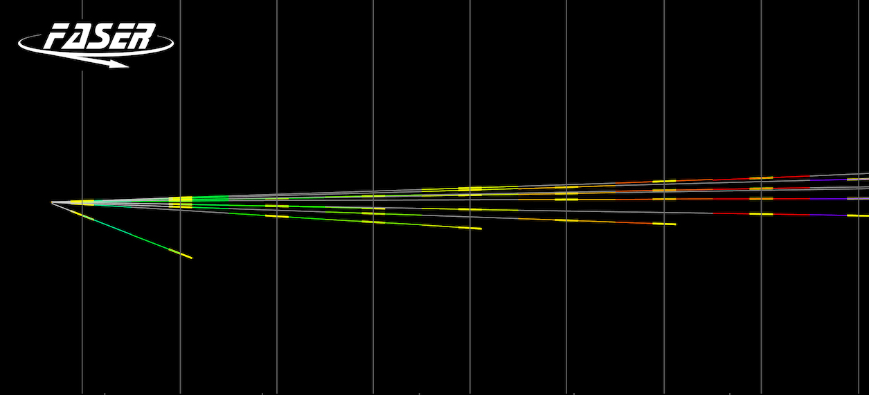
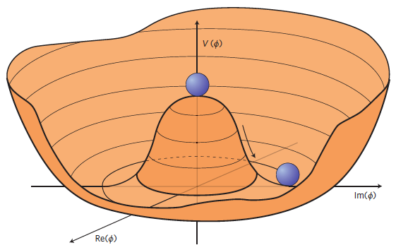
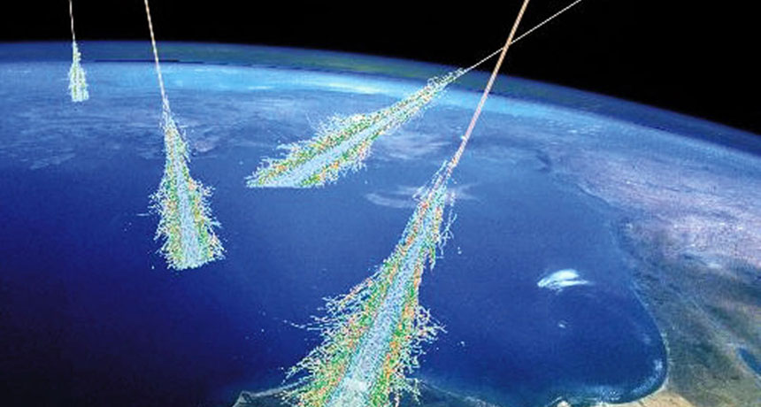

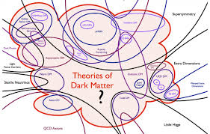

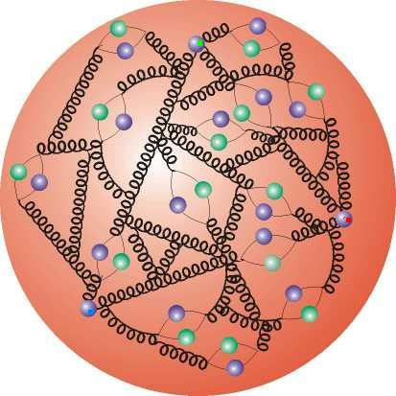
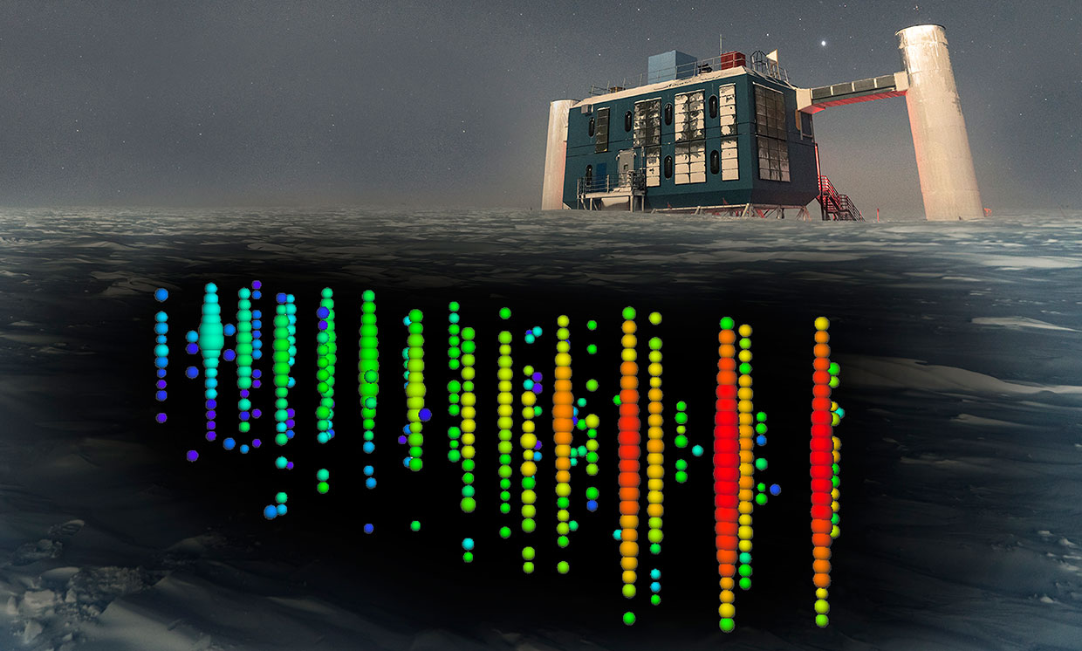
Broad Physics Opportunities and Discovery Potential in the Forward Region at the LHC
Max Fieg (UC Irvine → FNAL)
In collaboration with many great people:
Jonathan Feng, Felix Kling, Juan Rojo, Roshan Mammen Abraham, Juan M. Cruz-Martinez, Tommaso Giani, Peter Krack, Toni Mäkelä, Tanjona Rabemananjara, Holger Schulz, Torbjorn Sjostrand, Keith Dienes, Brooks Thomas, Fei Huang, Seung Lee, FASER
Mitchell Conference on Collider, Dark Matter, and Neutrino Physics
Theory
Broad Physics Opportunities and Discovery Potential in the Forward Region at the LHC

Slide 2
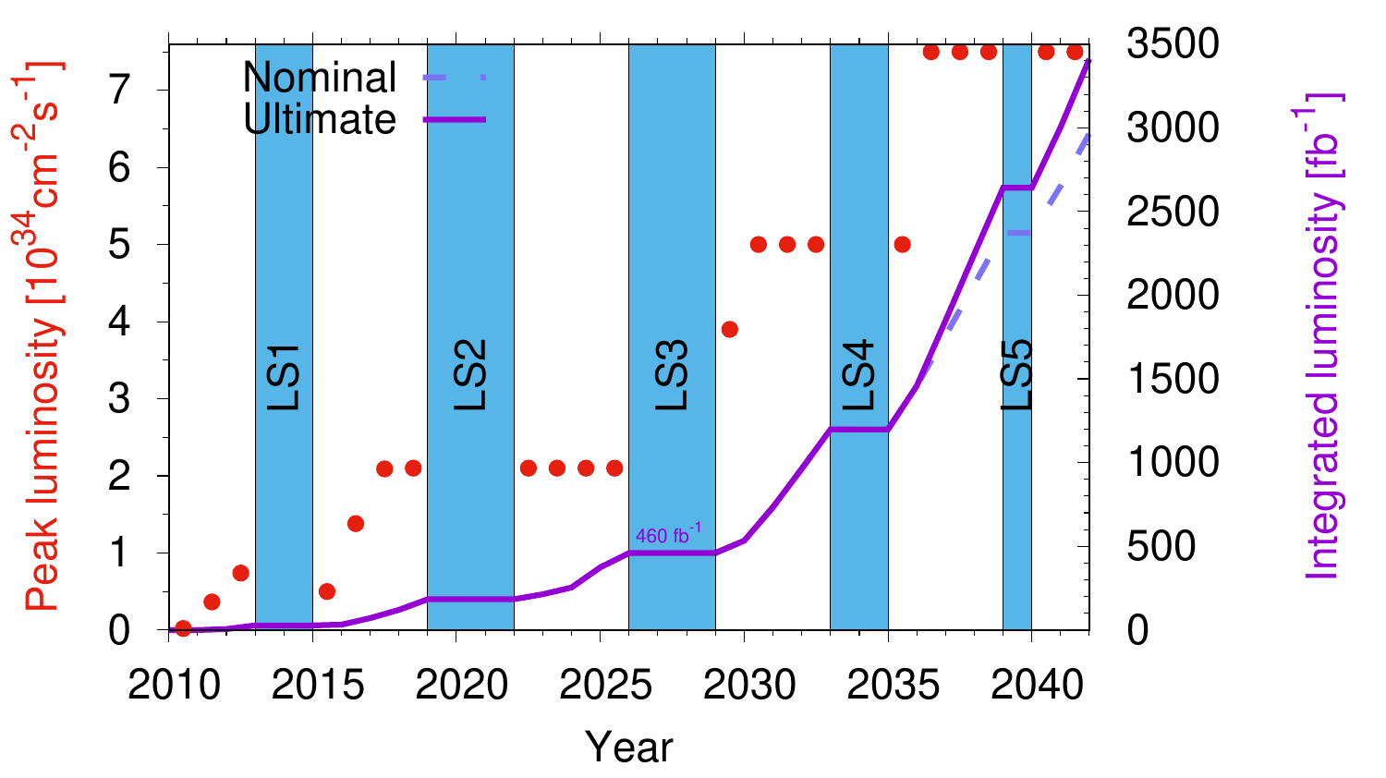
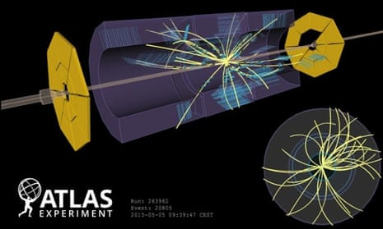
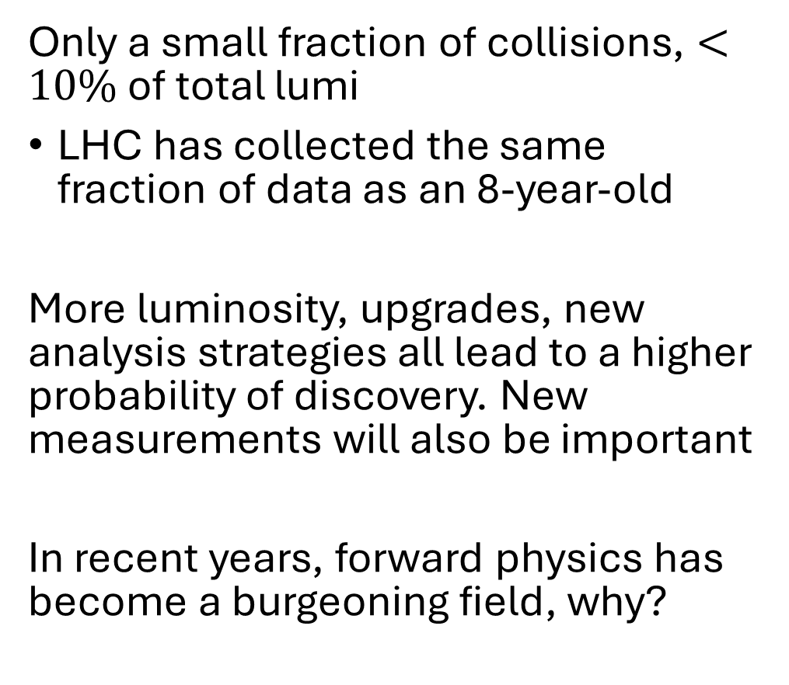
What more can we do with the LHC?
Only a small fraction of collisions, $<10\%$ of total lumi
LHC has collected the same fraction of data as an 8-year-old
More luminosity, upgrades, new analysis strategies all lead to a higher probability of discovery. New measurements will also be important
In recent years, forward physics has become a burgeoning field, why?

Slide 3
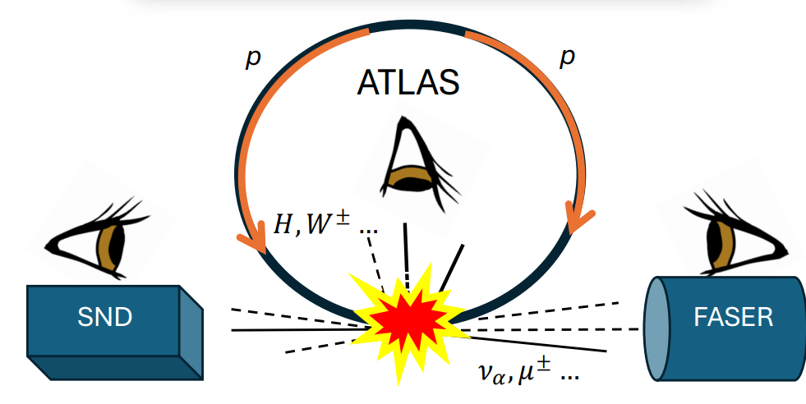


Forward Physics:A new way to observe collisions
Central experiments miss most of the soft collisions at the LHC
$$χ$$
$χ$,

Slide 4
Forward Physics:A new way to observe collisions
Central experiments miss most of the soft collisions at the LHC
Today the forward direction is instrumented by the FASER and SND experiments
$$χ$$
$χ$,

Slide 5
Forward Physics:A new way to observe collisions
Central experiments miss most of the soft collisions at the LHC
Today the forward direction is instrumented by the FASER and SND experiments
$$χ$$
$χ$,
“ These sources are complicated… Unless you have many ways to look at them, you’re not going to figure them out.”
-Francis Halzen on Multimessenger Astronomy, Scientific American
“ These collisions are complicated… Unless you have many ways to look at them, you’re not going to figure them out.”
Multimessenger Collider Physics

Slide 6
Forward Physics:A new way to observe collisions
Central experiments miss most of the soft collisions at the LHC
Today the forward direction is instrumented by the FASER and SND experiments
$$χ$$
$χ$,
“ These sources are complicated… Unless you have many ways to look at them, you’re not going to figure them out.”
-Francis Halzen on Multimessenger Astronomy, Scientific American
“ These collisions are complicated… Unless you have many ways to look at them, you’re not going to figure them out.”
Multimessenger Collider Physics
What should we expect to see in the forward direction?

Slide 7
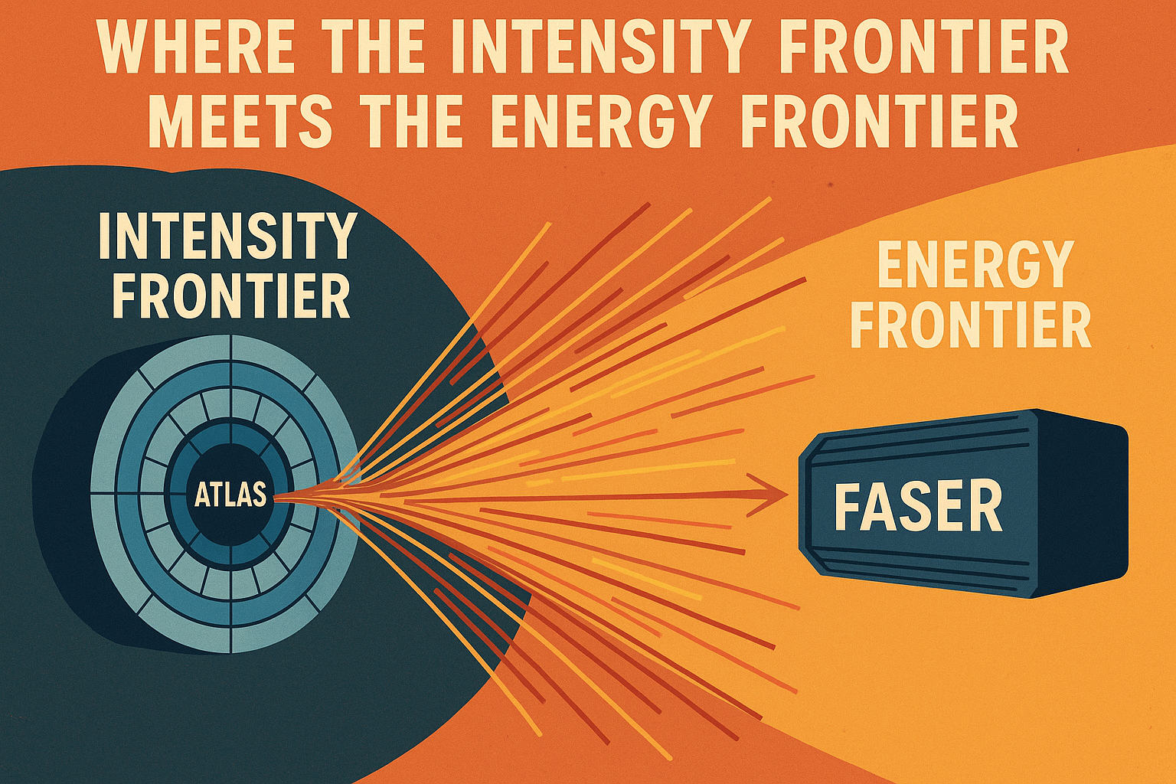
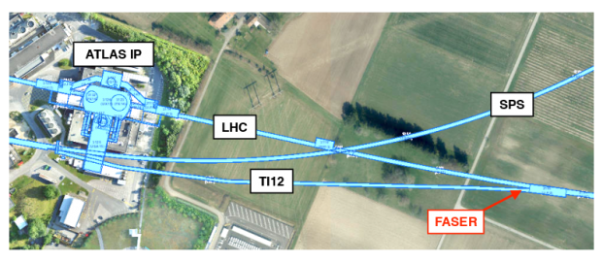
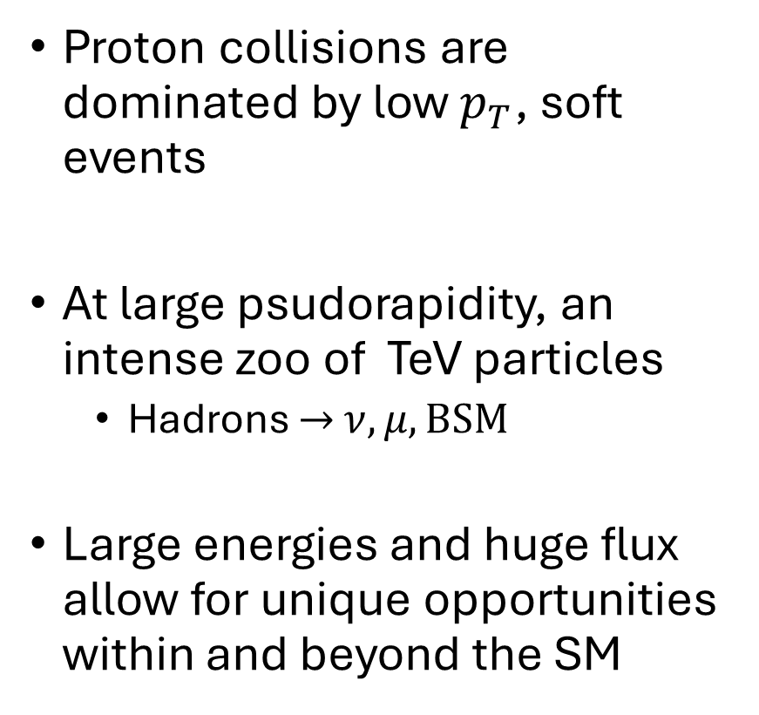
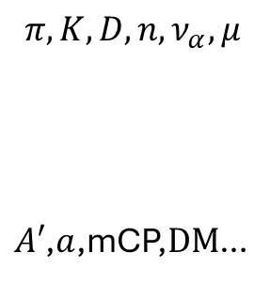
Intensity and Energy, why not both?
Proton collisions are dominated by low $p_{T}$, soft events
At large psudorapidity, an intense zoo of TeV particles
  Hadrons $→$ $ν,μ, BSM$
Large energies and huge flux allow for unique opportunities within and beyond the SM
$$π,K,D,n,ν_{α},μ$$
$A′$,$a$,mCP,$DM$…
480 m
Rock
Shield

Slide 8
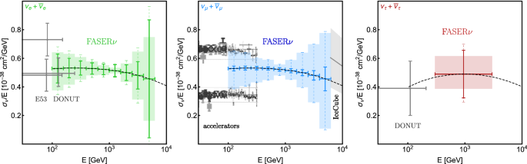
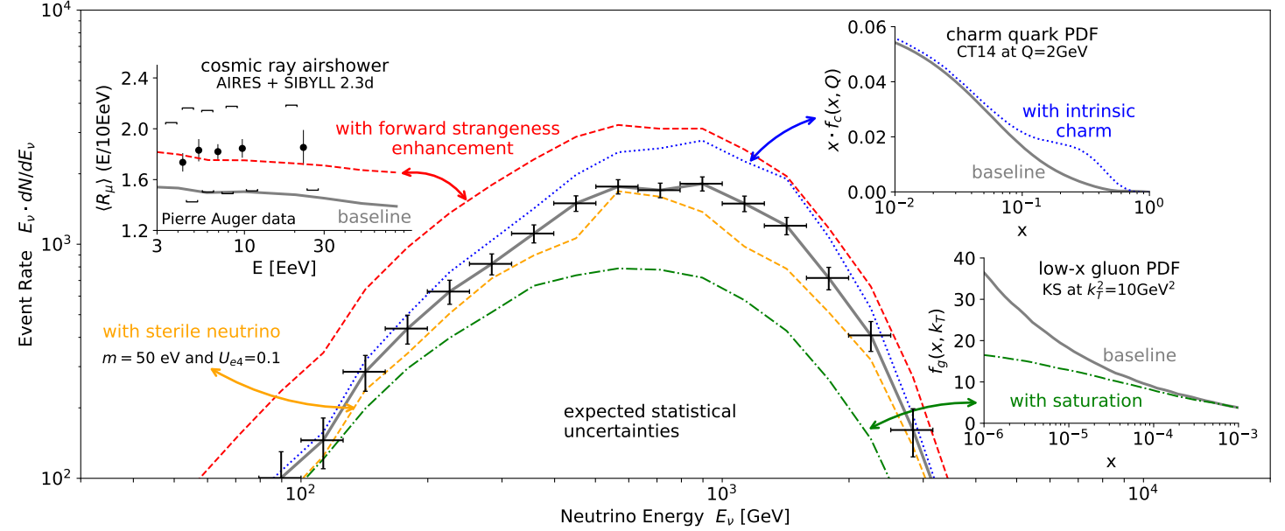
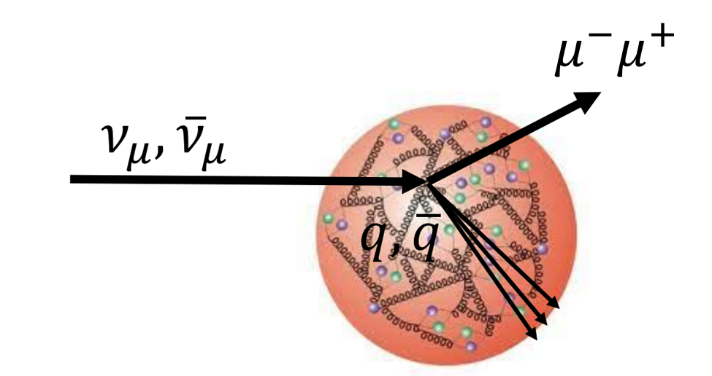

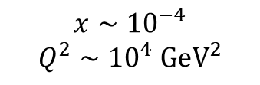



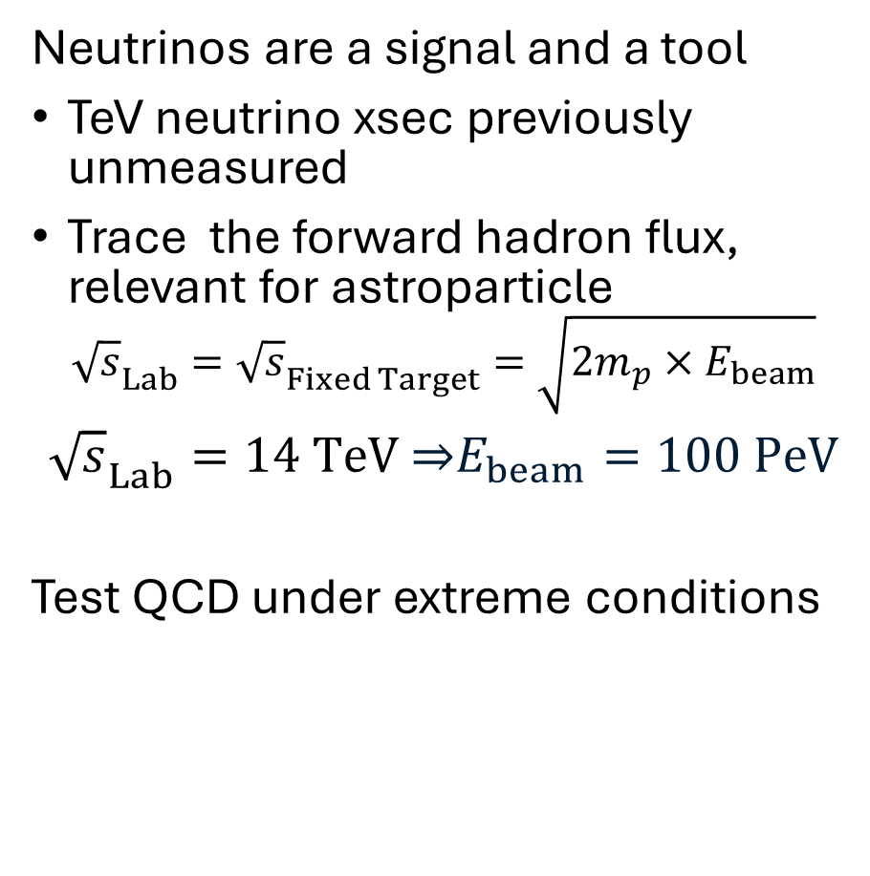







Guaranteed Discoveries
SM
Gap between astro and collider xsec measurements
Neutrinos are a signal and a tool
TeV neutrino xsec previously unmeasured
Trace the forward hadron flux, relevant for astroparticle
$${\sqrt{s}}_{Lab}={\sqrt{s}}_{Fixed Target}=\sqrt{2m_{p}×E_{beam}}$$
${\sqrt{s}}_{Lab}=14 TeV$ ⇒$E_{beam}=100 PeV$
Test QCD under extreme conditions
j
$$ν_{e}$$
$$ν_{μ}$$
$$ν_{τ}$$
$$x_{1}∼1$$
@FASER
@LHC
$$x∼{10}^{−4}$$
$$Q^{2}∼{10}^{4} {GeV}^{2}$$
$$x_{2}∼{10}^{−9}$$
Input to EPPSU 2503.19775

Slide 9
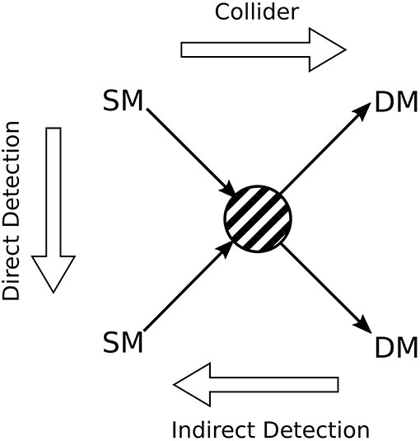
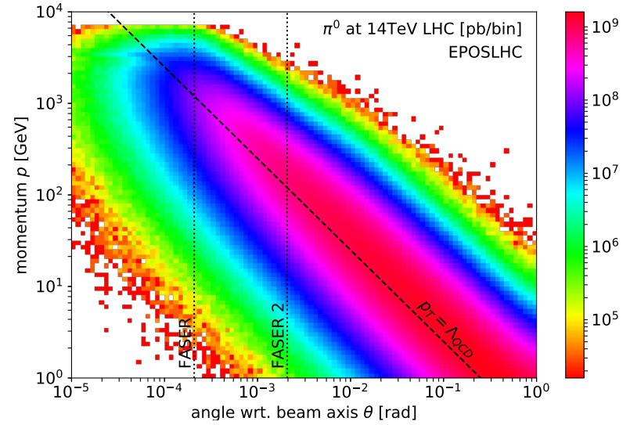






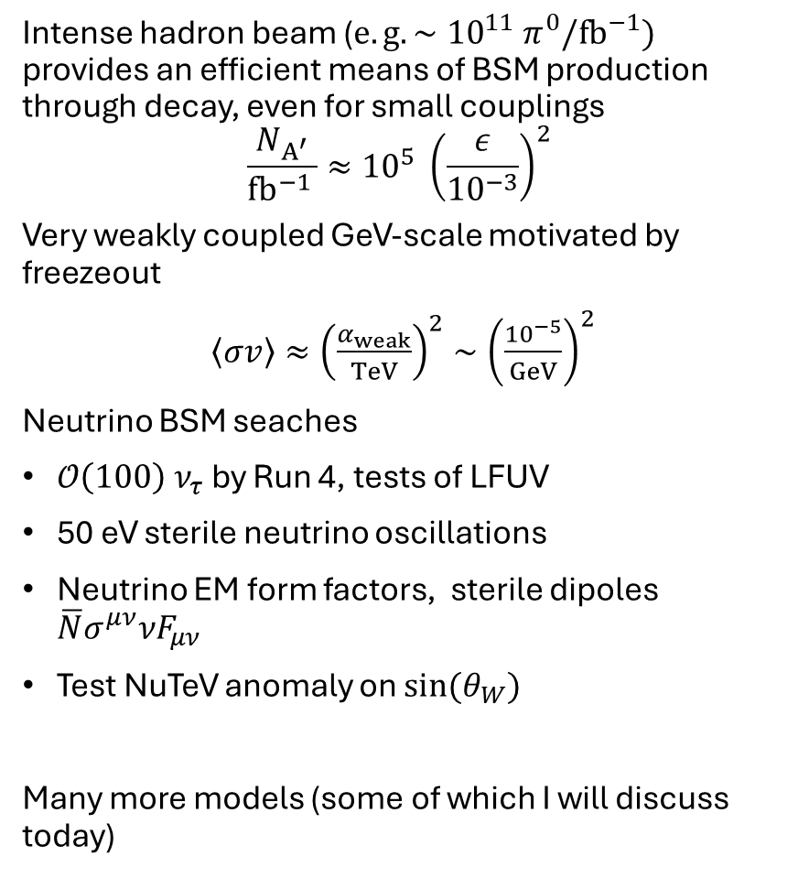



Possible Discoveries
BSM
Intense hadron beam (${e.g. ∼10}^{11} π^{0}/fb^{−1})$ provides an efficient means of BSM production through decay, even for small couplings
$$\frac{N_{A^{′}}}{fb^{−1 }}≈{10}^{5} {\left(\frac{ε}{{10}^{−3}}\right)}^{2}$$
Very weakly coupled GeV-scale motivated by freezeout
$\left\langle σv\right\rangle ≈{\left(\frac{α_{weak}}{TeV}\right)}^{2}∼{\left(\frac{{10}^{−5}}{GeV}\right)}^{2}$
Neutrino BSM seaches
$𝒪\left(100\right) ν_{τ}$ by Run 4, tests of LFUV
50 eV sterile neutrino oscillations
Neutrino EM form factors, sterile dipoles $\overline{N}σ^{μν}νF_{μν}$
Test NuTeV anomaly on $sin(θ_{W})$
Many more models (some of which I will discuss today)

Slide 10
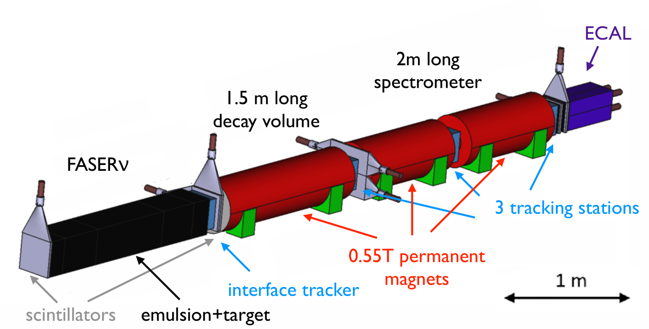
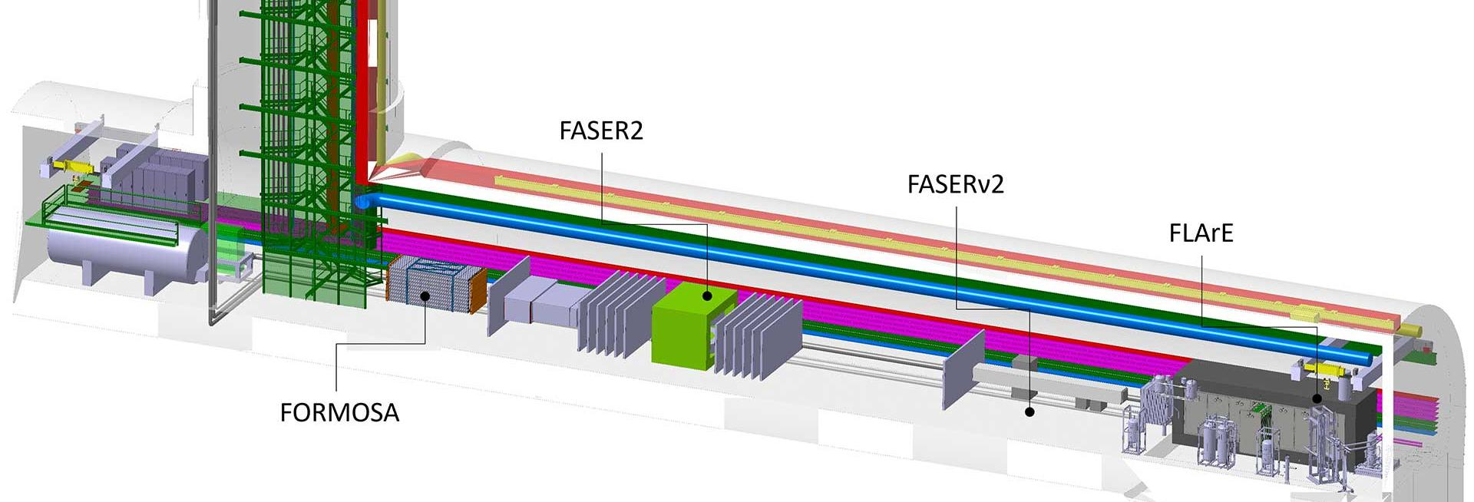

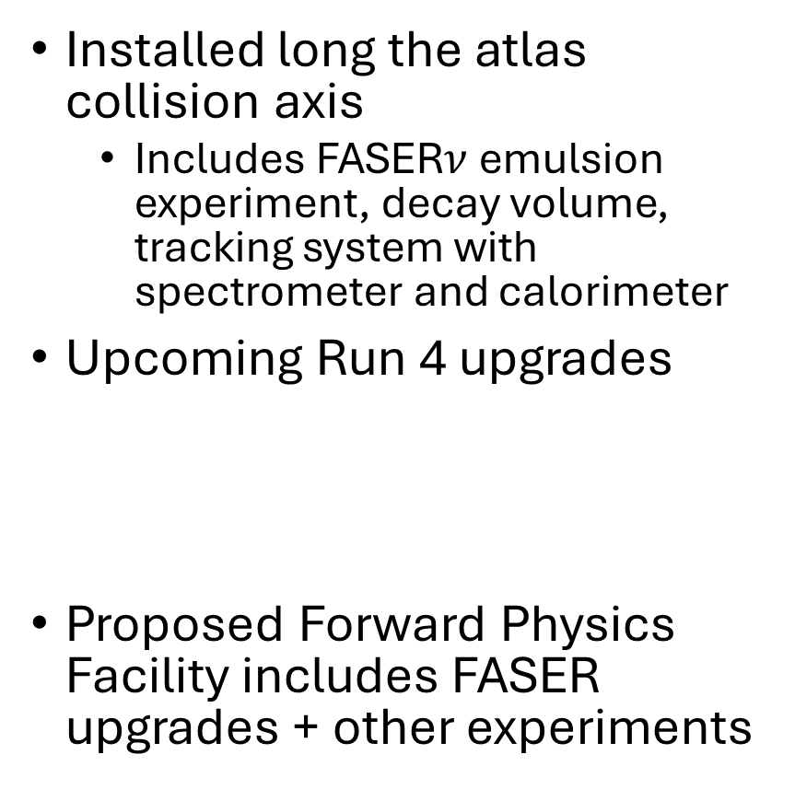
FASER Experiment
Installed long the atlas collision axis
  Includes FASER$ν$ emulsion experiment, decay volume, tracking system with spectrometer and calorimeter
Upcoming Run 4 upgrades
Proposed Forward Physics Facility includes FASER upgrades + other experiments

Slide 11
What can we do within the SM in the forward direction?

Slide 12
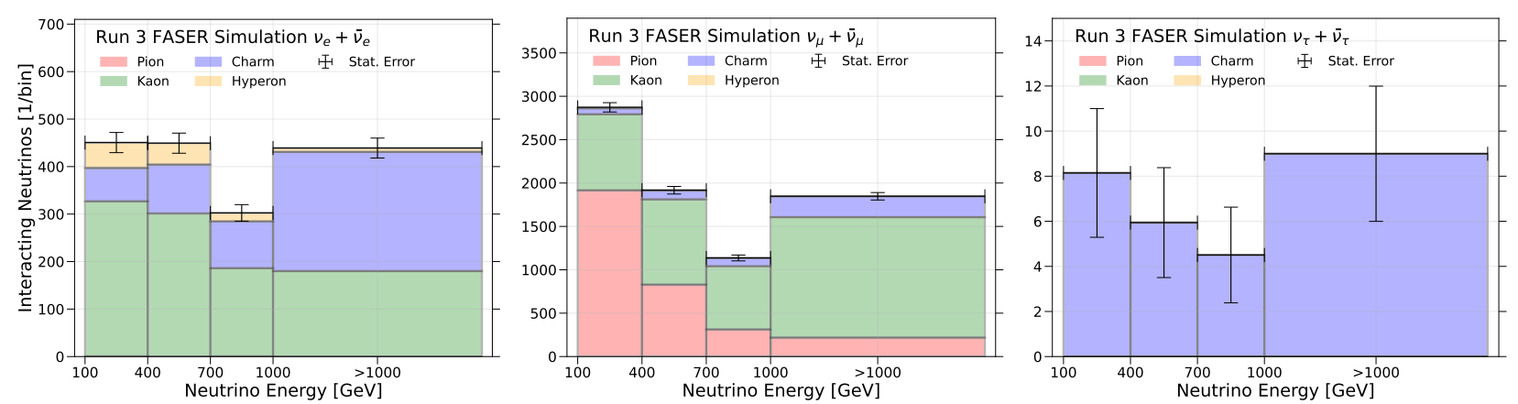
Forward hadron fluxes are messy and important
Use Neutrino fluxes at LHC to reconstruct forward hadron flux!
Simulation:
FASER (2402.13318)

Slide 13
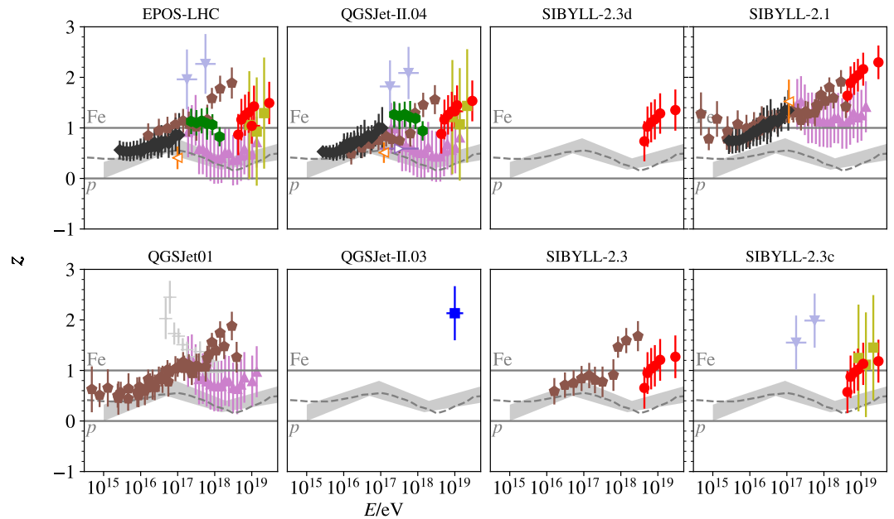
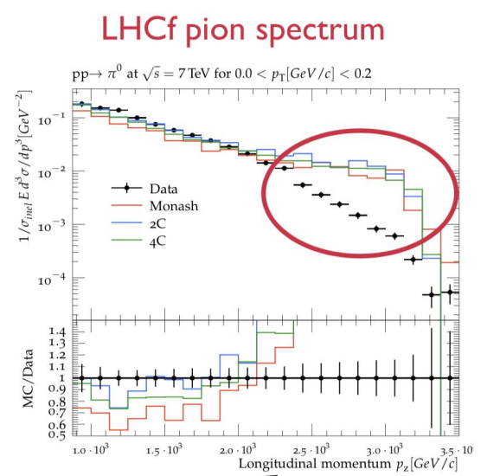
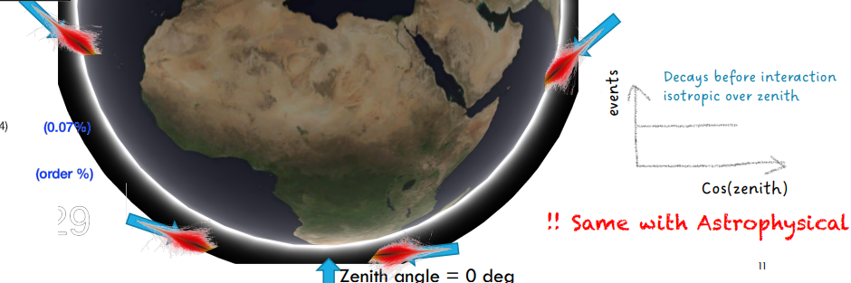
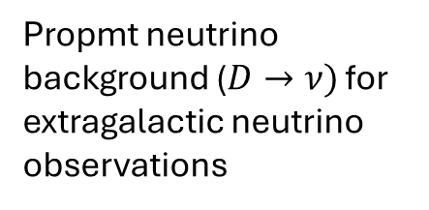

Forward hadron fluxes are messy and important!
The current forward data is not well-described by event generators
The “muon puzzle”:
too many CR produced muons for $E_{μ}>10 PeV$
Albrecht et al. (2105.06148)
Default Predictions
Propmt neutrino background ($D→ν)$ for extragalactic neutrino observations
Slide from Lu Lu
See Pedro, Vedran, Matheus and Bhupal talks from this morning

Slide 14
Forward hadron fluxes are messy and important!
Need data to improve modelling of non-perturbative QCD!
The current forward data is not well-described by event generators
The “muon puzzle”:
too many CR produced muons for $E_{μ}>10 PeV$
Albrecht et al. (2105.06148)
Default Predictions
Propmt neutrino background ($D→ν)$ for extragalactic neutrino observations
Slide from Lu Lu

Slide 15
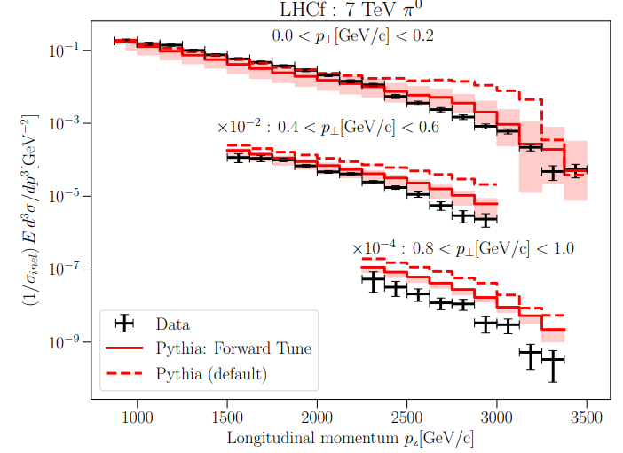
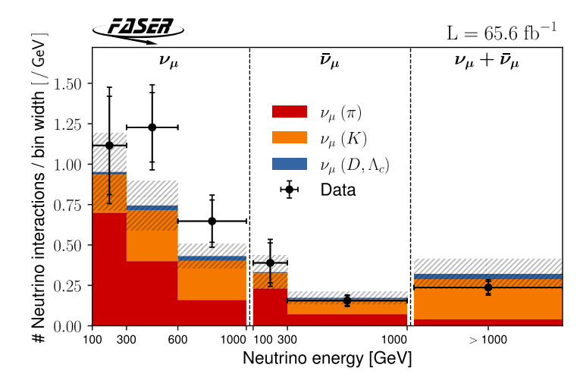
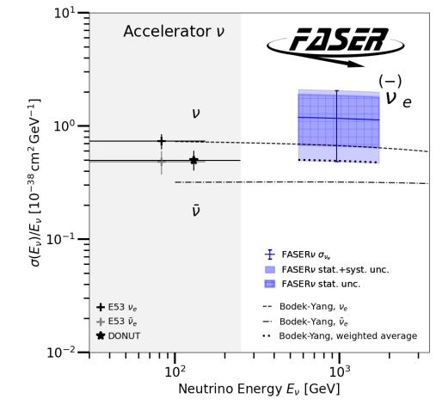

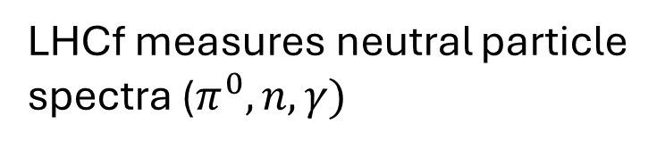
Along with LHCf, FASER provides crucial data to reduce flux uncertainties!
LHCf
FASER($ν)$
After tuning to LHCf
MF et al.
(2309.08604)
FASER (2412.03186)
FASER (2403.12520)
LHCf measures neutral particle spectra ($π^{0},n,γ)$
FASER($ν)$ reconstructs the $π^{±},K^{±},D$spectra
Charm production most important for neutrino telescopes, Run 4 proposal to improve these measurements, “FORTVNE”

Slide 16


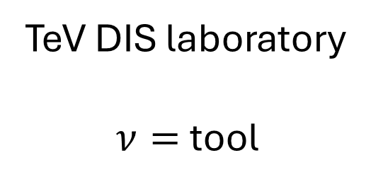
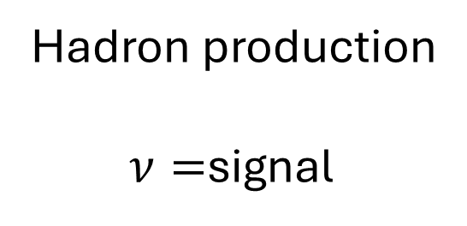
Non-perturbative QCD on both sides
Hadron production
$ν=$signal
TeV DIS laboratory
$ν=$tool

Slide 17
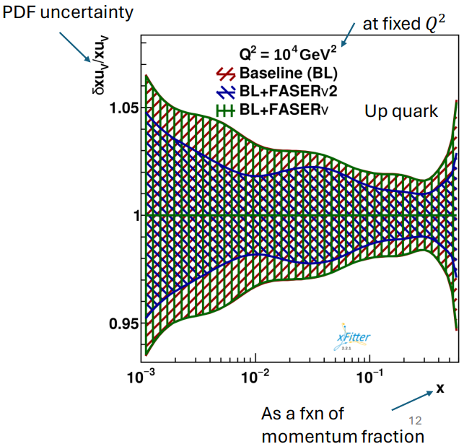
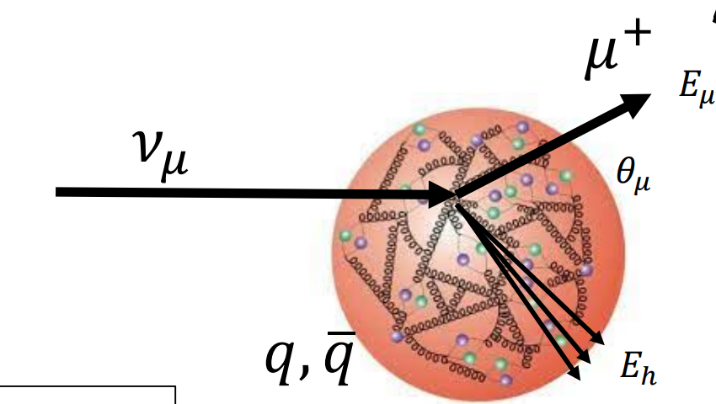
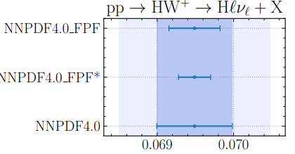

Use neutrinos to crack open the inside of the proton
By carefully reconstructing DIS variables…
we can fit the underlying PDF!
Reduce theory uncertainties for Drell-Yan production of, e.g. heavy bosons at the LHC!
$$σ(HW^{+})$$
Cruz-Martinez, MF et al. (2309.09581)

Slide 18
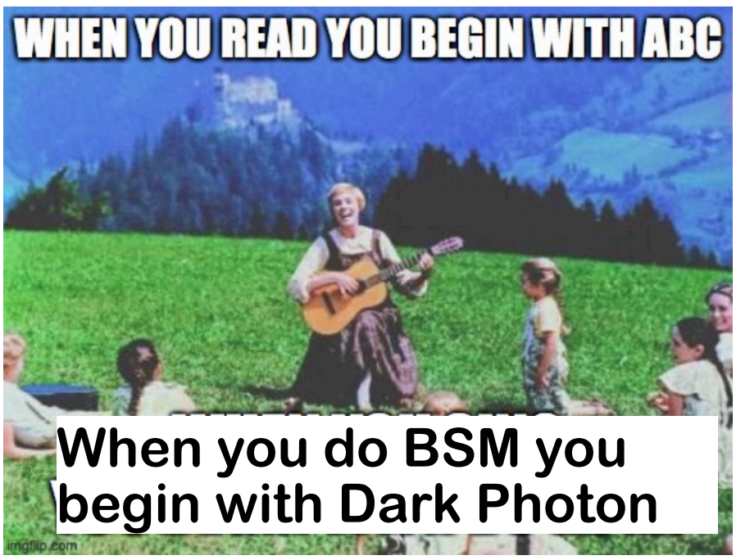
Let’s look at some of the recent BSM searches, and some ideas
Courtesy of Roshan Mammen Abraham

Slide 19
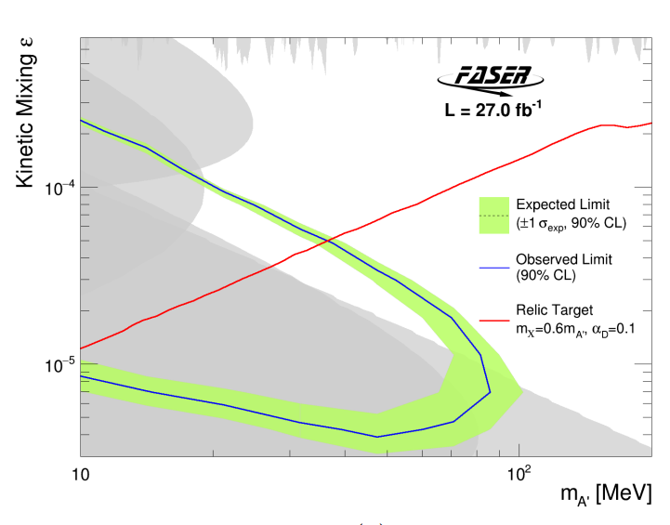
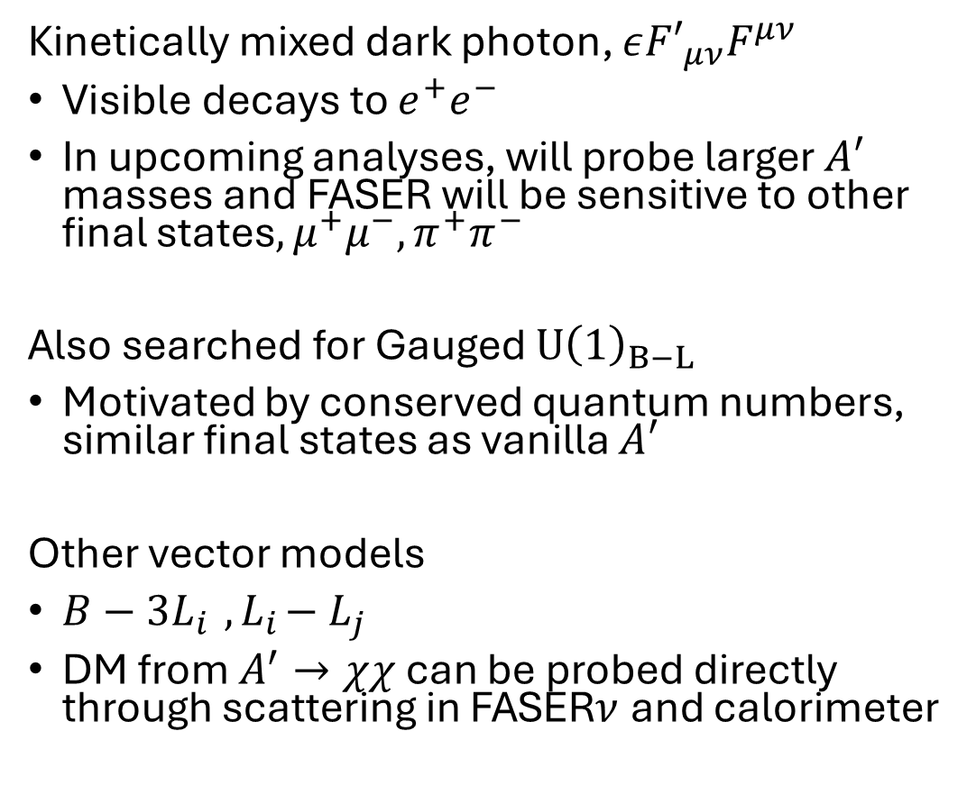

Dark photon, and dark photon-like models
Kinetically mixed dark photon, $ε{F′}_{μν}F^{μν}$
Visible decays to $e^{+}e^{−}$
In upcoming analyses, will probe larger $A′$ masses and FASER will be sensitive to other final states$,μ^{+}μ^{−},π^{+}π^{−}$
Also searched for Gauged $U{\left(1\right)}_{B−L}$
Motivated by conserved quantum numbers, similar final states as vanilla $A′$
Other vector models
$B−3L_{i}{ , L}_{i}−L_{j}$
DM from $A^{′}→χχ$ can be probed directly through scattering in FASER$ν$ and calorimeter
$$≪Run 3$$
$$Lumi$$
Let’s look at a model of inelastic DM

Slide 20
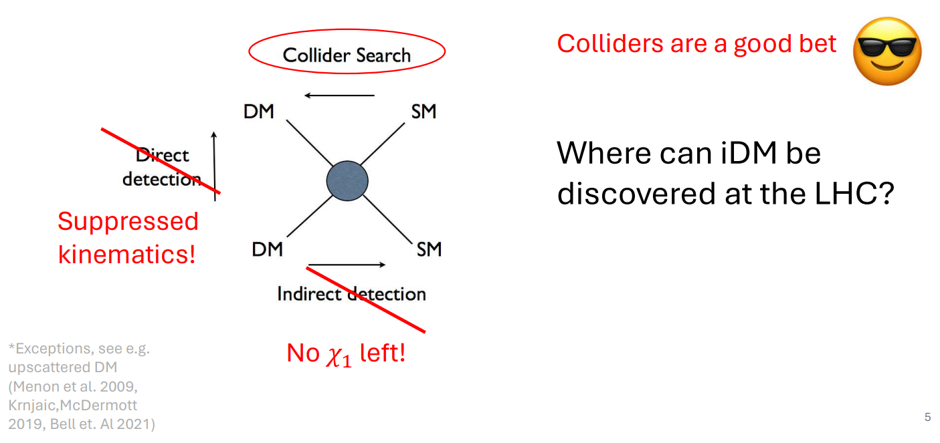
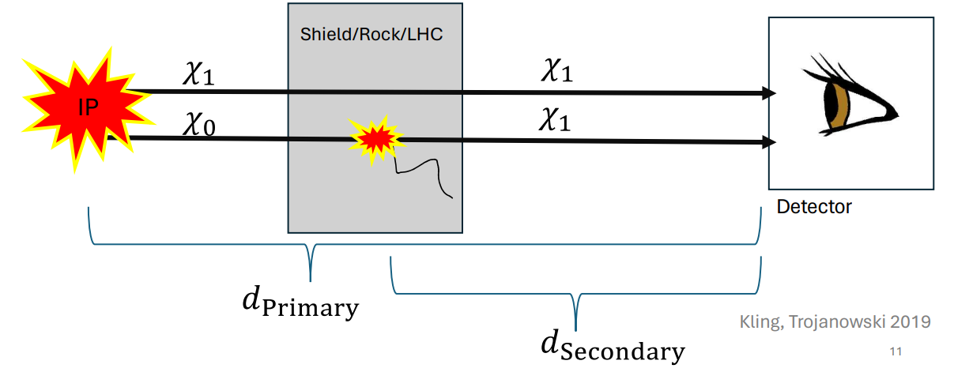
Inelastic Dark Matter
General class of models where DM only interacts with SM via an off-diagonal interaction with an excited state
iDM well-motivated for collider searches due to suppressed I.D., D.D.
Secondary production for FASER from shield/target, probe smaller lifetimes Kling Trojanowski (1911.11346)
See Christopher’s,Bhupal’s talks on iDM
Let’s look at a particular realization iDM that we studied to see one of FASER’s unique capabilities

Slide 21
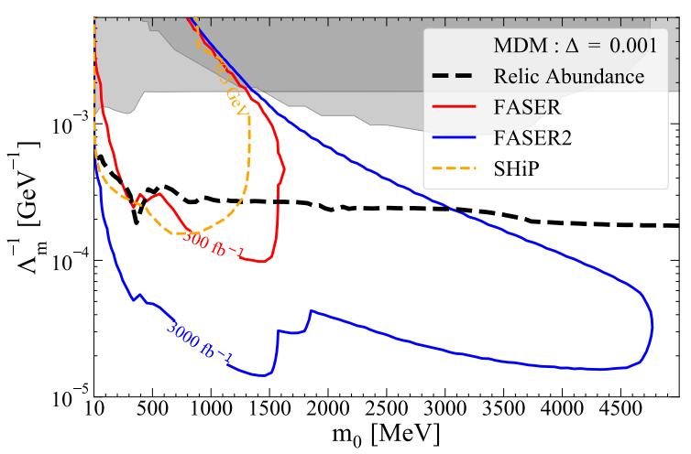
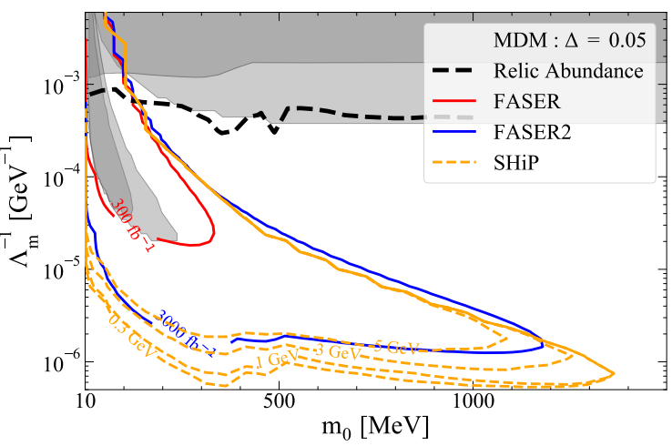


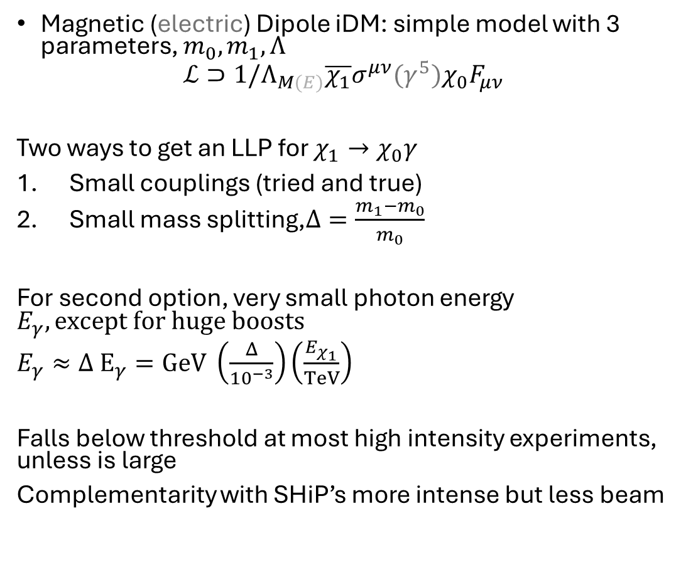

Dipole Inelastic Dark Matter
Magnetic (electric) Dipole iDM: simple model with 3 parameters, $m_{0},m_{1},Λ$
$$ℒ⊃1/Λ_{M(E)}\overline{χ_{1}}σ^{μν}(γ^{5})χ_{0}F_{μν}$$
Two ways to get an LLP for $χ_{1}→χ_{0}γ$
Small couplings (tried and true)
Small mass splitting,$Δ=\frac{m_{1}−m_{0}}{m_{0}}$
For second option, very small photon energy $E_{γ}, except for huge boosts$
$E_{γ}≈Δ{ E}_{γ}=GeV \left(\frac{Δ}{{10}^{−3}}\right)\left(\frac{E_{χ_{1}}}{TeV}\right)$
Falls below threshold at most high intensity experiments, unless is large
Complementarity with SHiP’s more intense but less beam
Small splitting
Larger splitting
2301.05252

Slide 22
What about new scalars?

Slide 23
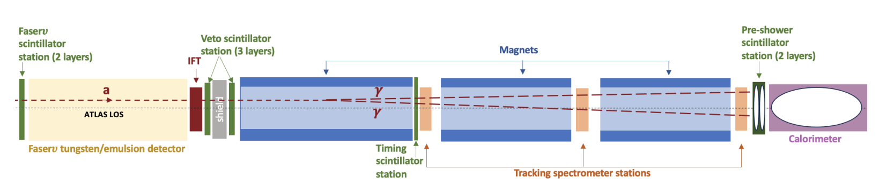


Faser search for ALPs of all shapes and sizes
First trackless FASER search, $2γ$ only. Searched for a number of ALP models
ALP-gluon $(\frac{a}{f_{a}}G\tilde{G})$ motivated by strong CP
ALP-W, best FASER sensitivity ☺
ALP-$γ$
Also searched for:
Up-philic scalars avoid flavor constraints (e.g. B decays)
Fermiophobic 2HDM
$U{\left(1\right)}_{B}$ vector, decays to $π^{0}→2γ$ for sufficient masses

Slide 24


Some of the results
What else can we look for with photon signatures?
Shining Light on the Dark Sector: Search for Axion-like Particles and Other New Physics in Photonic Final States with FASER

Slide 25


The LHC as a TeV Muon Beam Dump
The intense TeV muon beam is currently treated as background
But one physicist’s trash can be another’s treasure
Could there be BSM hiding in the discarded muon events?
Could the muon beam be used as a BSM production mechanism?
Connections to ${\left(g−2\right)}_{μ}$?

Slide 26


Muonphilic Scalar Production
$ℒ∼g_{s}S\overline{μ}μ+m_{S}^{2}S^{2}$

Slide 27




Muonphilic Scalars at FASER
FASER sensitive to muonphlic scalars
Including those that can explain ${\left(g−2\right)}_{μ}$
$Novel 2γ+μ$ (teal) probes shorter lifetimes
FASER 2 can completely cover ${\left(g−2\right)}_{μ}$ couplings for $m_{S}<2m_{μ}$

Slide 28
Still more to do at the LHC, but for now let’s look very far forward in time (2070s)
Discussions on the next collider: FCC, MuCol?

Slide 29


Slide 30



Forward Physics Facility at the 100 TeV FCC-pp
~10M $ν_{e},{100M ν}_{μ},1Mν_{τ}$
+$ν$ from Pb-Pb collisions, polarized PDFs, 100 GeV dark Higgs 10 TeV-scale quirks…
Neutrinos at MuCol considered, see Zhen Liu’s talk from this morning
Abraham, MF. et al. (2409.02163)

Slide 31




Quirks
FASER(2)
Found in models of neutral naturalness, quirks have a flipped hierarchy from quarks, new non-abelian “infracolor” charge
$$Λ_{IC}≪m_{Q}$$
Leads to macroscopic color string that cannot break. So when quirks are pair produced ($p_{T}=0$) then prefer to go in the forward direction
Sensitive to $∼TeV$ at FASER, 14 TeV for FPF@FCC
FPF@FCC
Abraham, MF. et al. (2409.02163)
Li et al. (2108.06748)

Slide 32




Summary
With TeV particles and large fluxes, the forward region is where the intensity frontier meets the energy frontier
FASER has directly observed neutrinos at the LHC, and searched for BSM. It has only just begun, Run 4 upgrades and FPF will greatly increase the forward program
Measurements have wide reaching implications for physics, QCD, neutrino & CR telescopes, dark matter, and EW boson production at ATLAS/CMS

Slide 34
Back up

Slide 35


Slide 36


Slide 37



Slide 38


Slide 39


Slide 40


Slide 41


