Slide 1

Photon Excess Signals from
Neutrino and Dark Matter Scattering at MiniBooNE and MicroBooNE
Doojin Kim
(doojin.kim@usd.edu)
Mitchell Conference
Texas A&M University, College Station, TX
May 14th, 2025
Based on 2504.08071 in collaboration with
Bhaskar Dutta, Aparajitha Karthikeyan, Adrian Thompson, and Richard Van de Water

Slide 2
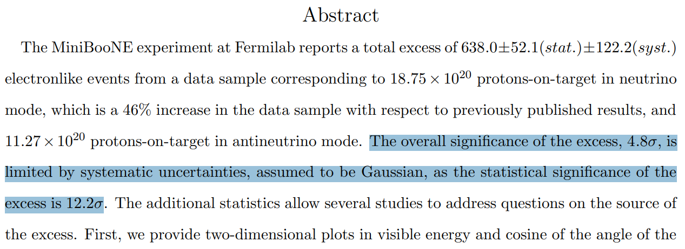
MiniBooNE Low-Energy Excess
[MiniBooNE Collaboration, arXiv:2006.16883]
See also [MiniBooNE Collaboration: arXiv:0812.2243; 1805.12028]

Slide 3

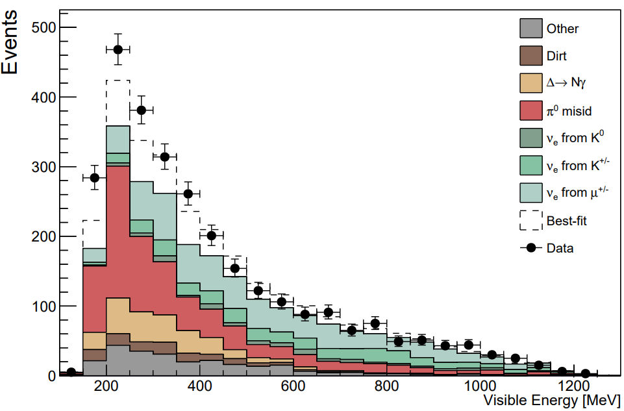
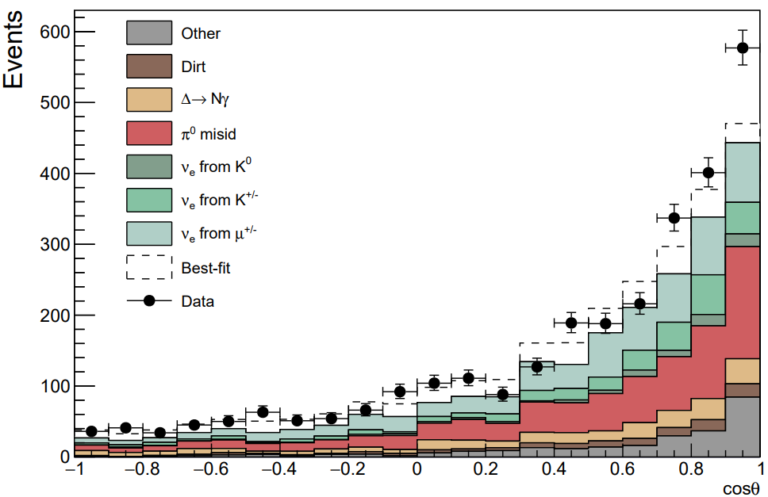


MiniBooNE Low-Energy Excess
The excess events populate in the lower energy regime.
The excess events spread across both on- and off-axis regions.
[MiniBooNE neutrino mode data]
[MiniBooNE Collaboration, arXiv:2006.16883]

Slide 4
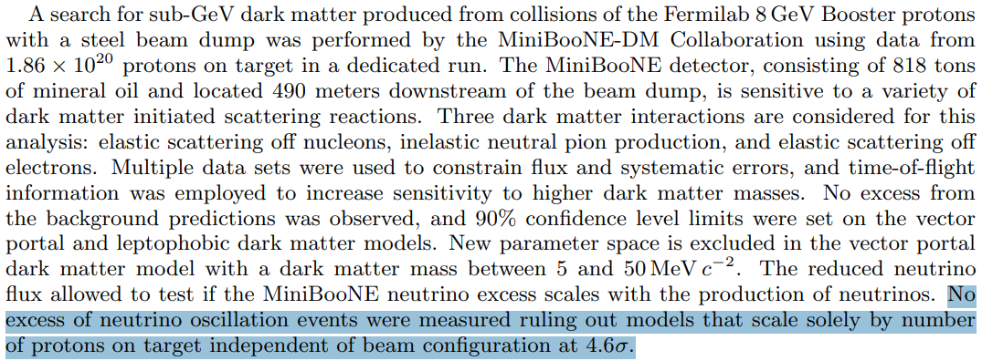
No Excess Events in the Dump-Mode Measurement
[MiniBooNE-DM Collaboration, arXiv:1807.06137]
Cf. Severe constraints on new physics explanations of the MB excess [Jordan, Kahn, Kenjaic, Moschella, Spitz, arXiv:1810.07185]

Slide 5

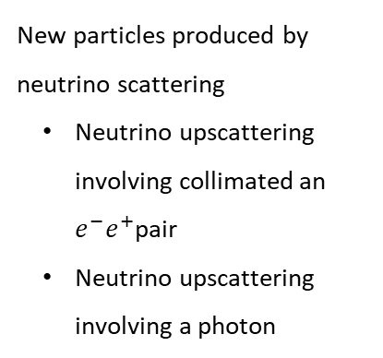




Earlier Explanations
Target
$$ν_{4}$$
Baseline
Detector
$$ν_{SM}$$
$$π^{+}/K^{+}$$
$$ν_{SM}$$
$$ν_{μ}→ν_{4}→ν_{e}$$
?
$e$-like visible particle(s)
New particles in the beam
  Sterile neutrino decay
Non-standard flavor transitions
  Oscillations (sterile neutrinos, Lorentz violation, matter effects, large extra dimension etc)
  Lepton number violating decay
New particles produced by neutrino scattering
  Neutrino upscattering involving collimated an $e^{−}e^{+}$pair
  Neutrino upscattering involving a photon

Slide 6





Electron-like vs. Photon-like or Merged e⁺e⁻-like Signals
[Electron-like signal]
[Photon-like (or merged e+e-) signal]
$$e^{−}$$
$$e^{−}$$
$$e^{+}$$
$$γ/Z′$$
As a mineral oil Cherenkov detector, it is challenging for MiniBooNE to distinguish electron-like signals and photon-like (or merged e+e-) signals.

Slide 7
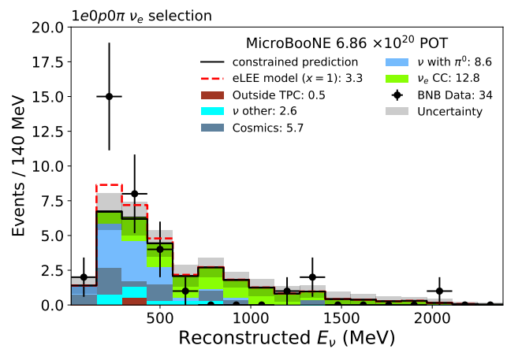
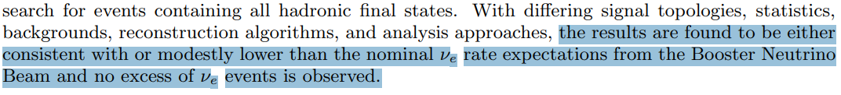
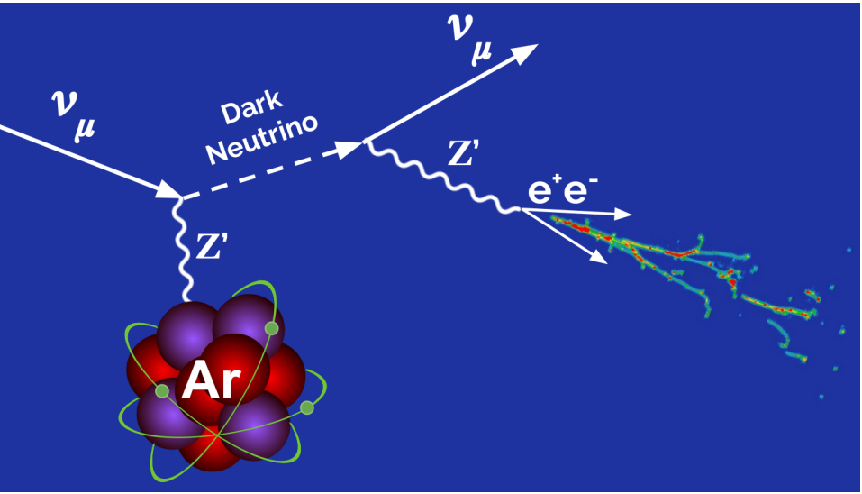
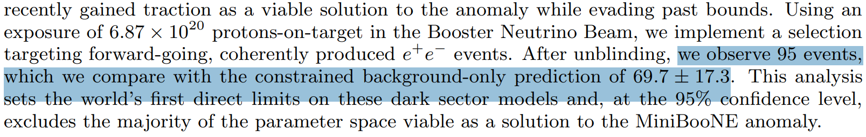
Various Tests at MicroBooNE
[MicroBooNE Collaboration, arXiv:2110.14054]
See also [MicroBooNE Collaboration, arXiv:2110.14080; 2110.13978; 2110.14065; 2412.14407]
[MicroBooNE Collaboration, arXiv:2502.10900]

Slide 8
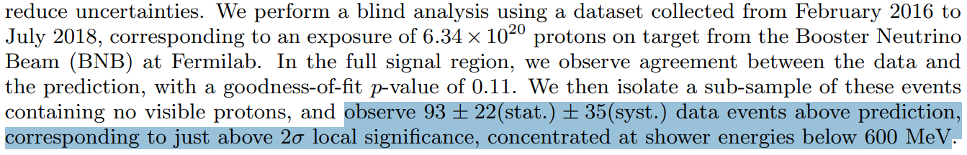
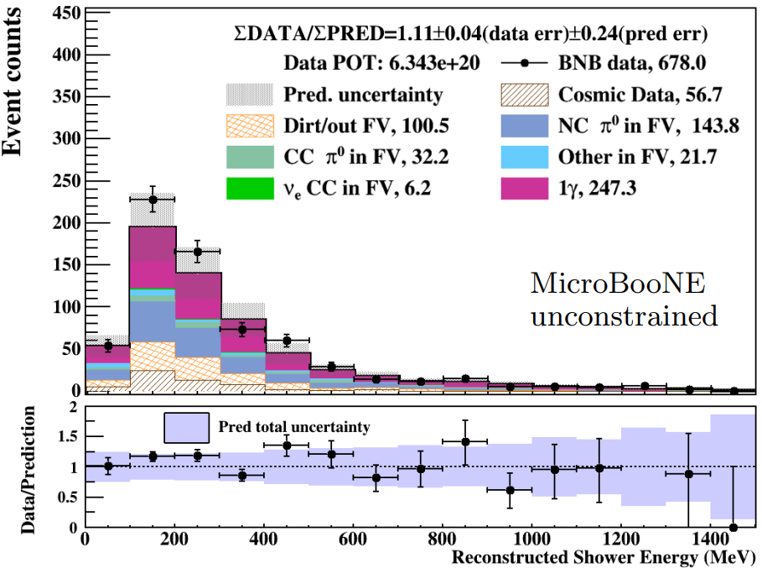
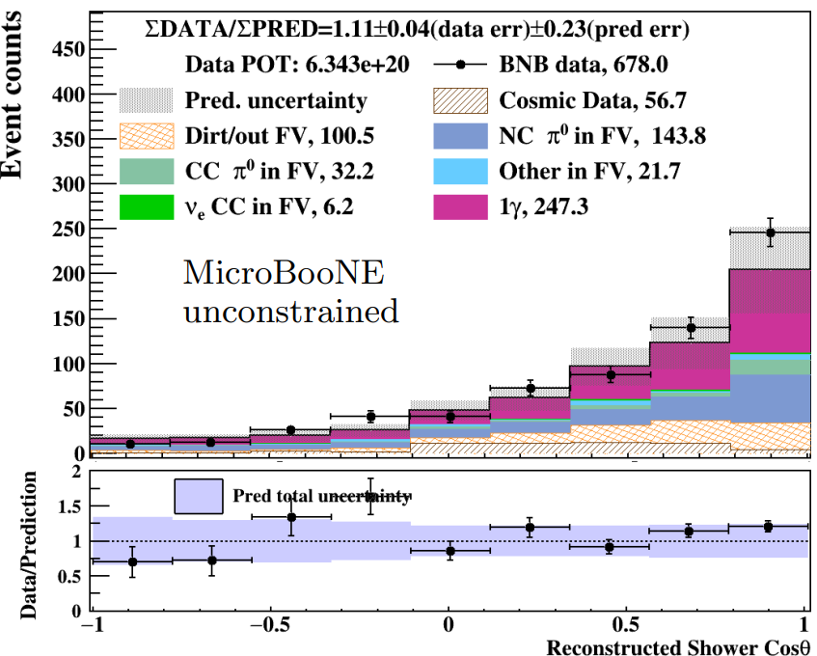
Photon-like Excess Signal?
[MicroBooNE Collaboration, arXiv:2502.06064]

Slide 9




Preferred Design Properties: Bottom-Up Approach
The majority of the excess events concentrated in the low-energy regime
Not only forward-directed events but also a large fraction of off-axis events
Charged-meson-sourced signal events
Photon-like signal events
No new neutrino flavors, no new dark-sector matter flavors
$⟹$ MiniBooNE-motivated
$⟹$ MB Dump-mode-based
$⟹$ MicroBooNE-motivated
$⟹$ Minimality-motivated

Slide 10
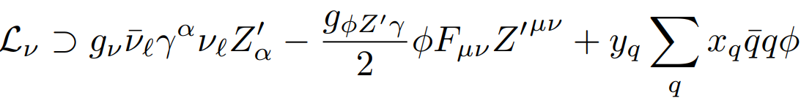










Proposed Neutrino Solution
(cf. $ν$-philic $Z′$ [e.g., Abdallah et al, arXiv:2106.01362; Chauhan, Xu, arXiv:2012.09980; Chauhan, Dev, Xu, arXiv:2204.11876], Dark axion portal [deNiverville, Lee, Seo, arXiv:1806.00757])
$$ν_{μ}$$
$$ν_{μ}$$
$$ν_{μ}$$
$$π^{+}$$
$$Z′$$
$$γ$$
$$φ$$
$$μ^{+}$$
$$N$$
$$N$$
[Neutrino production]
[Neutrino scattering]

Slide 11
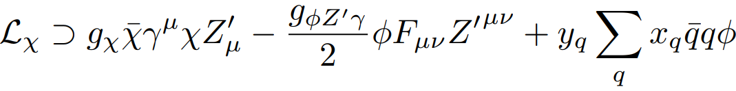













Proposed (Light) Dark-Matter Solution
(cf. Dark-matter flux from charged mesons [Dutta, DK, Thompson, Thornton, Van de Water, arXiv:2110.11944])
Focused dark-matter flux
$$ν_{μ}$$
$$χ$$
$$χ$$
$$χ$$
$$π^{+}$$
$$Z′$$
$$Z′$$
…
$$γ$$
$$φ$$
$$\overline{χ}$$
$$μ^{+}$$
$$N$$
$$N$$
[Dark-matter production]
[Dark-matter scattering]

Slide 12
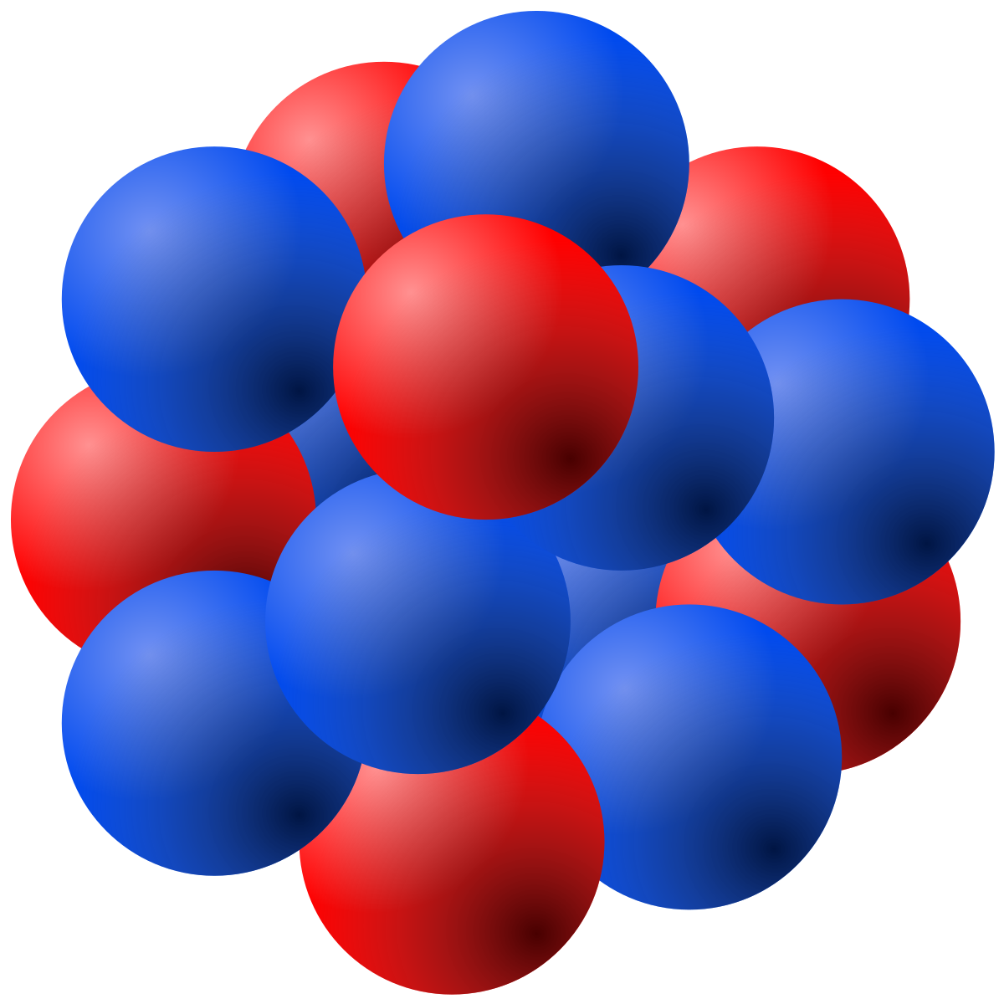









Mixing Nucleus and Nucleon Scattering Contributions
$$ν/χ$$
$$ν/χ$$
$$ν/χ$$
Photons tend to be more forward-directed and harder
$$ν/χ$$
Photons tend to be less forward-directed and softer
$$−q^{2}=Q^{2}<{(100 MeV)}^{2}$$
$$−q^{2}=Q^{2}>{(100 MeV)}^{2}$$
Nucleus scattering
$$⊕$$
Nucleon scattering

Slide 13
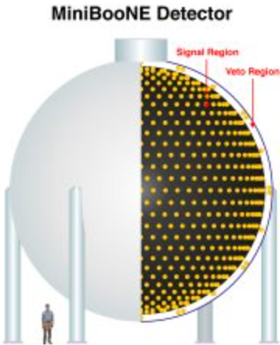
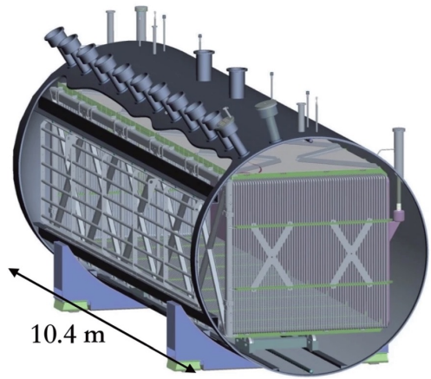








Methodology
Neutrino flux at the detectors published in [MiniBooNE Collaboration, arXiv:0806.1449; MicroBooNE Collaboration, arXiv:1612.05824]
GEANT4 simulation to estimate the meson flux inside the target
$$ν_{ℓ}$$
$$ν_{ℓ}$$
$π^{+},K^{+}$, …
$π^{+},K^{+}$, …
$$ℓ^{+}$$
$$ν_{ℓ}$$
$$χ$$
$π^{+},K^{+}$, …
$$Z′$$
$$χ$$
MicroBooNE Detector
$$ℓ^{+}$$
RKHorn package [Thompson, DOI:10.5281/zenodo.14219233] to simulate the focusing of charged mesons
[Beam - BNB target]
[Focusing horn]
[Dump]
[Detectors]

Slide 14
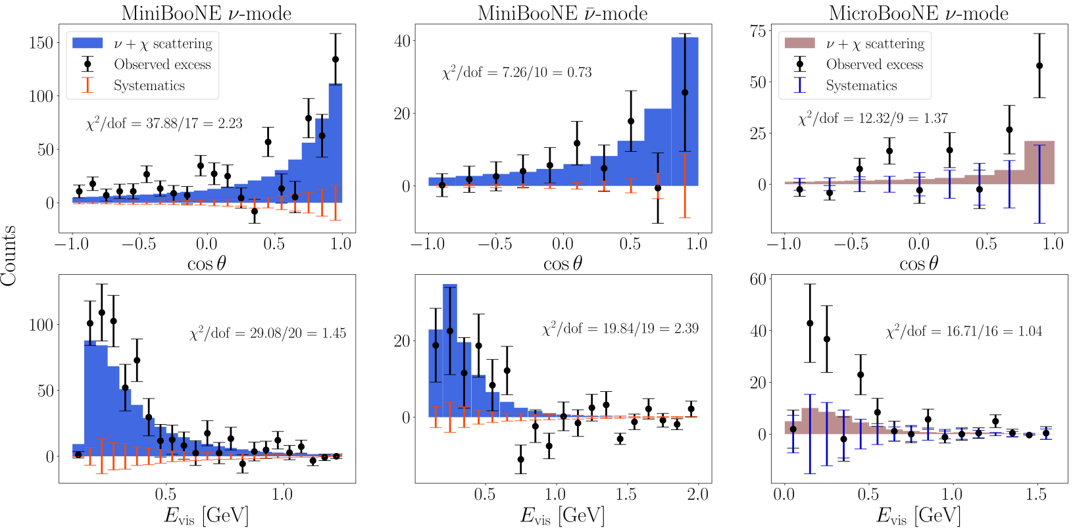
An Example Fit

Slide 15
Can This Explain the MicroBooNE Measurement?

Slide 16
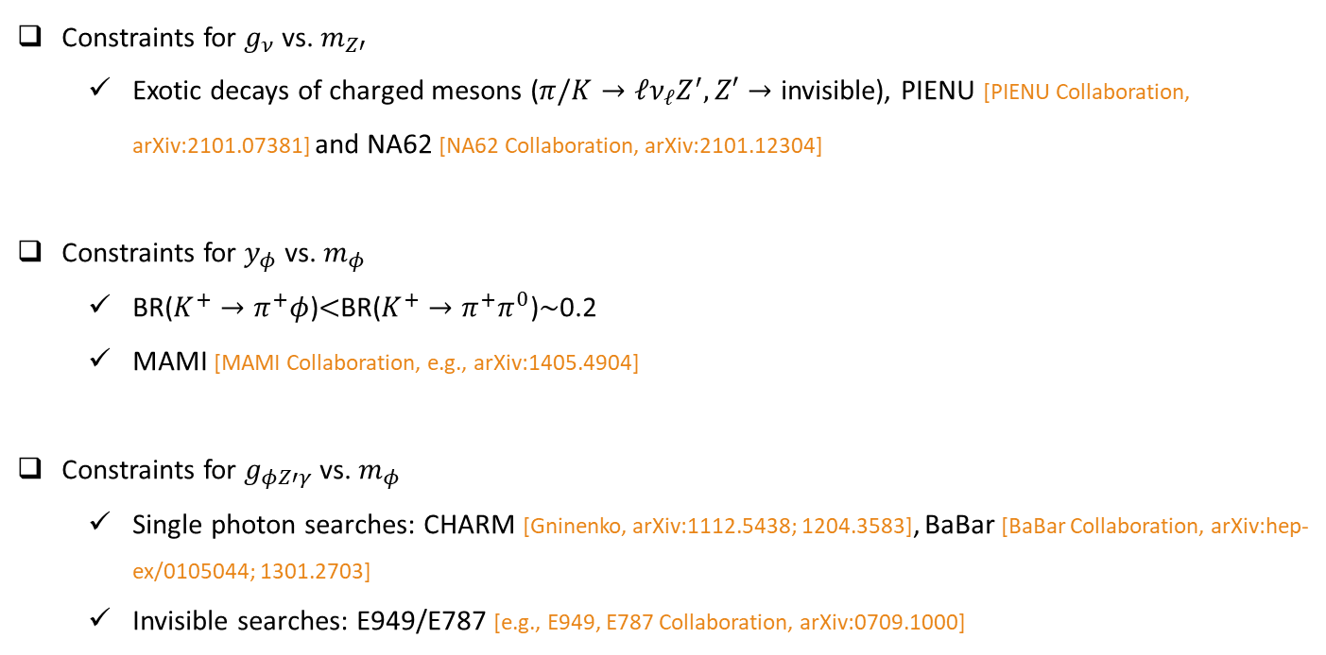

Constraints
MiniBooNE is sensitive to $g=g_{ν}g_{φZ′γ}y_{q}$.
Constraints for $g_{ν}$ vs. $m_{Z′}$
  Exotic decays of charged mesons ($π/K→ℓν_{ℓ}Z^{′},Z′→$ invisible), PIENU [PIENU Collaboration, arXiv:2101.07381] and NA62 [NA62 Collaboration, arXiv:2101.12304]
Constraints for $y_{φ}$ vs. $m_{φ}$
  BR($K^{+}→π^{+}φ$)$<$BR($K^{+}→π^{+}π^{0}$)$\sim$0.2
  MAMI [MAMI Collaboration, e.g., arXiv:1405.4904]
Constraints for $g_{φZ′γ}$ vs. $m_{φ}$
  Single photon searches: CHARM [Gninenko, arXiv:1112.5438; 1204.3583], BaBar [BaBar Collaboration, arXiv:hep-ex/0105044; 1301.2703]
  Invisible searches: E949/E787 [e.g., E949, E787 Collaboration, arXiv:0709.1000]

Slide 17
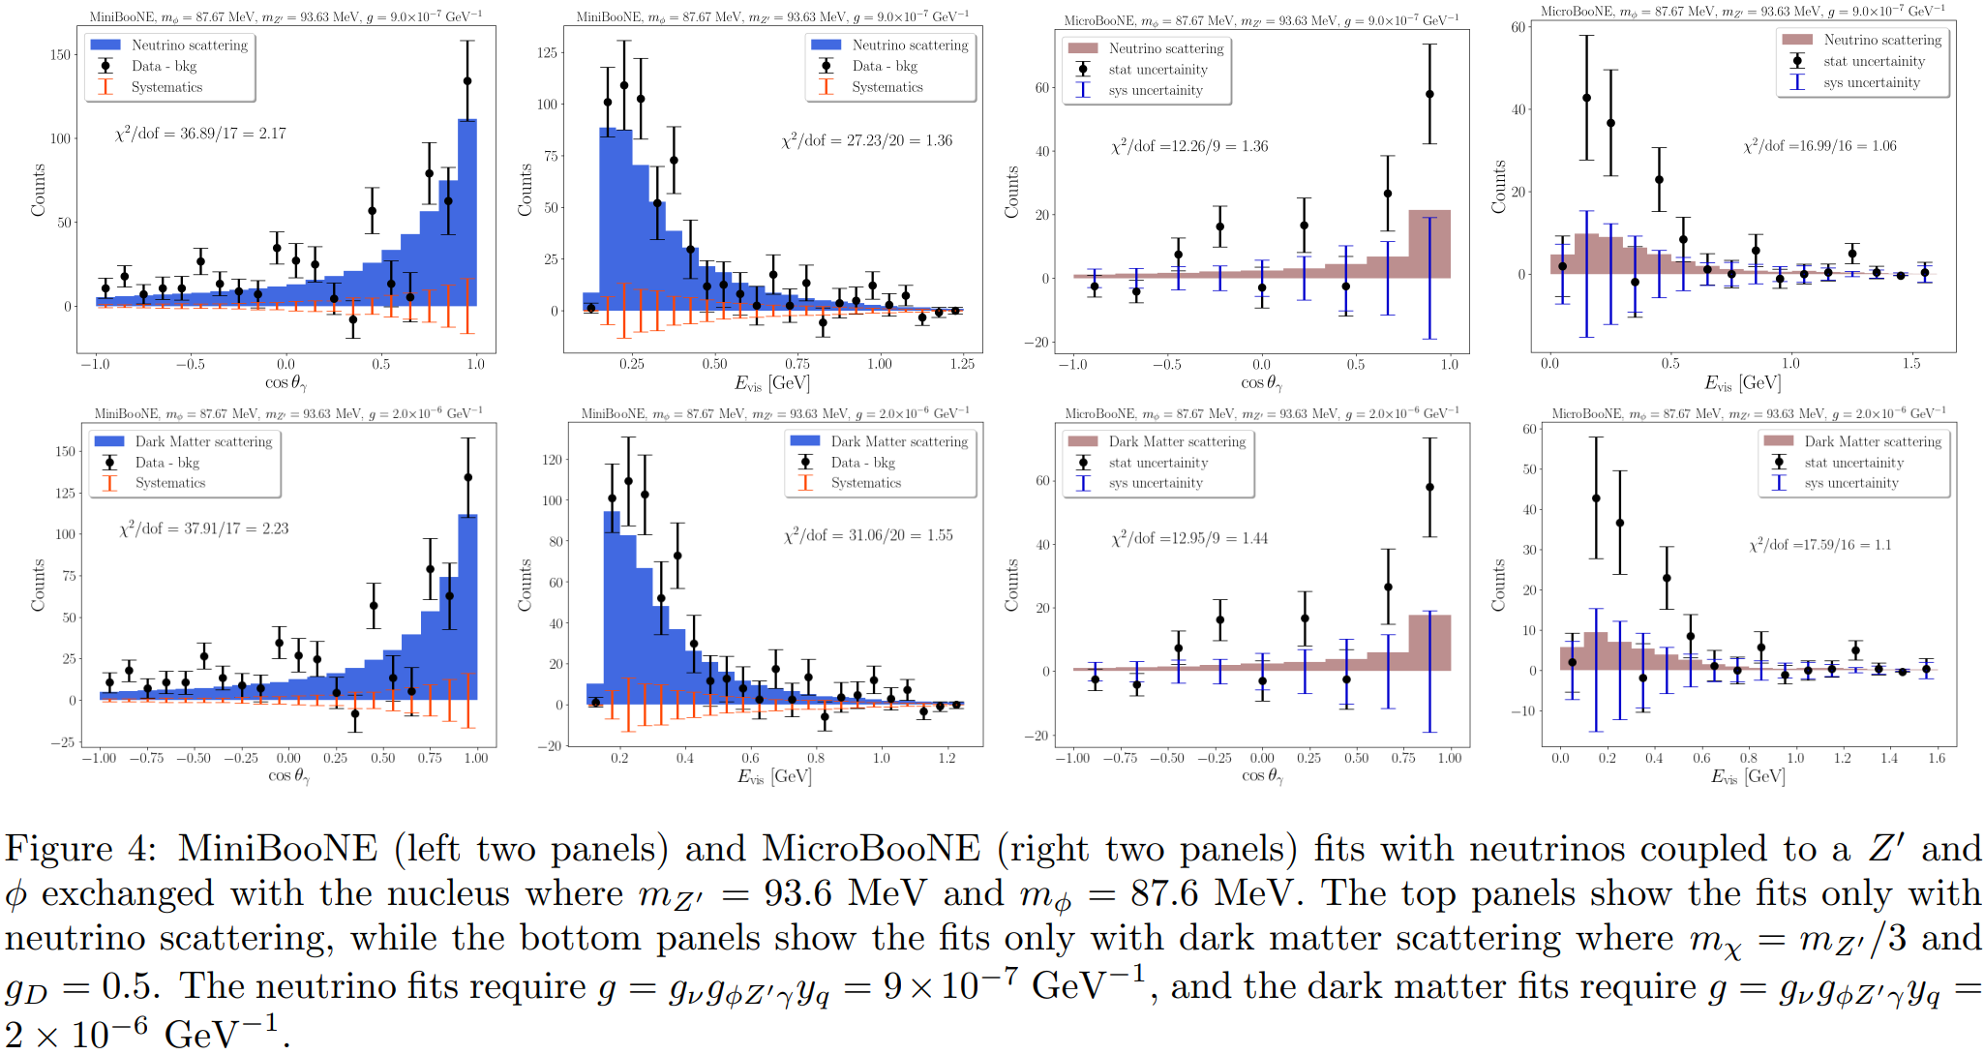
Neutrino or Dark-Matter Only Fits

Slide 18




























Same Event Topology in Different Scenarios
$$ν_{μ}/χ$$
$$ν_{μ}/χ$$
$$ν_{μ}/χ$$
$$ν_{μ}/χ$$
$$L_{μ}−L_{τ} Z′$$
$$φ$$
$$γ$$
$$γ$$
$$φ$$
$$Z′$$
$$N$$
$$N$$
$$N$$
$$N$$
$$ν_{μ}/χ$$
$$ν_{μ}/χ$$
$$ν_{μ}/χ$$
$$ν_{μ}/χ$$
$$φ$$
$$φ_{1}$$
$$γ$$
$$γ$$
$$φ$$
$$φ_{2}$$
$$N$$
$$N$$
$$N$$
$$N$$

Slide 19







Conclusions
A new solution to the MiniBooNE low-energy excess has been proposed, which also accommodates MicroBooNE’s mild excess of photon-like events.
$$ν_{μ}/χ$$
$$ν_{μ}/χ$$
$$Z′$$
$$γ$$
$$φ$$
$$N$$
$$N$$
We hope that the excess will be further confirmed by other experiments (e.g., CCM, ICARUS, SBND), potentially opening the gate to new physics.
Thank you!

Slide 20
Bonus Slides

Slide 21
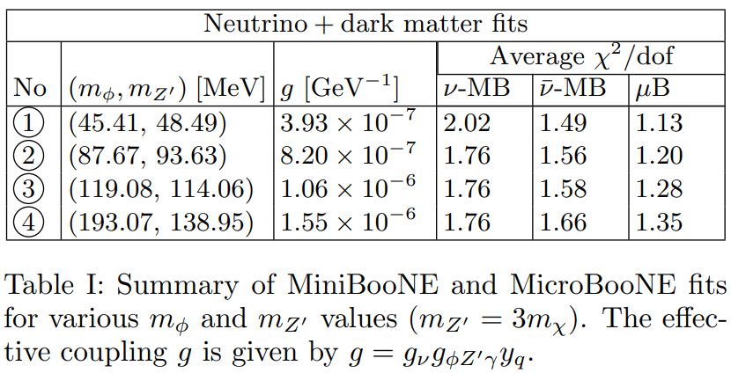
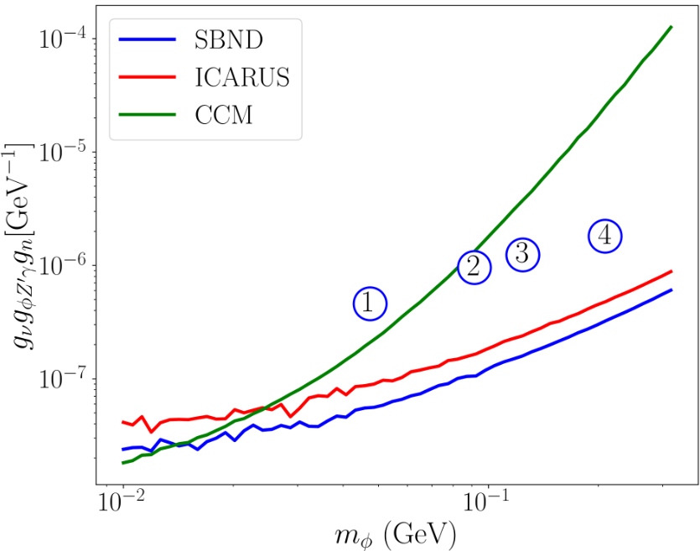
Future Tests at Different Experiments

Slide 22
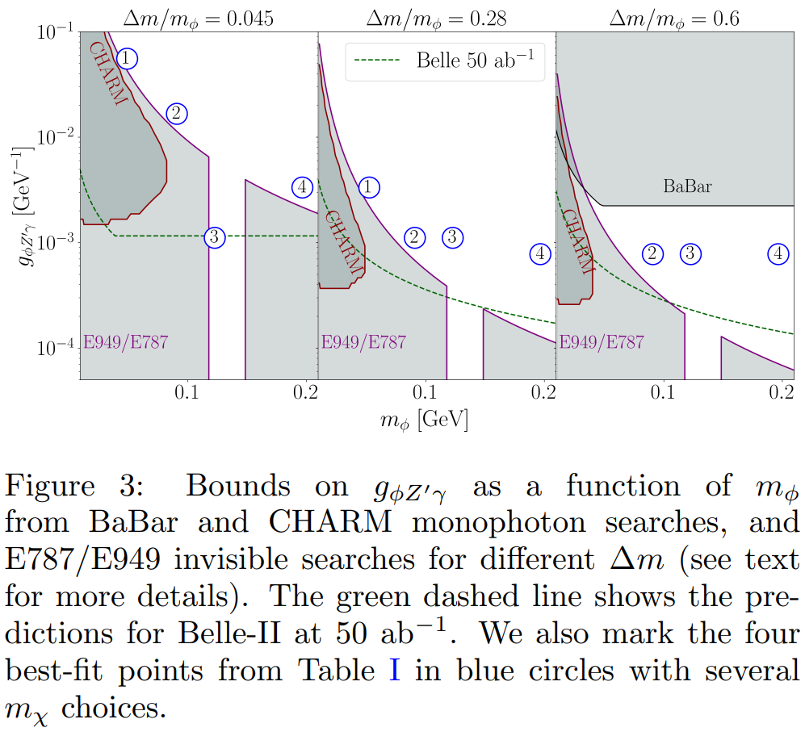
Constraints

Slide 23
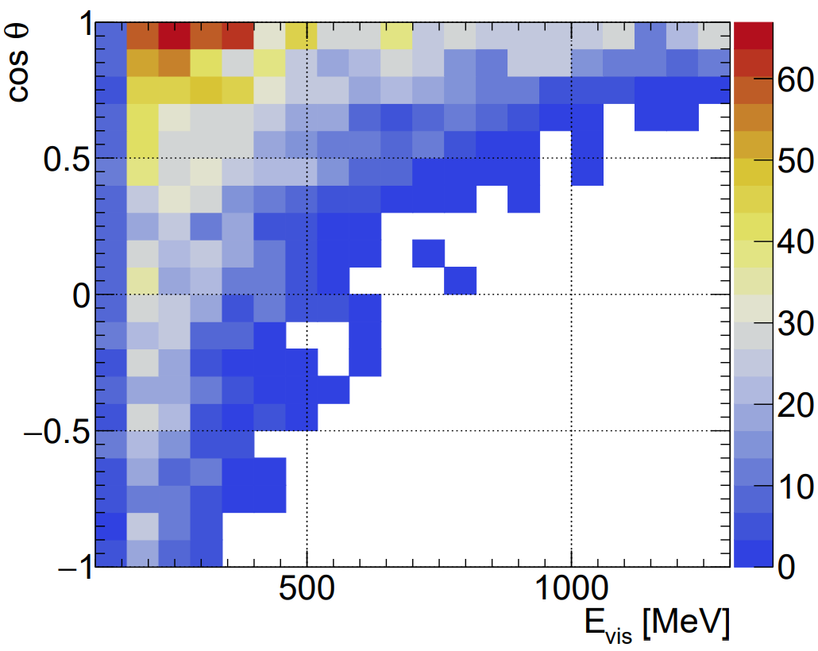
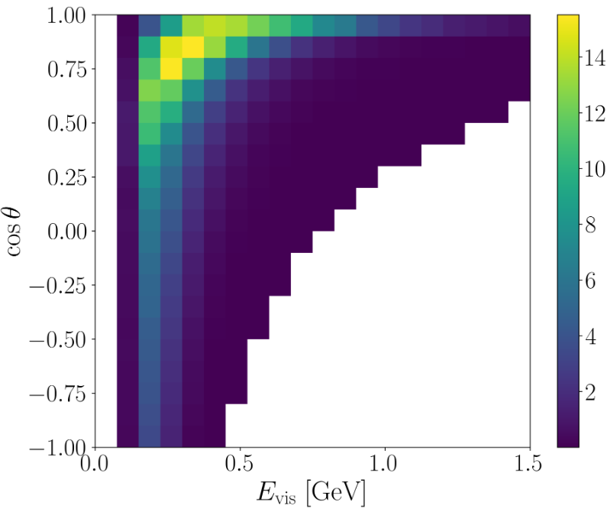
Correlation between Visible Energy and Angle
[MiniBooNE neutrino mode data]
[MiniBooNE Collaboration, arXiv:2006.16883]
[Dutta, Karthikeyan, DK, Thompson, Van de Water, arXiv:2504.08071]

Slide 24
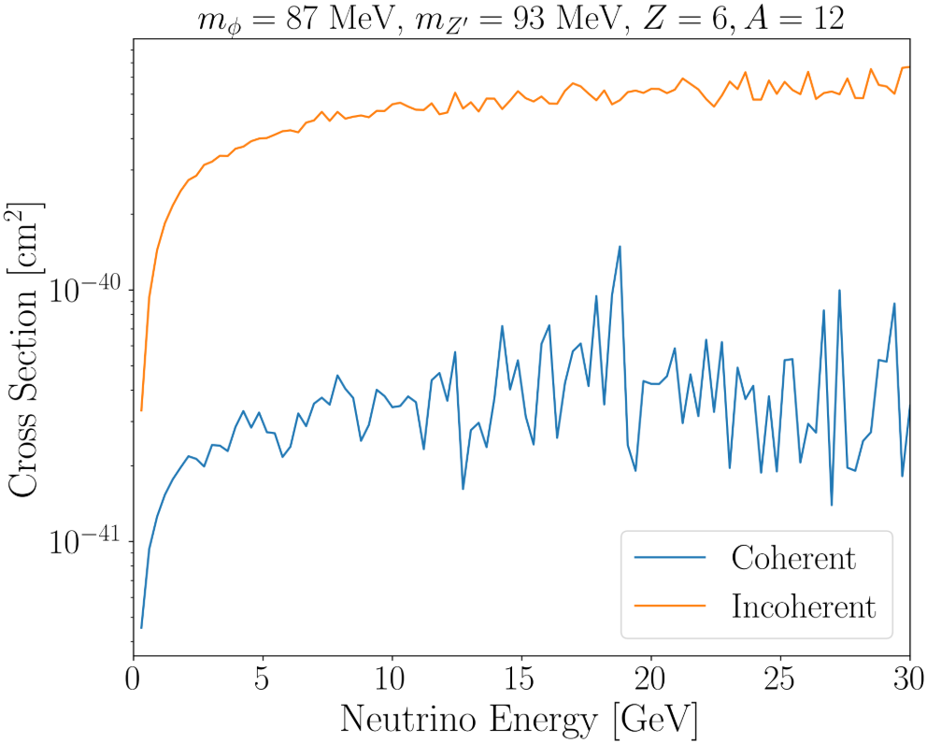
Scattering Cross Sections

