Slide 1



‘Dark’ Matter Effect as a Novel Solution to the KM3-230213A Puzzle
Bhupal Dev
In collaboration with
Bhaskar Dutta, Aparajitha Karthikeyan, Writasree Maitra, Louis Strigari, Ankur Verma,
arXiv: 2505.abcde (please don’t scoop us)
The Mitchell Conference on Collider, Dark Matter, and Neutrino Physics
Texas A&M University, College Station
May 13, 2025

Slide 2
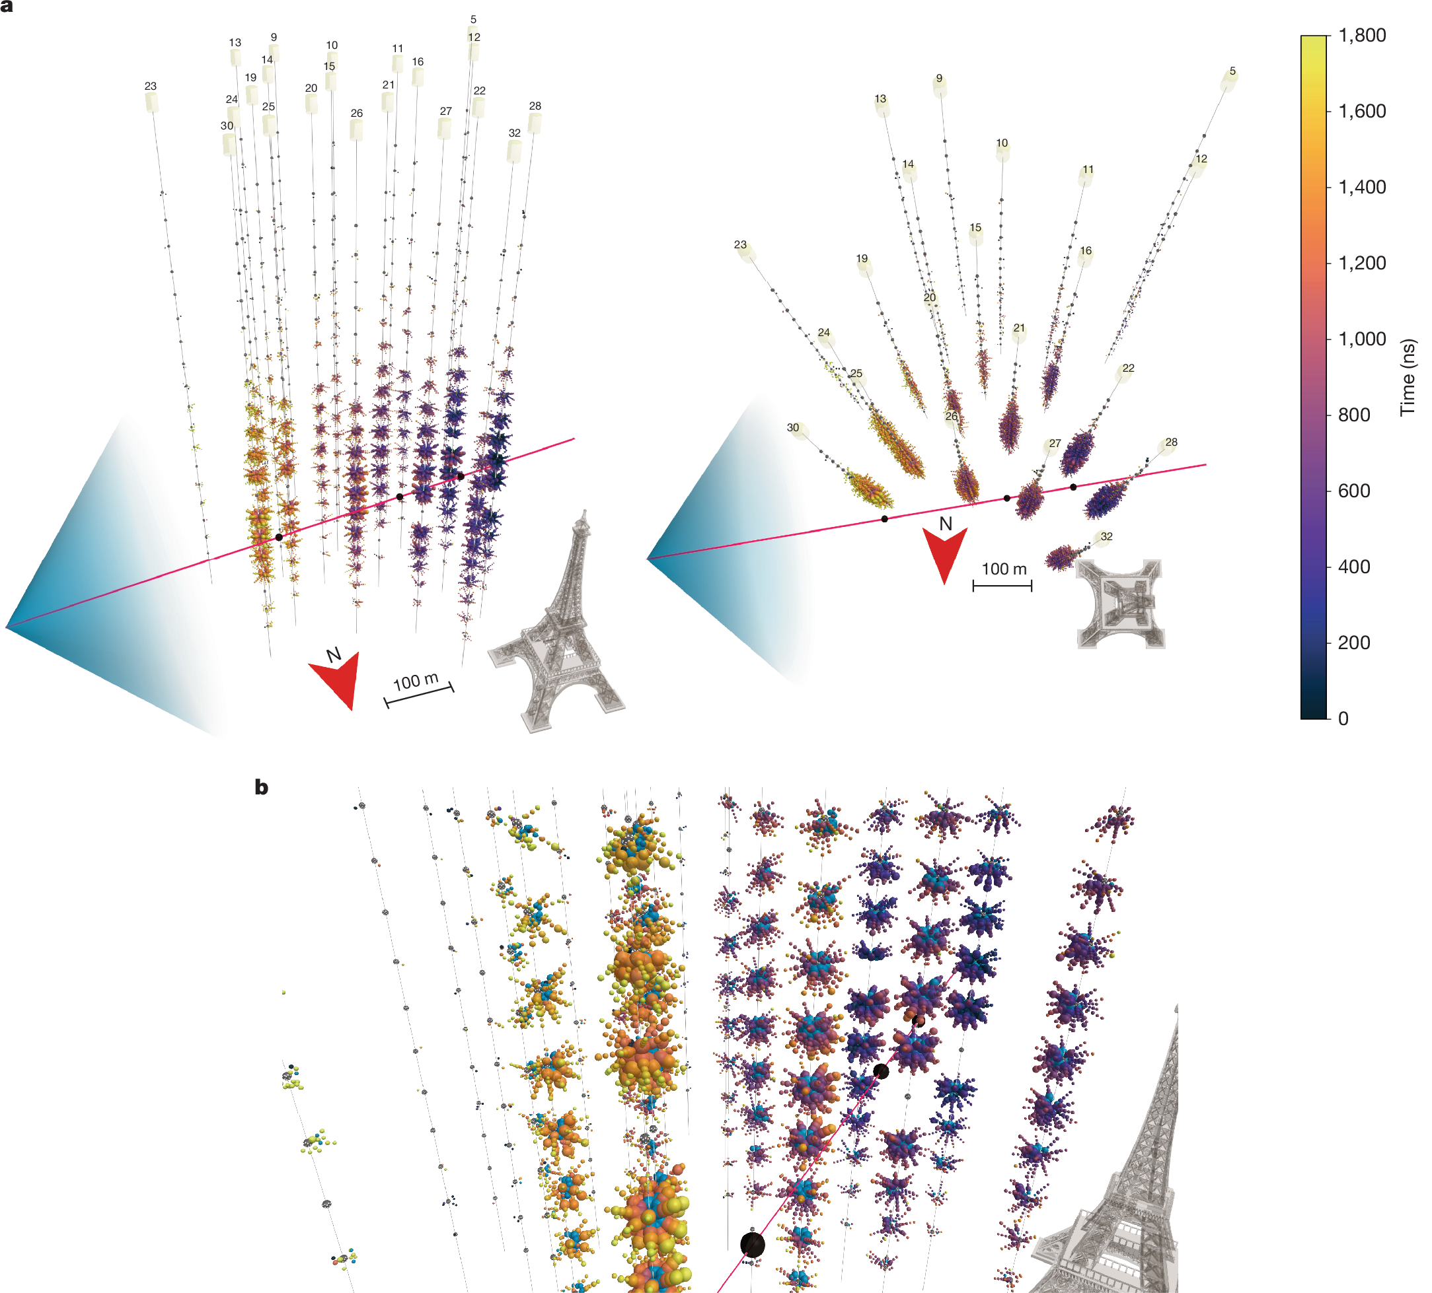

KM3-230213A
Nature 638, 376 (2025)
Facts
Detected a throughgoing muon in 335 days of live data from ARCA with 0.15 km³ instrumented volume.
3672 PMTs (35% of the active PMTs) triggered.
Estimated muon energy: ${120}_{−60}^{+110}$ PeV.
Event direction is 0.6⁰ above horizon (with 1.5⁰ uncertainty at 68% CL) at an azimuth of 259.8⁰.
In equatorial coordinates, RA=94.3⁰, dec.=-7.8⁰ (far from GC).
2 potential blazar sources pinpointed (at 68% CL).

Slide 3
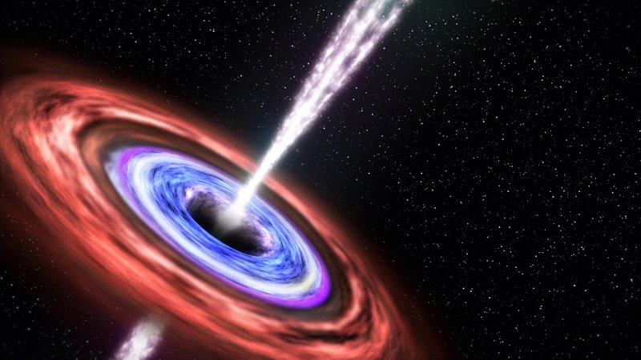
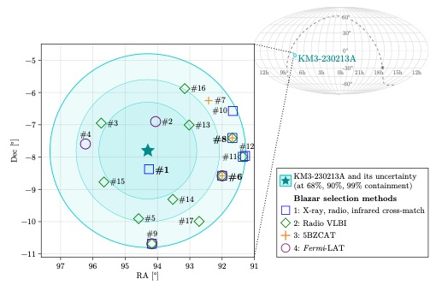

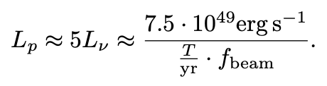
Potential Sources
2502.08484
Credit: NASA/GSFC
FSRQ preferred over BL-Lac due to high jet power.
Is this realistic?
Source neutrino luminosity required
Inferred jet luminosity

Slide 4
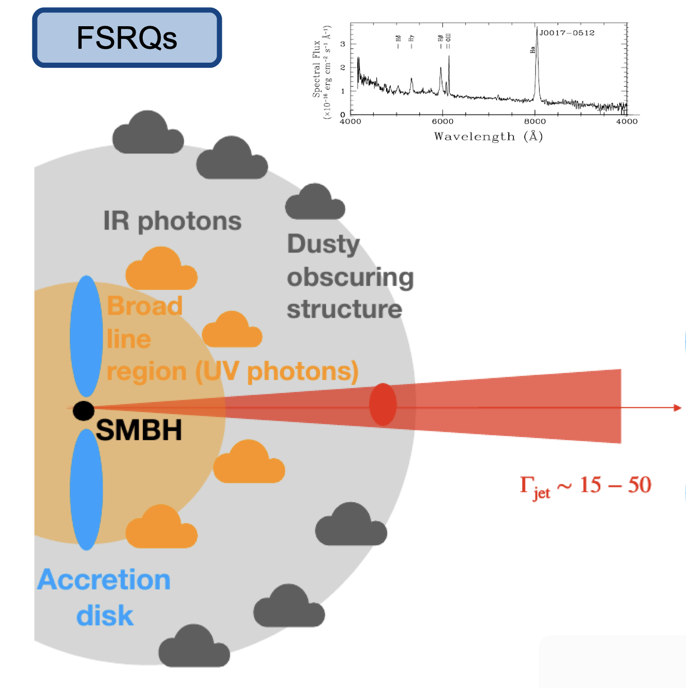
Blazar Luminosity Function
Ajello et al., 1110.3787
10⁴⁹ erg/s possible with f_{beam} ≅1000, i.e. emission within ~4⁰ around the jet direction.
Credit: F. Oikonomou
Why no visible EM cascade?
Depends on source redshift and IGMF.
Fang, Halzen, Hooper, 2502.09545 Crnogorčevića, Blanco, Linden, 2503.16606

Slide 5
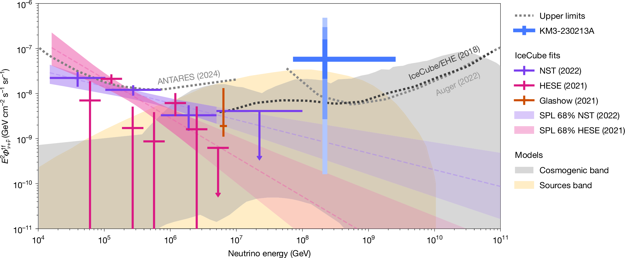
Standard Interpretation of the KM3NeT Event
Nature 638, 376 (2025)
2.2𝜎 tension with IceCube flux upper limit
Best-fit neutrino flux:
See also Li, Machado, Naredo-Tuero, Schwemberger,
2502.04508 and P. Machado’s talk

Slide 6
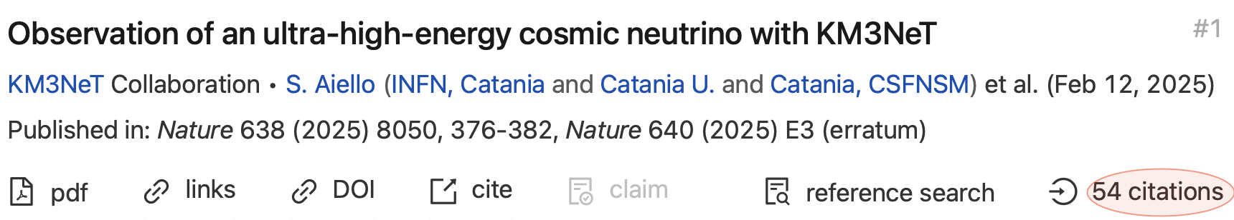

(BSM) Solutions?
Upward fluctuation in KM3NeT (one event in 70 years).
BSM? – It’s our duty.
Superheavy (~200 PeV) decaying dark matter is the ‘easiest’ solution.
Borah, Das, Okada, Sarmah, 2503.00097; Jho, Park, Shin, 2503.18737; Murase, Narita, Yin, 2504.15272;…
But does not address the tension with IceCube. Also, in conflict with gamma-ray constraints.
Key observation: Path length through Earth for KM3NeT event is ~10x larger than for IceCube, which could (partially) compensate for IceCube’s larger effective area and exposure time.
Use Earth matter effect to address the tension:
  Neutrino matter effect (Brdar, Chattopadhyay, 2502.21299; see V. Brdar’s talk)
  ‘Dark’ matter effect (BD, Dutta, Karthikeyan, Maitra, Strigari, Verma, 2505.abcde; this talk)
  Our ‘dark’ solution also alleviates the source luminosity tension (and gamma-ray constraints).

Slide 7
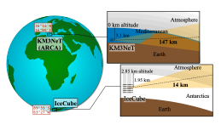
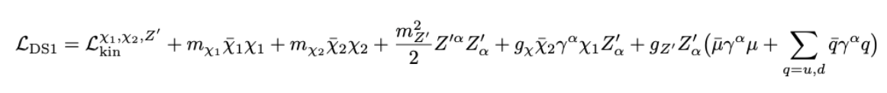
Main Idea
Figure adapted from 2502.21299
Production of blazar-boosted DM
59 km
418 km
12 km
Detection at KM/IC
17 km

Slide 8
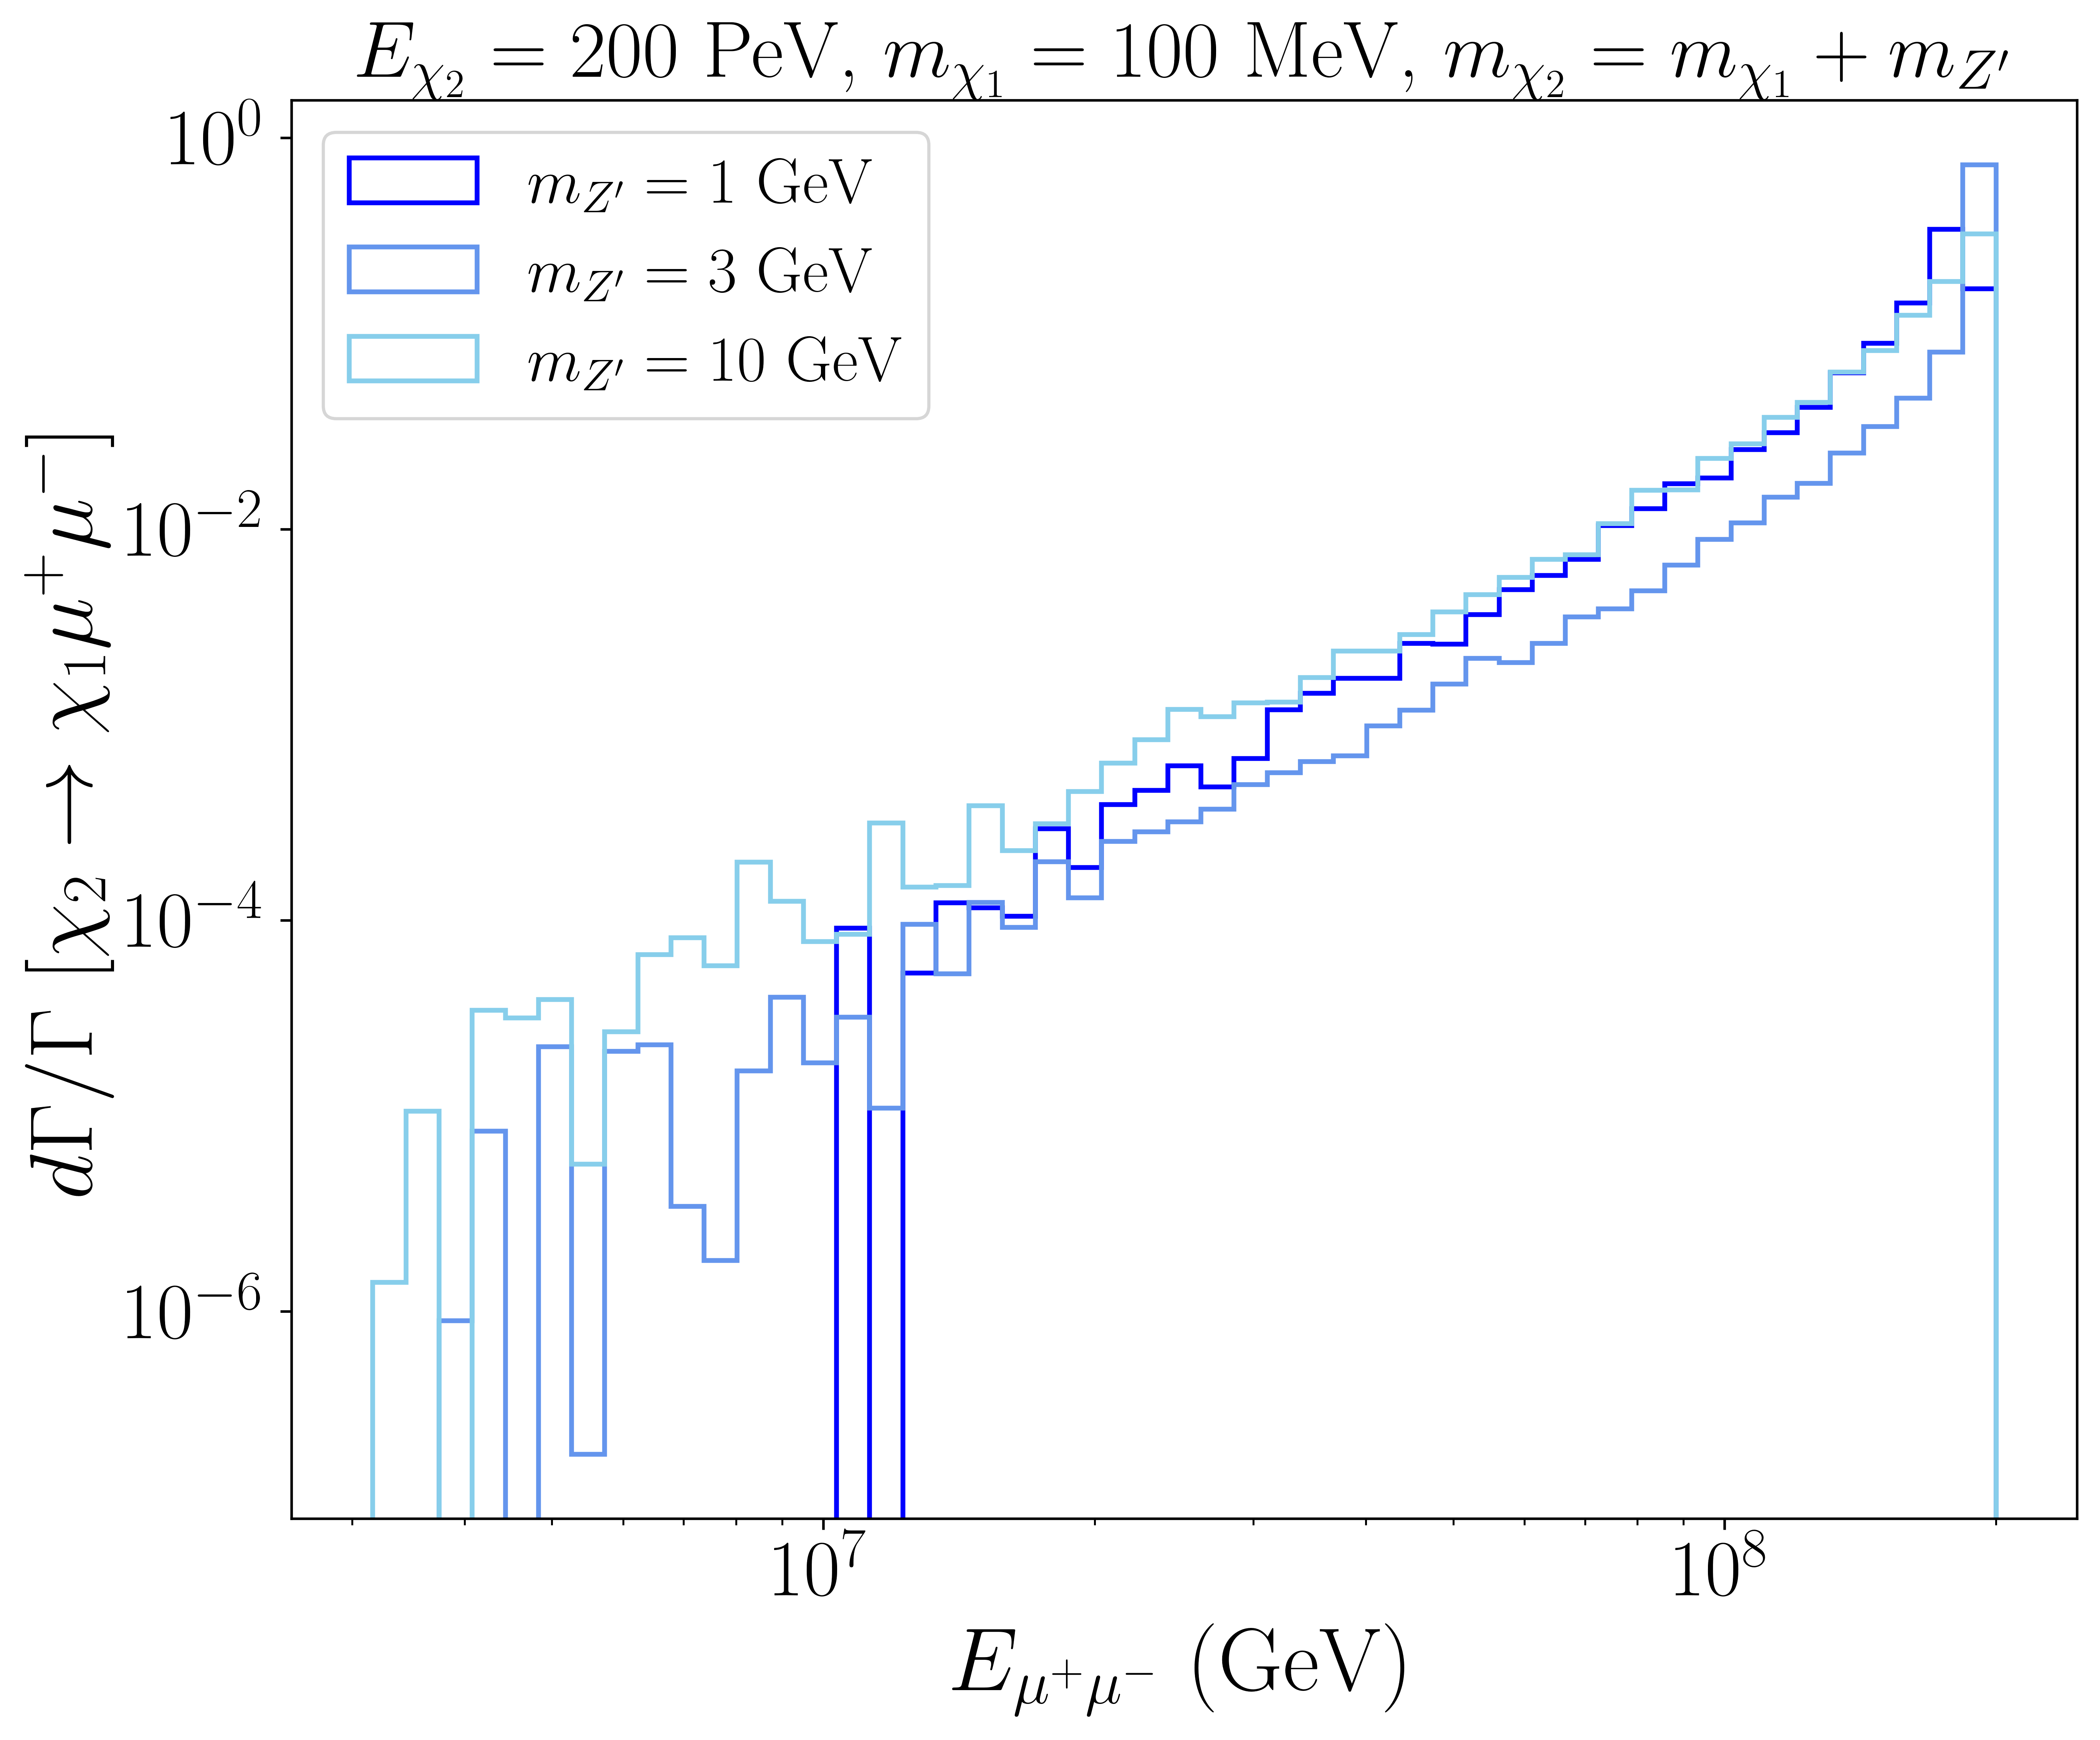
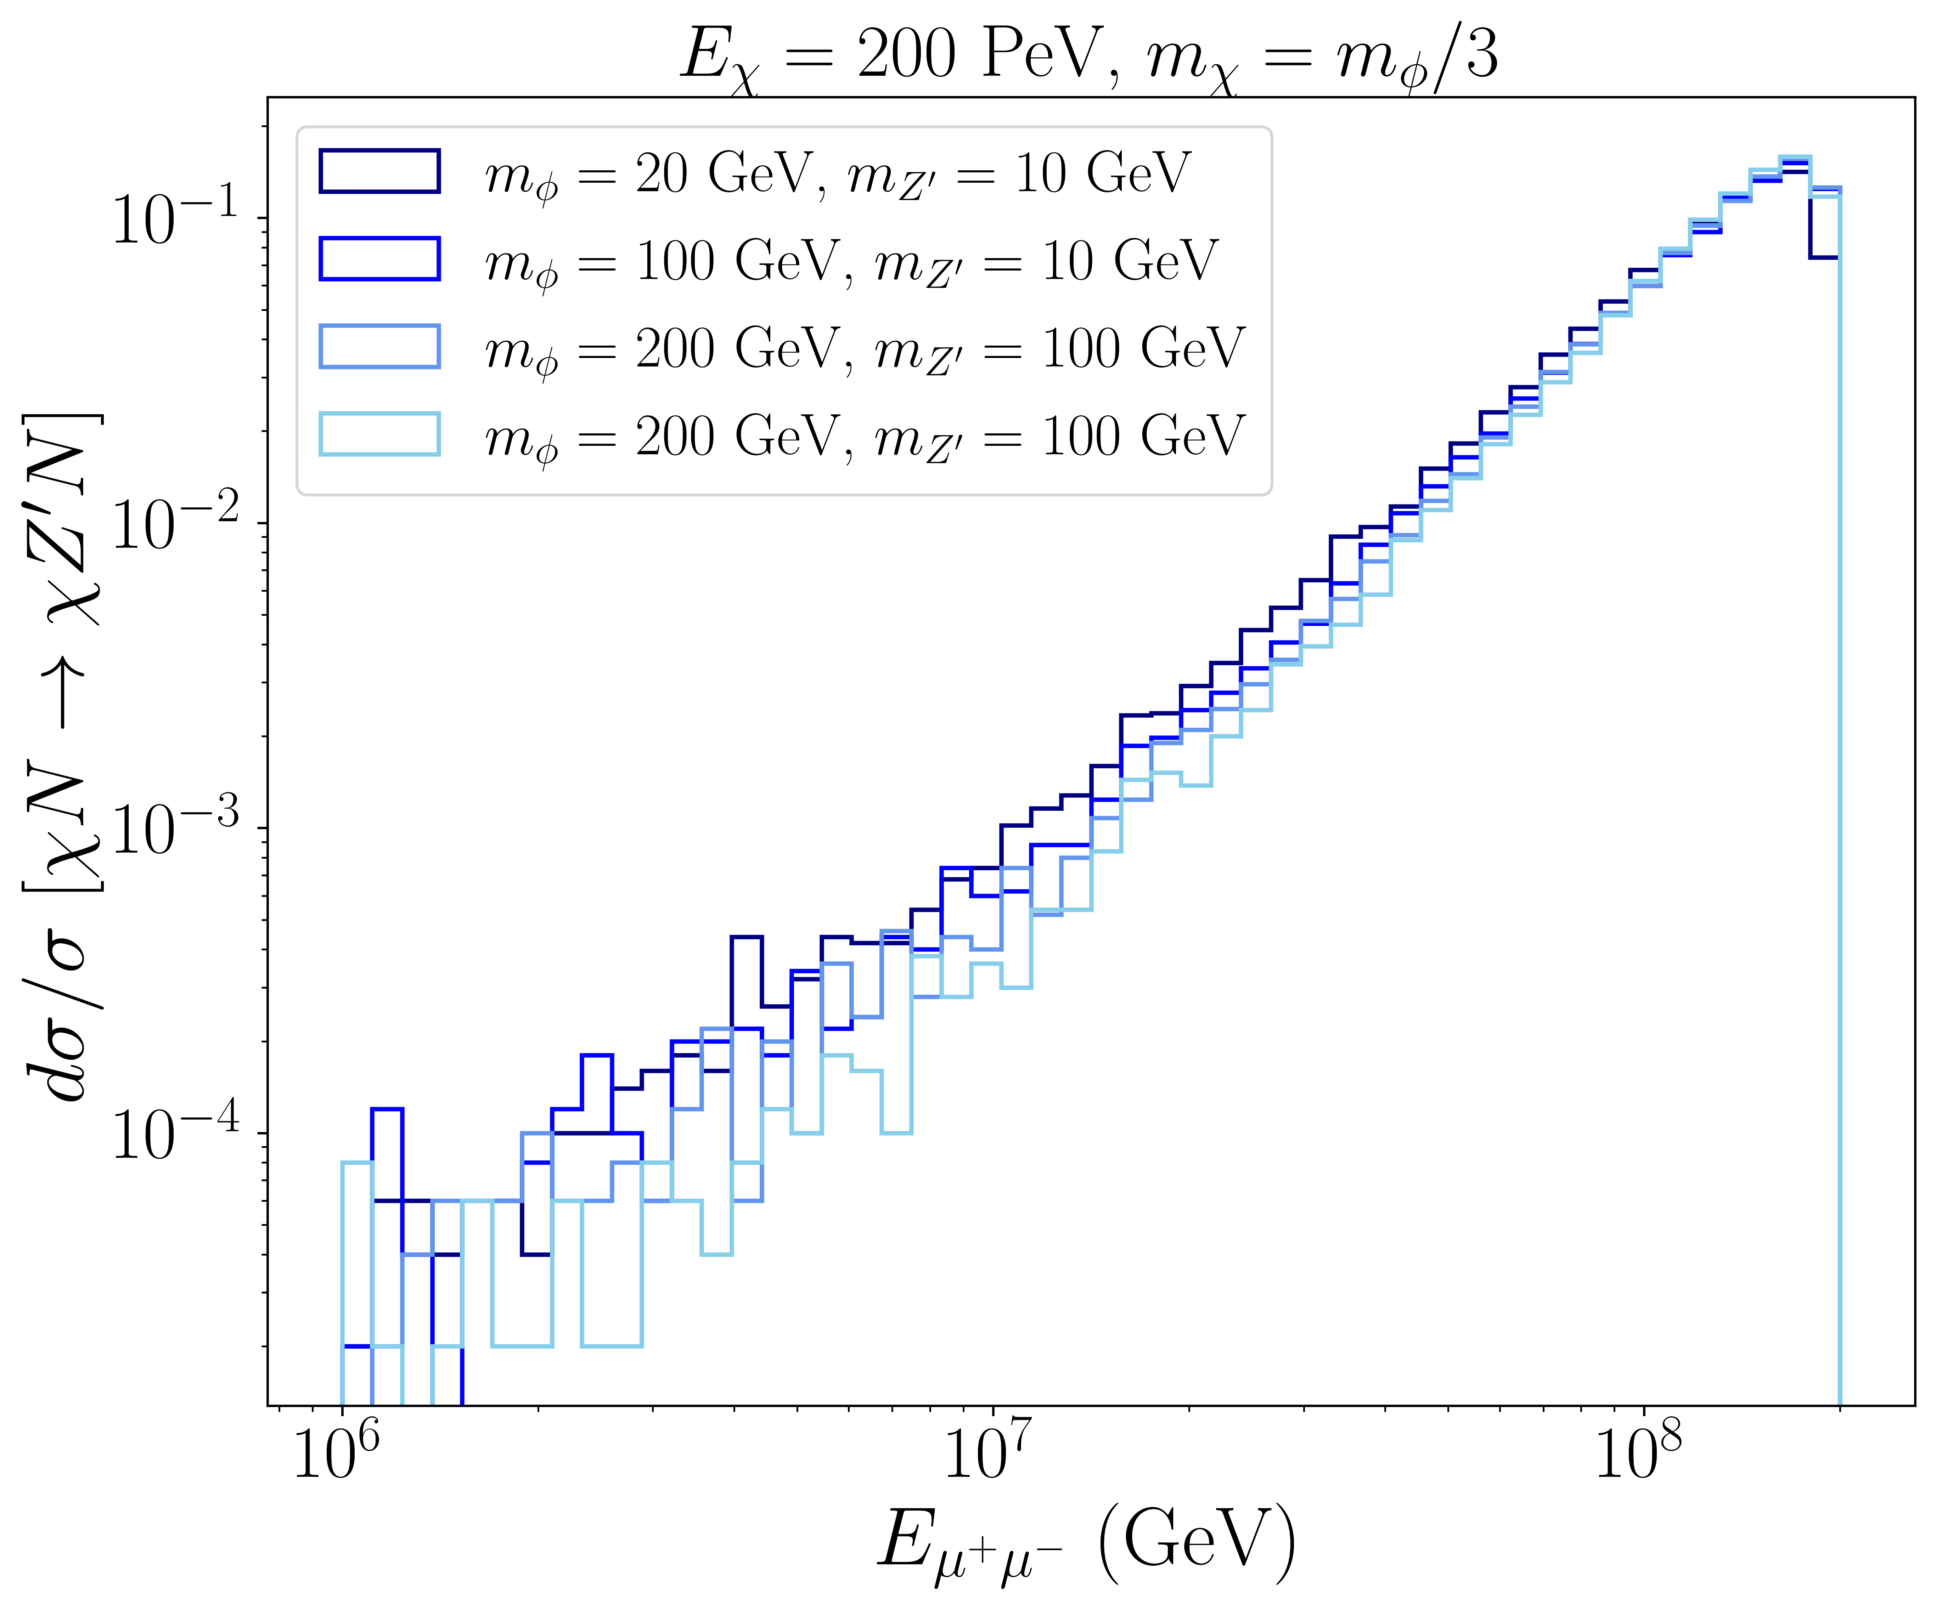
Energy Distributions
2-2 case
2-3 case

Slide 9
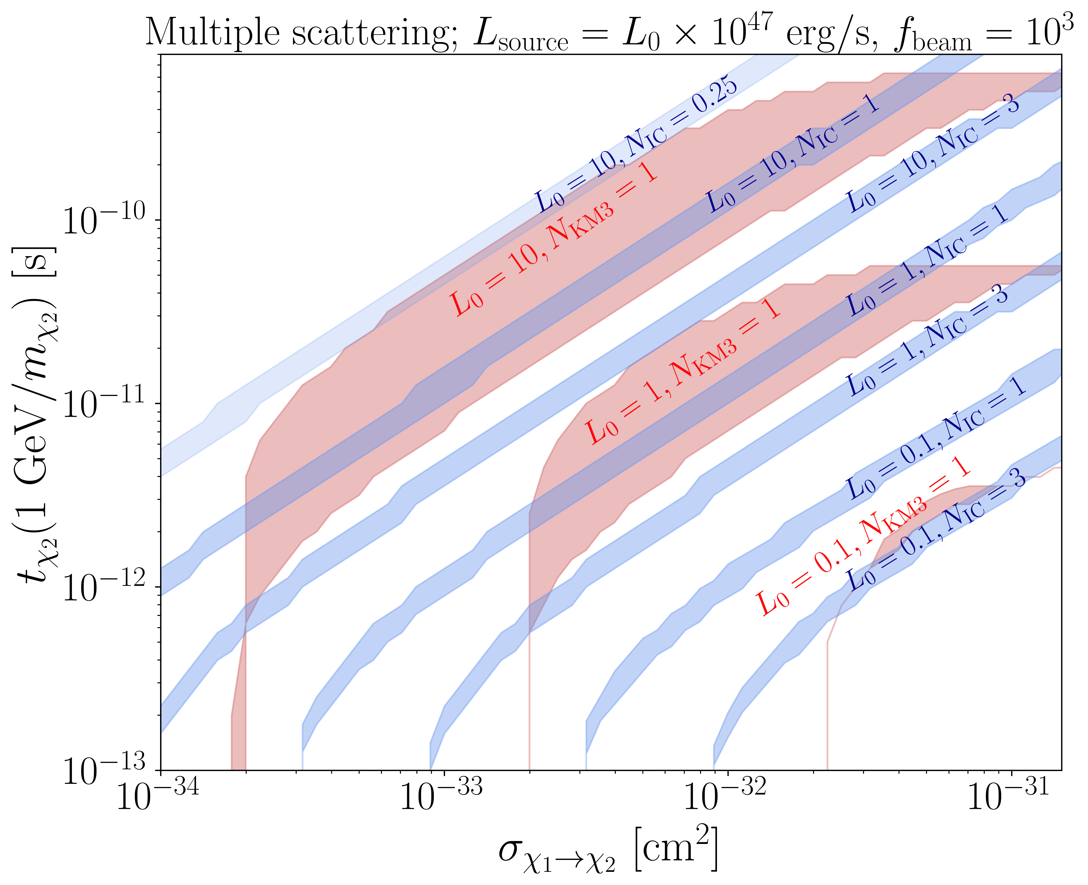
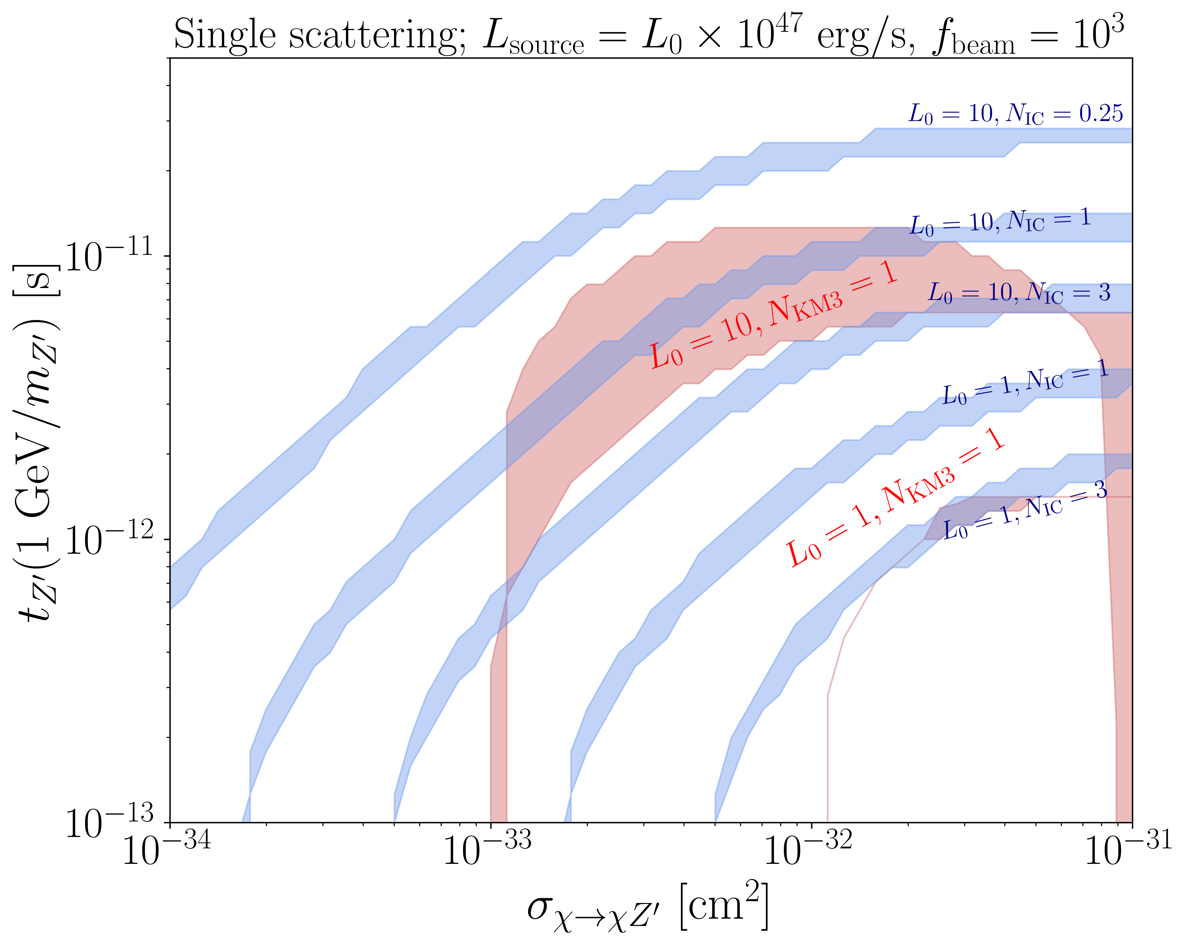
Event Numbers
2-2 scattering
2-3 scattering

Slide 10
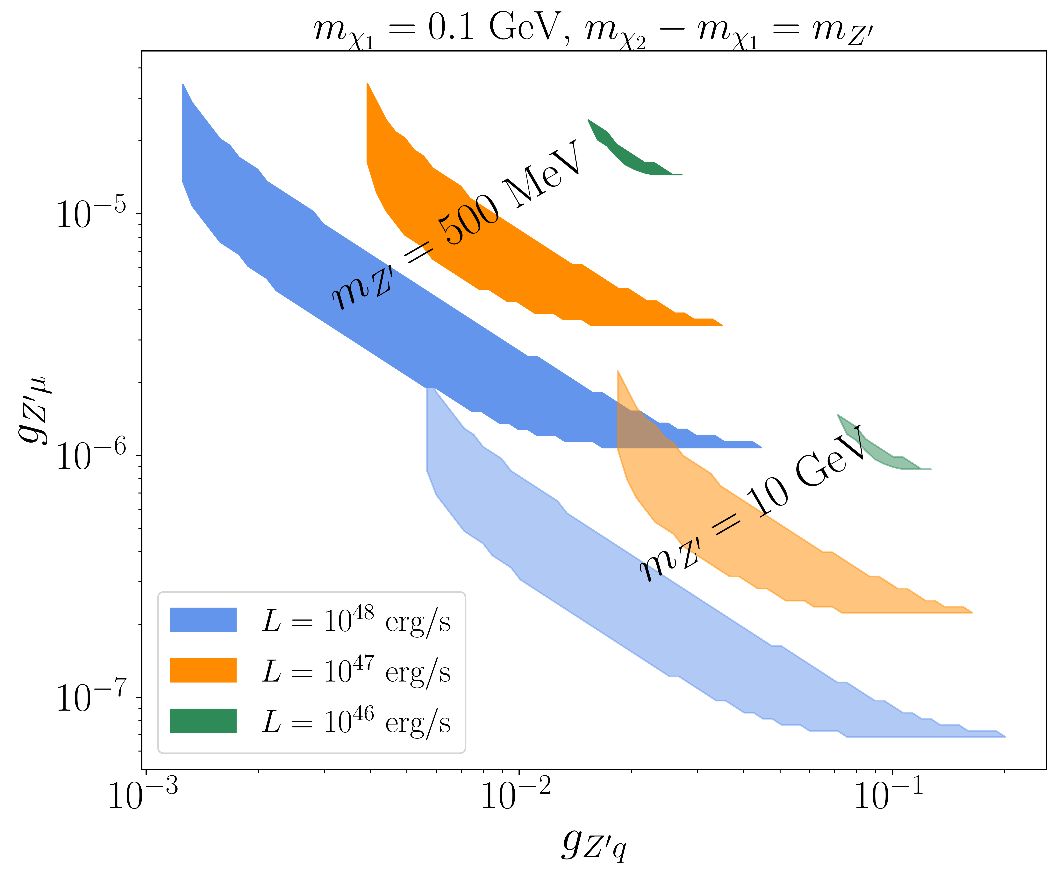
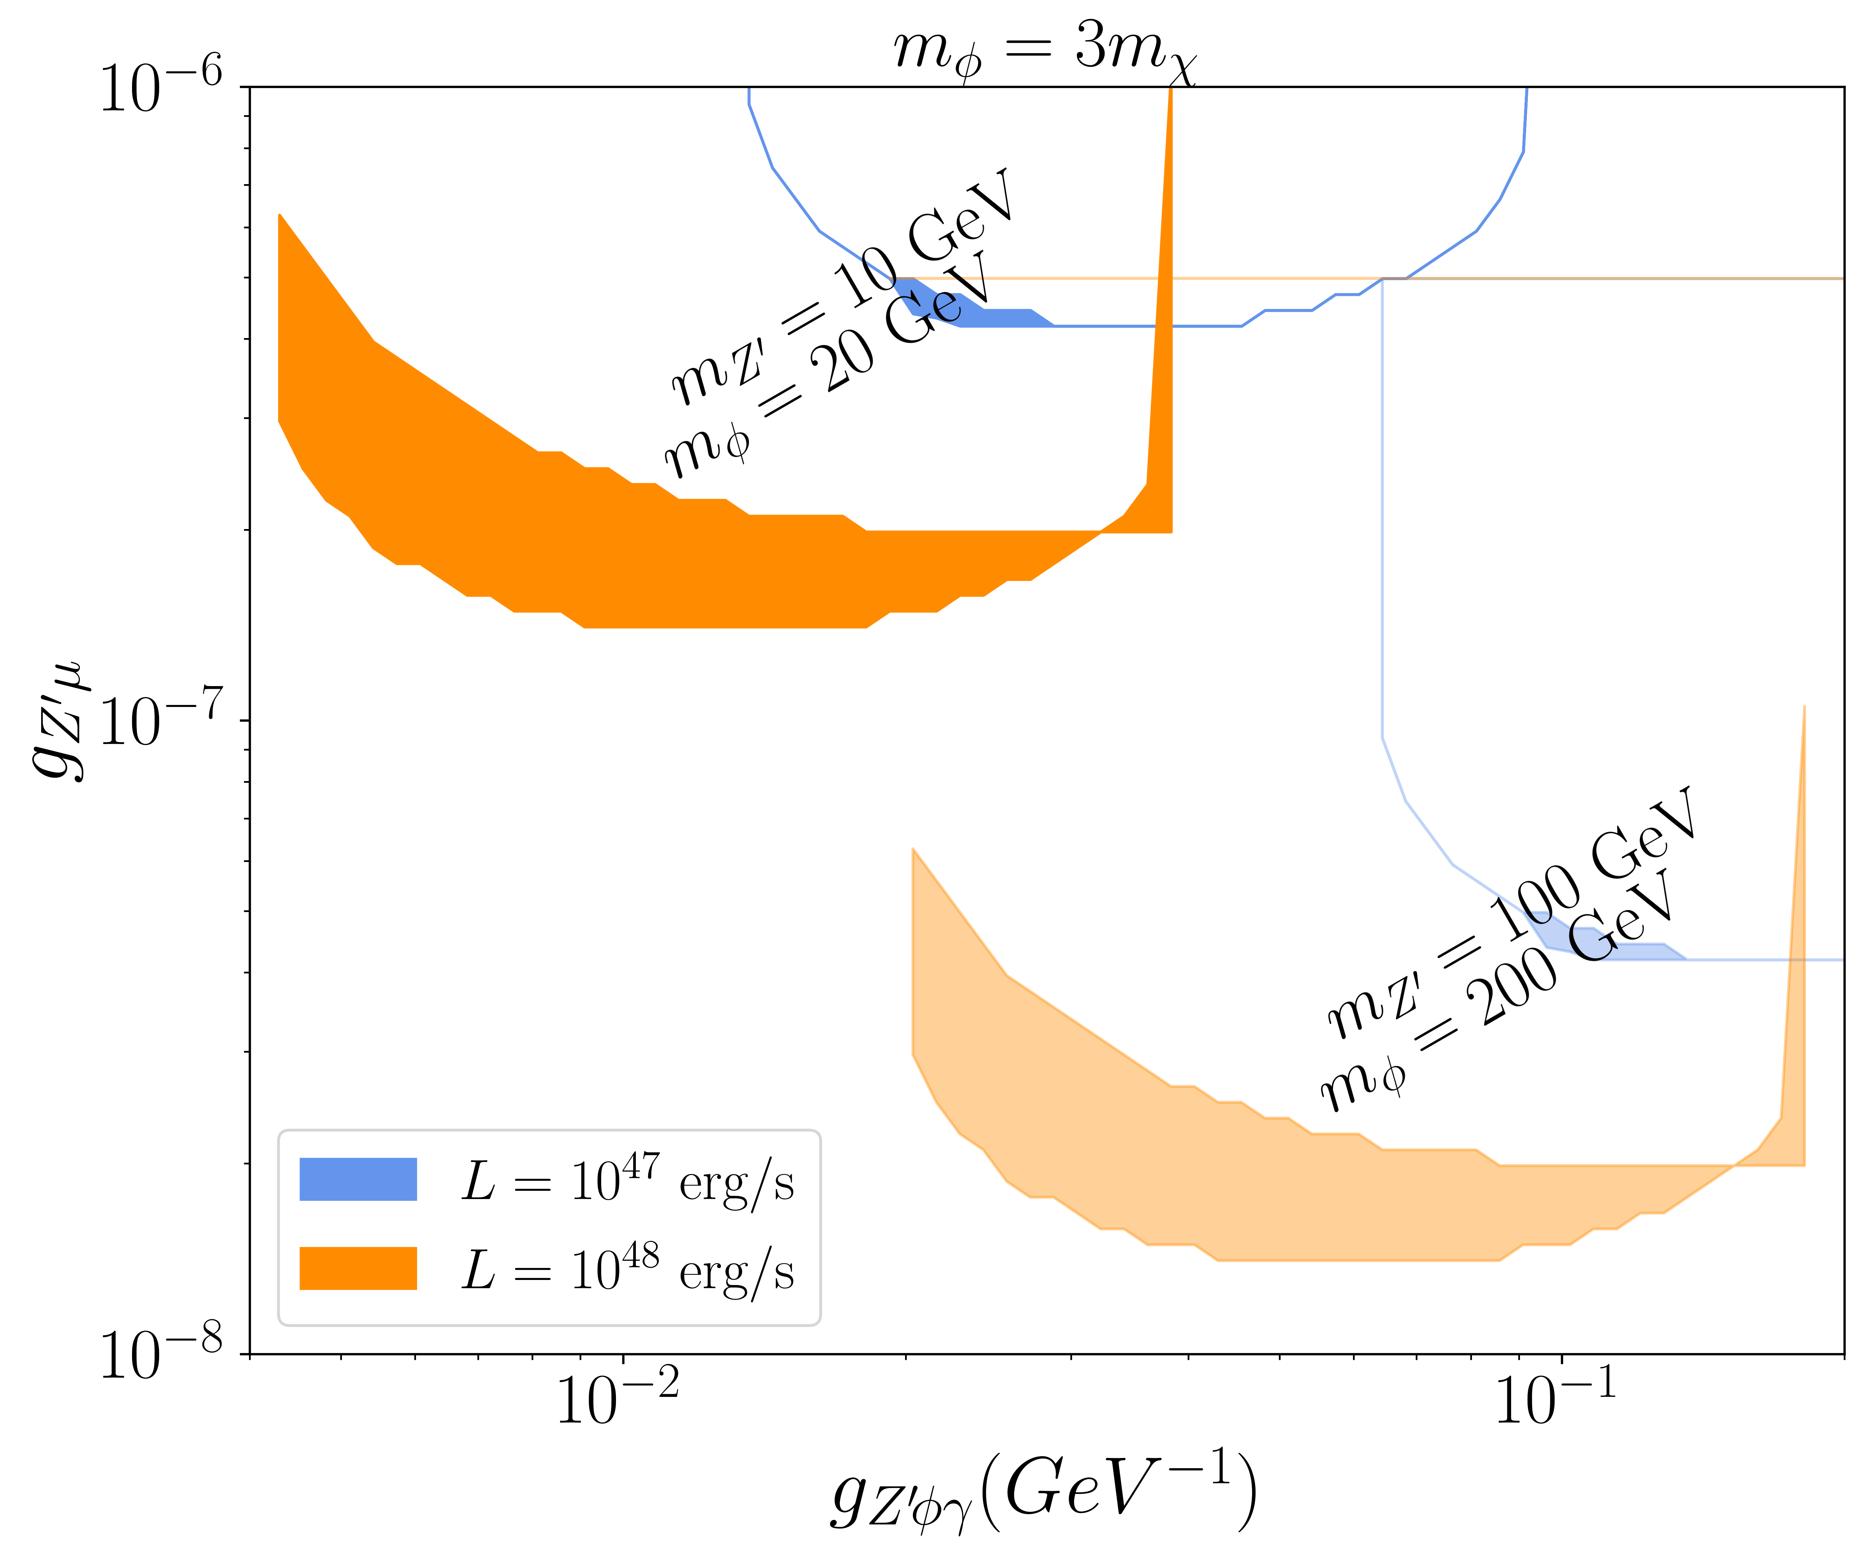
Preferred Parameter Space
2-2 case
2-3 case

Slide 11
Conclusions
The KM3NeT event is the highest energy (non-CR) event ever recorded.
Tension with IceCube non-observation at such energies.
Potential solution using blazar-boosted DM scattering in Earth matter.
Can also alleviate the tension with source luminosity.
Testable in future observations:
  Ratio of events at KM3NeT and IceCube for a given blazar luminosity.
  DM-induced events can be distinguished from neutrino-induced events using zenith angle distribution and flavor triangle analysis.
  Suppressed gamma-ray activity associated with DM flux compared to the neutrino flux.
  Different signal topology in DM direct detection experiments (need specialized trigger).

Slide 12
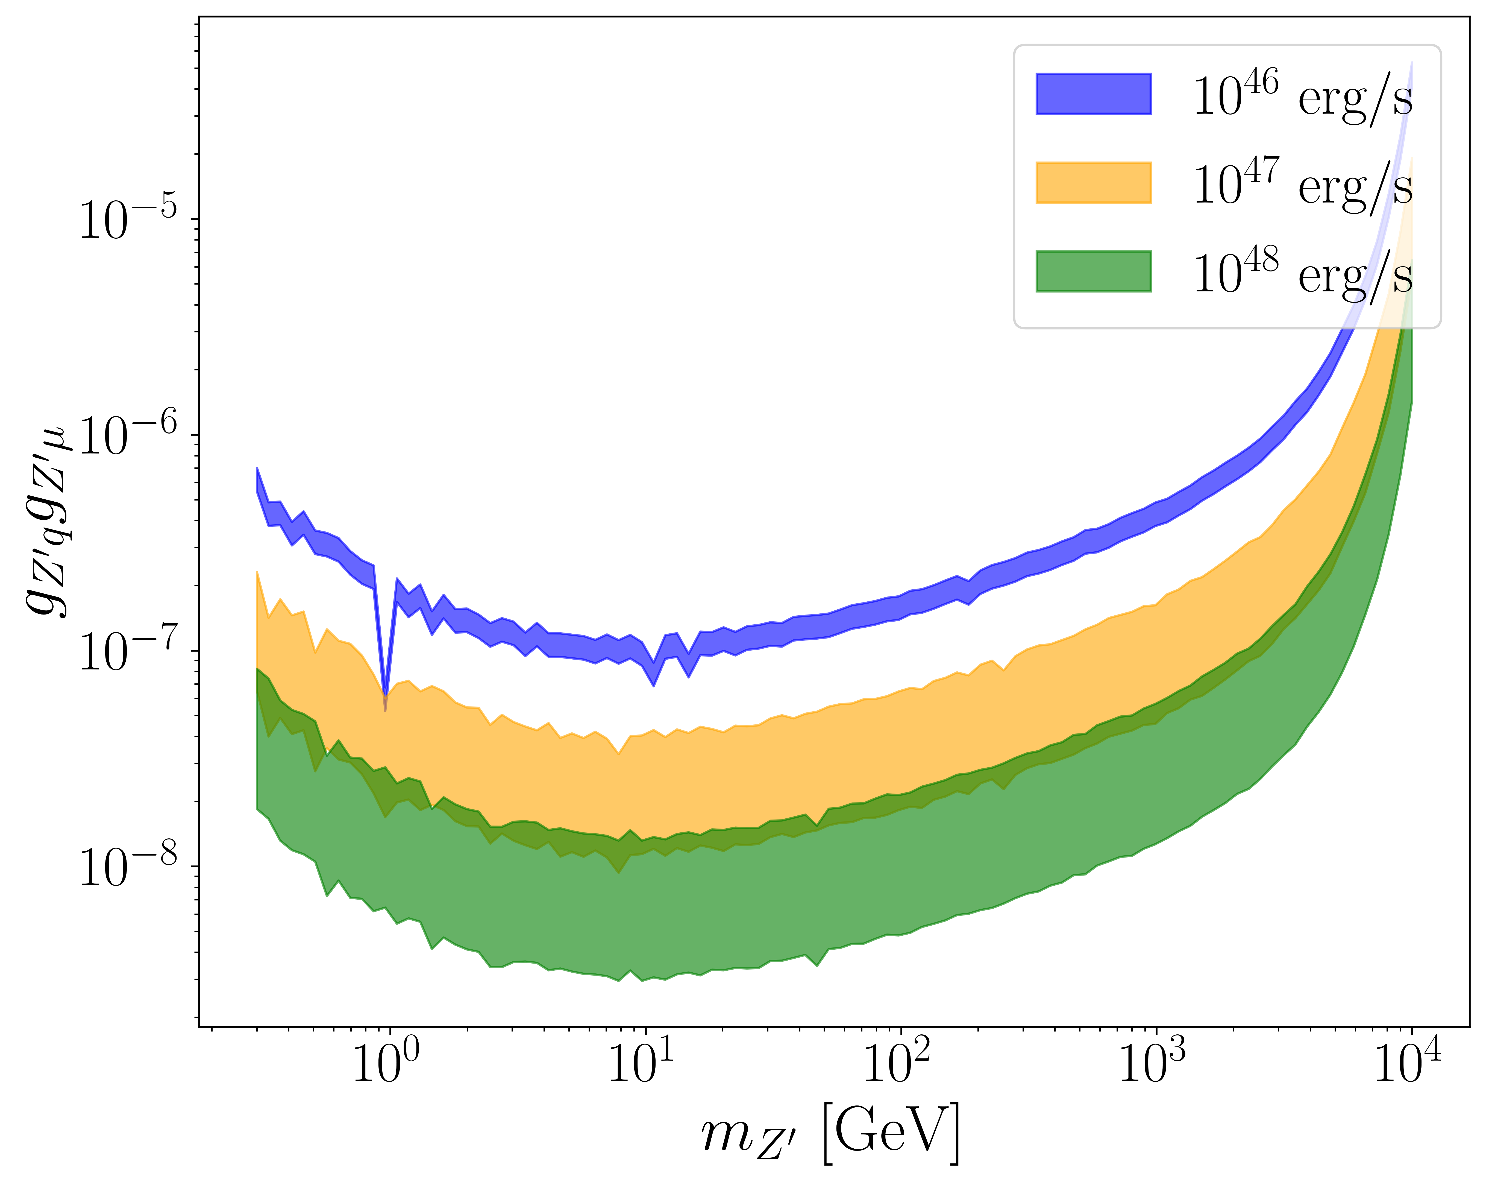
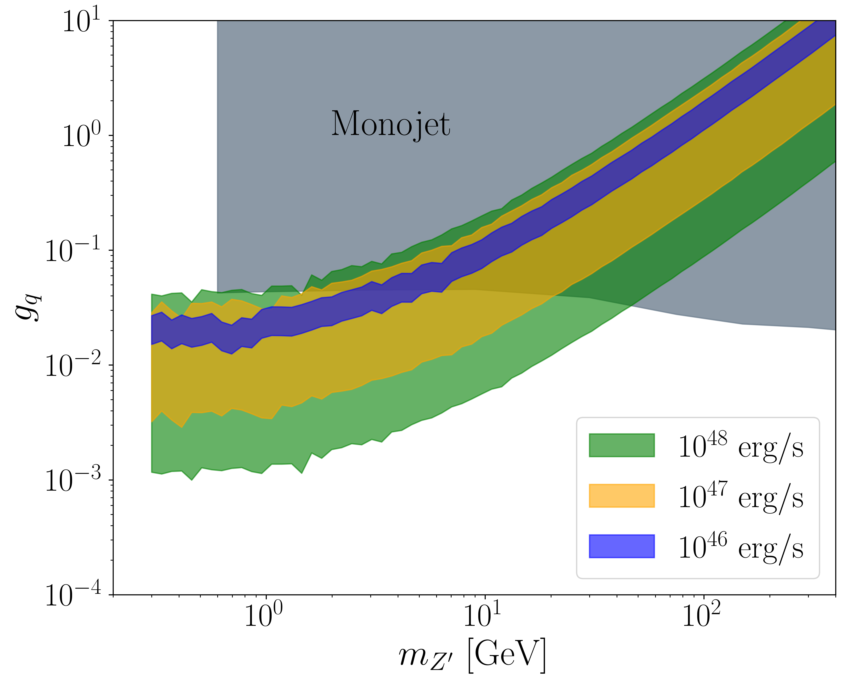
Extra: Preferred Parameter Space

Slide 13
