Slide 1



Searches via effective filed theory with ATLAS and CMS
Kenichi Hatakeyama
Baylor University
for ATLAS and CMS Collaborations
May 16, 2025

Slide 2
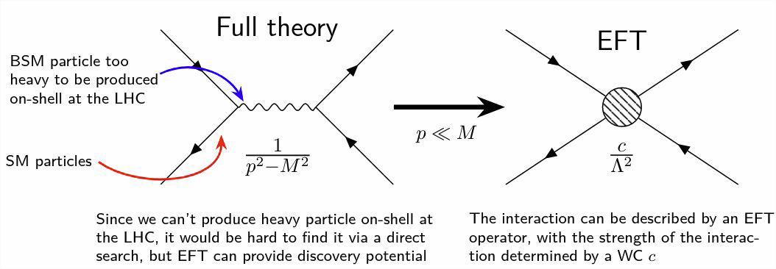
Effective field theory (EFT)
New particles may not be light enough to be produced at the LHC
EFT provides a framework for probing high-scale physics
  Model additional interactions between SM particles due to the exchange of heavier particles as a short-distance physics
EFT is an efficient model-independent approach to search for physics beyond the standard model (BSM).
p<<M
EFT
Notes:
Barbara Alvarez Gonzalez
ICHEP 2024

Slide 3
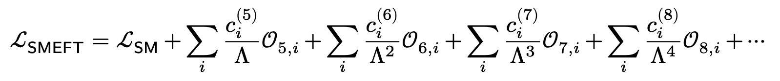
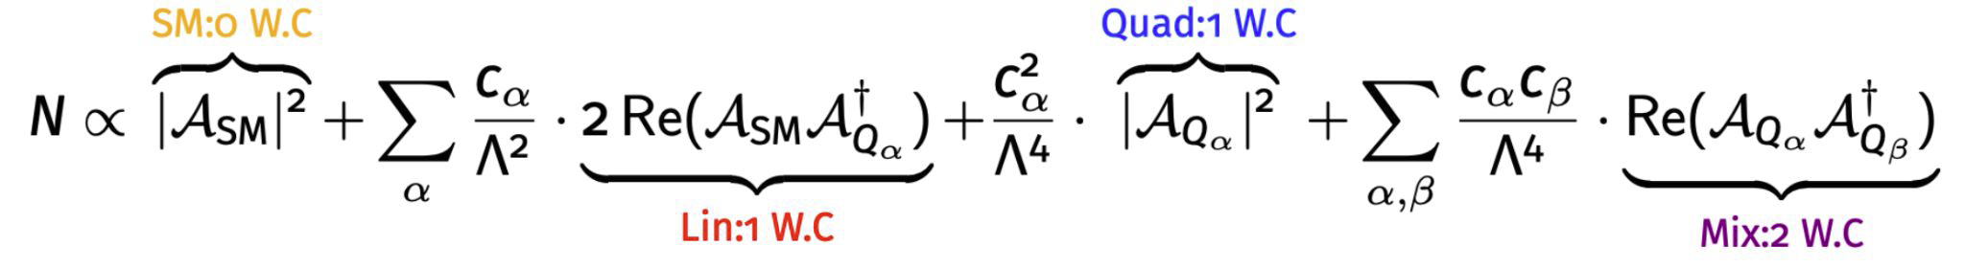
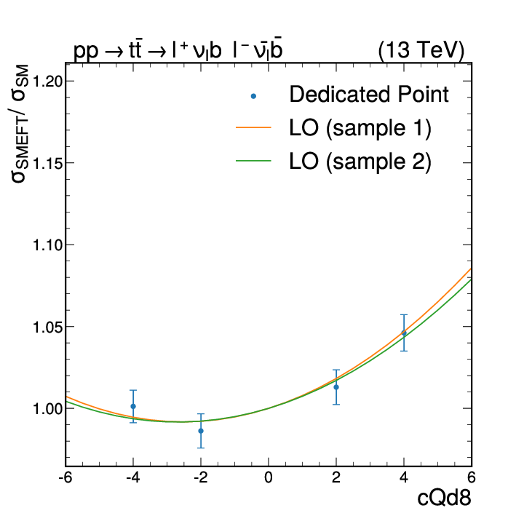
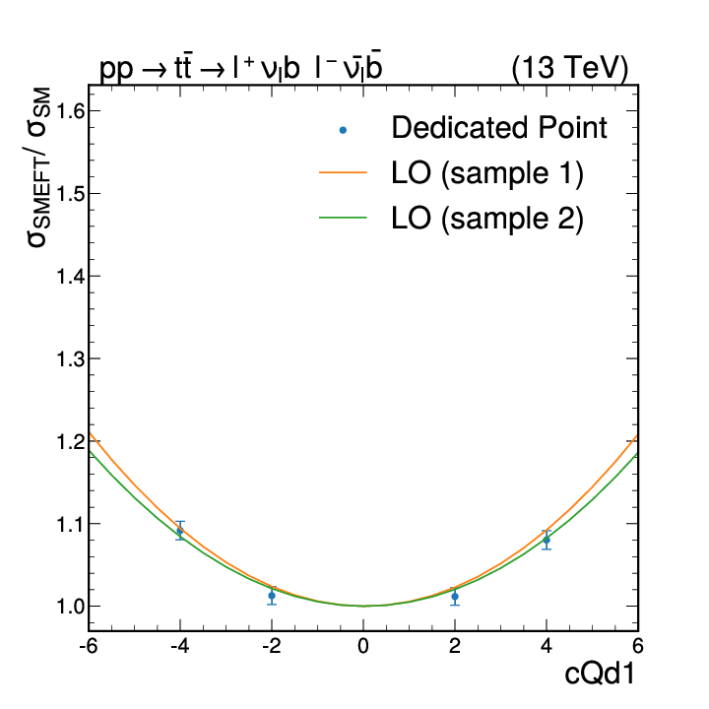
Effective field theory
Lepton number violation
Lepton & Baryon number violation
SMEFT: including 2499 dim-6 operators. Flavor symmetries reduce this number to O(100).
Various EFT analyses are performed in top, Higgs, EWK sectors
Notes:
Barbara Alvarez Gonzalez
ICHEP 2024
G. Pizzati
2504.02958
https://cds.cern.ch/record/2895759/plots

Slide 4
Top Quark Sector

Slide 5
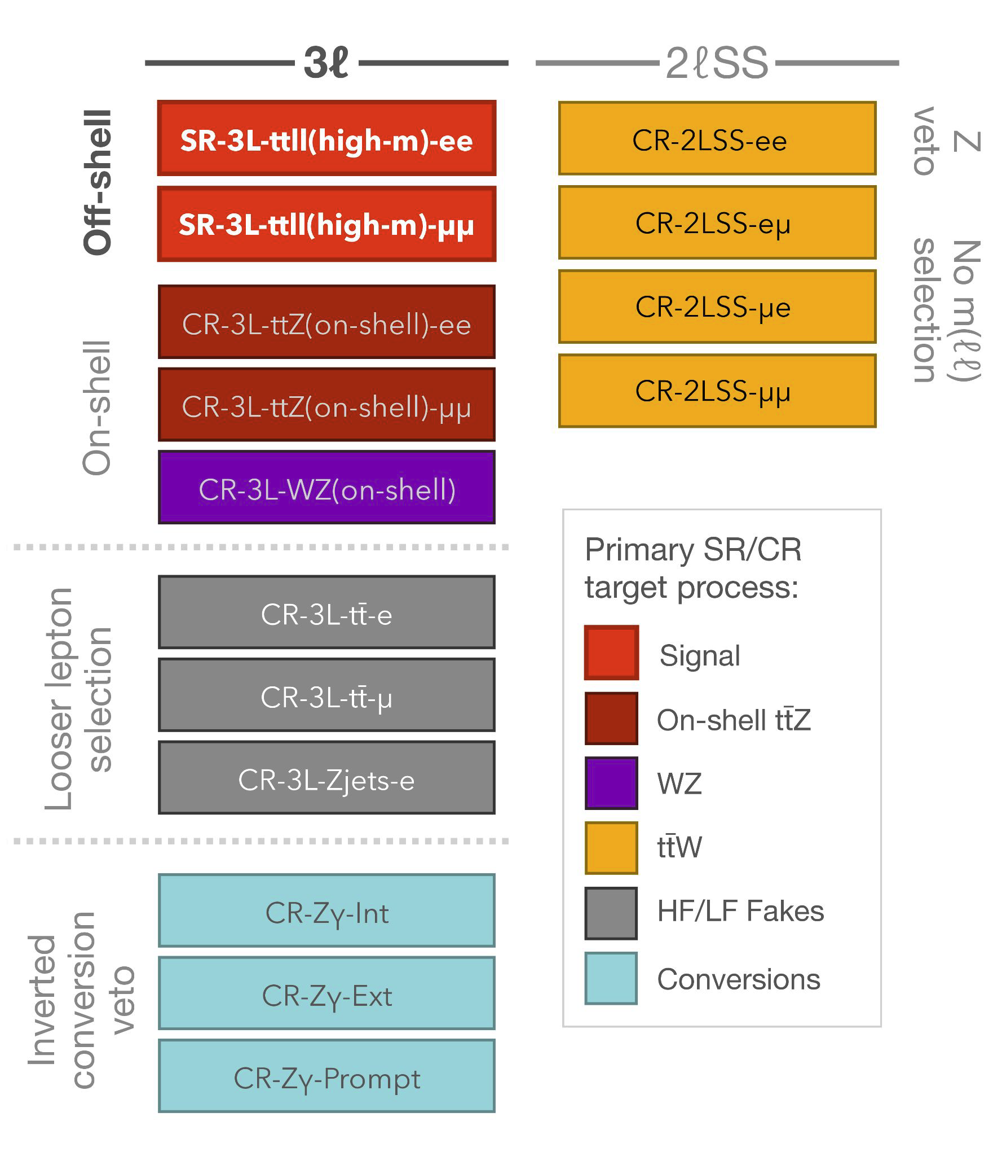
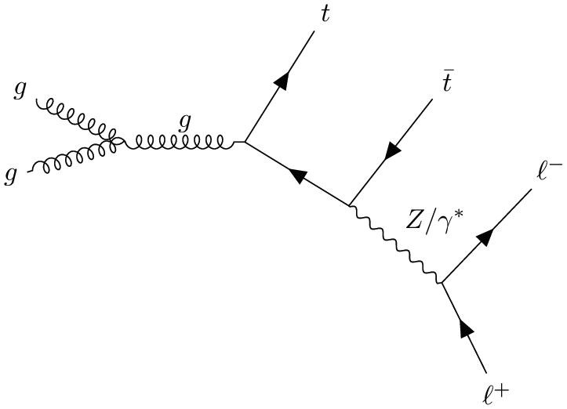
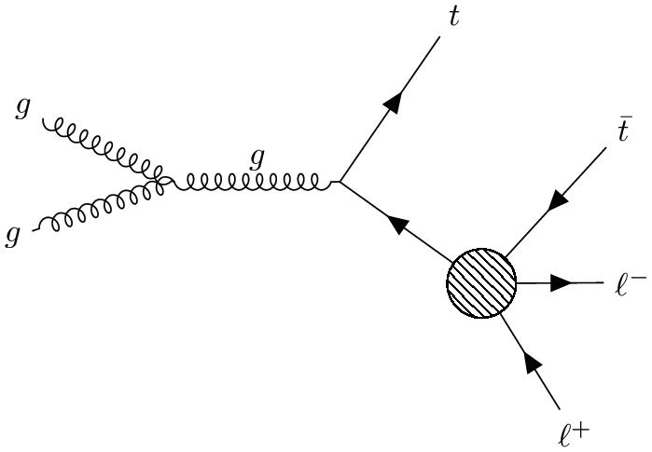
Measurement of high-mass ttℓℓ
High mass ttℓℓ measurement, where m(ℓℓ) > m(Z) + 10 GeV.
Sensitivity to many four-fermion operators grows with the energy
Analysis strategy: focus on 3L final state
Various CRs constrain SM ttW, ttZ, WZ+jet, and non-prompt leptons
arXiv:2504.05919, submitted to EPJC

Slide 6
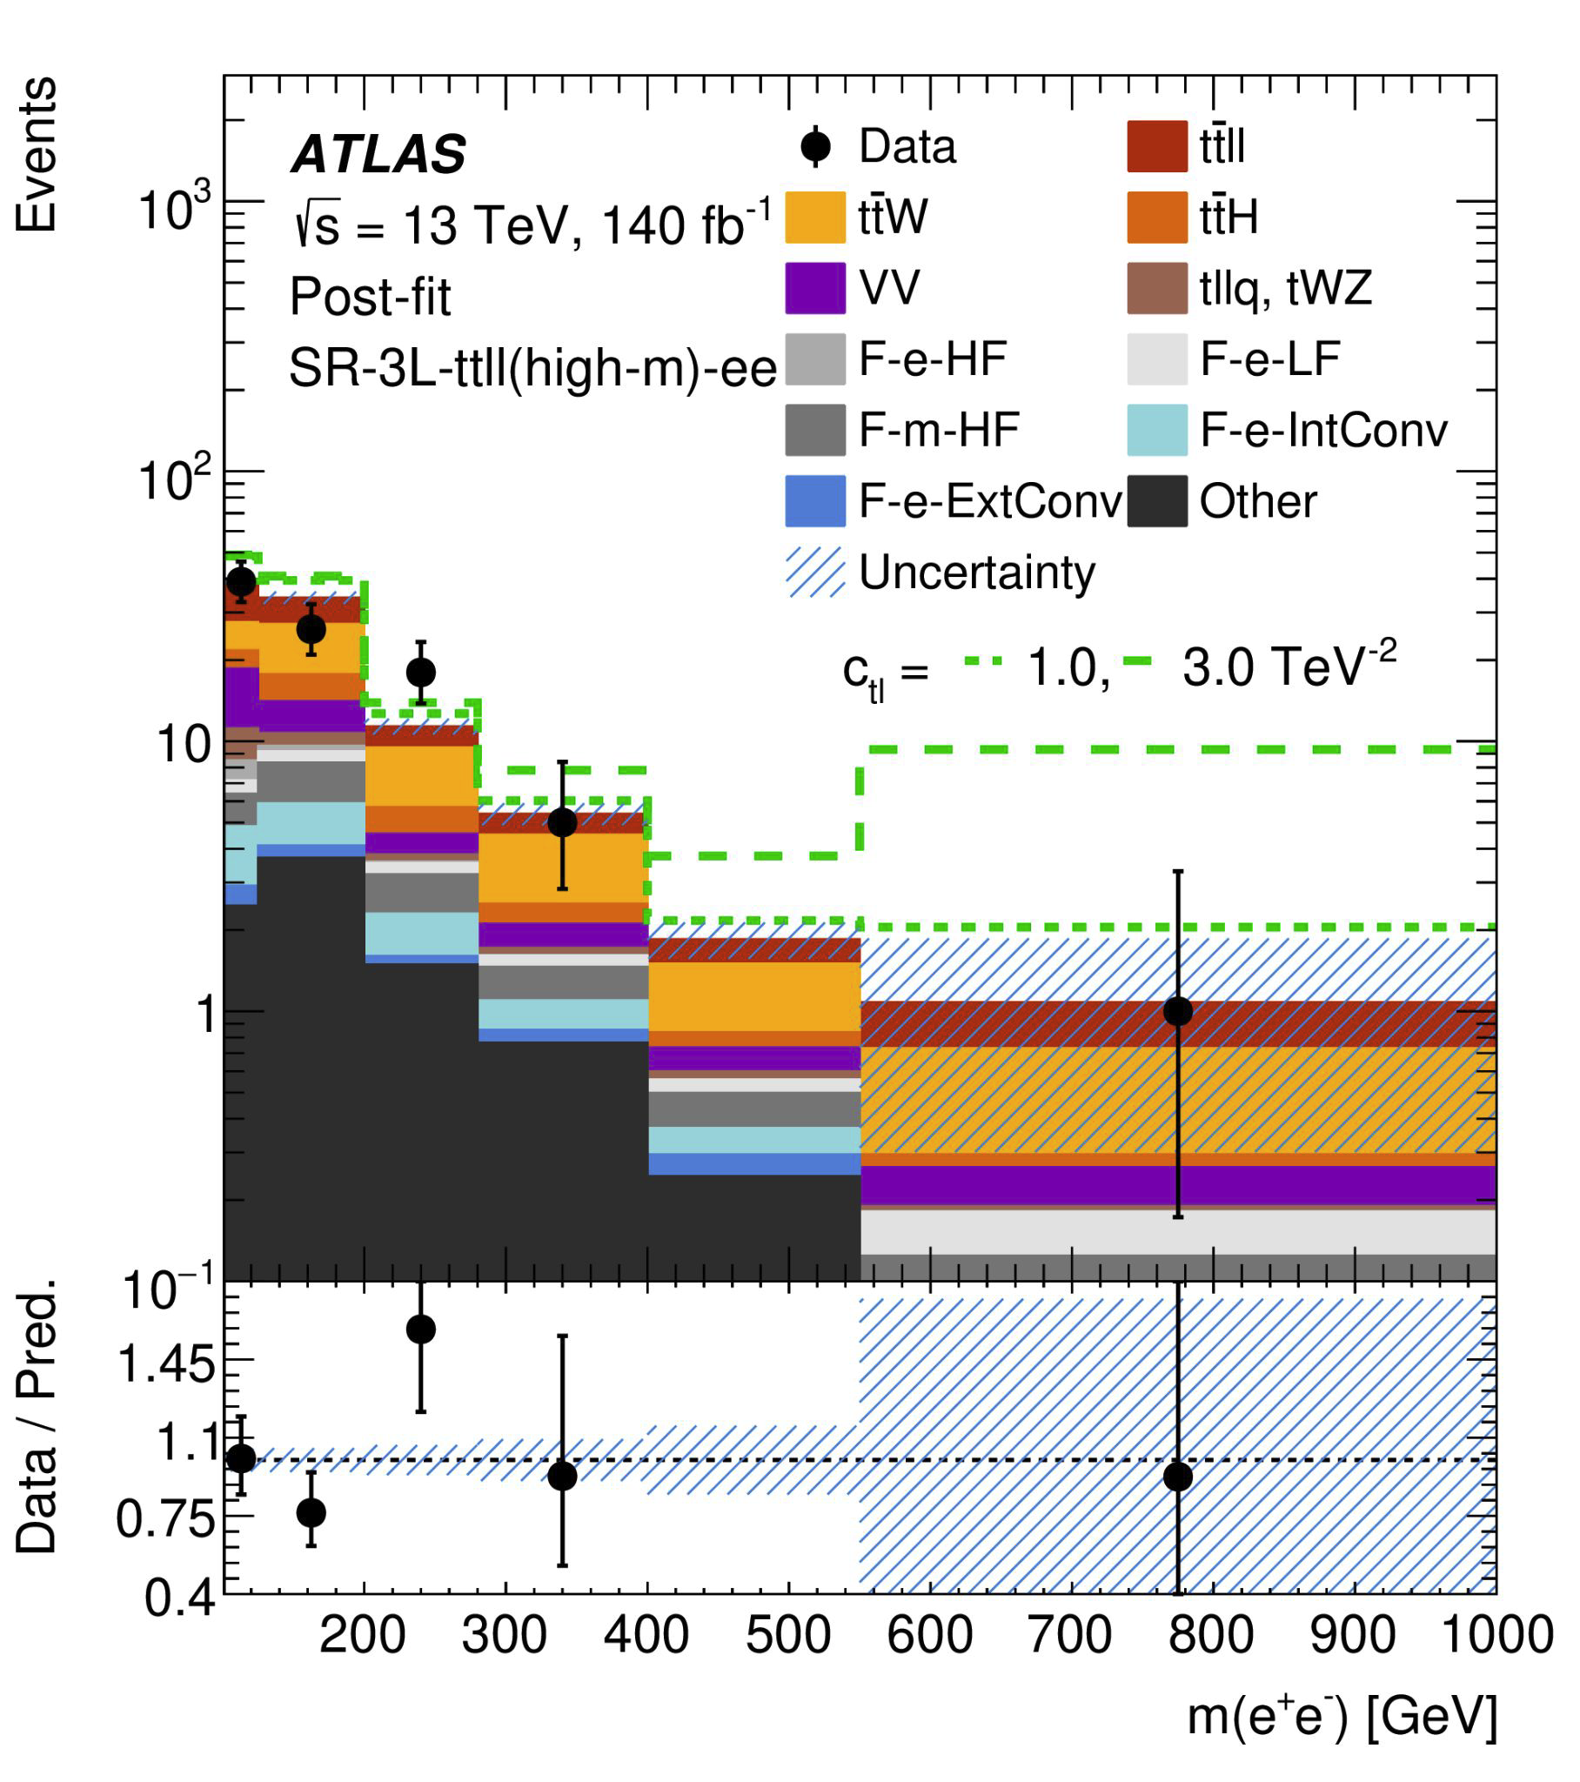
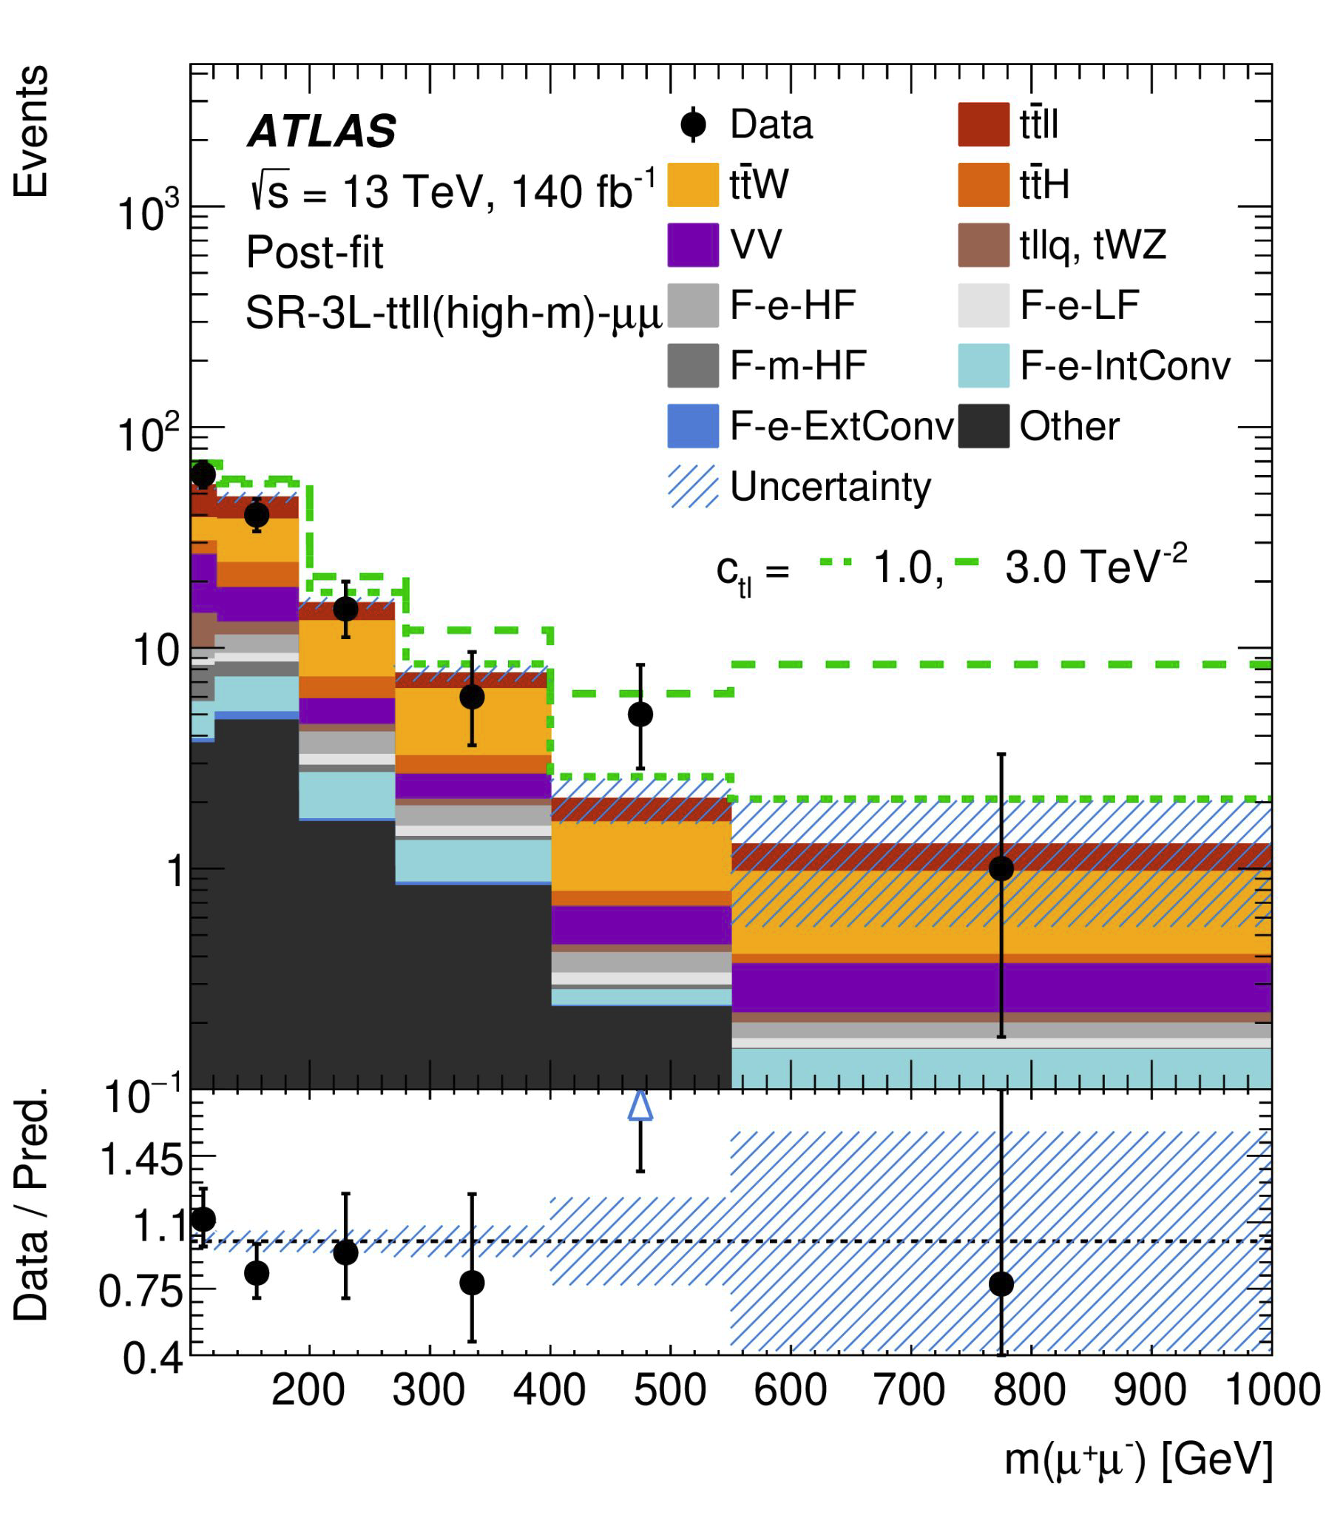
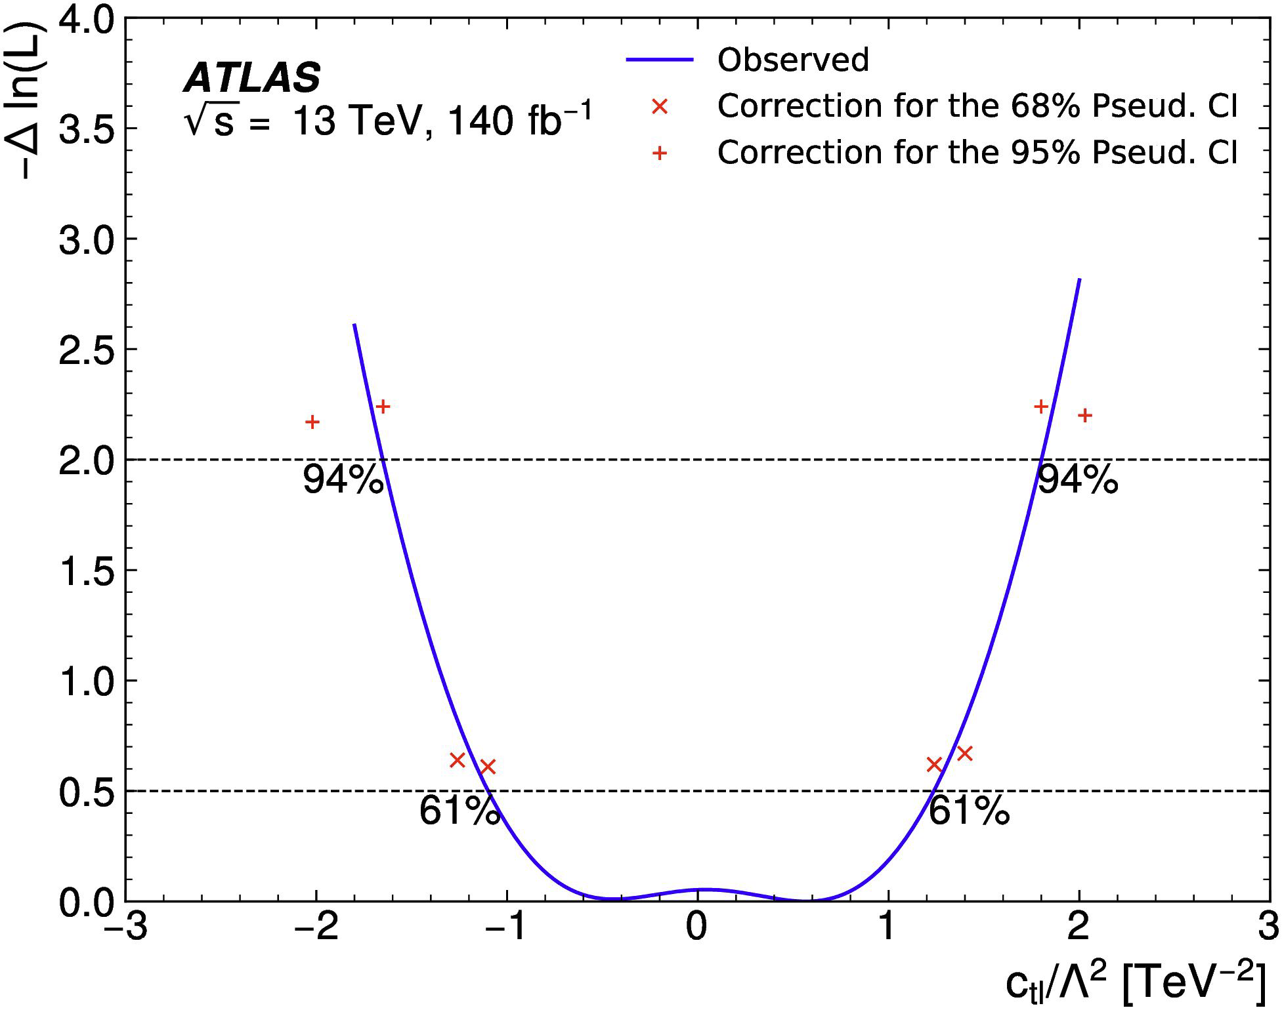
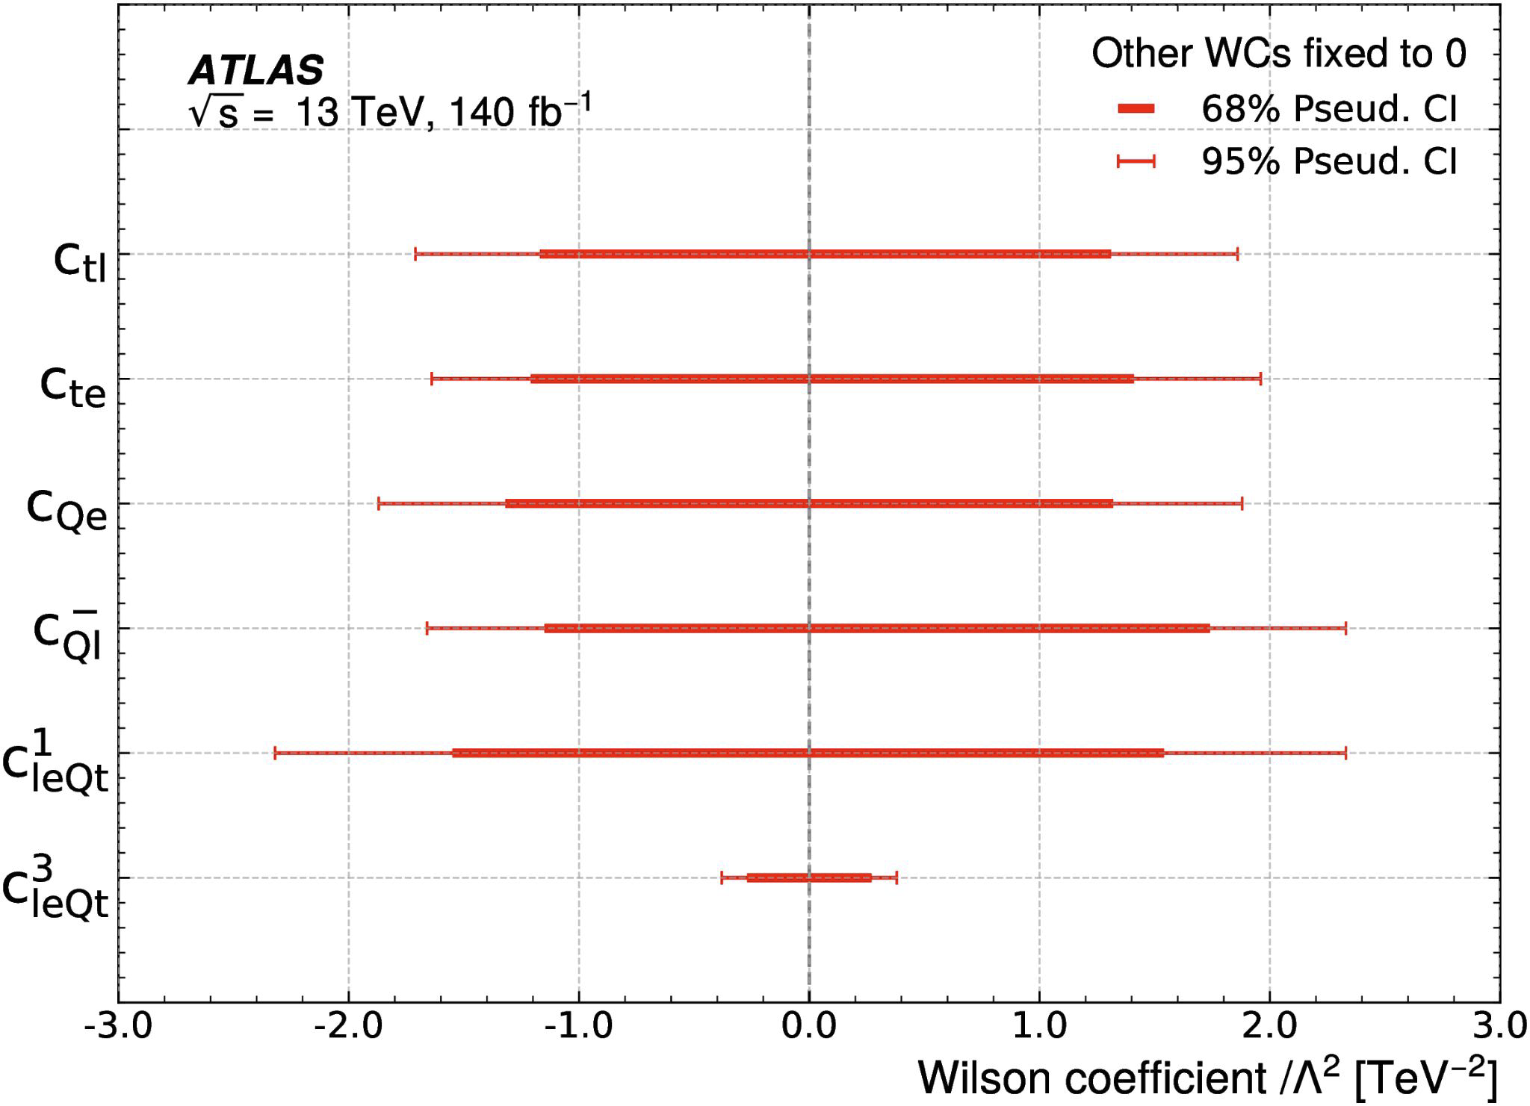
Measurement of high-mass ttℓℓ
Final discrimination: dilepton mass m(ℓℓ)
  Good sensitivity of WCs on the tail
Results fully compatible with SM expectations

Slide 7
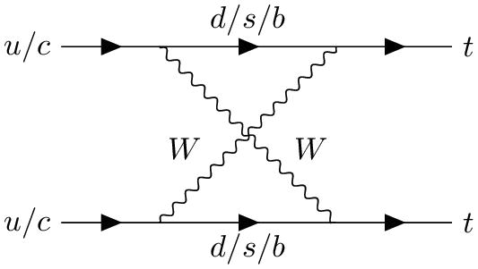
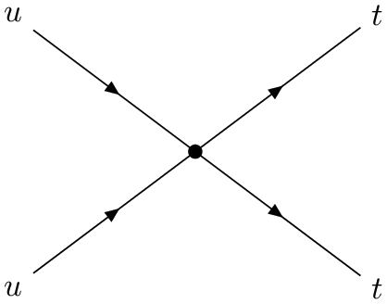
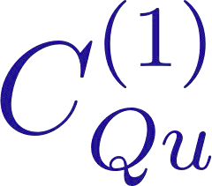
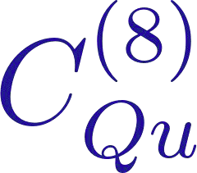
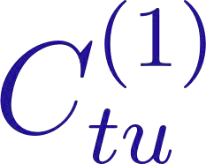
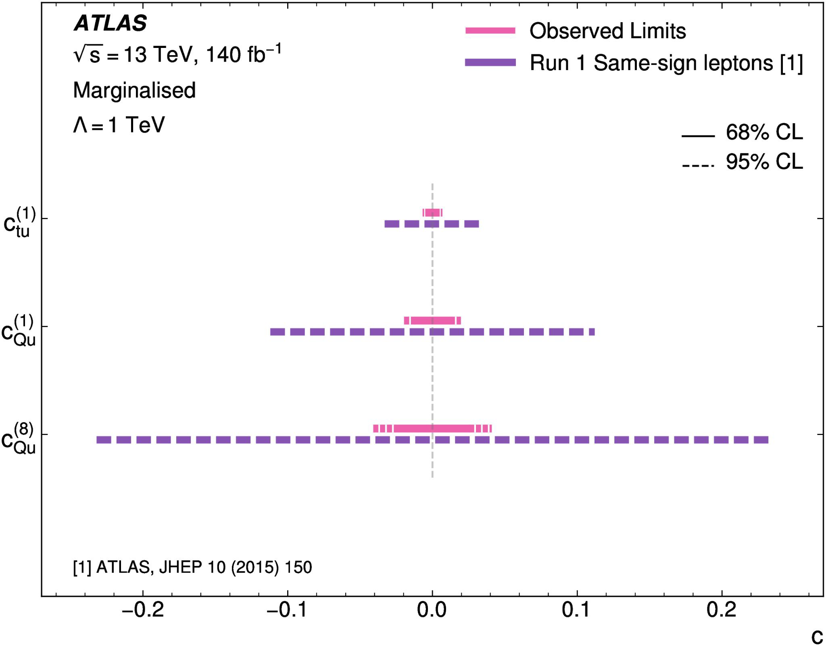
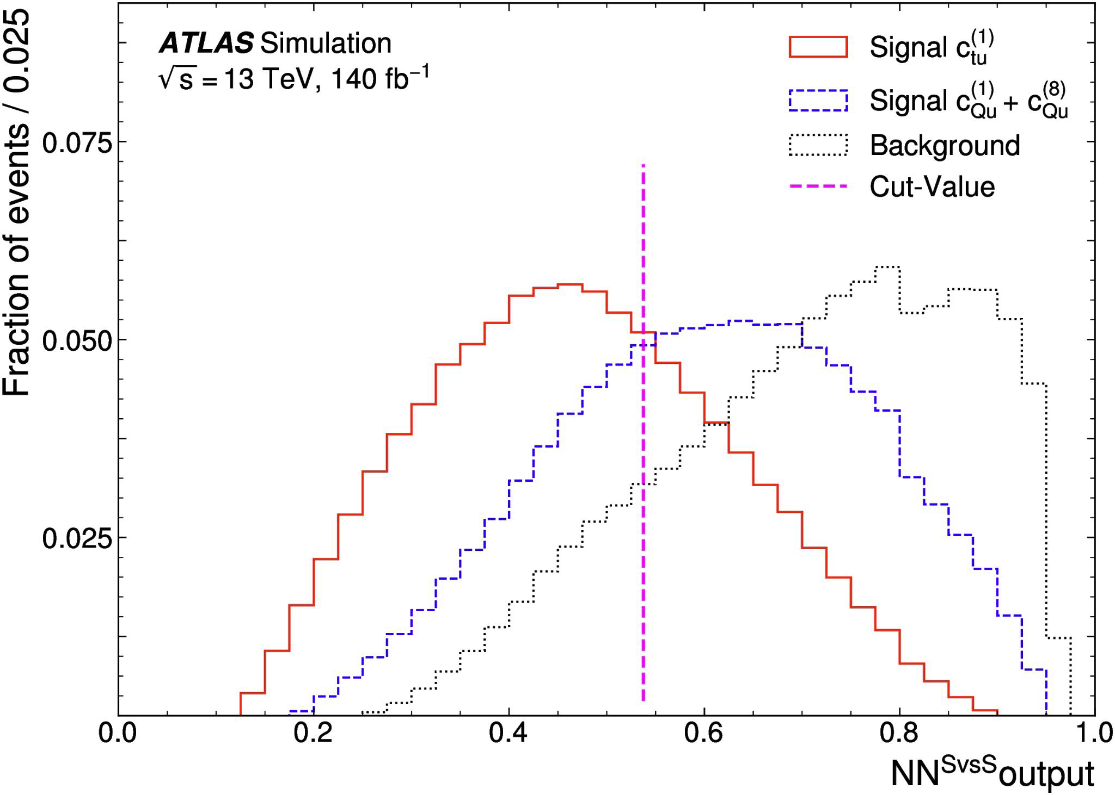
Same Sign Top Pair
arXiv:2409.14982, JHEP 02 (2025) 084
Same-sign top-quark pair production at LHC is strongly suppressed in SM
  Observation of this process would imply BSM physics
Signal vs signal NN to enhance the c_{Qu} and c_{tu} separation
  Differences due to the chirality
Signal vs background NN to distinguish SS top from background
Notes:
What are kinematic inputs to BDT?

Slide 8
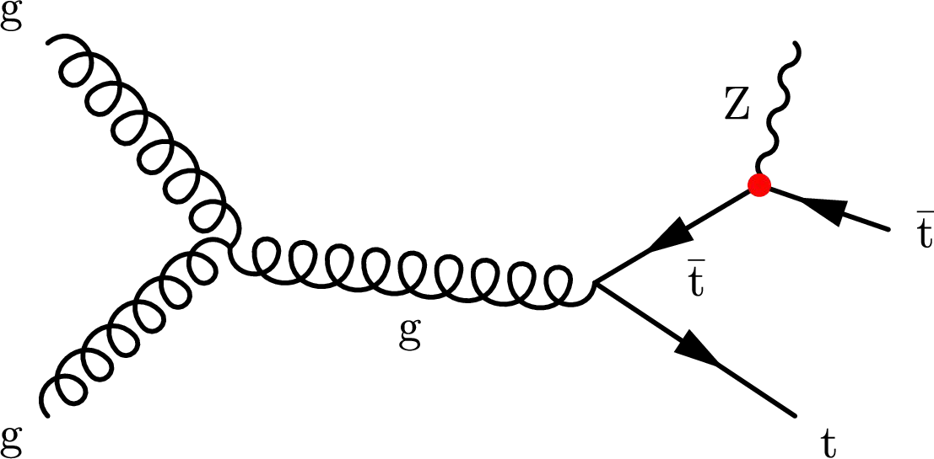
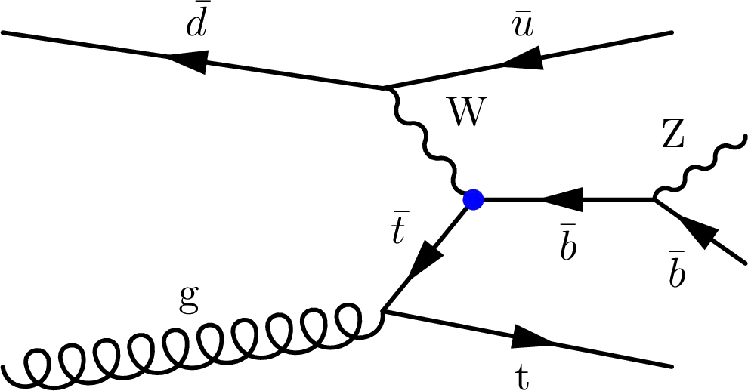
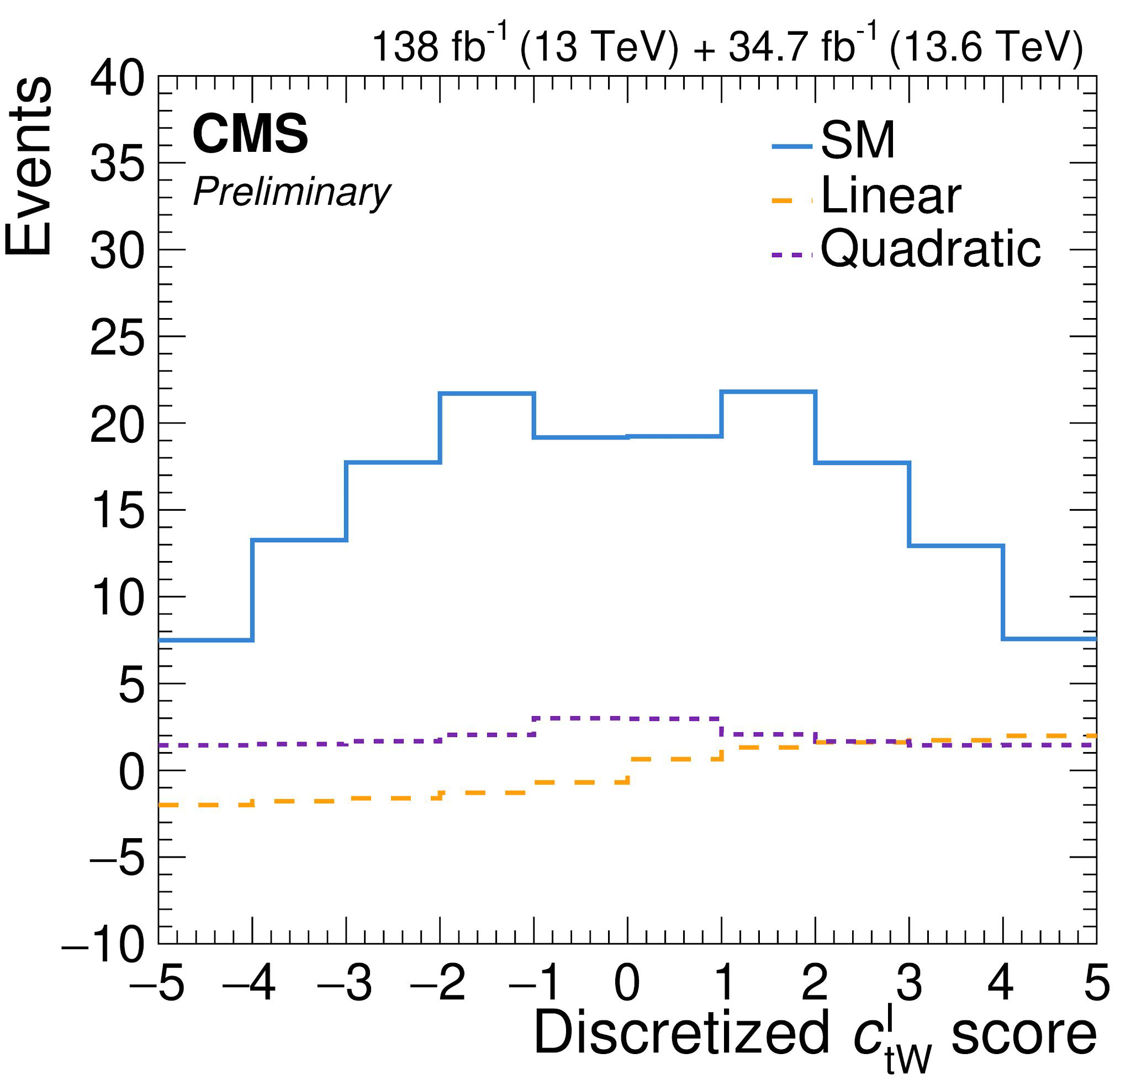
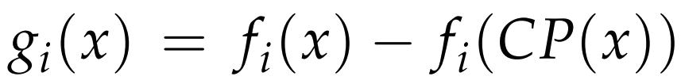
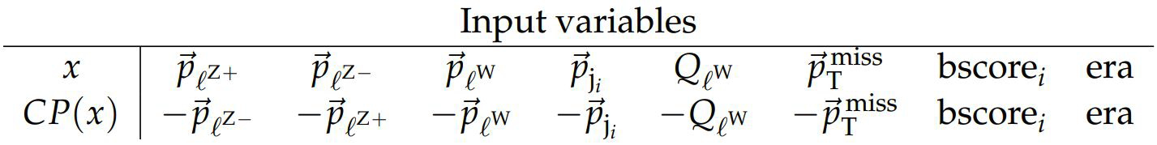
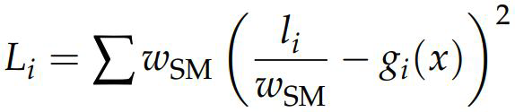
CP violation in ttZ and tZq
CMS-PAS-TOP-24-012
Previous ttZ and tZq differential results focus on observables invariant under CP transformations
New analysis focuses on interference between CP-violating c^{I}_{tW(Z)} and the SM
Neural network:
With CP transformed observables:
Trains g_{i}(x) to maximize sensitivity to modifications linear in the Wilson Coefficients

Slide 9
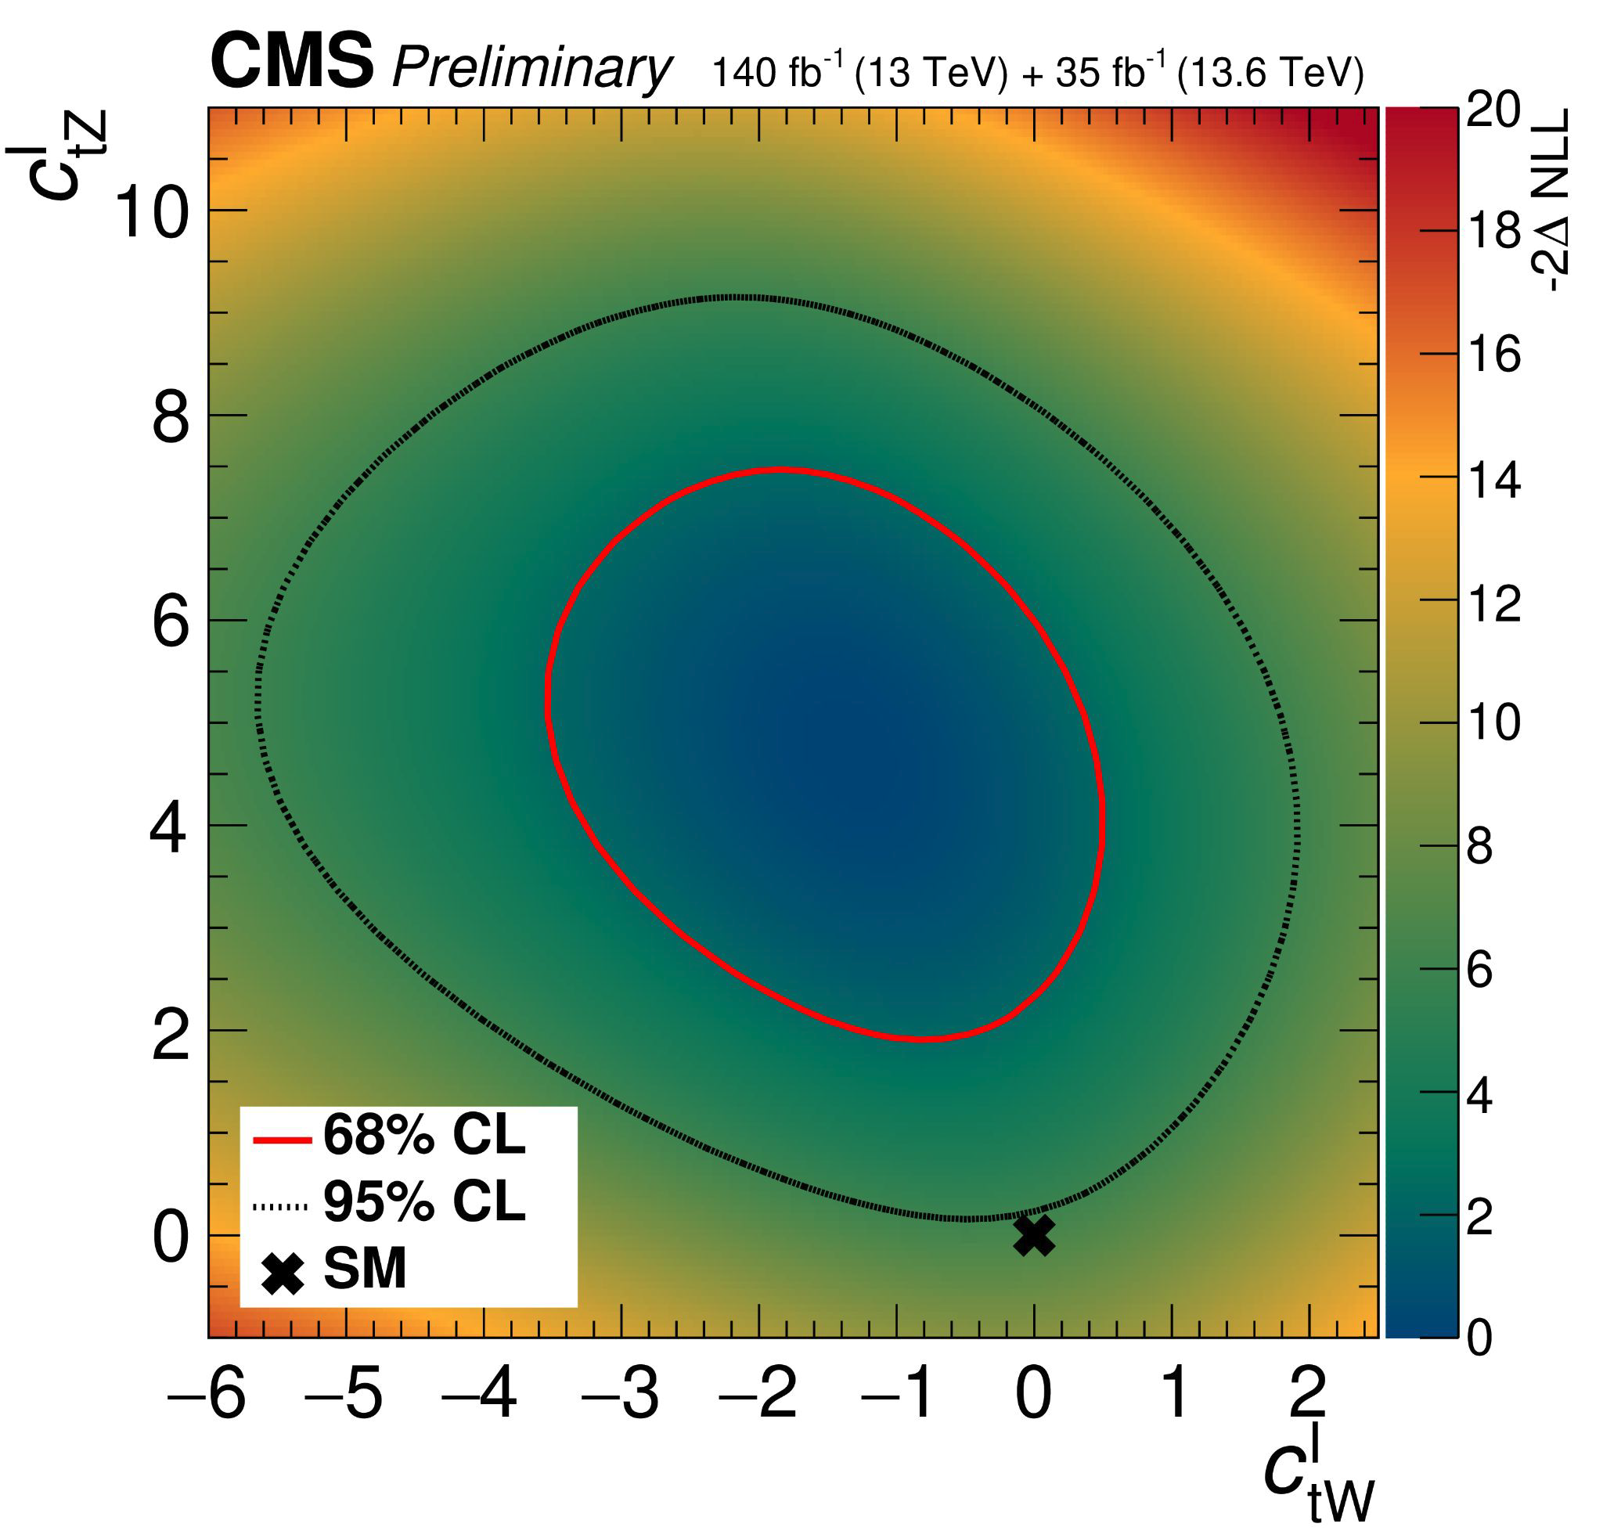
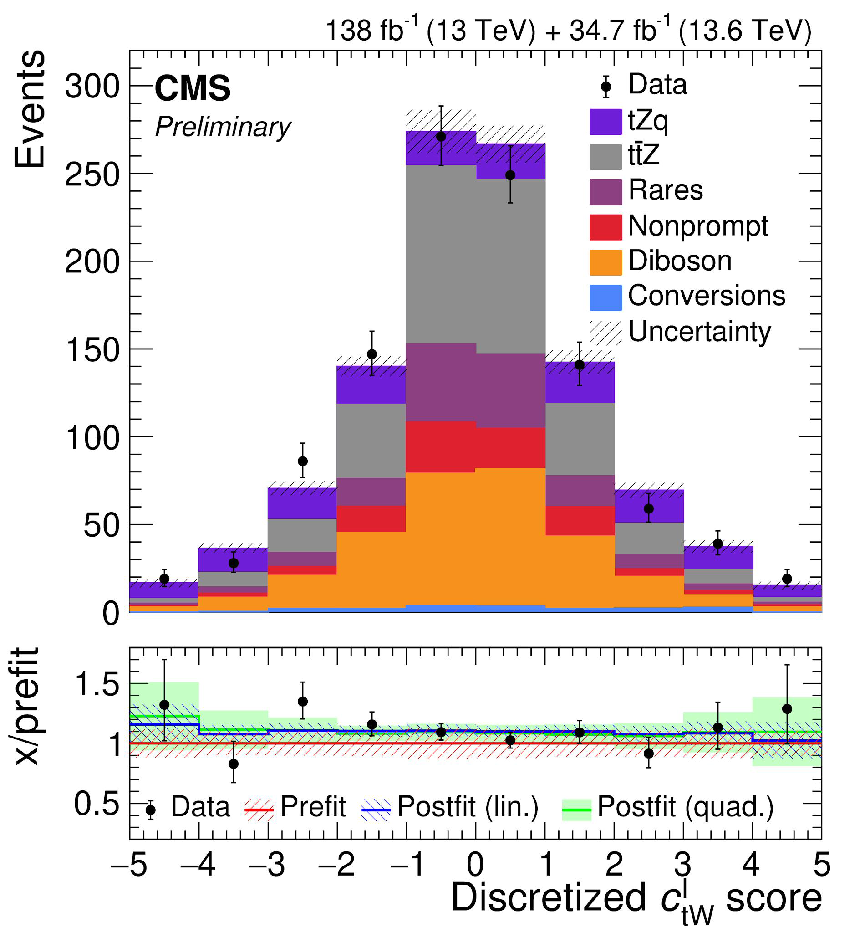
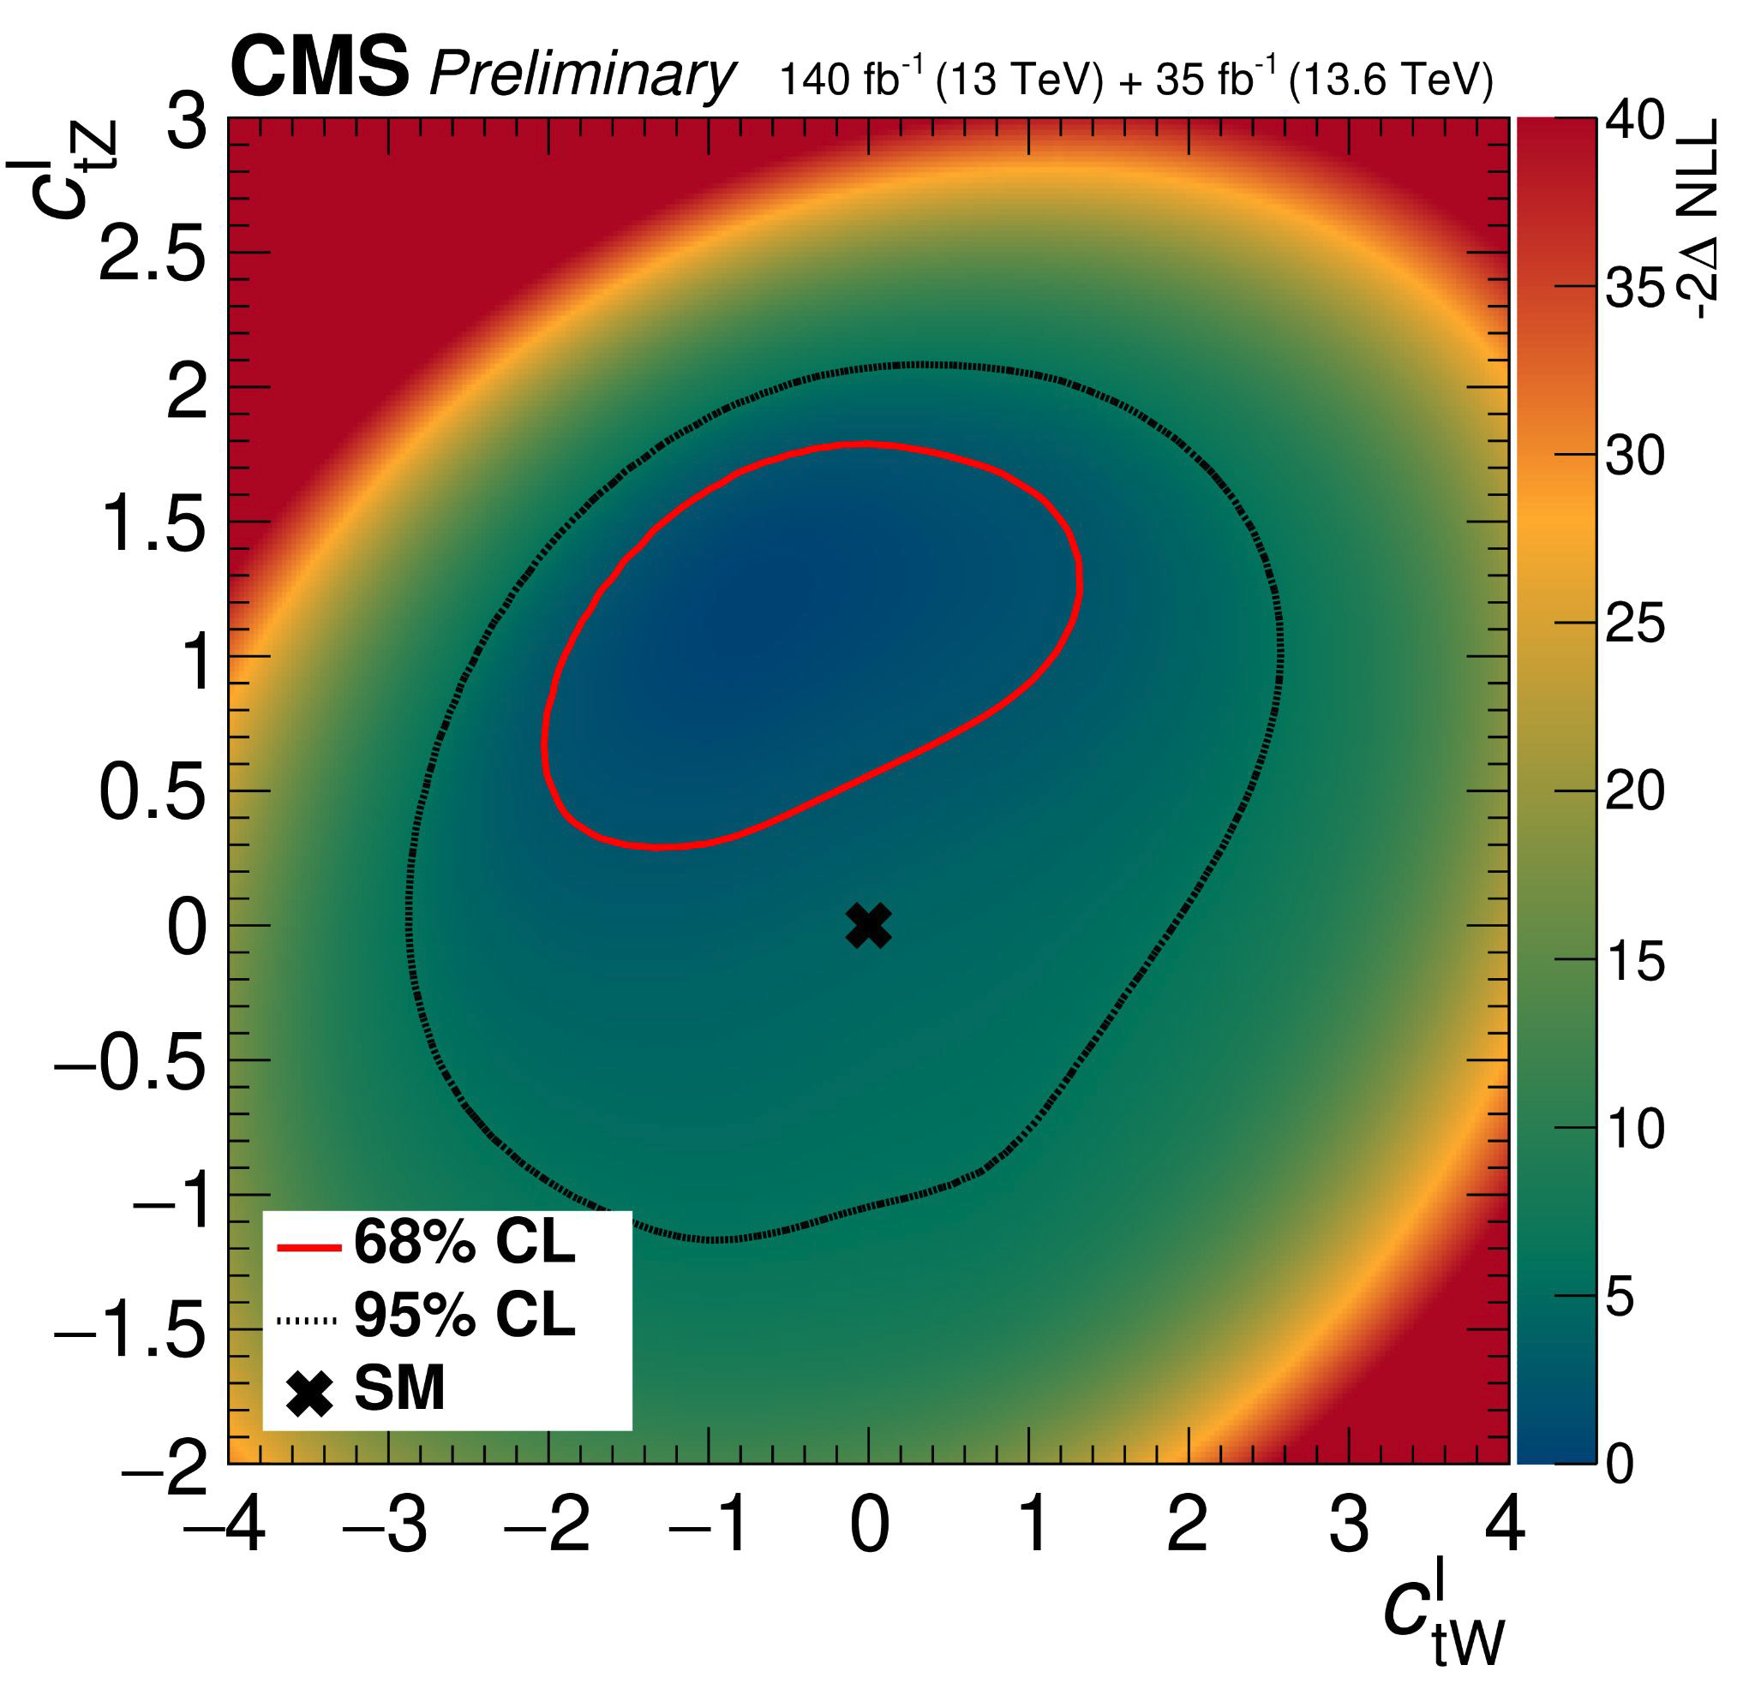
CP violation in ttZ and tZq
Results are shown from contributions linear in WCs (sensitivity from asymmetry) and linear+quadratic components
  Quadratic component has similar impact to linear component
Linear
Linear+quadratic

Slide 10
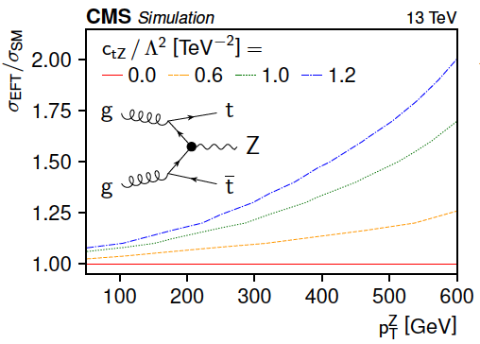
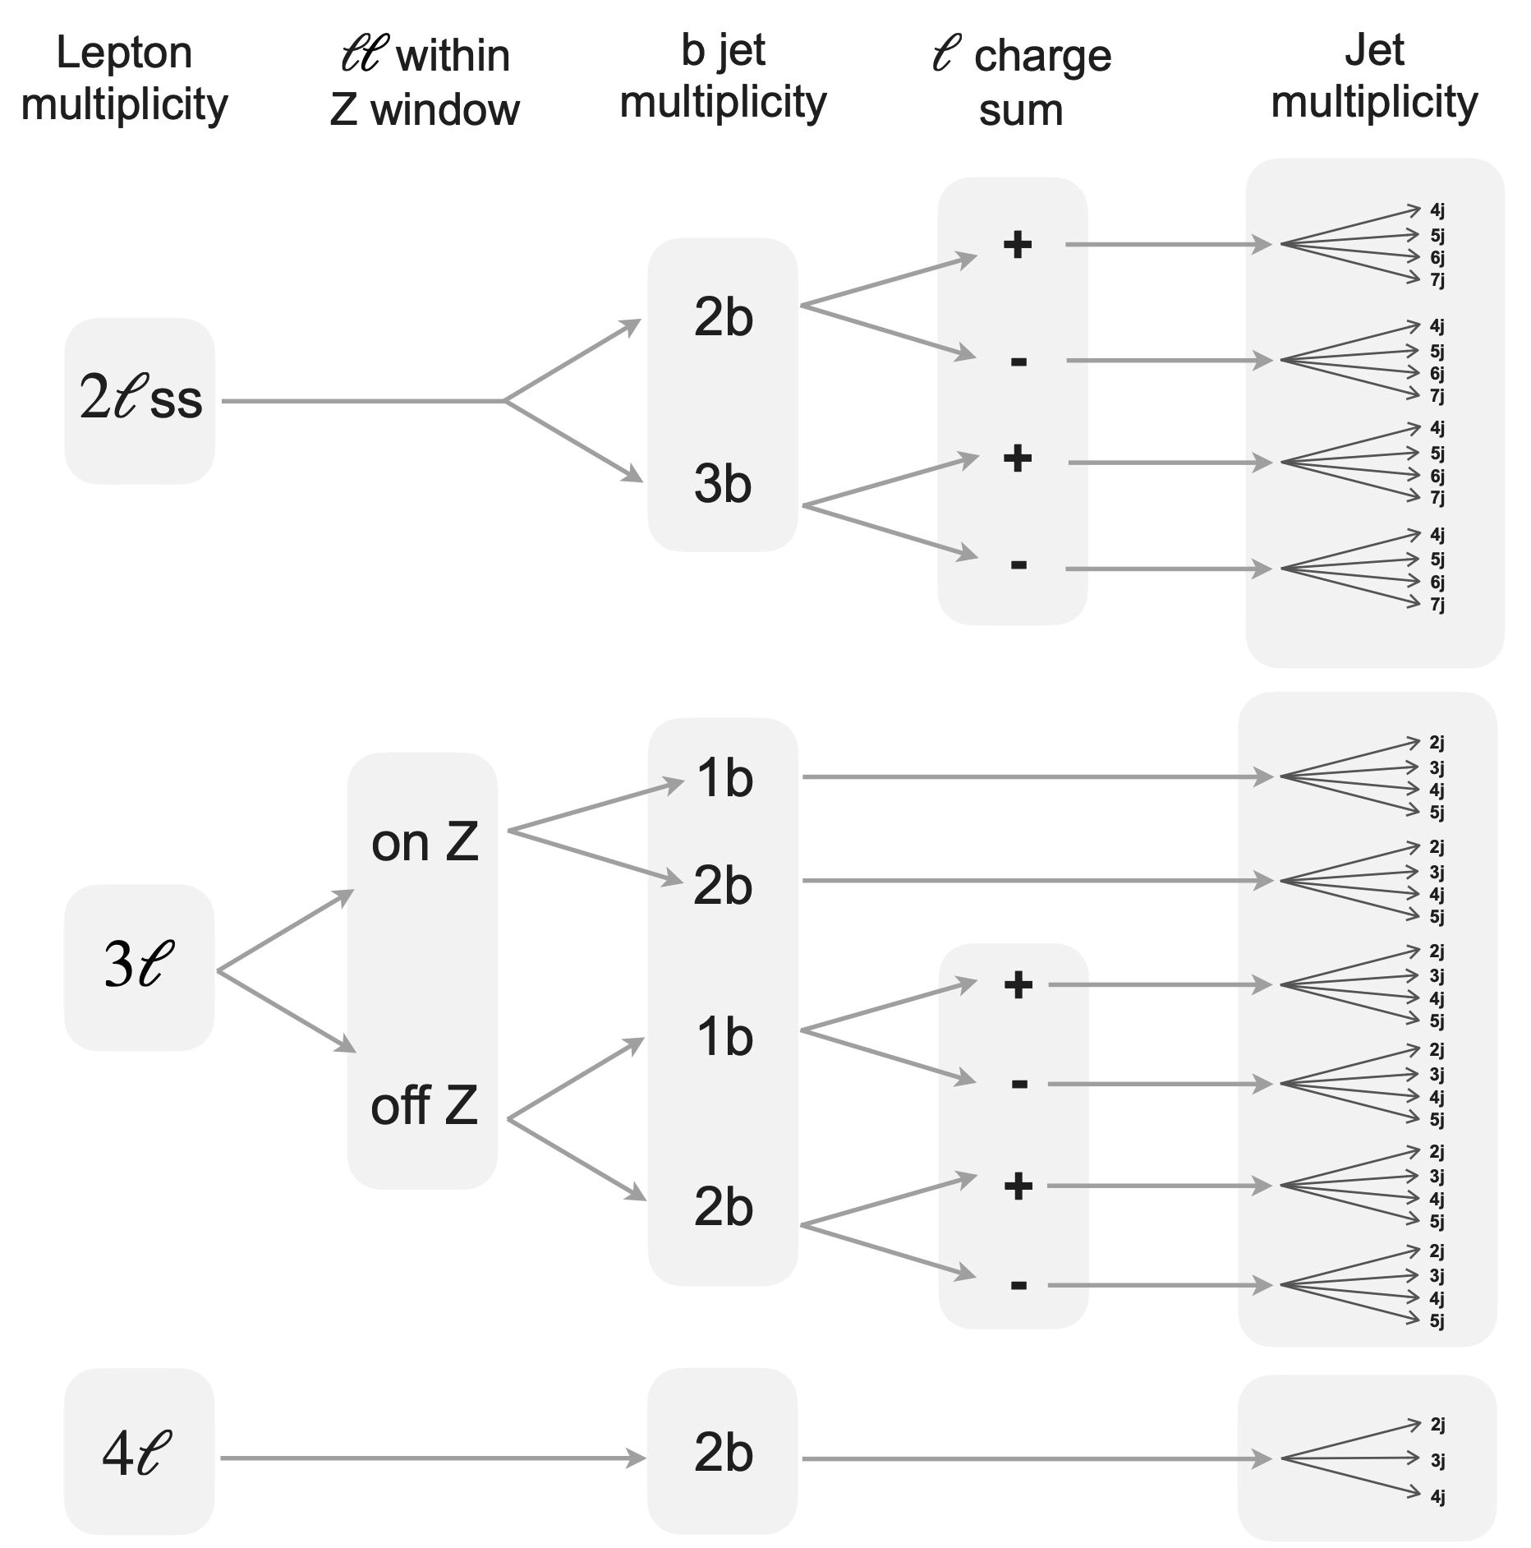
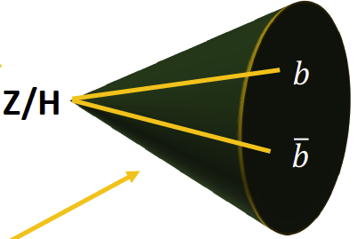
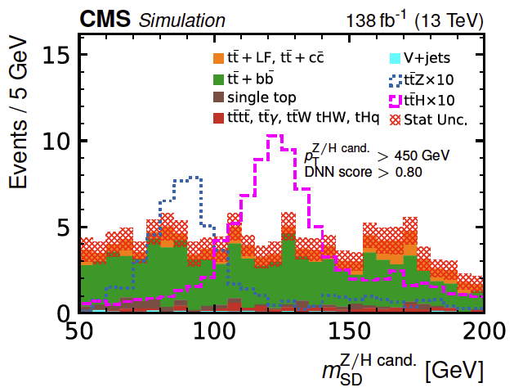
ttX Combination
CMS-PAS-TOP-24-004
Two input analyses target top quark prod. in association with heavy bosons:
  Boosted analysis:
  Multilepton analysis:
Uses the dim6top model and full Run 2 dataset (138 fb⁻¹ @ 13 TeV)
Combination using full likelihood
boosted
Phys. Rev. D 108, 032008
JHEP 12 (2023) 068
Multilepton
Analysis
Boosted
Analysis
43 categories, 178 total analysis bins

Slide 11
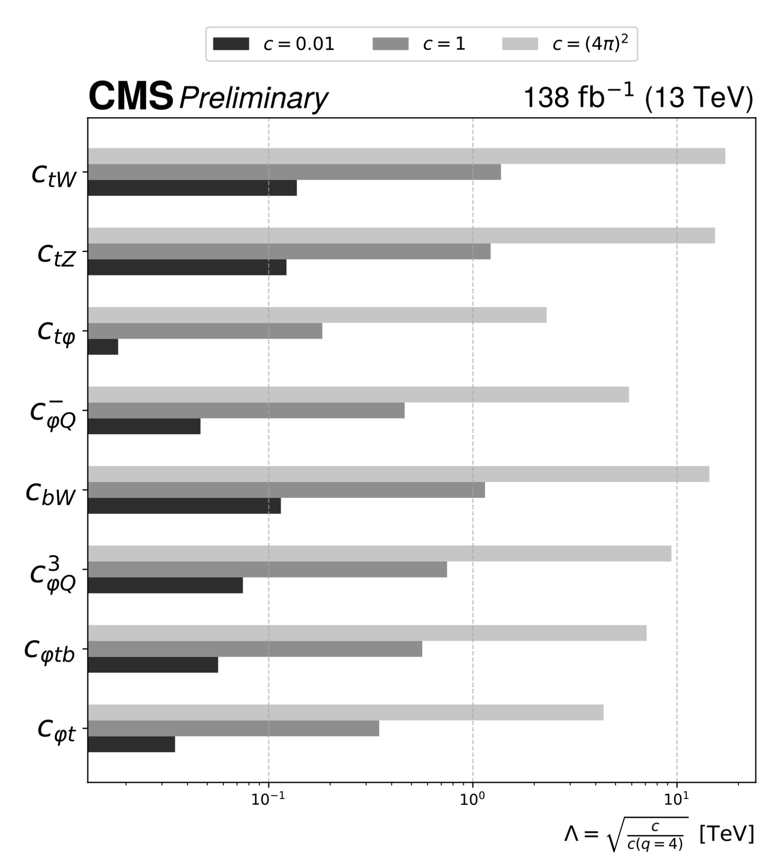
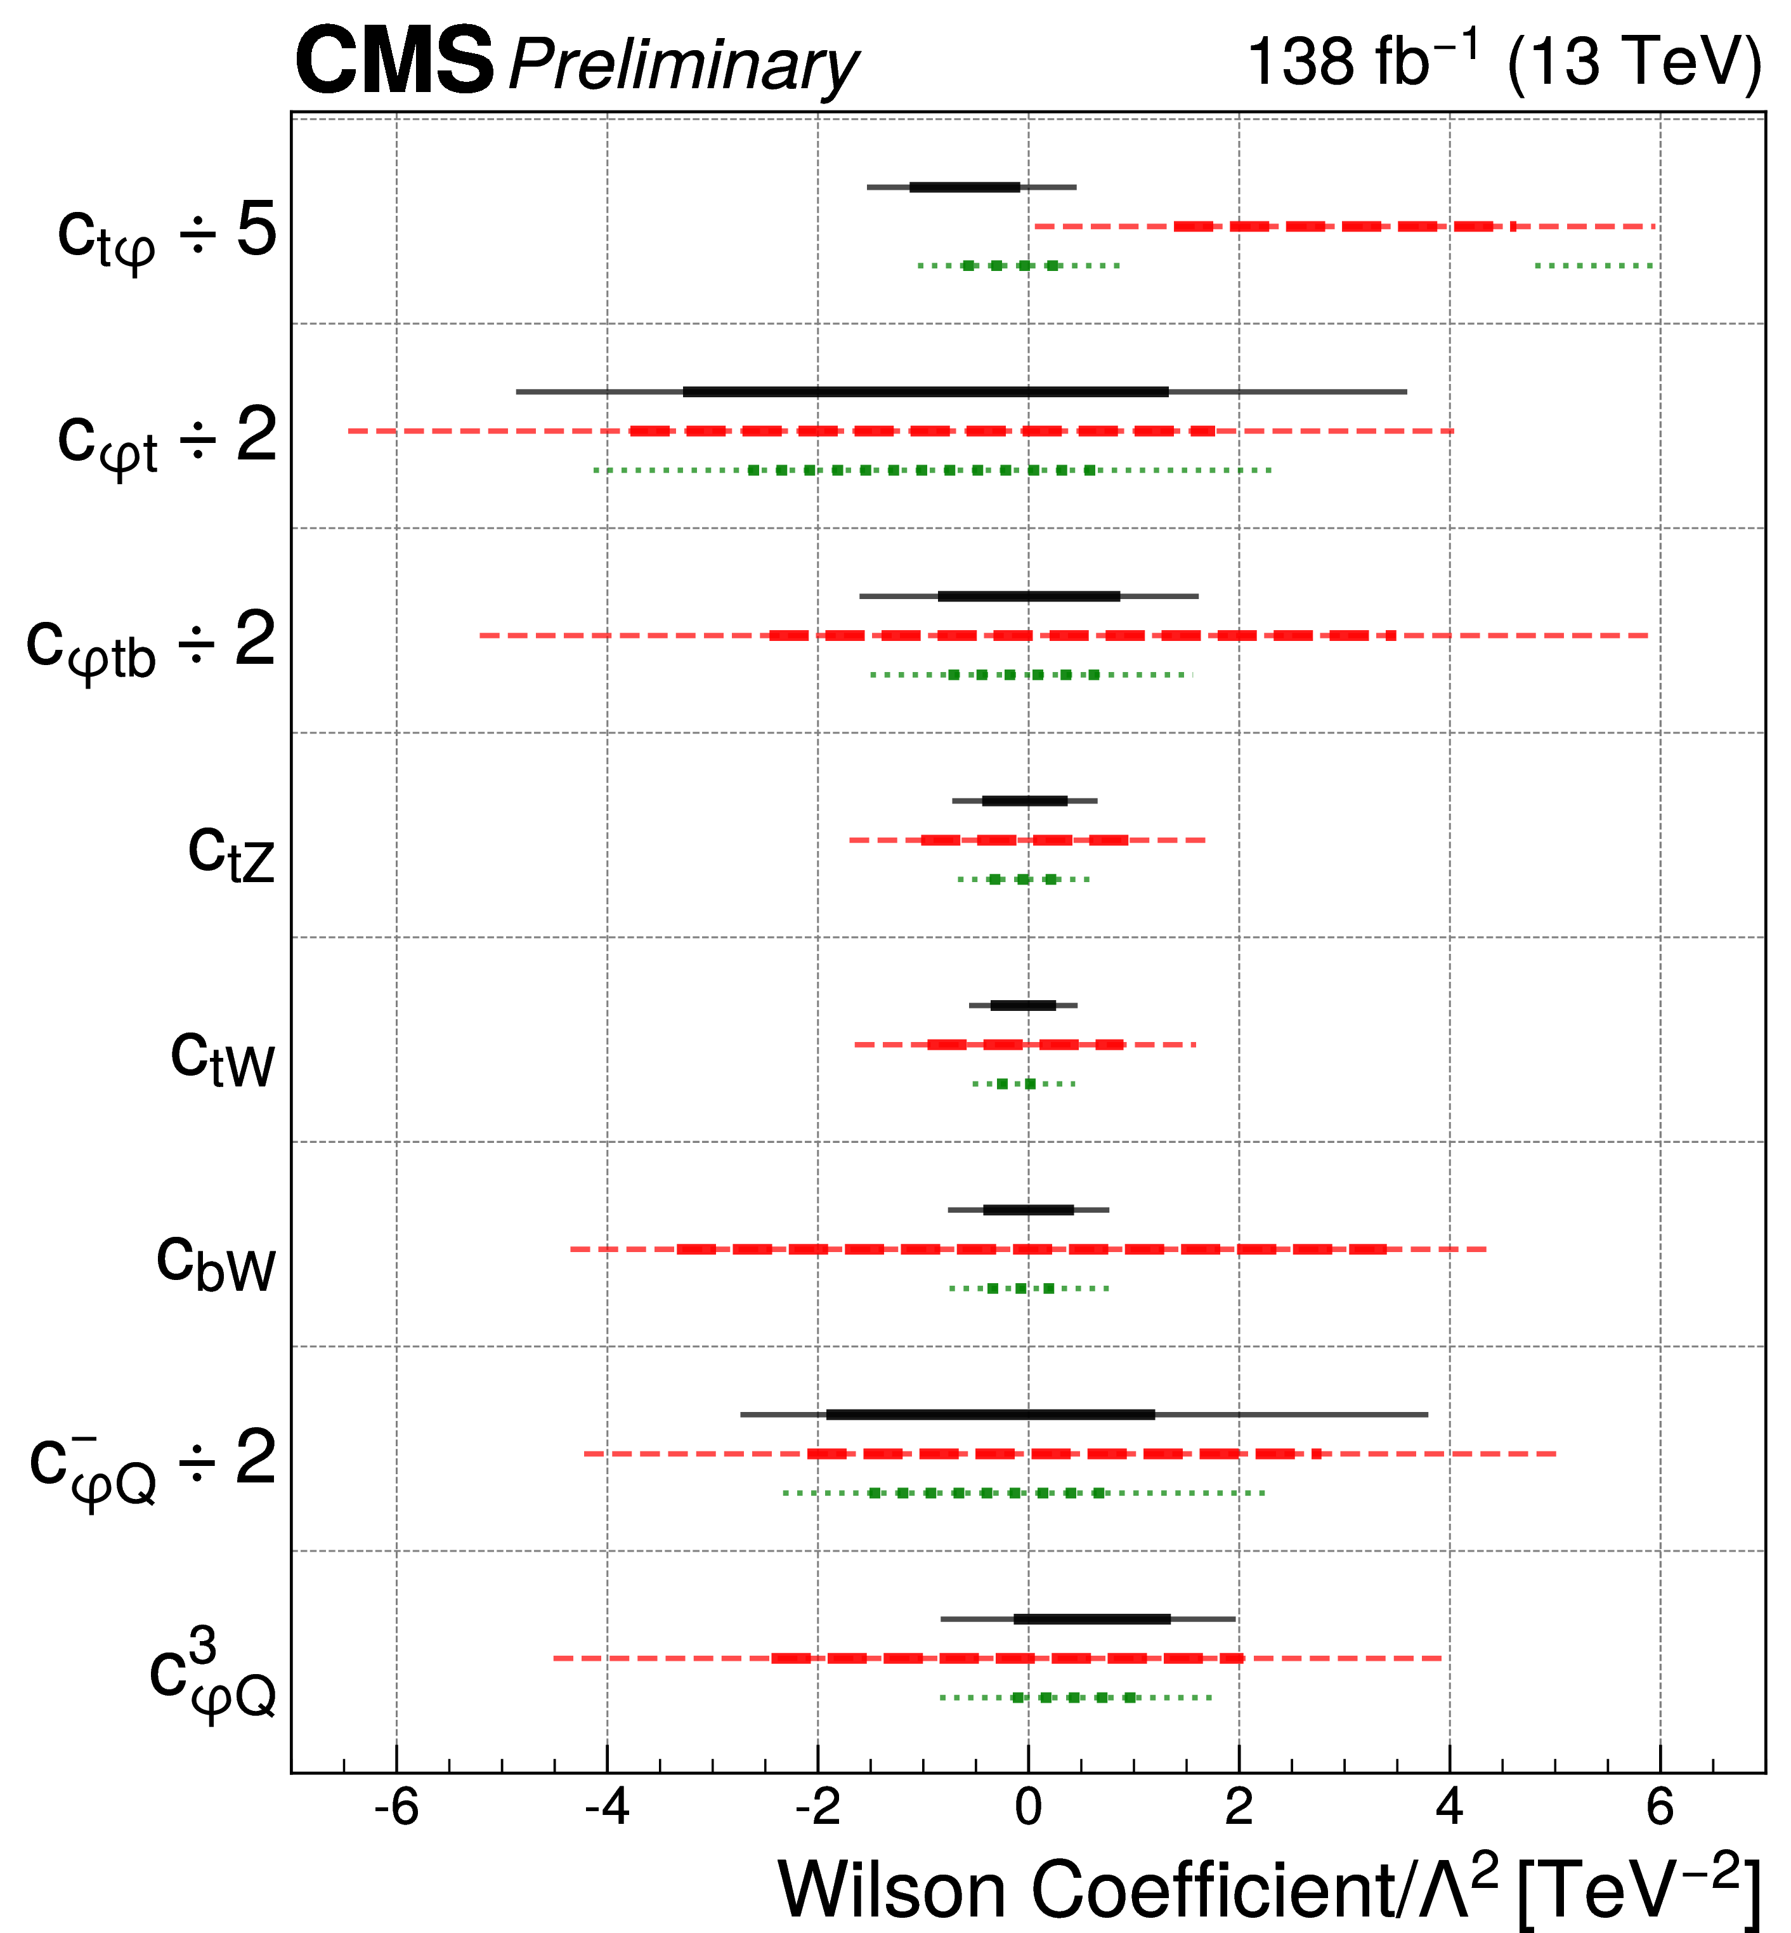
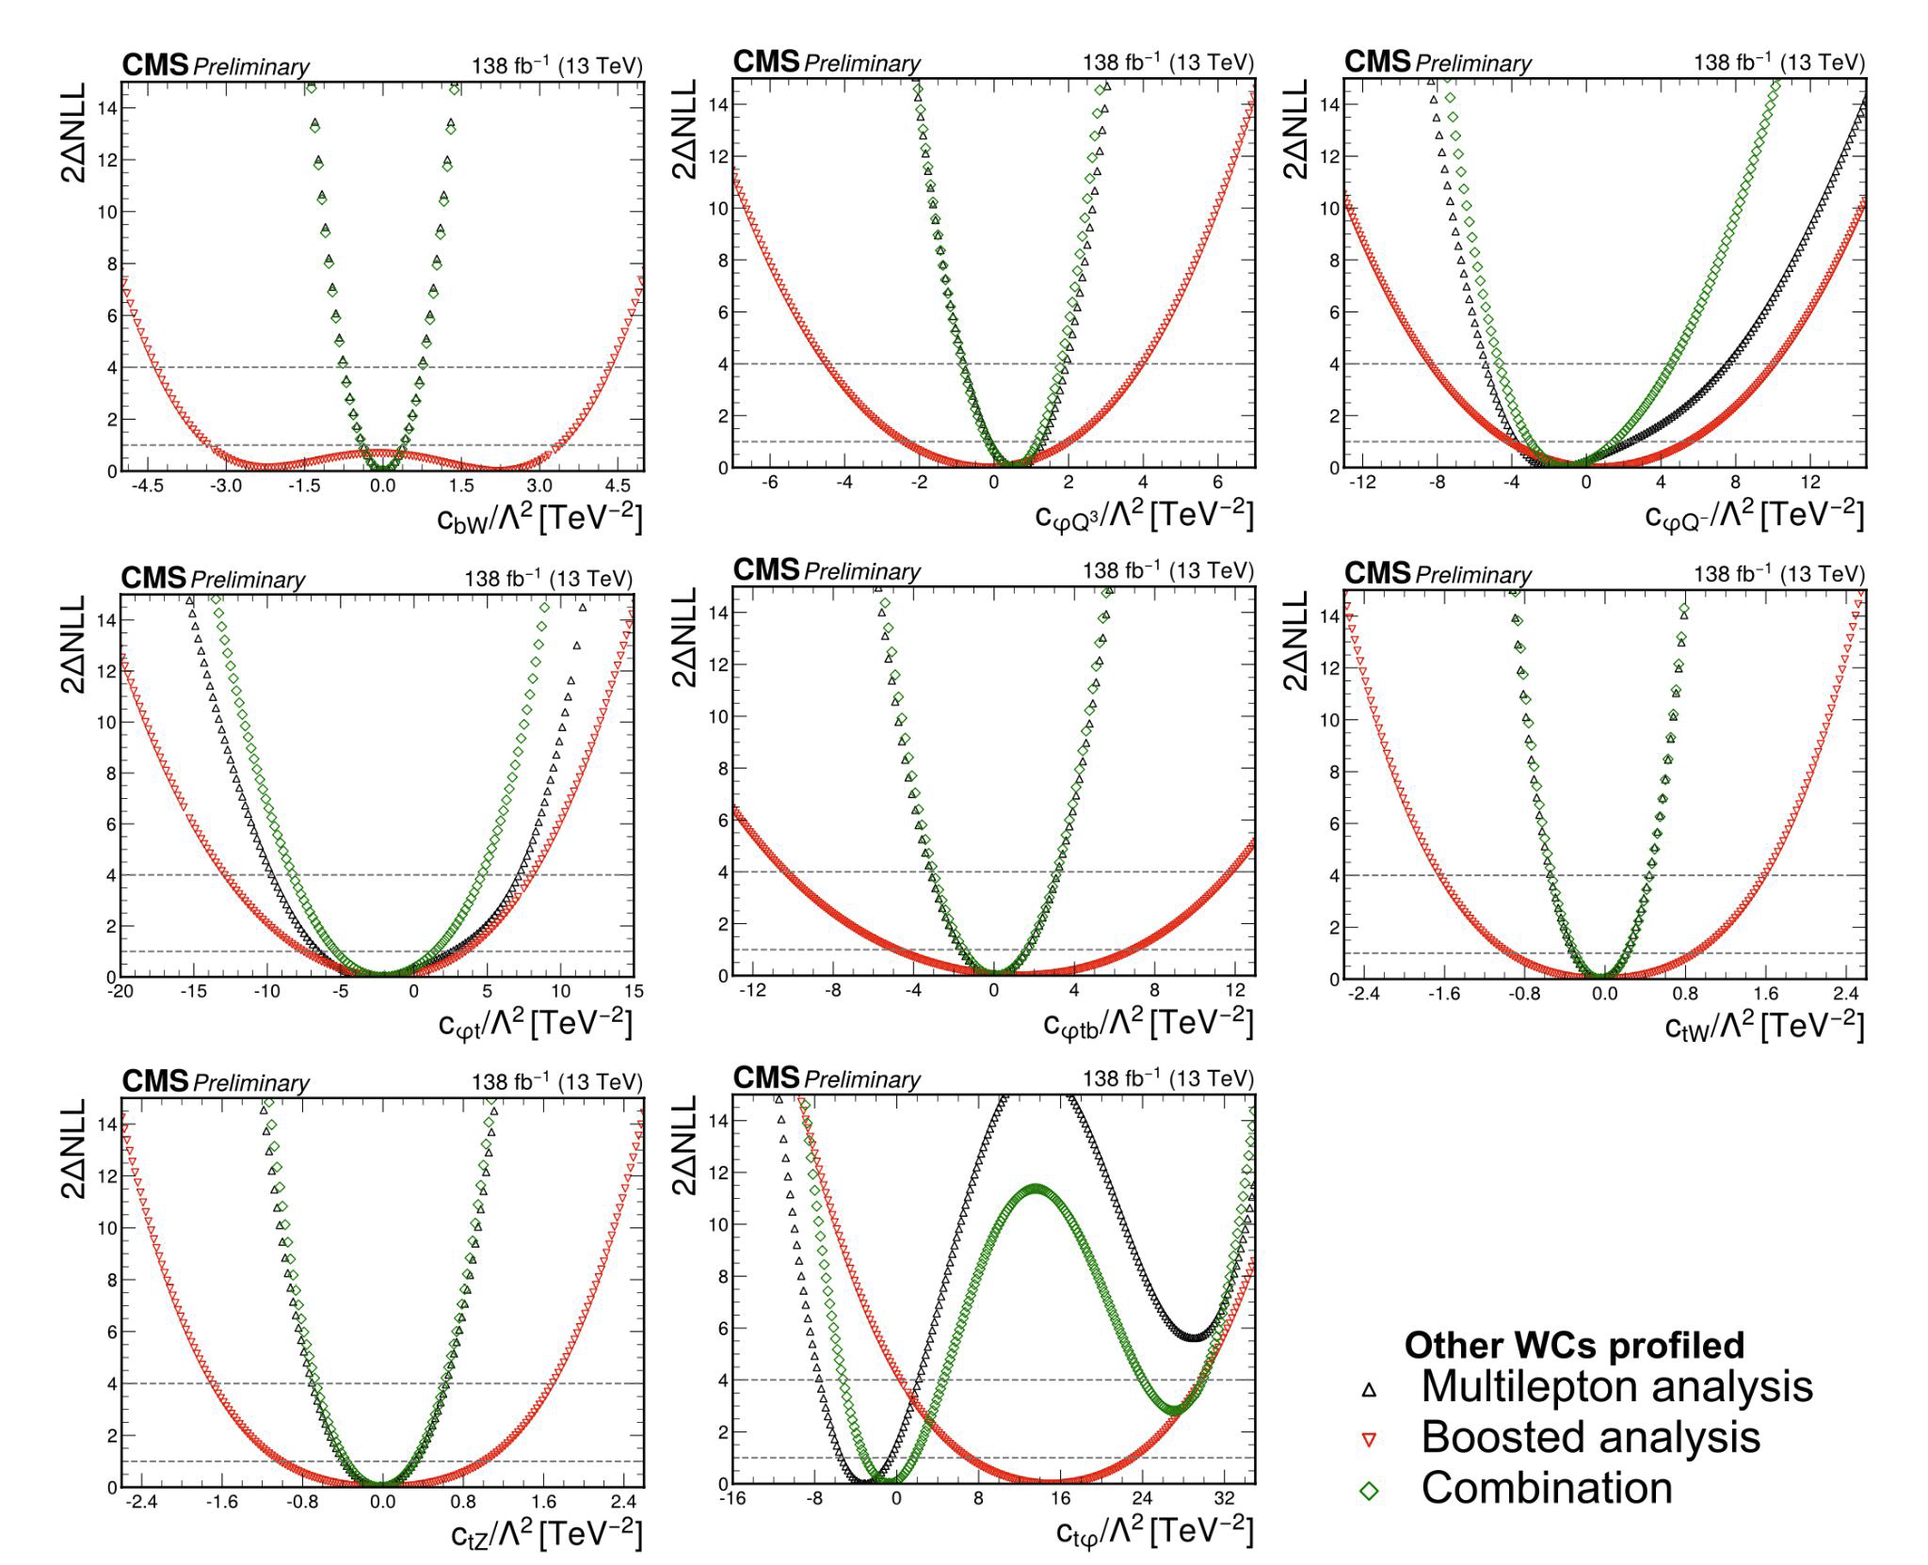
ttX Combination
Multilepton analysis is the main driver
Notable improvements up to 10% for operators like c_{tϕ}, c_{ϕt} and c⁻_{ϕQ}
Constraints usually placed on the c_{i}/Λ²
By fixing reference values for the c_{i}, we can also obtain limits on the BSM energy scale Λ
Highlights the potential scale of new physics

Slide 12
Higgs Sector

Slide 13
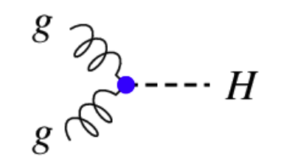
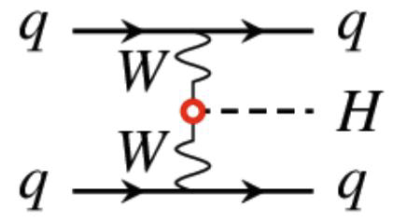
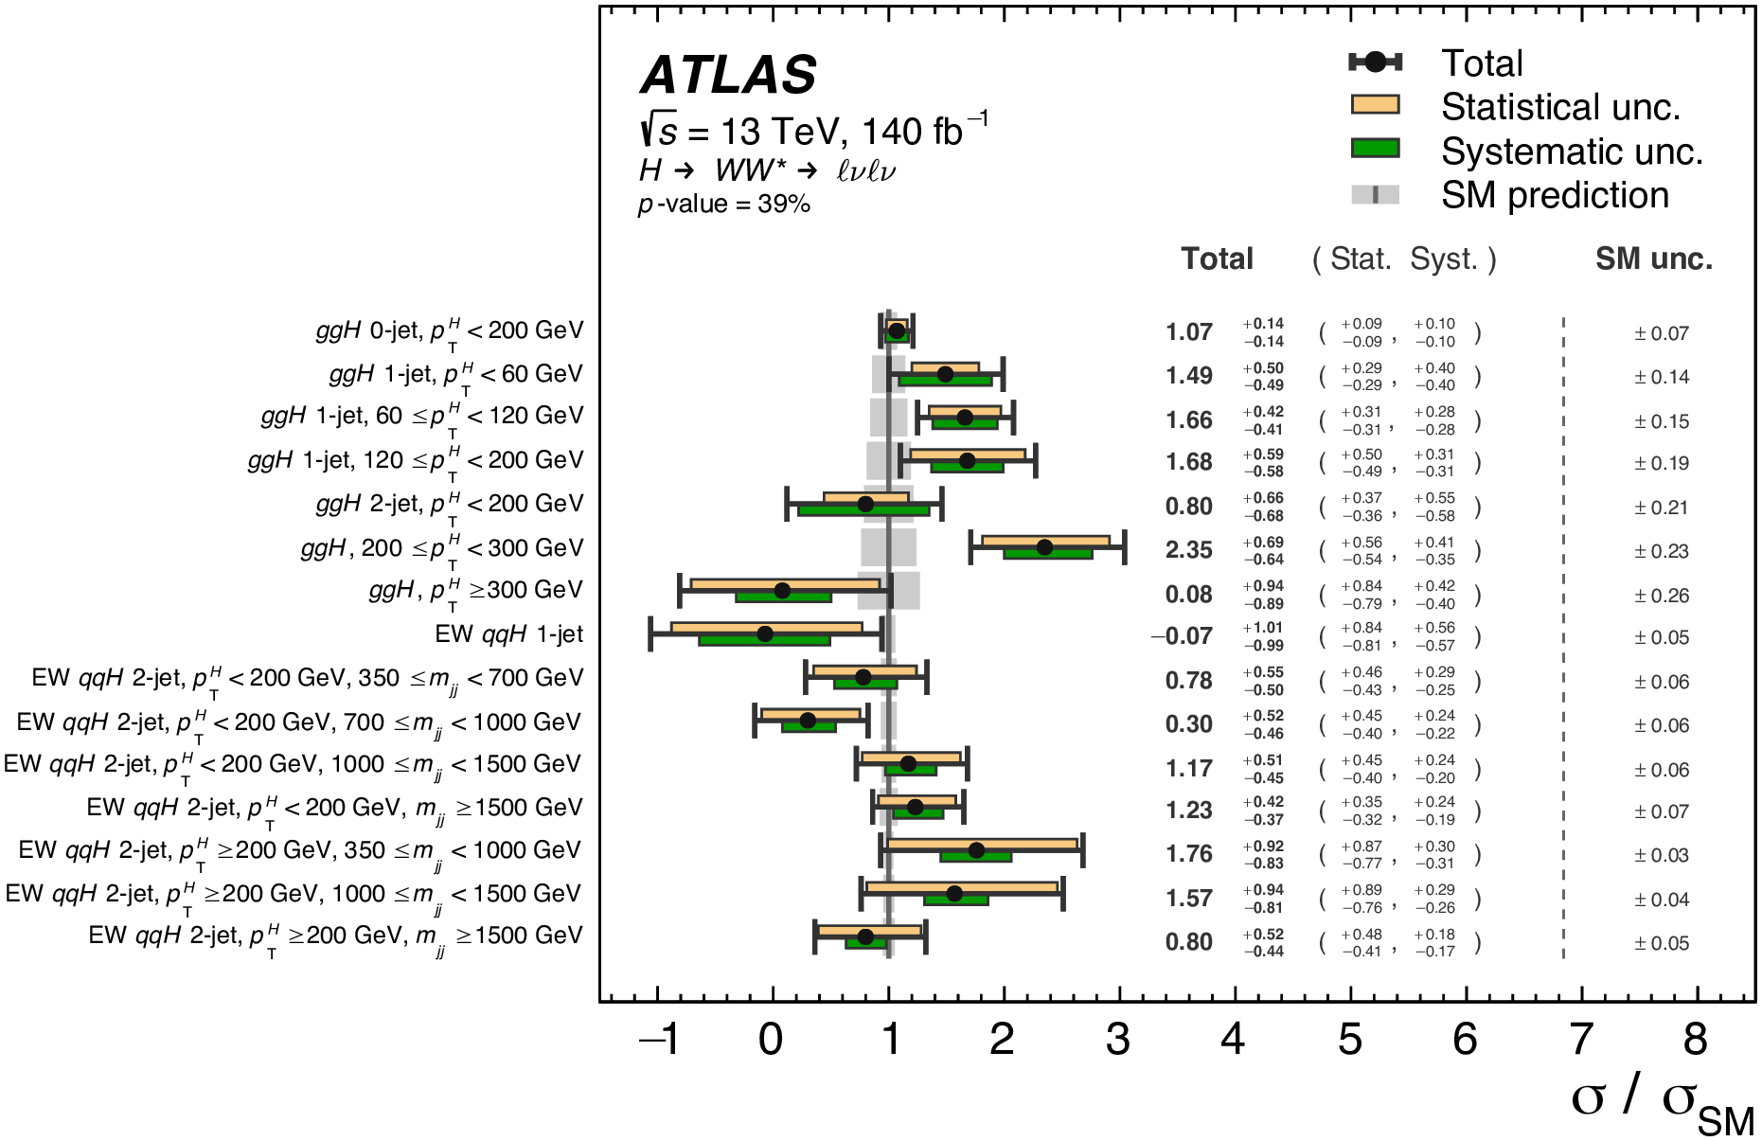
ggF & VBF 𝐻 → 𝑊𝑊*
arXiv:2504.07686
𝐻 → 𝑊𝑊∗: second-largest branching ratio, clean 𝑊𝑊∗ → ℓ𝜈ℓ𝜈 decay mode
  Probes Higgs boson coupling to vector bosons
Aim to measure ggF and VBF signal strengths in ggF and VBF STXS (simplified template cross sections) Stage 1.2 bins, etc
Gluon-gluon fusion
(ggF)
Vector boson fusion (VBF)
STXS sensitivity: 15 STXS categories in total
Improved precision (20-35%) in all channels comparing to previous measurements: new calibrations, categorization, DNNs, etc.

Slide 14
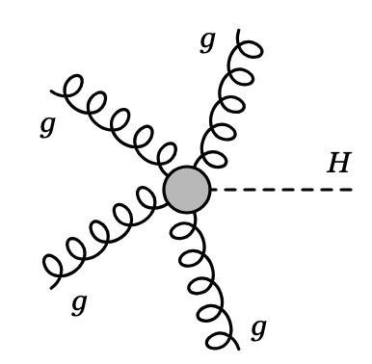
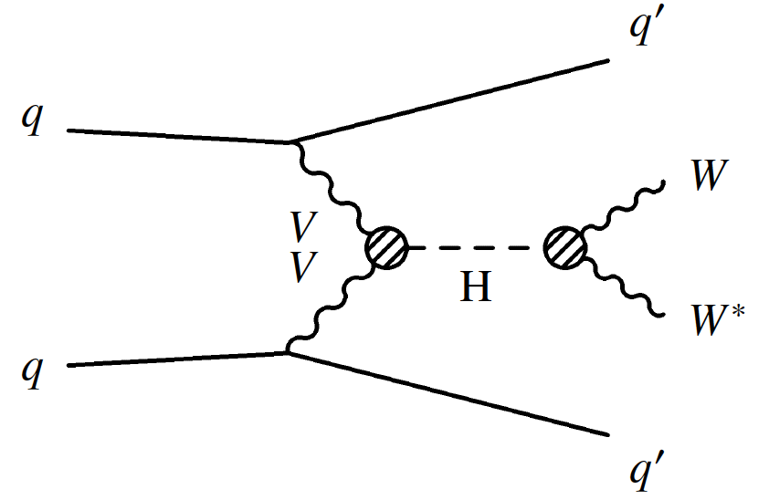
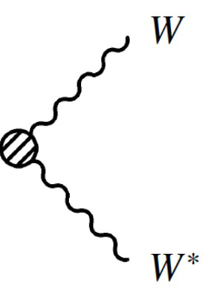
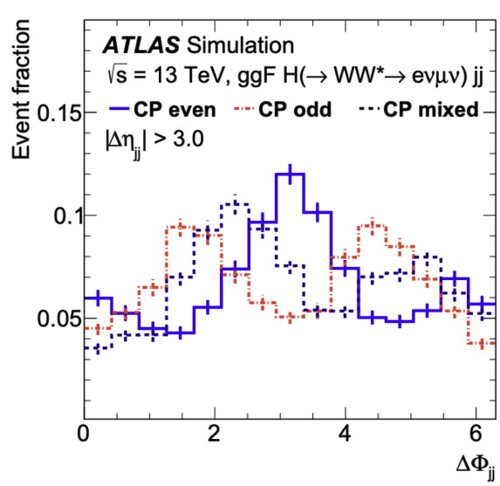
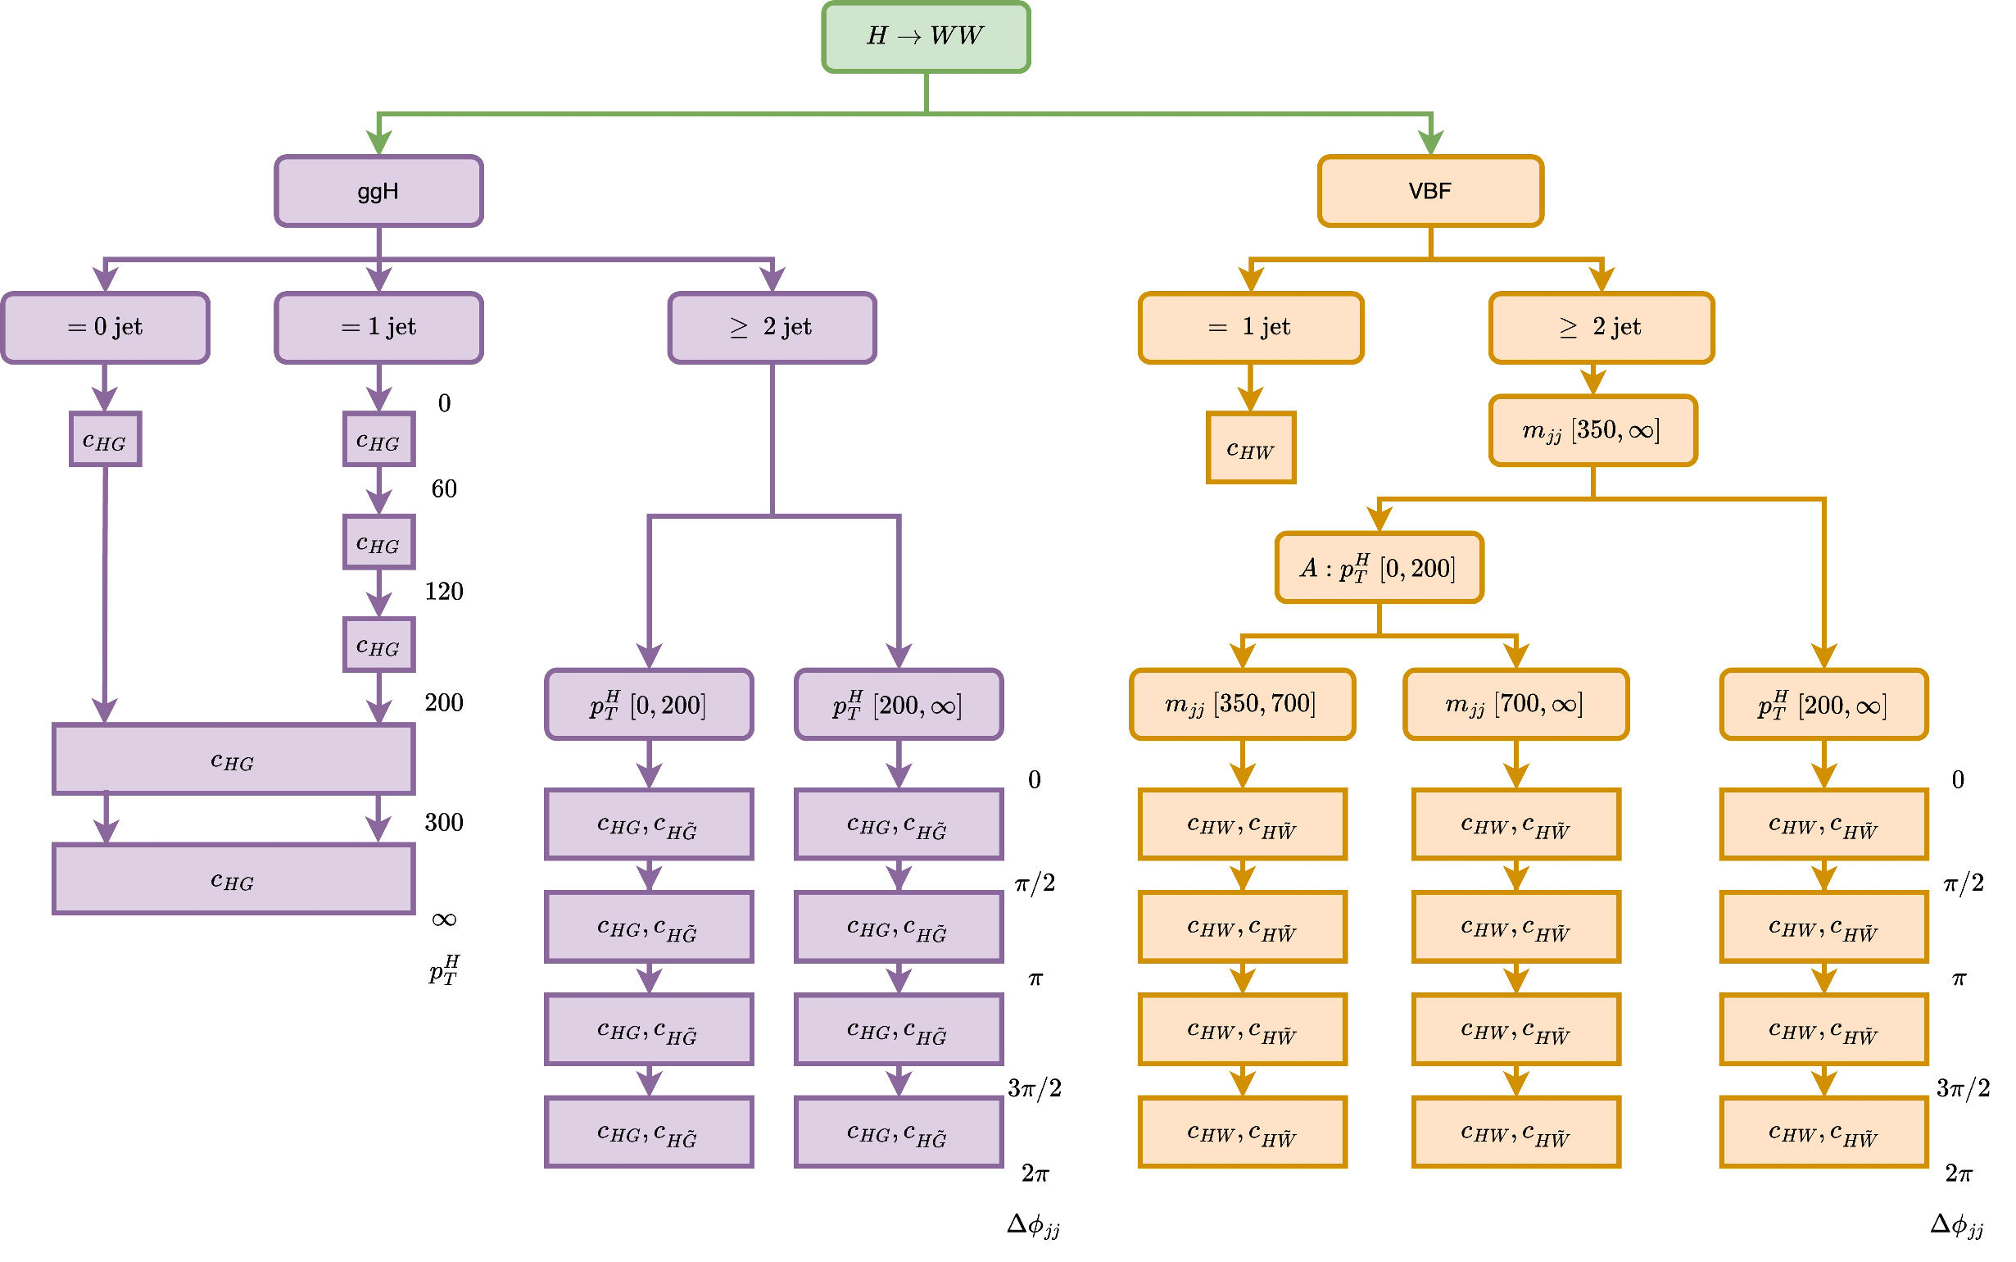

CP Structure: ggF & VBF 𝐻 → 𝑊𝑊*
arXiv:2504.07686
CP sensitivity from Δ𝜙_{(jj)} between the forward (highest 𝜂) and backward (lowest 𝜂) jets:
  Higgs - Gluon: $c_{HG}$, ${\tilde{c}}_{HG}$
  Higgs - W boson: $c_{HW}$, ${\tilde{c}}_{HW}$
CP-even is sensitive to STXS kinematic (including ΔΦ_{𝑗𝑗}), while CP-odd is primarily sensitive to the ΔΦ_{𝑗𝑗} shape
Gluon-gluon fusion
(ggF)
Vector boson fusion
Use STXS_{CP} bins

Slide 15
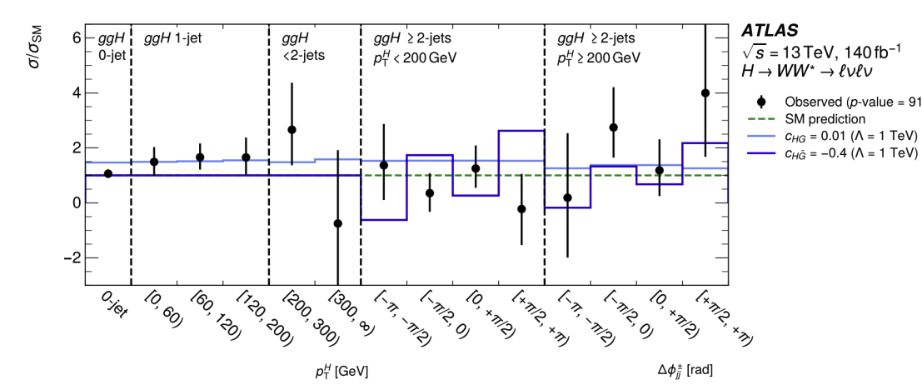
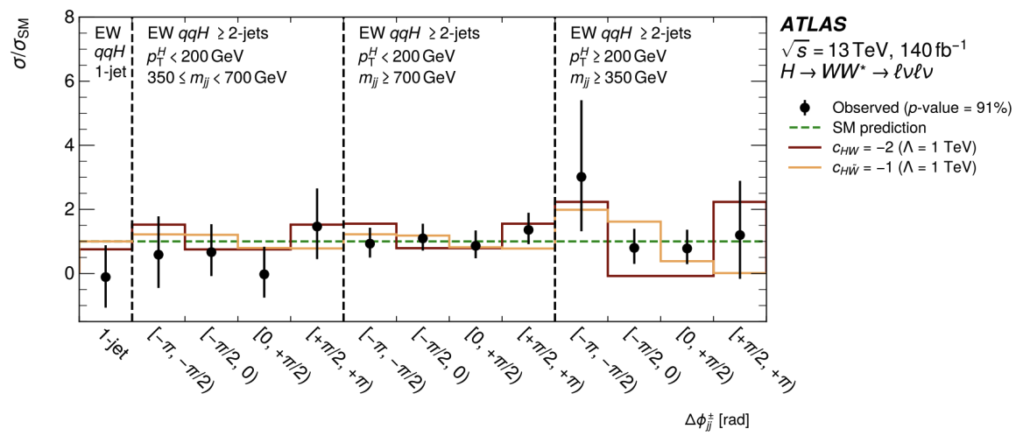
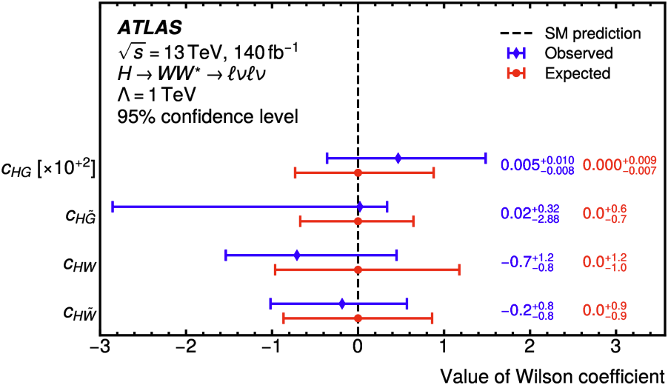
CP Structure: ggF & VBF 𝐻 → 𝑊𝑊*
Simultaneous constraints on CP-odd and CP-even operators in both ggH and HWW vertices based on CP-odd/SM interference

Slide 16
Electroweak Sector, Combination

Slide 17
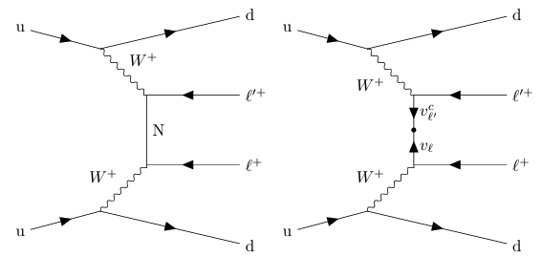

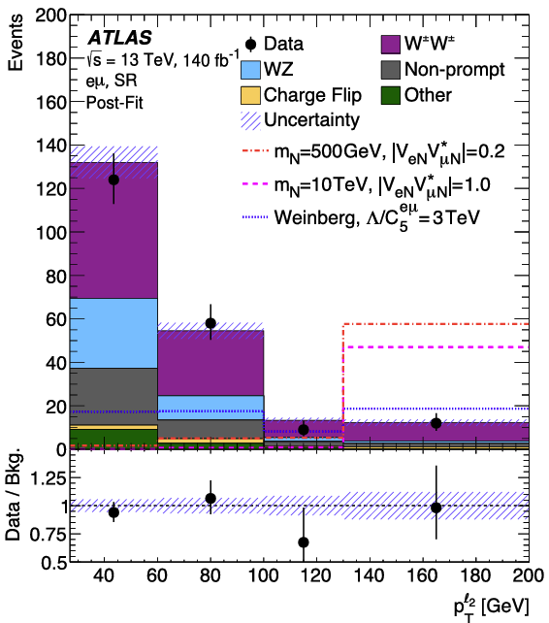

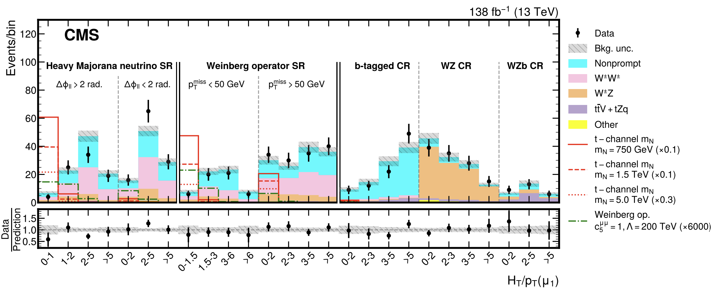
Same-Sign WW VBS
Heavy Majorana neutrino
Weinberg operator
Dim-5 Weinberg operator
  Violates lepton number and can generate heavy Majorana neutrinos
  So it’s often not considered
Both ATLAS & CMS studied same-sign WW VBS events with the two leptons are more back-to-back in φ and without much missing p_{T}
arXiv:2206.08956
arXiv:2403.15016

Slide 18

EFT Multi-Sector Combination
Sub. to EPJC, arXiv:2504.02958
Global fits enhance sensitivity and coverage in the EFT parameter space
Perform combination of Run II CMS measurements w/ 36–138 fb⁻¹ at 13 TeV
Inputs chosen to minimize overlap and maximize sensitivity to the complete operator set
64 dimension-6 CP-even operators considered
JHEP 07 (2021) 027
Phys. Rev. D 105, 052003
JHEP 05 (2021) 205
Phys. Rev. D 102, 092001
Phys Rev D 104, 092013
JHEP 12 (2023) 068
JHEP 02 (2022) 142
Phys. Rep. 427 (2006) 257
ATLAS Higgs+EWK EFT combination: ATL-PHYS-PUB-2022-037

Slide 19





EFT Multi-sector Global Combination
Sub. to EPJC, arXiv:2504.02958
EWPO
Incl jets
4-light
top-Higgs
4-heavy

Slide 20


Limits with other WCs profiled
The 64 considered SMEFT operators cannot be fit simultaneously → many Wilson Coefficients have degenerate effect
We focus on sensitive directions using a principal component analysis (PCA)
PCA identifies well-constrained linear combinations of WCs
Used only for linear EFT parametrization → quadratic terms are excluded
Eigenvectors with 1 / √λ > 5 are removed
Notes:
Higgs 2023, Beijing

Slide 21

Limits with other WCs profiled
The 64 considered SMEFT operators cannot be fit simultaneously → many Wilson Coefficients have degenerate effect
We focus on sensitive directions using a principal component analysis (PCA)
PCA identifies well-constrained linear combinations of WCs
Used only for linear EFT parametrization → quadratic terms are excluded
Eigenvectors with 1 / √λ > 5 are removed
Different analyses contribute differently to each eigenvector
Notes:
Higgs 2023, Beijing

Slide 22

Summary
EFT provides model-independent ways to search for the evidence of BSM physics at the LHC
A lot of efforts from ATLAS and CMS to provide strong constraints on EFT Wilson coefficients
  Covering processes involving top quarks, Higgs boson, electroweak bosons, and sometimes unexplored rare processes
  Results from combination of different EFT analyses are also rapidly appearing, overcoming interesting challenges
  More extensive set of results are shown in recent conferences such as LHCP if you are interested
More Run 3 analyses will come, and HL-LHC will extend it further. Stay tuned!
ATL-PHYS-PUB-2024-004
Notes:
Huacheng Cai | ATLAS EFT results in the top sector

Slide 23
Backup

Slide 24


Measurement of high-mass ttℓℓ
Flavour separate
  Electron and muon WCs constrained at the same time.
  The correlation between C11 and C22 is preserved.
Relative difference
  The first search for LFU-violation for EFT effects using this final state.
  Cancellation of systematic uncertainties is observed.
  Results still limited by the Run 2 statistics.

Slide 25



Same Sign Top Pair
Combined binned profile-likelihood fit over the SRs+CRs simultaneously
  The fitted signal yield in each of the four SRs is found to be ≤ 0.001
1D likelihood scan for each WC to extract the limit (results are marginalised)

Slide 26

EFT Multi-Sector Combination
EFT Operators

Slide 27
ttX Combination
Multilepton analysis is the main driver
Notable improvements up to 10% for operators like c_{tϕ}, c_{ϕt} and c⁻_{ϕQ}
c_{tϕ} exhibits a nontrivial behavior due to a mild event yield deficit at high boson p_{T}
Constraints usually placed on the c_{i}/Λ²
By fixing reference values for the c_{i}, we can also obtain limits on the BSM energy scale Λ
Highlights the potential scale of new physics

Slide 28










CP Structure of HVV
Interpretation from the combination of differential cross-section in H → γγ, H → ZZ, H → WW, H → ττ
Higgs differential cross-section measurement in H → WW decay: Using Adversarial DNN
arXiv:2504.13081 (CMS-HIG-23-013)
CMS-PAS-HIG-24-004

Slide 29

Higgs combination
CMS-PAS-HIG-21-018
First combined measurement of Higgs boson production modes in STXS stage 1.2 from CMS
Run 2 data: 138 fb⁻¹ at 13 TeV
SMEFT dim-6 included parametrizing Higgs STXS and decay rates as a function of Wilson coefficients:
  43 dimension-6 (topU3l) CP-even operators are included
  Both linear (1/Λ²) and linear-plus-quadratic (1/Λ⁴) expansions are considered
Equivalent ATLAS Higgs EFT combination:
arXiv:2402.05742, JHEP 11 (2024) 097
Notes:
https://cds.cern.ch/record/2816369
ATLAS Higgs + EWK
https://atlas.web.cern.ch/Atlas/GROUPS/PHYSICS/PAPERS/HIGG-2022-17/

Slide 30

Higgs combination
CMS-PAS-HIG-21-018
First combined measurement of Higgs boson production modes in STXS stage 1.2 from CMS
Run 2 data: 138 fb⁻¹ at 13 TeV
SMEFT dim-6 included parametrizing Higgs STXS and decay rates as a function of Wilson coefficients:
  43 dimension-6 (topU3l) CP-even operators are included
  Both linear (1/Λ²) and linear-plus-quadratic (1/Λ⁴) expansions are considered
Equivalent ATLAS Higgs EFT combination:
arXiv:2402.05742, JHEP 11 (2024) 097
Notes:
https://cds.cern.ch/record/2816369
ATLAS Higgs + EWK
https://atlas.web.cern.ch/Atlas/GROUPS/PHYSICS/PAPERS/HIGG-2022-17/

Slide 31


Higgs combination
CMS-PAS-HIG-21-018
Coefficients derived with the linear-only and linear + quadratic terms
Overall good agreement with the SM predictions
A few interesting deviations observed → c_{Hq}³ where p_{SM} = 0.01
c_{Hq}³ affects mostly the high p^{V}_{T} region in WH and ZH where measurements are in 3σ tension with SM expectations
EFT Impact
Observed Excess

Slide 32
EFT Multi-Sector Combination
Sub. to EPJC, arXiv:2504.02958
Global fits enhance sensitivity and coverage in the EFT parameter space
Perform combination of Run II CMS measurements w/ 36–138 fb⁻¹ at 13 TeV
Inputs chosen to minimize overlap and maximize sensitivity to the complete operator set
64 dimension-6 CP-even operators considered
Experimental full likelihood is used when possible. Otherwise, simplified likelihood is used.
JHEP 07 (2021) 027
Phys. Rev. D 105, 052003
JHEP 05 (2021) 205
Phys. Rev. D 102, 092001
Phys Rev D 104, 092013
JHEP 12 (2023) 068
JHEP 02 (2022) 142
Phys. Rep. 427 (2006) 257
ATLAS Higgs+EWK EFT combination: ATL-PHYS-PUB-2022-037

