Slide 1
Porting CMS Pixel Track Reconstruction to Julia: Final Results
Mohamad Khaled Charaf
Mohamad Ayman Charaf
Maya Ali
Dr. Andrea Bocci
Dr. Phillipe Gras
Dr. Mateusz Jakub Fila

Slide 2
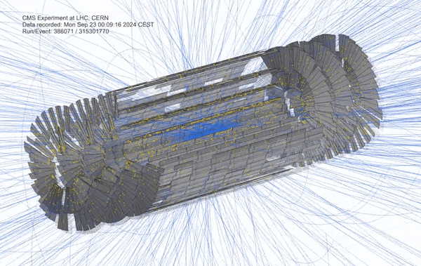
Outline
Project Context​
Main Goal​
Overview of the Patatrack Application​
Highlights from the Past Year​
Recent Developments​
Performance​
Next Steps and Future Work​
Conclusion​

Slide 3

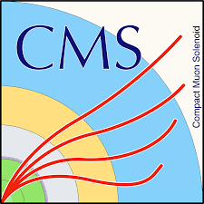
Project Context
Evaluation of Julia as a Language for High Energy Physics:
Potential of the Julia Programming Language for High Energy Physics Computing (doi:10.1007/s41781-023-00104-x)
Jet reconstruction (reclustering) with Julia (github.com/JuliaHEP/JetReconstruction.jl)
Patatrack Pixel Reconstruction:
Standalone application extracted from CMS software
Pixel Reconstruction: the process of identifying and reconstructing particle trajectories by analyzing data from pixel detectors
Tested over the years across multiple parallel programming models and accelerator platforms (OpenMP, CUDA, HIP, SYCL, Kokkos, etc.)

Slide 4
Main Goal
To evaluate the feasibility of using Julia for large-scale HEP applications by
porting the CMS pixel-only track reconstruction pipeline from C++ to Julia
Assess Julia’s capabilities in:
  Single-threaded performance on CPU
  Multi-threading and parallel CPU performance
  GPU acceleration and heterogeneous execution

Slide 5
Overview of the Application Framework
  Event and Event Setup
    Container of data and metadata
  Product Registry
    Interface between modules and the event
  ED Tokens
    Used to access data from the event
  Task Scheduling & Multithreading
    Currently implemented using Julia’s native @threads macro
  Plugin Factory
    Interface to instantiate modules

Slide 6
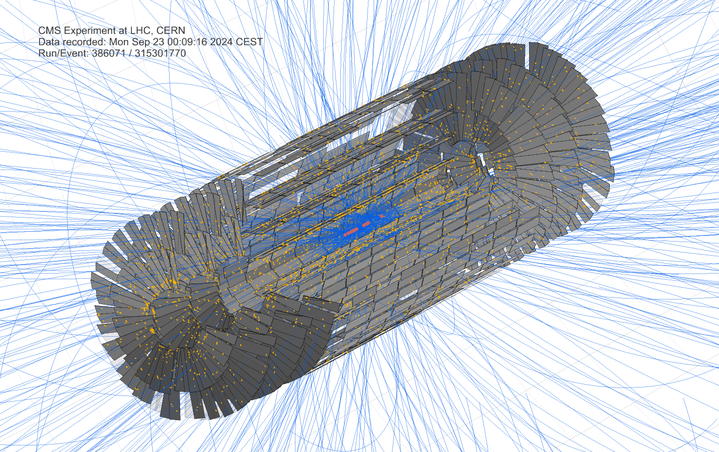
Overview of the Application Modules
BeamSpot
Clusterizer
A
B
Rechits
C
CountValidator
F
Ntuplets
&
Track Fitting
D
HistoValidator
G
Vertices
E

Slide 7
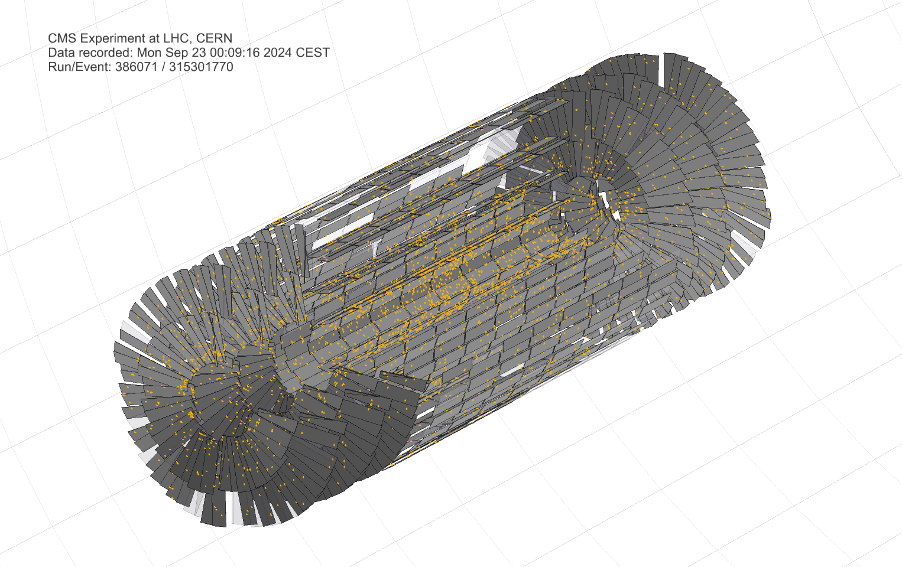
Overview of the Application Modules
BeamSpot
Clusterizer
A
B
Rechits
C
CountValidator
F
Ntuplets
&
Track Fitting
D
HistoValidator
G
Pixel Clusters
Vertices
E

Slide 8
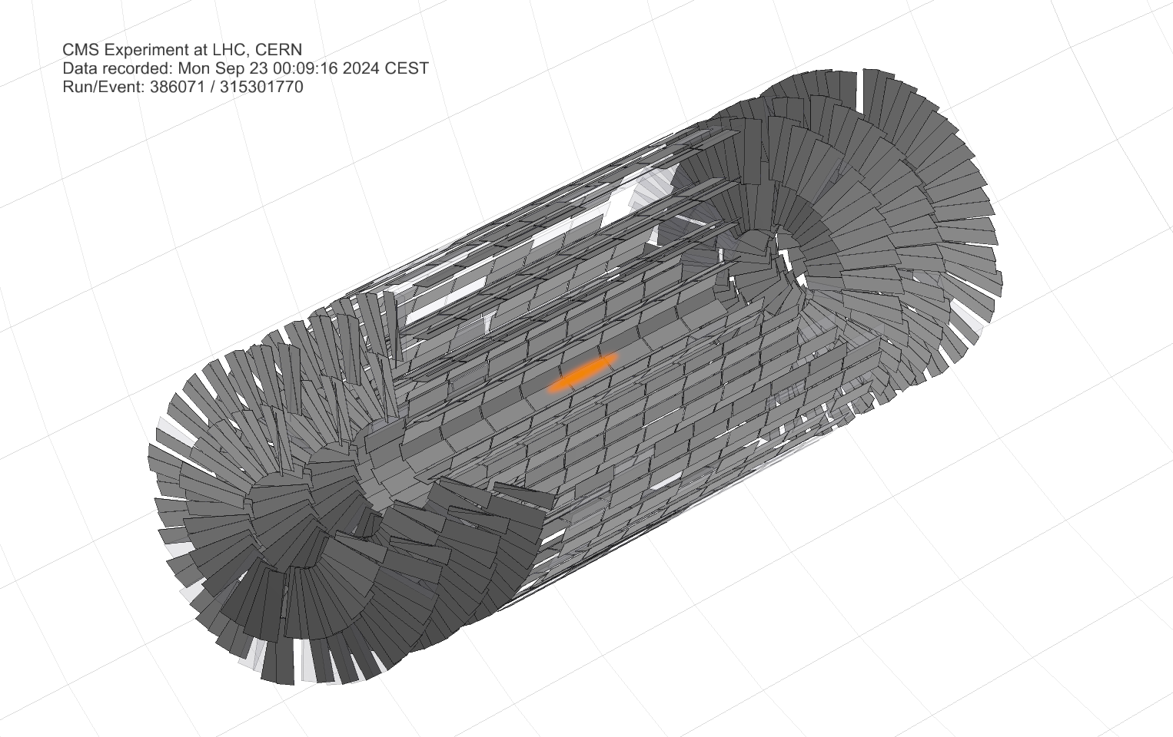
Overview of the Application Modules
BeamSpot
Clusterizer
A
B
Rechits
C
CountValidator
F
Ntuplets
&
Track Fitting
D
HistoValidator
G
Beam Spot
Vertices
E

Slide 9
Overview of the Application Modules
BeamSpot
Clusterizer
A
B
Rechits
C
CountValidator
F
Ntuplets
&
Track Fitting
D
HistoValidator
G
Reconstructed
Hits
Vertices
E

Slide 10
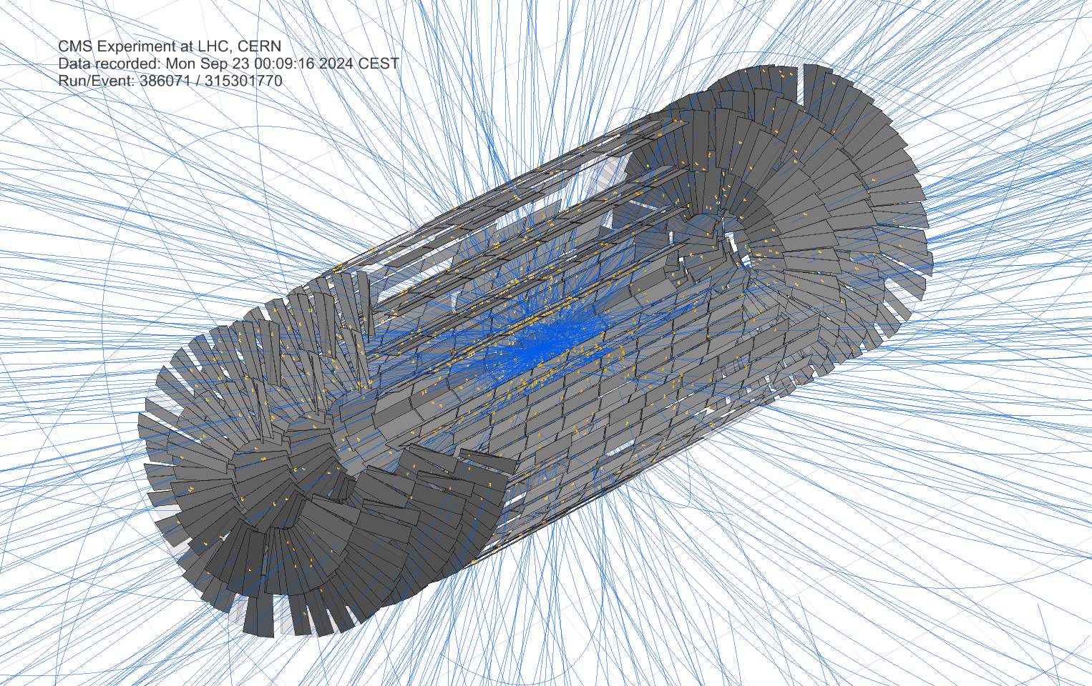
Overview of the Application Modules
BeamSpot
Clusterizer
A
B
Rechits
C
CountValidator
F
Ntuplets
&
Track Fitting
D
HistoValidator
G
Pixel Tracks
Vertices
E

Slide 11
Overview of the Application Modules
BeamSpot
Clusterizer
A
B
Rechits
C
CountValidator
F
Ntuplets
&
Track Fitting
D
HistoValidator
G
Vertices
Vertices
E

Slide 12
Overview of the Application Modules
BeamSpot
Clusterizer
A
B
Rechits
C
CountValidator
F
Ntuplets
&
Track Fitting
D
HistoValidator
G
Validators
Vertices
E

Slide 13
Highlights From The Past Year:
100% of Local Reconstruction
BeamSpot
Clusterizer
A
B
Rechits
C
CountValidator
F
Ntuplets
&
Track Fitting
D
HistoValidator
C++
Julia
G
31.4 evts/s
28.5 evts/s
Vertices
E

Slide 14
Recent Developments:
100% of Global Reconstruction
BeamSpot
Clusterizer
A
B
Rechits
C
CountValidator
F
Ntuplets
&
Track Fitting
D
HistoValidator
Ported & Validated:
G
Track Reconstruction
Vertex Reconstruction
Vertices
E
Validators (CountValidator, HistoValidator)

Slide 15

Performance

Slide 16
Benchmark Setup
  CPU: 2 x AMD EPYC 9534 64-Core Processor (125 cores available)
  Operating System: AlmaLinux 9.6 (Sage Margay)
  Execution Mode: Single-threaded
  Warm-up run: 1000 events
  Main performance test: 10000 events
  Repetitions: 10

Slide 17
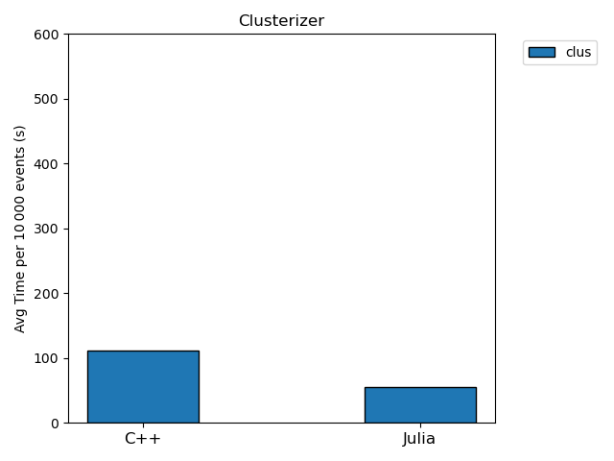
Clusterizer
C++: 111.1 Seconds
Julia: 55.5 Seconds

Slide 18
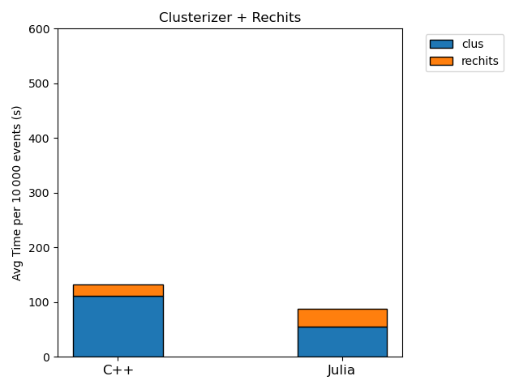
Rechits
C++: 20.9 Seconds
Julia: 32.8 Seconds

Slide 19
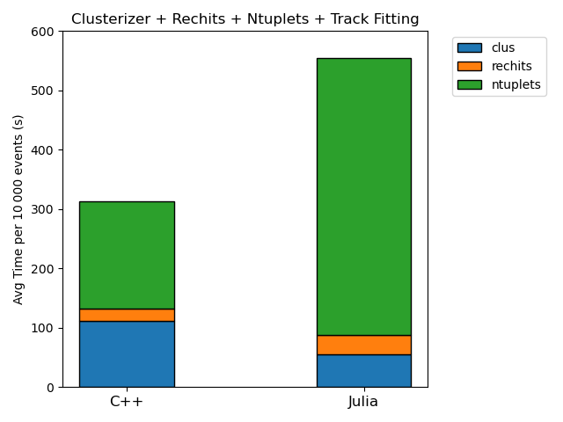
Ntuplets + Track Fitting
C++: 180.7 Seconds
Julia: 466.9 Seconds

Slide 20
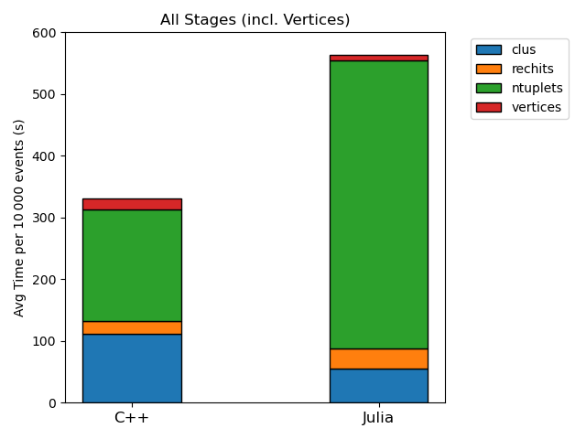
Vertices
C++: 17.7 Seconds
Julia: 7.9 Seconds

Slide 21
Multithreading
Sequential Framework
Parallelized Framework
Source
Source
A
A
A
A
C
B
C
B
C
B
C
B
D
D
D
D
E
E
E
E

Slide 22
Benchmark Setup
  CPU: 2 x AMD EPYC 9534 64-Core Processor (125 cores available)
  Operating System: AlmaLinux 9.6 (Sage Margay)
  Execution Mode: Multi-threaded
  Warm-up run: 1000 events
  Main performance test: 20,000 events C++, 10,000 events Julia
  Repetitions: 4

Slide 23
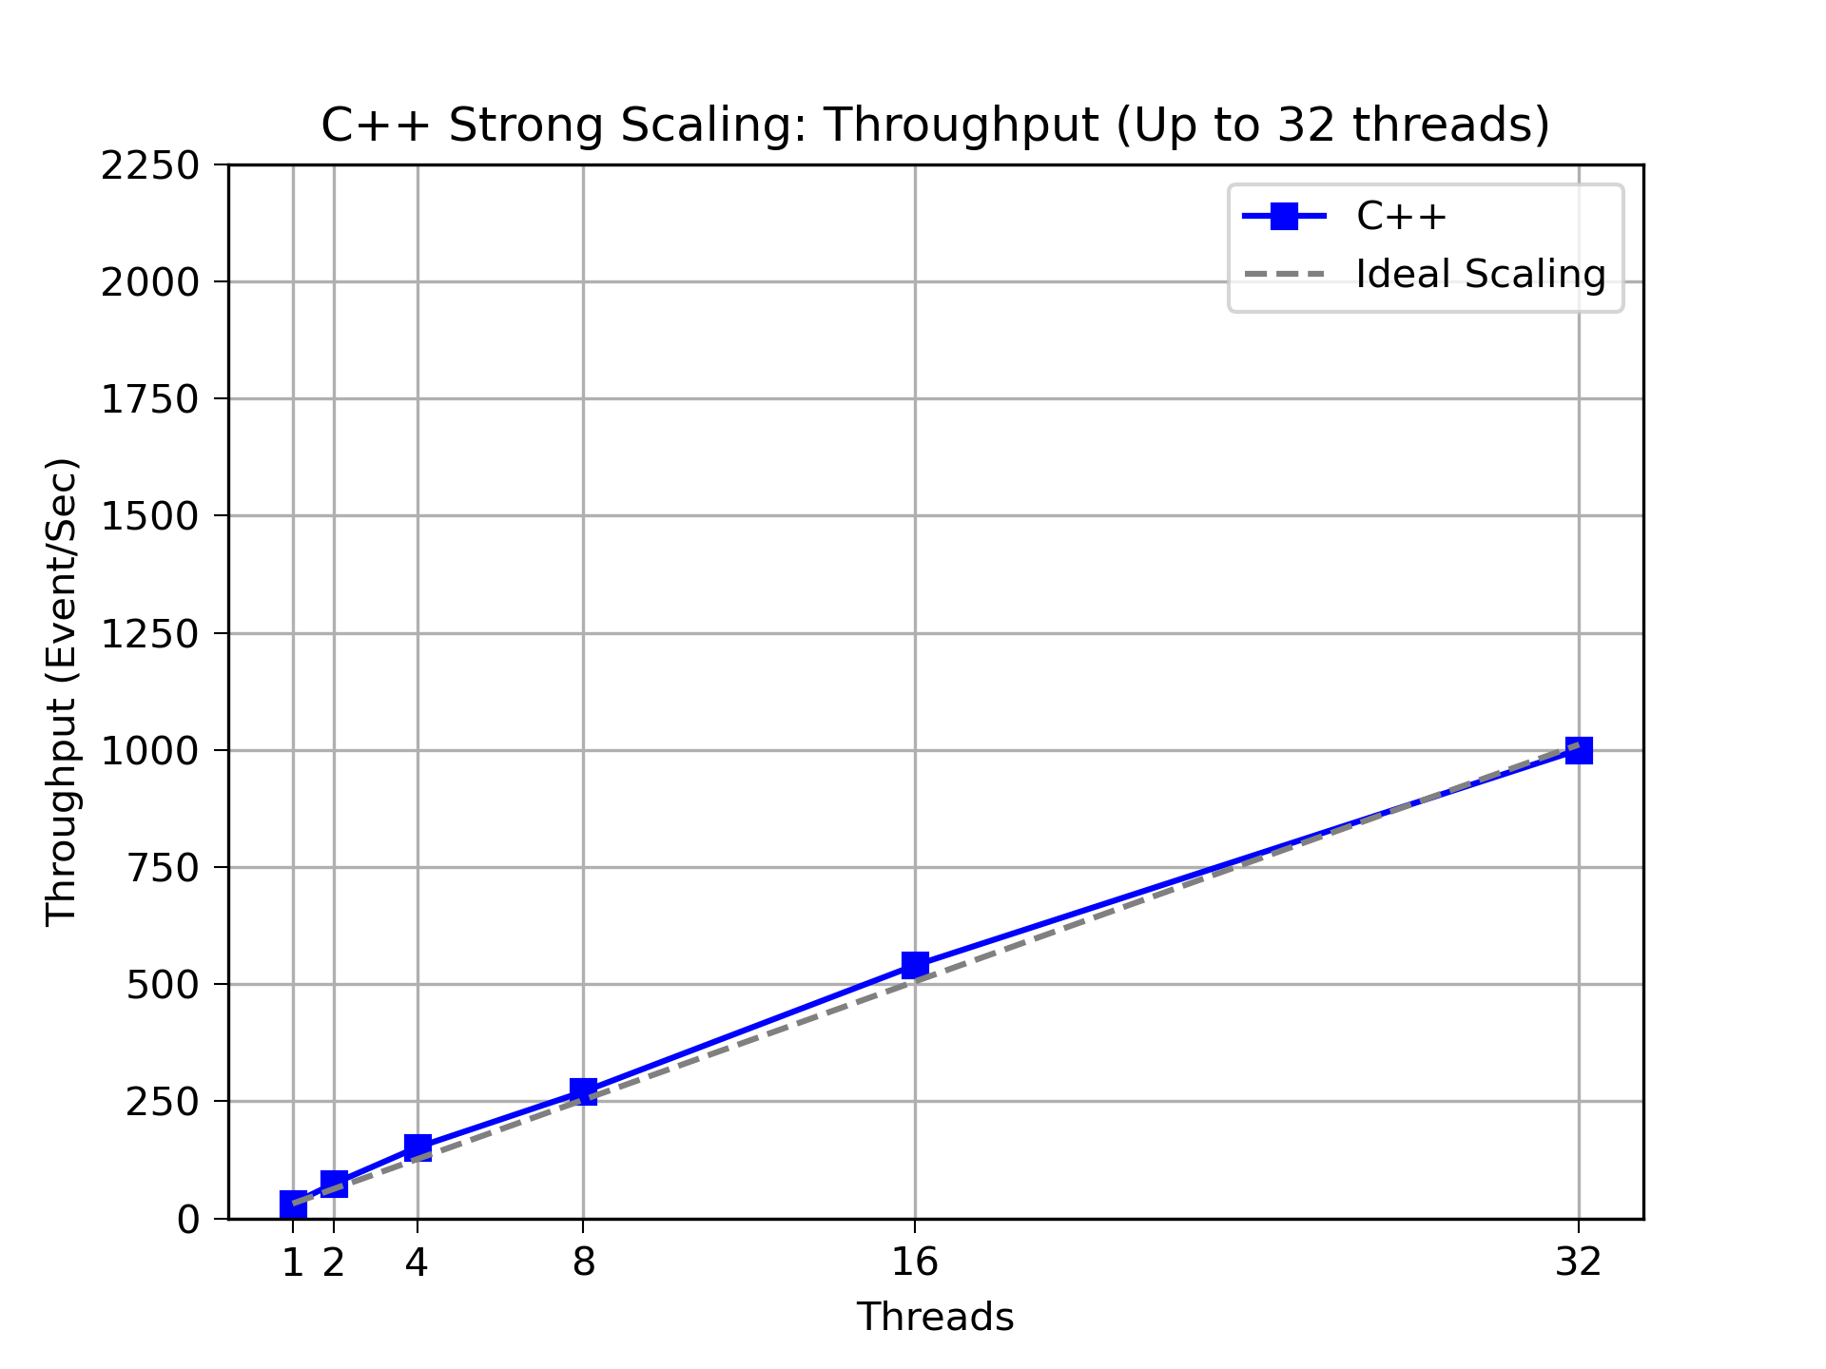
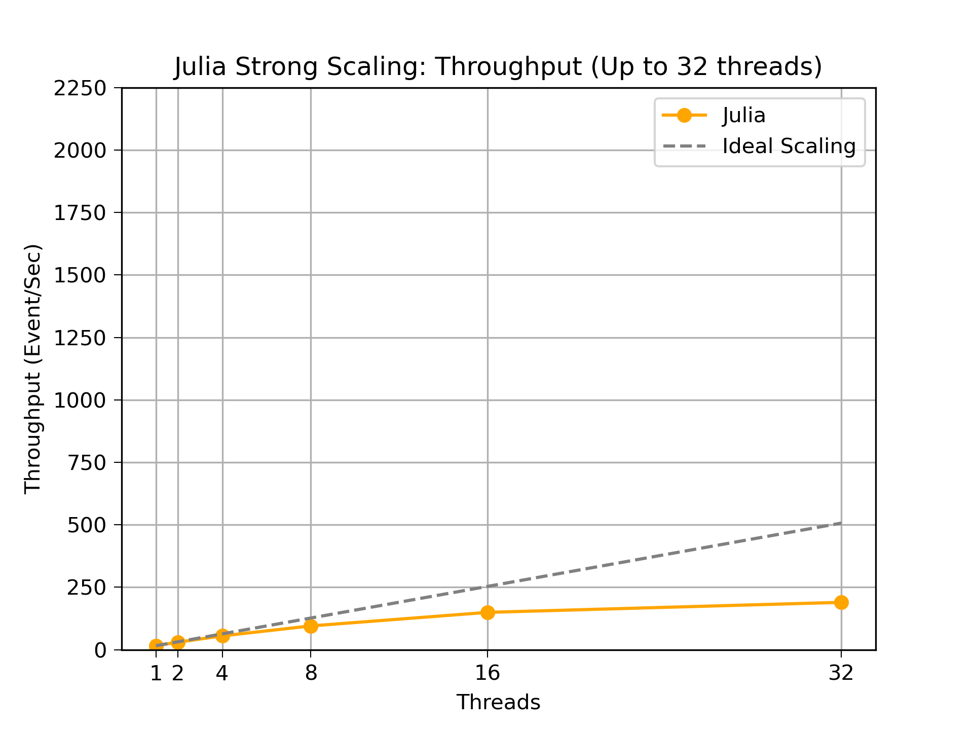
Results: Throughput
C++
Julia

Slide 24
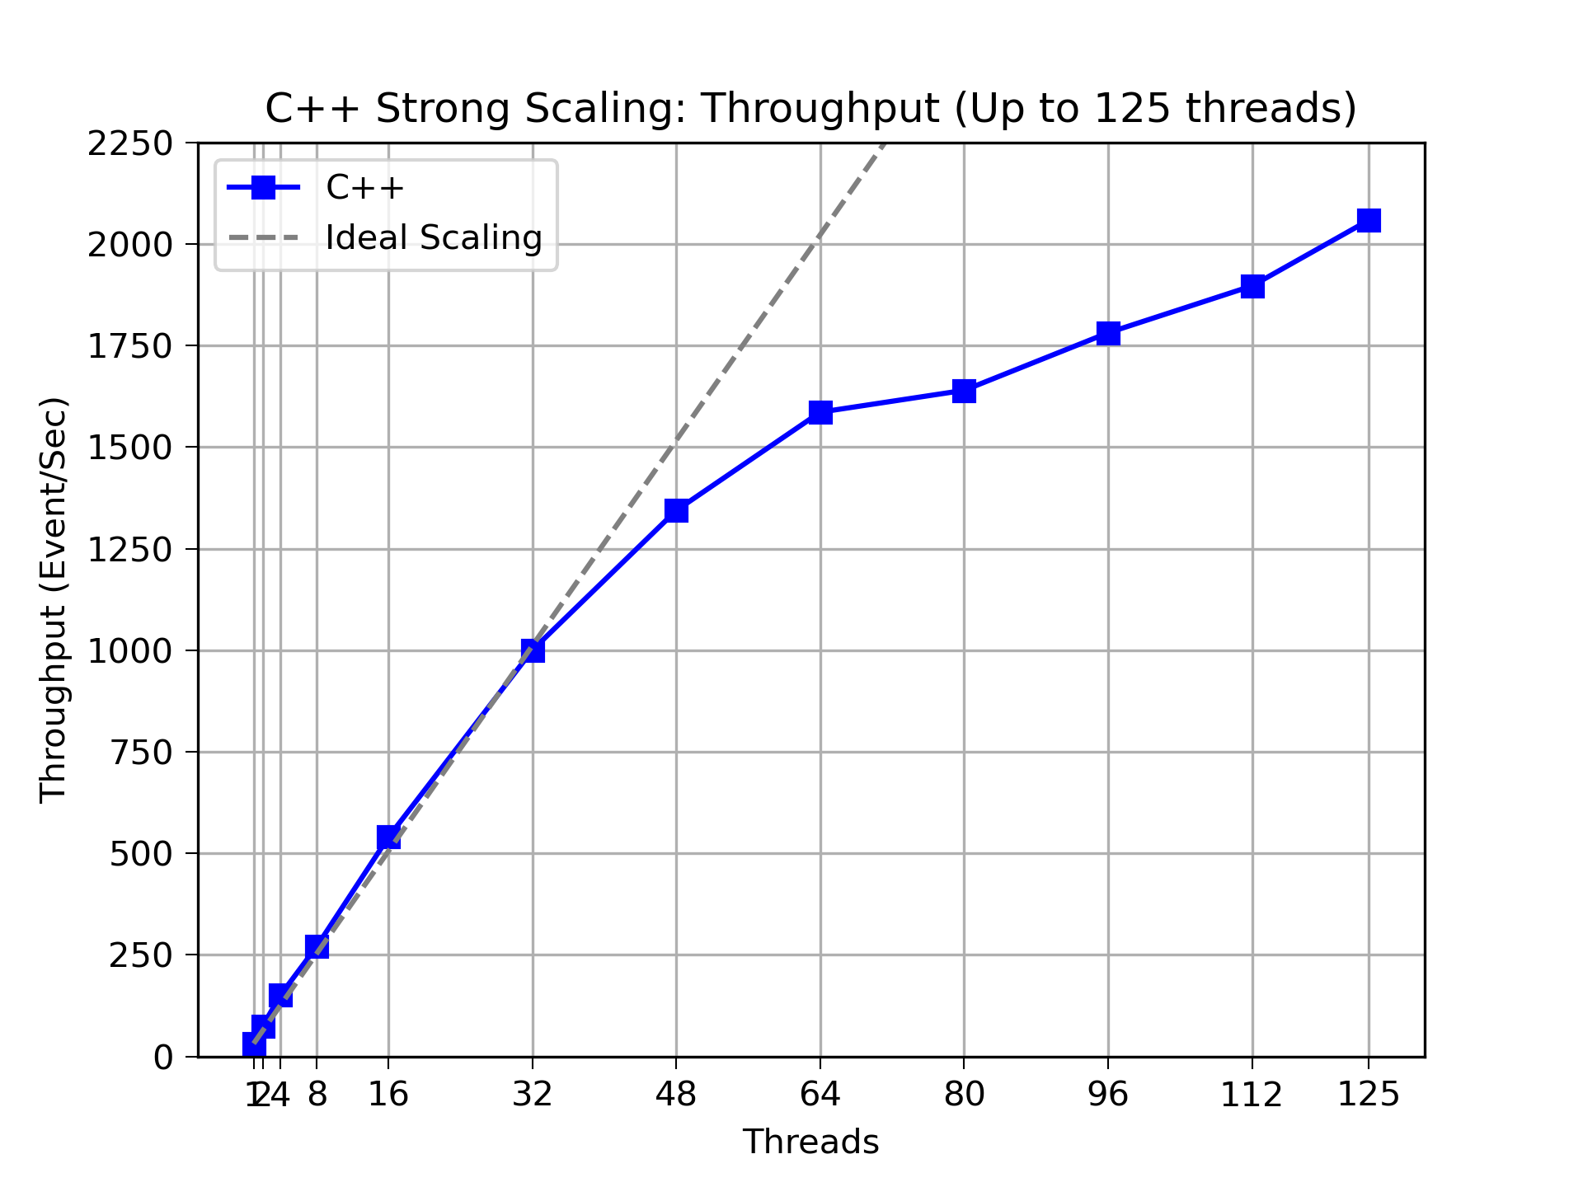
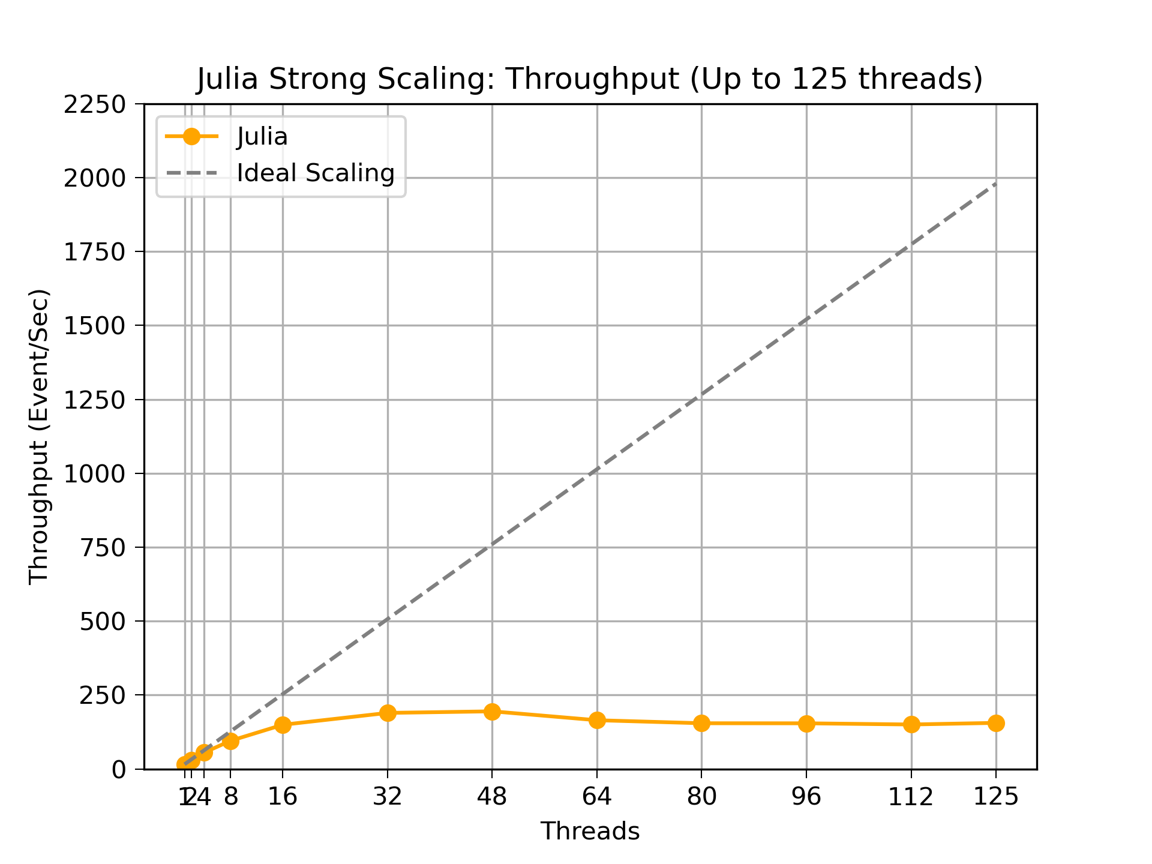
Results: Throughput
C++
Julia

Slide 25
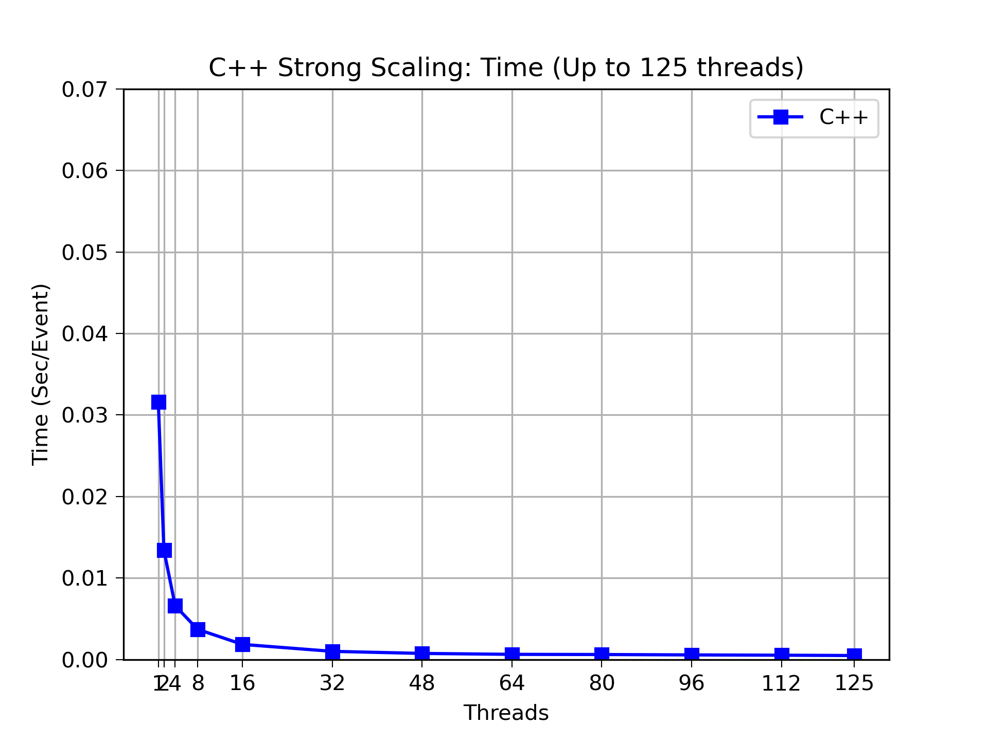
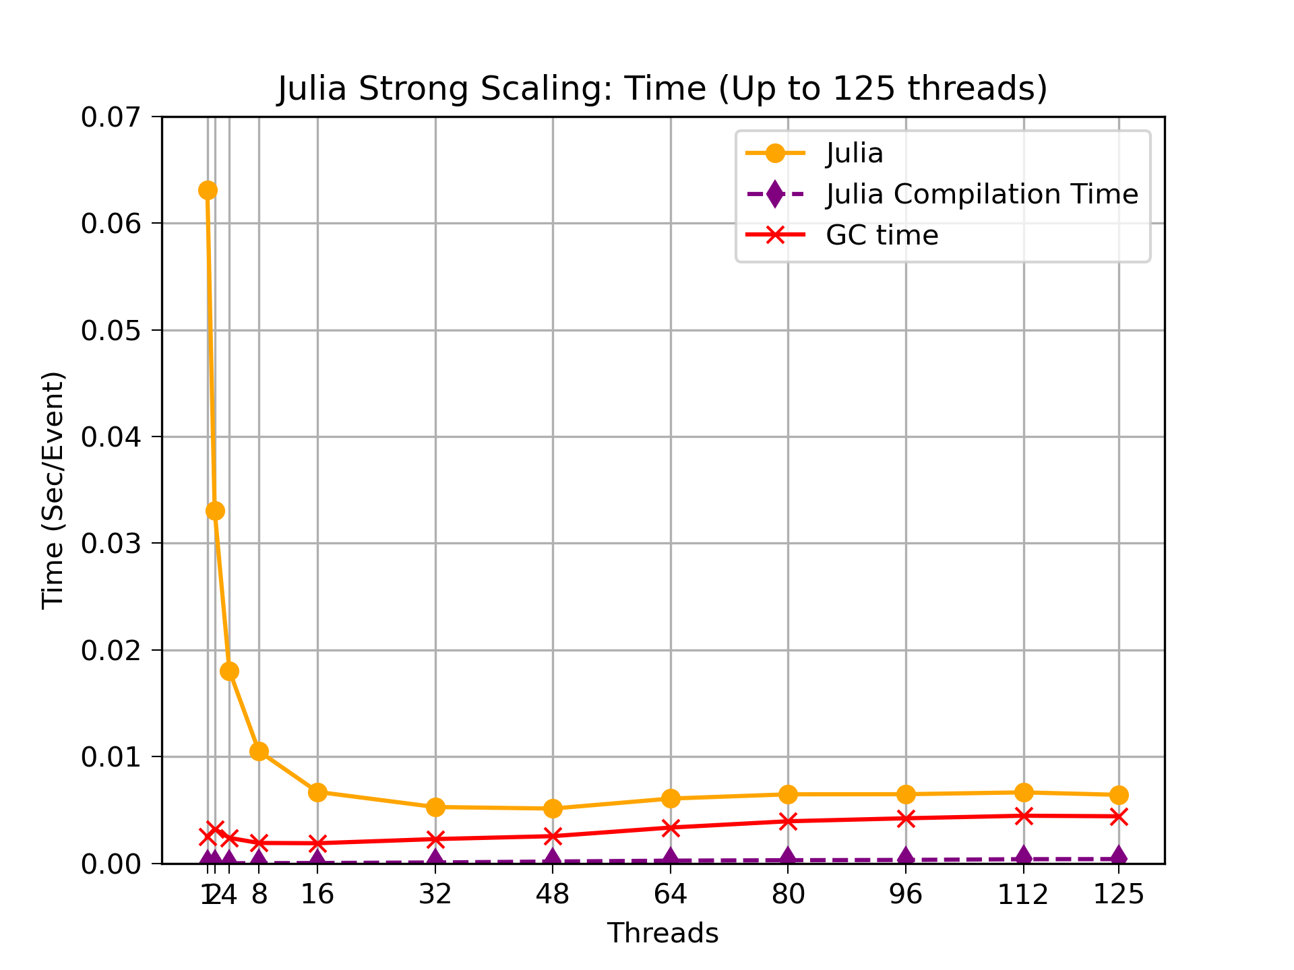
Results: Execution Time
C++
Julia

Slide 26

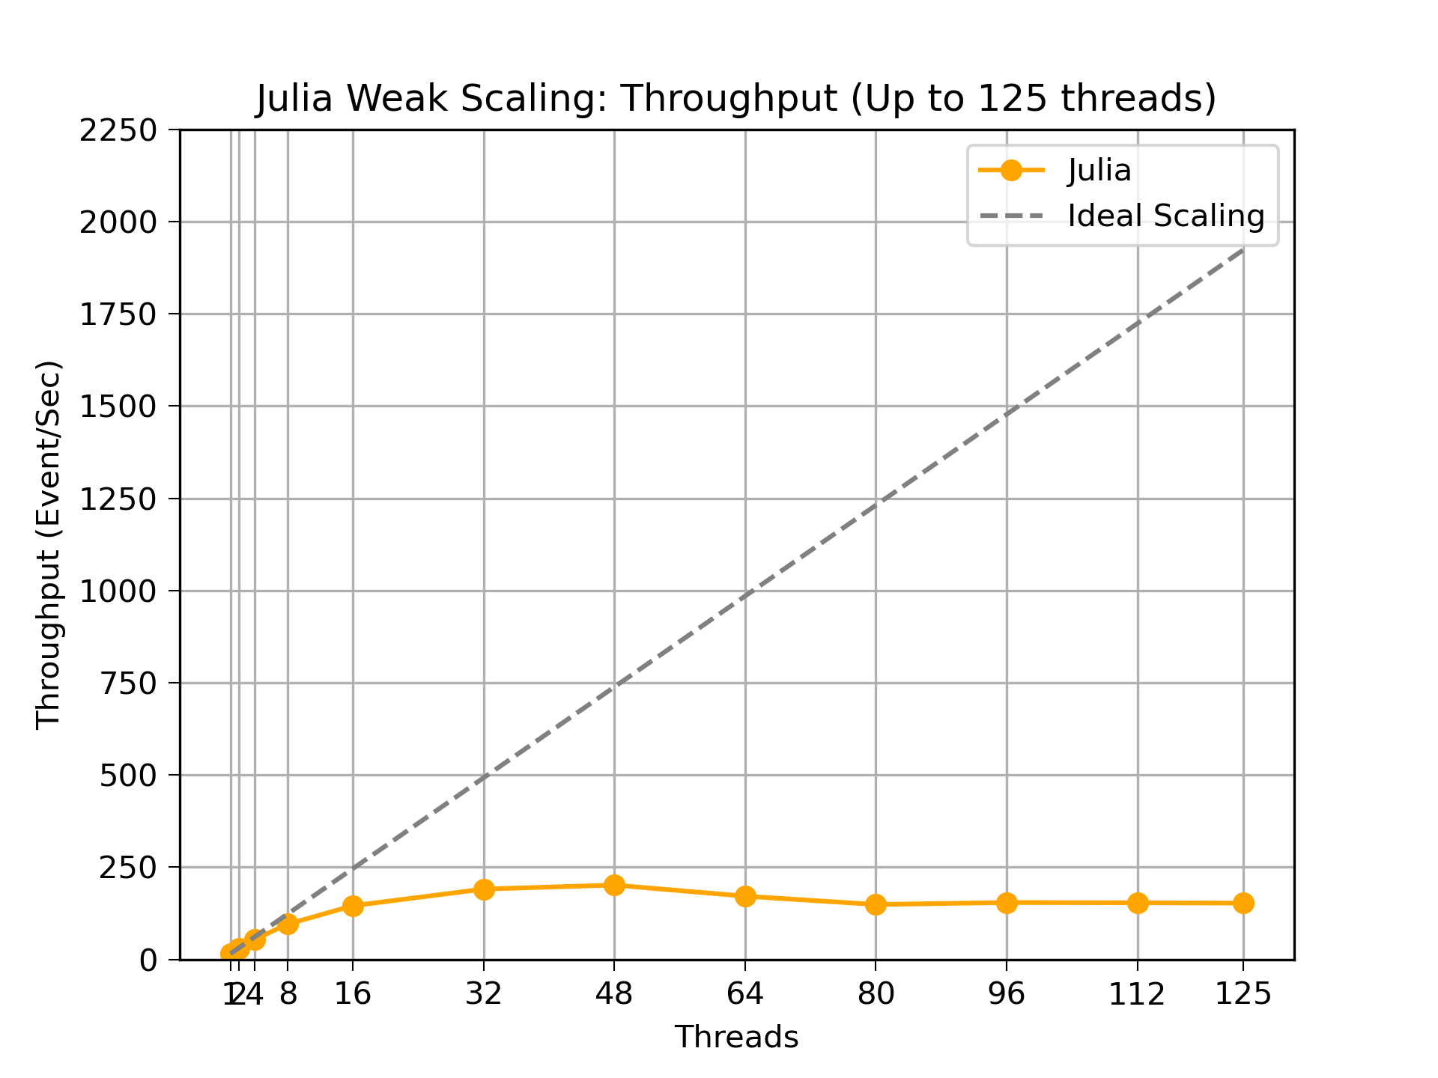
Results: Throughput
C++
Julia

Slide 27
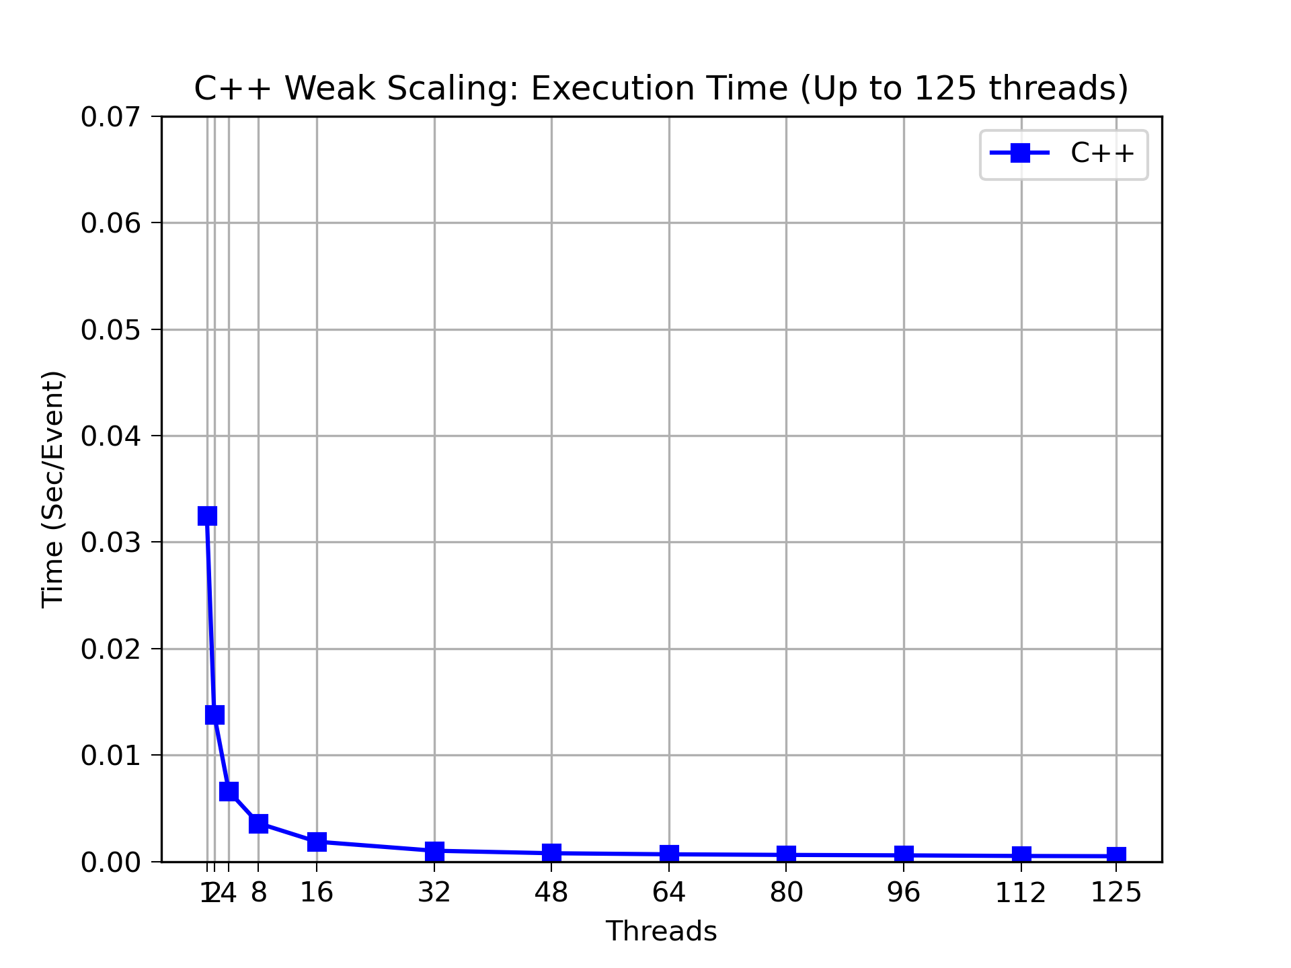
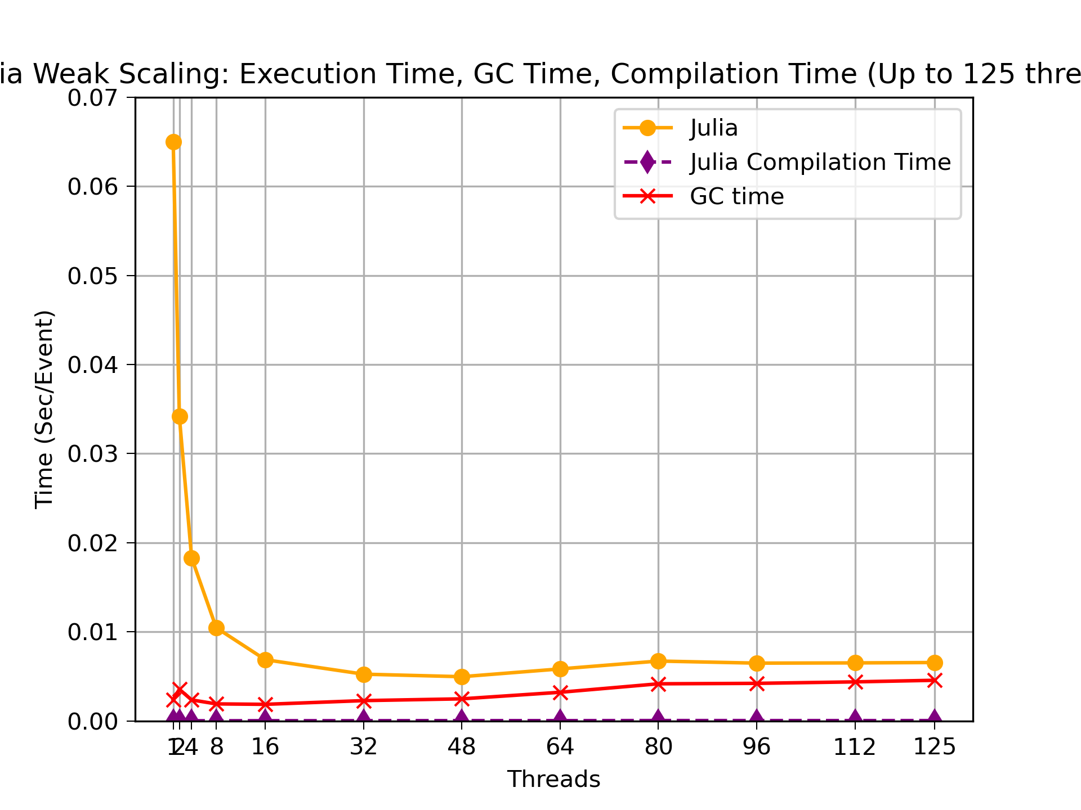
Results: Execution Time
C++
Julia

Slide 28
GC Marking Threads: Performance
07/29/2025
<number>

Slide 29
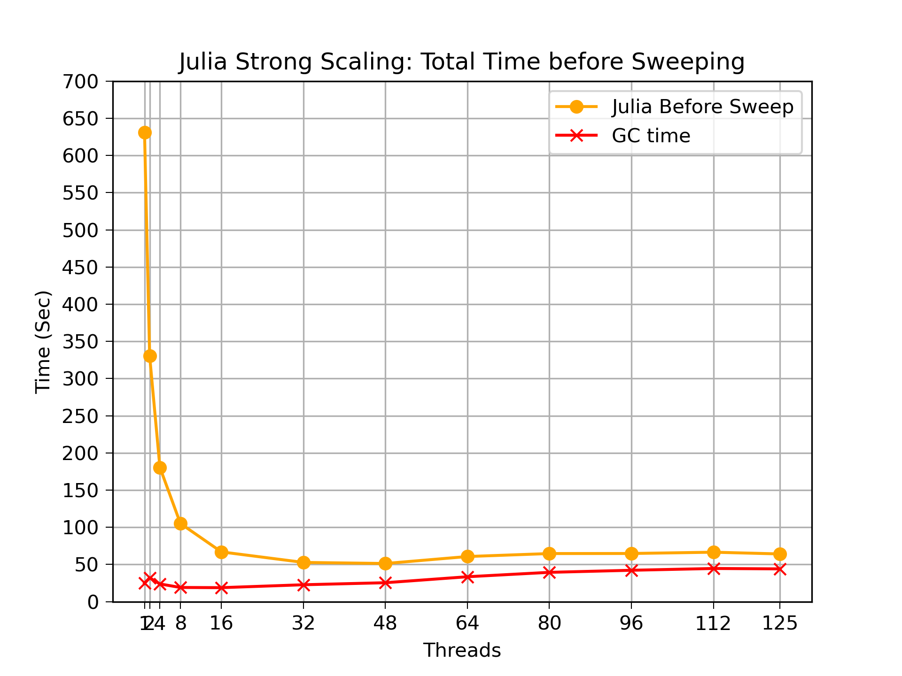
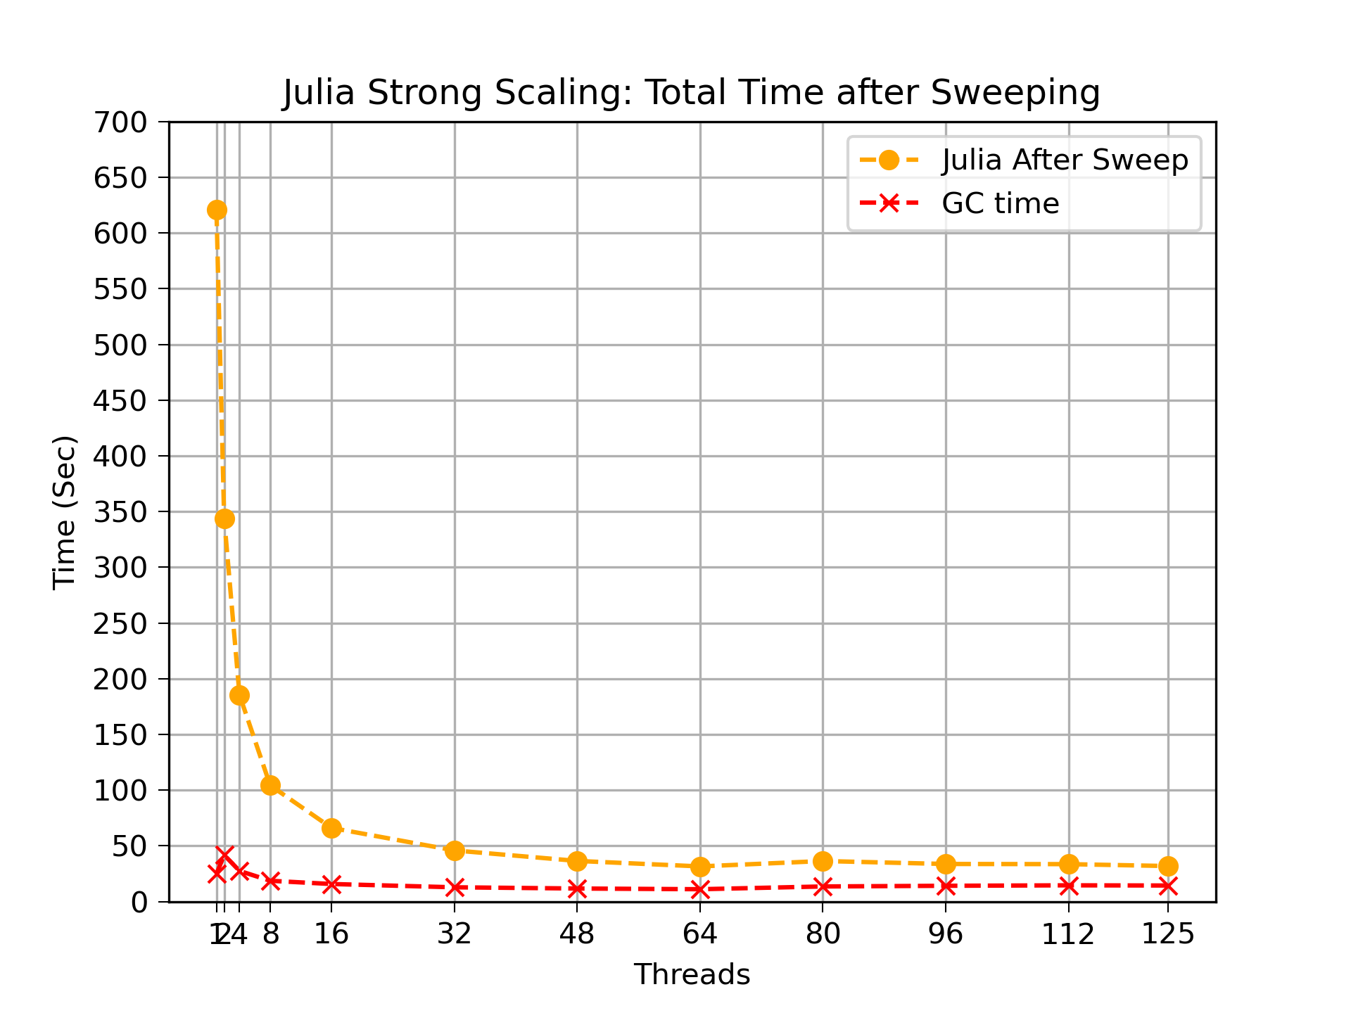
Results: Total Execution Time
Before
After

Slide 30
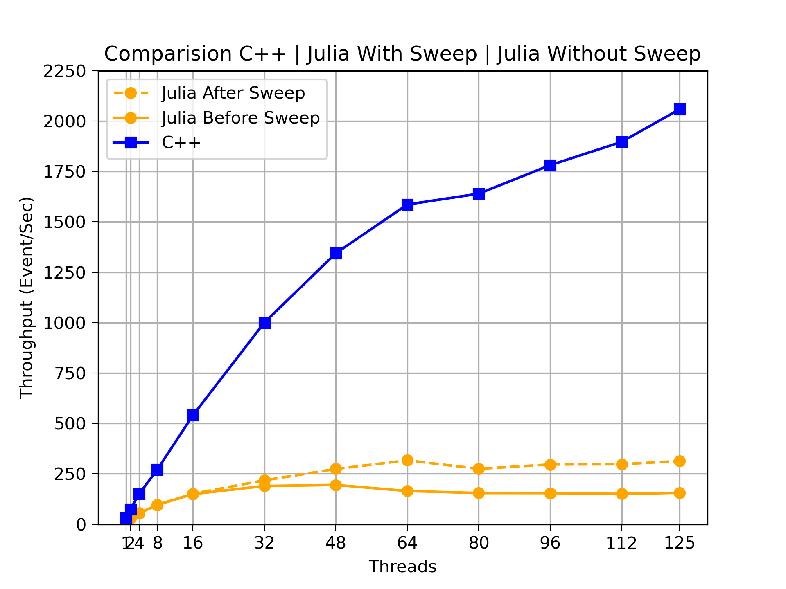
Comparison

Slide 31
Ahead of Time Compilation
  Why?
Cut JIT time & stabilize runs for benchmarks/deployment.
  Tried tools
PackageCompiler.jl (1.12.0-rc1) → broken (jl_get_binding_wr arg mismatch)
PackageCompiler.jl (1.11) → works
juliac (1.12.0-rc1, --trim=no) → works, smaller & faster compile than PC

Slide 32
Ahead of Time Compilation - Results
Results (AMD 5700G, 1000 events, 1 thread)
Compiler / Mode | Julia ver | Compile time | Binary size | Runtime (evt/s) | GC time (main)
JIT (baseline) | 1.12-rc1 | — | — | 54.80 s (18.25 evt/s) | 1.8 s (~3.3%)
PackageCompiler | 1.11.5 | ~630 s | ~24 KB exe + 544 MB deps | 57.28 s (17.46 evt/s) | 3.1 s (~5.4%)
juliac --trim=no | 1.12-rc1 | ~120 s | 301 MB | 58.37 s (17.13 evt/s) | 4.4 s (~7.5%)

Slide 33
Ahead of Time Compilation – Next Steps
  Investigate why GC grows with juliac image
  Re-test when 1.12 final + PC fix lands; retry --trim=safe
  Integrate make target to build & warm-up automatically

Slide 34
Next Steps and Future Work
  Finalize and validate local reconstruction on GPU
  Optimize track fitting (Bottleneck for CPU Single Threaded Version)
  Investigate GC overhead with increasing threads
  Test AOT compilation with future release of juliac

Slide 35
Conclusion
  Ported serial version to Julia
  Implemented multithreading using Julia’s native @threads macro
  Implemented AOT compilation using juliac

