Slide 1
Field quality of HCQQXF_SC002-FL000001
(LMQXFA01 type Q3, with MQXFA03 and MQXFA04)
L. Fiscarelli
MAB meeting 20/01/2025

Slide 2
Performed tests
At 1.9 K
  Field quality with Rotating Coils
    Machine cycles and Stair-step cycles
  Integrated gradient and alignment with Stretched wire
    Nominal current with both in series, low current for individual powering
At ambient temperature
  Longitudinal scan with Rotating Coil

Slide 3
Rotating coils at 1.9 K
Anticryostat flange
Longitudinal center
Shaft too short to cover at the same time both magnets
Two measurement positions
Cycles repeated twice

Slide 4
Main field and magnetic length
Current | A | 16230
 |  | A03 | A04 | Integral
CERN
Integrated gradient | T | 559.53 | 559.62 | 1119.15 | SSW | 1119.03
Central gradient TF | T/m/kA | 8.1790 | 8.1828
Lm | m | 4.215 | 4.214
Nodal distance | m | 4.770
FNAL
Integrated gradient | T | 559.70 | 559.95 | 1119.60
Difference | units | 8 | 1 | 4
Nodal distance | m | 4.772
Difference | mm | -2

Slide 5
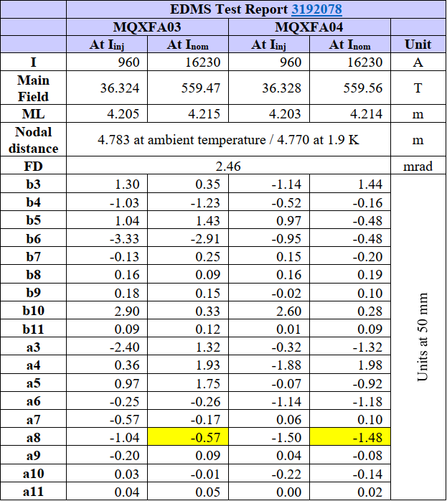
Field quality
Harmonics are given in units at the reference radius of 50 mm

Slide 6
TF vs current - ramp-up of machine cycle

Slide 7
Harmonics vs current - ramp-up of machine cycle

Slide 8
Harmonics vs current - ramp-up of machine cycle

Slide 9
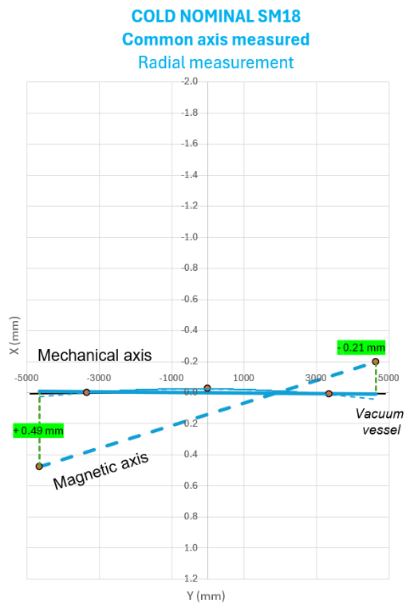
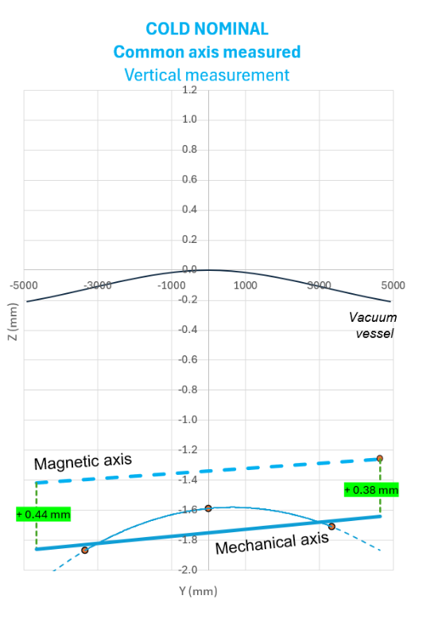
Magnetic common axis (1.9 K)

Slide 10
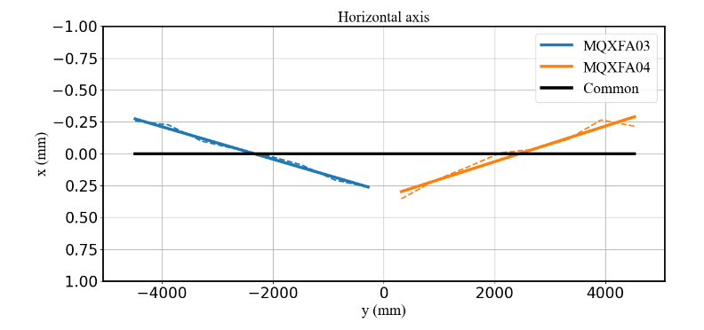
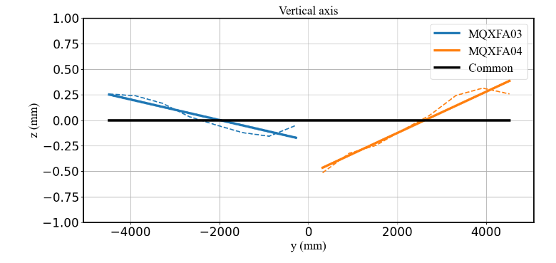
Relative magnetic axis
(ambient temperature)

Slide 11
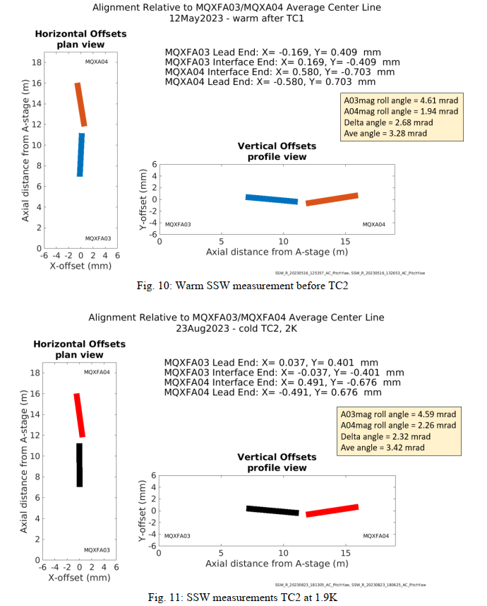
Relative alignment – data from AUP

Slide 12
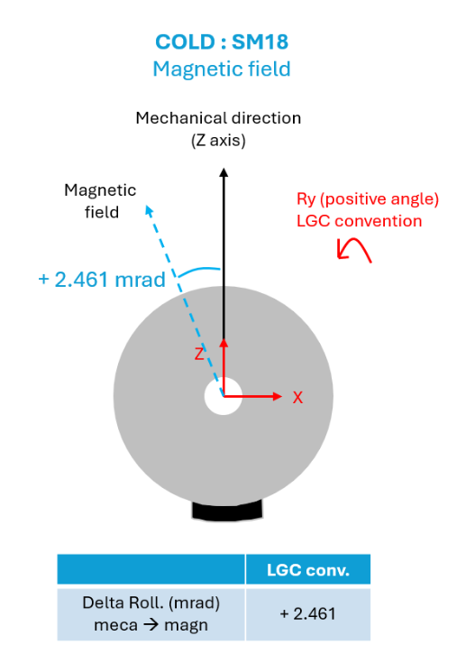
Field direction
Relative angle measured at ambient temperature:
1.99 mrad

Slide 13
Conclusions
Transfer function of the two magnet is within 5 units
In agreement with results from AUP (~5 units)
Results of field quality are confirmed as well:
  Only a8 slightly out of expected range (-1 units for MQXFA04)
Magnetic axis
  Common axis measured at 1.9 K
  Relative axis measured only at ambient temperature
  Relative angle at the limit (2.0 mrad)

