Slide 1
Geometrical Measurements
HCQQXF_SC002-FL000001 / LMQXFA01
Patrick Bestmann
MAB meeting 20/01/2025

Slide 2
Q3 HCQQXF_SC002-FL000001 / LMQXFA01
Measurements @ construction
  Coldmass form & shape
  Available data from FNL
Fiducialisation
Magnetic vs. mechanical axis
Conclusion

Slide 3
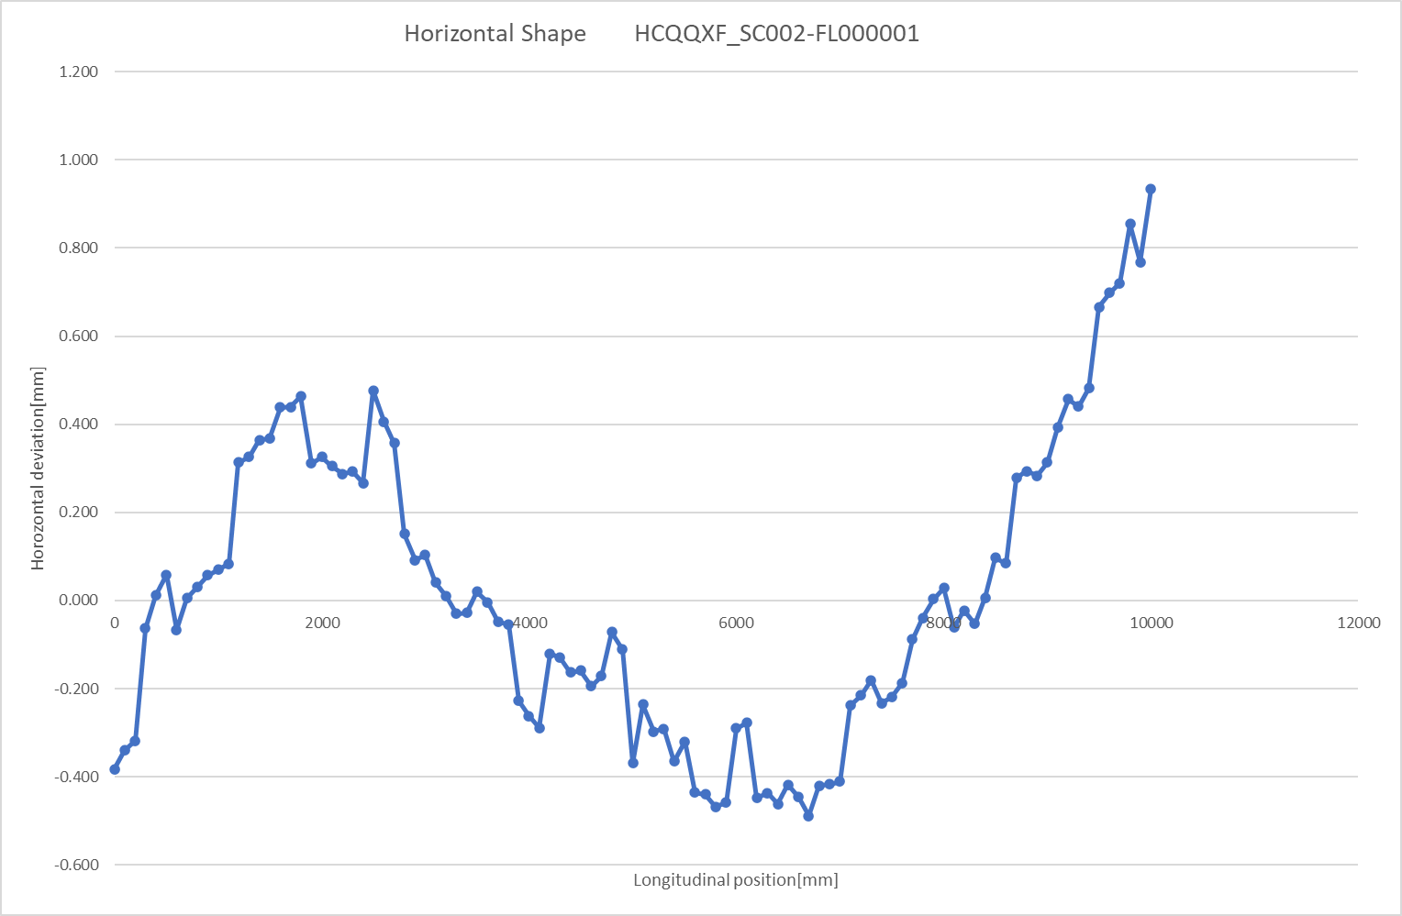
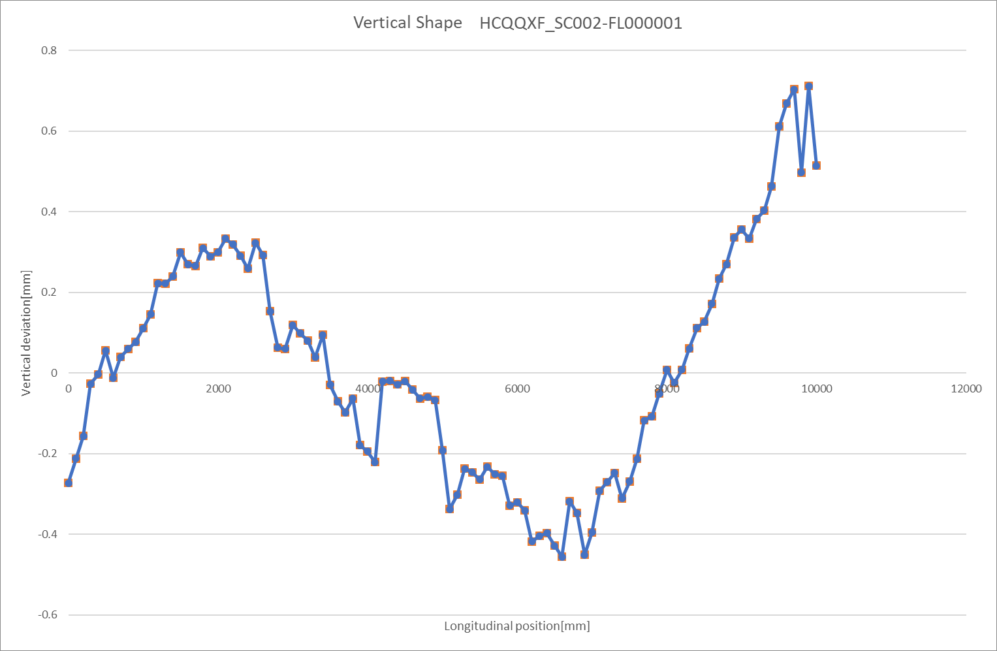
Q3 HCQQXF_SC002-FL000001 / LMQXFA01
Measurements @ FermiLab
Horizontal Shape
Vertical Shape
First geometry report from FNL with non coherent conventions

Slide 4
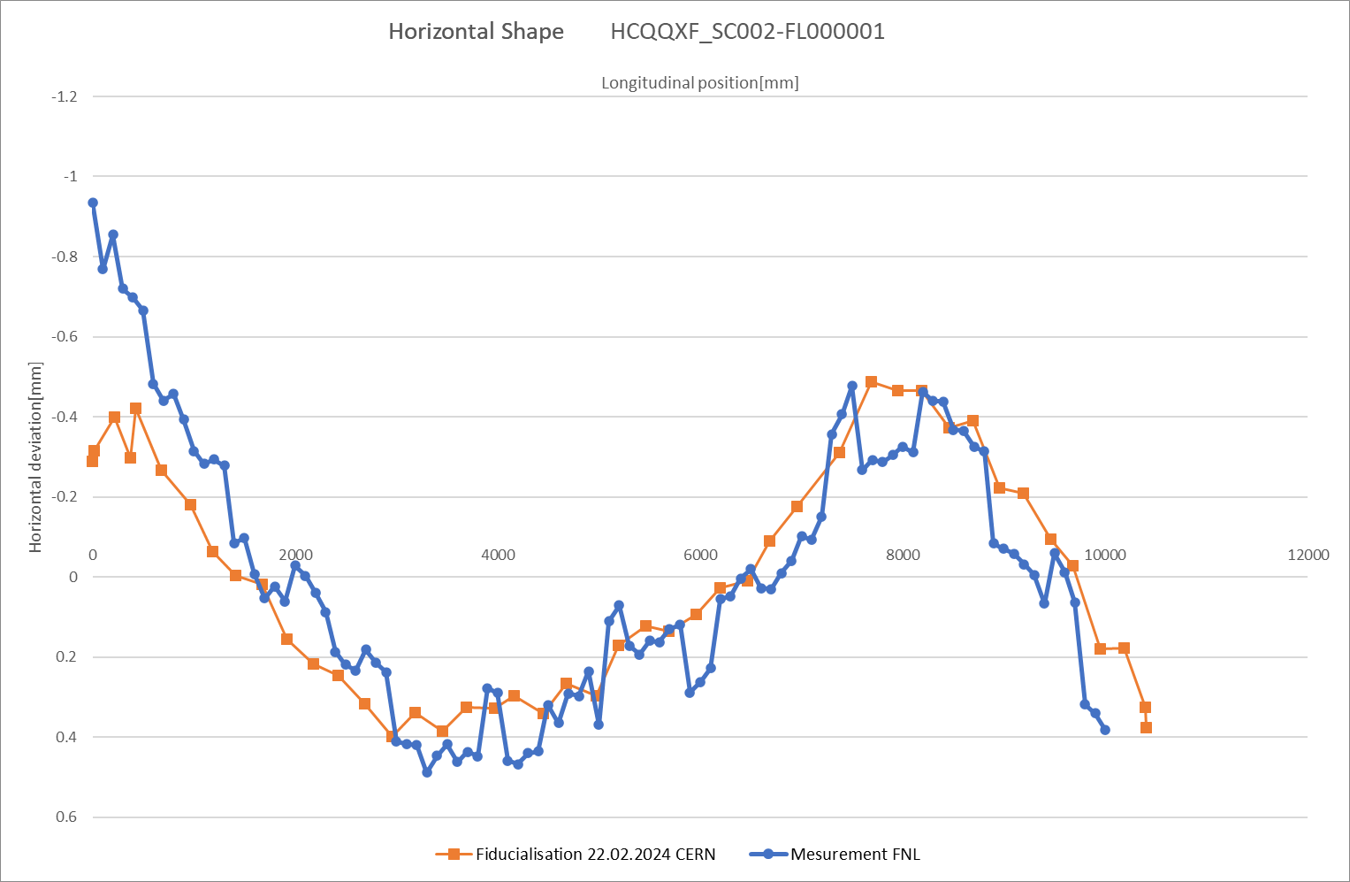
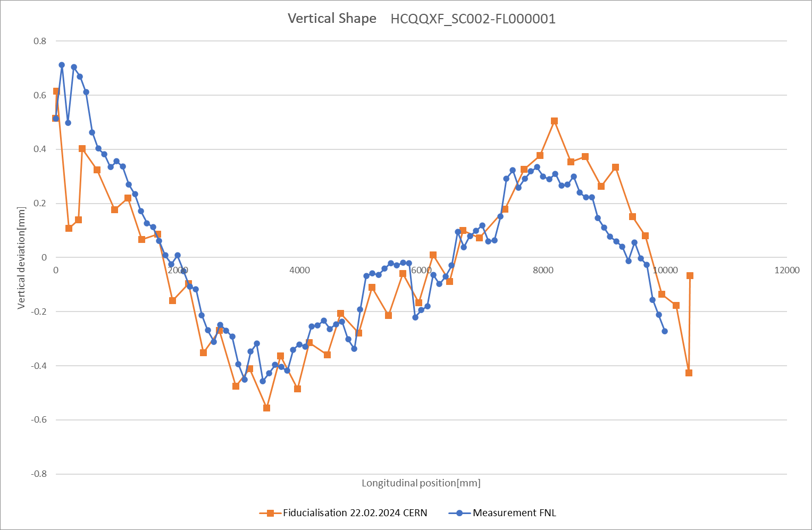
Q3 HCQQXF_SC002-FL000001 / LMQXFA01
Measurements @ FermiLab and CERN
Horizontal Shape
Vertical Shape
Seen from NIP-side to IP-side

Slide 5
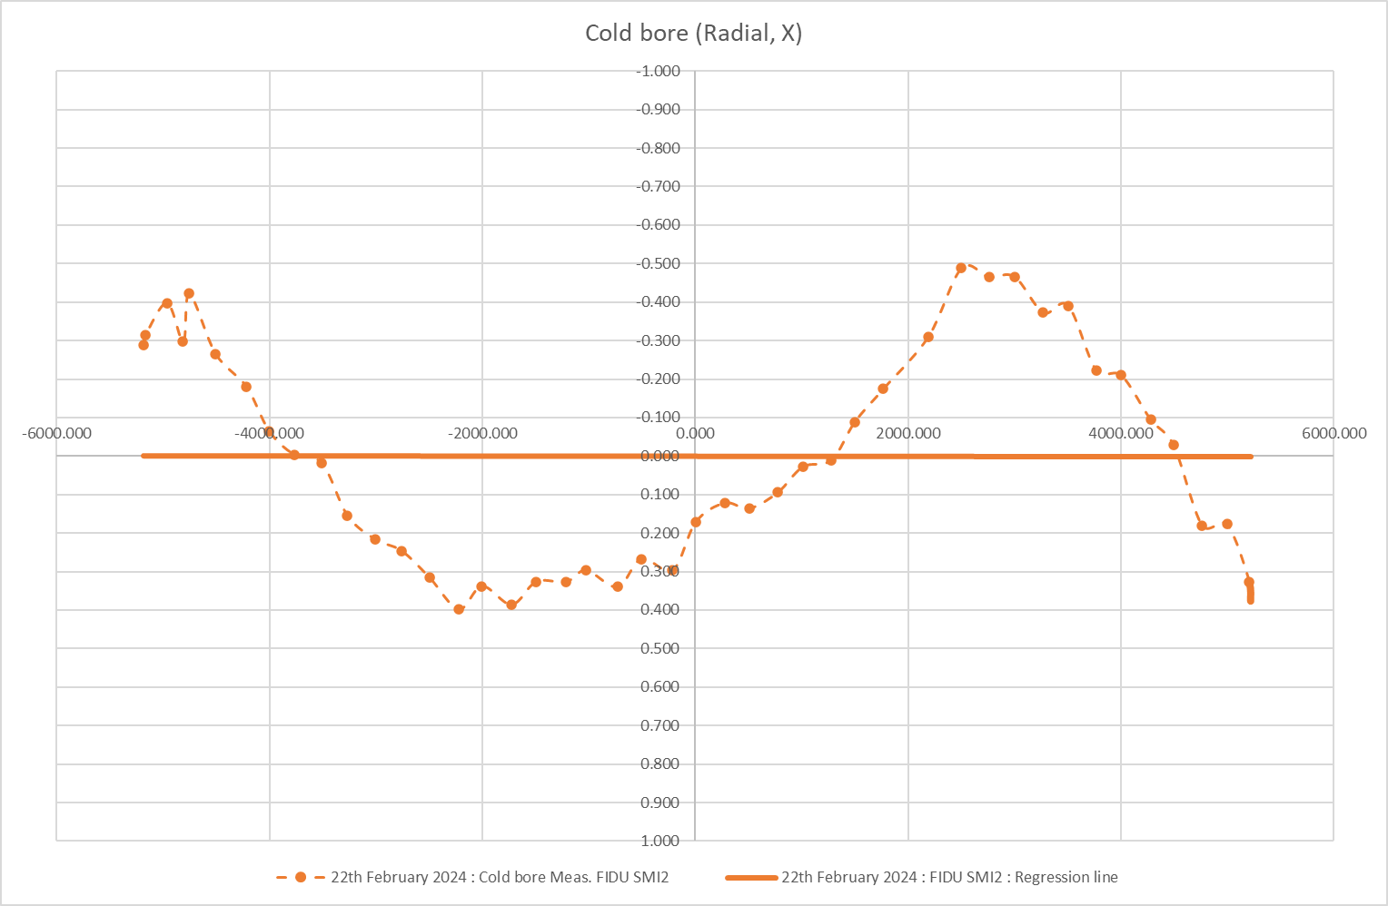
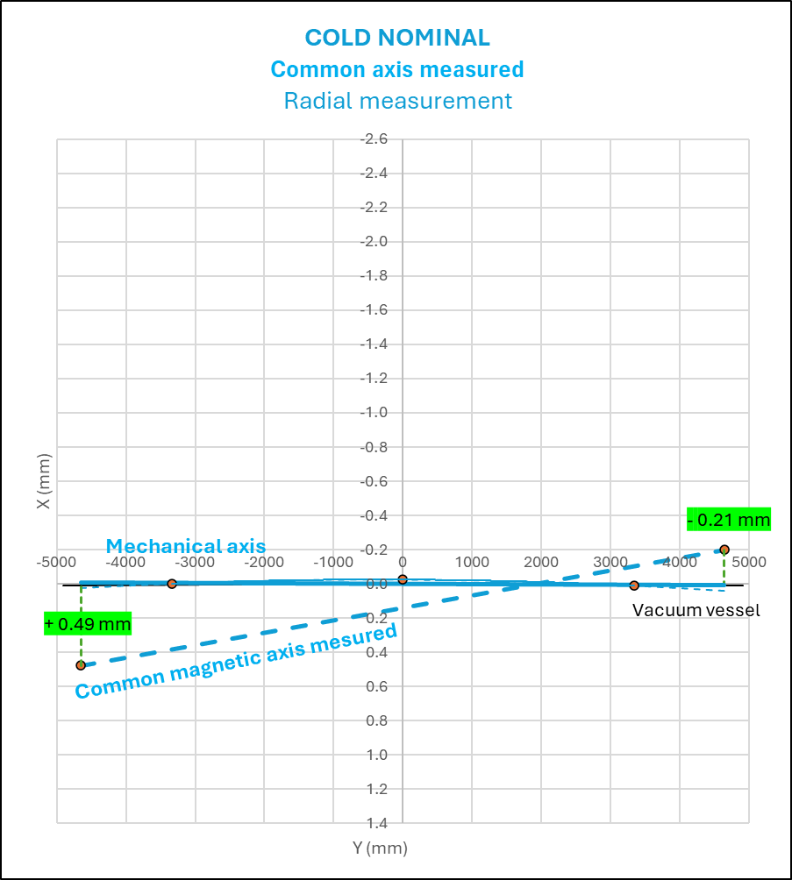
Q3 HCQQXF_SC002-FL000001 / LMQXFA01
Radial shape mechanical Fidu CERN
NIP side / Conn
IP side / Nconn

Slide 6
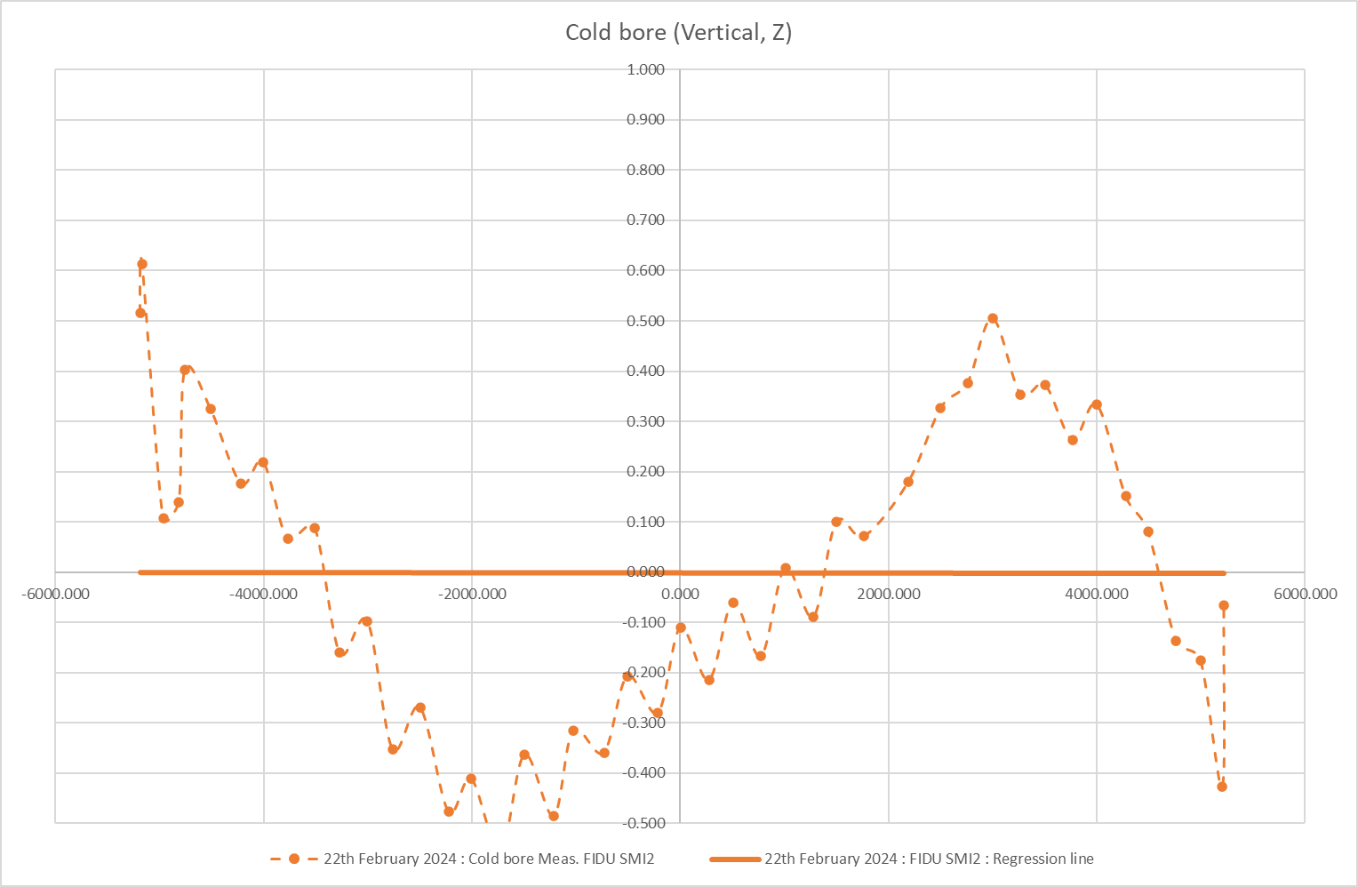
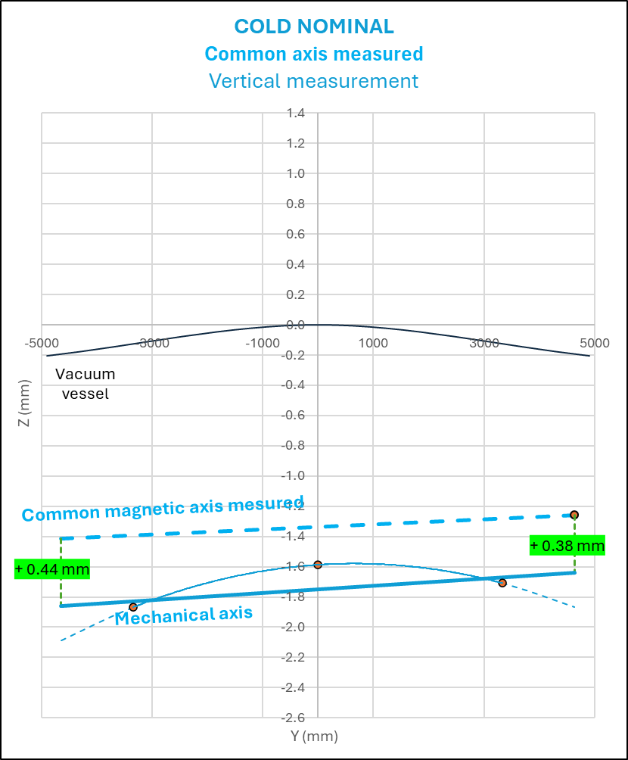
Q3 HCQQXF_SC002-FL000001 / LMQXFA01
Vertical shape mechanical Fidu CERN
NIP side / Conn
IP side / Nconn

Slide 7
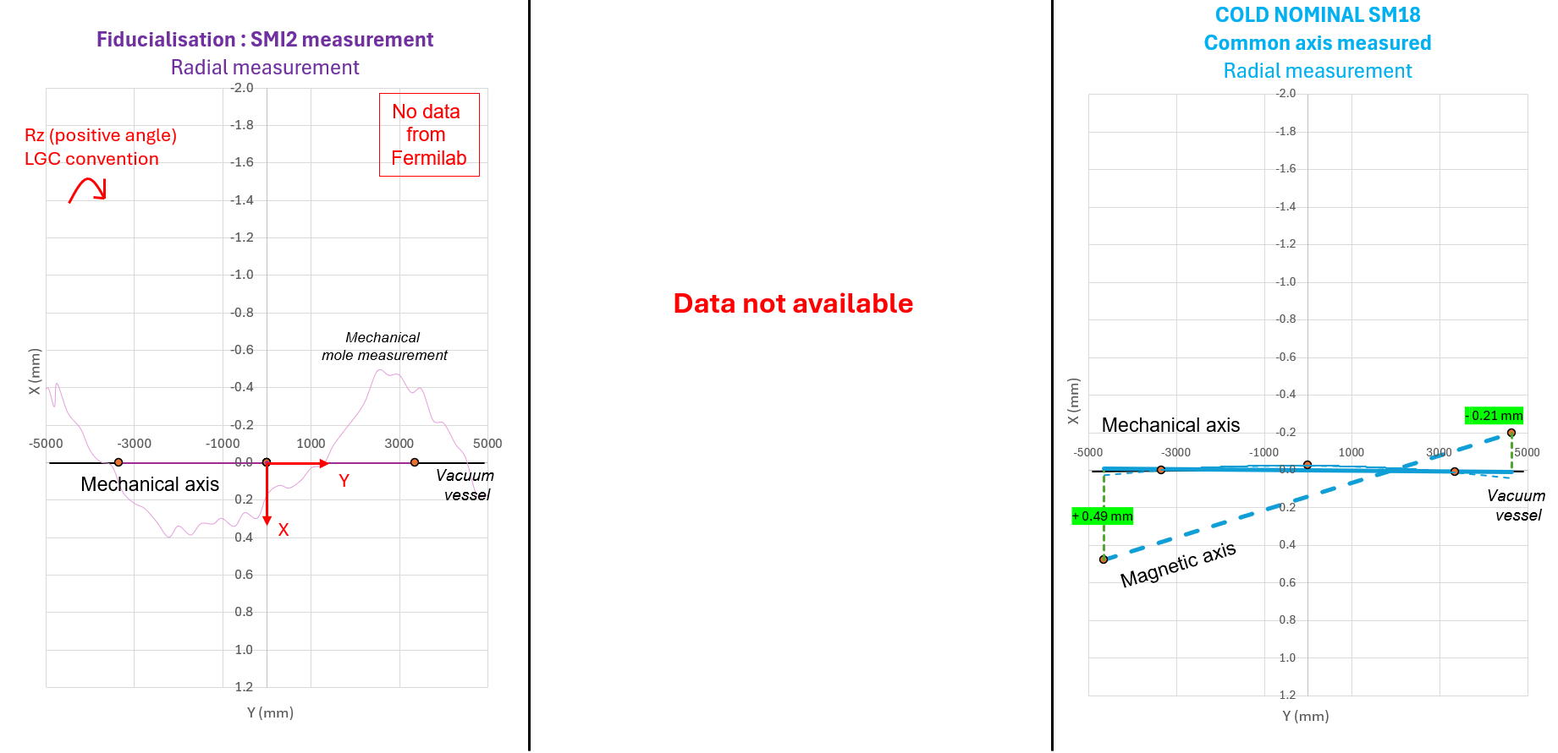
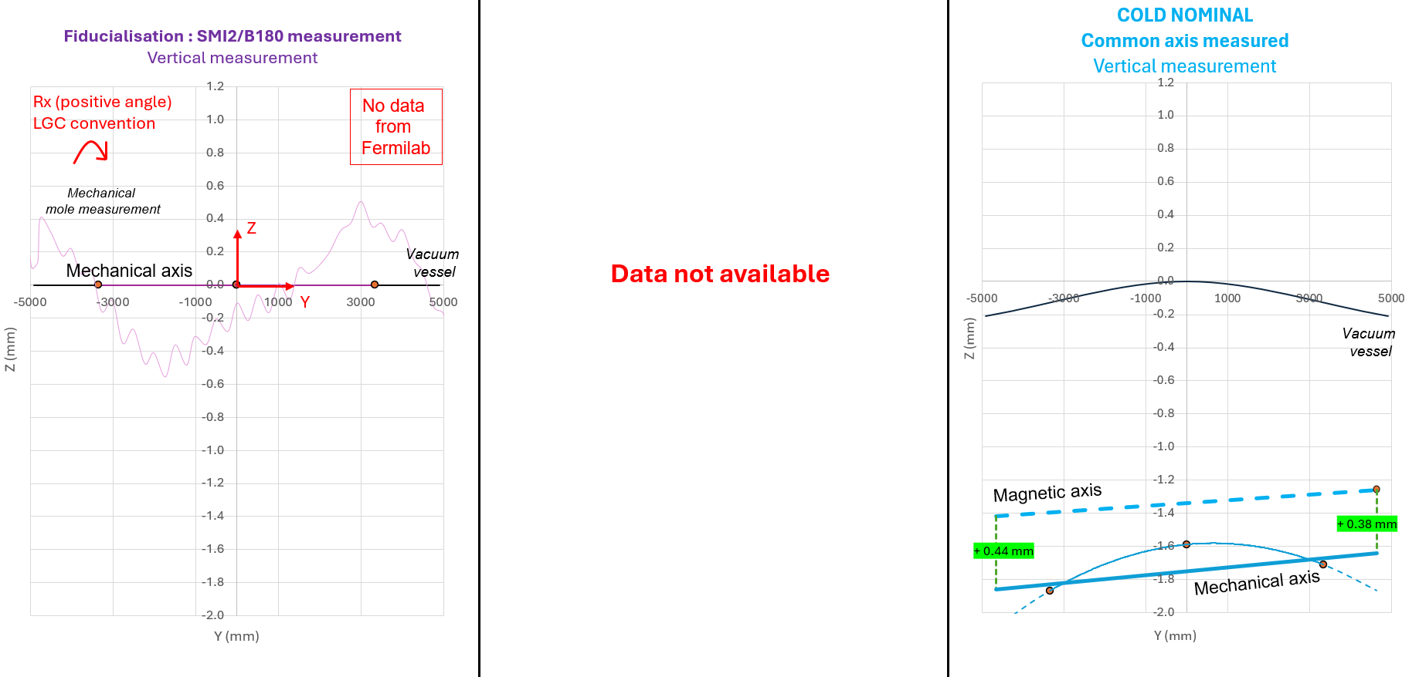
Q3 HCQQXF_SC002-FL000001 / LMQXFA01
Relation mechanical/magnetic axis only at cold

Slide 8
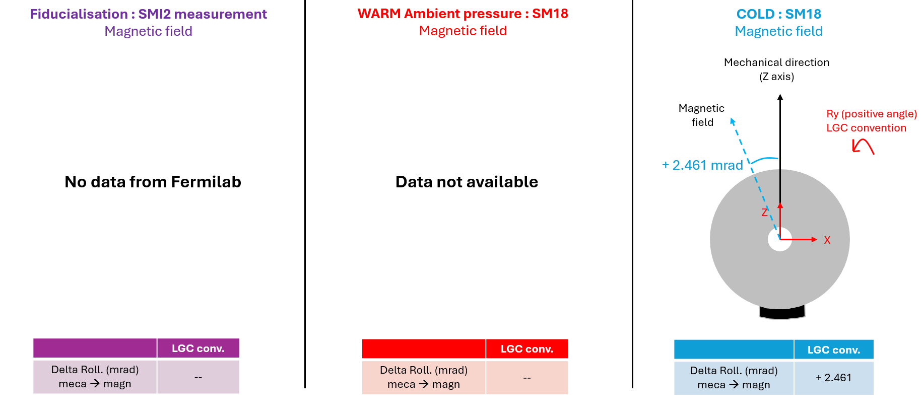
Q3 HCQQXF_SC002-FL000001 / LMQXFA01
The Field direction is only available at cold

Slide 9
General Feedback Q3 HCQQXF_SC002-FL000001
Data availability from FNL was an issue
Some initial problems in the beginning, solved now
Magnetic/mechanic offset only @ cold
Full details are in the test report: https://edms.cern.ch/document/3192078/1
FSI showing coherent data
Cartography of all extremities will be done end of Phase 2
BPM-Beamscreen extremities only in Phase 3 (not for String)

