Slide 1
Geometrical Measurements
HCQCXFC010-CR000001 / LMCXF01
Patrick Bestmann
MAB meeting 03/02/2025

Slide 2
CP HCQCXFC010-CR000001
Measurements @ construction
Fiducialisation
Magnetic vs. mechanical axis
Conclusion

Slide 3
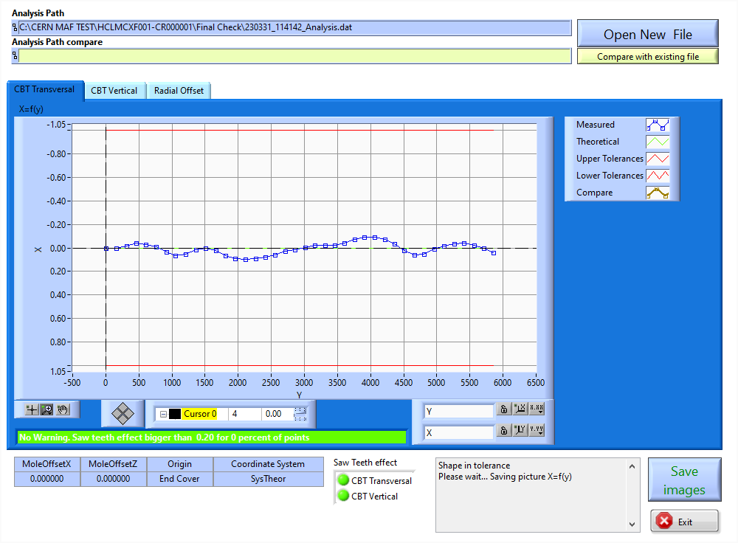
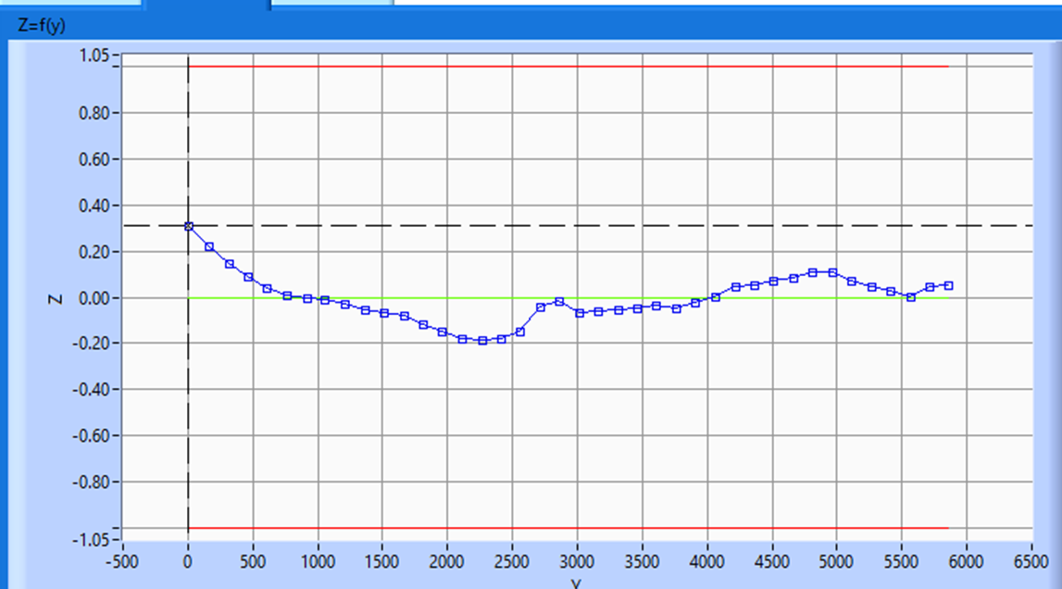
CP HCQCXFC010-CR000001
Measurements @ 180
Attention to traveller graphs from construction (conventions)
Horizontal Shape
Vertical Shape
seen from CS to NCS side
(IP-side to NIP-side)

Slide 4
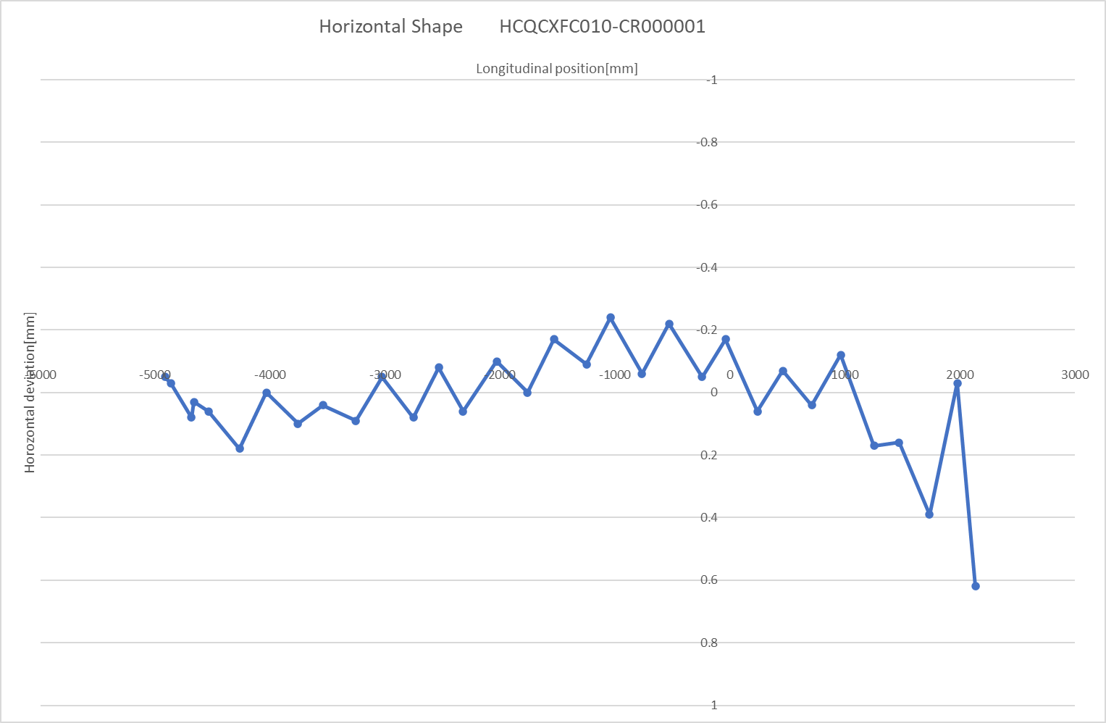
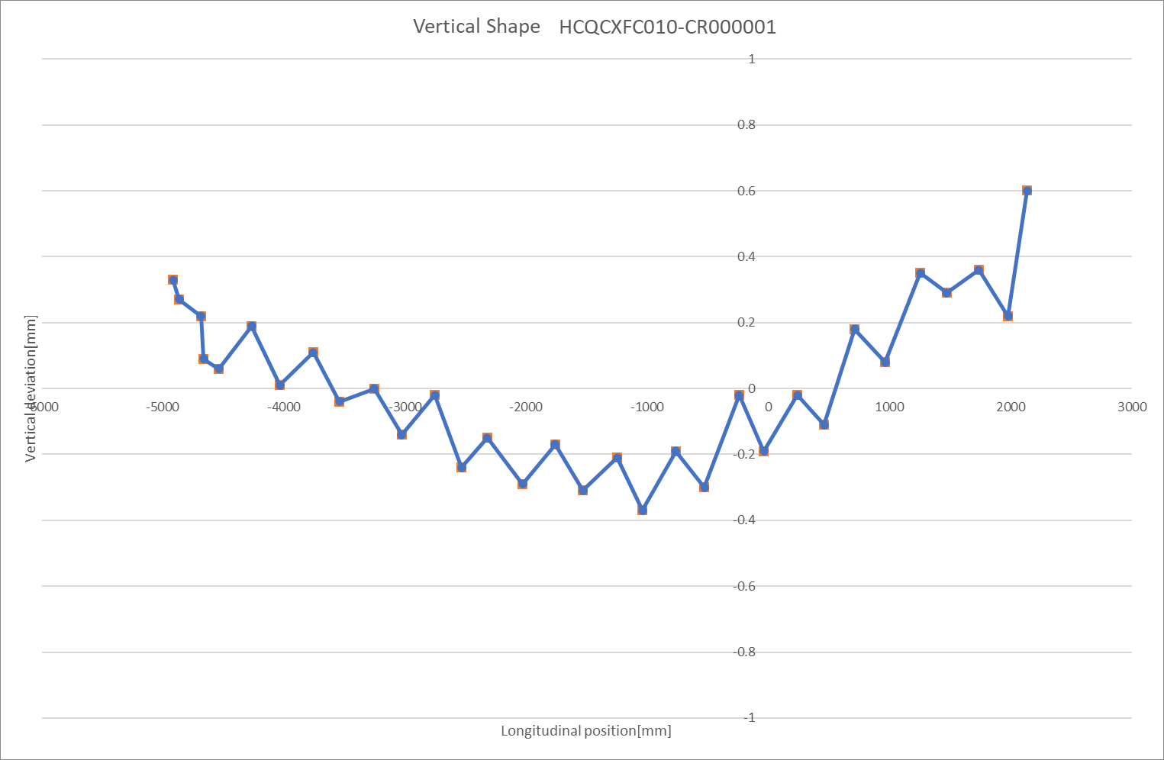
CP HCQCXFC010-CR000001
Measurements @ Fiducialisation
Horizontal Shape
Vertical Shape
Seen from NIP-side to IP-side

Slide 5
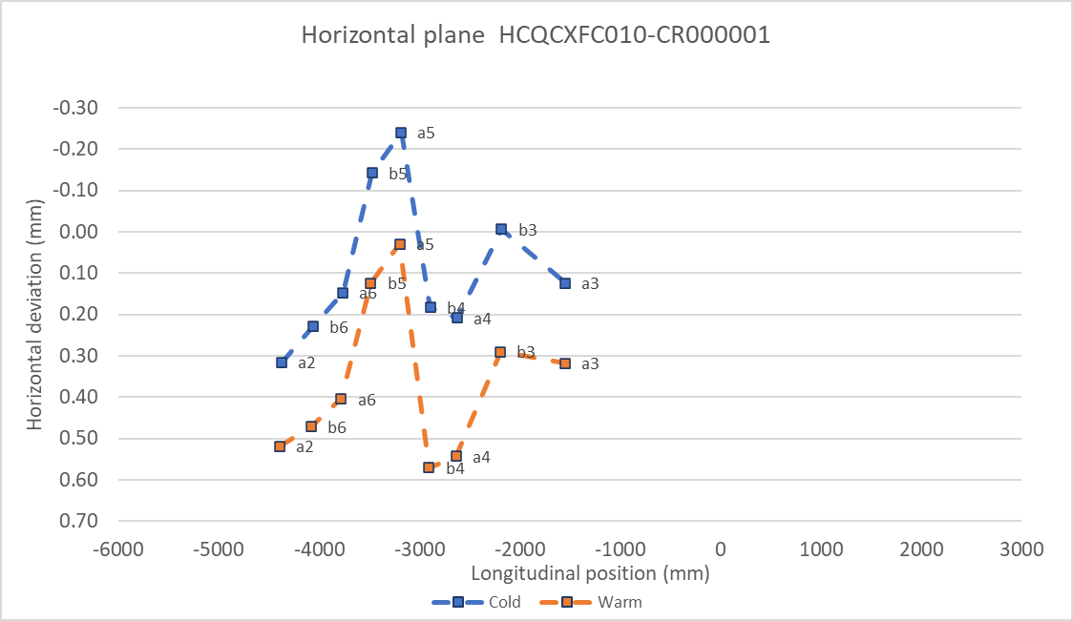
CP HCQCXFC010-CR000001
Magnetic measurements
Mechanical axis
Data provided
by Mariano Pentella
NIP side / NConn
IP side / Conn

Slide 6
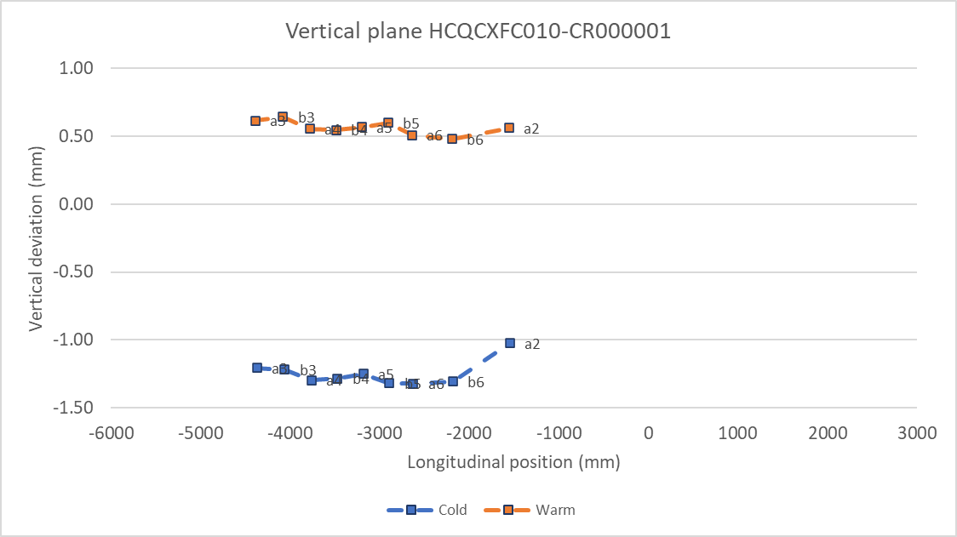
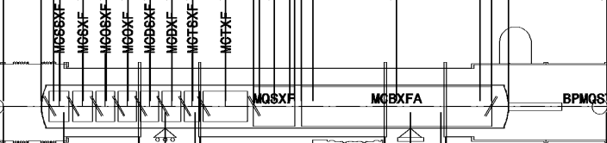
CP HCQCXFC010-CR000001
Magnetic measurements
Mechanical axis
Data provided
by Mariano Pentella
NIP side / NConn
IP side / Conn

Slide 7
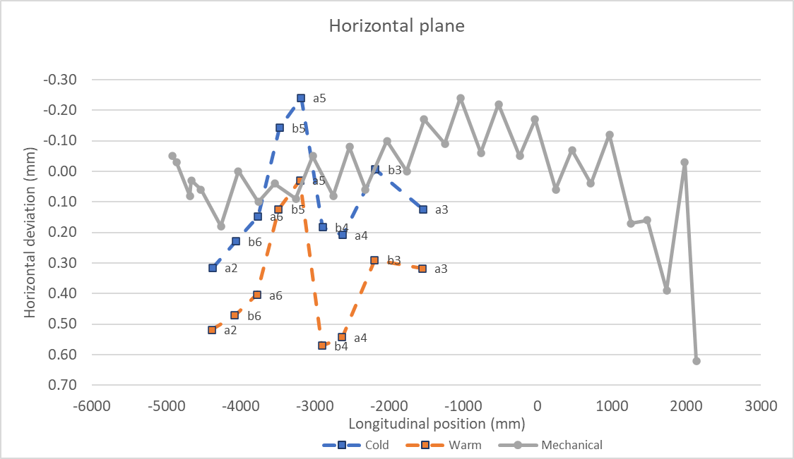
CP HCQCXFC010-CR000001
Combined Horizontal Profile
Data provided
by Mariano Pentella
NIP side / NConn
IP side / Conn

Slide 8
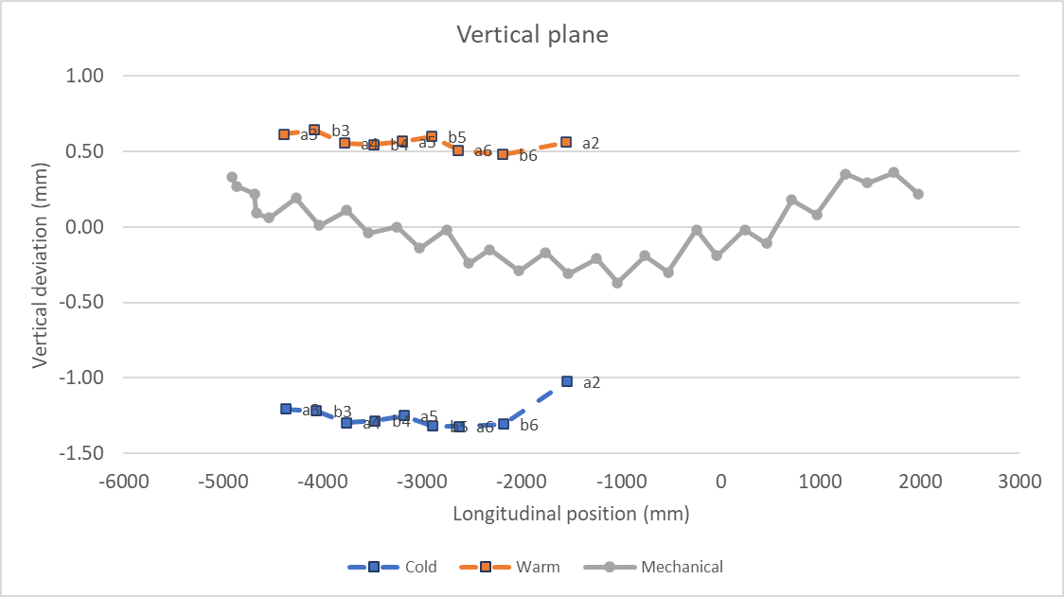
CP HCQCXFC010-CR000001
Combined Vertical Profile
Data provided
by Mariano Pentella
NIP side / NConn
IP side / Conn

Slide 9
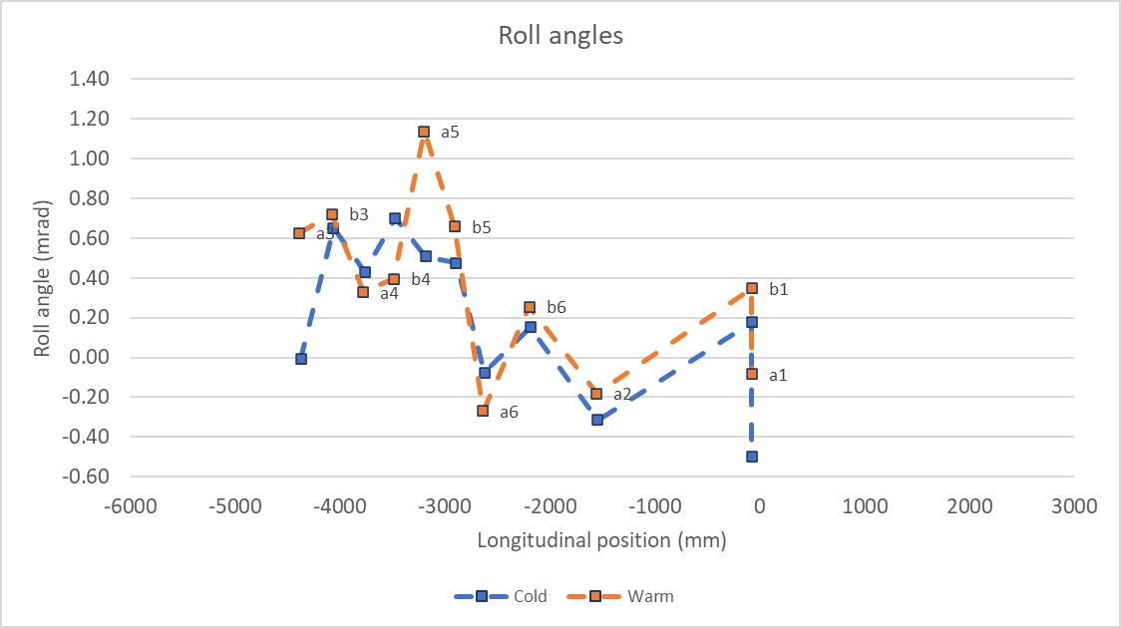
CP HCQCXFC010-CR000001
Measured roll angles for all magnets
Data provided
by Mariano Pentella

Slide 10
General Feedback CP HCQCXFC010-CR000001
Attention to traveller graphs from construction (conventions)
No FSI, Cold warm correlation only from magnetic measurements
  Derived from magnetic axis 1.5 to 1.7mm
Full details are in the report: https://edms.cern.ch/document/3230369/1
Cartography of all extremities done (some light NCs)
BPM-Beamscreen extremities only in Phase 3 (not for String)

